Slide 1


Boundless Lecture Slides
Available on the Boundless Teaching Platform
Free to share, print, make copies and changes. Get yours at www.boundless.com

Slide 2
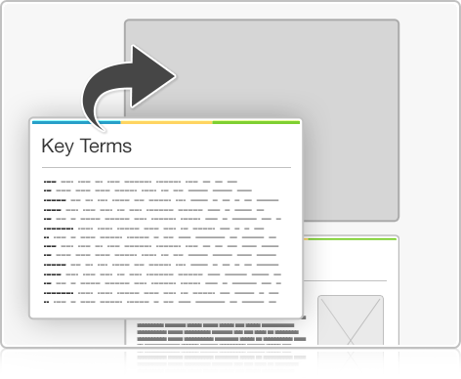


Using Boundless Presentations
Boundless Teaching Platform
Boundless empowers educators to engage their students with affordable, customizable textbooks and intuitive teaching tools. The free Boundless Teaching Platform gives educators the ability to customize textbooks in more than 20 subjects that align to hundreds of popular titles. Get started by using high quality Boundless books, or make switching to our platform easier by building from Boundless content pre-organized to match the assigned textbook. This platform gives educators the tools they need to assign readings and assessments, monitor student activity, and lead their classes with pre-made teaching resources.
Get started now at:
The Appendix
The appendix is for you to use to add depth and breadth to your lectures. You can simply drag and drop slides from the appendix into the main presentation to make for a richer lecture experience.
http://boundless.com/teaching-platform
Free to edit, share, and copy
Feel free to edit, share, and make as many copies of the Boundless presentations as you like. We encourage you to take these presentations and make them your own.
If you have any questions or problems please email:
educators@boundless.com
Free to share, print, make copies and changes. Get yours at www.boundless.com

Slide 3

About Boundless
Boundless is an innovative technology company making education more affordable and accessible for students everywhere. The company creates the world’s best open educational content in 20+ subjects that align to more than 1,000 popular college textbooks. Boundless integrates learning technology into all its premium books to help students study more efficiently at a fraction of the cost of traditional textbooks. The company also empowers educators to engage their students more effectively through customizable books and intuitive teaching tools as part of the Boundless Teaching Platform. More than 2 million learners access Boundless free and premium content each month across the company’s wide distribution platforms, including its website, iOS apps, Kindle books, and iBooks. To get started learning or teaching with Boundless, visit boundless.com.
Free to share, print, make copies and changes. Get yours at www.boundless.com

Slide 4
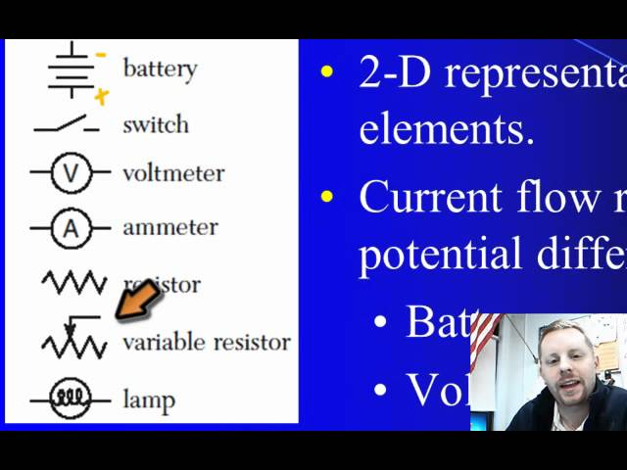
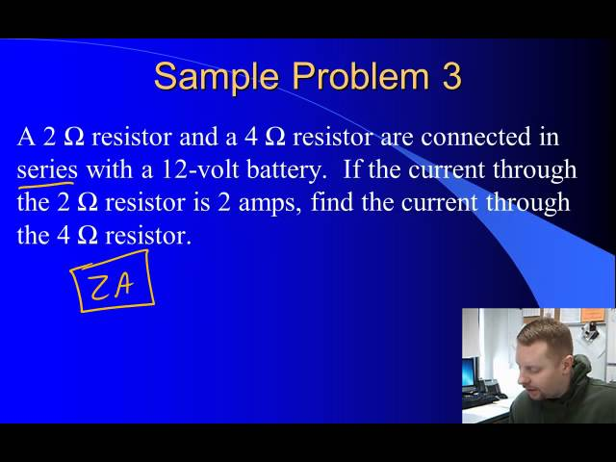
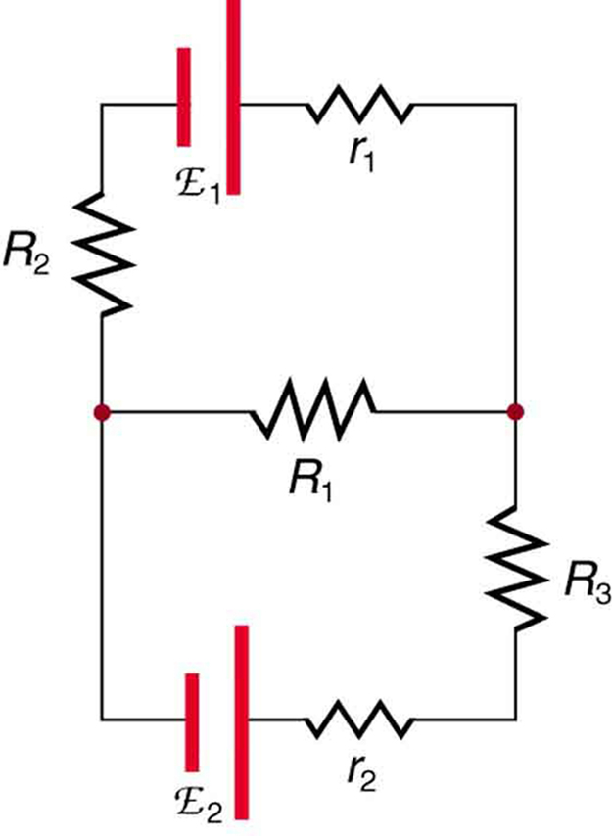
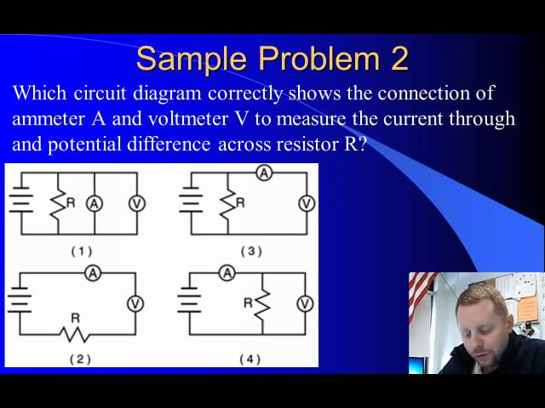
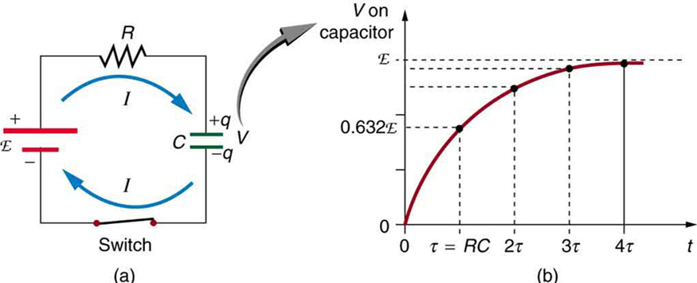

Circuits and Direct Currents
Overview
Resistors in Series and Parallel
Kirchhoff's Rules
Voltmeters and Ammeters
]
RC Circuits
Circuits and Direct Currents
Free to share, print, make copies and changes. Get yours at www.boundless.com

Slide 5

Overview
Circuits and Direct Currents > Overview
Different Types of Currents
Sources of EMF
Free to share, print, make copies and changes. Get yours at www.boundless.com
www.boundless.com/physics/textbooks/boundless-physics-textbook/circuits-and-direct-currents-20/overview-150/

Slide 6
Resistors in Series and Parallel
Circuits and Direct Currents > Resistors in Series and Parallel
Resisitors in Series
Resistors in Parallel
Combination Circuits
Charging a Battery: EMFs in Series and Parallel
EMF and Terminal Voltage
Free to share, print, make copies and changes. Get yours at www.boundless.com
www.boundless.com/physics/textbooks/boundless-physics-textbook/circuits-and-direct-currents-20/resistors-in-series-and-parallel-151/

Slide 7
Kirchhoff's Rules
Circuits and Direct Currents > Kirchhoff's Rules
Introduction and Importance
The Junction Rule
The Loop Rule
Applications
Free to share, print, make copies and changes. Get yours at www.boundless.com
www.boundless.com/physics/textbooks/boundless-physics-textbook/circuits-and-direct-currents-20/kirchhoff-s-rules-152/

Slide 8
Voltmeters and Ammeters
Circuits and Direct Currents > Voltmeters and Ammeters
Voltmeters and Ammeters
Null Measurements
Free to share, print, make copies and changes. Get yours at www.boundless.com
www.boundless.com/physics/textbooks/boundless-physics-textbook/circuits-and-direct-currents-20/voltmeters-and-ammeters-153/

Slide 9
RC Circuits
Circuits and Direct Currents > RC Circuits
Resistors and Capacitors in Series
Impedance
Phase Angle and Power Factor
Free to share, print, make copies and changes. Get yours at www.boundless.com
www.boundless.com/physics/textbooks/boundless-physics-textbook/circuits-and-direct-currents-20/rc-circuits-154/

Slide 10
Appendix
Free to share, print, make copies and changes. Get yours at www.boundless.com

Slide 11
Key terms
Circuits and Direct Currents
AC Alternating current.
alternating current (AC)—An electric current in which the direction of flow of the electrons reverses periodically having an average of zero, with positive and negative values (with a frequency of 50 Hz in Europe, 60 Hz in the US, 400 Hz for airport lighting, and some others); especially such a current produced by a rotating generator or alternator.
battery A device that produces electricity by a chemical reaction between two substances.
capacitor An electronic component capable of storing an electric charge, especially one consisting of two conductors separated by a dielectric.
capacitor An electronic component consisting of two conductor plates separated by empty space (sometimes a dielectric material is instead sandwiched between the plates), and capable of storing a certain amount of charge.
capacitor An electronic component capable of storing an electric charge, especially one consisting of two conductors separated by a dielectric.
combination circuit An electrical circuit containing multiple resistors that are connected in a combination of both series and parallel connections.
current The time rate of flow of electric charge.
current-voltage characteristic A current–voltage characteristic or I–V curve (current–voltage curve) is a relationship between the electric current through a circuit, device, or material, and the corresponding voltage, or potential difference across it.
DC Direct current; the unidirectional flow of electric charge.
differential equation An equation involving the derivatives of a function.
direct current An electric current in which the electrons flow in one direction, but may vary with time.
Free to share, print, make copies and changes. Get yours at www.boundless.com

Slide 12
Circuits and Direct Currents
electric charge A quantum number that determines the electromagnetic interactions of some subatomic particles; by convention, the electron has an electric charge of -1 and the proton +1, and quarks have fractional charge.
electrical circuit An interconnection of electrical elements such as resistors, inductors, capacitors, transmission lines, voltage sources, current sources and switches that has a closed loop giving a return path for the current.
electromotive force (EMF)—The voltage generated by a battery or by the magnetic force according to Faraday's Law. It is measured in units of volts, not newtons, and thus, is not actually a force.
electromotive force (EMF)—The voltage generated by a battery or by the magnetic force according to Faraday's Law. It is measured in units of volts, not newtons, and thus, is not actually a force.
electromotive force (EMF)—The voltage generated by a battery or by the magnetic force according to Faraday's Law. It is measured in units of volts, not newtons, and thus, is not actually a force.
electromotive force (EMF)—The voltage generated by a battery or by the magnetic force according to Faraday's Law. It is measured in units of volts (not newtons, N; EMF is not a force).
electromotive force (EMF)—The voltage generated by a battery or by the magnetic force according to Faraday's Law. It is measured in units of volts, not newtons, and thus, is not actually a force.
electromotive force (EMF)—The voltage generated by a battery or by the magnetic force according to Faraday's Law. It is measured in units of volts, not newtons, and thus, is not actually a force.
Faraday’s law of induction Is a basic law of electromagnetism that predicts how a magnetic field will interact with an electric circuit to produce an electromotive force.
galvanometer An analog measuring device, denoted by G, that measures current flow using a needle deflection caused by a magnetic field force acting upon a current-carrying wire.
impedance A measure of the opposition to the flow of an alternating current in a circuit; the aggregation of its resistance, inductive and capacitive reactance. Represented by the symbol Z.
impedance A measure of the opposition to the flow of an alternating current in a circuit; the aggregation of its resistance, inductive and capacitive reactance. Represented by the symbol Z.
Free to share, print, make copies and changes. Get yours at www.boundless.com

Slide 13
Circuits and Direct Currents
null measurements methods of measuring current and voltage more accurately by balancing the circuit so that no current flows through the measurement device
parallel An arrangement of electrical components such that a current flows along two or more paths.
parallel An arrangement of electrical components such that a current flows along two or more paths.
parallel An arrangement of electrical components such that a current flows along two or more paths.
potential difference The difference in potential energy between two points in an electric field; the difference in charge between two points in an electrical circuit; voltage.
potentiometer an instrument that measures a voltage by opposing it with a precise fraction of a known voltage, and without drawing current from the unknown source.
resistance The opposition to the passage of an electric current through that element.
resistance The opposition to the passage of an electric current through that element.
resistor An electric component that transmits current in direct proportion to the voltage across it.
resistor An electric component that transmits current in direct proportion to the voltage across it.
resistor An electric component that transmits current in direct proportion to the voltage across it.
rms Root mean square: a statistical measure of the magnitude of a varying quantity.
Free to share, print, make copies and changes. Get yours at www.boundless.com

Slide 14
Circuits and Direct Currents
series A number of things that follow on one after the other or are connected one after the other.
series A number of things that follow on one after the other or are connected one after the other.
series A number of things that follow on one after the other or are connected one after the other.
shunt resistance a small resistance R placed in parallel with a galvanometer G to produce an ammeter; the larger the current to be measured, the smaller R must be; most of the current flowing through the meter is shunted through R to protect the galvanometer
terminal voltage The voltage output of a device measured across its terminals.
Wheatstone bridge An instrument used to measure an unknown electrical resistance by balancing two legs of a bridge circuit, one leg of which includes the unknown component.
Free to share, print, make copies and changes. Get yours at www.boundless.com

Slide 15

Circuits and Direct Currents
Circuits
A brief introduction to electric circuits and current flow for introductory physics students.
Free to share, print, make copies and changes. Get yours at www.boundless.com
View on Boundless.com

Slide 16
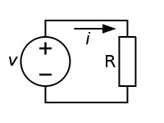
Circuits and Direct Currents
A Simple Circuit
A simple DC circuit with a voltage source (V) and resistor (R). The current i flowing through the circuit is given by Ohm's law.
Free to share, print, make copies and changes. Get yours at www.boundless.com
Wikipedia. Public domain http://en.wikipedia.org/w/index.php?title=File:Ohm's_Law_with_Voltage_source.svg&page=1 View on Boundless.com

Slide 17
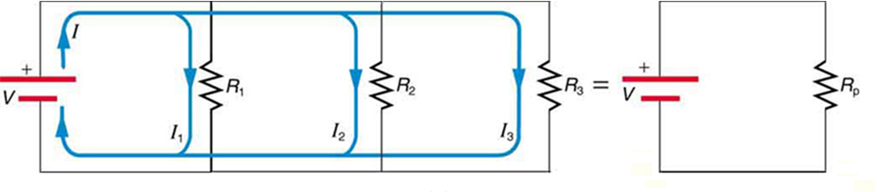
Circuits and Direct Currents
Parallel resistors
Three resistors connected in parallel to a battery and the equivalent single or parallel resistance.
Free to share, print, make copies and changes. Get yours at www.boundless.com
OpenStax CNX. "OpenStax College, College Physics. November 2, 2012." CC BY 3.0 http://cnx.org/content/m42356/latest/?collection=col11406/1.7 View on Boundless.com

Slide 18
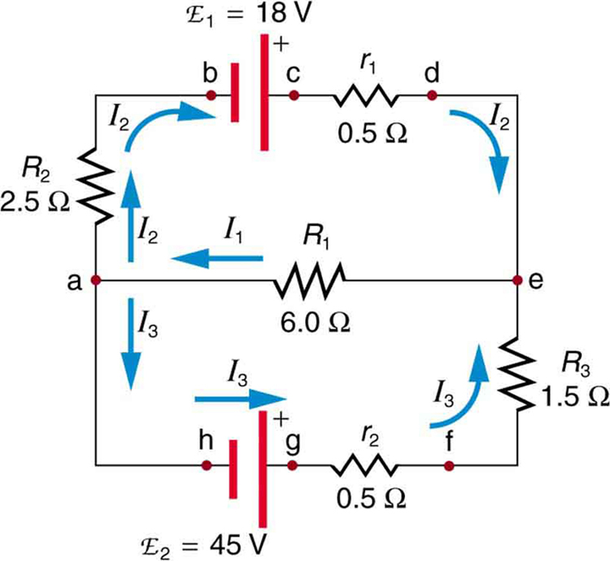
Circuits and Direct Currents
Kirchhoff's Rules: sample problem
This image shows a very complicated circuit, which can be reduced and solved using Kirchoff's Rules.
Free to share, print, make copies and changes. Get yours at www.boundless.com
OpenStax CNX. "OpenStax College, Kirchhoff’s Rules. January 14, 2013." CC BY 3.0 http://cnx.org/content/m42359/latest/ View on Boundless.com

Slide 19
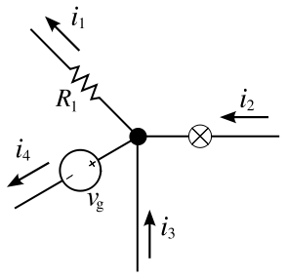
Circuits and Direct Currents
Kirchhoff's Junction Law
Kirchhoff's Junction Law illustrated as currents flowing into and out of a junction.
Free to share, print, make copies and changes. Get yours at www.boundless.com
Wikipedia. "KCL - Kirchhoff's circuit laws." CC BY-SA http://en.wikipedia.org/wiki/File:KCL_-_Kirchhoff's_circuit_laws.svg View on Boundless.com

Slide 20
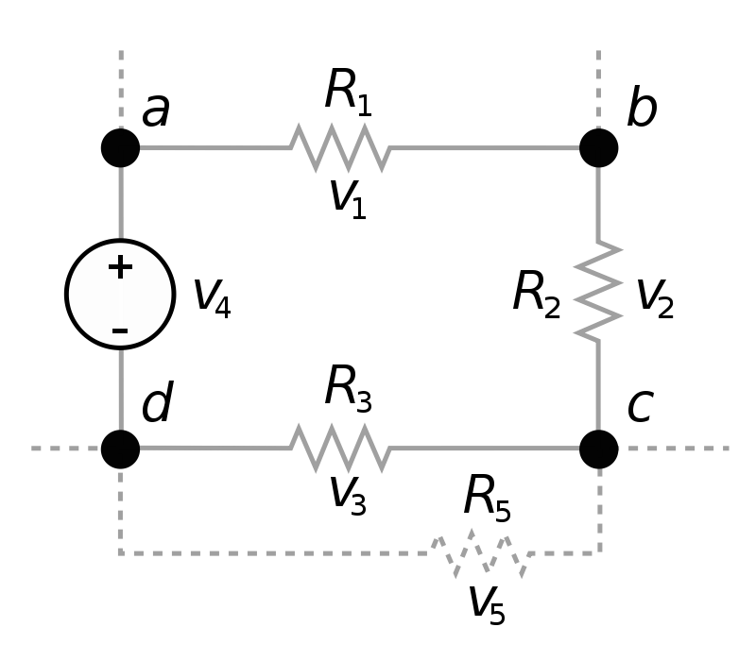
Circuits and Direct Currents
Kirchhoff's Loop Rule
Kirchhoff's loop rule states that the sum of all the voltages around the loop is equal to zero: v1 + v2 + v3 - v4 = 0.
Free to share, print, make copies and changes. Get yours at www.boundless.com
Wikipedia. "Kirchhoff voltage law." CC BY-SA http://en.wikipedia.org/wiki/File:Kirchhoff_voltage_law.svg View on Boundless.com

Slide 21
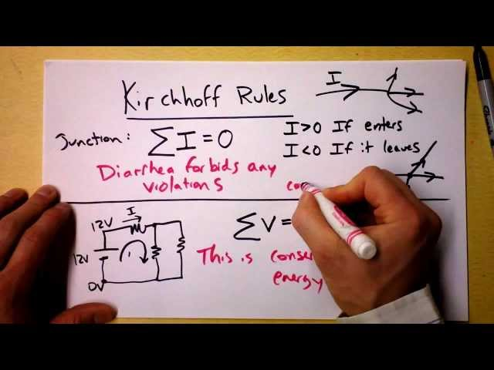
Circuits and Direct Currents
Kirchhoff's Loop and Junction Rules Theory
We justify Kirchhoff's Rules from diarrhea and conservation of energy. Some people call 'em laws, but not me!
Free to share, print, make copies and changes. Get yours at www.boundless.com
View on Boundless.com

Slide 22
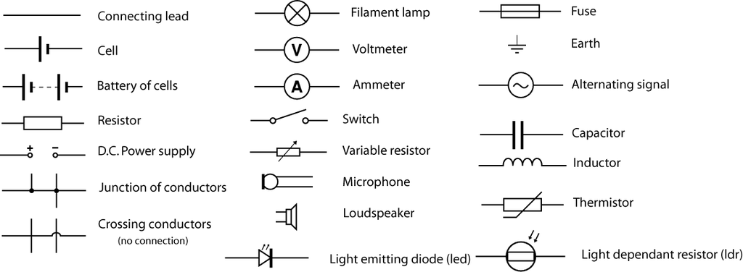
Circuits and Direct Currents
Example Circuit Element Symbols
A set of example circuit elements and their associated symbols commonly used in circuit diagrams.
Free to share, print, make copies and changes. Get yours at www.boundless.com
Wikibooks. "Circuit Symbols for A-level-OCR-Physics A." CC BY-SA 3.0 http://en.wikibooks.org/wiki/File:Circuit_Symbols_for_A-level-OCR-Physics_A.png View on Boundless.com

Slide 23
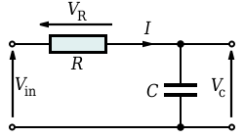
Circuits and Direct Currents
Series RC Circuit
Series RC circuit.
Free to share, print, make copies and changes. Get yours at www.boundless.com
Wikipedia. "RC circuit." CC BY http://en.wikipedia.org/wiki/RC_circuit View on Boundless.com

Slide 24
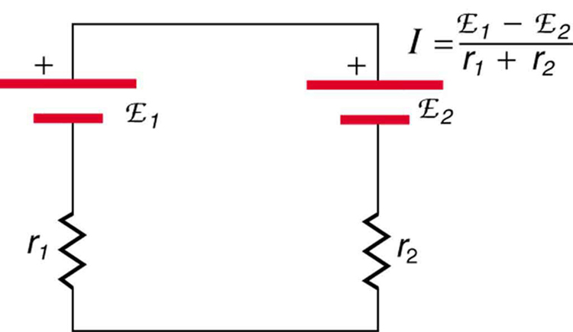
Circuits and Direct Currents
Battery Charger
This represents two voltage sources connected in series with their emfs in opposition. Current flows in the direction of the greater emf and is limited by the sum of the internal resistances. (Note that each emf is represented by script E in the figure. ) A battery charger connected to a battery is an example of such a connection. The charger must have a larger emf than the battery to reverse current through it.
Free to share, print, make copies and changes. Get yours at www.boundless.com
OpenStax CNX. "OpenStax College, College Physics. November 7, 2012." CC BY 3.0 http://cnx.org/content/m42357/latest/?collection=col11406/1.7 View on Boundless.com

Slide 25
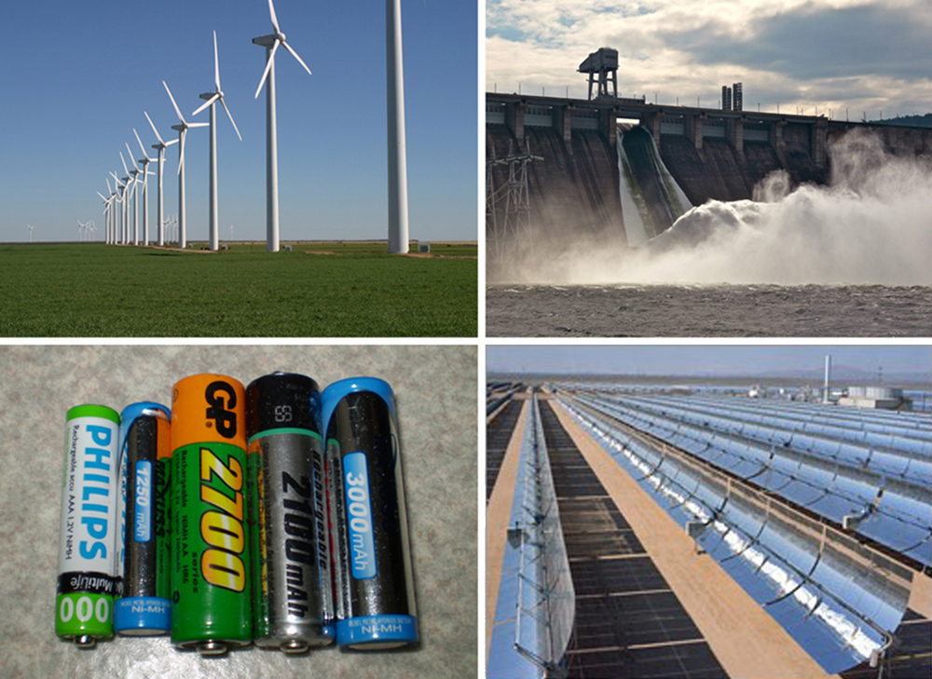
Circuits and Direct Currents
Examples of generators of electromotive force.
A variety of voltage sources (clockwise from top left): the Brazos Wind Farm in Fluvanna, Texas (credit: Leaflet, Wikimedia Commons); the Krasnoyarsk Dam in Russia (credit: Alex Polezhaev); a solar farm (credit: U.S. Department of Energy); and a group of nickel metal hydride batteries (credit: Tiaa Monto). The voltage output of each depends on its construction and load, and equals emf only if there is no load.
Free to share, print, make copies and changes. Get yours at www.boundless.com
OpenStax CNX. "OpenStax College, College Physics. November 3, 2012." CC BY 3.0 http://cnx.org/content/m42357/latest/?collection=col11406/1.7 View on Boundless.com

Slide 26
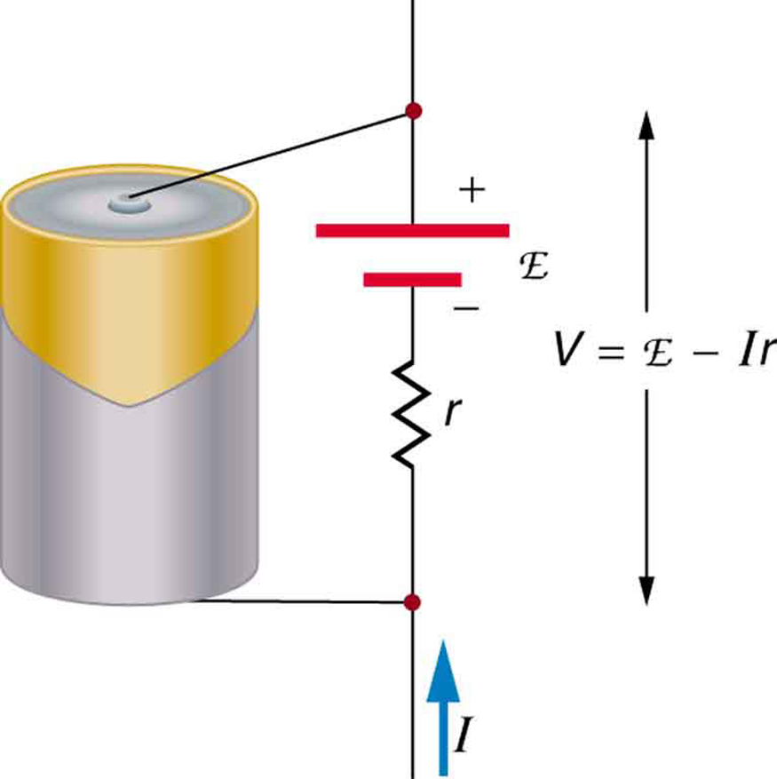
Circuits and Direct Currents
Schematic Representation of a Voltage Source
Any voltage source (in this case, a carbon-zinc dry cell) has an emf related to its source of potential difference, and an internal resistance r related to its construction. (Note that the script E stands for emf. ) Also shown are the output terminals across which the terminal voltage V is measured. Since V=emf−Ir, terminal voltage equals emf only if there is no current flowing.
Free to share, print, make copies and changes. Get yours at www.boundless.com
OpenStax CNX. "OpenStax College, College Physics. November 7, 2012." CC BY 3.0 http://cnx.org/content/m42357/latest/?collection=col11406/1.7 View on Boundless.com

Slide 27
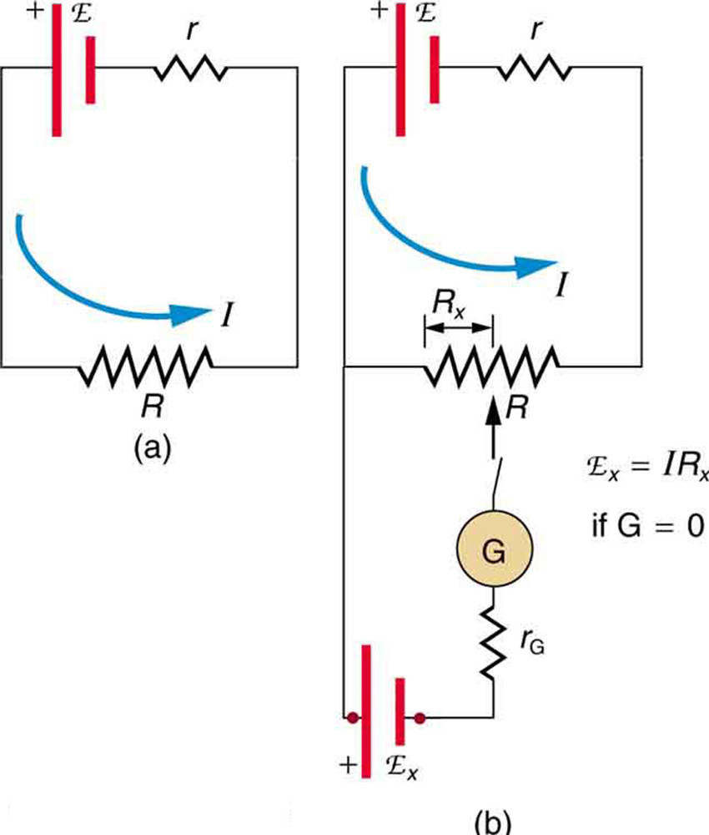
Circuits and Direct Currents
Potentiometer
The potentiometer is a null measurement device. (a. ) A voltage source connected to a long wire resistor passes a constant current I through it. (b.) An unknown EMF (labeled script Ex) is connected as shown, and the point of contact along R is adjusted until the galvanometer reads zero. The segment of wire has a resistance Rx and script Ex=IRx, where I is unaffected by the connection, since no current flows through the galvanometer. The unknown EMF is thus proportional to the resistance of the wire segment.
Free to share, print, make copies and changes. Get yours at www.boundless.com
OpenStax CNX. "OpenStax College, College Physics. October 26, 2012." CC BY 3.0 http://cnx.org/content/m42362/latest/?collection=col11406/latest View on Boundless.com

Slide 28
Circuits and Direct Currents
Kirchhoff's Loop and Junction Rules Theory
We justify Kirchhoff's Rules from diarrhea and conservation of energy. Some people call 'em laws, but not me!
Free to share, print, make copies and changes. Get yours at www.boundless.com
View on Boundless.com

Slide 29
Circuits and Direct Currents
Closed Circuit
To determine all variables (i.e., current and voltage drops across the different resistors) in this circuit, Kirchhoff's rules must be applied.
Free to share, print, make copies and changes. Get yours at www.boundless.com
OpenStax CNX. "OpenStax College, Kirchhoff’s Rules. January 14, 2013." CC BY 3.0 http://cnx.org/content/m42359/latest/ View on Boundless.com

Slide 30
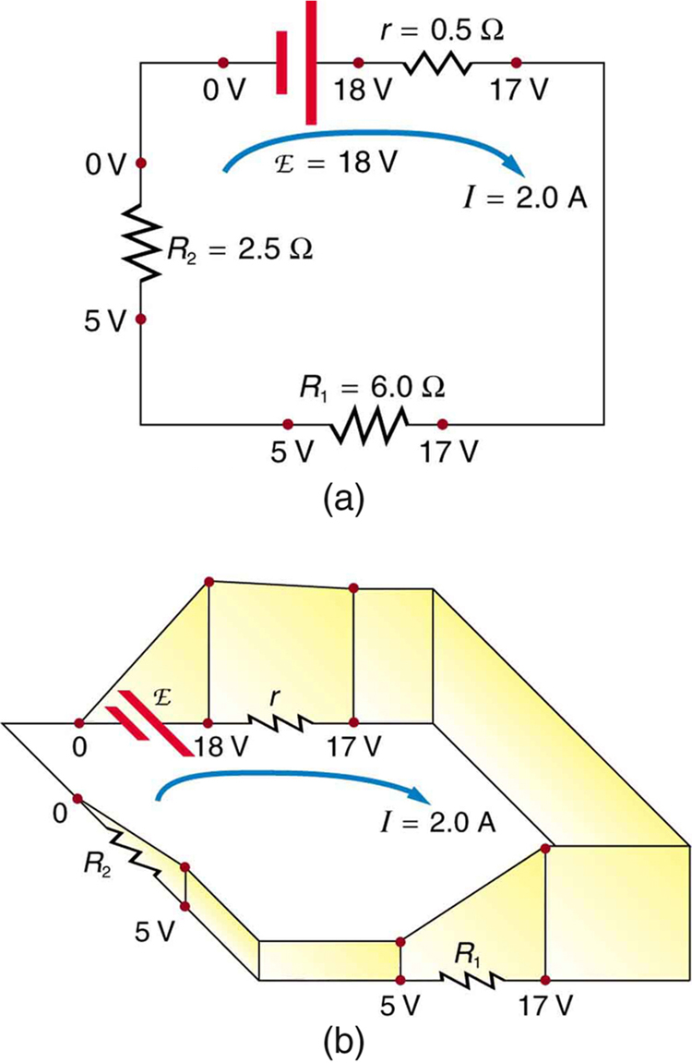
Circuits and Direct Currents
The Loop Rule
An example of Kirchhoff's second rule where the sum of the changes in potential around a closed loop must be zero. (a) In this standard schematic of a simple series circuit, the emf supplies 18 V, which is reduced to zero by the resistances, with 1 V across the internal resistance, and 12 V and 5 V across the two load resistances, for a total of 18 V. (b) This perspective view represents the potential as something like a roller coaster, where charge is raised in potential by the emf and lowered by the resistances. (Note that the script E stands for emf. )
Free to share, print, make copies and changes. Get yours at www.boundless.com
OpenStax CNX. "OpenStax College, Kirchhoff’s Rules. February 15, 2013." CC BY 3.0 http://cnx.org/content/m42359/latest/ View on Boundless.com

Slide 31
Circuits and Direct Currents
Series RC Circuit
Series RC circuit.
Free to share, print, make copies and changes. Get yours at www.boundless.com
Wikipedia. "RC circuit." CC BY http://en.wikipedia.org/wiki/RC_circuit View on Boundless.com

Slide 32
Circuits and Direct Currents
Series Circuits
A brief introduction to series circuit and series circuit analysis, including Kirchhoff's Current Law (KCL) and Kirchhoff's Voltage Law (KVL).
Free to share, print, make copies and changes. Get yours at www.boundless.com
View on Boundless.com

Slide 33
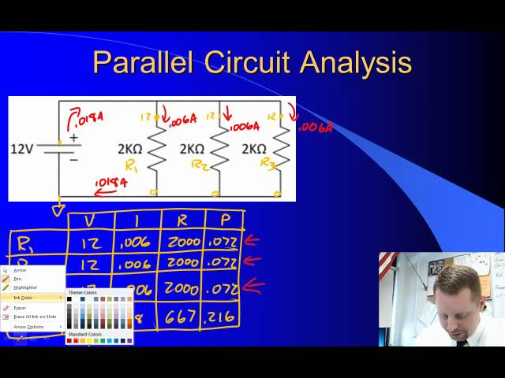
Circuits and Direct Currents
Parallel Circuits
A brief overview of parallel circuit analysis using VIRP tables for high school physics students.
Free to share, print, make copies and changes. Get yours at www.boundless.com
View on Boundless.com

Slide 34
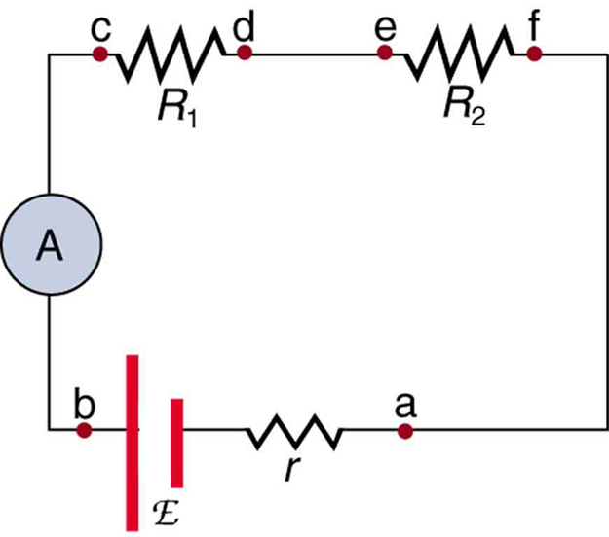
Circuits and Direct Currents
Ammeter in Series
An ammeter (A) is placed in series to measure current. All of the current in this circuit flows through the meter. The ammeter would have the same reading if located between points d and e or between points f and a, as it does in the position shown. (Note that the script capital E stands for EMF, and r stands for the internal resistance of the source of potential difference. )
Free to share, print, make copies and changes. Get yours at www.boundless.com
OpenStax CNX. "OpenStax College, College Physics. October 25, 2012." CC BY 3.0 http://cnx.org/content/m42360/latest/?collection=col11406/latest View on Boundless.com

Slide 35
Circuits and Direct Currents
Voltmeters and Ammeters
A brief introduction to voltmeters and ammeters for introductory physics students.
Free to share, print, make copies and changes. Get yours at www.boundless.com
View on Boundless.com

Slide 36
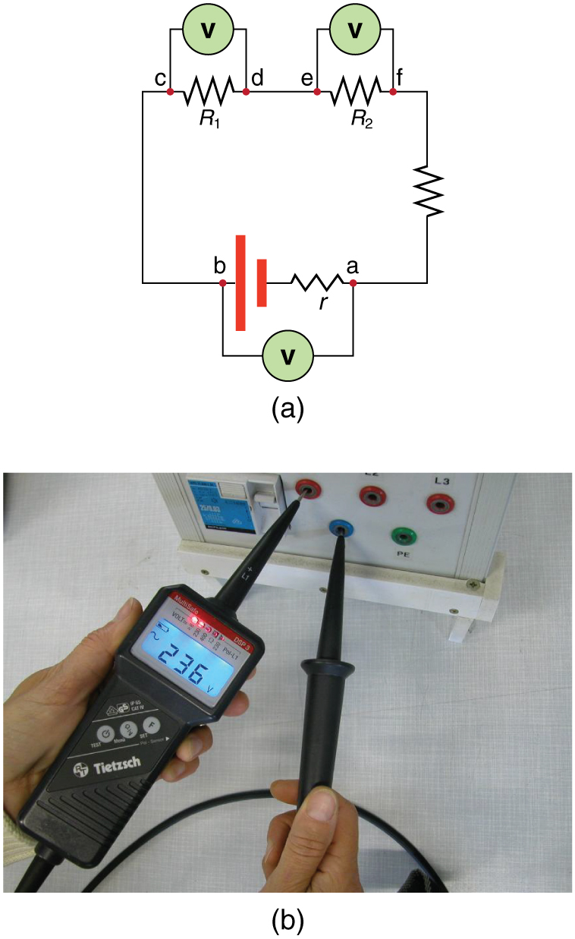
Circuits and Direct Currents
Voltmeter in Parallel
(a) To measure the potential difference in this series circuit, the voltmeter (V) is placed in parallel with the voltage source or either of the resistors. Note that terminal voltage is measured between points a and b. It is not possible to connect the voltmeter directly across the EMF without including its internal resistance, r. (b) A digital voltmeter in use
Free to share, print, make copies and changes. Get yours at www.boundless.com
OpenStax CNX. "OpenStax College, College Physics. October 25, 2012." CC BY 3.0 http://cnx.org/content/m42360/latest/?collection=col11406/latest View on Boundless.com

Slide 37
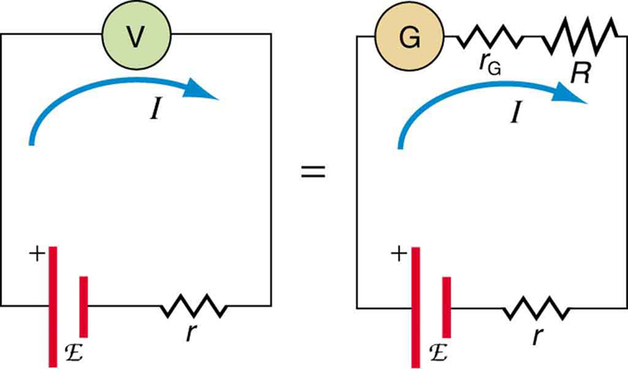
Circuits and Direct Currents
Voltmeter Connected to Battery
An analog voltmeter attached to a battery draws a small but nonzero current and measures a terminal voltage that differs from the EMF of the battery. (Note that the script capital E symbolizes electromotive force, or EMF. ) Since the internal resistance of the battery is not known precisely, it is not possible to calculate the EMF precisely.
Free to share, print, make copies and changes. Get yours at www.boundless.com
OpenStax CNX. "OpenStax College, College Physics. October 26, 2012." CC BY 3.0 http://cnx.org/content/m42362/latest/?collection=col11406/latest View on Boundless.com

Slide 38
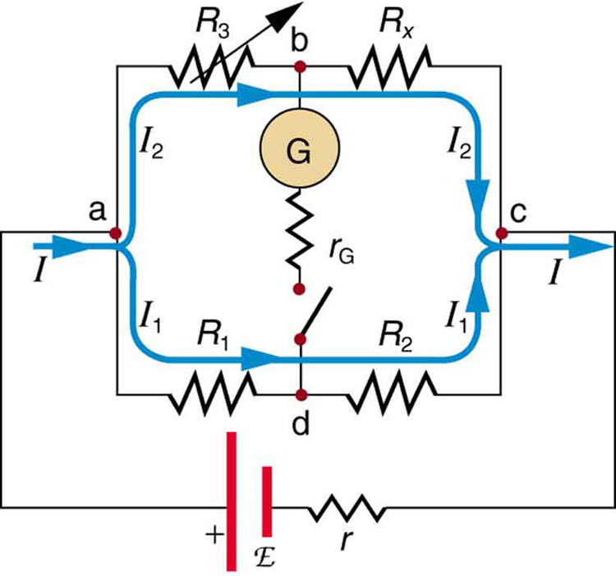
Circuits and Direct Currents
Wheatstone Bridge
The Wheatstone bridge is used to calculate unknown resistances. The variable resistance R3 is adjusted until the galvanometer reads zero with the switch closed. This simplifies the circuit, allowing Rx to be calculated based on the IR drops.
Free to share, print, make copies and changes. Get yours at www.boundless.com
OpenStax CNX. "OpenStax College, College Physics. October 26, 2012." CC BY 3.0 http://cnx.org/content/m42362/latest/?collection=col11406/latest View on Boundless.com

Slide 39
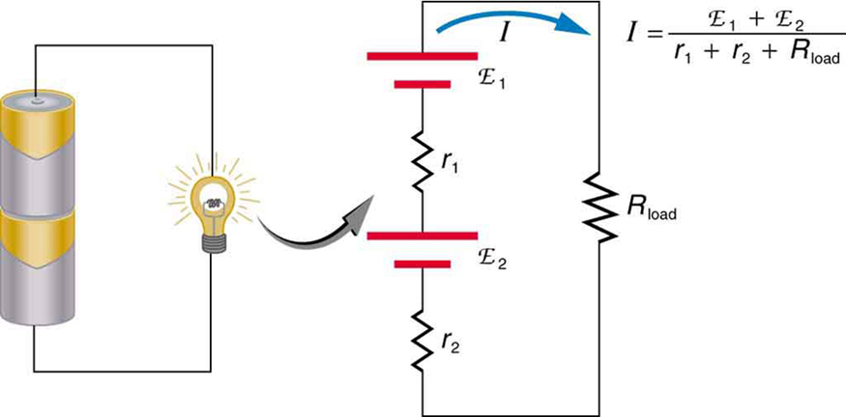
Circuits and Direct Currents
Flashlight and Bulb
A series connection of two voltage sources in the same direction. This schematic represents a flashlight with two cells (voltage sources) and a single bulb (load resistance) in series.
Free to share, print, make copies and changes. Get yours at www.boundless.com
OpenStax CNX. "OpenStax College, College Physics. November 7, 2012." CC BY 3.0 http://cnx.org/content/m42357/latest/?collection=col11406/1.7 View on Boundless.com

Slide 40
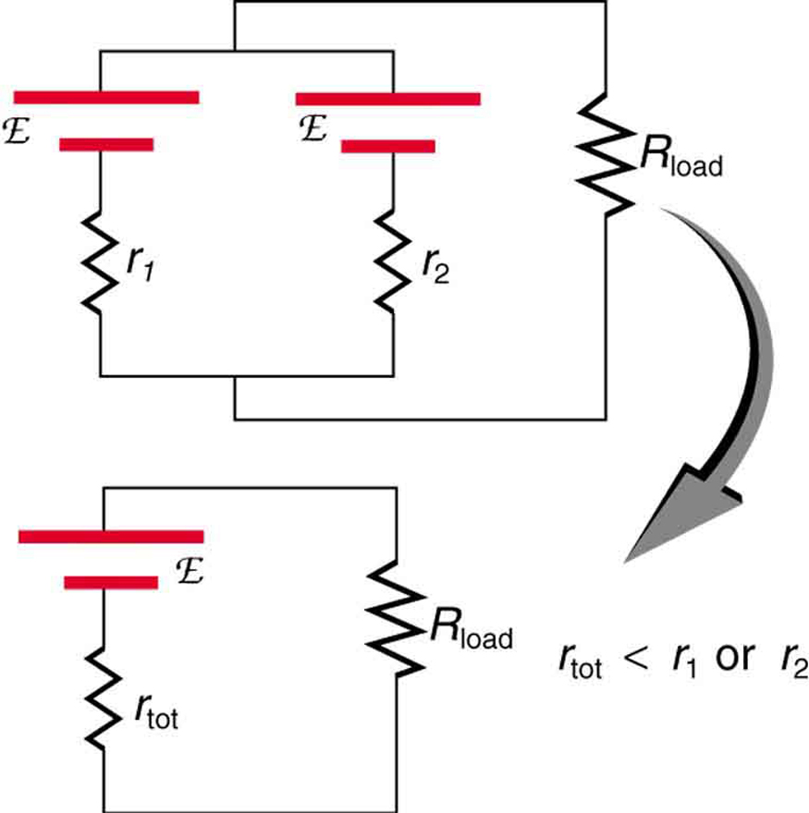
Circuits and Direct Currents
Two Identical EMFs
Two voltage sources with identical emfs (each labeled by script E) connected in parallel produce the same emf but have a smaller total internal resistance than the individual sources. Parallel combinations are often used to deliver more current.
Free to share, print, make copies and changes. Get yours at www.boundless.com
OpenStax CNX. "OpenStax College, College Physics. November 7, 2012." CC BY 3.0 http://cnx.org/content/m42357/latest/?collection=col11406/1.7 View on Boundless.com

Slide 41
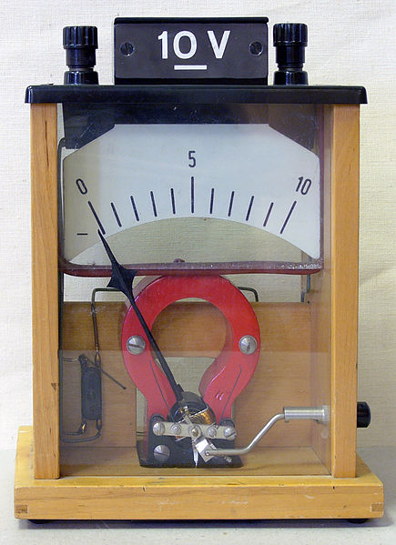
Circuits and Direct Currents
Voltmeter
Demonstration voltmeter from a physics class
Free to share, print, make copies and changes. Get yours at www.boundless.com
Wikipedia. "Voltmeters." CC BY http://en.wikipedia.org/wiki/Voltmeters View on Boundless.com

Slide 42
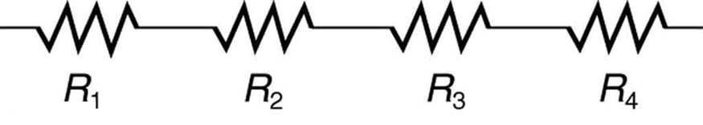
Circuits and Direct Currents
Resistors in Series
These four resistors are connected in series because if a current was applied at one end, it would flow through each resistor sequentially to the end.
Free to share, print, make copies and changes. Get yours at www.boundless.com
OpenStax CNX. "OpenStax College, College Physics. November 2, 2012." CC BY 3.0 http://cnx.org/content/m42356/latest/?collection=col11406/1.7 View on Boundless.com

Slide 43
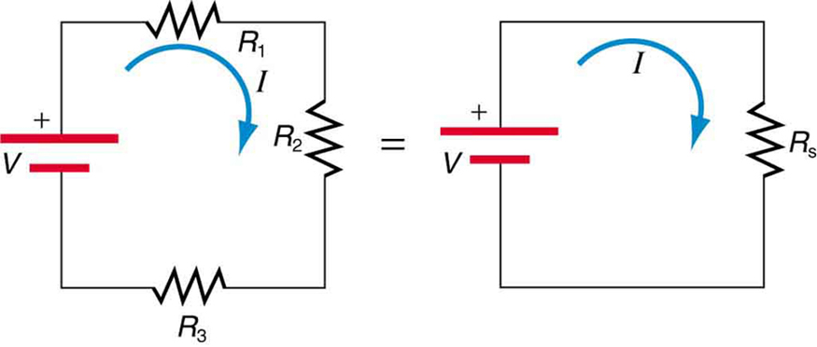
Circuits and Direct Currents
Resistors connected in a series circuit
Three resistors connected in series to a battery (left) and the equivalent single or series resistance (right).
Free to share, print, make copies and changes. Get yours at www.boundless.com
OpenStax CNX. "OpenStax College, College Physics. November 2, 2012." CC BY 3.0 http://cnx.org/content/m42356/latest/?collection=col11406/1.7 View on Boundless.com

Slide 44
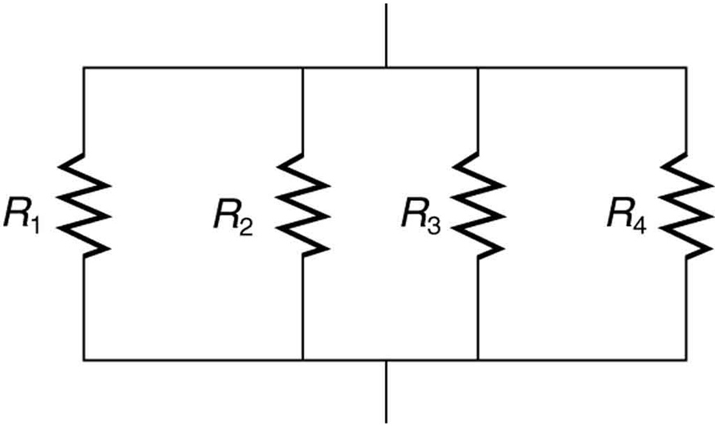
Circuits and Direct Currents
Resistors in Parallel
A parallel connection of resistors.
Free to share, print, make copies and changes. Get yours at www.boundless.com
OpenStax CNX. "OpenStax College, College Physics. November 2, 2012." CC BY 3.0 http://cnx.org/content/m42356/latest/?collection=col11406/1.7 View on Boundless.com

Slide 45
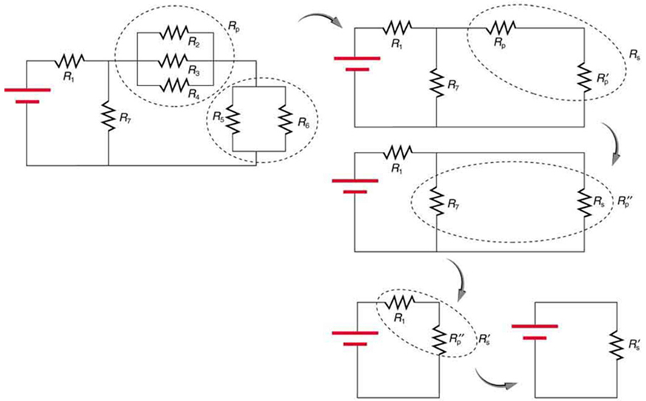
Circuits and Direct Currents
Reducing a combination circuit
This combination of seven resistors has both series and parallel parts. Each is identified and reduced to an equivalent resistance, and these are further reduced until a single equivalent resistance is reached.
Free to share, print, make copies and changes. Get yours at www.boundless.com
OpenStax CNX. "OpenStax College, College Physics. November 2, 2012." CC BY 3.0 http://cnx.org/content/m42356/latest/?collection=col11406/1.7 View on Boundless.com

Slide 46
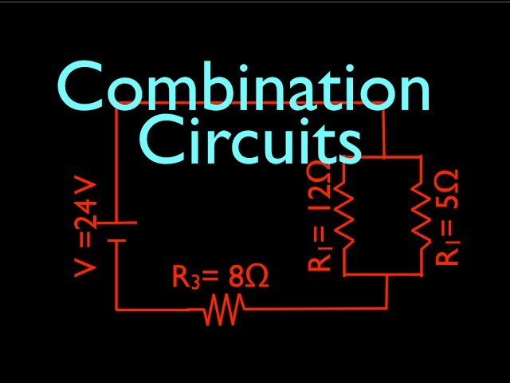
Circuits and Direct Currents
Combination Circuits
Two parallel resistors in series with one resistor.
Free to share, print, make copies and changes. Get yours at www.boundless.com
View on Boundless.com

Slide 47
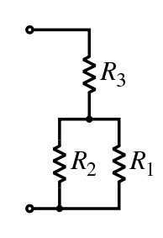
Circuits and Direct Currents
Resistor Network
In this combination circuit, the circuit can be broken up into a series component and a parallel component.
Free to share, print, make copies and changes. Get yours at www.boundless.com
Wikipedia. "Resistors." GNU FDL http://en.wikipedia.org/wiki/Resistors View on Boundless.com

Slide 48
Circuits and Direct Currents
Charging an RC Circuit
(a) An RC circuit with an initially uncharged capacitor. Current flows in the direction shown as soon as the switch is closed. Mutual repulsion of like charges in the capacitor progressively slows the flow as the capacitor is charged, stopping the current when the capacitor is fully charged and Q=C⋅emf. (b) A graph of voltage across the capacitor versus time, with the switch closing at time t=0. (Note that in the two parts of the figure, the capital script E stands for emf, q stands for the charge stored on the capacitor, and τ is the RC time constant. )
Free to share, print, make copies and changes. Get yours at www.boundless.com
OpenStax CNX. "OpenStax College, DC Circuits Containing Resistors and Capacitors. February 15, 2013." CC BY 3.0 http://cnx.org/content/m42363/latest/ View on Boundless.com

Slide 49
Attribution
Circuits and Direct Currents
Wiktionary. "potential difference." CC BY-SA 3.0 http://en.wiktionary.org/wiki/potential_difference
Boundless Learning. "Boundless." CC BY-SA 3.0 http://www.boundless.com//physics/definition/terminal-voltage
Wikipedia. "electromotive force." CC BY-SA 3.0 http://en.wikipedia.org/wiki/electromotive%20force
OpenStax CNX. "OpenStax College, College Physics. September 17, 2013." CC BY 3.0 http://cnx.org/content/m42357/latest/?collection=col11406/1.7
Wiktionary. "differential equation." CC BY-SA 3.0 http://en.wiktionary.org/wiki/differential_equation
Wiktionary. "capacitor." CC BY-SA 3.0 http://en.wiktionary.org/wiki/capacitor
OpenStax CNX. "OpenStax College, DC Circuits Containing Resistors and Capacitors. September 17, 2013." CC BY 3.0 http://cnx.org/content/m42363/latest/
Wikipedia. "DC." CC BY-SA 3.0 http://en.wikipedia.org/wiki/DC
Wiktionary. "capacitor." CC BY-SA 3.0 http://en.wiktionary.org/wiki/capacitor
Wiktionary. "resistor." CC BY-SA 3.0 http://en.wiktionary.org/wiki/resistor
Wiktionary. "impedance." CC BY-SA 3.0 http://en.wiktionary.org/wiki/impedance
Boundless Learning. "Boundless." CC BY-SA 3.0 http://www.boundless.com//physics/definition/ac
OpenStax CNX. "Don Johnson, The Impedance Concept. September 17, 2013." CC BY 3.0 http://cnx.org/content/m0024/latest/
Wikipedia. "Electrical impedance." CC BY-SA 3.0 http://en.wikipedia.org/wiki/Electrical_impedance
Wiktionary. "parallel." CC BY-SA 3.0 http://en.wiktionary.org/wiki/parallel
Wiktionary. "series." CC BY-SA 3.0 http://en.wiktionary.org/wiki/series
Wikipedia. "electromotive force." CC BY-SA 3.0 http://en.wikipedia.org/wiki/electromotive%20force
Free to share, print, make copies and changes. Get yours at www.boundless.com

Slide 50
Circuits and Direct Currents
OpenStax CNX. "OpenStax College, College Physics. September 17, 2013." CC BY 3.0 http://cnx.org/content/m42357/latest/?collection=col11406/1.7
OpenStax CNX. "OpenStax College, College Physics. September 17, 2013." CC BY 3.0 http://cnx.org/content/m42357/latest/?collection=col11406/1.7
Wiktionary. "resistor." CC BY-SA 3.0 http://en.wiktionary.org/wiki/resistor
Wikipedia. "electromotive force." CC BY-SA 3.0 http://en.wikipedia.org/wiki/electromotive%20force
Wikipedia. "Kirchhoff's circuit laws." CC BY-SA 3.0 http://en.wikipedia.org/wiki/Kirchhoff's_circuit_laws
Wiktionary. "direct current." CC BY-SA 3.0 http://en.wiktionary.org/wiki/direct_current
Wikipedia. "electrical circuit." CC BY-SA 3.0 http://en.wikipedia.org/wiki/electrical%20circuit
Wikipedia. "current-voltage characteristic." CC BY-SA 3.0 http://en.wikipedia.org/wiki/current-voltage%20characteristic
Light and Matter. CC BY-SA http://lightandmatter.com/simplej.pdf
Wikipedia. "Electrical circuit." CC BY-SA 3.0 http://en.wikipedia.org/wiki/Electrical_circuit
Wikipedia. "Electrical circuit." CC BY-SA 3.0 http://en.wikipedia.org/wiki/Electrical_circuit
Wikipedia. "Direct current." CC BY-SA 3.0 http://en.wikipedia.org/wiki/Direct_current
Wikipedia. "Direct current." CC BY-SA 3.0 http://en.wikipedia.org/wiki/Direct_current
Wikibooks. "Physics with Calculus/Electromagnetism/Current and Circuits." CC BY-SA 3.0 http://en.wikibooks.org/wiki/Physics_with_Calculus/Electromagnetism/Current_and_Circuits
Wikibooks. "FHSST Physics/Electricity/Flow of Charge." CC BY-SA 3.0 http://en.wikibooks.org/wiki/FHSST_Physics/Electricity/Flow_of_Charge
Wikibooks. "FHSST Physics/Electricity/Circuits." CC BY-SA 3.0 http://en.wikibooks.org/wiki/FHSST_Physics/Electricity/Circuits
Wiktionary. "parallel." CC BY-SA 3.0 http://en.wiktionary.org/wiki/parallel
Wikipedia. "resistance." CC BY-SA 3.0 http://en.wikipedia.org/wiki/resistance
Light and Matter. CC BY http://lightandmatter.com/lml.pdf
Free to share, print, make copies and changes. Get yours at www.boundless.com

Slide 51
Circuits and Direct Currents
OpenStax CNX. "OpenStax College, College Physics. September 17, 2013." CC BY 3.0 http://cnx.org/content/m42356/latest/?collection=col11406/1.7
Wikipedia. "combination circuit." CC BY-SA 3.0 http://en.wikipedia.org/wiki/combination%20circuit
Wiktionary. "parallel." CC BY-SA 3.0 http://en.wiktionary.org/wiki/parallel
Wiktionary. "series." CC BY-SA 3.0 http://en.wiktionary.org/wiki/series
Wikipedia. "Resistors." CC BY-SA 3.0 http://en.wikipedia.org/wiki/Resistors%23Series_and_parallel_resistors
OpenStax CNX. "OpenStax College, College Physics. September 17, 2013." CC BY 3.0 http://cnx.org/content/m42356/latest/?collection=col11406/1.7
Boundless Learning. "Boundless." CC BY-SA 3.0 http://www.boundless.com//physics/definition/faraday-s-law-of-induction--3
Wiktionary. "battery." CC BY-SA 3.0 http://en.wiktionary.org/wiki/battery
Wikipedia. "electromotive force." CC BY-SA 3.0 http://en.wikipedia.org/wiki/electromotive%20force
Wikipedia. "Voltage source." CC BY-SA 3.0 http://en.wikipedia.org/wiki/Voltage_source
Wikipedia. "Voltage source." CC BY-SA 3.0 http://en.wikipedia.org/wiki/Voltage_source
Wikipedia. "Voltage source." CC BY-SA 3.0 http://en.wikipedia.org/wiki/Voltage_source
OpenStax CNX. "Oka Kurniawan, Physics. September 17, 2013." CC BY 3.0 http://cnx.org/content/m42357/latest/?collection=col11428/latest
Wikibooks. "IB Physics/Electric Currents." CC BY-SA 3.0 http://en.wikibooks.org/wiki/IB_Physics/Electric_Currents
OpenStax CNX. "Oka Kurniawan, Physics. September 17, 2013." CC BY 3.0 http://cnx.org/content/m42357/latest/?collection=col11428/latest
Wikipedia. "Electromotive force." CC BY-SA 3.0 http://en.wikipedia.org/wiki/Electromotive_force
Wikibooks. "A-level Physics/Electrons, Waves and Photons/D.C.circuits." CC BY-SA 3.0 http://en.wikibooks.org/wiki/A-level_Physics/Electrons,_Waves_and_Photons/D.C._circuits
Wikibooks. "A-level Physics (Advancing Physics)/Voltage." CC BY-SA 3.0 http://en.wikibooks.org/wiki/A-level_Physics_(Advancing_Physics)/Voltage
Wikipedia. "Current source." CC BY-SA 3.0 https://en.wikipedia.org/wiki/Current_source
Free to share, print, make copies and changes. Get yours at www.boundless.com

Slide 52
Circuits and Direct Currents
Wikipedia. "Electromotive force." CC BY-SA 3.0 http://en.wikipedia.org/wiki/Electromotive_force
OpenStax CNX. "Oka Kurniawan, Physics. September 17, 2013." CC BY 3.0 http://cnx.org/content/m42357/latest/?collection=col11428/latest
Wiktionary. "alternating current." CC BY-SA 3.0 http://en.wiktionary.org/wiki/alternating_current
Wikipedia. "rms." CC BY-SA 3.0 http://en.wikipedia.org/wiki/rms
Wiktionary. "impedance." CC BY-SA 3.0 http://en.wiktionary.org/wiki/impedance
OpenStax CNX. "OpenStax College, RLC Series AC Circuits. September 17, 2013." CC BY 3.0 http://cnx.org/content/m42431/latest/
Wiktionary. "capacitor." CC BY-SA 3.0 http://en.wiktionary.org/wiki/capacitor
Wikipedia. "electromotive force." CC BY-SA 3.0 http://en.wikipedia.org/wiki/electromotive%20force
Wiktionary. "resistor." CC BY-SA 3.0 http://en.wiktionary.org/wiki/resistor
Wikipedia. "Kirchhoff's circuit laws." CC BY-SA 3.0 http://en.wikipedia.org/wiki/Kirchhoff's_circuit_laws
Wiktionary. "electric charge." CC BY-SA 3.0 http://en.wiktionary.org/wiki/electric_charge
Wiktionary. "current." CC BY-SA 3.0 http://en.wiktionary.org/wiki/current
Wikipedia. "Kirchhoff's circuit laws." CC BY-SA 3.0 http://en.wikipedia.org/wiki/Kirchhoff's_circuit_laws
Wikipedia. "electromotive force." CC BY-SA 3.0 http://en.wikipedia.org/wiki/electromotive%20force
OpenStax CNX. "OpenStax College, Kirchhoff’s Rules. September 17, 2013." CC BY 3.0 http://cnx.org/content/m42359/latest/
Wiktionary. "series." CC BY-SA 3.0 http://en.wiktionary.org/wiki/series
Wikipedia. "resistance." CC BY-SA 3.0 http://en.wikipedia.org/wiki/resistance
OpenStax CNX. "OpenStax College, College Physics. September 18, 2013." CC BY 3.0 http://cnx.org/content/m42356/latest/?collection=col11406/1.7
Light and Matter. CC BY http://lightandmatter.com/lml.pdf
Free to share, print, make copies and changes. Get yours at www.boundless.com

Slide 53
Circuits and Direct Currents
Boundless Learning. "Boundless." CC BY-SA 3.0 http://www.boundless.com//physics/definition/shunt-resistance
Boundless Learning. "Boundless." CC BY-SA 3.0 http://www.boundless.com//physics/definition/galvanometer
Wikipedia. "Ammeters." CC BY-SA 3.0 http://en.wikipedia.org/wiki/Ammeters
OpenStax CNX. "OpenStax College, College Physics. September 18, 2013." CC BY 3.0 http://cnx.org/content/m42360/latest/?collection=col11406/1.7
Wikipedia. "Voltmeters." CC BY-SA 3.0 http://en.wikipedia.org/wiki/Voltmeters
Wiktionary. "Wheatstone bridge." CC BY-SA 3.0 http://en.wiktionary.org/wiki/Wheatstone_bridge
Wiktionary. "potentiometer." CC BY-SA 3.0 http://en.wiktionary.org/wiki/potentiometer
Boundless Learning. "Boundless." CC BY-SA 3.0 http://www.boundless.com//physics/definition/null-measurements
Wikipedia. "Potentiometer (measuring instrument)." CC BY-SA 3.0 http://en.wikipedia.org/wiki/Potentiometer_(measuring_instrument)
Wikipedia. "Wheatstone bridge." CC BY-SA 3.0 http://en.wikipedia.org/wiki/Wheatstone_bridge
OpenStax CNX. "OpenStax College, College Physics. September 18, 2013." CC BY 3.0 http://cnx.org/content/m42362/latest/?collection=col11406/latest
Free to share, print, make copies and changes. Get yours at www.boundless.com

