Slide 1


Boundless Lecture Slides
Available on the Boundless Teaching Platform
Free to share, print, make copies and changes. Get yours at www.boundless.com

Slide 2
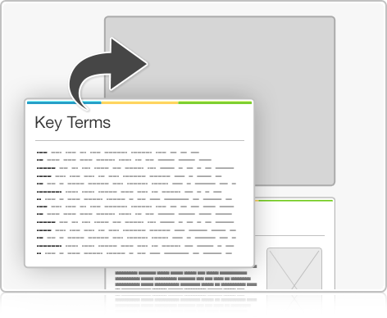
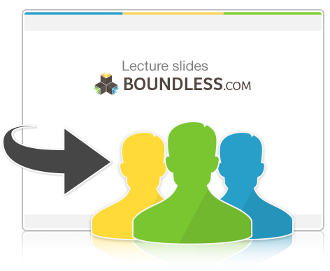

Using Boundless Presentations
Boundless Teaching Platform
Boundless empowers educators to engage their students with affordable, customizable textbooks and intuitive teaching tools. The free Boundless Teaching Platform gives educators the ability to customize textbooks in more than 20 subjects that align to hundreds of popular titles. Get started by using high quality Boundless books, or make switching to our platform easier by building from Boundless content pre-organized to match the assigned textbook. This platform gives educators the tools they need to assign readings and assessments, monitor student activity, and lead their classes with pre-made teaching resources.
Get started now at:
The Appendix
The appendix is for you to use to add depth and breadth to your lectures. You can simply drag and drop slides from the appendix into the main presentation to make for a richer lecture experience.
http://boundless.com/teaching-platform
Free to edit, share, and copy
Feel free to edit, share, and make as many copies of the Boundless presentations as you like. We encourage you to take these presentations and make them your own.
If you have any questions or problems please email:
educators@boundless.com
Free to share, print, make copies and changes. Get yours at www.boundless.com

Slide 3

About Boundless
Boundless is an innovative technology company making education more affordable and accessible for students everywhere. The company creates the world’s best open educational content in 20+ subjects that align to more than 1,000 popular college textbooks. Boundless integrates learning technology into all its premium books to help students study more efficiently at a fraction of the cost of traditional textbooks. The company also empowers educators to engage their students more effectively through customizable books and intuitive teaching tools as part of the Boundless Teaching Platform. More than 2 million learners access Boundless free and premium content each month across the company’s wide distribution platforms, including its website, iOS apps, Kindle books, and iBooks. To get started learning or teaching with Boundless, visit boundless.com.
Free to share, print, make copies and changes. Get yours at www.boundless.com

Slide 4
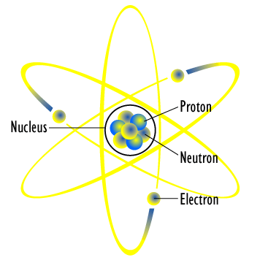
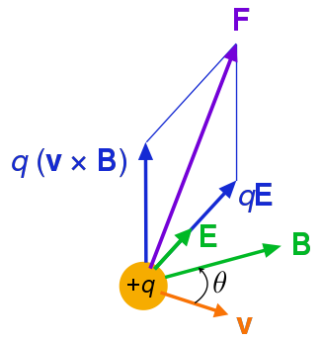
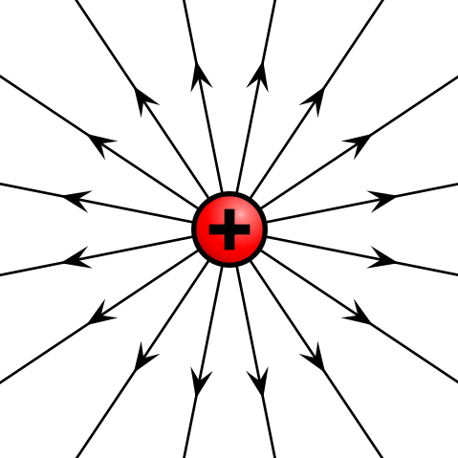
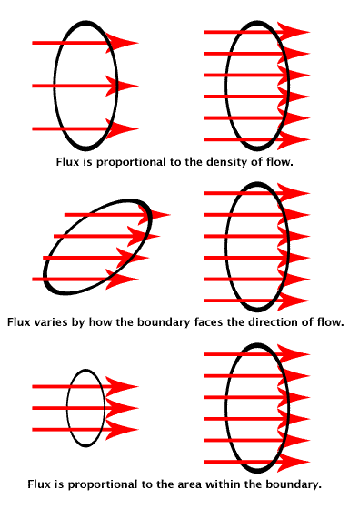

Electric Charge and Field
Overview
Shelding and Charging Through Induction
Coulomb's Law
The Electric Field Revisited
]
Electric Flux and Gauss's Law
Electric Charge and Field
Free to share, print, make copies and changes. Get yours at www.boundless.com

Slide 5
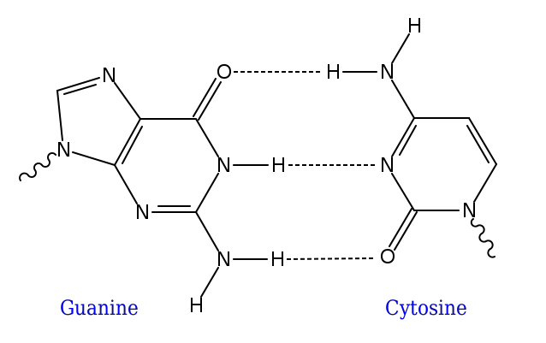
Electric Charge and Field (continued)
Applications of Electrostatics
]
Electric Charge and Field
Free to share, print, make copies and changes. Get yours at www.boundless.com

Slide 6

Overview
Electric Charge and Field > Overview
Electric Charge in the Atom
Properties of Electric Charges
Charge Separation
Polarization
Static Electricity, Charge, and the Conservation of Charge
Conductors and Insulators
The Millikan Oil-Drop Experiment
Free to share, print, make copies and changes. Get yours at www.boundless.com
www.boundless.com/physics/textbooks/boundless-physics-textbook/electric-charge-and-field-17/overview-133/

Slide 7
Shelding and Charging Through Induction
Electric Charge and Field > Shelding and Charging Through Induction
Electrostatic Shielding
Induced Charge
Free to share, print, make copies and changes. Get yours at www.boundless.com
www.boundless.com/physics/textbooks/boundless-physics-textbook/electric-charge-and-field-17/shelding-and-charging-through-induction-134/

Slide 8
Coulomb's Law
Electric Charge and Field > Coulomb's Law
Superposition of Forces
Spherical Distribution of Charge
Solving Problems with Vectors and Coulomb's Law
Free to share, print, make copies and changes. Get yours at www.boundless.com
www.boundless.com/physics/textbooks/boundless-physics-textbook/electric-charge-and-field-17/coulomb-s-law-135/

Slide 9
The Electric Field Revisited
Electric Charge and Field > The Electric Field Revisited
Electric Field from a Point Charge
Superposition of Fields
Electric Field Lines: Multiple Charges
Parallel-Plate Capacitor
Electric Fields and Conductors
Conductors and Fields in Static Equilibrium
Free to share, print, make copies and changes. Get yours at www.boundless.com
www.boundless.com/physics/textbooks/boundless-physics-textbook/electric-charge-and-field-17/the-electric-field-revisited-136/

Slide 10
Electric Flux and Gauss's Law
Electric Charge and Field > Electric Flux and Gauss's Law
Electric Flux
Gauss's Law
Free to share, print, make copies and changes. Get yours at www.boundless.com
www.boundless.com/physics/textbooks/boundless-physics-textbook/electric-charge-and-field-17/electric-flux-and-gauss-s-law-137/

Slide 11
Applications of Electrostatics
Electric Charge and Field > Applications of Electrostatics
Biology: DNA Structure and Replication
Photocopy Machines and Printers
Van de Graff Generators
Free to share, print, make copies and changes. Get yours at www.boundless.com
www.boundless.com/physics/textbooks/boundless-physics-textbook/electric-charge-and-field-17/applications-of-electrostatics-138/

Slide 12
Appendix
Free to share, print, make copies and changes. Get yours at www.boundless.com

Slide 13
Key terms
Electric Charge and Field
base A nucleotide's nucleobase in the context of a DNA or RNA biopolymer.
capacitor An electronic component capable of storing an electric charge, especially one consisting of two conductors separated by a dielectric.
conductor A material which contains movable electric charges.
conductor A material which contains movable electric charges.
corona discharge an electrical discharge brought on by the ionization of a fluid surrounding a conductor that is electrically energized
coulomb In the International System of Units, the derived unit of electric charge; the amount of electric charge carried by a current of 1 ampere flowing for 1 second. Symbol: C
coulomb's law the mathematical equation calculating the electrostatic force vector between two charged particles
coulomb's law the mathematical equation calculating the electrostatic force vector between two charged particles
dielectric An electrically insulating or nonconducting material considered for its electric susceptibility (i.e., its property of polarization when exposed to an external electric field).
dielectric An electrically insulating or nonconducting material considered for its electric susceptibility (i.e., its property of polarization when exposed to an external electric field).
dielectric An electrically insulating or nonconducting material considered for its electric susceptibility (i.e., its property of polarization when exposed to an external electric field).
dipole moment The vector product of the charge on either pole of a dipole and the distance separating them.
Free to share, print, make copies and changes. Get yours at www.boundless.com

Slide 14
Electric Charge and Field
discharge the act of releasing an accumulated charge
discharge the act of releasing an accumulated charge
discharge the act of releasing an accumulated charge
electric charge A quantum number that determines the electromagnetic interactions of some subatomic particles; by convention, the electron has an electric charge of -1 and the proton +1, and quarks have fractional charge.
electric charge A quantum number that determines the electromagnetic interactions of some subatomic particles; by convention, the electron has an electric charge of -1 and the proton +1, and quarks have fractional charge.
electric displacement field A vector field that appears in Maxwell's equations.
electric field A region of space around a charged particle, or between two voltages; it exerts a force on charged objects in its vicinity.
electric field A region of space around a charged particle, or between two voltages; it exerts a force on charged objects in its vicinity.
electric field A region of space around a charged particle, or between two voltages; it exerts a force on charged objects in its vicinity.
electric field A region of space around a charged particle, or between two voltages; it exerts a force on charged objects in its vicinity.
electrostatic force The electrostatic interaction between electrically charged particles; the amount and direction of attraction or repulsion between two charged bodies.
electrostatic force The electrostatic interaction between electrically charged particles; the amount and direction of attraction or repulsion between two charged bodies.
Free to share, print, make copies and changes. Get yours at www.boundless.com

Slide 15
Electric Charge and Field
electrostatic force The electrostatic interaction between electrically charged particles; the amount and direction of attraction or repulsion between two charged bodies.
equilibrium The state of a body at rest or in uniform motion, the resultant of all forces on which is zero.
Faraday shield A Faraday cage or Faraday shield is an enclosure formed by conducting material or by a mesh of such material. Such an enclosure blocks external static and non-static electric fields.
gravity Resultant force on Earth's surface, of the attraction by the Earth's masses, and the centrifugal pseudo-force caused by the Earth's rotation.
inductor A passive device that introduces inductance into an electrical circuit.
insulator A substance that does not transmit heat (thermal insulator), sound (acoustic insulator) or electricity (electrical insulator).
insulator A substance that does not transmit heat (thermal insulator), sound (acoustic insulator) or electricity (electrical insulator).
Lorentz force The force exerted on a charged particle in an electromagnetic field.
nucleus the massive, positively charged central part of an atom, made up of protons and neutrons
nucleus the massive, positively charged central part of an atom, made up of protons and neutrons
orthogonal Of two objects, at right angles; perpendicular to each other.
photoconductivity An increase in the electrical conductivity of a material as a result of incident electromagnetic radiation
Free to share, print, make copies and changes. Get yours at www.boundless.com

Slide 16
Electric Charge and Field
polarity the separation, alignment or orientation of something into two opposed poles
resistivity In general, the resistance to electric current of a material; in particular, the degree to which a material resists the flow of electricity.
static electricity an electric charge that has built up on an insulated body, often due to friction
static electricity an electric charge that has built up on an insulated body, often due to friction
static equilibrium the physical state in which all components of a system are at rest and the net force is equal to zero throughout the system
superposition principle The principle that a linear combination of two or more solutions of an equation is itself a solution; it is a feature of many physical laws.
terminal velocity The speed at which an object in free-fall and not in a vacuum ceases to accelerate downwards because the force of gravity is equal and opposite to the drag force acting against it.
unit vector A vector with length 1.
vector A directed quantity, one with both magnitude and direction; the between two points.
vector A directed quantity, one with both magnitude and direction; the between two points.
vector field a construction in which each point in a Euclidean space is associated with a vector; a function whose range is a vector space
vector field a construction in which each point in a Euclidean space is associated with a vector; a function whose range is a vector space
Free to share, print, make copies and changes. Get yours at www.boundless.com

Slide 17
Electric Charge and Field
voltage The amount of electrostatic potential between two points in space.
wavelength The length of a single cycle of a wave, as measured by the distance between one peak or trough of a wave and the next; it is often designated in physics as λ, and corresponds to the velocity of the wave divided by its frequency.
xerography a photocopying process in which a negative image formed on an electrically charged plate is transferred as a positive to paper and thermally fixed
Free to share, print, make copies and changes. Get yours at www.boundless.com

Slide 18
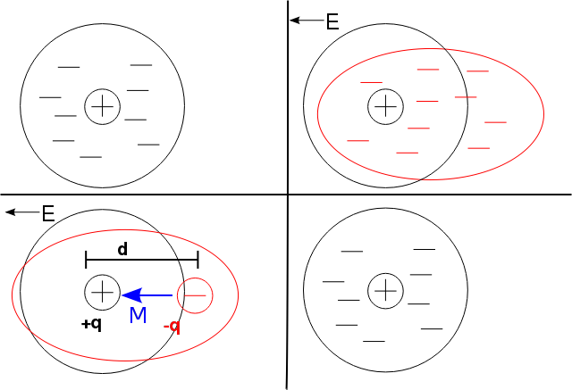

Electric Charge and Field
Reaction of an Atom to an Applied Electric Field
When an electric field (E) is applied, electrons drift away from the field. Their average location is displaced from the average location of the protons (which hasn't moved) by a distance of d. The atom's dipole moment is represented by M.
Free to share, print, make copies and changes. Get yours at www.boundless.com
Wikipedia. "Dielectric model." CC BY-SA http://en.wikipedia.org/wiki/File:Dielectric_model.svg View on Boundless.com

Slide 19
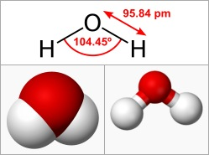
Electric Charge and Field
Water Molecule
Water is an example of a dipole molecule, which has a bent shape (the H-O-H angle is 104.45°) and in which the oxygen pulls electron density away from the H atoms, leaving the H relatively positive and the O relatively negative.
Free to share, print, make copies and changes. Get yours at www.boundless.com
Wikipedia. "Water molecule." GNU FDL http://en.wikipedia.org/wiki/Water_molecule View on Boundless.com

Slide 20
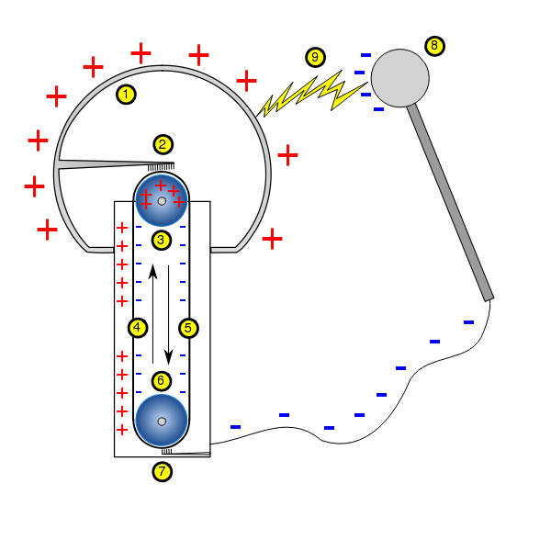
Electric Charge and Field
Schematic of a Van de Graaff Generator
Numbers in the diagram indicate: 1) hollow metal sphere; 2) upper electrode; 3) upper roller (for example an acrylic glass); 4) side of the belt with positive charges; 5) opposite side of the belt with negative charges; 6) lower roller (metal); 7) lower electrode (ground); 8) spherical device with negative charges, used to discharge the main sphere; 9) spark produced by the difference of potentials
Free to share, print, make copies and changes. Get yours at www.boundless.com
Wikipedia. "Van de graaf generator." CC BY-SA http://en.wikipedia.org/wiki/File:Van_de_graaf_generator.svg View on Boundless.com

Slide 21
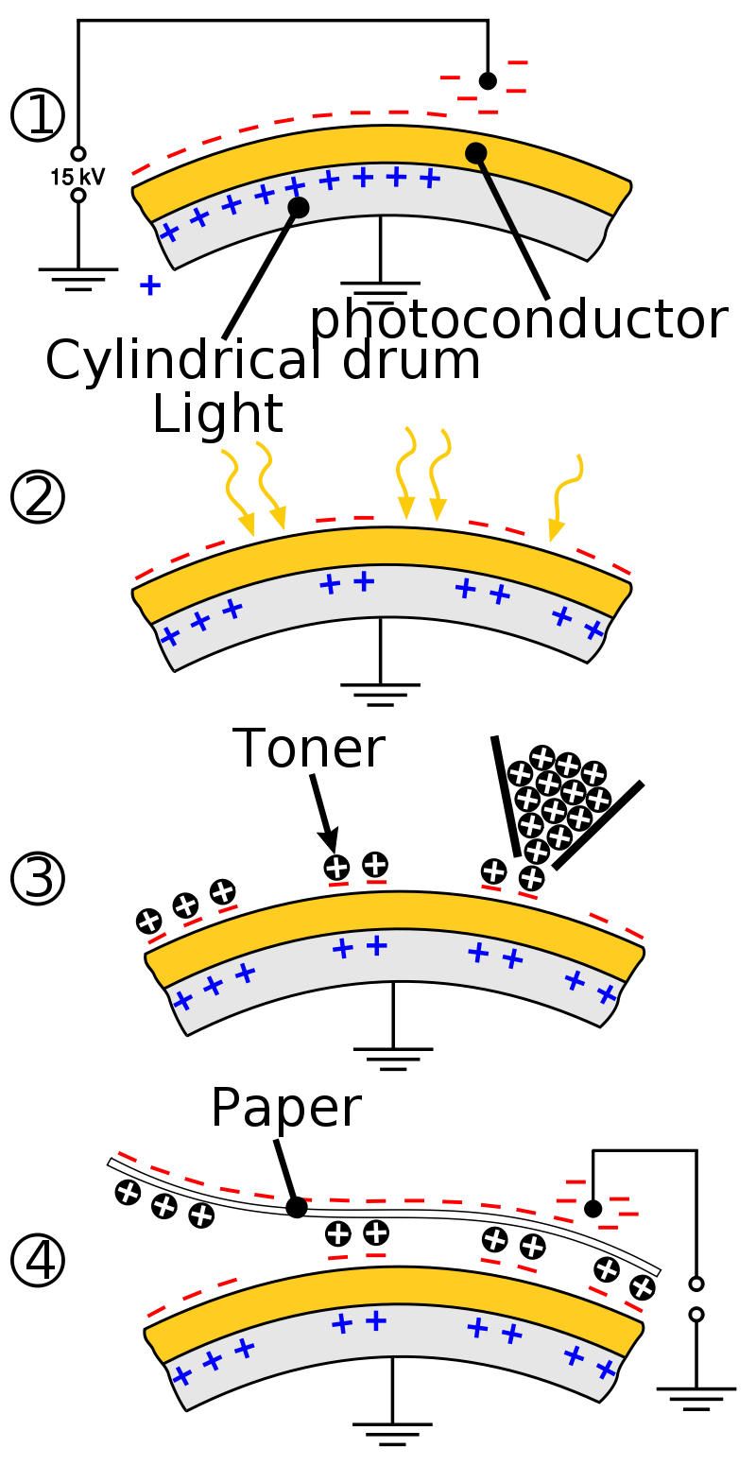
Electric Charge and Field
How a photocopier works
This image describes how a photocopier works.
Free to share, print, make copies and changes. Get yours at www.boundless.com
Wikipedia. "Xerographic photocopy process en." CC BY-SA http://en.wikipedia.org/wiki/File:Xerographic_photocopy_process_en.svg View on Boundless.com

Slide 22
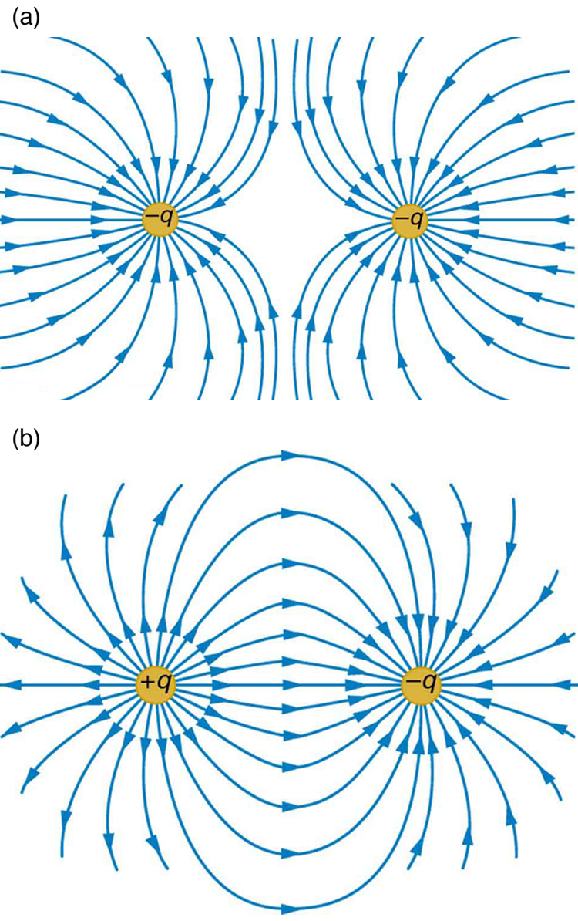
Electric Charge and Field
Field lines between like and unlike charges
Example a shows how the electric field is weak between like charges (the concentration of field lines is low between them). Example b, by contrast, has a strong field between the charges, as exhibited by the high concentration of field lines connecting them.
Free to share, print, make copies and changes. Get yours at www.boundless.com
OpenStax CNX. "OpenStax College, College Physics. December 29, 2012." CC BY 3.0 http://cnx.org/content/m42312/latest/?collection=col11406/latest View on Boundless.com

Slide 23
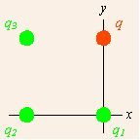
Electric Charge and Field
Multiple point charges
Coulomb's Law applied to more than one point source charges providing forces on a field charge.
Free to share, print, make copies and changes. Get yours at www.boundless.com
OpenStax CNX. "George Brown, CLF Multiple Point Sources. October 25, 2012." CC BY 3.0 http://cnx.org/content/m12747/latest/ View on Boundless.com

Slide 24
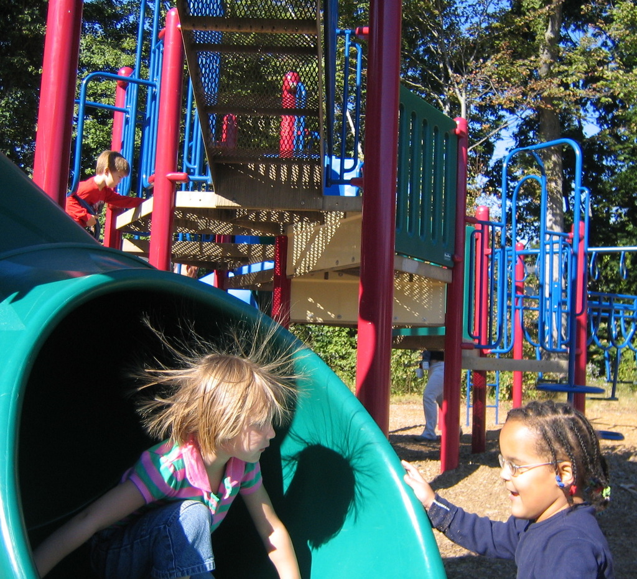
Electric Charge and Field
Static Electricity
Due to friction between her hair and the plastic slide, the girl on the left has created charge separation, resulting in her hair being attracted to the slide.
Free to share, print, make copies and changes. Get yours at www.boundless.com
Wikipedia. "Static on the playground (48616367)." CC BY-SA http://en.wikipedia.org/wiki/File:Static_on_the_playground_(48616367).jpg View on Boundless.com

Slide 25
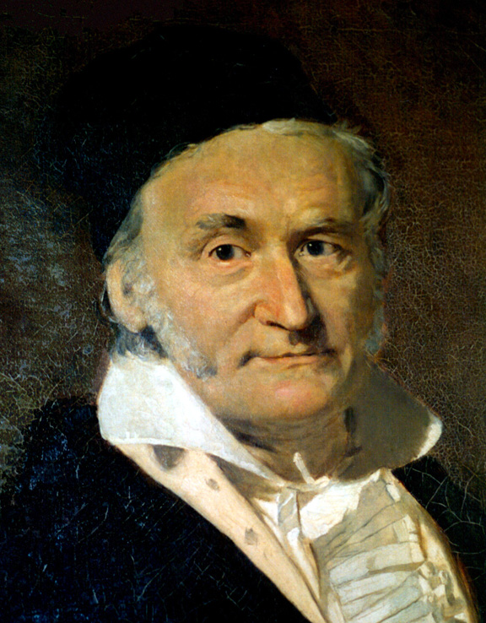
Electric Charge and Field
Carl Friedrich Gauss
Carl Friedrich Gauss (1777–1855), painted by Christian Albrecht Jensen
Free to share, print, make copies and changes. Get yours at www.boundless.com
Wikimedia. CC BY-SA http://upload.wikimedia.org/wikipedia/commons/9/9b/Carl_Friedrich_Gauss.jpg View on Boundless.com

Slide 26
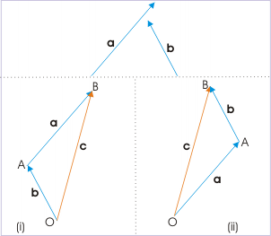
Electric Charge and Field
Vector addition
Forces a and b act upon an object at point O. Their sum is commutative, and results in a resultant vector c.
Free to share, print, make copies and changes. Get yours at www.boundless.com
OpenStax CNX. "Sunil Kumar Singh, Vector Addition. December 29, 2012." CC BY 3.0 http://cnx.org/content/m13601/latest/ View on Boundless.com

Slide 27

Electric Charge and Field
Application of Coulomb's Law
In a simple example, the vector notation of Coulomb's Law can be used when there are two point charges and only one of which is a source charge.
Free to share, print, make copies and changes. Get yours at www.boundless.com
OpenStax CNX. "George Brown, Coulomb Law Forces. October 25, 2012." CC BY 3.0 http://cnx.org/content/m12742/latest/ View on Boundless.com

Slide 28
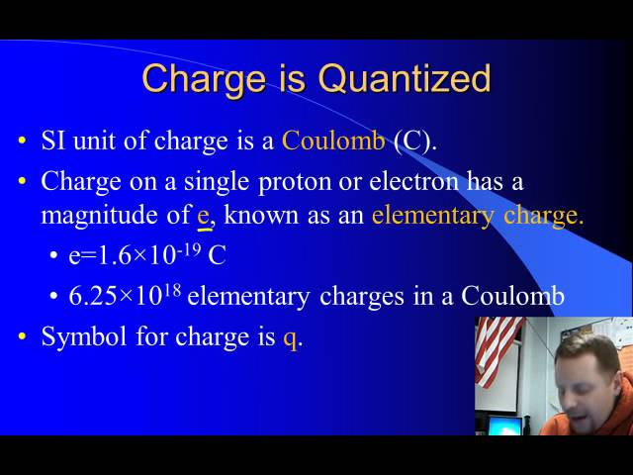
Electric Charge and Field
Electric Charge
A brief overview of atoms, ions, and electrical charge.
Free to share, print, make copies and changes. Get yours at www.boundless.com
View on Boundless.com

Slide 29
Electric Charge and Field
Planetary Model of an Atom
Small electrons orbit the large and relatively fixed nucleus of protons and neutrons.
Free to share, print, make copies and changes. Get yours at www.boundless.com
Wikimedia. CC BY http://upload.wikimedia.org/wikipedia/commons/d/d8/Atom_diagram.png View on Boundless.com

Slide 30
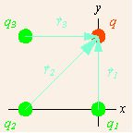
Electric Charge and Field
Displacements of field charge
The displacements of the field charge from each source charge are shown as light blue arrows.
Free to share, print, make copies and changes. Get yours at www.boundless.com
OpenStax CNX. "George Brown, CLF Multiple Point Sources. October 26, 2012." CC BY 3.0 http://cnx.org/content/m12747/latest/ View on Boundless.com

Slide 31
Electric Charge and Field
Static Electricity
Due to friction between her hair and the plastic slide, the girl on the left has created charge separation, resulting in her hair being attracted to the slide.
Free to share, print, make copies and changes. Get yours at www.boundless.com
Wikipedia. "Static on the playground (48616367)." CC BY-SA http://en.wikipedia.org/wiki/File:Static_on_the_playground_(48616367).jpg View on Boundless.com

Slide 32
Electric Charge and Field
Faraday Cage in Presence of an External Electrical Field
As the field is applied, the negative charge from the cage migrates toward the positive end of the field, canceling the effects of the field at both ends of the cage.
Free to share, print, make copies and changes. Get yours at www.boundless.com
Wikipedia. "Faraday cage." CC BY-SA http://en.wikipedia.org/wiki/File:Faraday_cage.gif View on Boundless.com

Slide 33
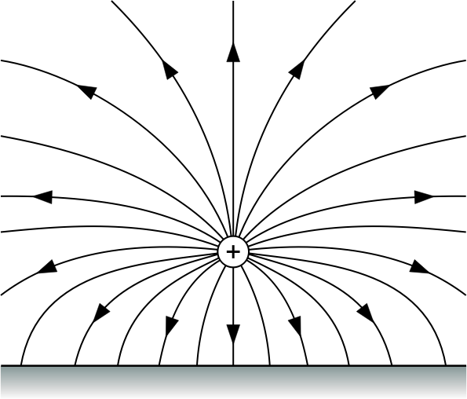
Electric Charge and Field
Field Lines Created by a Point Charge
Lines around the positive charge represent the electric field it creates.
Free to share, print, make copies and changes. Get yours at www.boundless.com
Wikipedia. "Field lines." CC BY-SA http://en.wikipedia.org/wiki/File:Field_lines.svg View on Boundless.com

Slide 34
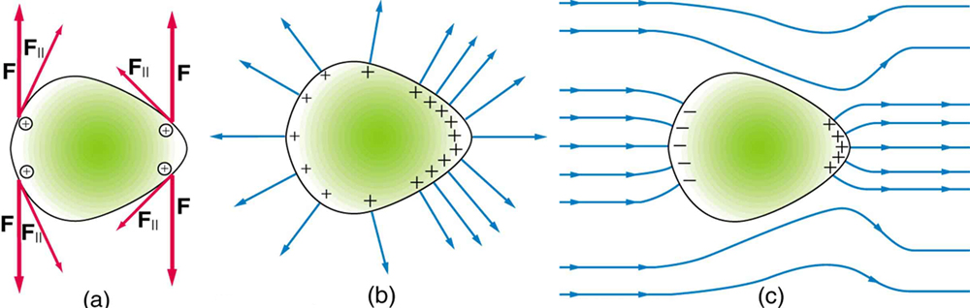
Electric Charge and Field
Electrical Charge at a Sharp Point of a Conductor
Repulsive forces towards the more sharply curved surface on the right aim more outward than along the surface of the conductor.
Free to share, print, make copies and changes. Get yours at www.boundless.com
OpenStax CNX. "OpenStax College, College Physics. December 28, 2012." CC BY 3.0 http://cnx.org/content/m42317/latest/?collection=col11406/latest View on Boundless.com

Slide 35
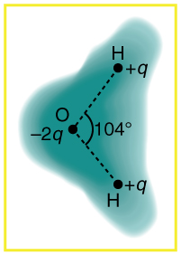
Electric Charge and Field
Charge distribution in a water molecule
Schematic representation of the outer electron cloud of a neutral water molecule. The electrons spend more time near the oxygen than the hydrogens, giving a permanent charge separation as shown. Water is thus a polar molecule. It is more easily affected by electrostatic forces than molecules with uniform charge distributions.
Free to share, print, make copies and changes. Get yours at www.boundless.com
OpenStax CNX. "OpenStax College, Coulomb’s Law. October 25, 2012." CC BY 3.0 http://cnx.org/content/m42308/latest/ View on Boundless.com

Slide 36
Electric Charge and Field
Lorentz Force on a Moving Particle
Lorentz force f on a charged particle (of charge q) in motion (instantaneous velocity v). The E field and B field vary in space and time.
Free to share, print, make copies and changes. Get yours at www.boundless.com
Wikipedia. "Lorentz force." CC BY http://en.wikipedia.org/wiki/Lorentz_force View on Boundless.com

Slide 37
Electric Charge and Field
Electrical Charge at a Sharp Point of a Conductor
Forces between like charges at either end of the conductor are identical, but the components of the forces parallel to the surfaces are different. The component parallel to the surface is greatest on the flattest surface and therefore moves charges away from one another more freely. This explains the difference in concentration of charge on flat vs. pointed areas of a conductor.
Free to share, print, make copies and changes. Get yours at www.boundless.com
OpenStax CNX. "OpenStax College, College Physics. December 28, 2012." CC BY 3.0 http://cnx.org/content/m42317/latest/?collection=col11406/latest View on Boundless.com

Slide 38

Electric Charge and Field
Coulomb's Law
The forces (F1 and F2) sum to produce the total force, which is calculated by Coulomb's Law and is proportional to the product of the charges q1 and q2, and inversely proportional to the square of the distance (r21) between them.
Free to share, print, make copies and changes. Get yours at www.boundless.com
Wikipedia. "Coulombslaw." CC BY-SA http://en.wikipedia.org/wiki/File:Coulombslaw.svg View on Boundless.com

Slide 39
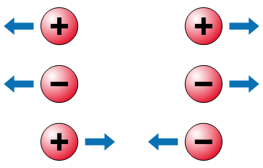
Electric Charge and Field
Charge Repulsion and Attraction
Charges of like sign (positive and positive, or negative and negative) will repel each other, whereas charges of opposite sign (positive and negative) will attract each other.
Free to share, print, make copies and changes. Get yours at www.boundless.com
Wikimedia. CC BY-SA http://upload.wikimedia.org/wikipedia/commons/thumb/d/de/Charges_repulsion_attraction.svg/364px-Charges_repulsion_attraction.svg.png View on Boundless.com

Slide 40
Electric Charge and Field
Electric Flux
Electric flux visualized. The ring shows the surface boundaries. The red arrows for the electric field lines.
Free to share, print, make copies and changes. Get yours at www.boundless.com
Wikimedia. CC BY-SA http://upload.wikimedia.org/wikipedia/commons/7/72/Flux_diagram.png View on Boundless.com

Slide 41
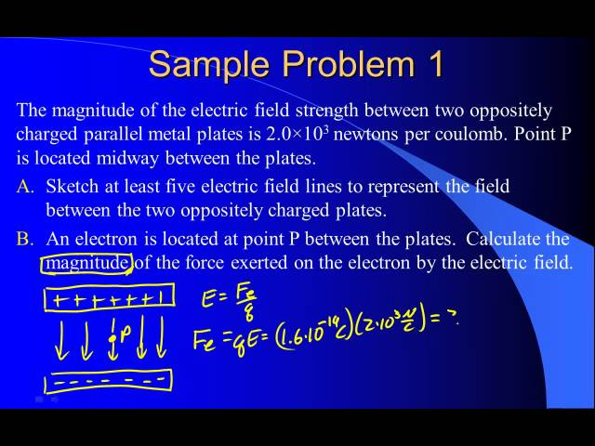
Electric Charge and Field
Parallel Plates and Equipotential Lines
A brief overview of parallel plates and equipotential lines from the viewpoint of electrostatics.
Free to share, print, make copies and changes. Get yours at www.boundless.com
View on Boundless.com

Slide 42
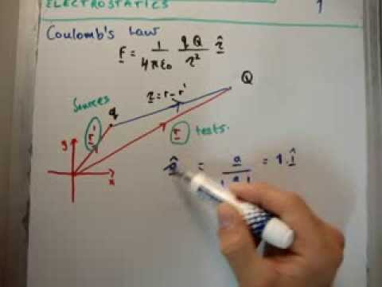
Electric Charge and Field
Coulomb's Law
In this video I continue with my series of tutorial videos on Electrostatics. It's pitched at undergraduate level and while it is mainly aimed at physics majors, it should be useful to anybody taking a first course in electricity and magnetism such as engineers etc..
Free to share, print, make copies and changes. Get yours at www.boundless.com
View on Boundless.com

Slide 43
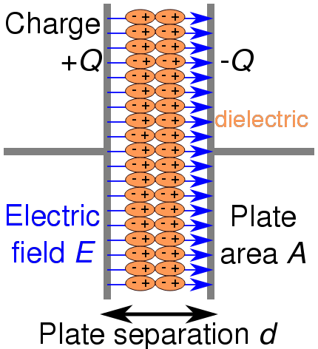
Electric Charge and Field
Diagram of a Parallel-Plate Capacitor
Charges in the dielectric material line up to oppose the charges of each plate of the capacitor. An electric field is created between the plates of the capacitor as charge builds on each plate.
Free to share, print, make copies and changes. Get yours at www.boundless.com
Wikipedia. "Capacitor schematic with dielectric." CC BY-SA http://en.wikipedia.org/wiki/File:Capacitor_schematic_with_dielectric.svg View on Boundless.com

Slide 44
Electric Charge and Field
Hydrogen bonding between Guanine and Cytosine
In the instance of guanine and cytosine, there are three instances in which hydrogen atoms are attracted to nearby nitrogen and oxygen atoms (denoted by dashed lines).
Free to share, print, make copies and changes. Get yours at www.boundless.com
Wikipedia. "GC DNA base pair." CC BY http://en.wikipedia.org/wiki/File:GC_DNA_base_pair.svg View on Boundless.com

Slide 45
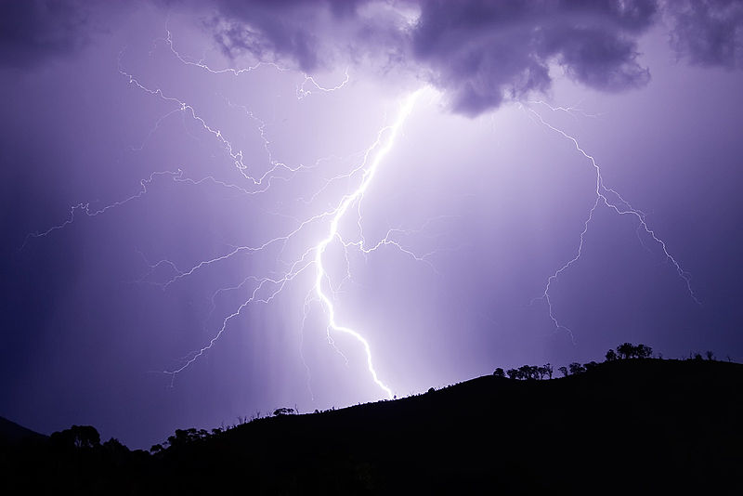
Electric Charge and Field
Lightning
Lightning is a dramatic natural example of static discharge.
Free to share, print, make copies and changes. Get yours at www.boundless.com
Wikimedia. CC BY-SA http://upload.wikimedia.org/wikipedia/commons/thumb/4/44/Lightning_strike_jan_2007.jpg/800px-Lightning_strike_jan_2007.jpg View on Boundless.com

Slide 46
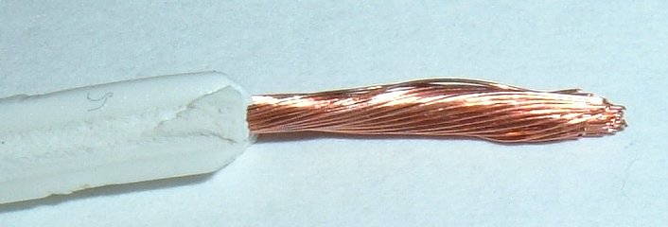
Electric Charge and Field
Conductor and Insulator in a Wire
This wire consists of a core of copper (a conductor) and a coating of polyethylene (an insulator). The copper allows current to flow through the wire, while the polyethylene ensures that the current does not escape.
Free to share, print, make copies and changes. Get yours at www.boundless.com
Wikipedia. "Stripped wire." CC BY-SA http://en.wikipedia.org/wiki/File:Stripped_wire.jpg View on Boundless.com

Slide 47
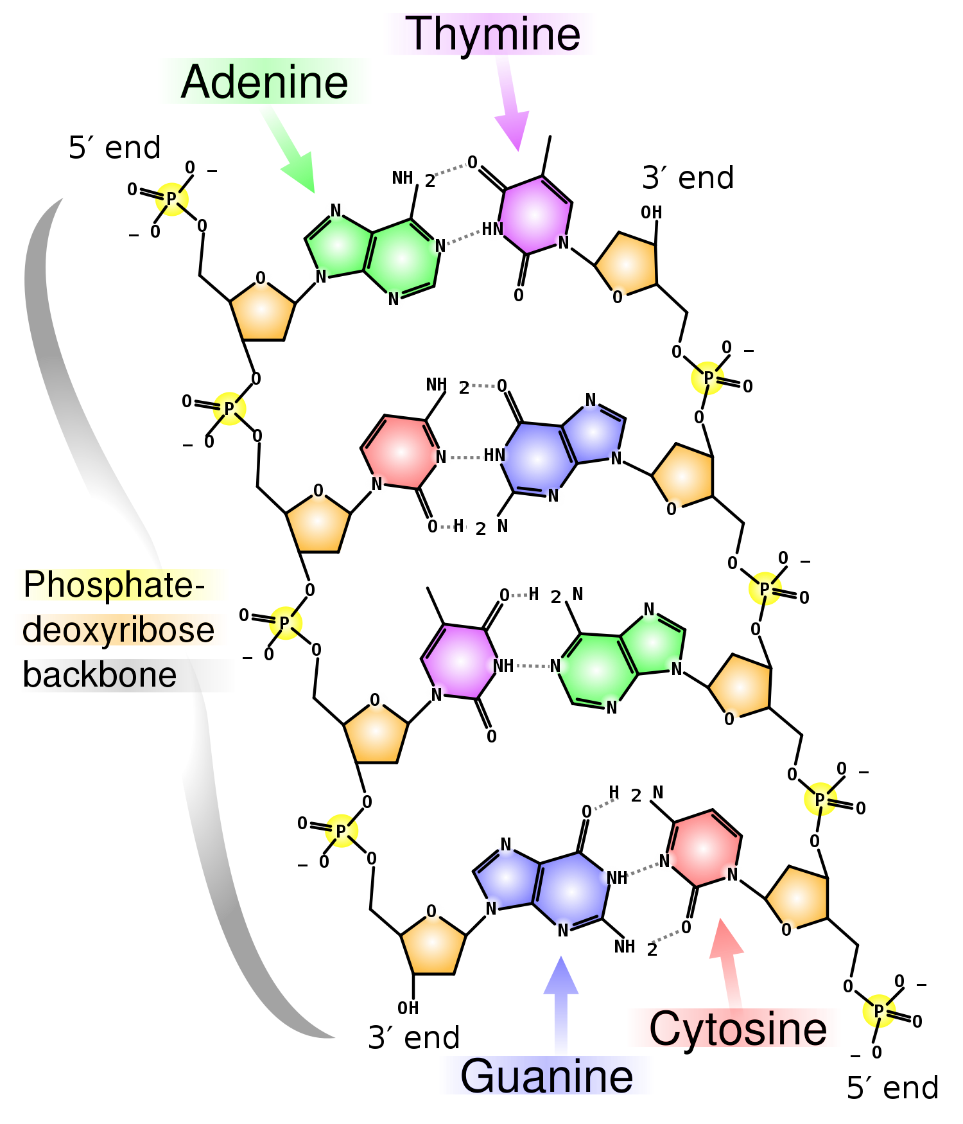
Electric Charge and Field
Phosphate in DNA
The complex molecules that make up our DNA are held together by a phosphate-deoxyribose backbone, as shown.
Free to share, print, make copies and changes. Get yours at www.boundless.com
Wikipedia. "File:DNA chemical structure.svg - Wikipedia, the free encyclopedia." CC BY-SA http://en.wikipedia.org/w/index.php?title=File:DNA_chemical_structure.svg&page=1 View on Boundless.com

Slide 48
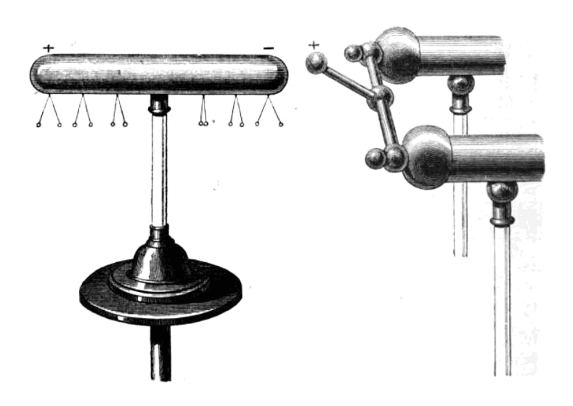
Electric Charge and Field
Electric Induction Experiment
Circa 1870, the positive end of an electrostatic generator is placed near an uncharged brass cylinder, causing the cylinder to polarize as its left end becomes positive and its right end becomes negative.
Free to share, print, make copies and changes. Get yours at www.boundless.com
Wikipedia. "Electrostatic induction experiment." CC BY-SA http://en.wikipedia.org/wiki/File:Electrostatic_induction_experiment.png View on Boundless.com

Slide 49
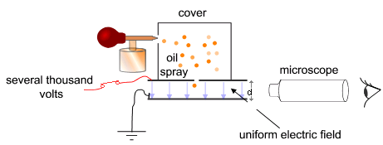
Electric Charge and Field
Simplified scheme of Millikan's oil-drop experiment
This apparatus has a parallel pair of horizontal metal plates. A uniform electric field is created between them. The ring has three holes for illumination and one for viewing through a microscope. Special oil for vacuum apparatus is sprayed into the chamber, where drops become electrically charged. The droplets enter the space between the plates and can be controlled by changing the voltage across the plates.
Free to share, print, make copies and changes. Get yours at www.boundless.com
Wikipedia. "Simplified scheme of Millikan's oil-drop experiment." CC BY-SA http://en.wikipedia.org/wiki/File:Simplified_scheme_of_Millikan%E2%80%99s_oil-drop_experiment.png View on Boundless.com

Slide 50
Electric Charge and Field
Electric field of positive point charge
The electric field of a positively charged particle points radially away from the charge.
Free to share, print, make copies and changes. Get yours at www.boundless.com
Wikimedia. "480px-VFPt_plus_thumb.svg.png." CC BY-SA 3.0 https://commons.wikimedia.org/wiki/File:VFPt_plus_thumb.svg View on Boundless.com

Slide 51
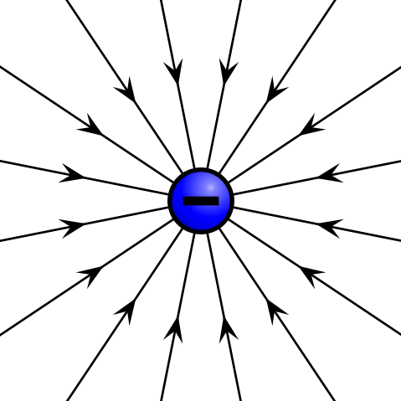
Electric Charge and Field
Electric field of negative point charge
The electric field of a negatively charged particle points radially toward the particle.
Free to share, print, make copies and changes. Get yours at www.boundless.com
Wikimedia. "480px-VFPt_minus_thumb.svg.png." CC BY-SA 3.0 https://commons.wikimedia.org/wiki/File:VFPt_minus_thumb.svg View on Boundless.com

Slide 52
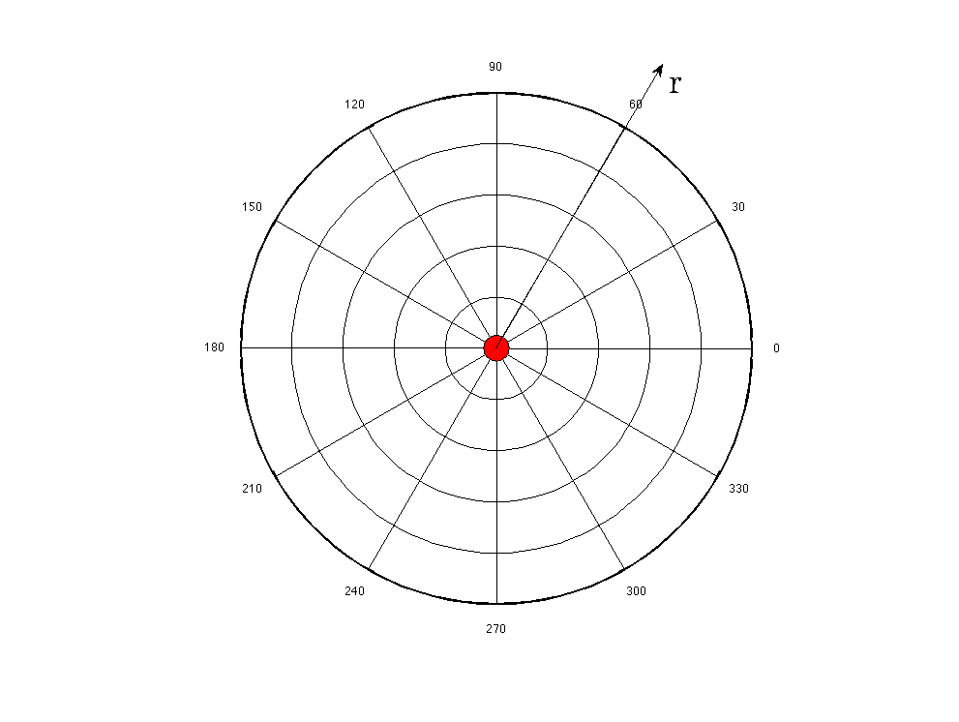
Electric Charge and Field
Radial Coordinate System
The electric field of a point charge is defined in radial coordinates. The positive r direction points away from the origin, and the negative r direction points toward the origin. The electric field of a point charge is symmetric with respect to the θdirection.
Free to share, print, make copies and changes. Get yours at www.boundless.com
Amazon Web Services. "Boundless." Public domain http://s3.amazonaws.com/figures.boundless.com/51225257e4b0c14bf4651470/radialCoords.png View on Boundless.com

Slide 53
Attribution
Electric Charge and Field
Wiktionary. "electric field." CC BY-SA 3.0 http://en.wiktionary.org/wiki/electric_field
Wiktionary. "electric charge." CC BY-SA 3.0 http://en.wiktionary.org/wiki/electric_charge
Wikipedia. "electric displacement field." CC BY-SA 3.0 http://en.wikipedia.org/wiki/electric%20displacement%20field
Wikipedia. "Gauss's law." CC BY-SA 3.0 http://en.wikipedia.org/wiki/Gauss's_law
Wiktionary. "dielectric." CC BY-SA 3.0 http://en.wiktionary.org/wiki/dielectric
Wiktionary. "inductor." CC BY-SA 3.0 http://en.wiktionary.org/wiki/inductor
Wiktionary. "discharge." CC BY-SA 3.0 http://en.wiktionary.org/wiki/discharge
Wikipedia. "Electrostatic induction." CC BY-SA 3.0 http://en.wikipedia.org/wiki/Electrostatic_induction
Wiktionary. "unit vector." CC BY-SA 3.0 http://en.wiktionary.org/wiki/unit_vector
Wiktionary. "Lorentz force." CC BY-SA 3.0 http://en.wiktionary.org/wiki/Lorentz_force
Wikipedia. "electrostatic force." CC BY-SA 3.0 http://en.wikipedia.org/wiki/electrostatic%20force
Wikipedia. "Coulomb's law." CC BY-SA 3.0 http://en.wikipedia.org/wiki/Coulomb's_law
Wiktionary. "electric field." CC BY-SA 3.0 http://en.wiktionary.org/wiki/electric_field
Wikipedia. "Electric flux." CC BY-SA 3.0 http://en.wikipedia.org/wiki/Electric_flux
Wikipedia. "electrostatic force." CC BY-SA 3.0 http://en.wikipedia.org/wiki/electrostatic%20force
Wikipedia. "Coulomb's law." CC BY-SA 3.0 http://en.wikipedia.org/wiki/Coulomb's_law
OpenStax CNX. "George Brown, CLF Multiple Point Sources. September 17, 2013." CC BY 3.0 http://cnx.org/content/m12747/latest/
Free to share, print, make copies and changes. Get yours at www.boundless.com

Slide 54
Electric Charge and Field
OpenStax CNX. "George Brown, Coulomb Law Forces. September 17, 2013." CC BY 3.0 http://cnx.org/content/m12742/latest/
Wiktionary. "vector field." CC BY-SA 3.0 http://en.wiktionary.org/wiki/vector_field
Wiktionary. "equilibrium." CC BY-SA 3.0 http://en.wiktionary.org/wiki/equilibrium
Wikipedia. "Electrical conductor." CC BY-SA 3.0 http://en.wikipedia.org/wiki/Electrical_conductor
Wikipedia. "Electric field." CC BY-SA 3.0 http://en.wikipedia.org/wiki/Electric_field
Wiktionary. "static electricity." CC BY-SA 3.0 http://en.wiktionary.org/wiki/static_electricity
Wiktionary. "discharge." CC BY-SA 3.0 http://en.wiktionary.org/wiki/discharge
Wiktionary. "nucleus." CC BY-SA 3.0 http://en.wiktionary.org/wiki/nucleus
Wikipedia. "Static electricity." CC BY-SA 3.0 http://en.wikipedia.org/wiki/Static_electricity
Wikipedia. "electrostatic force." CC BY-SA 3.0 http://en.wikipedia.org/wiki/electrostatic%20force
OpenStax CNX. "OpenStax College, Coulomb’s Law. September 17, 2013." CC BY 3.0 http://cnx.org/content/m42308/latest/
Wikipedia. "Coulomb's law." CC BY-SA 3.0 http://en.wikipedia.org/wiki/Coulomb's_law
Wiktionary. "xerography." CC BY-SA 3.0 http://en.wiktionary.org/wiki/xerography
Wiktionary. "photoconductivity." CC BY-SA 3.0 http://en.wiktionary.org/wiki/photoconductivity
Wikipedia. "Xerography." CC BY-SA 3.0 http://en.wikipedia.org/wiki/Xerography
Wiktionary. "electric field." CC BY-SA 3.0 http://en.wiktionary.org/wiki/electric_field
Wiktionary. "coulomb." CC BY-SA 3.0 http://en.wiktionary.org/wiki/coulomb
Wiktionary. "gravity." CC BY-SA 3.0 http://en.wiktionary.org/wiki/gravity
Wikipedia. "Electric field." CC BY-SA 3.0 http://en.wikipedia.org/wiki/Electric_field
Free to share, print, make copies and changes. Get yours at www.boundless.com

Slide 55
Electric Charge and Field
Wikipedia. "Electric charge." CC BY-SA 3.0 http://en.wikipedia.org/wiki/Electric_charge
Wiktionary. "vector." CC BY-SA 3.0 http://en.wiktionary.org/wiki/vector
OpenStax CNX. "OpenStax College, College Physics. September 17, 2013." CC BY 3.0 http://cnx.org/content/m42312/latest/?collection=col11406/latest
Wiktionary. "electric field." CC BY-SA 3.0 http://en.wiktionary.org/wiki/electric_field
Wiktionary. "terminal velocity." CC BY-SA 3.0 http://en.wiktionary.org/wiki/terminal_velocity
Wiktionary. "voltage." CC BY-SA 3.0 http://en.wiktionary.org/wiki/voltage
Wikipedia. "Oil drop experiment." CC BY-SA 3.0 http://en.wikipedia.org/wiki/Oil_drop_experiment
Wiktionary. "superposition principle." CC BY-SA 3.0 http://en.wiktionary.org/wiki/superposition_principle
Wiktionary. "vector." CC BY-SA 3.0 http://en.wiktionary.org/wiki/vector
Wiktionary. "orthogonal." CC BY-SA 3.0 http://en.wiktionary.org/wiki/orthogonal
Wikipedia. "Superposition principle." CC BY-SA 3.0 http://en.wikipedia.org/wiki/Superposition_principle
Wiktionary. "wavelength." CC BY-SA 3.0 http://en.wiktionary.org/wiki/wavelength
Wikipedia. "Faraday cage." CC BY-SA 3.0 http://en.wikipedia.org/wiki/Faraday_cage
Wiktionary. "vector field." CC BY-SA 3.0 http://en.wiktionary.org/wiki/vector_field
Wikipedia. "Coulomb's law." CC BY-SA 3.0 http://en.wikipedia.org/wiki/Coulomb's_law
Wikipedia. "Electric field." CC BY-SA 3.0 http://en.wikipedia.org/wiki/Electric_field
Wiktionary. "dipole moment." CC BY-SA 3.0 http://en.wiktionary.org/wiki/dipole_moment
Wiktionary. "insulator." CC BY-SA 3.0 http://en.wiktionary.org/wiki/insulator
Wiktionary. "dielectric." CC BY-SA 3.0 http://en.wiktionary.org/wiki/dielectric
Free to share, print, make copies and changes. Get yours at www.boundless.com

Slide 56
Electric Charge and Field
Wikipedia. "Dipolar polarization." CC BY-SA 3.0 http://en.wikipedia.org/wiki/Dipolar_polarization
Wiktionary. "polarity." CC BY-SA 3.0 http://en.wiktionary.org/wiki/polarity
Wikipedia. "Faraday shield." CC BY-SA 3.0 http://en.wikipedia.org/wiki/Faraday%20shield
Wikipedia. "corona discharge." CC BY-SA 3.0 http://en.wikipedia.org/wiki/corona%20discharge
Wikipedia. "Van de Graaff generator." CC BY-SA 3.0 http://en.wikipedia.org/wiki/Van_de_Graaff_generator
Wiktionary. "nucleus." CC BY-SA 3.0 http://en.wiktionary.org/wiki/nucleus
Wikipedia. "Electric charge." CC BY-SA 3.0 http://en.wikipedia.org/wiki/Electric_charge
Wiktionary. "static equilibrium." CC BY-SA 3.0 http://en.wiktionary.org/wiki/static_equilibrium
OpenStax CNX. "OpenStax College, College Physics. September 18, 2013." CC BY 3.0 http://cnx.org/content/m42317/latest/?collection=col11406/latest
Wikipedia. "conductor." CC BY-SA 3.0 http://en.wikipedia.org/wiki/conductor
Wiktionary. "dielectric." CC BY-SA 3.0 http://en.wiktionary.org/wiki/dielectric
Wiktionary. "capacitor." CC BY-SA 3.0 http://en.wiktionary.org/wiki/capacitor
Wikipedia. "Capacitor." CC BY-SA 3.0 http://en.wikipedia.org/wiki/Capacitor
Boundless Learning. "Boundless." CC BY-SA 3.0 http://www.boundless.com//chemistry/definition/base
OpenStax CNX. "Andrew Hughes, Primary DNA Molecular Structure. September 18, 2013." CC BY 3.0 http://cnx.org/content/m11411/latest/
Wikipedia. "Hydrogen bond." CC BY-SA 3.0 http://en.wikipedia.org/wiki/Hydrogen_bond
Wiktionary. "static electricity." CC BY-SA 3.0 http://en.wiktionary.org/wiki/static_electricity
Wiktionary. "electric charge." CC BY-SA 3.0 http://en.wiktionary.org/wiki/electric_charge
Wiktionary. "discharge." CC BY-SA 3.0 http://en.wiktionary.org/wiki/discharge
Free to share, print, make copies and changes. Get yours at www.boundless.com

Slide 57
Electric Charge and Field
Wikipedia. "Electric charge." CC BY-SA 3.0 http://en.wikipedia.org/wiki/Electric_charge
Wikipedia. "Static electricity." CC BY-SA 3.0 http://en.wikipedia.org/wiki/Static_electricity
Wikipedia. "Charge conservation." CC BY-SA 3.0 http://en.wikipedia.org/wiki/Charge_conservation
Wiktionary. "resistivity." CC BY-SA 3.0 http://en.wiktionary.org/wiki/resistivity
Wiktionary. "insulator." CC BY-SA 3.0 http://en.wiktionary.org/wiki/insulator
Wikipedia. "conductor." CC BY-SA 3.0 http://en.wikipedia.org/wiki/conductor
Wikipedia. "Electrical conductor." CC BY-SA 3.0 http://en.wikipedia.org/wiki/Electrical_conductor
Wikipedia. "Insulator (electricity)." CC BY-SA 3.0 http://en.wikipedia.org/wiki/Insulator_(electricity)
Free to share, print, make copies and changes. Get yours at www.boundless.com

