Slide 1


Boundless Lecture Slides
Available on the Boundless Teaching Platform
Free to share, print, make copies and changes. Get yours at www.boundless.com

Slide 2
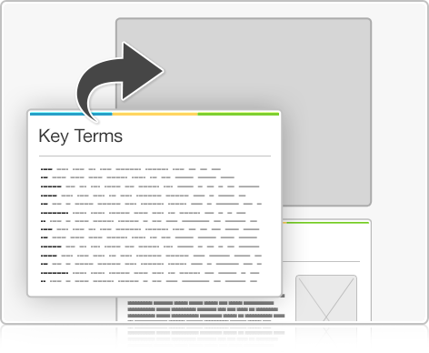


Using Boundless Presentations
Boundless Teaching Platform
Boundless empowers educators to engage their students with affordable, customizable textbooks and intuitive teaching tools. The free Boundless Teaching Platform gives educators the ability to customize textbooks in more than 20 subjects that align to hundreds of popular titles. Get started by using high quality Boundless books, or make switching to our platform easier by building from Boundless content pre-organized to match the assigned textbook. This platform gives educators the tools they need to assign readings and assessments, monitor student activity, and lead their classes with pre-made teaching resources.
Get started now at:
The Appendix
The appendix is for you to use to add depth and breadth to your lectures. You can simply drag and drop slides from the appendix into the main presentation to make for a richer lecture experience.
http://boundless.com/teaching-platform
Free to edit, share, and copy
Feel free to edit, share, and make as many copies of the Boundless presentations as you like. We encourage you to take these presentations and make them your own.
If you have any questions or problems please email:
educators@boundless.com
Free to share, print, make copies and changes. Get yours at www.boundless.com

Slide 3

About Boundless
Boundless is an innovative technology company making education more affordable and accessible for students everywhere. The company creates the world’s best open educational content in 20+ subjects that align to more than 1,000 popular college textbooks. Boundless integrates learning technology into all its premium books to help students study more efficiently at a fraction of the cost of traditional textbooks. The company also empowers educators to engage their students more effectively through customizable books and intuitive teaching tools as part of the Boundless Teaching Platform. More than 2 million learners access Boundless free and premium content each month across the company’s wide distribution platforms, including its website, iOS apps, Kindle books, and iBooks. To get started learning or teaching with Boundless, visit boundless.com.
Free to share, print, make copies and changes. Get yours at www.boundless.com

Slide 4
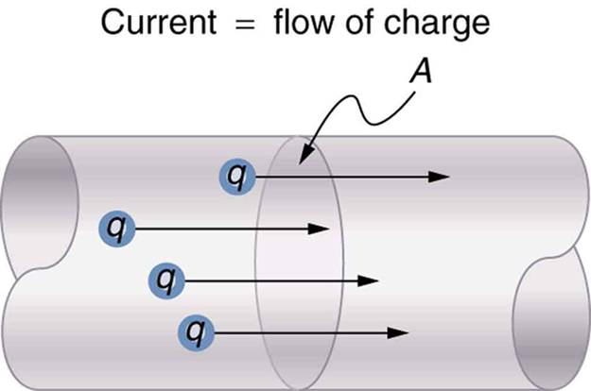

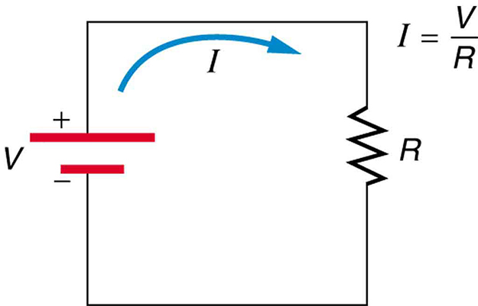
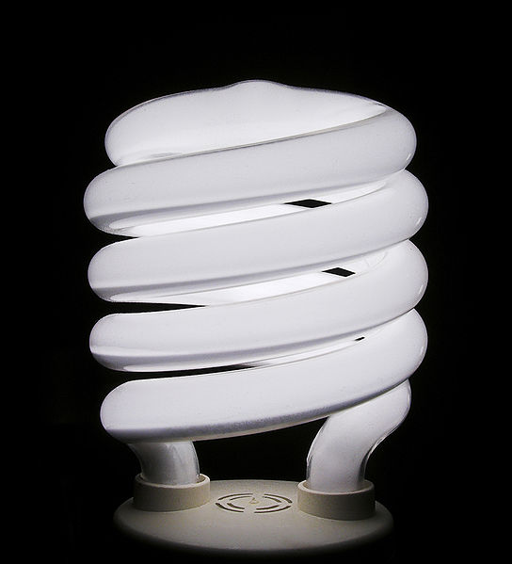
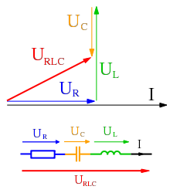
Electric Current and Resistance
Overview
Electric Current
Resistance and Resistors
Electric Power and Energy
]
Alternating Currents
Electric Current and Resistance
Free to share, print, make copies and changes. Get yours at www.boundless.com

Slide 5
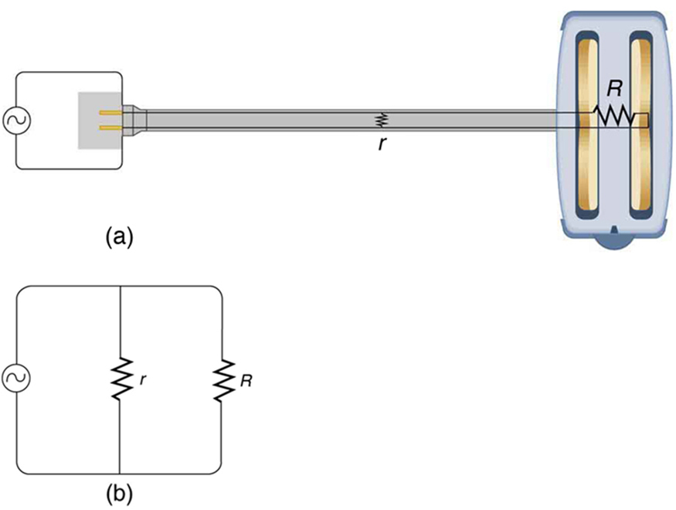
Electric Current and Resistance (continued)
Electricity in the World
]
Electric Current and Resistance
Free to share, print, make copies and changes. Get yours at www.boundless.com

Slide 6

Overview
Electric Current and Resistance > Overview
Overview of Electric Current
Free to share, print, make copies and changes. Get yours at www.boundless.com
www.boundless.com/physics/textbooks/boundless-physics-textbook/electric-current-and-resistance-19/overview-144/

Slide 7
Electric Current
Electric Current and Resistance > Electric Current
The Battery
Current and Voltage Measurements in Circuits
A Microscopic View: Drift Speed
Free to share, print, make copies and changes. Get yours at www.boundless.com
www.boundless.com/physics/textbooks/boundless-physics-textbook/electric-current-and-resistance-19/electric-current-145/

Slide 8
Resistance and Resistors
Electric Current and Resistance > Resistance and Resistors
Ohm's Law
Temperature and Superconductivity
Resistance and Resistivity
Dependence of Resistance on Temperature
Free to share, print, make copies and changes. Get yours at www.boundless.com
www.boundless.com/physics/textbooks/boundless-physics-textbook/electric-current-and-resistance-19/resistance-and-resistors-146/

Slide 9
Electric Power and Energy
Electric Current and Resistance > Electric Power and Energy
Energy Usage
Free to share, print, make copies and changes. Get yours at www.boundless.com
www.boundless.com/physics/textbooks/boundless-physics-textbook/electric-current-and-resistance-19/electric-power-and-energy-147/

Slide 10
Alternating Currents
Electric Current and Resistance > Alternating Currents
Phasors
Root Mean Square Values
Safety Precautions in the Household
Free to share, print, make copies and changes. Get yours at www.boundless.com
www.boundless.com/physics/textbooks/boundless-physics-textbook/electric-current-and-resistance-19/alternating-currents-148/

Slide 11
Electricity in the World
Electric Current and Resistance > Electricity in the World
Humans and Electric Hazards
Nerve Conduction and Electrocardiograms
Electric Activity in the Heart
Free to share, print, make copies and changes. Get yours at www.boundless.com
www.boundless.com/physics/textbooks/boundless-physics-textbook/electric-current-and-resistance-19/electricity-in-the-world-149/

Slide 12
Appendix
Free to share, print, make copies and changes. Get yours at www.boundless.com

Slide 13
Key terms
Electric Current and Resistance
action potential A short term change in the electrical potential that travels along a cell such as a nerve or muscle fiber.
ampere A unit of electrical current; the standard base unit in the International System of Units. Abbreviation: amp. Symbol: A.
battery A device that produces electricity by a chemical reaction between two substances.
complex numbers Numbers that have an imaginary part. Usually represented as i.
conductive medium A material that can transmit electricity.
critical temperature In superconducting materials, the characteristics of superconductivity appears at (and continues below) this temperature.
current The time rate of flow of electric charge.
diffusion the intermingling of the molecules of a fluid due to random thermal agitation
drift velocity The average velocity of the free charges in a conductor.
electric charge A quantum number that determines the electromagnetic interactions of some subatomic particles; by convention, the electron has an electric charge of -1 and the proton +1, and quarks have fractional charge.
electrical current the movement of charge through a circuit
electrical resistance The opposition offered by an electrical conductor to the flow of a current through itself, resulting in a conversion of electrical energy into heat and radiation. The SI derived unit of resistance is the ohm. Symbol: R.
Free to share, print, make copies and changes. Get yours at www.boundless.com

Slide 14
Electric Current and Resistance
electrocardiogram The visual output that an electrocardiograph produces
fibrillation the rapid, irregular, and unsynchronized contraction of the muscle fibers of the heart
high-temperature superconductors Materials that behave as superconductors at unusually high temperatures (above about 30 K).
kilowatt-hour a unit of electrical energy equal to that done by one kilowatt acting for one hour; equal to 3.6 mega-joules. Symbol: kWh.
myocardium The middle of the three layers forming the wall of the heart.
ohm in the International System of Units, the derived unit of electrical resistance; the electrical resistance of a device across which a potential difference of one volt causes a current of one ampere; symbol: Ω
ohmic That which obeys Ohm's law.
parallel equivalent resistance the resistance of a network such that each resistor is subject to the same potential difference (voltage), so that the currents through them add. In this case the inverse of the equivalent resistance is equal to the sum of the inverse resistance of all the resistors in the network.
phasor A representation of a complex number in terms of a complex exponential.
Purkinje fibers specialized cardiac muscle cells that are able to conduct cardiac muscle potentials quickly and efficiently; essential for maintaining consistent heart rhythm.
resistivity In general, the resistance to electric current of a material; in particular, the degree to which a material resists the flow of electricity.
resistivity In general, the resistance to electric current of a material; in particular, the degree to which a material resists the flow of electricity.
Free to share, print, make copies and changes. Get yours at www.boundless.com

Slide 15
Electric Current and Resistance
rms current the root mean square of the current, Irms=I0/√2 , where I0 is the peak current, in an AC system
rms voltage the root mean square of the voltage, Vrms=V0/√2 , where V0 is the peak voltage, in an AC system
root mean square The square root of the arithmetic mean of the squares.
semiconductor A substance with electrical properties intermediate between a good conductor and a good insulator.
series equivalent resistance The resistance of a network of resistors arranged such that the voltage across the network is the sum of the voltage across each resistor. In this case, the equivalent resistance is the sum of the resistance of all the resistors in the network.
shock hazard an electrical hazard that poses the risk of passing current through the body
shock hazard an electrical hazard that poses the risk of passing current through the body
simple circuit A circuit with a single voltage source and a single resistor.
sinoatrial node a group of specialized cardiac muscle cells (tissue) located in the right atrium of the heart, which generates the impulses that establish the normal sinus rhythm.
sinusoidal steady state Indicates every voltage and current in a system is sinusoidal with the same angular frequency ω.
superconductivity The property of a material whereby it has no resistance to the flow of an electric current.
temperature coefficient of resistivity An empirical quantity, denoted by α, which describes the change in resistance or resistivity of a material with temperature.
Free to share, print, make copies and changes. Get yours at www.boundless.com

Slide 16
Electric Current and Resistance
thermal hazard an electrical hazard caused by overheating (e.g., in a resistive element)
thermal hazard an electrical hazard caused by overheating (e.g., in a resistive element)
three-wire system a modern wiring system with safety precautions; contains live, neutral, and ground wires
voltage The amount of electrostatic potential between two points in space.
Free to share, print, make copies and changes. Get yours at www.boundless.com

Slide 17

Electric Current and Resistance
Short Circuit
A short circuit is an undesired low-resistance path across a voltage source. (a) Worn insulation on the wires of a toaster allows them to come into contact with a low resistance r. Since P = V2/r, thermal power is created so rapidly that the cord melts or burns. (b) A schematic of the short circuit.
Free to share, print, make copies and changes. Get yours at www.boundless.com
OpenStax CNX. "OpenStax College, College Physics. November 12, 2012." CC BY 3.0 http://cnx.org/content/m42350/latest/?collection=col11406/1.7 View on Boundless.com

Slide 18
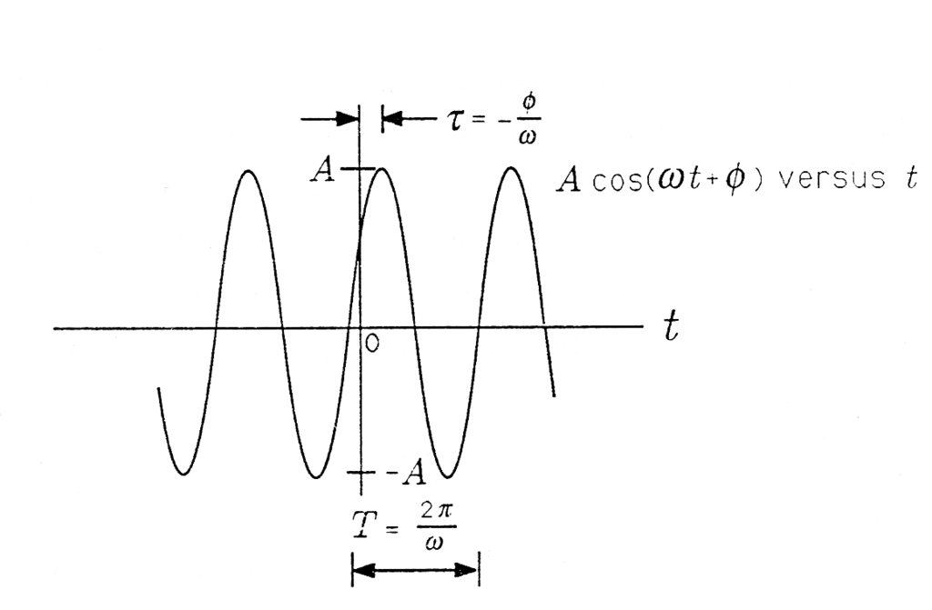
Electric Current and Resistance
Cosinusoidal Signal
A Cosinusoidal Signal.
Free to share, print, make copies and changes. Get yours at www.boundless.com
OpenStax CNX. "Louis Scharf, Phasors: Phasor Representation of Signals. October 26, 2012." CC BY 3.0 http://cnx.org/content/m21474/latest/ View on Boundless.com

Slide 19
Electric Current and Resistance
Phasor Diagram
An example of series RLC circuit and respective phasor diagram for a specific ω. Electrical engineers, electronics engineers, electronic engineering technicians and aircraft engineers all use phasor diagrams to visualize complex constants and variables (phasors). Like vectors, arrows drawn on graph paper or computer displays represent phasors.
Free to share, print, make copies and changes. Get yours at www.boundless.com
Wikipedia. "Phasor." GNU FDL http://en.wikipedia.org/wiki/Phasor View on Boundless.com

Slide 20
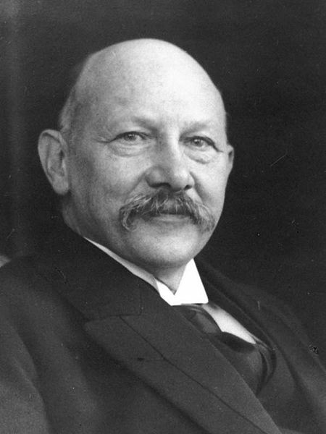
Electric Current and Resistance
Heike Kamerlingh Onnes
Heike Kamerlingh Onnes (1853-1926).
Free to share, print, make copies and changes. Get yours at www.boundless.com
Wikimedia. CC BY-SA http://upload.wikimedia.org/wikipedia/commons/thumb/9/94/Kamerlingh_portret.jpg/450px-Kamerlingh_portret.jpg View on Boundless.com

Slide 21
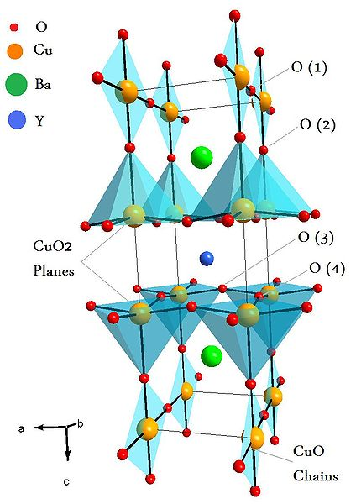
Electric Current and Resistance
Unit Cell of YBaCuO superconductor
Unit Cell of YBaCuO superconductor. Atoms are indicated with different colors.
Free to share, print, make copies and changes. Get yours at www.boundless.com
Wikimedia. CC BY-SA http://upload.wikimedia.org/wikipedia/commons/thumb/0/06/Ybco.jpg/424px-Ybco.jpg View on Boundless.com

Slide 22
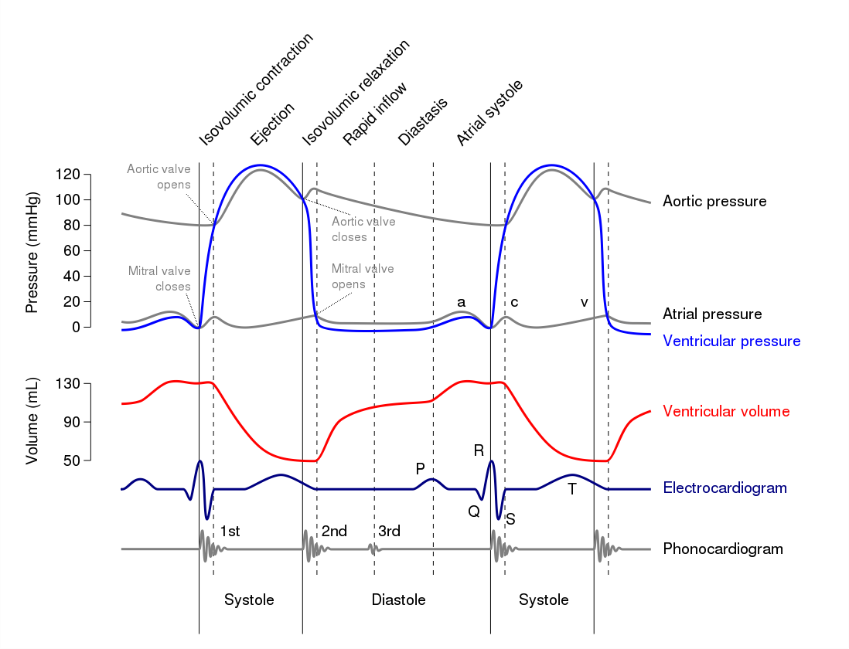
Electric Current and Resistance
ECG Curve
A normal ECG curve synchronized with other major events during the cardiac cycle.
Free to share, print, make copies and changes. Get yours at www.boundless.com
Wikipedia. "Electrocardiography." GNU FDL http://en.wikipedia.org/wiki/Electrocardiography View on Boundless.com

Slide 23
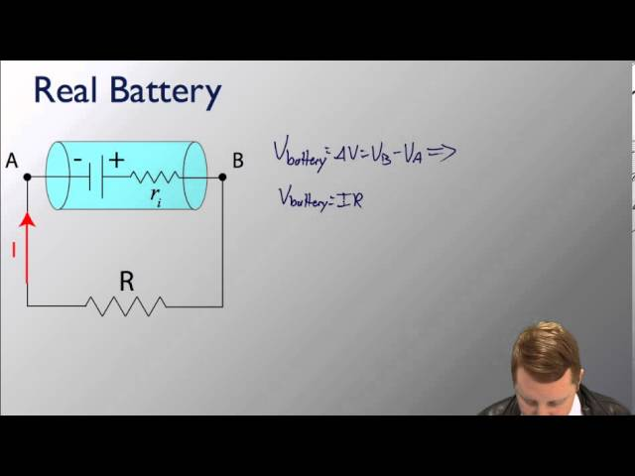
Electric Current and Resistance
Ideal and Real Batteries
A brief introduction to ideal and real batteries for students studying circuits.
Free to share, print, make copies and changes. Get yours at www.boundless.com
View on Boundless.com

Slide 24
Electric Current and Resistance
Symbol of a Battery in a Circuit Diagram
This is the symbol for a battery in a circuit diagram. It originated as a schematic drawing of the earliest type of battery, a voltaic pile. Notice the positive cathode and negative anode. This orientation is important when drawing circuit diagrams to depict the correct flow of electrons.
Free to share, print, make copies and changes. Get yours at www.boundless.com
Wikipedia. "Battery (electricity)." CC BY http://en.wikipedia.org/wiki/Battery_(electricity) View on Boundless.com

Slide 25
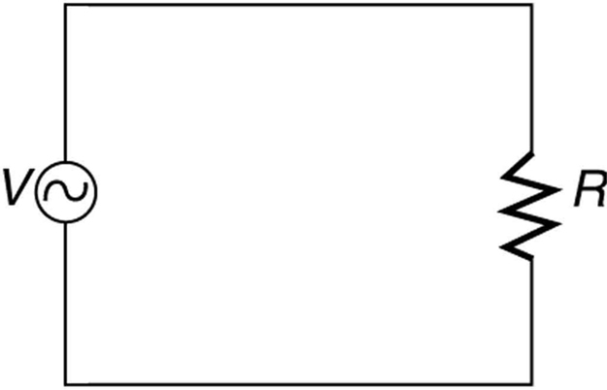
Electric Current and Resistance
AC Circuit Lacking Safety Features
A schematic of a simple AC circuit with a voltage source and a single appliance represented by the resistance R. It lacks safety features.
Free to share, print, make copies and changes. Get yours at www.boundless.com
OpenStax CNX. "OpenStax College, College Physics. October 30, 2012." CC BY 3.0 http://cnx.org/content/m42416/latest/?collection=col11406/1.7 View on Boundless.com

Slide 26
Electric Current and Resistance
Simple Circuit
A simple electric circuit in which a closed path for current to flow is supplied by conductors (usually metal wires) connecting a load to the terminals of a battery, represented by the red parallel lines. The zigzag symbol represents the single resistor and includes any resistance in the connections to the voltage source.
Free to share, print, make copies and changes. Get yours at www.boundless.com
OpenStax CNX. "OpenStax College, College Physics. October 22, 2012." CC BY 3.0 http://cnx.org/content/m42344/latest/?collection=col11406/1.7 View on Boundless.com

Slide 27
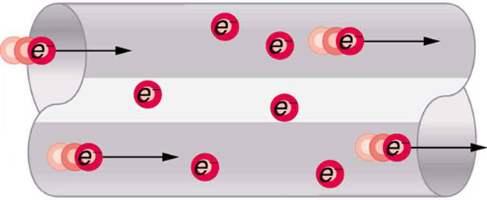
Electric Current and Resistance
Electrons Moving Through a Conductor
When charged particles are forced into this volume of a conductor, an equal number are quickly forced to leave. The repulsion between like charges makes it difficult to increase the number of charges in a volume. Thus, as one charge enters, another leaves almost immediately, carrying the signal rapidly forward.
Free to share, print, make copies and changes. Get yours at www.boundless.com
OpenStax CNX. "OpenStax College, College Physics. October 26, 2012." CC BY 3.0 http://cnx.org/content/m42341/latest/?collection=col11406/1.7 View on Boundless.com

Slide 28
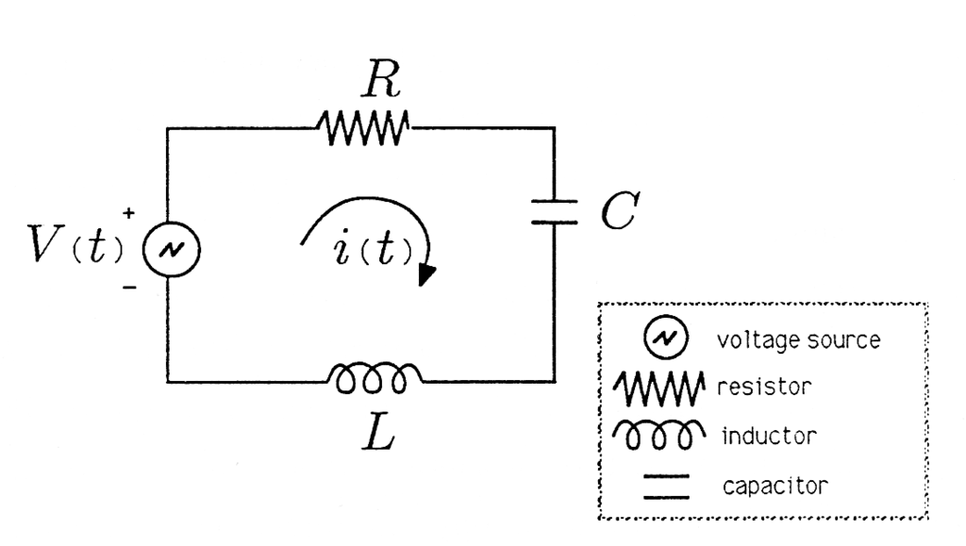
Electric Current and Resistance
Series RLC Circuit
Series RLC Circuit.
Free to share, print, make copies and changes. Get yours at www.boundless.com
OpenStax CNX. "Louis Scharf, Phasors: Sinusoidal Steady State and the Series RLC Circuit. October 26, 2012." CC BY 3.0 http://cnx.org/content/m21475/latest/ View on Boundless.com

Slide 29
Electric Current and Resistance
Structure of the heart
Structure diagram of a coronal section of the human heart from an anterior view. The two larger chambers are the ventricles.
Free to share, print, make copies and changes. Get yours at www.boundless.com
Wikipedia. "Heart diagram-en." CC BY-SA 3.0 http://en.wikipedia.org/wiki/File:Heart_diagram-en.svg View on Boundless.com

Slide 30
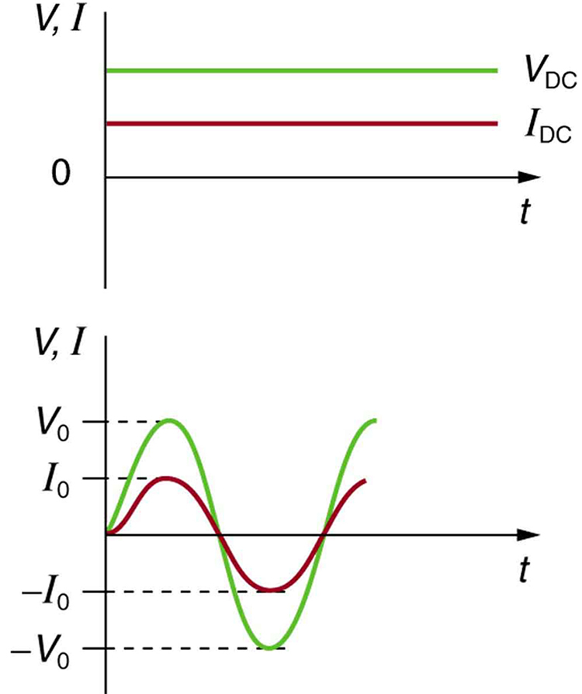
Electric Current and Resistance
Sinusoidal Voltage and Current
(a) DC voltage and current are constant in time, once the current is established. (b) A graph of voltage and current versus time for 60-Hz AC power. The voltage and current are sinusoidal and are in phase for a simple resistance circuit. The frequencies and peak voltages of AC sources differ greatly.
Free to share, print, make copies and changes. Get yours at www.boundless.com
OpenStax CNX. "OpenStax College, College Physics. October 29, 2012." CC BY 3.0 http://cnx.org/content/m42348/latest/?collection=col11406/1.7 View on Boundless.com

Slide 31
Electric Current and Resistance
Compact Fluorescent Light (CFL)
CFLs are much more efficient than incandescent bulbs and so consume much less energy for the intensity light produces.
Free to share, print, make copies and changes. Get yours at www.boundless.com
Wikipedia. "Compact fluorescent lamp." GNU FDL http://en.wikipedia.org/wiki/Compact_fluorescent_lamp View on Boundless.com

Slide 32
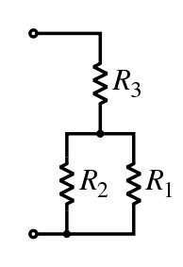
Electric Current and Resistance
Resistor Network
In this combination circuit, the circuit can be broken up into a series component and a parallel component.
Free to share, print, make copies and changes. Get yours at www.boundless.com
Wikipedia. "Resistors." GNU FDL http://en.wikipedia.org/wiki/Resistors View on Boundless.com

Slide 33
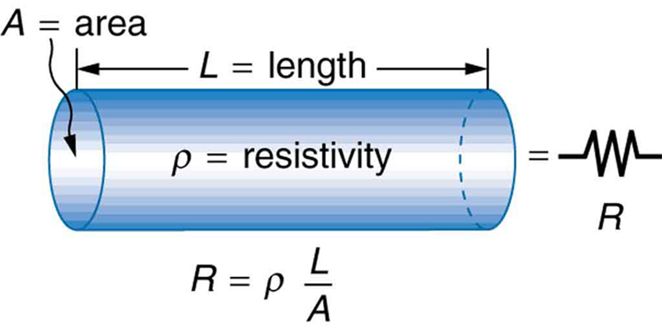
Electric Current and Resistance
Cylindrical Resistor
A uniform cylinder of length L and cross-sectional area A. Its resistance to the flow of current is similar to the resistance posed by a pipe to fluid flow. The longer the cylinder, the greater its resistance. The larger its cross-sectional area A, the smaller its resistance.
Free to share, print, make copies and changes. Get yours at www.boundless.com
OpenStax CNX. "OpenStax College, College Physics. October 22, 2012." CC BY 3.0 http://cnx.org/content/m42346/latest/?collection=col11406/1.7 View on Boundless.com

Slide 34
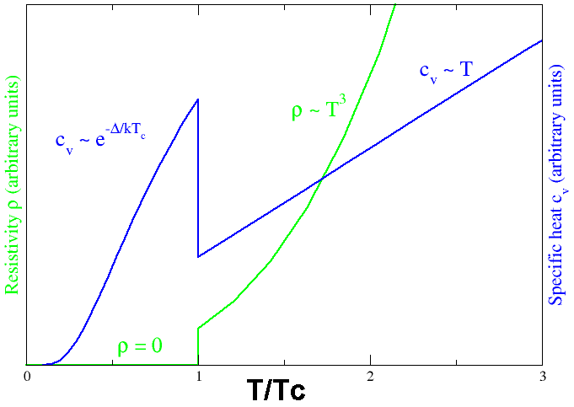
Electric Current and Resistance
Superconducting phase transition
Behavior of heat capacity (cv, blue) and resistivity (ρ, green) at the superconducting phase transition.
Free to share, print, make copies and changes. Get yours at www.boundless.com
Wikipedia. "Superconductors." GNU FDL http://en.wikipedia.org/wiki/Superconductors View on Boundless.com

Slide 35
Electric Current and Resistance
A Simple Circuit
A simple electric circuit made up of a voltage source and a resistor
Free to share, print, make copies and changes. Get yours at www.boundless.com
Wikipedia. "Electrical circuit." CC BY http://en.wikipedia.org/wiki/Electrical_circuit View on Boundless.com

Slide 36
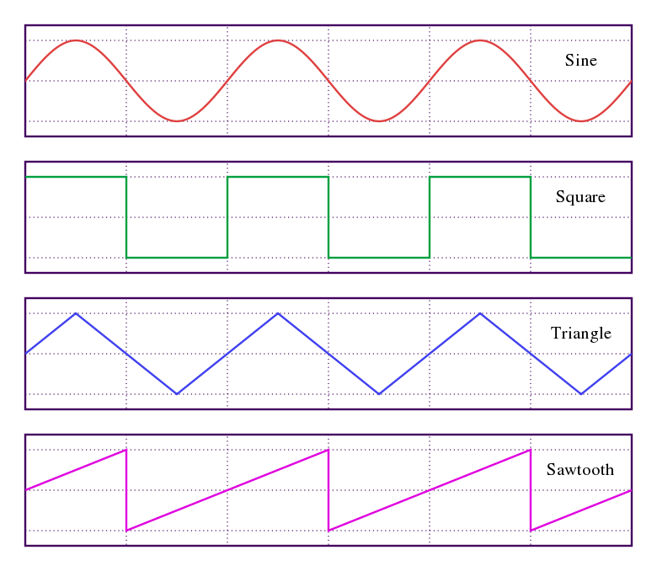
Electric Current and Resistance
Waveforms
Sine, square, triangle, and sawtooth waveforms
Free to share, print, make copies and changes. Get yours at www.boundless.com
Wikipedia. "Root mean square." GNU FDL http://en.wikipedia.org/wiki/Root_mean_square View on Boundless.com

Slide 37
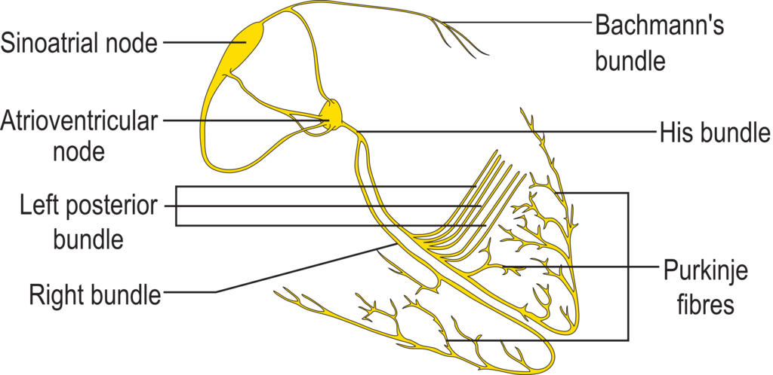
Electric Current and Resistance
Conduction System of the Heart
Isolated heart conduction system, showing the sinoatrial and Purkinje fibers.
Free to share, print, make copies and changes. Get yours at www.boundless.com
Wikipedia. "ConductionsystemoftheheartwithouttheHeart." CC BY-SA http://en.wikipedia.org/wiki/File:ConductionsystemoftheheartwithouttheHeart.png View on Boundless.com

Slide 38
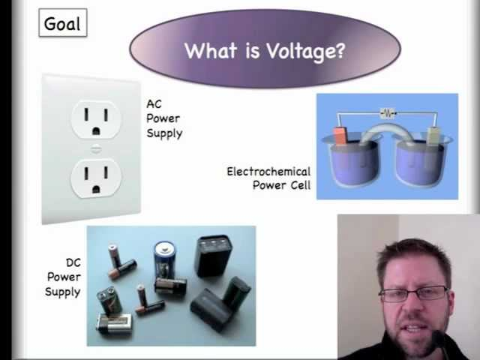
Electric Current and Resistance
What is Voltage?
This video helps with a conceptual understanding of voltage.
Free to share, print, make copies and changes. Get yours at www.boundless.com
View on Boundless.com

Slide 39
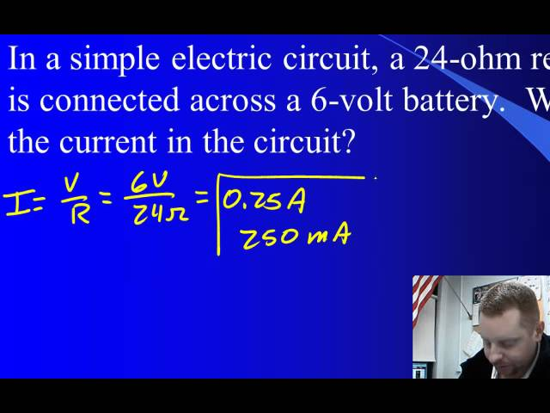
Electric Current and Resistance
Ohm's Law
A brief overview of Ohm's Law.
Free to share, print, make copies and changes. Get yours at www.boundless.com
View on Boundless.com

Slide 40
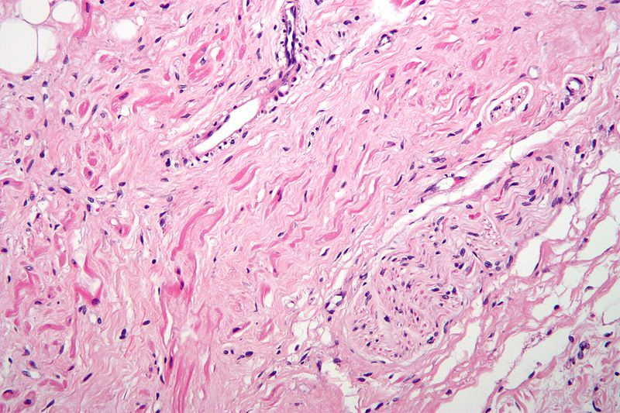
Electric Current and Resistance
Sinoatrial Node Tissue
High magnification micrograph of sinoatrial node tissue and an adjacent nerve fiber.
Free to share, print, make copies and changes. Get yours at www.boundless.com
Wikipedia. "Sinoatrial node high mag." CC BY-SA http://en.wikipedia.org/wiki/File:Sinoatrial_node_high_mag.jpg View on Boundless.com

Slide 41
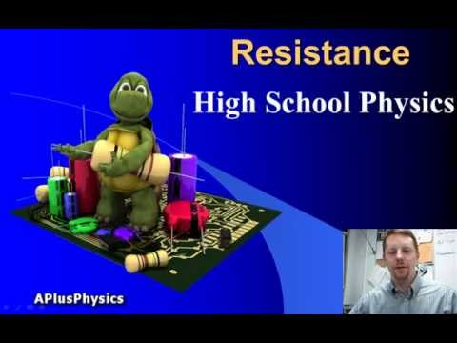
Electric Current and Resistance
Resistance, Resistors, and Resistivity
A brief overview of resistance, resistors, and resistivity.
Free to share, print, make copies and changes. Get yours at www.boundless.com
View on Boundless.com

Slide 42
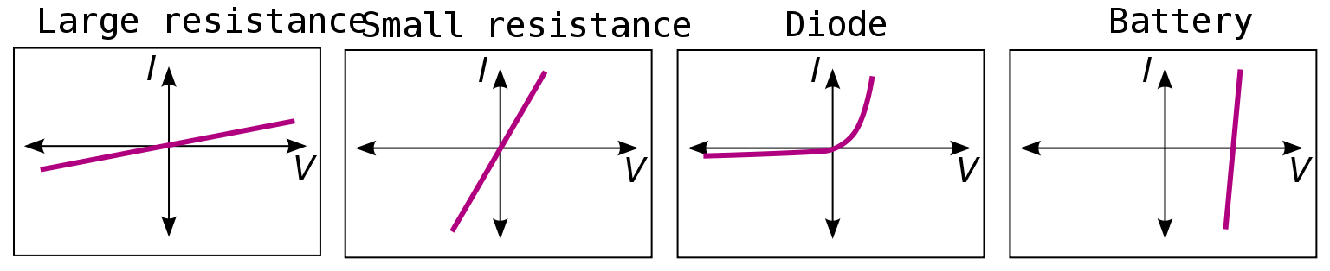
Electric Current and Resistance
Current-Voltage Curves
The I–V curves of four devices: two resistors, a diode, and a battery. The two resistors follow Ohm's law: The plot is a straight line through the origin. The other two devices do not follow Ohm's law.
Free to share, print, make copies and changes. Get yours at www.boundless.com
Wikipedia. "Ohm's law." Public domain http://en.wikipedia.org/wiki/Ohm's_law View on Boundless.com

Slide 43
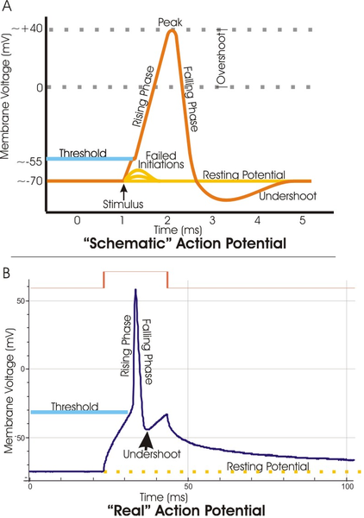
Electric Current and Resistance
Voltage channels are critical in the generation of an action potential
Top: view of an idealized action potential shows its various phases as the action potential passes a point on a cell membrane. Bottom: Recordings of action potentials are often distorted compared to the schematic view because of variations in electrophysiological techniques used to make the recording.
Free to share, print, make copies and changes. Get yours at www.boundless.com
Wikimedia. "Action potential vert." CC BY-SA 3.0 http://commons.wikimedia.org/wiki/File:Action_potential_vert.png View on Boundless.com

Slide 44
Electric Current and Resistance
Electric Current
The rate of flow of charge is current. An ampere is the flow of one coulomb through an area in one second.
Free to share, print, make copies and changes. Get yours at www.boundless.com
OpenStax CNX. "OpenStax College, College Physics. October 19, 2012." CC BY 3.0 http://cnx.org/content/m42341/latest/?collection=col11406/1.7 View on Boundless.com

Slide 45
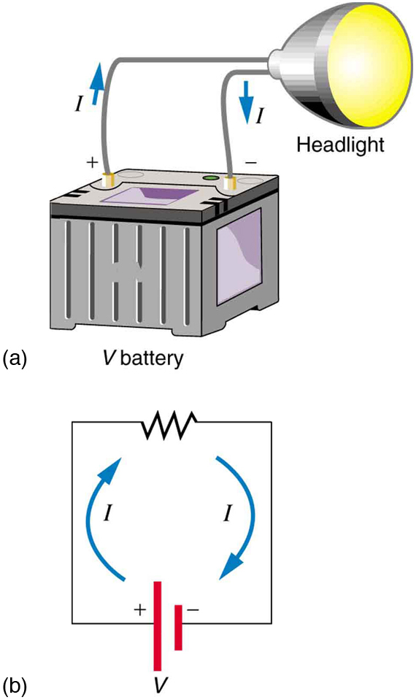
Electric Current and Resistance
Simple Electric Circuit
(a) A simple electric circuit. A closed path for current to flow through is supplied by conducting wires connecting a load to the terminals of a battery. (b) In this schematic, the battery is represented by the two parallel red lines, conducting wires are shown as straight lines, and the zigzag represents the load. The schematic represents a wide variety of similar circuits.
Free to share, print, make copies and changes. Get yours at www.boundless.com
OpenStax CNX. "OpenStax College, College Physics. October 19, 2012." CC BY 3.0 http://cnx.org/content/m42341/latest/?collection=col11406/1.7 View on Boundless.com

Slide 46
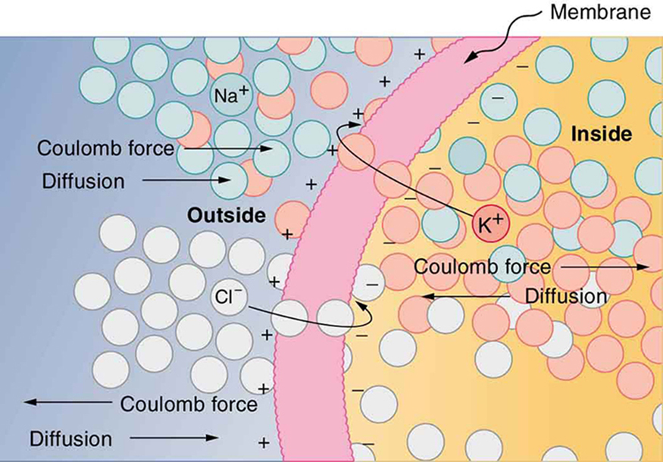
Electric Current and Resistance
Creating a Voltage Across a Cell Membrane
The semipermeable membrane of a cell has different concentrations of ions inside and out. Diffusion moves the K+ and Cl− ions in the direction shown, until the Coulomb force halts further transfer. This results in a layer of positive charge on the outside, a layer of negative charge on the inside, and thus a voltage across the cell membrane. The membrane is normally impermeable to Na+.
Free to share, print, make copies and changes. Get yours at www.boundless.com
OpenStax CNX. "OpenStax College, College Physics. December 6, 2012." CC BY 3.0 http://cnx.org/content/m42352/latest/?collection=col11406/1.7 View on Boundless.com

Slide 47
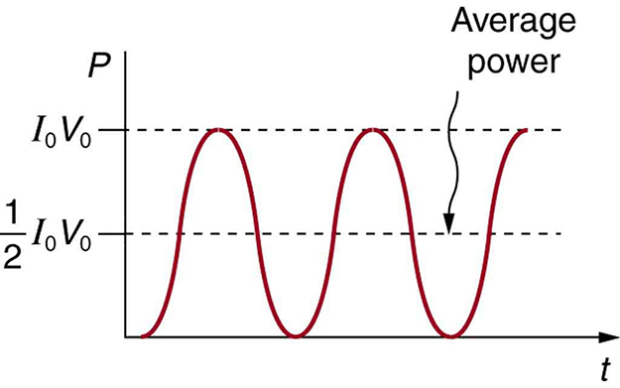
Electric Current and Resistance
Average Power
AC power as a function of time. Since the voltage and current are in phase here, their product is non-negative and fluctuates between zero and I0V0. Average power is (1/2)I0V0.
Free to share, print, make copies and changes. Get yours at www.boundless.com
OpenStax CNX. "OpenStax College, College Physics. October 29, 2012." CC BY 3.0 http://cnx.org/content/m42348/latest/?collection=col11406/1.7 View on Boundless.com

Slide 48
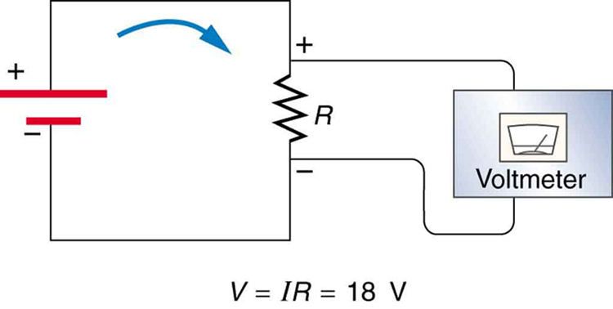
Electric Current and Resistance
Voltage Drop
The voltage drop across a resistor in a simple circuit equals the voltage output of the battery.
Free to share, print, make copies and changes. Get yours at www.boundless.com
OpenStax CNX. "OpenStax College, College Physics. October 22, 2012." CC BY 3.0 http://cnx.org/content/m42344/latest/?collection=col11406/1.7 View on Boundless.com

Slide 49
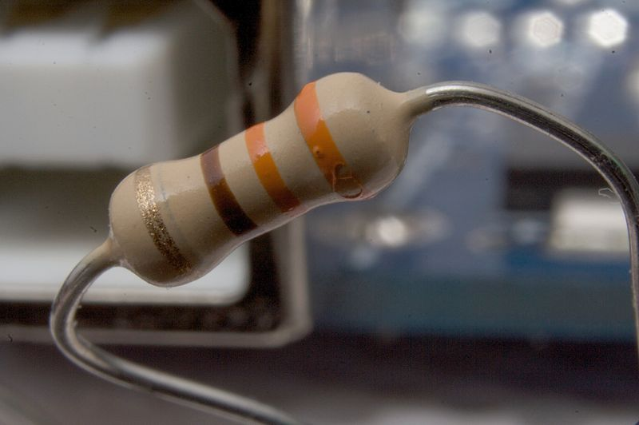
Electric Current and Resistance
Typical Resistor
A typical axial-lead resistor.
Free to share, print, make copies and changes. Get yours at www.boundless.com
Wikipedia. "Resistors." GNU FDL http://en.wikipedia.org/wiki/Resistors View on Boundless.com

Slide 50
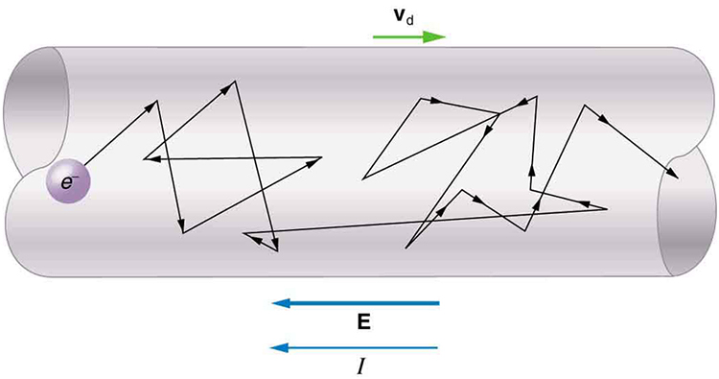
Electric Current and Resistance
Drift Speed
Free electrons moving in a conductor make many collisions with other electrons and atoms. The path of one electron is shown. The average velocity of the free charges is called the drift velocity and is in the direction opposite to the electric field for electrons. The collisions normally transfer energy to the conductor, requiring a constant supply of energy to maintain a steady current.
Free to share, print, make copies and changes. Get yours at www.boundless.com
OpenStax CNX. "OpenStax College, College Physics. October 26, 2012." CC BY 3.0 http://cnx.org/content/m42341/latest/?collection=col11406/1.7 View on Boundless.com

Slide 51
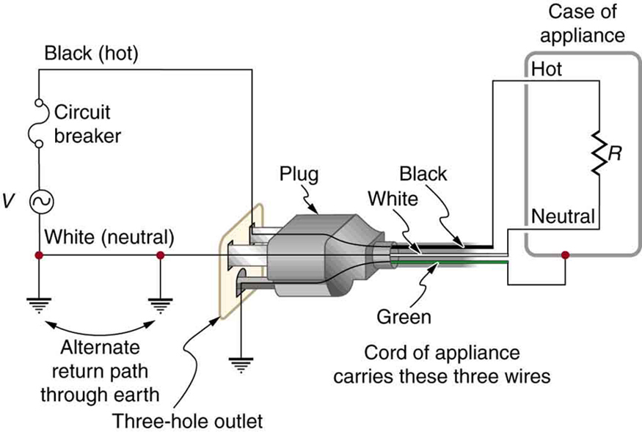
Electric Current and Resistance
Three-Prong Plug
The standard three-prong plug can only be inserted one way to ensure the proper function of the three-wire system.
Free to share, print, make copies and changes. Get yours at www.boundless.com
OpenStax CNX. "OpenStax College, College Physics. October 30, 2012." CC BY 3.0 http://cnx.org/content/m42416/latest/?collection=col11406/1.7 View on Boundless.com

Slide 52
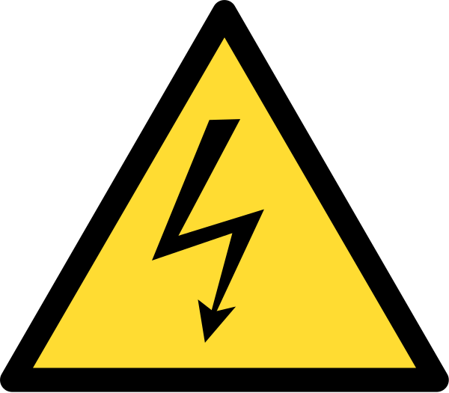
Electric Current and Resistance
High Voltage Warning
International safety symbol "Caution, risk of electric shock" (ISO 3864), also known as the high-voltage symbol
Free to share, print, make copies and changes. Get yours at www.boundless.com
Wikipedia. "High-voltage hazards." GNU FDL http://en.wikipedia.org/wiki/High-voltage_hazards View on Boundless.com

Slide 53
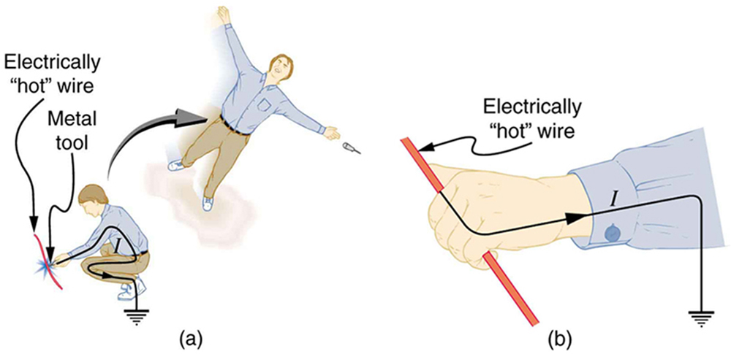
Electric Current and Resistance
Electric Shock and Muscular Contractions
An electric current can cause muscular contractions with varying effects. (a) The victim is "thrown" backward by involuntary muscle contractions that extend the legs and torso. (b) The victim can't let go of the wire that is stimulating all the muscles in the hand. Those that close the fingers are stronger than those that open them.
Free to share, print, make copies and changes. Get yours at www.boundless.com
OpenStax CNX. "OpenStax College, College Physics. November 12, 2012." CC BY 3.0 http://cnx.org/content/m42350/latest/?collection=col11406/1.7 View on Boundless.com

Slide 54
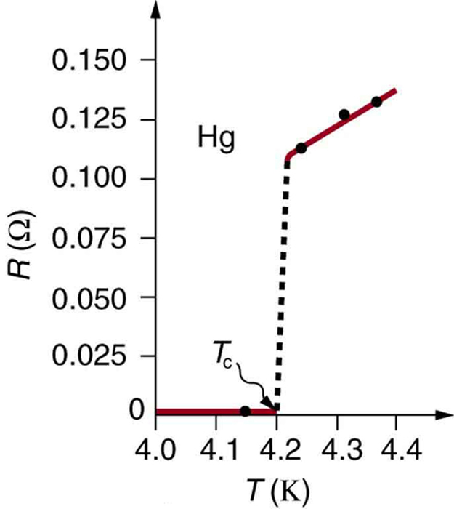
Electric Current and Resistance
Resistance of a sample of mercury
The resistance of a sample of mercury is zero at very low temperatures—it is a superconductor up to about 4.2 K. Above that critical temperature, its resistance makes a sudden jump and then increases nearly linearly with temperature.
Free to share, print, make copies and changes. Get yours at www.boundless.com
OpenStax CNX. "OpenStax College, College Physics. October 22, 2012." CC BY 3.0 http://cnx.org/content/m42346/latest/?collection=col11406/1.7 View on Boundless.com

Slide 55
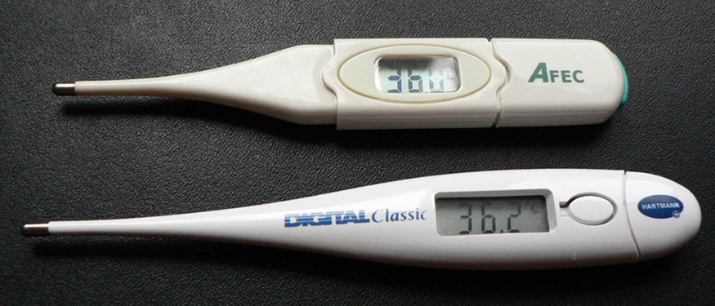
Electric Current and Resistance
Thermometers
These familiar thermometers are based on the automated measurement of a thermistor's temperature-dependent resistance.
Free to share, print, make copies and changes. Get yours at www.boundless.com
OpenStax CNX. "OpenStax College, College Physics. October 22, 2012." CC BY 3.0 http://cnx.org/content/m42346/latest/?collection=col11406/1.7 View on Boundless.com

Slide 56
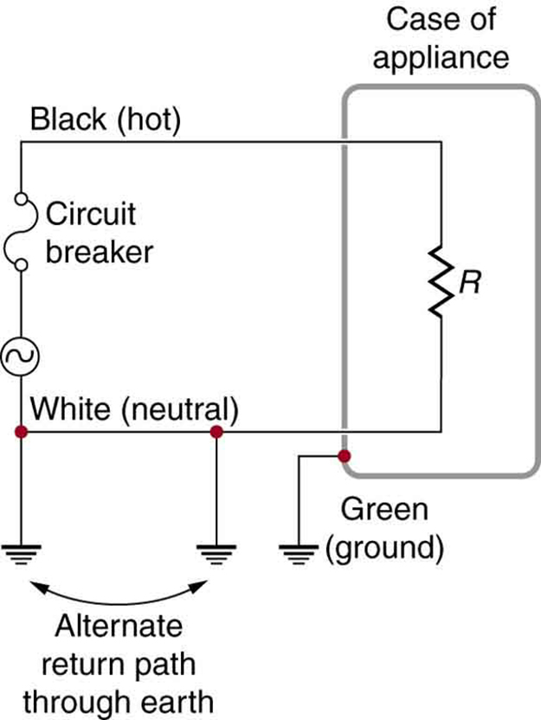
Electric Current and Resistance
Three-Wire System
The three-wire system connects the neutral wire to the earth at the voltage source and the user location. It exists at zero volts and supplies an alternative return path for the current through the earth. The case of the appliance is also grounded to zero volts. A circuit breaker or fuse prevents thermal overload and exists in series on the active (live/hot) wire. Wire insulation colors vary by region. It is essential to check locally to determine which color codes are in use, even if they were followed in one particular installation.
Free to share, print, make copies and changes. Get yours at www.boundless.com
OpenStax CNX. "OpenStax College, College Physics. October 30, 2012." CC BY 3.0 http://cnx.org/content/m42416/latest/?collection=col11406/1.7 View on Boundless.com

Slide 57
Attribution
Electric Current and Resistance
Wiktionary. "kilowatt-hour." CC BY-SA 3.0 http://en.wiktionary.org/wiki/kilowatt-hour
OpenStax CNX. "Don Johnson, Voltage, Current, and Generic Circuit Elements. September 17, 2013." CC BY 3.0 http://cnx.org/content/m0011/latest/
OpenStax CNX. "OpenStax College, College Physics. September 17, 2013." CC BY 3.0 http://cnx.org/content/m42714/latest/?collection=col11406/1.7
Wikipedia. "Electric power." CC BY-SA 3.0 http://en.wikipedia.org/wiki/Electric_power
Boundless Learning. "Boundless." CC BY-SA 3.0 http://www.boundless.com//physics/definition/three-wire-system
Boundless Learning. "Boundless." CC BY-SA 3.0 http://www.boundless.com//physics/definition/shock-hazard
Boundless Learning. "Boundless." CC BY-SA 3.0 http://www.boundless.com//physics/definition/thermal-hazard
OpenStax CNX. "OpenStax College, College Physics. September 17, 2013." CC BY 3.0 http://cnx.org/content/m42416/latest/?collection=col11406/1.7
Wiktionary. "current." CC BY-SA 3.0 http://en.wiktionary.org/wiki/current
Wiktionary. "voltage." CC BY-SA 3.0 http://en.wiktionary.org/wiki/voltage
Wiktionary. "battery." CC BY-SA 3.0 http://en.wiktionary.org/wiki/battery
Wikipedia. "Battery (electricity)." CC BY-SA 3.0 http://en.wikipedia.org/wiki/Battery_(electricity)
OpenStax CNX. "OpenStax College, College Physics. September 17, 2013." CC BY 3.0 http://cnx.org/content/m42324/latest/?collection=col11406/1.7
Wikipedia. "Battery (electricity)." CC BY-SA 3.0 http://en.wikipedia.org/wiki/Battery_(electricity)
Wiktionary. "semiconductor." CC BY-SA 3.0 http://en.wiktionary.org/wiki/semiconductor
Wiktionary. "resistivity." CC BY-SA 3.0 http://en.wiktionary.org/wiki/resistivity
Boundless Learning. "Boundless." CC BY-SA 3.0 http://www.boundless.com//physics/definition/temperature-coefficient-of-resistivity
Free to share, print, make copies and changes. Get yours at www.boundless.com

Slide 58
Electric Current and Resistance
Wikipedia. "Electrical resistance." CC BY-SA 3.0 http://en.wikipedia.org/wiki/Electrical_resistance
Wikipedia. "Electrical resistivity and conductivity." CC BY-SA 3.0 http://en.wikipedia.org/wiki/Electrical_resistivity_and_conductivity%23Temperature_dependence
OpenStax CNX. "OpenStax College, College Physics. September 17, 2013." CC BY 3.0 http://cnx.org/content/m42346/latest/?collection=col11406/1.7
Wiktionary. "electrical current." CC BY-SA 3.0 http://en.wiktionary.org/wiki/electrical_current
Wiktionary. "ohm." CC BY-SA 3.0 http://en.wiktionary.org/wiki/ohm
Wiktionary. "ampere." CC BY-SA 3.0 http://en.wiktionary.org/wiki/ampere
Wikipedia. "Voltage." CC BY-SA 3.0 http://en.wikipedia.org/wiki/Voltage
Wikipedia. "Electric current." CC BY-SA 3.0 http://en.wikipedia.org/wiki/Electric_current%23Current_density_and_Ohm.27s_law
Wikipedia. "Electric current." CC BY-SA 3.0 http://en.wikipedia.org/wiki/Electric_current
OpenStax CNX. "OpenStax College, College Physics. September 17, 2013." CC BY 3.0 http://cnx.org/content/m42341/latest/?collection=col11406/1.7
Light and Matter. CC BY http://lightandmatter.com/lml.pdf
Wiktionary. "complex numbers." CC BY-SA 3.0 http://en.wiktionary.org/wiki/complex_numbers
Wikipedia. "sinusoidal steady state." CC BY-SA 3.0 http://en.wikipedia.org/wiki/sinusoidal%20steady%20state
Wiktionary. "phasor." CC BY-SA 3.0 http://en.wiktionary.org/wiki/phasor
OpenStax CNX. "Louis Scharf, Phasors: Sinusoidal Steady State and the Series RLC Circuit. September 17, 2013." CC BY 3.0 http://cnx.org/content/m21475/latest/
Wikipedia. "Phasor." CC BY-SA 3.0 http://en.wikipedia.org/wiki/Phasor
OpenStax CNX. "Louis Scharf, Phasors: Phasor Representation of Signals. September 17, 2013." CC BY 3.0 http://cnx.org/content/m21474/latest/
OpenStax CNX. "Bill Wilson, Review of Phasors. September 17, 2013." CC BY 3.0 http://cnx.org/content/m11381/latest/
Boundless Learning. "Boundless." CC BY-SA 3.0 http://www.boundless.com//chemistry/definition/critical-temperature
Free to share, print, make copies and changes. Get yours at www.boundless.com

Slide 59
Electric Current and Resistance
Wikipedia. "high-temperature superconductors." CC BY-SA 3.0 http://en.wikipedia.org/wiki/high-temperature%20superconductors
Wiktionary. "superconductivity." CC BY-SA 3.0 http://en.wiktionary.org/wiki/superconductivity
Wikipedia. "Superconductors." CC BY-SA 3.0 http://en.wikipedia.org/wiki/Superconductors
Boundless Learning. "Boundless." CC BY-SA 3.0 http://www.boundless.com//physics/definition/drift-velocity
Wikipedia. "Electric current." CC BY-SA 3.0 http://en.wikipedia.org/wiki/Electric_current%23Drift_speed
OpenStax CNX. "OpenStax College, College Physics. September 17, 2013." CC BY 3.0 http://cnx.org/content/m42341/latest/?collection=col11406/1.7
Wiktionary. "fibrillation." CC BY-SA 3.0 http://en.wiktionary.org/wiki/fibrillation
Boundless Learning. "Boundless." CC BY-SA 3.0 http://www.boundless.com//physics/definition/thermal-hazard
Boundless Learning. "Boundless." CC BY-SA 3.0 http://www.boundless.com//physics/definition/shock-hazard
OpenStax CNX. "OpenStax College, College Physics. September 18, 2013." CC BY 3.0 http://cnx.org/content/m42350/latest/?collection=col11406/1.7
Wikipedia. "Electric shock." CC BY-SA 3.0 http://en.wikipedia.org/wiki/Electric_shock
Wikipedia. "Fibrillation." CC BY-SA 3.0 http://en.wikipedia.org/wiki/Fibrillation
Wikipedia. "Hazard symbol." CC BY-SA 3.0 http://en.wikipedia.org/wiki/Hazard_symbol
Wiktionary. "myocardium." CC BY-SA 3.0 http://en.wiktionary.org/wiki/myocardium
Wikipedia. "Purkinje fibers." CC BY-SA 3.0 http://en.wikipedia.org/wiki/Purkinje%20fibers
Wikipedia. "sinoatrial node." CC BY-SA 3.0 http://en.wikipedia.org/wiki/sinoatrial%20node
Wikipedia. "Sinoatrial node." CC BY-SA 3.0 http://en.wikipedia.org/wiki/Sinoatrial_node
Wikipedia. "Electrocardiogram." CC BY-SA 3.0 http://en.wikipedia.org/wiki/Electrocardiogram
Wikipedia. "Cardiomyocytes." CC BY-SA 3.0 http://en.wikipedia.org/wiki/Cardiomyocytes
Free to share, print, make copies and changes. Get yours at www.boundless.com

Slide 60
Electric Current and Resistance
Wikipedia. "Human heart." CC BY-SA 3.0 http://en.wikipedia.org/wiki/Human_heart
Wikipedia. "Purkinje fibers." CC BY-SA 3.0 http://en.wikipedia.org/wiki/Purkinje_fibers
Wiktionary. "ohmic." CC BY-SA 3.0 http://en.wiktionary.org/wiki/ohmic
Boundless Learning. "Boundless." CC BY-SA 3.0 http://www.boundless.com//physics/definition/simple-circuit
Wikipedia. "Ohm's law." CC BY-SA 3.0 http://en.wikipedia.org/wiki/Ohm's_law
OpenStax CNX. "OpenStax College, College Physics. September 18, 2013." CC BY 3.0 http://cnx.org/content/m42344/latest/?collection=col11406/1.7
Boundless Learning. "Boundless." CC BY-SA 3.0 http://www.boundless.com//physics/definition/parallel-equivalent-resistance
Boundless Learning. "Boundless." CC BY-SA 3.0 http://www.boundless.com//physics/definition/series-equivalent-resistance
Wiktionary. "resistivity." CC BY-SA 3.0 http://en.wiktionary.org/wiki/resistivity
OpenStax CNX. "OpenStax College, College Physics. September 18, 2013." CC BY 3.0 http://cnx.org/content/m42346/latest/?collection=col11406/1.7
Wikipedia. "Ohm's law." CC BY-SA 3.0 http://en.wikipedia.org/wiki/Ohm's_law
Wikipedia. "Electrical resistance." CC BY-SA 3.0 http://en.wikipedia.org/wiki/Electrical_resistance
Wikipedia. "Resistors." CC BY-SA 3.0 http://en.wikipedia.org/wiki/Resistors
OpenStax CNX. "OpenStax College, College Physics. September 18, 2013." CC BY 3.0 http://cnx.org/content/m42344/latest/?collection=col11406/1.7
Wiktionary. "electrical resistance." CC BY-SA 3.0 http://en.wiktionary.org/wiki/electrical_resistance
Wiktionary. "electric charge." CC BY-SA 3.0 http://en.wiktionary.org/wiki/electric_charge
Wiktionary. "conductive medium." CC BY-SA 3.0 http://en.wiktionary.org/wiki/conductive+medium
OpenStax CNX. "OpenStax College, College Physics. September 18, 2013." CC BY 3.0 http://cnx.org/content/m42346/latest/?collection=col11406/1.7
OpenStax CNX. "OpenStax College, College Physics. September 18, 2013." CC BY 3.0 http://cnx.org/content/m42341/latest/?collection=col11406/1.7
Free to share, print, make copies and changes. Get yours at www.boundless.com

Slide 61
Electric Current and Resistance
OpenStax CNX. "OpenStax College, College Physics. September 18, 2013." CC BY 3.0 http://cnx.org/content/m42339/latest/?collection=col11406/1.7
OpenStax CNX. "OpenStax College, College Physics. September 18, 2013." CC BY 3.0 http://cnx.org/content/m42344/latest/?collection=col11406/1.7
Wikipedia. "Electrical conductance." CC BY-SA 3.0 http://en.wikipedia.org/wiki/Electrical_conductance
Wikipedia. "Ohm's law." CC BY-SA 3.0 http://en.wikipedia.org/wiki/Ohm's_law
Wikipedia. "Electrical resistance." CC BY-SA 3.0 http://en.wikipedia.org/wiki/Electrical_resistance
Wikipedia. "Electric current." CC BY-SA 3.0 http://en.wikipedia.org/wiki/Electric_current
Wiktionary. "action potential." CC BY-SA 3.0 http://en.wiktionary.org/wiki/action_potential
Wiktionary. "electrocardiogram." CC BY-SA 3.0 http://en.wiktionary.org/wiki/electrocardiogram
Boundless Learning. "Boundless." CC BY-SA 3.0 http://www.boundless.com//biology/definition/diffusion
OpenStax CNX. "OpenStax College, College Physics. September 18, 2013." CC BY 3.0 http://cnx.org/content/m42352/latest/?collection=col11406/1.7
Wikipedia. "Electrocardiogram." CC BY-SA 3.0 http://en.wikipedia.org/wiki/Electrocardiogram
Wikipedia. "Action potential." CC BY-SA 3.0 http://en.wikipedia.org/wiki/Action_potential
Wiktionary. "root mean square." CC BY-SA 3.0 http://en.wiktionary.org/wiki/root_mean_square
Boundless Learning. "Boundless." CC BY-SA 3.0 http://www.boundless.com//physics/definition/rms-voltage
Boundless Learning. "Boundless." CC BY-SA 3.0 http://www.boundless.com//physics/definition/rms-current
Wikipedia. "Root mean square." CC BY-SA 3.0 http://en.wikipedia.org/wiki/Root_mean_square
OpenStax CNX. "OpenStax College, College Physics. September 18, 2013." CC BY 3.0 http://cnx.org/content/m42348/latest/?collection=col11406/1.7
Free to share, print, make copies and changes. Get yours at www.boundless.com

