Slide 1


Boundless Lecture Slides
Available on the Boundless Teaching Platform
Free to share, print, make copies and changes. Get yours at www.boundless.com

Slide 2
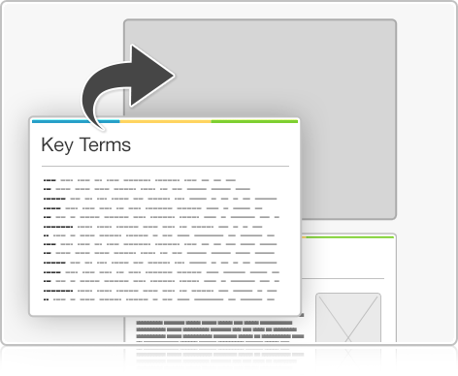


Using Boundless Presentations
Boundless Teaching Platform
Boundless empowers educators to engage their students with affordable, customizable textbooks and intuitive teaching tools. The free Boundless Teaching Platform gives educators the ability to customize textbooks in more than 20 subjects that align to hundreds of popular titles. Get started by using high quality Boundless books, or make switching to our platform easier by building from Boundless content pre-organized to match the assigned textbook. This platform gives educators the tools they need to assign readings and assessments, monitor student activity, and lead their classes with pre-made teaching resources.
Get started now at:
The Appendix
The appendix is for you to use to add depth and breadth to your lectures. You can simply drag and drop slides from the appendix into the main presentation to make for a richer lecture experience.
http://boundless.com/teaching-platform
Free to edit, share, and copy
Feel free to edit, share, and make as many copies of the Boundless presentations as you like. We encourage you to take these presentations and make them your own.
If you have any questions or problems please email:
educators@boundless.com
Free to share, print, make copies and changes. Get yours at www.boundless.com

Slide 3

About Boundless
Boundless is an innovative technology company making education more affordable and accessible for students everywhere. The company creates the world’s best open educational content in 20+ subjects that align to more than 1,000 popular college textbooks. Boundless integrates learning technology into all its premium books to help students study more efficiently at a fraction of the cost of traditional textbooks. The company also empowers educators to engage their students more effectively through customizable books and intuitive teaching tools as part of the Boundless Teaching Platform. More than 2 million learners access Boundless free and premium content each month across the company’s wide distribution platforms, including its website, iOS apps, Kindle books, and iBooks. To get started learning or teaching with Boundless, visit boundless.com.
Free to share, print, make copies and changes. Get yours at www.boundless.com

Slide 4
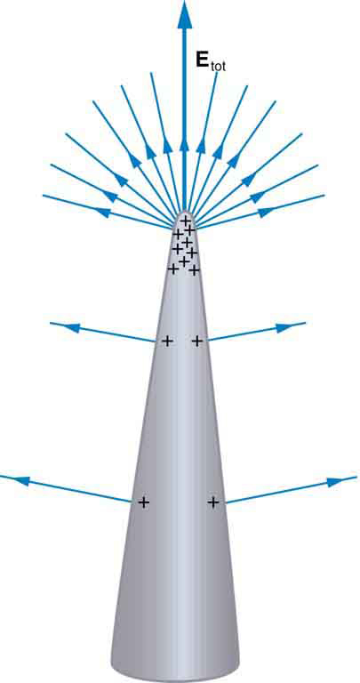
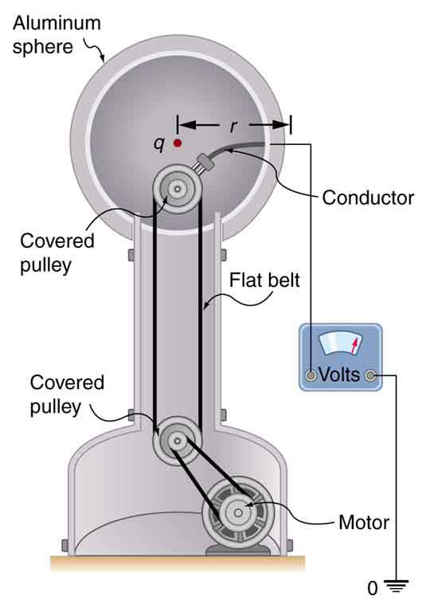

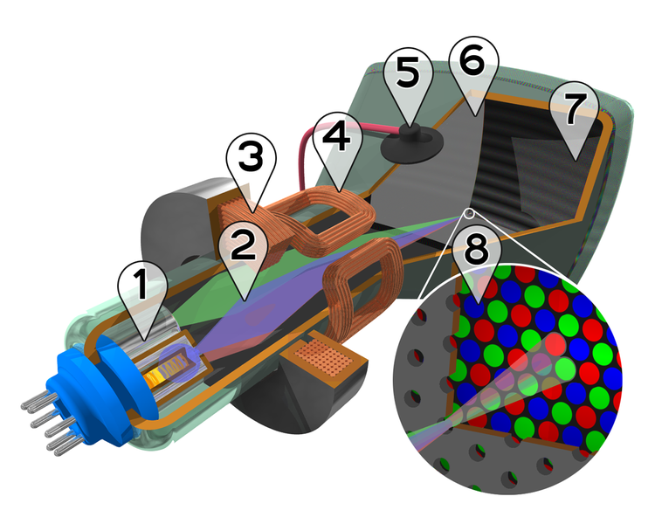
Electric Potential and Electric Field
Overview
Equipotential Surfaces and Lines
Point Charge
Capacitors and Dielectrics
]
Applications
Electric Potential and Electric Field
Free to share, print, make copies and changes. Get yours at www.boundless.com

Slide 5

Overview
Electric Potential and Electric Field > Overview
Relation Between Electric Potential and Field
Electric Potential Energy and Potential Difference
Electric Field and Changing Electric Potential
Potentials and Charged Conductors
Uniform Electric Field
Energy Conservation
The Electron-Volt
Dipole Moments
Free to share, print, make copies and changes. Get yours at www.boundless.com
www.boundless.com/physics/textbooks/boundless-physics-textbook/electric-potential-and-electric-field-18/overview-139/

Slide 6
Equipotential Surfaces and Lines
Electric Potential and Electric Field > Equipotential Surfaces and Lines
Ideal Conductors
Electric Potential in Human
Equipotential Lines
Free to share, print, make copies and changes. Get yours at www.boundless.com
www.boundless.com/physics/textbooks/boundless-physics-textbook/electric-potential-and-electric-field-18/equipotential-surfaces-and-lines-140/

Slide 7
Point Charge
Electric Potential and Electric Field > Point Charge
Electric Potential Due to a Point Charge
Superposition of Electric Potential
Free to share, print, make copies and changes. Get yours at www.boundless.com
www.boundless.com/physics/textbooks/boundless-physics-textbook/electric-potential-and-electric-field-18/point-charge-141/

Slide 8
Capacitors and Dielectrics
Electric Potential and Electric Field > Capacitors and Dielectrics
Capacitance
Capacitors with Dielectrics
Parallel-Plate Capacitor
Combinations of Capacitors: Series and Parallel
Dieletrics and their Breakdown
Free to share, print, make copies and changes. Get yours at www.boundless.com
www.boundless.com/physics/textbooks/boundless-physics-textbook/electric-potential-and-electric-field-18/capacitors-and-dielectrics-142/

Slide 9
Applications
Electric Potential and Electric Field > Applications
Cathode Ray Tube, TV and Computer Monitors, and the Oscilloscope
Free to share, print, make copies and changes. Get yours at www.boundless.com
www.boundless.com/physics/textbooks/boundless-physics-textbook/electric-potential-and-electric-field-18/applications-143/

Slide 10
Appendix
Free to share, print, make copies and changes. Get yours at www.boundless.com

Slide 11
Key terms
Electric Potential and Electric Field
axon A nerve fiber which is a long, slender projection of a nerve cell, and which conducts nerve impulses away from the body of the cell to a synapse.
breakdown A failure, particularly mechanical; something that has failed.
capacitance The property of an electric circuit or its element that permits it to store charge, defined as the ratio of stored charge to potential over that element or circuit (Q/V); SI unit: farad (F).
capacitance The property of an electric circuit or its element that permits it to store charge, defined as the ratio of stored charge to potential over that element or circuit (Q/V); SI unit: farad (F).
capacitor An electronic component capable of storing an electric charge, especially one consisting of two conductors separated by a dielectric.
capacitor An electronic component capable of storing an electric charge, especially one consisting of two conductors separated by a dielectric.
capacitor An electronic component capable of storing an electric charge, especially one consisting of two conductors separated by a dielectric.
cell membrane The semipermeable membrane that surrounds the cytoplasm of a cell.
circuit A pathway of electric current composed of individual electronic components, such as resistors, transistors, capacitors, inductors and diodes, connected by conductive wires or traces through which electric current can flow. T
conductor A material which contains movable electric charges.
conductor A material which contains movable electric charges.
coulomb In the International System of Units, the derived unit of electric charge; the amount of electric charge carried by a current of 1 ampere flowing for 1 second. Symbol: C
Free to share, print, make copies and changes. Get yours at www.boundless.com

Slide 12
Electric Potential and Electric Field
dielectric An electrically insulating or nonconducting material considered for its electric susceptibility (i.e., its property of polarization when exposed to an external electric field).
dielectric An electrically insulating or nonconducting material considered for its electric susceptibility (i.e., its property of polarization when exposed to an external electric field).
dielectric An electrically insulating or nonconducting material considered for its electric susceptibility (i.e., its property of polarization when exposed to an external electric field).
dielectric An electrically insulating or nonconducting material considered for its electric susceptibility (i.e., its property of polarization when exposed to an external electric field).
dipole moment The vector product of the charge on either pole of a dipole and the distance separating them.
electric field A region of space around a charged particle, or between two voltages; it exerts a force on charged objects in its vicinity.
electric field A region of space around a charged particle, or between two voltages; it exerts a force on charged objects in its vicinity.
electric field A region of space around a charged particle, or between two voltages; it exerts a force on charged objects in its vicinity.
electric potential The potential energy per unit charge at a point in a static electric field; voltage.
electric potential The potential energy per unit charge at a point in a static electric field; voltage.
electric potential The potential energy per unit charge at a point in a static electric field; voltage.
electron gun Any device that produces a stream of electrons, especially a narrow stream that is focused onto a phosphor screen.
Free to share, print, make copies and changes. Get yours at www.boundless.com

Slide 13
Electric Potential and Electric Field
electron volt A unit for measuring the energy of subatomic particles; the energy equal to that attained by an electron moving through a potential difference of one volt. Equivalent to 1.6022 x 10-19 joules.
equipotential A region whose every point has the same potential.
equipotential A region whose every point has the same potential.
flux density A measure of rate of flow of a fluid, particles or energy per unit area.
kinetic energy The energy possessed by an object because of its motion, equal to one half the mass of the body times the square of its velocity.
neuron A cell of the nervous system, which conducts nerve impulses; consisting of an axon and several dendrites. Neurons are connected by synapses.
particle accelerator A device that accelerates electrically charged particles to extremely high speeds, for the purpose of inducing high-energy reactions or producing high-energy radiation.
permittivity A property of a dielectric medium that determines the forces that electric charges placed in the medium exert on each other.
phosphor A substance that exhibits the phenomenon of luminescence; often transition metal compounds or rare earth compounds of various types. The most common uses of phosphors are in CRT displays and fluorescent lights.
potential difference The difference in potential energy between two points in an electric field; the difference in charge between two points in an electrical circuit; voltage.
potential difference The difference in potential energy between two points in an electric field; the difference in charge between two points in an electrical circuit; voltage.
potential difference The difference in potential energy between two points in an electric field; the difference in charge between two points in an electrical circuit; voltage.
Free to share, print, make copies and changes. Get yours at www.boundless.com

Slide 14
Electric Potential and Electric Field
potential energy The energy an object has because of its position (in a gravitational or electric field) or its condition (as a stretched or compressed spring, as a chemical reactant, or by having rest mass)
potential energy The energy an object has because of its position (in a gravitational or electric field) or its condition (as a stretched or compressed spring, as a chemical reactant, or by having rest mass)
radial Moving along a radius.
raster A scanning pattern of parallel lines that form the display of an image projected on a cathode-ray tube of a television set or display screen.
scalar A quantity that has magnitude but not direction; compare vector.
static equilibrium the physical state in which all components of a system are at rest and the net force is equal to zero throughout the system
superposition The summing of two or more field contributions occupying the same space.
torque A rotational or twisting effect of a force; (SI unit newton-meter or Nm; imperial unit foot-pound or ft-lb)
vector A directed quantity, one with both magnitude and direction; the between two points.
vector A directed quantity, one with both magnitude and direction; the between two points.
voltage The amount of electrostatic potential between two points in space.
work A measure of energy expended in moving an object; most commonly, force times displacement. No work is done if the object does not move.
Free to share, print, make copies and changes. Get yours at www.boundless.com

Slide 15

Electric Potential and Electric Field
Diagram of a Parallel-Plate Capacitor
Charges in the dielectric material line up to oppose the charges of each plate of the capacitor. An electric field is created between the plates of the capacitor as charge builds on each plate.
Free to share, print, make copies and changes. Get yours at www.boundless.com
Wikipedia. "Capacitor schematic with dielectric." CC BY-SA http://en.wikipedia.org/wiki/File:Capacitor_schematic_with_dielectric.svg View on Boundless.com

Slide 16
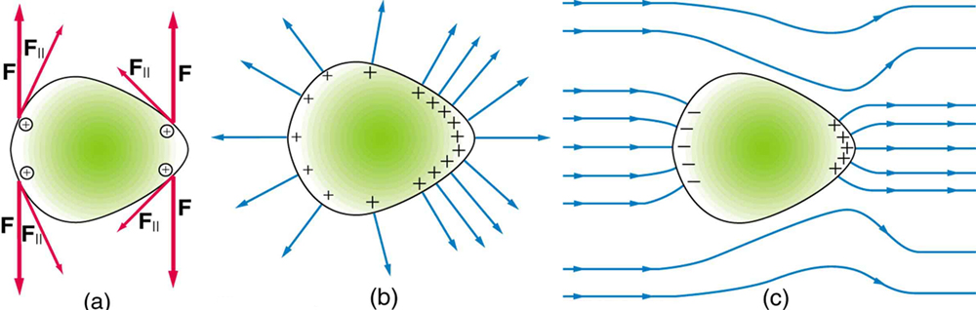
Electric Potential and Electric Field
Electrical Charge at a Sharp Point of a Conductor
Repulsive forces towards the more sharply curved surface on the right aim more outward than along the surface of the conductor.
Free to share, print, make copies and changes. Get yours at www.boundless.com
OpenStax CNX. "OpenStax College, College Physics. December 28, 2012." CC BY 3.0 http://cnx.org/content/m42317/latest/?collection=col11406/latest View on Boundless.com

Slide 17
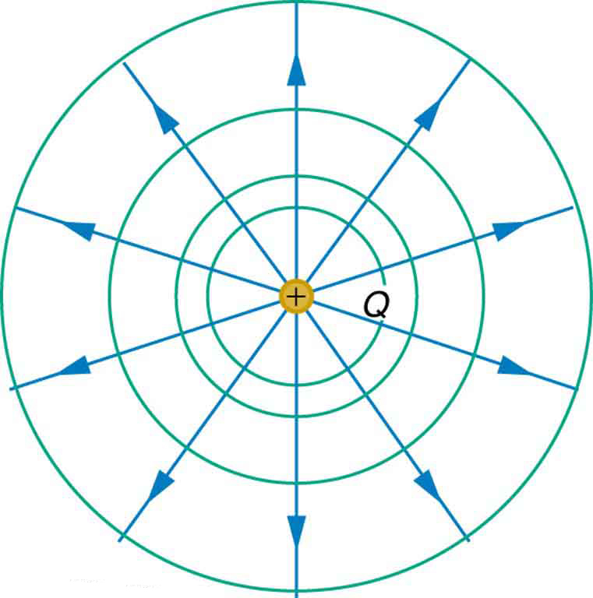
Electric Potential and Electric Field
Equipotential Lines
An isolated point charge Q with its electric field lines (blue) and equipotential lines (green)
Free to share, print, make copies and changes. Get yours at www.boundless.com
OpenStax CNX. "OpenStax College, Equipotential Lines. January 4, 2013." CC BY 3.0 http://cnx.org/content/m42331/latest/ View on Boundless.com

Slide 18
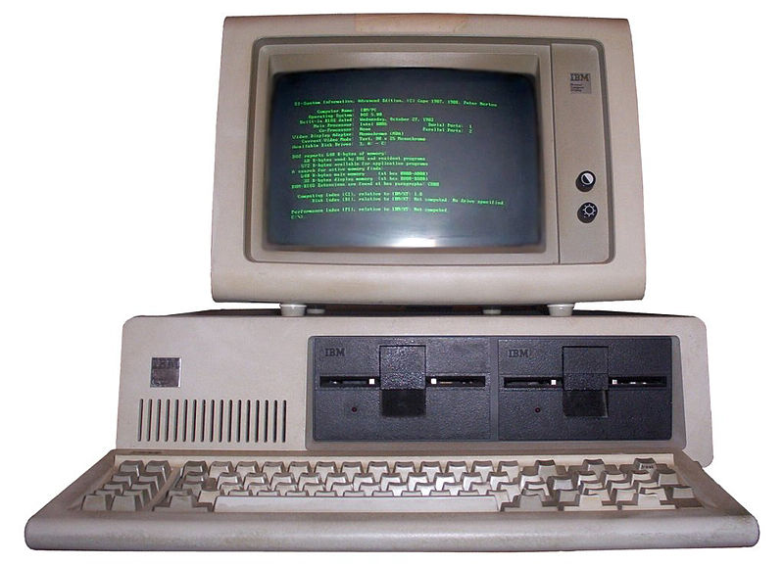
Electric Potential and Electric Field
Monochrome Computer CRT Monitor
Monochrome monitor - this CRT uses only one type of phosphor.
Free to share, print, make copies and changes. Get yours at www.boundless.com
Wikipedia. "Phosphor." GNU FDL http://en.wikipedia.org/wiki/Phosphor View on Boundless.com

Slide 19
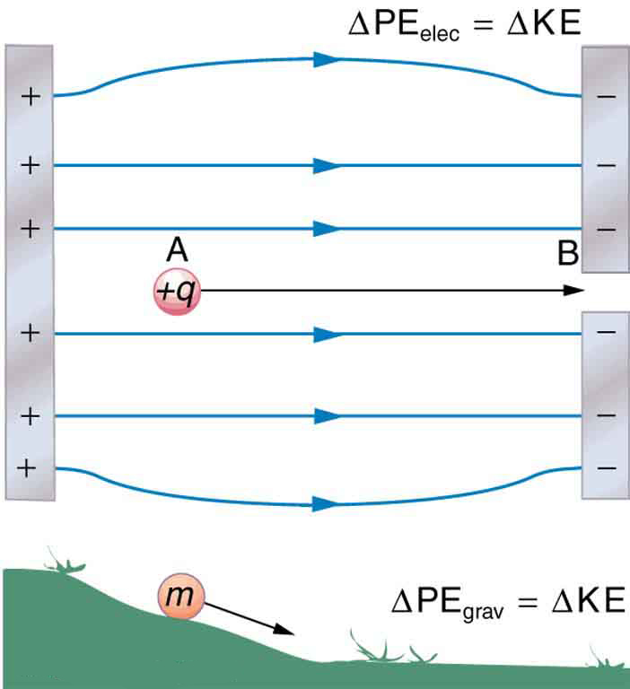
Electric Potential and Electric Field
Similarities Between Activity of Gravitational and Electric Fields on an Object
The charge, +q, is moved down the electric field in the same way that the object, m, is moved down the hill. In both instances, the particle in motion goes from a higher to a lower potential energy state.
Free to share, print, make copies and changes. Get yours at www.boundless.com
OpenStax CNX. "OpenStax College, Electric Potential Energy: Potential Difference. January 3, 2013." CC BY 3.0 http://cnx.org/content/m42324/latest/ View on Boundless.com

Slide 20
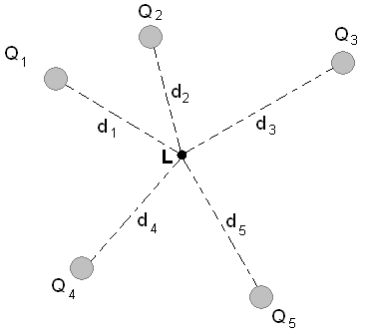
Electric Potential and Electric Field
Superposition of Electric Potential
The electric potential at point L is the sum of voltages from each point charge (scalars).
Free to share, print, make copies and changes. Get yours at www.boundless.com
Wikimedia. "Potencial eletrico resultante." Public domain http://commons.wikimedia.org/wiki/File:Potencial_eletrico_resultante.PNG View on Boundless.com

Slide 21
Electric Potential and Electric Field
Electric field and potential in one dimension
The presence of an electric field around the static point charge (large red dot) creates a potential difference, causing the test charge (small red dot) to experience a force and move.
Free to share, print, make copies and changes. Get yours at www.boundless.com
Wikipedia. "Electric field." CC BY-SA http://en.wikipedia.org/wiki/File:Electric_field.gif View on Boundless.com

Slide 22
Electric Potential and Electric Field
Parallel-Plate Capacitor
The dielectric prevents charge flow from one plate to the other.
Free to share, print, make copies and changes. Get yours at www.boundless.com
Wikipedia. "Parallel plate capacitor." CC BY-SA http://en.wikipedia.org/wiki/File:Parallel_plate_capacitor.svg View on Boundless.com

Slide 23
Electric Potential and Electric Field
Van de Graaff Generator
The voltage of this demonstration Van de Graaff generator is measured between the charged sphere and ground. Earth's potential is taken to be zero as a reference. The potential of the charged conducting sphere is the same as that of an equal point charge at its center.
Free to share, print, make copies and changes. Get yours at www.boundless.com
OpenStax CNX. "OpenStax College, College Physics. December 13, 2012." CC BY 3.0 http://cnx.org/content/m42328/latest/?collection=col11406/1.7 View on Boundless.com

Slide 24
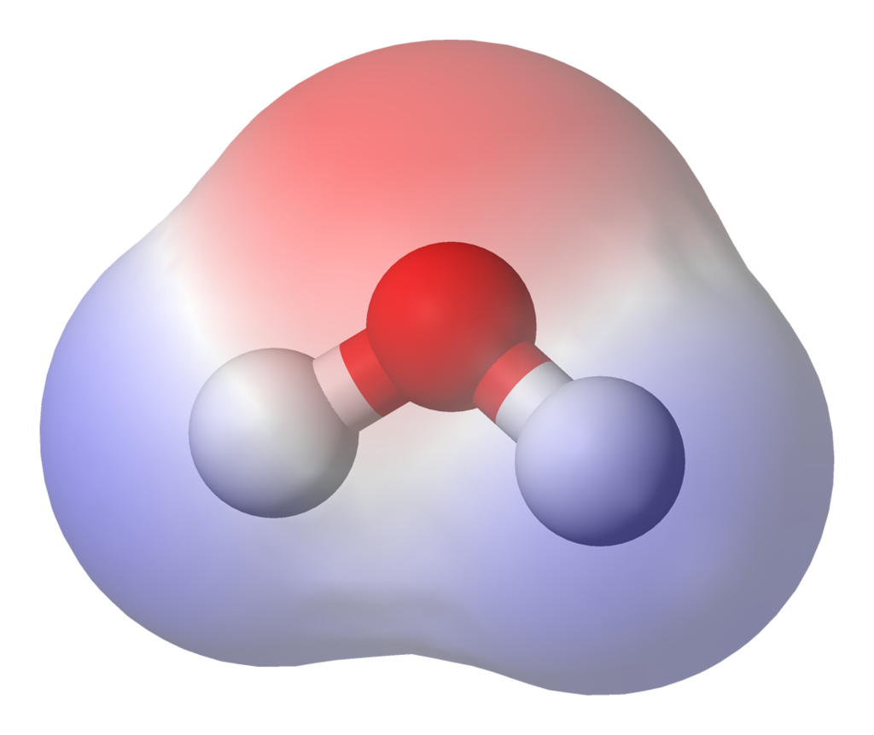
Electric Potential and Electric Field
Molecular Dipole Moment in Water
This water (H2O) molecule has a high density of electrons (denoted by the red shading) near the red O atom. Closer to the white H atoms, there is a low density of electrons. Therefore, the molecule is is a dipole, with negativity near the O and positivity closer to the H atoms.
Free to share, print, make copies and changes. Get yours at www.boundless.com
Wikipedia. "Water-elpot-transparent-3D-balls." CC BY-SA http://en.wikipedia.org/wiki/File:Water-elpot-transparent-3D-balls.png View on Boundless.com

Slide 25
Electric Potential and Electric Field
Parallel Capacitors
This image depicts capacitors C1, C2, and so on until Cn in parallel.
Free to share, print, make copies and changes. Get yours at www.boundless.com
Wikipedia. "Capacitors in parallel." CC BY-SA http://en.wikipedia.org/wiki/File:Capacitors_in_parallel.svg View on Boundless.com

Slide 26
Electric Potential and Electric Field
Potential difference in a static field
When a charge q moves from point A to point B, the potential difference is independent of path taken.
Free to share, print, make copies and changes. Get yours at www.boundless.com
Wikipedia. "Electrostatic definition of voltage." CC BY-SA http://en.wikipedia.org/wiki/File:Electrostatic_definition_of_voltage.svg View on Boundless.com

Slide 27
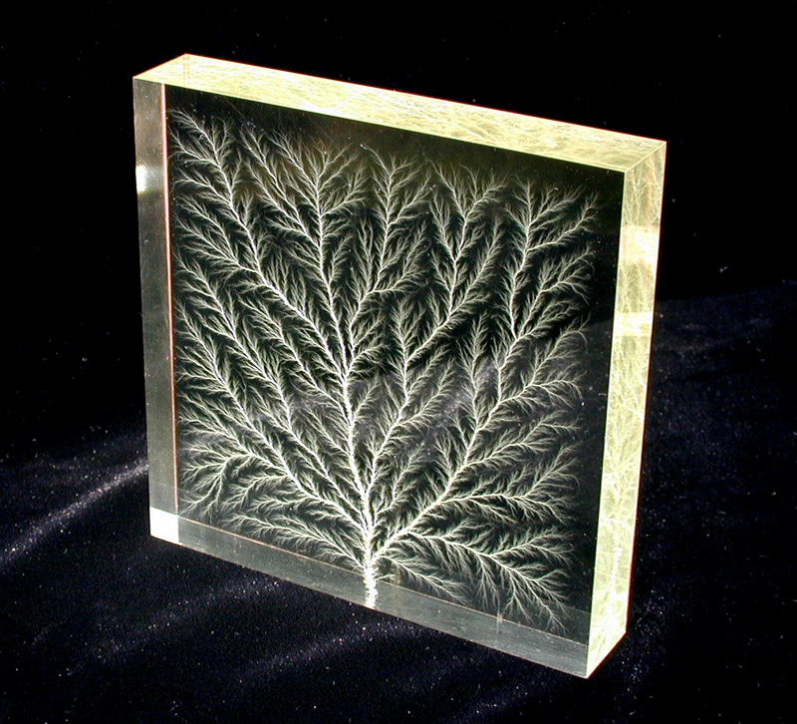
Electric Potential and Electric Field
Dielectric breakdown of plexiglas
The treelike pattern in the plexiglas stems from the root of the breakdown. Current is dispersed in many different directions, creating different stems.
Free to share, print, make copies and changes. Get yours at www.boundless.com
Wikipedia. "Square1." CC BY-SA http://en.wikipedia.org/wiki/File:Square1.jpg View on Boundless.com

Slide 28
Electric Potential and Electric Field
Capacitors in Series
This image depicts capacitors C1, C2 and so on until Cn in a series.
Free to share, print, make copies and changes. Get yours at www.boundless.com
Wikipedia. "Capacitors in series." CC BY-SA http://en.wikipedia.org/wiki/File:Capacitors_in_series.svg View on Boundless.com

Slide 29
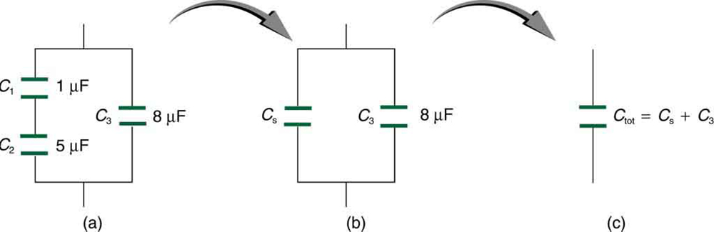
Electric Potential and Electric Field
Capacitors in Series and in Parallel
The initial problem can be simplified by finding the capacitance of the series, then using it as part of the parallel calculation.
Free to share, print, make copies and changes. Get yours at www.boundless.com
OpenStax CNX. "OpenStax College, Capacitors in Series and Parallel. January 7, 2013." CC BY 3.0 http://cnx.org/content/m42336/latest/ View on Boundless.com

Slide 30
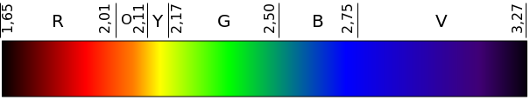
Electric Potential and Electric Field
Energy of Photons in the Visible Spectrum
Relationship between wavelength and energy expressed in electron volts.
Free to share, print, make copies and changes. Get yours at www.boundless.com
Wikimedia. CC BY-SA http://upload.wikimedia.org/wikipedia/commons/thumb/7/7f/Colors_in_eV.svg/605px-Colors_in_eV.svg.png View on Boundless.com

Slide 31
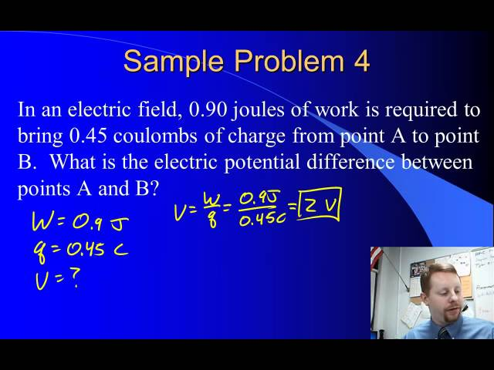
Electric Potential and Electric Field
Electric Potential Difference
A brief overview of electric potential difference and electric potential energy for beginning physics students.
Free to share, print, make copies and changes. Get yours at www.boundless.com
View on Boundless.com

Slide 32
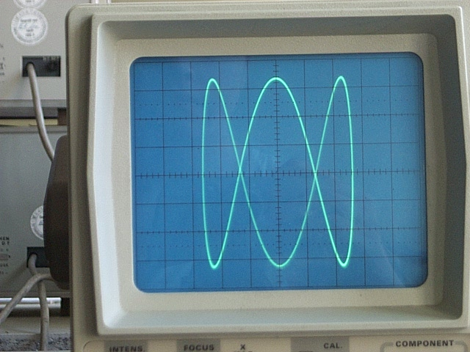
Electric Potential and Electric Field
Oscilloscope Display
Example of an analog oscilloscope display. Shown is a Lissajous figure, showing a harmonic relationship of one horizontal oscillation cycle to three vertical oscillation cycles.
Free to share, print, make copies and changes. Get yours at www.boundless.com
Wikipedia. "Oscilloscope." GNU FDL http://en.wikipedia.org/wiki/Oscilloscope View on Boundless.com

Slide 33
Electric Potential and Electric Field
The Neuron
Neurons receive an impulse at the dendrites. This impulse is passed through the axon, a long extension of the cell, in the form of an electrical potential created by differing concentrations of sodium and potassium ions on either side of a membrane in the axon.
Free to share, print, make copies and changes. Get yours at www.boundless.com
Wikipedia. "Complete neuron cell diagram en." CC BY-SA http://en.wikipedia.org/wiki/File:Complete_neuron_cell_diagram_en.svg View on Boundless.com

Slide 34
Electric Potential and Electric Field
Color Cathode Ray Tube
Cutaway rendering of a color CRT: 1) Three Electron guns (for red, green, and blue phosphor dots) 2) Electron beams 3) Focusing coils 4) Deflection coils 5) Anode connection 6) Mask for separating beams for red, green, and blue part of displayed image 7) Phosphor layer with red, green, and blue zones 8) Close-up of the phosphor-coated inner side of the screen
Free to share, print, make copies and changes. Get yours at www.boundless.com
Wikipedia. "Cathode ray tube." GNU FDL http://en.wikipedia.org/wiki/Cathode_ray_tube%23Ionizing_radiation View on Boundless.com

Slide 35
Electric Potential and Electric Field
Parallel-Plate Capacitor
In a capacitor, the opposite plates take on opposite charges. The dielectric ensures that the charges are separated and do not transfer from one plate to the other.
Free to share, print, make copies and changes. Get yours at www.boundless.com
Wikipedia. "Parallel plate capacitor." CC BY-SA http://en.wikipedia.org/wiki/File:Parallel_plate_capacitor.svg View on Boundless.com

Slide 36
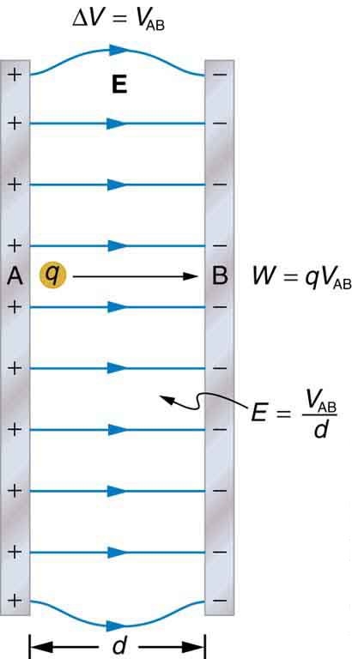
Electric Potential and Electric Field
Relationships within a uniform electric field
In this image, Work (W), field strength (E), and potential difference (∆V) are defined for points A and B within the constructs of a uniform potential field between the positive and negative plates.
Free to share, print, make copies and changes. Get yours at www.boundless.com
OpenStax CNX. "OpenStax College, Electric Potential in a Uniform Electric Field. January 4, 2013." CC BY 3.0 http://cnx.org/content/m42326/latest/ View on Boundless.com

Slide 37
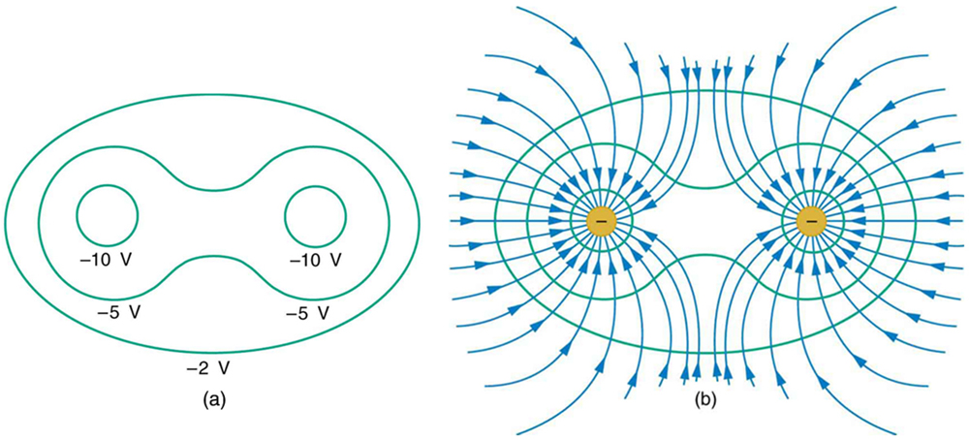
Electric Potential and Electric Field
Equipotential lines with multiple charges
Equipotential lines become irregularly shaped when there are multiple charges vicinal to one another. At a point between the charges, a test charge may "feel" the effects of both charges.
Free to share, print, make copies and changes. Get yours at www.boundless.com
OpenStax CNX. "OpenStax College, Equipotential Lines. January 4, 2013." CC BY 3.0 http://cnx.org/content/m42331/latest/ View on Boundless.com

Slide 38
Electric Potential and Electric Field
Charge Distribution on a Conductor with an Irregular Surface
Curvature causes electric field lines to extend such that they further distance themselves from one another with increasing distance from the conductor surface. As such, charges (and field lines) aggregate around areas of curvature.
Free to share, print, make copies and changes. Get yours at www.boundless.com
OpenStax CNX. "OpenStax College, Conductors and Electric Fields in Static Equilibrium. January 9, 2013." CC BY 3.0 http://cnx.org/content/m42317/latest/ View on Boundless.com

Slide 39
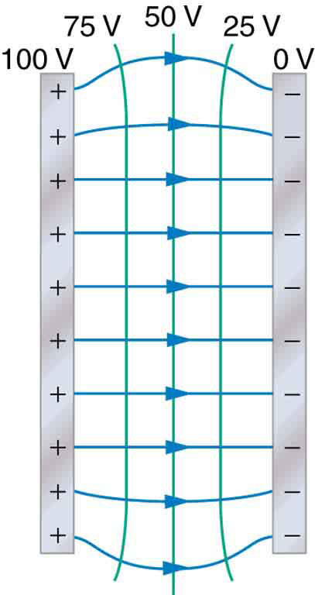
Electric Potential and Electric Field
Equipotential Lines Between Two Plates
When charges are lined up and continuous on conducting plates, equipotential lines are straight between them. The only exception is a curving of the lines near the edges of the conductor plates.
Free to share, print, make copies and changes. Get yours at www.boundless.com
OpenStax CNX. "OpenStax College, Equipotential Lines. January 6, 2013." CC BY 3.0 http://cnx.org/content/m42331/latest/ View on Boundless.com

Slide 40
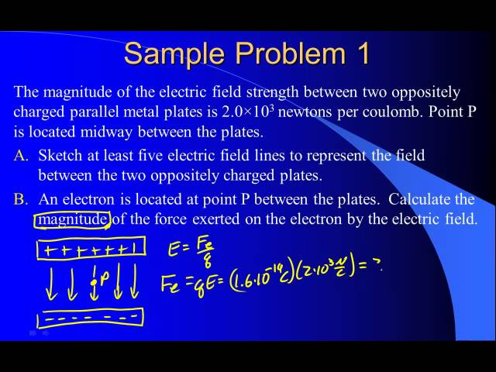
Electric Potential and Electric Field
Parallel Plates and Equipotential Lines
A brief overview of parallel plates and equipotential lines from the viewpoint of electrostatics.
Free to share, print, make copies and changes. Get yours at www.boundless.com
View on Boundless.com

Slide 41
Electric Potential and Electric Field
Equipotential Lines
An isolated point charge Q with its electric field lines (blue) and equipotential lines (green)
Free to share, print, make copies and changes. Get yours at www.boundless.com
OpenStax CNX. "OpenStax College, Equipotential Lines. January 4, 2013." CC BY 3.0 http://cnx.org/content/m42331/latest/ View on Boundless.com

Slide 42
Attribution
Electric Potential and Electric Field
Wiktionary. "flux density." CC BY-SA 3.0 http://en.wiktionary.org/wiki/flux_density
Wikipedia. "conductor." CC BY-SA 3.0 http://en.wikipedia.org/wiki/conductor
Wikipedia. "Electrical conductivity." CC BY-SA 3.0 http://en.wikipedia.org/wiki/Electrical_conductivity
Wiktionary. "breakdown." CC BY-SA 3.0 http://en.wiktionary.org/wiki/breakdown
Wikipedia. "conductor." CC BY-SA 3.0 http://en.wikipedia.org/wiki/conductor
Wiktionary. "dielectric." CC BY-SA 3.0 http://en.wiktionary.org/wiki/dielectric
Wikipedia. "Electrical breakdown." CC BY-SA 3.0 http://en.wikipedia.org/wiki/Electrical_breakdown
Wikipedia. "Breakdown voltage." CC BY-SA 3.0 http://en.wikipedia.org/wiki/Breakdown_voltage
Wiktionary. "electric field." CC BY-SA 3.0 http://en.wiktionary.org/wiki/electric_field
Wiktionary. "electric potential." CC BY-SA 3.0 http://en.wiktionary.org/wiki/electric_potential
Wikipedia. "Electric field." CC BY-SA 3.0 http://en.wikipedia.org/wiki/Electric_field
Wikipedia. "Electric potential." CC BY-SA 3.0 http://en.wikipedia.org/wiki/Electric_potential
Wiktionary. "dipole moment." CC BY-SA 3.0 http://en.wiktionary.org/wiki/dipole_moment
Wiktionary. "torque." CC BY-SA 3.0 http://en.wiktionary.org/wiki/torque
Wiktionary. "vector." CC BY-SA 3.0 http://en.wiktionary.org/wiki/vector
Wikipedia. "Electric dipole moment." CC BY-SA 3.0 http://en.wikipedia.org/wiki/Electric_dipole_moment
Wiktionary. "potential difference." CC BY-SA 3.0 http://en.wiktionary.org/wiki/potential_difference
Free to share, print, make copies and changes. Get yours at www.boundless.com

Slide 43
Electric Potential and Electric Field
Wiktionary. "electric field." CC BY-SA 3.0 http://en.wiktionary.org/wiki/electric_field
Wikipedia. "Electric field." CC BY-SA 3.0 http://en.wikipedia.org/wiki/Electric_field
OpenStax CNX. "OpenStax College, Electric Potential in a Uniform Electric Field. September 17, 2013." CC BY 3.0 http://cnx.org/content/m42326/latest/
Wiktionary. "capacitance." CC BY-SA 3.0 http://en.wiktionary.org/wiki/capacitance
Wiktionary. "capacitor." CC BY-SA 3.0 http://en.wiktionary.org/wiki/capacitor
Wiktionary. "dielectric." CC BY-SA 3.0 http://en.wiktionary.org/wiki/dielectric
Wikipedia. "Dielectric." CC BY-SA 3.0 http://en.wikipedia.org/wiki/Dielectric
Wikipedia. "circuit." CC BY-SA 3.0 http://en.wikipedia.org/wiki/circuit
Wiktionary. "capacitor." CC BY-SA 3.0 http://en.wiktionary.org/wiki/capacitor
Wikipedia. "Series and parallel circuits." CC BY-SA 3.0 http://en.wikipedia.org/wiki/Series_and_parallel_circuits
Wiktionary. "potential difference." CC BY-SA 3.0 http://en.wiktionary.org/wiki/potential_difference
Wikipedia. "potential energy." CC BY-SA 3.0 http://en.wikipedia.org/wiki/potential%20energy
Wikipedia. "kinetic energy." CC BY-SA 3.0 http://en.wikipedia.org/wiki/kinetic%20energy
Wikipedia. "Electric potential energy." CC BY-SA 3.0 http://en.wikipedia.org/wiki/Electric_potential_energy
Wiktionary. "electric field." CC BY-SA 3.0 http://en.wiktionary.org/wiki/electric_field
Wiktionary. "electric potential." CC BY-SA 3.0 http://en.wiktionary.org/wiki/electric_potential
Wiktionary. "work." CC BY-SA 3.0 http://en.wiktionary.org/wiki/work
Wikipedia. "Electric potential." CC BY-SA 3.0 http://en.wikipedia.org/wiki/Electric_potential
Wiktionary. "static equilibrium." CC BY-SA 3.0 http://en.wiktionary.org/wiki/static_equilibrium
Free to share, print, make copies and changes. Get yours at www.boundless.com

Slide 44
Electric Potential and Electric Field
Wiktionary. "equipotential." CC BY-SA 3.0 http://en.wiktionary.org/wiki/equipotential
OpenStax CNX. "OpenStax College, Equipotential Lines. September 17, 2013." CC BY 3.0 http://cnx.org/content/m42331/latest/
Wiktionary. "potential difference." CC BY-SA 3.0 http://en.wiktionary.org/wiki/potential_difference
Wiktionary. "particle accelerator." CC BY-SA 3.0 http://en.wiktionary.org/wiki/particle_accelerator
Wiktionary. "electron volt." CC BY-SA 3.0 http://en.wiktionary.org/wiki/electron_volt
Wikipedia. "Electronvolt." CC BY-SA 3.0 http://en.wikipedia.org/wiki/Electronvolt
Wiktionary. "radial." CC BY-SA 3.0 http://en.wiktionary.org/wiki/radial
Wiktionary. "equipotential." CC BY-SA 3.0 http://en.wiktionary.org/wiki/equipotential
OpenStax CNX. "OpenStax College, Equipotential Lines. September 17, 2013." CC BY 3.0 http://cnx.org/content/m42331/latest/
Wiktionary. "capacitance." CC BY-SA 3.0 http://en.wiktionary.org/wiki/capacitance
Wiktionary. "dielectric." CC BY-SA 3.0 http://en.wiktionary.org/wiki/dielectric
Wikipedia. "Capacitance." CC BY-SA 3.0 http://en.wikipedia.org/wiki/Capacitance
Wikipedia. "potential energy." CC BY-SA 3.0 http://en.wikipedia.org/wiki/potential%20energy
Wiktionary. "coulomb." CC BY-SA 3.0 http://en.wiktionary.org/wiki/coulomb
Wikipedia. "Electric potential energy." CC BY-SA 3.0 http://en.wikipedia.org/wiki/Electric_potential_energy
Wikipedia. "Voltage." CC BY-SA 3.0 http://en.wikipedia.org/wiki/Voltage
Wiktionary. "electric potential." CC BY-SA 3.0 http://en.wiktionary.org/wiki/electric_potential
Wiktionary. "voltage." CC BY-SA 3.0 http://en.wiktionary.org/wiki/voltage
Wikipedia. "Electric potential." CC BY-SA 3.0 http://en.wikipedia.org/wiki/Electric_potential
Free to share, print, make copies and changes. Get yours at www.boundless.com

Slide 45
Electric Potential and Electric Field
OpenStax CNX. "OpenStax College, College Physics. September 17, 2013." CC BY 3.0 http://cnx.org/content/m42328/latest/?collection=col11406/1.7
OpenStax CNX. "OpenStax College, College Physics. September 17, 2013." CC BY 3.0 http://cnx.org/content/m42324/latest/?collection=col11406/1.7
Wiktionary. "scalar." CC BY-SA 3.0 http://en.wiktionary.org/wiki/scalar
Wiktionary. "vector." CC BY-SA 3.0 http://en.wiktionary.org/wiki/vector
Boundless Learning. "Boundless." CC BY-SA 3.0 http://www.boundless.com//physics/definition/superposition
Wikipedia. "Electric potential." CC BY-SA 3.0 http://en.wikipedia.org/wiki/Electric_potential
OpenStax CNX. "OpenStax College, College Physics. September 18, 2013." CC BY 3.0 http://cnx.org/content/m42324/latest/?collection=col11406/1.7
OpenStax CNX. "OpenStax College, Electric Potential in a Uniform Electric Field. September 18, 2013." CC BY 3.0 http://cnx.org/content/m42326/latest/
Wiktionary. "cell membrane." CC BY-SA 3.0 http://en.wiktionary.org/wiki/cell_membrane
Wikipedia. "axon." CC BY-SA 3.0 http://en.wikipedia.org/wiki/axon
Wiktionary. "neuron." CC BY-SA 3.0 http://en.wiktionary.org/wiki/neuron
Wikipedia. "Resting potential." CC BY-SA 3.0 http://en.wikipedia.org/wiki/Resting_potential
Wikipedia. "Neuron." CC BY-SA 3.0 http://en.wikipedia.org/wiki/Neuron
Wiktionary. "electron gun." CC BY-SA 3.0 http://en.wiktionary.org/wiki/electron_gun
Wiktionary. "raster." CC BY-SA 3.0 http://en.wiktionary.org/wiki/raster
Wikipedia. "phosphor." CC BY-SA 3.0 http://en.wikipedia.org/wiki/phosphor
OpenStax CNX. "CJ Ganier, Using an Oscilloscope. September 18, 2013." CC BY 3.0 http://cnx.org/content/m11902/latest/
Wikipedia. "Television set." CC BY-SA 3.0 http://en.wikipedia.org/wiki/Television_set
Wikipedia. "Raster scan." CC BY-SA 3.0 http://en.wikipedia.org/wiki/Raster_scan
Free to share, print, make copies and changes. Get yours at www.boundless.com

Slide 46
Electric Potential and Electric Field
Wikipedia. "Computer monitor." CC BY-SA 3.0 http://en.wikipedia.org/wiki/Computer_monitor
Wikipedia. "Oscilloscope." CC BY-SA 3.0 http://en.wikipedia.org/wiki/Oscilloscope
Wikipedia. "Phosphor." CC BY-SA 3.0 http://en.wikipedia.org/wiki/Phosphor
Wikipedia. "Cathode ray tube." CC BY-SA 3.0 http://en.wikipedia.org/wiki/Cathode_ray_tube%23Phosphor_persistence
Wiktionary. "capacitor." CC BY-SA 3.0 http://en.wiktionary.org/wiki/capacitor
Wiktionary. "permittivity." CC BY-SA 3.0 http://en.wiktionary.org/wiki/permittivity
Wiktionary. "dielectric." CC BY-SA 3.0 http://en.wiktionary.org/wiki/dielectric
Wikipedia. "Capacitor." CC BY-SA 3.0 http://en.wikipedia.org/wiki/Capacitor
Free to share, print, make copies and changes. Get yours at www.boundless.com

