Slide 1


Boundless Lecture Slides
Available on the Boundless Teaching Platform
Free to share, print, make copies and changes. Get yours at www.boundless.com

Slide 2



Using Boundless Presentations
Boundless Teaching Platform
Boundless empowers educators to engage their students with affordable, customizable textbooks and intuitive teaching tools. The free Boundless Teaching Platform gives educators the ability to customize textbooks in more than 20 subjects that align to hundreds of popular titles. Get started by using high quality Boundless books, or make switching to our platform easier by building from Boundless content pre-organized to match the assigned textbook. This platform gives educators the tools they need to assign readings and assessments, monitor student activity, and lead their classes with pre-made teaching resources.
Get started now at:
The Appendix
The appendix is for you to use to add depth and breadth to your lectures. You can simply drag and drop slides from the appendix into the main presentation to make for a richer lecture experience.
http://boundless.com/teaching-platform
Free to edit, share, and copy
Feel free to edit, share, and make as many copies of the Boundless presentations as you like. We encourage you to take these presentations and make them your own.
If you have any questions or problems please email:
educators@boundless.com
Free to share, print, make copies and changes. Get yours at www.boundless.com

Slide 3

About Boundless
Boundless is an innovative technology company making education more affordable and accessible for students everywhere. The company creates the world’s best open educational content in 20+ subjects that align to more than 1,000 popular college textbooks. Boundless integrates learning technology into all its premium books to help students study more efficiently at a fraction of the cost of traditional textbooks. The company also empowers educators to engage their students more effectively through customizable books and intuitive teaching tools as part of the Boundless Teaching Platform. More than 2 million learners access Boundless free and premium content each month across the company’s wide distribution platforms, including its website, iOS apps, Kindle books, and iBooks. To get started learning or teaching with Boundless, visit boundless.com.
Free to share, print, make copies and changes. Get yours at www.boundless.com

Slide 4
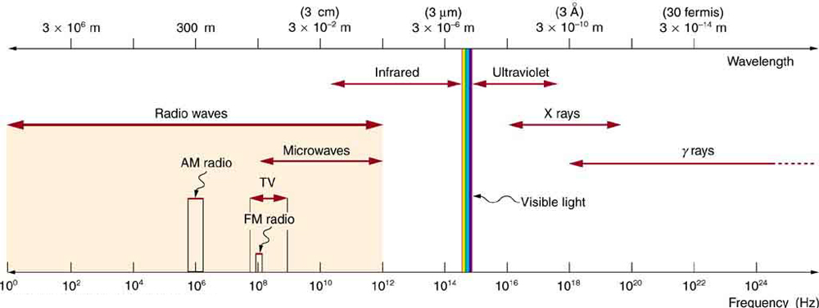
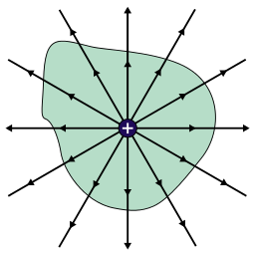
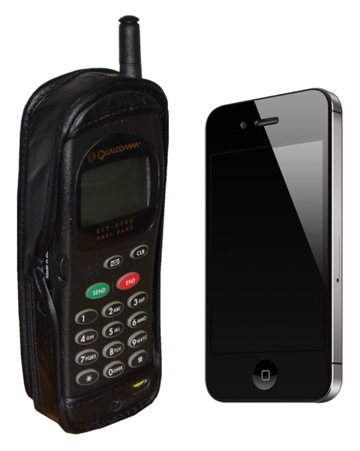

Electromagnetic Waves
The Electromagnetic Spectrum
Electromagnetic Waves and their Properties
Applications of EM Waves
]
Electromagnetic Waves
Free to share, print, make copies and changes. Get yours at www.boundless.com

Slide 5

The Electromagnetic Spectrum
Electromagnetic Waves > The Electromagnetic Spectrum
Radio Waves
Microwaves
Infrared Waves
Visible Light
Ultraviolet Light
X-Rays
Gamma Rays
Free to share, print, make copies and changes. Get yours at www.boundless.com
www.boundless.com/physics/textbooks/boundless-physics-textbook/electromagnetic-waves-23/the-electromagnetic-spectrum-165/

Slide 6
Electromagnetic Waves and their Properties
Electromagnetic Waves > Electromagnetic Waves and their Properties
Maxwell's Equations
The Production of Electromagnetic Waves
Energy and Momentum
The Speed of Light
The Doppler Effect
Momentum Transfer and Radiation Pressure Atom
Free to share, print, make copies and changes. Get yours at www.boundless.com
www.boundless.com/physics/textbooks/boundless-physics-textbook/electromagnetic-waves-23/electromagnetic-waves-and-their-properties-166/

Slide 7
Applications of EM Waves
Electromagnetic Waves > Applications of EM Waves
Wireless Communication
Free to share, print, make copies and changes. Get yours at www.boundless.com
www.boundless.com/physics/textbooks/boundless-physics-textbook/electromagnetic-waves-23/applications-of-em-waves-167/

Slide 8
Appendix
Free to share, print, make copies and changes. Get yours at www.boundless.com

Slide 9
Key terms
Electromagnetic Waves
AM radio waves Waves used to carry commercial radio signals between 540 and 1600 kHz. Information is carried by amplitude variation, while the frequency remains constant.
classical electrodynamics A branch of theoretical physics that studies consequences of the electromagnetic forces between electric charges and currents.
conductor A material which contains movable electric charges.
differential equation An equation involving the derivatives of a function.
doppler effect Apparent change in frequency of a wave when the observer and the source of the wave move relative to each other.
doppler effect Apparent change in frequency of a wave when the observer and the source of the wave move relative to each other.
electromagnetic wave A wave of oscillating electric and magnetic fields.
emissivity The energy-emitting propensity of a surface, usually measured at a specific wavelength.
flux A quantitative description of the transfer of a given vector quantity through a surface. In this context, we refer to the electric flux and magnetic flux.
FM radio waves Waves used to carry commercial radio signals between 88 and 108 MHz. Information is carried by frequency modulation, while the signal amplitude remains constant.
frequency The quotient of the number of times n a periodic phenomenon occurs over the time t in which it occurs: f = n / t.
gamma decay A nuclear reaction with the emission of a gamma ray.
Free to share, print, make copies and changes. Get yours at www.boundless.com

Slide 10
Electromagnetic Waves
gamma ray A very high frequency (and therefore very high energy) electromagnetic radiation emitted as a consequence of radioactivity.
ionizing radiation high-energy radiation that is capable of causing ionization in substances through which it passes; also includes high-energy particles
ionizing radiation high-energy radiation that is capable of causing ionization in substances through which it passes; also includes high-energy particles
non-ionizing radiation Radiation that does not cause atmospheric ionization; electrically neutral radiation.
optical window the optical portion of the electromagnetic spectrum that passes through the atmosphere all the way to the ground. The window runs from around 300 nanometers (ultraviolet-C) at the short end up into the range the eye can use, roughly 400-700 nm and continues up through the visual infrared to around 1100 nm, which is thermal infrared.
ozone layer A region of the stratosphere, between 15 and 30 kilometres in altitude, containing a relatively high concentration of ozone; it absorbs most solar ultraviolet radiation.
phase Waves are said to be "in phase" when they begin at the same part (e.g., crest) of their respective cycles.
photon The quantum of light and other electromagnetic energy, regarded as a discrete particle having zero rest mass, no electric charge, and an indefinitely long lifetime.
radar A method of detecting distant objects and determining their position, velocity, or other characteristics by analysis of sent radio waves (usually microwaves) reflected from their surfaces.
radio wave Electromagnetic radiation having a wavelength between about .5 centimeters and 30,000 meters; used for the broadcasting of radio and television signals.
radio waves Designates a portion of the electromagnetic spectrum having frequencies ranging from 300 GHz to 3 kHz, or equivalently, wavelengths from 1 millimeter to 100 kilometers.
radiograph An image, often a photographic negative, produced by radiation other than normal light; especially an X-ray photograph.
Free to share, print, make copies and changes. Get yours at www.boundless.com

Slide 11
Electromagnetic Waves
refractive index The ratio of the speed of light in air or vacuum to that in another medium.
special relativity A theory that (neglecting the effects of gravity) reconciles the principle of relativity with the observation that the speed of light is constant in all frames of reference.
spectral color a color that is evoked by a single wavelength of light in the visible spectrum, or by a relatively narrow band of wavelengths. Every wavelength of light is perceived as a spectral color, in a continuous spectrum; the colors of sufficiently close wavelengths are indistinguishable.
telecommunication The science and technology of the communication or messages over a distance, especially using electric, electronic or electromagnetic impulses.
terahertz radiation Electromagnetic waves with frequencies around one terahertz.
thermal agitation The thermal motion of atoms and molecules in any object at a temperature above absolute zero, causing them to emit and absorb radiation.
thermal radiation The electromagnetic radiation emitted from a body as a consequence of its temperature; increasing the temperature of the body increases the amount of radiation produced, and shifts it to shorter wavelengths (higher frequencies) in a manner explained only by quantum mechanics.
thermography Any of several techniques for the remote measurement of the temperature variations of a body, especially by creating images produced by infrared radiation.
visible light the part of the electromagnetic spectrum, between infrared and ultraviolet, that is visible to the human eye
wavelength The length of a single cycle of a wave, as measured by the distance between one peak or trough of a wave and the next; it is often designated in physics as λ, and corresponds to the velocity of the wave divided by its frequency.
x-ray crystallography A technique in which the patterns formed by the diffraction of X-rays on passing through a crystalline substance yield information on the lattice structure of the crystal, and the molecular structure of the substance.
X-ray spectroscopy The use of an X-ray spectrometer for chemical analysis.
Free to share, print, make copies and changes. Get yours at www.boundless.com

Slide 12
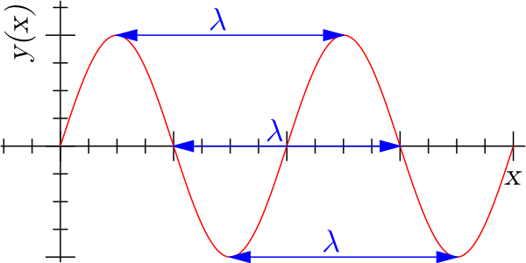

Electromagnetic Waves
Wavelength
Wavelength of the sinusoidal function is represented by λ.
Free to share, print, make copies and changes. Get yours at www.boundless.com
Wikipedia. "Sine wavelength." CC BY-SA http://en.wikipedia.org/wiki/File:Sine_wavelength.svg View on Boundless.com

Slide 13
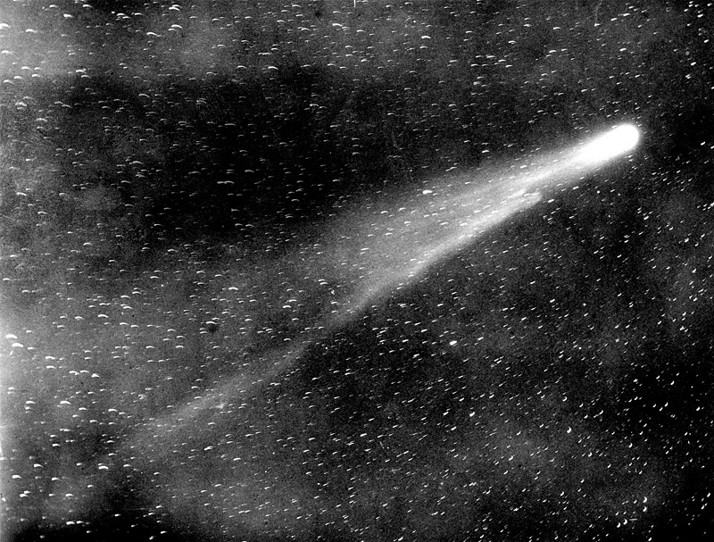
Electromagnetic Waves
Halley's Comet
As a comet approaches the inner Solar System, solar radiation causes the volatile materials within the comet to vaporize and stream out of the nucleus. The streams of dust and gas thus released form an atmosphere around the comet (called the coma), and the force exerted on the coma by the Sun's radiation pressure and solar wind cause the formation of an enormous tail that points away from the Sun.
Free to share, print, make copies and changes. Get yours at www.boundless.com
Wikipedia. "Comet." CC BY http://en.wikipedia.org/wiki/Comet View on Boundless.com

Slide 14
Electromagnetic Waves
The Doppler Effect and Sirens
Waves emitted by a siren in a moving vehicle
Free to share, print, make copies and changes. Get yours at www.boundless.com
Wikipedia. "Dopplerfrequenz." CC BY-SA http://en.wikipedia.org/wiki/File:Dopplerfrequenz.gif View on Boundless.com

Slide 15
Electromagnetic Waves
Electromagnetic Spectrum
The electromagnetic spectrum, showing the major categories of electromagnetic waves. The range of frequencies and wavelengths is remarkable. The dividing line between some categories is distinct, whereas other categories overlap. Microwaves encompass the high frequency portion of the radio section of the EM spectrum.
Free to share, print, make copies and changes. Get yours at www.boundless.com
OpenStax CNX. "OpenStax College, College Physics. April 28, 2014." CC BY 3.0 http://cnx.org/content/m42444/latest/?collection=col11406/1.7 View on Boundless.com

Slide 16
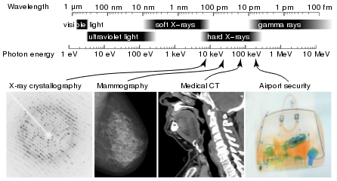
Electromagnetic Waves
X-Ray Spectrum and Applications
X-rays are part of the electromagnetic spectrum, with wavelengths shorter than those of visible light. Different applications use different parts of the X-ray spectrum.
Free to share, print, make copies and changes. Get yours at www.boundless.com
Wikipedia. "X-rays." GNU FDL http://en.wikipedia.org/wiki/X-rays View on Boundless.com

Slide 17
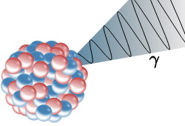
Electromagnetic Waves
Gamma Decay
Illustration of an emission of a gamma ray (γ) from an atomic nucleus
Free to share, print, make copies and changes. Get yours at www.boundless.com
Wikipedia. "Gamma rays." Public domain http://en.wikipedia.org/wiki/Gamma_rays View on Boundless.com

Slide 18
Electromagnetic Waves
Electromagnetic Waves
Electric (red) and magnetic (blue) waves propagate in phase sinusoidally, and perpendicularly to one another.
Free to share, print, make copies and changes. Get yours at www.boundless.com
Wikipedia. "Electromagneticwave3D." CC BY-SA http://en.wikipedia.org/wiki/File:Electromagneticwave3D.gif View on Boundless.com

Slide 19
Electromagnetic Waves
Example of Gauss's Law
A positive charge contained within a region of space creates an electric field that emanates from the surface of that region.
Free to share, print, make copies and changes. Get yours at www.boundless.com
Wikimedia. "GaussLaw1." CC BY-SA 3.0 http://upload.wikimedia.org/wikipedia/commons/5/57/GaussLaw1.svg View on Boundless.com

Slide 20
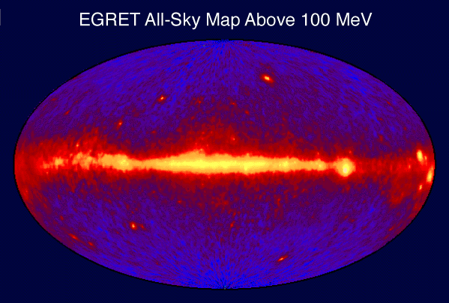
Electromagnetic Waves
Gamma Ray Sky Map
This is an image of the entire sky in 100 MeV or greater gamma rays as seen by the EGRET instrument aboard the CGRO spacecraft. Bright spots within the galactic plane are pulsars (spinning neutron stars with strong magnetic fields), while those above and below the plane are thought to be quasars (galaxies with supermassive black holes actively accreting matter).
Free to share, print, make copies and changes. Get yours at www.boundless.com
Wikipedia. "Gamma rays." Public domain http://en.wikipedia.org/wiki/Gamma_rays View on Boundless.com

Slide 21
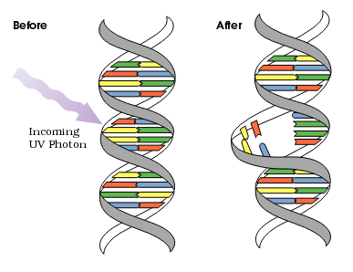
Electromagnetic Waves
DNA UV Mutation
Ultraviolet photons harm the DNA molecules of living organisms in different ways. In one common damage event, adjacent thymine bases bond with each other, instead of across the "ladder. " This "thymine dimer" makes a bulge, and the distorted DNA molecule does not function properly.
Free to share, print, make copies and changes. Get yours at www.boundless.com
Wikipedia. "Ultraviolet." Public domain http://en.wikipedia.org/wiki/Ultraviolet View on Boundless.com

Slide 22
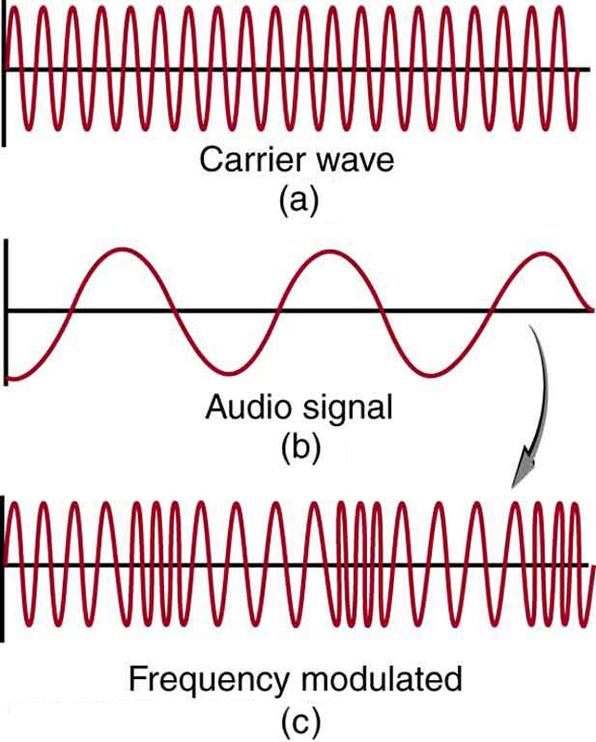
Electromagnetic Waves
FM Radio
Frequency modulation for FM radio. (a) A carrier wave at the station's basic frequency. (b) An audio signal at much lower audible frequencies. (c) The frequency of the carrier is modulated by the audio signal without changing its amplitude.
Free to share, print, make copies and changes. Get yours at www.boundless.com
OpenStax CNX. "OpenStax College, College Physics. December 17, 2012." CC BY 3.0 http://cnx.org/content/m42444/latest/?collection=col11406/1.7 View on Boundless.com

Slide 23
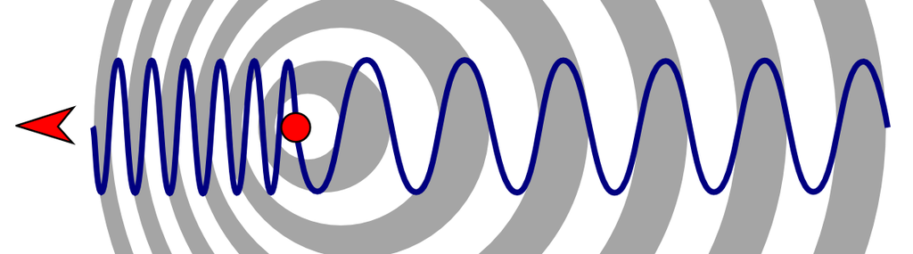
Electromagnetic Waves
The Doppler Effect
Wavelength change due to the motion of source
Free to share, print, make copies and changes. Get yours at www.boundless.com
Wikipedia. "Doppler effect diagrammatic." CC BY-SA http://en.wikipedia.org/wiki/File:Doppler_effect_diagrammatic.png View on Boundless.com

Slide 24
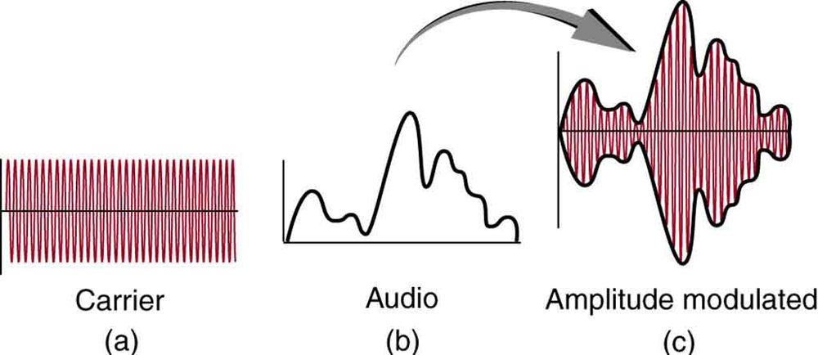
Electromagnetic Waves
AM Radio
Amplitude modulation for AM radio. (a) A carrier wave at the station's basic frequency. (b) An audio signal at much lower audible frequencies. (c) The amplitude of the carrier is modulated by the audio signal without changing its basic frequency.
Free to share, print, make copies and changes. Get yours at www.boundless.com
OpenStax CNX. "OpenStax College, College Physics. December 17, 2012." CC BY 3.0 http://cnx.org/content/m42444/latest/?collection=col11406/1.7 View on Boundless.com

Slide 25
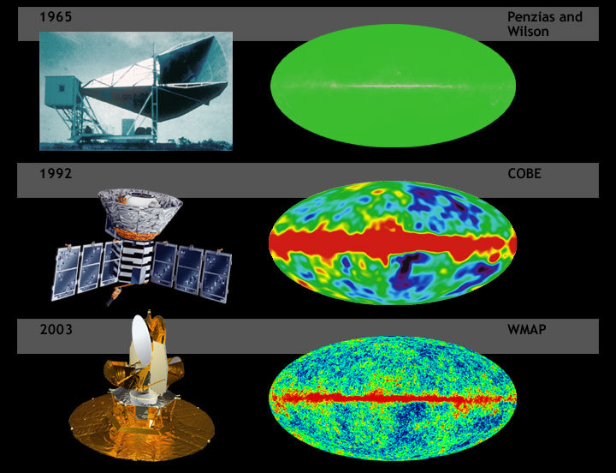
Electromagnetic Waves
Cosmic Microwave Background
Cosmic background radiation of the Big Bang mapped with increasing resolution.
Free to share, print, make copies and changes. Get yours at www.boundless.com
Wikipedia. "Microwaves." Public domain http://en.wikipedia.org/wiki/Microwaves View on Boundless.com

Slide 26
Electromagnetic Waves
Light Going from Earth to the Moon
A beam of light is depicted travelling between the Earth and the Moon in the time it takes a light pulse to move between them: 1.255 seconds at their mean orbital (surface-to-surface) distance. The relative sizes and separation of the Earth–Moon system are shown to scale.
Free to share, print, make copies and changes. Get yours at www.boundless.com
Wikipedia. "Speed of light." GNU FDL http://en.wikipedia.org/wiki/Speed_of_light View on Boundless.com

Slide 27
Electromagnetic Waves
Electromagnetic Spectrum
The electromagnetic spectrum, showing the major categories of electromagnetic waves. The range of frequencies and wavelengths is remarkable. The dividing line between some categories is distinct, whereas other categories overlap. Microwaves overlap with the high frequency portion of the radio section of the EM spectrum.
Free to share, print, make copies and changes. Get yours at www.boundless.com
OpenStax CNX. "OpenStax College, College Physics. December 17, 2012." CC BY 3.0 http://cnx.org/content/m42444/latest/?collection=col11406/1.7 View on Boundless.com

Slide 28
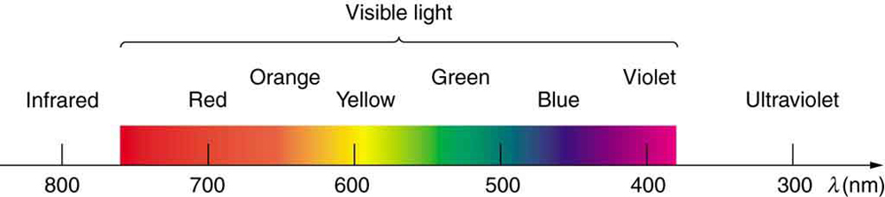
Electromagnetic Waves
Visible Spectrum
A small part of the electromagnetic spectrum that includes its visible components. The divisions between infrared, visible, and ultraviolet are not perfectly distinct, nor are those between the seven rainbow colors.
Free to share, print, make copies and changes. Get yours at www.boundless.com
OpenStax CNX. "OpenStax College, College Physics. December 19, 2012." CC BY 3.0 http://cnx.org/content/m42444/latest/?collection=col11406/1.7 View on Boundless.com

Slide 29
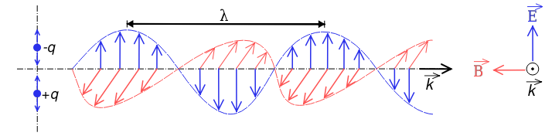
Electromagnetic Waves
Electromagnetic Wave
Electromagnetic waves are a self-propagating transverse wave of oscillating electric and magnetic fields. The direction of the electric field is indicated in blue, the magnetic field in red, and the wave propagates in the positive x-direction. Notice that the electric and magnetic field waves are in phase.
Free to share, print, make copies and changes. Get yours at www.boundless.com
Wikipedia. "Onde electromagnetique." CC BY-SA http://en.wikipedia.org/wiki/File:Onde_electromagnetique.svg View on Boundless.com

Slide 30
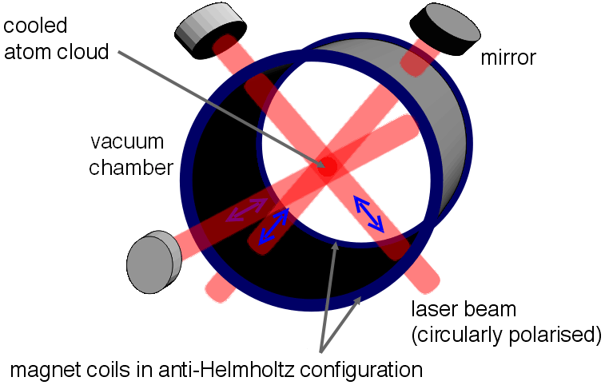
Electromagnetic Waves
The Magneto Optical Trap
Experimental setup of Magneto Optical Trap (MOT), which uses radiation pressure to cool atomic species. Atoms are slowed down by absorbing (and emitting) photons.
Free to share, print, make copies and changes. Get yours at www.boundless.com
Wikipedia. "Magneto-optical trap." CC BY http://en.wikipedia.org/wiki/Magneto-optical_trap View on Boundless.com

Slide 31
Electromagnetic Waves
Two cellular phones
The Qualcomm QCP-2700, a mid-1990s candybar style phone, and an iPhone 4S, a current production smartphone.
Free to share, print, make copies and changes. Get yours at www.boundless.com
Wikipedia. "Two Cell Phones." CC BY http://en.wikipedia.org/wiki/File:Two_Cell_Phones.png View on Boundless.com

Slide 32
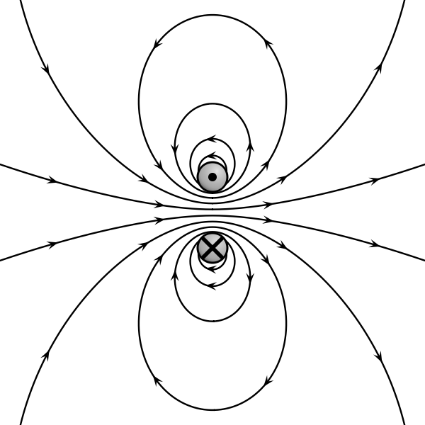
Electromagnetic Waves
Field lines caused by a magnetic dipole
The field lines created by this magnetic dipole either form loops or extend infinitely.
Free to share, print, make copies and changes. Get yours at www.boundless.com
Wikipedia. "VFPt dipole magnetic1." CC BY-SA http://en.wikipedia.org/wiki/File:VFPt_dipole_magnetic1.svg View on Boundless.com

Slide 33
Electromagnetic Waves
Electromagnetic Spectrum
The electromagnetic spectrum, showing the major categories of electromagnetic waves. The range of frequencies and wavelengths is remarkable. The dividing line between some categories is distinct, whereas other categories overlap. Microwaves encompass the high frequency portion of the radio section of the EM spectrum.
Free to share, print, make copies and changes. Get yours at www.boundless.com
OpenStax CNX. "OpenStax College, College Physics. April 28, 2014." CC BY 3.0 http://cnx.org/content/m42444/latest/?collection=col11406/1.7 View on Boundless.com

Slide 34
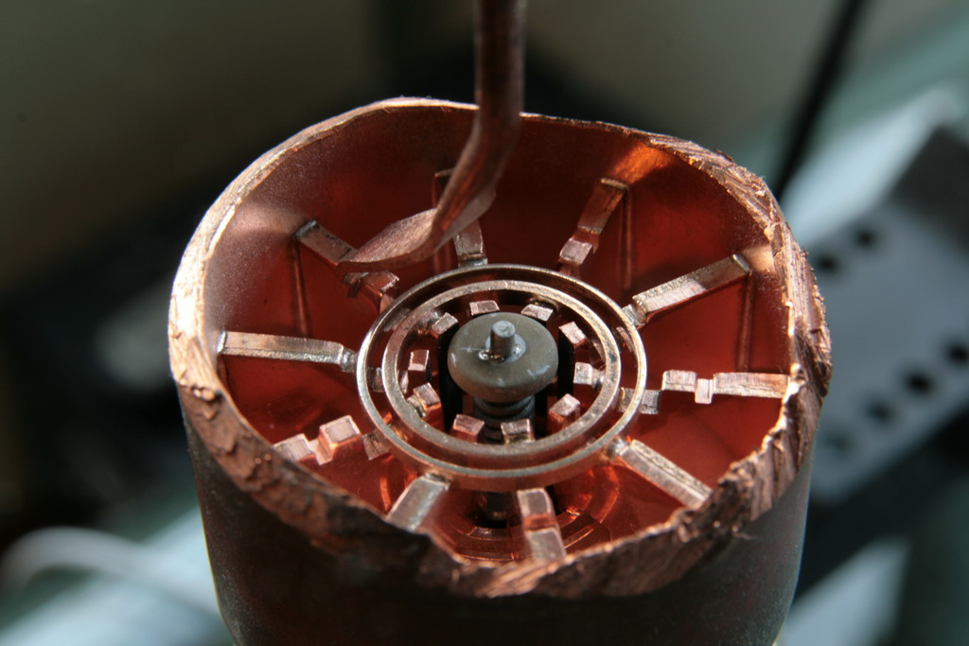
Electromagnetic Waves
Cavity Magnetron
Cutaway view inside a cavity magnetron as used in a microwave oven.
Free to share, print, make copies and changes. Get yours at www.boundless.com
Wikipedia. "Microwaves." GNU FDL http://en.wikipedia.org/wiki/Microwaves View on Boundless.com

Slide 35
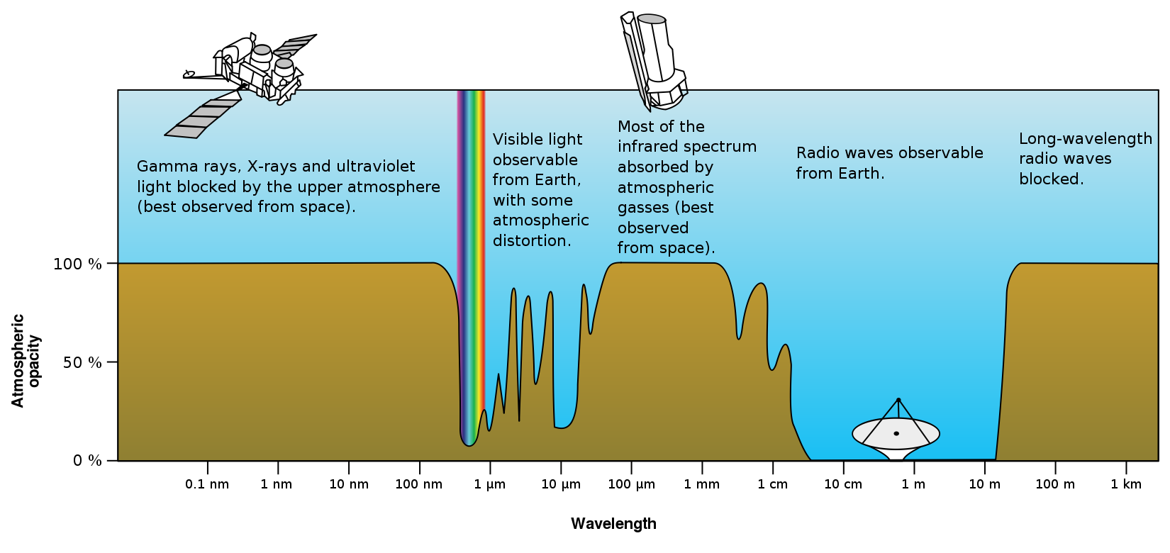
Electromagnetic Waves
Atmospheric Transmittance
This is a plot of Earth's atmospheric opacity (opposite of transmittance) to various wavelengths of electromagnetic radiation, including visible light. Visible light passes relatively unimpeded through the atmosphere in the "optical window." Most UV wavelengths are absorbed by oxygen and ozone in Earth's atmosphere. Observations of astronomical UV sources must be done from space.
Free to share, print, make copies and changes. Get yours at www.boundless.com
Wikipedia. "Electromagnetic spectrum." Public domain http://en.wikipedia.org/wiki/Electromagnetic_spectrum%23Microwaves View on Boundless.com

Slide 36
Electromagnetic Waves
Electromagnetic Spectrum
The electromagnetic spectrum, showing the major categories of electromagnetic waves. The range of frequencies and wavelengths is remarkable. The dividing line between some categories is distinct, whereas other categories overlap. Microwaves encompass the high frequency portion of the radio section of the EM spectrum.
Free to share, print, make copies and changes. Get yours at www.boundless.com
OpenStax CNX. "OpenStax College, College Physics. April 28, 2014." CC BY 3.0 http://cnx.org/content/m42444/latest/?collection=col11406/1.7 View on Boundless.com

Slide 37
Electromagnetic Waves
Atmospheric Transmittance
This is a plot of Earth's atmospheric transmittance (or opacity) to various wavelengths of electromagnetic radiation. Most UV wavelengths are absorbed by oxygen and ozone in Earth's atmosphere. Observations of astronomical UV sources must be done from space.
Free to share, print, make copies and changes. Get yours at www.boundless.com
Wikipedia. "Electromagnetic spectrum." Public domain http://en.wikipedia.org/wiki/Electromagnetic_spectrum%23Microwaves View on Boundless.com

Slide 38
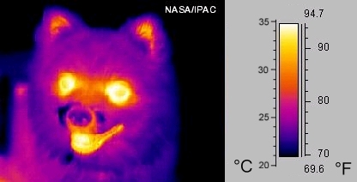
Electromagnetic Waves
Thermography
A thermographic image of a dog
Free to share, print, make copies and changes. Get yours at www.boundless.com
Wikipedia. "Infrared radiation." Public domain http://en.wikipedia.org/wiki/Infrared_radiation View on Boundless.com

Slide 39
Electromagnetic Waves
Atmospheric Transmittance
This is a plot of Earth's atmospheric transmittance (or opacity) to various wavelengths of electromagnetic radiation. Most UV wavelengths are absorbed by oxygen and ozone in Earth's atmosphere. Observations of astronomical UV sources must be done from space.
Free to share, print, make copies and changes. Get yours at www.boundless.com
Wikipedia. "Electromagnetic spectrum." Public domain http://en.wikipedia.org/wiki/Electromagnetic_spectrum%23Microwaves View on Boundless.com

Slide 40
Electromagnetic Waves
Electromagnetic Spectrum
The electromagnetic spectrum, showing the major categories of electromagnetic waves. The range of frequencies and wavelengths is remarkable. The dividing line between some categories is distinct, whereas other categories overlap. Microwaves encompass the high frequency portion of the radio section of the EM spectrum.
Free to share, print, make copies and changes. Get yours at www.boundless.com
OpenStax CNX. "OpenStax College, College Physics. April 28, 2014." CC BY 3.0 http://cnx.org/content/m42444/latest/?collection=col11406/1.7 View on Boundless.com

Slide 41
Electromagnetic Waves
Electromagnetic Spectrum
The electromagnetic spectrum, showing the major categories of electromagnetic waves. The range of frequencies and wavelengths is remarkable. The dividing line between some categories is distinct, whereas other categories overlap. Microwaves encompass the high frequency portion of the radio section of the EM spectrum.
Free to share, print, make copies and changes. Get yours at www.boundless.com
OpenStax CNX. "OpenStax College, College Physics. April 28, 2014." CC BY 3.0 http://cnx.org/content/m42444/latest/?collection=col11406/1.7 View on Boundless.com

Slide 42
Attribution
Electromagnetic Waves
Boundless Learning. "Boundless." CC BY-SA 3.0 http://www.boundless.com//physics/definition/doppler-effect--2
Wikipedia. "Doppler effect." CC BY-SA 3.0 http://en.wikipedia.org/wiki/Doppler_effect
Wiktionary. "radio wave." CC BY-SA 3.0 http://en.wiktionary.org/wiki/radio_wave
Wiktionary. "telecommunication." CC BY-SA 3.0 http://en.wiktionary.org/wiki/telecommunication
Wikipedia. "conductor." CC BY-SA 3.0 http://en.wikipedia.org/wiki/conductor
Wikipedia. "Wireless communication." CC BY-SA 3.0 http://en.wikipedia.org/wiki/Wireless_communication
Wikipedia. "Wireless communication." CC BY-SA 3.0 http://en.wikipedia.org/wiki/Wireless_communication
Wikipedia. "classical electrodynamics." CC BY-SA 3.0 http://en.wikipedia.org/wiki/classical%20electrodynamics
Boundless Learning. "Boundless." CC BY-SA 3.0 http://www.boundless.com//physics/definition/doppler-effect--2
Wikipedia. "Radiation pressure." CC BY-SA 3.0 http://en.wikipedia.org/wiki/Radiation_pressure
Wiktionary. "terahertz radiation." CC BY-SA 3.0 http://en.wiktionary.org/wiki/terahertz_radiation
Wiktionary. "radar." CC BY-SA 3.0 http://en.wiktionary.org/wiki/radar
Boundless Learning. "Boundless." CC BY-SA 3.0 http://www.boundless.com//physics/definition/thermal-agitation
OpenStax CNX. "OpenStax College, College Physics. September 18, 2013." CC BY 3.0 http://cnx.org/content/m42444/latest/?collection=col11406/1.7
Wikipedia. "Ultra high frequency." CC BY-SA 3.0 http://en.wikipedia.org/wiki/Ultra_high_frequency
Wikipedia. "Microwaves." CC BY-SA 3.0 http://en.wikipedia.org/wiki/Microwaves
Wikipedia. "Electromagnetic spectrum." CC BY-SA 3.0 http://en.wikipedia.org/wiki/Electromagnetic_spectrum
Free to share, print, make copies and changes. Get yours at www.boundless.com

Slide 43
Electromagnetic Waves
Wikipedia. "Super high frequency." CC BY-SA 3.0 http://en.wikipedia.org/wiki/Super_high_frequency
Wikipedia. "Extremely high frequency." CC BY-SA 3.0 http://en.wikipedia.org/wiki/Extremely_high_frequency
Boundless Learning. "Boundless." CC BY-SA 3.0 http://www.boundless.com//physics/definition/fm-radio-waves
Boundless Learning. "Boundless." CC BY-SA 3.0 http://www.boundless.com//physics/definition/am-radio-waves
Boundless Learning. "Boundless." CC BY-SA 3.0 http://www.boundless.com//physics/definition/radio-waves
Wikipedia. "Electromagnetic spectrum." CC BY-SA 3.0 http://en.wikipedia.org/wiki/Electromagnetic_spectrum
OpenStax CNX. "OpenStax College, College Physics. September 18, 2013." CC BY 3.0 http://cnx.org/content/m42444/latest/?collection=col11406/1.7
Wikipedia. "Radio frequency." CC BY-SA 3.0 http://en.wikipedia.org/wiki/Radio_frequency
Wikipedia. "Radio waves." CC BY-SA 3.0 http://en.wikipedia.org/wiki/Radio_waves
Wikipedia. "Radio spectrum." CC BY-SA 3.0 http://en.wikipedia.org/wiki/Radio_spectrum
Wiktionary. "X-ray spectroscopy." CC BY-SA 3.0 http://en.wiktionary.org/wiki/X-ray_spectroscopy
Wikipedia. "x-ray crystallography." CC BY-SA 3.0 http://en.wikipedia.org/wiki/x-ray%20crystallography
Wiktionary. "radiograph." CC BY-SA 3.0 http://en.wiktionary.org/wiki/radiograph
OpenStax CNX. "OpenStax College, College Physics. September 18, 2013." CC BY 3.0 http://cnx.org/content/m42444/latest/?collection=col11406/1.7
Wikipedia. "Electromagnetic spectrum." CC BY-SA 3.0 http://en.wikipedia.org/wiki/Electromagnetic_spectrum
Wikipedia. "X-rays." CC BY-SA 3.0 http://en.wikipedia.org/wiki/X-rays
Wiktionary. "ionizing radiation." CC BY-SA 3.0 http://en.wiktionary.org/wiki/ionizing_radiation
Wiktionary. "non-ionizing radiation." CC BY-SA 3.0 http://en.wiktionary.org/wiki/non-ionizing_radiation
Wiktionary. "ozone layer." CC BY-SA 3.0 http://en.wiktionary.org/wiki/ozone_layer
Free to share, print, make copies and changes. Get yours at www.boundless.com

Slide 44
Electromagnetic Waves
OpenStax CNX. "OpenStax College, College Physics. September 18, 2013." CC BY 3.0 http://cnx.org/content/m42444/latest/?collection=col11406/1.7
Wikipedia. "Electromagnetic spectrum." CC BY-SA 3.0 http://en.wikipedia.org/wiki/Electromagnetic_spectrum
Wiktionary. "gamma ray." CC BY-SA 3.0 http://en.wiktionary.org/wiki/gamma_ray
Wiktionary. "ionizing radiation." CC BY-SA 3.0 http://en.wiktionary.org/wiki/ionizing_radiation
Wiktionary. "gamma decay." CC BY-SA 3.0 http://en.wiktionary.org/wiki/gamma_decay
OpenStax CNX. "OpenStax College, College Physics. September 18, 2013." CC BY 3.0 http://cnx.org/content/m42444/latest/?collection=col11406/1.7
Wikipedia. "Electromagnetic spectrum." CC BY-SA 3.0 http://en.wikipedia.org/wiki/Electromagnetic_spectrum
Wikipedia. "Gamma rays." CC BY-SA 3.0 http://en.wikipedia.org/wiki/Gamma_rays
Wiktionary. "thermal radiation." CC BY-SA 3.0 http://en.wiktionary.org/wiki/thermal_radiation
Wiktionary. "thermography." CC BY-SA 3.0 http://en.wiktionary.org/wiki/thermography
Wiktionary. "emissivity." CC BY-SA 3.0 http://en.wiktionary.org/wiki/emissivity
OpenStax CNX. "OpenStax College, College Physics. September 18, 2013." CC BY 3.0 http://cnx.org/content/m42444/latest/?collection=col11406/1.7
Wikipedia. "Infrared radiation." CC BY-SA 3.0 http://en.wikipedia.org/wiki/Infrared_radiation
Wikipedia. "Electromagnetic spectrum." CC BY-SA 3.0 http://en.wikipedia.org/wiki/Electromagnetic_spectrum
Wiktionary. "differential equation." CC BY-SA 3.0 http://en.wiktionary.org/wiki/differential_equation
Wikipedia. "Maxwell's equations." CC BY-SA 3.0 http://en.wikipedia.org/wiki/Maxwell's_equations
Wiktionary. "flux." CC BY-SA 3.0 http://en.wiktionary.org/wiki/flux
Wiktionary. "frequency." CC BY-SA 3.0 http://en.wiktionary.org/wiki/frequency
Wiktionary. "wavelength." CC BY-SA 3.0 http://en.wiktionary.org/wiki/wavelength
Free to share, print, make copies and changes. Get yours at www.boundless.com

Slide 45
Electromagnetic Waves
Wikipedia. "photon." CC BY-SA 3.0 http://en.wikipedia.org/wiki/photon
Wikipedia. "Electromagnetic radiation." CC BY-SA 3.0 http://en.wikipedia.org/wiki/Electromagnetic_radiation
Wiktionary. "special relativity." CC BY-SA 3.0 http://en.wiktionary.org/wiki/special_relativity
Wiktionary. "refractive index." CC BY-SA 3.0 http://en.wiktionary.org/wiki/refractive_index
Wikipedia. "Speed of light." CC BY-SA 3.0 http://en.wikipedia.org/wiki/Speed_of_light
Wiktionary. "phase." CC BY-SA 3.0 http://en.wiktionary.org/wiki/phase
Wikipedia. "electromagnetic wave." CC BY-SA 3.0 http://en.wikipedia.org/wiki/electromagnetic%20wave
Wikipedia. "Electromagnetic radiation." CC BY-SA 3.0 http://en.wikipedia.org/wiki/Electromagnetic_radiation
Wiktionary. "visible light." CC BY-SA 3.0 http://en.wiktionary.org/wiki/visible_light
Wikipedia. "optical window." CC BY-SA 3.0 http://en.wikipedia.org/wiki/optical%20window
Wikipedia. "spectral color." CC BY-SA 3.0 http://en.wikipedia.org/wiki/spectral%20color
Wikipedia. "Electromagnetic spectrum." CC BY-SA 3.0 http://en.wikipedia.org/wiki/Electromagnetic_spectrum
OpenStax CNX. "OpenStax College, College Physics. September 18, 2013." CC BY 3.0 http://cnx.org/content/m42444/latest/?collection=col11406/1.7
Wikipedia. "Visible spectrum." CC BY-SA 3.0 http://en.wikipedia.org/wiki/Visible_spectrum
Wikipedia. "Spectral color." CC BY-SA 3.0 http://en.wikipedia.org/wiki/Spectral_color
Free to share, print, make copies and changes. Get yours at www.boundless.com

