Slide 1


Boundless Lecture Slides
Available on the Boundless Teaching Platform
Free to share, print, make copies and changes. Get yours at www.boundless.com

Slide 2
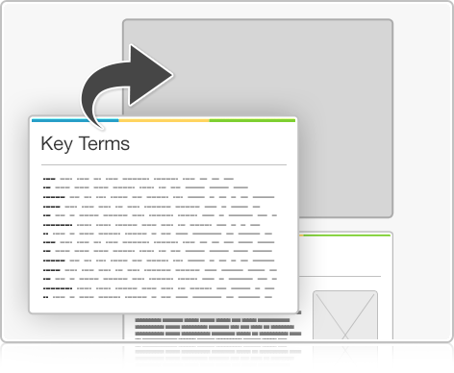


Using Boundless Presentations
Boundless Teaching Platform
Boundless empowers educators to engage their students with affordable, customizable textbooks and intuitive teaching tools. The free Boundless Teaching Platform gives educators the ability to customize textbooks in more than 20 subjects that align to hundreds of popular titles. Get started by using high quality Boundless books, or make switching to our platform easier by building from Boundless content pre-organized to match the assigned textbook. This platform gives educators the tools they need to assign readings and assessments, monitor student activity, and lead their classes with pre-made teaching resources.
Get started now at:
The Appendix
The appendix is for you to use to add depth and breadth to your lectures. You can simply drag and drop slides from the appendix into the main presentation to make for a richer lecture experience.
http://boundless.com/teaching-platform
Free to edit, share, and copy
Feel free to edit, share, and make as many copies of the Boundless presentations as you like. We encourage you to take these presentations and make them your own.
If you have any questions or problems please email:
educators@boundless.com
Free to share, print, make copies and changes. Get yours at www.boundless.com

Slide 3

About Boundless
Boundless is an innovative technology company making education more affordable and accessible for students everywhere. The company creates the world’s best open educational content in 20+ subjects that align to more than 1,000 popular college textbooks. Boundless integrates learning technology into all its premium books to help students study more efficiently at a fraction of the cost of traditional textbooks. The company also empowers educators to engage their students more effectively through customizable books and intuitive teaching tools as part of the Boundless Teaching Platform. More than 2 million learners access Boundless free and premium content each month across the company’s wide distribution platforms, including its website, iOS apps, Kindle books, and iBooks. To get started learning or teaching with Boundless, visit boundless.com.
Free to share, print, make copies and changes. Get yours at www.boundless.com

Slide 4
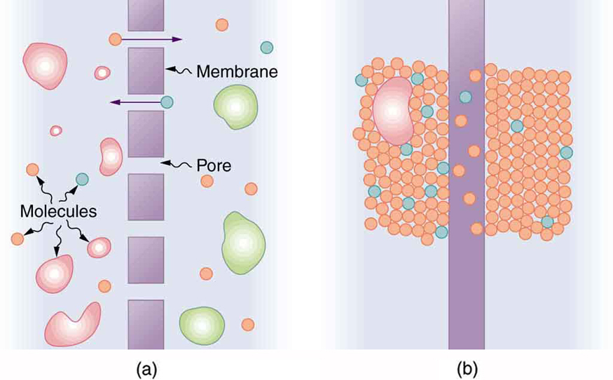
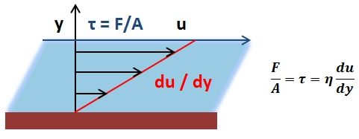
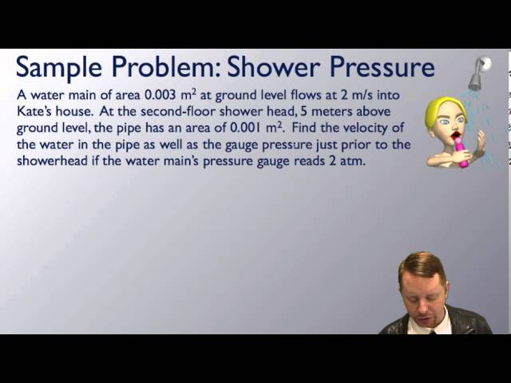
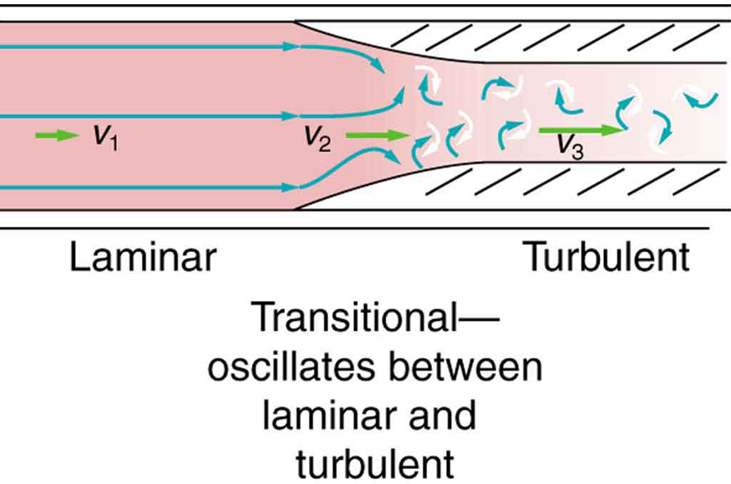

Fluid Dynamics and Its Applications
Overview
Flow in Tubes
Bernoulli's Equation
Other Applications
]
Fluid Dynamics and Its Applications
Free to share, print, make copies and changes. Get yours at www.boundless.com

Slide 5

Overview
Fluid Dynamics and Its Applications > Overview
Biological and Medical Applications
Flow Rate and Velocity
Free to share, print, make copies and changes. Get yours at www.boundless.com
www.boundless.com/physics/textbooks/boundless-physics-textbook/fluid-dynamics-and-its-applications-11/overview-97/

Slide 6
Flow in Tubes
Fluid Dynamics and Its Applications > Flow in Tubes
Poiseuille's Equation and Viscosity
Blood Flow
Free to share, print, make copies and changes. Get yours at www.boundless.com
www.boundless.com/physics/textbooks/boundless-physics-textbook/fluid-dynamics-and-its-applications-11/flow-in-tubes-98/

Slide 7
Bernoulli's Equation
Fluid Dynamics and Its Applications > Bernoulli's Equation
Application of Bernoulli's Equation: Pressure and Speed
Torricelli's Law
Surface Tension
Free to share, print, make copies and changes. Get yours at www.boundless.com
www.boundless.com/physics/textbooks/boundless-physics-textbook/fluid-dynamics-and-its-applications-11/bernoulli-s-equation-99/

Slide 8
Other Applications
Fluid Dynamics and Its Applications > Other Applications
Turbulence Explained
Motionof an Object in a Viscous Field
Molecular Transport Phenomena
Pumps and the Heart
Free to share, print, make copies and changes. Get yours at www.boundless.com
www.boundless.com/physics/textbooks/boundless-physics-textbook/fluid-dynamics-and-its-applications-11/other-applications-100/

Slide 9
Appendix
Free to share, print, make copies and changes. Get yours at www.boundless.com

Slide 10
Key terms
Fluid Dynamics and Its Applications
adhesion The ability of a substance to stick to an unlike substance.
atrium An upper chamber of the heart that receives blood from the veins and forces it into a ventricle. In higher vertebrates, the right atrium receives blood from the superior vena cava and inferior vena cava, and the left atrium receives blood from the left and right pulmonary veins.
cohesion Various intermolecular forces that hold solids and liquids together.
contraction A reversible reduction in size.
dialysis A method of separating molecules or particles of different sizes by differential diffusion through a semipermeable membrane.
diastole The phase or process of relaxation and dilation of the heart chambers, between contractions, during which they fill with blood; an instance of the process.
diffusion the intermingling of the molecules of a fluid due to random thermal agitation
Ideal Fluid An inviscid and incompressible fluid
incompressible Unable to be compressed or condensed.
inviscid A fluid with zero viscosity (internal friction). In reality viscosity is always present. However, it is often very small compared with other forces (e.g. gravity, pressure) and for common fluids (water and air) the fluid can be approximated as having zero viscosity.
laminar Of fluid motion, smooth and regular, flowing as though in different layers.
Laminar Flow Non-turbulent motion of a fluid in which parallel layers have different velocities relative to each other.
Free to share, print, make copies and changes. Get yours at www.boundless.com

Slide 11
Fluid Dynamics and Its Applications
osmosis The net movement of solvent molecules from a region of high solvent potential to a region of lower solvent potential through a partially permeable membrane.
Reynolds Number A dimensionless number, v ρ l /η, where v is the fluid velocity, ρ the density, η the viscosity and l a dimension of the system. The value of the number indicates the type of fluid flow.
shear stress The external force acting on an object or surface parallel to the slope or plane in which it lies; the stress tending to produce shear.
streamlined Designed to offer little resistance to the flow of fluid, especially by having sleek, graceful lines.
systole The rhythmic contraction of the heart, by which blood is driven through the arteries.
turbulence Disturbance in a gas or fluid, characterized by evidence of internal motion or unrest.
turbulent Being in, or causing, disturbance or unrest.
Turbulent Flow The motion of a fluid having local velocities and pressures that fluctuate randomly.
vascular Of, pertaining to, or containing vessels that conduct or circulate fluids (such as blood, lymph, or sap) through the body of an animal or plant.
ventricle One of two lower chambers of the heart.
vessel A tube or canal that carries fluid in an animal or plant.
viscosity A quantity expressing the magnitude of internal friction in a fluid, as measured by the force per unit area resisting uniform flow.
Free to share, print, make copies and changes. Get yours at www.boundless.com

Slide 12
Fluid Dynamics and Its Applications
viscosity A quantity expressing the magnitude of internal friction in a fluid, as measured by the force per unit area resisting uniform flow.
viscosity The property of a fluid that resists the force which tends to cause it to flow.
wettability The ability of a solid surface to reduce the surface tension of a liquid in contact with it such that it spreads over the surface and wets it.
Free to share, print, make copies and changes. Get yours at www.boundless.com

Slide 13


Fluid Dynamics and Its Applications
Volumetric Flow Rate
Volumetric Flow Rate Surface Integral and its simplification
Free to share, print, make copies and changes. Get yours at www.boundless.com
http://N/A. CC BY-SA 3.0 http://N/A View on Boundless.com

Slide 14
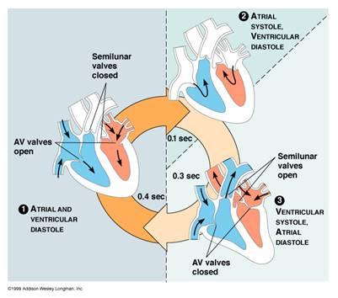
Fluid Dynamics and Its Applications
Cardiac Cycle
The heart pumps blood through the body.
Free to share, print, make copies and changes. Get yours at www.boundless.com
OpenStax CNX. "Daniel Williamson, 2.3.1 Blood Circulatory System. February 16, 2013." CC BY 3.0 http://cnx.org/content/m43150/latest/ View on Boundless.com

Slide 15
Fluid Dynamics and Its Applications
Toricelli's Law
The exit velocity depends on the height of the fluid above the exit hole.
Free to share, print, make copies and changes. Get yours at www.boundless.com
Wikimedia. Public domain http://upload.wikimedia.org/wikipedia/commons/thumb/5/5b/TorricelliLaw.svg/200px-TorricelliLaw.svg.png View on Boundless.com

Slide 16
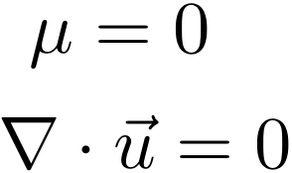
Fluid Dynamics and Its Applications
Ideal Fluid
Applies to an ideal fluid (inviscid, incompressible)
Free to share, print, make copies and changes. Get yours at www.boundless.com
Amazon Web Services. "Boundless." Public domain http://s3.amazonaws.com/figures.boundless.com/5106d670e4b010f3dd6d22de/ideal.png View on Boundless.com

Slide 17

Fluid Dynamics and Its Applications
Poiseuille's Equation
Can be used to determine the pressure drop of a constant viscosity fluid exhibiting laminar flow through a rigid pipe.
Free to share, print, make copies and changes. Get yours at www.boundless.com
http://N/A. CC BY-SA 3.0 http://N/A View on Boundless.com

Slide 18
Fluid Dynamics and Its Applications
Turbulent Flow in an Artery
Flow is laminar in the large part of this blood vessel and turbulent in the part narrowed by plaque, where velocity is high. In the transition region, the flow can oscillate chaotically between laminar and turbulent flow.
Free to share, print, make copies and changes. Get yours at www.boundless.com
OpenStax CNX. "OpenStax College, The Onset of Turbulence. February 16, 2013." CC BY 3.0 http://cnx.org/content/m42210/latest/ View on Boundless.com

Slide 19
Fluid Dynamics and Its Applications
A Semipermeable Membrane
A semipermeable membrane with small pores that allow only small molecules to pass through.
Free to share, print, make copies and changes. Get yours at www.boundless.com
OpenStax CNX. "OpenStax College, College Physics. March 2, 2013." CC BY 3.0 http://cnx.org/content/m42212/latest/?collection=col11406/1.7 View on Boundless.com

Slide 20

Fluid Dynamics and Its Applications
Flow Velocity
Mathematical Expression for Flow Velocity
Free to share, print, make copies and changes. Get yours at www.boundless.com
http://N/A. CC BY-SA 3.0 http://N/A View on Boundless.com

Slide 21
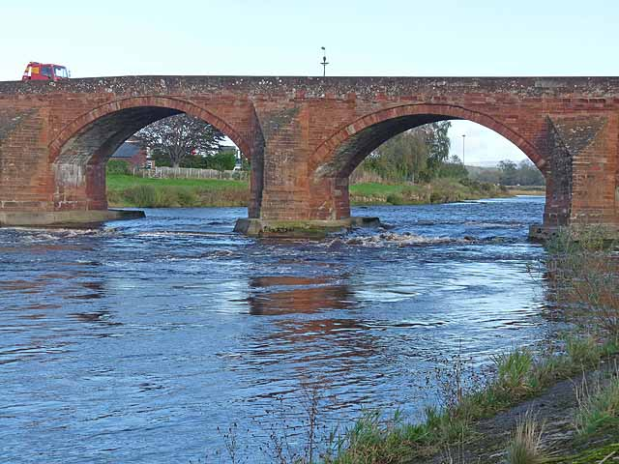
Fluid Dynamics and Its Applications
Longtown Bridge
Turbulent flow is visible around the bridge supports of the Longtown bridge.
Free to share, print, make copies and changes. Get yours at www.boundless.com
Geograph. "Longtown Bridge (C) Oliver Dixon :: Geograph Britain and Ireland." CC BY http://www.geograph.org.uk/photo/2638153 View on Boundless.com

Slide 22

Fluid Dynamics and Its Applications
Exchange of Energy
Potential energy at the top of the reservoir becomes kinetic energy at the exit.
Free to share, print, make copies and changes. Get yours at www.boundless.com
Amazon Web Services. "Boundless." Public domain http://s3.amazonaws.com/figures.boundless.com/5106d406e4b010f3dd6d22c1/peke.png View on Boundless.com

Slide 23
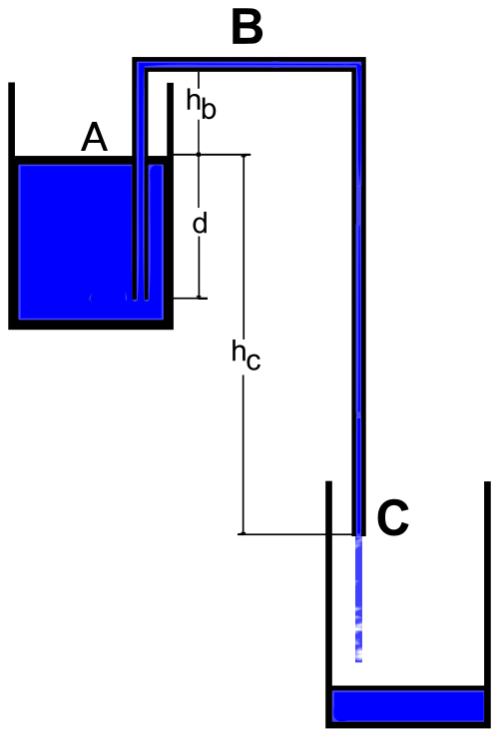
Fluid Dynamics and Its Applications
Syphoning
Syphoning fluid between two reservoirs. The flow rate out can be determined by drawing a streamline from point ( A ) to point ( C ).
Free to share, print, make copies and changes. Get yours at www.boundless.com
Wikimedia. "Syphoning2." Public domain http://commons.wikimedia.org/wiki/File:Syphoning2.svg View on Boundless.com

Slide 24
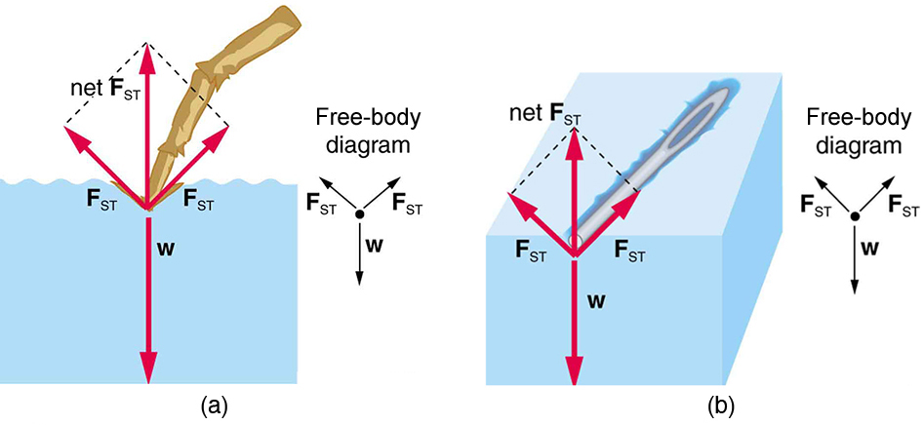
Fluid Dynamics and Its Applications
Surface Tension FBD
Force diagrams showing the direction of forces for water supporting a water strider (insect) foot and a pin. In both cases, the vertical component of the surface tension is enough to support the weight of the object.
Free to share, print, make copies and changes. Get yours at www.boundless.com
OpenStax CNX. "Erik Christensen, College Physics II. February 5, 2013." CC BY 3.0 http://cnx.org/content/m42197/latest/?collection=col11458/1.2 View on Boundless.com

Slide 25
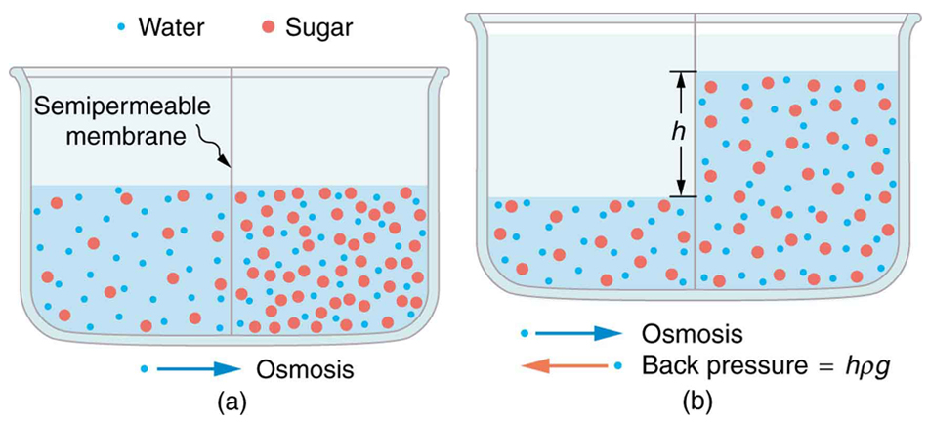
Fluid Dynamics and Its Applications
Diffusion
(a) Two sugar-water solutions of different concentrations, separated by a semipermeable membrane that passes water but not sugar. Osmosis will be to the right, since water is less concentrated there. (b) The fluid level rises until the back pressure ρgh equals the relative osmotic pressure; then, the net transfer of water is zero.
Free to share, print, make copies and changes. Get yours at www.boundless.com
OpenStax CNX. "OpenStax College, Molecular Transport Phenomena: Diffusion, Osmosis, and Related Processes. February 16, 2013." CC BY 3.0 http://cnx.org/content/m42212/latest/ View on Boundless.com

Slide 26

Fluid Dynamics and Its Applications
Poiseuille's Equation
Analogous to Ohm's Law Analogy
Free to share, print, make copies and changes. Get yours at www.boundless.com
http://N/A. CC BY-SA 3.0 http://N/A View on Boundless.com

Slide 27
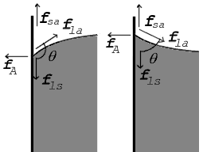
Fluid Dynamics and Its Applications
Contact Angle
The contact angle is the angle, measured in the fluid, that results when a liquid-gas interface, meets a solid surface.
Free to share, print, make copies and changes. Get yours at www.boundless.com
Wikipedia. "SurfTensionContactAngle." Public domain http://en.wikipedia.org/wiki/File:SurfTensionContactAngle.png View on Boundless.com

Slide 28
Fluid Dynamics and Its Applications
Bernoulli's Principle
A brief introduction to Bernoulli's Principle for students studying fluids.
Free to share, print, make copies and changes. Get yours at www.boundless.com
View on Boundless.com

Slide 29
Fluid Dynamics and Its Applications
Torricelli's Principle
A brief introduction to Torricelli's Principle for students studying fluids.
Free to share, print, make copies and changes. Get yours at www.boundless.com
View on Boundless.com

Slide 30
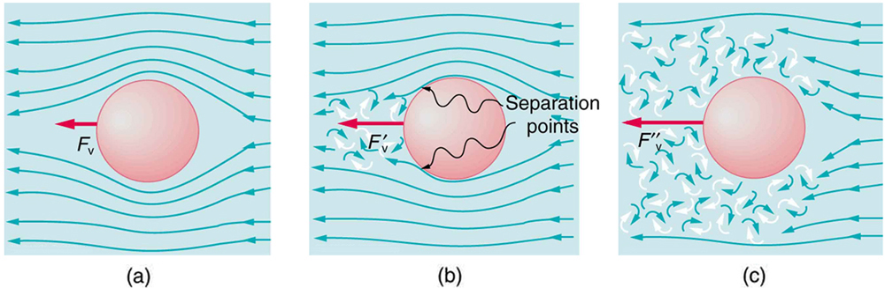
Fluid Dynamics and Its Applications
Motion of an object in a viscous fluid.
(a) Motion of this sphere to the right is equivalent to fluid flow to the left. Here the flow is laminar with N′R less than 1. There is a force, called viscous drag FV, to the left on the ball due to the fluid's viscosity. (b) At a higher speed, the flow becomes partially turbulent, creating a wake starting where the flow lines separate from the surface. Pressure in the wake is less than in front of the sphere, because fluid speed is less, creating a net force to the left F′V that is significantly greater than for laminar flow. Here N′R is greater than 10. (c) At much higher speeds, where N′R is greater than 10^6, flow becomes turbulent everywhere on the surface and behind the sphere. Drag increases dramatically.
Free to share, print, make copies and changes. Get yours at www.boundless.com
OpenStax CNX. "OpenStax College, Motion of an Object in a Viscous Fluid. February 16, 2013." CC BY 3.0 http://cnx.org/content/m42211/latest/ View on Boundless.com

Slide 31
Fluid Dynamics and Its Applications
An illustrative overview of the mammalian cardiovascular system
Keep in mind that both circular paths are working simultaneously and not in a sequential manner as the numbering in the illustration might suggest. Both the ventricles are working together in harmony; as tiny amounts of blood are moving in the pulmonary circuit, the remainder of the blood moves through the systemic circuit.
Free to share, print, make copies and changes. Get yours at www.boundless.com
Wikimedia. "Circulatory System en." Public domain http://commons.wikimedia.org/wiki/File:Circulatory_System_en.svg View on Boundless.com

Slide 32
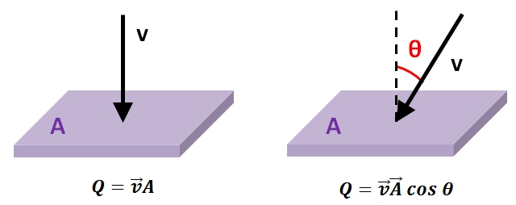
Fluid Dynamics and Its Applications
Flow Velocity - Volumetric Flow Rate Relation
This figure shows the relation between flow velocity and volumetric flow rate.
Free to share, print, make copies and changes. Get yours at www.boundless.com
http://N/A. CC BY-SA 3.0 http://N/A View on Boundless.com

Slide 33
Fluid Dynamics and Its Applications
Representation of Viscosity
A proportionality constant relating an applied shear stress to the resulting shear velocity.
Free to share, print, make copies and changes. Get yours at www.boundless.com
http://N/A. CC BY-SA 3.0 http://N/A View on Boundless.com

Slide 34
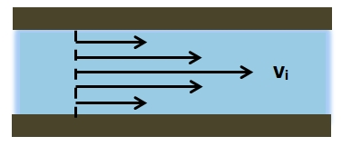
Fluid Dynamics and Its Applications
Relative Magnitudes of Velocity Vectors
Laminar fluid flow in a circular pipe at the same direction.
Free to share, print, make copies and changes. Get yours at www.boundless.com
http://N/A. CC BY-SA 3.0 http://N/A View on Boundless.com

Slide 35
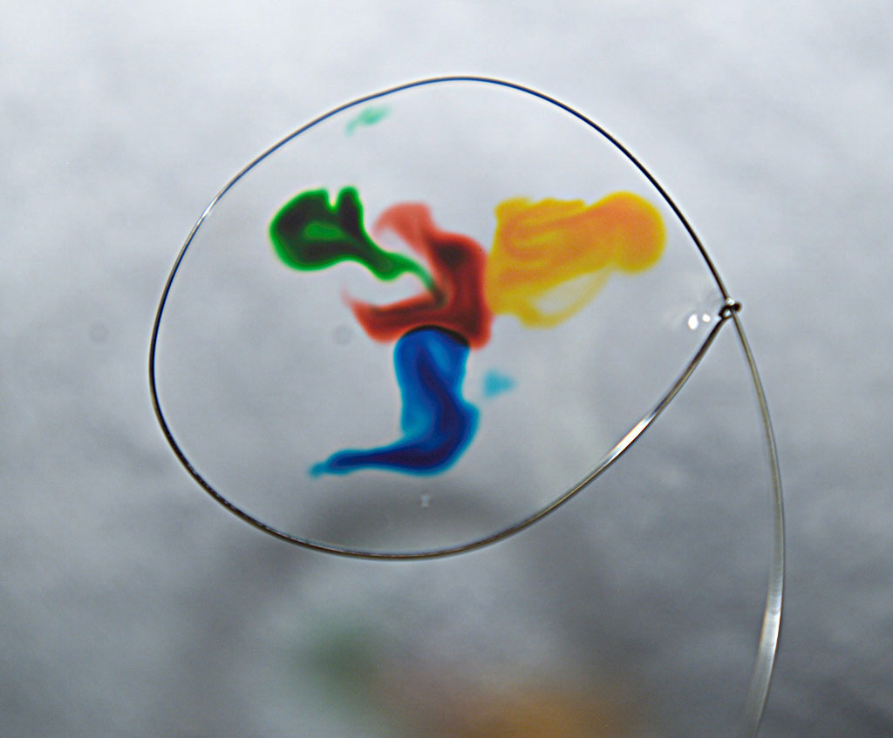
Fluid Dynamics and Its Applications
Food Coloring
Food coloring spreading on a thin water film.
Free to share, print, make copies and changes. Get yours at www.boundless.com
Wikipedia. "Food coloring." CC BY http://en.wikipedia.org/wiki/Food_coloring View on Boundless.com

Slide 36
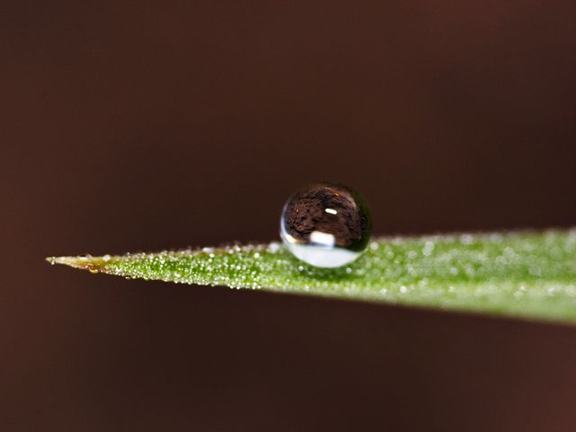
Fluid Dynamics and Its Applications
Water Droplet on Leaf
When a water droplet forms on a leaf, the cohesive forces between the water molecules are greater than the adhesive forces between the water and leaf surface. The leaf is a hydrophobic surface.
Free to share, print, make copies and changes. Get yours at www.boundless.com
Wikipedia. "Dew 2." GNU FDL http://en.wikipedia.org/wiki/File:Dew_2.jpg View on Boundless.com

Slide 37
Attribution
Fluid Dynamics and Its Applications
Wiktionary. "contraction." CC BY-SA 3.0 http://en.wiktionary.org/wiki/contraction
Wiktionary. "ventricle." CC BY-SA 3.0 http://en.wiktionary.org/wiki/ventricle
Wiktionary. "atrium." CC BY-SA 3.0 http://en.wiktionary.org/wiki/atrium
OpenStax CNX. "Daniel Williamson, 2.3.1 Blood Circulatory System. September 17, 2013." CC BY 3.0 http://cnx.org/content/m43150/latest/
Wiktionary. "wettability." CC BY-SA 3.0 http://en.wiktionary.org/wiki/wettability
Wiktionary. "adhesion." CC BY-SA 3.0 http://en.wiktionary.org/wiki/adhesion
Wiktionary. "cohesion." CC BY-SA 3.0 http://en.wiktionary.org/wiki/cohesion
Wikipedia. "Surface tension." CC BY-SA 3.0 http://en.wikipedia.org/wiki/Surface_tension%23Effects_of_surface_tension
Boundless Learning. "Boundless." CC BY-SA 3.0 http://www.boundless.com//physics/definition/inviscid
Wiktionary. "viscosity." CC BY-SA 3.0 http://en.wiktionary.org/wiki/viscosity
Wiktionary. "incompressible." CC BY-SA 3.0 http://en.wiktionary.org/wiki/incompressible
Boundless Learning. "Boundless." CC BY-SA 3.0 http://www.boundless.com//physics/definition/ideal-fluid
Boundless Learning. "Boundless." CC BY-SA 3.0 http://www.boundless.com//physics/definition/laminar-flow
Boundless Learning. "Boundless." CC BY-SA 3.0 http://www.boundless.com//physics/definition/turbulent-flow
Wikipedia. "Volumetric flow rate." CC BY-SA 3.0 http://en.wikipedia.org/wiki/Volumetric_flow_rate
Wikipedia. "Flow measurement." CC BY-SA 3.0 http://en.wikipedia.org/wiki/Flow_measurement
Wikipedia. "Flow measurement)." CC BY-SA 3.0 http://en.wikipedia.org/wiki/Flow_measurement)
Free to share, print, make copies and changes. Get yours at www.boundless.com

Slide 38
Fluid Dynamics and Its Applications
Wiktionary. "shear stress." CC BY-SA 3.0 http://en.wiktionary.org/wiki/shear_stress
Boundless Learning. "Boundless." CC BY-SA 3.0 http://www.boundless.com//physics/definition/reynolds-number
Wiktionary. "viscosity." CC BY-SA 3.0 http://en.wiktionary.org/wiki/viscosity
Wikipedia. "Poiseuille." CC BY-SA 3.0 http://en.wikipedia.org/wiki/Poiseuille
Wikipedia. "Laminar flow." CC BY-SA 3.0 http://en.wikipedia.org/wiki/Laminar_flow
Wikipedia. "Viscosity." CC BY-SA 3.0 http://en.wikipedia.org/wiki/Viscosity
Wikipedia. "Poiseuille." CC BY-SA 3.0 http://en.wikipedia.org/wiki/Poiseuille
Wiktionary. "streamlined." CC BY-SA 3.0 http://en.wiktionary.org/wiki/streamlined
Wiktionary. "turbulent." CC BY-SA 3.0 http://en.wiktionary.org/wiki/turbulent
Wiktionary. "laminar." CC BY-SA 3.0 http://en.wiktionary.org/wiki/laminar
OpenStax CNX. "OpenStax College, The Onset of Turbulence. September 17, 2013." CC BY 3.0 http://cnx.org/content/m42210/latest/
Wikipedia. "Turbulence." CC BY-SA 3.0 http://en.wikipedia.org/wiki/Turbulence%23Examples_of_turbulence
Wikipedia. "Turbulence." CC BY-SA 3.0 http://en.wikipedia.org/wiki/Turbulence%23Examples_of_turbulence
Boundless Learning. "Boundless." CC BY-SA 3.0 http://www.boundless.com//biology/definition/diffusion
OpenStax CNX. "OpenStax College, Molecular Transport Phenomena: Diffusion, Osmosis, and Related Processes. September 17, 2013." CC BY 3.0 http://cnx.org/content/m42212/latest/
Wikipedia. "dialysis." CC BY-SA 3.0 http://en.wikipedia.org/wiki/dialysis
Wiktionary. "osmosis." CC BY-SA 3.0 http://en.wiktionary.org/wiki/osmosis
Wiktionary. "vascular." CC BY-SA 3.0 http://en.wiktionary.org/wiki/vascular
Wikipedia. "Haemodynamics." CC BY-SA 3.0 http://en.wikipedia.org/wiki/Haemodynamics
Free to share, print, make copies and changes. Get yours at www.boundless.com

Slide 39
Fluid Dynamics and Its Applications
OpenStax CNX. "OpenStax College, College Physics. September 17, 2013." CC BY 3.0 http://cnx.org/content/m42212/latest/?collection=col11406/1.7
OpenStax CNX. "OpenStax College, College Physics. September 17, 2013." CC BY 3.0 http://cnx.org/content/m42212/latest/?collection=col11406/1.7
OpenStax CNX. "OpenStax College, Introduction to Fluid Dynamics and Its Biological and Medical Applications. September 17, 2013." CC BY 3.0 http://cnx.org/content/m42204/latest/
Wiktionary. "vessel." CC BY-SA 3.0 http://en.wiktionary.org/wiki/vessel
Wiktionary. "systole." CC BY-SA 3.0 http://en.wiktionary.org/wiki/systole
Wiktionary. "diastole." CC BY-SA 3.0 http://en.wiktionary.org/wiki/diastole
Wikipedia. "Blood flow." CC BY-SA 3.0 http://en.wikipedia.org/wiki/Blood_flow
Wiktionary. "turbulence." CC BY-SA 3.0 http://en.wiktionary.org/wiki/turbulence
Wiktionary. "viscosity." CC BY-SA 3.0 http://en.wiktionary.org/wiki/viscosity
Wikipedia. "Viscous." CC BY-SA 3.0 http://en.wikipedia.org/wiki/Viscous%23Newtonian_and_non-Newtonian_fluids
OpenStax CNX. "OpenStax College, Motion of an Object in a Viscous Fluid. September 18, 2013." CC BY 3.0 http://cnx.org/content/m42211/latest/
Free to share, print, make copies and changes. Get yours at www.boundless.com

