Slide 1


Boundless Lecture Slides
Available on the Boundless Teaching Platform
Free to share, print, make copies and changes. Get yours at www.boundless.com

Slide 2



Using Boundless Presentations
Boundless Teaching Platform
Boundless empowers educators to engage their students with affordable, customizable textbooks and intuitive teaching tools. The free Boundless Teaching Platform gives educators the ability to customize textbooks in more than 20 subjects that align to hundreds of popular titles. Get started by using high quality Boundless books, or make switching to our platform easier by building from Boundless content pre-organized to match the assigned textbook. This platform gives educators the tools they need to assign readings and assessments, monitor student activity, and lead their classes with pre-made teaching resources.
Get started now at:
The Appendix
The appendix is for you to use to add depth and breadth to your lectures. You can simply drag and drop slides from the appendix into the main presentation to make for a richer lecture experience.
http://boundless.com/teaching-platform
Free to edit, share, and copy
Feel free to edit, share, and make as many copies of the Boundless presentations as you like. We encourage you to take these presentations and make them your own.
If you have any questions or problems please email:
educators@boundless.com
Free to share, print, make copies and changes. Get yours at www.boundless.com

Slide 3

About Boundless
Boundless is an innovative technology company making education more affordable and accessible for students everywhere. The company creates the world’s best open educational content in 20+ subjects that align to more than 1,000 popular college textbooks. Boundless integrates learning technology into all its premium books to help students study more efficiently at a fraction of the cost of traditional textbooks. The company also empowers educators to engage their students more effectively through customizable books and intuitive teaching tools as part of the Boundless Teaching Platform. More than 2 million learners access Boundless free and premium content each month across the company’s wide distribution platforms, including its website, iOS apps, Kindle books, and iBooks. To get started learning or teaching with Boundless, visit boundless.com.
Free to share, print, make copies and changes. Get yours at www.boundless.com

Slide 4
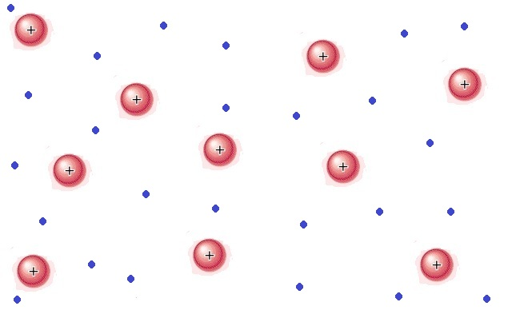
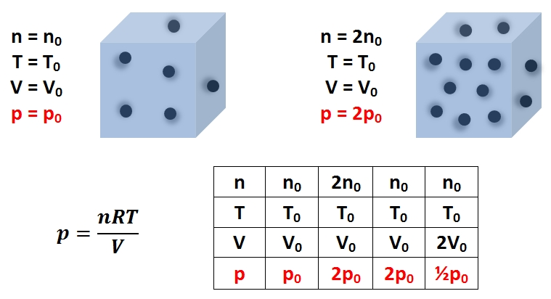
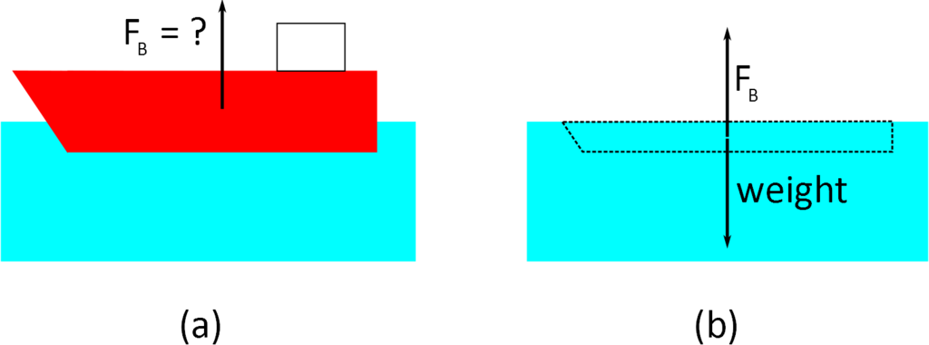
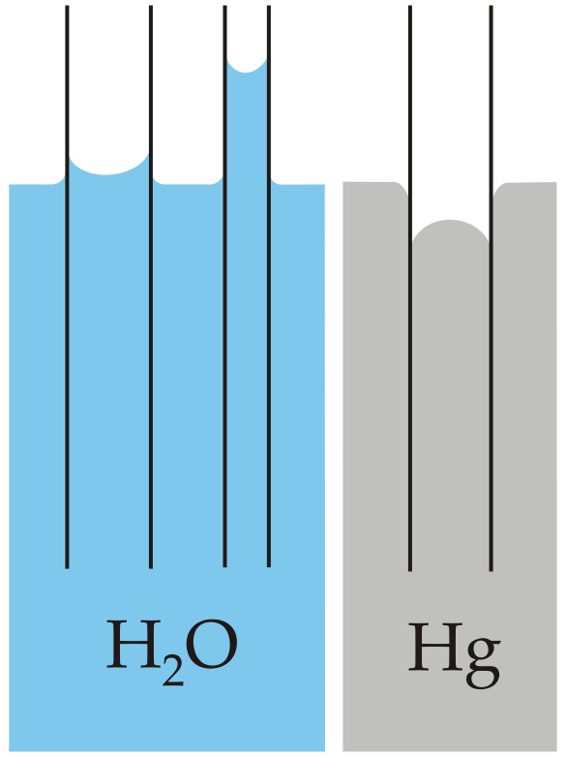
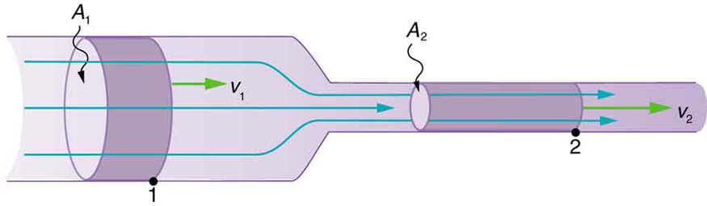

Fluids
Introduction
Density and Pressure
Archimedes' Principle
Cohesion and Adhesion
]
Fluids in Motion
Fluids
Free to share, print, make copies and changes. Get yours at www.boundless.com

Slide 5

Fluids (continued)
Deformation of Solids
]
Fluids
Free to share, print, make copies and changes. Get yours at www.boundless.com

Slide 6

Introduction
Fluids > Introduction
Phases of Matter
What is a Fluid?
Free to share, print, make copies and changes. Get yours at www.boundless.com
www.boundless.com/physics/textbooks/boundless-physics-textbook/fluids-10/introduction-91/

Slide 7
Density and Pressure
Fluids > Density and Pressure
Pressure
Variation of Pressure With Depth
Static Equilibrium
Pascal's Principle
Gauge Pressure and Atmospheric Pressure
Measurements: Gauge Pressure and the Barometer
Pressure in the Body
Free to share, print, make copies and changes. Get yours at www.boundless.com
www.boundless.com/physics/textbooks/boundless-physics-textbook/fluids-10/density-and-pressure-92/

Slide 8
Archimedes' Principle
Fluids > Archimedes' Principle
Buoyancy and Archimedes' Principle
Complete Submersion
Flotation
Free to share, print, make copies and changes. Get yours at www.boundless.com
www.boundless.com/physics/textbooks/boundless-physics-textbook/fluids-10/archimedes-principle-93/

Slide 9
Cohesion and Adhesion
Fluids > Cohesion and Adhesion
Surface Tension and Capillary Action
Free to share, print, make copies and changes. Get yours at www.boundless.com
www.boundless.com/physics/textbooks/boundless-physics-textbook/fluids-10/cohesion-and-adhesion-94/

Slide 10
Fluids in Motion
Fluids > Fluids in Motion
Flow Rate and the Equation of Continuity
Free to share, print, make copies and changes. Get yours at www.boundless.com
www.boundless.com/physics/textbooks/boundless-physics-textbook/fluids-10/fluids-in-motion-95/

Slide 11
Deformation of Solids
Fluids > Deformation of Solids
Length
Shape
Volume
Stress and Strain
Free to share, print, make copies and changes. Get yours at www.boundless.com
www.boundless.com/physics/textbooks/boundless-physics-textbook/fluids-10/deformation-of-solids-96/

Slide 12
Appendix
Free to share, print, make copies and changes. Get yours at www.boundless.com

Slide 13
Key terms
Fluids
Alveoli Small air sacs or cavities in the lung that give the tissue a honeycomb appearance and expand its surface area for the exchange of oxygen and carbon dioxide.
Aneroid Barometer A device for measuring pressure, often specially calibrated for use as an altimeter, consisting of a box or chamber partially exhausted of air, having an elastic top and a pointer to indicate the degree of compression of the top caused by the external air.
Archimedes principle The buoyant force exerted on a body immersed in a fluid is equal to the weight of the fluid the body displaces.
Archimedes principle The buoyant force exerted on a body immersed in a fluid is equal to the weight of the fluid the body displaces.
Archimedes principle The buoyant force exerted on a body immersed in a fluid is equal to the weight of the fluid the body displaces.
Buoyancy The power of supporting a body so that it floats; upward pressure exerted by the fluid in which a body is immersed.
buoyant force An upward force exerted by a fluid that opposes the weight of an immersed object.
continuity Lack of interruption or disconnection; the quality of being continuous in space or time.
coulomb's law the mathematical equation calculating the electrostatic force vector between two charged particles
cross section A section formed by a plane cutting through an object, usually at right angles to an axis.
dimension A measure of spatial extent in a particular direction, such as height, width or breadth, or depth.
dimension A measure of spatial extent in a particular direction, such as height, width or breadth, or depth.
Free to share, print, make copies and changes. Get yours at www.boundless.com

Slide 14
Fluids
enthalpy the total amount of energy in a system, including both the internal energy and the energy needed to displace its environment
equilibrium A state of rest or balance due to the equal action of opposing forces.
Euclidean Adhering to the principles of traditional geometry, in which parallel lines are equidistant.
fluidity A measure of the extent to which something is fluid. The reciprocal of its viscosity.
Gauge Pressure The pressure of a system above atmospheric pressure.
hydraulic press Device that uses a hydraulic cylinder (closed static fluid) to generate a compressive force.
ideal gas Theoretical gas characterized by random motion whose individual molecules do not interact with one another and are chemically inert.
incompressible Unable to be compressed or condensed.
incompressible Unable to be compressed or condensed.
intermolecular from one molecule to another; between molecules
kinetic energy The energy associated with a moving particle or object having a certain mass.
plane A level or flat surface.
Free to share, print, make copies and changes. Get yours at www.boundless.com

Slide 15
Fluids
plasma a state of matter consisting of partially ionized gas
Poiseuille’s Law The law that the velocity of a liquid flowing through a capillary is directly proportional to the pressure of the liquid and the fourth power of the radius of the capillary and is inversely proportional to the viscosity of the liquid and the length of the capillary.
Pressure the amount of force that is applied over a given area divided by the size of that area
shear stress The component of stress that causes parallel layers of a material to move relative to each other in their own planes.
special relativity A theory that (neglecting the effects of gravity) reconciles the principle of relativity with the observation that the speed of light is constant in all frames of reference.
static equilibrium the physical state in which all components of a system are at rest and the net force is equal to zero throughout the system
sublimation the transition of a substance from the solid phase directly to the vapor state such that it does not pass through the intermediate, liquid phase
Thoracic Cavity A hollow place or space, or a potential space, within the body or one of its organs.
torque Something that produces or tends to produce torsion or rotation; the moment of a force or system of forces tending to cause rotation.
Torr A unit of pressure equal to one millimeter of mercury (760 torr = 101,325 Pa).
vector field a construction in which each point in a Euclidean space is associated with a vector; a function whose range is a vector space
viscosity A quantity expressing the magnitude of internal friction in a fluid, as measured by the force per unit area resisting uniform flow.
Free to share, print, make copies and changes. Get yours at www.boundless.com

Slide 16
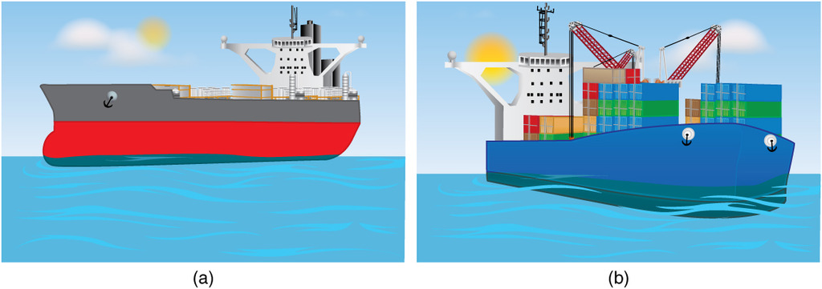

Fluids
Density and Submersion
An unloaded ship (a) floats higher in the water than a loaded ship (b).
Free to share, print, make copies and changes. Get yours at www.boundless.com
OpenStax CNX. "OpenStax College, College Physics. November 3, 2012." CC BY 3.0 http://cnx.org/content/m42196/latest/?collection=col11406/1.7 View on Boundless.com

Slide 17
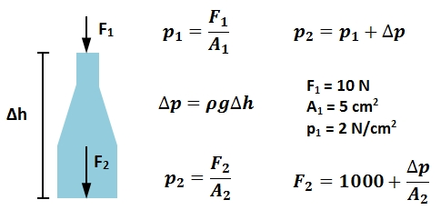
Fluids
Pressure Applied to a Hydrostatic Fluid
A downwards force of 10 N is applied to a bottle filled with a static liquid of constant density ρ at the spout of cross-sectional area of 5 cm2, yielding an applied pressure of 2 N/cm2.
Free to share, print, make copies and changes. Get yours at www.boundless.com
http://N/A. CC BY-SA 3.0 http://N/A View on Boundless.com

Slide 18

Fluids
Variation of Pressure with Height
The density of the liquid is p, g is the acceleration due to gravity, and h is the height of the fluid in the barometer column.
Free to share, print, make copies and changes. Get yours at www.boundless.com
http://N/A. CC BY-SA 3.0 http://N/A View on Boundless.com

Slide 19
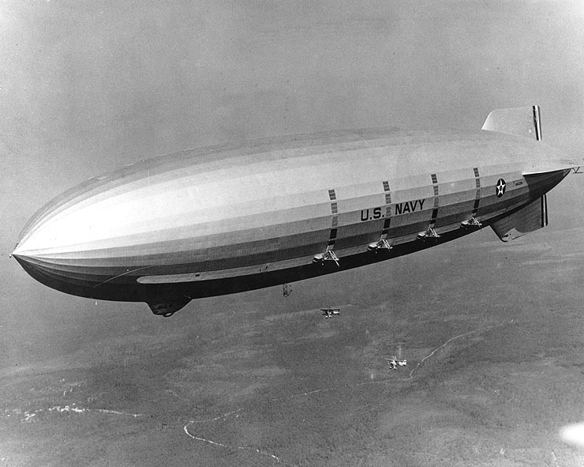
Fluids
Helium airship
The USS Macon, a 1930s helium-filled airship.
Free to share, print, make copies and changes. Get yours at www.boundless.com
Wikimedia. "USS Macon F9C." Public domain http://commons.wikimedia.org/wiki/File:USS_Macon_F9C.jpg View on Boundless.com

Slide 20
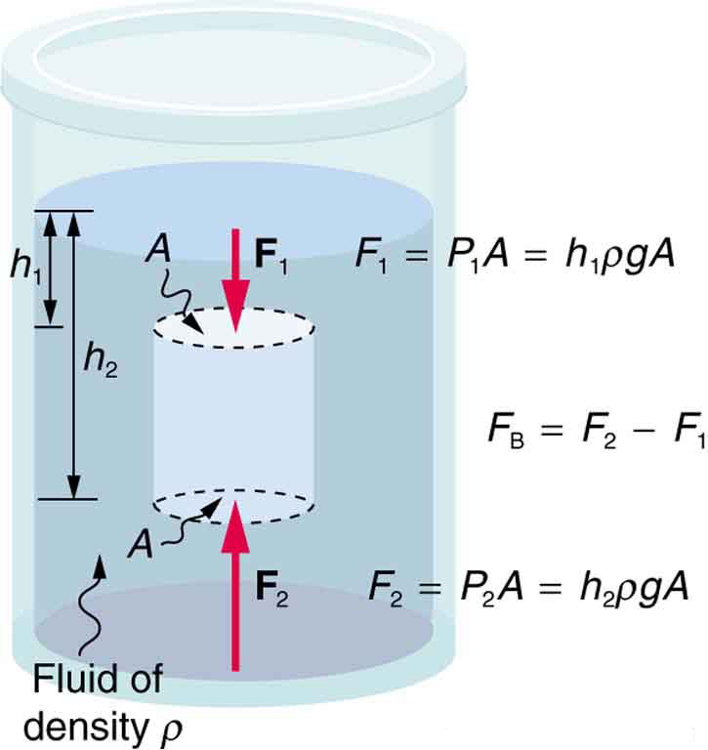
Fluids
Buoyant force
The fluid pushes on all sides of a submerged object. However, because pressure increases with depth, the upward push on the bottom surface (F2) is greater than the downward push on the top surface (F1). Therefore, the net buoyant force is always upwards.
Free to share, print, make copies and changes. Get yours at www.boundless.com
OpenStax CNX. "OpenStax College, College Physics. November 3, 2012." CC BY 3.0 http://cnx.org/content/m42196/latest/?collection=col11406/latest View on Boundless.com

Slide 21
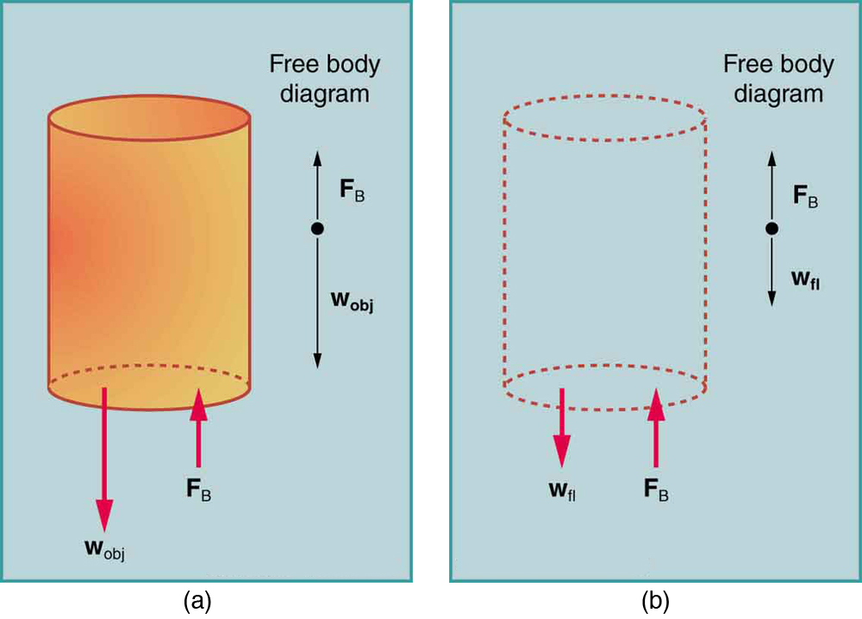
Fluids
Archimedes principle
The volume of the fluid displaced (b) is the same as the volume of the original cylinder (a).
Free to share, print, make copies and changes. Get yours at www.boundless.com
OpenStax CNX. "OpenStax College, College Physics. November 3, 2012." CC BY 3.0 http://cnx.org/content/m42196/latest/?collection=col11406/1.7 View on Boundless.com

Slide 22
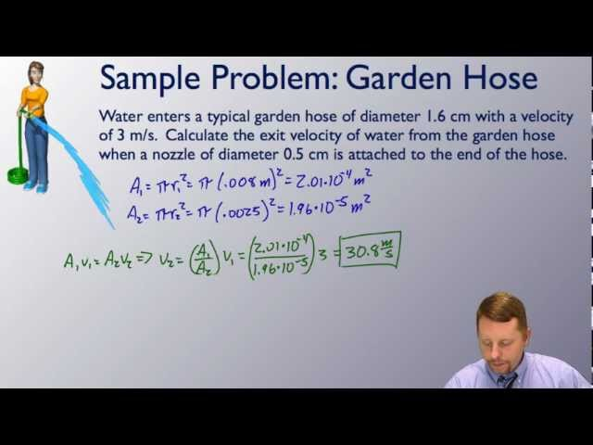
Fluids
Continuity Equation for Fluids
A brief introduction to the Continuity Equation for Fluids.
Free to share, print, make copies and changes. Get yours at www.boundless.com
View on Boundless.com

Slide 23
Fluids
Flow in = Flow out
Using the known properties of a fluid in one condition, we can use the continuity equation to solve for the properties of the same fluid under other conditions.
Free to share, print, make copies and changes. Get yours at www.boundless.com
OpenStax CNX. "OpenStax College, Flow Rate and Its Relation to Velocity. February 16, 2013." CC BY 3.0 http://cnx.org/content/m42205/latest/ View on Boundless.com

Slide 24

Fluids
Pressure as Energy per Unit Volume
This equation gives the expression for pressure as a function of depth within an incompressible, static liquid as well as the derivation of this equation from the definition of pressure as a measure of energy per unit volume (ρ is the density of the gas, g is the acceleration due to gravity, and h is the depth within the liquid).
Free to share, print, make copies and changes. Get yours at www.boundless.com
http://N/A. CC BY-SA 3.0 http://N/A View on Boundless.com

Slide 25

Fluids
Energy per Unit Volume
This equation is the derivation of pressure as a measure of energy per unit volume from its definition as force per unit area.
Free to share, print, make copies and changes. Get yours at www.boundless.com
http://N/A. CC BY-SA 3.0 http://N/A View on Boundless.com

Slide 26

Fluids
Equation for Mean Arterial Pressure
The mean arterial pressure (MAP) is the average pressure over a cardiac cycle and is determined this equation, where CO is the cardiac outputs, SVR is the systemic vascular resistance, and CVP is the central venous pressure (CVP).
Free to share, print, make copies and changes. Get yours at www.boundless.com
http://N/A. CC BY-SA 3.0 http://N/A View on Boundless.com

Slide 27

Fluids
Approximation for Mean Arterial Pressure
In practice, the mean arterial pressure (MAP) can be approximated from easily obtainable blood pressure measurements.
Free to share, print, make copies and changes. Get yours at www.boundless.com
http://N/A. CC BY-SA 3.0 http://N/A View on Boundless.com

Slide 28
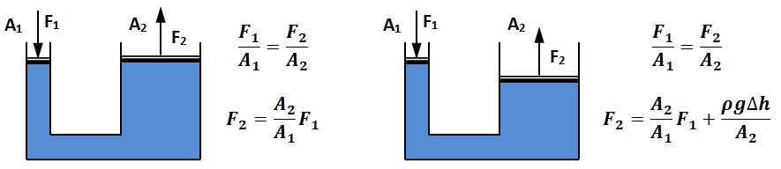
Fluids
Hydraulic Press Diagrams
Two different types of hydraulic press configurations, the first in which there is no difference in height of the static liquid and the second in which there is a difference in height Δh of the static liquid.
Free to share, print, make copies and changes. Get yours at www.boundless.com
http://N/A. CC BY-SA 3.0 http://N/A View on Boundless.com

Slide 29
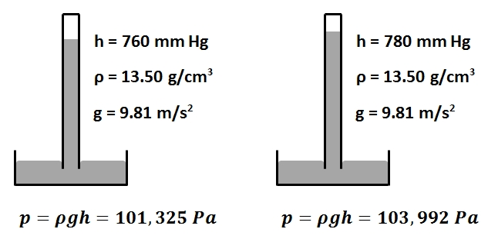
Fluids
Hydrostatic Column Barometer
The concept of determining pressure using the fluid height in a hydrostatic column barometer
Free to share, print, make copies and changes. Get yours at www.boundless.com
http://N/A. CC BY-SA 3.0 http://N/A View on Boundless.com

Slide 30
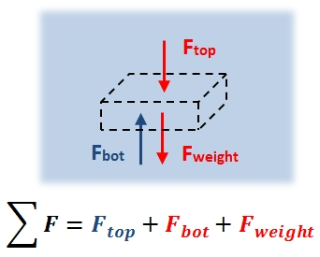
Fluids
Region Within a Static Fluid
This figure is a free body diagram of a region within a static fluid.
Free to share, print, make copies and changes. Get yours at www.boundless.com
http://N/A. CC BY-SA 3.0 http://N/A View on Boundless.com

Slide 31
Fluids
Capillarity
Capillary action of water compared to mercury, in each case with respect to glass
Free to share, print, make copies and changes. Get yours at www.boundless.com
Wikipedia. "File:Capillarity.svg - Wikipedia, the free encyclopedia." CC BY-SA http://en.wikipedia.org/w/index.php?title=File:Capillarity.svg&page=1 View on Boundless.com

Slide 32
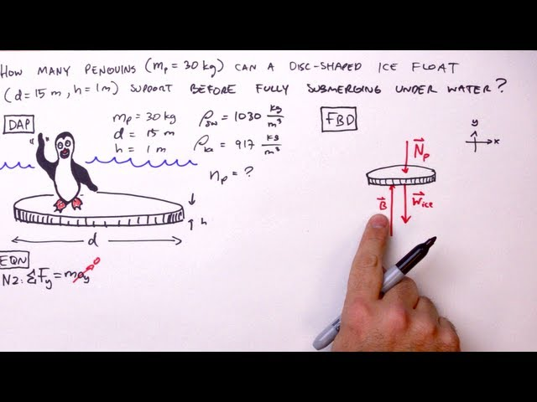
Fluids
Archimedes' Principle - Simple Example
We use Archimedes' Principle to determine the number of penguins an ice float can dryly support.
Free to share, print, make copies and changes. Get yours at www.boundless.com
View on Boundless.com

Slide 33

Fluids
Pressure within a gas
The force contributing to the pressure of a gas within the medium is not a continuous distribution as for liquids and the barometric equation given in this figure must be utilized to determine the pressure exerted by the gas at a certain depth (or height) within the gas (p0 is the pressure at h = 0, M is the mass of a single molecule of gas, g is the acceleration due to gravity, k is the Boltzmann constant, T is the temperature of the gas, and h is the height or depth within the gas)
Free to share, print, make copies and changes. Get yours at www.boundless.com
http://N/A. CC BY-SA 3.0 http://N/A View on Boundless.com

Slide 34

Fluids
Shapes
Examples of shapes.
Free to share, print, make copies and changes. Get yours at www.boundless.com
Wikipedia. "Polygon." CC BY http://en.wikipedia.org/wiki/Polygon View on Boundless.com

Slide 35
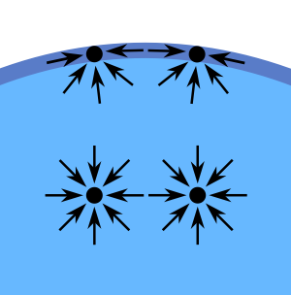
Fluids
Diagram of Surface-Tension Forces
Diagram of the forces on molecules of a liquid
Free to share, print, make copies and changes. Get yours at www.boundless.com
Wikipedia. Public domain http://en.wikipedia.org/w/index.php?title=File:Wassermolek%C3%BCleInTr%C3%B6pfchen.svg&page=1 View on Boundless.com

Slide 36
Fluids
Archimedes principle
The buoyant force on the ship (a) is equal to the weight of the water displaced by the ship—shown as the dashed region in (b).
Free to share, print, make copies and changes. Get yours at www.boundless.com
Amazon Web Services. "Boundless." License: Other http://s3.amazonaws.com/figures.boundless.com/50953ccfe4b0b4558d8e546b/Ships.png View on Boundless.com

Slide 37
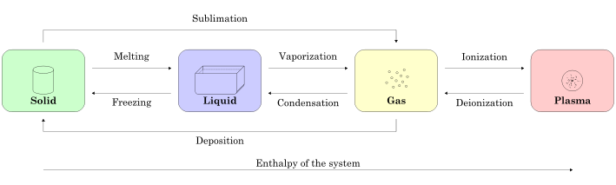
Fluids
States of Matter
This figure illustrates the relationship between the enthalpy of a system and the state of matter that the system is in.
Free to share, print, make copies and changes. Get yours at www.boundless.com
Wikipedia. "Physics matter state transition 1 en." CC BY-SA http://en.wikipedia.org/wiki/File:Physics_matter_state_transition_1_en.svg View on Boundless.com

Slide 38
Fluids
Plasma
Matter in the plasma state has variable volume and shape, but as well as neutral atoms, it contains a significant number of ions and electrons, both of which can move around freely.
Free to share, print, make copies and changes. Get yours at www.boundless.com
Wikipedia. "Electron Sea (Plasma)." CC BY-SA http://en.wikipedia.org/wiki/File:Electron_Sea_(Plasma).jpg View on Boundless.com

Slide 39
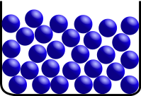
Fluids
Liquid
Liquids maintain a fixed volume, but their shape will mold to the shape of the container they are being held in.
Free to share, print, make copies and changes. Get yours at www.boundless.com
Wikipedia. "Teilchenmodell Fluessigkeit." GNU FDL 1.2 http://en.wikipedia.org/wiki/File:Teilchenmodell_Fluessigkeit.svg View on Boundless.com

Slide 40

Fluids
Solid
Solids are in a state of matter that maintains a fixed volume and shape.
Free to share, print, make copies and changes. Get yours at www.boundless.com
Wikipedia. "Stohrem." CC BY-SA http://en.wikipedia.org/wiki/File:Stohrem.jpg View on Boundless.com

Slide 41
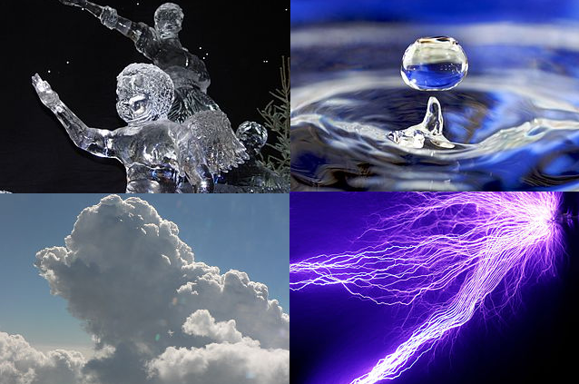
Fluids
Four Fundamental States of Matter
Four fundamental states of matter: 1) top left corner corresponds to solid; 2) top right corner corresponds to liquid; 3) bottom left corner corresponds to gas; 4) bottom right corner corresponds to plasma.
Free to share, print, make copies and changes. Get yours at www.boundless.com
Wikimedia. CC BY-SA http://upload.wikimedia.org/wikipedia/commons/d/de/Four_Fundamental_States_of_Matter.png View on Boundless.com

Slide 42
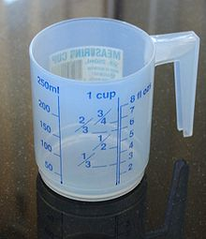
Fluids
Measuring Volume
A measuring cup can be used to measure volumes of liquids. This cup measures volume in units of cups, fluid ounces and millilitres.
Free to share, print, make copies and changes. Get yours at www.boundless.com
Wikipedia. "Volume." CC BY http://en.wikipedia.org/wiki/Volume View on Boundless.com

Slide 43
Fluids
Length
The metric length of one kilometre is equivalent to the imperial measurement of 0.62137 miles.
Free to share, print, make copies and changes. Get yours at www.boundless.com
Wikipedia. "Length." CC BY http://en.wikipedia.org/wiki/Length View on Boundless.com

Slide 44

Fluids
Gas
The particles are much farther from each other, usually a farther length than the size of the particles, and move a lot
Free to share, print, make copies and changes. Get yours at www.boundless.com
Wikipedia. "State of matter." CC BY http://en.wikipedia.org/wiki/State_of_matter View on Boundless.com

Slide 45
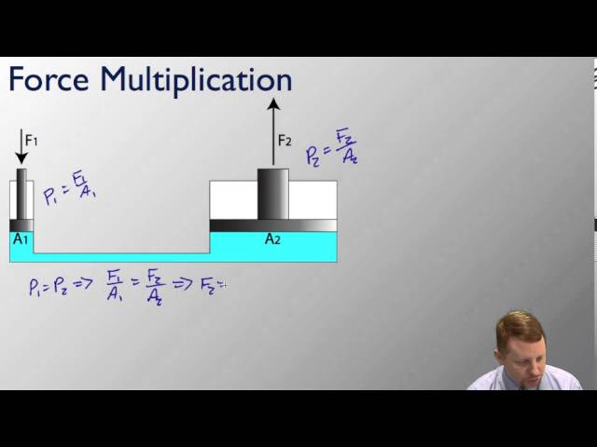
Fluids
Pressure and Pascal's Principle
A brief introduction to pressure and Pascal's Principle, including hydraulics.
Free to share, print, make copies and changes. Get yours at www.boundless.com
View on Boundless.com

Slide 46
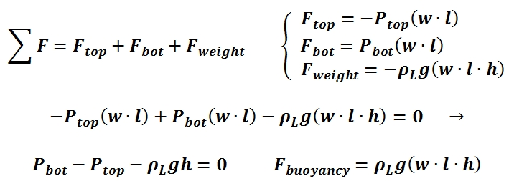
Fluids
Static Equilibrium of a Region Within a Fluid
This figure shows the equations for static equilibrium of a region within a fluid.
Free to share, print, make copies and changes. Get yours at www.boundless.com
http://N/A. CC BY-SA 3.0 http://N/A View on Boundless.com

Slide 47

Fluids
Pressure and Height
Atmospheric pressure depends on altitude or height.
Free to share, print, make copies and changes. Get yours at www.boundless.com
http://N/A. License: Other http://N/A View on Boundless.com

Slide 48
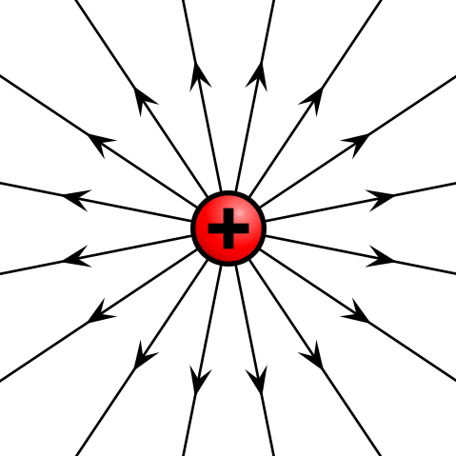
Fluids
Electric field of positive point charge
The electric field of a positively charged particle points radially away from the charge.
Free to share, print, make copies and changes. Get yours at www.boundless.com
Wikimedia. "480px-VFPt_plus_thumb.svg.png." CC BY-SA 3.0 https://commons.wikimedia.org/wiki/File:VFPt_plus_thumb.svg View on Boundless.com

Slide 49
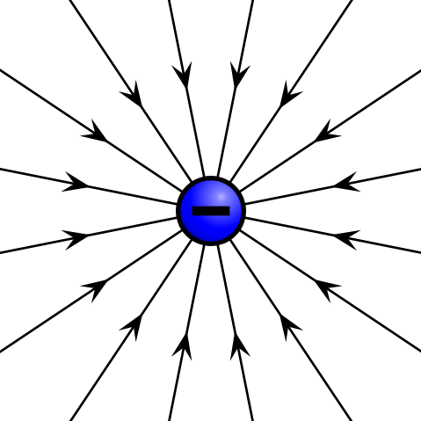
Fluids
Electric field of negative point charge
The electric field of a negatively charged particle points radially toward the particle.
Free to share, print, make copies and changes. Get yours at www.boundless.com
Wikimedia. "480px-VFPt_minus_thumb.svg.png." CC BY-SA 3.0 https://commons.wikimedia.org/wiki/File:VFPt_minus_thumb.svg View on Boundless.com

Slide 50
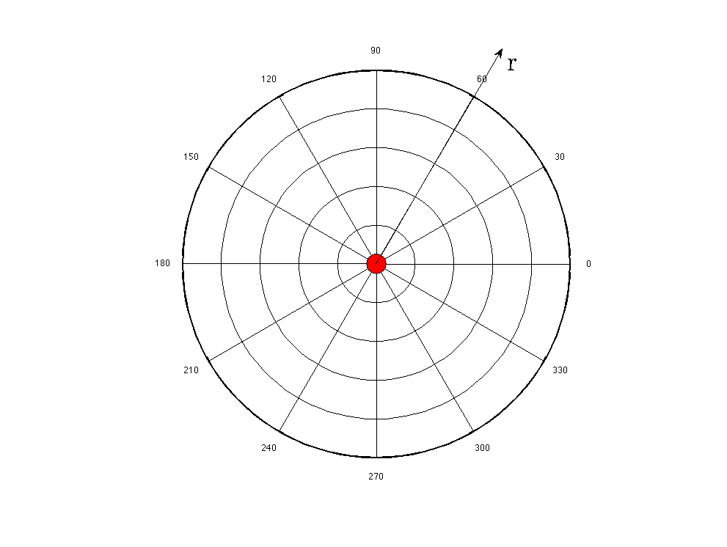
Fluids
Radial Coordinate System
The electric field of a point charge is defined in radial coordinates. The positive r direction points away from the origin, and the negative r direction points toward the origin. The electric field of a point charge is symmetric with respect to the θdirection.
Free to share, print, make copies and changes. Get yours at www.boundless.com
Amazon Web Services. "Boundless." Public domain http://s3.amazonaws.com/figures.boundless.com/51225257e4b0c14bf4651470/radialCoords.png View on Boundless.com

Slide 51
Fluids
Pressure of an Ideal Gas
This image is a representation of the ideal gas law, as well as the effect of varying the equation parameters on the gas pressure.
Free to share, print, make copies and changes. Get yours at www.boundless.com
http://N/A. CC BY-SA 3.0 http://N/A View on Boundless.com

Slide 52
Fluids
Pressure and Pascal's Principle
A brief introduction to pressure and Pascal's Principle, including hydraulics.
Free to share, print, make copies and changes. Get yours at www.boundless.com
View on Boundless.com

Slide 53
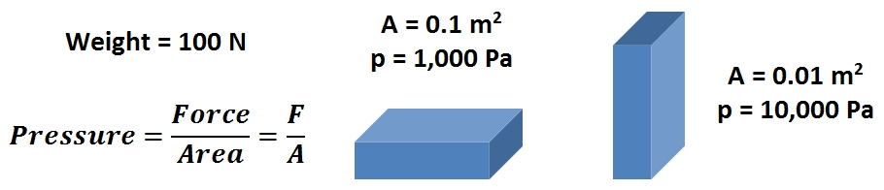
Fluids
Pressure as a Function of Surface Area
Pressure can be increased by either increasing the force or by decreasing the area or can oppositely be decreased by either decreasing the force or increasing the area.
Free to share, print, make copies and changes. Get yours at www.boundless.com
http://N/A. CC BY-SA 3.0 http://N/A View on Boundless.com

Slide 54
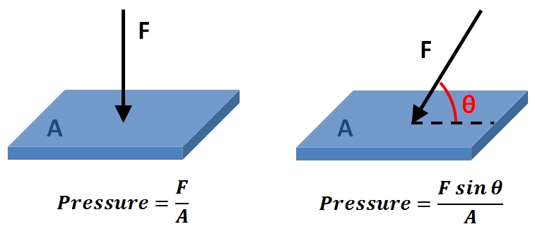
Fluids
Representation of Pressure
This image shows the graphical representations and corresponding mathematical expressions for the case in which a force acts perpendicular to the surface of contact, as well as the case in which a force acts at angle θ relative to the surface.
Free to share, print, make copies and changes. Get yours at www.boundless.com
http://N/A. CC BY-SA 3.0 http://N/A View on Boundless.com

Slide 55
Attribution
Fluids
Wikipedia. "Pressure measurement." CC BY-SA 3.0 http://en.wikipedia.org/wiki/Pressure_measurement
Wikipedia. "Atmospheric pressure." CC BY-SA 3.0 http://en.wikipedia.org/wiki/Atmospheric_pressure
Wikipedia. "Pressure measurement." CC BY-SA 3.0 http://en.wikipedia.org/wiki/Pressure_measurement
Wikipedia. "Barometer." CC BY-SA 3.0 http://en.wikipedia.org/wiki/Barometer
Wikipedia. "Archimedes principle." CC BY-SA 3.0 http://en.wikipedia.org/wiki/Archimedes_principle
OpenStax CNX. "OpenStax College, College Physics. September 17, 2013." CC BY 3.0 http://cnx.org/content/m42196/latest/?collection=col11406/1.7
Wikipedia. "Archimedes principle." CC BY-SA 3.0 http://en.wikipedia.org/wiki/Archimedes%20principle
Wikipedia. "buoyant force." CC BY-SA 3.0 http://en.wikipedia.org/wiki/buoyant%20force
OpenStax CNX. "OpenStax College, College Physics. September 17, 2013." CC BY 3.0 http://cnx.org/content/m42196/latest/?collection=col11406/latest
Wikipedia. "Archimedes principle." CC BY-SA 3.0 http://en.wikipedia.org/wiki/Archimedes%20principle
Wikipedia. "Mechanical equilibrium." CC BY-SA 3.0 http://en.wikipedia.org/wiki/Mechanical_equilibrium
Wikipedia. "Hydrostatic equilibrium)." CC BY-SA 3.0 http://en.wikipedia.org/wiki/Hydrostatic_equilibrium)
Wiktionary. "torque." CC BY-SA 3.0 http://en.wiktionary.org/wiki/torque
Wiktionary. "equilibrium." CC BY-SA 3.0 http://en.wiktionary.org/wiki/equilibrium
Wikipedia. "Length." CC BY-SA 3.0 http://en.wikipedia.org/wiki/Length
Wiktionary. "special relativity." CC BY-SA 3.0 http://en.wiktionary.org/wiki/special_relativity
Wiktionary. "dimension." CC BY-SA 3.0 http://en.wiktionary.org/wiki/dimension
Free to share, print, make copies and changes. Get yours at www.boundless.com

Slide 56
Fluids
Wikipedia. "Pascal's law." CC BY-SA 3.0 http://en.wikipedia.org/wiki/Pascal's_law
OpenStax CNX. "OpenStax College, College Physics. September 17, 2013." CC BY 3.0 http://cnx.org/content/m42196/latest/?collection=col11406/1.7
Wikipedia. "Archimedes principle." CC BY-SA 3.0 http://en.wikipedia.org/wiki/Archimedes%20principle
Wikipedia. "Fluids." CC BY-SA 3.0 http://en.wikipedia.org/wiki/Fluids
Wiktionary. "shear stress." CC BY-SA 3.0 http://en.wiktionary.org/wiki/shear_stress
Wiktionary. "viscosity." CC BY-SA 3.0 http://en.wiktionary.org/wiki/viscosity
OpenStax CNX. "OpenStax College, What Is a Fluid?. September 17, 2013." CC BY 3.0 http://cnx.org/content/m42186/latest/
Wiktionary. "fluidity." CC BY-SA 3.0 http://en.wiktionary.org/wiki/fluidity
Wikipedia. "Bernoulli's equation." CC BY-SA 3.0 http://en.wikipedia.org/wiki/Bernoulli's_equation
Wikipedia. "Equation of continuity." CC BY-SA 3.0 http://en.wikipedia.org/wiki/Equation_of_continuity
Wikipedia. "Flow rate." CC BY-SA 3.0 http://en.wikipedia.org/wiki/Flow_rate
Wiktionary. "incompressible." CC BY-SA 3.0 http://en.wiktionary.org/wiki/incompressible
Wiktionary. "continuity." CC BY-SA 3.0 http://en.wiktionary.org/wiki/continuity
OpenStax CNX. "OpenStax College, Flow Rate and Its Relation to Velocity. September 17, 2013." CC BY 3.0 http://cnx.org/content/m42205/latest/
Wikipedia. "Shape." CC BY-SA 3.0 http://en.wikipedia.org/wiki/Shape
Wiktionary. "plane." CC BY-SA 3.0 http://en.wiktionary.org/wiki/plane
Wiktionary. "Euclidean." CC BY-SA 3.0 http://en.wiktionary.org/wiki/Euclidean
Wikipedia. "State of matter." CC BY-SA 3.0 http://en.wikipedia.org/wiki/State_of_matter
Wiktionary. "sublimation." CC BY-SA 3.0 http://en.wiktionary.org/wiki/sublimation
Free to share, print, make copies and changes. Get yours at www.boundless.com

Slide 57
Fluids
Wiktionary. "enthalpy." CC BY-SA 3.0 http://en.wiktionary.org/wiki/enthalpy
Wiktionary. "plasma." CC BY-SA 3.0 http://en.wiktionary.org/wiki/plasma
Wikipedia. "Volume." CC BY-SA 3.0 http://en.wikipedia.org/wiki/Volume
Wiktionary. "dimension." CC BY-SA 3.0 http://en.wiktionary.org/wiki/dimension
Wiktionary. "cross section." CC BY-SA 3.0 http://en.wiktionary.org/wiki/cross_section
Wikipedia. "Adhesion." CC BY-SA 3.0 http://en.wikipedia.org/wiki/Adhesion
Wikipedia. "Cohesion (chemistry)." CC BY-SA 3.0 http://en.wikipedia.org/wiki/Cohesion_(chemistry)
Wikipedia. "Surface tension." CC BY-SA 3.0 http://en.wikipedia.org/wiki/Surface_tension
Wikipedia. "Surface tension." CC BY-SA 3.0 http://en.wikipedia.org/wiki/Surface_tension
Wikipedia. "Surface tension." CC BY-SA 3.0 http://en.wikipedia.org/wiki/Surface_tension
Wiktionary. "intermolecular." CC BY-SA 3.0 http://en.wiktionary.org/wiki/intermolecular
Wiktionary. "Pressure." CC BY-SA 3.0 http://en.wiktionary.org/wiki/Pressure
OpenStax CNX. "OpenStax College, College Physics. September 17, 2013." CC BY 3.0 http://cnx.org/content/m42197/latest/?collection=col11406/1.7
OpenStax CNX. "OpenStax College, College Physics. September 17, 2013." CC BY 3.0 http://cnx.org/content/m42197/latest/?collection=col11406/1.7
OpenStax CNX. "OpenStax College, College Physics. September 17, 2013." CC BY 3.0 http://cnx.org/content/m42197/latest/?collection=col11406/1.7
Wikipedia. "Capillary action." CC BY-SA 3.0 http://en.wikipedia.org/wiki/Capillary_action
Wiktionary. "vector field." CC BY-SA 3.0 http://en.wiktionary.org/wiki/vector_field
Wikipedia. "Electric field." CC BY-SA 3.0 http://en.wikipedia.org/wiki/Electric_field
Wikipedia. "Coulomb's law." CC BY-SA 3.0 http://en.wikipedia.org/wiki/Coulomb's_law
Free to share, print, make copies and changes. Get yours at www.boundless.com

Slide 58
Fluids
Wikipedia. "Blood pressure." CC BY-SA 3.0 http://en.wikipedia.org/wiki/Blood_pressure
Boundless Learning. "Boundless." CC BY-SA 3.0 http://www.boundless.com//physics/definition/poiseuille-s-law--3
Boundless Learning. "Boundless." CC BY-SA 3.0 http://www.boundless.com//physics/definition/thoracic-cavity
Boundless Learning. "Boundless." CC BY-SA 3.0 http://www.boundless.com//physics/definition/alveoli--2
Wiktionary. "ideal gas." CC BY-SA 3.0 http://en.wiktionary.org/wiki/ideal_gas
Wikipedia. "kinetic energy." CC BY-SA 3.0 http://en.wikipedia.org/wiki/kinetic%20energy
Wikipedia. "Pressure." CC BY-SA 3.0 http://en.wikipedia.org/wiki/Pressure
Wikipedia. "Pressure." CC BY-SA 3.0 http://en.wikipedia.org/wiki/Pressure
Wiktionary. "incompressible." CC BY-SA 3.0 http://en.wiktionary.org/wiki/incompressible
Wiktionary. "static equilibrium." CC BY-SA 3.0 http://en.wiktionary.org/wiki/static_equilibrium
Wikipedia. "Fluid statics." CC BY-SA 3.0 http://en.wikipedia.org/wiki/Fluid_statics%23Pressure_in_fluids_at_rest
Free to share, print, make copies and changes. Get yours at www.boundless.com

