Slide 1


Boundless Lecture Slides
Available on the Boundless Teaching Platform
Free to share, print, make copies and changes. Get yours at www.boundless.com

Slide 2



Using Boundless Presentations
Boundless Teaching Platform
Boundless empowers educators to engage their students with affordable, customizable textbooks and intuitive teaching tools. The free Boundless Teaching Platform gives educators the ability to customize textbooks in more than 20 subjects that align to hundreds of popular titles. Get started by using high quality Boundless books, or make switching to our platform easier by building from Boundless content pre-organized to match the assigned textbook. This platform gives educators the tools they need to assign readings and assessments, monitor student activity, and lead their classes with pre-made teaching resources.
Get started now at:
The Appendix
The appendix is for you to use to add depth and breadth to your lectures. You can simply drag and drop slides from the appendix into the main presentation to make for a richer lecture experience.
http://boundless.com/teaching-platform
Free to edit, share, and copy
Feel free to edit, share, and make as many copies of the Boundless presentations as you like. We encourage you to take these presentations and make them your own.
If you have any questions or problems please email:
educators@boundless.com
Free to share, print, make copies and changes. Get yours at www.boundless.com

Slide 3

About Boundless
Boundless is an innovative technology company making education more affordable and accessible for students everywhere. The company creates the world’s best open educational content in 20+ subjects that align to more than 1,000 popular college textbooks. Boundless integrates learning technology into all its premium books to help students study more efficiently at a fraction of the cost of traditional textbooks. The company also empowers educators to engage their students more effectively through customizable books and intuitive teaching tools as part of the Boundless Teaching Platform. More than 2 million learners access Boundless free and premium content each month across the company’s wide distribution platforms, including its website, iOS apps, Kindle books, and iBooks. To get started learning or teaching with Boundless, visit boundless.com.
Free to share, print, make copies and changes. Get yours at www.boundless.com

Slide 4
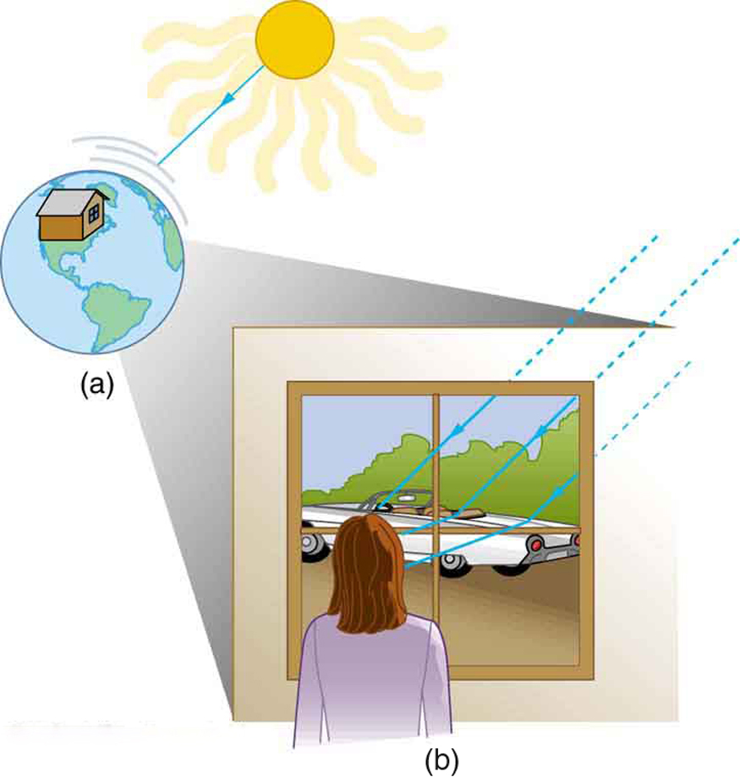
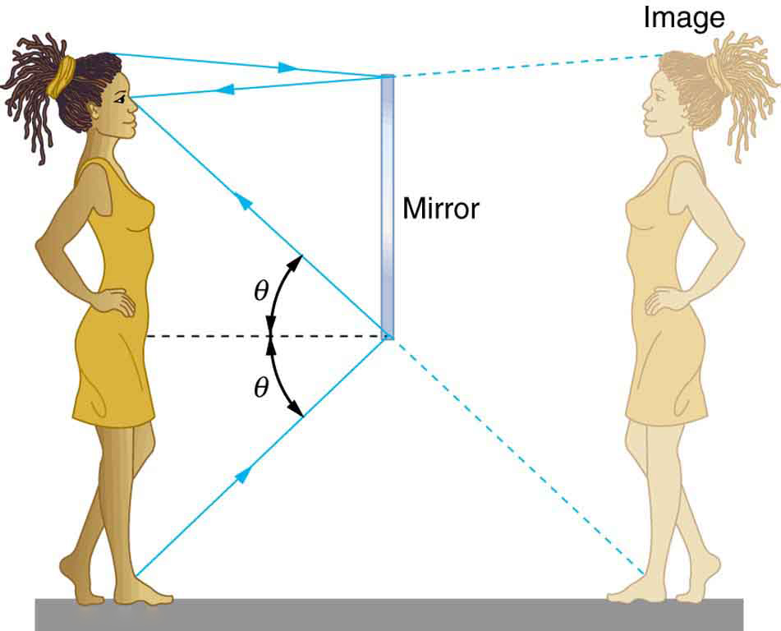
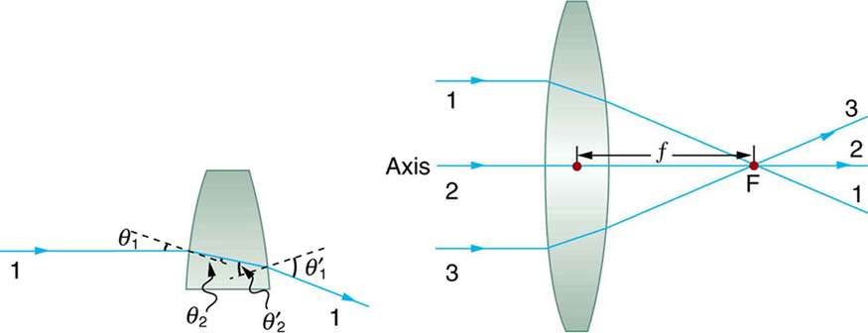

Geometric Optics
Overview
Reflection, Refraction, and Dispersion
Lenses
Mirrors
]
Geometric Optics
Free to share, print, make copies and changes. Get yours at www.boundless.com

Slide 5

Overview
Geometric Optics > Overview
The Ray Aspect of Light
Free to share, print, make copies and changes. Get yours at www.boundless.com
www.boundless.com/physics/textbooks/boundless-physics-textbook/geometric-optics-24/overview-168/

Slide 6
Reflection, Refraction, and Dispersion
Geometric Optics > Reflection, Refraction, and Dispersion
The Law of Reflection and Its Consequences
The Law of Refraction: Snell's Law and the Index of Refraction
Total Internal Reflection and Fiber Optics
Total Polarization
Dispersion: Rainbows and Prisims
Free to share, print, make copies and changes. Get yours at www.boundless.com
www.boundless.com/physics/textbooks/boundless-physics-textbook/geometric-optics-24/reflection-refraction-and-dispersion-169/

Slide 7
Lenses
Geometric Optics > Lenses
Thin Lenses and Ray Tracing
The Thin Lens Equation and Magnification
Combinations of Lenses
The Lensmaker's Equation
Refraction Through Lenses
Free to share, print, make copies and changes. Get yours at www.boundless.com
www.boundless.com/physics/textbooks/boundless-physics-textbook/geometric-optics-24/lenses-170/

Slide 8
Mirrors
Geometric Optics > Mirrors
Image Reflection by a Plane Mirror
Image Formation by Spherical Mirrors: Reflection and Sign Conventions
Free to share, print, make copies and changes. Get yours at www.boundless.com
www.boundless.com/physics/textbooks/boundless-physics-textbook/geometric-optics-24/mirrors-171/

Slide 9
Appendix
Free to share, print, make copies and changes. Get yours at www.boundless.com

Slide 10
Key terms
Geometric Optics
aberration The convergence to different foci, by a lens or mirror, of rays of light emanating from one and the same point, or the deviation of such rays from a single focus; a defect in a focusing mechanism that prevents the intended focal point.
achromatic doublet A type of lens made up of two simple lenses paired together designed so that the chromatic aberration of each lens partially offsets the other; in this way light in a range of wavelengths may be brought to the same focus.
afocal system An optical system that produces no net convergence or divergence of the beam, i.e. has an infinite effective focal length. This type of system can be created with a pair of optical elements where the distance between the elements is equal to the sum of each element's focal length (d = f1+f2).
cladding One or more layers of materials of lower refractive index, in intimate contact with a core material of higher refractive index.
concave curved like the inner surface of a sphere or bowl
concave lens A lens having at least one concave surface, such that light rays passing through it bend away from its optical axis.
convex curved or bowed outward like the outside of a bowl or sphere or circle
convex lens A lens having at least one convex surface, such that light passing through it, may be brought to a focus.
dielectric An electrically insulating or nonconducting material considered for its electric susceptibility (i.e., its property of polarization when exposed to an external electric field).
dipole A separation of positive and negative charges.
focal point A focus—a point at which rays of light or other radiation converge.
focal point A focus—a point at which rays of light or other radiation converge.
Free to share, print, make copies and changes. Get yours at www.boundless.com

Slide 11
Geometric Optics
geometric optics Optics that describes light propagation in terms of "rays".
image distance The distance of the image from the center of the lens.
index of refraction For a material, the ratio of the speed of light in vacuum to that in the material.
magnification The apparent enlargement of an object in an image.
polarizer An optical filter that passes light of a specific polarization and blocks waves of other polarizations.
ray tracing A technique used in optics for analysis of optical systems.
reflection the property of a propagated wave being thrown back from a surface (such as a mirror)
reflection the property of a propagated wave being thrown back from a surface (such as a mirror)
refraction Changing of a light ray's direction when it passes through variations in matter.
refraction Changing of a light ray's direction when it passes through variations in matter.
refraction Changing of a light ray's direction when it passes through variations in matter.
Snell's law A formula used to describe the relationship between the angles of incidence and refraction.
Free to share, print, make copies and changes. Get yours at www.boundless.com

Slide 12
Geometric Optics
surface vertices The points where each surface crosses the optical axis. They are important primarily because they are the physically measurable parameters for the position of the optical elements, and so the positions of the other cardinal points must be known with respect to the vertices to describe the physical system.
thick lens Lenses whose thicknesses are not negligible (i.e., one cannot make the simple assumption that a light ray is refracted only once in the lens).
thin lens A thin lens is defined to be one whose thickness allows rays to refract but does not allow properties such as dispersion and aberrations.
thin lens equation Relates object distance do, image distance di, and focal length f: $\frac{1}{d_o}+\frac{1}{d_i}=\frac{1}{f}$
virtual image A virtual image occurs when light rays do not actually meet at the image
Free to share, print, make copies and changes. Get yours at www.boundless.com

Slide 13
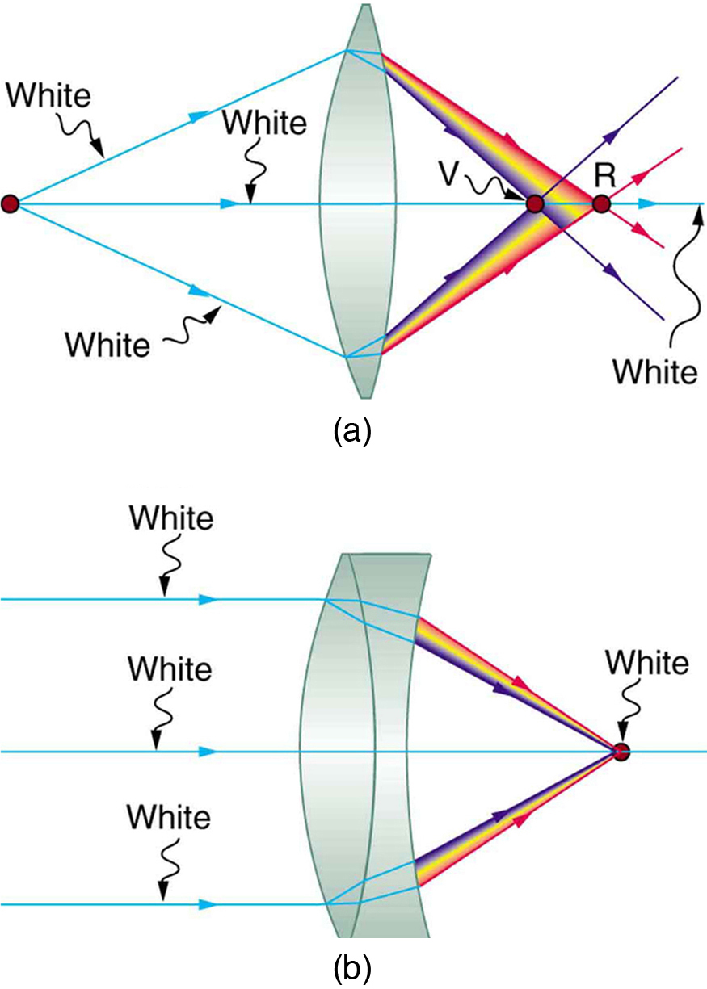

Geometric Optics
Achromatic Doublet
(a) Chromatic aberration is caused by the dependence of a lens's index of refraction on color (wavelength). The lens is more powerful for violet (V) than for red (R), producing images with different locations and magnifications. (b) Multiple-lens systems, such as this achromatic doublet, can partially correct chromatic aberrations, but they may require lenses of different materials and add to the expense of optical systems such as cameras.
Free to share, print, make copies and changes. Get yours at www.boundless.com
OpenStax CNX. "OpenStax College, College Physics. January 6, 2013." CC BY 3.0 http://cnx.org/content/m42292/latest/?collection=col11406/1.7 View on Boundless.com

Slide 14
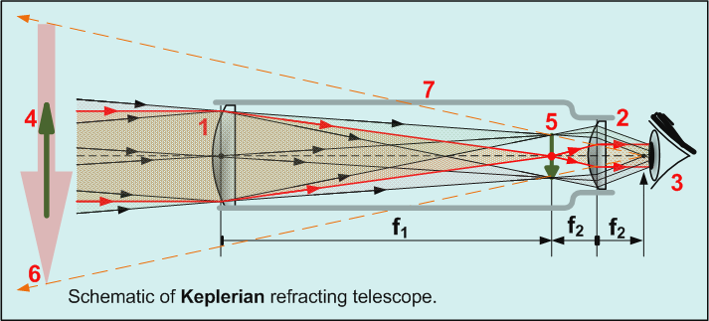
Geometric Optics
Keplerian Telescope
All refracting telescopes use the same principles. The combination of an objective lens 1 and some type of eyepiece 2 is used to gather more light than the human eye could collect on its own, focus it 5, and present the viewer with a brighter, clearer, and magnified virtual image 6. The magnification can be found by dividing the focal length of the objective lens by the focal length of the eyepiece.
Free to share, print, make copies and changes. Get yours at www.boundless.com
Wikipedia. "Refracting telescope." GNU FDL http://en.wikipedia.org/wiki/Refracting_telescope View on Boundless.com

Slide 15
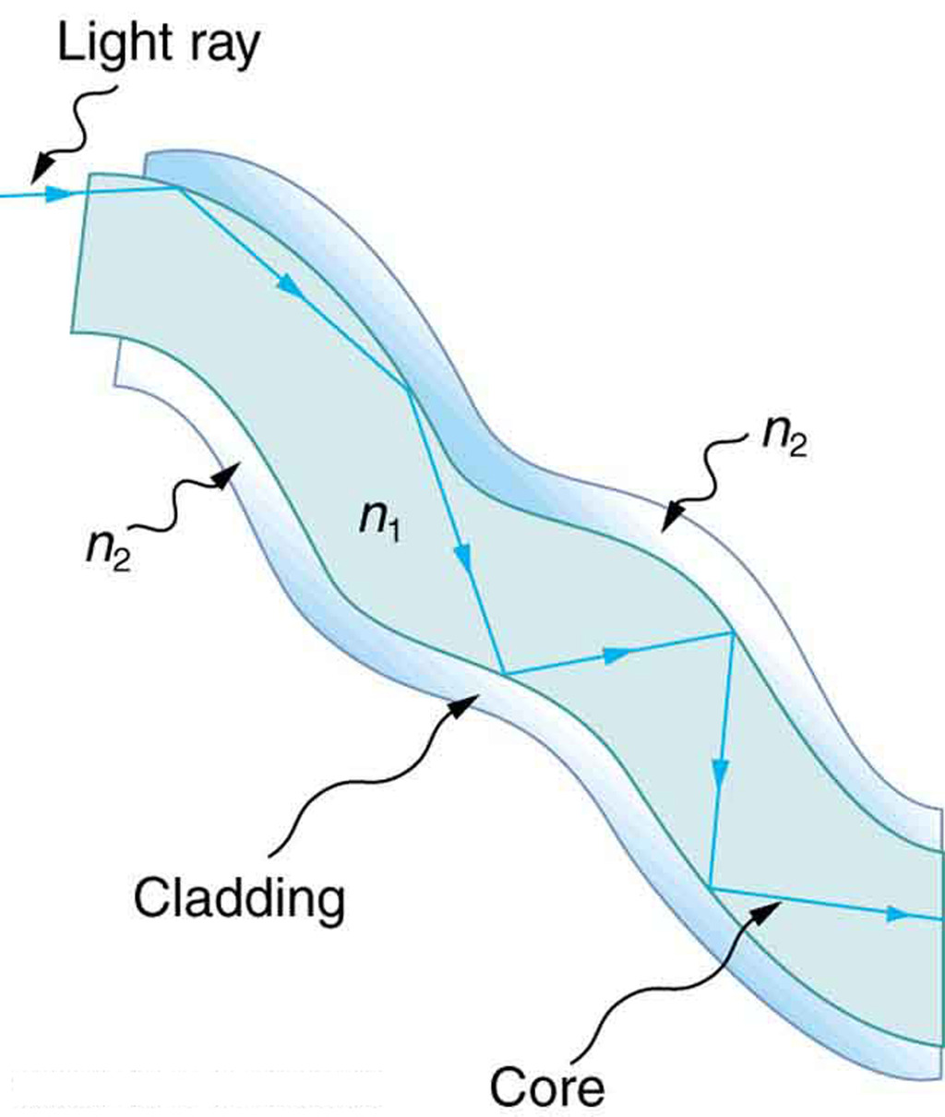
Geometric Optics
Fig 2
Fibers in bundles are clad by a material that has a lower index of refraction than the core to ensure total internal reflection, even when fibers are in contact with one another. This shows a single fiber with its cladding.
Free to share, print, make copies and changes. Get yours at www.boundless.com
OpenStax CNX. "OpenStax College, Total Internal Reflection. January 29, 2013." CC BY 3.0 http://cnx.org/content/m42462/latest/ View on Boundless.com

Slide 16

Geometric Optics
Magnifying Glass
Sunlight focused by a converging magnifying glass can burn paper. Light rays from the sun are nearly parallel and cross at the focal point of the lens. The more powerful the lens, the closer to the lens the rays will cross.
Free to share, print, make copies and changes. Get yours at www.boundless.com
OpenStax CNX. "OpenStax College, College Physics. January 1, 2013." CC BY 3.0 http://cnx.org/content/m42470/latest/?collection=col11406/1.7 View on Boundless.com

Slide 17
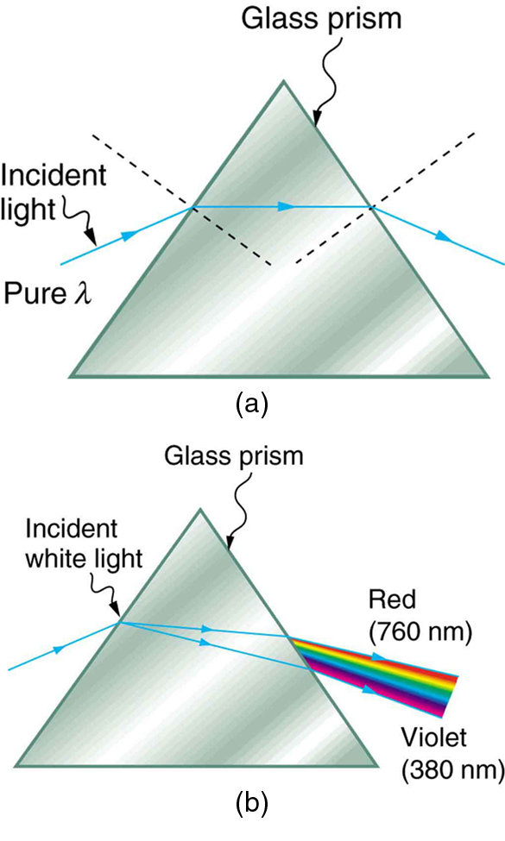
Geometric Optics
Pure Light and Light Dispersion
(a) A pure wavelength of light falls onto a prism and is refracted at both surfaces. (b) White light is dispersed by the prism (shown exaggerated). Since the index of refraction varies with wavelength, the angles of refraction vary with wavelength. A sequence of red to violet is produced, because the index of refraction increases steadily with decreasing wavelength.
Free to share, print, make copies and changes. Get yours at www.boundless.com
OpenStax CNX. "OpenStax College, Dispersion: The Rainbow and Prisms. January 29, 2013." CC BY 3.0 http://cnx.org/content/m42466/latest/ View on Boundless.com

Slide 18
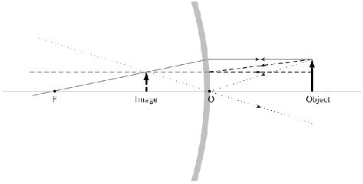
Geometric Optics
Convex Mirror Ray Diagram
A convex mirror with three rays drawn to locate the image. Each incident ray is reflected according to the Law of Reflection. The reflected rays diverge. If the reflected rays are extended behind the mirror, then their intersection gives the location of the image behind the mirror. For a convex mirror, the image is virtual and upright.
Free to share, print, make copies and changes. Get yours at www.boundless.com
OpenStax CNX. "Free High School Science Texts Project, Geometrical optics: Mirrors. December 30, 2012." CC BY 3.0 http://cnx.org/content/m40068/latest/ View on Boundless.com

Slide 19
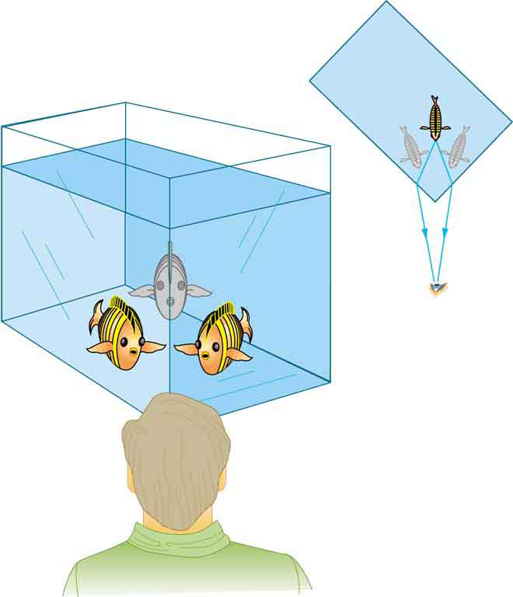
Geometric Optics
Law of Refraction
Looking at the fish tank as shown, we can see the same fish in two different locations, because light changes directions when it passes from water to air. In this case, the light can reach the observer by two different paths, and so the fish seems to be in two different places. This bending of light is called refraction and is responsible for many optical phenomena.
Free to share, print, make copies and changes. Get yours at www.boundless.com
OpenStax CNX. "OpenStax College, College Physics. November 10, 2012." CC BY 3.0 http://cnx.org/content/m42459/latest/?collection=col11406/1.7 View on Boundless.com

Slide 20
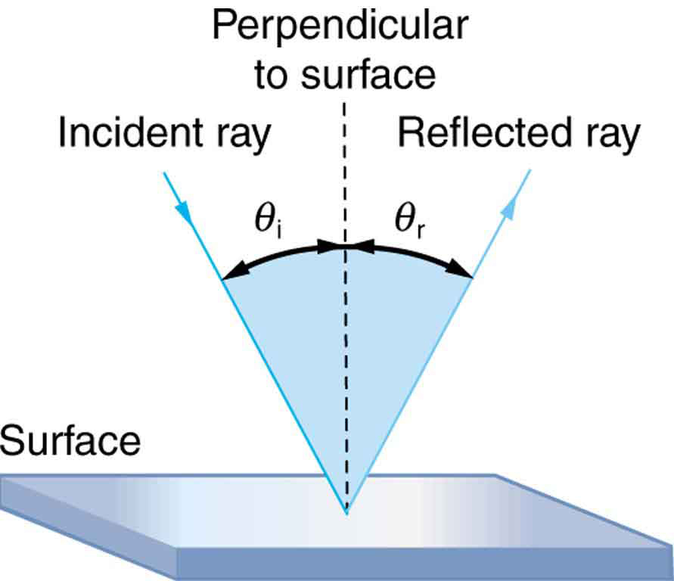
Geometric Optics
Law of Reflection
The law of reflection states that the angle of reflection equals the angle of incidence: θr = θi. The angles are measured relative to the perpendicular to the surface at the point where the ray strikes the surface.
Free to share, print, make copies and changes. Get yours at www.boundless.com
OpenStax CNX. "OpenStax College, College Physics. November 10, 2012." CC BY 3.0 http://cnx.org/content/m42456/latest/?collection=col11406/1.7 View on Boundless.com

Slide 21
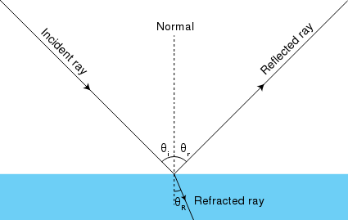
Geometric Optics
Reflected Rays
This diagram shows how light rays reflects off of a surface.
Free to share, print, make copies and changes. Get yours at www.boundless.com
Wikipedia. "Ray optics diagram incidence reflection and refraction." Public domain http://en.wikipedia.org/wiki/File:Ray_optics_diagram_incidence_reflection_and_refraction.svg View on Boundless.com

Slide 22
Geometric Optics
Methods of Travel by a Ray of Light
Light can travel through empty space directly from the source, through media like air and glass, reflect from an object like a mirror, or travel in a straight line.
Free to share, print, make copies and changes. Get yours at www.boundless.com
OpenStax CNX. "OpenStax College, The Ray Aspect of Light. December 24, 2012." CC BY 3.0 http://cnx.org/content/m42452/latest/ View on Boundless.com

Slide 23
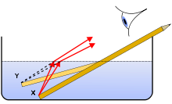
Geometric Optics
Refraction of Light Rays
The concept of refraction explains how a pencil submerged in water appears to bend.
Free to share, print, make copies and changes. Get yours at www.boundless.com
Wikipedia. "Pencil in a bowl of water." CC BY-SA http://en.wikipedia.org/wiki/File:Pencil_in_a_bowl_of_water.svg View on Boundless.com

Slide 24
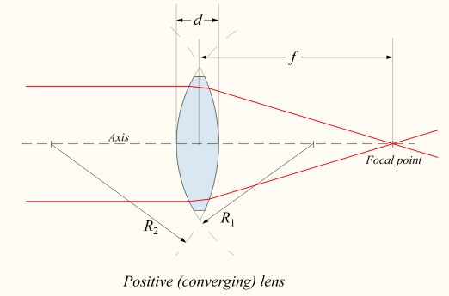
Geometric Optics
Thick Converging Lens
Diagram of a positive (converging) lens. The lensmaker's formula relates the radii of curvature, the index of refraction of the lens, the thickness of the lens, and the focal length.
Free to share, print, make copies and changes. Get yours at www.boundless.com
Wikipedia. "Lensmaker's equation." GNU FDL http://en.wikipedia.org/wiki/Lensmaker's_equation%23Lensmaker.27s_equation View on Boundless.com

Slide 25
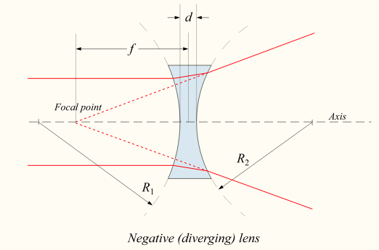
Geometric Optics
Negative Diverging Lens
Diagram of a negative (diverging) lens. The lensmaker's formula relates the radii of curvature, the index of refraction of the lens, the thickness of the lens, and the focal length.
Free to share, print, make copies and changes. Get yours at www.boundless.com
Wikipedia. "Lensmaker's equation." GNU FDL http://en.wikipedia.org/wiki/Lensmaker's_equation%23Lensmaker.27s_equation View on Boundless.com

Slide 26
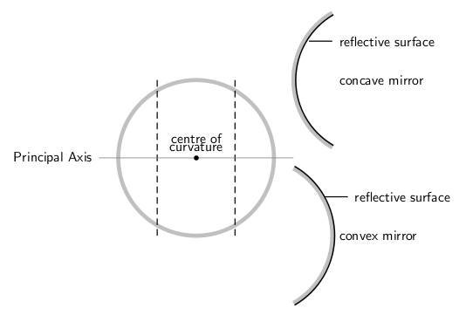
Geometric Optics
Spherical Mirrors
This figure shows the difference between a concave and convex mirror.
Free to share, print, make copies and changes. Get yours at www.boundless.com
OpenStax CNX. "Free High School Science Texts Project, Geometrical optics: Mirrors. December 30, 2012." CC BY 3.0 http://cnx.org/content/m40068/latest/ View on Boundless.com

Slide 27
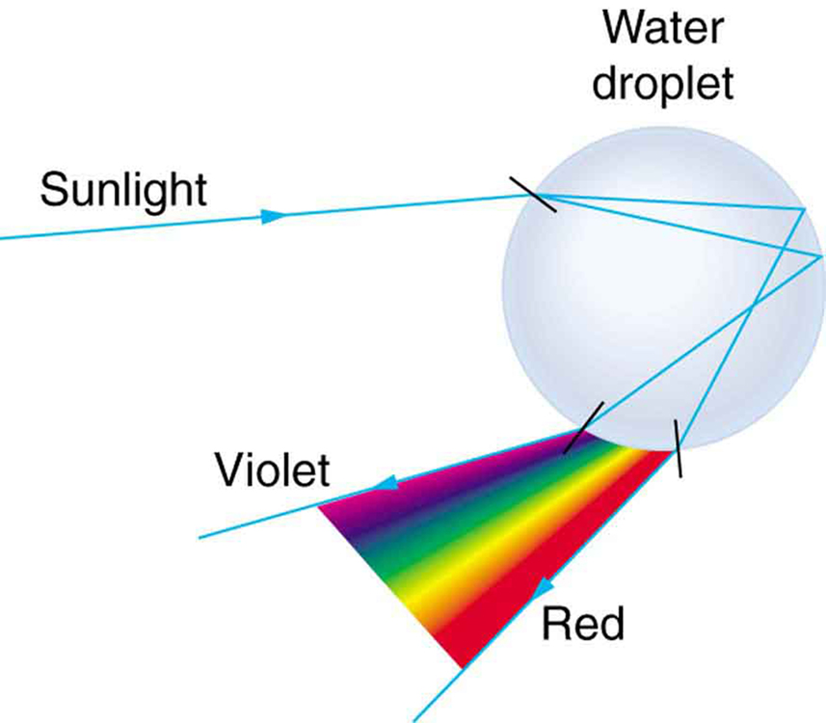
Geometric Optics
Light Reflecting on Water Droplet
Part of the light falling on this water drop enters and is reflected from the back of the drop. This light is refracted and dispersed both as it enters and as it leaves the drop.
Free to share, print, make copies and changes. Get yours at www.boundless.com
OpenStax CNX. "OpenStax College, Dispersion: The Rainbow and Prisms. January 29, 2013." CC BY 3.0 http://cnx.org/content/m42466/latest/ View on Boundless.com

Slide 28
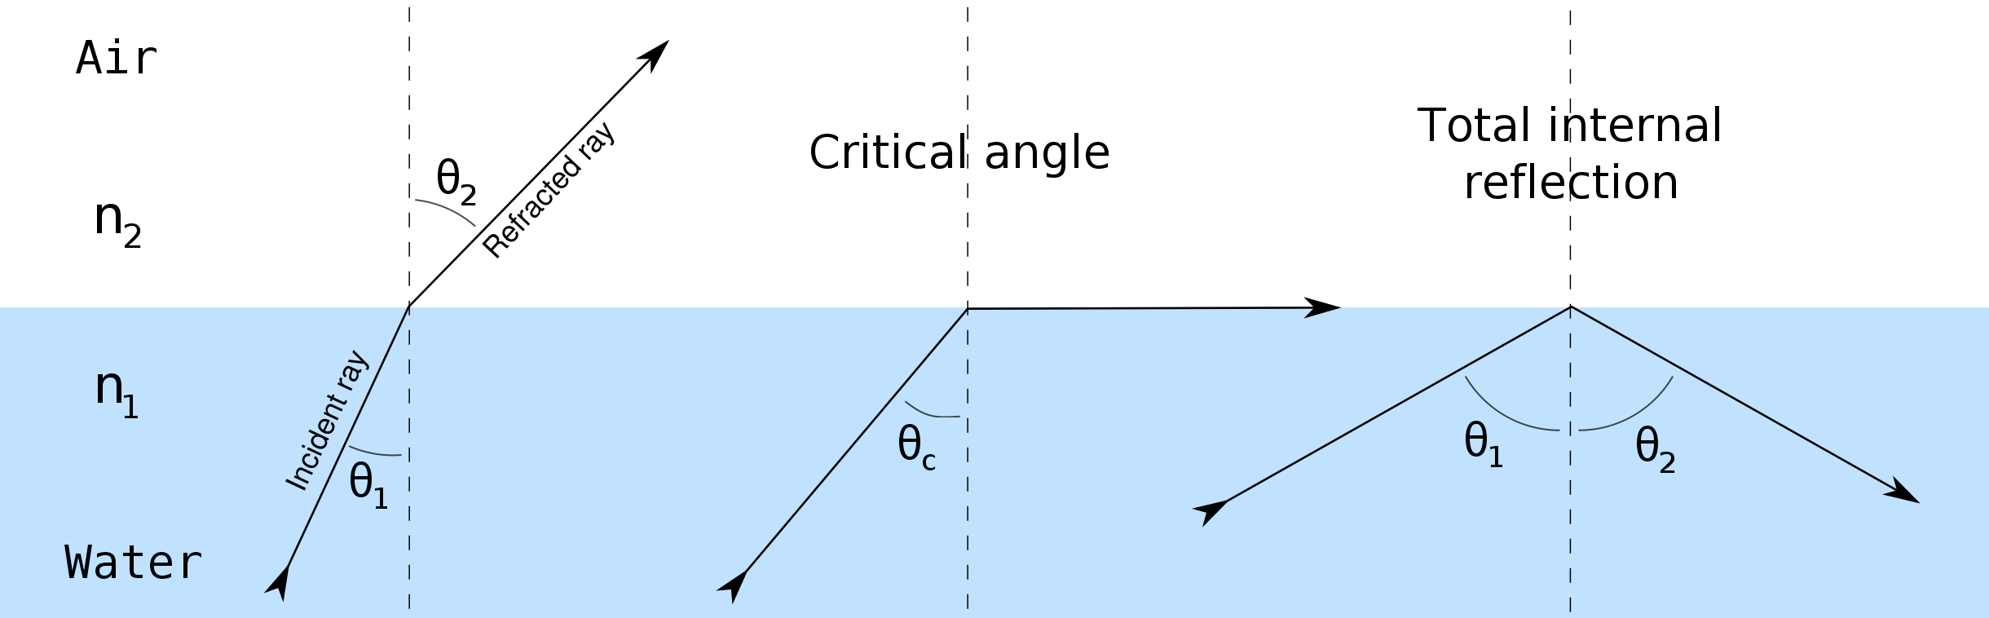
Geometric Optics
Fig 1
Refraction of light at the interface between two media, including total internal reflection.
Free to share, print, make copies and changes. Get yours at www.boundless.com
Wikipedia. "Total internal reflection." CC BY http://en.wikipedia.org/wiki/Total_internal_reflection View on Boundless.com

Slide 29
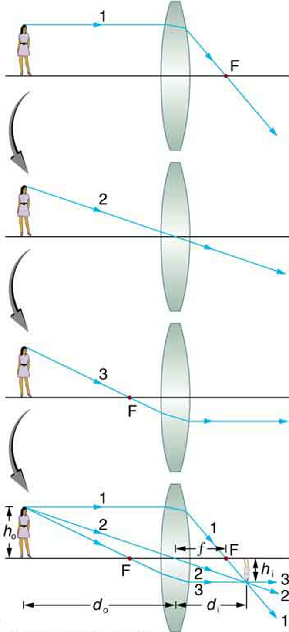
Geometric Optics
Image Formation with a Thin Lens
Ray tracing is used to locate the image formed by a lens. Rays originating from the same point on the object are traced—the three chosen rays each follow one of the rules for ray tracing, so that their paths are easy to determine. The image is located at the point where the rays cross. In this case, a real image—one that can be projected on a screen—is formed.
Free to share, print, make copies and changes. Get yours at www.boundless.com
OpenStax CNX. "OpenStax College, College Physics. December 30, 2012." CC BY 3.0 http://cnx.org/content/m42470/latest/?collection=col11406/1.7 View on Boundless.com

Slide 30
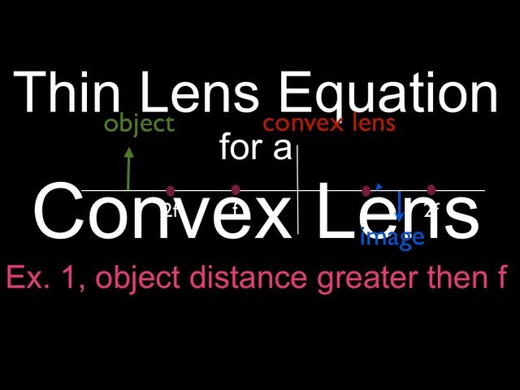
Geometric Optics
Thin Lens Equations for a Convex Lens
Shows how to use the thin lens equation to calculate the image distance, image height and image orientation for convex lenses when the object distance is greater the the focal length (f).
Free to share, print, make copies and changes. Get yours at www.boundless.com
View on Boundless.com

Slide 31
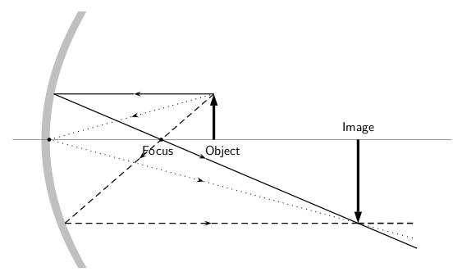
Geometric Optics
Concave Ray Diagram
This is a ray diagram of a concave mirror. The steps taken to draw are the same as those in a plane mirror.
Free to share, print, make copies and changes. Get yours at www.boundless.com
OpenStax CNX. "Free High School Science Texts Project, Geometrical optics: Mirrors. December 30, 2012." CC BY 3.0 http://cnx.org/content/m40068/latest/ View on Boundless.com

Slide 32
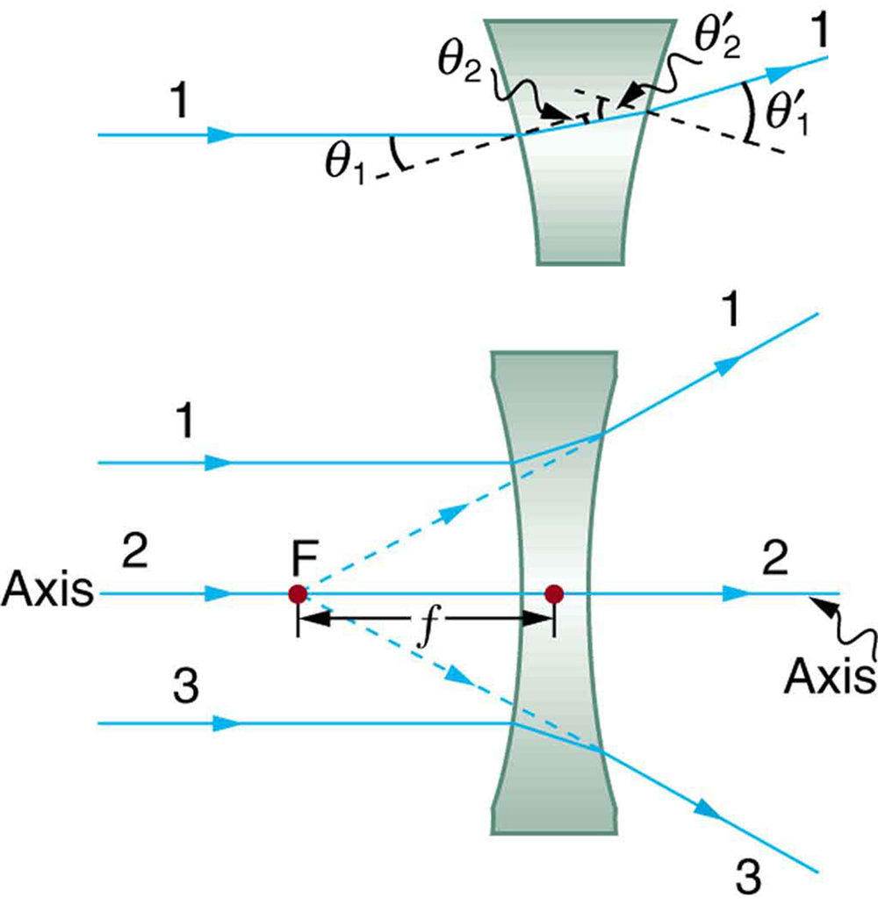
Geometric Optics
Diverging Lens
Rays of light entering a diverging lens parallel to its axis are diverged, and all appear to originate at its focal point F. The dashed lines are not rays—they indicate the directions from which the rays appear to come. The focal length f of a diverging lens is negative. An expanded view of the path taken by ray 1 shows the perpendiculars and the angles of incidence and refraction at both surfaces.
Free to share, print, make copies and changes. Get yours at www.boundless.com
OpenStax CNX. "OpenStax College, Image Formation by Lenses. December 29, 2012." CC BY 3.0 http://cnx.org/content/m42470/latest/#import-auto-id1625442 View on Boundless.com

Slide 33
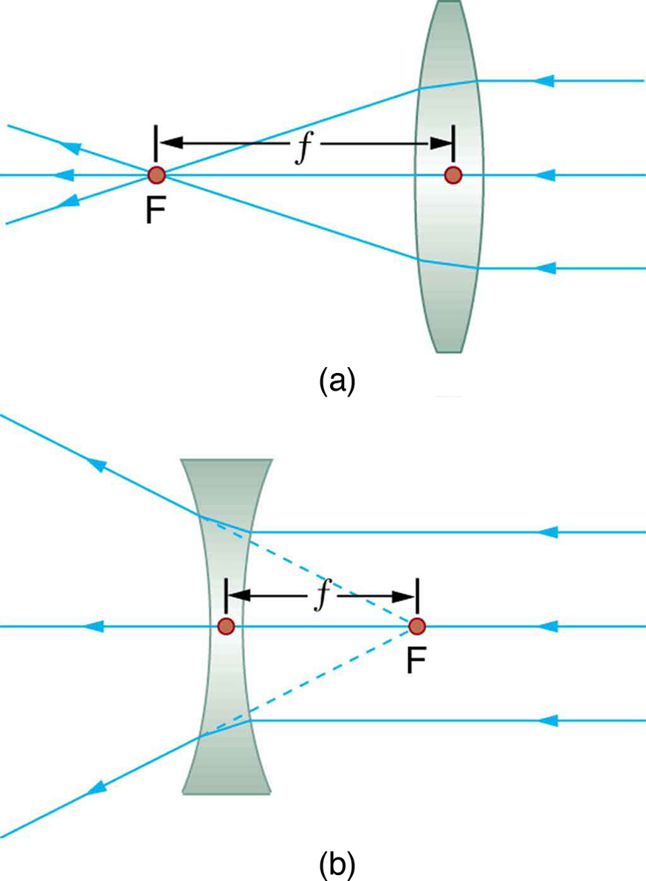
Geometric Optics
Thin Lens
Thin lenses have the same focal length on either side. (a) Parallel light rays entering a converging lens from the right cross at its focal point on the left. (b) Parallel light rays entering a diverging lens from the right seem to come from the focal point on the right.
Free to share, print, make copies and changes. Get yours at www.boundless.com
OpenStax CNX. "OpenStax College, Image Formation by Lenses. December 29, 2012." CC BY 3.0 http://cnx.org/content/m42470/latest/#import-auto-id1625442 View on Boundless.com

Slide 34
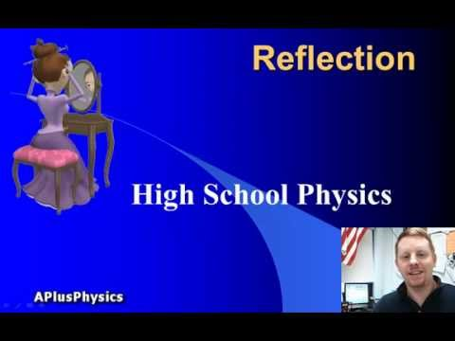
Geometric Optics
Reflection
A brief overview of reflection and the law of reflection.
Free to share, print, make copies and changes. Get yours at www.boundless.com
View on Boundless.com

Slide 35
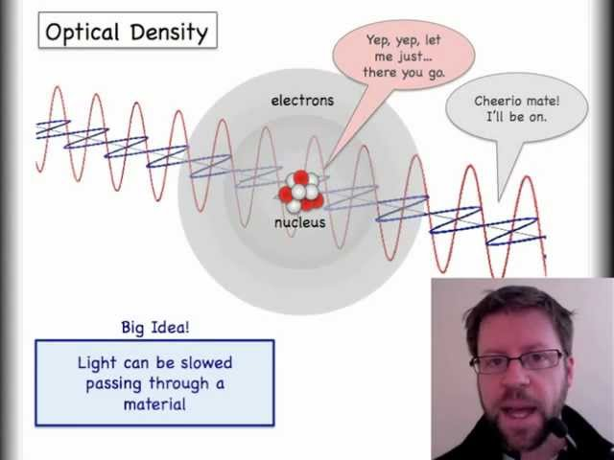
Geometric Optics
Understanding Snell's Law with the Index of Refraction
This video introduces refraction with Snell's Law and the index of refraction.The second video discusses total internal reflection (TIR) in detail. http://www.youtube.com/watch?v=fvrvqm3Erzk
Free to share, print, make copies and changes. Get yours at www.boundless.com
View on Boundless.com

Slide 36
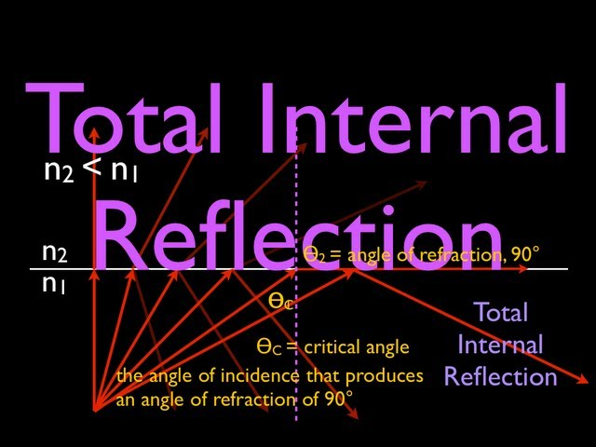
Geometric Optics
What is Total Internal Reflection?
Describes the concept of total internal reflection, derives the equation for the critical angle and shows one example.
Free to share, print, make copies and changes. Get yours at www.boundless.com
View on Boundless.com

Slide 37
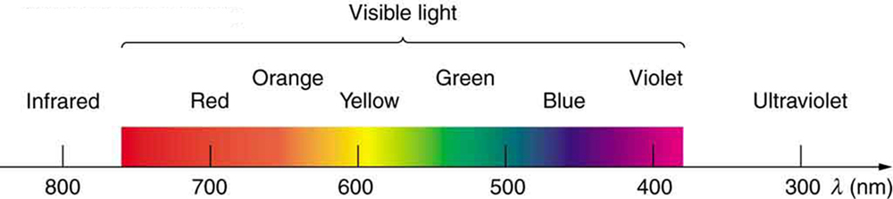
Geometric Optics
Colors of a Rainbow
Even though rainbows are associated with seven colors, the rainbow is a continuous distribution of colors according to wavelengths.
Free to share, print, make copies and changes. Get yours at www.boundless.com
OpenStax CNX. "OpenStax College, Dispersion: The Rainbow and Prisms. January 29, 2013." CC BY 3.0 http://cnx.org/content/m42466/latest/Figure%2026_05_02.jpg View on Boundless.com

Slide 38
Geometric Optics
Convex Lens
Rays of light entering a converging lens parallel to its axis converge at its focal point F. (Ray 2 lies on the axis of the lens. ) The distance from the center of the lens to the focal point is the lens's focal length f. An expanded view of the path taken by ray 1 shows the perpendiculars and the angles of incidence and refraction at both surfaces.
Free to share, print, make copies and changes. Get yours at www.boundless.com
OpenStax CNX. "OpenStax College, Image Formation by Lenses. December 29, 2012." CC BY 3.0 http://cnx.org/content/m42470/latest/#import-auto-id1625442 View on Boundless.com

Slide 39
Geometric Optics
Mirror Reflection
An image in a mirror appears as though it is behind the mirror. The two rays shown are those that strike the mirror at just the correct angles to be reflected into the eyes of the viewer. The image appears to come from the direction the rays are coming from when they enter the viewer's eyes.
Free to share, print, make copies and changes. Get yours at www.boundless.com
OpenStax CNX. "OpenStax College, College Physics. November 10, 2012." CC BY 3.0 http://cnx.org/content/m42456/latest/?collection=col11406/1.7 View on Boundless.com

Slide 40
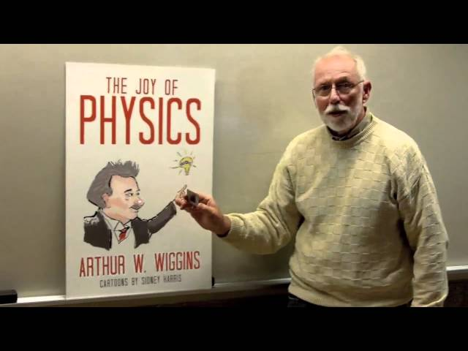
Geometric Optics
Polarization Experience
A polarizing filter allows light of a particular plane of polarization to pass, but scatters the rest of the light. When two polarizing filters are crossed, almost no light gets through. Some materials have molecules that rotate the plane of polarization of light. When one of these materials is placed between crossed polarizing filters, more light is allowed to pass through.
Free to share, print, make copies and changes. Get yours at www.boundless.com
View on Boundless.com

Slide 41
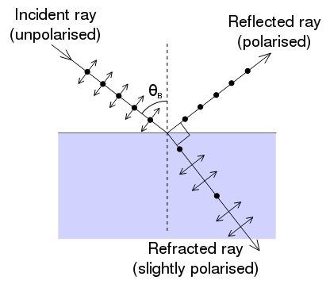
Geometric Optics
Fig 1
An illustration of the polarization of light that is incident on an interface at Brewster's angle.
Free to share, print, make copies and changes. Get yours at www.boundless.com
Wikipedia. "Brewster's angle." CC BY http://en.wikipedia.org/wiki/Brewster's_angle View on Boundless.com

Slide 42
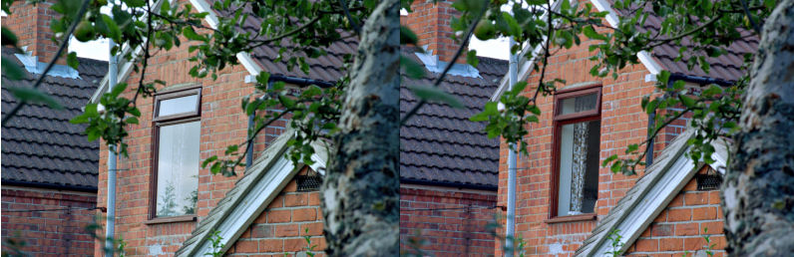
Geometric Optics
Fig 2
Photograph taken of a window with a camera polarizer filter rotated to two different angles. In the picture at left, the polarizer is aligned with the polarization angle of the window reflection. In the picture at right, the polarizer has been rotated 90° eliminating the heavily polarized reflected sunlight.
Free to share, print, make copies and changes. Get yours at www.boundless.com
Wikipedia. "Brewster's angle." CC BY http://en.wikipedia.org/wiki/Brewster's_angle View on Boundless.com

Slide 43
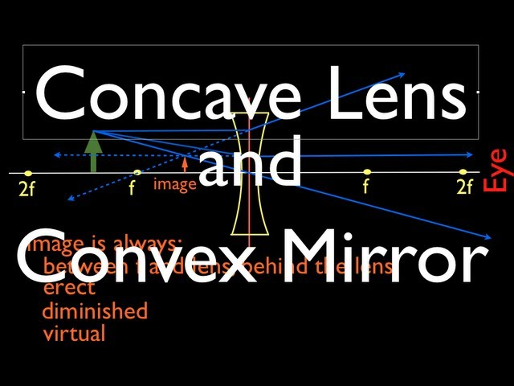
Geometric Optics
Ray Diagrams, Concave Lens and Convex Mirror
Shows how to draw the ray diagrams for locating the image produced by a concave lens and a convex mirror.
Free to share, print, make copies and changes. Get yours at www.boundless.com
View on Boundless.com

Slide 44
Attribution
Geometric Optics
Wiktionary. "reflection." CC BY-SA 3.0 http://en.wiktionary.org/wiki/reflection
OpenStax CNX. "OpenStax College, College Physics. September 17, 2013." CC BY 3.0 http://cnx.org/content/m42456/latest/?collection=col11406/1.7
Light and Matter. CC BY http://lightandmatter.com/simpleo.pdf
Boundless Learning. "Boundless." CC BY-SA 3.0 http://www.boundless.com//physics/definition/thick-lens
Wikipedia. "surface vertices." CC BY-SA 3.0 http://en.wikipedia.org/wiki/surface%20vertices
Wikipedia. "Lensmaker's equation." CC BY-SA 3.0 http://en.wikipedia.org/wiki/Lensmaker's_equation%23Lensmaker.27s_equation
Wikipedia. "polarizer." CC BY-SA 3.0 http://en.wikipedia.org/wiki/polarizer
Wiktionary. "dipole." CC BY-SA 3.0 http://en.wiktionary.org/wiki/dipole
Wiktionary. "dielectric." CC BY-SA 3.0 http://en.wiktionary.org/wiki/dielectric
Wikipedia. "Brewster's angle." CC BY-SA 3.0 http://en.wikipedia.org/wiki/Brewster's_angle
Wikipedia. "achromatic doublet." CC BY-SA 3.0 http://en.wikipedia.org/wiki/achromatic%20doublet
Wikipedia. "afocal system." CC BY-SA 3.0 http://en.wikipedia.org/wiki/afocal%20system
Wiktionary. "aberration." CC BY-SA 3.0 http://en.wiktionary.org/wiki/aberration
Wikipedia. "Lens (optics)." CC BY-SA 3.0 http://en.wikipedia.org/wiki/Lens_(optics)%23Compound_lenses
Wikipedia. "Achromat." CC BY-SA 3.0 http://en.wikipedia.org/wiki/Achromat
Wikipedia. "Doublet (lens)." CC BY-SA 3.0 http://en.wikipedia.org/wiki/Doublet_(lens)
OpenStax CNX. "OpenStax College, College Physics. September 17, 2013." CC BY 3.0 http://cnx.org/content/m42292/latest/?collection=col11406/1.7
Free to share, print, make copies and changes. Get yours at www.boundless.com

Slide 45
Geometric Optics
Wikipedia. "cladding." CC BY-SA 3.0 http://en.wikipedia.org/wiki/cladding
Wikipedia. "Snell's law." CC BY-SA 3.0 http://en.wikipedia.org/wiki/Snell's%20law
OpenStax CNX. "Free High School Science Texts Project, Geometrical Optics: Total Internal Reflection. September 17, 2013." CC BY 3.0 http://cnx.org/content/m40070/latest/
Wikipedia. "Total internal reflection." CC BY-SA 3.0 http://en.wikipedia.org/wiki/Total_internal_reflection
Wikipedia. "Fiber optics." CC BY-SA 3.0 http://en.wikipedia.org/wiki/Fiber_optics
Boundless Learning. "Boundless." CC BY-SA 3.0 http://www.boundless.com//physics/definition/refraction
OpenStax CNX. "OpenStax College, Dispersion: The Rainbow and Prisms. September 17, 2013." CC BY 3.0 http://cnx.org/content/m42466/latest/
Wiktionary. "index of refraction." CC BY-SA 3.0 http://en.wiktionary.org/wiki/index+of+refraction
Boundless Learning. "Boundless." CC BY-SA 3.0 http://www.boundless.com//physics/definition/refraction
OpenStax CNX. "OpenStax College, College Physics. September 17, 2013." CC BY 3.0 http://cnx.org/content/m42459/latest/?collection=col11406/1.7
Boundless Learning. "Boundless." CC BY-SA 3.0 http://www.boundless.com//physics/definition/virtual-image
OpenStax CNX. "Free High School Science Texts Project, Geometrical optics: Mirrors. September 17, 2013." CC BY 3.0 http://cnx.org/content/m40068/latest/
Wikipedia. "Optics." CC BY-SA 3.0 http://en.wikipedia.org/wiki/Optics%23Reflections
Wiktionary. "magnification." CC BY-SA 3.0 http://en.wiktionary.org/wiki/magnification
Boundless Learning. "Boundless." CC BY-SA 3.0 http://www.boundless.com//physics/definition/thin-lens-equation
Boundless Learning. "Boundless." CC BY-SA 3.0 http://www.boundless.com//physics/definition/image-distance
OpenStax CNX. "OpenStax College, College Physics. September 18, 2013." CC BY 3.0 http://cnx.org/content/m42470/latest/?collection=col11406/1.7
Wikipedia. "Magnification." CC BY-SA 3.0 http://en.wikipedia.org/wiki/Magnification%23Calculating_the_magnification_of_optical_systems
Wikipedia. "Thin lens approximation." CC BY-SA 3.0 http://en.wikipedia.org/wiki/Thin_lens_approximation
Free to share, print, make copies and changes. Get yours at www.boundless.com

Slide 46
Geometric Optics
Wiktionary. "convex." CC BY-SA 3.0 http://en.wiktionary.org/wiki/convex
Boundless Learning. "Boundless." CC BY-SA 3.0 http://www.boundless.com//biology/definition/concave
Wikipedia. "Optics." CC BY-SA 3.0 http://en.wikipedia.org/wiki/Optics%23Reflections
OpenStax CNX. "Free High School Science Texts Project, Geometrical optics: Mirrors. September 18, 2013." CC BY 3.0 http://cnx.org/content/m40068/latest/
Wikipedia. "geometric optics." CC BY-SA 3.0 http://en.wikipedia.org/wiki/geometric%20optics
Boundless Learning. "Boundless." CC BY-SA 3.0 http://www.boundless.com//physics/definition/refraction
Wiktionary. "reflection." CC BY-SA 3.0 http://en.wiktionary.org/wiki/reflection
Wikipedia. "Light ray." CC BY-SA 3.0 http://en.wikipedia.org/wiki/Light_ray
OpenStax CNX. "OpenStax College, The Ray Aspect of Light. September 18, 2013." CC BY 3.0 http://cnx.org/content/m42452/latest/
Wiktionary. "focal point." CC BY-SA 3.0 http://en.wiktionary.org/wiki/focal_point
Wiktionary. "convex lens." CC BY-SA 3.0 http://en.wiktionary.org/wiki/convex_lens
Boundless Learning. "Boundless." CC BY-SA 3.0 http://www.boundless.com//physics/definition/concave-lens
OpenStax CNX. "OpenStax College, College Physics. September 18, 2013." CC BY 3.0 http://cnx.org/content/m42459/latest/?collection=col11406/1.7
OpenStax CNX. "OpenStax College, College Physics. September 18, 2013." CC BY 3.0 http://cnx.org/content/m42470/latest/?collection=col11406/1.7
Wikipedia. "Lens (optics)." CC BY-SA 3.0 http://en.wikipedia.org/wiki/Lens_(optics)
Wikipedia. "Refraction." CC BY-SA 3.0 http://en.wikipedia.org/wiki/Refraction
Wiktionary. "focal point." CC BY-SA 3.0 http://en.wiktionary.org/wiki/focal_point
Wiktionary. "ray tracing." CC BY-SA 3.0 http://en.wiktionary.org/wiki/ray_tracing
Boundless Learning. "Boundless." CC BY-SA 3.0 http://www.boundless.com//physics/definition/thin-lens
Free to share, print, make copies and changes. Get yours at www.boundless.com

Slide 47
Geometric Optics
OpenStax CNX. "Rory Adams, Free High School Science Texts Project, Mark Horner, and Heather Williams, Geometrical Optics - Grade 10. September 18, 2013." CC BY 3.0 http://cnx.org/content/m32826/latest/
Wikipedia. "Ray tracing (physics)." CC BY-SA 3.0 http://en.wikipedia.org/wiki/Ray_tracing_(physics)
Wikipedia. "Lens (optics)." CC BY-SA 3.0 http://en.wikipedia.org/wiki/Lens_(optics)
OpenStax CNX. "OpenStax College, College Physics. September 18, 2013." CC BY 3.0 http://cnx.org/content/m42452/latest/?collection=col11406/1.7
Wikipedia. "Thin lens approximation." CC BY-SA 3.0 http://en.wikipedia.org/wiki/Thin_lens_approximation
Wikipedia. "Simple lens." CC BY-SA 3.0 http://en.wikipedia.org/wiki/Simple_lens
OpenStax CNX. "OpenStax College, Image Formation by Lenses. September 18, 2013." CC BY 3.0 http://cnx.org/content/m42470/latest/
Free to share, print, make copies and changes. Get yours at www.boundless.com

