Slide 1


Boundless Lecture Slides
Available on the Boundless Teaching Platform
Free to share, print, make copies and changes. Get yours at www.boundless.com

Slide 2



Using Boundless Presentations
Boundless Teaching Platform
Boundless empowers educators to engage their students with affordable, customizable textbooks and intuitive teaching tools. The free Boundless Teaching Platform gives educators the ability to customize textbooks in more than 20 subjects that align to hundreds of popular titles. Get started by using high quality Boundless books, or make switching to our platform easier by building from Boundless content pre-organized to match the assigned textbook. This platform gives educators the tools they need to assign readings and assessments, monitor student activity, and lead their classes with pre-made teaching resources.
Get started now at:
The Appendix
The appendix is for you to use to add depth and breadth to your lectures. You can simply drag and drop slides from the appendix into the main presentation to make for a richer lecture experience.
http://boundless.com/teaching-platform
Free to edit, share, and copy
Feel free to edit, share, and make as many copies of the Boundless presentations as you like. We encourage you to take these presentations and make them your own.
If you have any questions or problems please email:
educators@boundless.com
Free to share, print, make copies and changes. Get yours at www.boundless.com

Slide 3

About Boundless
Boundless is an innovative technology company making education more affordable and accessible for students everywhere. The company creates the world’s best open educational content in 20+ subjects that align to more than 1,000 popular college textbooks. Boundless integrates learning technology into all its premium books to help students study more efficiently at a fraction of the cost of traditional textbooks. The company also empowers educators to engage their students more effectively through customizable books and intuitive teaching tools as part of the Boundless Teaching Platform. More than 2 million learners access Boundless free and premium content each month across the company’s wide distribution platforms, including its website, iOS apps, Kindle books, and iBooks. To get started learning or teaching with Boundless, visit boundless.com.
Free to share, print, make copies and changes. Get yours at www.boundless.com

Slide 4

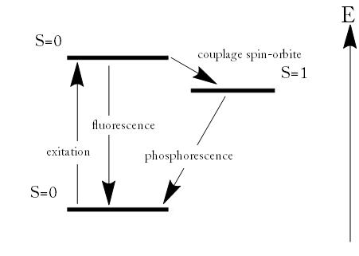

Introduction to Quantum Physics
History and Quantum Mechanical Quantities
Applications of Quantum Mechanics
]
Introduction to Quantum Physics
Free to share, print, make copies and changes. Get yours at www.boundless.com

Slide 5

History and Quantum Mechanical Quantities
Introduction to Quantum Physics > History and Quantum Mechanical Quantities
The Photoelectric Effect
Photon Energies of the EM Spectrum
Energy, Mass, and Momentum of Photon
Implications of Quantum Mechanics
Particle-Wave Duality
Diffraction Revisited
The Wave Function
de Broglie and the Wave Nature of Matter
The Heisenberg Uncertainty Principle
Philosophical Implications
Free to share, print, make copies and changes. Get yours at www.boundless.com
www.boundless.com/physics/textbooks/boundless-physics-textbook/introduction-to-quantum-physics-28/history-and-quantum-mechanical-quantities-182/

Slide 6
Applications of Quantum Mechanics
Introduction to Quantum Physics > Applications of Quantum Mechanics
Fluorescence and Phosphorescence
Lasers
Holography
The Periodic Table of Elements
X-Rays
Quantum-Mechanical View of Atoms
Free to share, print, make copies and changes. Get yours at www.boundless.com
www.boundless.com/physics/textbooks/boundless-physics-textbook/introduction-to-quantum-physics-28/applications-of-quantum-mechanics-183/

Slide 7
Appendix
Free to share, print, make copies and changes. Get yours at www.boundless.com

Slide 8
Key terms
Introduction to Quantum Physics
atomic orbital The quantum mechanical behavior of an electron in an atom describing the probability of the electron's particular position and energy.
Bell's theorem A no-go theorem famous for drawing an important line in the sand between quantum mechanics (QM) and the world as we know it classically. In its simplest form, Bell's theorem states: No physical theory of local hidden variables can ever reproduce all of the predictions of quantum mechanics.
black body An idealized physical body that absorbs all incident electromagnetic radiation, regardless of frequency or angle of incidence. Although black body is a theoretical concept, you can find approximate realizations of black body in nature.
black body radiation The type of electromagnetic radiation within or surrounding a body in thermodynamic equilibrium with its environment, or emitted by a black body (an opaque and non-reflective body) held at constant, uniform temperature.
black body radiation The type of electromagnetic radiation within or surrounding a body in thermodynamic equilibrium with its environment, or emitted by a black body (an opaque and non-reflective body) held at constant, uniform temperature.
black body radiation The type of electromagnetic radiation within or surrounding a body in thermodynamic equilibrium with its environment, or emitted by a black body (an opaque and non-reflective body) held at constant, uniform temperature.
coherence an ideal property of waves that enables stationary (i.e., temporally and spatially constant) interference
cryptography the practice and study of techniques for secure communication in the presence of third parties
diffraction The bending of a wave around the edges of an opening or an obstacle.
electron affinity the amount of energy released when an electron is added to a neutral atom or molecule to form a negative ion
elementary particle a particle not known to have any substructure
epistemological Of or pertaining to epistemology or theory of knowledge, as a field of study.
Free to share, print, make copies and changes. Get yours at www.boundless.com

Slide 9
Introduction to Quantum Physics
free-electron laser a laser that use a relativistic electron beam as the lasing medium, which moves freely through a magnetic structure
grating Any regularly spaced collection of essentially identical, parallel, elongated elements.
ground state the stationary state of lowest energy of a particle or system of particles
harmonic oscillator a system that, when displaced from its equilibrium position, experiences a restoring force F proportional to the displacement x
interference An effect caused by the superposition of two systems of waves, such as a distortion on a broadcast signal due to atmospheric or other effects.
ionization energy the amount of energy required to remove an electron from an atom or molecule in the gas phase
laser A device that produces a monochromatic, coherent beam of light.
matter wave A concept reflects the wave-particle duality of matter. The theory was proposed by Louis de Broglie.
Maxwell's equations A set of equations describing how electric and magnetic fields are generated and altered by each other and by charges and currents.
Maxwell's equations A set of equations describing how electric and magnetic fields are generated and altered by each other and by charges and currents.
monochromatic Describes a beam of light with a single wavelength (i.e., of one specific color or frequency).
particle accelerator A device that accelerates electrically charged particles to extremely high speeds, for the purpose of inducing high-energy reactions or producing high-energy radiation.
Free to share, print, make copies and changes. Get yours at www.boundless.com

Slide 10
Introduction to Quantum Physics
photoelectric effect The observation of electrons being emitted from matter (metals and non-metallic solids, liquids, or gases) as a consequence of their absorption of energy from electromagnetic radiation.
photoelectric effect The occurrence of electrons being emitted from matter (metals and non-metallic solids, liquids, or gases) as a consequence of their absorption of energy from electromagnetic radiation.
photoelectric effects In photoelectric effects, electrons are emitted from matter (metals and non-metallic solids, liquids or gases) as a consequence of their absorption of energy from electromagnetic radiation.
photoelectron Electrons emitted from matter by absorbing energy from electromagnetic radiation.
photon The quantum of light and other electromagnetic energy, regarded as a discrete particle having zero rest mass, no electric charge, and an indefinitely long lifetime.
photon The quantum of light and other electromagnetic energy, regarded as a discrete particle having zero rest mass, no electric charge, and an indefinitely long lifetime.
Planck constant a physical constant that is the quantum of action in quantum mechanics. It has a unit of angular momentum. The Planck constant was first described as the proportionality constant between the energy of a photon (unit of electromagnetic radiation) and the frequency of its associated electromagnetic wave in his derivation of the Planck's law
probability density function Any function whose integral over a set gives the probability that a random variable has a value in that set.
Rayleigh criterion The angular resolution of an optical system can be estimated from the diameter of the aperture and the wavelength of the light, which was first proposed by Lord Rayleigh.
relativistic quantum mechanics a theoretical framework for constructing quantum mechanical models of fields and many-body systems
scanning tunneling microscope An instrument for imaging surfaces at the atomic level.
Schrödinger equation A partial-differential that describes how the quantum state of some physical system changes with time. It was formulated in late 1925 and published in 1926 by the Austrian physicist Erwin Schrödinger
Free to share, print, make copies and changes. Get yours at www.boundless.com

Slide 11
Introduction to Quantum Physics
semiclassical approach A theory in which one part of a system is described quantum-mechanically whereas the other is treated classically.
silver halide The light-sensitive chemicals used in photographic film and pape
special relativity A theory that (neglecting the effects of gravity) reconciles the principle of relativity with the observation that the speed of light is constant in all frames of reference.
spin A quantum angular momentum associated with subatomic particles; it also creates a magnetic moment.
string theory an active research framework in particle physics that attempts to reconcile quantum mechanics and general relativity
wave-particle duality A postulation that all particles exhibit both wave and particle properties. It is a central concept of quantum mechanics.
wave-particle duality A postulation that all particles exhibit both wave and particle properties. It is a central concept of quantum mechanics.
wave-particle duality A postulation that all particles exhibit both wave and particle properties. It is a central concept of quantum mechanics.
Free to share, print, make copies and changes. Get yours at www.boundless.com

Slide 12
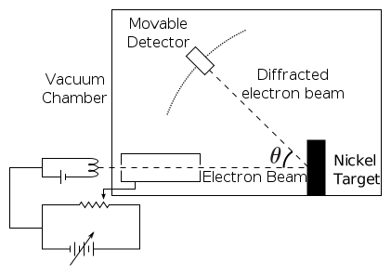

Introduction to Quantum Physics
Davisson-Germer Experimental Setup
The experiment included an electron gun consisting of a heated filament that released thermally excited electrons, which were then accelerated through a potential difference (giving them a certain amount of kinetic energy towards the nickel crystal). To avoid collisions of the electrons with other molecules on their way towards the surface, the experiment was conducted in a vacuum chamber. To measure the number of electrons that were scattered at different angles, an electron detector that could be moved on an arc path about the crystal was used. The detector was designed to accept only elastically scattered electrons.
Free to share, print, make copies and changes. Get yours at www.boundless.com
Wikimedia. CC BY-SA http://upload.wikimedia.org/wikipedia/commons/thumb/4/4e/Davisson-Germer_experiment.svg/421px-Davisson-Germer_experiment.svg.png View on Boundless.com

Slide 13
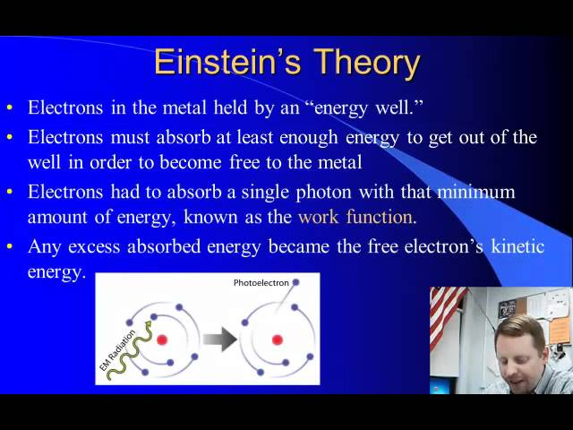
Introduction to Quantum Physics
Photoelectric Effect
A brief introduction to the Photoelectric Effect and electron photoemission.
Free to share, print, make copies and changes. Get yours at www.boundless.com
View on Boundless.com

Slide 14
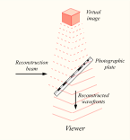
Introduction to Quantum Physics
Reconstructing a hologram
An interference pattern can be considered an encoded version of a scene, requiring a particular key - the original light source - in order to view its contents. This missing key is provided later by shining a laser, identical to the one used to record the hologram, onto the developed film. When this beam illuminates the hologram, it is diffracted by the hologram's surface pattern. This produces a light field identical to the one originally produced by the scene and scattered onto the hologram
Free to share, print, make copies and changes. Get yours at www.boundless.com
Wikipedia. "Holography." CC BY http://en.wikipedia.org/wiki/Holography View on Boundless.com

Slide 15
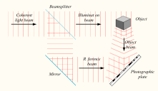
Introduction to Quantum Physics
Recording a hologram
Holograms are recorded using a flash of light that illuminates a scene and then imprints on a recording medium, much in the way a photograph is recorded. In addition, however, part of the light beam must be shone directly onto the recording medium - this second light beam is known as the reference beam.
Free to share, print, make copies and changes. Get yours at www.boundless.com
Wikipedia. "Holography." CC BY http://en.wikipedia.org/wiki/Holography View on Boundless.com

Slide 16
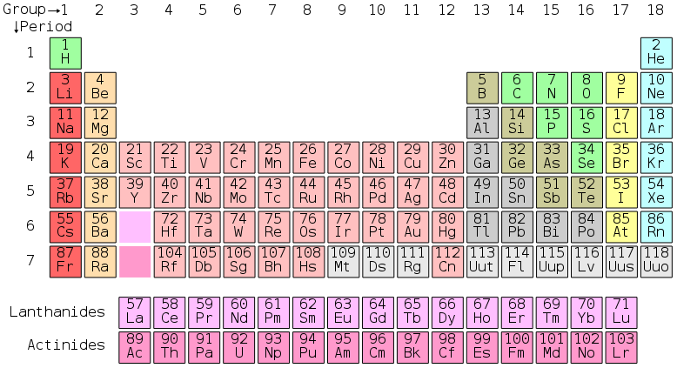
Introduction to Quantum Physics
The periodic table
Here is the complete periodic table with atomic numbers, groups, and periods. Each entry on the periodic table represents one element, and compounds are made up of several of these elements.
Free to share, print, make copies and changes. Get yours at www.boundless.com
Wikipedia. "Periodic table." CC BY http://en.wikipedia.org/wiki/File:Periodic_table.svg View on Boundless.com

Slide 17
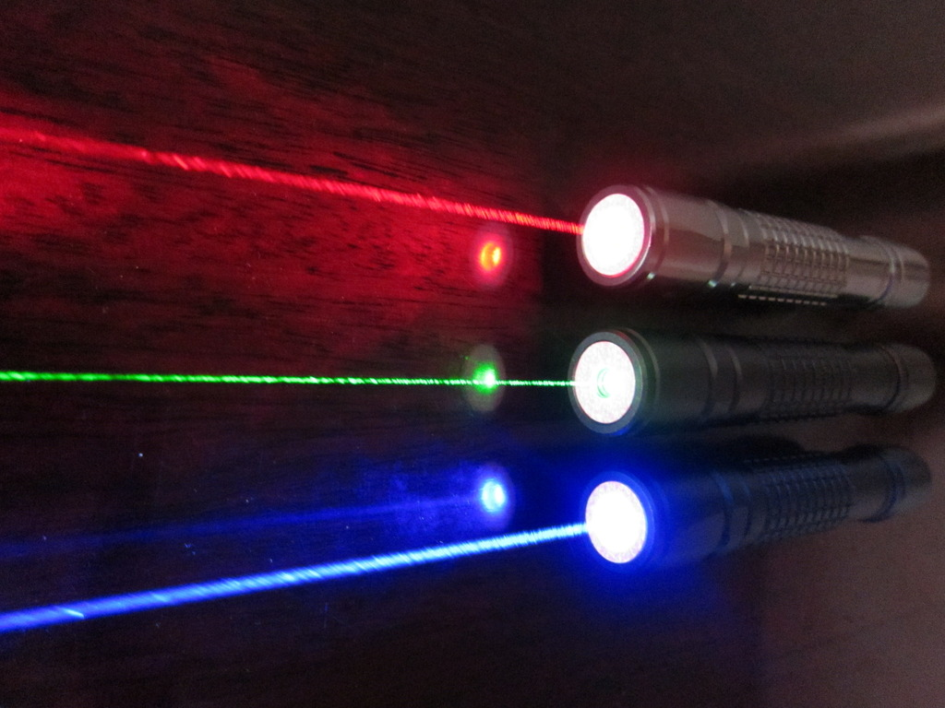
Introduction to Quantum Physics
Laser
Red (635-nm), green (532-nm), and blue-violet (445-nm) lasers
Free to share, print, make copies and changes. Get yours at www.boundless.com
Wikipedia. "Laser." CC BY http://en.wikipedia.org/wiki/Laser View on Boundless.com

Slide 18
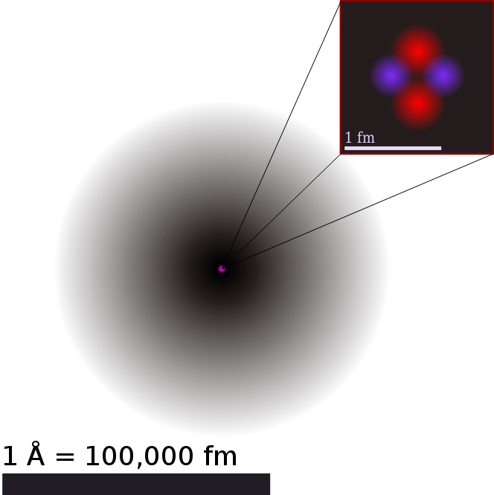
Introduction to Quantum Physics
Illustration of the Helium Atom
This is an illustration of the helium atom, depicting the nucleus (pink) and the electron cloud distribution (black). The nucleus (upper right) in helium-4 is in reality spherically symmetric and closely resembles the electron cloud, although for more complicated nuclei this is not always the case. The black bar is one angstrom (10-10 m, or 100 pm).
Free to share, print, make copies and changes. Get yours at www.boundless.com
Wikipedia. "Atom." CC BY http://en.wikipedia.org/wiki/Atom View on Boundless.com

Slide 19
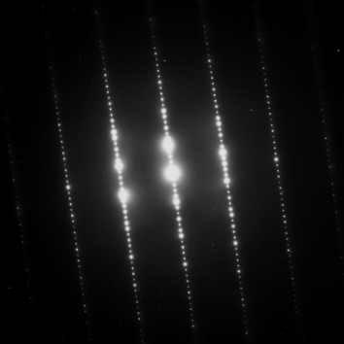
Introduction to Quantum Physics
Electron Diffraction Pattern
Typical electron diffraction pattern obtained in a transmission electron microscope with a parallel electron beam.
Free to share, print, make copies and changes. Get yours at www.boundless.com
Wikipedia. "Electron diffraction." CC BY http://en.wikipedia.org/wiki/Electron_diffraction View on Boundless.com

Slide 20
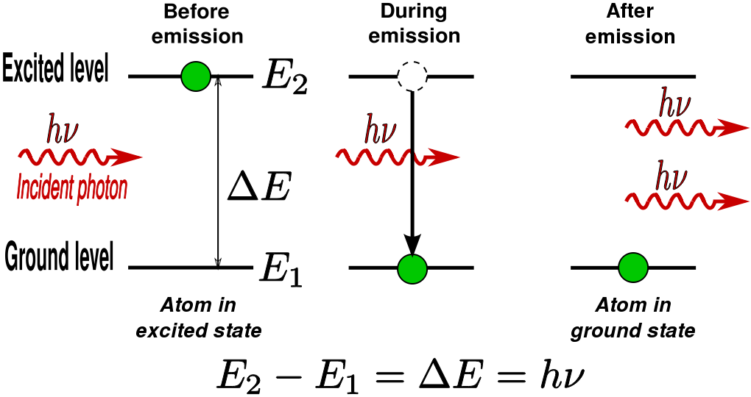
Introduction to Quantum Physics
Stimulated Photon Emission
In stimulated emission process, a photon (with a frequency equal to the atomic transition) encounters an excited atom, and a new photon identical to the incoming photon is produced. The result is an atom in the ground state with two outgoing photons.
Free to share, print, make copies and changes. Get yours at www.boundless.com
Wikipedia. "Stimulated emission." CC BY http://en.wikipedia.org/wiki/Stimulated_emission View on Boundless.com

Slide 21
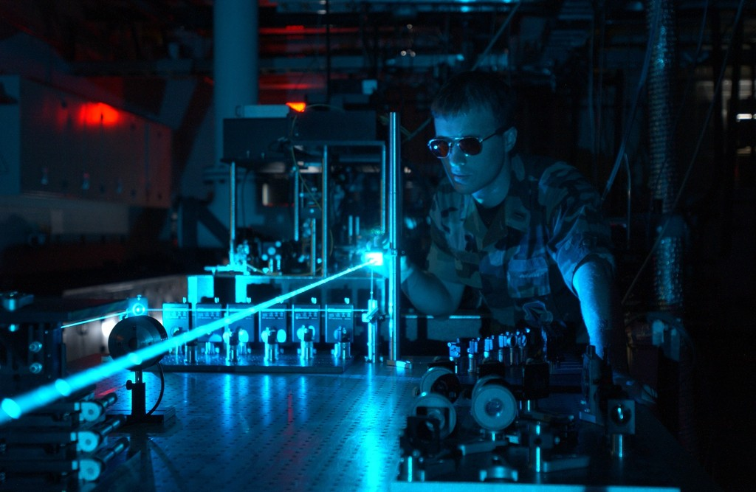
Introduction to Quantum Physics
laser
Photons emitted in a coherent beam from a laser.
Free to share, print, make copies and changes. Get yours at www.boundless.com
Wikimedia. CC BY http://upload.wikimedia.org/wikipedia/commons/a/a0/Military_laser_experiment.jpg View on Boundless.com

Slide 22
Introduction to Quantum Physics
Trajectories of a Harmonic Oscillator
This figure shows some trajectories of a harmonic oscillator (a ball attached to a spring) in classical mechanics (A-B) and quantum mechanics (C-H). In quantum mechanics (C-H), the ball has a wave function, which is shown with its real part in blue and its imaginary part in red. The trajectories C-F are examples of standing waves, or "stationary states. " Each standing-wave frequency is proportional to a possible energy level of the oscillator. This "energy quantization" does not occur in classical physics, where the oscillator can have any energy.
Free to share, print, make copies and changes. Get yours at www.boundless.com
Wikipedia. "Wave function." CC BY http://en.wikipedia.org/wiki/Wave_function%23Requirements View on Boundless.com

Slide 23
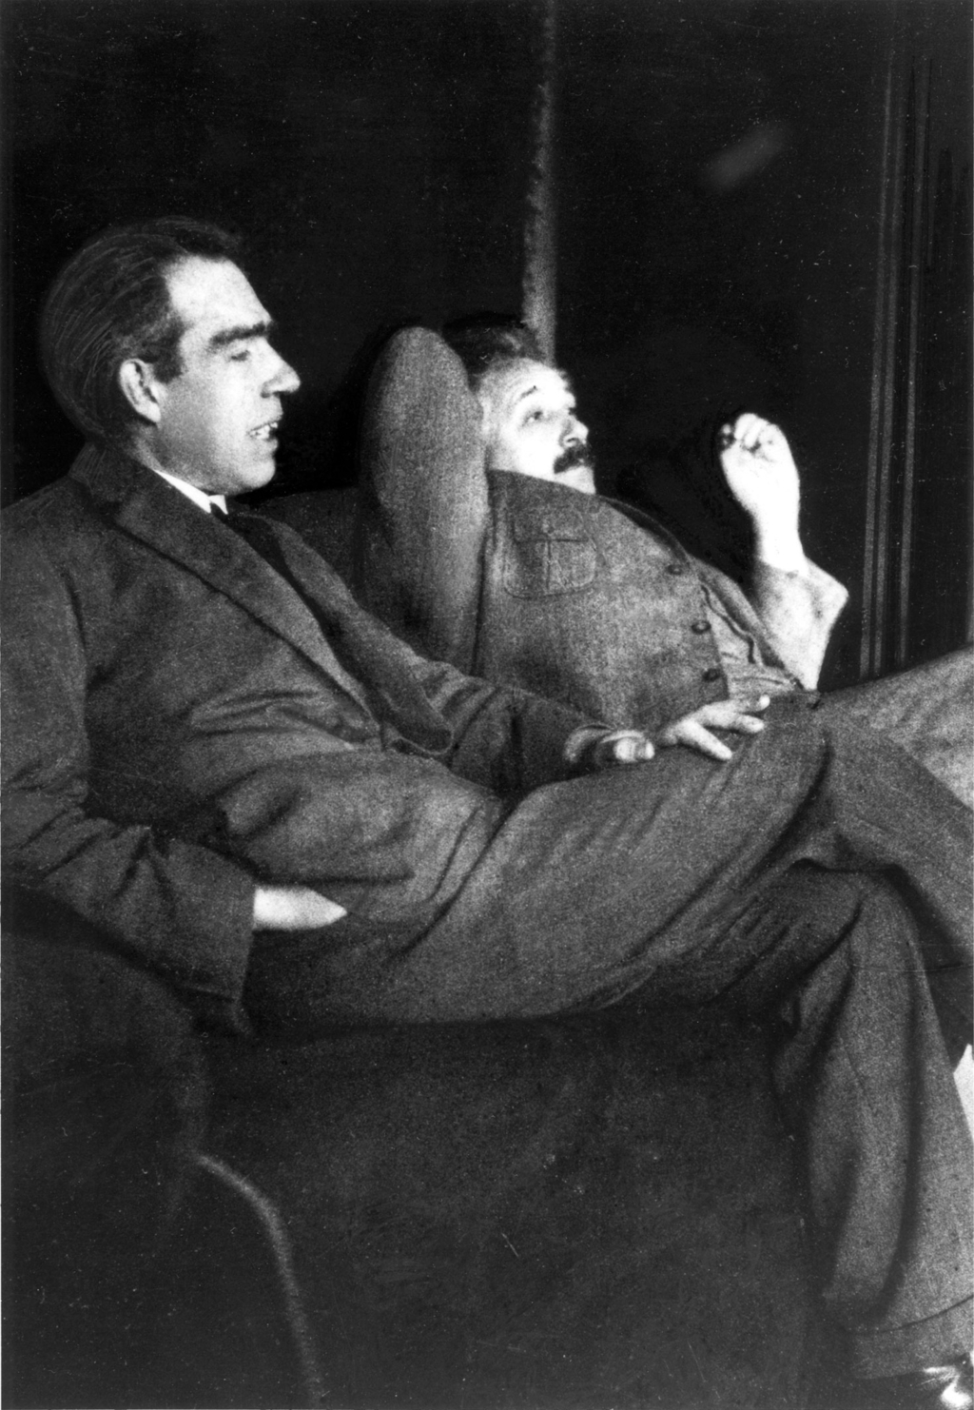
Introduction to Quantum Physics
Niels Bohr and Albert Einstein
Niels Bohr (left) and Albert Einstein (right). Despite their pioneering contributions to the inception of the quantum mechanics, they disagreed on its interpretation.
Free to share, print, make copies and changes. Get yours at www.boundless.com
Wikipedia. "Bohr–Einstein debates." CC BY http://en.wikipedia.org/wiki/Bohr%E2%80%93Einstein_debates View on Boundless.com

Slide 24
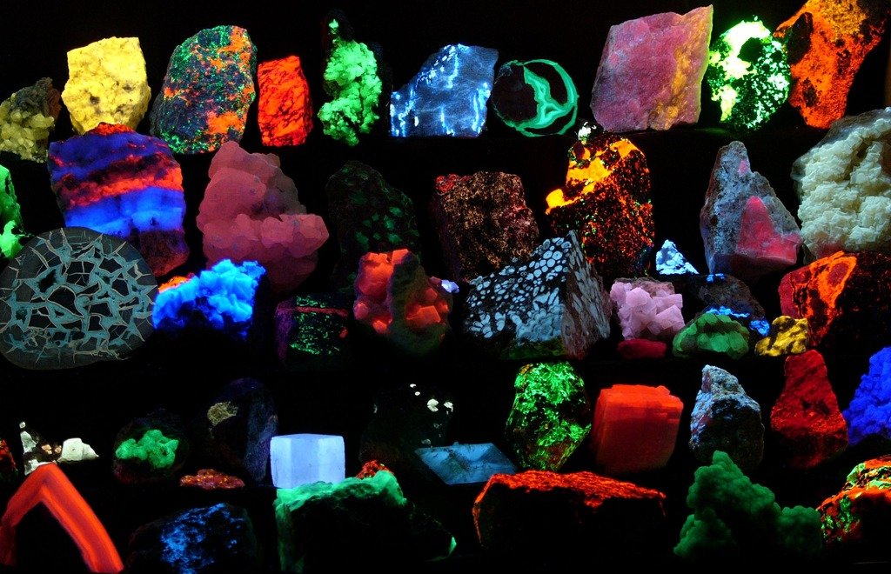
Introduction to Quantum Physics
Fluorescence
Fluorescent minerals emit visible light when exposed to ultraviolet light
Free to share, print, make copies and changes. Get yours at www.boundless.com
Wikipedia. "Fluorescence." CC BY http://en.wikipedia.org/wiki/Fluorescence%23Physical_principles View on Boundless.com

Slide 25
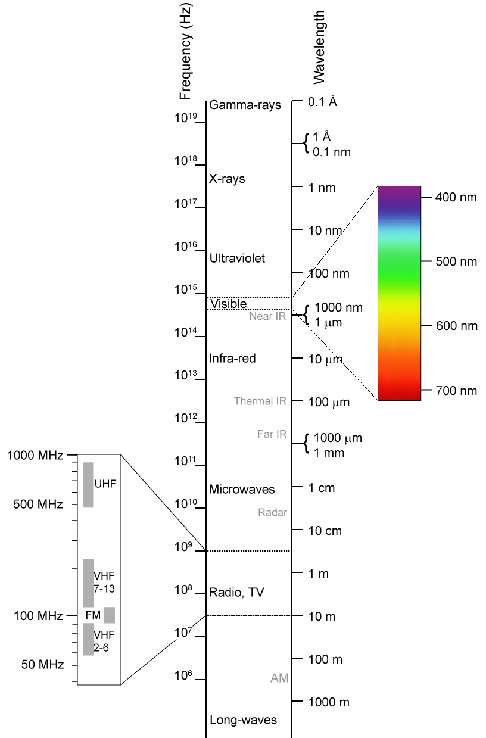
Introduction to Quantum Physics
Electromagnetic spectrum
This shows the electromagnetic spectrum, including the visible region, as a function of both frequency (left) and wavelength (right).
Free to share, print, make copies and changes. Get yours at www.boundless.com
Wikipedia. "Electromagnetic-Spectrum." CC BY-SA http://en.wikipedia.org/wiki/File:Electromagnetic-Spectrum.png View on Boundless.com

Slide 26
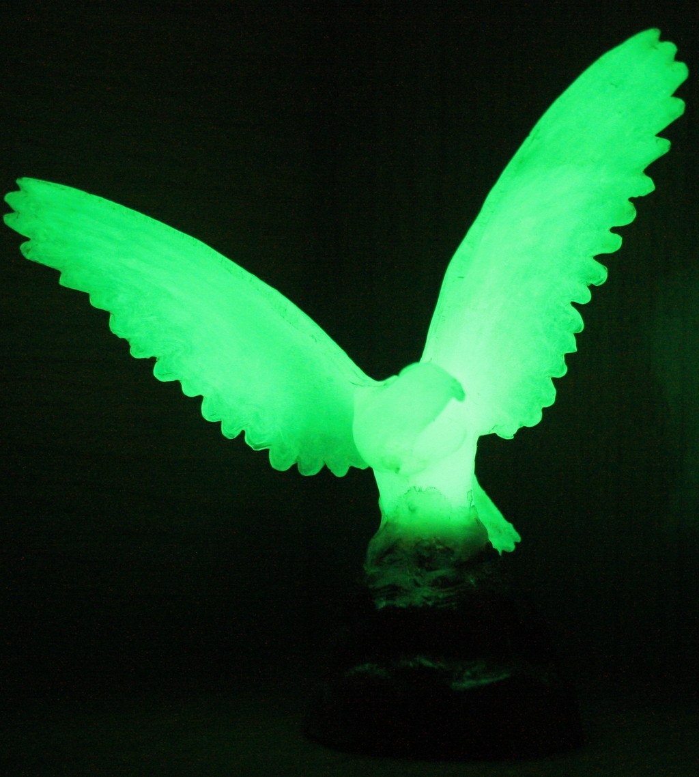
Introduction to Quantum Physics
Phosphorescence
Phosphorescent material glowing in the dark.
Free to share, print, make copies and changes. Get yours at www.boundless.com
Wikipedia. "Phosphorescence." CC BY http://en.wikipedia.org/wiki/Phosphorescence View on Boundless.com

Slide 27
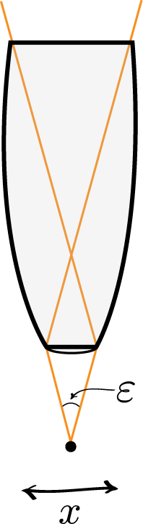
Introduction to Quantum Physics
Heisenberg Microscope
Heisenberg's microscope, with cone of light rays focusing on a particle with angle \epsilon
Free to share, print, make copies and changes. Get yours at www.boundless.com
Wikipedia. "Heisenberg's microscope." CC BY http://en.wikipedia.org/wiki/Heisenberg's_microscope View on Boundless.com

Slide 28
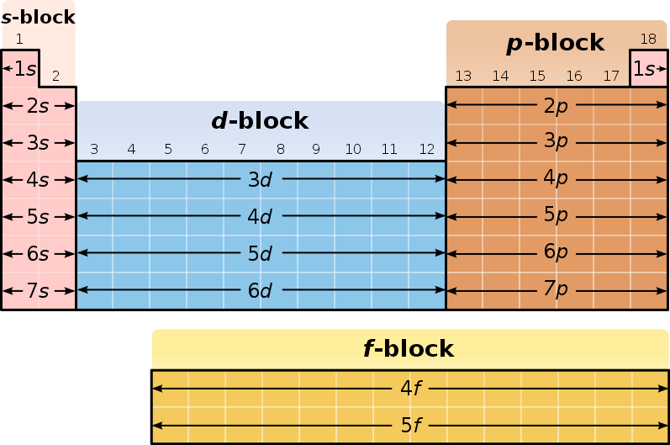
Introduction to Quantum Physics
Blocks in the Periodic Table
A diagram of the periodic table, highlighting the different blocks
Free to share, print, make copies and changes. Get yours at www.boundless.com
Wikipedia. "Periodic table." CC BY http://en.wikipedia.org/wiki/Periodic_table View on Boundless.com

Slide 29
Introduction to Quantum Physics
Fluorescence and Phosphorescence
Energy scheme used to explain the difference between fluorescence and phosphorescence
Free to share, print, make copies and changes. Get yours at www.boundless.com
Wikipedia. "Phosphorescence." CC BY http://en.wikipedia.org/wiki/Phosphorescence View on Boundless.com

Slide 30
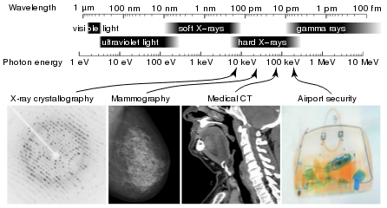
Introduction to Quantum Physics
X-Ray Spectrum and Applications
X-rays are part of the electromagnetic spectrum, with wavelengths shorter than those of visible light. Different applications use different parts of the X-ray spectrum.
Free to share, print, make copies and changes. Get yours at www.boundless.com
Wikipedia. "X-rays." GNU FDL http://en.wikipedia.org/wiki/X-rays View on Boundless.com

Slide 31
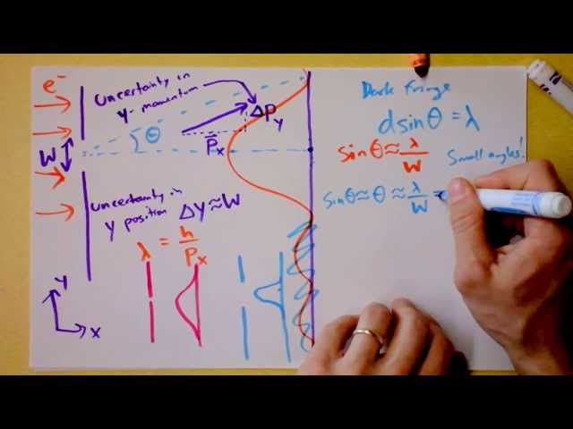
Introduction to Quantum Physics
Heisenberg Uncertainty Principle Derived and Explained
One of the most-oft quoted results of quantum physics, this doozie forces us to reconsider what we can know about the universe. Some things cannot be known simultaneously. In fact, if anything about a system is known perfectly, there is likely another characteristic that is completely shrouded in uncertainty. So significant figures ARE important after all!
Free to share, print, make copies and changes. Get yours at www.boundless.com
View on Boundless.com

Slide 32
Introduction to Quantum Physics
The Photoelectric Effect
Electrons are emitted from matter by absorbed light.
Free to share, print, make copies and changes. Get yours at www.boundless.com
Wikipedia. "File:Photoelectric effect.svg - Wikipedia, the free encyclopedia." CC BY-SA http://en.wikipedia.org/w/index.php?title=File:Photoelectric_effect.svg&page=1 View on Boundless.com

Slide 33
Attribution
Introduction to Quantum Physics
Wikipedia. "Rayleigh criterion." CC BY-SA 3.0 http://en.wikipedia.org/wiki/Rayleigh%20criterion
Wikipedia. "matter wave." CC BY-SA 3.0 http://en.wikipedia.org/wiki/matter%20wave
Wikipedia. "Uncertainty principle." CC BY-SA 3.0 http://en.wikipedia.org/wiki/Uncertainty_principle
Wikipedia. "Heisenberg's microscope." CC BY-SA 3.0 http://en.wikipedia.org/wiki/Heisenberg's_microscope
Wikipedia. "black body radiation." CC BY-SA 3.0 http://en.wikipedia.org/wiki/black%20body%20radiation
Wikipedia. "wave-particle duality." CC BY-SA 3.0 http://en.wikipedia.org/wiki/wave-particle%20duality
Wikipedia. "photoelectron." CC BY-SA 3.0 http://en.wikipedia.org/wiki/photoelectron
Wikipedia. "Photoelectric effect." CC BY-SA 3.0 http://en.wikipedia.org/wiki/Photoelectric_effect
Wikipedia. "Photoelectric effect." CC BY-SA 3.0 http://en.wikipedia.org/wiki/Photoelectric_effect
Wikipedia. "free-electron laser." CC BY-SA 3.0 http://en.wikipedia.org/wiki/free-electron%20laser
Wikipedia. "coherence." CC BY-SA 3.0 http://en.wikipedia.org/wiki/coherence
Boundless Learning. "Boundless." CC BY-SA 3.0 http://www.boundless.com//physics/definition/monochromatic
Wikipedia. "Laser." CC BY-SA 3.0 http://en.wikipedia.org/wiki/Laser%23Types_and_operating_principles
Wikipedia. "Laser." CC BY-SA 3.0 http://en.wikipedia.org/wiki/Laser%23Gain_medium_and_cavity
Wikipedia. "photoelectric effects." CC BY-SA 3.0 http://en.wikipedia.org/wiki/photoelectric%20effects
Wikipedia. "Maxwell's equations." CC BY-SA 3.0 http://en.wikipedia.org/wiki/Maxwell's%20equations
Boundless Learning. "Boundless." CC BY-SA 3.0 http://www.boundless.com//physics/definition/black-body
Free to share, print, make copies and changes. Get yours at www.boundless.com

Slide 34
Introduction to Quantum Physics
Wikipedia. "Particle wave." CC BY-SA 3.0 http://en.wikipedia.org/wiki/Particle_wave
Wikipedia. "Copenhagen interpretation." CC BY-SA 3.0 http://en.wikipedia.org/wiki/Copenhagen_interpretation
Wikipedia. "Planck constant." CC BY-SA 3.0 http://en.wikipedia.org/wiki/Planck%20constant
Wikipedia. "Maxwell's equations." CC BY-SA 3.0 http://en.wikipedia.org/wiki/Maxwell's%20equations
Wikipedia. "Electromagnetic spectrum." CC BY-SA 3.0 http://en.wikipedia.org/wiki/Electromagnetic_spectrum
Wikipedia. "Electromagnetic spectrum." CC BY-SA 3.0 http://en.wikipedia.org/wiki/Electromagnetic_spectrum
Wikipedia. "Electromagnetic spectrum." CC BY-SA 3.0 http://en.wikipedia.org/wiki/Electromagnetic_spectrum
Wikipedia. "Schrodinger equation." CC BY-SA 3.0 http://en.wikipedia.org/wiki/Schrodinger%20equation
Wikipedia. "harmonic oscillator." CC BY-SA 3.0 http://en.wikipedia.org/wiki/harmonic%20oscillator
Wikipedia. "Wave function." CC BY-SA 3.0 http://en.wikipedia.org/wiki/Wave_function%23Requirements
Wiktionary. "ground state." CC BY-SA 3.0 http://en.wiktionary.org/wiki/ground_state
Wiktionary. "spin." CC BY-SA 3.0 http://en.wiktionary.org/wiki/spin
Wikipedia. "photon." CC BY-SA 3.0 http://en.wikipedia.org/wiki/photon
Wikipedia. "Phosphorescence." CC BY-SA 3.0 http://en.wikipedia.org/wiki/Phosphorescence
Wikipedia. "Fluorescence." CC BY-SA 3.0 http://en.wikipedia.org/wiki/Fluorescence%23Physical_principles
Wiktionary. "particle accelerator." CC BY-SA 3.0 http://en.wiktionary.org/wiki/particle_accelerator
Wikipedia. "photon." CC BY-SA 3.0 http://en.wikipedia.org/wiki/photon
Wikipedia. "X-ray." CC BY-SA 3.0 http://en.wikipedia.org/wiki/X-ray
Wikipedia. "grating." CC BY-SA 3.0 http://en.wikipedia.org/wiki/grating
Free to share, print, make copies and changes. Get yours at www.boundless.com

Slide 35
Introduction to Quantum Physics
Boundless Learning. "Boundless." CC BY-SA 3.0 http://www.boundless.com//physics/definition/photoelectric-effect
Wikipedia. "black body radiation." CC BY-SA 3.0 http://en.wikipedia.org/wiki/black%20body%20radiation
Wikipedia. "Electron diffraction." CC BY-SA 3.0 http://en.wikipedia.org/wiki/Electron_diffraction
OpenStax CNX. "Gabriela Escalera, Andrew Barron, Neutron Diffraction. September 17, 2013." CC BY 3.0 http://cnx.org/content/m43582/latest/
Wikipedia. "Electron diffraction." CC BY-SA 3.0 http://en.wikipedia.org/wiki/Electron_diffraction
Wikipedia. "Electron diffraction." CC BY-SA 3.0 http://en.wikipedia.org/wiki/Electron_diffraction
Wiktionary. "interference." CC BY-SA 3.0 http://en.wiktionary.org/wiki/interference
Wiktionary. "laser." CC BY-SA 3.0 http://en.wiktionary.org/wiki/laser
Wikipedia. "silver halide." CC BY-SA 3.0 http://en.wikipedia.org/wiki/silver%20halide
Wikipedia. "Holography." CC BY-SA 3.0 http://en.wikipedia.org/wiki/Holography
Wiktionary. "atomic orbital." CC BY-SA 3.0 http://en.wiktionary.org/wiki/atomic_orbital
Wiktionary. "ionization energy." CC BY-SA 3.0 http://en.wiktionary.org/wiki/ionization_energy
Wikipedia. "electron affinity." CC BY-SA 3.0 http://en.wikipedia.org/wiki/electron%20affinity
OpenStax CNX. "Free High School Science Texts Project, The Periodic Table: Groups and Periods. September 17, 2013." CC BY 3.0 http://cnx.org/content/m38760/latest/
Wikipedia. "Periodic table." CC BY-SA 3.0 http://en.wikipedia.org/wiki/Periodic_table
Wikipedia. "black body radiation." CC BY-SA 3.0 http://en.wikipedia.org/wiki/black%20body%20radiation
Boundless Learning. "Boundless." CC BY-SA 3.0 http://www.boundless.com//physics/definition/photoelectric-effect
Wikipedia. "elementary particle." CC BY-SA 3.0 http://en.wikipedia.org/wiki/elementary%20particle
Wikipedia. "Photon." CC BY-SA 3.0 http://en.wikipedia.org/wiki/Photon
Free to share, print, make copies and changes. Get yours at www.boundless.com

Slide 36
Introduction to Quantum Physics
Wiktionary. "special relativity." CC BY-SA 3.0 http://en.wiktionary.org/wiki/special_relativity
Wiktionary. "diffraction." CC BY-SA 3.0 http://en.wiktionary.org/wiki/diffraction
Wikipedia. "wave-particle duality." CC BY-SA 3.0 http://en.wikipedia.org/wiki/wave-particle%20duality
Wikipedia. "De Broglie wavelength." CC BY-SA 3.0 http://en.wikipedia.org/wiki/De_Broglie_wavelength
Wikipedia. "De Broglie wavelength." CC BY-SA 3.0 http://en.wikipedia.org/wiki/De_Broglie_wavelength
Wiktionary. "probability density function." CC BY-SA 3.0 http://en.wiktionary.org/wiki/probability_density_function
Wikipedia. "Bell's theorem." CC BY-SA 3.0 http://en.wikipedia.org/wiki/Bell's%20theorem
Wiktionary. "epistemological." CC BY-SA 3.0 http://en.wiktionary.org/wiki/epistemological
Wikipedia. "Quantum mechanics." CC BY-SA 3.0 http://en.wikipedia.org/wiki/Quantum_mechanics
Wikipedia. "wave-particle duality." CC BY-SA 3.0 http://en.wikipedia.org/wiki/wave-particle%20duality
Wikipedia. "semiclassical approach." CC BY-SA 3.0 http://en.wikipedia.org/wiki/semiclassical%20approach
Wikipedia. "scanning tunneling microscope." CC BY-SA 3.0 http://en.wikipedia.org/wiki/scanning%20tunneling%20microscope
Wikipedia. "Atom." CC BY-SA 3.0 http://en.wikipedia.org/wiki/Atom
Wikipedia. "Quantum electrodynamics." CC BY-SA 3.0 http://en.wikipedia.org/wiki/Quantum_electrodynamics
Wikipedia. "Theodor W. Hänsch." CC BY-SA 3.0 http://en.wikipedia.org/wiki/Theodor_W._H%C3%A4nsch
Wikipedia. "cryptography." CC BY-SA 3.0 http://en.wikipedia.org/wiki/cryptography
Wikipedia. "relativistic quantum mechanics." CC BY-SA 3.0 http://en.wikipedia.org/wiki/relativistic%20quantum%20mechanics
Wikipedia. "string theory." CC BY-SA 3.0 http://en.wikipedia.org/wiki/string%20theory
Wikipedia. "Quantum mechanics." CC BY-SA 3.0 http://en.wikipedia.org/wiki/Quantum_mechanics%23Applications
Free to share, print, make copies and changes. Get yours at www.boundless.com

