Slide 1


Boundless Lecture Slides
Available on the Boundless Teaching Platform
Free to share, print, make copies and changes. Get yours at www.boundless.com

Slide 2



Using Boundless Presentations
Boundless Teaching Platform
Boundless empowers educators to engage their students with affordable, customizable textbooks and intuitive teaching tools. The free Boundless Teaching Platform gives educators the ability to customize textbooks in more than 20 subjects that align to hundreds of popular titles. Get started by using high quality Boundless books, or make switching to our platform easier by building from Boundless content pre-organized to match the assigned textbook. This platform gives educators the tools they need to assign readings and assessments, monitor student activity, and lead their classes with pre-made teaching resources.
Get started now at:
The Appendix
The appendix is for you to use to add depth and breadth to your lectures. You can simply drag and drop slides from the appendix into the main presentation to make for a richer lecture experience.
http://boundless.com/teaching-platform
Free to edit, share, and copy
Feel free to edit, share, and make as many copies of the Boundless presentations as you like. We encourage you to take these presentations and make them your own.
If you have any questions or problems please email:
educators@boundless.com
Free to share, print, make copies and changes. Get yours at www.boundless.com

Slide 3

About Boundless
Boundless is an innovative technology company making education more affordable and accessible for students everywhere. The company creates the world’s best open educational content in 20+ subjects that align to more than 1,000 popular college textbooks. Boundless integrates learning technology into all its premium books to help students study more efficiently at a fraction of the cost of traditional textbooks. The company also empowers educators to engage their students more effectively through customizable books and intuitive teaching tools as part of the Boundless Teaching Platform. More than 2 million learners access Boundless free and premium content each month across the company’s wide distribution platforms, including its website, iOS apps, Kindle books, and iBooks. To get started learning or teaching with Boundless, visit boundless.com.
Free to share, print, make copies and changes. Get yours at www.boundless.com

Slide 4
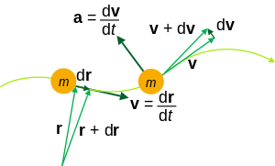
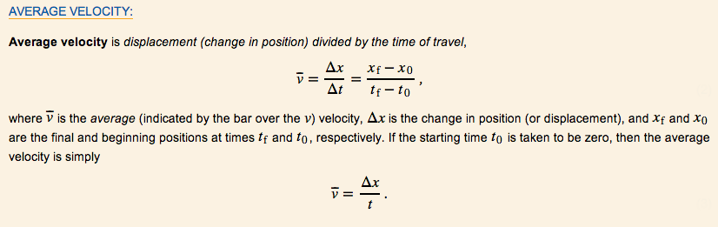
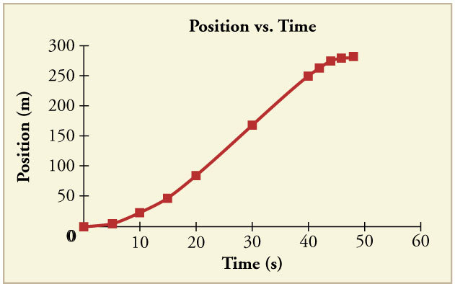

Kinematics
Basics of Kinematics
Speed and Velocity
Acceleration
Problem-Solving for Basic Kinematics
]
Free-Falling Objects
Kinematics
Free to share, print, make copies and changes. Get yours at www.boundless.com

Slide 5

Basics of Kinematics
Kinematics > Basics of Kinematics
Defining Kinematics
Reference Frames and Displacement
Introduction to Scalars and Vectors
Free to share, print, make copies and changes. Get yours at www.boundless.com
www.boundless.com/physics/textbooks/boundless-physics-textbook/kinematics-2/basics-of-kinematics-35/

Slide 6
Speed and Velocity
Kinematics > Speed and Velocity
Average Velocity: A Graphical Interpretation
Instananeous Velocity: A Graphical Interpretation
Free to share, print, make copies and changes. Get yours at www.boundless.com
www.boundless.com/physics/textbooks/boundless-physics-textbook/kinematics-2/speed-and-velocity-36/

Slide 7
Acceleration
Kinematics > Acceleration
Graphical Interpretation
Motion with Constant Acceleration
Free to share, print, make copies and changes. Get yours at www.boundless.com
www.boundless.com/physics/textbooks/boundless-physics-textbook/kinematics-2/acceleration-37/

Slide 8
Problem-Solving for Basic Kinematics
Kinematics > Problem-Solving for Basic Kinematics
Applications
Motion Diagrams
Free to share, print, make copies and changes. Get yours at www.boundless.com
www.boundless.com/physics/textbooks/boundless-physics-textbook/kinematics-2/problem-solving-for-basic-kinematics-38/

Slide 9
Free-Falling Objects
Kinematics > Free-Falling Objects
Free-Falling Objects
Free to share, print, make copies and changes. Get yours at www.boundless.com
www.boundless.com/physics/textbooks/boundless-physics-textbook/kinematics-2/free-falling-objects-39/

Slide 10
Appendix
Free to share, print, make copies and changes. Get yours at www.boundless.com

Slide 11
Key terms
Kinematics
acceleration The amount by which a speed or velocity increases (and so a scalar quantity or a vector quantity).
acceleration The amount by which a speed or velocity changes within a certain period of time (and so a scalar quantity or a vector quantity).
acceleration The amount by which a speed or velocity increases (and so a scalar quantity or a vector quantity).
diagram A graph or chart.
displacement A vector quantity that denotes distance with a directional component.
frame of reference A coordinate system or set of axes within which to measure the position, orientation, and other properties of objects in it.
instantaneous (As in velocity)—occurring, arising, or functioning without any delay; happening within an imperceptibly brief period of time.
kinematic of or relating to motion or kinematics
kinematics The branch of mechanics concerned with objects in motion, but not with the forces involved.
kinematics The branch of physics concerned with objects in motion.
motion A change of position with respect to time.
position A place or location.
Free to share, print, make copies and changes. Get yours at www.boundless.com

Slide 12
Kinematics
scalar A quantity that has magnitude but not direction; compare vector.
stroboscopic Relating to an instrument used to make a cyclically moving object appear to be slow-moving, or stationary.
vector A directed quantity, one with both magnitude and direction; the between two points.
velocity A vector quantity that denotes the rate of change of position with respect to time, or a speed with a directional component.
velocity A vector quantity that denotes the rate of change of position with respect to time, or a speed with a directional component.
Free to share, print, make copies and changes. Get yours at www.boundless.com

Slide 13

Kinematics
Average Velocity
The kinematic formula for calculating average velocity is the change in position over the time of travel.
Free to share, print, make copies and changes. Get yours at www.boundless.com
OpenStax CNX. "OpenStax College, College Physics. October 20, 2012." CC BY 3.0 http://cnx.org/content/m42096/latest/?collection=col11406/1.7 View on Boundless.com

Slide 14
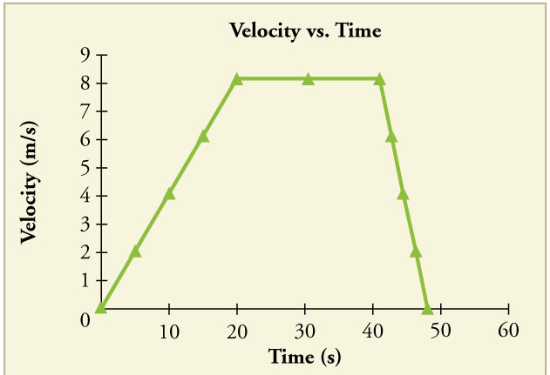
Kinematics
Velocity vs Time
The object's velocity increases as it accelerates at the beginning of the journey. It remains the same in the middle of the journey (where there is no acceleration). It decreases as the object decelerates at the end of the journey.
Free to share, print, make copies and changes. Get yours at www.boundless.com
OpenStax CNX. "OpenStax College, College Physics. October 25, 2012." CC BY 3.0 http://cnx.org/content/m42100/latest/?collection=col11406/1.7 View on Boundless.com

Slide 15
Kinematics
Position vs Time Graph
Notice that the object's position changes slowly at the beginning of the journey, then more and more quickly as it picks up speed. Its position then changes more slowly as it slows down at the end of the journey. In the middle of the journey, while the velocity remains constant, the position changes at a constant rate.
Free to share, print, make copies and changes. Get yours at www.boundless.com
OpenStax CNX. "OpenStax College, College Physics. October 25, 2012." CC BY 3.0 http://cnx.org/content/m42100/latest/?collection=col11406/1.7 View on Boundless.com

Slide 16
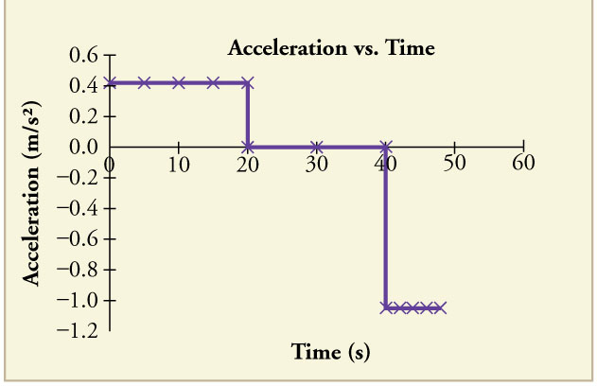
Kinematics
Acceleration vs Time Graph
The object has positive acceleration as it speeds up at the beginning of the journey. It has no acceleration as it travels at constant velocity in the middle of the journey. Its acceleration is negative as it slows down at the end of the journey.
Free to share, print, make copies and changes. Get yours at www.boundless.com
OpenStax CNX. "OpenStax College, College Physics. October 25, 2012." CC BY 3.0 http://cnx.org/content/m42100/latest/?collection=col11406/1.7 View on Boundless.com

Slide 17
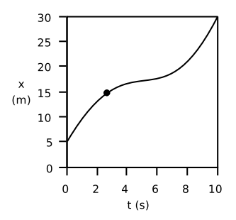
Kinematics
Motion with Changing Velocity
Motion is often observed with changing velocity. This would result in a curvy line when graphed with distance over time.
Free to share, print, make copies and changes. Get yours at www.boundless.com
Light and Matter. CC BY http://lightandmatter.com/lmb.pdf View on Boundless.com

Slide 18
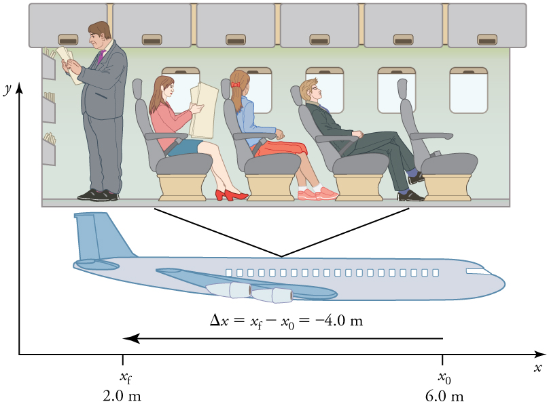
Kinematics
Displacement in Terms of Frame of Reference
A passenger moves from his seat to the back of the plane. His location relative to the airplane is given by x. The -4.0m displacement of the passenger relative to the plane is represented by an arrow toward the rear of the plane. Notice that the arrow representing his displacement is twice as long as the arrow representing the displacement of the professor (he moves twice as far).
Free to share, print, make copies and changes. Get yours at www.boundless.com
OpenStax CNX. "OpenStax College, College Physics. October 25, 2012." CC BY 3.0 http://cnx.org/content/m42033/latest/?collection=col11406/1.7 View on Boundless.com

Slide 19
Kinematics
Vector representation
A vector is frequently represented by a line segment with a definite direction, or graphically as an arrow, connecting an initial point A with a terminal point B.
Free to share, print, make copies and changes. Get yours at www.boundless.com
Wikipedia. "Vector (physics)." CC BY http://en.wikipedia.org/wiki/Vector_(physics) View on Boundless.com

Slide 20
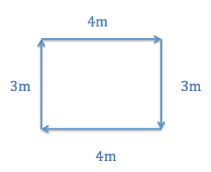
Kinematics
Average Speed vs. Average Velocity
If you started walking from one corner and went all the way around the rectangle in 30 seconds, your average speed would be 0.47 m/s, but your average velocity would be 0 m/s.
Free to share, print, make copies and changes. Get yours at www.boundless.com
http://None. CC BY-SA 3.0 http://None View on Boundless.com

Slide 21
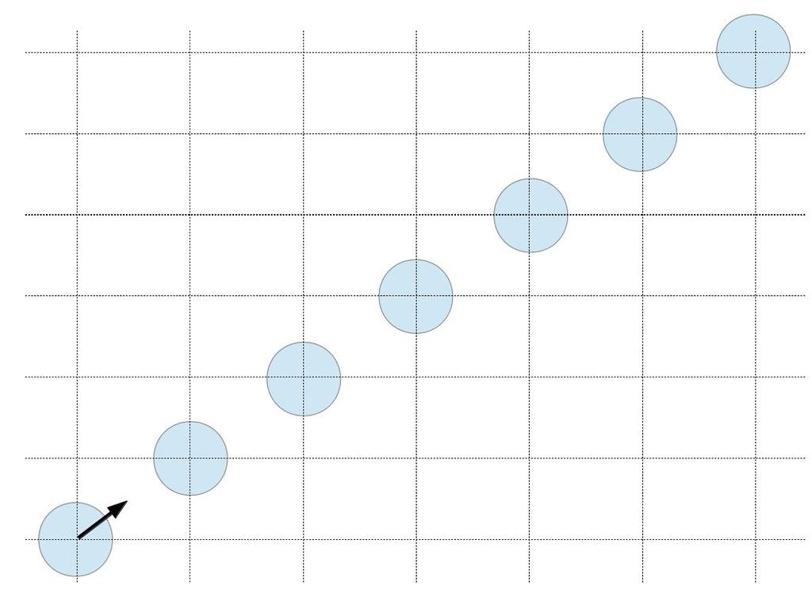
Kinematics
Puck Sliding on Ice
Motion diagram of a puck sliding on ice. The puck is moving at a constant velocity.
Free to share, print, make copies and changes. Get yours at www.boundless.com
Amazon Web Services. "Boundless." CC BY http://s3.amazonaws.com/figures.boundless.com/51129b2ee4b0c14bf464ce1b/1.jpg View on Boundless.com

Slide 22
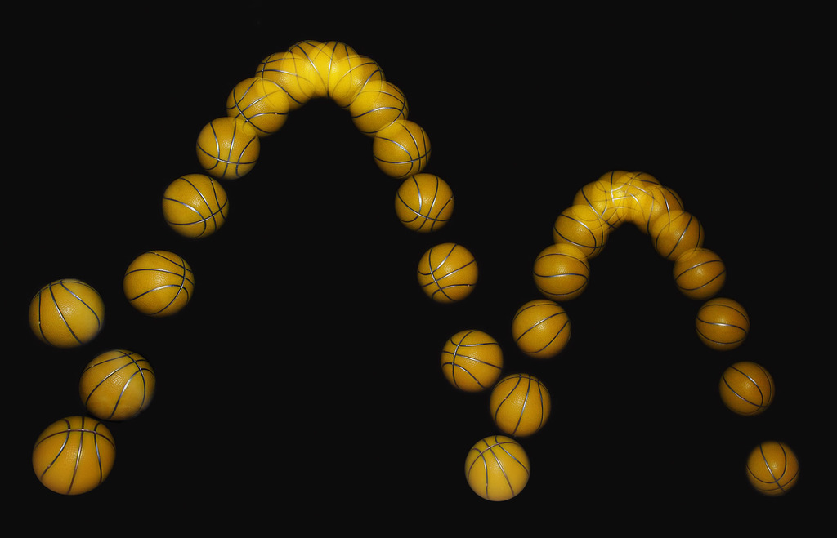
Kinematics
Bouncing Ball
A bouncing ball captured with a stroboscopic flash at 25 images per second.
Free to share, print, make copies and changes. Get yours at www.boundless.com
Wikimedia. CC BY http://upload.wikimedia.org/wikipedia/commons/3/3c/Bouncing_ball_strobe_edit.jpg View on Boundless.com

Slide 23
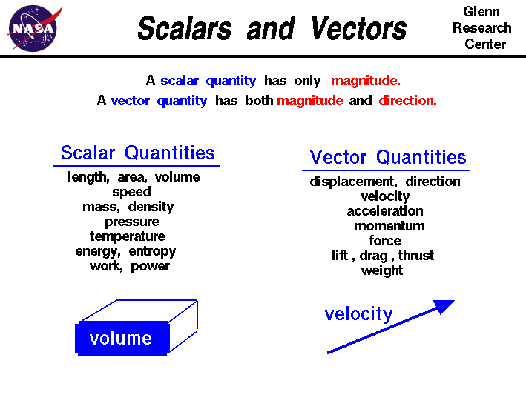
Kinematics
Scalars vs. Vectors
A brief list of quantities that are either scalars or vectors.
Free to share, print, make copies and changes. Get yours at www.boundless.com
National Air and Space Association. "Scalars and Vectors." Public domain http://www.grc.nasa.gov/WWW/k-12/airplane/vectors.html View on Boundless.com

Slide 24
Kinematics
Free Fall
This clip shows an object in free fall.
Free to share, print, make copies and changes. Get yours at www.boundless.com
Wikipedia. "Free-fall." CC BY-SA http://en.wikipedia.org/wiki/File:Free-fall.gif View on Boundless.com

Slide 25

Kinematics
Scalars and Vectors
Mr. Andersen explains the differences between scalar and vectors quantities. He also uses a demonstration to show the importance of vectors and vector addition.
Free to share, print, make copies and changes. Get yours at www.boundless.com
View on Boundless.com

Slide 26
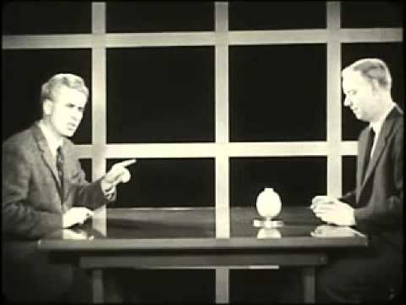
Kinematics
Frames of Reference (1960) Educational Film
Frames of Reference is a 1960 educational film by Physical Sciences Study Committee. The film was made to be shown in high school physics courses. In the film University of Toronto physics professors Patterson Hume and Donald Ivey explain the distinction between inertial and nonintertial frames of reference, while demonstrating these concepts through humorous camera tricks. For example, the film opens with Dr. Hume, who appears to be upside down, accusing Dr. Ivey of being upside down. Only when the pair flip a coin does it become obvious that Dr. Ivey — and the camera — are indeed inverted. The film's humor serves both to hold students' interest and to demonstrate the concepts being discussed. This PSSC film utilizes a fascinating set consisting of a rotating table and furniture occupying surprisingly unpredictable spots within the viewing area. The fine cinematography by Abraham Morochnik, and funny narration by University of Toronto professors Donald Ivey and Patterson Hume is a wonderful example of the fun a creative team of filmmakers can have with a subject that other, less imaginative types might find pedestrian. Producer: Richard Leacock Production Company: Educational Development Corp. Sponsor: Eric Prestamon
Free to share, print, make copies and changes. Get yours at www.boundless.com
View on Boundless.com

Slide 27
Kinematics
Kinematics of a particle trajectory
Kinematic equations can be used to calculate the trajectory of particles or objects. The physical quantities relevant to the motion of a particle include: mass m, position r, velocity v, acceleration a.
Free to share, print, make copies and changes. Get yours at www.boundless.com
Wikipedia. "Kinematics." CC BY http://en.wikipedia.org/wiki/Kinematics View on Boundless.com

Slide 28
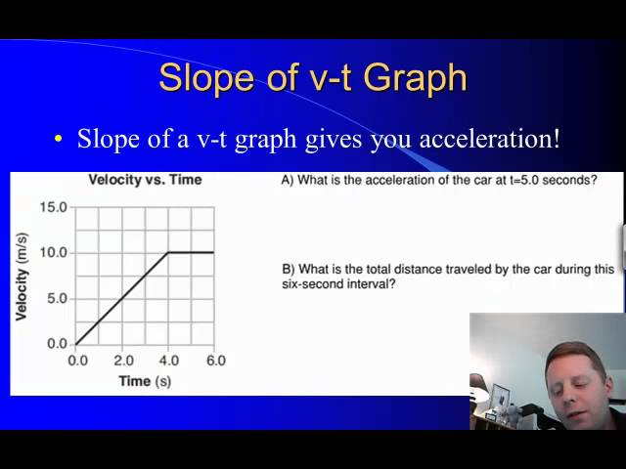
Kinematics
Graphing Motion
A brief introduction to particle diagrams and motion graphs.
Free to share, print, make copies and changes. Get yours at www.boundless.com
View on Boundless.com

Slide 29
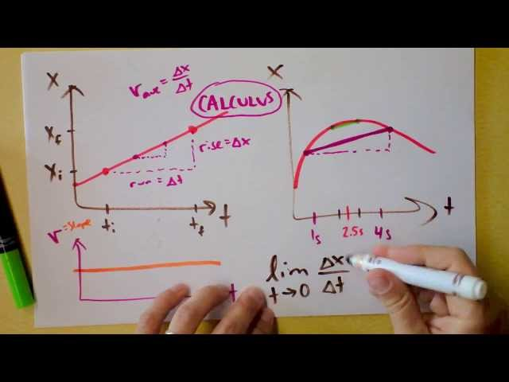
Kinematics
Instantaneous Velocity, Acceleration, Jerk, Slopes, Graphs vs. Time
This is how kinematics begins.
Free to share, print, make copies and changes. Get yours at www.boundless.com
View on Boundless.com

Slide 30
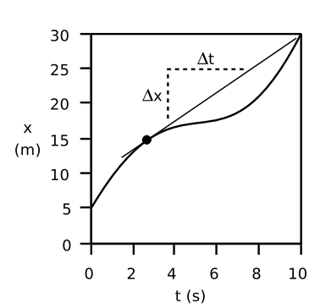
Kinematics
Determining instantaneous velocity
The velocity at any given moment is deﬁned as the slope of the tangent line through the relevant point on the graph
Free to share, print, make copies and changes. Get yours at www.boundless.com
Light and Matter. CC BY http://lightandmatter.com/lmb.pdf View on Boundless.com

Slide 31
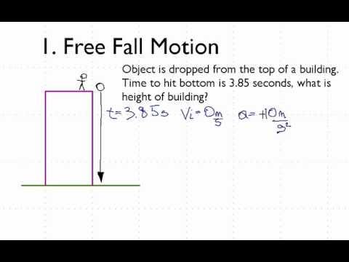
Kinematics
Free Fall Motion - YouTube
Describes how to calculate the time for an object to fall if given the height and the height that an object fell if given the time to fall.
Free to share, print, make copies and changes. Get yours at www.boundless.com
View on Boundless.com

Slide 32
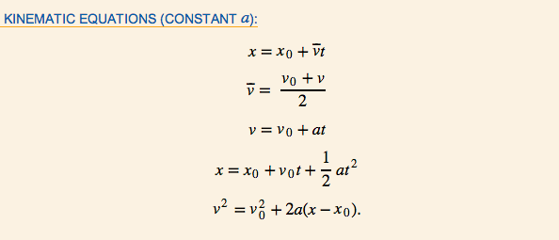
Kinematics
Kinematic Equations
A summary of kinematic equations that can be used in scenarios with a constant acceleration
Free to share, print, make copies and changes. Get yours at www.boundless.com
OpenStax CNX. "OpenStax College, College Physics. October 19, 2012." CC BY 3.0 http://cnx.org/content/m42099/latest/?collection=col11406/1.7 View on Boundless.com

Slide 33
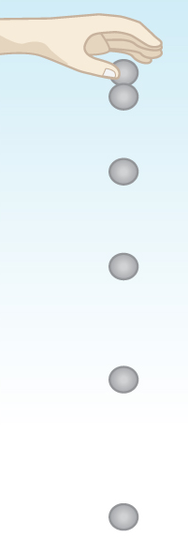
Kinematics
One-Dimensional Motion
When you drop an object, it falls vertically toward the center of the earth due to the constant acceleration of gravity.
Free to share, print, make copies and changes. Get yours at www.boundless.com
OpenStax CNX. "OpenStax College, College Physics. October 19, 2012." CC BY 3.0 http://cnx.org/content/m42102/latest/?collection=col11406/1.7 View on Boundless.com

Slide 34
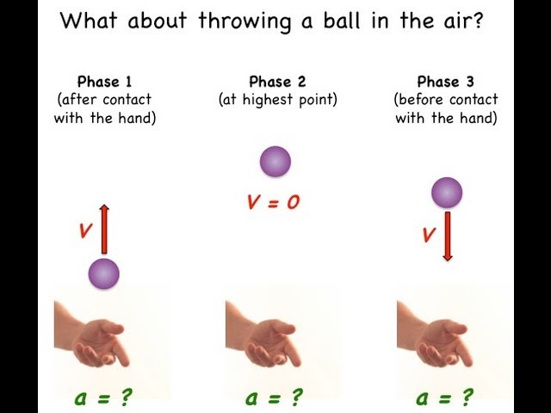
Kinematics
Constant Acceleration Explained with Vectors and Algebra
This video answers the question "what is acceleration? ".
Free to share, print, make copies and changes. Get yours at www.boundless.com
View on Boundless.com

Slide 35
Attribution
Kinematics
Wiktionary. "kinematic." CC BY-SA 3.0 http://en.wiktionary.org/wiki/kinematic
Wiktionary. "acceleration." CC BY-SA 3.0 http://en.wiktionary.org/wiki/acceleration
Wikipedia. "Acceleration." CC BY-SA 3.0 http://en.wikipedia.org/wiki/Acceleration
Wikipedia. "stroboscopic." CC BY-SA 3.0 http://en.wikipedia.org/wiki/stroboscopic
Wiktionary. "diagram." CC BY-SA 3.0 http://en.wiktionary.org/wiki/diagram
Wiktionary. "motion." CC BY-SA 3.0 http://en.wiktionary.org/wiki/motion
Wikipedia. "Motion diagram." CC BY-SA 3.0 http://en.wikipedia.org/wiki/Motion_diagram
Wiktionary. "kinematics." CC BY-SA 3.0 http://en.wiktionary.org/wiki/kinematics
OpenStax CNX. "OpenStax College, College Physics. September 17, 2013." CC BY 3.0 http://cnx.org/content/m42125/latest/?collection=col11406/1.7
Wiktionary. "kinematics." CC BY-SA 3.0 http://en.wiktionary.org/wiki/kinematics
Wikipedia. "Kinematics." CC BY-SA 3.0 http://en.wikipedia.org/wiki/Kinematics
OpenStax CNX. "OpenStax College, College Physics. September 17, 2013." CC BY 3.0 http://cnx.org/content/m42122/latest/?collection=col11406/1.7
Wiktionary. "scalar." CC BY-SA 3.0 http://en.wiktionary.org/wiki/scalar
Wiktionary. "vector." CC BY-SA 3.0 http://en.wiktionary.org/wiki/vector
Wikipedia. "Vector (physics)." CC BY-SA 3.0 http://en.wikipedia.org/wiki/Vector_(physics)
OpenStax CNX. "OpenStax College, College Physics. September 17, 2013." CC BY 3.0 http://cnx.org/content/m42124/latest/?collection=col11406/1.7
Wikipedia. "Scalar (physics)." CC BY-SA 3.0 http://en.wikipedia.org/wiki/Scalar_(physics)
Free to share, print, make copies and changes. Get yours at www.boundless.com

Slide 36
Kinematics
Wiktionary. "position." CC BY-SA 3.0 http://en.wiktionary.org/wiki/position
Wiktionary. "velocity." CC BY-SA 3.0 http://en.wiktionary.org/wiki/velocity
Wiktionary. "acceleration." CC BY-SA 3.0 http://en.wiktionary.org/wiki/acceleration
OpenStax CNX. "OpenStax College, College Physics. September 17, 2013." CC BY 3.0 http://cnx.org/content/m42100/latest/?collection=col11406/1.7
Wikipedia. "Acceleration." CC BY-SA 3.0 http://en.wikipedia.org/wiki/Acceleration
Wiktionary. "velocity." CC BY-SA 3.0 http://en.wiktionary.org/wiki/velocity
OpenStax CNX. "OpenStax College, College Physics. September 17, 2013." CC BY 3.0 http://cnx.org/content/m42096/latest/?collection=col11406/1.7
Wiktionary. "instantaneous." CC BY-SA 3.0 http://en.wiktionary.org/wiki/instantaneous
Light and Matter. CC BY http://lightandmatter.com/lmb.pdf
Wiktionary. "frame of reference." CC BY-SA 3.0 http://en.wiktionary.org/wiki/frame_of_reference
Wiktionary. "displacement." CC BY-SA 3.0 http://en.wiktionary.org/wiki/displacement
OpenStax CNX. "OpenStax College, College Physics. September 17, 2013." CC BY 3.0 http://cnx.org/content/m42033/latest/?collection=col11406/1.7
Light and Matter. CC BY http://lightandmatter.com/lmb.pdf
Light and Matter. CC BY http://lightandmatter.com/lmb.pdf
Wiktionary. "acceleration." CC BY-SA 3.0 http://en.wiktionary.org/wiki/acceleration
Wikipedia. "Free fall." CC BY-SA 3.0 http://en.wikipedia.org/wiki/Free_fall
Light and Matter. CC BY http://lightandmatter.com/lmb.pdf
Free to share, print, make copies and changes. Get yours at www.boundless.com

