Slide 1


Boundless Lecture Slides
Available on the Boundless Teaching Platform
Free to share, print, make copies and changes. Get yours at www.boundless.com

Slide 2



Using Boundless Presentations
Boundless Teaching Platform
Boundless empowers educators to engage their students with affordable, customizable textbooks and intuitive teaching tools. The free Boundless Teaching Platform gives educators the ability to customize textbooks in more than 20 subjects that align to hundreds of popular titles. Get started by using high quality Boundless books, or make switching to our platform easier by building from Boundless content pre-organized to match the assigned textbook. This platform gives educators the tools they need to assign readings and assessments, monitor student activity, and lead their classes with pre-made teaching resources.
Get started now at:
The Appendix
The appendix is for you to use to add depth and breadth to your lectures. You can simply drag and drop slides from the appendix into the main presentation to make for a richer lecture experience.
http://boundless.com/teaching-platform
Free to edit, share, and copy
Feel free to edit, share, and make as many copies of the Boundless presentations as you like. We encourage you to take these presentations and make them your own.
If you have any questions or problems please email:
educators@boundless.com
Free to share, print, make copies and changes. Get yours at www.boundless.com

Slide 3

About Boundless
Boundless is an innovative technology company making education more affordable and accessible for students everywhere. The company creates the world’s best open educational content in 20+ subjects that align to more than 1,000 popular college textbooks. Boundless integrates learning technology into all its premium books to help students study more efficiently at a fraction of the cost of traditional textbooks. The company also empowers educators to engage their students more effectively through customizable books and intuitive teaching tools as part of the Boundless Teaching Platform. More than 2 million learners access Boundless free and premium content each month across the company’s wide distribution platforms, including its website, iOS apps, Kindle books, and iBooks. To get started learning or teaching with Boundless, visit boundless.com.
Free to share, print, make copies and changes. Get yours at www.boundless.com

Slide 4
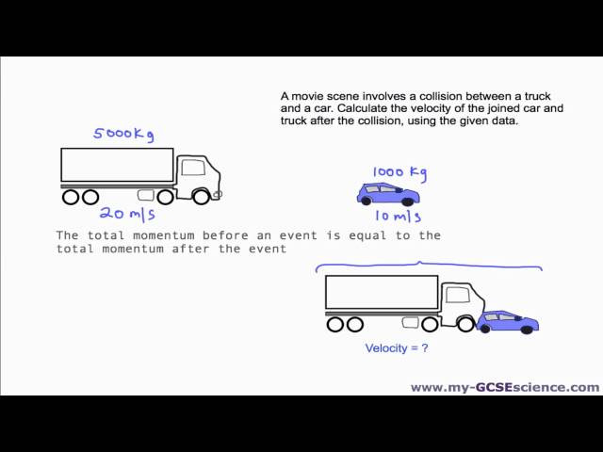
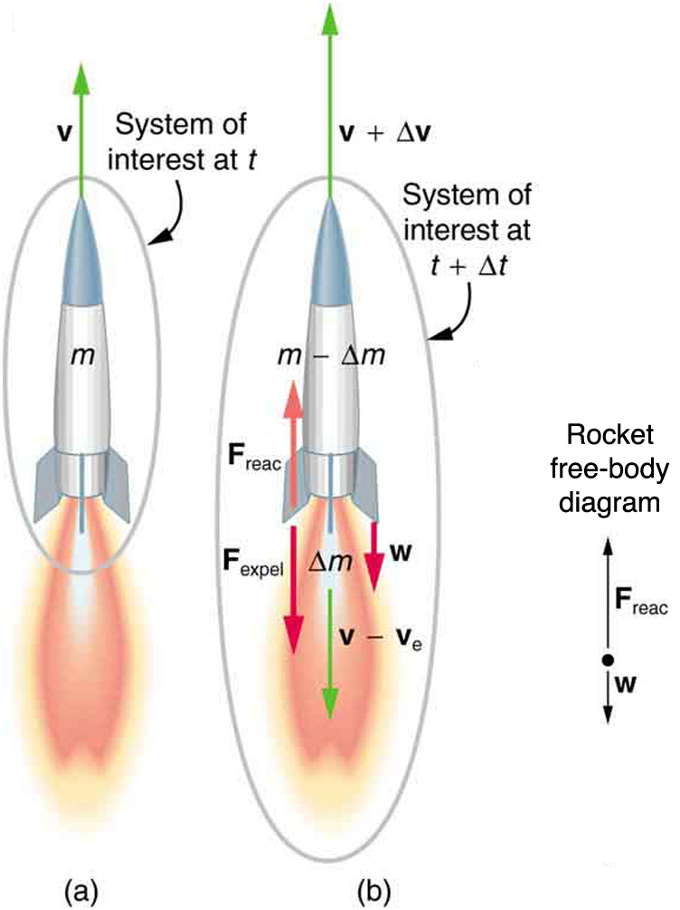

Linear Momentum and Collisions
Introduction
Conservation of Momentum
Collisions
Rocket Propulsion
]
Center of Mass
Linear Momentum and Collisions
Free to share, print, make copies and changes. Get yours at www.boundless.com

Slide 5

Introduction
Linear Momentum and Collisions > Introduction
Linear Momentum
Momentum, Force, and Newton's Second Law
Impulse
Free to share, print, make copies and changes. Get yours at www.boundless.com
www.boundless.com/physics/textbooks/boundless-physics-textbook/linear-momentum-and-collisions-7/introduction-68/

Slide 6
Conservation of Momentum
Linear Momentum and Collisions > Conservation of Momentum
Internal vs. External Forces
Free to share, print, make copies and changes. Get yours at www.boundless.com
www.boundless.com/physics/textbooks/boundless-physics-textbook/linear-momentum-and-collisions-7/conservation-of-momentum-69/

Slide 7
Collisions
Linear Momentum and Collisions > Collisions
Conservation of Energy and Momentum
Glancing Collisions
Elastic Collisions in One Dimension
Elastic Collisions in Multiple Dimensions
Inelastic Collisions in One Dimension
Inelastic Collisions in Multiple Dimensions
Free to share, print, make copies and changes. Get yours at www.boundless.com
www.boundless.com/physics/textbooks/boundless-physics-textbook/linear-momentum-and-collisions-7/collisions-70/

Slide 8
Rocket Propulsion
Linear Momentum and Collisions > Rocket Propulsion
Rocket Propulsion, Changing Mass, and Momentum
Free to share, print, make copies and changes. Get yours at www.boundless.com
www.boundless.com/physics/textbooks/boundless-physics-textbook/linear-momentum-and-collisions-7/rocket-propulsion-71/

Slide 9
Center of Mass
Linear Momentum and Collisions > Center of Mass
Locating the Center of Mass
Motion of the Center of Mass
Center of Mass of the Human Body
Center of Mass and Translational Motion
Free to share, print, make copies and changes. Get yours at www.boundless.com
www.boundless.com/physics/textbooks/boundless-physics-textbook/linear-momentum-and-collisions-7/center-of-mass-72/

Slide 10
Appendix
Free to share, print, make copies and changes. Get yours at www.boundless.com

Slide 11
Key terms
Linear Momentum and Collisions
center of mass The center of mass (COM) is the unique point at the center of a distribution of mass in space that has the property that the weighted position vectors relative to this point sum to zero.
center of mass The center of mass (COM) is the unique point at the center of a distribution of mass in space that has the property that the weighted position vectors relative to this point sum to zero.
closed system A physical system that doesn't exchange any matter with its surroundings and isn't subject to any force whose source is external to the system.
conservation A particular measurable property of an isolated physical system does not change as the system evolves.
degrees of freedom A degree of freedom is an independent physical parameter, often called a dimension, in the formal description of the state of a physical system. The set of all dimensions of a system is known as a phase space.
dimension A measure of spatial extent in a particular direction, such as height, width or breadth, or depth.
elastic referring to elastic collision, in contrast to inelastic collision. A collision in which kinetic energy is conserved
elastic collision An encounter between two bodies in which the total kinetic energy of the two bodies after the encounter is equal to their total kinetic energy before the encounter. Elastic collisions occur only if there is no net conversion of kinetic energy into other forms.
elastic collision An encounter between two bodies in which the total kinetic energy of the two bodies after the encounter is equal to their total kinetic energy before the encounter. Elastic collisions occur only if there is no net conversion of kinetic energy into other forms.
force A physical quantity that denotes ability to push, pull, twist or accelerate a body which is measured in a unit dimensioned in mass × distance/time² (ML/T²): SI: newton (N); CGS: dyne (dyn)
friction A force that resists the relative motion or tendency to such motion of two bodies in contact.
impulse The integral of force over time.
Free to share, print, make copies and changes. Get yours at www.boundless.com

Slide 12
Linear Momentum and Collisions
inelastic (As referring to an inelastic collision, in contrast to an elastic collision. ) A collision in which kinetic energy is not conserved.
inelastic (As referring to an inelastic collision, in contrast to an elastic collision. ) A collision in which kinetic energy is not conserved.
kinetic energy The energy possessed by an object because of its motion, equal to one half the mass of the body times the square of its velocity.
kinetic energy The energy possessed by an object because of its motion, equal to one half the mass of the body times the square of its velocity.
kinetic energy The energy possessed by an object because of its motion, equal to one half the mass of the body times the square of its velocity.
kinetic energy The energy possessed by an object because of its motion, equal to one half the mass of the body times the square of its velocity.
kinetic energy The energy possessed by an object because of its motion, equal to one half the mass of the body times the square of its velocity.
kinetic energy The energy possessed by an object because of its motion, equal to one half the mass of the body times the square of its velocity.
momentum (of a body in motion) the product of its mass and velocity.
momentum (of a body in motion) the product of its mass and velocity.
momentum (of a body in motion) the product of its mass and velocity.
momentum (of a body in motion) the product of its mass and velocity.
Free to share, print, make copies and changes. Get yours at www.boundless.com

Slide 13
Linear Momentum and Collisions
momentum (of a body in motion) the product of its mass and velocity.
momentum (of a body in motion) the product of its mass and velocity.
Newton's third law of motion states that all forces exist in pairs: if one object A exerts a force FA on a second object B, then B simultaneously exerts a force FB on A, and the two forces are equal and opposite: FA = −FB.
plumb line A cord with a weight attached, used to produce a vertical line.
point particle An idealization of particles heavily used in physics. Its defining feature is that it lacks spatial extension, meaning that geometrically the particle is equivalent to a point.
rigid body An idealized solid whose size and shape are fixed and remain unaltered when forces are applied; used in Newtonian mechanics to model real objects.
rigid body An idealized solid whose size and shape are fixed and remain unaltered when forces are applied; used in Newtonian mechanics to model real objects.
torque A rotational or twisting effect of a force; (SI unit newton-meter or Nm; imperial unit foot-pound or ft-lb)
Free to share, print, make copies and changes. Get yours at www.boundless.com

Slide 14

Linear Momentum and Collisions
Plumb Line Method for Center of Mass
Suspend the object from two locations and to drop plumb lines from the suspension points. The intersection of the two lines is the center of mass.
Free to share, print, make copies and changes. Get yours at www.boundless.com
Wikipedia. "File:Center gravity 2.svg - Wikipedia, the free encyclopedia." Public domain http://en.wikipedia.org/w/index.php?title=File:Center_gravity_2.svg&page=1 View on Boundless.com

Slide 15
Linear Momentum and Collisions
Elastic Collision of Two Unequal Masses
In this animation, two unequal masses collide and recoil.
Free to share, print, make copies and changes. Get yours at www.boundless.com
Wikipedia. "Elastic collision." CC BY http://en.wikipedia.org/wiki/Elastic_collision View on Boundless.com

Slide 16
Linear Momentum and Collisions
Newton's Cradle
Total momentum of the system (or Cradle) is conserved. (neglecting frictional loss in the system. )
Free to share, print, make copies and changes. Get yours at www.boundless.com
Wikipedia. "Momentum." CC BY http://en.wikipedia.org/wiki/Momentum View on Boundless.com

Slide 17
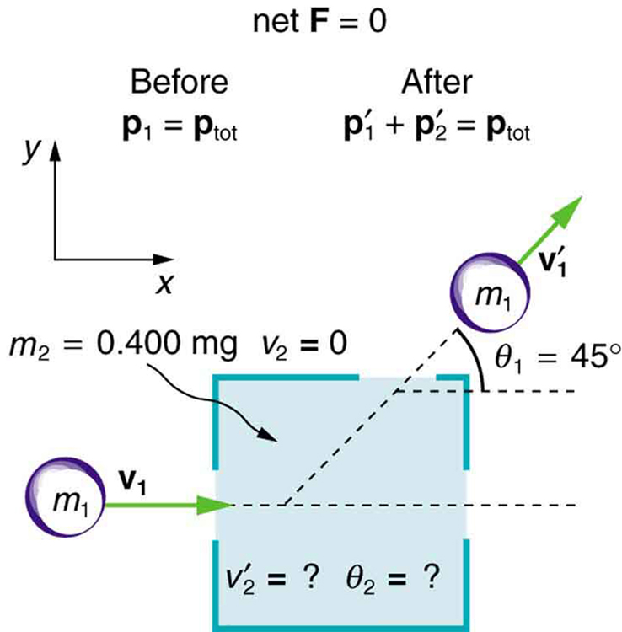
Linear Momentum and Collisions
Collision Example
This illustrates the example problem in which one mass collides into another mass that is initially stationary.
Free to share, print, make copies and changes. Get yours at www.boundless.com
OpenStax CNX. "OpenStax College, College Physics. January 16, 2015." CC BY 3.0 http://cnx.org/content/m42165/latest/?collection=col11406/latest View on Boundless.com

Slide 18
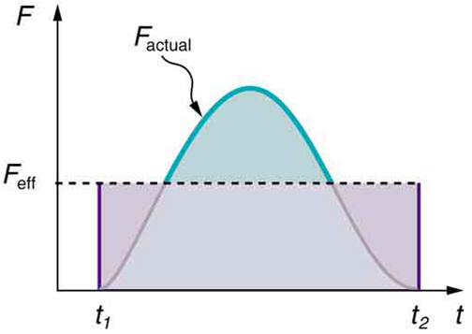
Linear Momentum and Collisions
Force vs. Time
A graph of force versus time with time along the x-axis and force along the y-axis for an actual force and an equivalent effective force. The areas under the two curves are equal.
Free to share, print, make copies and changes. Get yours at www.boundless.com
OpenStax CNX. "OpenStax College, College Physics. January 26, 2013." CC BY 3.0 http://cnx.org/content/m42159/latest/?collection=col11406/1.7 View on Boundless.com

Slide 19
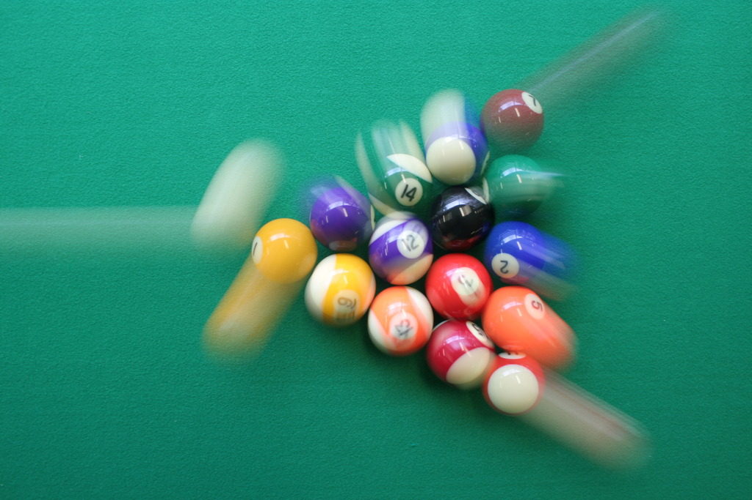
Linear Momentum and Collisions
Momentum in a Closed System
In a game of pool, the system of entire balls can be considered a closed system. Therefore, the total momentum of the balls is conserved.
Free to share, print, make copies and changes. Get yours at www.boundless.com
Wikipedia. "Momentum." CC BY http://en.wikipedia.org/wiki/Momentum View on Boundless.com

Slide 20
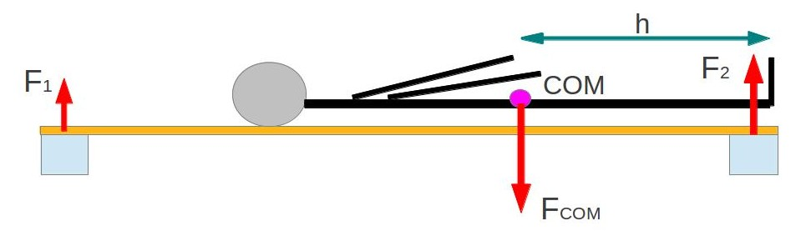
Linear Momentum and Collisions
The COM of a Human Body
This figure demonstrates measuring the COM of a human body.
Free to share, print, make copies and changes. Get yours at www.boundless.com
Amazon Web Services. "Boundless." CC BY http://s3.amazonaws.com/figures.boundless.com/51119464e4b0f11e4bcb2448/1.jpg View on Boundless.com

Slide 21
Linear Momentum and Collisions
Inelastic Collision
In this animation, one mass collides into another initially stationary mass in a perfectly inelastic collision.
Free to share, print, make copies and changes. Get yours at www.boundless.com
Wikipedia. "Inelastic collision." CC BY http://en.wikipedia.org/wiki/Inelastic_collision View on Boundless.com

Slide 22
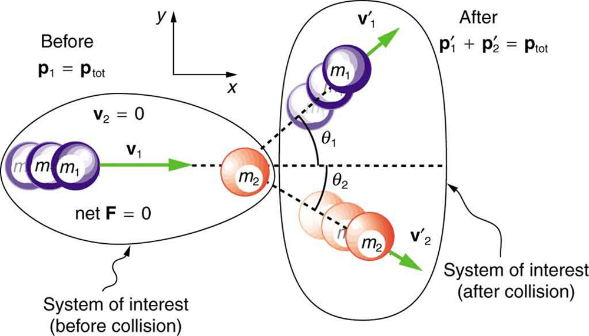
Linear Momentum and Collisions
Illustration of Elastic Collision in Two Dimensions
In this illustration, we see the initial and final configurations of two masses that undergo an elastic collision in two dimensions.
Free to share, print, make copies and changes. Get yours at www.boundless.com
OpenStax CNX. "OpenStax College, College Physics. February 10, 2013." CC BY 3.0 http://cnx.org/content/m42165/latest/?collection=col11406/latest View on Boundless.com

Slide 23
Linear Momentum and Collisions
COM of the Earth and Moon
Earth and Moon orbiting a COM inside the Earth. The red cross represents the COM of the two-body system. The COM will orbit around the Sun as if it is a point particle.
Free to share, print, make copies and changes. Get yours at www.boundless.com
Wikipedia. "Center of mass." CC BY http://en.wikipedia.org/wiki/Center_of_mass View on Boundless.com

Slide 24
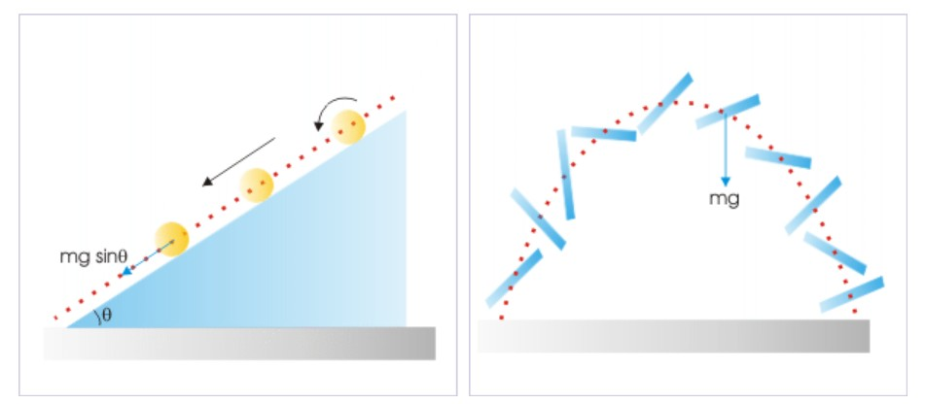
Linear Momentum and Collisions
Forces on the COM
Left: The force appears to operate on the COM is "mgsinθ. Right: The force appears to operate on the COM is "mg".
Free to share, print, make copies and changes. Get yours at www.boundless.com
OpenStax CNX. "Sunil Kumar Singh, Center of Mass. February 5, 2013." CC BY 3.0 http://cnx.org/content/m14119/latest/ View on Boundless.com

Slide 25
Linear Momentum and Collisions
Collision Example
This illustrates the example problem in which one mass collides into another mass that is initially stationary.
Free to share, print, make copies and changes. Get yours at www.boundless.com
OpenStax CNX. "OpenStax College, College Physics. February 10, 2013." CC BY 3.0 http://cnx.org/content/m42165/latest/?collection=col11406/latest View on Boundless.com

Slide 26
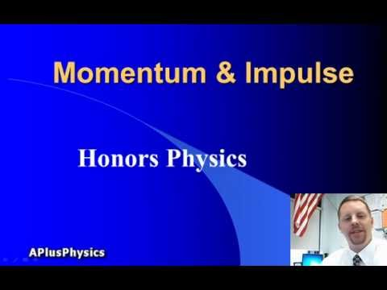
Linear Momentum and Collisions
Momentum & Impulse
A brief overview of momentum and impulse for high school physics students.
Free to share, print, make copies and changes. Get yours at www.boundless.com
View on Boundless.com

Slide 27
Linear Momentum and Collisions
Conservation of Energy and Momentum
GCSE physics - how to calculate momentum and use the conservation of momentum law.
Free to share, print, make copies and changes. Get yours at www.boundless.com
View on Boundless.com

Slide 28
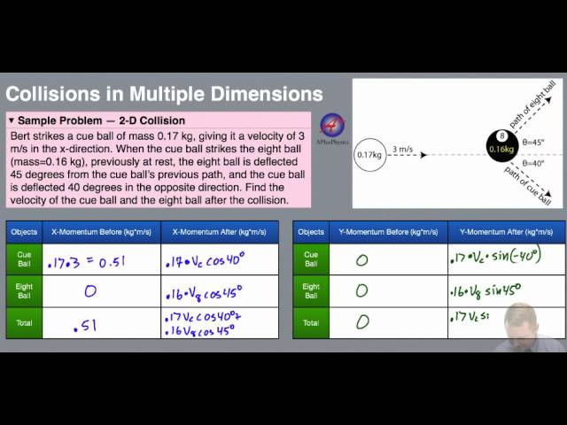
Linear Momentum and Collisions
Collisions in Multiple Dimensions
A brief introduction to problem solving of collisions in two dimensions using the law of conservation of momentum.
Free to share, print, make copies and changes. Get yours at www.boundless.com
View on Boundless.com

Slide 29
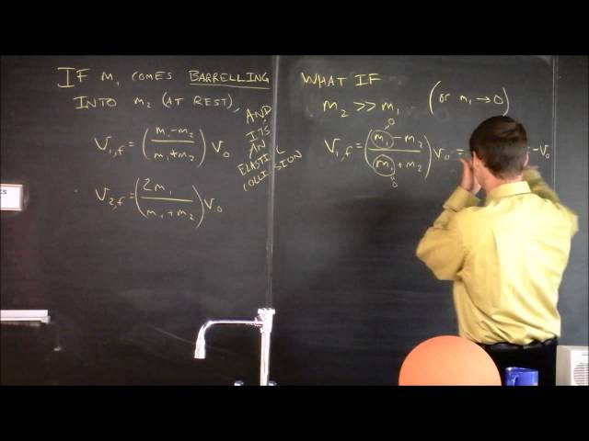
Linear Momentum and Collisions
Examples of Collisions
Free to share, print, make copies and changes. Get yours at www.boundless.com
View on Boundless.com

Slide 30
Linear Momentum and Collisions
Free-body diagram of rocket propulsion
(a) This rocket has a mass m and an upward velocity v. The net external force on the system is −mg, if air resistance is neglected. (b) A time Δt later the system has two main parts, the ejected gas and the remainder of the rocket. The reaction force on the rocket is what overcomes the gravitational force and accelerates it upward.
Free to share, print, make copies and changes. Get yours at www.boundless.com
OpenStax CNX. "OpenStax College, Introduction to Rocket Propulsion. November 3, 2012." CC BY 3.0 http://cnx.org/content/m42166/latest/ View on Boundless.com

Slide 31
Linear Momentum and Collisions
Newton's Cradle
Total momentum of the system (or Cradle) is conserved. (neglecting frictional loss in the system. )
Free to share, print, make copies and changes. Get yours at www.boundless.com
Wikipedia. "Momentum." CC BY http://en.wikipedia.org/wiki/Momentum View on Boundless.com

Slide 32
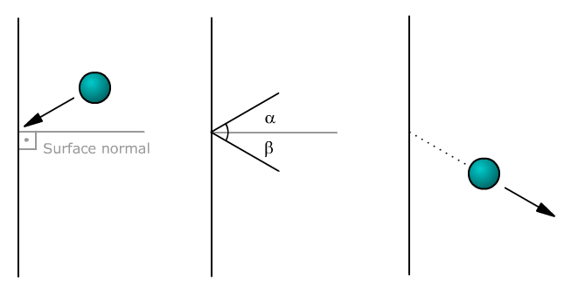
Linear Momentum and Collisions
Collision
Object is deflected after the collision withthe surface. The angles between the body and the surface normal areindicated as α and β. The angles between the body and the surface are 90 - α and 90 - β.
Free to share, print, make copies and changes. Get yours at www.boundless.com
Wikimedia. CC BY-SA http://upload.wikimedia.org/wikipedia/commons/3/34/Deflection.png View on Boundless.com

Slide 33
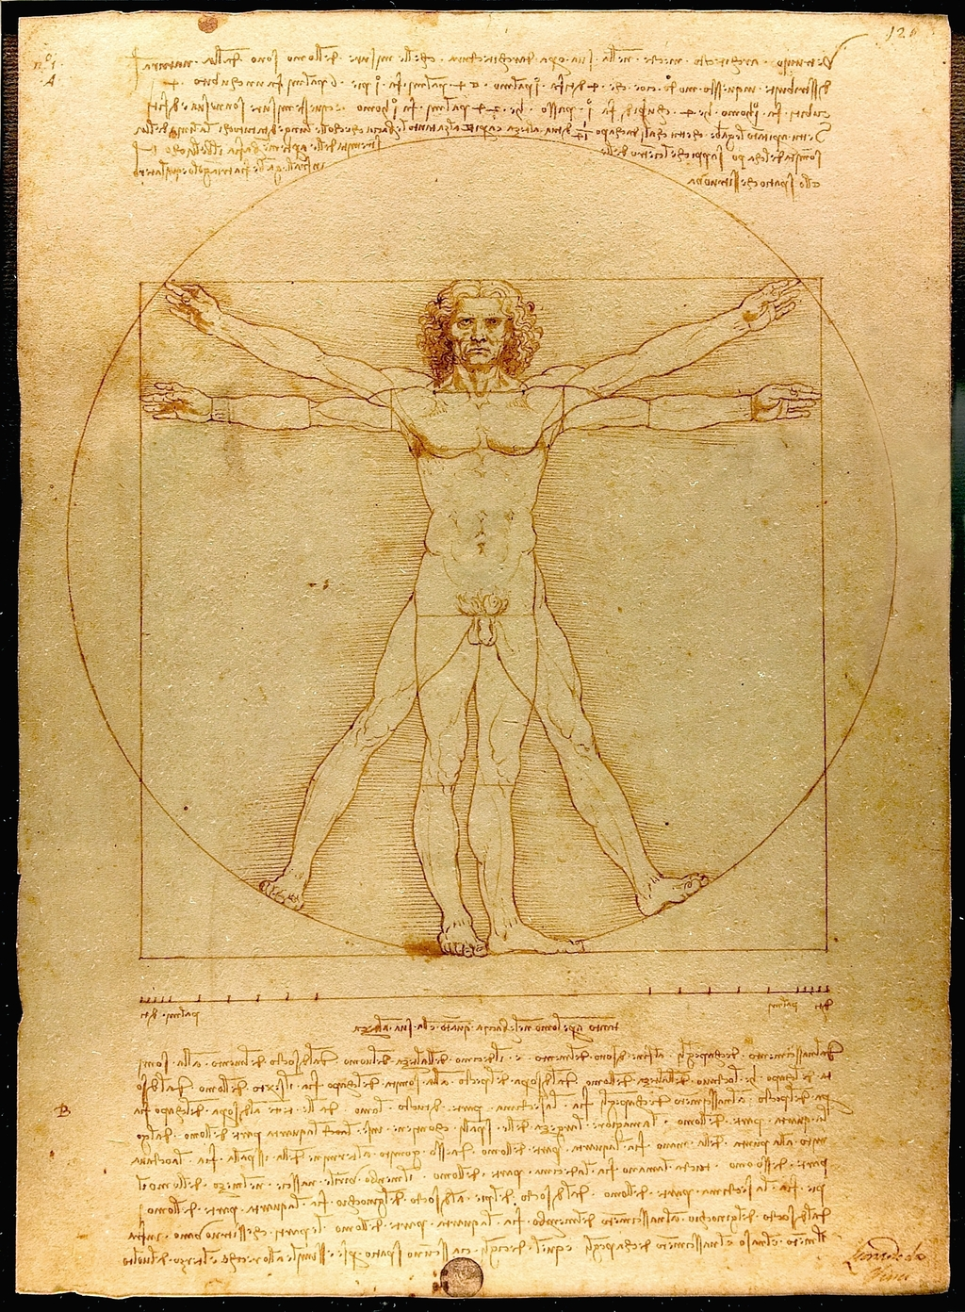
Linear Momentum and Collisions
Leonardo da Vinci's "The Vitruvian Man"
Vitruvian Man: A drawing created by Leonardo da Vinci. The drawing is based on the correlations of ideal human proportions with geometry described[4] by the ancient Roman architect Vitruvius in Book III of his treatise De Architectura.
Free to share, print, make copies and changes. Get yours at www.boundless.com
Wikipedia. "Da Vinci Vitruve Luc Viatour." Public domain http://en.wikipedia.org/wiki/File:Da_Vinci_Vitruve_Luc_Viatour.jpg View on Boundless.com

Slide 34
Attribution
Linear Momentum and Collisions
Wikipedia. "closed system." CC BY-SA 3.0 http://en.wikipedia.org/wiki/closed%20system
Wikipedia. "Momentum." CC BY-SA 3.0 http://en.wikipedia.org/wiki/Momentum
OpenStax CNX. "OpenStax College, College Physics. September 17, 2013." CC BY 3.0 http://cnx.org/content/m42156/latest/?collection=col11406/1.7
Wiktionary. "momentum." CC BY-SA 3.0 http://en.wiktionary.org/wiki/momentum
Wikipedia. "kinetic energy." CC BY-SA 3.0 http://en.wikipedia.org/wiki/kinetic%20energy
Wiktionary. "force." CC BY-SA 3.0 http://en.wiktionary.org/wiki/force
Wikipedia. "Collision." CC BY-SA 3.0 http://en.wikipedia.org/wiki/Collision
Wikipedia. "Angle of incidence." CC BY-SA 3.0 http://en.wikipedia.org/wiki/Angle_of_incidence
Wiktionary. "torque." CC BY-SA 3.0 http://en.wiktionary.org/wiki/torque
Wikipedia. "center of mass." CC BY-SA 3.0 http://en.wikipedia.org/wiki/center%20of%20mass
Wikipedia. "Vitruvian Man." CC BY-SA 3.0 http://en.wikipedia.org/wiki/Vitruvian_Man
Wiktionary. "plumb line." CC BY-SA 3.0 http://en.wiktionary.org/wiki/plumb_line
Wikipedia. "Center of mass." CC BY-SA 3.0 http://en.wikipedia.org/wiki/Center_of_mass%23Locating_the_center_of_mass
Wikipedia. "Center of mass." CC BY-SA 3.0 http://en.wikipedia.org/wiki/Center_of_mass%23Locating_the_center_of_mass
OpenStax CNX. "Sunil Kumar Singh, Center of Mass. September 17, 2013." CC BY 3.0 http://cnx.org/content/m14119/latest/
Wiktionary. "rigid body." CC BY-SA 3.0 http://en.wiktionary.org/wiki/rigid_body
Wikipedia. "point particle." CC BY-SA 3.0 http://en.wikipedia.org/wiki/point%20particle
Free to share, print, make copies and changes. Get yours at www.boundless.com

Slide 35
Linear Momentum and Collisions
OpenStax CNX. "Sunil Kumar Singh, Center of Mass. September 17, 2013." CC BY 3.0 http://cnx.org/content/m14119/latest/
Wikipedia. "inelastic." CC BY-SA 3.0 http://en.wikipedia.org/wiki/inelastic
Wiktionary. "elastic." CC BY-SA 3.0 http://en.wiktionary.org/wiki/elastic
Wikipedia. "Momentum." CC BY-SA 3.0 http://en.wikipedia.org/wiki/Momentum
Wiktionary. "rigid body." CC BY-SA 3.0 http://en.wiktionary.org/wiki/rigid_body
Wikipedia. "center of mass." CC BY-SA 3.0 http://en.wikipedia.org/wiki/center%20of%20mass
Wikipedia. "Center of mass." CC BY-SA 3.0 http://en.wikipedia.org/wiki/Center_of_mass
Wiktionary. "momentum." CC BY-SA 3.0 http://en.wiktionary.org/wiki/momentum
Wikipedia. "kinetic energy." CC BY-SA 3.0 http://en.wikipedia.org/wiki/kinetic%20energy
OpenStax CNX. "OpenStax College, College Physics. September 17, 2013." CC BY 3.0 http://cnx.org/content/m42165/latest/?collection=col11406/latest
Wikipedia. "Inelastic collision." CC BY-SA 3.0 http://en.wikipedia.org/wiki/Inelastic_collision
Wikipedia. "elastic collision." CC BY-SA 3.0 http://en.wikipedia.org/wiki/elastic%20collision
Wiktionary. "momentum." CC BY-SA 3.0 http://en.wiktionary.org/wiki/momentum
Wikipedia. "kinetic energy." CC BY-SA 3.0 http://en.wikipedia.org/wiki/kinetic%20energy
Wikipedia. "Elastic collision." CC BY-SA 3.0 http://en.wikipedia.org/wiki/Elastic_collision
David McClung. CC BY http://www.themcclungs.net/physics/download/H/Momentum/ElasticCollisions.pdf
Wiktionary. "degrees of freedom." CC BY-SA 3.0 http://en.wiktionary.org/wiki/degrees_of_freedom
Wikipedia. "kinetic energy." CC BY-SA 3.0 http://en.wikipedia.org/wiki/kinetic%20energy
Wikipedia. "Inelastic collision." CC BY-SA 3.0 http://en.wikipedia.org/wiki/Inelastic_collision
Free to share, print, make copies and changes. Get yours at www.boundless.com

Slide 36
Linear Momentum and Collisions
Wiktionary. "momentum." CC BY-SA 3.0 http://en.wiktionary.org/wiki/momentum
Wiktionary. "dimension." CC BY-SA 3.0 http://en.wiktionary.org/wiki/dimension
Wikipedia. "kinetic energy." CC BY-SA 3.0 http://en.wikipedia.org/wiki/kinetic%20energy
OpenStax CNX. "OpenStax College, College Physics. September 17, 2013." CC BY 3.0 http://cnx.org/content/m42165/latest/?collection=col11406/latest
Wiktionary. "impulse." CC BY-SA 3.0 http://en.wiktionary.org/wiki/impulse
Wiktionary. "momentum." CC BY-SA 3.0 http://en.wiktionary.org/wiki/momentum
Wikipedia. "Impulse (physics)." CC BY-SA 3.0 http://en.wikipedia.org/wiki/Impulse_(physics)
OpenStax CNX. "OpenStax College, College Physics. September 17, 2013." CC BY 3.0 http://cnx.org/content/m42159/latest/?collection=col11406/1.7
Wikipedia. "elastic collision." CC BY-SA 3.0 http://en.wikipedia.org/wiki/elastic%20collision
Wikipedia. "inelastic." CC BY-SA 3.0 http://en.wikipedia.org/wiki/inelastic
Wikipedia. "conservation." CC BY-SA 3.0 http://en.wikipedia.org/wiki/conservation
OpenStax CNX. "OpenStax College, Introduction to Linear Momentum and Collisions. September 17, 2013." CC BY 3.0 http://cnx.org/content/m42155/latest/
Wikipedia. "Momentum." CC BY-SA 3.0 http://en.wikipedia.org/wiki/Momentum
Wiktionary. "friction." CC BY-SA 3.0 http://en.wiktionary.org/wiki/friction
Wiktionary. "momentum." CC BY-SA 3.0 http://en.wiktionary.org/wiki/momentum
Wikipedia. "kinetic energy." CC BY-SA 3.0 http://en.wikipedia.org/wiki/kinetic%20energy
Wikipedia. "Inelastic collision." CC BY-SA 3.0 http://en.wikipedia.org/wiki/Inelastic_collision
Wikipedia. "Newton's third law of motion." CC BY-SA 3.0 http://en.wikipedia.org/wiki/Newton's%20third%20law%20of%20motion
OpenStax CNX. "OpenStax College, Introduction to Rocket Propulsion. September 18, 2013." CC BY 3.0 http://cnx.org/content/m42166/latest/
Free to share, print, make copies and changes. Get yours at www.boundless.com

Slide 37
Linear Momentum and Collisions
OpenStax CNX. "OpenStax College, Introduction to Rocket Propulsion. September 18, 2013." CC BY 3.0 http://cnx.org/content/m42166/latest/
OpenStax CNX. "OpenStax College, Introduction to Rocket Propulsion. September 18, 2013." CC BY 3.0 http://cnx.org/content/m42166/latest/
OpenStax CNX. "Sunil Kumar Singh, Rocket. September 18, 2013." CC BY 3.0 http://cnx.org/content/m14866/latest/
Free to share, print, make copies and changes. Get yours at www.boundless.com

