Slide 1


Boundless Lecture Slides
Available on the Boundless Teaching Platform
Free to share, print, make copies and changes. Get yours at www.boundless.com

Slide 2
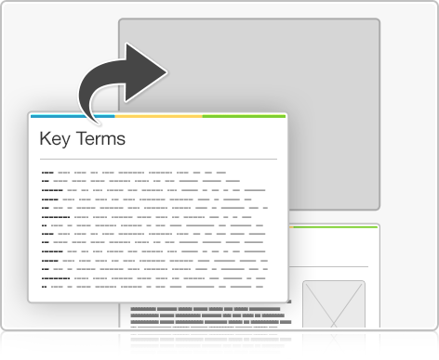


Using Boundless Presentations
Boundless Teaching Platform
Boundless empowers educators to engage their students with affordable, customizable textbooks and intuitive teaching tools. The free Boundless Teaching Platform gives educators the ability to customize textbooks in more than 20 subjects that align to hundreds of popular titles. Get started by using high quality Boundless books, or make switching to our platform easier by building from Boundless content pre-organized to match the assigned textbook. This platform gives educators the tools they need to assign readings and assessments, monitor student activity, and lead their classes with pre-made teaching resources.
Get started now at:
The Appendix
The appendix is for you to use to add depth and breadth to your lectures. You can simply drag and drop slides from the appendix into the main presentation to make for a richer lecture experience.
http://boundless.com/teaching-platform
Free to edit, share, and copy
Feel free to edit, share, and make as many copies of the Boundless presentations as you like. We encourage you to take these presentations and make them your own.
If you have any questions or problems please email:
educators@boundless.com
Free to share, print, make copies and changes. Get yours at www.boundless.com

Slide 3

About Boundless
Boundless is an innovative technology company making education more affordable and accessible for students everywhere. The company creates the world’s best open educational content in 20+ subjects that align to more than 1,000 popular college textbooks. Boundless integrates learning technology into all its premium books to help students study more efficiently at a fraction of the cost of traditional textbooks. The company also empowers educators to engage their students more effectively through customizable books and intuitive teaching tools as part of the Boundless Teaching Platform. More than 2 million learners access Boundless free and premium content each month across the company’s wide distribution platforms, including its website, iOS apps, Kindle books, and iBooks. To get started learning or teaching with Boundless, visit boundless.com.
Free to share, print, make copies and changes. Get yours at www.boundless.com

Slide 4
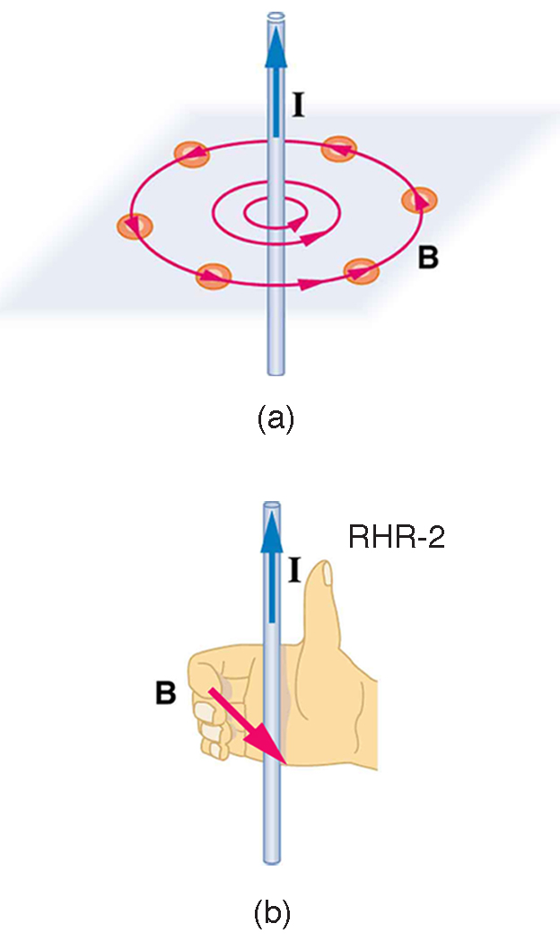
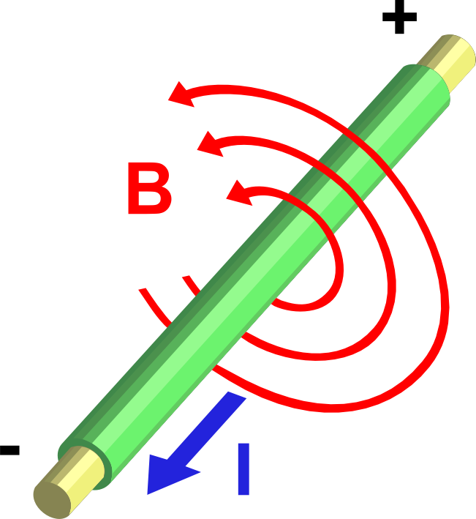
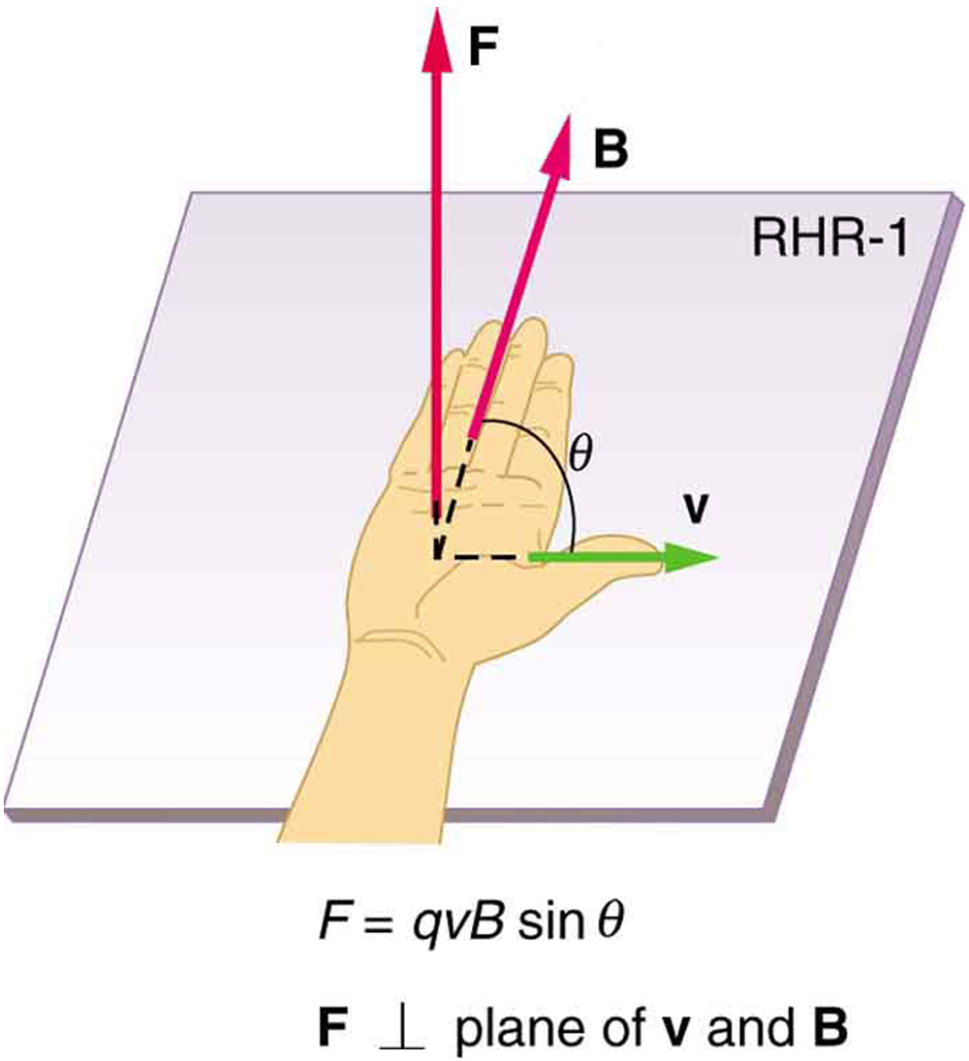
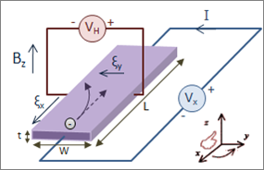

Magnetism
Magnetism and Magnetic Fields
Magnets
Magnetic Force on a Moving Electric Charge
Motion of a Charged Particle in a Magnetic Field
]
Magnetic Fields, Magnetic Forces, and Conductors
Magnetism
Free to share, print, make copies and changes. Get yours at www.boundless.com

Slide 5
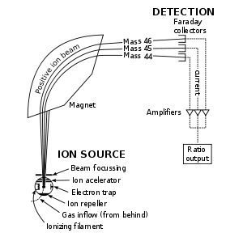
Magnetism (continued)
Applications of Magnetism
]
Magnetism
Free to share, print, make copies and changes. Get yours at www.boundless.com

Slide 6

Magnetism and Magnetic Fields
Magnetism > Magnetism and Magnetic Fields
Electric Currents and Magnetic Fields
Permanent Magnets
Magnetic Field Lines
Geomagnetism
Free to share, print, make copies and changes. Get yours at www.boundless.com
www.boundless.com/physics/textbooks/boundless-physics-textbook/magnetism-21/magnetism-and-magnetic-fields-155/

Slide 7
Magnets
Magnetism > Magnets
Ferromagnets and Electromagnets
Free to share, print, make copies and changes. Get yours at www.boundless.com
www.boundless.com/physics/textbooks/boundless-physics-textbook/magnetism-21/magnets-156/

Slide 8
Magnetic Force on a Moving Electric Charge
Magnetism > Magnetic Force on a Moving Electric Charge
Magnitude of the Magnetic Force
Direction of the Magnetic Force: The Right Hand Rule
Free to share, print, make copies and changes. Get yours at www.boundless.com
www.boundless.com/physics/textbooks/boundless-physics-textbook/magnetism-21/magnetic-force-on-a-moving-electric-charge-157/

Slide 9
Motion of a Charged Particle in a Magnetic Field
Magnetism > Motion of a Charged Particle in a Magnetic Field
Electric vs. Magnetic Forces
Constant Velocity Produces a Straight-Line
Circular Motion
Helical Motion
Examples and Applications
Free to share, print, make copies and changes. Get yours at www.boundless.com
www.boundless.com/physics/textbooks/boundless-physics-textbook/magnetism-21/motion-of-a-charged-particle-in-a-magnetic-field-158/

Slide 10
Magnetic Fields, Magnetic Forces, and Conductors
Magnetism > Magnetic Fields, Magnetic Forces, and Conductors
The Hall Effect
Magnetic Force on a Current-Carrying Conductor
Torque on a Current Loop: Rectangular and General
Ampere's Law: Magnetic Field Due to a Long Straight Wire
Magnetic Force Between Two Parallel Conductors
Free to share, print, make copies and changes. Get yours at www.boundless.com
www.boundless.com/physics/textbooks/boundless-physics-textbook/magnetism-21/magnetic-fields-magnetic-forces-and-conductors-159/

Slide 11
Applications of Magnetism
Magnetism > Applications of Magnetism
Mass Spectrometer
Ferromagnetism
Paramagnetism and Diamagnetism
Solenoids, Current Loops, and Electromagnets
Free to share, print, make copies and changes. Get yours at www.boundless.com
www.boundless.com/physics/textbooks/boundless-physics-textbook/magnetism-21/applications-of-magnetism-160/

Slide 12
Appendix
Free to share, print, make copies and changes. Get yours at www.boundless.com

Slide 13
Key terms
Magnetism
ampere A unit of electrical current; the standard base unit in the International System of Units. Abbreviation: amp. Symbol: A.
Ampere's Law An equation that relates magnetic fields to electric currents that produce them. Using Ampere's law, one can determine the magnetic field associated with a given current or current associated with a given magnetic field, providing there is no time changing electric field present.
B-field A synonym for the magnetic field.
Biot-Savart Law An equation that describes the magnetic field generated by an electric current. It relates the magnetic field to the magnitude, direction, length, and proximity of the electric current. The law is valid in the magnetostatic approximation, and is consistent with both Ampère's circuital law and Gauss's law for magnetism.
Coulomb force the electrostatic force between two charges, as described by Coulomb's law
Curie temperature The temperature above which a material will lose its magnetism.
current The time rate of flow of electric charge.
cyclotron An early particle accelerator in which charged particles were generated at a central source and accelerated spirally outward through a fixed magnetic and alternating electric fields.
cyclotron frequency The frequency of a charged particle moving perpendicular to the direction of a uniform magnetic field B (constant magnitude and direction). Given by the equality of the centripetal force and magnetic Lorentz force.
diamagnetism A weak form of magnetism that is only observed in the presence of an external magnetic field; due to an induced magnetic field in an opposite direction.
dipole moment The vector product of the charge on either pole of a dipole and the distance separating them.
drift velocity The average velocity of the free charges in a conductor.
Free to share, print, make copies and changes. Get yours at www.boundless.com

Slide 14
Magnetism
dynamo A mechanism by which a celestial body such as Earth or a star generates a magnetic field over astronomical timescales via a rotating, convecting, and electrically conducting fluid.
electric charge A quantum number that determines the electromagnetic interactions of some subatomic particles; by convention, the electron has an electric charge of -1 and the proton +1, and quarks have fractional charge.
electric field A region of space around a charged particle, or between two voltages; it exerts a force on charged objects in its vicinity.
electromagnet A magnet which attracts metals only when electrically activated.
electron shell The collective states of all electrons in an atom having the same principal quantum number (visualized as an orbit in which the electrons move).
elementary charge The electric charge on a single proton.
ferromagnetic Of a material, such as iron or nickel, that is easily magnetized.
ferromagnetic Of a material, such as iron or nickel, that is easily magnetized.
ferromagnetism The phenomenon whereby certain substances can become permanent magnets when subjected to a magnetic field.
gyroradius The radius of the circular motion of a charged particle in the presence of a uniform magnetic field.
helical motion The motion that is produced when one component of the velocity is constant in magnitude and direction (i.e., straight-line motion) while the other component is constant in speed but uniformly varies in direction (i.e., circular motion). It is the superposition of straight-line and circular motion.
magnetic domain A region within a magnetic material which has uniform magnetization. This means that the individual magnetic moments of the atoms are aligned with one another and they point in the same direction.
Free to share, print, make copies and changes. Get yours at www.boundless.com

Slide 15
Magnetism
magnetic field A condition in the space around a magnet or electric current in which there is a detectable magnetic force, and where two magnetic poles are present.
magnetic field A condition in the space around a magnet or electric current in which there is a detectable magnetic force, and where two magnetic poles are present.
magnetic field A condition in the space around a magnet or electric current in which there is a detectable magnetic force, and where two magnetic poles are present.
magnetic field A condition in the space around a magnet or electric current in which there is a detectable magnetic force, and where two magnetic poles are present.
magnetic field A condition in the space around a magnet or electric current in which there is a detectable magnetic force, and where two magnetic poles are present.
magnetic field A condition in the space around a magnet or electric current in which there is a detectable magnetic force, and where two magnetic poles are present.
magnetic field lines A graphical representation of the magnitude and the direction of a magnetic field.
magnetic mirror A magnetic field configuration where the field strength changes when moving along a field line. The mirror effect results in a tendency for charged particles to bounce back from the high field region.
magnetron A device in which electrons are made to resonate in a specially shaped chamber and thus produce microwave radiation; used in radar, and in microwave ovens.
mass The quantity of matter which a body contains, irrespective of its bulk or volume. It is one of four fundamental properties of matter. It is measured in kilograms in the SI system of measurement.
mass spectrometer A device used in mass spectrometry to discover the mass composition of a given substance.
orthogonal Of two objects, at right angles; perpendicular to each other.
Free to share, print, make copies and changes. Get yours at www.boundless.com

Slide 16
Magnetism
paramagnetism The tendency of magnetic dipoles to align with an external magnetic field; materials that exhibit this tendency become temporary magnets.
permanent magnet A material, or piece of such material, which retains its magnetism even when not subjected to any external magnetic fields.
right hand rule Direction of angular velocity ω and angular momentum L in which the thumb of your right hand points when you curl your fingers in the direction of rotation.
solenoid A coil of wire that acts as a magnet when an electric current flows through it.
spin A quantum angular momentum associated with subatomic particles; it also creates a magnetic moment.
straight-line motion motion that proceeds in a single direction
tesla In the International System of Units, the derived unit of magnetic flux density or magnetic inductivity. Symbol: T
torque A rotational or twisting effect of a force; (SI unit newton-meter or Nm; imperial unit foot-pound or ft-lb)
transverse Not tangent, so that a nondegenerate angle is formed between the two things intersecting.
Free to share, print, make copies and changes. Get yours at www.boundless.com

Slide 17
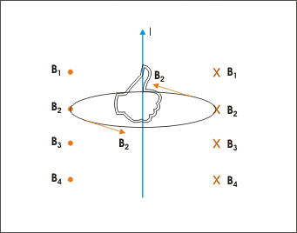

Magnetism
Direction of magnetic field
The direction of the magnetic field can be determined by the right hand rule.
Free to share, print, make copies and changes. Get yours at www.boundless.com
OpenStax CNX. "Sunil Kumar Singh, Magnetic Field Due to Current in Straight Wire. January 12, 2013." CC BY 3.0 http://cnx.org/content/m31103/latest/ View on Boundless.com

Slide 18
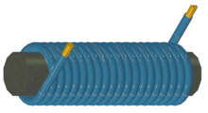
Magnetism
Electromagnet (Solenoid)
A simple electromagnet consisting of a coil of insulated wire wrapped around an iron core. The strength of magnetic field generated is proportional to the amount of current.
Free to share, print, make copies and changes. Get yours at www.boundless.com
Wikipedia. "Electromagnets." GNU FDL http://en.wikipedia.org/wiki/Electromagnets View on Boundless.com

Slide 19
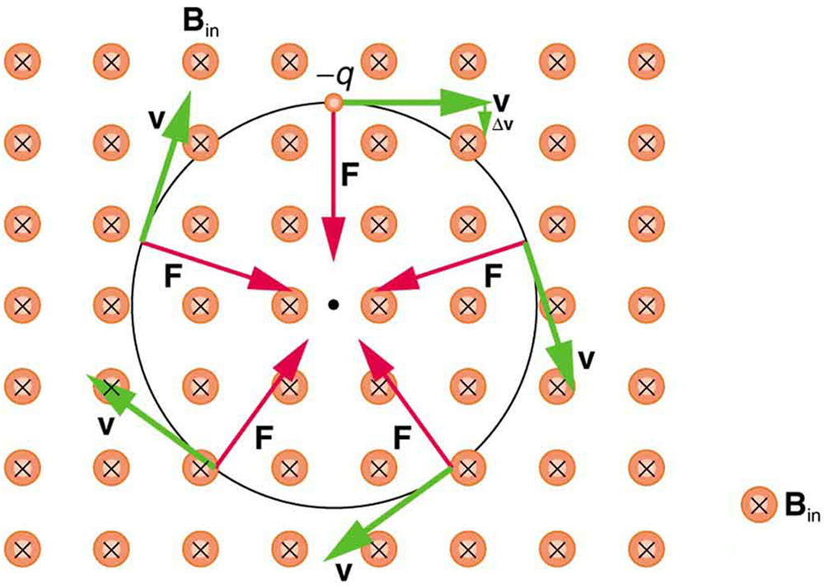
Magnetism
Circular Motion of Charged Particle in Magnetic Field
A negatively charged particle moves in the plane of the page in a region where the magnetic field is perpendicular into the page (represented by the small circles with x's—like the tails of arrows). The magnetic force is perpendicular to the velocity, and so velocity changes in direction but not magnitude. Uniform circular motion results.
Free to share, print, make copies and changes. Get yours at www.boundless.com
OpenStax CNX. "OpenStax College, College Physics. January 16, 2015." CC BY 3.0 http://cnx.org/content/m42375/latest/?collection=col11406/1.7 View on Boundless.com

Slide 20
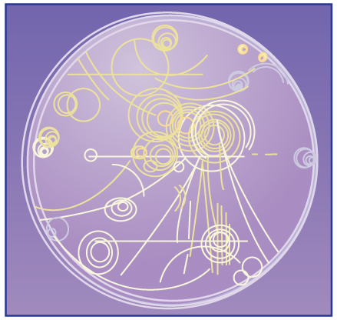
Magnetism
Bubble Chamber
Trails of bubbles are produced by high-energy charged particles moving through the superheated liquid hydrogen in this artist's rendition of a bubble chamber. There is a strong magnetic field perpendicular to the page that causes the curved paths of the particles. The radius of the path can be used to find the mass, charge, and energy of the particle.
Free to share, print, make copies and changes. Get yours at www.boundless.com
OpenStax CNX. "OpenStax College, College Physics. November 26, 2012." CC BY 3.0 http://cnx.org/content/m42375/latest/?collection=col11406/1.7 View on Boundless.com

Slide 21
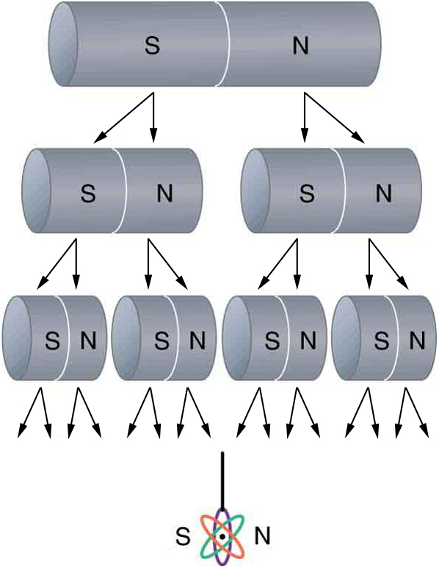
Magnetism
North and South Poles Always Come in Pairs
North and south poles always occur in pairs. Attempts to separate them result in more pairs of poles. If we continue to split the magnet, we will eventually get down to an iron atom with a north pole and a south pole—these, too, cannot be separated.
Free to share, print, make copies and changes. Get yours at www.boundless.com
OpenStax CNX. "OpenStax College, College Physics. November 21, 2012." CC BY 3.0 http://cnx.org/content/m42366/latest/?collection=col11406/1.7 View on Boundless.com

Slide 22
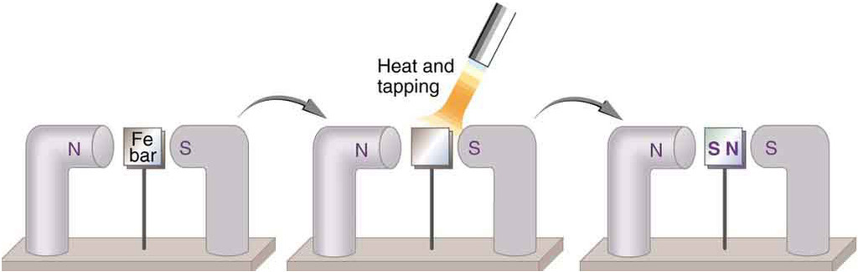
Magnetism
Making a Ferromagnet
An unmagnetized piece of iron is placed between two magnets, heated, and then cooled, or simply tapped when cold. The iron becomes a permanent magnet with the poles aligned as shown: its south pole is adjacent to the north pole of the original magnet, and its north pole is adjacent to the south pole of the original magnet. Note that there are attractive forces between the magnets.
Free to share, print, make copies and changes. Get yours at www.boundless.com
OpenStax CNX. "OpenStax College, College Physics. November 18, 2012." CC BY 3.0 http://cnx.org/content/m42368/latest/?collection=col11406/1.7 View on Boundless.com

Slide 23
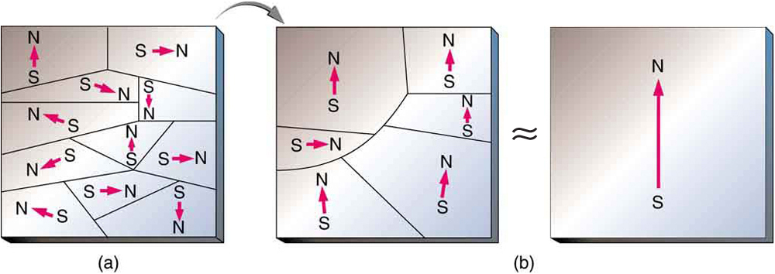
Magnetism
Unmagnetized to Magnetized Iron
(a) An unmagnetized piece of iron (or other ferromagnetic material) has randomly oriented domains. (b) When magnetized by an external field, the domains show greater alignment, and some grow at the expense of others. Individual atoms are aligned within domains; each atom acts like a tiny bar magnet.
Free to share, print, make copies and changes. Get yours at www.boundless.com
OpenStax CNX. "OpenStax College, Ferromagnets and Electromagnets. November 18, 2012." CC BY 3.0 http://cnx.org/content/m42368/latest/Figure_23_02_02a.jpg View on Boundless.com

Slide 24
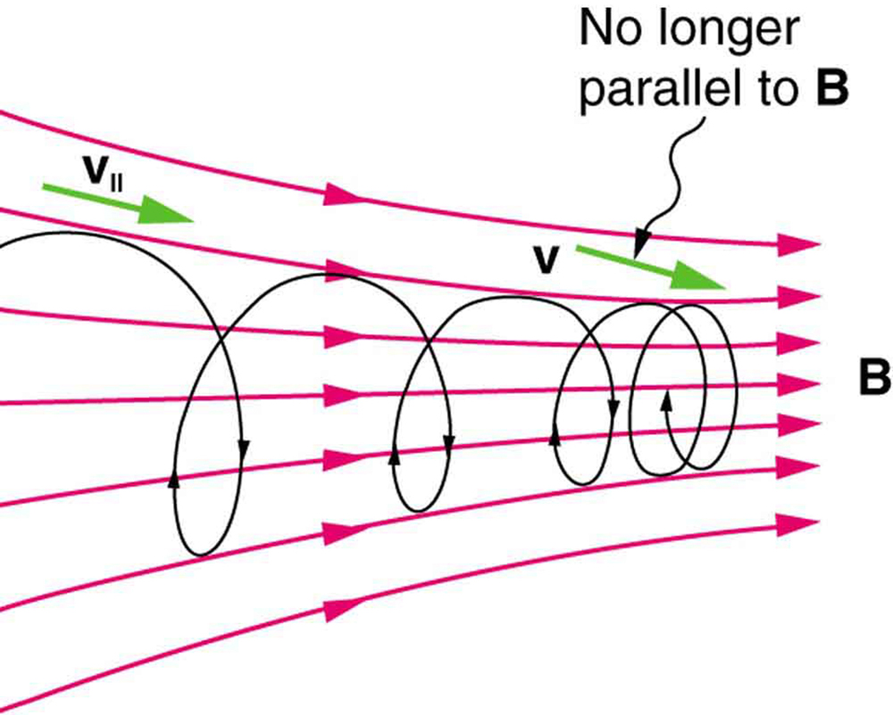
Magnetism
Helical Motion and Magnetic Mirrors
When a charged particle moves along a magnetic field line into a region where the field becomes stronger, the particle experiences a force that reduces the component of velocity parallel to the field. This force slows the motion along the field line and here reverses it, forming a "magnetic mirror. "
Free to share, print, make copies and changes. Get yours at www.boundless.com
OpenStax CNX. "OpenStax College, College Physics. November 27, 2012." CC BY 3.0 http://cnx.org/content/m42375/latest/?collection=col11406/1.7 View on Boundless.com

Slide 25
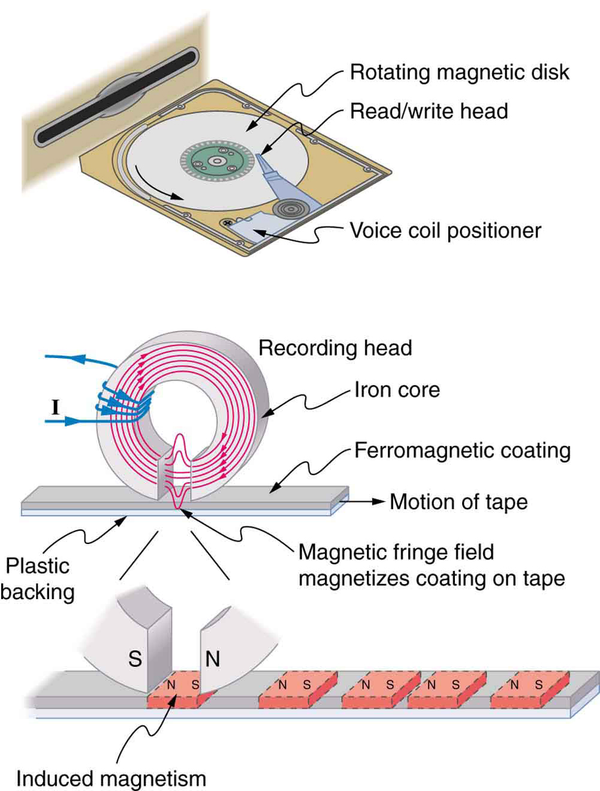
Magnetism
Uses of Electromagnets
An electromagnet induces regions of permanent magnetism on a floppy disk coated with a ferromagnetic material. The information stored here is digital (a region is either magnetic or not); in other applications, it can be analog (with a varying strength), such as on audiotapes.
Free to share, print, make copies and changes. Get yours at www.boundless.com
OpenStax CNX. "OpenStax College, Ferromagnets and Electromagnets. February 1, 2013." CC BY 3.0 http://cnx.org/content/m42368/latest/Figure_23_02_06a.jpg View on Boundless.com

Slide 26
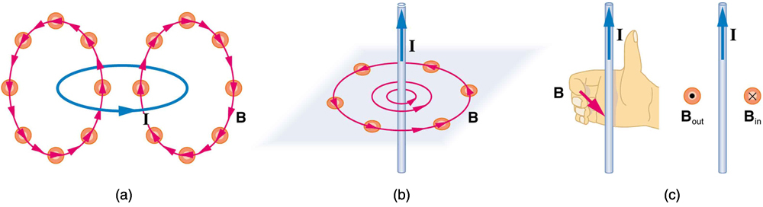
Magnetism
Mapping Magnetic Field Lines
Small compasses could be used to map the fields shown here. (A) The magnetic field of a circular current loop is similar to that of a bar magnet. (B) A long and straight wire creates a field with magnetic field lines forming circular loops. (C) When the wire is in the plane of the paper, the field is perpendicular to the paper. Note that the symbols used for the field pointing inward (like the tail of an arrow) and the field pointing outward (like the tip of an arrow).
Free to share, print, make copies and changes. Get yours at www.boundless.com
OpenStax CNX. "OpenStax College, College Physics. November 19, 2012." CC BY 3.0 http://cnx.org/content/m42370/latest/?collection=col11406/1.7 View on Boundless.com

Slide 27
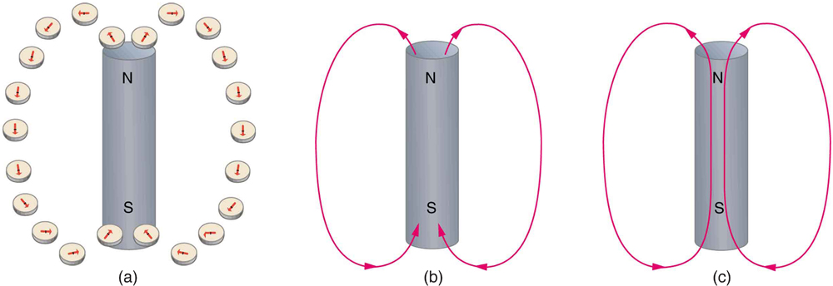
Magnetism
Visualizing Magnetic Field Lines
Magnetic field lines are defined to have the direction that a small compass points when placed at a location. (A) If small compasses are used to map the magnetic field around a bar magnet, they will point in the directions shown: away from the north pole of the magnet, toward the south pole of the magnet (recall that Earth's north magnetic pole is really a south pole in terms of definitions of poles on a bar magnet. ) (B) Connecting the arrows gives continuous magnetic field lines. The strength of the field is proportional to the closeness (or density) of the lines. (C) If the interior of the magnet could be probed, the field lines would be found to form continuous closed loops.
Free to share, print, make copies and changes. Get yours at www.boundless.com
OpenStax CNX. "OpenStax College, College Physics. November 19, 2012." CC BY 3.0 http://cnx.org/content/m42370/latest/?collection=col11406/1.7 View on Boundless.com

Slide 28
Magnetism
Unmagnetized to Magnetized Iron
(a) An unmagnetized piece of iron (or other ferromagnetic material) has randomly oriented domains. (b) When magnetized by an external field, the domains show greater alignment, and some grow at the expense of others. Individual atoms are aligned within domains; each atom acts like a tiny bar magnet.
Free to share, print, make copies and changes. Get yours at www.boundless.com
OpenStax CNX. "OpenStax College, Ferromagnets and Electromagnets. January 16, 2015." CC BY 3.0 http://cnx.org/content/m42368/latest/Figure_23_02_02a.jpg View on Boundless.com

Slide 29
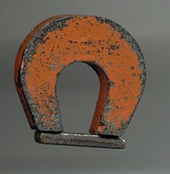
Magnetism
Example of a Permanent Magnet
An example of a permanent magnet: a "horseshoe magnet" made of alnico, an iron alloy. The magnet is made in the shape of a horseshoe to bring the two magnetic poles close to each other, to create a strong magnetic field there that can pick up heavy pieces of iron.
Free to share, print, make copies and changes. Get yours at www.boundless.com
Wikipedia. "Permanent magnets." GNU FDL http://en.wikipedia.org/wiki/Permanent_magnets View on Boundless.com

Slide 30
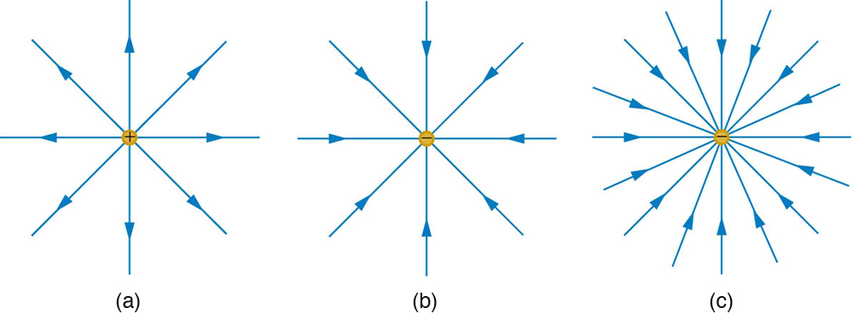
Magnetism
Electric Field Generated by Point Charges
The electric field surrounding three different point charges: (a) A positive charge; (b) a negative charge of equal magnitude; (c) a larger negative charge.
Free to share, print, make copies and changes. Get yours at www.boundless.com
OpenStax CNX. "OpenStax College, College Physics. December 10, 2012." CC BY 3.0 http://cnx.org/content/m42312/latest/?collection=col11406/1.7 View on Boundless.com

Slide 31
Magnetism
Circular Motion of Charged Particle in Magnetic Field
A negatively charged particle moves in the plane of the page in a region where the magnetic field is perpendicular into the page (represented by the small circles with x's—like the tails of arrows). The magnetic force is perpendicular to the velocity, and so velocity changes in direction but not magnitude. Uniform circular motion results.
Free to share, print, make copies and changes. Get yours at www.boundless.com
OpenStax CNX. "OpenStax College, College Physics. November 26, 2012." CC BY 3.0 http://cnx.org/content/m42375/latest/?collection=col11406/1.7 View on Boundless.com

Slide 32
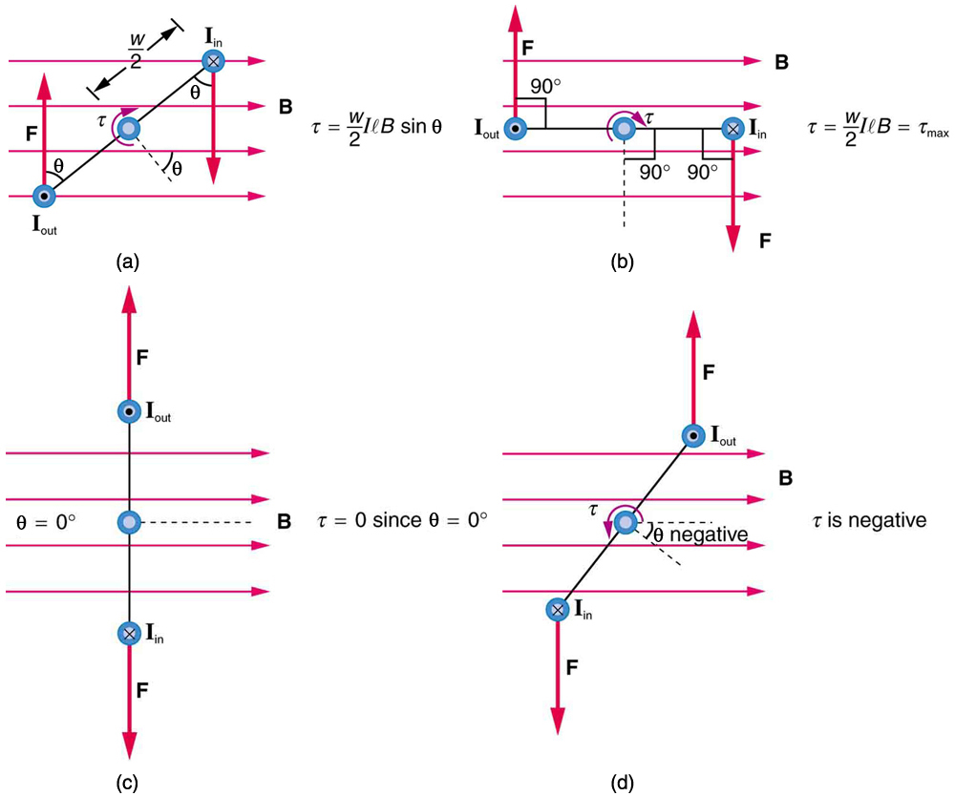
Magnetism
Varying torque on a charged loop in a magnetic field
Maximum torque occurs in (b), when is 90 degrees. Minimum torque is 0, and occurs in (c) when θ is 0 degrees. When loop rotates past =0, the torque reverses (d).
Free to share, print, make copies and changes. Get yours at www.boundless.com
OpenStax CNX. "OpenStax College, Torque on a Current Loop: Motors and Meters. January 9, 2013." CC BY 3.0 http://cnx.org/content/m42380/latest/ View on Boundless.com

Slide 33
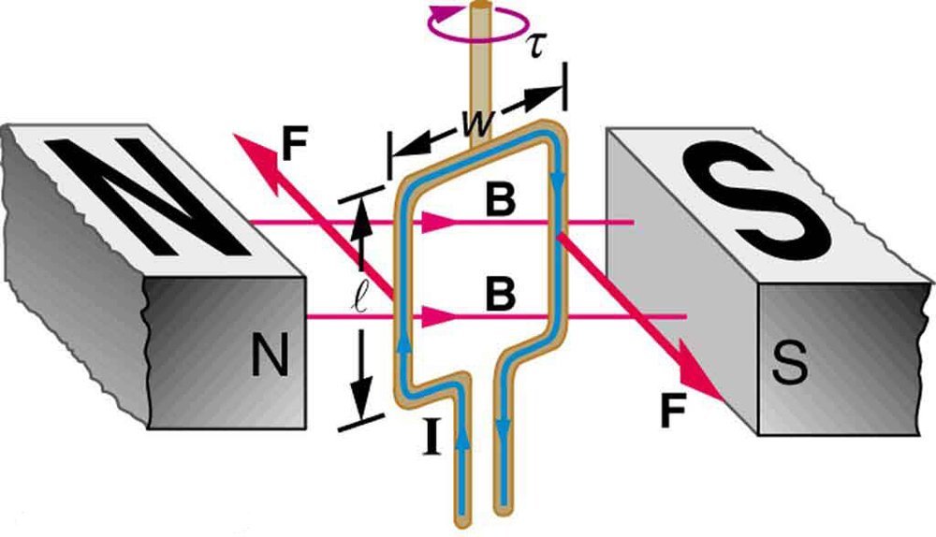
Magnetism
Torque on a Current Loop
Electrical energy from the current is converted to mechanical energy as the loop and shaft rotate, and this mechanical energy is then used to power another device.
Free to share, print, make copies and changes. Get yours at www.boundless.com
OpenStax CNX. "OpenStax College, Torque on a Current Loop: Motors and Meters. January 9, 2013." CC BY 3.0 http://cnx.org/content/m42380/latest/ View on Boundless.com

Slide 34
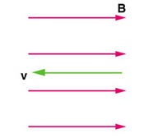
Magnetism
Zero Force When Velocity is Parallel to Magnetic Field
In the case above the magnetic force is zero because the velocity is parallel to the magnetic field lines.
Free to share, print, make copies and changes. Get yours at www.boundless.com
OpenStax CNX. "OpenStax College, College Physics. November 28, 2012." CC BY 3.0 http://cnx.org/content/m42372/latest/?collection=col11406/1.7 View on Boundless.com

Slide 35
Magnetism
Current Produces a Magnetic Field
Current (I) through a wire produces a magnetic field (B). The field is oriented according to the right-hand rule.
Free to share, print, make copies and changes. Get yours at www.boundless.com
Wikipedia. "Electromagnets." GNU FDL http://en.wikipedia.org/wiki/Electromagnets View on Boundless.com

Slide 36
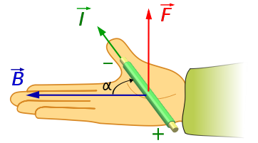
Magnetism
Force on a Current-Carrying Wire
The right hand rule can be used to determine the direction of the force on a current-carrying wire placed in an external magnetic field.
Free to share, print, make copies and changes. Get yours at www.boundless.com
Wikipedia. "Magnetic field." GNU FDL http://en.wikipedia.org/wiki/Magnetic_field%23Magnetic_pole_model_and_the_H-field View on Boundless.com

Slide 37
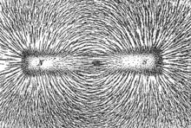
Magnetism
Bar Magnet and Magnetic Field Lines
The direction of magnetic field lines represented by the alignment of iron filings sprinkled on paper placed above a bar magnet.
Free to share, print, make copies and changes. Get yours at www.boundless.com
Wikipedia. "Magnetic field lines." GNU FDL http://en.wikipedia.org/wiki/Magnetic_field_lines%23Magnetic_field_lines View on Boundless.com

Slide 38
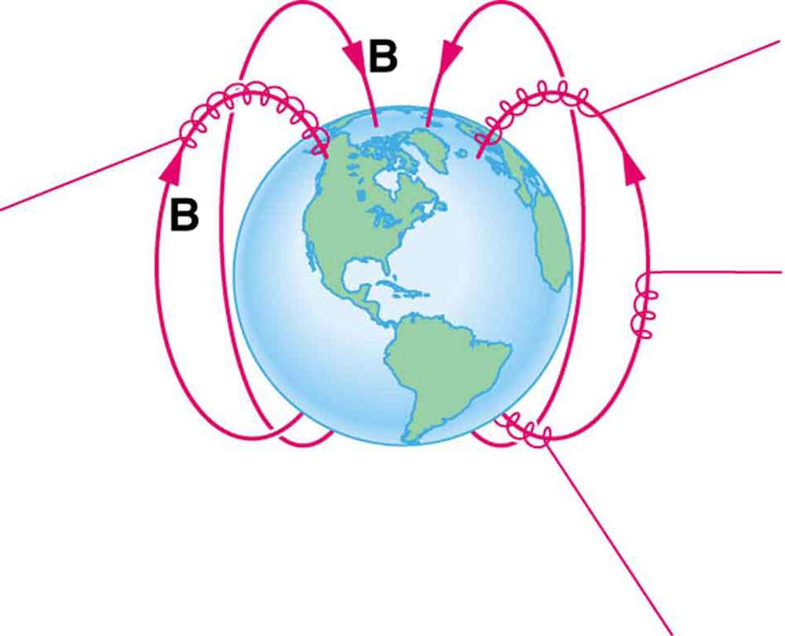
Magnetism
Charged Particles Spiral Along Earth's Magnetic Field Lines
Energetic electrons and protons, components of cosmic rays, from the Sun and deep outer space often follow the Earth's magnetic field lines rather than cross them. (Recall that the Earth's north magnetic pole is really a south pole in terms of a bar magnet. )
Free to share, print, make copies and changes. Get yours at www.boundless.com
OpenStax CNX. "OpenStax College, College Physics. November 27, 2012." CC BY 3.0 http://cnx.org/content/m42375/latest/?collection=col11406/1.7 View on Boundless.com

Slide 39
Magnetism
Right Hand Rule
Magnetic fields exert forces on moving charges. This force is one of the most basic known. The direction of the magnetic force on a moving charge is perpendicular to the plane formed by v and B and follows right hand rule–1 (RHR-1) as shown. The magnitude of the force is proportional to q, v, B, and the sine of the angle between v and B.
Free to share, print, make copies and changes. Get yours at www.boundless.com
OpenStax CNX. "OpenStax College, College Physics. January 16, 2015." CC BY 3.0 http://cnx.org/content/m42372/latest/?collection=col11406/1.7 View on Boundless.com

Slide 40
Magnetism
Schematic of Mass Spectrometer
Schematics of a simple mass spectrometer with sector type mass analyzer. This one is for the measurement of carbon dioxide isotope ratios as in the carbon-13urea breath test.
Free to share, print, make copies and changes. Get yours at www.boundless.com
Wikipedia. "Mass spectrometry." GNU FDL http://en.wikipedia.org/wiki/Mass_spectrometry View on Boundless.com

Slide 41
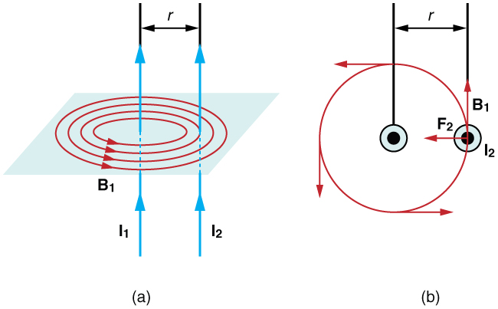
Magnetism
Magnetic fields and force exerted by parallel current-carrying wires.
Currents I1 and I2 flow in the same direction, separated by a distance of r.
Free to share, print, make copies and changes. Get yours at www.boundless.com
OpenStax CNX. "OpenStax College, Magnetic Force between Two Parallel Conductors. January 9, 2013." CC BY 3.0 http://cnx.org/content/m42386/latest/ View on Boundless.com

Slide 42
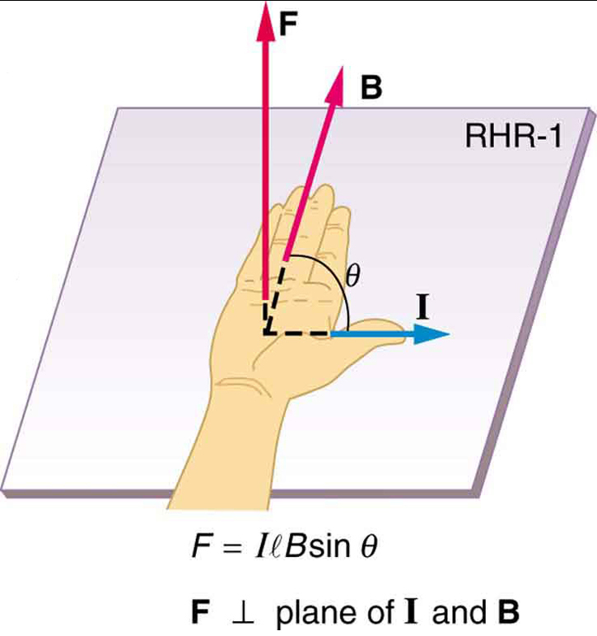
Magnetism
Right Hand Rule
Used to determine direction of magnetic force.
Free to share, print, make copies and changes. Get yours at www.boundless.com
OpenStax CNX. "OpenStax College, Magnetic Force on a Current-Carrying Conductor. January 12, 2013." CC BY 3.0 http://cnx.org/content/m42398/latest/ View on Boundless.com

Slide 43
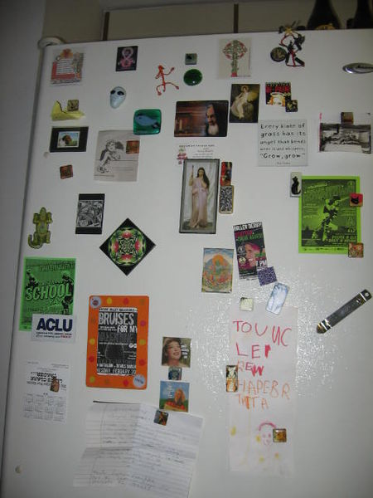
Magnetism
Refrigerator Magnets
Different magnets attached to the doors of a refrigerator.
Free to share, print, make copies and changes. Get yours at www.boundless.com
Wikimedia. CC BY-SA http://upload.wikimedia.org/wikipedia/commons/thumb/6/6a/FridgeMagnetPlethora5734.jpg/450px-FridgeMagnetPlethora5734.jpg View on Boundless.com

Slide 44
Magnetism
Hall Effect for Electrons
Initially, the electrons are attracted by the magnetic force and follow the curved arrow. Eventually, when electrons accumulate in excess on the left side and are in deficit on the right, an electric field ξy is created. This force becomes strong enough to cancel out the magnetic force, so future electrons follow a straight (rather than curved) path.
Free to share, print, make copies and changes. Get yours at www.boundless.com
Wikipedia. "Hall Effect Measurement Setup for Electrons." CC BY-SA http://en.wikipedia.org/wiki/File:Hall_Effect_Measurement_Setup_for_Electrons.png View on Boundless.com

Slide 45
Magnetism
Right Hand Rule
Magnetic fields exert forces on moving charges. This force is one of the most basic known. The direction of the magnetic force on a moving charge is perpendicular to the plane formed by v and B and follows right hand rule–1 (RHR-1) as shown. The magnitude of the force is proportional to q, v, B, and the sine of the angle between v and B.
Free to share, print, make copies and changes. Get yours at www.boundless.com
OpenStax CNX. "OpenStax College, College Physics. November 14, 2012." CC BY 3.0 http://cnx.org/content/m42372/latest/?collection=col11406/1.7 View on Boundless.com

Slide 46
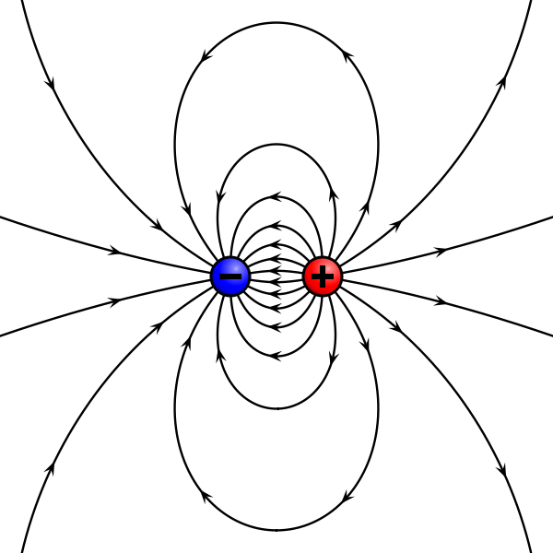
Magnetism
Magnetic Pole Model
The magnetic pole model: two opposing poles, North (+) and South (−), separated by a distance d produce an H-field (lines).
Free to share, print, make copies and changes. Get yours at www.boundless.com
Wikipedia. "Magnetic field lines." GNU FDL http://en.wikipedia.org/wiki/Magnetic_field_lines%23Magnetic_field_lines View on Boundless.com

Slide 47
Magnetism
Right Hand Rule
Magnetic fields exert forces on moving charges. This force is one of the most basic known. The direction of the magnetic force on a moving charge is perpendicular to the plane formed by v and B and follows right hand rule–1 (RHR-1) as shown. The magnitude of the force is proportional to q, v, B, and the sine of the angle between v and B.
Free to share, print, make copies and changes. Get yours at www.boundless.com
OpenStax CNX. "OpenStax College, College Physics. November 14, 2012." CC BY 3.0 http://cnx.org/content/m42372/latest/?collection=col11406/1.7 View on Boundless.com

Slide 48
Magnetism
Magnetic Field Generated by Current
(a) Compasses placed near a long straight current-carrying wire indicate that field lines form circular loops centered on the wire. (b) Right hand rule 2 states that, if the right hand thumb points in the direction of the current, the fingers curl in the direction of the field. This rule is consistent with the field mapped for the long straight wire and is valid for any current segment.
Free to share, print, make copies and changes. Get yours at www.boundless.com
OpenStax CNX. "OpenStax College, Magnetic Fields Produced by Currents: Ampere’s Law. November 19, 2012." CC BY 3.0 http://cnx.org/content/m42382/latest/#import-auto-id1166991852141 View on Boundless.com

Slide 49
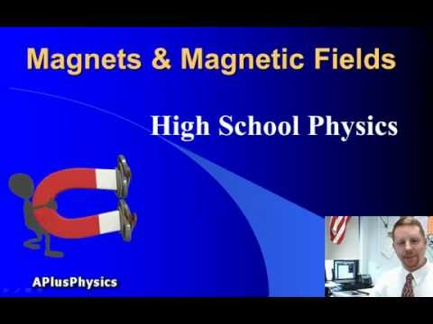
Magnetism
Magnets and Magnetic Fields
A brief introduction to magnetism for introductory physics students.
Free to share, print, make copies and changes. Get yours at www.boundless.com
View on Boundless.com

Slide 50
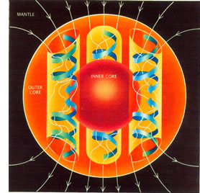
Magnetism
Origin of Earth's Magnetic Field
A schematic illustrating the relationship between motion of conducting fluid, organized into rolls by the Coriolis force, and the magnetic field the motion generates.
Free to share, print, make copies and changes. Get yours at www.boundless.com
Wikipedia. "Earth's magnetic field." GNU FDL http://en.wikipedia.org/wiki/Earth's_magnetic_field View on Boundless.com

Slide 51
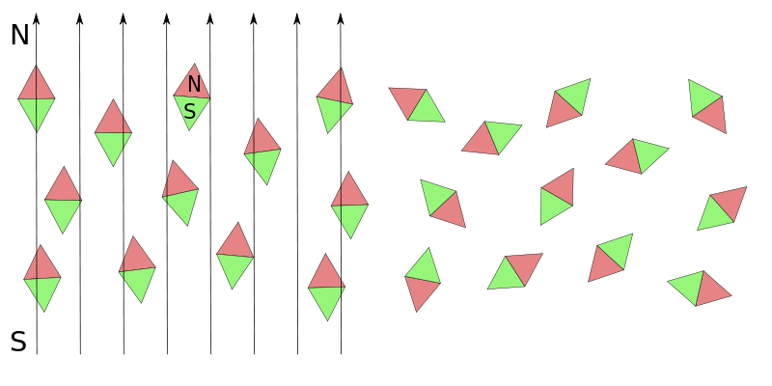
Magnetism
Paramagnetic Materials and Electric Fields
Orientation in paramagnetic material when electric field is applied (right image) and removed (left image).
Free to share, print, make copies and changes. Get yours at www.boundless.com
Wikimedia. CC BY-SA http://upload.wikimedia.org/wikipedia/commons/thumb/0/0d/Paramagnetism_with_and_without_field.svg/800px-Paramagnetism_with_and_without_field.svg.png View on Boundless.com

Slide 52
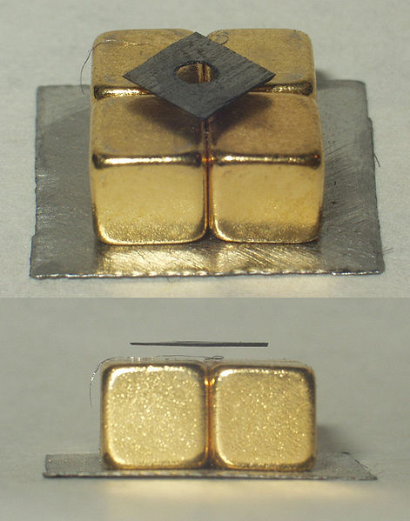
Magnetism
Levitating Carbon
Pyrolytic carbon levitating over permanent magnets
Free to share, print, make copies and changes. Get yours at www.boundless.com
Wikimedia. CC BY-SA http://upload.wikimedia.org/wikipedia/commons/thumb/c/c9/Diamagnetic_graphite_levitation.jpg/471px-Diamagnetic_graphite_levitation.jpg View on Boundless.com

Slide 53
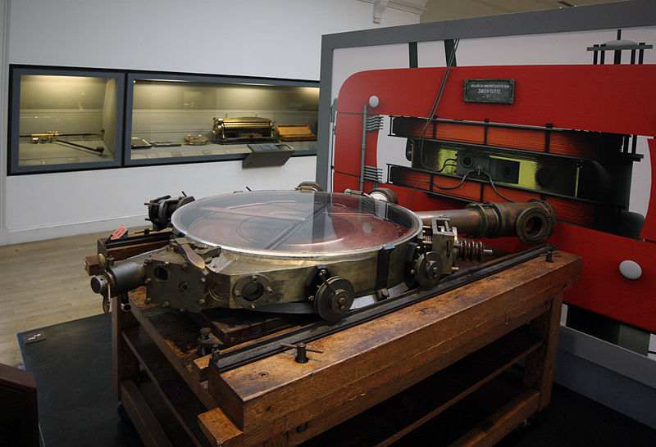
Magnetism
Cyclotron
A French cyclotron, produced in Zurich, Switzerland in 1937
Free to share, print, make copies and changes. Get yours at www.boundless.com
Wikipedia. "Cyclotron." GNU FDL http://en.wikipedia.org/wiki/Cyclotron View on Boundless.com

Slide 54
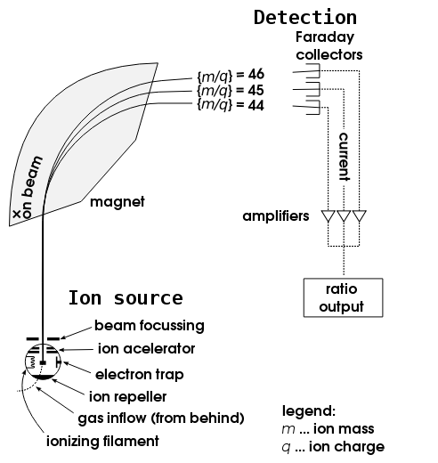
Magnetism
Mass Spectrometry
Schematics of a simple mass spectrometer with sector type mass analyzer. This one is for the measurement of carbon dioxide isotope ratios (IRMS) as in the carbon-13 urea breath test.
Free to share, print, make copies and changes. Get yours at www.boundless.com
Wikipedia. "Mass spectrometers." Public domain http://en.wikipedia.org/wiki/Mass_spectrometers View on Boundless.com

Slide 55
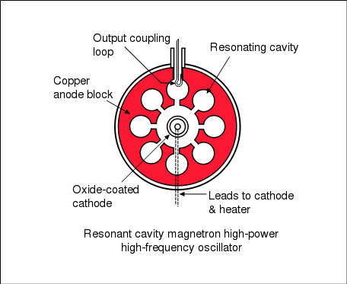
Magnetism
Cavity Magnetron Diagram
A cross-sectional diagram of a resonant cavity magnetron. Magnetic lines of force are parallel to the geometric axis of this structure.
Free to share, print, make copies and changes. Get yours at www.boundless.com
Wikipedia. "Magnetron." GNU FDL http://en.wikipedia.org/wiki/Magnetron View on Boundless.com

Slide 56
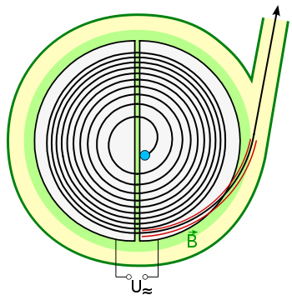
Magnetism
Cyclotron Sketch
Sketch of a particle being accelerated in a cyclotron, and being ejected through a beamline.
Free to share, print, make copies and changes. Get yours at www.boundless.com
Wikipedia. "Cyclotron." Public domain http://en.wikipedia.org/wiki/Cyclotron View on Boundless.com

Slide 57
Attribution
Magnetism
Wiktionary. "magnetic field." CC BY-SA 3.0 http://en.wiktionary.org/wiki/magnetic_field
Boundless Learning. "Boundless." CC BY-SA 3.0 http://www.boundless.com//physics/definition/drift-velocity
OpenStax CNX. "OpenStax College, Magnetic Force on a Current-Carrying Conductor. September 17, 2013." CC BY 3.0 http://cnx.org/content/m42398/latest/
Wiktionary. "solenoid." CC BY-SA 3.0 http://en.wiktionary.org/wiki/solenoid
Boundless Learning. "Boundless." CC BY-SA 3.0 http://www.boundless.com//physics/definition/curie-temperature
Wikipedia. "magnetic domain." CC BY-SA 3.0 http://en.wikipedia.org/wiki/magnetic%20domain
Wikipedia. "Ferromagnets." CC BY-SA 3.0 http://en.wikipedia.org/wiki/Ferromagnets
Wikipedia. "Electromagnets." CC BY-SA 3.0 http://en.wikipedia.org/wiki/Electromagnets
OpenStax CNX. "OpenStax College, College Physics. September 17, 2013." CC BY 3.0 http://cnx.org/content/m42368/latest/?collection=col11406/1.7
Wikipedia. "cyclotron frequency." CC BY-SA 3.0 http://en.wikipedia.org/wiki/cyclotron%20frequency
Wiktionary. "gyroradius." CC BY-SA 3.0 http://en.wiktionary.org/wiki/gyroradius
Wikipedia. "Gyroradius." CC BY-SA 3.0 http://en.wikipedia.org/wiki/Gyroradius
OpenStax CNX. "OpenStax College, College Physics. September 17, 2013." CC BY 3.0 http://cnx.org/content/m42375/latest/?collection=col11406/1.7
Wikipedia. "Cyclotron resonance." CC BY-SA 3.0 http://en.wikipedia.org/wiki/Cyclotron_resonance
Wikipedia. "Cyclotron." CC BY-SA 3.0 http://en.wikipedia.org/wiki/Cyclotron
Wiktionary. "permanent magnet." CC BY-SA 3.0 http://en.wiktionary.org/wiki/permanent_magnet
Wiktionary. "electromagnet." CC BY-SA 3.0 http://en.wiktionary.org/wiki/electromagnet
Free to share, print, make copies and changes. Get yours at www.boundless.com

Slide 58
Magnetism
Wiktionary. "ferromagnetic." CC BY-SA 3.0 http://en.wiktionary.org/wiki/ferromagnetic
Wikipedia. "Permanent magnets." CC BY-SA 3.0 http://en.wikipedia.org/wiki/Permanent_magnets
OpenStax CNX. "OpenStax College, College Physics. September 17, 2013." CC BY 3.0 http://cnx.org/content/m42366/latest/?collection=col11406/1.7
Wiktionary. "magnetic field." CC BY-SA 3.0 http://en.wiktionary.org/wiki/magnetic_field
Wiktionary. "current." CC BY-SA 3.0 http://en.wiktionary.org/wiki/current
Wiktionary. "ampere." CC BY-SA 3.0 http://en.wiktionary.org/wiki/ampere
OpenStax CNX. "OpenStax College, Magnetic Force between Two Parallel Conductors. September 17, 2013." CC BY 3.0 http://cnx.org/content/m42386/latest/
Boundless Learning. "Boundless." CC BY-SA 3.0 http://www.boundless.com//physics/definition/straight-line-motion
OpenStax CNX. "OpenStax College, College Physics. September 17, 2013." CC BY 3.0 http://cnx.org/content/m42372/latest/?collection=col11406/1.7
Wikipedia. "Newton's laws." CC BY-SA 3.0 http://en.wikipedia.org/wiki/Newton's_laws
Wiktionary. "magnetic field." CC BY-SA 3.0 http://en.wiktionary.org/wiki/magnetic_field
Wiktionary. "electric charge." CC BY-SA 3.0 http://en.wiktionary.org/wiki/electric_charge
Wiktionary. "mass." CC BY-SA 3.0 http://en.wiktionary.org/wiki/mass
Wikipedia. "Mass spectrometer." CC BY-SA 3.0 http://en.wikipedia.org/wiki/Mass_spectrometer
OpenStax CNX. "Justin Law and Andrew R. Barron, Principles of Mass Spectrometry and Modern Applications. September 17, 2013." CC BY 3.0 http://cnx.org/content/m38353/latest/
Wiktionary. "Coulomb force." CC BY-SA 3.0 http://en.wiktionary.org/wiki/Coulomb_force
Wiktionary. "magnetic field." CC BY-SA 3.0 http://en.wiktionary.org/wiki/magnetic_field
Wiktionary. "tesla." CC BY-SA 3.0 http://en.wiktionary.org/wiki/tesla
Wikipedia. "Magnetic force." CC BY-SA 3.0 http://en.wikipedia.org/wiki/Magnetic_force
Free to share, print, make copies and changes. Get yours at www.boundless.com

Slide 59
Magnetism
OpenStax CNX. "OpenStax College, College Physics. September 17, 2013." CC BY 3.0 http://cnx.org/content/m42372/latest/?collection=col11406/1.7
Wiktionary. "magnetic field." CC BY-SA 3.0 http://en.wiktionary.org/wiki/magnetic_field
Wiktionary. "ferromagnetic." CC BY-SA 3.0 http://en.wiktionary.org/wiki/ferromagnetic
OpenStax CNX. "OpenStax College, Ferromagnets and Electromagnets. September 17, 2013." CC BY 3.0 http://cnx.org/content/m42368/latest/
Wikipedia. "Solenoid." CC BY-SA 3.0 http://en.wikipedia.org/wiki/Solenoid
Wiktionary. "dipole moment." CC BY-SA 3.0 http://en.wiktionary.org/wiki/dipole_moment
Wiktionary. "electron shell." CC BY-SA 3.0 http://en.wiktionary.org/wiki/electron_shell
Wiktionary. "spin." CC BY-SA 3.0 http://en.wiktionary.org/wiki/spin
Wikipedia. "Ferromagnetism." CC BY-SA 3.0 http://en.wikipedia.org/wiki/Ferromagnetism
Wikipedia. "Ferromagnetism." CC BY-SA 3.0 http://en.wikipedia.org/wiki/Ferromagnetism
OpenStax CNX. "OpenStax College, Ferromagnets and Electromagnets. September 17, 2013." CC BY 3.0 http://cnx.org/content/m42368/latest/
Wiktionary. "paramagnetism." CC BY-SA 3.0 http://en.wiktionary.org/wiki/paramagnetism
Wiktionary. "ferromagnetism." CC BY-SA 3.0 http://en.wiktionary.org/wiki/ferromagnetism
Wiktionary. "diamagnetism." CC BY-SA 3.0 http://en.wiktionary.org/wiki/diamagnetism
Wikipedia. "Paramagnetism." CC BY-SA 3.0 http://en.wikipedia.org/wiki/Paramagnetism
Wikipedia. "Diamagnetism." CC BY-SA 3.0 http://en.wikipedia.org/wiki/Diamagnetism
Wikipedia. "Paramagnetism." CC BY-SA 3.0 http://en.wikipedia.org/wiki/Paramagnetism
Wikipedia. "Diamagnetism." CC BY-SA 3.0 http://en.wikipedia.org/wiki/Diamagnetism
Wikipedia. "magnetic mirror." CC BY-SA 3.0 http://en.wikipedia.org/wiki/magnetic%20mirror
Free to share, print, make copies and changes. Get yours at www.boundless.com

Slide 60
Magnetism
Boundless Learning. "Boundless." CC BY-SA 3.0 http://www.boundless.com//physics/definition/helical-motion
OpenStax CNX. "OpenStax College, College Physics. September 17, 2013." CC BY 3.0 http://cnx.org/content/m42375/latest/?collection=col11406/1.7
Wikipedia. "Magnetic mirror." CC BY-SA 3.0 http://en.wikipedia.org/wiki/Magnetic_mirror
Wiktionary. "torque." CC BY-SA 3.0 http://en.wiktionary.org/wiki/torque
OpenStax CNX. "OpenStax College, Torque on a Current Loop: Motors and Meters. September 17, 2013." CC BY 3.0 http://cnx.org/content/m42380/latest/
Boundless Learning. "Boundless." CC BY-SA 3.0 http://www.boundless.com//physics/definition/b-field
Boundless Learning. "Boundless." CC BY-SA 3.0 http://www.boundless.com//physics/definition/magnetic-field-lines
OpenStax CNX. "OpenStax College, College Physics. September 17, 2013." CC BY 3.0 http://cnx.org/content/m42370/latest/?collection=col11406/1.7
Wikipedia. "Magnetic field lines." CC BY-SA 3.0 http://en.wikipedia.org/wiki/Magnetic_field_lines%23Magnetic_field_lines
Wiktionary. "elementary charge." CC BY-SA 3.0 http://en.wiktionary.org/wiki/elementary_charge
Wiktionary. "transverse." CC BY-SA 3.0 http://en.wiktionary.org/wiki/transverse
Wikipedia. "Hall effect." CC BY-SA 3.0 http://en.wikipedia.org/wiki/Hall_effect
Boundless Learning. "Boundless." CC BY-SA 3.0 http://www.boundless.com//physics/definition/right-hand-rule
OpenStax CNX. "OpenStax College, College Physics. September 18, 2013." CC BY 3.0 http://cnx.org/content/m42372/latest/?collection=col11406/1.7
Wikipedia. "Right hand rule." CC BY-SA 3.0 http://en.wikipedia.org/wiki/Right_hand_rule
Wikipedia. "Magnetic force." CC BY-SA 3.0 http://en.wikipedia.org/wiki/Magnetic_force
Wiktionary. "mass spectrometer." CC BY-SA 3.0 http://en.wiktionary.org/wiki/mass_spectrometer
Wiktionary. "magnetron." CC BY-SA 3.0 http://en.wiktionary.org/wiki/magnetron
Wiktionary. "cyclotron." CC BY-SA 3.0 http://en.wiktionary.org/wiki/cyclotron
Free to share, print, make copies and changes. Get yours at www.boundless.com

Slide 61
Magnetism
Wikipedia. "Cyclotron." CC BY-SA 3.0 http://en.wikipedia.org/wiki/Cyclotron
Wikipedia. "Mass spectrometers." CC BY-SA 3.0 http://en.wikipedia.org/wiki/Mass_spectrometers
Wikipedia. "Magnetron." CC BY-SA 3.0 http://en.wikipedia.org/wiki/Magnetron
Wikipedia. "Synchrotron." CC BY-SA 3.0 http://en.wikipedia.org/wiki/Synchrotron
OpenStax CNX. "OpenStax College, College Physics. September 18, 2013." CC BY 3.0 http://cnx.org/content/m42375/latest/?collection=col11406/1.7
Wiktionary. "orthogonal." CC BY-SA 3.0 http://en.wiktionary.org/wiki/orthogonal
OpenStax CNX. "OpenStax College, College Physics. September 18, 2013." CC BY 3.0 http://cnx.org/content/m42308/latest/?collection=col11406/1.7
OpenStax CNX. "OpenStax College, College Physics. September 18, 2013." CC BY 3.0 http://cnx.org/content/m42370/latest/?collection=col11406/1.7
OpenStax CNX. "OpenStax College, College Physics. September 18, 2013." CC BY 3.0 http://cnx.org/content/m42310/latest/?collection=col11406/1.7
Wikipedia. "Magnetic field lines." CC BY-SA 3.0 http://en.wikipedia.org/wiki/Magnetic_field_lines%23Magnetic_field_lines
OpenStax CNX. "OpenStax College, College Physics. September 18, 2013." CC BY 3.0 http://cnx.org/content/m42312/latest/?collection=col11406/1.7
Wikipedia. "Magnetic force." CC BY-SA 3.0 http://en.wikipedia.org/wiki/Magnetic_force%23History
Wikipedia. "Electric force." CC BY-SA 3.0 http://en.wikipedia.org/wiki/Electric_force
Wikipedia. "Electric field." CC BY-SA 3.0 http://en.wikipedia.org/wiki/Electric_field
OpenStax CNX. "OpenStax College, College Physics. September 18, 2013." CC BY 3.0 http://cnx.org/content/m42372/latest/?collection=col11406/1.7
OpenStax CNX. "OpenStax College, College Physics. September 18, 2013." CC BY 3.0 http://cnx.org/content/m42375/latest/?collection=col11406/1.7
Wikipedia. "Ampere's Law." CC BY-SA 3.0 http://en.wikipedia.org/wiki/Ampere's%20Law
Wikipedia. "Biot-Savart Law." CC BY-SA 3.0 http://en.wikipedia.org/wiki/Biot-Savart%20Law
Wikipedia. "Electric current." CC BY-SA 3.0 http://en.wikipedia.org/wiki/Electric_current%23Electromagnetism
Free to share, print, make copies and changes. Get yours at www.boundless.com

Slide 62
Magnetism
Wikipedia. "Magnetic field." CC BY-SA 3.0 http://en.wikipedia.org/wiki/Magnetic_field%23Magnetic_pole_model_and_the_H-field
Wikipedia. "Ampere's law." CC BY-SA 3.0 http://en.wikipedia.org/wiki/Ampere's_law
OpenStax CNX. "OpenStax College, College Physics. September 18, 2013." CC BY 3.0 http://cnx.org/content/m42382/latest/?collection=col11406/1.7
Wikipedia. "Biot–Savart law." CC BY-SA 3.0 http://en.wikipedia.org/wiki/Biot%E2%80%93Savart_law
Wikipedia. "dynamo." CC BY-SA 3.0 http://en.wikipedia.org/wiki/dynamo
Wikipedia. "Geomagnetism." CC BY-SA 3.0 http://en.wikipedia.org/wiki/Geomagnetism
OpenStax CNX. "OpenStax College, College Physics. September 18, 2013." CC BY 3.0 http://cnx.org/content/m42375/latest/?collection=col11406/1.7
Wiktionary. "magnetic field." CC BY-SA 3.0 http://en.wiktionary.org/wiki/magnetic_field
Wiktionary. "electric field." CC BY-SA 3.0 http://en.wiktionary.org/wiki/electric_field
OpenStax CNX. "Sunil Kumar Singh, Ampere's Law. September 18, 2013." CC BY 3.0 http://cnx.org/content/m31895/latest/
Wikipedia. "Ampère's circuital law." CC BY-SA 3.0 http://en.wikipedia.org/wiki/Amp%C3%A8re's_circuital_law
Wikipedia. "Biot–Savart law." CC BY-SA 3.0 http://en.wikipedia.org/wiki/Biot%E2%80%93Savart_law
OpenStax CNX. "Sunil Kumar Singh, Magnetic Field Due to Current in Straight Wire. September 18, 2013." CC BY 3.0 http://cnx.org/content/m31103/latest/
Free to share, print, make copies and changes. Get yours at www.boundless.com

