Slide 1


Boundless Lecture Slides
Available on the Boundless Teaching Platform
Free to share, print, make copies and changes. Get yours at www.boundless.com

Slide 2



Using Boundless Presentations
Boundless Teaching Platform
Boundless empowers educators to engage their students with affordable, customizable textbooks and intuitive teaching tools. The free Boundless Teaching Platform gives educators the ability to customize textbooks in more than 20 subjects that align to hundreds of popular titles. Get started by using high quality Boundless books, or make switching to our platform easier by building from Boundless content pre-organized to match the assigned textbook. This platform gives educators the tools they need to assign readings and assessments, monitor student activity, and lead their classes with pre-made teaching resources.
Get started now at:
The Appendix
The appendix is for you to use to add depth and breadth to your lectures. You can simply drag and drop slides from the appendix into the main presentation to make for a richer lecture experience.
http://boundless.com/teaching-platform
Free to edit, share, and copy
Feel free to edit, share, and make as many copies of the Boundless presentations as you like. We encourage you to take these presentations and make them your own.
If you have any questions or problems please email:
educators@boundless.com
Free to share, print, make copies and changes. Get yours at www.boundless.com

Slide 3

About Boundless
Boundless is an innovative technology company making education more affordable and accessible for students everywhere. The company creates the world’s best open educational content in 20+ subjects that align to more than 1,000 popular college textbooks. Boundless integrates learning technology into all its premium books to help students study more efficiently at a fraction of the cost of traditional textbooks. The company also empowers educators to engage their students more effectively through customizable books and intuitive teaching tools as part of the Boundless Teaching Platform. More than 2 million learners access Boundless free and premium content each month across the company’s wide distribution platforms, including its website, iOS apps, Kindle books, and iBooks. To get started learning or teaching with Boundless, visit boundless.com.
Free to share, print, make copies and changes. Get yours at www.boundless.com

Slide 4

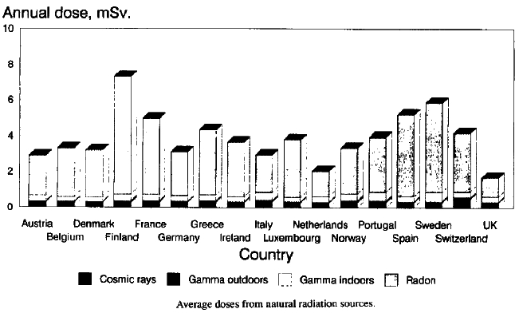
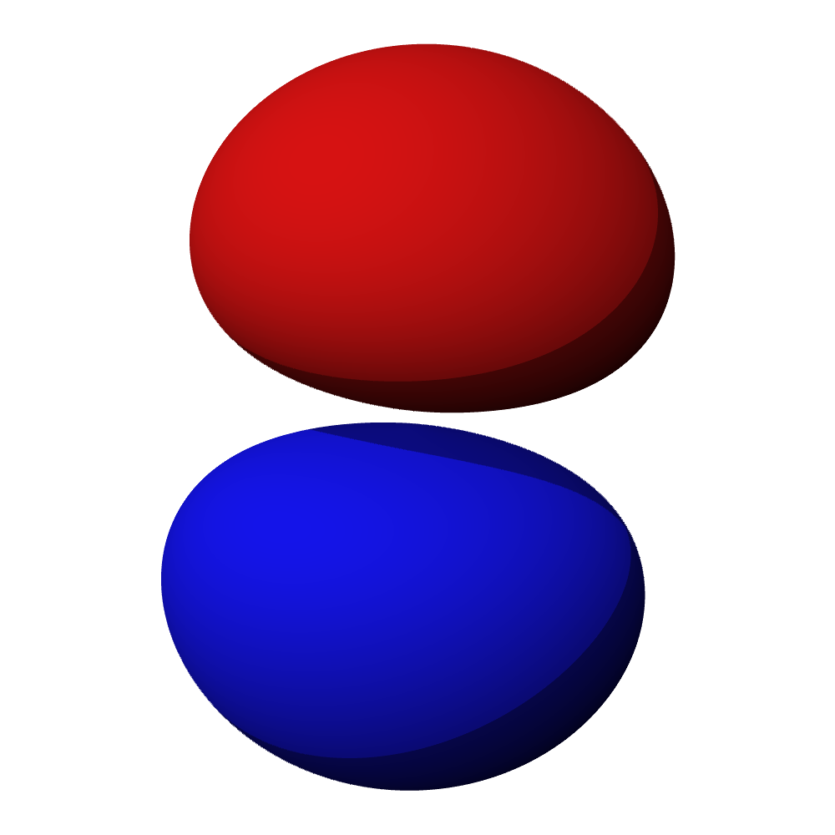
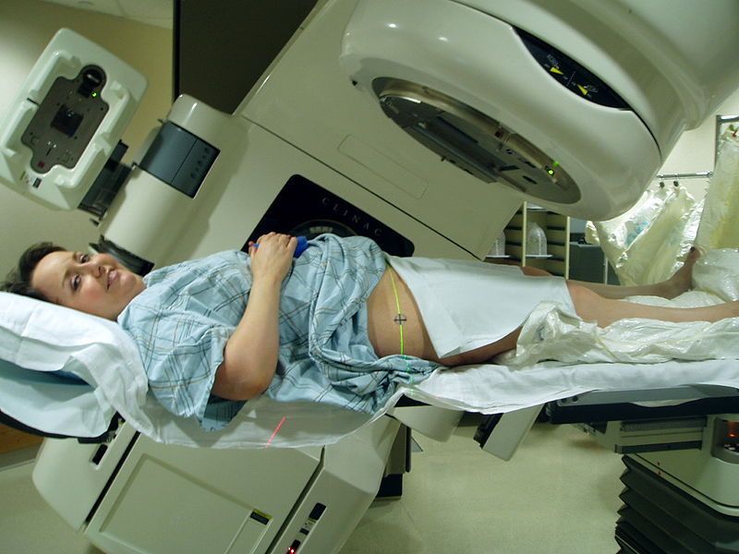
Nuclear Physics and Radioactivity
The Nucleus
Radioactivity
Quantum Tunneling and Conservation Laws
Applications of Nuclear Physics
]
Nuclear Physics and Radioactivity
Free to share, print, make copies and changes. Get yours at www.boundless.com

Slide 5

The Nucleus
Nuclear Physics and Radioactivity > The Nucleus
Nuclear Size and Density
Nuclear Stability
Binding Energy and Nuclear Forces
Free to share, print, make copies and changes. Get yours at www.boundless.com
www.boundless.com/physics/textbooks/boundless-physics-textbook/nuclear-physics-and-radioactivity-30/the-nucleus-189/

Slide 6
Radioactivity
Nuclear Physics and Radioactivity > Radioactivity
Natural Radioactivity
Radiation Detection
Radioactive Decay Series: Introduction
Alpha Decay
Beta Decay
Gamma Decay
Half-Life and Rate of Decay; Carbon-14 Dating
Calculations Involving Half-Life and Decay-Rates
Free to share, print, make copies and changes. Get yours at www.boundless.com
www.boundless.com/physics/textbooks/boundless-physics-textbook/nuclear-physics-and-radioactivity-30/radioactivity-190/

Slide 7
Quantum Tunneling and Conservation Laws
Nuclear Physics and Radioactivity > Quantum Tunneling and Conservation Laws
Quantum Tunneling
Conservation of Nucleon Number and Other Laws
Free to share, print, make copies and changes. Get yours at www.boundless.com
www.boundless.com/physics/textbooks/boundless-physics-textbook/nuclear-physics-and-radioactivity-30/quantum-tunneling-and-conservation-laws-191/

Slide 8
Applications of Nuclear Physics
Nuclear Physics and Radioactivity > Applications of Nuclear Physics
Medical Imaging and Diagnostics
Dosimetry
Biological Effects of Radiation
Therapeutic Uses of Radiation
Radiation from Food
Tracers
Nuclear Fusion
Nuclear Fission in Reactors
Emission Topography
Nuclear Weapons
NMR and MRIs
Free to share, print, make copies and changes. Get yours at www.boundless.com
www.boundless.com/physics/textbooks/boundless-physics-textbook/nuclear-physics-and-radioactivity-30/applications-of-nuclear-physics-192/

Slide 9
Appendix
Free to share, print, make copies and changes. Get yours at www.boundless.com

Slide 10
Key terms
Nuclear Physics and Radioactivity
alpha particle A positively charged nucleus of a helium-4 atom (consisting of two protons and two neutrons), emitted as a consequence of radioactivity; α-particle.
atomic spectra emission or absorption lines formed when an electron makes a transition from one energy level of an atom to another
beta decay a nuclear reaction in which a beta particle (electron or positron) is emitted
brachytherapy Radiotherapy using radioactive sources positioned within (or close to) the treatment volume.
brachytherapy Radiotherapy using radioactive sources positioned within (or close to) the treatment volume.
carbon-14 carbon-14 is a radioactive isotope of carbon with a nucleus containing 6 protons and 8 neutrons.
computed tomography (CT) - A form of radiography which uses computer software to create images, or slices, at various planes of depth from images taken around a body or volume of interest.
control rod any of a number of steel tubes, containing boron or another neutron absorber, that is inserted into the core of a nuclear reactor in order to control its rate of reaction
decay to change by undergoing fission, by emitting radiation, or by capturing or losing one or more electrons
diode an electronic device that allows current to flow in one direction only; a valve
diode an electronic device that allows current to flow in one direction only; a valve
dosimeter A dosimeter is a device used to measure a dose of ionizing radiation. These normally take the form of either optically stimulated luminescence (OSL), photographic-film, thermoluminescent (TLD), or electronic personal dosimeters (PDM).
Free to share, print, make copies and changes. Get yours at www.boundless.com

Slide 11
Nuclear Physics and Radioactivity
electromagnetic radiation radiation (quantized as photons) consisting of oscillating electric and magnetic fields oriented perpendicularly to each other, moving through space
external beam therapy Radiotherapy that directs the radiation at the tumour from outside the body.
external beam therapy Radiotherapy that directs the radiation at the tumour from outside the body.
fission The process of splitting the nucleus of an atom into smaller particles; nuclear fission.
fission The process of splitting the nucleus of an atom into smaller particles; nuclear fission.
fission The process of splitting the nucleus of an atom into smaller particles; nuclear fission.
fusion A nuclear reaction in which nuclei combine to form more massive nuclei with the concomitant release of energy.
fusion A nuclear reaction in which nuclei combine to form more massive nuclei with the concomitant release of energy.
fusion A nuclear reaction in which nuclei combine to form more massive nuclei with the concomitant release of energy.
gamma ray A very high frequency (and therefore very high energy) electromagnetic radiation emitted as a consequence of radioactivity.
gamma ray A very high frequency (and therefore very high energy) electromagnetic radiation emitted as a consequence of radioactivity.
gluon A massless gauge boson that binds quarks together to form baryons, mesons and other hadrons; it is associated with the strong nuclear force.
Free to share, print, make copies and changes. Get yours at www.boundless.com

Slide 12
Nuclear Physics and Radioactivity
half-life the time required for half of the nuclei in a sample of a specific isotope to undergo radioactive decay
half-life the time required for half of the nuclei in a sample of a specific isotope to undergo radioactive decay
ionizing radiation high-energy radiation that is capable of causing ionization in substances through which it passes; also includes high-energy particles
ionizing radiation high-energy radiation that is capable of causing ionization in substances through which it passes; also includes high-energy particles
ionizing radiation high-energy radiation that is capable of causing ionization in substances through which it passes; also includes high-energy particles
ionizing radiation high-energy radiation that is capable of causing ionization in substances through which it passes; also includes high-energy particles
ionizing radiation high-energy radiation that is capable of causing ionization in substances through which it passes; also includes high-energy particles
isotope any of two or more forms of an element where the atoms have the same number of protons but a different number of neutrons within their nuclei. As a consequence, atoms for the same isotope will have the same atomic number but different mass numbers (atomic weights)
magnetic resonance imaging Commonly referred to as MRI; a technique that uses nuclear magnetic resonance to form cross sectional images of the human body for diagnostic purposes.
nuclear magnetic resonance (NMRI) - The absorption of electromagnetic radiation (radio waves), at a specific frequency, by an atomic nucleus placed in a strong magnetic field; used in spectroscopy and in magnetic resonance imaging.
nuclear reactor any device in which a controlled chain reaction is maintained for the purpose of creating heat (for power generation) or for creating neutrons and other fission products for experimental, medical, or other purposes
nucleon One of the subatomic particles of the atomic nucleus (i.e., a proton or a neutron).
Free to share, print, make copies and changes. Get yours at www.boundless.com

Slide 13
Nuclear Physics and Radioactivity
nucleosynthesis any of several processes that lead to the synthesis of heavier atomic nuclei
nucleus the massive, positively charged central part of an atom, made up of protons and neutrons
nucleus the massive, positively charged central part of an atom, made up of protons and neutrons
nuclide A nuclide (from "nucleus") is an atomic species characterized by the specific constitution of its nucleus -- i.e., by its number of protons (), its number of neutrons (), and its nuclear energy state.
positron The antimatter equivalent of an electron, having the same mass but a positive charge.
positron The antimatter equivalent of an electron, having the same mass but a positive charge.
quark In the Standard Model, an elementary subatomic particle that forms matter. Quarks are never found alone in nature, but combine to form hadrons, such as protons and neutrons.
radioactive decay any of several processes by which unstable nuclei emit subatomic particles and/or ionizing radiation and disintegrate into one or more smaller nuclei
radioactive decay any of several processes by which unstable nuclei emit subatomic particles and/or ionizing radiation and disintegrate into one or more smaller nuclei
radioactive decay any of several processes by which unstable nuclei emit subatomic particles and/or ionizing radiation and disintegrate into one or more smaller nuclei
radioactive tracer a radioactive isotope that, when injected into a chemically similar substance, or artificially attached to a biological or physical system, can be traced by radiation detection devices
radioisotope a radioactive isotope of an element
Free to share, print, make copies and changes. Get yours at www.boundless.com

Slide 14
Nuclear Physics and Radioactivity
radioisotope a radioactive isotope of an element
radiometric dating Radiometric dating is a technique used to date objects based on a comparison between the observed abundance of a naturally occurring radioactive isotope and its decay products using known decay rates.
radionuclide A radionuclide is an atom with an unstable nucleus, characterized by excess energy available to be imparted either to a newly created radiation particle within the nucleus or via internal conversion.
radionuclide A radionuclide is an atom with an unstable nucleus, characterized by excess energy available to be imparted either to a newly created radiation particle within the nucleus or via internal conversion.
radionuclide A radionuclide is an atom with an unstable nucleus, characterized by excess energy available to be imparted either to a newly created radiation particle within the nucleus or via internal conversion.
radon a radioactive chemical element (symbol Rn, formerly Ro) with atomic number 86; one of the noble gases
scintillator any substance that glows under the action of photons or other high-energy particles
semiconductor A substance with electrical properties intermediate between a good conductor and a good insulator.
sievert in the International System of Units, the derived unit of radiation dose; the dose received in one hour at a distance of 1 cm from a point source of 1 mg of radium in a 0.5 mm thick platinum enclosure; symbol: Sv
tomography Imaging by sections or sectioning.
tracer A chemical used to track the progress or history of a natural process.
transmutation the transformation of one element into another by a nuclear reaction
Free to share, print, make copies and changes. Get yours at www.boundless.com

Slide 15
Nuclear Physics and Radioactivity
tunneling the quantum-mechanical passing of a particle through an energy barrier
warfare The waging of war or armed conflict against an enemy.
x-ray Short-wavelength electromagnetic radiation usually produced by bombarding a metal target in a vacuum. Used to create images of the internal structure of objects; this is possible because x-rays pass through most objects and can expose photographic film
α-particle two protons and two neutrons bound together into a particle identical to a helium nucleus
Free to share, print, make copies and changes. Get yours at www.boundless.com

Slide 16
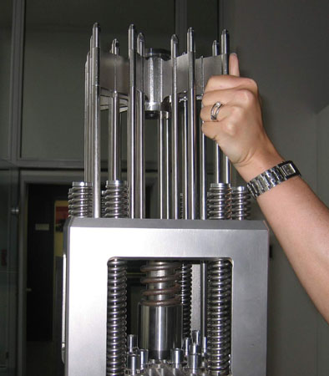

Nuclear Physics and Radioactivity
Control Rod Assembly
Control rod assembly, above fuel element
Free to share, print, make copies and changes. Get yours at www.boundless.com
Wikimedia. CC BY-SA http://upload.wikimedia.org/wikipedia/commons/d/de/PWR_control_rod_assemby.jpg View on Boundless.com

Slide 17
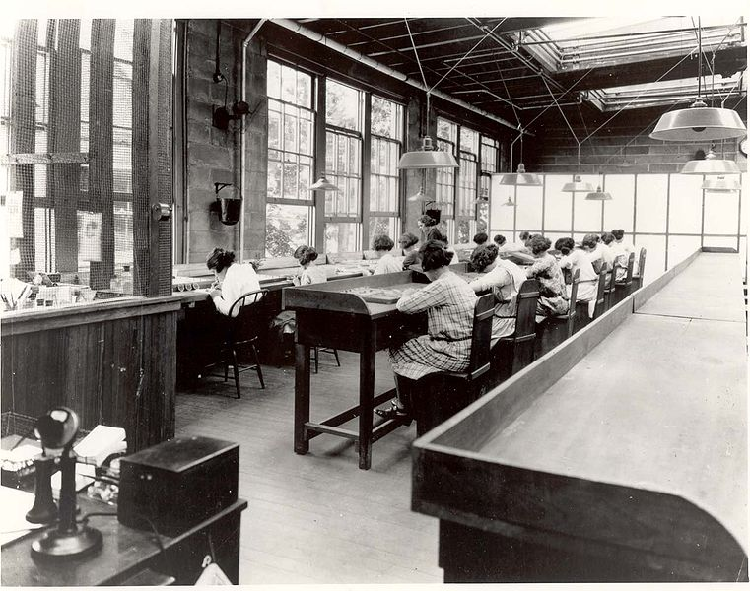
Nuclear Physics and Radioactivity
Radium Girls
Radium dial painters working in a factory
Free to share, print, make copies and changes. Get yours at www.boundless.com
Wikimedia. CC BY-SA http://upload.wikimedia.org/wikipedia/en/thumb/e/e3/USRadiumGirls-Argonne1,ca1922-23-150dpi.jpg/761px-USRadiumGirls-Argonne1,ca1922-23-150dpi.jpg View on Boundless.com

Slide 18
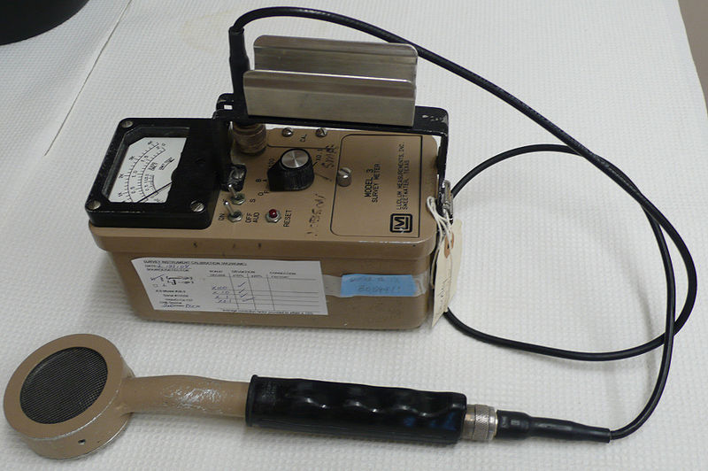
Nuclear Physics and Radioactivity
Geiger Counter
Image of a Geiger counter with pancake-type probe
Free to share, print, make copies and changes. Get yours at www.boundless.com
Wikimedia. CC BY-SA http://upload.wikimedia.org/wikipedia/commons/thumb/3/37/Geiger_counter_2.jpg/800px-Geiger_counter_2.jpg View on Boundless.com

Slide 19
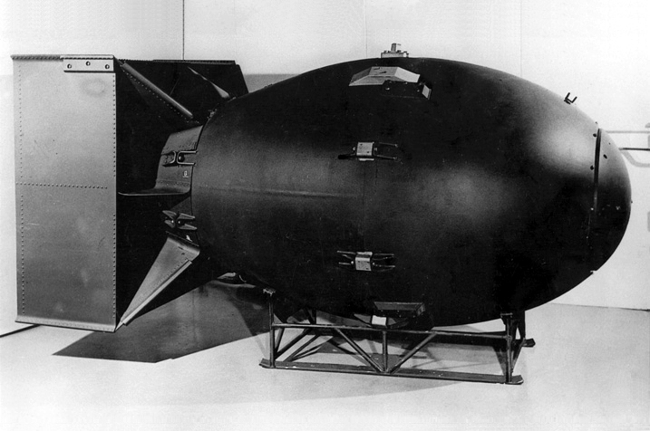
Nuclear Physics and Radioactivity
Fat Man Atomic Bomb
The first nuclear weapons were gravity bombs, such as this "Fat Man" weapon dropped on Nagasaki, Japan. They were very large and could only be delivered by heavy bomber aircraft.
Free to share, print, make copies and changes. Get yours at www.boundless.com
Wikimedia. CC BY-SA http://upload.wikimedia.org/wikipedia/commons/c/c2/Fat_man.jpg View on Boundless.com

Slide 20
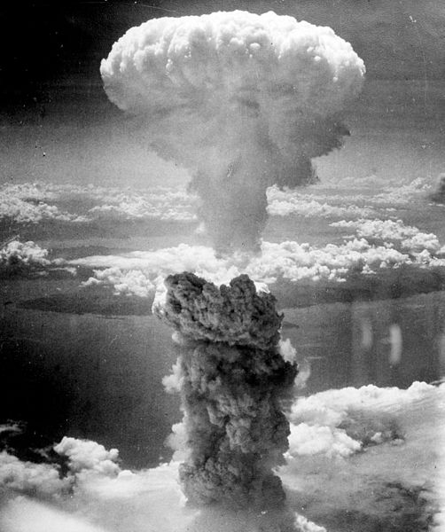
Nuclear Physics and Radioactivity
Nagasaki Atomic Bombing
The mushroom cloud of the atomic bombing of Nagasaki, Japan (August 9,1945) rose some 18 kilometers (11 mi) above the bomb's hypocenter.
Free to share, print, make copies and changes. Get yours at www.boundless.com
Wikimedia. CC BY-SA http://upload.wikimedia.org/wikipedia/commons/thumb/e/e0/Nagasakibomb.jpg/502px-Nagasakibomb.jpg View on Boundless.com

Slide 21
Nuclear Physics and Radioactivity
Alpha Decay
Alpha decay is one type of radioactive decay. An atomic nucleus emits an alpha particle and thereby transforms ("decays") into an atom with a mass number smaller by four and an atomic number smaller by two. Many other types of decay are possible.
Free to share, print, make copies and changes. Get yours at www.boundless.com
Wikimedia. CC BY-SA http://upload.wikimedia.org/wikipedia/commons/thumb/7/79/Alpha_Decay.svg/250px-Alpha_Decay.svg.png View on Boundless.com

Slide 22
Nuclear Physics and Radioactivity
External Beam Therapy
Radiation therapy of the pelvis. Lasers and a mold under the legs are used for precise positioning
Free to share, print, make copies and changes. Get yours at www.boundless.com
Wikimedia. CC BY-SA http://upload.wikimedia.org/wikipedia/commons/thumb/d/d5/Radiation_therapy.jpg/800px-Radiation_therapy.jpg View on Boundless.com

Slide 23
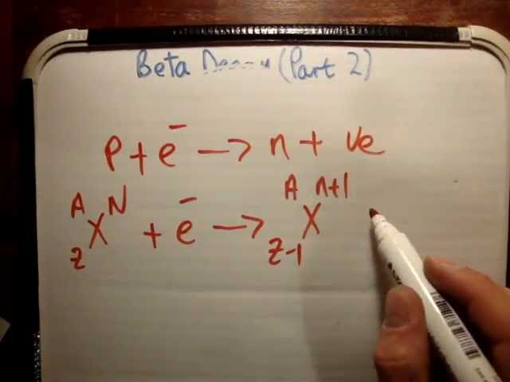
Nuclear Physics and Radioactivity
Beta Decay 2/2
In this video I introduce Beta decay and discuss it from an basic level to a perhaps second or third year University level.
Free to share, print, make copies and changes. Get yours at www.boundless.com
View on Boundless.com

Slide 24
Nuclear Physics and Radioactivity
Radioactive decay simulation
A simulation of many identical atoms undergoing radioactive decay, starting with four atoms (left) and 400 atoms (right). The number at the top indicates how many half-lives have elapsed
Free to share, print, make copies and changes. Get yours at www.boundless.com
Wikipedia. "Half-life." GNU FDL http://en.wikipedia.org/wiki/Half-life View on Boundless.com

Slide 25
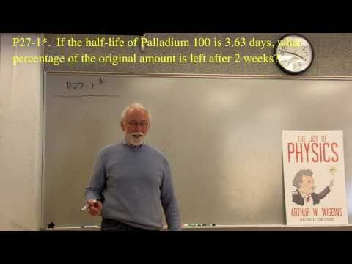
Nuclear Physics and Radioactivity
Half-life
Part of a series of videos on physics problem-solving. The problems are taken from "The Joy of Physics. " This one deals with radioactive half-life. The viewer is urged to pause the video at the problem statement and work the problem before watching the rest of the video.
Free to share, print, make copies and changes. Get yours at www.boundless.com
View on Boundless.com

Slide 26
Nuclear Physics and Radioactivity
Natural Radiation Atlas of Europe
Bar chart of average annual dosages from natural radiation sources for major European countries
Free to share, print, make copies and changes. Get yours at www.boundless.com
Wikimedia. CC BY-SA http://upload.wikimedia.org/wikipedia/commons/5/55/Natural_Radiation_Atlas_of_Europe.jpg View on Boundless.com

Slide 27
Nuclear Physics and Radioactivity
Formation and Decay of Carbon-14
Diagram of the formation of carbon-14 (1), the decay of carbon-14 (2), and equations describing the carbon-12:carbon-14 ratio in living and dead organisms
Free to share, print, make copies and changes. Get yours at www.boundless.com
Wikimedia. CC BY-SA http://upload.wikimedia.org/wikipedia/commons/thumb/7/70/Carbon_14_formation_and_decay.svg/800px-Carbon_14_formation_and_decay.svg.png View on Boundless.com

Slide 28
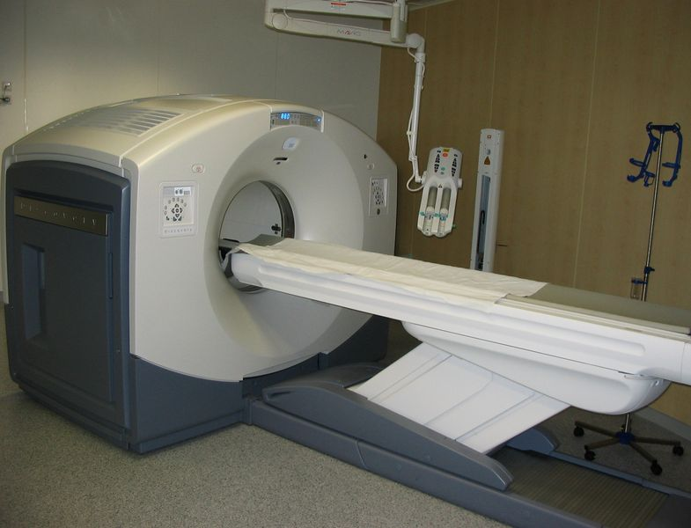
Nuclear Physics and Radioactivity
PET/CT-System
PET/CT-System with 16-slice CT; the ceiling mounted device is an injection pump for CT contrast agent.
Free to share, print, make copies and changes. Get yours at www.boundless.com
Wikimedia. CC BY-SA http://upload.wikimedia.org/wikipedia/commons/thumb/c/c4/16slicePETCT.jpg/785px-16slicePETCT.jpg View on Boundless.com

Slide 29
Nuclear Physics and Radioactivity
Nuclear Fission Reaction
An induced nuclear fission event. A neutron is absorbed by the nucleus of a uranium-235 atom, which in turn splits into fast-moving lighter elements (fission products) and free neutrons
Free to share, print, make copies and changes. Get yours at www.boundless.com
Wikimedia. CC BY-SA http://upload.wikimedia.org/wikipedia/commons/thumb/1/15/Nuclear_fission.svg/309px-Nuclear_fission.svg.png View on Boundless.com

Slide 30

Nuclear Physics and Radioactivity
Radura Logo
The Radura logo, required by U.S. Food and Drug Administration regulations to show a food has been treated with ionizing radiation
Free to share, print, make copies and changes. Get yours at www.boundless.com
Wikimedia. CC BY-SA http://upload.wikimedia.org/wikipedia/commons/thumb/9/9d/Radura-Symbol.svg/185px-Radura-Symbol.svg.png View on Boundless.com

Slide 31
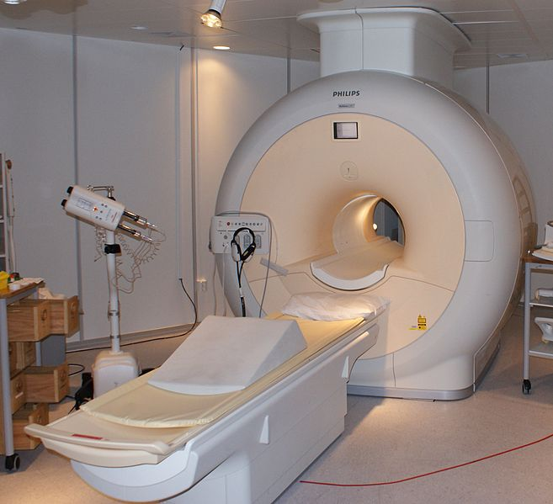
Nuclear Physics and Radioactivity
MRI Scanner
Phillips MRI scanner in Gothenburg, Sweden.
Free to share, print, make copies and changes. Get yours at www.boundless.com
Wikimedia. CC BY-SA http://upload.wikimedia.org/wikipedia/commons/thumb/e/ee/MRI-Philips.JPG/657px-MRI-Philips.JPG View on Boundless.com

Slide 32

Nuclear Physics and Radioactivity
Personal Radiation Dosimeter
A physician wearing a personal radiation dosimeter
Free to share, print, make copies and changes. Get yours at www.boundless.com
Wikimedia. CC BY-SA http://upload.wikimedia.org/wikipedia/commons/6/62/Dosimeter.gif View on Boundless.com

Slide 33
Nuclear Physics and Radioactivity
Beta Decay
β decay in an atomic nucleus (the accompanying antineutrino is omitted). The inset shows beta decay of a free neutron
Free to share, print, make copies and changes. Get yours at www.boundless.com
Wikimedia. CC BY-SA http://upload.wikimedia.org/wikipedia/commons/thumb/a/aa/Beta-minus_Decay.svg/250px-Beta-minus_Decay.svg.png View on Boundless.com

Slide 34
Nuclear Physics and Radioactivity
Radioactive Decay Series Diagram
This diagram provides examples of four decay series: thorium (in blue), radium (in red), actinium (in green), and neptunium (in purple).
Free to share, print, make copies and changes. Get yours at www.boundless.com
Wikimedia. CC BY-SA http://upload.wikimedia.org/wikipedia/commons/thumb/6/62/Radioactive_decay_chains_diagram.svg/800px-Radioactive_decay_chains_diagram.svg.png View on Boundless.com

Slide 35
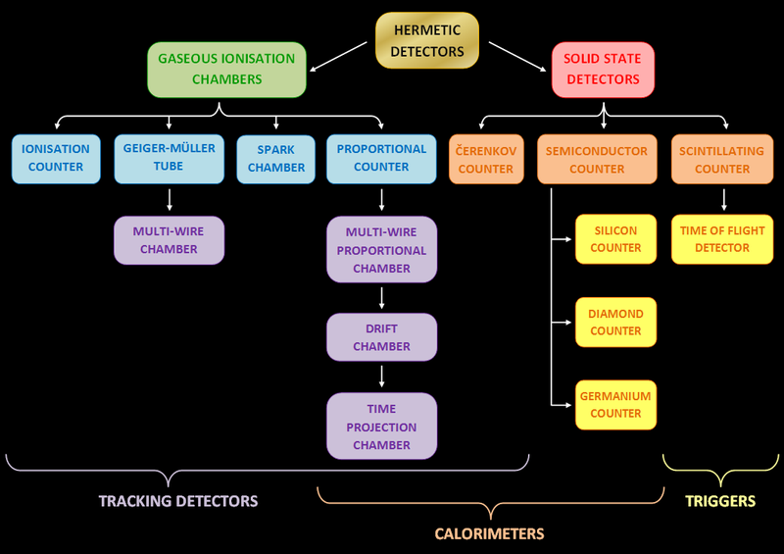
Nuclear Physics and Radioactivity
Different Types of Radiation Detectors
different types of radiation detectors (counters)
Free to share, print, make copies and changes. Get yours at www.boundless.com
Wikimedia. CC BY-SA http://upload.wikimedia.org/wikipedia/commons/thumb/c/c0/Detectors_summary_3.png/800px-Detectors_summary_3.png View on Boundless.com

Slide 36
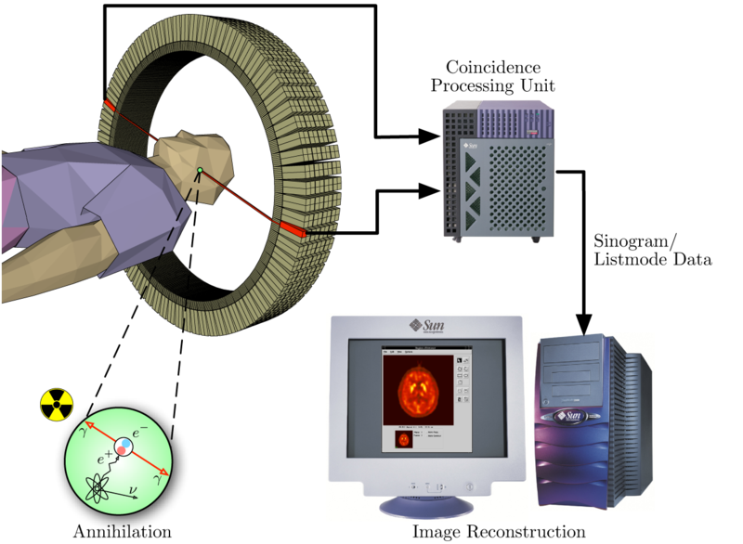
Nuclear Physics and Radioactivity
Positron Emission Tomography Acquisition Process
Schema of a PET acquisition process.
Free to share, print, make copies and changes. Get yours at www.boundless.com
Wikimedia. CC BY-SA http://upload.wikimedia.org/wikipedia/commons/thumb/c/c1/PET-schema.png/800px-PET-schema.png View on Boundless.com

Slide 37
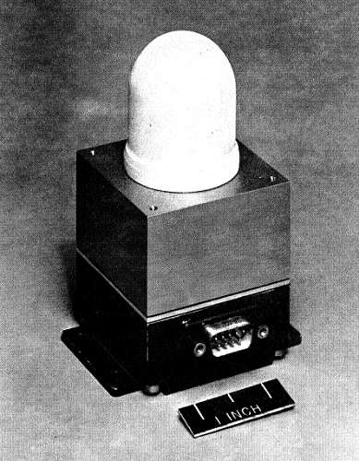
Nuclear Physics and Radioactivity
Ionization Chamber
This ionization chamber was used in the South Atlantic Anomaly Probe project.
Free to share, print, make copies and changes. Get yours at www.boundless.com
Wikimedia. CC BY-SA http://upload.wikimedia.org/wikipedia/commons/7/71/Ion-Chamber-Dosimeter-SAAP.jpg View on Boundless.com

Slide 38
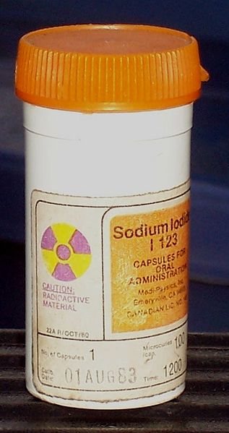
Nuclear Physics and Radioactivity
Iodine; 123 Radioisotope
Lead container containing iodine-123 radioisotope
Free to share, print, make copies and changes. Get yours at www.boundless.com
Wikimedia. CC BY-SA http://upload.wikimedia.org/wikipedia/commons/thumb/6/6f/Lead_container_for_nuclear_medications.jpg/317px-Lead_container_for_nuclear_medications.jpg View on Boundless.com

Slide 39
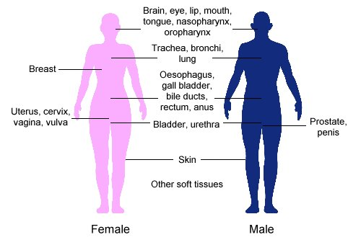
Nuclear Physics and Radioactivity
Clinical Applications of Brachytherapy
Body sites in which brachytherapy can be used to treat cancer
Free to share, print, make copies and changes. Get yours at www.boundless.com
Wikimedia. CC BY-SA http://upload.wikimedia.org/wikipedia/commons/4/4c/Clinical_applications_of_brachytherapy.jpg View on Boundless.com

Slide 40
Nuclear Physics and Radioactivity
External Beam Therapy
Radiation therapy of the pelvis. Lasers and a mold under the legs are used for precise positioning
Free to share, print, make copies and changes. Get yours at www.boundless.com
Wikimedia. CC BY-SA http://upload.wikimedia.org/wikipedia/commons/thumb/d/d5/Radiation_therapy.jpg/800px-Radiation_therapy.jpg View on Boundless.com

Slide 41
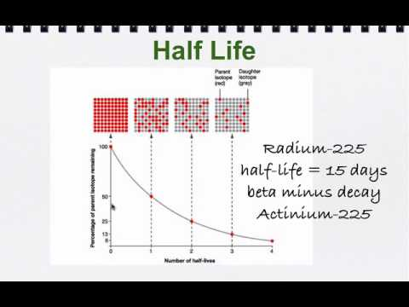
Nuclear Physics and Radioactivity
Half-life
Describes radioactive half life and how to do some simple calculations using half life.
Free to share, print, make copies and changes. Get yours at www.boundless.com
View on Boundless.com

Slide 42
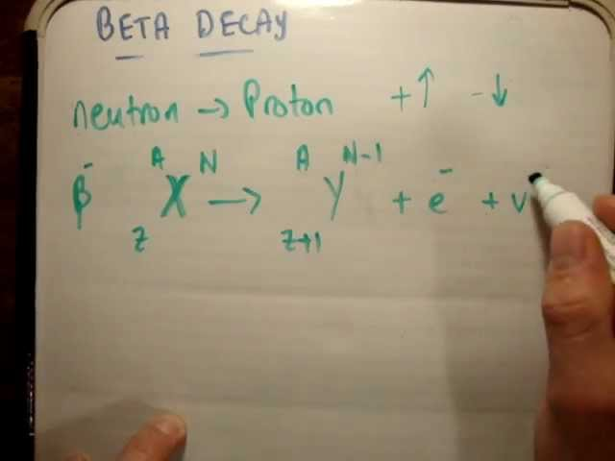
Nuclear Physics and Radioactivity
Beta Decay 1/2
In this video I introduce Beta decay and discuss it from an basic level to a perhaps second or third year University level.
Free to share, print, make copies and changes. Get yours at www.boundless.com
View on Boundless.com

Slide 43
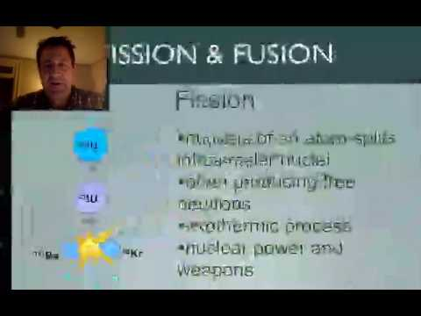
Nuclear Physics and Radioactivity
Fission and Fusion
Describes the difference between fission and fusion
Free to share, print, make copies and changes. Get yours at www.boundless.com
View on Boundless.com

Slide 44
Nuclear Physics and Radioactivity
Fission and Fusion
Describes the difference between fission and fusion
Free to share, print, make copies and changes. Get yours at www.boundless.com
View on Boundless.com

Slide 45
Nuclear Physics and Radioactivity
Nuclear fission of U-235
If U-235 is bombarded with a neutron (light blue small circe), the resulting U-236 produced is unstable and undergoes fission. The resulting elements (shown here as Kr-92 and Ba-141) do not contain as many nucleons as U-236, with the remaining three neutrons being released as high-energy particles, able to bombard another U-235 atom and maintain a chain reaction.
Free to share, print, make copies and changes. Get yours at www.boundless.com
Wikipedia. "File:Nuclear fission.svg - Wikipedia, the free encyclopedia." CC BY-SA http://en.wikipedia.org/w/index.php?title=File:Nuclear_fission.svg&page=1 View on Boundless.com

Slide 46
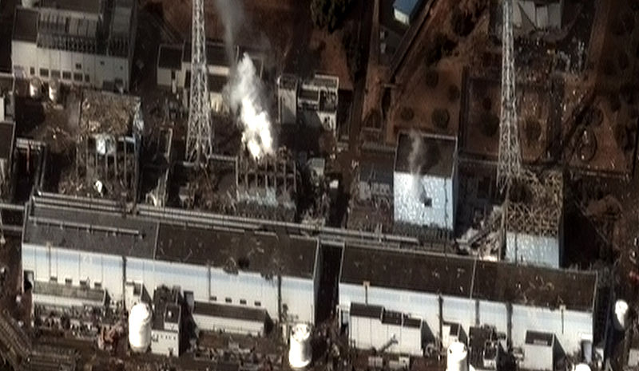
Nuclear Physics and Radioactivity
Fukushima Daiichi Nuclear Disaster
Satellite image taken March 16, 2011 of the four damaged reactor buildings
Free to share, print, make copies and changes. Get yours at www.boundless.com
Wikimedia. CC BY-SA http://upload.wikimedia.org/wikipedia/commons/thumb/7/7d/Fukushima_I_by_Digital_Globe.jpg/800px-Fukushima_I_by_Digital_Globe.jpg View on Boundless.com

Slide 47
Nuclear Physics and Radioactivity
P-Orbital
The red and blue lobes represent the volume in which there is a 90 percent probability of finding an electron at any given time if the orbital is occupied.
Free to share, print, make copies and changes. Get yours at www.boundless.com
Wikipedia. "P2M0." CC BY-SA http://en.wikipedia.org/wiki/File:P2M0.png View on Boundless.com

Slide 48
Nuclear Physics and Radioactivity
Figure 1
Top: Expected results: alpha particles passing through the plum pudding model of the atom undisturbed.Bottom: Observed results: a small portion of the particles were deflected, indicating a small, concentrated positive charge. Note that the image is not to scale; in reality the nucleus is vastly smaller than the electron shell.
Free to share, print, make copies and changes. Get yours at www.boundless.com
Wikimedia. CC BY-SA http://upload.wikimedia.org/wikipedia/commons/thumb/c/c3/Rutherford_gold_foil_experiment_results.svg/302px-Rutherford_gold_foil_experiment_results.svg.png View on Boundless.com

Slide 49
Nuclear Physics and Radioactivity
Drawing of Atomic Nucleus
A model of the atomic nucleus showing it as a compact bundle of the two types of nucleons: protons (red) and neutrons (blue).
Free to share, print, make copies and changes. Get yours at www.boundless.com
Wikimedia. CC BY-SA http://upload.wikimedia.org/wikipedia/commons/thumb/f/f0/Nucleus_drawing.svg/470px-Nucleus_drawing.svg.png View on Boundless.com

Slide 50
Nuclear Physics and Radioactivity
Cobalt-60 Decay Scheme
Path of decay of Co-60 to Ni-60. Excited levels for Ni-60 that drop to ground state via emission of gamma rays are indicated
Free to share, print, make copies and changes. Get yours at www.boundless.com
Wikimedia. CC BY-SA http://upload.wikimedia.org/wikipedia/commons/thumb/e/e0/Cobalt-60_Decay_Scheme.svg/450px-Cobalt-60_Decay_Scheme.svg.png View on Boundless.com

Slide 51
Nuclear Physics and Radioactivity
Fusion of Deuterium with Tritium
Fusion of deuterium with tritium creating helium-4, freeing a neutron, and releasing 17.59 MeV of energy; some mass changes form to appear as the kinetic energy of the products
Free to share, print, make copies and changes. Get yours at www.boundless.com
Wikimedia. CC BY-SA http://upload.wikimedia.org/wikipedia/commons/thumb/3/3b/Deuterium-tritium_fusion.svg/248px-Deuterium-tritium_fusion.svg.png View on Boundless.com

Slide 52
Nuclear Physics and Radioactivity
Alpha Decay
Alpha decay is one type of radioactive decay. An atomic nucleus emits an alpha particle and thereby transforms ("decays") into an atom with a mass number smaller by four and an atomic number smaller by two. Many other types of decay are possible.
Free to share, print, make copies and changes. Get yours at www.boundless.com
Wikimedia. CC BY-SA http://upload.wikimedia.org/wikipedia/commons/thumb/7/79/Alpha_Decay.svg/250px-Alpha_Decay.svg.png View on Boundless.com

Slide 53
Attribution
Nuclear Physics and Radioactivity
Wiktionary. "radioisotope." CC BY-SA 3.0 http://en.wiktionary.org/wiki/radioisotope
Wiktionary. "half-life." CC BY-SA 3.0 http://en.wiktionary.org/wiki/half-life
Wiktionary. "decay." CC BY-SA 3.0 http://en.wiktionary.org/wiki/decay
Wikipedia. "Radioactive decay series." CC BY-SA 3.0 http://en.wikipedia.org/wiki/Radioactive_decay_series
Wiktionary. "quark." CC BY-SA 3.0 http://en.wiktionary.org/wiki/quark
Wiktionary. "gluon." CC BY-SA 3.0 http://en.wiktionary.org/wiki/gluon
Wiktionary. "nucleus." CC BY-SA 3.0 http://en.wiktionary.org/wiki/nucleus
Wikipedia. "Nuclear force." CC BY-SA 3.0 http://en.wikipedia.org/wiki/Nuclear_force
Wikipedia. "Nuclear binding energy." CC BY-SA 3.0 http://en.wikipedia.org/wiki/Nuclear_binding_energy
Wikipedia. "Binding energy." CC BY-SA 3.0 http://en.wikipedia.org/wiki/Binding_energy
Wiktionary. "nucleosynthesis." CC BY-SA 3.0 http://en.wiktionary.org/wiki/nucleosynthesis
Wiktionary. "fusion." CC BY-SA 3.0 http://en.wiktionary.org/wiki/fusion
Wikipedia. "Nuclear fusion." CC BY-SA 3.0 http://en.wikipedia.org/wiki/Nuclear_fusion
Wiktionary. "gamma ray." CC BY-SA 3.0 http://en.wiktionary.org/wiki/gamma_ray
Wiktionary. "ionizing radiation." CC BY-SA 3.0 http://en.wiktionary.org/wiki/ionizing_radiation
Wiktionary. "x-ray." CC BY-SA 3.0 http://en.wiktionary.org/wiki/x-ray
Wikipedia. "Food irradiation." CC BY-SA 3.0 http://en.wikipedia.org/wiki/Food_irradiation
Free to share, print, make copies and changes. Get yours at www.boundless.com

Slide 54
Nuclear Physics and Radioactivity
Wiktionary. "alpha particle." CC BY-SA 3.0 http://en.wiktionary.org/wiki/alpha_particle
Wiktionary. "radioactive decay." CC BY-SA 3.0 http://en.wiktionary.org/wiki/radioactive_decay
Wikipedia. "Alpha decay." CC BY-SA 3.0 http://en.wikipedia.org/wiki/Alpha_decay
Wiktionary. "warfare." CC BY-SA 3.0 http://en.wiktionary.org/wiki/warfare
Wiktionary. "fission." CC BY-SA 3.0 http://en.wiktionary.org/wiki/fission
Wiktionary. "fusion." CC BY-SA 3.0 http://en.wiktionary.org/wiki/fusion
Wikipedia. "Nuclear weapon." CC BY-SA 3.0 http://en.wikipedia.org/wiki/Nuclear_weapon
Wiktionary. "sievert." CC BY-SA 3.0 http://en.wiktionary.org/wiki/sievert
Wiktionary. "radon." CC BY-SA 3.0 http://en.wiktionary.org/wiki/radon
Wikipedia. "radionuclide." CC BY-SA 3.0 http://en.wikipedia.org/wiki/radionuclide
Wikipedia. "Natural radioactivity." CC BY-SA 3.0 http://en.wikipedia.org/wiki/Natural_radioactivity
Wiktionary. "radioactive decay." CC BY-SA 3.0 http://en.wiktionary.org/wiki/radioactive_decay
Wikipedia. "radionuclide." CC BY-SA 3.0 http://en.wikipedia.org/wiki/radionuclide
Wiktionary. "nuclide." CC BY-SA 3.0 http://en.wiktionary.org/wiki/nuclide
Wikipedia. "Radioactive decay." CC BY-SA 3.0 http://en.wikipedia.org/wiki/Radioactive_decay
Wikipedia. "Unstable isotope." CC BY-SA 3.0 http://en.wikipedia.org/wiki/Unstable_isotope
Wiktionary. "scintillator." CC BY-SA 3.0 http://en.wiktionary.org/wiki/scintillator
Wiktionary. "semiconductor." CC BY-SA 3.0 http://en.wiktionary.org/wiki/semiconductor
Wiktionary. "diode." CC BY-SA 3.0 http://en.wiktionary.org/wiki/diode
Free to share, print, make copies and changes. Get yours at www.boundless.com

Slide 55
Nuclear Physics and Radioactivity
Wikipedia. "Gaseous ionization detector." CC BY-SA 3.0 http://en.wikipedia.org/wiki/Gaseous_ionization_detector
Wikipedia. "Radiation detector." CC BY-SA 3.0 http://en.wikipedia.org/wiki/Radiation_detector
Wikipedia. "Semiconductor detector." CC BY-SA 3.0 http://en.wikipedia.org/wiki/Semiconductor_detector
Wikipedia. "Scintillation detector." CC BY-SA 3.0 http://en.wikipedia.org/wiki/Scintillation_detector
Wiktionary. "ionizing radiation." CC BY-SA 3.0 http://en.wiktionary.org/wiki/ionizing_radiation
Wikipedia. "external beam therapy." CC BY-SA 3.0 http://en.wikipedia.org/wiki/external%20beam%20therapy
Wiktionary. "brachytherapy." CC BY-SA 3.0 http://en.wiktionary.org/wiki/brachytherapy
Wikipedia. "External beam radiotherapy." CC BY-SA 3.0 http://en.wikipedia.org/wiki/External_beam_radiotherapy
Wikipedia. "Radiation therapy." CC BY-SA 3.0 http://en.wikipedia.org/wiki/Radiation_therapy
Wikipedia. "Brachytherapy." CC BY-SA 3.0 http://en.wikipedia.org/wiki/Brachytherapy
Wikipedia. "Nuclear medicine." CC BY-SA 3.0 http://en.wikipedia.org/wiki/Nuclear_medicine
Boundless Learning. "Boundless." CC BY-SA 3.0 http://www.boundless.com//physics/definition/atomic-spectra
Wiktionary. "nucleus." CC BY-SA 3.0 http://en.wiktionary.org/wiki/nucleus
Wikipedia. "Wikipedia, the free encyclopedia." CC BY-SA 3.0 http://en.wikipedia.org/wiki/?-particle
Wikipedia. "Nuclear density." CC BY-SA 3.0 http://en.wikipedia.org/wiki/Nuclear_density
Wikipedia. "Nuclear size." CC BY-SA 3.0 http://en.wikipedia.org/wiki/Nuclear_size
Wiktionary. "control rod." CC BY-SA 3.0 http://en.wiktionary.org/wiki/control_rod
Wiktionary. "nuclear reactor." CC BY-SA 3.0 http://en.wiktionary.org/wiki/nuclear_reactor
Wiktionary. "fission." CC BY-SA 3.0 http://en.wiktionary.org/wiki/fission
Free to share, print, make copies and changes. Get yours at www.boundless.com

Slide 56
Nuclear Physics and Radioactivity
Wikipedia. "Nuclear reactors." CC BY-SA 3.0 http://en.wikipedia.org/wiki/Nuclear_reactors
Wikipedia. "Nuclear fission." CC BY-SA 3.0 http://en.wikipedia.org/wiki/Nuclear_fission
Wikipedia. "Atomic reactor." CC BY-SA 3.0 http://en.wikipedia.org/wiki/Atomic_reactor
Wiktionary. "electromagnetic radiation." CC BY-SA 3.0 http://en.wiktionary.org/wiki/electromagnetic_radiation
Wiktionary. "gamma ray." CC BY-SA 3.0 http://en.wiktionary.org/wiki/gamma_ray
Wikipedia. "Gamma decay." CC BY-SA 3.0 http://en.wikipedia.org/wiki/Gamma_decay%23Gamma_ray_production
Wiktionary. "ionizing radiation." CC BY-SA 3.0 http://en.wiktionary.org/wiki/ionizing_radiation
Wikipedia. "Biological effects of ionizing radiation." CC BY-SA 3.0 http://en.wikipedia.org/wiki/Biological_effects_of_ionizing_radiation
Wikipedia. "Radium Girls." CC BY-SA 3.0 http://en.wikipedia.org/wiki/Radium_Girls
Wiktionary. "ionizing radiation." CC BY-SA 3.0 http://en.wiktionary.org/wiki/ionizing_radiation
Wiktionary. "diode." CC BY-SA 3.0 http://en.wiktionary.org/wiki/diode
Wiktionary. "dosimeter." CC BY-SA 3.0 http://en.wiktionary.org/wiki/dosimeter
Wikipedia. "Dosimetry." CC BY-SA 3.0 http://en.wikipedia.org/wiki/Dosimetry
Wiktionary. "beta decay." CC BY-SA 3.0 http://en.wiktionary.org/wiki/beta_decay
Wiktionary. "transmutation." CC BY-SA 3.0 http://en.wiktionary.org/wiki/transmutation
Wiktionary. "positron." CC BY-SA 3.0 http://en.wiktionary.org/wiki/positron
Wikipedia. "Beta decay." CC BY-SA 3.0 http://en.wikipedia.org/wiki/Beta_decay
Wikipedia. "Beta decay." CC BY-SA 3.0 http://en.wikipedia.org/wiki/Beta_decay
Wikipedia. "radionuclide." CC BY-SA 3.0 http://en.wikipedia.org/wiki/radionuclide
Free to share, print, make copies and changes. Get yours at www.boundless.com

Slide 57
Nuclear Physics and Radioactivity
Wiktionary. "half-life." CC BY-SA 3.0 http://en.wiktionary.org/wiki/half-life
Wikipedia. "Half-life." CC BY-SA 3.0 http://en.wikipedia.org/wiki/Half-life
Wikipedia. "Decay rate." CC BY-SA 3.0 http://en.wikipedia.org/wiki/Decay_rate
Wikipedia. "Radioactive decay." CC BY-SA 3.0 http://en.wikipedia.org/wiki/Radioactive_decay%23Half-life
Wiktionary. "radioactive tracer." CC BY-SA 3.0 http://en.wiktionary.org/wiki/radioactive_tracer
Wiktionary. "radioactive decay." CC BY-SA 3.0 http://en.wiktionary.org/wiki/radioactive_decay
Wiktionary. "isotope." CC BY-SA 3.0 http://en.wiktionary.org/wiki/isotope
Wikipedia. "Radioactive tracer." CC BY-SA 3.0 http://en.wikipedia.org/wiki/Radioactive_tracer
Wiktionary. "computed tomography." CC BY-SA 3.0 http://en.wiktionary.org/wiki/computed_tomography
Wiktionary. "nuclear magnetic resonance." CC BY-SA 3.0 http://en.wiktionary.org/wiki/nuclear_magnetic_resonance
Wiktionary. "magnetic resonance imaging." CC BY-SA 3.0 http://en.wiktionary.org/wiki/magnetic_resonance_imaging
Wikipedia. "Magnetic resonance imaging." CC BY-SA 3.0 http://en.wikipedia.org/wiki/Magnetic_resonance_imaging
Wiktionary. "tunneling." CC BY-SA 3.0 http://en.wiktionary.org/wiki/tunneling
Wikipedia. "Quantum tunnelling." CC BY-SA 3.0 http://en.wikipedia.org/wiki/Quantum_tunnelling
Wikipedia. "carbon-14." CC BY-SA 3.0 http://en.wikipedia.org/wiki/carbon-14
Wiktionary. "radioisotope." CC BY-SA 3.0 http://en.wiktionary.org/wiki/radioisotope
Wikipedia. "radiometric dating." CC BY-SA 3.0 http://en.wikipedia.org/wiki/radiometric%20dating
Wikipedia. "Radiocarbon dating." CC BY-SA 3.0 http://en.wikipedia.org/wiki/Radiocarbon_dating
Wikipedia. "Carbon-14." CC BY-SA 3.0 http://en.wikipedia.org/wiki/Carbon-14
Free to share, print, make copies and changes. Get yours at www.boundless.com

Slide 58
Nuclear Physics and Radioactivity
Wiktionary. "ionizing radiation." CC BY-SA 3.0 http://en.wiktionary.org/wiki/ionizing_radiation
Wikipedia. "external beam therapy." CC BY-SA 3.0 http://en.wikipedia.org/wiki/external%20beam%20therapy
Wiktionary. "brachytherapy." CC BY-SA 3.0 http://en.wiktionary.org/wiki/brachytherapy
Wikipedia. "Radiation therapy." CC BY-SA 3.0 http://en.wikipedia.org/wiki/Radiation_therapy
Wikipedia. "Nuclear medicine." CC BY-SA 3.0 http://en.wikipedia.org/wiki/Nuclear_medicine
Wikipedia. "External beam radiotherapy." CC BY-SA 3.0 http://en.wikipedia.org/wiki/External_beam_radiotherapy
Wikipedia. "Brachytherapy." CC BY-SA 3.0 http://en.wikipedia.org/wiki/Brachytherapy
Wiktionary. "tracer." CC BY-SA 3.0 http://en.wiktionary.org/wiki/tracer
Wiktionary. "positron." CC BY-SA 3.0 http://en.wiktionary.org/wiki/positron
Wiktionary. "tomography." CC BY-SA 3.0 http://en.wiktionary.org/wiki/tomography
Wikipedia. "Positron emission tomography." CC BY-SA 3.0 http://en.wikipedia.org/wiki/Positron_emission_tomography
Wikipedia. "Tomography." CC BY-SA 3.0 http://en.wikipedia.org/wiki/Tomography
Wiktionary. "fusion." CC BY-SA 3.0 http://en.wiktionary.org/wiki/fusion
Wiktionary. "fission." CC BY-SA 3.0 http://en.wiktionary.org/wiki/fission
Wiktionary. "nucleon." CC BY-SA 3.0 http://en.wiktionary.org/wiki/nucleon
Wikipedia. "Nuclear fusion." CC BY-SA 3.0 http://en.wikipedia.org/wiki/Nuclear_fusion
Wikipedia. "Radioactive decay." CC BY-SA 3.0 http://en.wikipedia.org/wiki/Radioactive_decay
Wikipedia. "Nuclear fission." CC BY-SA 3.0 http://en.wikipedia.org/wiki/Nuclear_fission
Free to share, print, make copies and changes. Get yours at www.boundless.com

