Slide 1


Boundless Lecture Slides
Available on the Boundless Teaching Platform
Free to share, print, make copies and changes. Get yours at www.boundless.com

Slide 2



Using Boundless Presentations
Boundless Teaching Platform
Boundless empowers educators to engage their students with affordable, customizable textbooks and intuitive teaching tools. The free Boundless Teaching Platform gives educators the ability to customize textbooks in more than 20 subjects that align to hundreds of popular titles. Get started by using high quality Boundless books, or make switching to our platform easier by building from Boundless content pre-organized to match the assigned textbook. This platform gives educators the tools they need to assign readings and assessments, monitor student activity, and lead their classes with pre-made teaching resources.
Get started now at:
The Appendix
The appendix is for you to use to add depth and breadth to your lectures. You can simply drag and drop slides from the appendix into the main presentation to make for a richer lecture experience.
http://boundless.com/teaching-platform
Free to edit, share, and copy
Feel free to edit, share, and make as many copies of the Boundless presentations as you like. We encourage you to take these presentations and make them your own.
If you have any questions or problems please email:
educators@boundless.com
Free to share, print, make copies and changes. Get yours at www.boundless.com

Slide 3

About Boundless
Boundless is an innovative technology company making education more affordable and accessible for students everywhere. The company creates the world’s best open educational content in 20+ subjects that align to more than 1,000 popular college textbooks. Boundless integrates learning technology into all its premium books to help students study more efficiently at a fraction of the cost of traditional textbooks. The company also empowers educators to engage their students more effectively through customizable books and intuitive teaching tools as part of the Boundless Teaching Platform. More than 2 million learners access Boundless free and premium content each month across the company’s wide distribution platforms, including its website, iOS apps, Kindle books, and iBooks. To get started learning or teaching with Boundless, visit boundless.com.
Free to share, print, make copies and changes. Get yours at www.boundless.com

Slide 4
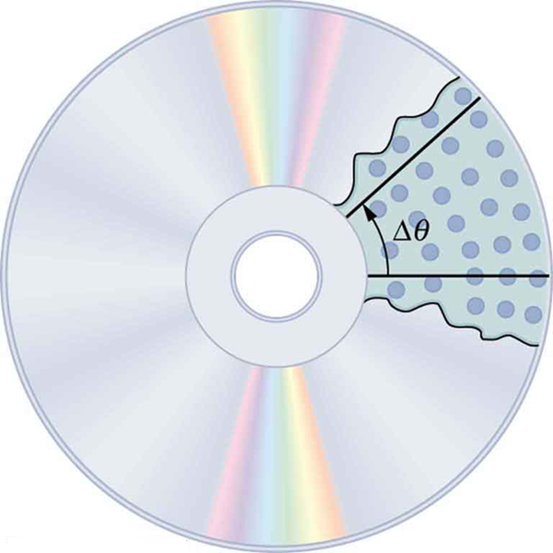
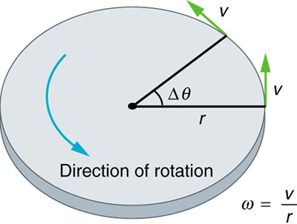
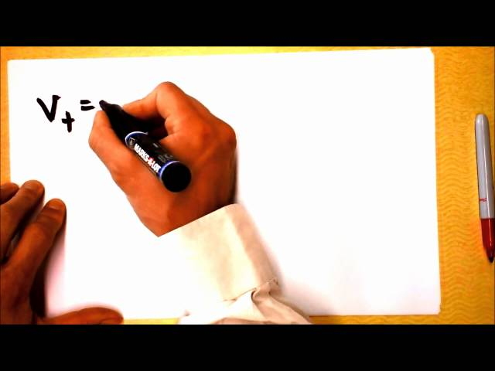
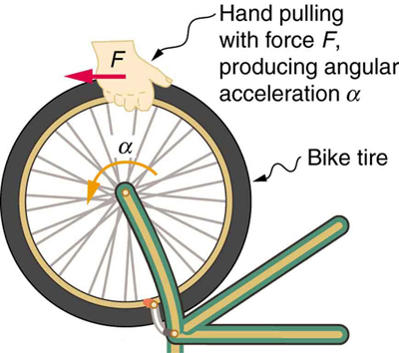
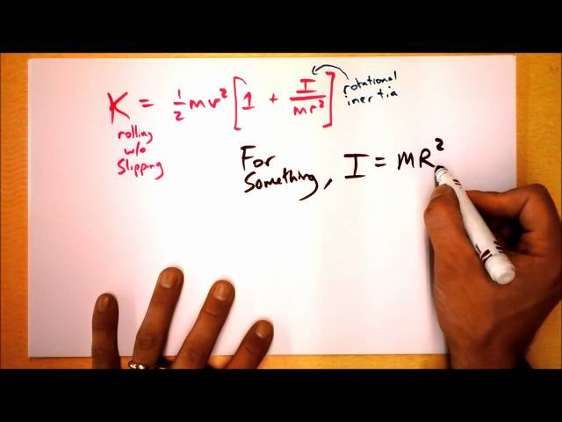

Rotational Kinematics, Angular Momentum, and Energy
Quantities of Rotational Kinematics
Angular Acceleration
Rotational Kinematics
Dynamics
]
Rotational Kinetic Energy
Rotational Kinematics, Angular Momentum, and En...
Free to share, print, make copies and changes. Get yours at www.boundless.com

Slide 5
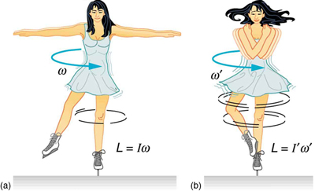
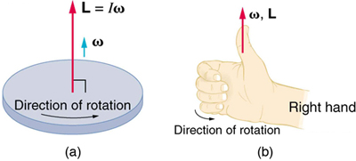
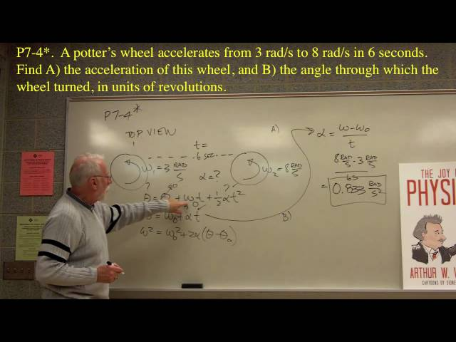
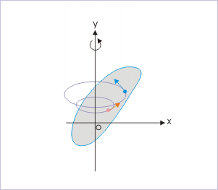
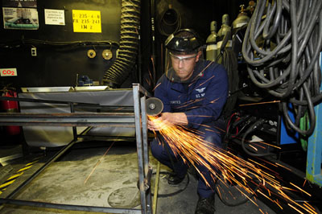
Rotational Kinematics, Angular Momentum, and Energy (continued)
Conservation of Angular Momentum
Vector Nature of Rotational Kinematics
Problem Solving
Linear and Rotational Quantities
]
Conservation of Energy
Rotational Kinematics, Angular Momentum, and En...
Free to share, print, make copies and changes. Get yours at www.boundless.com

Slide 6

Quantities of Rotational Kinematics
Rotational Kinematics, Angular Momentum, and En... > Quantities of Rotational Kinematics
Angular Position, Theta
Angular Velocity, Omega
Angular Acceleration, Alpha
Free to share, print, make copies and changes. Get yours at www.boundless.com
www.boundless.com/physics/textbooks/boundless-physics-textbook/rotational-kinematics-angular-momentum-and-energy-9/quantities-of-rotational-kinematics-81/

Slide 7
Angular Acceleration
Rotational Kinematics, Angular Momentum, and En... > Angular Acceleration
Constant Angular Acceleration
Free to share, print, make copies and changes. Get yours at www.boundless.com
www.boundless.com/physics/textbooks/boundless-physics-textbook/rotational-kinematics-angular-momentum-and-energy-9/angular-acceleration-82/

Slide 8
Rotational Kinematics
Rotational Kinematics, Angular Momentum, and En... > Rotational Kinematics
Rolling Without Slipping
Free to share, print, make copies and changes. Get yours at www.boundless.com
www.boundless.com/physics/textbooks/boundless-physics-textbook/rotational-kinematics-angular-momentum-and-energy-9/rotational-kinematics-83/

Slide 9
Dynamics
Rotational Kinematics, Angular Momentum, and En... > Dynamics
Rotational Inertia
Free to share, print, make copies and changes. Get yours at www.boundless.com
www.boundless.com/physics/textbooks/boundless-physics-textbook/rotational-kinematics-angular-momentum-and-energy-9/dynamics-84/

Slide 10
Rotational Kinetic Energy
Rotational Kinematics, Angular Momentum, and En... > Rotational Kinetic Energy
Rotational Kinetic Energy: Work, Energy, and Power
Moment of Inertia
Free to share, print, make copies and changes. Get yours at www.boundless.com
www.boundless.com/physics/textbooks/boundless-physics-textbook/rotational-kinematics-angular-momentum-and-energy-9/rotational-kinetic-energy-85/

Slide 11
Conservation of Angular Momentum
Rotational Kinematics, Angular Momentum, and En... > Conservation of Angular Momentum
Conservation of Angular Momentum
Rotational Collisions
Free to share, print, make copies and changes. Get yours at www.boundless.com
www.boundless.com/physics/textbooks/boundless-physics-textbook/rotational-kinematics-angular-momentum-and-energy-9/conservation-of-angular-momentum-86/

Slide 12
Vector Nature of Rotational Kinematics
Rotational Kinematics, Angular Momentum, and En... > Vector Nature of Rotational Kinematics
Angular Quantities as Vectors
Gyroscopes
Free to share, print, make copies and changes. Get yours at www.boundless.com
www.boundless.com/physics/textbooks/boundless-physics-textbook/rotational-kinematics-angular-momentum-and-energy-9/vector-nature-of-rotational-kinematics-87/

Slide 13
Problem Solving
Rotational Kinematics, Angular Momentum, and En... > Problem Solving
Problem-Solving Techniques
Free to share, print, make copies and changes. Get yours at www.boundless.com
www.boundless.com/physics/textbooks/boundless-physics-textbook/rotational-kinematics-angular-momentum-and-energy-9/problem-solving-88/

Slide 14
Linear and Rotational Quantities
Rotational Kinematics, Angular Momentum, and En... > Linear and Rotational Quantities
Relationship Between Linear and Rotational Quantitues
Free to share, print, make copies and changes. Get yours at www.boundless.com
www.boundless.com/physics/textbooks/boundless-physics-textbook/rotational-kinematics-angular-momentum-and-energy-9/linear-and-rotational-quantities-89/

Slide 15
Conservation of Energy
Rotational Kinematics, Angular Momentum, and En... > Conservation of Energy
Conservation of Energy in Rotational Motion
Free to share, print, make copies and changes. Get yours at www.boundless.com
www.boundless.com/physics/textbooks/boundless-physics-textbook/rotational-kinematics-angular-momentum-and-energy-9/conservation-of-energy-90/

Slide 16
Appendix
Free to share, print, make copies and changes. Get yours at www.boundless.com

Slide 17
Key terms
Rotational Kinematics, Angular Momentum, and En...
angular Relating to an angle or angles; having an angle or angles; forming an angle or corner; sharp-cornered; pointed; as in, an angular figure.
angular acceleration The rate of change of angular velocity, often represented by α.
angular momentum A vector quantity describing an object in circular motion; its magnitude is equal to the momentum of the particle, and the direction is perpendicular to the plane of its circular motion.
angular momentum A vector quantity describing an object in circular motion; its magnitude is equal to the momentum of the particle, and the direction is perpendicular to the plane of its circular motion.
Angular position The angle in radians (degrees, revolutions) through which a point or line has been rotated in a specified sense about a specified axis.
angular velocity A vector quantity describing the motion of an object in circular motion; its magnitude is equal to the angular speed () of the particle, and the direction is perpendicular to the plane of its circular motion.
angular velocity A vector quantity describing an object in circular motion; its magnitude is equal to the speed of the particle and the direction is perpendicular to the plane of its circular motion.
angular velocity A vector quantity describing an object in circular motion; its magnitude is equal to the speed of the particle and the direction is perpendicular to the plane of its circular motion.
angular velocity A vector quantity describing an object in circular motion; its magnitude is equal to the speed of the particle and the direction is perpendicular to the plane of its circular motion.
angular velocity A vector quantity describing an object in circular motion; its magnitude is equal to the speed of the particle and the direction is perpendicular to the plane of its circular motion.
gimbal A device for suspending something, such as a ship's compass, so that it will remain level when its support is tipped.
inertia The property of a body that resists any change to its uniform motion; equivalent to its mass.
Free to share, print, make copies and changes. Get yours at www.boundless.com

Slide 18
Rotational Kinematics, Angular Momentum, and En...
inertia The property of a body that resists any change to its uniform motion; equivalent to its mass.
kinematics The branch of mechanics concerned with objects in motion, but not with the forces involved.
kinematics The branch of mechanics concerned with objects in motion, but not with the forces involved.
linear velocity A vector quantity that denotes the rate of change of position with respect to time of the object's center of mass.
momentum (of a body in motion) the product of its mass and velocity.
quantum mechanics The branch of physics that studies matter and energy at the level of atoms and other elementary particles; it substitutes probabilistic mechanisms for classical Newtonian ones.
right hand rule Direction of angular velocity ω and angular momentum L in which the thumb of your right hand points when you curl your fingers in the direction of rotation.
right hand rule Direction of angular velocity ω and angular momentum L in which the thumb of your right hand points when you curl your fingers in the direction of rotation.
rotation The act of turning around a centre or an axis.
rotational inertia The tendency of a rotating object to remain rotating unless a torque is applied to it.
rotational inertia The tendency of a rotating object to remain rotating unless a torque is applied to it.
rotational inertia The tendency of a rotating object to remain rotating unless a torque is applied to it.
Free to share, print, make copies and changes. Get yours at www.boundless.com

Slide 19
Rotational Kinematics, Angular Momentum, and En...
tangential acceleration The acceleration in a direction tangent to the circle at the point of interest in circular motion.
torque A rotational or twisting effect of a force; (SI unit newton-meter or Nm; imperial unit foot-pound or ft-lb)
torque A rotational or twisting effect of a force; (SI unit newton-meter or Nm; imperial unit foot-pound or ft-lb)
torque A rotational or twisting effect of a force; (SI unit newton-meter or Nm; imperial unit foot-pound or ft-lb)
torque A rotational or twisting effect of a force; (SI unit newton-meter or Nm; imperial unit foot-pound or ft-lb)
torque A rotational or twisting effect of a force; (SI unit newton-meter or Nm; imperial unit foot-pound or ft-lb)
torque A rotational or twisting effect of a force; (SI unit newton-meter or Nm; imperial unit foot-pound or ft-lb)
uniform circular motion Movement around a circular path with constant speed.
work A measure of energy expended in moving an object; most commonly, force times displacement. No work is done if the object does not move.
Free to share, print, make copies and changes. Get yours at www.boundless.com

Slide 20

Rotational Kinematics, Angular Momentum, and En...
A Rotating Body
Each particle constituting the body executes a uniform circular motion about the fixed axis. For the description of the motion, angular quantities are the better choice.
Free to share, print, make copies and changes. Get yours at www.boundless.com
OpenStax CNX. "Sunil Kumar Singh, Circular Motion and Rotational Kinematics. February 1, 2013." CC BY 3.0 http://cnx.org/content/m14014/latest/ View on Boundless.com

Slide 21
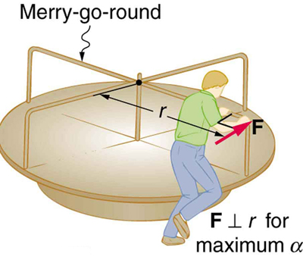
Rotational Kinematics, Angular Momentum, and En...
Moment of Inertia on a Merry-Go-Round
A father pushes a playground merry-go-round at its edge and perpendicular to its radius to achieve maximum torque.
Free to share, print, make copies and changes. Get yours at www.boundless.com
OpenStax CNX. "OpenStax College, College Physics. November 9, 2012." CC BY 3.0 http://cnx.org/content/m42179/latest/?collection=col11406/1.7 View on Boundless.com

Slide 22
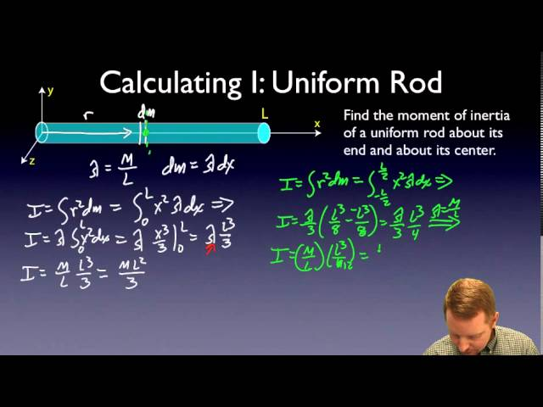
Rotational Kinematics, Angular Momentum, and En...
Moment of Inertia
A brief introduction to moment of inertia (rotational inertia) for calculus-based physics students.
Free to share, print, make copies and changes. Get yours at www.boundless.com
View on Boundless.com

Slide 23
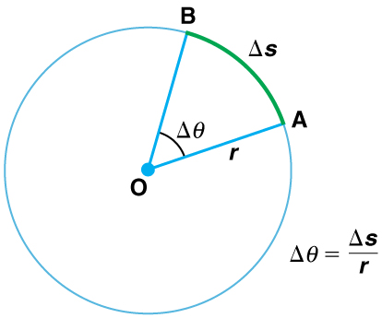
Rotational Kinematics, Angular Momentum, and En...
Angle θ and Arc Length s
The radius of a circle is rotated through an angle Δ. The arc length Δs is described on the circumference.
Free to share, print, make copies and changes. Get yours at www.boundless.com
OpenStax CNX. "OpenStax College, College Physics. November 10, 2012." CC BY 3.0 http://cnx.org/content/m42083/latest/?collection=col11406/1.7 View on Boundless.com

Slide 24
Rotational Kinematics, Angular Momentum, and En...
Rotation Angle
All points on a CD travel in circular arcs. The pits along a line from the center to the edge all move through the same angle Δ in a time Δt.
Free to share, print, make copies and changes. Get yours at www.boundless.com
OpenStax CNX. "OpenStax College, College Physics. November 10, 2012." CC BY 3.0 http://cnx.org/content/m42083/latest/?collection=col11406/1.7 View on Boundless.com

Slide 25
Rotational Kinematics, Angular Momentum, and En...
Rotational motion
Part of a series of videos on physics problem-solving. The problems are taken from "The Joy of Physics. " This one deals with angular motion. The viewer is urged to pause the video at the problem statement and work the problem before watching the rest of the video.
Free to share, print, make copies and changes. Get yours at www.boundless.com
View on Boundless.com

Slide 26
Rotational Kinematics, Angular Momentum, and En...
Rotational Inertia
Force is required to spin the bike wheel. The greater the force, the greater the angular acceleration produced. The more massive the wheel, the smaller the angular acceleration. If you push on a spoke closer to the axle, the angular acceleration will be smaller.
Free to share, print, make copies and changes. Get yours at www.boundless.com
OpenStax CNX. "OpenStax College, College Physics. November 9, 2012." CC BY 3.0 http://cnx.org/content/m42179/latest/?collection=col11406/1.7 View on Boundless.com

Slide 27
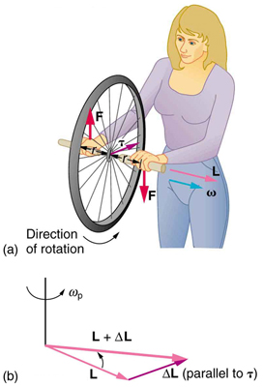
Rotational Kinematics, Angular Momentum, and En...
Gyroscopic Effect
In figure (a), a person holding the spinning bike wheel lifts it with her right hand and pushes down with her left hand in an attempt to rotate the wheel. This action creates a torque directly toward her. This torque causes a change in angular momentum ΔL in exactly the same direction. Figure (b) shows a vector diagram depicting how ΔL and L add, producing a new angular momentum pointing more toward the person. The wheel moves toward the person, perpendicular to the forces she exerts on it.
Free to share, print, make copies and changes. Get yours at www.boundless.com
OpenStax CNX. "OpenStax College, College Physics. November 17, 2012." CC BY 3.0 http://cnx.org/content/m42184/latest/?collection=col11406/1.7 View on Boundless.com

Slide 28
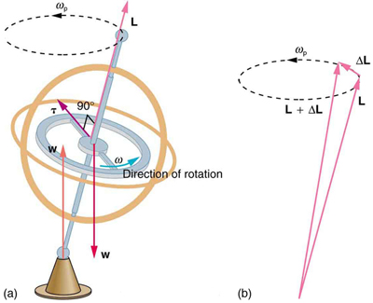
Rotational Kinematics, Angular Momentum, and En...
Gyroscopes
As seen in figure (a), the forces on a spinning gyroscope are its weight and the supporting force from the stand. These forces create a horizontal torque on the gyroscope, which create a change in angular momentum ΔL that is also horizontal. In figure (b), ΔL and L add to produce a new angular momentum with the same magnitude, but different direction, so that the gyroscope precesses in the direction shown instead of falling over.
Free to share, print, make copies and changes. Get yours at www.boundless.com
OpenStax CNX. "OpenStax College, College Physics. November 17, 2012." CC BY 3.0 http://cnx.org/content/m42184/latest/?collection=col11406/1.7 View on Boundless.com

Slide 29
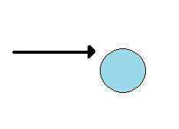
Rotational Kinematics, Angular Momentum, and En...
Arrow hitting cyclinde
The arrow hits the edge of the cylinder causing it to roll.
Free to share, print, make copies and changes. Get yours at www.boundless.com
Amazon Web Services. "Boundless." CC BY http://s3.amazonaws.com/figures.boundless.com/514cc462b483dab00d000947/arrow.jpg View on Boundless.com

Slide 30
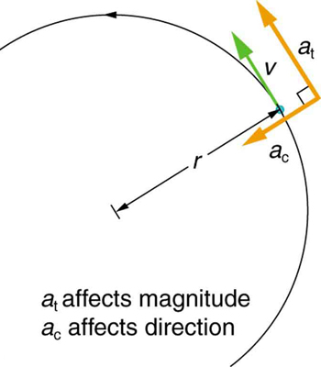
Rotational Kinematics, Angular Momentum, and En...
Centripetal Acceleration
Centripetal acceleration occurs as the direction of velocity changes; it is perpendicular to the circular motion. Centripetal and tangential acceleration are thus perpendicular to each other.
Free to share, print, make copies and changes. Get yours at www.boundless.com
OpenStax CNX. "OpenStax College, College Physics. November 10, 2012." CC BY 3.0 http://cnx.org/content/m42177/latest/?collection=col11406/1.7 View on Boundless.com

Slide 31
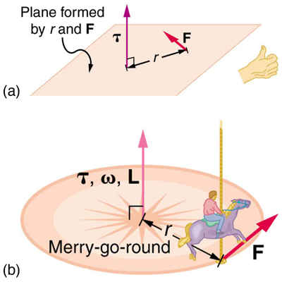
Rotational Kinematics, Angular Momentum, and En...
Direction of Torque and Angular Momentum
In figure (a), the torque is perpendicular to the plane formed by r and F and is the direction your right thumb would point to if you curled your fingers in the direction of F. Figure (b) shows that the direction of the torque is the same as that of the angular momentum it produces.
Free to share, print, make copies and changes. Get yours at www.boundless.com
OpenStax CNX. "OpenStax College, College Physics. November 17, 2012." CC BY 3.0 http://cnx.org/content/m42184/latest/?collection=col11406/1.7 View on Boundless.com

Slide 32
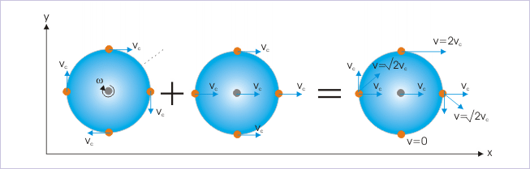
Rotational Kinematics, Angular Momentum, and En...
Rolling Motion
Rolling motion is a combination of rotational and translational motion.
Free to share, print, make copies and changes. Get yours at www.boundless.com
OpenStax CNX. "Sunil Kumar Singh, Rolling Motion. November 8, 2012." CC BY 3.0 http://cnx.org/content/m14311/latest/ View on Boundless.com

Slide 33
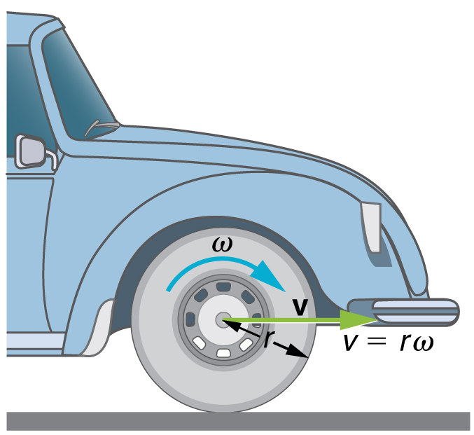
Rotational Kinematics, Angular Momentum, and En...
Angular Velocity
A car moving at a velocity v to the right has a tire rotating with an angular velocity ω. The speed of the tread of the tire relative to the axle is v, the same as if the car were jacked up. Thus the car moves forward at linear velocity v=rω, where r is the tire radius. A larger angular velocity for the tire means a greater velocity for the car.
Free to share, print, make copies and changes. Get yours at www.boundless.com
OpenStax CNX. "OpenStax College, College Physics. November 10, 2012." CC BY 3.0 http://cnx.org/content/m42083/latest/?collection=col11406/1.7 View on Boundless.com

Slide 34
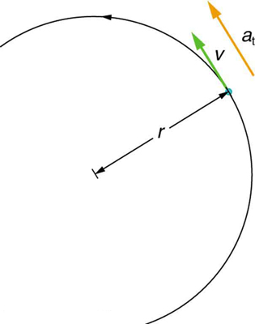
Rotational Kinematics, Angular Momentum, and En...
Tangential acceleration
In circular motion, acceleration can occur as the magnitude of the velocity changes: a is tangent to the motion. This acceleration is called tangential acceleration.
Free to share, print, make copies and changes. Get yours at www.boundless.com
OpenStax CNX. "OpenStax College, College Physics. November 10, 2012." CC BY 3.0 http://cnx.org/content/m42177/latest/?collection=col11406/1.7 View on Boundless.com

Slide 35
Rotational Kinematics, Angular Momentum, and En...
The Rotating Earth
The earth's rotation is a prominent example of rotational kinetic energy.
Free to share, print, make copies and changes. Get yours at www.boundless.com
Wikimedia. CC BY-SA http://upload.wikimedia.org/wikipedia/commons/3/30/Globespin.gif View on Boundless.com

Slide 36
Rotational Kinematics, Angular Momentum, and En...
Linear and Angular
This figure shows uniform circular motion and some of its defined quantities.
Free to share, print, make copies and changes. Get yours at www.boundless.com
OpenStax CNX. "OpenStax College, College Physics. February 17, 2013." CC BY 3.0 http://cnx.org/content/m42177/latest/?collection=col11406/1.7 View on Boundless.com

Slide 37

Rotational Kinematics, Angular Momentum, and En...
Bowling ball and pi
When a bowling ball collides with a pin, linear and angular momentum is conserved
Free to share, print, make copies and changes. Get yours at www.boundless.com
Wikipedia. "Ball." GNU FDL http://en.wikipedia.org/wiki/Ball View on Boundless.com

Slide 38
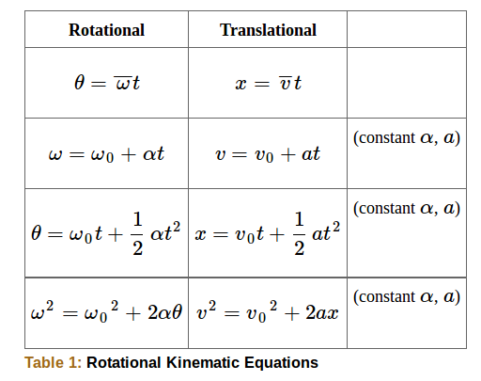
Rotational Kinematics, Angular Momentum, and En...
Equation list
Rotational and translational kinematic equations.
Free to share, print, make copies and changes. Get yours at www.boundless.com
OpenStax CNX. "OpenStax College, Kinematics of Rotational Motion. February 8, 2013." CC BY 3.0 http://cnx.org/content/m42178/latest/ View on Boundless.com

Slide 39
Rotational Kinematics, Angular Momentum, and En...
Conservation of Angular Momentum
An ice skater is spinning on the tip of her skate with her arms extended. Her angular momentum is conserved because the net torque on her is negligibly small. In the next image, her rate of spin increases greatly when she pulls in her arms, decreasing her moment of inertia. The work she does to pull in her arms results in an increase in rotational kinetic energy.
Free to share, print, make copies and changes. Get yours at www.boundless.com
OpenStax CNX. "OpenStax College, College Physics. November 9, 2012." CC BY 3.0 http://cnx.org/content/m42182/latest/?collection=col11406/1.7 View on Boundless.com

Slide 40
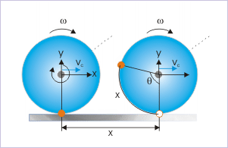
Rotational Kinematics, Angular Momentum, and En...
Rolling Without Slipping
A body rolling a distance of x on a plane without slipping.
Free to share, print, make copies and changes. Get yours at www.boundless.com
OpenStax CNX. "Sunil Kumar Singh, Rolling Motion. November 8, 2012." CC BY 3.0 http://cnx.org/content/m14311/latest/ View on Boundless.com

Slide 41
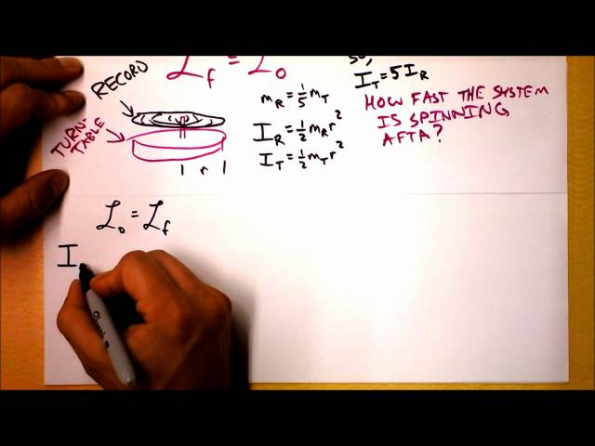
Rotational Kinematics, Angular Momentum, and En...
Conservation of Angular Momentum Theory
What it do?
Free to share, print, make copies and changes. Get yours at www.boundless.com
View on Boundless.com

Slide 42
Rotational Kinematics, Angular Momentum, and En...
Connecting Linear and Rotational Motion! Rolling without Slipping!
How fast does the axle of a bike wheel move? How fast does the BOTTOM of a wheel move?
Free to share, print, make copies and changes. Get yours at www.boundless.com
View on Boundless.com

Slide 43
Rotational Kinematics, Angular Momentum, and En...
Kinetic Energy of Rotation
Things that roll without slipping have some fraction of their energy as translational kinetic and the remainder as rotational kinetic. The ratio depends on the moment of inertia of the object that's rolling.
Free to share, print, make copies and changes. Get yours at www.boundless.com
View on Boundless.com

Slide 44
Rotational Kinematics, Angular Momentum, and En...
Grindstone
The motor works in spinning the grindstone, giving it rotational kinetic energy. That energy is then converted to heat, light, sound, and vibration. (Credit: U.S. Navy photo by Mass Communication Specialist Seaman Zachary David Bell. )
Free to share, print, make copies and changes. Get yours at www.boundless.com
OpenStax CNX. "OpenStax College, Rotational Kinetic Energy: Work and Energy Revisited. February 9, 2013." CC BY 3.0 http://cnx.org/content/m42180/latest/Figure_11_04_01a.jpg View on Boundless.com

Slide 45
Rotational Kinematics, Angular Momentum, and En...
The Right Hand Rule
Figure (a) shows a disk is rotating counterclockwise when viewed from above. Figure (b) shows the right-hand rule. The direction of angular velocity ω size and angular momentum L are defined to be the direction in which the thumb of your right hand points when you curl your fingers in the direction of the disk's rotation as shown.
Free to share, print, make copies and changes. Get yours at www.boundless.com
OpenStax CNX. "OpenStax College, College Physics. November 17, 2012." CC BY 3.0 http://cnx.org/content/m42184/latest/?collection=col11406/1.7 View on Boundless.com

Slide 46
Attribution
Rotational Kinematics, Angular Momentum, and En...
Wiktionary. "rotation." CC BY-SA 3.0 http://en.wiktionary.org/wiki/rotation
Wiktionary. "momentum." CC BY-SA 3.0 http://en.wiktionary.org/wiki/momentum
OpenStax CNX. "OpenStax College, College Physics. September 17, 2013." CC BY 3.0 http://cnx.org/content/m42182/latest/?collection=col11406/1.7
Light and Matter. CC BY http://lightandmatter.com/meh.pdf
Vegetarian USA. CC BY-SA http://www.vegetarianusa.com/physics/essentialphysics1.pdf
Wiktionary. "velocity." CC BY-SA 3.0 http://en.wiktionary.org/wiki/velocity
Boundless Learning. "Boundless." CC BY-SA 3.0 http://www.boundless.com//physics/definition/angular-velocity
Wikipedia. "Kinematics." CC BY-SA 3.0 http://en.wikipedia.org/wiki/Kinematics%23Rolling_without_slipping
OpenStax CNX. "Sunil Kumar Singh, Rolling Motion. September 17, 2013." CC BY 3.0 http://cnx.org/content/m14311/latest/
Wiktionary. "torque." CC BY-SA 3.0 http://en.wiktionary.org/wiki/torque
Boundless Learning. "Boundless." CC BY-SA 3.0 http://www.boundless.com//physics/definition/angular-velocity
Wiktionary. "inertia." CC BY-SA 3.0 http://en.wiktionary.org/wiki/inertia
OpenStax CNX. "Richard Baldwin, Phy1300: Angular Momentum -- Rotational Kinetic Energy and Inertia. September 17, 2013." CC BY 3.0 http://cnx.org/content/m38440/latest/
Wikipedia. "Rotational energy." CC BY-SA 3.0 http://en.wikipedia.org/wiki/Rotational_energy
Boundless Learning. "Boundless." CC BY-SA 3.0 http://www.boundless.com//physics/definition/angular-velocity
Boundless Learning. "Boundless." CC BY-SA 3.0 http://www.boundless.com//physics/definition/rotational-inertia
Wiktionary. "work." CC BY-SA 3.0 http://en.wiktionary.org/wiki/work
Free to share, print, make copies and changes. Get yours at www.boundless.com

Slide 47
Rotational Kinematics, Angular Momentum, and En...
OpenStax CNX. "OpenStax College, Rotational Kinetic Energy: Work and Energy Revisited. September 17, 2013." CC BY 3.0 http://cnx.org/content/m42180/latest/
Boundless Learning. "Boundless." CC BY-SA 3.0 http://www.boundless.com//physics/definition/right-hand-rule
Boundless Learning. "Boundless." CC BY-SA 3.0 http://www.boundless.com//physics/definition/angular-velocity
Boundless Learning. "Boundless." CC BY-SA 3.0 http://www.boundless.com//physics/definition/angular-momentum
OpenStax CNX. "OpenStax College, College Physics. September 17, 2013." CC BY 3.0 http://cnx.org/content/m42184/latest/?collection=col11406/1.7
Wiktionary. "angular." CC BY-SA 3.0 http://en.wiktionary.org/wiki/angular
Wiktionary. "kinematics." CC BY-SA 3.0 http://en.wiktionary.org/wiki/kinematics
OpenStax CNX. "OpenStax College, Kinematics of Rotational Motion. September 17, 2013." CC BY 3.0 http://cnx.org/content/m42178/latest/
Wiktionary. "torque." CC BY-SA 3.0 http://en.wiktionary.org/wiki/torque
Wiktionary. "inertia." CC BY-SA 3.0 http://en.wiktionary.org/wiki/inertia
OpenStax CNX. "OpenStax College, College Physics. September 17, 2013." CC BY 3.0 http://cnx.org/content/m42179/latest/?collection=col11406/1.7
Wikipedia. "Moment of inertia." CC BY-SA 3.0 http://en.wikipedia.org/wiki/Moment_of_inertia
Wikipedia. "Angular position." CC BY-SA 3.0 http://en.wikipedia.org/wiki/Angular%20position
Wikipedia. "Angle of rotation." CC BY-SA 3.0 http://en.wikipedia.org/wiki/Angle_of_rotation
OpenStax CNX. "OpenStax College, College Physics. September 17, 2013." CC BY 3.0 http://cnx.org/content/m42083/latest/?collection=col11406/1.7
Wiktionary. "kinematics." CC BY-SA 3.0 http://en.wiktionary.org/wiki/kinematics
OpenStax CNX. "OpenStax College, Kinematics of Rotational Motion. September 17, 2013." CC BY 3.0 http://cnx.org/content/m42178/latest/
Wiktionary. "torque." CC BY-SA 3.0 http://en.wiktionary.org/wiki/torque
Boundless Learning. "Boundless." CC BY-SA 3.0 http://www.boundless.com//physics/definition/rotational-inertia
Free to share, print, make copies and changes. Get yours at www.boundless.com

Slide 48
Rotational Kinematics, Angular Momentum, and En...
OpenStax CNX. "OpenStax College, College Physics. September 17, 2013." CC BY 3.0 http://cnx.org/content/m42179/latest/?collection=col11406/1.7
OpenStax CNX. "OpenStax College, College Physics. September 17, 2013." CC BY 3.0 http://cnx.org/content/m42179/latest/?collection=col11406/1.7
Wiktionary. "torque." CC BY-SA 3.0 http://en.wiktionary.org/wiki/torque
Wiktionary. "gimbal." CC BY-SA 3.0 http://en.wiktionary.org/wiki/gimbal
Boundless Learning. "Boundless." CC BY-SA 3.0 http://www.boundless.com//physics/definition/right-hand-rule
OpenStax CNX. "OpenStax College, College Physics. September 17, 2013." CC BY 3.0 http://cnx.org/content/m42184/latest/?collection=col11406/1.7
Wikipedia. "Gyroscope." CC BY-SA 3.0 http://en.wikipedia.org/wiki/Gyroscope
Boundless Learning. "Boundless." CC BY-SA 3.0 http://www.boundless.com//physics/definition/angular-velocity
OpenStax CNX. "OpenStax College, College Physics. September 17, 2013." CC BY 3.0 http://cnx.org/content/m42083/latest/?collection=col11406/1.7
Wiktionary. "angular acceleration." CC BY-SA 3.0 http://en.wiktionary.org/wiki/angular_acceleration
Boundless Learning. "Boundless." CC BY-SA 3.0 http://www.boundless.com//physics/definition/tangential-acceleration
Wikipedia. "Angular acceleration." CC BY-SA 3.0 http://en.wikipedia.org/wiki/Angular_acceleration
OpenStax CNX. "OpenStax College, College Physics. September 17, 2013." CC BY 3.0 http://cnx.org/content/m42177/latest/?collection=col11406/1.7
Boundless Learning. "Boundless." CC BY-SA 3.0 http://www.boundless.com//physics/definition/rotational-inertia
Wiktionary. "torque." CC BY-SA 3.0 http://en.wiktionary.org/wiki/torque
Boundless Learning. "Boundless." CC BY-SA 3.0 http://www.boundless.com//physics/definition/uniform-circular-motion
OpenStax CNX. "Sunil Kumar Singh, Circular Motion and Rotational Kinematics. September 17, 2013." CC BY 3.0 http://cnx.org/content/m14014/latest/
Wiktionary. "quantum mechanics." CC BY-SA 3.0 http://en.wiktionary.org/wiki/quantum_mechanics
Wiktionary. "torque." CC BY-SA 3.0 http://en.wiktionary.org/wiki/torque
Free to share, print, make copies and changes. Get yours at www.boundless.com

Slide 49
Rotational Kinematics, Angular Momentum, and En...
Boundless Learning. "Boundless." CC BY-SA 3.0 http://www.boundless.com//physics/definition/angular-momentum
Light and Matter. CC BY http://lightandmatter.com/simplee.pdf
OpenStax CNX. "OpenStax College, College Physics. September 18, 2013." CC BY 3.0 http://cnx.org/content/m42182/latest/?collection=col11406/1.7
Free to share, print, make copies and changes. Get yours at www.boundless.com

