Slide 1


Boundless Lecture Slides
Available on the Boundless Teaching Platform
Free to share, print, make copies and changes. Get yours at www.boundless.com

Slide 2



Using Boundless Presentations
Boundless Teaching Platform
Boundless empowers educators to engage their students with affordable, customizable textbooks and intuitive teaching tools. The free Boundless Teaching Platform gives educators the ability to customize textbooks in more than 20 subjects that align to hundreds of popular titles. Get started by using high quality Boundless books, or make switching to our platform easier by building from Boundless content pre-organized to match the assigned textbook. This platform gives educators the tools they need to assign readings and assessments, monitor student activity, and lead their classes with pre-made teaching resources.
Get started now at:
The Appendix
The appendix is for you to use to add depth and breadth to your lectures. You can simply drag and drop slides from the appendix into the main presentation to make for a richer lecture experience.
http://boundless.com/teaching-platform
Free to edit, share, and copy
Feel free to edit, share, and make as many copies of the Boundless presentations as you like. We encourage you to take these presentations and make them your own.
If you have any questions or problems please email:
educators@boundless.com
Free to share, print, make copies and changes. Get yours at www.boundless.com

Slide 3

About Boundless
Boundless is an innovative technology company making education more affordable and accessible for students everywhere. The company creates the world’s best open educational content in 20+ subjects that align to more than 1,000 popular college textbooks. Boundless integrates learning technology into all its premium books to help students study more efficiently at a fraction of the cost of traditional textbooks. The company also empowers educators to engage their students more effectively through customizable books and intuitive teaching tools as part of the Boundless Teaching Platform. More than 2 million learners access Boundless free and premium content each month across the company’s wide distribution platforms, including its website, iOS apps, Kindle books, and iBooks. To get started learning or teaching with Boundless, visit boundless.com.
Free to share, print, make copies and changes. Get yours at www.boundless.com

Slide 4
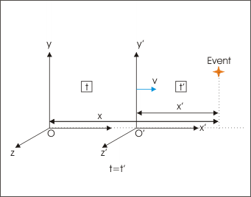


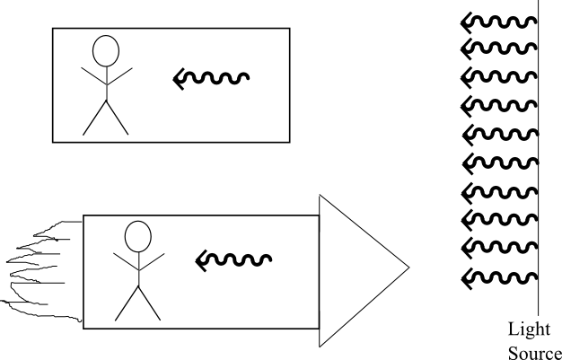
Special Relativity
Introduction
Consequences of Special Relativity
Relativistic Quantities
Implications of Special Relativity
]
Special Relativity
Free to share, print, make copies and changes. Get yours at www.boundless.com

Slide 5

Introduction
Special Relativity > Introduction
Gallilean-Newtonian Relativity
Einstein's Postulates
The Speed of Light
Free to share, print, make copies and changes. Get yours at www.boundless.com
www.boundless.com/physics/textbooks/boundless-physics-textbook/special-relativity-27/introduction-178/

Slide 6
Consequences of Special Relativity
Special Relativity > Consequences of Special Relativity
Simultaneity
Time Dilation
Effects of Time Dilation: The Twin Paradox and the Decay of the Muon
Length Contraction
Free to share, print, make copies and changes. Get yours at www.boundless.com
www.boundless.com/physics/textbooks/boundless-physics-textbook/special-relativity-27/consequences-of-special-relativity-179/

Slide 7
Relativistic Quantities
Special Relativity > Relativistic Quantities
Relativistic Addition of Velocities
Relativistic Momentum
Relativistic Energy and Mass
Matter and Antimatter
Relativistic Kinetic Energy
Free to share, print, make copies and changes. Get yours at www.boundless.com
www.boundless.com/physics/textbooks/boundless-physics-textbook/special-relativity-27/relativistic-quantities-180/

Slide 8
Implications of Special Relativity
Special Relativity > Implications of Special Relativity
Shifting the Paradigm of Physics
Four-Dimensional Space-Time
The Relativistic Universe
Free to share, print, make copies and changes. Get yours at www.boundless.com
www.boundless.com/physics/textbooks/boundless-physics-textbook/special-relativity-27/implications-of-special-relativity-181/

Slide 9
Appendix
Free to share, print, make copies and changes. Get yours at www.boundless.com

Slide 10
Key terms
Special Relativity
absolute space A concept introduced by Newton that assumes space remains always similar and immovable.
aether A space-filling substance or field, thought to be necessary as a transmission medium for the propagation of electromagnetic or gravitational forces.
annihilation the process of a particle and its corresponding antiparticle combining to produce energy
antimatter matter that is composed of the antiparticles of those that constitute normal matter
classical mechanics All of the physical laws of nature that account for the behaviour of the normal world, but break down when dealing with the very small (see quantum mechanics) or the very fast or very heavy (see relativity).
Galilean transformation a transformation used to transform between the coordinates of two reference frames which differ only by constant relative motion within the constructs of Newtonian physics.
general relativity A theory extending special relativity and uniformly accounting for gravity and accelerated frames of reference, postulating that space-time curves in the presence of mass.
interferometer Any of several instruments that use the interference of waves to determine wavelengths and wave velocities, determine refractive indices, and measure small distances, temperature changes, stresses, and many other useful measurements.
length contraction Observers measure a moving object's length as being smaller than it would be if it were stationary.
line element An invariant quantity in special relativity
Lorentz factor The factor, used in special relativity, to calculate the degree of time dilation, length contraction and relativistic mass of an object moving relative to an observer.
Lorentz factor The factor, used in special relativity, to calculate the degree of time dilation, length contraction and relativistic mass of an object moving relative to an observer.
Free to share, print, make copies and changes. Get yours at www.boundless.com

Slide 11
Special Relativity
Lorentz factor The factor, used in special relativity, to calculate the degree of time dilation, length contraction and relativistic mass of an object moving relative to an observer.
Lorentz invariance First introduced by Lorentz in an effort to explain how the speed of light was observed to be independent of the reference frame, and to understand the symmetries of the laws of electromagnetism.
Lorentz transformation a transformation relating the spacetime coordinates of one frame of reference to another in special relativity
Lorentz transformation a transformation relating the spacetime coordinates of one frame of reference to another in special relativity
Lorentz transformation a transformation relating the spacetime coordinates of one frame of reference to another in special relativity
luminiferous aether Light-bearing aether; the postulated medium for the propagation of light.
luminiferous aether Light-bearing aether; the postulated medium for the propagation of light.
Maxwell's equations A set of equations describing how electric and magnetic fields are generated and altered by each other and by charges and currents.
metric A metric, or distance function, is a function which defines a distance between elements of a set.
Minkowski space A four dimensional flat space-time. Because it is flat, it is devoid of matter.
positron The antimatter equivalent of an electron, having the same mass but a positive charge.
relativity of simultaneity For space-like separated space-time points, the time-ordering between events is relative.
Free to share, print, make copies and changes. Get yours at www.boundless.com

Slide 12
Special Relativity
rest mass the mass of a body when it is not moving relative to an observer
special relativity A theory that (neglecting the effects of gravity) reconciles the principle of relativity with the observation that the speed of light is constant in all frames of reference.
special relativity A theory that (neglecting the effects of gravity) reconciles the principle of relativity with the observation that the speed of light is constant in all frames of reference.
special relativity A theory that (neglecting the effects of gravity) reconciles the principle of relativity with the observation that the speed of light is constant in all frames of reference.
special relativity A theory that (neglecting the effects of gravity) reconciles the principle of relativity with the observation that the speed of light is constant in all frames of reference.
special relativity A theory that (neglecting the effects of gravity) reconciles the principle of relativity with the observation that the speed of light is constant in all frames of reference.
special relativity A theory that (neglecting the effects of gravity) reconciles the principle of relativity with the observation that the speed of light is constant in all frames of reference.
special relativity A theory that (neglecting the effects of gravity) reconciles the principle of relativity with the observation that the speed of light is constant in all frames of reference.
special relativity A theory that (neglecting the effects of gravity) reconciles the principle of relativity with the observation that the speed of light is constant in all frames of reference.
speed of light the speed of electromagnetic radiation in a perfect vacuum: exactly 299,792,458 meters per second by definition
speed of light the speed of electromagnetic radiation in a perfect vacuum: exactly 299,792,458 meters per second by definition
speed of light the speed of electromagnetic radiation in a perfect vacuum: exactly 299,792,458 meters per second by definition
Free to share, print, make copies and changes. Get yours at www.boundless.com

Slide 13
Special Relativity
time dilation The slowing of the passage of time experienced by objects in motion relative to an observer; measurable only at relativistic speeds.
time dilation The slowing of the passage of time experienced by objects in motion relative to an observer; measurable only at relativistic speeds.
time dilation The slowing of the passage of time experienced by objects in motion relative to an observer; measurable only at relativistic speeds.
Free to share, print, make copies and changes. Get yours at www.boundless.com

Slide 14
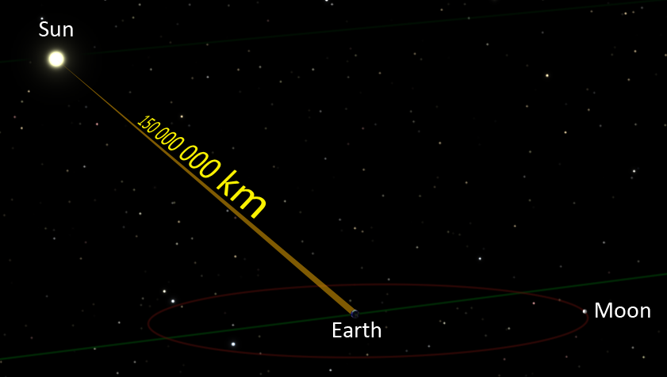

Special Relativity
Sunlight's Flight to Earth
Sunlight takes about 8 minutes and 19 seconds to reach the earth (based on the average distance between the sun and the earth)
Free to share, print, make copies and changes. Get yours at www.boundless.com
Wikipedia. "Earth to Sun - en." CC BY http://en.wikipedia.org/wiki/File:Earth_to_Sun_-_en.png View on Boundless.com

Slide 15
Special Relativity
Observer Standing on the Platform
Reference frame of an observer standing on the platform (length contraction not depicted).
Free to share, print, make copies and changes. Get yours at www.boundless.com
Wikimedia. CC BY-SA http://upload.wikimedia.org/wikipedia/commons/thumb/7/72/Traincar_Relativity2.svg/800px-Traincar_Relativity2.svg.png View on Boundless.com

Slide 16
Special Relativity
Spacetime Diagram of the Twin Paradox
Spacetime diagram of the twin paradox. Time is relative, but both twins are not equivalent (the ship experiences additional acceleration to changes the direction of travel).
Free to share, print, make copies and changes. Get yours at www.boundless.com
Wikimedia. CC BY-SA http://upload.wikimedia.org/wikipedia/commons/thumb/c/ce/Twin_Paradox_Minkowski_Diagram.svg/485px-Twin_Paradox_Minkowski_Diagram.svg.png View on Boundless.com

Slide 17
Special Relativity
Measuring Light
A stationary observer will measure the same speed of light as an observer who is moving in a rocket ship even if that rocket is moving close to light speed.
Free to share, print, make copies and changes. Get yours at www.boundless.com
Amazon Web Services. "Boundless." License: Other http://s3.amazonaws.com/figures.boundless.com/50947657e4b0b4558d8e4fac/sr_lightmeasure.png View on Boundless.com

Slide 18
Special Relativity
Two Coordinate Systems
Two coordinate systems in which the primed frame moves with velocity v with respect to the unprimed frame
Free to share, print, make copies and changes. Get yours at www.boundless.com
Wikipedia. "File:Frames of reference in relative motion.svg - Wikipedia, the free encyclopedia." CC BY-SA http://en.wikipedia.org/w/index.php?title=File:Frames_of_reference_in_relative_motion.svg&page=1 View on Boundless.com

Slide 19
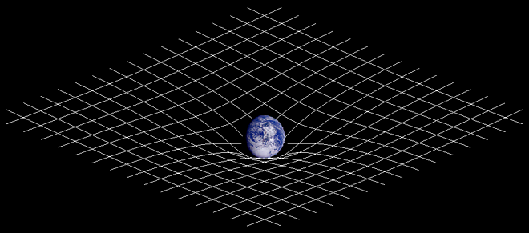
Special Relativity
Curvature of space-time
The massive Earth is altering the curvature of space-time.
Free to share, print, make copies and changes. Get yours at www.boundless.com
Wikipedia. "Spacetime curvature." CC BY-SA http://en.wikipedia.org/wiki/File:Spacetime_curvature.png View on Boundless.com

Slide 20
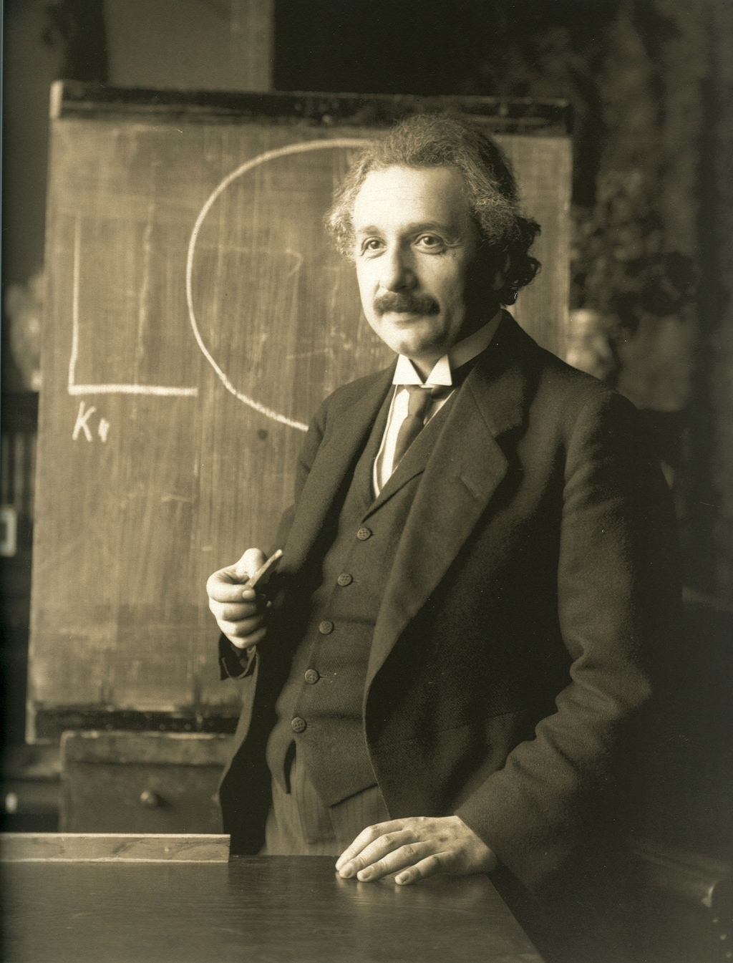
Special Relativity
Albert Einstein
Albert Einstein, a true pioneer of modern physics. His work on relativity, gavity, quantum mechanics, and statistical physics revolutionized physics.
Free to share, print, make copies and changes. Get yours at www.boundless.com
Wikimedia. CC BY http://upload.wikimedia.org/wikipedia/commons/6/66/Einstein_1921_by_F_Schmutzer.jpg View on Boundless.com

Slide 21
Special Relativity
Galilean Invariance
Newtonian mechanics is invariant under a Galilean transformation between observation frames (shown). This is called Galilean invariance.
Free to share, print, make copies and changes. Get yours at www.boundless.com
OpenStax CNX. "Sunil Kumar Singh, Special Theory of Relativity. January 30, 2013." CC BY 3.0 http://cnx.org/content/m32527/latest/ View on Boundless.com

Slide 22
Special Relativity
Relativistic and Newtonian Kinetic Energy
This figure illustrates how relativistic and Newtonian Kinetic Energy are related to the speed of an object. The relativistic kinetic energy increases to infinity when an object approaches the speed of light, this indicates that no body with mass can reach the speed of light. On the other hand, Newtonian kinetic energy continues to increase without bound as the speed of an object increases.
Free to share, print, make copies and changes. Get yours at www.boundless.com
Wikipedia. "Tests of relativistic energy and momentum." CC BY http://en.wikipedia.org/wiki/Tests_of_relativistic_energy_and_momentum View on Boundless.com

Slide 23
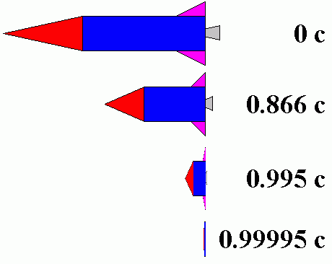
Special Relativity
Observed Length of an Object
Observed length of an object at rest and at different speeds
Free to share, print, make copies and changes. Get yours at www.boundless.com
Creation Wiki. GNU FDL http://creationwiki.org/images/9/91/Srlc1.png View on Boundless.com

Slide 24
Special Relativity
Observer Onboard the Train
The train-and-platform experiment from the reference frame of an observer onboard the train.
Free to share, print, make copies and changes. Get yours at www.boundless.com
Wikimedia. CC BY-SA http://upload.wikimedia.org/wikipedia/commons/thumb/c/ce/Traincar_Relativity1.svg/735px-Traincar_Relativity1.svg.png View on Boundless.com

Slide 25
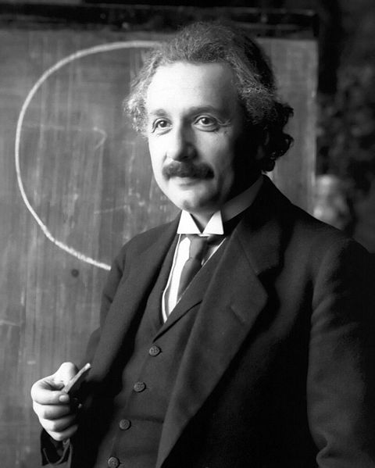
Special Relativity
Albert Einstein
Albert Einstein in 1921
Free to share, print, make copies and changes. Get yours at www.boundless.com
Wikimedia. CC BY-SA http://upload.wikimedia.org/wikipedia/commons/thumb/f/f5/Einstein_1921_portrait2.jpg/480px-Einstein_1921_portrait2.jpg View on Boundless.com

Slide 26
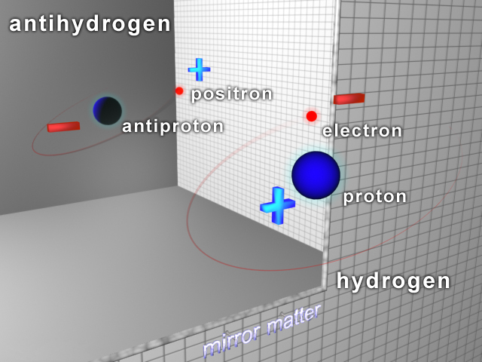
Special Relativity
Antihydrogen and Hydrogen Atoms
Antihydrogen consists of an antiproton and a positron; hydrogen consists of a proton and an electron.
Free to share, print, make copies and changes. Get yours at www.boundless.com
Wikimedia. CC BY-SA http://upload.wikimedia.org/wikipedia/commons/b/b8/3D_image_of_Antihydrogen.jpg View on Boundless.com

Slide 27
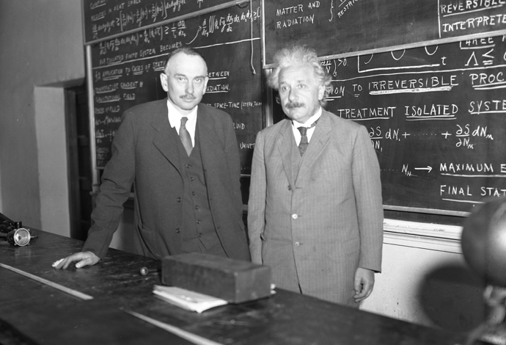
Special Relativity
Richard C. Tolman and Albert Einstein
Richard C. Tolman (1881 - 1948) with Albert Einstein (1879 - 1955) at Caltech, 1932
Free to share, print, make copies and changes. Get yours at www.boundless.com
Wikimedia. CC BY-SA http://upload.wikimedia.org/wikipedia/commons/c/c7/Tolman_&_Einstein.jpg View on Boundless.com

Slide 28
Special Relativity
Setup of the Fizeau Experiment
A light ray emanating from the source S' is reflected by a beam splitter G and is collimated into a parallel beam by lens L. After passing the slits O1 and O2, two rays of light travel through the tubes A1 and A2, through which water is streaming back and forth as shown by the arrows. The rays reflect off a mirror m at the focus of lens L', so that one ray always propagates in the same direction as the water stream, and the other ray opposite to the direction of the water stream. After passing back and forth through the tubes, both rays unite at S, where they produce interference fringes that can be visualized through the illustrated eyepiece. The interference pattern can be analyzed to determine the speed of light traveling along each leg of the tube.
Free to share, print, make copies and changes. Get yours at www.boundless.com
Wikimedia. CC BY-SA http://upload.wikimedia.org/wikipedia/en/thumb/a/a7/Fizeau-Mascart1_retouched.png/799px-Fizeau-Mascart1_retouched.png View on Boundless.com

Slide 29
Special Relativity
Geometry for a Clock at Rest
This illustrates the path that light must traverse when the clock is at rest.
Free to share, print, make copies and changes. Get yours at www.boundless.com
Wikipedia. "Time dilation." CC BY http://en.wikipedia.org/wiki/Time_dilation%23Simple_inference_of_time_dilation_due_to_relative_velocity View on Boundless.com

Slide 30
Special Relativity
Geometry for a Moving Clock
This illustrates the path that light must traverse when the clock is moving from the perspective of a stationary observer.
Free to share, print, make copies and changes. Get yours at www.boundless.com
Wikipedia. "Time dilation." CC BY http://en.wikipedia.org/wiki/Time_dilation%23Simple_inference_of_time_dilation_due_to_relative_velocity View on Boundless.com

Slide 31
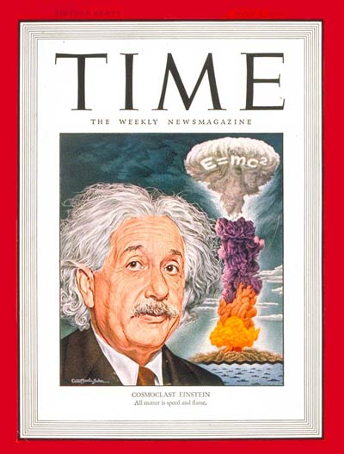
Special Relativity
Time Magazine - July 1, 1946
The popular connection between Einstein, E = mc2, and the atomic bomb was prominently indicated on the cover of Time magazine (July 1946) by the writing of the equation on the mushroom cloud itself.
Free to share, print, make copies and changes. Get yours at www.boundless.com
Wikimedia. CC BY-SA http://upload.wikimedia.org/wikipedia/en/5/57/Einstein_-_Time_Magazine_-_July_1,_1946.jpg View on Boundless.com

Slide 32
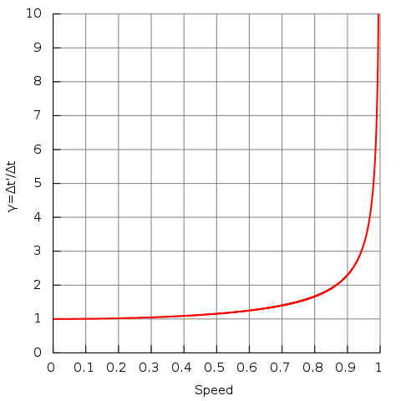
Special Relativity
Lorentz Factor
Lorentz factor as a function of speed (in natural units where c = 1). Notice that for small speeds (less than 0.1), γ is approximately 1.
Free to share, print, make copies and changes. Get yours at www.boundless.com
Wikimedia. CC BY-SA http://upload.wikimedia.org/wikipedia/commons/thumb/4/4f/Time_dilation.svg/480px-Time_dilation.svg.png View on Boundless.com

Slide 33
Special Relativity
Relativistic and Newtonian Momentum
This figure illustrates that relativistic momentum approaches infinity as the speed of light is approached. Newtonian momentum increases linearly with speed.
Free to share, print, make copies and changes. Get yours at www.boundless.com
Wikipedia. "Tests of relativistic energy and momentum." CC BY http://en.wikipedia.org/wiki/Tests_of_relativistic_energy_and_momentum View on Boundless.com

Slide 34
Attribution
Special Relativity
Wiktionary. "Lorentz transformation." CC BY-SA 3.0 http://en.wiktionary.org/wiki/Lorentz_transformation
Boundless Learning. "Boundless." CC BY-SA 3.0 http://www.boundless.com//physics/definition/relativity-of-simultaneity
Boundless Learning. "Boundless." CC BY-SA 3.0 http://www.boundless.com//physics/definition/line-element
Wikipedia. "Relativity of simultaneity." CC BY-SA 3.0 http://en.wikipedia.org/wiki/Relativity_of_simultaneity
Wikipedia. "Special relativity." CC BY-SA 3.0 http://en.wikipedia.org/wiki/Special_relativity
Wiktionary. "special relativity." CC BY-SA 3.0 http://en.wiktionary.org/wiki/special_relativity
Wiktionary. "Lorentz transformation." CC BY-SA 3.0 http://en.wiktionary.org/wiki/Lorentz_transformation
Wikipedia. "Galilean transformation." CC BY-SA 3.0 http://en.wikipedia.org/wiki/Galilean%20transformation
Wikipedia. "Four-momentum." CC BY-SA 3.0 http://en.wikipedia.org/wiki/Four-momentum
Wikipedia. "Momentum." CC BY-SA 3.0 http://en.wikipedia.org/wiki/Momentum
Wikipedia. "Invariant (physics)." CC BY-SA 3.0 http://en.wikipedia.org/wiki/Invariant_(physics)
Wiktionary. "speed of light." CC BY-SA 3.0 http://en.wiktionary.org/wiki/speed_of_light
Wiktionary. "special relativity." CC BY-SA 3.0 http://en.wiktionary.org/wiki/special_relativity
Wiktionary. "interferometer." CC BY-SA 3.0 http://en.wiktionary.org/wiki/interferometer
Wikipedia. "Velocity-addition formula." CC BY-SA 3.0 http://en.wikipedia.org/wiki/Velocity-addition_formula
Wikipedia. "Velocity-addition formula." CC BY-SA 3.0 http://en.wikipedia.org/wiki/Velocity-addition_formula
Wiktionary. "general relativity." CC BY-SA 3.0 http://en.wiktionary.org/wiki/general_relativity
Free to share, print, make copies and changes. Get yours at www.boundless.com

Slide 35
Special Relativity
Boundless Learning. "Boundless." CC BY-SA 3.0 http://www.boundless.com//physics/definition/minkowski-space--2
Wikipedia. "metric." CC BY-SA 3.0 http://en.wikipedia.org/wiki/metric
Wikipedia. "General relativity." CC BY-SA 3.0 http://en.wikipedia.org/wiki/General_relativity
Wikipedia. "Metric (mathematics)." CC BY-SA 3.0 http://en.wikipedia.org/wiki/Metric_(mathematics)
Wiktionary. "special relativity." CC BY-SA 3.0 http://en.wiktionary.org/wiki/special_relativity
Wiktionary. "Lorentz transformation." CC BY-SA 3.0 http://en.wiktionary.org/wiki/Lorentz_transformation
Wikipedia. "luminiferous aether." CC BY-SA 3.0 http://en.wikipedia.org/wiki/luminiferous%20aether
Wikipedia. "Speed of light." CC BY-SA 3.0 http://en.wikipedia.org/wiki/Speed_of_light%23Fundamental_role_in_physics
Wiktionary. "positron." CC BY-SA 3.0 http://en.wiktionary.org/wiki/positron
Wiktionary. "annihilation." CC BY-SA 3.0 http://en.wiktionary.org/wiki/annihilation
Wiktionary. "antimatter." CC BY-SA 3.0 http://en.wiktionary.org/wiki/antimatter
Wikipedia. "Antimatter." CC BY-SA 3.0 http://en.wikipedia.org/wiki/Antimatter
Wikipedia. "Positron emission tomography." CC BY-SA 3.0 http://en.wikipedia.org/wiki/Positron_emission_tomography
Wiktionary. "Lorentz factor." CC BY-SA 3.0 http://en.wiktionary.org/wiki/Lorentz_factor
Wiktionary. "rest mass." CC BY-SA 3.0 http://en.wiktionary.org/wiki/rest_mass
Wiktionary. "special relativity." CC BY-SA 3.0 http://en.wiktionary.org/wiki/special_relativity
Wikipedia. "Mass in special relativity." CC BY-SA 3.0 http://en.wikipedia.org/wiki/Mass_in_special_relativity
Wikipedia. "Mass in special relativity." CC BY-SA 3.0 http://en.wikipedia.org/wiki/Mass_in_special_relativity%23Relativistic_mass
Wikipedia. "Mass." CC BY-SA 3.0 http://en.wikipedia.org/wiki/Mass%23Mass_and_energy_in_special_relativity
Free to share, print, make copies and changes. Get yours at www.boundless.com

Slide 36
Special Relativity
Wikipedia. "Mass in special relativity." CC BY-SA 3.0 http://en.wikipedia.org/wiki/Mass_in_special_relativity%23Relativistic_mass
Wikipedia. "Tests of special relativity." CC BY-SA 3.0 http://en.wikipedia.org/wiki/Tests_of_special_relativity
Wikipedia. "Mass-energy equivalence." CC BY-SA 3.0 http://en.wikipedia.org/wiki/Mass-energy_equivalence
Wiktionary. "Lorentz factor." CC BY-SA 3.0 http://en.wiktionary.org/wiki/Lorentz_factor
Wiktionary. "classical mechanics." CC BY-SA 3.0 http://en.wiktionary.org/wiki/classical_mechanics
Wiktionary. "special relativity." CC BY-SA 3.0 http://en.wiktionary.org/wiki/special_relativity
Wikipedia. "Kinetic energy." CC BY-SA 3.0 http://en.wikipedia.org/wiki/Kinetic_energy
Wikipedia. "Kinetic energy." CC BY-SA 3.0 http://en.wikipedia.org/wiki/Kinetic_energy
Wikipedia. "Correspondence principle." CC BY-SA 3.0 http://en.wikipedia.org/wiki/Correspondence_principle
Wiktionary. "special relativity." CC BY-SA 3.0 http://en.wiktionary.org/wiki/special_relativity
Wikipedia. "aether." CC BY-SA 3.0 http://en.wikipedia.org/wiki/aether
Wikipedia. "Simultaneity." CC BY-SA 3.0 http://en.wikipedia.org/wiki/Simultaneity
Wikipedia. "Relativity of simultaneity." CC BY-SA 3.0 http://en.wikipedia.org/wiki/Relativity_of_simultaneity
Wiktionary. "special relativity." CC BY-SA 3.0 http://en.wiktionary.org/wiki/special_relativity
Wiktionary. "time dilation." CC BY-SA 3.0 http://en.wiktionary.org/wiki/time_dilation
Wikipedia. "length contraction." CC BY-SA 3.0 http://en.wikipedia.org/wiki/length%20contraction
Wikipedia. "Time dilation." CC BY-SA 3.0 http://en.wikipedia.org/wiki/Time_dilation%23Muon_lifetime
Wikipedia. "Speed of sound." CC BY-SA 3.0 http://en.wikipedia.org/wiki/Speed_of_sound
Wikipedia. "Special relativity." CC BY-SA 3.0 http://en.wikipedia.org/wiki/Special_relativity
Free to share, print, make copies and changes. Get yours at www.boundless.com

Slide 37
Special Relativity
Wiktionary. "special relativity." CC BY-SA 3.0 http://en.wiktionary.org/wiki/special_relativity
Wiktionary. "time dilation." CC BY-SA 3.0 http://en.wiktionary.org/wiki/time_dilation
Wikipedia. "Twin paradox." CC BY-SA 3.0 http://en.wikipedia.org/wiki/Twin_paradox
Boundless Learning. "Boundless." CC BY-SA 3.0 http://www.boundless.com//physics/definition/lorentz-invariance
Wikipedia. "absolute space." CC BY-SA 3.0 http://en.wikipedia.org/wiki/absolute%20space
Wikipedia. "Galilean invariance." CC BY-SA 3.0 http://en.wikipedia.org/wiki/Galilean_invariance%23Electromagnetism
Wiktionary. "speed of light." CC BY-SA 3.0 http://en.wiktionary.org/wiki/speed_of_light
Wikipedia. "Time dilation." CC BY-SA 3.0 http://en.wikipedia.org/wiki/Time_dilation%23Simple_inference_of_time_dilation_due_to_relative_velocity
Wikipedia. "Length contraction." CC BY-SA 3.0 http://en.wikipedia.org/wiki/Length_contraction
Wiktionary. "Lorentz factor." CC BY-SA 3.0 http://en.wiktionary.org/wiki/Lorentz_factor
Wiktionary. "speed of light." CC BY-SA 3.0 http://en.wiktionary.org/wiki/speed_of_light
Wiktionary. "time dilation." CC BY-SA 3.0 http://en.wiktionary.org/wiki/time_dilation
Wikipedia. "luminiferous aether." CC BY-SA 3.0 http://en.wikipedia.org/wiki/luminiferous%20aether
Wikipedia. "Maxwell's equations." CC BY-SA 3.0 http://en.wikipedia.org/wiki/Maxwell's%20equations
OpenStax CNX. "Sunil Kumar Singh, Special Theory of Relativity. September 17, 2013." CC BY 3.0 http://cnx.org/content/m32527/latest/
OpenStax CNX. "OpenStax College, College Physics. September 17, 2013." CC BY 3.0 http://cnx.org/content/m42528/latest/?collection=col11406/1.7
Free to share, print, make copies and changes. Get yours at www.boundless.com

