Slide 1


Boundless Lecture Slides
Available on the Boundless Teaching Platform
Free to share, print, make copies and changes. Get yours at www.boundless.com

Slide 2
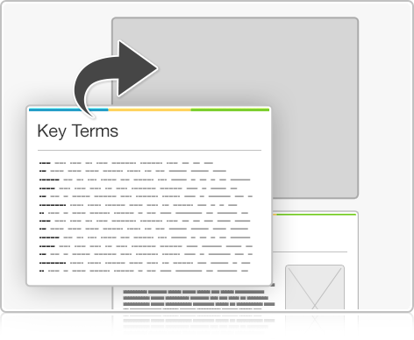
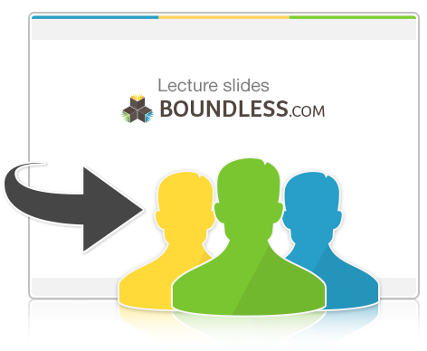

Using Boundless Presentations
Boundless Teaching Platform
Boundless empowers educators to engage their students with affordable, customizable textbooks and intuitive teaching tools. The free Boundless Teaching Platform gives educators the ability to customize textbooks in more than 20 subjects that align to hundreds of popular titles. Get started by using high quality Boundless books, or make switching to our platform easier by building from Boundless content pre-organized to match the assigned textbook. This platform gives educators the tools they need to assign readings and assessments, monitor student activity, and lead their classes with pre-made teaching resources.
Get started now at:
The Appendix
The appendix is for you to use to add depth and breadth to your lectures. You can simply drag and drop slides from the appendix into the main presentation to make for a richer lecture experience.
http://boundless.com/teaching-platform
Free to edit, share, and copy
Feel free to edit, share, and make as many copies of the Boundless presentations as you like. We encourage you to take these presentations and make them your own.
If you have any questions or problems please email:
educators@boundless.com
Free to share, print, make copies and changes. Get yours at www.boundless.com

Slide 3

About Boundless
Boundless is an innovative technology company making education more affordable and accessible for students everywhere. The company creates the world’s best open educational content in 20+ subjects that align to more than 1,000 popular college textbooks. Boundless integrates learning technology into all its premium books to help students study more efficiently at a fraction of the cost of traditional textbooks. The company also empowers educators to engage their students more effectively through customizable books and intuitive teaching tools as part of the Boundless Teaching Platform. More than 2 million learners access Boundless free and premium content each month across the company’s wide distribution platforms, including its website, iOS apps, Kindle books, and iBooks. To get started learning or teaching with Boundless, visit boundless.com.
Free to share, print, make copies and changes. Get yours at www.boundless.com

Slide 4
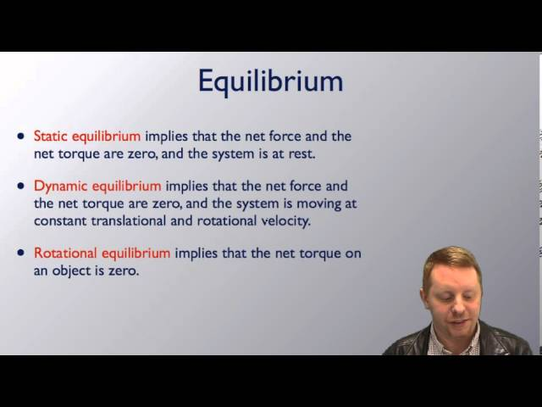
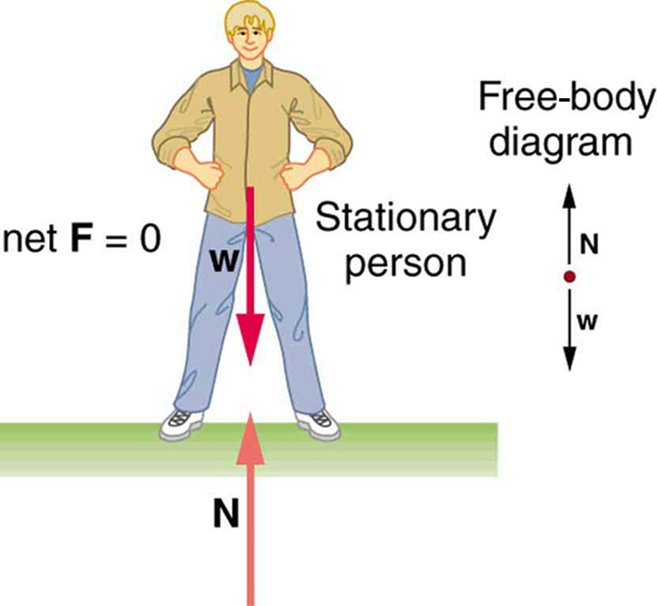
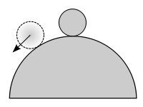

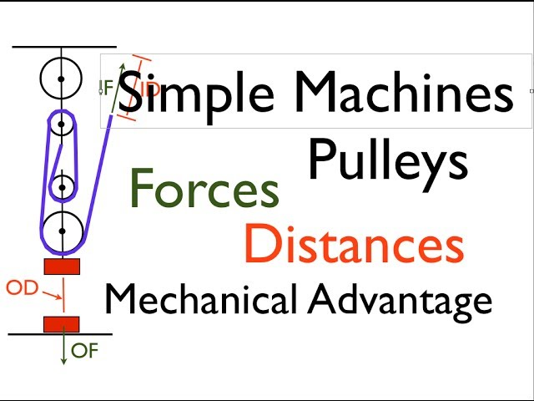
Static Equilibrium, Elasticity, and Torque
Introduction
Conditions for Equilibrium
Stability
Solving Statics Problems
]
Applications of Statics
Static Equilibrium, Elasticity, and Torque
Free to share, print, make copies and changes. Get yours at www.boundless.com

Slide 5
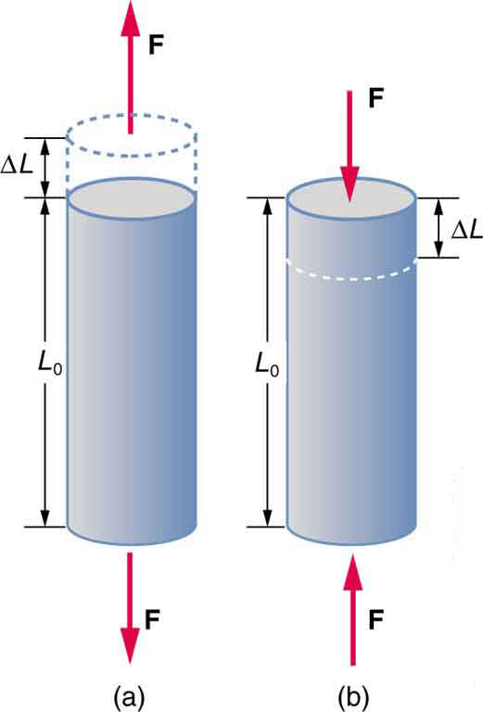

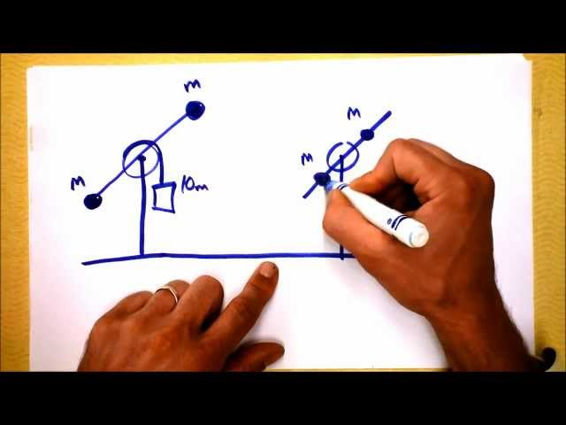
Static Equilibrium, Elasticity, and Torque (continued)
Elasticity, Stress, Strain, and Fracture
The Center of Gravity
Torque and Angular Acceleration
]
Static Equilibrium, Elasticity, and Torque
Free to share, print, make copies and changes. Get yours at www.boundless.com

Slide 6

Introduction
Static Equilibrium, Elasticity, and Torque > Introduction
Torque
Free to share, print, make copies and changes. Get yours at www.boundless.com
www.boundless.com/physics/textbooks/boundless-physics-textbook/static-equilibrium-elasticity-and-torque-8/introduction-73/

Slide 7
Conditions for Equilibrium
Static Equilibrium, Elasticity, and Torque > Conditions for Equilibrium
First Condition
Second Condition
Two-Component Forces
Free to share, print, make copies and changes. Get yours at www.boundless.com
www.boundless.com/physics/textbooks/boundless-physics-textbook/static-equilibrium-elasticity-and-torque-8/conditions-for-equilibrium-74/

Slide 8
Stability
Static Equilibrium, Elasticity, and Torque > Stability
Stability, Balance, and Center of Mass
Free to share, print, make copies and changes. Get yours at www.boundless.com
www.boundless.com/physics/textbooks/boundless-physics-textbook/static-equilibrium-elasticity-and-torque-8/stability-75/

Slide 9
Solving Statics Problems
Static Equilibrium, Elasticity, and Torque > Solving Statics Problems
Problem-Solving Techniques
Free to share, print, make copies and changes. Get yours at www.boundless.com
www.boundless.com/physics/textbooks/boundless-physics-textbook/static-equilibrium-elasticity-and-torque-8/solving-statics-problems-76/

Slide 10
Applications of Statics
Static Equilibrium, Elasticity, and Torque > Applications of Statics
Simple Machines
Arches and Domes
Muscles and Joints
Free to share, print, make copies and changes. Get yours at www.boundless.com
www.boundless.com/physics/textbooks/boundless-physics-textbook/static-equilibrium-elasticity-and-torque-8/applications-of-statics-77/

Slide 11
Elasticity, Stress, Strain, and Fracture
Static Equilibrium, Elasticity, and Torque > Elasticity, Stress, Strain, and Fracture
Elasticity, Stress, and Strain
Fracture
Free to share, print, make copies and changes. Get yours at www.boundless.com
www.boundless.com/physics/textbooks/boundless-physics-textbook/static-equilibrium-elasticity-and-torque-8/elasticity-stress-strain-and-fracture-78/

Slide 12
The Center of Gravity
Static Equilibrium, Elasticity, and Torque > The Center of Gravity
Center of Gravity
Free to share, print, make copies and changes. Get yours at www.boundless.com
www.boundless.com/physics/textbooks/boundless-physics-textbook/static-equilibrium-elasticity-and-torque-8/the-center-of-gravity-79/

Slide 13
Torque and Angular Acceleration
Static Equilibrium, Elasticity, and Torque > Torque and Angular Acceleration
Relationship Between Torque and Angular Acceleration
Free to share, print, make copies and changes. Get yours at www.boundless.com
www.boundless.com/physics/textbooks/boundless-physics-textbook/static-equilibrium-elasticity-and-torque-8/torque-and-angular-acceleration-80/

Slide 14
Appendix
Free to share, print, make copies and changes. Get yours at www.boundless.com

Slide 15
Key terms
Static Equilibrium, Elasticity, and Torque
angular acceleration The rate of change of angular velocity, often represented by α.
angular motion The motion of a body about a fixed point or fixed axis (as of a planet or pendulum). It is equal to the angle passed over at the point or axis by a line drawn to the body.
angular velocity A vector quantity describing an object in circular motion; its magnitude is equal to the speed of the particle and the direction is perpendicular to the plane of its circular motion.
center of mass The center of mass (COM) is the unique point at the center of a distribution of mass in space that has the property that the weighted position vectors relative to this point sum to zero.
center of mass The center of mass (COM) is the unique point at the center of a distribution of mass in space that has the property that the weighted position vectors relative to this point sum to zero.
compressive stress Stress on materials that leads to a smaller volume.
deformation A transformation; change of shape.
elastic Capable of stretching; particularly, capable of stretching so as to return to an original shape or size when force is released.
equilibrium The state of a body at rest or in uniform motion, the resultant of all forces on which is zero.
equilibrium The state of a body at rest or in uniform motion, the resultant of all forces on which is zero.
force A physical quantity that denotes ability to push, pull, twist or accelerate a body which is measured in a unit dimensioned in mass × distance/time² (ML/T²): SI: newton (N); CGS: dyne (dyn)
joint Any part of the body where two bones join, in most cases allowing that part of the body to be bent or straightened.
Free to share, print, make copies and changes. Get yours at www.boundless.com

Slide 16
Static Equilibrium, Elasticity, and Torque
leverage A force amplified by means of a lever rotating around a pivot.
machine A mechanical or electrical device that performs or assists in the performance of human tasks, whether physical or computational, laborious or for entertainment.
mechanical advantage In a simple machine, the ratio of the output force to the input force.
moment of inertia A measure of a body's resistance to a change in its angular rotation velocity
muscle A contractile form of tissue which animals use to effect movement.
pendentive The concave triangular sections of vaulting that provide the transition between a dome and the square base on which it is set and transfer the weight of the dome.
rotational inertia The tendency of a rotating object to remain rotating unless a torque is applied to it.
stable equilibrium The response [of a system in static equilibrium] to a small perturbation is forces that tend to restore the equilibrium.
static equilibrium the physical state in which all components of a system are at rest and the net force is equal to zero throughout the system
strain The amount by which a material deforms under stress or force, given as a ratio of the deformation to the initial dimension of the material and typically symbolized by ε is termed the engineering strain. The true strain is defined as the natural logarithm of the ratio of the final dimension to the initial dimension.
tensile stress Stress state leading to expansion; that is, the length of a material tends to increase in the tensile direction while the volume remains constant.
torque A rotational or twisting effect of a force; (SI unit newton-meter or Nm; imperial unit foot-pound or ft-lb)
Free to share, print, make copies and changes. Get yours at www.boundless.com

Slide 17
Static Equilibrium, Elasticity, and Torque
torque A rotational or twisting effect of a force; (SI unit newton-meter or Nm; imperial unit foot-pound or ft-lb)
torque A rotational or twisting effect of a force; (SI unit newton-meter or Nm; imperial unit foot-pound or ft-lb)
torque A rotational or twisting effect of a force; (SI unit newton-meter or Nm; imperial unit foot-pound or ft-lb)
translation Motion of a body on a linear path, without deformation or rotation, i.e. such that every part of the body moves at the same speed and in the same direction; also (in physics), the linear motion of a body considered independently of its rotation.
vector A directed quantity, one with both magnitude and direction; the between two points.
Free to share, print, make copies and changes. Get yours at www.boundless.com

Slide 18
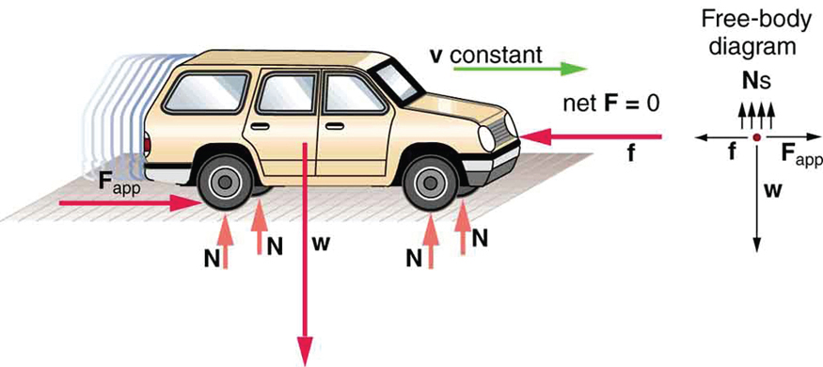

Static Equilibrium, Elasticity, and Torque
Car Moving at Constant Velocity
A moving car for which the net x and y force components are zero
Free to share, print, make copies and changes. Get yours at www.boundless.com
OpenStax CNX. "OpenStax College, College Physics. March 1, 2013." CC BY 3.0 http://cnx.org/content/m42170/latest/?collection=col11406/1.7 View on Boundless.com

Slide 19
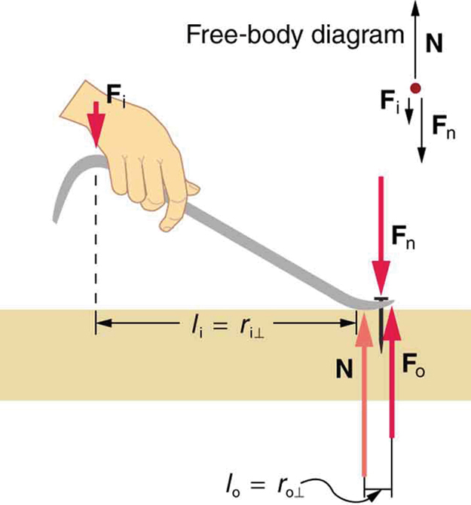
Static Equilibrium, Elasticity, and Torque
Lever
The amount of force produced by a machine can not be greater than the amount of force put into it.
Free to share, print, make copies and changes. Get yours at www.boundless.com
OpenStax CNX. "OpenStax College, Simple Machines. February 13, 2013." CC BY 3.0 http://cnx.org/content/m42174/latest/ View on Boundless.com

Slide 20
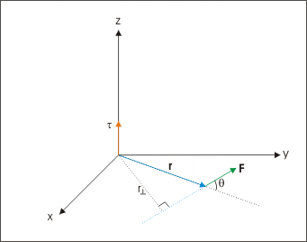
Static Equilibrium, Elasticity, and Torque
Torque
Torque in terms of moment arm.
Free to share, print, make copies and changes. Get yours at www.boundless.com
OpenStax CNX. "Sunil Kumar Singh, Torque. February 9, 2013." CC BY 3.0 http://cnx.org/content/m14402/latest/tp4.gif View on Boundless.com

Slide 21
Static Equilibrium, Elasticity, and Torque
Tension/Compression
Tension: The rod is stretched a length ΔL when a force is applied parallel to its length. (b) Compression: The same rod is compressed by forces with the same magnitude in the opposite direction. For very small deformations and uniform materials, ΔL is approximately the same for the same magnitude of tension or compression. For larger deformations, the cross-sectional area changes as the rod is compressed or stretched.
Free to share, print, make copies and changes. Get yours at www.boundless.com
OpenStax CNX. "OpenStax College, Elasticity: Stress and Strain. January 16, 2015." CC BY 3.0 http://cnx.org/content/m42081/latest/ View on Boundless.com

Slide 22
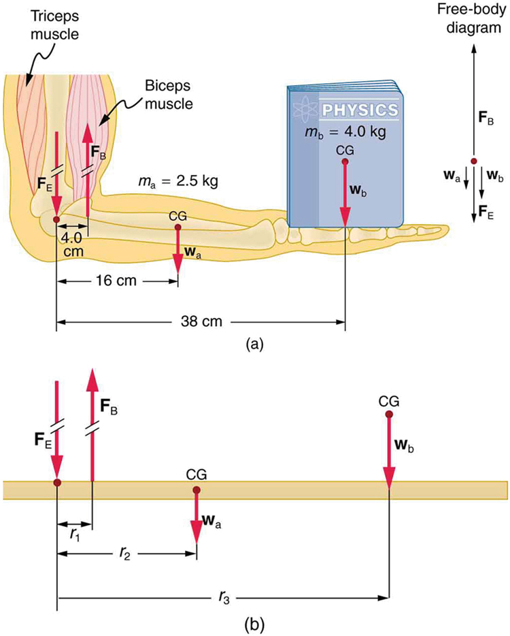
Static Equilibrium, Elasticity, and Torque
The Forearm of a Person Holding a Book
(a. ) The biceps exert a force FB to support the weight of the forearm and the book. The triceps are assumed to be relaxed. (b.) An approximately equivalent mechanical system with the pivot at the elbow joint
Free to share, print, make copies and changes. Get yours at www.boundless.com
OpenStax CNX. "OpenStax College, Forces and Torques in Muscles and Joints. February 23, 2013." CC BY 3.0 http://cnx.org/content/m42175/latest/ View on Boundless.com

Slide 23
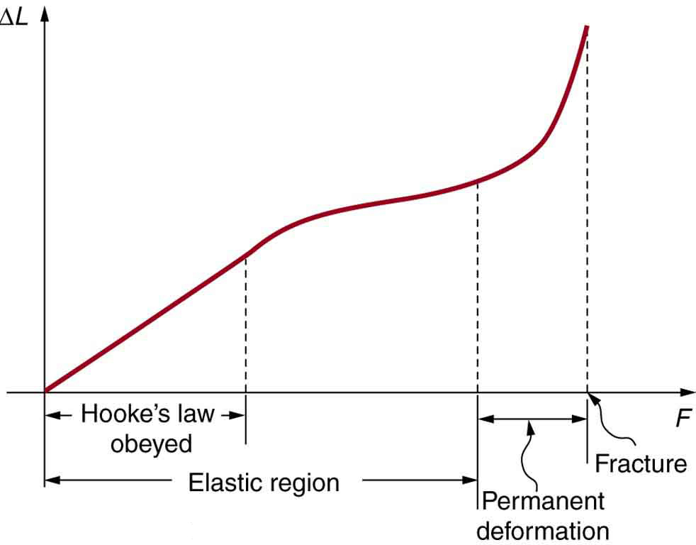
Static Equilibrium, Elasticity, and Torque
Fracture
This is a graph of deformation ΔL versus applied force F. The straight segment is the linear region where Hooke's law is obeyed. The slope of the straight region is 1k. For larger forces, the graph is curved but the deformation is still elastic—L will return to zero if the force is removed. Still greater forces permanently deform the object until it finally fractures. The shape of the curve near fracture depends on several factors, including how the force F is applied. Note that in this graph the slope increases just before fracture, indicating that a small increase in F is producing a large increase in L near the fracture.
Free to share, print, make copies and changes. Get yours at www.boundless.com
OpenStax CNX. "OpenStax College, Elasticity: Stress and Strain. February 9, 2013." CC BY 3.0 http://cnx.org/content/m42081/latest/Figure_06_03_01a.jpg View on Boundless.com

Slide 24
Static Equilibrium, Elasticity, and Torque
Figure 1
Relationship between force (F), torque (τ), momentum (p), and angular momentum (L) vectors in a rotating system
Free to share, print, make copies and changes. Get yours at www.boundless.com
Wikimedia. CC BY-SA http://upload.wikimedia.org/wikipedia/commons/0/09/Torque_animation.gif View on Boundless.com

Slide 25
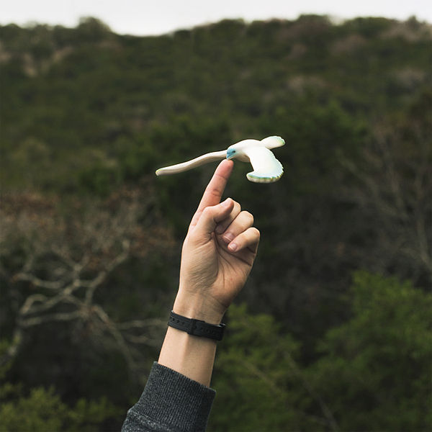
Static Equilibrium, Elasticity, and Torque
Center of Mass
This child's toy uses the principles of 'center of mass' to stay balanced on a finger.
Free to share, print, make copies and changes. Get yours at www.boundless.com
Connexions. "Connexions." CC BY 3.0 http://cnx.org View on Boundless.com

Slide 26
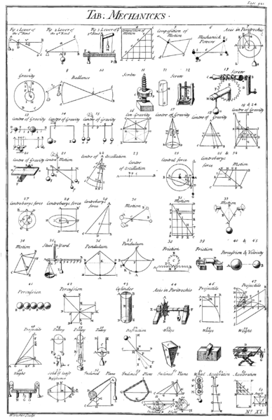
Static Equilibrium, Elasticity, and Torque
Simple Machines
Table of simple mechanisms, from Chambers' Cyclopedia, 1728. [1] Simple machines provide a "vocabulary" for understanding more complex machines.
Free to share, print, make copies and changes. Get yours at www.boundless.com
Wikipedia. "Table of Mechanicks, Cyclopaedia, Volume 2." Public domain http://en.wikipedia.org/wiki/File:Table_of_Mechanicks,_Cyclopaedia,_Volume_2.png View on Boundless.com

Slide 27
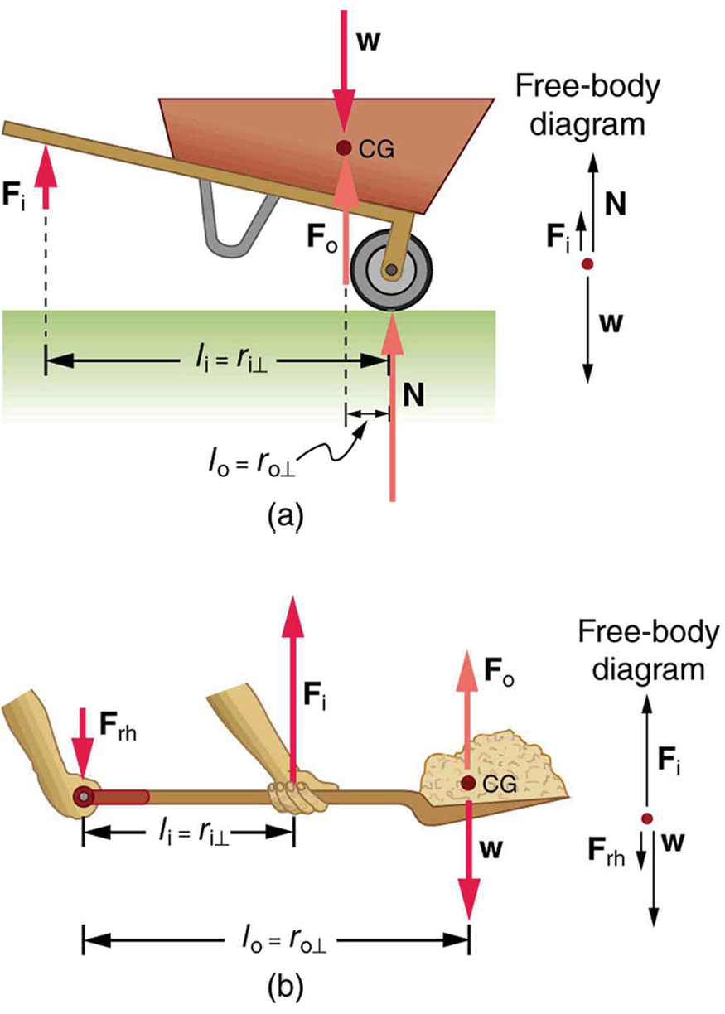
Static Equilibrium, Elasticity, and Torque
Examples of Simple Machines
Both of these machines use the concept of levers.
Free to share, print, make copies and changes. Get yours at www.boundless.com
OpenStax CNX. "OpenStax College, Simple Machines. February 13, 2013." CC BY 3.0 http://cnx.org/content/m42174/latest/ View on Boundless.com

Slide 28
Static Equilibrium, Elasticity, and Torque
Torque
A brief introduction to torque for students studying rotational motion in algebra-based physics courses such as AP Physics 1 and Honors Physics.
Free to share, print, make copies and changes. Get yours at www.boundless.com
View on Boundless.com

Slide 29
Static Equilibrium, Elasticity, and Torque
Simple Machines, Pulleys; Forces, Distances and MA
Describes the following terms as they relate to simple machine; input force, output force, input distance, output distance, mechanical advantage.
Free to share, print, make copies and changes. Get yours at www.boundless.com
View on Boundless.com

Slide 30
Static Equilibrium, Elasticity, and Torque
Torque, Angular Acceleration, and the Role of the Church in the French Revolution
Why do things change their angular velocity? Soon, you'll know.
Free to share, print, make copies and changes. Get yours at www.boundless.com
View on Boundless.com

Slide 31
Static Equilibrium, Elasticity, and Torque
Center of Gravity
Although the center of mass is in the midpoint of the stick, all of the particles are moving as well.
Free to share, print, make copies and changes. Get yours at www.boundless.com
OpenStax CNX. "Sunil Kumar Singh, Center of Mass. February 16, 2013." CC BY 3.0 http://cnx.org/content/m14119/latest/ View on Boundless.com

Slide 32
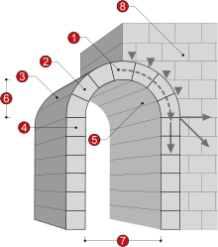
Static Equilibrium, Elasticity, and Torque
Arches
A masonry arch1. Keystone 2. Voussoir 3. Extrados 4. Impost 5. Intrados 6. Rise 7. Clear span 8. Abutment
Free to share, print, make copies and changes. Get yours at www.boundless.com
Wikipedia. "Arch." GNU FDL http://en.wikipedia.org/wiki/Arch View on Boundless.com

Slide 33
Static Equilibrium, Elasticity, and Torque
Unstable Equilibrium
A ball on top of a hill can initially be balanced, but if it moves slightly left or right, it gets pushed further and further away from the initial equilibrium position. This is an example of unstable equilibrium.
Free to share, print, make copies and changes. Get yours at www.boundless.com
Wikimedia. "Unstable equilibrium." Public domain http://commons.wikimedia.org/wiki/File:Unstable_equilibrium.svg View on Boundless.com

Slide 34
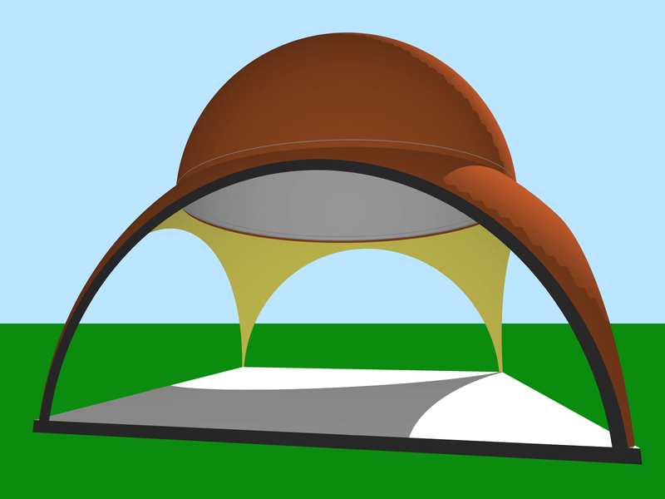
Static Equilibrium, Elasticity, and Torque
Compound Dome
A compound dome (red) with pendentives (yellow) from a sphere of greater radius than the dome.
Free to share, print, make copies and changes. Get yours at www.boundless.com
Wikipedia. "Pendentive and Dome." CC BY-SA http://en.wikipedia.org/wiki/File:Pendentive_and_Dome.png View on Boundless.com

Slide 35
Static Equilibrium, Elasticity, and Torque
A Car in Dynamic Equilibrium
This car is in dynamic equilibrium because it is moving at constant velocity. The forces in all directions are balanced.
Free to share, print, make copies and changes. Get yours at www.boundless.com
OpenStax CNX. "OpenStax College, College Physics. March 1, 2013." CC BY 3.0 http://cnx.org/content/m42170/latest/?collection=col11406/1.7 View on Boundless.com

Slide 36
Static Equilibrium, Elasticity, and Torque
Person in Static Equilibrium
This motionless person is in static equilibrium.
Free to share, print, make copies and changes. Get yours at www.boundless.com
OpenStax CNX. "OpenStax College, The First Condition for Equilibrium. March 1, 2013." CC BY 3.0 http://cnx.org/content/m42170/latest/Figure_10_01_01a.jpg View on Boundless.com

Slide 37
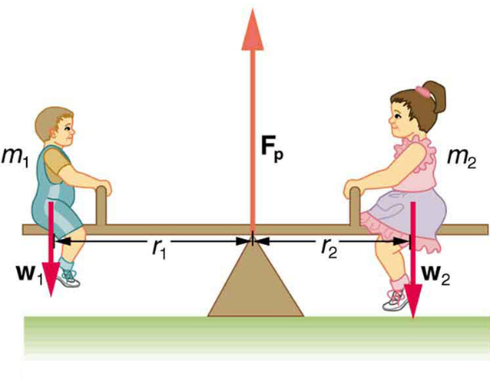
Static Equilibrium, Elasticity, and Torque
Two children on a seesaw
The system is in static equilibrium, showing no acceleration in any direction.
Free to share, print, make copies and changes. Get yours at www.boundless.com
OpenStax CNX. "OpenStax College, College Physics. March 2, 2013." CC BY 3.0 http://cnx.org/content/m42171/latest/?collection=col11406/1.7 View on Boundless.com

Slide 38
Attribution
Static Equilibrium, Elasticity, and Torque
Wikipedia. "angular motion." CC BY-SA 3.0 http://en.wikipedia.org/wiki/angular%20motion
Boundless Learning. "Boundless." CC BY-SA 3.0 http://www.boundless.com//physics/definition/angular-velocity
Wiktionary. "vector." CC BY-SA 3.0 http://en.wiktionary.org/wiki/vector
OpenStax CNX. "Sunil Kumar Singh, Torque. September 17, 2013." CC BY 3.0 http://cnx.org/content/m14402/latest/
Wiktionary. "static equilibrium." CC BY-SA 3.0 http://en.wiktionary.org/wiki/static_equilibrium
Wikipedia. "stable equilibrium." CC BY-SA 3.0 http://en.wikipedia.org/wiki/stable%20equilibrium
Wikipedia. "center of mass." CC BY-SA 3.0 http://en.wikipedia.org/wiki/center%20of%20mass
Wikipedia. "Mechanical equilibrium." CC BY-SA 3.0 http://en.wikipedia.org/wiki/Mechanical_equilibrium
Wikipedia. "Mechanical equilibrium." CC BY-SA 3.0 http://en.wikipedia.org/wiki/Mechanical_equilibrium
Wikipedia. "Potential energy." CC BY-SA 3.0 http://en.wikipedia.org/wiki/Potential_energy
Wikipedia. "Center of mass." CC BY-SA 3.0 http://en.wikipedia.org/wiki/Center_of_mass
Wiktionary. "equilibrium." CC BY-SA 3.0 http://en.wiktionary.org/wiki/equilibrium
Wikibooks. "Statics/Newton's Laws and Equilibrium." CC BY-SA 3.0 http://en.wikibooks.org/wiki/Statics/Newton's_Laws_and_Equilibrium
OpenStax CNX. "OpenStax College, College Physics. September 17, 2013." CC BY 3.0 http://cnx.org/content/m42167/latest/?collection=col11406/1.7
Wiktionary. "equilibrium." CC BY-SA 3.0 http://en.wiktionary.org/wiki/equilibrium
Wiktionary. "torque." CC BY-SA 3.0 http://en.wiktionary.org/wiki/torque
OpenStax CNX. "OpenStax College, College Physics. September 17, 2013." CC BY 3.0 http://cnx.org/content/m42170/latest/?collection=col11406/1.7
Free to share, print, make copies and changes. Get yours at www.boundless.com

Slide 39
Static Equilibrium, Elasticity, and Torque
OpenStax CNX. "OpenStax College, College Physics. September 17, 2013." CC BY 3.0 http://cnx.org/content/m42171/latest/?collection=col11406/1.7
Wiktionary. "elastic." CC BY-SA 3.0 http://en.wiktionary.org/wiki/elastic
Wiktionary. "strain." CC BY-SA 3.0 http://en.wiktionary.org/wiki/strain
Wikipedia. "Fracture." CC BY-SA 3.0 http://en.wikipedia.org/wiki/Fracture
Wiktionary. "angular acceleration." CC BY-SA 3.0 http://en.wiktionary.org/wiki/angular_acceleration
Boundless Learning. "Boundless." CC BY-SA 3.0 http://www.boundless.com//physics/definition/rotational-inertia
Wiktionary. "torque." CC BY-SA 3.0 http://en.wiktionary.org/wiki/torque
OpenStax CNX. "Richard Baldwin, Phy1320: Angular Momentum -- The Mathematics of Torque. September 17, 2013." CC BY 3.0 http://cnx.org/content/m38460/latest/
Wiktionary. "moment of inertia." CC BY-SA 3.0 http://en.wiktionary.org/wiki/moment_of_inertia
Wiktionary. "torque." CC BY-SA 3.0 http://en.wiktionary.org/wiki/torque
OpenStax CNX. "OpenStax College, College Physics. September 17, 2013." CC BY 3.0 http://cnx.org/content/m42167/latest/?collection=col11406/1.7
OpenStax CNX. "OpenStax College, College Physics. September 17, 2013." CC BY 3.0 http://cnx.org/content/m42173/latest/?collection=col11406/1.7
Wiktionary. "deformation." CC BY-SA 3.0 http://en.wiktionary.org/wiki/deformation
OpenStax CNX. "OpenStax College, Elasticity: Stress and Strain. September 17, 2013." CC BY 3.0 http://cnx.org/content/m42081/latest/
Wiktionary. "joint." CC BY-SA 3.0 http://en.wiktionary.org/wiki/joint
Wiktionary. "muscle." CC BY-SA 3.0 http://en.wiktionary.org/wiki/muscle
OpenStax CNX. "OpenStax College, Forces and Torques in Muscles and Joints. September 17, 2013." CC BY 3.0 http://cnx.org/content/m42175/latest/
Wiktionary. "torque." CC BY-SA 3.0 http://en.wiktionary.org/wiki/torque
Wiktionary. "force." CC BY-SA 3.0 http://en.wiktionary.org/wiki/force
Free to share, print, make copies and changes. Get yours at www.boundless.com

Slide 40
Static Equilibrium, Elasticity, and Torque
Wiktionary. "translation." CC BY-SA 3.0 http://en.wiktionary.org/wiki/translation
OpenStax CNX. "OpenStax College, College Physics. September 17, 2013." CC BY 3.0 http://cnx.org/content/m42170/latest/?collection=col11406/1.7
OpenStax CNX. "OpenStax College, College Physics. September 17, 2013." CC BY 3.0 http://cnx.org/content/m42170/latest/?collection=col11406/1.7
Wiktionary. "leverage." CC BY-SA 3.0 http://en.wiktionary.org/wiki/leverage
Wiktionary. "machine." CC BY-SA 3.0 http://en.wiktionary.org/wiki/machine
Wikipedia. "Simple machines." CC BY-SA 3.0 http://en.wikipedia.org/wiki/Simple_machines
OpenStax CNX. "OpenStax College, Simple Machines. September 17, 2013." CC BY 3.0 http://cnx.org/content/m42174/latest/
Wikipedia. "center of mass." CC BY-SA 3.0 http://en.wikipedia.org/wiki/center%20of%20mass
OpenStax CNX. "Sunil Kumar Singh, Center of Mass. September 18, 2013." CC BY 3.0 http://cnx.org/content/m14119/latest/
Wikipedia. "Center of gravity." CC BY-SA 3.0 http://en.wikipedia.org/wiki/Center_of_gravity
Wiktionary. "pendentive." CC BY-SA 3.0 http://en.wiktionary.org/wiki/pendentive
Wikipedia. "tensile stress." CC BY-SA 3.0 http://en.wikipedia.org/wiki/tensile%20stress
Wikipedia. "compressive stress." CC BY-SA 3.0 http://en.wikipedia.org/wiki/compressive%20stress
Wikipedia. "Dome." CC BY-SA 3.0 http://en.wikipedia.org/wiki/Dome%23General_types
Wikipedia. "Arch." CC BY-SA 3.0 http://en.wikipedia.org/wiki/Arch
Free to share, print, make copies and changes. Get yours at www.boundless.com

