Slide 1


Boundless Lecture Slides
Available on the Boundless Teaching Platform
Free to share, print, make copies and changes. Get yours at www.boundless.com

Slide 2



Using Boundless Presentations
Boundless Teaching Platform
Boundless empowers educators to engage their students with affordable, customizable textbooks and intuitive teaching tools. The free Boundless Teaching Platform gives educators the ability to customize textbooks in more than 20 subjects that align to hundreds of popular titles. Get started by using high quality Boundless books, or make switching to our platform easier by building from Boundless content pre-organized to match the assigned textbook. This platform gives educators the tools they need to assign readings and assessments, monitor student activity, and lead their classes with pre-made teaching resources.
Get started now at:
The Appendix
The appendix is for you to use to add depth and breadth to your lectures. You can simply drag and drop slides from the appendix into the main presentation to make for a richer lecture experience.
http://boundless.com/teaching-platform
Free to edit, share, and copy
Feel free to edit, share, and make as many copies of the Boundless presentations as you like. We encourage you to take these presentations and make them your own.
If you have any questions or problems please email:
educators@boundless.com
Free to share, print, make copies and changes. Get yours at www.boundless.com

Slide 3

About Boundless
Boundless is an innovative technology company making education more affordable and accessible for students everywhere. The company creates the world’s best open educational content in 20+ subjects that align to more than 1,000 popular college textbooks. Boundless integrates learning technology into all its premium books to help students study more efficiently at a fraction of the cost of traditional textbooks. The company also empowers educators to engage their students more effectively through customizable books and intuitive teaching tools as part of the Boundless Teaching Platform. More than 2 million learners access Boundless free and premium content each month across the company’s wide distribution platforms, including its website, iOS apps, Kindle books, and iBooks. To get started learning or teaching with Boundless, visit boundless.com.
Free to share, print, make copies and changes. Get yours at www.boundless.com

Slide 4
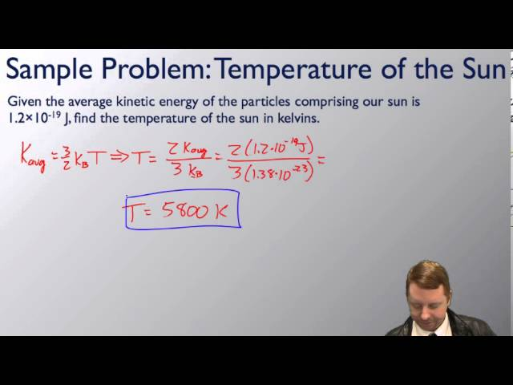
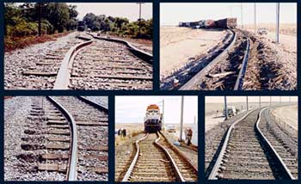


Temperature and Kinetic Theory
Introduction
Temperature and Temperature Scales
Thermal Expansion
Ideal Gas Law
]
Kinetic Theory
Temperature and Kinetic Theory
Free to share, print, make copies and changes. Get yours at www.boundless.com

Slide 5
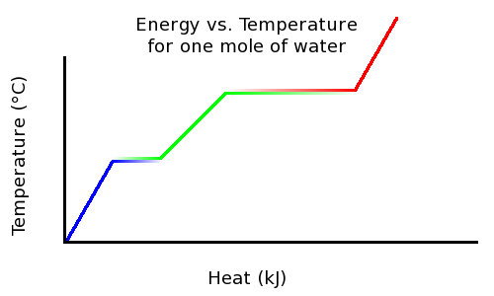
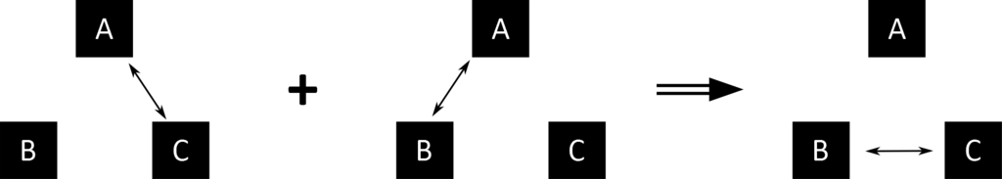

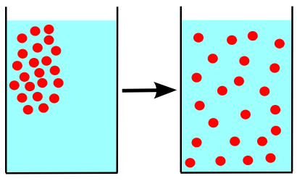
Temperature and Kinetic Theory (continued)
Phase Changes
The Zeroth Law of Thermodynamics
Thermal Stresses
Diffusion
]
Temperature and Kinetic Theory
Free to share, print, make copies and changes. Get yours at www.boundless.com

Slide 6

Introduction
Temperature and Kinetic Theory > Introduction
Overview of Temperature and Kinetic Theory
Atomic Theory of Matter
Free to share, print, make copies and changes. Get yours at www.boundless.com
www.boundless.com/physics/textbooks/boundless-physics-textbook/temperature-and-kinetic-theory-12/introduction-101/

Slide 7
Temperature and Temperature Scales
Temperature and Kinetic Theory > Temperature and Temperature Scales
Celsius Scale
Farenheit Scale
Absolute Zero
Kelvin Scale
Free to share, print, make copies and changes. Get yours at www.boundless.com
www.boundless.com/physics/textbooks/boundless-physics-textbook/temperature-and-kinetic-theory-12/temperature-and-temperature-scales-102/

Slide 8
Thermal Expansion
Temperature and Kinetic Theory > Thermal Expansion
Linear Expansion
Area Expansion
Volume Expansion
Special Properties of Water
Free to share, print, make copies and changes. Get yours at www.boundless.com
www.boundless.com/physics/textbooks/boundless-physics-textbook/temperature-and-kinetic-theory-12/thermal-expansion-103/

Slide 9
Ideal Gas Law
Temperature and Kinetic Theory > Ideal Gas Law
Equations of State
Isotherms
Constant Pressure
Problem Solving
Avogador's Number
Absolute Temperature
Free to share, print, make copies and changes. Get yours at www.boundless.com
www.boundless.com/physics/textbooks/boundless-physics-textbook/temperature-and-kinetic-theory-12/ideal-gas-law-104/

Slide 10
Kinetic Theory
Temperature and Kinetic Theory > Kinetic Theory
Origin of Pressure
Speed Distribution of Molecules
Temperature
Internal Energy of an Ideal Gas
Free to share, print, make copies and changes. Get yours at www.boundless.com
www.boundless.com/physics/textbooks/boundless-physics-textbook/temperature-and-kinetic-theory-12/kinetic-theory-105/

Slide 11
Phase Changes
Temperature and Kinetic Theory > Phase Changes
Phase Changes and Energy Conservation
Humidity, Evaporation, and Boiling
Free to share, print, make copies and changes. Get yours at www.boundless.com
www.boundless.com/physics/textbooks/boundless-physics-textbook/temperature-and-kinetic-theory-12/phase-changes-106/

Slide 12
The Zeroth Law of Thermodynamics
Temperature and Kinetic Theory > The Zeroth Law of Thermodynamics
The Zeroth Law of Thermodynamics
Free to share, print, make copies and changes. Get yours at www.boundless.com
www.boundless.com/physics/textbooks/boundless-physics-textbook/temperature-and-kinetic-theory-12/the-zeroth-law-of-thermodynamics-107/

Slide 13
Thermal Stresses
Temperature and Kinetic Theory > Thermal Stresses
Thermal Stresses
Free to share, print, make copies and changes. Get yours at www.boundless.com
www.boundless.com/physics/textbooks/boundless-physics-textbook/temperature-and-kinetic-theory-12/thermal-stresses-108/

Slide 14
Diffusion
Temperature and Kinetic Theory > Diffusion
Diffusion
Free to share, print, make copies and changes. Get yours at www.boundless.com
www.boundless.com/physics/textbooks/boundless-physics-textbook/temperature-and-kinetic-theory-12/diffusion-109/

Slide 15
Appendix
Free to share, print, make copies and changes. Get yours at www.boundless.com

Slide 16
Key terms
Temperature and Kinetic Theory
absolute zero The coldest possible temperature: zero on the Kelvin scale and approximately -273.15°C and -459.67°F. The total absence of heat; the temperature at which motion of all molecules would cease.
absolute zero The coldest possible temperature: zero on the Kelvin scale and approximately -273.15°C and -459.67°F. The total absence of heat; the temperature at which motion of all molecules would cease.
absolute zero The coldest possible temperature: zero on the Kelvin scale and approximately -273.15°C and -459.67°F. The total absence of heat; the temperature at which motion of all molecules would cease.
adiabatic Occurring without gain or loss of heat.
atom The smallest possible amount of matter which still retains its identity as a chemical element, now known to consist of a nucleus surrounded by electrons.
Avogadro's number the number of constituent particles (usually atoms or molecules) in one mole of a given substance. It has dimensions of reciprocal mol and its value is equal to 6.02214129·1023 mol-1
Boltzmann's constant The physical constant relating energy at the particle level with temperature observed at the bulk level. It is the gas constant R divided by Avogadro's number, NA.
brine a solution of salt (usually sodium chloride) in water
Brownian motion Random motion of particles suspended in a fluid, arising from those particles being struck by individual molecules of the fluid.
Brownian motion Random motion of particles suspended in a fluid, arising from those particles being struck by individual molecules of the fluid.
chemical reaction A process, involving the breaking or making of interatomic bonds, in which one or more substances are changed into others.
concentration The proportion of a substance in a mixture.
Free to share, print, make copies and changes. Get yours at www.boundless.com

Slide 17
Temperature and Kinetic Theory
degree of freedom Any of the coordinates, a minimum number of which are needed to specify the motion of a mechanical system.
differential A qualitative or quantitative difference between similar or comparable things.
diffusion Diffusion is the movement of particles from regions of high concentration toward regions of lower concentration.
entropy A measure of how evenly energy (or some analogous property) is distributed in a system.
equilibrium The state of a body at rest or in uniform motion, the resultant of all forces on which is zero.
equilibrium The state of a body at rest or in uniform motion, the resultant of all forces on which is zero.
Faraday constant The magnitude of electric charge per mole of electrons.
frigorific mixture A mixture of two or more chemicals that reaches an equilibrium temperature independent of the temperature of any of its constituent chemicals. The temperature is also relatively independent of the quantities of mixtures as long as a significant amount of each original chemical is present in its pure form
gas constant A universal constant, R, that appears in the ideal gas law, (PV = nRT), derived from two fundamental constants, the Boltzman constant and Avogadro's number, (R = NAk).
humidity The amount of water vapor in the air.
hydrogen bond A weak bond in which a hydrogen atom in one molecule is attracted to an electronegative atom (usually nitrogen or oxygen) in the same or different molecule.
ideal gas A hypothetical gas whose molecules exhibit no interaction and undergo elastic collision with each other and with the walls of the container.
Free to share, print, make copies and changes. Get yours at www.boundless.com

Slide 18
Temperature and Kinetic Theory
ideal gas A hypothetical gas whose molecules exhibit no interaction and undergo elastic collision with each other and with the walls of the container.
ideal gas A hypothetical gas whose molecules exhibit no interaction and undergo elastic collision with each other and with the walls of the container.
ideal gas A hypothetical gas whose molecules exhibit no interaction and undergo elastic collision with each other and with the walls of the container.
ideal gas A hypothetical gas whose molecules exhibit no interaction and undergo elastic collision with each other and with the walls of the container.
ideal gas A hypothetical gas whose molecules exhibit no interaction and undergo elastic collision with each other and with the walls of the container.
intermolecular from one molecule to another; between molecules
internal energy The sum of all energy present in the system, including kinetic and potential energy; equivalently, the energy needed to create a system, excluding the energy necessary to displace its surroundings.
International System of Units (SI): The standard set of basic units of measurement used in scientific literature worldwide.
isotropic Having properties that are identical in all directions; exhibiting isotropy.
kelvin in the International System of Units, the base unit of thermodynamic temperature; 1/273.16 of the thermodynamic temperature of the triple point of water; symbolized as K
kinetic theory of gases The kinetic theory of gases describes a gas as a large number of small particles (atoms or molecules), all of which are in constant, random motion.
kinetic theory of gases The kinetic theory of gases describes a gas as a large number of small particles (atoms or molecules), all of which are in constant, random motion.
Free to share, print, make copies and changes. Get yours at www.boundless.com

Slide 19
Temperature and Kinetic Theory
kinetic theory of gases The kinetic theory of gases describes a gas as a large number of small particles (atoms or molecules), all of which are in constant, random motion.
linear thermal expansion coefficient The fractional change in length per degree of temperature change.
linear thermal expansion coefficient The fractional change in length per degree of temperature change.
mole In the International System of Units, the base unit of amount of substance; the amount of substance of a system which contains as many elementary entities as there are atoms in 12 g of carbon-12. Symbol: mol.
moment of inertia A measure of a body's resistance to a change in its angular rotation velocity
Newtonian mechanics Early classical mechanics as propounded by Isaac Newton, especially that based on his laws of motion and theory of gravity.
noble gas Any of the elements of group 18 of the periodic table, being monatomic and (with very limited exceptions) inert.
plasma a state of matter consisting of partially ionized gas
potential A curve describing the situation where the difference in the potential energies of an object in two different positions depends only on those positions.
rms Root mean square: a statistical measure of the magnitude of a varying quantity.
rms Root mean square: a statistical measure of the magnitude of a varying quantity.
SI units International System of Units (abbreviated SI from French: Le Système international d'unités). It is the modern form of the metric system.
Free to share, print, make copies and changes. Get yours at www.boundless.com

Slide 20
Temperature and Kinetic Theory
specific heat The ratio of the amount of heat needed to raise the temperature of a unit mass of substance by a unit degree to the amount of heat needed to raise that of the same mass of water by the same amount.
standard atmosphere an international reference pressure defined as 101.325 kPa and formerly used as a unit of pressure
stress The internal distribution of force per unit area (pressure) within a body reacting to applied forces which causes strain or deformation and is typically symbolized by σ.
the first law of thermodynamics A version of the law of energy conservation: the change in the internal energy of a closed system is equal to the amount of heat supplied to the system, minus the amount of work done by the system on its surroundings.
thermal equilibrium Two systems are in thermal equilibrium if they could transfer heat between each other, but don't.
thermodynamic Relating to the conversion of heat into other forms of energy.
thermodynamics a branch of natural science concerned with heat and its relation to energy and work
Triple point The unique temperature and pressure at which the solid, liquid and gas phases of a substance are all in equilibrium.
vapor pressure The pressure that a vapor exerts, or the partial pressure if it is mixed with other gases.
Vienna Standard Mean Ocean Water A standard defining a standardized isotopic composition of water.
zeroth law of thermodynamics Let A, B and C be three systems. If A and C are in thermal equilibrium, and A and B are in thermal equilibrium, then B and C are in thermal equilibrium.
Free to share, print, make copies and changes. Get yours at www.boundless.com

Slide 21
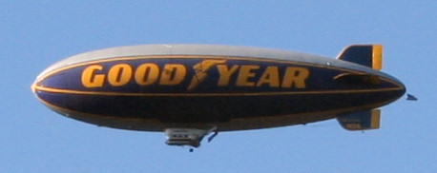

Temperature and Kinetic Theory
Helium Blimp
Helium, like other noble gases, is a monatomic gas, which often can be described by the ideal gas law. It is the gas of choice to fill airships such as the Goodyear blimp.
Free to share, print, make copies and changes. Get yours at www.boundless.com
Wikipedia. "Helium." CC BY http://en.wikipedia.org/wiki/Helium View on Boundless.com

Slide 22
Temperature and Kinetic Theory
Zeroth Law of Thermodynamics
The double arrow represents thermal equilibrium between systems. If systems A and C are in equilibrium, and systems A and B are in equilibrium, then systems B and C are in equilibrium. The systems A, B, and C are at the same temperature.
Free to share, print, make copies and changes. Get yours at www.boundless.com
Amazon Web Services. "Boundless." CC BY-SA 3.0 http://s3.amazonaws.com/figures.boundless.com/5094796fe4b0b4558d8e505e/zeroth_law.png View on Boundless.com

Slide 23
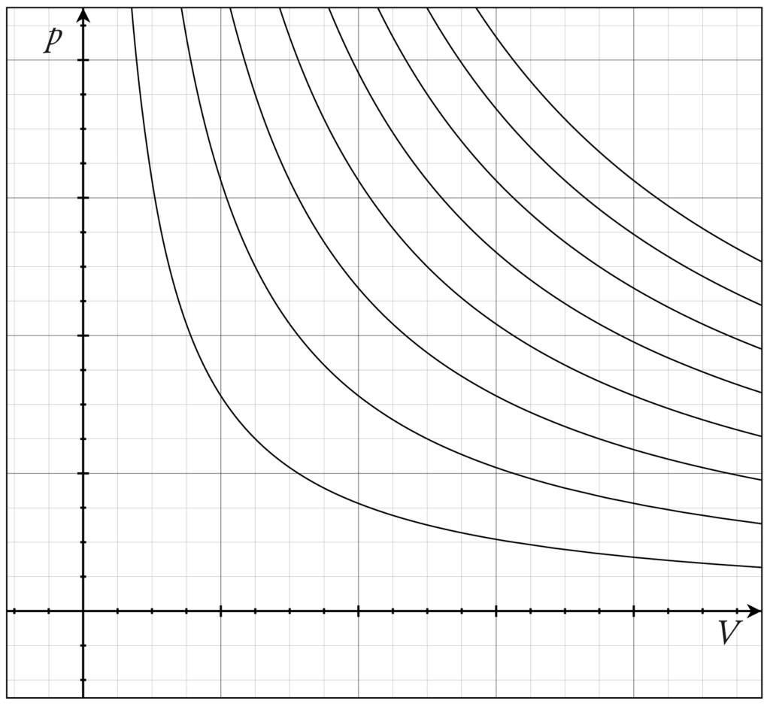
Temperature and Kinetic Theory
Isotherms of an Ideal Gas
Several isotherms of an ideal gas on a PV diagram.
Free to share, print, make copies and changes. Get yours at www.boundless.com
Wikipedia. "Isothermal process." CC BY http://en.wikipedia.org/wiki/Isothermal_process View on Boundless.com

Slide 24
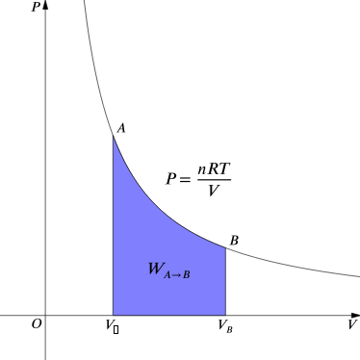
Temperature and Kinetic Theory
Work Done by Gas During Expansion
The blue area represents "work" done by the gas during expansion for this isothermal change.
Free to share, print, make copies and changes. Get yours at www.boundless.com
Wikipedia. "Isothermal process." CC BY http://en.wikipedia.org/wiki/Isothermal_process View on Boundless.com

Slide 25
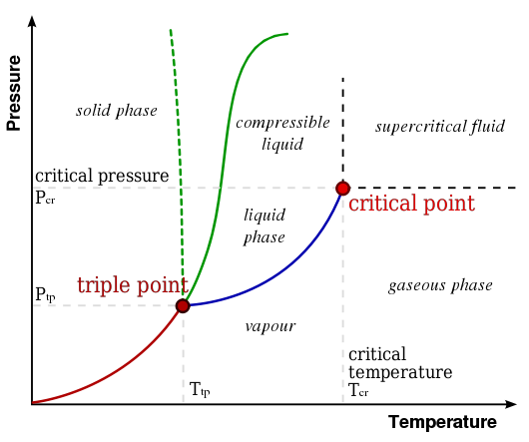
Temperature and Kinetic Theory
Phase Diagram of Water
In this typical phase diagram of water, the green lines mark the freezing point, and the blue line marks the boiling point, showing how they vary with pressure. The dotted line illustrates the anomalous behavior of water. Note that water changes states based on the pressure and temperature.
Free to share, print, make copies and changes. Get yours at www.boundless.com
Wikipedia. "Phase diagram." GNU FDL http://en.wikipedia.org/wiki/Phase_diagram View on Boundless.com

Slide 26
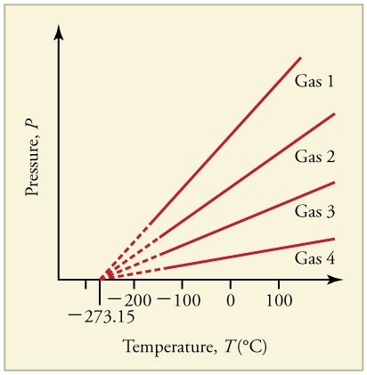
Temperature and Kinetic Theory
Graph of Pressure Versus Temperature
Graph of pressure versus temperature for various gases kept at a constant volume. Note that all of the graphs extrapolate to zero pressure at the same temperature
Free to share, print, make copies and changes. Get yours at www.boundless.com
OpenStax CNX. "OpenStax College, Temperature. April 28, 2014." CC BY 3.0 http://cnx.org/content/m42214/latest/ View on Boundless.com

Slide 27
Temperature and Kinetic Theory
Temperature Scales
A brief introduction to temperature and temperature scales for students studying thermal physics or thermodynamics.
Free to share, print, make copies and changes. Get yours at www.boundless.com
View on Boundless.com

Slide 28
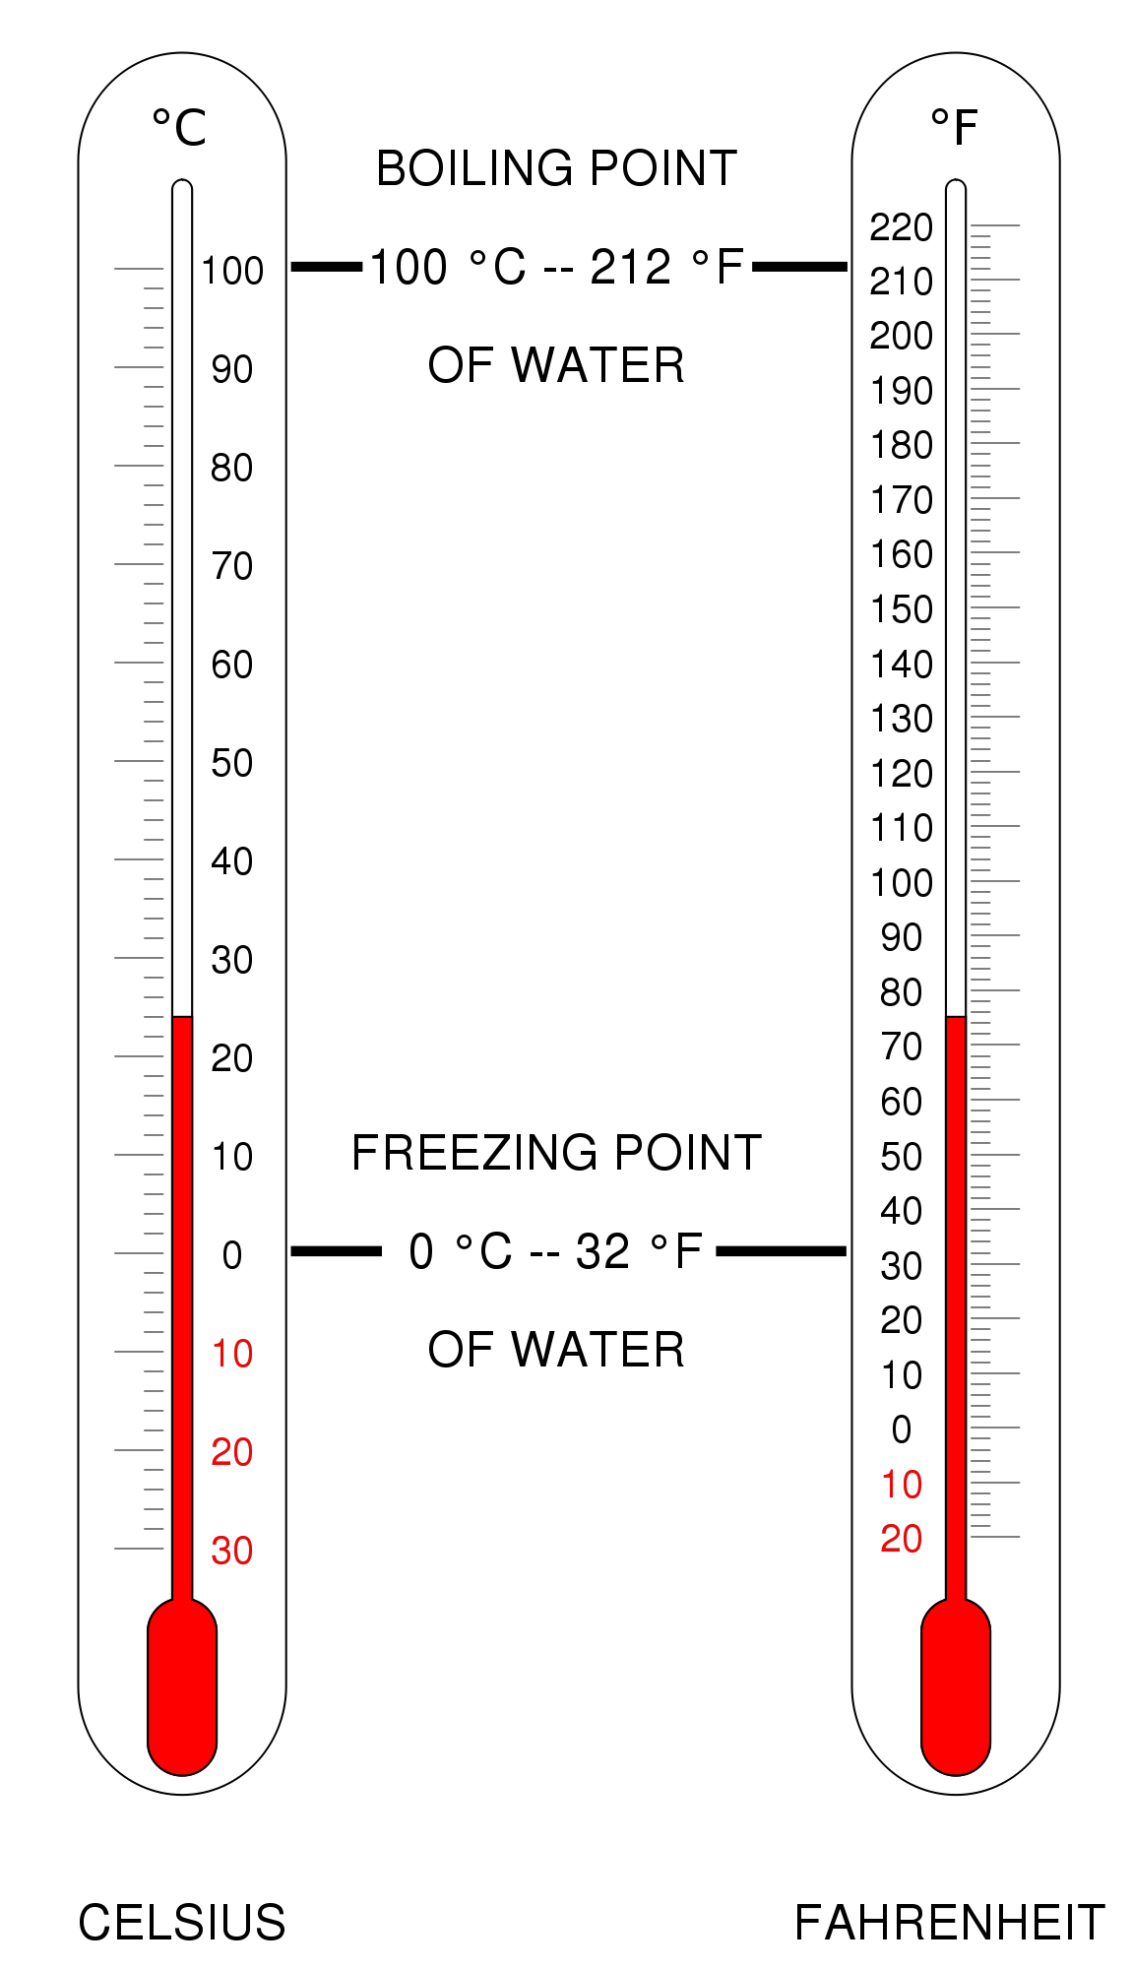
Temperature and Kinetic Theory
Fig 2
Comparison of Celsius vs Fahrenheit scales.
Free to share, print, make copies and changes. Get yours at www.boundless.com
Wikipedia. "Fahrenheit." CC BY http://en.wikipedia.org/wiki/Fahrenheit View on Boundless.com

Slide 29
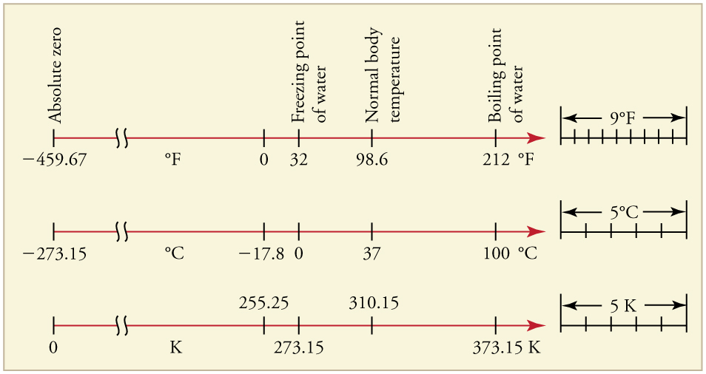
Temperature and Kinetic Theory
Relationships Between the Temperature Scales
Relationships between the Fahrenheit, Celsius, and Kelvin temperature scales, rounded to the nearest degree. The relative sizes of the scales are also shown
Free to share, print, make copies and changes. Get yours at www.boundless.com
OpenStax CNX. "OpenStax College, Temperature. February 2, 2013." CC BY 3.0 http://cnx.org/content/m42214/latest/ View on Boundless.com

Slide 30
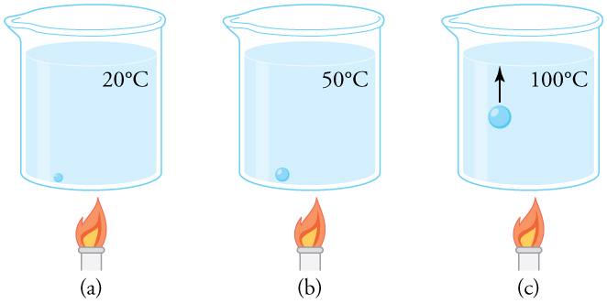
Temperature and Kinetic Theory
Close-up of the Boiling Process
(a) An air bubble in water starts out saturated with water vapor at 20ºC. (b) As the temperature rises, water vapor enters the bubble because its vapor pressure increases. The bubble expands to keep its pressure at 1.00 atm. (c) At 100ºC, water vapor enters the bubble continuously because water's vapor pressure exceeds its partial pressure in the bubble, which must be less than 1.00 atm. The bubble grows and rises to the surface.
Free to share, print, make copies and changes. Get yours at www.boundless.com
OpenStax CNX. "OpenStax College, College Physics. November 3, 2012." CC BY 3.0 http://cnx.org/content/m42219/latest/?collection=col11406/1.7 View on Boundless.com

Slide 31
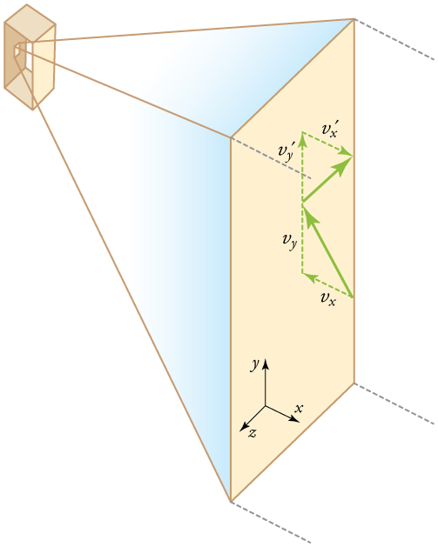
Temperature and Kinetic Theory
Elastic Collisions When Molecules Hit the Wall of the Container
Gas in a box exerts an outward pressure on its walls. A molecule colliding with a rigid wall has the direction of its velocity and momentum in the x-direction reversed. This direction is perpendicular to the wall. The components of its velocity momentum in the y- and z-directions are not changed, which means there is no force parallel to the wall.
Free to share, print, make copies and changes. Get yours at www.boundless.com
OpenStax CNX. "OpenStax College, Kinetic Theory: Atomic and Molecular Explanation of Pressure and Temperature. February 4, 2013." CC BY 3.0 http://cnx.org/content/m42217/latest/ View on Boundless.com

Slide 32
Temperature and Kinetic Theory
Thermal Expansion Joints
Thermal expansion joints like these in the Auckland Harbour Bridge in New Zealand allow bridges to change length without buckling. (credit: Ingolfson, Wikimedia Commons)
Free to share, print, make copies and changes. Get yours at www.boundless.com
OpenStax CNX. "OpenStax College, Thermal Expansion of Solids and Liquids. November 4, 2012." CC BY 3.0 http://cnx.org/content/m42215/latest/ View on Boundless.com

Slide 33
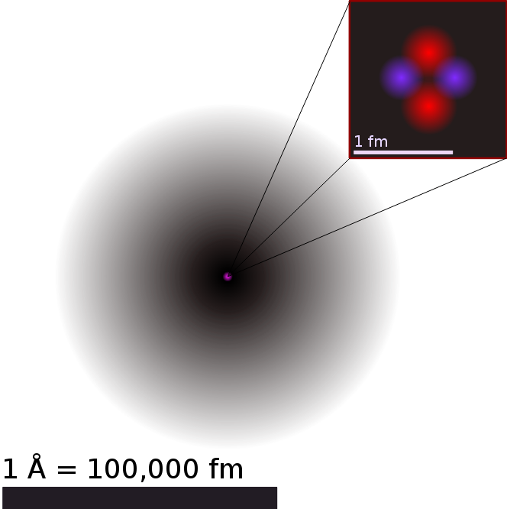
Temperature and Kinetic Theory
Illustration of the Helium Atom
This is an illustration of the helium atom, depicting the nucleus (pink) and the electron cloud distribution (black). The nucleus (upper right) in helium-4 is in reality spherically symmetric and closely resembles the electron cloud, although for more complicated nuclei this is not always the case. The black bar is one angstrom (10-10 m, or 100 pm).
Free to share, print, make copies and changes. Get yours at www.boundless.com
Wikipedia. "Atom." CC BY http://en.wikipedia.org/wiki/Atom View on Boundless.com

Slide 34

Temperature and Kinetic Theory
Boomerang Nebula
The rapid expansion of gases resulting in the Boomerang Nebula causes the lowest observed temperature outside a laboratory.
Free to share, print, make copies and changes. Get yours at www.boundless.com
Wikipedia. "Absolute zero." CC BY http://en.wikipedia.org/wiki/Absolute_zero View on Boundless.com

Slide 35
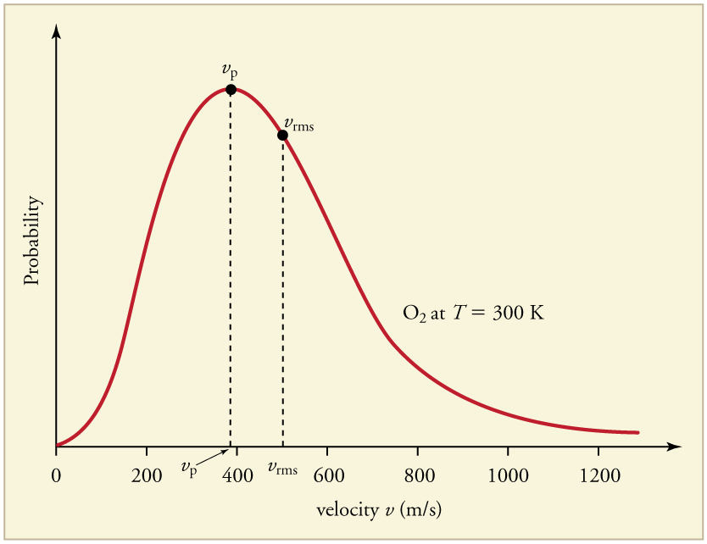
Temperature and Kinetic Theory
Maxwell-Boltzmann Distribution
The Maxwell-Boltzmann distribution of molecular speeds in an ideal gas. The most likely speed v_p is less than the rms speed v_rms. Although very high speeds are possible, only a tiny fraction of the molecules have speeds that are an order of magnitude greater than v_rms.
Free to share, print, make copies and changes. Get yours at www.boundless.com
OpenStax CNX. "OpenStax College, Kinetic Theory: Atomic and Molecular Explanation of Pressure and Temperature. February 4, 2013." CC BY 3.0 http://cnx.org/content/m42217/latest/ View on Boundless.com

Slide 36
Temperature and Kinetic Theory
Fig 1
Thermal expansion of long continuous sections of rail tracks is the driving force for rail buckling. This phenomenon resulted in 190 train derailments during 1998–2002 in the US alone.
Free to share, print, make copies and changes. Get yours at www.boundless.com
Wikipedia. "Thermal expansion." CC BY http://en.wikipedia.org/wiki/Thermal_expansion View on Boundless.com

Slide 37
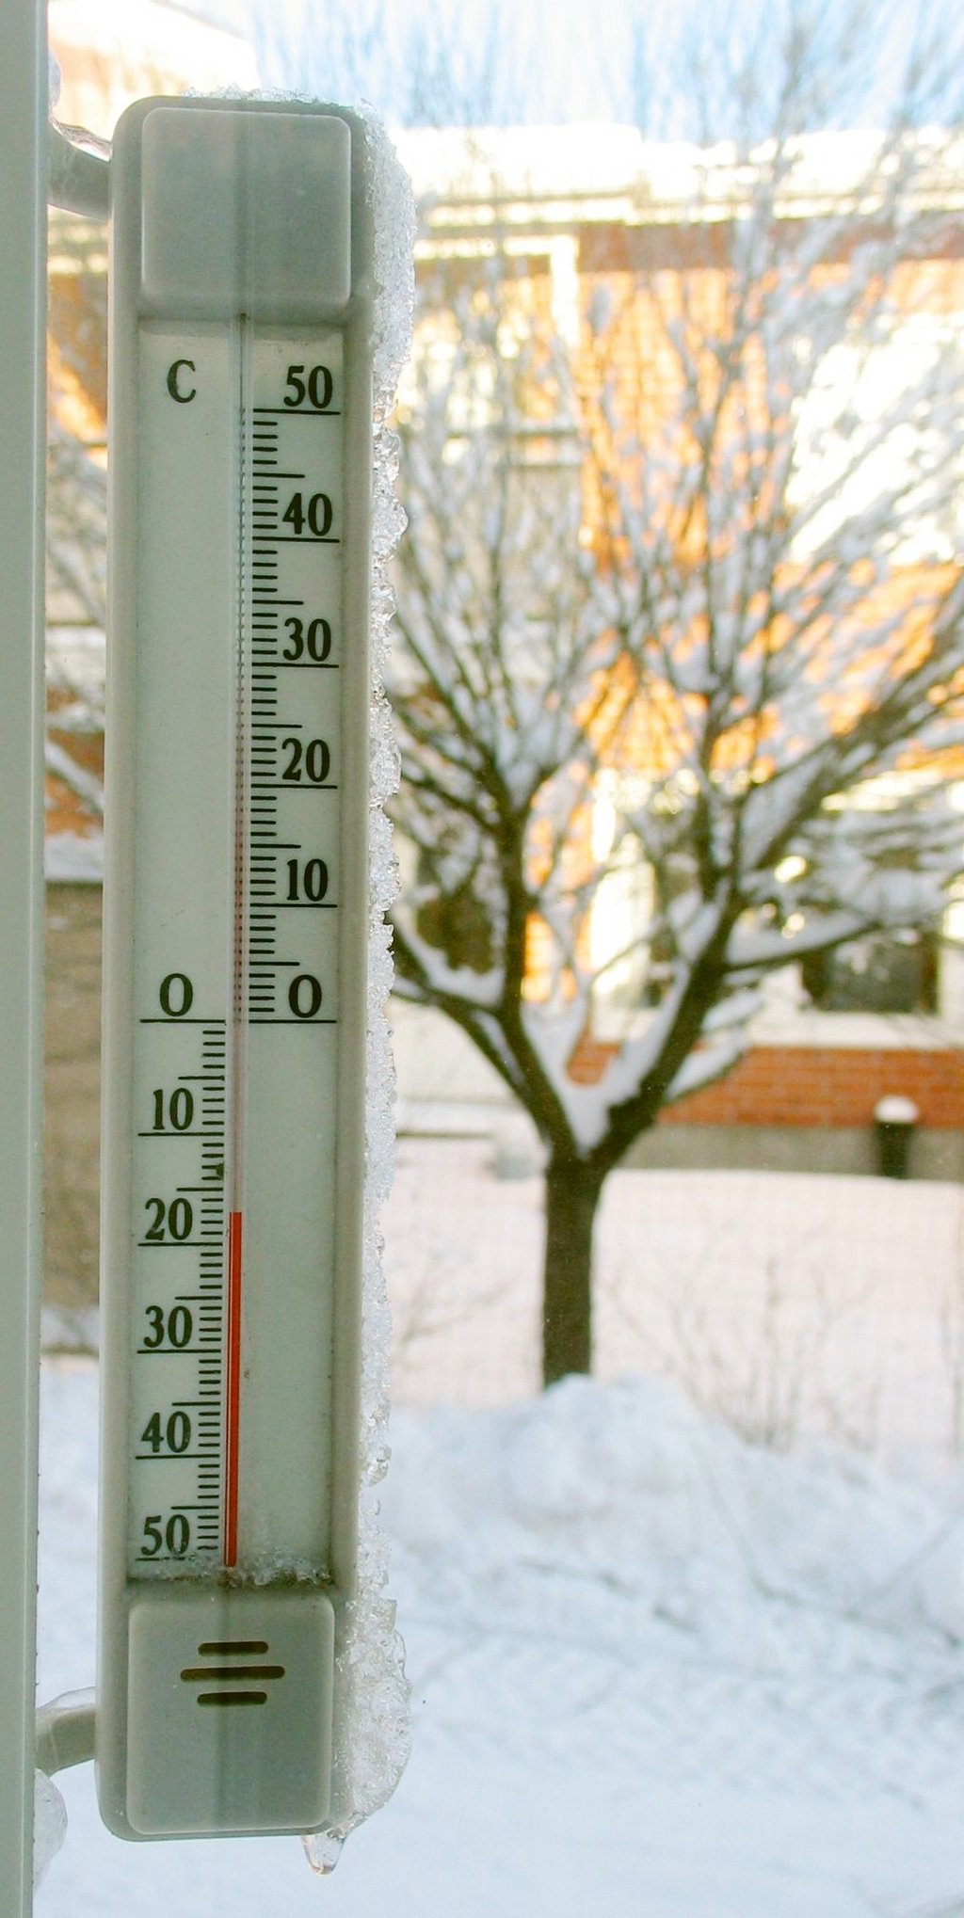
Temperature and Kinetic Theory
Thermometer
A thermometer calibrated in degrees Celsius
Free to share, print, make copies and changes. Get yours at www.boundless.com
Wikipedia. "Celsius." CC BY http://en.wikipedia.org/wiki/Celsius View on Boundless.com

Slide 38
Temperature and Kinetic Theory
Graph of Pressure Versus Temperature
Graph of pressure versus temperature for various gases kept at a constant volume. Note that all of the graphs extrapolate to zero pressure at the same temperature
Free to share, print, make copies and changes. Get yours at www.boundless.com
OpenStax CNX. "OpenStax College, Temperature. February 2, 2013." CC BY 3.0 http://cnx.org/content/m42214/latest/ View on Boundless.com

Slide 39
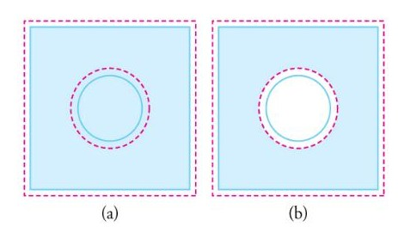
Temperature and Kinetic Theory
Fig 1
In general, objects expand in all directions as temperature increases. In these drawings, the original boundaries of the objects are shown with solid lines, and the expanded boundaries with dashed lines. (a) Area increases because both length and width increase. The area of a circular plug also increases. (b) If the plug is removed, the hole it leaves becomes larger with increasing temperature, just as if the expanding plug were still in place.
Free to share, print, make copies and changes. Get yours at www.boundless.com
OpenStax CNX. "OpenStax College, Thermal Expansion of Solids and Liquids. February 2, 2013." CC BY 3.0 http://cnx.org/content/m42215/latest/ View on Boundless.com

Slide 40
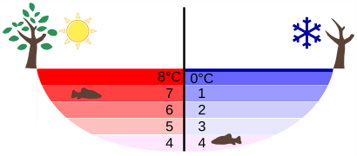
Temperature and Kinetic Theory
Temperature in a Lake
Temperature distribution in a lake on warm and cold days in winter
Free to share, print, make copies and changes. Get yours at www.boundless.com
Wikipedia. "Properties of water." CC BY http://en.wikipedia.org/wiki/Properties_of_water View on Boundless.com

Slide 41
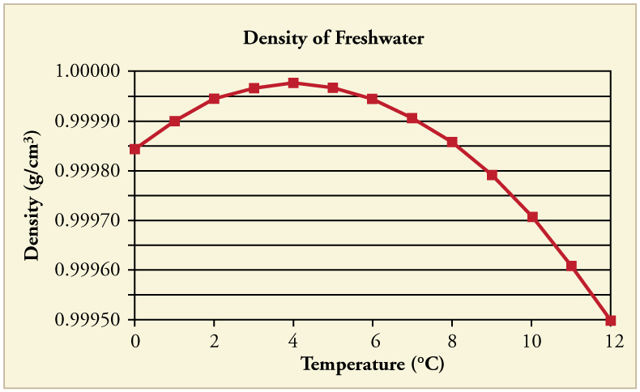
Temperature and Kinetic Theory
Water Density vs. Temperature
The density of water as a function of temperature. Note that the thermal expansion is actually very small. The maximum density at +4ºC is only 0.0075% greater than the density at 2ºC, and 0.012% greater than that at 0ºC.
Free to share, print, make copies and changes. Get yours at www.boundless.com
OpenStax CNX. "OpenStax College, Thermal Expansion of Solids and Liquids. February 2, 2013." CC BY 3.0 http://cnx.org/content/m42215/latest/ View on Boundless.com

Slide 42
Temperature and Kinetic Theory
Atoms and Modules in a Gas
Atoms and molecules in a gas are typically widely separated, as shown. Because the forces between them are quite weak at these distances, they are often described by the ideal gas law.
Free to share, print, make copies and changes. Get yours at www.boundless.com
OpenStax CNX. "OpenStax College, The Ideal Gas Law. February 4, 2013." CC BY 3.0 http://cnx.org/content/m42216/latest/ View on Boundless.com

Slide 43
Temperature and Kinetic Theory
Temperature vs. Heat
This graph shows the temperature of ice as heat is added.
Free to share, print, make copies and changes. Get yours at www.boundless.com
Wikibooks. "Phase Heat Diagram." CC BY-SA 3.0 http://en.wikibooks.org/wiki/File:Phase_Heat_Diagram.png View on Boundless.com

Slide 44
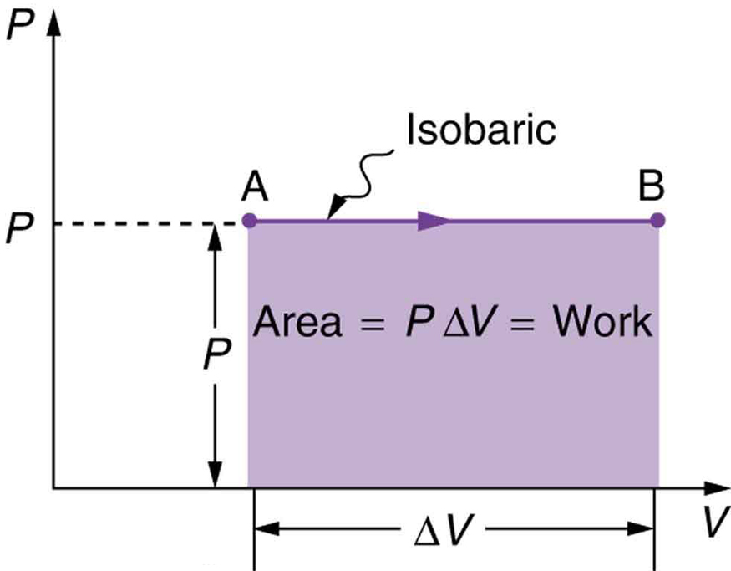
Temperature and Kinetic Theory
Fig 2
A graph of pressure versus volume for a constant-pressure, or isobaric process. The area under the curve equals the work done by the gas, since W=PΔV.
Free to share, print, make copies and changes. Get yours at www.boundless.com
OpenStax CNX. "OpenStax College, The First Law of Thermodynamics and Some Simple Processes. February 5, 2013." CC BY 3.0 http://cnx.org/content/m42233/latest/ View on Boundless.com

Slide 45

Temperature and Kinetic Theory
Tire Pressure
Tire pressure may change significantly during the operation of the vehicle. This is mostly due to the temperature change of the air in tires.
Free to share, print, make copies and changes. Get yours at www.boundless.com
Wikipedia. "Tire." CC BY http://en.wikipedia.org/wiki/Tire View on Boundless.com

Slide 46
Temperature and Kinetic Theory
Temperature Scales
A brief introduction to temperature and temperature scales for students studying thermal physics or thermodynamics.
Free to share, print, make copies and changes. Get yours at www.boundless.com
View on Boundless.com

Slide 47
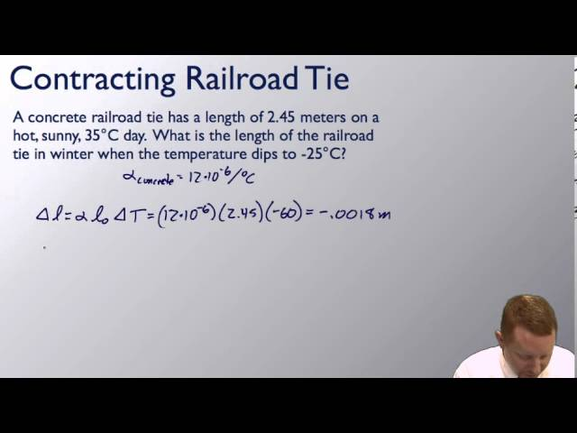
Temperature and Kinetic Theory
Thermal Expansion
A brief introduction to thermal expansion for students.
Free to share, print, make copies and changes. Get yours at www.boundless.com
View on Boundless.com

Slide 48
Temperature and Kinetic Theory
Thermal Expansion - Volume Expansion
A brief introduction to thermal expansion for students.
Free to share, print, make copies and changes. Get yours at www.boundless.com
View on Boundless.com

Slide 49
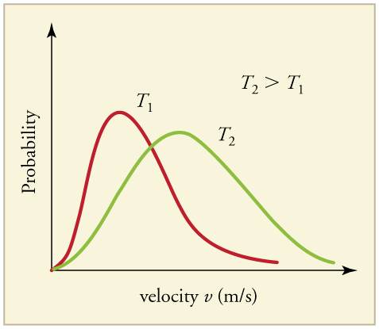
Temperature and Kinetic Theory
Maxwell-Boltzmann Distribution at Higher Temperatures
The Maxwell-Boltzmann distribution is shifted to higher speeds and is broadened at higher temperatures.
Free to share, print, make copies and changes. Get yours at www.boundless.com
OpenStax CNX. "OpenStax College, Kinetic Theory: Atomic and Molecular Explanation of Pressure and Temperature. February 4, 2013." CC BY 3.0 http://cnx.org/content/m42217/latest/ View on Boundless.com

Slide 50
Temperature and Kinetic Theory
Pressure
Pressure arises from the force exerted by molecules or atoms impacting on the walls of a container.
Free to share, print, make copies and changes. Get yours at www.boundless.com
Wikipedia. "Kinetic theory." GNU FDL http://en.wikipedia.org/wiki/Kinetic_theory View on Boundless.com

Slide 51
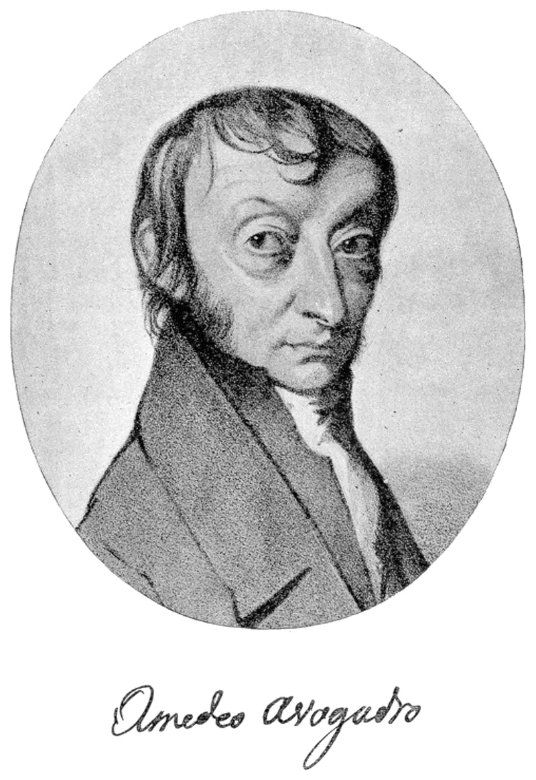
Temperature and Kinetic Theory
Amadeo Avogadro
Amedeo Avogadro (1776–1856). He established the relationship between the masses of the same volume of different gases (at the same temperature and pressure) corresponds to the relationship between their respective molecular weights.
Free to share, print, make copies and changes. Get yours at www.boundless.com
Wikipedia. "Avogadro Amedeo." CC BY-SA http://en.wikipedia.org/wiki/File:Avogadro_Amedeo.jpg View on Boundless.com

Slide 52
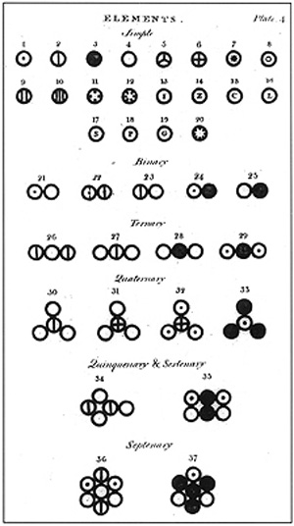
Temperature and Kinetic Theory
John Dalton's A New System of Chemical Philosophy
Various atoms and molecules as depicted in John Dalton's A New System of Chemical Philosophy (1808).
Free to share, print, make copies and changes. Get yours at www.boundless.com
Wikipedia. "John Dalton." GNU FDL http://en.wikipedia.org/wiki/John_Dalton View on Boundless.com

Slide 53
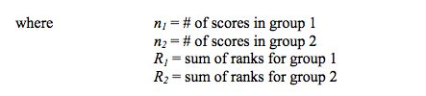
Temperature and Kinetic Theory
Calculating U
Free to share, print, make copies and changes. Get yours at www.boundless.com
Angel Fire. CC BY http://www.angelfire.com/wv/bwhomedir/notes/nonpar.pdf View on Boundless.com

Slide 54
Temperature and Kinetic Theory
Translational Motion of Helium
Real gases do not always behave according to the ideal model under certain conditions, such as high pressure. Here, the size of helium atoms relative to their spacing is shown to scale under 1950 atmospheres of pressure.
Free to share, print, make copies and changes. Get yours at www.boundless.com
Wikipedia. "Kinetic theory." GNU FDL http://en.wikipedia.org/wiki/Kinetic_theory View on Boundless.com

Slide 55
Temperature and Kinetic Theory
Translational Motion of Helium
Real gases do not always behave according to the ideal model under certain conditions, such as high pressure. Here, the size of helium atoms relative to their spacing is shown to scale under 1950 atmospheres of pressure.
Free to share, print, make copies and changes. Get yours at www.boundless.com
Wikipedia. "Kinetic theory." GNU FDL http://en.wikipedia.org/wiki/Kinetic_theory View on Boundless.com

Slide 56
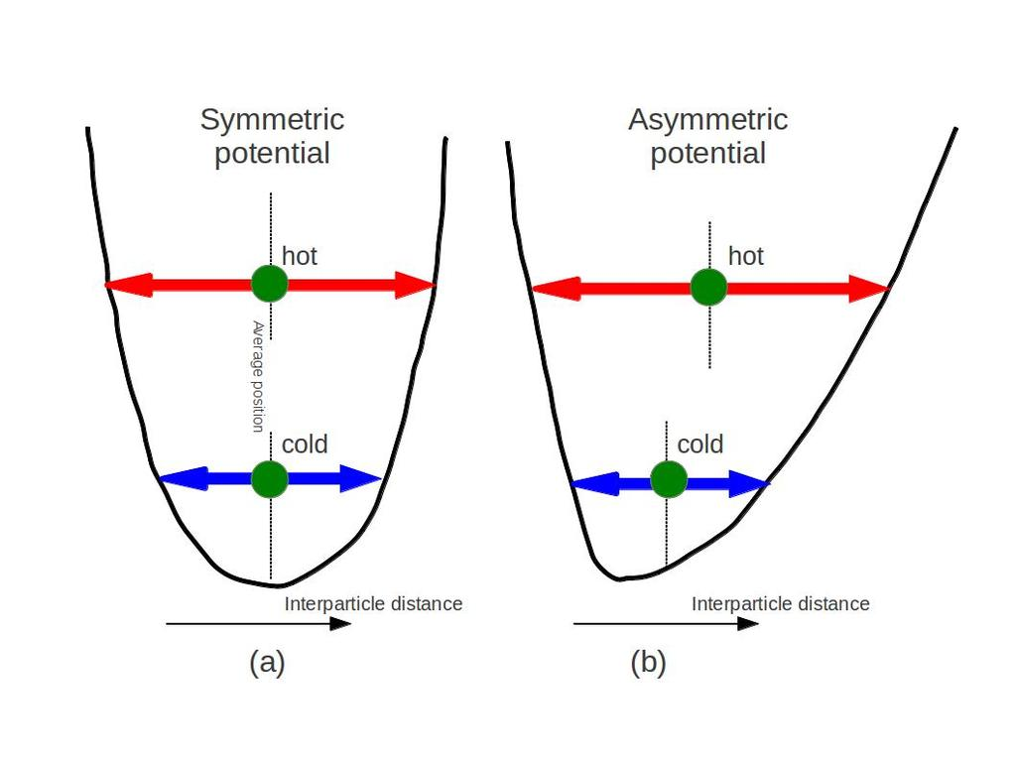
Temperature and Kinetic Theory
Fig 2
Typical inter-particle potential in condensed matter (such as solid or liquid).
Free to share, print, make copies and changes. Get yours at www.boundless.com
Amazon Web Services. "Boundless." CC BY http://s3.amazonaws.com/figures.boundless.com/510d56c6e4b0c14bf464b1af/1.jpg View on Boundless.com

Slide 57
Temperature and Kinetic Theory
Temperature Scales
A brief introduction to temperature and temperature scales for students studying thermal physics or thermodynamics.
Free to share, print, make copies and changes. Get yours at www.boundless.com
View on Boundless.com

Slide 58
Temperature and Kinetic Theory
Temperature Scales
A brief introduction to temperature and temperature scales for students studying thermal physics or thermodynamics.
Free to share, print, make copies and changes. Get yours at www.boundless.com
View on Boundless.com

Slide 59
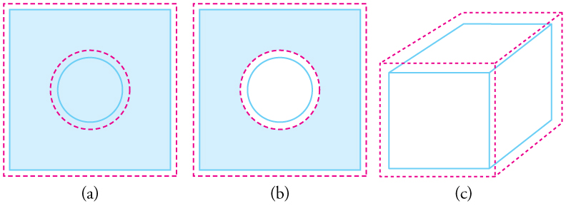
Temperature and Kinetic Theory
Volumetric Expansion
In general, objects expand in all directions as temperature increases. In these drawings, the original boundaries of the objects are shown with solid lines, and the expanded boundaries with dashed lines. (a) Area increases because both length and width increase. The area of a circular plug also increases. (b) If the plug is removed, the hole it leaves becomes larger with increasing temperature, just as if the expanding plug were still in place. (c) Volume also increases, because all three dimensions increase.
Free to share, print, make copies and changes. Get yours at www.boundless.com
OpenStax CNX. "OpenStax College, Thermal Expansion of Solids and Liquids. February 2, 2013." CC BY 3.0 http://cnx.org/content/m42215/latest/ View on Boundless.com

Slide 60
Temperature and Kinetic Theory
Translational Motion of Helium
Real gases do not always behave according to the ideal model under certain conditions, such as high pressure. Here, the size of helium atoms relative to their spacing is shown to scale under 1950 atmospheres of pressure.
Free to share, print, make copies and changes. Get yours at www.boundless.com
Wikipedia. "Kinetic theory." GNU FDL http://en.wikipedia.org/wiki/Kinetic_theory View on Boundless.com

Slide 61
Temperature and Kinetic Theory
Phase Diagram of Water
In this typical phase diagram of water, the green lines mark the freezing point, and the blue line marks the boiling point, showing how they vary with pressure. The dotted line illustrates the anomalous behavior of water. Note that water changes states based on the pressure and temperature.
Free to share, print, make copies and changes. Get yours at www.boundless.com
Wikipedia. "Phase diagram." GNU FDL http://en.wikipedia.org/wiki/Phase_diagram View on Boundless.com

Slide 62
Temperature and Kinetic Theory
Diffusion
Particles moving from areas of high concentration to areas of low concentration.
Free to share, print, make copies and changes. Get yours at www.boundless.com
Wikimedia. "Diffusion." CC BY-SA http://commons.wikimedia.org/wiki/File:Diffusion.svg View on Boundless.com

Slide 63
Temperature and Kinetic Theory
Formulae for calculating U
Free to share, print, make copies and changes. Get yours at www.boundless.com
Angel Fire. CC BY http://www.angelfire.com/wv/bwhomedir/notes/nonpar.pdf View on Boundless.com

Slide 64
Attribution
Temperature and Kinetic Theory
Wikipedia. "linear thermal expansion coefficient." CC BY-SA 3.0 http://en.wikipedia.org/wiki/linear%20thermal%20expansion%20coefficient
Wikipedia. "Thermal expansion." CC BY-SA 3.0 http://en.wikipedia.org/wiki/Thermal_expansion%23Area_expansion
Wiktionary. "ideal gas." CC BY-SA 3.0 http://en.wiktionary.org/wiki/ideal_gas
Wiktionary. "absolute zero." CC BY-SA 3.0 http://en.wiktionary.org/wiki/absolute_zero
Wikipedia. "Triple point." CC BY-SA 3.0 http://en.wikipedia.org/wiki/Triple%20point
OpenStax CNX. "OpenStax College, Temperature. September 17, 2013." CC BY 3.0 http://cnx.org/content/m42214/latest/
Wikipedia. "Kelvin." CC BY-SA 3.0 http://en.wikipedia.org/wiki/Kelvin
Wikipedia. "frigorific mixture." CC BY-SA 3.0 http://en.wikipedia.org/wiki/frigorific%20mixture
Wikipedia. "brine." CC BY-SA 3.0 http://en.wikipedia.org/wiki/brine
Wikipedia. "Fahrenheit." CC BY-SA 3.0 http://en.wikipedia.org/wiki/Fahrenheit
Wiktionary. "ideal gas." CC BY-SA 3.0 http://en.wiktionary.org/wiki/ideal_gas
Wiktionary. "mole." CC BY-SA 3.0 http://en.wiktionary.org/wiki/mole
Wikipedia. "Avogadro's number." CC BY-SA 3.0 http://en.wikipedia.org/wiki/Avogadro's%20number
Wikipedia. "Ideal gas law." CC BY-SA 3.0 http://en.wikipedia.org/wiki/Ideal_gas_law%23Empirical
Wikipedia. "thermodynamics." CC BY-SA 3.0 http://en.wikipedia.org/wiki/thermodynamics
Wikipedia. "entropy." CC BY-SA 3.0 http://en.wikipedia.org/wiki/entropy
Wikipedia. "Absolute zero." CC BY-SA 3.0 http://en.wikipedia.org/wiki/Absolute_zero
Free to share, print, make copies and changes. Get yours at www.boundless.com

Slide 65
Temperature and Kinetic Theory
Wiktionary. "specific heat." CC BY-SA 3.0 http://en.wiktionary.org/wiki/specific_heat
Wikipedia. "the first law of thermodynamics." CC BY-SA 3.0 http://en.wikipedia.org/wiki/the%20first%20law%20of%20thermodynamics
Wikipedia. "Isobaric process." CC BY-SA 3.0 http://en.wikipedia.org/wiki/Isobaric_process
OpenStax CNX. "OpenStax College, The First Law of Thermodynamics and Some Simple Processes. September 17, 2013." CC BY 3.0 http://cnx.org/content/m42233/latest/
Wikipedia. "linear thermal expansion coefficient." CC BY-SA 3.0 http://en.wikipedia.org/wiki/linear%20thermal%20expansion%20coefficient
Wiktionary. "isotropic." CC BY-SA 3.0 http://en.wiktionary.org/wiki/isotropic
Wikipedia. "Thermal expansion." CC BY-SA 3.0 http://en.wikipedia.org/wiki/Thermal_expansion
Wiktionary. "equilibrium." CC BY-SA 3.0 http://en.wiktionary.org/wiki/equilibrium
Wiktionary. "concentration." CC BY-SA 3.0 http://en.wiktionary.org/wiki/concentration
Boundless Learning. "Boundless." CC BY-SA 3.0 http://www.boundless.com//biology/definition/diffusion
Wikipedia. "Diffusion equilibrium." CC BY-SA 3.0 http://en.wikipedia.org/wiki/Diffusion_equilibrium
Wikipedia. "Diffusion." CC BY-SA 3.0 http://en.wikipedia.org/wiki/Diffusion
Wiktionary. "ideal gas." CC BY-SA 3.0 http://en.wiktionary.org/wiki/ideal_gas
Wiktionary. "degree of freedom." CC BY-SA 3.0 http://en.wiktionary.org/wiki/degree_of_freedom
Wiktionary. "Brownian motion." CC BY-SA 3.0 http://en.wiktionary.org/wiki/Brownian_motion
Wikipedia. "Kinetic theory." CC BY-SA 3.0 http://en.wikipedia.org/wiki/Kinetic_theory%23Temperature_and_kinetic_energy
Wikipedia. "Temperature." CC BY-SA 3.0 http://en.wikipedia.org/wiki/Temperature%23Kinetic_theory_of_gases
Wiktionary. "hydrogen bond." CC BY-SA 3.0 http://en.wiktionary.org/wiki/hydrogen_bond
Wikipedia. "Properties of water." CC BY-SA 3.0 http://en.wikipedia.org/wiki/Properties_of_water
Free to share, print, make copies and changes. Get yours at www.boundless.com

Slide 66
Temperature and Kinetic Theory
OpenStax CNX. "OpenStax College, Thermal Expansion of Solids and Liquids. September 17, 2013." CC BY 3.0 http://cnx.org/content/m42215/latest/
Wiktionary. "absolute zero." CC BY-SA 3.0 http://en.wiktionary.org/wiki/absolute_zero
Wiktionary. "kelvin." CC BY-SA 3.0 http://en.wiktionary.org/wiki/kelvin
Wikipedia. "standard atmosphere." CC BY-SA 3.0 http://en.wikipedia.org/wiki/standard%20atmosphere
Wikipedia. "Celsius." CC BY-SA 3.0 http://en.wikipedia.org/wiki/Celsius
Wiktionary. "Newtonian mechanics." CC BY-SA 3.0 http://en.wiktionary.org/wiki/Newtonian_mechanics
Wikipedia. "kinetic theory of gases." CC BY-SA 3.0 http://en.wikipedia.org/wiki/kinetic%20theory%20of%20gases
Wikipedia. "Kinetic theory." CC BY-SA 3.0 http://en.wikipedia.org/wiki/Kinetic_theory%23Pressure_and_kinetic_energy
Wiktionary. "ideal gas." CC BY-SA 3.0 http://en.wiktionary.org/wiki/ideal_gas
Wikipedia. "rms." CC BY-SA 3.0 http://en.wikipedia.org/wiki/rms
Wikipedia. "kinetic theory of gases." CC BY-SA 3.0 http://en.wikipedia.org/wiki/kinetic%20theory%20of%20gases
OpenStax CNX. "OpenStax College, College Physics. September 17, 2013." CC BY 3.0 http://cnx.org/content/m42217/latest/?collection=col11406/1.7
OpenStax CNX. "OpenStax College, College Physics. September 17, 2013." CC BY 3.0 http://cnx.org/content/m42217/latest/?collection=col11406/1.7
Wiktionary. "Boltzmann's constant." CC BY-SA 3.0 http://en.wiktionary.org/wiki/Boltzmann's_constant
Wiktionary. "noble gas." CC BY-SA 3.0 http://en.wiktionary.org/wiki/noble_gas
Wiktionary. "moment of inertia." CC BY-SA 3.0 http://en.wiktionary.org/wiki/moment_of_inertia
Wikipedia. "Internal energy." CC BY-SA 3.0 http://en.wikipedia.org/wiki/Internal_energy%23Internal_energy_of_the_ideal_gas
Wikipedia. "rms." CC BY-SA 3.0 http://en.wikipedia.org/wiki/rms
Wikipedia. "Maxwell–Boltzmann distribution." CC BY-SA 3.0 http://en.wikipedia.org/wiki/Maxwell%E2%80%93Boltzmann_distribution
Free to share, print, make copies and changes. Get yours at www.boundless.com

Slide 67
Temperature and Kinetic Theory
OpenStax CNX. "OpenStax College, Kinetic Theory: Atomic and Molecular Explanation of Pressure and Temperature. September 17, 2013." CC BY 3.0 http://cnx.org/content/m42217/latest/
Wikipedia. "potential." CC BY-SA 3.0 http://en.wikipedia.org/wiki/potential
Wikipedia. "Thermal expansion." CC BY-SA 3.0 http://en.wikipedia.org/wiki/Thermal_expansion
Wikipedia. "zeroth law of thermodynamics." CC BY-SA 3.0 http://en.wikipedia.org/wiki/zeroth%20law%20of%20thermodynamics
Boundless Learning. "Boundless." CC BY-SA 3.0 http://www.boundless.com//physics/definition/thermal-equilibrium--2
Wikipedia. "Zeroth law of thermodynamics." CC BY-SA 3.0 http://en.wikipedia.org/wiki/Zeroth_law_of_thermodynamics
Wiktionary. "vapor pressure." CC BY-SA 3.0 http://en.wiktionary.org/wiki/vapor_pressure
OpenStax CNX. "OpenStax College, Phase Changes. September 17, 2013." CC BY 3.0 http://cnx.org/content/m42218/latest/#import-auto-id2387893
Wiktionary. "equilibrium." CC BY-SA 3.0 http://en.wiktionary.org/wiki/equilibrium
Wiktionary. "humidity." CC BY-SA 3.0 http://en.wiktionary.org/wiki/humidity
OpenStax CNX. "OpenStax College, College Physics. September 17, 2013." CC BY 3.0 http://cnx.org/content/m42219/latest/?collection=col11406/1.7
Wikipedia. "Evaporation." CC BY-SA 3.0 http://en.wikipedia.org/wiki/Evaporation
OpenStax CNX. "OpenStax College, College Physics. September 17, 2013." CC BY 3.0 http://cnx.org/content/m42219/latest/?collection=col11406/1.7
Wikipedia. "Evaporation." CC BY-SA 3.0 http://en.wikipedia.org/wiki/Evaporation
Wiktionary. "ideal gas." CC BY-SA 3.0 http://en.wiktionary.org/wiki/ideal_gas
Wiktionary. "adiabatic." CC BY-SA 3.0 http://en.wiktionary.org/wiki/adiabatic
Boundless Learning. "Boundless." CC BY-SA 3.0 http://www.boundless.com//physics/definition/internal-energy
Wikipedia. "Isothermal process." CC BY-SA 3.0 http://en.wikipedia.org/wiki/Isothermal_process
Wiktionary. "gas constant." CC BY-SA 3.0 http://en.wiktionary.org/wiki/gas_constant
Free to share, print, make copies and changes. Get yours at www.boundless.com

Slide 68
Temperature and Kinetic Theory
Wiktionary. "Brownian motion." CC BY-SA 3.0 http://en.wiktionary.org/wiki/Brownian_motion
Wikipedia. "Faraday constant." CC BY-SA 3.0 http://en.wikipedia.org/wiki/Faraday%20constant
Wikipedia. "Avogadro constant." CC BY-SA 3.0 http://en.wikipedia.org/wiki/Avogadro_constant%23Measurement
OpenStax CNX. "OpenStax College, The Ideal Gas Law. September 17, 2013." CC BY 3.0 http://cnx.org/content/m42216/latest/
Wikipedia. "Brownian motion." CC BY-SA 3.0 http://en.wikipedia.org/wiki/Brownian_motion
Wiktionary. "chemical reaction." CC BY-SA 3.0 http://en.wiktionary.org/wiki/chemical_reaction
Wiktionary. "atom." CC BY-SA 3.0 http://en.wiktionary.org/wiki/atom
Wikipedia. "kinetic theory of gases." CC BY-SA 3.0 http://en.wikipedia.org/wiki/kinetic%20theory%20of%20gases
Wikipedia. "Atomic theory." CC BY-SA 3.0 http://en.wikipedia.org/wiki/Atomic_theory
Wikipedia. "Kinetic theory." CC BY-SA 3.0 http://en.wikipedia.org/wiki/Kinetic_theory
Wiktionary. "ideal gas." CC BY-SA 3.0 http://en.wiktionary.org/wiki/ideal_gas
Boundless Learning. "Boundless." CC BY-SA 3.0 http://www.boundless.com//physics/definition/si-units
OpenStax CNX. "Free High School Science Texts Project, Thermal Properties and Ideal Gases: Ideal Gas Law and General Gas Equation. September 17, 2013." CC BY 3.0 http://cnx.org/content/m39086/latest/
Wikipedia. "Ideal gas law." CC BY-SA 3.0 http://en.wikipedia.org/wiki/Ideal_gas_law
Wiktionary. "intermolecular." CC BY-SA 3.0 http://en.wiktionary.org/wiki/intermolecular
Wiktionary. "plasma." CC BY-SA 3.0 http://en.wiktionary.org/wiki/plasma
Wiktionary. "thermodynamic." CC BY-SA 3.0 http://en.wiktionary.org/wiki/thermodynamic
OpenStax CNX. "OpenStax College, Phase Changes. September 17, 2013." CC BY 3.0 http://cnx.org/content/m42218/latest/
Wikibooks. "General Chemistry/Phase Changes." CC BY-SA 3.0 http://en.wikibooks.org/wiki/General_Chemistry/Phase_Changes
Free to share, print, make copies and changes. Get yours at www.boundless.com

Slide 69
Temperature and Kinetic Theory
Wiktionary. "Vienna Standard Mean Ocean Water." CC BY-SA 3.0 http://en.wiktionary.org/wiki/Vienna_Standard_Mean_Ocean_Water
Wiktionary. "absolute zero." CC BY-SA 3.0 http://en.wiktionary.org/wiki/absolute_zero
Wikipedia. "International System of Units." CC BY-SA 3.0 http://en.wikipedia.org/wiki/International%20System%20of%20Units
Wikipedia. "Thermodynamic temperature." CC BY-SA 3.0 http://en.wikipedia.org/wiki/Thermodynamic_temperature
Wiktionary. "differential." CC BY-SA 3.0 http://en.wiktionary.org/wiki/differential
Wiktionary. "stress." CC BY-SA 3.0 http://en.wiktionary.org/wiki/stress
OpenStax CNX. "OpenStax College, Thermal Expansion of Solids and Liquids. September 18, 2013." CC BY 3.0 http://cnx.org/content/m42215/latest/
Wikipedia. "Thermal expansion." CC BY-SA 3.0 http://en.wikipedia.org/wiki/Thermal_expansion
OpenStax CNX. "OpenStax College, Thermal Expansion of Solids and Liquids. September 18, 2013." CC BY 3.0 http://cnx.org/content/m42215/latest/
OpenStax CNX. "OpenStax College, Thermal Expansion of Solids and Liquids. September 18, 2013." CC BY 3.0 http://cnx.org/content/m42215/latest/
Free to share, print, make copies and changes. Get yours at www.boundless.com

