Slide 1


Boundless Lecture Slides
Available on the Boundless Teaching Platform
Free to share, print, make copies and changes. Get yours at www.boundless.com

Slide 2



Using Boundless Presentations
Boundless Teaching Platform
Boundless empowers educators to engage their students with affordable, customizable textbooks and intuitive teaching tools. The free Boundless Teaching Platform gives educators the ability to customize textbooks in more than 20 subjects that align to hundreds of popular titles. Get started by using high quality Boundless books, or make switching to our platform easier by building from Boundless content pre-organized to match the assigned textbook. This platform gives educators the tools they need to assign readings and assessments, monitor student activity, and lead their classes with pre-made teaching resources.
Get started now at:
The Appendix
The appendix is for you to use to add depth and breadth to your lectures. You can simply drag and drop slides from the appendix into the main presentation to make for a richer lecture experience.
http://boundless.com/teaching-platform
Free to edit, share, and copy
Feel free to edit, share, and make as many copies of the Boundless presentations as you like. We encourage you to take these presentations and make them your own.
If you have any questions or problems please email:
educators@boundless.com
Free to share, print, make copies and changes. Get yours at www.boundless.com

Slide 3

About Boundless
Boundless is an innovative technology company making education more affordable and accessible for students everywhere. The company creates the world’s best open educational content in 20+ subjects that align to more than 1,000 popular college textbooks. Boundless integrates learning technology into all its premium books to help students study more efficiently at a fraction of the cost of traditional textbooks. The company also empowers educators to engage their students more effectively through customizable books and intuitive teaching tools as part of the Boundless Teaching Platform. More than 2 million learners access Boundless free and premium content each month across the company’s wide distribution platforms, including its website, iOS apps, Kindle books, and iBooks. To get started learning or teaching with Boundless, visit boundless.com.
Free to share, print, make copies and changes. Get yours at www.boundless.com

Slide 4
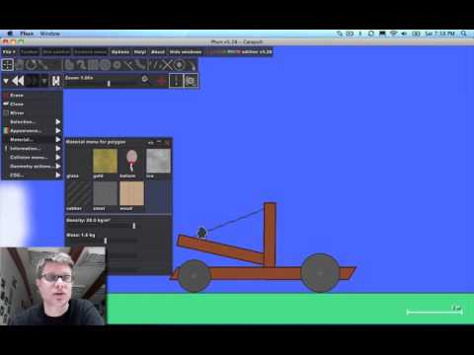
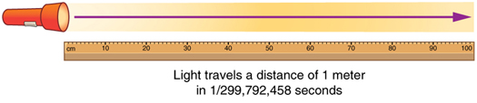
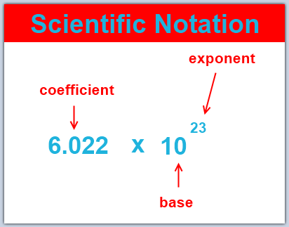

The Basics of Physics
The Basics of Physics
Units
Significant Figures and Order of Magnitude
Solving Physics Problems
]
The Basics of Physics
Free to share, print, make copies and changes. Get yours at www.boundless.com

Slide 5

The Basics of Physics
The Basics of Physics > The Basics of Physics
Introduction: Physics and Matter
Physics and Other Fields
Models, Theories, and Laws
Free to share, print, make copies and changes. Get yours at www.boundless.com
www.boundless.com/physics/textbooks/boundless-physics-textbook/the-basics-of-physics-1/the-basics-of-physics-31/

Slide 6
Units
The Basics of Physics > Units
Length
Mass
Time
Prefixes and Other Systems of Units
Converting Units
Free to share, print, make copies and changes. Get yours at www.boundless.com
www.boundless.com/physics/textbooks/boundless-physics-textbook/the-basics-of-physics-1/units-32/

Slide 7
Significant Figures and Order of Magnitude
The Basics of Physics > Significant Figures and Order of Magnitude
Scientific Notation
Round-off Error
Order of Magnitude Calculations
Free to share, print, make copies and changes. Get yours at www.boundless.com
www.boundless.com/physics/textbooks/boundless-physics-textbook/the-basics-of-physics-1/significant-figures-and-order-of-magnitude-33/

Slide 8
Solving Physics Problems
The Basics of Physics > Solving Physics Problems
Dimensional Analysis
Trigonometry
General Problem-Solving Tricks
Free to share, print, make copies and changes. Get yours at www.boundless.com
www.boundless.com/physics/textbooks/boundless-physics-textbook/the-basics-of-physics-1/solving-physics-problems-34/

Slide 9
Appendix
Free to share, print, make copies and changes. Get yours at www.boundless.com

Slide 10
Key terms
The Basics of Physics
acceleration the rate at which the velocity of a body changes with time
application the act of putting something into operation
approximation An imprecise solution or result that is adequate for a defined purpose.
conversion a change between different units of measurement for the same quantity.
dimension A measure of spatial extent in a particular direction, such as height, width or breadth, or depth.
dynamic Changing; active; in motion.
exponent The power to which a number, symbol or expression is to be raised. For example, the 3 in .
inertia the tendency of an object to resist any change in its motion
Law A concise description, usually in the form of a mathematical equation, used to describe a pattern in nature
Length How far apart objects are physically.
matter The basic structural component of the universe. Matter usually has mass and volume.
Model A representation of something difficult or impossible to display directly
Free to share, print, make copies and changes. Get yours at www.boundless.com

Slide 11
The Basics of Physics
Order of Magnitude The class of scale or magnitude of any amount, where each class contains values of a fixed ratio (most often 10) to the class preceding it. For example, something that is 2 orders of magnitude larger is 100 times larger; something that is 3 orders of magnitude larger is 1000 times larger; and something that is 6 orders of magnitude larger is one million times larger, because 102 = 100, 103 = 1000, and 106 = one million
prefix That which is prefixed; especially one or more letters or syllables added to the beginning of a word to modify its meaning; as, pre- in prefix, con- in conjure.
Radiation the emission of energy as electromagnetic waves or as moving or oscillating subatomic particles.
scientific method A method of discovering knowledge about the natural world based in making falsifiable predictions (hypotheses), testing them empirically, and developing peer-reviewed theories that best explain the known data.
Scientific notation A method of writing, or of displaying real numbers as a decimal number between 1 and 10 followed by an integer power of 10
static Fixed in place; having no motion.
theory An explanation for patterns in nature that is supported by scientific evidence and verified multiple times by various groups of researchers
trigonometry The branch of mathematics that deals with the relationships between the sides and the angles of triangles and the calculations based on them, particularly the trigonometric functions.
Free to share, print, make copies and changes. Get yours at www.boundless.com

Slide 12
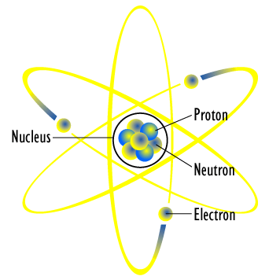

The Basics of Physics
Planetary Model of an Atom
The planetary model of the atom in which electrons are pictured as orbiting the nucleus, analogous to the way planets orbit the Sun
Free to share, print, make copies and changes. Get yours at www.boundless.com
Wikimedia. CC BY http://upload.wikimedia.org/wikipedia/commons/d/d8/Atom_diagram.png View on Boundless.com

Slide 13
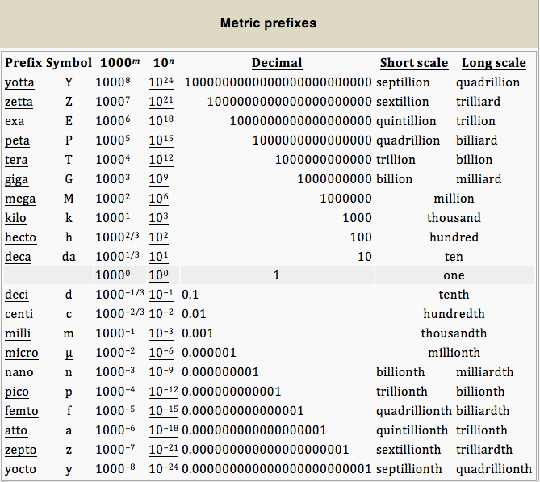
The Basics of Physics
SI Unit Prefixes
The twenty prefixes officially specified by the International System of Units
Free to share, print, make copies and changes. Get yours at www.boundless.com
Wikipedia. "Metric prefix." CC BY http://en.wikipedia.org/wiki/Metric_prefix View on Boundless.com

Slide 14
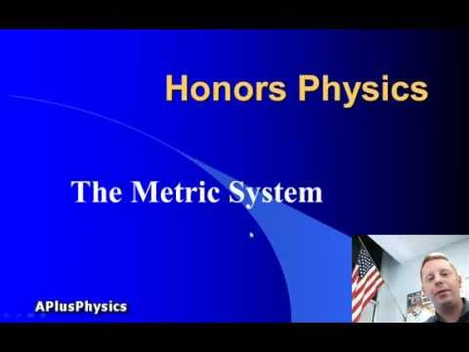
The Basics of Physics
Metric System - Prefixes
A brief introduction to the metric system and unit conversions.
Free to share, print, make copies and changes. Get yours at www.boundless.com
View on Boundless.com

Slide 15
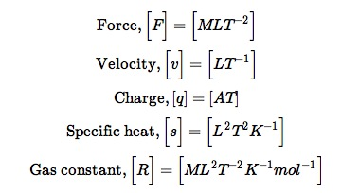
The Basics of Physics
Dimensional Quantities
Every physical quantity is some combination of the seven basic quantities.
Free to share, print, make copies and changes. Get yours at www.boundless.com
OpenStax CNX. "Sunil Kumar Singh, Dimensional Analysis. February 13, 2013." CC BY 3.0 http://cnx.org/content/m15037/latest/ View on Boundless.com

Slide 16
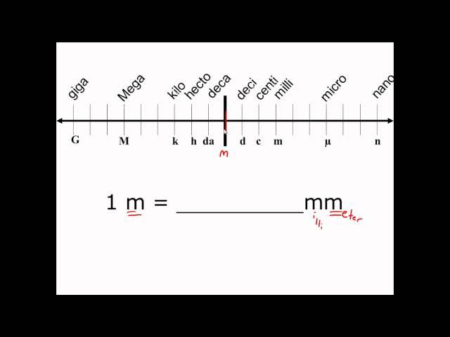
The Basics of Physics
Unit Conversion in the Metric System
EASY Unit Conversion in the Metric System - This simple extra help video tutorial explains the metric system and how to make simple metric conversions.
Free to share, print, make copies and changes. Get yours at www.boundless.com
View on Boundless.com

Slide 17
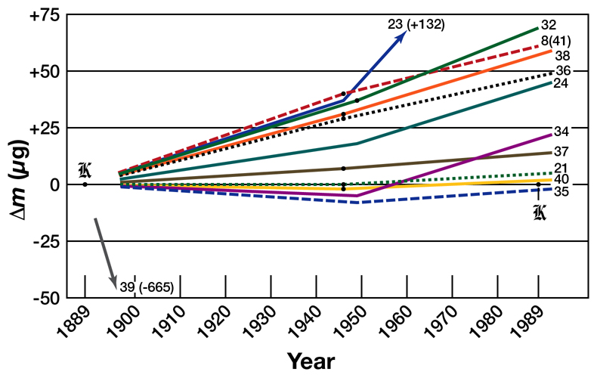
The Basics of Physics
Prototype Mass Drifts
A graph of the relative change in mass of selected kilogram prototypes.
Free to share, print, make copies and changes. Get yours at www.boundless.com
Wikipedia. "Prototype mass drifts." GNU FDL http://en.wikipedia.org/wiki/File:Prototype_mass_drifts.jpg View on Boundless.com

Slide 18
The Basics of Physics
What is Physics?
Mr. Andersen explains the importance of physics as a science. History and virtual examples are used to give the discipline context.
Free to share, print, make copies and changes. Get yours at www.boundless.com
View on Boundless.com

Slide 19
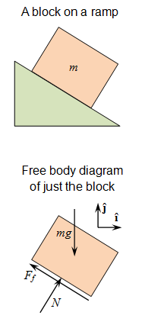
The Basics of Physics
Free Body Diagram
Use this figure to work through the example problem.
Free to share, print, make copies and changes. Get yours at www.boundless.com
Wikipedia. "Free Body Diagram." CC BY-SA http://en.wikipedia.org/wiki/File:Free_Body_Diagram.png View on Boundless.com

Slide 20
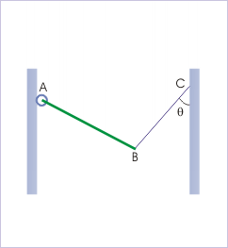
The Basics of Physics
Free Body Diagram
The rod is hinged from a wall and is held with the help of a string.
Free to share, print, make copies and changes. Get yours at www.boundless.com
OpenStax CNX. "Sunil Kumar Singh, Free Body Diagram (Application). February 16, 2013." CC BY 3.0 http://cnx.org/content/m14720/latest/ View on Boundless.com

Slide 21
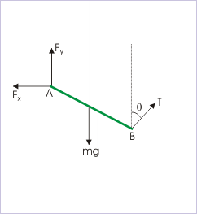
The Basics of Physics
Free Body Diagram
The free body diagram as a finished product
Free to share, print, make copies and changes. Get yours at www.boundless.com
OpenStax CNX. "Sunil Kumar Singh, Free Body Diagram (Application). February 16, 2013." CC BY 3.0 http://cnx.org/content/m14720/latest/ View on Boundless.com

Slide 22
The Basics of Physics
Metric System - Mass
A brief introduction to the metric system and unit conversions.
Free to share, print, make copies and changes. Get yours at www.boundless.com
View on Boundless.com

Slide 23
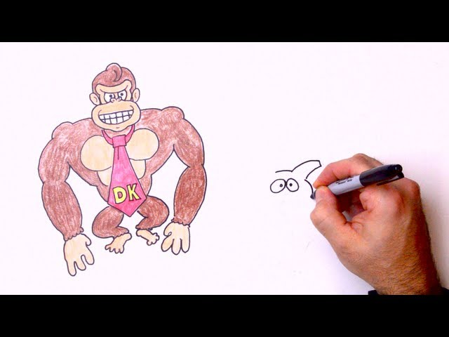
The Basics of Physics
How To Solve Any Physics Problem
Learn five simple steps in five minutes! In this episode we cover the most effective problem-solving method I've encountered and call upon some fuzzy friends to help us remember the steps.
Free to share, print, make copies and changes. Get yours at www.boundless.com
View on Boundless.com

Slide 24

The Basics of Physics
Converting 1 year into seconds using the Factor-Label Method
Physically crossing out units that cancel out helps visualize the "leftover" unit(s).
Free to share, print, make copies and changes. Get yours at www.boundless.com
Light and Matter. CC BY http://lightandmatter.com/lma.pdf View on Boundless.com

Slide 25
The Basics of Physics
Metric System - Length
A brief introduction to the metric system and unit conversions.
Free to share, print, make copies and changes. Get yours at www.boundless.com
View on Boundless.com

Slide 26
The Basics of Physics
Meter Defined by Speed of Light
The meter is defined to be the distance that light travels in 1/299,792,458 of a second in a vacuum. Distance traveled is speed multiplied by time.
Free to share, print, make copies and changes. Get yours at www.boundless.com
OpenStax CNX. "OpenStax College, College Physics. October 10, 2012." CC BY 3.0 http://cnx.org/content/m42091/latest/?collection=col11406/1.7 View on Boundless.com

Slide 27
The Basics of Physics
Metric System - Time
A brief introduction to the metric system and unit conversions.
Free to share, print, make copies and changes. Get yours at www.boundless.com
View on Boundless.com

Slide 28
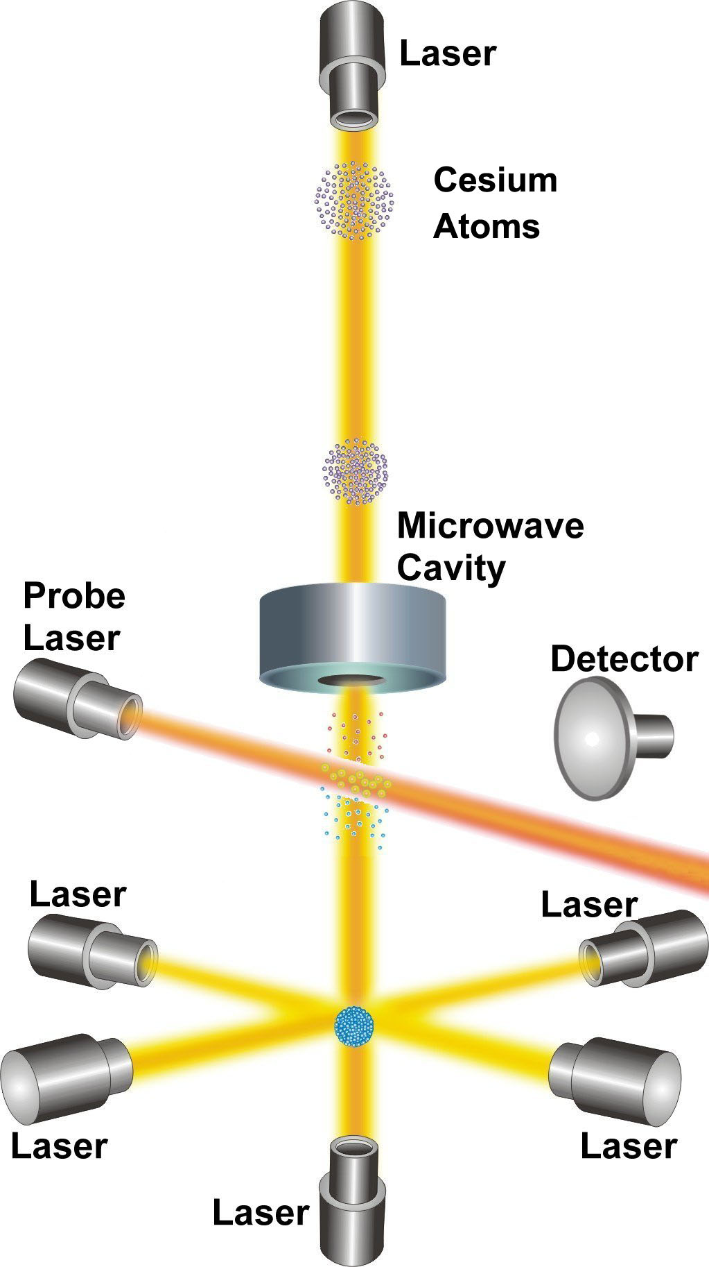
The Basics of Physics
NIST-F1 Cesium Clock
NIST-F1 is referred to as a fountain clock because it uses a fountain-like movement of atoms to obtain its improved reckoning of time.
Free to share, print, make copies and changes. Get yours at www.boundless.com
http://www.nist.gov/public_affairs/releases/n99-22.cfm. "NIST-F1 Cesium Fountain Clock." CC BY http://www.nist.gov/public_affairs/releases/n99-22.cfm View on Boundless.com

Slide 29
The Basics of Physics
Scientific Notation
There are three parts to writing a number in scientific notation: the coefficient, the base, and the exponent.
Free to share, print, make copies and changes. Get yours at www.boundless.com
http://www.thechembook.com/chemistry/index.php/Scientific_notation. CC BY http://www.thechembook.com/chemistry/index.php/Scientific_notation View on Boundless.com

Slide 30

The Basics of Physics
Guessing the Number of Jelly Beans
Can you guess how many jelly beans are in the jar? If you try to guess directly, you will almost certainly underestimate. The right way to do it is to estimate the linear dimensions and then estimate the volume indirectly.
Free to share, print, make copies and changes. Get yours at www.boundless.com
Light and Matter. CC BY http://lightandmatter.com/lmb.pdf View on Boundless.com

Slide 31
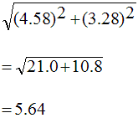
The Basics of Physics
Round-off Error
Rounding these numbers off to one decimal place or to the nearest whole number would change the answer to 5.7 and 6, respectively. The more rounding off that is done, the more errors are introduced.
Free to share, print, make copies and changes. Get yours at www.boundless.com
Amazon Web Services. "Boundless." CC BY-SA 3.0 http://s3.amazonaws.com/figures.boundless.com/507f7290e4b0423da53f9927/ROE.png View on Boundless.com

Slide 32
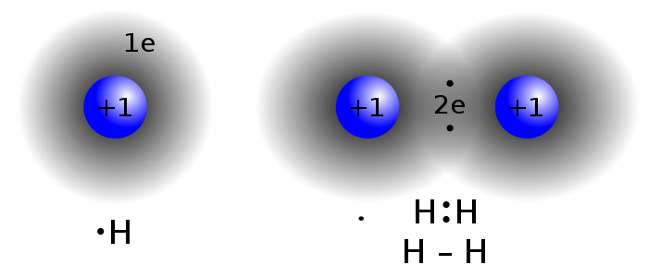
The Basics of Physics
Physics in Chemistry
The study of matter and electricity in physics is fundamental towards the understanding of concepts in chemistry, such as the covalent bond.
Free to share, print, make copies and changes. Get yours at www.boundless.com
Wikipedia. "Covalent bond." CC BY http://en.wikipedia.org/wiki/Covalent_bond View on Boundless.com

Slide 33
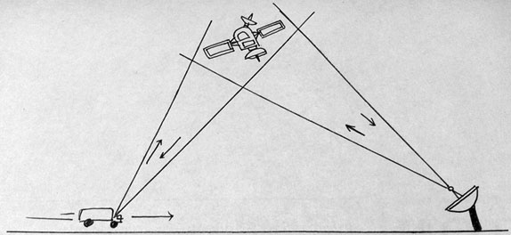
The Basics of Physics
Global Positioning System
GPS calculates the speed of an object, the distance over which it travels, and the time it takes to travel that distance using equations based on the laws of physics.
Free to share, print, make copies and changes. Get yours at www.boundless.com
Amazon Web Services. "Boundless." CC BY-SA 3.0 http://s3.amazonaws.com/figures.boundless.com/5078e0f6e4b04e6a3fb83a94/gps.jpg View on Boundless.com

Slide 34
Attribution
The Basics of Physics
Boundless Learning. "Boundless." CC BY-SA 3.0 http://www.boundless.com//physics/definition/radiation
Wikipedia. "Second." CC BY-SA 3.0 http://en.wikipedia.org/wiki/Second
OpenStax CNX. "OpenStax College, College Physics. September 17, 2013." CC BY 3.0 http://cnx.org/content/m42091/latest/?collection=col11406/1.7
Boundless Learning. "Boundless." CC BY-SA 3.0 http://www.boundless.com//physics/definition/application
Light and Matter. CC BY http://lightandmatter.com/lma.pdf
OpenStax CNX. "OpenStax College, College Physics. September 17, 2013." CC BY 3.0 http://cnx.org/content/m42092/latest/?collection=col11406/1.7
Wiktionary. "inertia." CC BY-SA 3.0 http://en.wiktionary.org/wiki/inertia
Wiktionary. "acceleration." CC BY-SA 3.0 http://en.wiktionary.org/wiki/acceleration
Wikipedia. "Mass." CC BY-SA 3.0 http://en.wikipedia.org/wiki/Mass
Wikipedia. "Kilogram." CC BY-SA 3.0 http://en.wikipedia.org/wiki/Kilogram
OpenStax CNX. "OpenStax College, College Physics. September 17, 2013." CC BY 3.0 http://cnx.org/content/m42091/latest/?collection=col11406/1.7
Wiktionary. "scientific method." CC BY-SA 3.0 http://en.wiktionary.org/wiki/scientific_method
Wiktionary. "matter." CC BY-SA 3.0 http://en.wiktionary.org/wiki/matter
Wikipedia. "Physics." CC BY-SA 3.0 http://en.wikipedia.org/wiki/Physics
OpenStax CNX. "OpenStax College, College Physics. September 17, 2013." CC BY 3.0 http://cnx.org/content/m42092/latest/?collection=col11406/1.7
Wikipedia. "Matter." CC BY-SA 3.0 http://en.wikipedia.org/wiki/Matter
Light and Matter. CC BY http://lightandmatter.com/lma.pdf
Free to share, print, make copies and changes. Get yours at www.boundless.com

Slide 35
The Basics of Physics
Wiktionary. "prefix." CC BY-SA 3.0 http://en.wiktionary.org/wiki/prefix
Wikipedia. "SI Unit Prefixes." CC BY-SA 3.0 http://en.wikipedia.org/wiki/SI_Unit_Prefixes
OpenStax CNX. "OpenStax College, College Physics. September 17, 2013." CC BY 3.0 http://cnx.org/content/m42091/latest/?collection=col11406/1.7
Wikipedia. "United States customary units." CC BY-SA 3.0 http://en.wikipedia.org/wiki/United_States_customary_units
Wiktionary. "approximation." CC BY-SA 3.0 http://en.wiktionary.org/wiki/approximation
Wikipedia. "Round-off error." CC BY-SA 3.0 http://en.wikipedia.org/wiki/Round-off_error
Boundless Learning. "Boundless." CC BY-SA 3.0 http://www.boundless.com//physics/definition/law
Wikipedia. "theory." CC BY-SA 3.0 http://en.wikipedia.org/wiki/theory
Boundless Learning. "Boundless." CC BY-SA 3.0 http://www.boundless.com//physics/definition/model
OpenStax CNX. "OpenStax College, College Physics. September 17, 2013." CC BY 3.0 http://cnx.org/content/m42092/latest/?collection=col11406/1.7
Wikipedia. "Order of Magnitude." CC BY-SA 3.0 http://en.wikipedia.org/wiki/Order%20of%20Magnitude
Wikipedia. "Order of magnitude." CC BY-SA 3.0 http://en.wikipedia.org/wiki/Order_of_magnitude
Light and Matter. CC BY http://lightandmatter.com/lmb.pdf
Wikipedia. "Length." CC BY-SA 3.0 http://en.wikipedia.org/wiki/Length
OpenStax CNX. "OpenStax College, College Physics. September 17, 2013." CC BY 3.0 http://cnx.org/content/m42091/latest/?collection=col11406/1.7
Wikipedia. "Unit of length." CC BY-SA 3.0 http://en.wikipedia.org/wiki/Unit_of_length
Wiktionary. "exponent." CC BY-SA 3.0 http://en.wiktionary.org/wiki/exponent
Wikipedia. "Scientific notation." CC BY-SA 3.0 http://en.wikipedia.org/wiki/Scientific%20notation
OpenStax CNX. "OpenStax College, College Physics. September 17, 2013." CC BY 3.0 http://cnx.org/content/m42120/latest/?collection=col11406/1.7
Free to share, print, make copies and changes. Get yours at www.boundless.com

Slide 36
The Basics of Physics
Light and Matter. CC BY http://lightandmatter.com/lma.pdf
Wikipedia. "Scientific notation." CC BY-SA 3.0 http://en.wikipedia.org/wiki/Scientific_notation
Wikipedia. "Significant figures." CC BY-SA 3.0 http://en.wikipedia.org/wiki/Significant_figures
Wiktionary. "trigonometry." CC BY-SA 3.0 http://en.wiktionary.org/wiki/trigonometry
OpenStax CNX. "Sunil Kumar Singh, Free Body Diagram (Application). September 17, 2013." CC BY 3.0 http://cnx.org/content/m14720/latest/
Wiktionary. "dynamic." CC BY-SA 3.0 http://en.wiktionary.org/wiki/dynamic
Wiktionary. "static." CC BY-SA 3.0 http://en.wiktionary.org/wiki/static
Wikipedia. "Free body diagram." CC BY-SA 3.0 http://en.wikipedia.org/wiki/Free_body_diagram
Boundless Learning. "Boundless." CC BY-SA 3.0 http://www.boundless.com//physics/definition/conversion
OpenStax CNX. "OpenStax College, College Physics. September 17, 2013." CC BY 3.0 http://cnx.org/content/m42091/latest/?collection=col11406/1.7
Wikipedia. "Units conversion by factor-label." CC BY-SA 3.0 http://en.wikipedia.org/wiki/Units_conversion_by_factor-label
Wiktionary. "dimension." CC BY-SA 3.0 http://en.wiktionary.org/wiki/dimension
Wikipedia. "Dimensional analysis." CC BY-SA 3.0 http://en.wikipedia.org/wiki/Dimensional_analysis
OpenStax CNX. "Sunil Kumar Singh, Dimensional Analysis. September 18, 2013." CC BY 3.0 http://cnx.org/content/m15037/latest/
Free to share, print, make copies and changes. Get yours at www.boundless.com

