Slide 1


Boundless Lecture Slides
Available on the Boundless Teaching Platform
Free to share, print, make copies and changes. Get yours at www.boundless.com

Slide 2



Using Boundless Presentations
Boundless Teaching Platform
Boundless empowers educators to engage their students with affordable, customizable textbooks and intuitive teaching tools. The free Boundless Teaching Platform gives educators the ability to customize textbooks in more than 20 subjects that align to hundreds of popular titles. Get started by using high quality Boundless books, or make switching to our platform easier by building from Boundless content pre-organized to match the assigned textbook. This platform gives educators the tools they need to assign readings and assessments, monitor student activity, and lead their classes with pre-made teaching resources.
Get started now at:
The Appendix
The appendix is for you to use to add depth and breadth to your lectures. You can simply drag and drop slides from the appendix into the main presentation to make for a richer lecture experience.
http://boundless.com/teaching-platform
Free to edit, share, and copy
Feel free to edit, share, and make as many copies of the Boundless presentations as you like. We encourage you to take these presentations and make them your own.
If you have any questions or problems please email:
educators@boundless.com
Free to share, print, make copies and changes. Get yours at www.boundless.com

Slide 3

About Boundless
Boundless is an innovative technology company making education more affordable and accessible for students everywhere. The company creates the world’s best open educational content in 20+ subjects that align to more than 1,000 popular college textbooks. Boundless integrates learning technology into all its premium books to help students study more efficiently at a fraction of the cost of traditional textbooks. The company also empowers educators to engage their students more effectively through customizable books and intuitive teaching tools as part of the Boundless Teaching Platform. More than 2 million learners access Boundless free and premium content each month across the company’s wide distribution platforms, including its website, iOS apps, Kindle books, and iBooks. To get started learning or teaching with Boundless, visit boundless.com.
Free to share, print, make copies and changes. Get yours at www.boundless.com

Slide 4
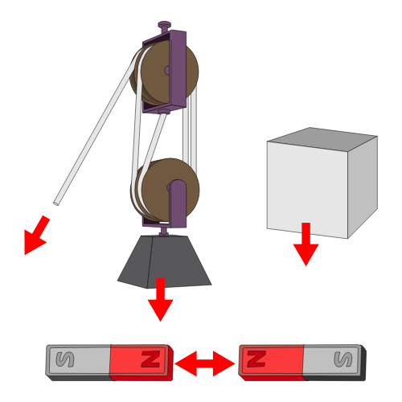
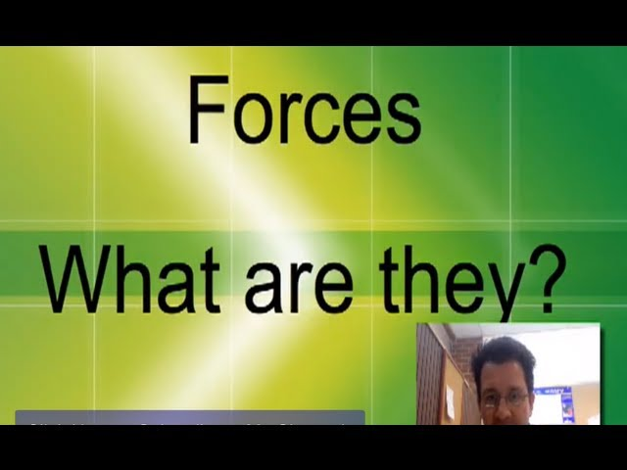
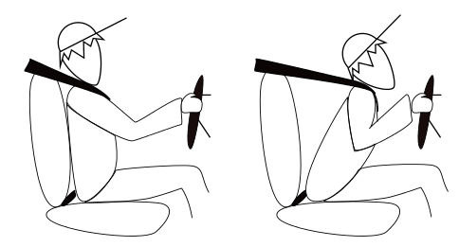
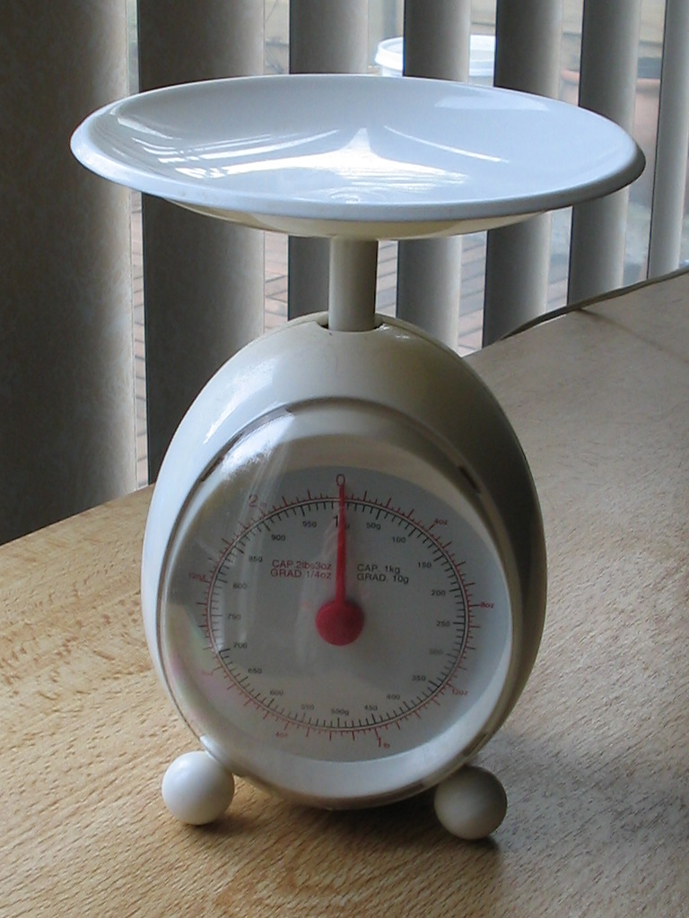
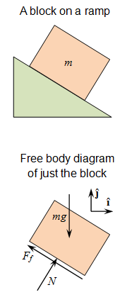

The Laws of Motion
Introduction
Force and Mass
Newton's Laws
Other Examples of Forces
]
Problem-Solving
The Laws of Motion
Free to share, print, make copies and changes. Get yours at www.boundless.com

Slide 5
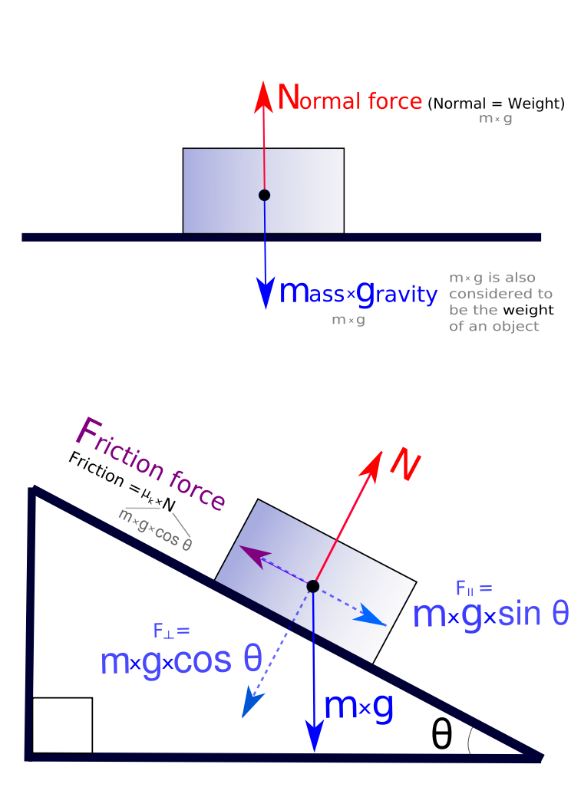
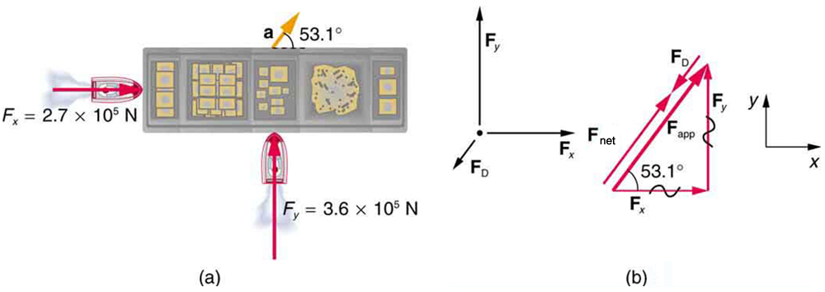
The Laws of Motion (continued)
Vector Nature of Forces
Further Applications of Newton's Laws
]
The Laws of Motion
Free to share, print, make copies and changes. Get yours at www.boundless.com

Slide 6

Introduction
The Laws of Motion > Introduction
Newton and His Laws
Free to share, print, make copies and changes. Get yours at www.boundless.com
www.boundless.com/physics/textbooks/boundless-physics-textbook/the-laws-of-motion-4/introduction-44/

Slide 7
Force and Mass
The Laws of Motion > Force and Mass
Force
Mass
Free to share, print, make copies and changes. Get yours at www.boundless.com
www.boundless.com/physics/textbooks/boundless-physics-textbook/the-laws-of-motion-4/force-and-mass-45/

Slide 8
Newton's Laws
The Laws of Motion > Newton's Laws
The First Law: Inertia
The Second Law: Force and Acceleration
The Third Law: Symmetry in Forces
Free to share, print, make copies and changes. Get yours at www.boundless.com
www.boundless.com/physics/textbooks/boundless-physics-textbook/the-laws-of-motion-4/newton-s-laws-46/

Slide 9
Other Examples of Forces
The Laws of Motion > Other Examples of Forces
Weight
Normal Forces
Free to share, print, make copies and changes. Get yours at www.boundless.com
www.boundless.com/physics/textbooks/boundless-physics-textbook/the-laws-of-motion-4/other-examples-of-forces-47/

Slide 10
Problem-Solving
The Laws of Motion > Problem-Solving
A General Approach
Free to share, print, make copies and changes. Get yours at www.boundless.com
www.boundless.com/physics/textbooks/boundless-physics-textbook/the-laws-of-motion-4/problem-solving-48/

Slide 11
Vector Nature of Forces
The Laws of Motion > Vector Nature of Forces
Forces in Two Dimensions
Free to share, print, make copies and changes. Get yours at www.boundless.com
www.boundless.com/physics/textbooks/boundless-physics-textbook/the-laws-of-motion-4/vector-nature-of-forces-49/

Slide 12
Further Applications of Newton's Laws
The Laws of Motion > Further Applications of Newton's Laws
Applications of Newton's Laws
Friction: Kinetic
Friction: Static
Problem-Solving With Friction and Inclines
Drag
Stress and Strain
Translational Equilibrium
Connected Objects
Circular Motion
Free to share, print, make copies and changes. Get yours at www.boundless.com
www.boundless.com/physics/textbooks/boundless-physics-textbook/the-laws-of-motion-4/further-applications-of-newton-s-laws-50/

Slide 13
Appendix
Free to share, print, make copies and changes. Get yours at www.boundless.com

Slide 14
Key terms
The Laws of Motion
acceleration The amount by which a speed or velocity increases (and so a scalar quantity or a vector quantity).
dynamic Changing; active; in motion.
equation An assertion that two expressions are equal, expressed by writing the two expressions separated by an equal sign; from which one is to determine a particular quantity.
equilibrium The state of a body at rest or in uniform motion, the resultant of all forces on which is zero.
fluid Any substance which can flow with relative ease, tends to assume the shape of its container, and obeys Bernoulli's principle; a liquid, gas or plasma.
force A force is any influence that causes an object to undergo a certain change, either concerning its movement, direction or geometrical construction.
force Any influence that causes an object to undergo a certain change, either concerning its movement, direction or geometrical construction.
free-body diagram A free body diagram, also called a force diagram, is a pictorial representation often used by physicists and engineers to analyze the forces acting on a body of interest.
friction A force that resists the relative motion or tendency to such motion of two bodies in contact.
friction A force that resists the relative motion or tendency to such motion of two bodies in contact.
friction A force that resists the relative motion or tendency to such motion of two bodies in contact.
Gravitational acceleration Gravitational acceleration is the acceleration that an object undergoes due solely to gravity
Free to share, print, make copies and changes. Get yours at www.boundless.com

Slide 15
The Laws of Motion
incline A slope.
inertia The property of a body that resists any change to its uniform motion; equivalent to its mass.
kinetic Of or relating to motion
kinetic energy The energy possessed by an object because of its motion, equal to one half the mass of the body times the square of its velocity.
kinetic energy The energy possessed by an object because of its motion, equal to one half the mass of the body times the square of its velocity.
mass The quantity of matter which a body contains, irrespective of its bulk or volume. It is one of four fundamental properties of matter. It is measured in kilograms in the SI system of measurement.
momentum (of a body in motion) the product of its mass and velocity.
net force The combination of all the forces that act on an object.
normal A line or vector that is perpendicular to another line, surface, or plane.
perpendicular at or forming a right angle (to).
perpendicular at or forming a right angle (to).
resultant A vector that is the vector sum of multiple vectors
Free to share, print, make copies and changes. Get yours at www.boundless.com

Slide 16
The Laws of Motion
rigid Stiff, rather than flexible.
static Fixed in place; having no motion.
static Fixed in place; having no motion.
strain The amount by which a material deforms under stress or force, given as a ratio of the deformation to the initial dimension of the material and typically symbolized by is termed the engineering strain. The true strain is defined as the natural logarithm of the ratio of the final dimension to the initial dimension.
stress The internal distribution of force per unit area (pressure) within a body reacting to applied forces which causes strain or deformation and is typically symbolized by .
symmetry Exact correspondence on either side of a dividing line, plane, center or axis.
tangent a straight line touching a curve at a single point without crossing it at that point
thrust The force generated by propulsion, as in a jet engine.
torque A rotational or twisting effect of a force; (SI unit newton-meter or Nm; imperial unit foot-pound or ft-lb)
uniform motion Motion at a constant velocity (with zero acceleration). Note that an object in motion will not change its velocity unless an unbalanced force acts upon it.
vector A directed quantity, one with both magnitude and direction; the between two points.
vector A directed quantity, one with both magnitude and direction; the between two points.
Free to share, print, make copies and changes. Get yours at www.boundless.com

Slide 17
The Laws of Motion
velocity A vector quantity that denotes the rate of change of position with respect to time, or a speed with a directional component.
Free to share, print, make copies and changes. Get yours at www.boundless.com

Slide 18
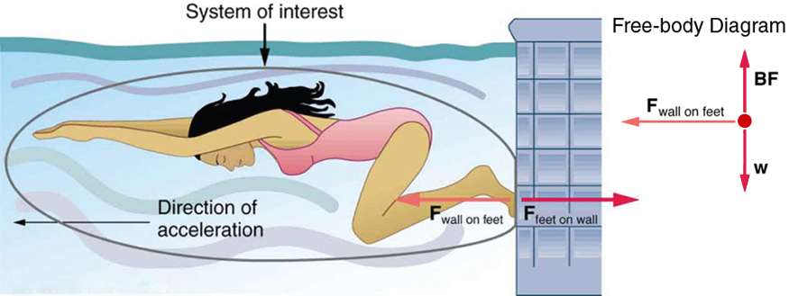

The Laws of Motion
Newton's Third Law of Motion
When a swimmer pushes off the wall, the swimmer is using the third law of motion.
Free to share, print, make copies and changes. Get yours at www.boundless.com
OpenStax CNX. "OpenStax College, Newton’s Third Law of Motion: Symmetry in Forces. January 25, 2013." CC BY 3.0 http://cnx.org/content/m42074/latest/ View on Boundless.com

Slide 19
The Laws of Motion
Forces as Vectors
Free-body diagrams of an object on a flat surface and an inclined plane. Forces are resolved and added together to determine their magnitudes and the net force.
Free to share, print, make copies and changes. Get yours at www.boundless.com
Wikipedia. "File:Freebodydiagram3 pn.svg - Wikipedia, the free encyclopedia." CC BY-SA http://en.wikipedia.org/w/index.php?title=File:Freebodydiagram3_pn.svg&page=1 View on Boundless.com

Slide 20
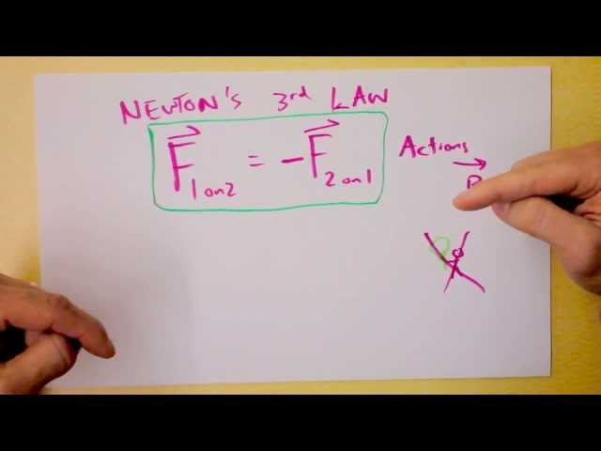
The Laws of Motion
Newton's Third Law
The most fundamental statement of basic physical reality is also the most often misunderstood. As your mom if she's clear on Newton's Third. Then ask her why things can move if every force has a paired opposite force all the time, forever.
Free to share, print, make copies and changes. Get yours at www.boundless.com
View on Boundless.com

Slide 21
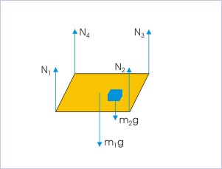
The Laws of Motion
Forces on a Table
These six forces are in equilibrium. The four forces of the table leg counteract the force of the table and the object pushing on them.
Free to share, print, make copies and changes. Get yours at www.boundless.com
OpenStax CNX. "Sunil Kumar Singh, Equilibrium. January 31, 2013." CC BY 3.0 http://cnx.org/content/m14870/latest/e1.gif View on Boundless.com

Slide 22
The Laws of Motion
Spring Scale
A spring scale measures weight by finding the extent to which a spring is compressed.This is proportional to the force that a mass exerts on the scale due to its weight.
Free to share, print, make copies and changes. Get yours at www.boundless.com
Wikipedia. "Weight." CC BY http://en.wikipedia.org/wiki/Weight View on Boundless.com

Slide 23
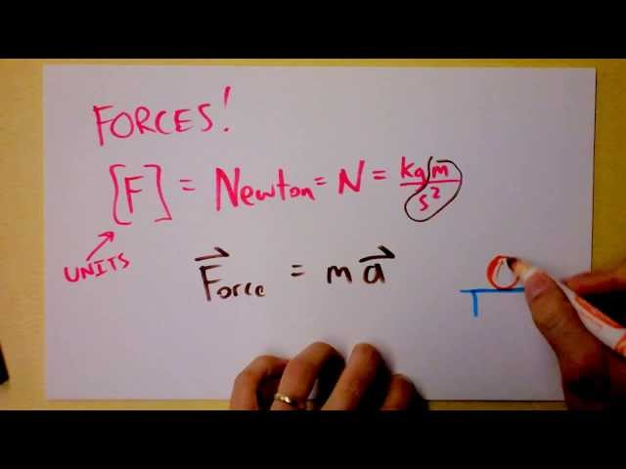
The Laws of Motion
Newton's Three Laws of Mechanics - Second Law - Part 1
Here we'll see how many people can confuse your understanding of Newton's 2nd law of motion through oversight, sloppy language, or cruel intentions.
Free to share, print, make copies and changes. Get yours at www.boundless.com
View on Boundless.com

Slide 24
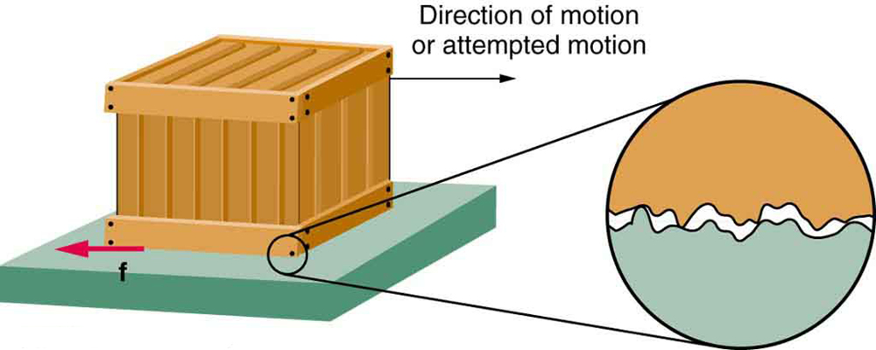
The Laws of Motion
Friction
Frictional forces always oppose motion or attempted motion between objects in contact. Friction arises in part because of the roughness of the surfaces in contact, as seen in the expanded view. In order for the object to move, it must rise to where the peaks can skip along the bottom surface. Thus, a force is required just to set the object in motion. Some of the peaks will be broken off, also requiring a force to maintain motion. Much of the friction is actually due to attractive forces between molecules making up the two objects, so that even perfectly smooth surfaces are not friction-free. Such adhesive forces also depend on the substances the surfaces are made of, explaining, for example, why rubber-soled shoes slip less than those with leather soles.
Free to share, print, make copies and changes. Get yours at www.boundless.com
OpenStax CNX. "OpenStax College, Friction. January 31, 2013." CC BY 3.0 http://cnx.org/content/m42139/latest/Figure_06_01_01a.jpg View on Boundless.com

Slide 25
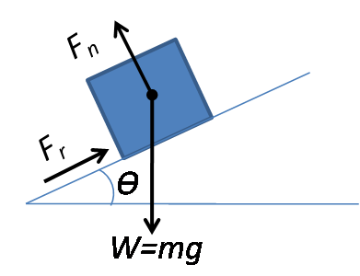
The Laws of Motion
Inclined Plane
A mass rests on an inclined plane that is at an angle to the horizontal. The following forces act on the mass: the weight of the mass (),the force due to friction (),and the normal force ().
Free to share, print, make copies and changes. Get yours at www.boundless.com
Wikipedia. "Normal force." CC BY http://en.wikipedia.org/wiki/Normal_force View on Boundless.com

Slide 26
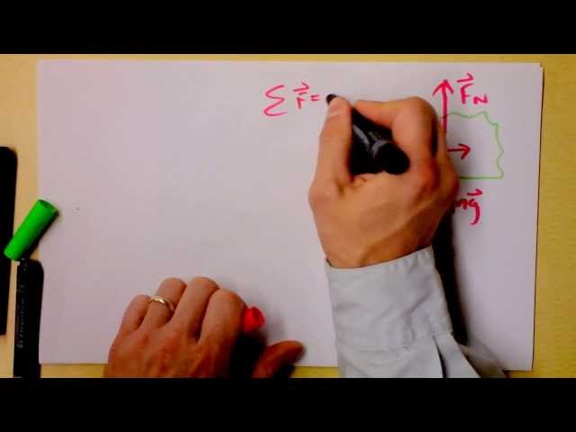
The Laws of Motion
Static Friction and some friction challenges
Here, I talk about sneaky ol' static friction.
Free to share, print, make copies and changes. Get yours at www.boundless.com
View on Boundless.com

Slide 27
The Laws of Motion
Examples of Force
Some situations in which forces are at play.
Free to share, print, make copies and changes. Get yours at www.boundless.com
Wikipedia. "File:Force examples.svg - Wikipedia, the free encyclopedia." CC BY-SA http://en.wikipedia.org/w/index.php?title=File:Force_examples.svg&page=1 View on Boundless.com

Slide 28
The Laws of Motion
Free body diagram
An example of a drawing to help identify forces and directions.
Free to share, print, make copies and changes. Get yours at www.boundless.com
Wikipedia. "Free body diagram." GNU FDL http://en.wikipedia.org/wiki/Free_body_diagram View on Boundless.com

Slide 29
The Laws of Motion
What is a force?
Describes what forces are and what they do.
Free to share, print, make copies and changes. Get yours at www.boundless.com
View on Boundless.com

Slide 30
The Laws of Motion
Examples of Force
Some situations in which forces are at play.
Free to share, print, make copies and changes. Get yours at www.boundless.com
Wikipedia. "File:Force examples.svg - Wikipedia, the free encyclopedia." CC BY-SA http://en.wikipedia.org/w/index.php?title=File:Force_examples.svg&page=1 View on Boundless.com

Slide 31
The Laws of Motion
Newton's First Law
Newton's first law in effect on the driver of a car
Free to share, print, make copies and changes. Get yours at www.boundless.com
OpenStax CNX. "Free High School Science Texts Project, Forces: Newton's First Law. January 18, 2013." CC BY 3.0 http://cnx.org/content/m38960/latest/ View on Boundless.com

Slide 32
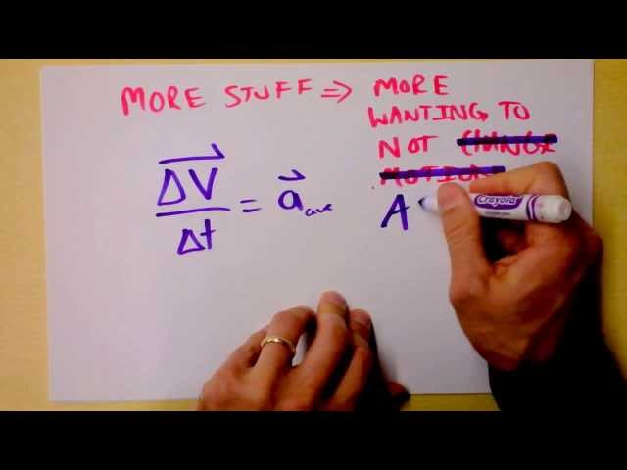
The Laws of Motion
Doc Physics - Newton
Newton's first law is hugely counterintuitive. You may have learned it in gradeschool, though. Let's see it for the mind-blowing conclusion it really is.
Free to share, print, make copies and changes. Get yours at www.boundless.com
View on Boundless.com

Slide 33
The Laws of Motion
Force and Mass
This animation demonstrates the connection between force and mass.
Free to share, print, make copies and changes. Get yours at www.boundless.com
Wikipedia. "Elastischer stoß3." CC BY-SA http://en.wikipedia.org/wiki/File:Elastischer_sto%C3%9F3.gif View on Boundless.com

Slide 34
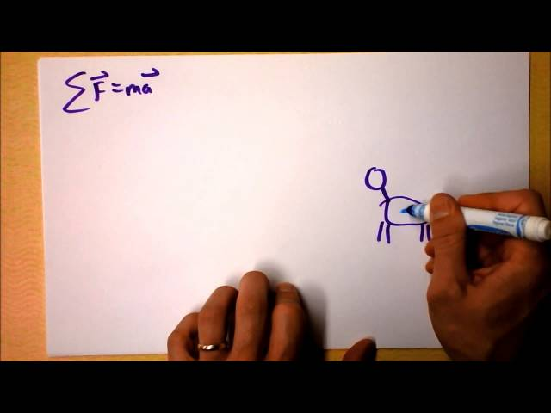
The Laws of Motion
Newton's Three Laws of Mechanics - Second Law - Part Two
Equilibrium is investigated and Newton's 1st law is seen as a special case of Newton's 2nd law!
Free to share, print, make copies and changes. Get yours at www.boundless.com
View on Boundless.com

Slide 35
The Laws of Motion
Drag Force on a Barge
(a) A view from above of two tugboats pushing on a barge. (b) The free-body diagram for the ship contains only forces acting in the plane of the water. It omits the two vertical forces—the weight of the barge and the buoyant force of the water supporting it cancel and are not shown. Since the applied forces are perpendicular, the - and -axes are in the same direction as and . The problem quickly becomes a one-dimensional problem along the direction of , since friction is in the direction opposite to .
Free to share, print, make copies and changes. Get yours at www.boundless.com
OpenStax CNX. "OpenStax College, Further Applications of Newton’s Laws of Motion. January 31, 2013." CC BY 3.0 http://cnx.org/content/m42132/latest/Figure_04_07_01.jpg View on Boundless.com

Slide 36
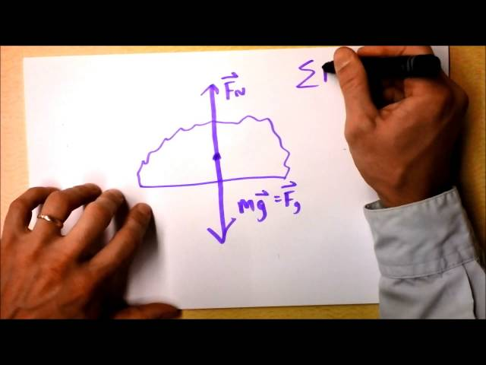
The Laws of Motion
Kinetic Friction Introduction
Here, I'll explain the microscopic justification of friction and what we can know about it. The coefficient of friction, too!
Free to share, print, make copies and changes. Get yours at www.boundless.com
View on Boundless.com

Slide 37
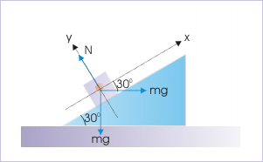
The Laws of Motion
Block and incline system
Forces on the block
Free to share, print, make copies and changes. Get yours at www.boundless.com
OpenStax CNX. "Sunil Kumar Singh, Motion on Accelerated Incline Plane (Application). March 19, 2013." CC BY 3.0 http://cnx.org/content/m14079/latest/ai15.gif View on Boundless.com

Slide 38
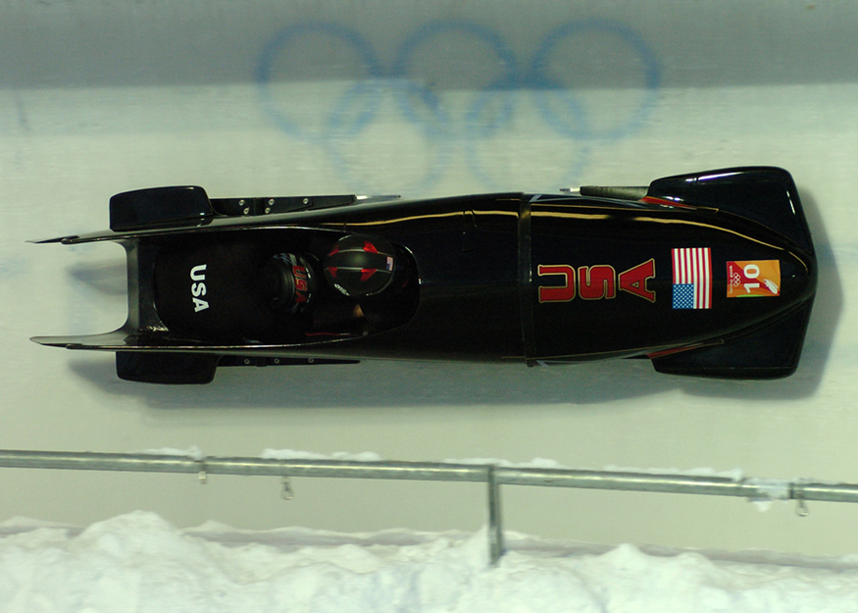
The Laws of Motion
Aerodynamic Shape
From racing cars to bobsled racers, aerodynamic shaping is crucial to achieving top speeds. Bobsleds are designed for speed. They are shaped like a bullet with tapered fins. (credit: U.S. Army, via Wikimedia Commons)
Free to share, print, make copies and changes. Get yours at www.boundless.com
OpenStax CNX. "OpenStax College, Drag Forces. January 31, 2013." CC BY 3.0 http://cnx.org/content/m42080/latest/Figure_06_02_02a.jpg View on Boundless.com

Slide 39
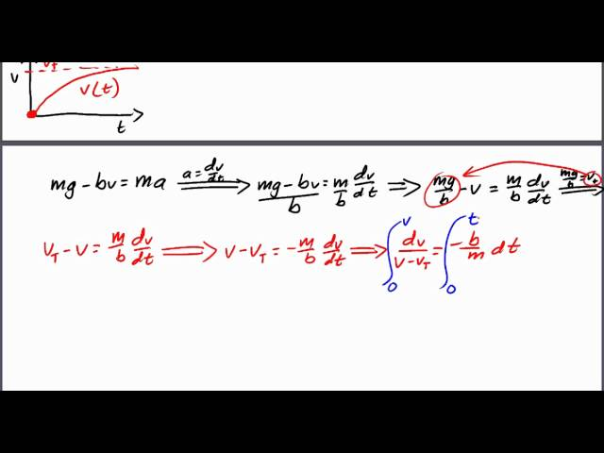
The Laws of Motion
Retarding and Drag Forces
A brief look at retarding (drag) forces in physics, for students in introductory physics classes that use calculus. This video walks through a single scenario of an object experiencing a drag force where the drag force is proportional to the object's velocity.
Free to share, print, make copies and changes. Get yours at www.boundless.com
View on Boundless.com

Slide 40
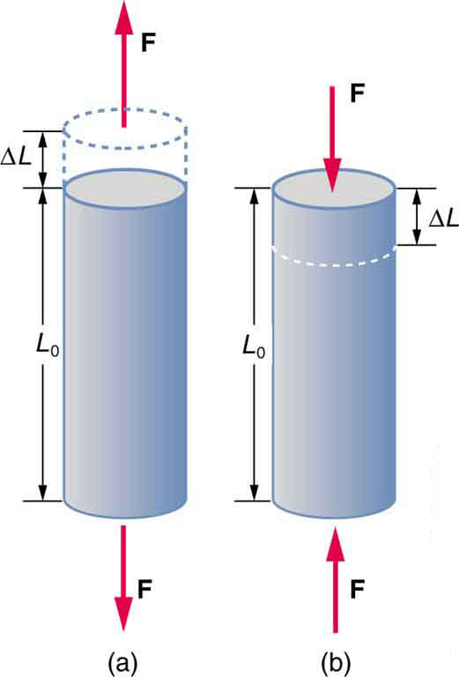
The Laws of Motion
Tension/Compression
Tension: The rod is stretched a length when a force is applied parallel to its length. (b) Compression: The same rod is compressed by forces with the same magnitude in the opposite direction. For very small deformations and uniform materials, is approximately the same for the same magnitude of tension or compression. For larger deformations, the cross-sectional area changes as the rod is compressed or stretched.
Free to share, print, make copies and changes. Get yours at www.boundless.com
OpenStax CNX. "OpenStax College, Elasticity: Stress and Strain. January 31, 2013." CC BY 3.0 http://cnx.org/content/m42081/latest/Figure_06_03_03a.jpg View on Boundless.com

Slide 41
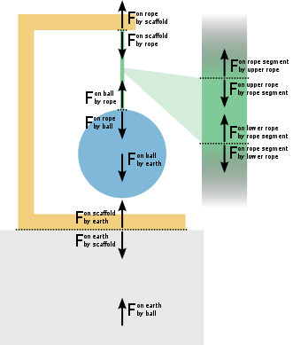
The Laws of Motion
Tension Forces
The forces involved in supporting a ball by a rope. Tension is the force of the rope on the scaffold, the force of the rope on the ball, and the balanced forces acting on and produced by segments of the rope.
Free to share, print, make copies and changes. Get yours at www.boundless.com
Wikipedia. "Tension (physics)." CC BY http://en.wikipedia.org/wiki/Tension_(physics) View on Boundless.com

Slide 42
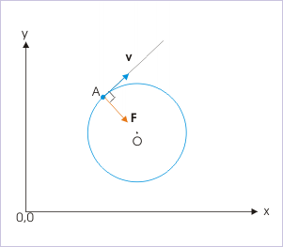
The Laws of Motion
Uniform Circular Motion
In uniform circular motion, the centripetal force is perpendicular to the velocity. The centripetal force points toward the center of the circle, keeping the object on the circular track.
Free to share, print, make copies and changes. Get yours at www.boundless.com
OpenStax CNX. "Sunil Kumar Singh, Uniform Circular Motion. January 31, 2013." CC BY 3.0 http://cnx.org/content/m13871/latest/ucm2.gif View on Boundless.com

Slide 43
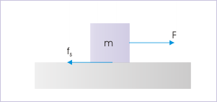
The Laws of Motion
Static Friction
To move a block at rest on a surface, a force must be applied which is great enough to overcome the force of static friction.
Free to share, print, make copies and changes. Get yours at www.boundless.com
OpenStax CNX. "Sunil Kumar Singh, Friction. January 31, 2013." CC BY 3.0 http://cnx.org/content/m14068/latest/f2.gif View on Boundless.com

Slide 44
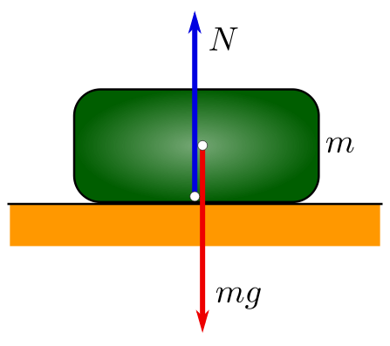
The Laws of Motion
Forces Acting on an Object at Rest
A force diagram showing the forces acting on an object at rest on a surface. Notice that the amount of force that the table is pushing upward on the object (the N vector) is equal to the downward force of the object's weight (shown here as mg, as weight is equal to the object's mass multiplied by the acceleration due to gravity): because these forces are equal, the object is in a state of equilibrium (all the forces acting on it balance to zero).
Free to share, print, make copies and changes. Get yours at www.boundless.com
Wikipedia. "Static equilibrium." CC BY http://en.wikipedia.org/wiki/Static_equilibrium View on Boundless.com

Slide 45
Attribution
The Laws of Motion
Wiktionary. "force." CC BY-SA 3.0 http://en.wiktionary.org/wiki/force
Wikipedia. "Newton's laws of motion." CC BY-SA 3.0 http://en.wikipedia.org/wiki/Newton's_laws_of_motion
Wiktionary. "friction." CC BY-SA 3.0 http://en.wiktionary.org/wiki/friction
Wiktionary. "static." CC BY-SA 3.0 http://en.wiktionary.org/wiki/static
Wiktionary. "kinetic." CC BY-SA 3.0 http://en.wiktionary.org/wiki/kinetic
Wikipedia. "Friction." CC BY-SA 3.0 http://en.wikipedia.org/wiki/Friction%23Static_friction
Wiktionary. "rigid." CC BY-SA 3.0 http://en.wiktionary.org/wiki/rigid
Wikipedia. "Tension (physics)." CC BY-SA 3.0 http://en.wikipedia.org/wiki/Tension_(physics)
Wiktionary. "friction." CC BY-SA 3.0 http://en.wiktionary.org/wiki/friction
Wiktionary. "incline." CC BY-SA 3.0 http://en.wiktionary.org/wiki/incline
Wiktionary. "equilibrium." CC BY-SA 3.0 http://en.wiktionary.org/wiki/equilibrium
OpenStax CNX. "Sunil Kumar Singh, Motion on Accelerated Incline Plane (Application). September 17, 2013." CC BY 3.0 http://cnx.org/content/m14079/latest/
OpenStax CNX. "Sunil Kumar Singh, Working with Friction (Application). September 17, 2013." CC BY 3.0 http://cnx.org/content/m14806/latest/
Wiktionary. "torque." CC BY-SA 3.0 http://en.wiktionary.org/wiki/torque
Wiktionary. "dynamic." CC BY-SA 3.0 http://en.wiktionary.org/wiki/dynamic
Wiktionary. "static." CC BY-SA 3.0 http://en.wiktionary.org/wiki/static
OpenStax CNX. "Sunil Kumar Singh, Equilibrium. September 17, 2013." CC BY 3.0 http://cnx.org/content/m14870/latest/
Free to share, print, make copies and changes. Get yours at www.boundless.com

Slide 46
The Laws of Motion
Wikipedia. "free-body diagram." CC BY-SA 3.0 http://en.wikipedia.org/wiki/free-body%20diagram
Wiktionary. "resultant." CC BY-SA 3.0 http://en.wiktionary.org/wiki/resultant
Wiktionary. "vector." CC BY-SA 3.0 http://en.wiktionary.org/wiki/vector
Wikipedia. "Net force." CC BY-SA 3.0 http://en.wikipedia.org/wiki/Net_force
Wikipedia. "Force." CC BY-SA 3.0 http://en.wikipedia.org/wiki/Force
OpenStax CNX. "OpenStax College, College Physics. September 17, 2013." CC BY 3.0 http://cnx.org/content/m42069/latest/?collection=col11406/1.7
OpenStax CNX. "Sunil Kumar Singh, Force. September 17, 2013." CC BY 3.0 http://cnx.org/content/m14040/latest/
Wiktionary. "vector." CC BY-SA 3.0 http://en.wiktionary.org/wiki/vector
Wiktionary. "velocity." CC BY-SA 3.0 http://en.wiktionary.org/wiki/velocity
Wiktionary. "force." CC BY-SA 3.0 http://en.wiktionary.org/wiki/force
OpenStax CNX. "OpenStax College, College Physics. September 17, 2013." CC BY 3.0 http://cnx.org/content/m42069/latest/?collection=col11406/latest
OpenStax CNX. "OpenStax College, College Physics. September 17, 2013." CC BY 3.0 http://cnx.org/content/m42069/latest/?collection=col11406/latest
Wikipedia. "Force." CC BY-SA 3.0 http://en.wikipedia.org/wiki/Force
Wikipedia. "Gravitational acceleration." CC BY-SA 3.0 http://en.wikipedia.org/wiki/Gravitational%20acceleration
Wikipedia. "Weight." CC BY-SA 3.0 http://en.wikipedia.org/wiki/Weight
Wiktionary. "fluid." CC BY-SA 3.0 http://en.wiktionary.org/wiki/fluid
Wikipedia. "Drag (physics)." CC BY-SA 3.0 http://en.wikipedia.org/wiki/Drag_(physics)
OpenStax CNX. "OpenStax College, Drag Forces. September 17, 2013." CC BY 3.0 http://cnx.org/content/m42080/latest/
Wikipedia. "perpendicular." CC BY-SA 3.0 http://en.wikipedia.org/wiki/perpendicular
Free to share, print, make copies and changes. Get yours at www.boundless.com

Slide 47
The Laws of Motion
Wiktionary. "tangent." CC BY-SA 3.0 http://en.wiktionary.org/wiki/tangent
OpenStax CNX. "Sunil Kumar Singh, Uniform Circular Motion. September 17, 2013." CC BY 3.0 http://cnx.org/content/m13871/latest/
Wikipedia. "kinetic energy." CC BY-SA 3.0 http://en.wikipedia.org/wiki/kinetic%20energy
Wikipedia. "Drag (physics)." CC BY-SA 3.0 http://en.wikipedia.org/wiki/Drag_(physics)
OpenStax CNX. "OpenStax College, Elasticity: Stress and Strain. September 17, 2013." CC BY 3.0 http://cnx.org/content/m42081/latest/
OpenStax CNX. "OpenStax College, Introduction: Further Applications of Newton’s Laws. September 17, 2013." CC BY 3.0 http://cnx.org/content/m42138/latest/
Wikipedia. "friction." CC BY-SA 3.0 http://en.wikipedia.org/wiki/friction
Wiktionary. "mass." CC BY-SA 3.0 http://en.wiktionary.org/wiki/mass
Wikibooks. "Special Relativity/Relativistic dynamics." CC BY-SA 3.0 http://en.wikibooks.org/wiki/Special_Relativity/Relativistic_dynamics%23Mass
Wikipedia. "Physical properties." CC BY-SA 3.0 http://en.wikipedia.org/wiki/Physical_properties
Wikipedia. "Mass." CC BY-SA 3.0 http://en.wikipedia.org/wiki/Mass
Wiktionary. "strain." CC BY-SA 3.0 http://en.wiktionary.org/wiki/strain
Wiktionary. "stress." CC BY-SA 3.0 http://en.wiktionary.org/wiki/stress
OpenStax CNX. "OpenStax College, Elasticity: Stress and Strain. September 17, 2013." CC BY 3.0 http://cnx.org/content/m42081/latest/
Wikipedia. "Deformation (engineering)." CC BY-SA 3.0 http://en.wikipedia.org/wiki/Deformation_(engineering)
Wiktionary. "equation." CC BY-SA 3.0 http://en.wiktionary.org/wiki/equation
OpenStax CNX. "OpenStax College, College Physics. September 17, 2013." CC BY 3.0 http://cnx.org/content/m42125/latest/?collection=col11406/latest
Wikipedia. "kinetic energy." CC BY-SA 3.0 http://en.wikipedia.org/wiki/kinetic%20energy
OpenStax CNX. "OpenStax College, Friction. September 17, 2013." CC BY 3.0 http://cnx.org/content/m42139/latest/
Free to share, print, make copies and changes. Get yours at www.boundless.com

Slide 48
The Laws of Motion
Wikipedia. "Friction." CC BY-SA 3.0 http://en.wikipedia.org/wiki/Friction
Wikipedia. "Friction." CC BY-SA 3.0 http://en.wikipedia.org/wiki/Friction%23Kinetic_friction
Wiktionary. "normal." CC BY-SA 3.0 http://en.wiktionary.org/wiki/normal
Wikipedia. "perpendicular." CC BY-SA 3.0 http://en.wikipedia.org/wiki/perpendicular
Wikipedia. "Newton's laws of motion." CC BY-SA 3.0 http://en.wikipedia.org/wiki/Newton's_laws_of_motion
Wikipedia. "Normal force." CC BY-SA 3.0 http://en.wikipedia.org/wiki/Normal_force
Wiktionary. "symmetry." CC BY-SA 3.0 http://en.wiktionary.org/wiki/symmetry
Wiktionary. "thrust." CC BY-SA 3.0 http://en.wiktionary.org/wiki/thrust
Wikipedia. "Newtons first law." CC BY-SA 3.0 http://en.wikipedia.org/wiki/Newtons_first_law
OpenStax CNX. "OpenStax College, Newton’s Third Law of Motion: Symmetry in Forces. September 17, 2013." CC BY 3.0 http://cnx.org/content/m42074/latest/
Wiktionary. "inertia." CC BY-SA 3.0 http://en.wiktionary.org/wiki/inertia
Wiktionary. "friction." CC BY-SA 3.0 http://en.wiktionary.org/wiki/friction
Wikipedia. "uniform motion." CC BY-SA 3.0 http://en.wikipedia.org/wiki/uniform%20motion
Wikipedia. "Newtons first law." CC BY-SA 3.0 http://en.wikipedia.org/wiki/Newtons_first_law
OpenStax CNX. "Free High School Science Texts Project, Forces: Newton's First Law. September 18, 2013." CC BY 3.0 http://cnx.org/content/m38960/latest/
OpenStax CNX. "OpenStax College, Newton’s First Law of Motion: Inertia. September 18, 2013." CC BY 3.0 http://cnx.org/content/m42130/latest/
Wiktionary. "net force." CC BY-SA 3.0 http://en.wiktionary.org/wiki/net_force
Wiktionary. "momentum." CC BY-SA 3.0 http://en.wiktionary.org/wiki/momentum
Wiktionary. "acceleration." CC BY-SA 3.0 http://en.wiktionary.org/wiki/acceleration
Free to share, print, make copies and changes. Get yours at www.boundless.com

Slide 49
The Laws of Motion
Wikipedia. "Newtons first law." CC BY-SA 3.0 http://en.wikipedia.org/wiki/Newtons_first_law
OpenStax CNX. "Sunil Kumar Singh, Newton's Second Law of Motion. September 18, 2013." CC BY 3.0 http://cnx.org/content/m14042/latest/
Free to share, print, make copies and changes. Get yours at www.boundless.com

