Slide 1


Boundless Lecture Slides
Available on the Boundless Teaching Platform
Free to share, print, make copies and changes. Get yours at www.boundless.com

Slide 2



Using Boundless Presentations
Boundless Teaching Platform
Boundless empowers educators to engage their students with affordable, customizable textbooks and intuitive teaching tools. The free Boundless Teaching Platform gives educators the ability to customize textbooks in more than 20 subjects that align to hundreds of popular titles. Get started by using high quality Boundless books, or make switching to our platform easier by building from Boundless content pre-organized to match the assigned textbook. This platform gives educators the tools they need to assign readings and assessments, monitor student activity, and lead their classes with pre-made teaching resources.
Get started now at:
The Appendix
The appendix is for you to use to add depth and breadth to your lectures. You can simply drag and drop slides from the appendix into the main presentation to make for a richer lecture experience.
http://boundless.com/teaching-platform
Free to edit, share, and copy
Feel free to edit, share, and make as many copies of the Boundless presentations as you like. We encourage you to take these presentations and make them your own.
If you have any questions or problems please email:
educators@boundless.com
Free to share, print, make copies and changes. Get yours at www.boundless.com

Slide 3

About Boundless
Boundless is an innovative technology company making education more affordable and accessible for students everywhere. The company creates the world’s best open educational content in 20+ subjects that align to more than 1,000 popular college textbooks. Boundless integrates learning technology into all its premium books to help students study more efficiently at a fraction of the cost of traditional textbooks. The company also empowers educators to engage their students more effectively through customizable books and intuitive teaching tools as part of the Boundless Teaching Platform. More than 2 million learners access Boundless free and premium content each month across the company’s wide distribution platforms, including its website, iOS apps, Kindle books, and iBooks. To get started learning or teaching with Boundless, visit boundless.com.
Free to share, print, make copies and changes. Get yours at www.boundless.com

Slide 4
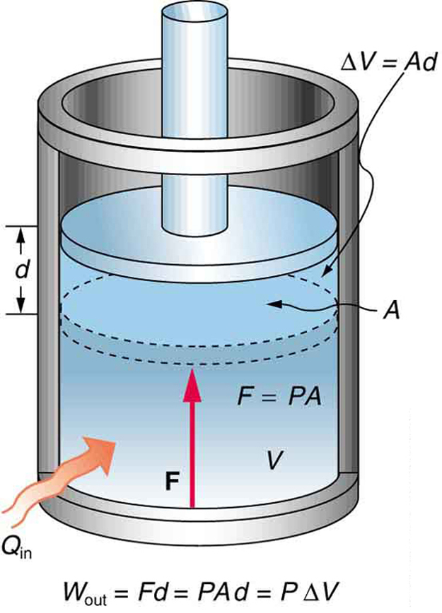
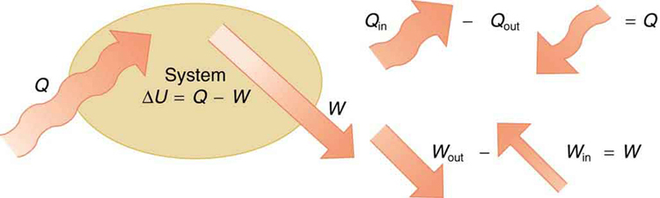
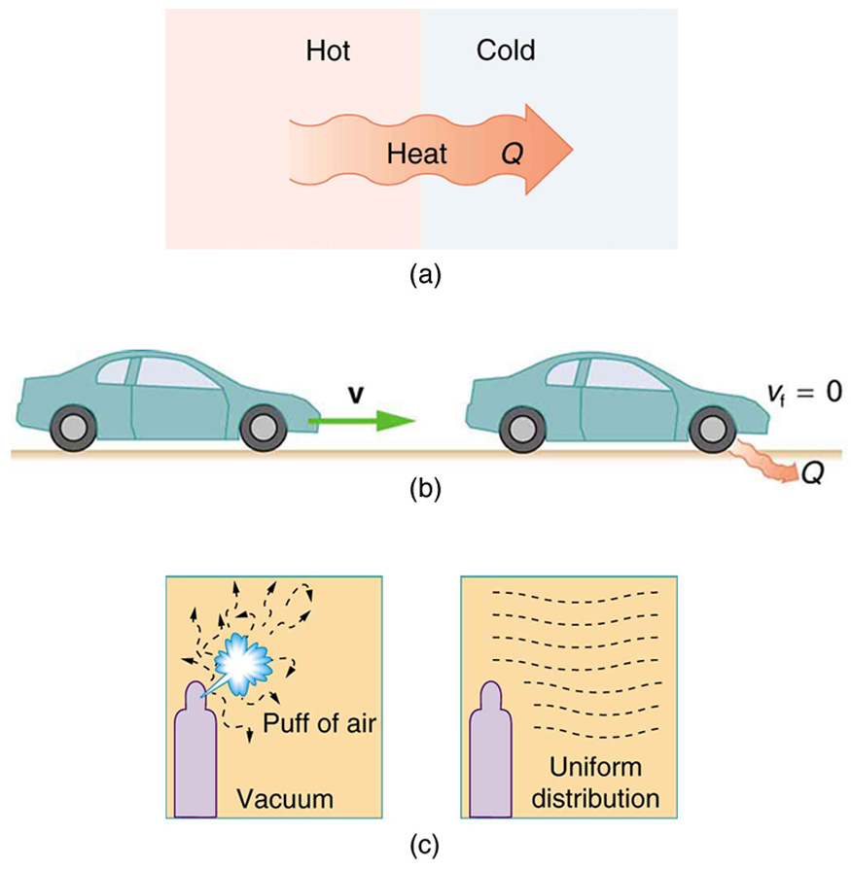
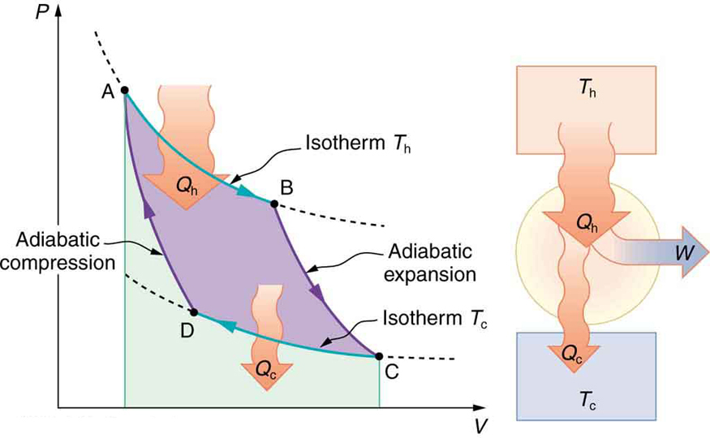
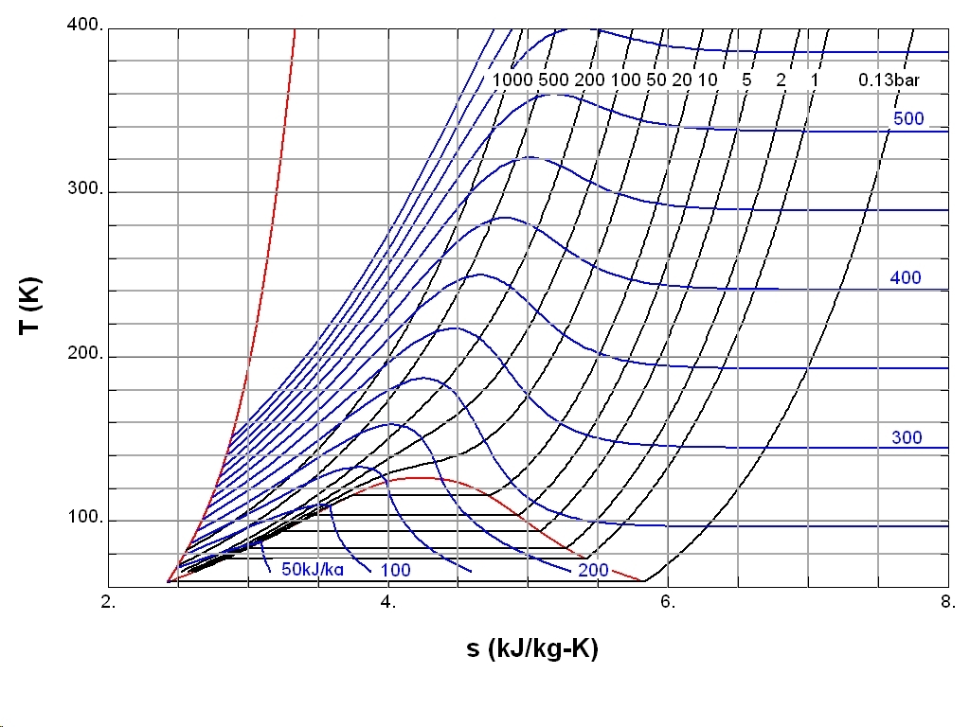

Thermodynamics
Introduction
The First Law of Thermodynamics
The Second Law of Thermodynamics
Entropy
]
The Third Law of Thermodynamics
Thermodynamics
Free to share, print, make copies and changes. Get yours at www.boundless.com

Slide 5

Introduction
Thermodynamics > Introduction
Work
A Review of the Zeroth Law
Free to share, print, make copies and changes. Get yours at www.boundless.com
www.boundless.com/physics/textbooks/boundless-physics-textbook/thermodynamics-14/introduction-116/

Slide 6
The First Law of Thermodynamics
Thermodynamics > The First Law of Thermodynamics
The First Law
Constant Pressure and Volume
Isothermal Processes
Adiabatic Processes
Human Metabolism
Free to share, print, make copies and changes. Get yours at www.boundless.com
www.boundless.com/physics/textbooks/boundless-physics-textbook/thermodynamics-14/the-first-law-of-thermodynamics-117/

Slide 7
The Second Law of Thermodynamics
Thermodynamics > The Second Law of Thermodynamics
The Second Law
Heat Engines
Carnot Cycles
Heat Pumps and Refrigerators
Free to share, print, make copies and changes. Get yours at www.boundless.com
www.boundless.com/physics/textbooks/boundless-physics-textbook/thermodynamics-14/the-second-law-of-thermodynamics-118/

Slide 8
Entropy
Thermodynamics > Entropy
What is Entropy?
Stastical Interpretation of Entropy
Order to Disorder
Heat Death
Living Systems and Evolution
Global Warming Revisited
Thermal Pollution
Free to share, print, make copies and changes. Get yours at www.boundless.com
www.boundless.com/physics/textbooks/boundless-physics-textbook/thermodynamics-14/entropy-119/

Slide 9
The Third Law of Thermodynamics
Thermodynamics > The Third Law of Thermodynamics
The Third Law
Adiabatic Processes
Free to share, print, make copies and changes. Get yours at www.boundless.com
www.boundless.com/physics/textbooks/boundless-physics-textbook/thermodynamics-14/the-third-law-of-thermodynamics-120/

Slide 10
Appendix
Free to share, print, make copies and changes. Get yours at www.boundless.com

Slide 11
Key terms
Thermodynamics
absolute zero The coldest possible temperature: zero on the Kelvin scale and approximately -273.15°C and -459.67°F. The total absence of heat; the temperature at which motion of all molecules would cease.
absolute zero The coldest possible temperature: zero on the Kelvin scale and approximately -273.15°C and -459.67°F. The total absence of heat; the temperature at which motion of all molecules would cease.
absolute zero The coldest possible temperature: zero on the Kelvin scale and approximately -273.15°C and -459.67°F. The total absence of heat; the temperature at which motion of all molecules would cease.
asteroid A naturally occurring solid object, which is smaller than a planet and is not a comet, that orbits a star.
Boyle's law The observation that the pressure of an ideal gas is inversely proportional to its volume at constant temperature.
Boyle's law The observation that the pressure of an ideal gas is inversely proportional to its volume at constant temperature.
calorie The energy needed to increase the temperature of 1 kilogram of water by 1 kelvin. It is equivalent to 1,000 (small) calories.
Carnot cycle A theoretical thermodynamic cycle. It is the most efficient cycle for converting a given amount of thermal energy into work.
Carnot cycle A theoretical thermodynamic cycle. It is the most efficient cycle for converting a given amount of thermal energy into work.
CFC An organic compound that was commonly used as a refrigerant. Not commonly used anymore because of its ozone depletion effect.
degeneracy Two or more different quantum states are said to be degenerate if they are all at the same energy level.
demagnetization The process of removing the magnetic field from an object.
Free to share, print, make copies and changes. Get yours at www.boundless.com

Slide 12
Thermodynamics
disorder Absence of some symmetry or correlation in a many-particle system.
disorder Absence of some symmetry or correlation in a many-particle system.
entropy A measure of how evenly energy (or some analogous property) is distributed in a system.
entropy A measure of how evenly energy (or some analogous property) is distributed in a system.
entropy A measure of how evenly energy (or some analogous property) is distributed in a system.
entropy A measure of how evenly energy (or some analogous property) is distributed in a system.
geothermal Pertaining to heat energy extracted from reservoirs in the Earth's interior.
heat energy transferred from one body to another by thermal interactions
heat energy transferred from one body to another by thermal interactions
heat engine Any device which converts heat energy into mechanical work.
heat engine Any device which converts heat energy into mechanical work.
heat pump A device that transfers heat from something at a lower temperature to something at a higher temperature by doing work.
Free to share, print, make copies and changes. Get yours at www.boundless.com

Slide 13
Thermodynamics
ideal gas A hypothetical gas whose molecules exhibit no interaction and undergo elastic collision with each other and with the walls of the container.
ideal gas A hypothetical gas whose molecules exhibit no interaction and undergo elastic collision with each other and with the walls of the container.
internal energy The sum of all energy present in the system, including kinetic and potential energy; equivalently, the energy needed to create a system, excluding the energy necessary to displace its surroundings.
internal energy The sum of all energy present in the system, including kinetic and potential energy; equivalently, the energy needed to create a system, excluding the energy necessary to displace its surroundings.
internal energy The sum of all energy present in the system, including kinetic and potential energy; equivalently, the energy needed to create a system, excluding the energy necessary to displace its surroundings.
internal energy The sum of all energy present in the system, including kinetic and potential energy; equivalently, the energy needed to create a system, excluding the energy necessary to displace its surroundings.
isentropic Having a constant entropy.
law of conservation of energy The law stating that the total amount of energy in any isolated system remains constant, and cannot be created or destroyed, although it may change forms.
Maxwell-Boltzmann distribution A distribution describing particle speeds in gases, where the particles move freely without interacting with one another, except for very brief elastic collisions in which they may exchange momentum and kinetic energy.
metabolism The complete set of chemical reactions that occur in living cells.
microstate The specific detailed microscopic configuration of a system.
oxidation A reaction in which the atoms of an element lose electrons and the valence of the element increases.
Free to share, print, make copies and changes. Get yours at www.boundless.com

Slide 14
Thermodynamics
reversible Capable of returning to the original state without consumption of free energy and increase of entropy.
reversible Capable of returning to the original state without consumption of free energy and increase of entropy.
reversible Capable of returning to the original state without consumption of free energy and increase of entropy.
the first law of thermodynamics A version of the law of conservation of energy, specialized for thermodynamical systems. Usually expressed as ΔU=Q−W.
the second law of thermodynamics A law stating that states that the entropy of an isolated system never decreases, because isolated systems spontaneously evolve toward thermodynamic equilibrium—the state of maximum entropy. Equivalently, perpetual motion machines of the second kind are impossible.
thermal energy The internal energy of a system in thermodynamic equilibrium due to its temperature.
thermal equilibrium Two systems are in thermal equilibrium if they could transfer heat between each other, but don't.
thermodynamic temperature Temperature defined in terms of the laws of thermodynamics rather than the properties of a real material: expressed in kelvins.
thermodynamics a branch of natural science concerned with heat and its relation to energy and work
Free to share, print, make copies and changes. Get yours at www.boundless.com

Slide 15
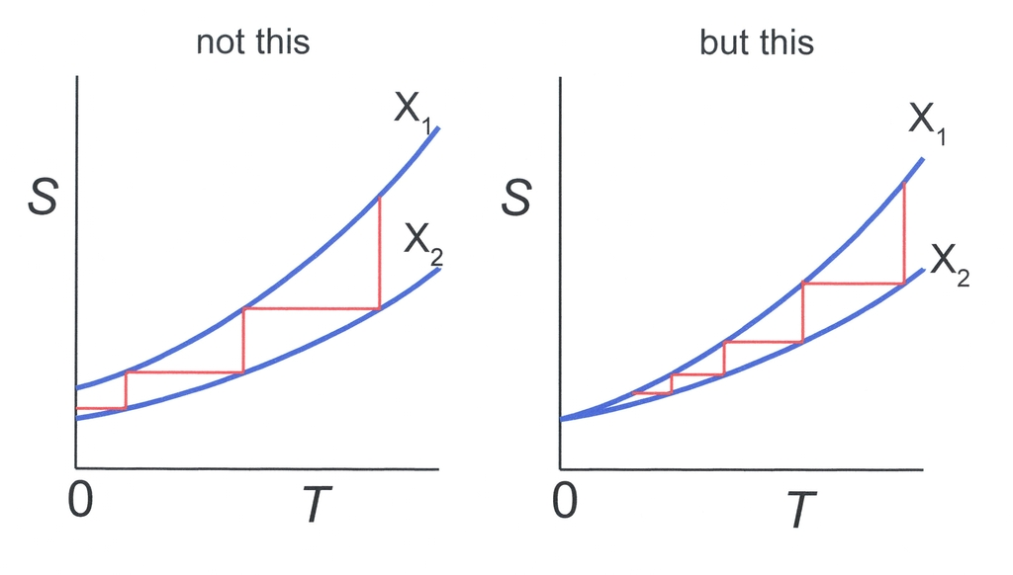

Thermodynamics
Can Absolute Zero be Reached?
Temperature-Entropy diagram. Horizontal lines represent isentropic processes, while vertical lines represent isothermal processes. Left side: Absolute zero can be reached in a finite number of steps if S(T=0,X1)≠S(T=0, X2). Right: An infinite number of steps is needed since S(0,X1)= S(0,X2).
Free to share, print, make copies and changes. Get yours at www.boundless.com
Wikipedia. "Third law of thermodynamics." GNU FDL http://en.wikipedia.org/wiki/Third_law_of_thermodynamics View on Boundless.com

Slide 16
Thermodynamics
Fig 1
An isobaric expansion of a gas requires heat transfer during the expansion to keep the pressure constant. Since pressure is constant, the work done is PΔV.
Free to share, print, make copies and changes. Get yours at www.boundless.com
OpenStax CNX. "OpenStax College, The First Law of Thermodynamics and Some Simple Processes. February 4, 2013." CC BY 3.0 http://cnx.org/content/m42233/latest/ View on Boundless.com

Slide 17
Thermodynamics
Fig 1
An isobaric expansion of a gas requires heat transfer during the expansion to keep the pressure constant. Since pressure is constant, the work done is PΔV.
Free to share, print, make copies and changes. Get yours at www.boundless.com
OpenStax CNX. "OpenStax College, The First Law of Thermodynamics and Some Simple Processes. February 4, 2013." CC BY 3.0 http://cnx.org/content/m42233/latest/ View on Boundless.com

Slide 18
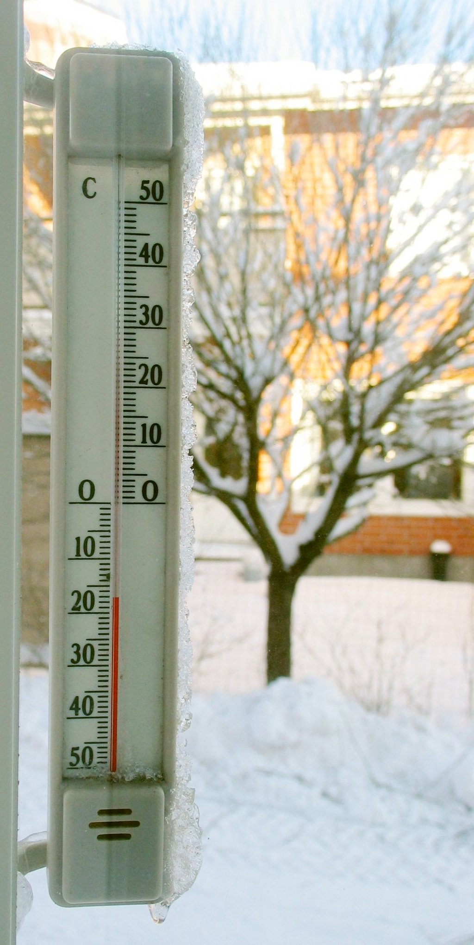
Thermodynamics
Thermometer
A thermometer calibrated in degrees Celsius
Free to share, print, make copies and changes. Get yours at www.boundless.com
Wikipedia. "Celsius." CC BY http://en.wikipedia.org/wiki/Celsius View on Boundless.com

Slide 19
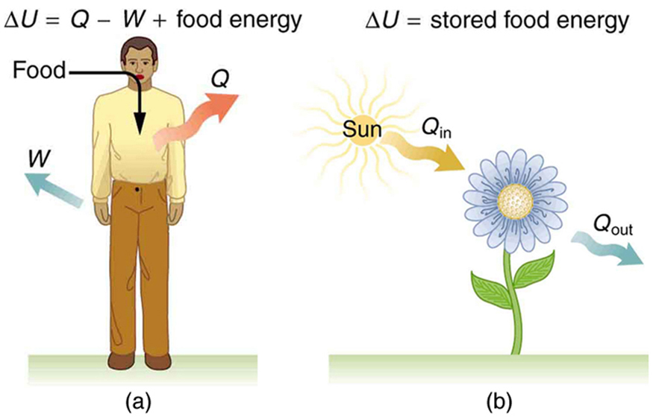
Thermodynamics
Metabolism
(a) The first law of thermodynamics applied to metabolism. Heat transferred out of the body (Q) and work done by the body (W) remove internal energy, while food intake replaces it. (Food intake may be considered as work done on the body. ) (b) Plants convert part of the radiant heat transfer in sunlight to stored chemical energy, a process called photosynthesis.
Free to share, print, make copies and changes. Get yours at www.boundless.com
OpenStax CNX. "OpenStax College, The First Law of Thermodynamics. February 12, 2013." CC BY 3.0 http://cnx.org/content/m42232/latest/ View on Boundless.com

Slide 20
Thermodynamics
PV Diagram for a Carnot Cycle
PV diagram for a Carnot cycle, employing only reversible isothermal and adiabatic processes. Heat transfer Qh occurs into the working substance during the isothermal path AB, which takes place at constant temperature Th. Heat transfer Qc occurs out of the working substance during the isothermal path CD, which takes place at constant temperature Tc. The net work output W equals the area inside the path ABCDA. Also shown is a schematic of a Carnot engine operating between hot and cold reservoirs at temperatures Th and Tc.
Free to share, print, make copies and changes. Get yours at www.boundless.com
OpenStax CNX. "OpenStax College, College Physics. February 13, 2013." CC BY 3.0 http://cnx.org/content/m42235/latest/?collection=col11406/latest View on Boundless.com

Slide 21
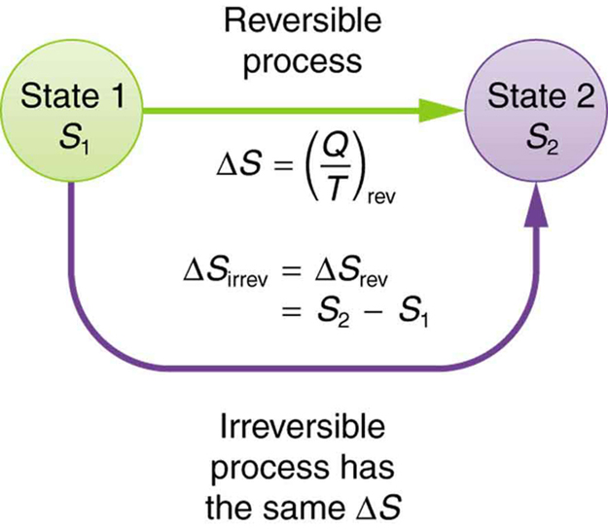
Thermodynamics
Change in Entropy
When a system goes from state one to state two, its entropy changes by the same amount ΔS, whether a hypothetical reversible path is followed or a real irreversible path is taken.
Free to share, print, make copies and changes. Get yours at www.boundless.com
OpenStax CNX. "OpenStax College, College Physics. February 13, 2013." CC BY 3.0 http://cnx.org/content/m42237/latest/?collection=col11406/latest View on Boundless.com

Slide 22
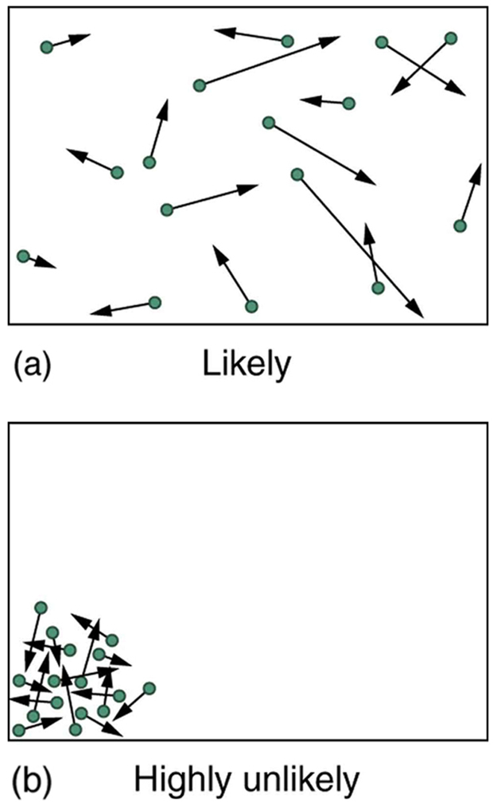
Thermodynamics
Kinetic Theory
(a) The ordinary state of gas in a container is a disorderly, random distribution of atoms or molecules with a Maxwell-Boltzmann distribution of speeds. It is so unlikely that these atoms or molecules would ever end up in one corner of the container that it might as well be impossible. (b) With energy transfer, the gas can be forced into one corner and its entropy greatly reduced. But left alone, it will spontaneously increase its entropy and return to the normal conditions, because they are immensely more likely.
Free to share, print, make copies and changes. Get yours at www.boundless.com
OpenStax CNX. "OpenStax College, College Physics. February 13, 2013." CC BY 3.0 http://cnx.org/content/m42238/latest/?collection=col11406/latest View on Boundless.com

Slide 23
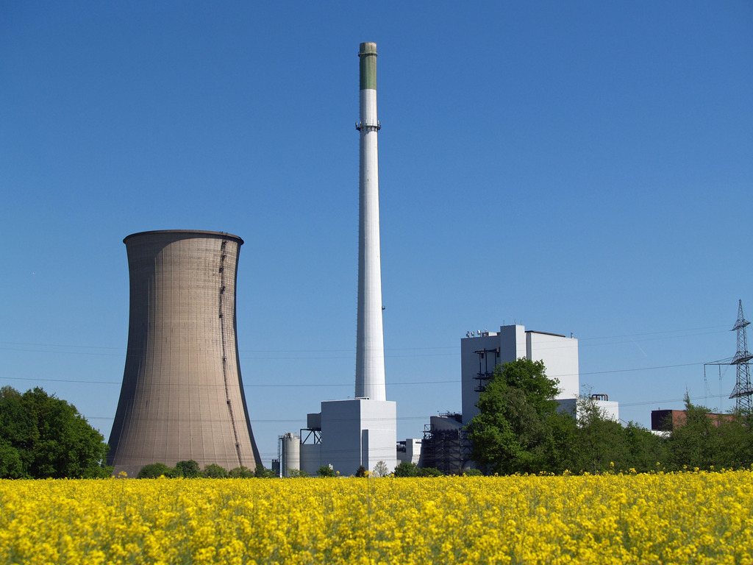
Thermodynamics
Cooling Tower
This is a cooling tower at Gustav Knepper Power Station, Dortmund, Germany. Cooling water is circulated inside the tower.
Free to share, print, make copies and changes. Get yours at www.boundless.com
Wikipedia. "Thermal pollution." CC BY http://en.wikipedia.org/wiki/Thermal_pollution View on Boundless.com

Slide 24
Thermodynamics
PV Diagram for a Carnot Cycle
PV diagram for a Carnot cycle, employing only reversible isothermal and adiabatic processes. Heat transfer Qh occurs into the working substance during the isothermal path AB, which takes place at constant temperature Th. Heat transfer Qc occurs out of the working substance during the isothermal path CD, which takes place at constant temperature Tc. The net work output W equals the area inside the path ABCDA. Also shown is a schematic of a Carnot engine operating between hot and cold reservoirs at temperatures Th and Tc.
Free to share, print, make copies and changes. Get yours at www.boundless.com
OpenStax CNX. "OpenStax College, College Physics. January 16, 2015." CC BY 3.0 http://cnx.org/content/m42235/latest/?collection=col11406/latest View on Boundless.com

Slide 25
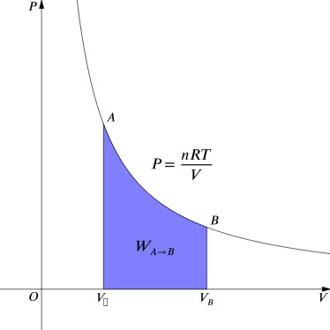
Thermodynamics
Work Done by Gas During Expansion
The blue area represents "work" done by the gas during expansion for this isothermal change.
Free to share, print, make copies and changes. Get yours at www.boundless.com
Wikipedia. "Isothermal process." CC BY http://en.wikipedia.org/wiki/Isothermal_process View on Boundless.com

Slide 26
Thermodynamics
One-Way Processed in Nature
Examples of one-way processes in nature. (a) Heat transfer occurs spontaneously from hot to cold and not from cold to hot. (b) The brakes of this car convert its kinetic energy to heat transfer to the environment. The reverse process is impossible. (c) The burst of gas let into this vacuum chamber quickly expands to uniformly fill every part of the chamber. The random motions of the gas molecules will never return them to the corner.
Free to share, print, make copies and changes. Get yours at www.boundless.com
OpenStax CNX. "OpenStax College, College Physics. February 13, 2013." CC BY 3.0 http://cnx.org/content/m42234/latest/?collection=col11406/latest View on Boundless.com

Slide 27
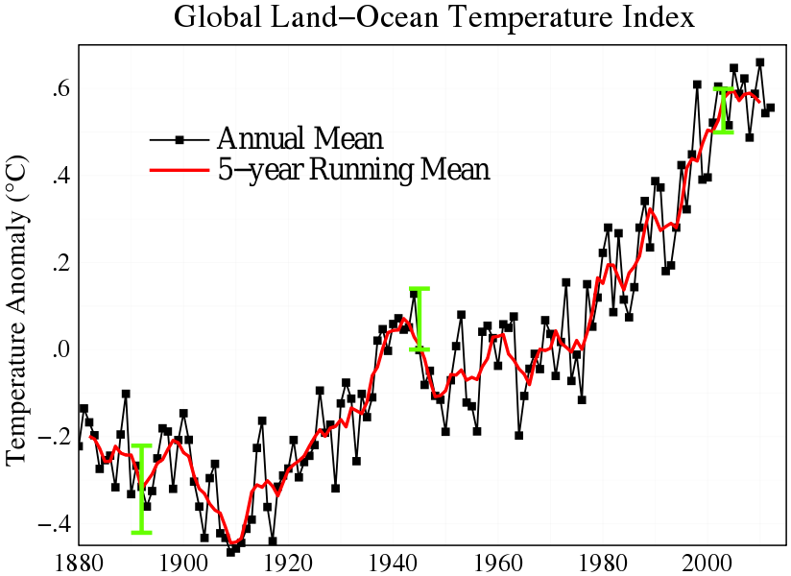
Thermodynamics
Global Land-Ocean Temperature
Global mean land-ocean temperature change from 1880 – 2012, relative to the 1951 – 1980 mean. The black line is the annual mean and the red line is the five-year running mean. The green bars show uncertainty estimates.
Free to share, print, make copies and changes. Get yours at www.boundless.com
Wikipedia. "Global warming." CC BY http://en.wikipedia.org/wiki/Global_warming View on Boundless.com

Slide 28
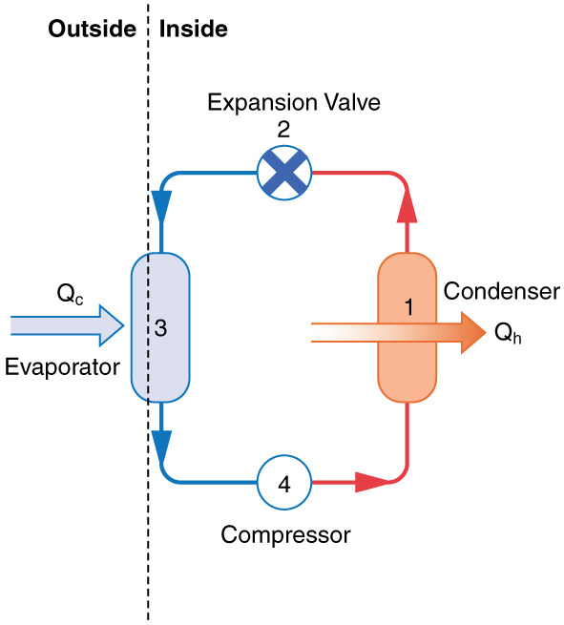
Thermodynamics
Simple Heat Pump
A simple heat pump has four basic components: (1) condenser, (2) expansion valve, (3) evaporator, and (4) compressor.
Free to share, print, make copies and changes. Get yours at www.boundless.com
OpenStax CNX. "OpenStax College, College Physics. February 13, 2013." CC BY 3.0 http://cnx.org/content/m42236/latest/?collection=col11406/latest View on Boundless.com

Slide 29
Thermodynamics
Work Done by Gas During Expansion
The blue area represents "work" done by the gas during expansion for this isothermal change.
Free to share, print, make copies and changes. Get yours at www.boundless.com
Wikipedia. "Isothermal process." CC BY http://en.wikipedia.org/wiki/Isothermal_process View on Boundless.com

Slide 30
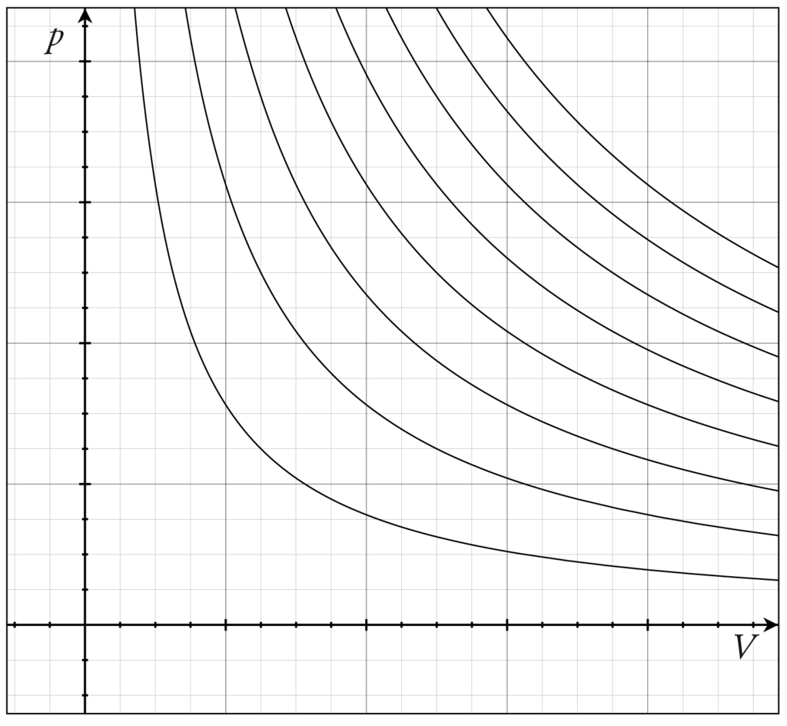
Thermodynamics
Isotherms of an Ideal Gas
Several isotherms of an ideal gas on a PV diagram.
Free to share, print, make copies and changes. Get yours at www.boundless.com
Wikipedia. "Isothermal process." CC BY http://en.wikipedia.org/wiki/Isothermal_process View on Boundless.com

Slide 31
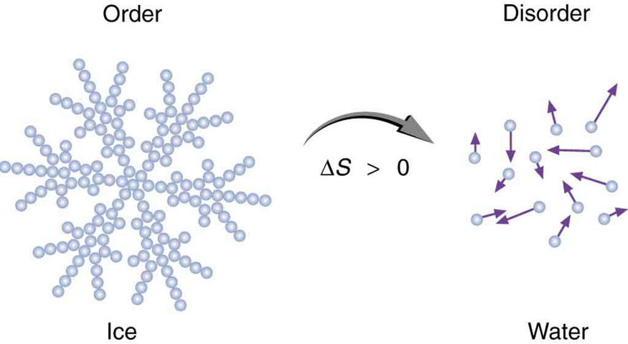
Thermodynamics
Entropy of Ice
When ice melts, it becomes more disordered and less structured. The systematic arrangement of molecules in a crystal structure is replaced by a more random and less orderly movement of molecules without fixed locations or orientations. Its entropy increases because heat transfer occurs into it. Entropy is a measure of disorder.
Free to share, print, make copies and changes. Get yours at www.boundless.com
OpenStax CNX. "OpenStax College, College Physics. February 13, 2013." CC BY 3.0 http://cnx.org/content/m42237/latest/?collection=col11406/latest View on Boundless.com

Slide 32
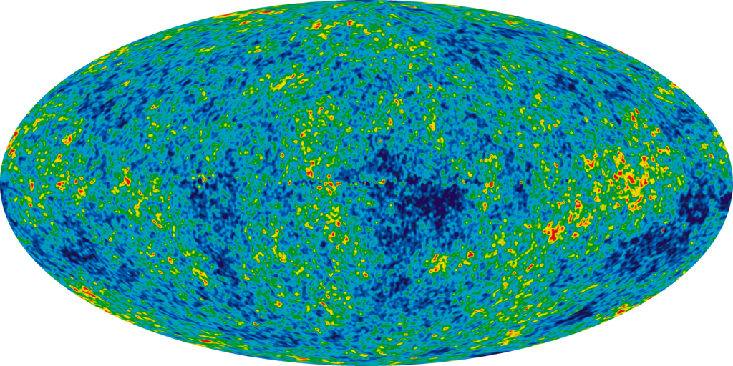
Thermodynamics
Infant Universe
The image of an infant universe reveals temperature fluctuations (shown as color differences) that correspond to the seeds that grew to become the galaxies.
Free to share, print, make copies and changes. Get yours at www.boundless.com
Wikipedia. "Heat death of the universe." CC BY http://en.wikipedia.org/wiki/Heat_death_of_the_universe View on Boundless.com

Slide 33
Thermodynamics
Temperature Entropy of Nitrogen
Temperature–entropy diagram of nitrogen. The red curve at the left is the melting curve. Absolute value of entropy can be determined shown here, thanks to the third law of thermodynamics.
Free to share, print, make copies and changes. Get yours at www.boundless.com
Wikipedia. "Entropy (classical thermodynamics)." CC BY http://en.wikipedia.org/wiki/Entropy_(classical_thermodynamics) View on Boundless.com

Slide 34
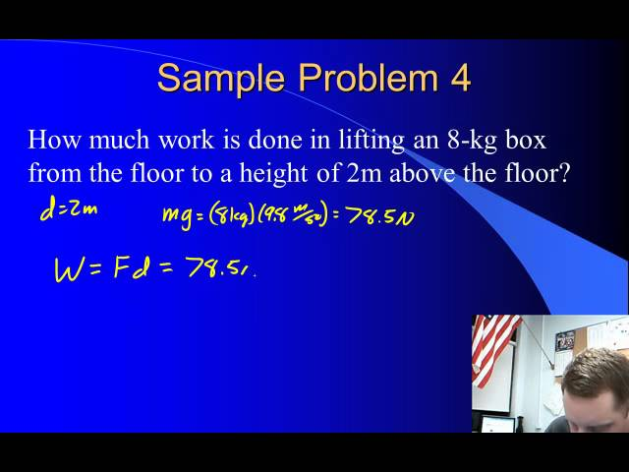
Thermodynamics
Work
A brief overview of work for algebra-based physics students.
Free to share, print, make copies and changes. Get yours at www.boundless.com
View on Boundless.com

Slide 35
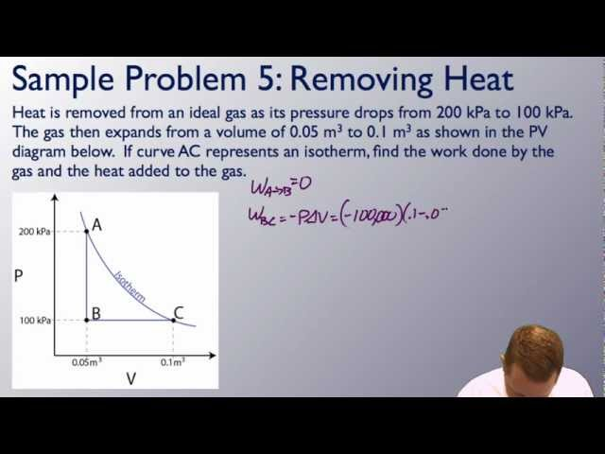
Thermodynamics
Thermodynamics and PV Diagrams
A brief introduction to the zeroth and 1st laws of thermodynamics as well as PV diagrams for students.
Free to share, print, make copies and changes. Get yours at www.boundless.com
View on Boundless.com

Slide 36
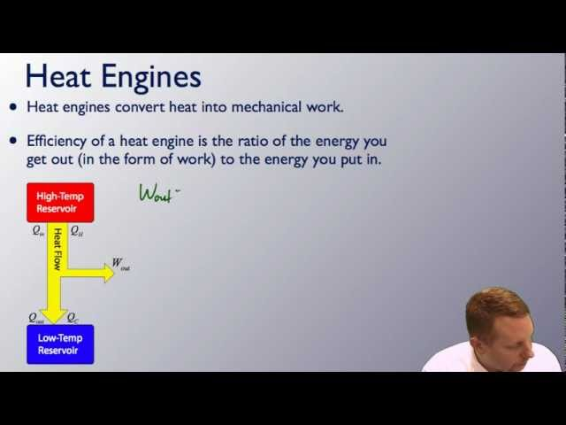
Thermodynamics
Thermodynamics and Heat Engines
A brief introduction to heat engines and thermodynamic concepts such as the Carnot Engine for students.
Free to share, print, make copies and changes. Get yours at www.boundless.com
View on Boundless.com

Slide 37
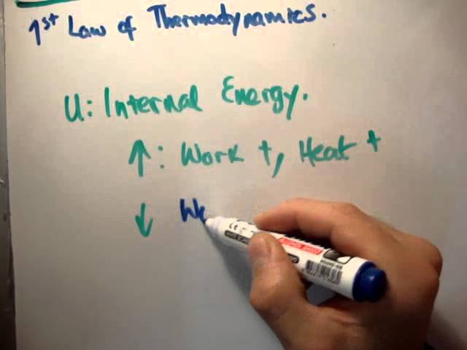
Thermodynamics
First Law of Thermodynamics
In this video I continue with my series of tutorial videos on Thermal Physics and Thermodynamics. It's pitched at undergraduate level and while it is mainly aimed at physics majors, it should be useful to anybody taking a first course in thermodynamics such as engineers etc..
Free to share, print, make copies and changes. Get yours at www.boundless.com
View on Boundless.com

Slide 38
Thermodynamics
Internal Energy
The first law of thermodynamics is the conservation-of-energy principle stated for a system where heat and work are the methods of transferring energy for a system in thermal equilibrium. Q represents the net heat transfer—it is the sum of all heat transfers into and out of the system. Q is positive for net heat transfer into the system. W is the total work done on and by the system. W is positive when more work is done by the system than on it. The change in the internal energy of the system, ΔU, is related to heat and work by the first law of thermodynamics, ΔU=Q−W.
Free to share, print, make copies and changes. Get yours at www.boundless.com
OpenStax CNX. "OpenStax College, The First Law of Thermodynamics. October 1, 2012." CC BY 3.0 http://cnx.org/content/m42232/latest/ View on Boundless.com

Slide 39
Thermodynamics
Thermodynamics and Heat Engines
A brief introduction to heat engines and thermodynamic concepts such as the Carnot Engine for students.
Free to share, print, make copies and changes. Get yours at www.boundless.com
View on Boundless.com

Slide 40
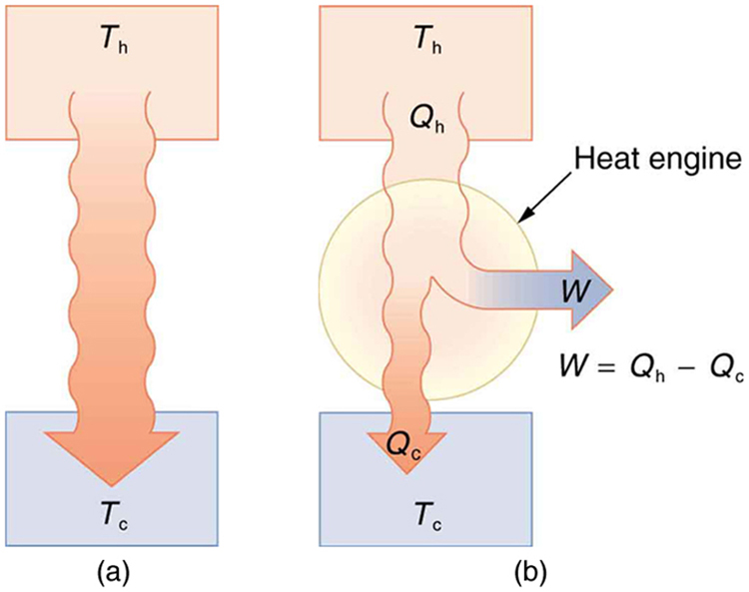
Thermodynamics
Heat Transfer
(a) Heat transfer occurs spontaneously from a hot object to a cold one, consistent with the second law of thermodynamics. (b) A heat engine, represented here by a circle, uses part of the heat transfer to do work. The hot and cold objects are called the hot and cold reservoirs. Qh is the heat transfer out of the hot reservoir, W is the work output, and Qc is the heat transfer into the cold reservoir.
Free to share, print, make copies and changes. Get yours at www.boundless.com
OpenStax CNX. "OpenStax College, College Physics. February 13, 2013." CC BY 3.0 http://cnx.org/content/m42234/latest/?collection=col11406/latest View on Boundless.com

Slide 41
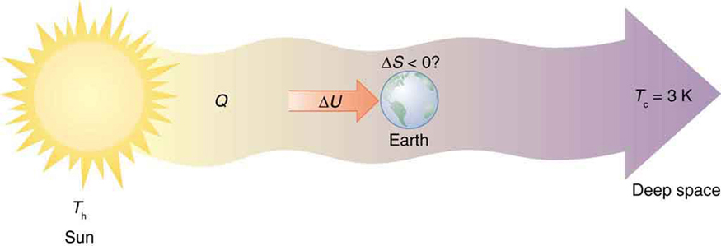
Thermodynamics
Earth's Entropy
Earth's entropy may decrease in the process of intercepting a small part of the heat transfer from the Sun into deep space. Entropy for the entire process increases greatly while Earth becomes more structured with living systems and stored energy in various forms.
Free to share, print, make copies and changes. Get yours at www.boundless.com
OpenStax CNX. "OpenStax College, College Physics. February 13, 2013." CC BY 3.0 http://cnx.org/content/m42237/latest/?collection=col11406/latest View on Boundless.com

Slide 42
Attribution
Thermodynamics
Wikipedia. "Third law of thermodynamics." CC BY-SA 3.0 http://en.wikipedia.org/wiki/Third_law_of_thermodynamics
Wiktionary. "demagnetization." CC BY-SA 3.0 http://en.wiktionary.org/wiki/demagnetization
Wikipedia. "Magnetic refrigeration." CC BY-SA 3.0 http://en.wikipedia.org/wiki/Magnetic_refrigeration
Wiktionary. "isentropic." CC BY-SA 3.0 http://en.wiktionary.org/wiki/isentropic
Wiktionary. "absolute zero." CC BY-SA 3.0 http://en.wiktionary.org/wiki/absolute_zero
Wikipedia. "Third law of thermodynamics." CC BY-SA 3.0 http://en.wikipedia.org/wiki/Third_law_of_thermodynamics
Wikipedia. "degeneracy." CC BY-SA 3.0 http://en.wikipedia.org/wiki/degeneracy
Wiktionary. "absolute zero." CC BY-SA 3.0 http://en.wiktionary.org/wiki/absolute_zero
Wiktionary. "microstate." CC BY-SA 3.0 http://en.wiktionary.org/wiki/microstate
Wikipedia. "Thermal energy." CC BY-SA 3.0 http://en.wikipedia.org/wiki/Thermal_energy
Wikipedia. "Heat engine." CC BY-SA 3.0 http://en.wikipedia.org/wiki/Heat_engine
OpenStax CNX. "OpenStax College, College Physics. September 17, 2013." CC BY 3.0 http://cnx.org/content/m42234/latest/?collection=col11406/latest
Boundless Learning. "Boundless." CC BY-SA 3.0 http://www.boundless.com//physics/definition/internal-energy
Wikipedia. "Thermal pollution." CC BY-SA 3.0 http://en.wikipedia.org/wiki/Thermal_pollution
Wiktionary. "heat pump." CC BY-SA 3.0 http://en.wiktionary.org/wiki/heat_pump
Wiktionary. "heat engine." CC BY-SA 3.0 http://en.wiktionary.org/wiki/heat_engine
Wikipedia. "entropy." CC BY-SA 3.0 http://en.wikipedia.org/wiki/entropy
Free to share, print, make copies and changes. Get yours at www.boundless.com

Slide 43
Thermodynamics
OpenStax CNX. "OpenStax College, College Physics. September 17, 2013." CC BY 3.0 http://cnx.org/content/m42237/latest/?collection=col11406/latest
Wiktionary. "reversible." CC BY-SA 3.0 http://en.wiktionary.org/wiki/reversible
Wikipedia. "Isothermal process." CC BY-SA 3.0 http://en.wikipedia.org/wiki/Isothermal_process
Wiktionary. "Boyle's law." CC BY-SA 3.0 http://en.wiktionary.org/wiki/Boyle's_law
Wiktionary. "ideal gas." CC BY-SA 3.0 http://en.wiktionary.org/wiki/ideal_gas
Wikipedia. "Entropy and the environment." CC BY-SA 3.0 http://en.wikipedia.org/wiki/Entropy_and_the_environment
Wikipedia. "Carnot cycle." CC BY-SA 3.0 http://en.wikipedia.org/wiki/Carnot%20cycle
Wiktionary. "absolute zero." CC BY-SA 3.0 http://en.wiktionary.org/wiki/absolute_zero
Wikipedia. "Thermodynamic process." CC BY-SA 3.0 http://en.wikipedia.org/wiki/Thermodynamic_process
OpenStax CNX. "OpenStax College, The First Law of Thermodynamics and Some Simple Processes. September 17, 2013." CC BY 3.0 http://cnx.org/content/m42233/latest/
Boundless Learning. "Boundless." CC BY-SA 3.0 http://www.boundless.com//physics/definition/internal-energy
Wiktionary. "heat engine." CC BY-SA 3.0 http://en.wiktionary.org/wiki/heat_engine
Boundless Learning. "Boundless." CC BY-SA 3.0 http://www.boundless.com//physics/definition/the-second-law-of-thermodynamics
OpenStax CNX. "OpenStax College, College Physics. September 17, 2013." CC BY 3.0 http://cnx.org/content/m42235/latest/?collection=col11406/latest
Wikipedia. "entropy." CC BY-SA 3.0 http://en.wikipedia.org/wiki/entropy
Wikipedia. "the first law of thermodynamics." CC BY-SA 3.0 http://en.wikipedia.org/wiki/the%20first%20law%20of%20thermodynamics
OpenStax CNX. "OpenStax College, College Physics. September 17, 2013." CC BY 3.0 http://cnx.org/content/m42234/latest/?collection=col11406/latest
Wikipedia. "entropy." CC BY-SA 3.0 http://en.wikipedia.org/wiki/entropy
Wiktionary. "geothermal." CC BY-SA 3.0 http://en.wiktionary.org/wiki/geothermal
Free to share, print, make copies and changes. Get yours at www.boundless.com

Slide 44
Thermodynamics
Wiktionary. "asteroid." CC BY-SA 3.0 http://en.wiktionary.org/wiki/asteroid
OpenStax CNX. "OpenStax College, College Physics. September 17, 2013." CC BY 3.0 http://cnx.org/content/m42237/latest/?collection=col11406/latest
Wikipedia. "Work (thermodynamics)." CC BY-SA 3.0 http://en.wikipedia.org/wiki/Work_(thermodynamics)
Wikipedia. "heat." CC BY-SA 3.0 http://en.wikipedia.org/wiki/heat
OpenStax CNX. "OpenStax College, College Physics. September 17, 2013." CC BY 3.0 http://cnx.org/content/m42232/latest/?collection=col11406/1.7
Boundless Learning. "Boundless." CC BY-SA 3.0 http://www.boundless.com//physics/definition/internal-energy
Wikipedia. "thermodynamics." CC BY-SA 3.0 http://en.wikipedia.org/wiki/thermodynamics
Wikipedia. "First law of thermodynamics." CC BY-SA 3.0 http://en.wikipedia.org/wiki/First_law_of_thermodynamics
Wikipedia. "heat." CC BY-SA 3.0 http://en.wikipedia.org/wiki/heat
Wiktionary. "law of conservation of energy." CC BY-SA 3.0 http://en.wiktionary.org/wiki/law_of_conservation_of_energy
Boundless Learning. "Boundless." CC BY-SA 3.0 http://www.boundless.com//physics/definition/internal-energy
OpenStax CNX. "OpenStax College, The First Law of Thermodynamics. September 17, 2013." CC BY 3.0 http://cnx.org/content/m42232/latest/
Wiktionary. "reversible." CC BY-SA 3.0 http://en.wiktionary.org/wiki/reversible
Wikipedia. "Isothermal process." CC BY-SA 3.0 http://en.wikipedia.org/wiki/Isothermal_process
Wiktionary. "Boyle's law." CC BY-SA 3.0 http://en.wiktionary.org/wiki/Boyle's_law
Wiktionary. "ideal gas." CC BY-SA 3.0 http://en.wiktionary.org/wiki/ideal_gas
Boundless Learning. "Boundless." CC BY-SA 3.0 http://www.boundless.com//physics/definition/thermal-equilibrium--2
Wiktionary. "thermodynamic temperature." CC BY-SA 3.0 http://en.wiktionary.org/wiki/thermodynamic_temperature
OpenStax CNX. "OpenStax College, Temperature. September 17, 2013." CC BY 3.0 http://cnx.org/content/m42214/latest/
Free to share, print, make copies and changes. Get yours at www.boundless.com

Slide 45
Thermodynamics
Wiktionary. "calorie." CC BY-SA 3.0 http://en.wiktionary.org/wiki/calorie
Wiktionary. "oxidation." CC BY-SA 3.0 http://en.wiktionary.org/wiki/oxidation
Wiktionary. "metabolism." CC BY-SA 3.0 http://en.wiktionary.org/wiki/metabolism
OpenStax CNX. "OpenStax College, The First Law of Thermodynamics. September 17, 2013." CC BY 3.0 http://cnx.org/content/m42232/latest/
Wikipedia. "Carnot cycle." CC BY-SA 3.0 http://en.wikipedia.org/wiki/Carnot%20cycle
Wiktionary. "reversible." CC BY-SA 3.0 http://en.wiktionary.org/wiki/reversible
OpenStax CNX. "OpenStax College, College Physics. September 17, 2013." CC BY 3.0 http://cnx.org/content/m42237/latest/?collection=col11406/latest
Wikipedia. "Maxwell-Boltzmann distribution." CC BY-SA 3.0 http://en.wikipedia.org/wiki/Maxwell-Boltzmann%20distribution
Wikipedia. "disorder." CC BY-SA 3.0 http://en.wikipedia.org/wiki/disorder
OpenStax CNX. "OpenStax College, College Physics. September 17, 2013." CC BY 3.0 http://cnx.org/content/m42238/latest/?collection=col11406/latest
Wikipedia. "disorder." CC BY-SA 3.0 http://en.wikipedia.org/wiki/disorder
Wikipedia. "entropy." CC BY-SA 3.0 http://en.wikipedia.org/wiki/entropy
OpenStax CNX. "OpenStax College, College Physics. September 17, 2013." CC BY 3.0 http://cnx.org/content/m42237/latest/?collection=col11406/latest
Wikipedia. "Heat pump." CC BY-SA 3.0 http://en.wikipedia.org/wiki/Heat_pump
OpenStax CNX. "OpenStax College, College Physics. September 17, 2013." CC BY 3.0 http://cnx.org/content/m42236/latest/?collection=col11406/latest
Boundless Learning. "Boundless." CC BY-SA 3.0 http://www.boundless.com//physics/definition/cfc
Free to share, print, make copies and changes. Get yours at www.boundless.com

