Slide 1


Boundless Lecture Slides
Available on the Boundless Teaching Platform
Free to share, print, make copies and changes. Get yours at www.boundless.com

Slide 2



Using Boundless Presentations
Boundless Teaching Platform
Boundless empowers educators to engage their students with affordable, customizable textbooks and intuitive teaching tools. The free Boundless Teaching Platform gives educators the ability to customize textbooks in more than 20 subjects that align to hundreds of popular titles. Get started by using high quality Boundless books, or make switching to our platform easier by building from Boundless content pre-organized to match the assigned textbook. This platform gives educators the tools they need to assign readings and assessments, monitor student activity, and lead their classes with pre-made teaching resources.
Get started now at:
The Appendix
The appendix is for you to use to add depth and breadth to your lectures. You can simply drag and drop slides from the appendix into the main presentation to make for a richer lecture experience.
http://boundless.com/teaching-platform
Free to edit, share, and copy
Feel free to edit, share, and make as many copies of the Boundless presentations as you like. We encourage you to take these presentations and make them your own.
If you have any questions or problems please email:
educators@boundless.com
Free to share, print, make copies and changes. Get yours at www.boundless.com

Slide 3

About Boundless
Boundless is an innovative technology company making education more affordable and accessible for students everywhere. The company creates the world’s best open educational content in 20+ subjects that align to more than 1,000 popular college textbooks. Boundless integrates learning technology into all its premium books to help students study more efficiently at a fraction of the cost of traditional textbooks. The company also empowers educators to engage their students more effectively through customizable books and intuitive teaching tools as part of the Boundless Teaching Platform. More than 2 million learners access Boundless free and premium content each month across the company’s wide distribution platforms, including its website, iOS apps, Kindle books, and iBooks. To get started learning or teaching with Boundless, visit boundless.com.
Free to share, print, make copies and changes. Get yours at www.boundless.com

Slide 4
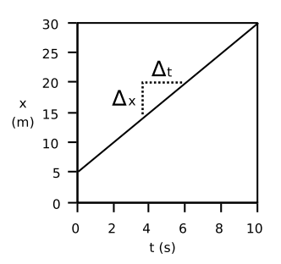
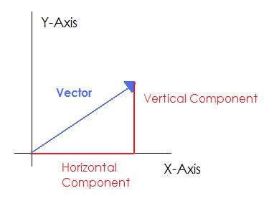
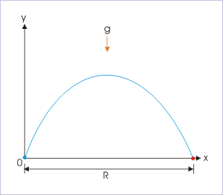
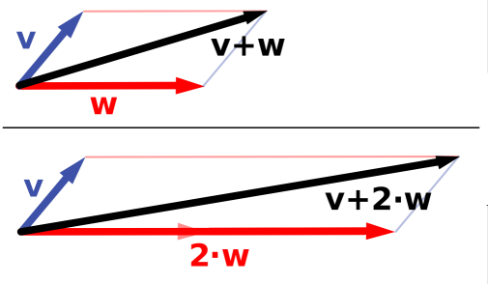

Two-Dimensional Kinematics
Motion in Two Dimensions
Vectors
Projectile Motion
Multiple Velocities
]
Two-Dimensional Kinematics
Free to share, print, make copies and changes. Get yours at www.boundless.com

Slide 5

Motion in Two Dimensions
Two-Dimensional Kinematics > Motion in Two Dimensions
Constant Velocity
Constant Acceleration
Free to share, print, make copies and changes. Get yours at www.boundless.com
www.boundless.com/physics/textbooks/boundless-physics-textbook/two-dimensional-kinematics-3/motion-in-two-dimensions-40/

Slide 6
Vectors
Two-Dimensional Kinematics > Vectors
Components of a Vector
Scalars vs. Vectors
Adding and Subtracting Vectors Graphically
Adding and Subtracting Vectors Using Components
Multiplying Vectors by a Scalar
Unit Vectors and Multiplication by a Scalar
Position, Displacement, Velocity, and Acceleration as Vectors
Free to share, print, make copies and changes. Get yours at www.boundless.com
www.boundless.com/physics/textbooks/boundless-physics-textbook/two-dimensional-kinematics-3/vectors-41/

Slide 7
Projectile Motion
Two-Dimensional Kinematics > Projectile Motion
Basic Equations and Parabolic Path
Solving Problems
Zero Launch Angle
General Launch Angle
Key Points: Range, Symmetry, Maximum Height
Free to share, print, make copies and changes. Get yours at www.boundless.com
www.boundless.com/physics/textbooks/boundless-physics-textbook/two-dimensional-kinematics-3/projectile-motion-42/

Slide 8
Multiple Velocities
Two-Dimensional Kinematics > Multiple Velocities
Addition of Velocities
Relative Velocity
Free to share, print, make copies and changes. Get yours at www.boundless.com
www.boundless.com/physics/textbooks/boundless-physics-textbook/two-dimensional-kinematics-3/multiple-velocities-43/

Slide 9
Appendix
Free to share, print, make copies and changes. Get yours at www.boundless.com

Slide 10
Key terms
Two-Dimensional Kinematics
acceleration the rate at which the velocity of a body changes with time
axis An imaginary line around which an object spins or is symmetrically arranged.
bilateral symmetry the property of being symmetrical about a vertical plane
Component A part of a vector. For example, horizontal and vertical components.
constant velocity Motion that does not change in speed nor direction.
Coordinate axes A set of perpendicular lines which define coordinates relative to an origin. Example: x and y coordinate axes define horizontal and vertical position.
Coordinate axes A set of perpendicular lines which define coordinates relative to an origin. Example: x and y coordinate axes define horizontal and vertical position.
coordinates Numbers indicating a position with respect to some axis. Ex: and coordinates indicate position relative to and axes.
displacement The length and direction of a straight line between two objects.
gravity Resultant force on Earth's surface, of the attraction by the Earth's masses, and the centrifugal pseudo-force caused by the Earth's rotation.
kinematic of or relating to motion or kinematics
magnitude A number assigned to a vector indicating its length.
Free to share, print, make copies and changes. Get yours at www.boundless.com

Slide 11
Two-Dimensional Kinematics
magnitude A number assigned to a vector indicating its length.
origin The center of a coordinate axis, defined as being the coordinate 0 in all axes.
relative Expressed in relation to another item, rather than in complete form.
relative Expressed in relation to another item, rather than in complete form.
reorientate to orientate anew; to cause to face a different direction
scalar A quantity which can be described by a single number, as opposed to a vector which requires a direction and a number.
scalar A quantity that has magnitude but not direction; compare vector.
symmetrical Exhibiting symmetry; having harmonious or proportionate arrangement of parts; having corresponding parts or relations.
trajectory The path of a body as it travels through space.
trajectory The path of a body as it travels through space.
trajectory The path of a body as it travels through space.
trajectory The path of a body as it travels through space.
Free to share, print, make copies and changes. Get yours at www.boundless.com

Slide 12
Two-Dimensional Kinematics
unit vector A vector of magnitude 1.
vector A directed quantity, one with both magnitude and direction; the between two points.
velocity The rate of change of displacement with respect to change in time.
Free to share, print, make copies and changes. Get yours at www.boundless.com

Slide 13

Two-Dimensional Kinematics
Free to share, print, make copies and changes. Get yours at www.boundless.com
Wikibooks. "Statistics Ground Zero/Regression." CC BY-SA 3.0 http://en.wikibooks.org/wiki/Statistics_Ground_Zero/Regression View on Boundless.com

Slide 14
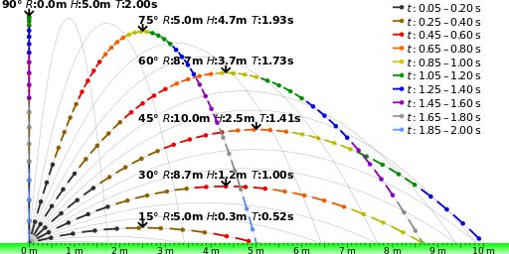
Two-Dimensional Kinematics
Launch Angle
The launch angle determines the range and maximum height that an object will experience after being launched. This image shows that path of the same object being launched at the same velocity but different angles.
Free to share, print, make copies and changes. Get yours at www.boundless.com
Wikipedia. "Ideal projectile motion for different angles." CC BY-SA http://en.wikipedia.org/wiki/File:Ideal_projectile_motion_for_different_angles.svg View on Boundless.com

Slide 15

Two-Dimensional Kinematics
Scalars and Vectors
Mr. Andersen explains the differences between scalar and vectors quantities. He also uses a demonstration to show the importance of vectors and vector addition.
Free to share, print, make copies and changes. Get yours at www.boundless.com
View on Boundless.com

Slide 16
Two-Dimensional Kinematics
Components of a Vector
The original vector, defined relative to a set of axes. The horizontal component stretches from the start of the vector to its furthest x-coordinate. The vertical component stretches from the x-axis to the most vertical point on the vector. Together, the two components and the vector form a right triangle.
Free to share, print, make copies and changes. Get yours at www.boundless.com
Amazon Web Services. "Boundless." CC BY http://s3.amazonaws.com/figures.boundless.com/5101a2b3e4b04253d8aba44b/vectordecomp.jpg View on Boundless.com

Slide 17
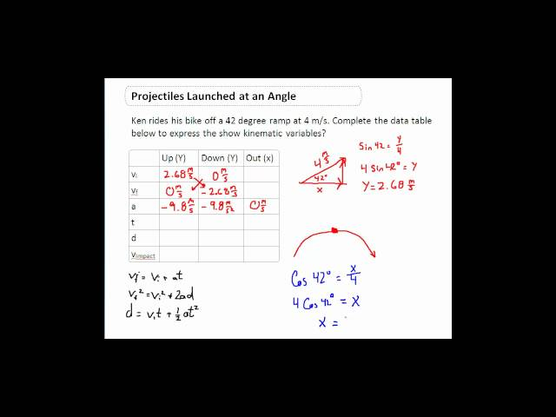
Two-Dimensional Kinematics
Projectiles at an Angle
This video gives a clear and simple explanation of how to solve a problem on Projectiles Launched at an Angle. I try to go step by step through this difficult problem to layout how to solve it in a super clear way. 2D kinematic problems take time to solve, take notes on the order of how I solved it. Best wishes. Tune into my other videos for more help. Peace.
Free to share, print, make copies and changes. Get yours at www.boundless.com
View on Boundless.com

Slide 18
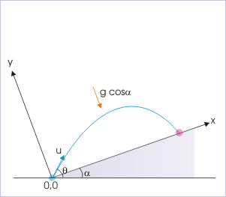
Two-Dimensional Kinematics
Diagram for Example 2
When dealing with an object in projectile motion on an incline, we first need to use the given information to reorient the coordinate system in order to have the object launch and fall on the same surface.
Free to share, print, make copies and changes. Get yours at www.boundless.com
OpenStax CNX. "Sunil Kumar Singh, Projectile Motion on an Incline. February 2, 2013." CC BY 3.0 http://cnx.org/content/m14614/latest/ View on Boundless.com

Slide 19
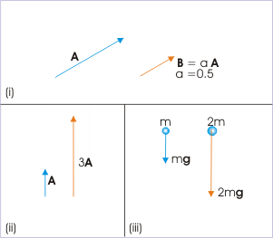
Two-Dimensional Kinematics
Scalar Multiplication
(i) Multiplying the vector A by 0.5 halves its length. (ii) Multiplying the vector A by 3 triples its length. (iii) Increasing the mass (scalar) increases the force (vector).
Free to share, print, make copies and changes. Get yours at www.boundless.com
OpenStax CNX. "Sunil Kumar Singh, Scalar (Dot) Product. January 16, 2015." CC BY 3.0 http://cnx.org/content/m14513/latest/vm2a.gif View on Boundless.com

Slide 20
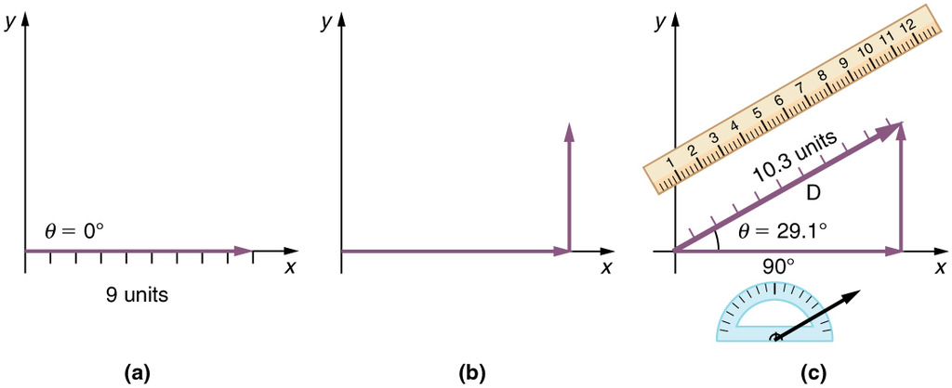
Two-Dimensional Kinematics
Graphical Addition of Vectors
The head-to-tail method of vector addition requires that you lay out the first vector along a set of coordinate axes. Next, place the tail of the next vector on the head of the first one. Draw a new vector from the origin to the head of the last vector. This new vector is the sum of the original two.
Free to share, print, make copies and changes. Get yours at www.boundless.com
OpenStax CNX. "OpenStax College, Vector Addition and Subtraction: Graphical Methods. January 24, 2013." CC BY 3.0 http://cnx.org/content/m42127/latest/Figure_03_02_03.jpg View on Boundless.com

Slide 21
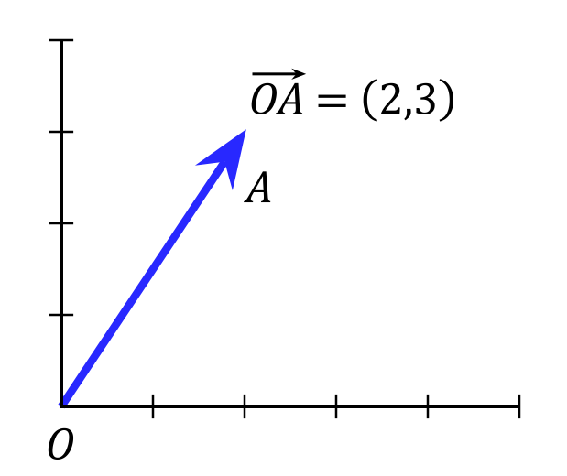
Two-Dimensional Kinematics
A Vector
An example of a vector. Vectors are usually represented by arrows with their length representing the magnitude and their direction represented by the direction the arrow points.
Free to share, print, make copies and changes. Get yours at www.boundless.com
Wikimedia. CC BY http://upload.wikimedia.org/wikipedia/commons/thumb/5/5d/Position_vector.svg/220px-Position_vector.svg.png View on Boundless.com

Slide 22
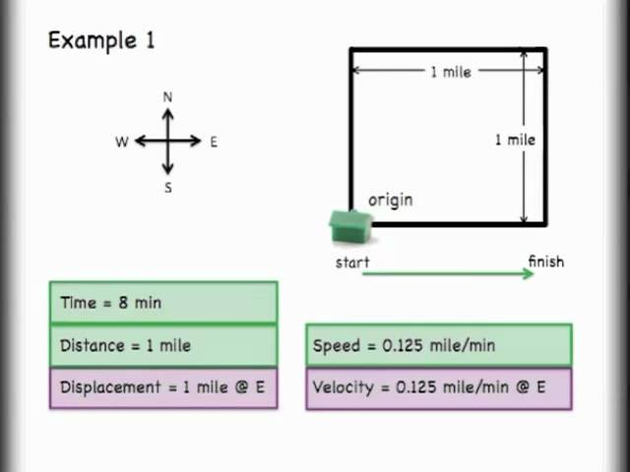
Two-Dimensional Kinematics
The difference between Vectors and Scalars, Introduction and Basics
This video introduces the difference between scalars and vectors. Ideas about magnitude and direction are introduced and examples of both vectors and scalars are given.
Free to share, print, make copies and changes. Get yours at www.boundless.com
View on Boundless.com

Slide 23
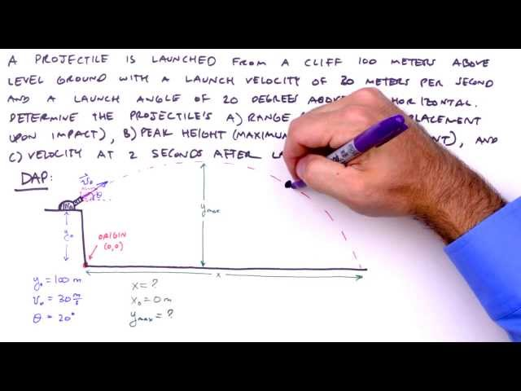
Two-Dimensional Kinematics
How To Solve Any Projectile Motion Problem (The Toolbox Method)
Introducing the "Toolbox" method of solving projectile motion problems! Here we use kinematic equations and modify with initial conditions to generate a "toolbox" of equations with which to solve a classic three-part projectile motion problem.
Free to share, print, make copies and changes. Get yours at www.boundless.com
View on Boundless.com

Slide 24
Two-Dimensional Kinematics
Scalar Multiplication
(i) Multiplying the vector by the scalar yields the vector which is half as long. (ii) Multiplying the vector by 3 triples its length. (iii) Doubling the mass (scalar) doubles the force (vector) of gravity.
Free to share, print, make copies and changes. Get yours at www.boundless.com
OpenStax CNX. "Sunil Kumar Singh, Scalar (Dot) Product. March 12, 2014." CC BY 3.0 http://cnx.org/content/m14513/latest/vm2a.gif View on Boundless.com

Slide 25
Two-Dimensional Kinematics
Vector Addition
Addition of velocities is simply the addition of vectors.
Free to share, print, make copies and changes. Get yours at www.boundless.com
Wikipedia. "Vector Addition and Scaling." CC BY-SA 3.0 http://en.wikipedia.org/wiki/Vector_space View on Boundless.com

Slide 26
Two-Dimensional Kinematics
Projectile Trajectories
The launch angle determines the range and maximum height that an object will experience after being launched.This image shows that path of the same object being launched at the same speed but different angles.
Free to share, print, make copies and changes. Get yours at www.boundless.com
Wikipedia. "Ideal projectile motion for different angles." CC BY-SA http://en.wikipedia.org/wiki/File:Ideal_projectile_motion_for_different_angles.svg View on Boundless.com

Slide 27
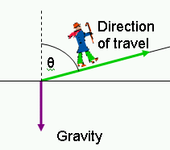
Two-Dimensional Kinematics
Vector Diagram
Here is a man walking up a hill. His direction of travel is defined by the angle theta relative to the vertical axis and by the length of the arrow going up the hill. He is also being accelerated downward by gravity.
Free to share, print, make copies and changes. Get yours at www.boundless.com
Amazon Web Services. "Boundless." CC BY http://s3.amazonaws.com/figures.boundless.com/510a0e5de4b0f11e4bcb01ad/Man_walking_up_a_hill.png View on Boundless.com

Slide 28
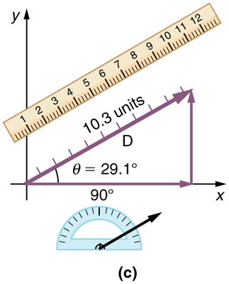
Two-Dimensional Kinematics
Vector with Horizontal and Vertical Components
The vector in this image has a magnitude of 10.3 units and a direction of 29.1 degrees above the x-axis. It can be decomposed into a horizontal part and a vertical part as shown.
Free to share, print, make copies and changes. Get yours at www.boundless.com
OpenStax CNX. "OpenStax College, Vector Addition and Subtraction: Graphical Methods. January 24, 2013." CC BY 3.0 http://cnx.org/content/m42127/latest/Figure_03_02_06a.jpg View on Boundless.com

Slide 29
Two-Dimensional Kinematics
Motion with Constant Velocity
When an object is moving with constant velocity, it does not change direction nor speed and therefore is represented as a straight line when graphed as distance over time.
Free to share, print, make copies and changes. Get yours at www.boundless.com
Light and Matter. CC BY http://lightandmatter.com/lmb.pdf View on Boundless.com

Slide 30
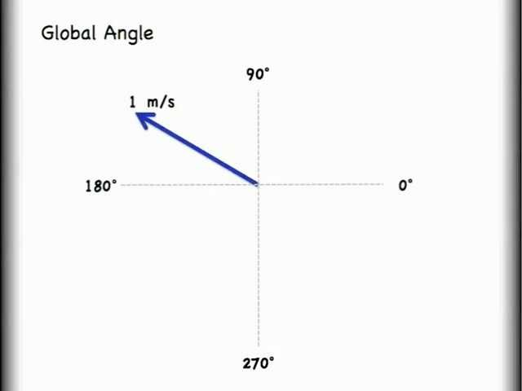
Two-Dimensional Kinematics
Vector Addition Lesson 1 of 2: Head to Tail Addition Method
This video gets viewers started with vector addition and subtraction. The first lesson shows graphical addition while the second video takes a more mathematical approach and shows vector addition by components.
Free to share, print, make copies and changes. Get yours at www.boundless.com
View on Boundless.com

Slide 31
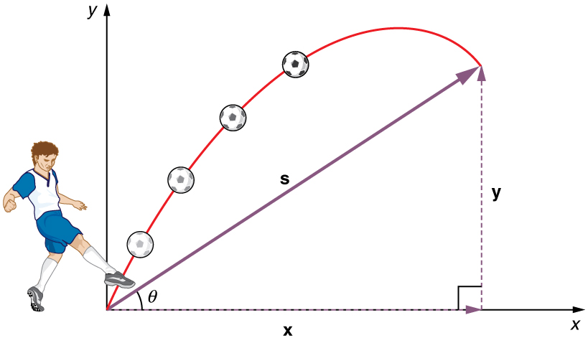
Two-Dimensional Kinematics
Projectile Motion
Throwing a rock or kicking a ball generally produces a projectile pattern of motion that has both a vertical and a horizontal component.
Free to share, print, make copies and changes. Get yours at www.boundless.com
OpenStax CNX. "OpenStax College, College Physics. October 19, 2012." CC BY 3.0 http://cnx.org/content/m42042/latest/?collection=col11406/1.7 View on Boundless.com

Slide 32
Two-Dimensional Kinematics
Range of Trajectory
The range of a trajectory is shown in this figure.
Free to share, print, make copies and changes. Get yours at www.boundless.com
OpenStax CNX. "Sunil Kumar Singh, Features of Projectile Motion. January 25, 2013." CC BY 3.0 http://cnx.org/content/m13847/latest/ View on Boundless.com

Slide 33
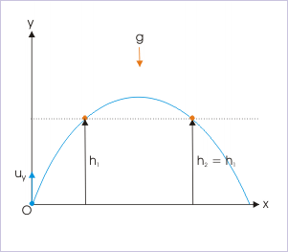
Two-Dimensional Kinematics
Diagram for Example 1
Use this figure as a reference to solve example 1. The problem is to make sure the object is able to clear both posts.
Free to share, print, make copies and changes. Get yours at www.boundless.com
OpenStax CNX. "Sunil Kumar Singh, Features of Projectile Motion. February 2, 2013." CC BY 3.0 http://cnx.org/content/m13847/latest/ View on Boundless.com

Slide 34
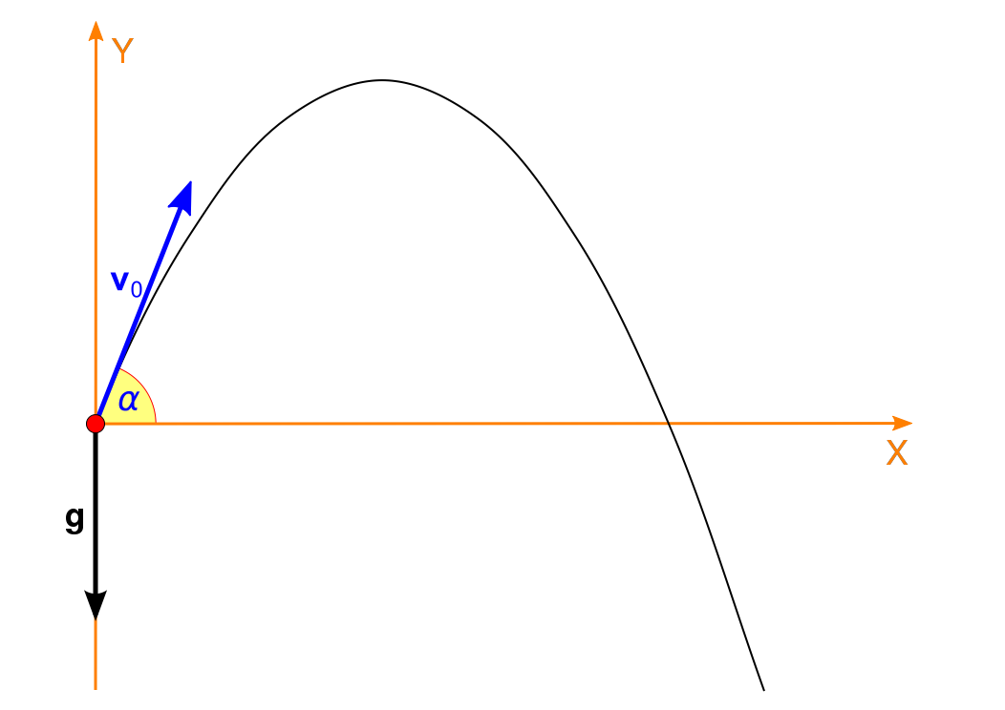
Two-Dimensional Kinematics
Projectile motion
Projectile moving following a parabola.Initial launch angle is , and the velocity is .
Free to share, print, make copies and changes. Get yours at www.boundless.com
Wikipedia. "Ferde hajitas1." CC BY-SA http://en.wikipedia.org/wiki/File:Ferde_hajitas1.svg View on Boundless.com

Slide 35
Two-Dimensional Kinematics
Range
The range of a projectile motion, as seen in this image, is independent of the forces of gravity.
Free to share, print, make copies and changes. Get yours at www.boundless.com
OpenStax CNX. "Sunil Kumar Singh, Features of Projectile Motion. January 25, 2013." CC BY 3.0 http://cnx.org/content/m13847/latest/ View on Boundless.com

Slide 36
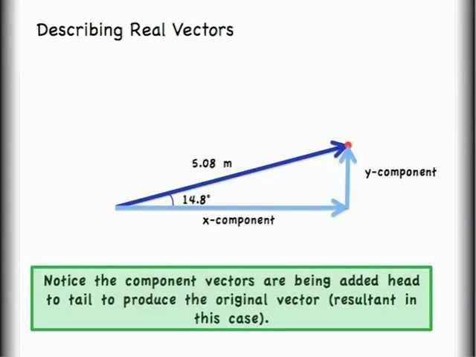
Two-Dimensional Kinematics
Vector Addition Lesson 2 of 2: How to Add Vectors by Components
This video gets viewers started with vector addition using a mathematical approach and shows vector addition by components.
Free to share, print, make copies and changes. Get yours at www.boundless.com
View on Boundless.com

Slide 37
Attribution
Two-Dimensional Kinematics
Wiktionary. "origin." CC BY-SA 3.0 http://en.wiktionary.org/wiki/origin
OpenStax CNX. "OpenStax College, Vector Addition and Subtraction: Graphical Methods. September 17, 2013." CC BY 3.0 http://cnx.org/content/m42127/latest/
Boundless Learning. "Boundless." CC BY-SA 3.0 http://www.boundless.com//physics/definition/coordinate-axes
Boundless Learning. "Boundless." CC BY-SA 3.0 http://www.boundless.com//physics/definition/component
OpenStax CNX. "OpenStax College, Vector Addition and Subtraction: Graphical Methods. September 17, 2013." CC BY 3.0 http://cnx.org/content/m42127/latest/
Wikipedia. "Euclidean vector." CC BY-SA 3.0 http://en.wikipedia.org/wiki/Euclidean_vector
Wikipedia. "Scalar (physics)." CC BY-SA 3.0 http://en.wikipedia.org/wiki/Scalar_(physics)
Boundless Learning. "Boundless." CC BY-SA 3.0 http://www.boundless.com//physics/definition/coordinate-axes
Wiktionary. "unit vector." CC BY-SA 3.0 http://en.wiktionary.org/wiki/unit_vector
Wikipedia. "Scalar (physics)." CC BY-SA 3.0 http://en.wikipedia.org/wiki/Scalar_(physics)
Wiktionary. "scalar." CC BY-SA 3.0 http://en.wiktionary.org/wiki/scalar
OpenStax CNX. "Sunil Kumar Singh, Scalar (Dot) Product. September 17, 2013." CC BY 3.0 http://cnx.org/content/m14513/latest/
Wikipedia. "Unit vector." CC BY-SA 3.0 http://en.wikipedia.org/wiki/Unit_vector
Wikipedia. "Displacement (vector)." CC BY-SA 3.0 http://en.wikipedia.org/wiki/Displacement_(vector)
Wiktionary. "displacement." CC BY-SA 3.0 http://en.wiktionary.org/wiki/displacement
Wiktionary. "acceleration." CC BY-SA 3.0 http://en.wiktionary.org/wiki/acceleration
Wiktionary. "velocity." CC BY-SA 3.0 http://en.wiktionary.org/wiki/velocity
Free to share, print, make copies and changes. Get yours at www.boundless.com

Slide 38
Two-Dimensional Kinematics
Wikipedia. "Relative velocity." CC BY-SA 3.0 http://en.wikipedia.org/wiki/Relative_velocity
Wikipedia. "Velocity-addition formula." CC BY-SA 3.0 http://en.wikipedia.org/wiki/Velocity-addition_formula
Wiktionary. "relative." CC BY-SA 3.0 http://en.wiktionary.org/wiki/relative
OpenStax CNX. "Sunil Kumar Singh, Relative Velocity in Two Dimensions. September 17, 2013." CC BY 3.0 http://cnx.org/content/m14030/latest/
Wikipedia. "Velocity-addition formula." CC BY-SA 3.0 http://en.wikipedia.org/wiki/Velocity-addition_formula
Wiktionary. "relative." CC BY-SA 3.0 http://en.wiktionary.org/wiki/relative
OpenStax CNX. "OpenStax College, Addition of Velocities. September 17, 2013." CC BY 3.0 http://cnx.org/content/m42045/latest/
Wikipedia. "Velocity." CC BY-SA 3.0 http://en.wikipedia.org/wiki/Velocity
Boundless Learning. "Boundless." CC BY-SA 3.0 http://www.boundless.com//physics/definition/constant-velocity
Light and Matter. CC BY http://lightandmatter.com/lmb.pdf
Wikipedia. "Trajectory." CC BY-SA 3.0 http://en.wikipedia.org/wiki/Trajectory
Wikipedia. "Trajectory of a projectile." CC BY-SA 3.0 http://en.wikipedia.org/wiki/Trajectory_of_a_projectile
Wiktionary. "trajectory." CC BY-SA 3.0 http://en.wiktionary.org/wiki/trajectory
OpenStax CNX. "Sunil Kumar Singh, Features of Projectile Motion. September 17, 2013." CC BY 3.0 http://cnx.org/content/m13847/latest/
Wiktionary. "vector." CC BY-SA 3.0 http://en.wiktionary.org/wiki/vector
Wiktionary. "scalar." CC BY-SA 3.0 http://en.wiktionary.org/wiki/scalar
Wiktionary. "magnitude." CC BY-SA 3.0 http://en.wiktionary.org/wiki/magnitude
OpenStax CNX. "Sunil Kumar Singh, Scalar (Dot) Product. September 17, 2013." CC BY 3.0 http://cnx.org/content/m14513/latest/
Wikipedia. "coordinates." CC BY-SA 3.0 http://en.wikipedia.org/wiki/coordinates
Free to share, print, make copies and changes. Get yours at www.boundless.com

Slide 39
Two-Dimensional Kinematics
Wikipedia. "Euclidean vector." CC BY-SA 3.0 http://en.wikipedia.org/wiki/Euclidean_vector
Wiktionary. "magnitude." CC BY-SA 3.0 http://en.wiktionary.org/wiki/magnitude
Wiktionary. "axis." CC BY-SA 3.0 http://en.wiktionary.org/wiki/axis
OpenStax CNX. "Sunil Kumar Singh, Components of a Vector. September 17, 2013." CC BY 3.0 http://cnx.org/content/m14519/latest/
Wikipedia. "Acceleration." CC BY-SA 3.0 http://en.wikipedia.org/wiki/Acceleration
Wiktionary. "kinematic." CC BY-SA 3.0 http://en.wiktionary.org/wiki/kinematic
OpenStax CNX. "OpenStax College, College Physics. September 17, 2013." CC BY 3.0 http://cnx.org/content/m42042/latest/?collection=col11406/1.7
Wikipedia. "Projectile motion." CC BY-SA 3.0 http://en.wikipedia.org/wiki/Projectile_motion
Wiktionary. "trajectory." CC BY-SA 3.0 http://en.wiktionary.org/wiki/trajectory
OpenStax CNX. "Sunil Kumar Singh, Features of Projectile Motion. September 18, 2013." CC BY 3.0 http://cnx.org/content/m13847/latest/
Wiktionary. "symmetrical." CC BY-SA 3.0 http://en.wiktionary.org/wiki/symmetrical
Wiktionary. "reorientate." CC BY-SA 3.0 http://en.wiktionary.org/wiki/reorientate
OpenStax CNX. "Sunil Kumar Singh, Features of Projectile Motion. September 18, 2013." CC BY 3.0 http://cnx.org/content/m13847/latest/
OpenStax CNX. "Sunil Kumar Singh, Projectile Motion on an Incline. September 18, 2013." CC BY 3.0 http://cnx.org/content/m14614/latest/
Wikipedia. "Trajectory." CC BY-SA 3.0 http://en.wikipedia.org/wiki/Trajectory
Wikipedia. "Trajectory of a projectile." CC BY-SA 3.0 http://en.wikipedia.org/wiki/Trajectory_of_a_projectile
Wiktionary. "trajectory." CC BY-SA 3.0 http://en.wiktionary.org/wiki/trajectory
OpenStax CNX. "Sunil Kumar Singh, Features of Projectile Motion. September 18, 2013." CC BY 3.0 http://cnx.org/content/m13847/latest/
Wikipedia. "Projectile motion." CC BY-SA 3.0 http://en.wikipedia.org/wiki/Projectile_motion
Free to share, print, make copies and changes. Get yours at www.boundless.com

Slide 40
Two-Dimensional Kinematics
Wiktionary. "trajectory." CC BY-SA 3.0 http://en.wiktionary.org/wiki/trajectory
OpenStax CNX. "Sunil Kumar Singh, Features of Projectile Motion. September 18, 2013." CC BY 3.0 http://cnx.org/content/m13847/latest/
Wiktionary. "bilateral symmetry." CC BY-SA 3.0 http://en.wiktionary.org/wiki/bilateral_symmetry
Wiktionary. "gravity." CC BY-SA 3.0 http://en.wiktionary.org/wiki/gravity
Free to share, print, make copies and changes. Get yours at www.boundless.com

