Slide 1


Boundless Lecture Slides
Available on the Boundless Teaching Platform
Free to share, print, make copies and changes. Get yours at www.boundless.com

Slide 2
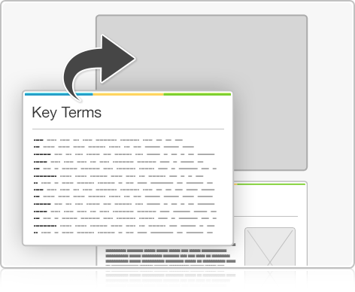


Using Boundless Presentations
Boundless Teaching Platform
Boundless empowers educators to engage their students with affordable, customizable textbooks and intuitive teaching tools. The free Boundless Teaching Platform gives educators the ability to customize textbooks in more than 20 subjects that align to hundreds of popular titles. Get started by using high quality Boundless books, or make switching to our platform easier by building from Boundless content pre-organized to match the assigned textbook. This platform gives educators the tools they need to assign readings and assessments, monitor student activity, and lead their classes with pre-made teaching resources.
Get started now at:
The Appendix
The appendix is for you to use to add depth and breadth to your lectures. You can simply drag and drop slides from the appendix into the main presentation to make for a richer lecture experience.
http://boundless.com/teaching-platform
Free to edit, share, and copy
Feel free to edit, share, and make as many copies of the Boundless presentations as you like. We encourage you to take these presentations and make them your own.
If you have any questions or problems please email:
educators@boundless.com
Free to share, print, make copies and changes. Get yours at www.boundless.com

Slide 3

About Boundless
Boundless is an innovative technology company making education more affordable and accessible for students everywhere. The company creates the world’s best open educational content in 20+ subjects that align to more than 1,000 popular college textbooks. Boundless integrates learning technology into all its premium books to help students study more efficiently at a fraction of the cost of traditional textbooks. The company also empowers educators to engage their students more effectively through customizable books and intuitive teaching tools as part of the Boundless Teaching Platform. More than 2 million learners access Boundless free and premium content each month across the company’s wide distribution platforms, including its website, iOS apps, Kindle books, and iBooks. To get started learning or teaching with Boundless, visit boundless.com.
Free to share, print, make copies and changes. Get yours at www.boundless.com

Slide 4
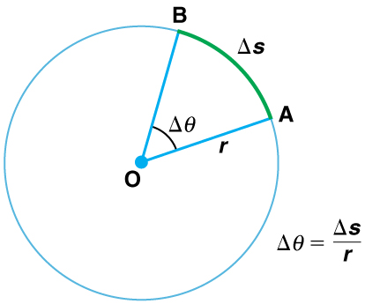
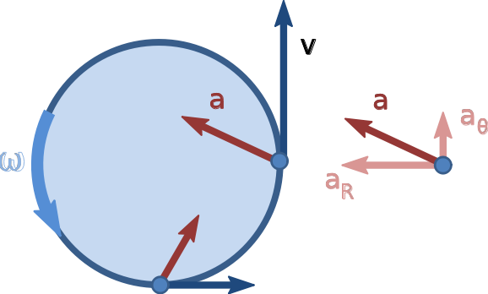
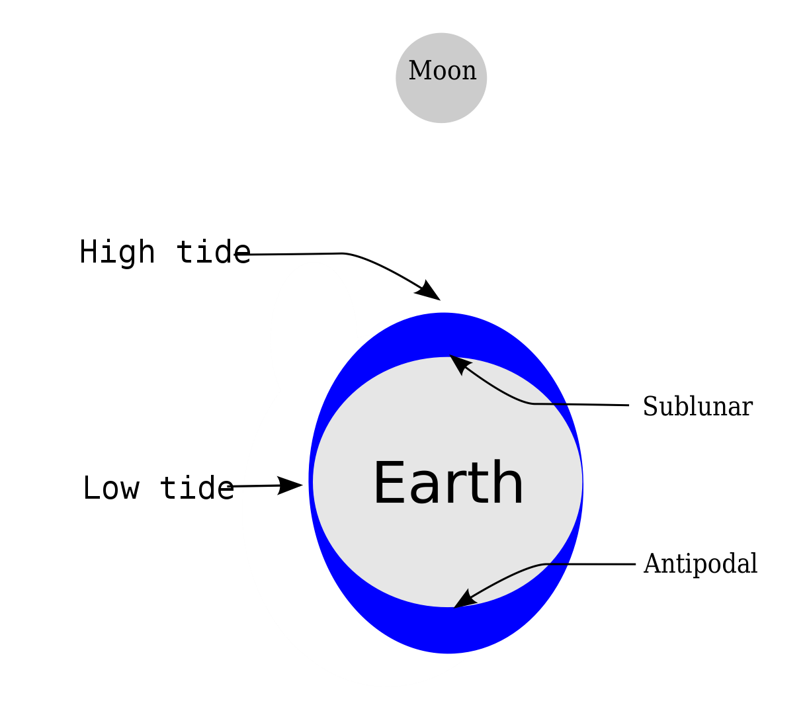
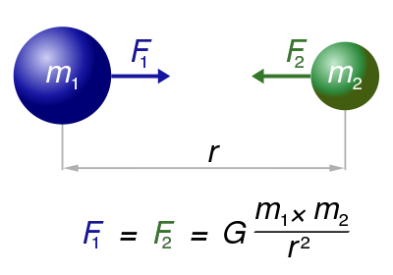

Uniform Circular Motion and Gravitation
Introduction to UCM and Gravitation
Non-Uniform Circular Motion
Velocity, Acceleration, and Force
Types of Forces in Nature
]
Newton's Law of Universal Gravitation
Uniform Circular Motion and Gravitation
Free to share, print, make copies and changes. Get yours at www.boundless.com

Slide 5
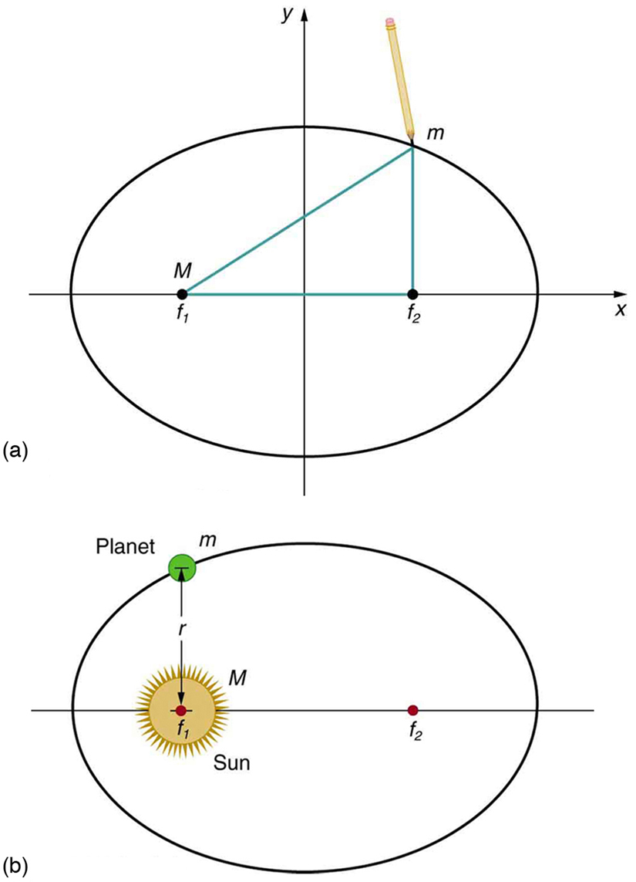
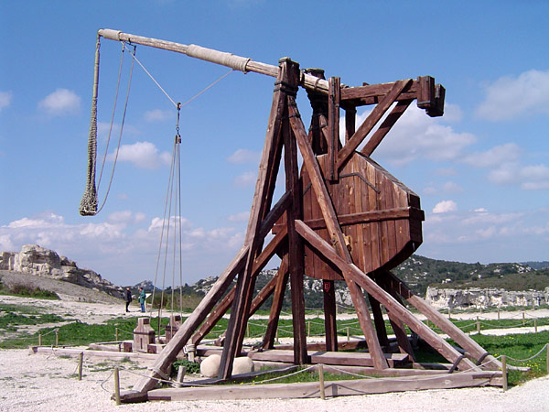
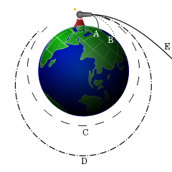
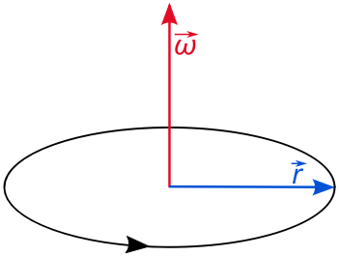
Uniform Circular Motion and Gravitation (continued)
Kepler's Laws
Gravitational Potential Energy
Energy Conservation
Angular vs. Linear Quantities
]
Uniform Circular Motion and Gravitation
Free to share, print, make copies and changes. Get yours at www.boundless.com

Slide 6

Introduction to UCM and Gravitation
Uniform Circular Motion and Gravitation > Introduction to UCM and Gravitation
Kinematics of UCM
Dynamics of UCM
Banked and Unbacked Highway Curves
Free to share, print, make copies and changes. Get yours at www.boundless.com
www.boundless.com/physics/textbooks/boundless-physics-textbook/uniform-circular-motion-and-gravitation-5/introduction-to-ucm-and-gravitation-51/

Slide 7
Non-Uniform Circular Motion
Uniform Circular Motion and Gravitation > Non-Uniform Circular Motion
Overview of Non-Uniform Circular Motion
Free to share, print, make copies and changes. Get yours at www.boundless.com
www.boundless.com/physics/textbooks/boundless-physics-textbook/uniform-circular-motion-and-gravitation-5/non-uniform-circular-motion-52/

Slide 8
Velocity, Acceleration, and Force
Uniform Circular Motion and Gravitation > Velocity, Acceleration, and Force
Rotational Angle and Angular Velocity
Centripetial Acceleration
Centripetal Force
Free to share, print, make copies and changes. Get yours at www.boundless.com
www.boundless.com/physics/textbooks/boundless-physics-textbook/uniform-circular-motion-and-gravitation-5/velocity-acceleration-and-force-53/

Slide 9
Types of Forces in Nature
Uniform Circular Motion and Gravitation > Types of Forces in Nature
Tides
The Coriolois Force
Other Geophysical Applications
Free to share, print, make copies and changes. Get yours at www.boundless.com
www.boundless.com/physics/textbooks/boundless-physics-textbook/uniform-circular-motion-and-gravitation-5/types-of-forces-in-nature-54/

Slide 10
Newton's Law of Universal Gravitation
Uniform Circular Motion and Gravitation > Newton's Law of Universal Gravitation
The Law of Universal Gravitation
Gravitational Attraction of Spherical Bodies: A Uniform Sphere
Weight of the Earth
Free to share, print, make copies and changes. Get yours at www.boundless.com
www.boundless.com/physics/textbooks/boundless-physics-textbook/uniform-circular-motion-and-gravitation-5/newton-s-law-of-universal-gravitation-55/

Slide 11
Kepler's Laws
Uniform Circular Motion and Gravitation > Kepler's Laws
Kepler's First Law
Kepler's Second Law
Kepler's Third Law
Orbital Maneuvers
Satellites
Free to share, print, make copies and changes. Get yours at www.boundless.com
www.boundless.com/physics/textbooks/boundless-physics-textbook/uniform-circular-motion-and-gravitation-5/kepler-s-laws-56/

Slide 12
Gravitational Potential Energy
Uniform Circular Motion and Gravitation > Gravitational Potential Energy
Defining Graviational Potential Energy
Free to share, print, make copies and changes. Get yours at www.boundless.com
www.boundless.com/physics/textbooks/boundless-physics-textbook/uniform-circular-motion-and-gravitation-5/gravitational-potential-energy-57/

Slide 13
Energy Conservation
Uniform Circular Motion and Gravitation > Energy Conservation
Escape Speed
Free to share, print, make copies and changes. Get yours at www.boundless.com
www.boundless.com/physics/textbooks/boundless-physics-textbook/uniform-circular-motion-and-gravitation-5/energy-conservation-58/

Slide 14
Angular vs. Linear Quantities
Uniform Circular Motion and Gravitation > Angular vs. Linear Quantities
Angular vs. Linear Quantities
Free to share, print, make copies and changes. Get yours at www.boundless.com
www.boundless.com/physics/textbooks/boundless-physics-textbook/uniform-circular-motion-and-gravitation-5/angular-vs-linear-quantities-59/

Slide 15
Appendix
Free to share, print, make copies and changes. Get yours at www.boundless.com

Slide 16
Key terms
Uniform Circular Motion and Gravitation
acceleration The amount by which a speed or velocity increases (and so a scalar quantity or a vector quantity).
angular momentum A vector quantity describing an object in circular motion; its magnitude is equal to the momentum of the particle, and the direction is perpendicular to the plane of its circular motion.
angular velocity A vector quantity describing an object in circular motion; its magnitude is equal to the speed of the particle and the direction is perpendicular to the plane of its circular motion.
angular velocity A vector quantity describing an object in circular motion; its magnitude is equal to the speed of the particle and the direction is perpendicular to the plane of its circular motion.
angular velocity A vector quantity describing an object in circular motion; its magnitude is equal to the speed of the particle and the direction is perpendicular to the plane of its circular motion.
artificial satellite In the context of spaceflight, a satellite is an object which has been placed into orbit by human endeavour.
asteroid A naturally occurring solid object, which is smaller than a planet and is not a comet, that orbits a star.
astronomical unit The mean distance from the Earth to the Sun (the semi-major axis of Earth's orbit), approximately 149,600,000 kilometres (symbol AU), used to measure distances in the solar system.
ballistics the science of mechanics that deals with the flight, behavior, and effects of projectiles, especially bullets, gravity bombs, rockets, or the like
center of mass The center of mass (COM) is the unique point at the center of a distribution of mass in space that has the property that the weighted position vectors relative to this point sum to zero.
centrifugal force the apparent outward force that draws a rotating body away from the center of rotation
centripetal Directed or moving towards a center.
Free to share, print, make copies and changes. Get yours at www.boundless.com

Slide 17
Uniform Circular Motion and Gravitation
centripetal Directed or moving towards a center.
centripetal Directed or moving towards a center.
centripetal Directed or moving towards a center.
circular motion Motion in such a way that the path taken is that of a circle.
delta-v The maximum change in the scalar speed of a rocket if the rocket were operated in a vacuum away from external forces (i.e., if no other external forces act).
diurnal Having a daily cycle that is completed every 24 hours, usually referring to tasks, processes, tides, or sunrise to sunset.
eccentricity The coefficient of variation between and : . The further appart the foci are, the stronger the eccentricity.
fictitious force an apparent force that acts on all masses in a non-inertial frame of reference, such as a rotating reference frame
gradient The rate at which a physical quantity increases or decreases relative to change in a given variable, especially distance.
gravitational force A very long-range, but relatively weak fundamental force of attraction that acts between all particles that have mass; believed to be mediated by gravitons.
gravity Resultant force on Earth's surface, of the attraction by the Earth's masses, and the centrifugal pseudo-force caused by the Earth's rotation.
Hohmann transfer orbit The Hohmann transfer orbit is an elliptical orbit used to transfer between two circular orbits of different altitudes, in the same plane. The orbital maneuver to perform the Hohmann transfer uses two engine impulses, one to move a spacecraft onto the transfer orbit and a second to move off it.
Free to share, print, make copies and changes. Get yours at www.boundless.com

Slide 18
Uniform Circular Motion and Gravitation
induction Use inductive reasoning to generalize and interpret results from applying Newton's Law of Gravitation.
inertial frame A frame of reference that describes time and space homogeneously, isotropically, and in a time-independent manner.
inertial frame A frame of reference that describes time and space homogeneously, isotropically, and in a time-independent manner.
inverse Opposite in effect or nature or order.
kinetic energy The energy possessed by an object because of its motion, equal to one half the mass of the body times the square of its velocity.
mean motion An angle of (radians) divided by the orbital period (of a celestial body in an elliptic orbit).
meteorology the interdisciplinary scientific study of the atmosphere
natural satellite A natural satellite, moon, or secondary planet is a celestial body that orbits a planet or smaller body, which is called its primary.
Newton's law of gravitation This law states that every point mass in the universe attracts every other point mass with a force that is directly proportional to the product of their masses and inversely proportional to the square of the distance between them.
normal force Any force acting normal, to a surface, or perpendicular to the tangent plane.
perihelion The point in the elliptical orbit of a planet or comet etc. where it is nearest to the Sun. The point farthest from the Sun is called aphelion.
planet A large body which directly orbits any star (or star cluster) but which has not attained nuclear fusion.
Free to share, print, make copies and changes. Get yours at www.boundless.com

Slide 19
Uniform Circular Motion and Gravitation
point mass A theoretical point with mass assigned to it.
potential energy The energy an object has because of its position (in a gravitational or electric field) or its condition (as a stretched or compressed spring, as a chemical reactant, or by having rest mass)
potential energy The energy an object has because of its position (in a gravitational or electric field) or its condition (as a stretched or compressed spring, as a chemical reactant, or by having rest mass)
propulsion Force causing movement.
radial Moving along a radius.
radians The angle subtended at the centre of a circle by an arc of the circle of the same length as the circle's radius.
semi-latus rectum The latus rectum is a chord perpendicular to the major axis and passing through the focus. The semi-latus rectum is half the latus rectrum. See distance p in.
sidereal year The orbital period of the Earth; a measure of the time it takes for the Sun to return to the same position with respect to the stars of the celestial sphere. A sidereal year is about 20.4 minutes longer than the tropical year due to precession of the equinoxes.
vector A directed quantity, one with both magnitude and direction; the between two points.
velocity A vector quantity that denotes the rate of change of position with respect to time, or a speed with a directional component.
weight The force on an object due to the gravitational attraction between it and the Earth (or whatever astronomical object it is primarily influenced by).
Free to share, print, make copies and changes. Get yours at www.boundless.com

Slide 20

Uniform Circular Motion and Gravitation
Angular velocity diagram
A vector diagram illustrating circular motion. The blue vector connects the origin (center) of the motion to the position of the particle. The red vector is the angular velocity vector, pointing perpendicular to the plane of motion and with magnitude equal to the instantaneous velocity.
Free to share, print, make copies and changes. Get yours at www.boundless.com
Wikipedia. "File:Angular velocity.svg - Wikipedia, the free encyclopedia." CC BY-SA http://en.wikipedia.org/w/index.php?title=File:Angular_velocity.svg&page=1 View on Boundless.com

Slide 21
Uniform Circular Motion and Gravitation
Ellipses and Kepler's First Law
(a) An ellipse is a closed curve such that the sum of the distances from a point on the curve to the two foci ( and ) is a constant. You can draw an ellipse as shown by putting a pin at each focus, and then placing a string around a pencil and the pins and tracing a line on paper. A circle is a special case of an ellipse in which the two foci coincide (thus any point on the circle is the same distance from the center). (b) For any closed gravitational orbit, follows an elliptical path with at one focus. Kepler's first law states this fact for planets orbiting the Sun.
Free to share, print, make copies and changes. Get yours at www.boundless.com
OpenStax CNX. "OpenStax College, College Physics. January 28, 2013." CC BY 3.0 http://cnx.org/content/m42144/latest/?collection=col11406/1.7 View on Boundless.com

Slide 22
Uniform Circular Motion and Gravitation
Frames of Reference
In the inertial frame of reference (upper part of the picture), the black object moves in a straight line. However, the observer (red dot) who is standing in the rotating/non-inertial frame of reference (lower part of the picture) sees the object as following a curved path due to the Coriolis and centrifugal forces present in this frame.
Free to share, print, make copies and changes. Get yours at www.boundless.com
Wikipedia. "Coriolis effect." CC BY http://en.wikipedia.org/wiki/Coriolis_effect View on Boundless.com

Slide 23
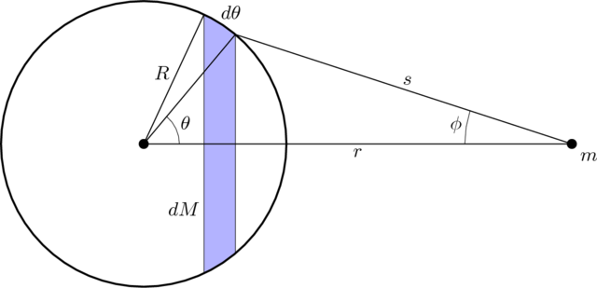
Uniform Circular Motion and Gravitation
Diagram used in the proof of the Shell Theorem
This diagram outlines the geometry considered when proving The Shell Theorem. In particular, in this case a spherical shell of mass (left side of figure) exerts a force on mass (right side of the figure) outside of it. The surface area of a thin slice of the sphere is shown in color. (Note: The proof of the theorem is not presented here. Interested readers can explore further using the sources listed at the bottom of this article.)
Free to share, print, make copies and changes. Get yours at www.boundless.com
Wikimedia Commons. "Shell-diag-1." CC BY-SA 2.5 https://commons.wikimedia.org/wiki/File:Shell-diag-1.png View on Boundless.com

Slide 24
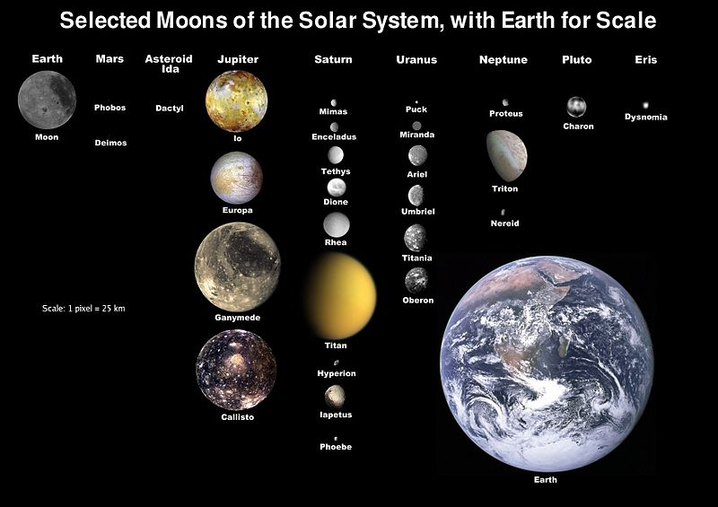
Uniform Circular Motion and Gravitation
Moons of the Solar System
Nineteen natural satellites are large enough to be round, and one, Saturn's Titan, has a substantial atmosphere.
Free to share, print, make copies and changes. Get yours at www.boundless.com
Wikipedia. "Natural satellite." Public domain http://en.wikipedia.org/wiki/Natural_satellite View on Boundless.com

Slide 25
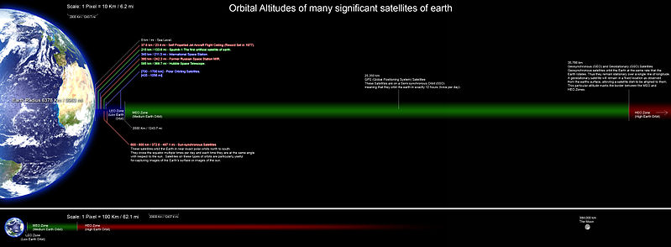
Uniform Circular Motion and Gravitation
Orbital Altitudes
Orbital Altitudes of several significant satellites of earth.
Free to share, print, make copies and changes. Get yours at www.boundless.com
Wikipedia. "Satellites." GNU FDL http://en.wikipedia.org/wiki/Satellites View on Boundless.com

Slide 26
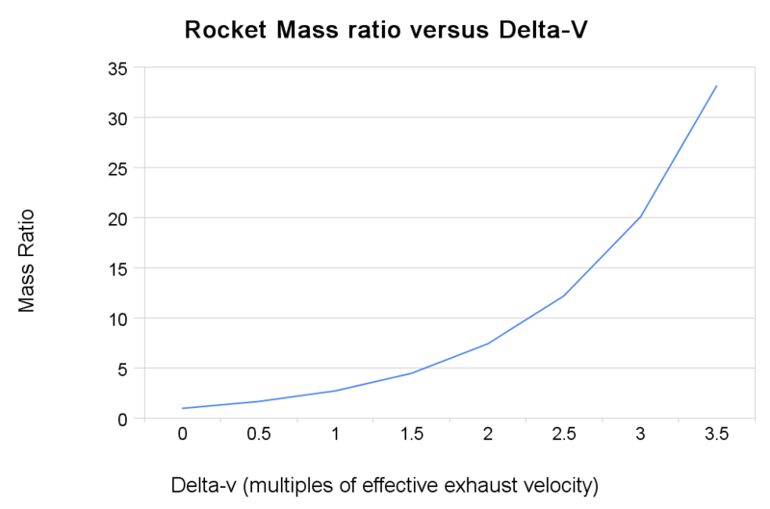
Uniform Circular Motion and Gravitation
Rocket Equation
Rocket mass ratios versus final velocity calculated from the rocket equation
Free to share, print, make copies and changes. Get yours at www.boundless.com
Wikipedia. "Orbital maneuver." Public domain http://en.wikipedia.org/wiki/Orbital_maneuver View on Boundless.com

Slide 27
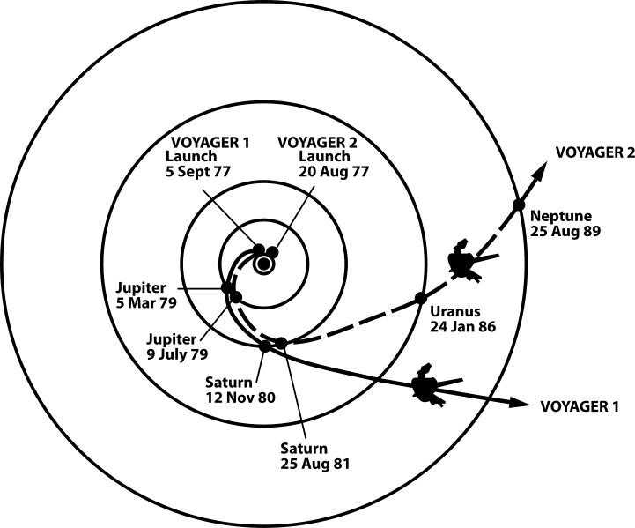
Uniform Circular Motion and Gravitation
Voyager Path Using Gravity Assists
The trajectories that enabled NASA's twin Voyager spacecraft to tour the four gas giant planets and achieve velocity to escape our solar system
Free to share, print, make copies and changes. Get yours at www.boundless.com
Wikipedia. "Orbital maneuver." Public domain http://en.wikipedia.org/wiki/Orbital_maneuver View on Boundless.com

Slide 28
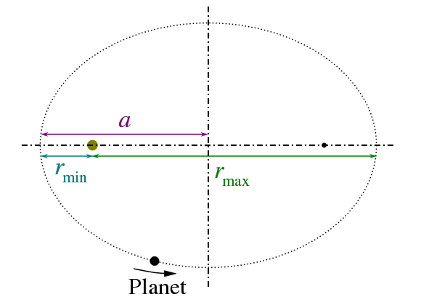
Uniform Circular Motion and Gravitation
Kepler's Third Law
Kepler's third law states that the square of the period of the orbit of a planet about the Sun is proportional to the cube of the semi-major axis of the orbit.
Free to share, print, make copies and changes. Get yours at www.boundless.com
Wikimedia. "Search results for "kepler%27s third law" - Wikimedia Commons." Public domain http://commons.wikimedia.org/w/index.php?search=kepler's+third+law&button=&title=Special:Search View on Boundless.com

Slide 29
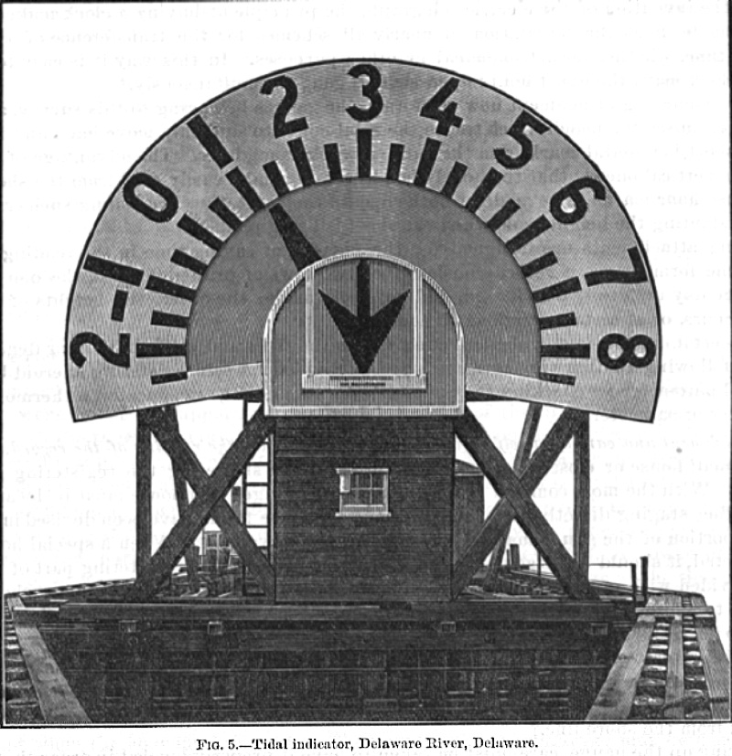
Uniform Circular Motion and Gravitation
Tidal Indicator
Tidal Indicator, Delaware River, Delaware c. 1897. In the moment pictured, the tide is 1.25 feet above mean low water and is still falling, as indicated by the pointing of the arrow. The indicator is powered by a system of pulleys, cables, and a float
Free to share, print, make copies and changes. Get yours at www.boundless.com
Wikipedia. "Tide." CC BY http://en.wikipedia.org/wiki/Tide View on Boundless.com

Slide 30
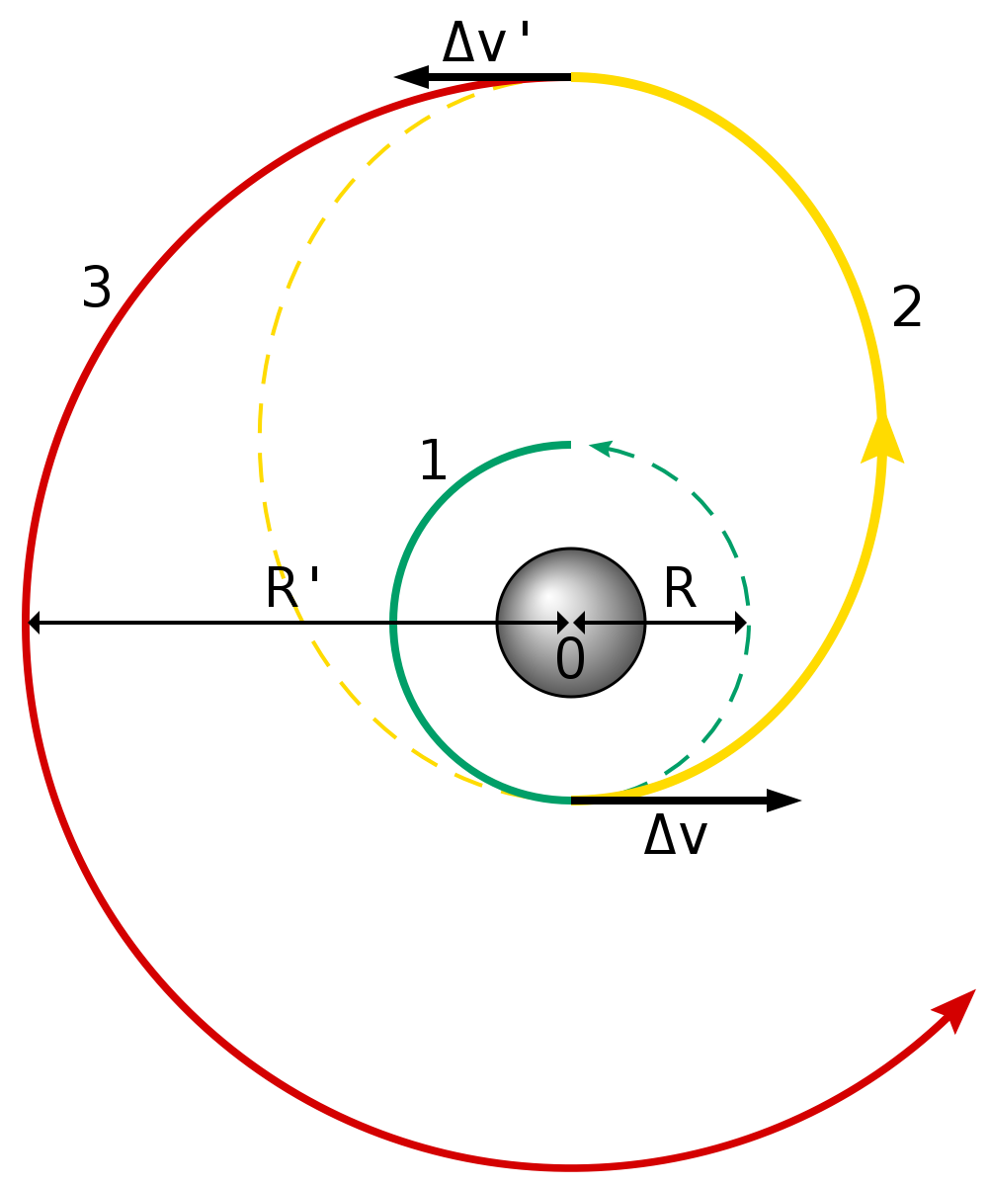
Uniform Circular Motion and Gravitation
Hohmann Transfer Orbit
A diagram of the Hohmann Transfer Orbit.
Free to share, print, make copies and changes. Get yours at www.boundless.com
Wikipedia. "Orbital maneuver." GNU FDL http://en.wikipedia.org/wiki/Orbital_maneuver View on Boundless.com

Slide 31
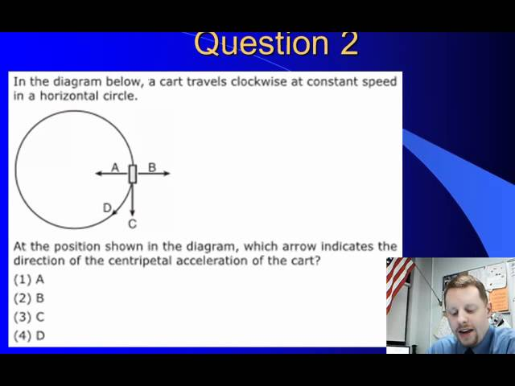
Uniform Circular Motion and Gravitation
Centripetal Acceleration
A brief overview of centripetal acceleration for high school physics students.
Free to share, print, make copies and changes. Get yours at www.boundless.com
View on Boundless.com

Slide 32
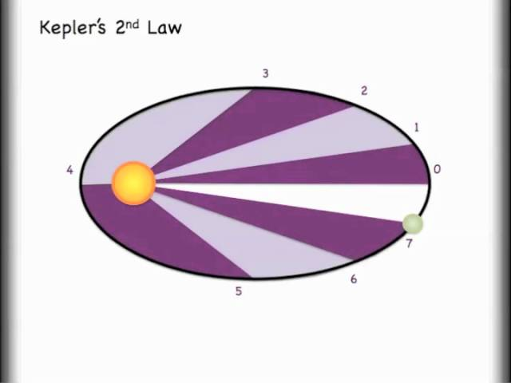
Uniform Circular Motion and Gravitation
Understanding Kepler's 3 Laws and Orbits
In this video you will be introduced to Kepler's 3 laws and see how they are relevant to orbiting objects.
Free to share, print, make copies and changes. Get yours at www.boundless.com
View on Boundless.com

Slide 33
Uniform Circular Motion and Gravitation
Angle and Arc Length
The radius of a circle is rotated through an angle . The arc length is described on the circumference.
Free to share, print, make copies and changes. Get yours at www.boundless.com
OpenStax CNX. "OpenStax College, College Physics. January 16, 2015." CC BY 3.0 http://cnx.org/content/m42083/latest/?collection=col11406/1.7 View on Boundless.com

Slide 34
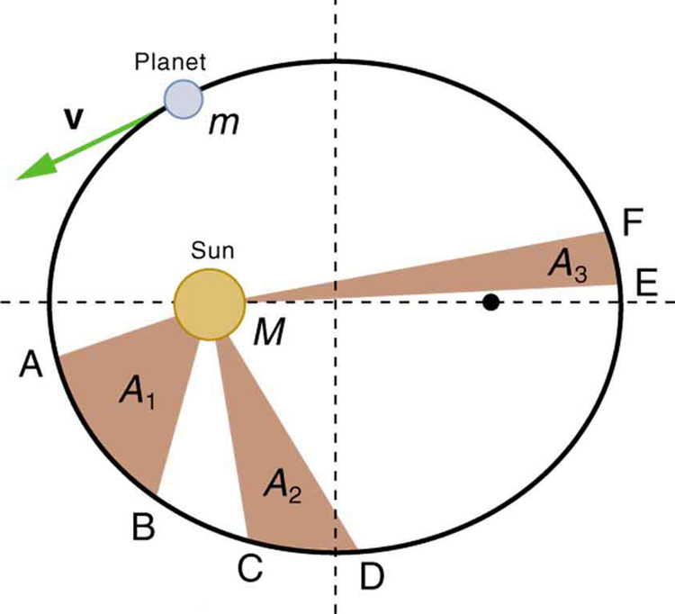
Uniform Circular Motion and Gravitation
Kepler's Second Law
The shaded regions have equal areas. It takes equal times for to go from to , from to , and from to . The mass moves fastest when it is closest to . Kepler's second law was originally devised for planets orbiting the Sun, but it has broader validity.
Free to share, print, make copies and changes. Get yours at www.boundless.com
OpenStax CNX. "OpenStax College, College Physics. January 28, 2013." CC BY 3.0 http://cnx.org/content/m42144/latest/?collection=col11406/1.7 View on Boundless.com

Slide 35
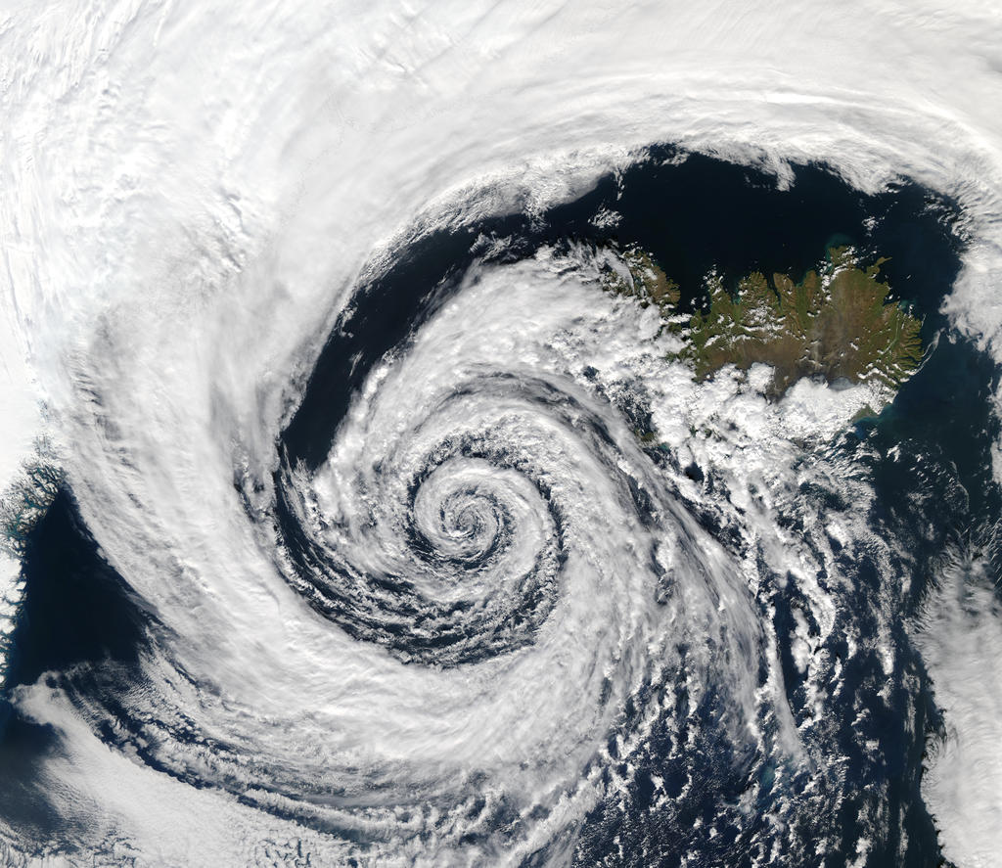
Uniform Circular Motion and Gravitation
Coriolis Force
This low-pressure system over Iceland spins counter-clockwise due to balance between the Coriolis force and the pressure gradient force.
Free to share, print, make copies and changes. Get yours at www.boundless.com
Wikipedia. "Coriolis effect." CC BY http://en.wikipedia.org/wiki/Coriolis_effect View on Boundless.com

Slide 36
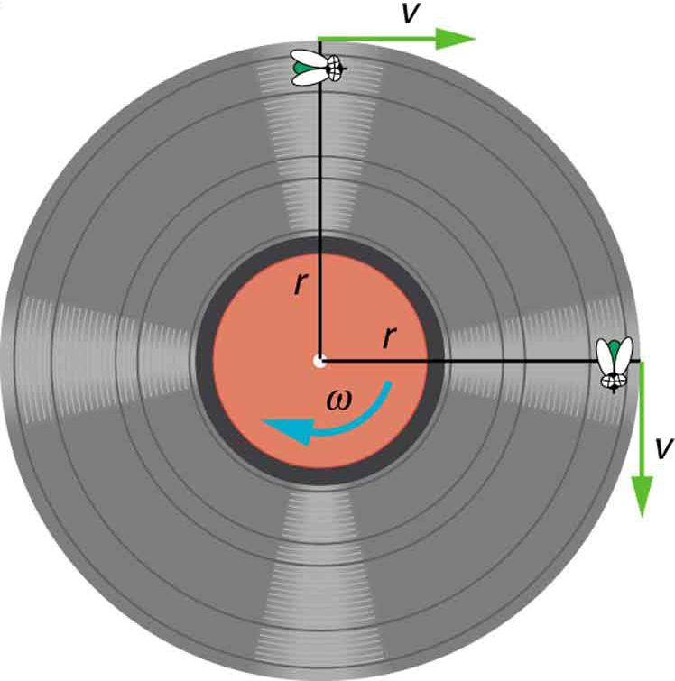
Uniform Circular Motion and Gravitation
Angular Velocity
A fly on the edge of a rotating object records a constant velocity . The object is rotating with an angular velocity equal to .
Free to share, print, make copies and changes. Get yours at www.boundless.com
OpenStax CNX. "OpenStax College, Rotation Angle and Angular Velocity. January 25, 2013." CC BY 3.0 http://cnx.org/content/m42083/latest/Figure_07_01_04a.jpg View on Boundless.com

Slide 37
Uniform Circular Motion and Gravitation
Angle θ and Arc Length s
The radius of a circle is rotated through an angle . The arc length is described on the circumference.
Free to share, print, make copies and changes. Get yours at www.boundless.com
OpenStax CNX. "OpenStax College, College Physics. November 10, 2012." CC BY 3.0 http://cnx.org/content/m42083/latest/?collection=col11406/1.7 View on Boundless.com

Slide 38
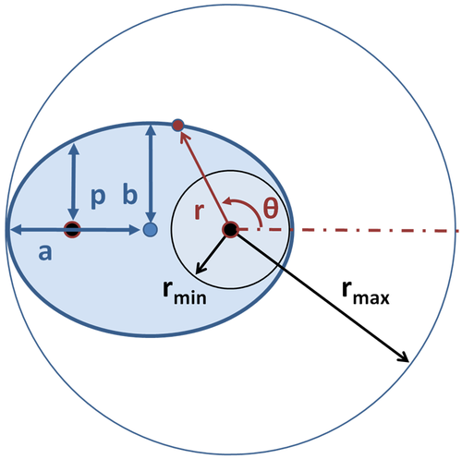
Uniform Circular Motion and Gravitation
Orbit As Ellipse
Heliocentric coordinate system for ellipse. Also shown are: semi-major axis , semi-minor axis and semi-latus rectum ; center of ellipse and its two foci marked by large dots. For °, and for °, .
Free to share, print, make copies and changes. Get yours at www.boundless.com
Wikipedia. "Kepler's laws." GNU FDL http://en.wikipedia.org/wiki/Kepler's_laws View on Boundless.com

Slide 39
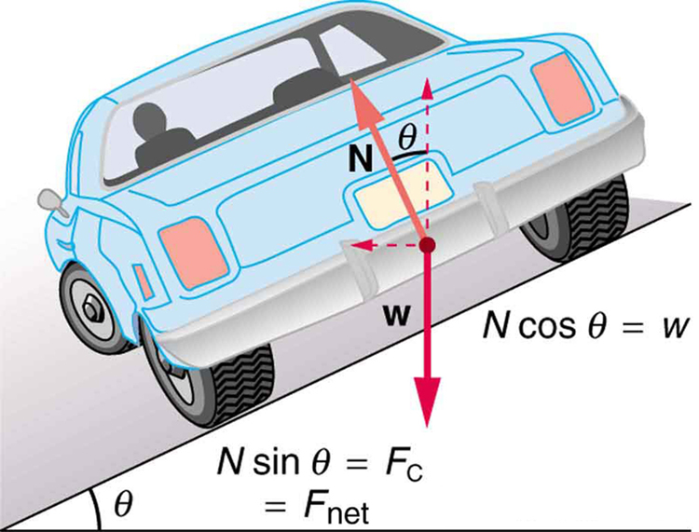
Uniform Circular Motion and Gravitation
Car on a Banked Curve
The car on this banked curve is moving away and turning to the left.
Free to share, print, make copies and changes. Get yours at www.boundless.com
OpenStax CNX. "OpenStax College, College Physics. February 6, 2013." CC BY 3.0 http://cnx.org/content/m42086/latest/?collection=col11406/1.7 View on Boundless.com

Slide 40
Uniform Circular Motion and Gravitation
Understanding Kepler's 3 Laws and Orbits
In this video you will be introduced to Kepler's 3 laws and see how they are relevant to orbiting objects.
Free to share, print, make copies and changes. Get yours at www.boundless.com
View on Boundless.com

Slide 41
Uniform Circular Motion and Gravitation
Diagram of non-uniform circular motion
In non-uniform circular motion, the magnitude of the angular velocity changes over time.
Free to share, print, make copies and changes. Get yours at www.boundless.com
Wikipedia. "File:Nonuniform circular motion.svg - Wikipedia, the free encyclopedia." CC BY-SA http://en.wikipedia.org/w/index.php?title=File:Nonuniform_circular_motion.svg&page=1 View on Boundless.com

Slide 42
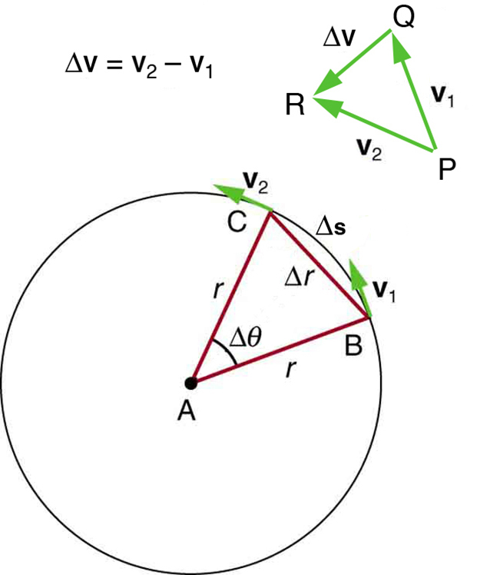
Uniform Circular Motion and Gravitation
Centripetal Acceleration
As an object moves around a circle, the direction of the velocity vector constantly changes.
Free to share, print, make copies and changes. Get yours at www.boundless.com
OpenStax CNX. "OpenStax College, Centripetal Acceleration. January 25, 2013." CC BY 3.0 http://cnx.org/content/m42084/latest/Figure_07_02_01a.jpg View on Boundless.com

Slide 43
Uniform Circular Motion and Gravitation
The Direction of Angular Velocity
The angular velocity describes the speed of rotation and the orientation of the instantaneous axis about which the rotation occurs. The direction of the angular velocity will be along the axis of rotation. In this case (counter-clockwise rotation), the vector points upwards.
Free to share, print, make copies and changes. Get yours at www.boundless.com
Wikipedia. "Angular velocity." CC BY http://en.wikipedia.org/wiki/Angular_velocity View on Boundless.com

Slide 44
Uniform Circular Motion and Gravitation
Ellipses and Kepler's First Law
(a) An ellipse is a closed curve such that the sum of the distances from a point on the curve to the two foci ( and ) is a constant. You can draw an ellipse as shown by putting a pin at each focus, and then placing a string around a pencil and the pins and tracing a line on paper. A circle is a special case of an ellipse in which the two foci coincide (thus any point on the circle is the same distance from the center). (b) For any closed gravitational orbit, follows an elliptical path with at one focus. Kepler's first law states this fact for planets orbiting the Sun.
Free to share, print, make copies and changes. Get yours at www.boundless.com
OpenStax CNX. "OpenStax College, College Physics. January 28, 2013." CC BY 3.0 http://cnx.org/content/m42144/latest/?collection=col11406/1.7 View on Boundless.com

Slide 45
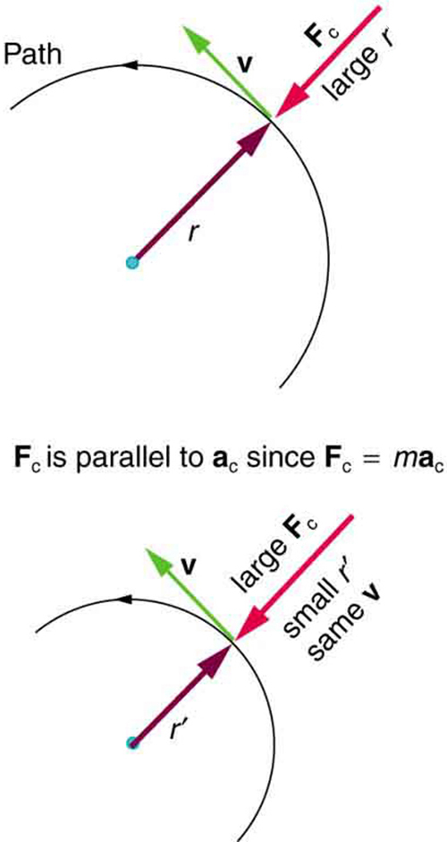
Uniform Circular Motion and Gravitation
Centripetal force
As an object travels around a circular path at a constant speed, it experiences a centripetal force accelerating it toward the center.
Free to share, print, make copies and changes. Get yours at www.boundless.com
OpenStax CNX. "OpenStax College, Centripetal Force. January 25, 2013." CC BY 3.0 http://cnx.org/content/m42086/latest/Figure_07_03_01a.jpg View on Boundless.com

Slide 46
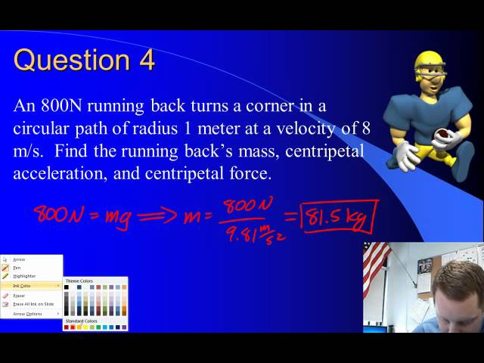
Uniform Circular Motion and Gravitation
Overview of centripetal force
A brief overview of centripetal force.
Free to share, print, make copies and changes. Get yours at www.boundless.com
View on Boundless.com

Slide 47
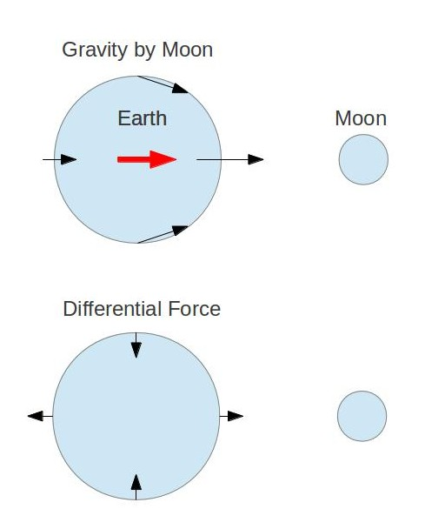
Uniform Circular Motion and Gravitation
Moon's Gravity on the Earth
Top picture shows the gravity force due to the Moon at different locations on Earth. Bottom picture shows the differential force . This is the acceleration "felt" by an observer living on Earth.
Free to share, print, make copies and changes. Get yours at www.boundless.com
Amazon Web Services. "Boundless." CC BY http://s3.amazonaws.com/figures.boundless.com/51085139e4b0c14bf46493bf/1.jpg View on Boundless.com

Slide 48
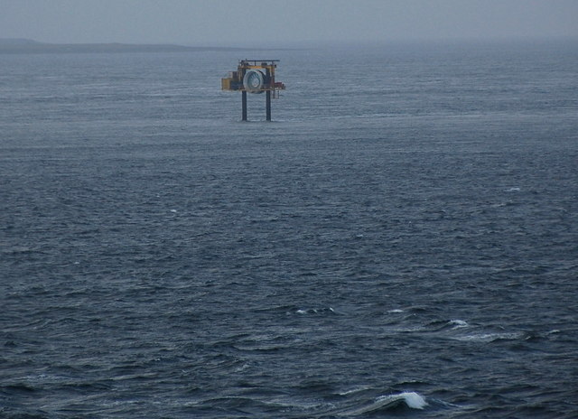
Uniform Circular Motion and Gravitation
Tidal Energy Generator
Tidal energy generator that works like a wind turbine, but with the ocean currents providing the energy. The circle in the middle is the turbine. The contraption travels up and down the two legs just like a lift and sits on the sea floor when in use.
Free to share, print, make copies and changes. Get yours at www.boundless.com
Wikimedia. CC BY-SA http://upload.wikimedia.org/wikipedia/commons/4/4a/Tidal_energy_generator,_Eday_-_geograph.org.uk_-_1267433.jpg View on Boundless.com

Slide 49
Uniform Circular Motion and Gravitation
Earth's tides.
Schematic of the lunar portion of earth's tides showing (exaggerated) high tides at the sublunar and antipodal points for the hypothetical case of an ocean of constant depth with no land. There would also be smaller, superimposed bulges on the sides facing toward and away from the sun.
Free to share, print, make copies and changes. Get yours at www.boundless.com
Wikipedia. "Tide." CC BY http://en.wikipedia.org/wiki/Tide View on Boundless.com

Slide 50
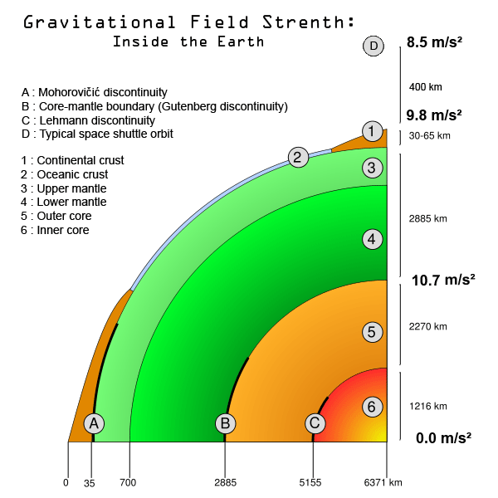
Uniform Circular Motion and Gravitation
Gravitational Field of Earth
Diagram of the gravitational field strength within the Earth.
Free to share, print, make copies and changes. Get yours at www.boundless.com
Wikimedia. CC BY-SA http://upload.wikimedia.org/wikipedia/commons/4/43/Earth-G-force.png View on Boundless.com

Slide 51
Uniform Circular Motion and Gravitation
Trebuchet
A trebuchet uses the gravitational potential energy of the counterweight to throw projectiles over long distances.
Free to share, print, make copies and changes. Get yours at www.boundless.com
Wikipedia. "Trebuchet." CC BY-SA http://en.wikipedia.org/wiki/File:Trebuchet.jpg View on Boundless.com

Slide 52
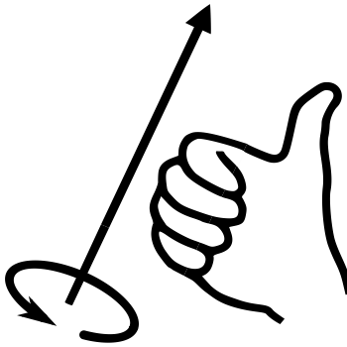
Uniform Circular Motion and Gravitation
Right hand rule
When determining the direction of an angular vector, use the right hand rule: curl the fingers of your right hand in the direction of the circular motion and your thumb points in the vector direction.
Free to share, print, make copies and changes. Get yours at www.boundless.com
Wikipedia. "File:Right-hand grip rule.svg - Wikipedia, the free encyclopedia." CC BY-SA http://en.wikipedia.org/w/index.php?title=File:Right-hand_grip_rule.svg&page=1 View on Boundless.com

Slide 53
Uniform Circular Motion and Gravitation
Understanding Kepler's 3 Laws and Orbits
In this video you will be introduced to Kepler's 3 laws and see how they are relevant to orbiting objects.
Free to share, print, make copies and changes. Get yours at www.boundless.com
View on Boundless.com

Slide 54
Uniform Circular Motion and Gravitation
Kepler's Second Law
The shaded regions have equal areas. It takes equal times for m to go from A to B, from C to D, and from E to F. The mass m moves fastest when it is closest to M. Kepler's second law was originally devised for planets orbiting the Sun, but it has broader validity.
Free to share, print, make copies and changes. Get yours at www.boundless.com
OpenStax CNX. "OpenStax College, College Physics. April 28, 2014." CC BY 3.0 http://cnx.org/content/m42144/latest/?collection=col11406/1.7 View on Boundless.com

Slide 55
Uniform Circular Motion and Gravitation
Isaac Newton's Analysis of Escape Speed
In this figure, Objects A and B don't have the required escape speed and so they fall back to Earth after launch. Objects C and D don't either, they achieve a circular and an elliptical orbit respectively. Object E is launched with sufficient escape velocity and escapes the Earth.
Free to share, print, make copies and changes. Get yours at www.boundless.com
Wikipedia. "Escape velocity." CC BY http://en.wikipedia.org/wiki/Escape_velocity View on Boundless.com

Slide 56
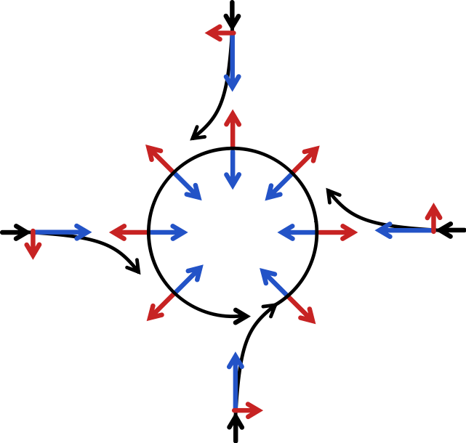
Uniform Circular Motion and Gravitation
Flow Representation
A schematic representation of flow around a low-pressure area in the Northern Hemisphere. The pressure-gradient force is represented by blue arrows and the Coriolis acceleration (always perpendicular to the velocity) by red arrows
Free to share, print, make copies and changes. Get yours at www.boundless.com
Wikipedia. "Coriolis effect." CC BY http://en.wikipedia.org/wiki/Coriolis_effect%23Ballistic_missiles_and_satellites View on Boundless.com

Slide 57
Uniform Circular Motion and Gravitation
Forces on two masses
All masses are attracted to each other. The force is proportional to the masses and inversely proportional to the square of the distance.
Free to share, print, make copies and changes. Get yours at www.boundless.com
Wikipedia. "Universal gravitation." GNU FDL http://en.wikipedia.org/wiki/Universal_gravitation View on Boundless.com

Slide 58
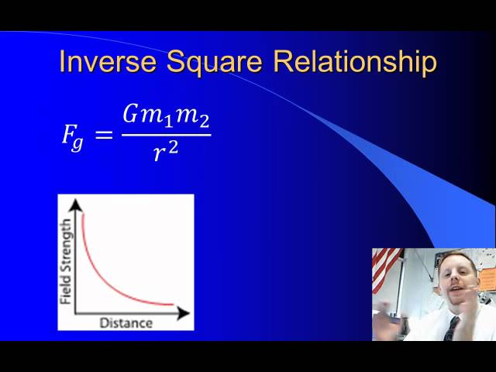
Uniform Circular Motion and Gravitation
Newton's Law of Universal Gravitation
A brief introduction to Newton's Law of Universal Gravitation for high school students.
Free to share, print, make copies and changes. Get yours at www.boundless.com
View on Boundless.com

Slide 59
Attribution
Uniform Circular Motion and Gravitation
Boundless Learning. "Boundless." CC BY-SA 3.0 http://www.boundless.com//physics/definition/angular-velocity
Wiktionary. "centripetal." CC BY-SA 3.0 http://en.wiktionary.org/wiki/centripetal
OpenStax CNX. "OpenStax College, Centripetal Force. September 17, 2013." CC BY 3.0 http://cnx.org/content/m42086/latest/
Boundless Learning. "Boundless." CC BY-SA 3.0 http://www.boundless.com//physics/definition/circular-motion
Wiktionary. "acceleration." CC BY-SA 3.0 http://en.wiktionary.org/wiki/acceleration
Wiktionary. "velocity." CC BY-SA 3.0 http://en.wiktionary.org/wiki/velocity
OpenStax CNX. "OpenStax College, Centripetal Acceleration. September 17, 2013." CC BY 3.0 http://cnx.org/content/m42084/latest/
Boundless Learning. "Boundless." CC BY-SA 3.0 http://www.boundless.com//physics/definition/ballistics
Wikipedia. "meteorology." CC BY-SA 3.0 http://en.wikipedia.org/wiki/meteorology
Wikipedia. "Tide." CC BY-SA 3.0 http://en.wikipedia.org/wiki/Tide
Wikipedia. "Coriolis effect." CC BY-SA 3.0 http://en.wikipedia.org/wiki/Coriolis_effect%23Ballistic_missiles_and_satellites
Wikipedia. "inertial frame." CC BY-SA 3.0 http://en.wikipedia.org/wiki/inertial%20frame
Wiktionary. "gradient." CC BY-SA 3.0 http://en.wiktionary.org/wiki/gradient
Wiktionary. "diurnal." CC BY-SA 3.0 http://en.wiktionary.org/wiki/diurnal
Wikipedia. "Tide." CC BY-SA 3.0 http://en.wikipedia.org/wiki/Tide
Wikipedia. "Tide." CC BY-SA 3.0 http://en.wikipedia.org/wiki/Tide
Wiktionary. "centripetal." CC BY-SA 3.0 http://en.wiktionary.org/wiki/centripetal
Free to share, print, make copies and changes. Get yours at www.boundless.com

Slide 60
Uniform Circular Motion and Gravitation
OpenStax CNX. "OpenStax College, College Physics. September 17, 2013." CC BY 3.0 http://cnx.org/content/m42083/latest/?collection=col11406/1.7
OpenStax CNX. "OpenStax College, College Physics. September 17, 2013." CC BY 3.0 http://cnx.org/content/m42084/latest/?collection=col11406/1.7
OpenStax CNX. "OpenStax College, College Physics. September 17, 2013." CC BY 3.0 http://cnx.org/content/m42083/latest/?collection=col11406/1.7
OpenStax CNX. "OpenStax College, College Physics. September 17, 2013." CC BY 3.0 http://cnx.org/content/m42086/latest/?collection=col11406/1.7
Wiktionary. "perihelion." CC BY-SA 3.0 http://en.wiktionary.org/wiki/perihelion
Boundless Learning. "Boundless." CC BY-SA 3.0 http://www.boundless.com//physics/definition/semi-latus-rectum
Boundless Learning. "Boundless." CC BY-SA 3.0 http://www.boundless.com//physics/definition/eccentricity
OpenStax CNX. "OpenStax College, College Physics. September 17, 2013." CC BY 3.0 http://cnx.org/content/m42144/latest/?collection=col11406/1.7
Wikipedia. "Kepler's laws." CC BY-SA 3.0 http://en.wikipedia.org/wiki/Kepler's_laws
Wiktionary. "propulsion." CC BY-SA 3.0 http://en.wiktionary.org/wiki/propulsion
Wikipedia. "potential energy." CC BY-SA 3.0 http://en.wikipedia.org/wiki/potential%20energy
Wikipedia. "kinetic energy." CC BY-SA 3.0 http://en.wikipedia.org/wiki/kinetic%20energy
Wikipedia. "Escape velocity." CC BY-SA 3.0 http://en.wikipedia.org/wiki/Escape_velocity
Boundless Learning. "Boundless." CC BY-SA 3.0 http://www.boundless.com//physics/definition/angular-velocity
Boundless Learning. "Boundless." CC BY-SA 3.0 http://www.boundless.com//physics/definition/angular-momentum
Wiktionary. "vector." CC BY-SA 3.0 http://en.wiktionary.org/wiki/vector
Wikipedia. "Radians." CC BY-SA 3.0 http://en.wikipedia.org/wiki/Radians
Wikipedia. "Right hand rule." CC BY-SA 3.0 http://en.wikipedia.org/wiki/Right_hand_rule
Wikipedia. "Angular velocity." CC BY-SA 3.0 http://en.wikipedia.org/wiki/Angular_velocity
Free to share, print, make copies and changes. Get yours at www.boundless.com

Slide 61
Uniform Circular Motion and Gravitation
Wikipedia. "Hohmann transfer orbit." CC BY-SA 3.0 http://en.wikipedia.org/wiki/Hohmann%20transfer%20orbit
Wiktionary. "delta-v." CC BY-SA 3.0 http://en.wiktionary.org/wiki/delta-v
Wikipedia. "Orbital maneuver." CC BY-SA 3.0 http://en.wikipedia.org/wiki/Orbital_maneuver
Wiktionary. "radians." CC BY-SA 3.0 http://en.wiktionary.org/wiki/radians
OpenStax CNX. "OpenStax College, Rotation Angle and Angular Velocity. September 17, 2013." CC BY 3.0 http://cnx.org/content/m42083/latest/
Wiktionary. "planet." CC BY-SA 3.0 http://en.wiktionary.org/wiki/planet
Wiktionary. "asteroid." CC BY-SA 3.0 http://en.wiktionary.org/wiki/asteroid
OpenStax CNX. "OpenStax College, College Physics. September 17, 2013." CC BY 3.0 http://cnx.org/content/m42143/latest/?collection=col11406/1.7
OpenStax CNX. "OpenStax College, College Physics. September 17, 2013." CC BY 3.0 http://cnx.org/content/m42144/latest/?collection=col11406/1.7
Wiktionary. "normal force." CC BY-SA 3.0 http://en.wiktionary.org/wiki/normal_force
Wiktionary. "centripetal." CC BY-SA 3.0 http://en.wiktionary.org/wiki/centripetal
OpenStax CNX. "OpenStax College, College Physics. September 17, 2013." CC BY 3.0 http://cnx.org/content/m42086/latest/?collection=col11406/1.7
Wikipedia. "inertial frame." CC BY-SA 3.0 http://en.wikipedia.org/wiki/inertial%20frame
Wikipedia. "fictitious force." CC BY-SA 3.0 http://en.wikipedia.org/wiki/fictitious%20force
Wikipedia. "centrifugal force." CC BY-SA 3.0 http://en.wikipedia.org/wiki/centrifugal%20force
Wikipedia. "Coriolis effect." CC BY-SA 3.0 http://en.wikipedia.org/wiki/Coriolis_effect
Wikipedia. "center of mass." CC BY-SA 3.0 http://en.wikipedia.org/wiki/center%20of%20mass
Wikipedia. "Center of mass." CC BY-SA 3.0 http://en.wikipedia.org/wiki/Center_of_mass
Wikipedia. "Newton's law of universal gravitation." CC BY-SA 3.0 http://en.wikipedia.org/wiki/Newton's_law_of_universal_gravitation
Free to share, print, make copies and changes. Get yours at www.boundless.com

Slide 62
Uniform Circular Motion and Gravitation
Light and Matter. CC BY http://lightandmatter.com/mef.pdf
Wikipedia. "Shell theorem." CC BY-SA 3.0 http://en.wikipedia.org/wiki/Shell_theorem
Wiktionary. "gravitational force." CC BY-SA 3.0 http://en.wiktionary.org/wiki/gravitational_force
Wiktionary. "point mass." CC BY-SA 3.0 http://en.wiktionary.org/wiki/point_mass
Wiktionary. "weight." CC BY-SA 3.0 http://en.wiktionary.org/wiki/weight
OpenStax CNX. "OpenStax College, College Physics. September 17, 2013." CC BY 3.0 http://cnx.org/content/m42073/latest/?collection=col11406/1.7
Wikipedia. "Law of universal gravitation." CC BY-SA 3.0 http://en.wikipedia.org/wiki/Law_of_universal_gravitation
Wikipedia. "Law of universal gravitation." CC BY-SA 3.0 http://en.wikipedia.org/wiki/Law_of_universal_gravitation
Wikipedia. "Gravitational constant." CC BY-SA 3.0 http://en.wikipedia.org/wiki/Gravitational_constant
Wiktionary. "inverse." CC BY-SA 3.0 http://en.wiktionary.org/wiki/inverse
Wiktionary. "induction." CC BY-SA 3.0 http://en.wiktionary.org/wiki/induction
WIKIPEDIA. "Isaac Newton." CC BY-SA 3.0 http://en.wikipedia.org/wiki/Isaac_Newton%23Apple_incident
WIKIPEDIA. "Newton's law of universal gravitation." CC BY-SA 3.0 http://en.wikipedia.org/wiki/Newton's_law_of_universal_gravitation
Wikipedia. "Newton's law of gravitation." CC BY-SA 3.0 http://en.wikipedia.org/wiki/Newton's%20law%20of%20gravitation
Wikipedia. "potential energy." CC BY-SA 3.0 http://en.wikipedia.org/wiki/potential%20energy
Wiktionary. "gravity." CC BY-SA 3.0 http://en.wiktionary.org/wiki/gravity
Wikibooks. "Physics with Calculus/Mechanics/Gravitational Potential Energy." CC BY-SA 3.0 http://en.wikibooks.org/wiki/Physics_with_Calculus/Mechanics/Gravitational_Potential_Energy
Wikipedia. "Gravitational potential energy." CC BY-SA 3.0 http://en.wikipedia.org/wiki/Gravitational_potential_energy%23Gravitational_potential_energy
Wiktionary. "centripetal." CC BY-SA 3.0 http://en.wiktionary.org/wiki/centripetal
Free to share, print, make copies and changes. Get yours at www.boundless.com

Slide 63
Uniform Circular Motion and Gravitation
Wiktionary. "radial." CC BY-SA 3.0 http://en.wiktionary.org/wiki/radial
Wikipedia. "Non-uniform circular motion." CC BY-SA 3.0 http://en.wikipedia.org/wiki/Non-uniform_circular_motion
OpenStax CNX. "Sunil Kumar Singh, Non-Uniform Circular Motion. September 17, 2013." CC BY 3.0 http://cnx.org/content/m14020/latest/
Wikipedia. "Non-uniform circular motion." CC BY-SA 3.0 http://en.wikipedia.org/wiki/Non-uniform_circular_motion
Wiktionary. "mean motion." CC BY-SA 3.0 http://en.wiktionary.org/wiki/mean_motion
Boundless Learning. "Boundless." CC BY-SA 3.0 http://www.boundless.com//physics/definition/angular-velocity
Wikipedia. "Kepler's laws." CC BY-SA 3.0 http://en.wikipedia.org/wiki/Kepler's_laws
OpenStax CNX. "OpenStax College, College Physics. September 18, 2013." CC BY 3.0 http://cnx.org/content/m42144/latest/?collection=col11406/1.7
Wiktionary. "sidereal year." CC BY-SA 3.0 http://en.wiktionary.org/wiki/sidereal_year
Wiktionary. "astronomical unit." CC BY-SA 3.0 http://en.wiktionary.org/wiki/astronomical_unit
Wikipedia. "Kepler's laws." CC BY-SA 3.0 http://en.wikipedia.org/wiki/Kepler's_laws
OpenStax CNX. "OpenStax College, College Physics. September 18, 2013." CC BY 3.0 http://cnx.org/content/m42144/latest/?collection=col11406/1.7
Wikipedia. "artificial satellite." CC BY-SA 3.0 http://en.wikipedia.org/wiki/artificial%20satellite
Wikipedia. "natural satellite." CC BY-SA 3.0 http://en.wikipedia.org/wiki/natural%20satellite
Wikipedia. "Satellites." CC BY-SA 3.0 http://en.wikipedia.org/wiki/Satellites
Free to share, print, make copies and changes. Get yours at www.boundless.com

