Slide 1


Boundless Lecture Slides
Available on the Boundless Teaching Platform
Free to share, print, make copies and changes. Get yours at www.boundless.com

Slide 2



Using Boundless Presentations
Boundless Teaching Platform
Boundless empowers educators to engage their students with affordable, customizable textbooks and intuitive teaching tools. The free Boundless Teaching Platform gives educators the ability to customize textbooks in more than 20 subjects that align to hundreds of popular titles. Get started by using high quality Boundless books, or make switching to our platform easier by building from Boundless content pre-organized to match the assigned textbook. This platform gives educators the tools they need to assign readings and assessments, monitor student activity, and lead their classes with pre-made teaching resources.
Get started now at:
The Appendix
The appendix is for you to use to add depth and breadth to your lectures. You can simply drag and drop slides from the appendix into the main presentation to make for a richer lecture experience.
http://boundless.com/teaching-platform
Free to edit, share, and copy
Feel free to edit, share, and make as many copies of the Boundless presentations as you like. We encourage you to take these presentations and make them your own.
If you have any questions or problems please email:
educators@boundless.com
Free to share, print, make copies and changes. Get yours at www.boundless.com

Slide 3

About Boundless
Boundless is an innovative technology company making education more affordable and accessible for students everywhere. The company creates the world’s best open educational content in 20+ subjects that align to more than 1,000 popular college textbooks. Boundless integrates learning technology into all its premium books to help students study more efficiently at a fraction of the cost of traditional textbooks. The company also empowers educators to engage their students more effectively through customizable books and intuitive teaching tools as part of the Boundless Teaching Platform. More than 2 million learners access Boundless free and premium content each month across the company’s wide distribution platforms, including its website, iOS apps, Kindle books, and iBooks. To get started learning or teaching with Boundless, visit boundless.com.
Free to share, print, make copies and changes. Get yours at www.boundless.com

Slide 4
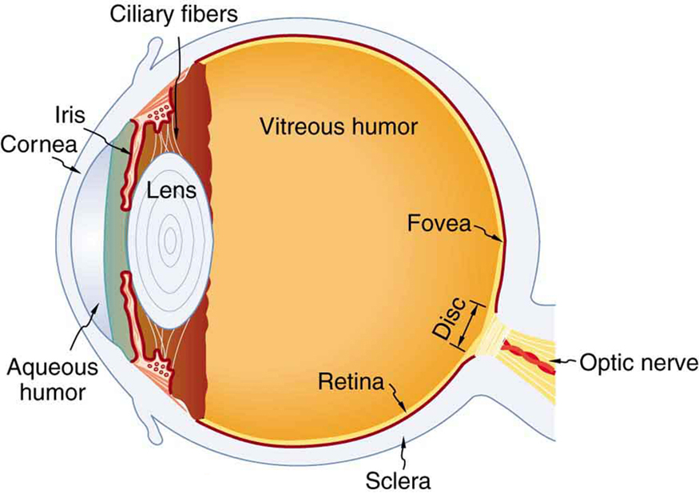


Vision and Optical Instruments
The Human Eye
Other Optical Instruments
]
Vision and Optical Instruments
Free to share, print, make copies and changes. Get yours at www.boundless.com

Slide 5

The Human Eye
Vision and Optical Instruments > The Human Eye
The Human Eye
Color Vision
Resolution of the Human Eye
Nearsightedness, Farsidedness, and Vision Correction
Free to share, print, make copies and changes. Get yours at www.boundless.com
www.boundless.com/physics/textbooks/boundless-physics-textbook/vision-and-optical-instruments-25/the-human-eye-172/

Slide 6
Other Optical Instruments
Vision and Optical Instruments > Other Optical Instruments
The Magnifying Glass
The Camera
The Compound Microscope
The Telescope
X-Ray Diffraction
X-Ray Imaging and CT Scans
Specialty Microscopes and Contrast
Limits of Resolution and Circular Aperatures
The Lambda Limit
Aberrations
Free to share, print, make copies and changes. Get yours at www.boundless.com
www.boundless.com/physics/textbooks/boundless-physics-textbook/vision-and-optical-instruments-25/other-optical-instruments-173/

Slide 7
Appendix
Free to share, print, make copies and changes. Get yours at www.boundless.com

Slide 8
Key terms
Vision and Optical Instruments
aberration The convergence to different foci, by a lens or mirror, of rays of light emanating from one and the same point, or the deviation of such rays from a single focus; a defect in a focusing mechanism that prevents the intended focal point.
achromatic free from color; transmitting light without color-related distortion
aperture The diameter of the aperture that restricts the width of the light path through the whole system. For a telescope, this is the diameter of the objective lens (e.g., a telescope may have a 100 cm aperture).
aperture The diameter of the aperture that restricts the width of the light path through the whole system. For a telescope, this is the diameter of the objective lens (e.g., a telescope may have a 100 cm aperture).
chromatic aberration an optical aberration, in which an image has colored fringes, caused by differential refraction of light of different wavelengths
chromatic aberration an optical aberration, in which an image has colored fringes, caused by differential refraction of light of different wavelengths
constructive interference Occurs when waves interfere with each other crest to crest and the waves are exactly in phase with each other.
contrast A difference in lightness, brightness and/or hue between two colors that makes them more or less distinguishable
convex curved or bowed outward like the outside of a bowl or sphere or circle
crystallography The experimental science of determining the arrangement of atoms in solids.
destructive interference Occurs when waves interfere with each other crest to trough (peak to valley) and are exactly out of phase with each other.
diffraction The bending of a wave around the edges of an opening or an obstacle.
Free to share, print, make copies and changes. Get yours at www.boundless.com

Slide 9
Vision and Optical Instruments
diopter a unit of measure of the power of a lens or mirror, equal to the reciprocal of its focal length in meters. Myopia is diagnosed and measured in diopters
distortion (optics) an aberration that causes magnification to change over the field of view.
dynamic contrast ratio Luminosity ratio of the brightest and darkest color the system is capable of processing over time (while the picture is moving).
field of view The angular extent of what can be seen, either with the eye or with an optical instrument or camera.
hyperopia A disorder of the vision where the eye focusses images behind the retina instead of on it, so that distant objects can be seen better than near objects.
lens an object, usually made of glass, that focuses or defocuses the light that passes through it
luminance The intensity of an object, independent from its color.
myopia A disorder of the vision where distant objects appear blurred because the eye focuses their images in front of the retina instead of on it.
nanostructure Any manufactured structure having a scale between molecular and microscopic.
pupil The hole in the middle of the iris of the eye, through which light passes to be focused on the retina.
radiography The use of X-rays to view a non-uniformly composed material such as the human body.
refraction Changing of a light ray's direction when it passes through variations in matter.
Free to share, print, make copies and changes. Get yours at www.boundless.com

Slide 10
Vision and Optical Instruments
shutter speed The duration of time for which the shutter of a camera remains open when exposing photographic film or other photosensitive material to light for the purpose of recording an image
spherical aberration a type of lens aberration that causes blurriness, particularly away from the center of the lens
static contrast ratio Luminosity ratio of the brightest and darkest color the system is capable of processing simultaneously at any instant of time.
superimposed Positioned on or above something else, especially in layers
tomography Imaging by sections or sectioning.
Free to share, print, make copies and changes. Get yours at www.boundless.com

Slide 11


Vision and Optical Instruments
Near Sighted Vision
This occurs when the image is formed before the retina
Free to share, print, make copies and changes. Get yours at www.boundless.com
OpenStax CNX. "Free High School Science Texts Project, Geometrical Optics: The Human Eye (Grade 11). December 25, 2012." CC BY 3.0 http://cnx.org/content/m39031/latest/ View on Boundless.com

Slide 12
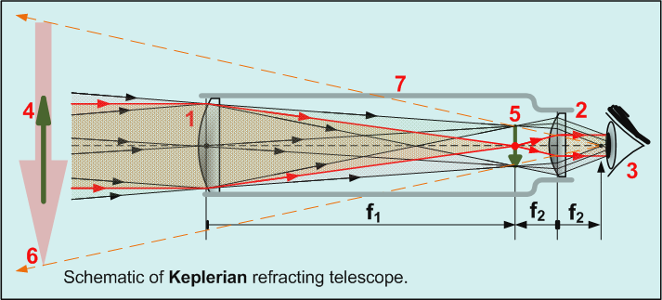
Vision and Optical Instruments
Schematic of Keplerian Refracting Telescope
All refracting telescopes use the same principles. The combination of an objective lens 1 and some type of eyepiece 2 is used to gather more light than the human eye is able to collect on its own, focus it 5, and present the viewer with a brighter, clearer, and magnified virtual image 6.
Free to share, print, make copies and changes. Get yours at www.boundless.com
Wikipedia. "Schematic of Keplerian refracting telescope." CC BY-SA 3.0 http://en.wikipedia.org/wiki/Refracting_telescope View on Boundless.com

Slide 13
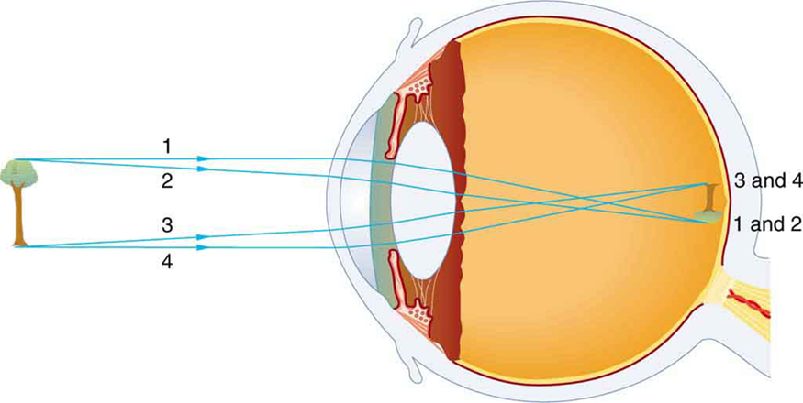
Vision and Optical Instruments
Vision Diagram
An image is formed on the retina with light rays converging most at the cornea and upon entering and exiting the lens. Rays from the top and bottom of the object are traced and produce an inverted real image on the retina. The distance to the object is drawn smaller than scale.
Free to share, print, make copies and changes. Get yours at www.boundless.com
OpenStax CNX. "OpenStax College, Physics of the Eye. December 25, 2012." CC BY 3.0 http://cnx.org/content/m42482/latest/ View on Boundless.com

Slide 14
Vision and Optical Instruments
Diagram of the Human Eye
The cornea and lens of an eye act together to form a real image on the light-sensing retina, which has its densest concentration of receptors in the fovea and a blind spot over the optic nerve. The power of the lens of an eye is adjustable to provide an image on the retina for varying object distances. Layers of tissues with varying indices of refraction in the lens are shown here. However, they have been omitted from other pictures for clarity.
Free to share, print, make copies and changes. Get yours at www.boundless.com
OpenStax CNX. "OpenStax College, Physics of the Eye. December 25, 2012." CC BY 3.0 http://cnx.org/content/m42482/latest/ View on Boundless.com

Slide 15
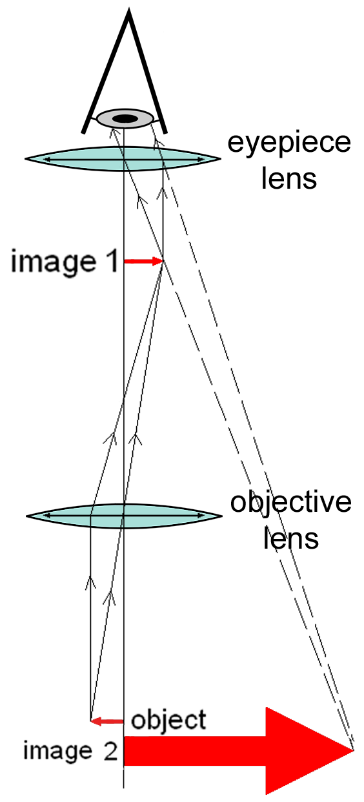
Vision and Optical Instruments
Diagram of a Compound Microscope
This diagram shows the setup of mirrors that allow for the magnification of images.
Free to share, print, make copies and changes. Get yours at www.boundless.com
Wikipedia. "Optical_microscope_nikon_alphaphot." CC BY-SA 3.0 http://en.wikipedia.org/wiki/Optical_microscope View on Boundless.com

Slide 16
Vision and Optical Instruments
Magnifying Glass
A magnifying glass is a convex lens that lets the observer see a larger image of the object under observation.
Free to share, print, make copies and changes. Get yours at www.boundless.com
Pixabay. "Magnifying Glass." Public domain http://pixabay.com/p-450690/?no_redirect View on Boundless.com

Slide 17
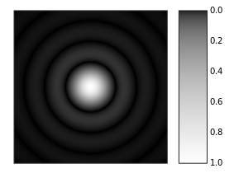
Vision and Optical Instruments
Airy Disk
Computer-generated image of an Airy disk. The gray scale intensities have been adjusted to enhance the brightness of the outer rings of the Airy pattern.
Free to share, print, make copies and changes. Get yours at www.boundless.com
Wikipedia. "Airy Disk." Public domain http://en.wikipedia.org/wiki/Airy_disk%23mediaviewer/File:Airy-pattern.svg View on Boundless.com

Slide 18
Vision and Optical Instruments
Vision Diagram
An image is formed on the retina with light rays converging most at the cornea and upon entering and exiting the lens. Rays from the top and bottom of the object are traced and produce an inverted real image on the retina. The distance to the object is drawn smaller than scale.
Free to share, print, make copies and changes. Get yours at www.boundless.com
OpenStax CNX. "OpenStax College, Physics of the Eye. December 25, 2012." CC BY 3.0 http://cnx.org/content/m42482/latest/ View on Boundless.com

Slide 19

Vision and Optical Instruments
Far Sighted Vision
This occurs when the image is formed behind the retina
Free to share, print, make copies and changes. Get yours at www.boundless.com
OpenStax CNX. "Free High School Science Texts Project, Geometrical Optics: The Human Eye (Grade 11). December 25, 2012." CC BY 3.0 http://cnx.org/content/m39031/latest/ View on Boundless.com

Slide 20
Vision and Optical Instruments
Schematic Diagram of the Human Eye
Structure of the eye and closeup of the retina.
Free to share, print, make copies and changes. Get yours at www.boundless.com
Wikibooks. "File:Schematic diagram of the human eye en.svg - Wikibooks, open books for an open world." CC BY-SA 3.0 http://en.wikibooks.org/w/index.php?title=File:Schematic_diagram_of_the_human_eye_en.svg&filetimestamp=20080202013345 View on Boundless.com

Slide 21
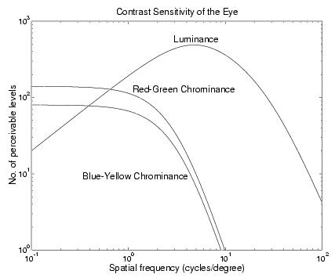
Vision and Optical Instruments
Visual Sensitivity
This graph shows the sensitivity of the eye to luminance (Y) and chrominance (U, V) components of images. The horizontal scale is spatial frequency, and represents the frequency of an alternating pattern of parallel stripes with sinusoidally varying intensity. The vertical scale is the contrast sensitivity of human vision, which is the ratio of the maximum visible range of intensities to the minimum discernible peak-to-peak intensity variation at the specified frequency.
Free to share, print, make copies and changes. Get yours at www.boundless.com
OpenStax CNX. "Nick Kingsbury, Human Vision. December 25, 2012." CC BY 3.0 http://cnx.org/content/m11084/latest/ View on Boundless.com

Slide 22
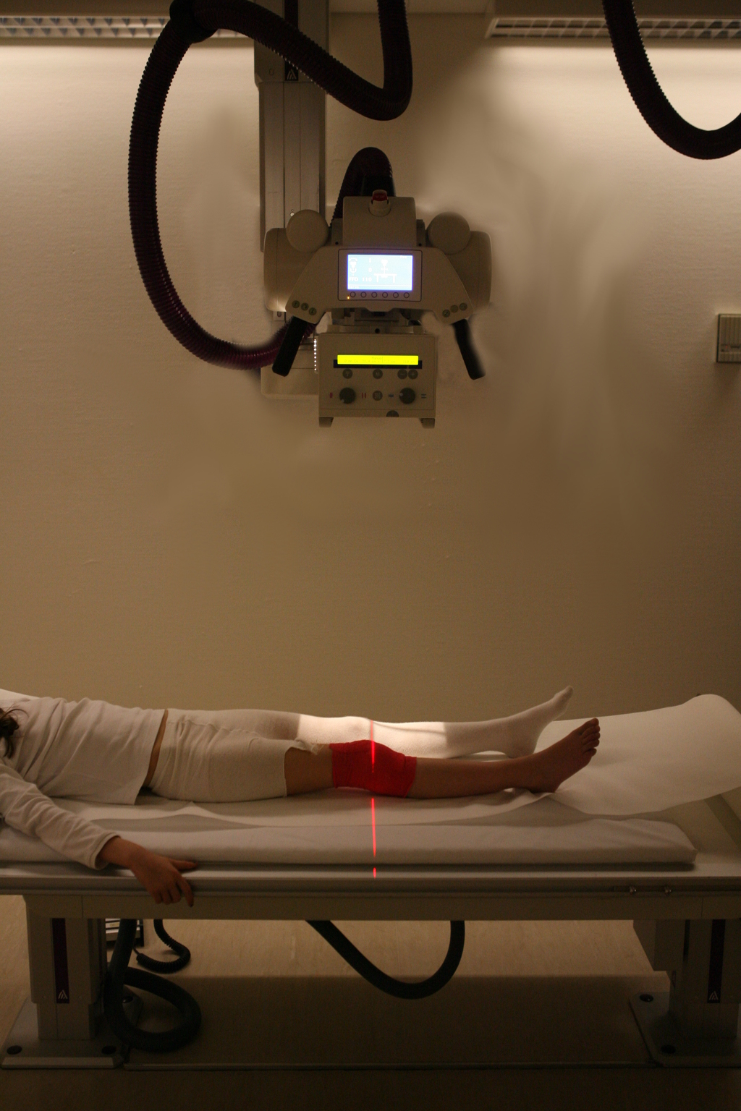
Vision and Optical Instruments
X-Ray Radiography
Radiography of the knee in a modern X-ray machine.
Free to share, print, make copies and changes. Get yours at www.boundless.com
Wikipedia. "Radiography." CC BY-SA 3.0 http://en.wikipedia.org/wiki/Radiography View on Boundless.com

Slide 23
Attribution
Vision and Optical Instruments
Boundless Learning. "Boundless." CC BY-SA 3.0 http://www.boundless.com//physics/definition/destructive-interference
Boundless Learning. "Boundless." CC BY-SA 3.0 http://www.boundless.com//physics/definition/constructive-interference
Wiktionary. "crystallography." CC BY-SA 3.0 http://en.wiktionary.org/wiki/crystallography
OpenStax CNX. "Wayne Lin and Andrew Barron, An Introduction to X-Ray Diffraction. September 17, 2013." CC BY 3.0 http://cnx.org/content/m38289/latest/
Wiktionary. "shutter speed." CC BY-SA 3.0 http://en.wiktionary.org/wiki/shutter_speed
Wikipedia. "Camera lens." CC BY-SA 3.0 http://en.wikipedia.org/wiki/Camera_lens
Wikipedia. "Camera." CC BY-SA 3.0 http://en.wikipedia.org/wiki/Camera
Wiktionary. "chromatic aberration." CC BY-SA 3.0 http://en.wiktionary.org/wiki/chromatic_aberration
Wikipedia. "Compound microscope." CC BY-SA 3.0 http://en.wikipedia.org/wiki/Compound_microscope%23Compound_microscope
OpenStax CNX. "OpenStax College, Microscopes. September 17, 2013." CC BY 3.0 http://cnx.org/content/m42491/latest/
Wiktionary. "pupil." CC BY-SA 3.0 http://en.wiktionary.org/wiki/pupil
Wiktionary. "aperture." CC BY-SA 3.0 http://en.wiktionary.org/wiki/aperture
Wikipedia. "Human eye." CC BY-SA 3.0 http://en.wikipedia.org/wiki/Human_eye
OpenStax CNX. "OpenStax College, Physics of the Eye. September 17, 2013." CC BY 3.0 http://cnx.org/content/m42482/latest/
Wiktionary. "convex." CC BY-SA 3.0 http://en.wiktionary.org/wiki/convex
Wiktionary. "lens." CC BY-SA 3.0 http://en.wiktionary.org/wiki/lens
Wiktionary. "diopter." CC BY-SA 3.0 http://en.wiktionary.org/wiki/diopter
Free to share, print, make copies and changes. Get yours at www.boundless.com

Slide 24
Vision and Optical Instruments
Wikipedia. "Magnifying glass." CC BY-SA 3.0 http://en.wikipedia.org/wiki/Magnifying_glass
Wiktionary. "spherical aberration." CC BY-SA 3.0 http://en.wiktionary.org/wiki/spherical_aberration
Wiktionary. "chromatic aberration." CC BY-SA 3.0 http://en.wiktionary.org/wiki/chromatic_aberration
Wiktionary. "achromatic." CC BY-SA 3.0 http://en.wiktionary.org/wiki/achromatic
OpenStax CNX. "OpenStax College, Telescopes. September 17, 2013." CC BY 3.0 http://cnx.org/content/m42493/latest/
Wikipedia. "Telescopes." CC BY-SA 3.0 http://en.wikipedia.org/wiki/Telescopes
Wikipedia. "Refracting telescope." CC BY-SA 3.0 http://en.wikipedia.org/wiki/Refracting_telescope
Wikipedia. "Catadioptric." CC BY-SA 3.0 http://en.wikipedia.org/wiki/Catadioptric%23Catadioptric_telescopes
Wikipedia. "Reflecting telescope." CC BY-SA 3.0 http://en.wikipedia.org/wiki/Reflecting_telescope
Wiktionary. "nanostructure." CC BY-SA 3.0 http://en.wiktionary.org/wiki/nanostructure
Wiktionary. "diffraction." CC BY-SA 3.0 http://en.wiktionary.org/wiki/diffraction
Wiktionary. "aperture." CC BY-SA 3.0 http://en.wiktionary.org/wiki/aperture
Wikipedia. "Diffraction limit." CC BY-SA 3.0 http://en.wikipedia.org/wiki/Diffraction_limit
Wiktionary. "hyperopia." CC BY-SA 3.0 http://en.wiktionary.org/wiki/hyperopia
Wiktionary. "myopia." CC BY-SA 3.0 http://en.wiktionary.org/wiki/myopia
Wikipedia. "Human eye." CC BY-SA 3.0 http://en.wikipedia.org/wiki/Human_eye
OpenStax CNX. "OpenStax College, Physics of the Eye. September 17, 2013." CC BY 3.0 http://cnx.org/content/m42482/latest/
OpenStax CNX. "Free High School Science Texts Project, Geometrical Optics: The Human Eye (Grade 11). September 17, 2013." CC BY 3.0 http://cnx.org/content/m39031/latest/
Wiktionary. "field of view." CC BY-SA 3.0 http://en.wiktionary.org/wiki/field_of_view
Free to share, print, make copies and changes. Get yours at www.boundless.com

Slide 25
Vision and Optical Instruments
Wikipedia. "dynamic contrast ratio." CC BY-SA 3.0 http://en.wikipedia.org/wiki/dynamic%20contrast%20ratio
Wikipedia. "static contrast ratio." CC BY-SA 3.0 http://en.wikipedia.org/wiki/static%20contrast%20ratio
Wikipedia. "Optics." CC BY-SA 3.0 http://en.wikipedia.org/wiki/Optics
Wikipedia. "Human eye." CC BY-SA 3.0 http://en.wikipedia.org/wiki/Human_eye%23Dynamic_range
Wiktionary. "distortion." CC BY-SA 3.0 http://en.wiktionary.org/wiki/distortion
Wiktionary. "aberration." CC BY-SA 3.0 http://en.wiktionary.org/wiki/aberration
Boundless Learning. "Boundless." CC BY-SA 3.0 http://www.boundless.com//physics/definition/refraction
OpenStax CNX. "OpenStax College, Aberrations. September 17, 2013." CC BY 3.0 http://cnx.org/content/m42292/latest/
Wikipedia. "Chromatic aberration." CC BY-SA 3.0 http://en.wikipedia.org/wiki/Chromatic_aberration
Wikipedia. "Distortion (optics)." CC BY-SA 3.0 http://en.wikipedia.org/wiki/Distortion_(optics)
Wikipedia. "Coma aberration." CC BY-SA 3.0 http://en.wikipedia.org/wiki/Coma_aberration
Wiktionary. "superimposed." CC BY-SA 3.0 http://en.wiktionary.org/wiki/superimposed
Wiktionary. "tomography." CC BY-SA 3.0 http://en.wiktionary.org/wiki/tomography
Wikipedia. "radiography." CC BY-SA 3.0 http://en.wikipedia.org/wiki/radiography
Wikipedia. "Computed tomography." CC BY-SA 3.0 http://en.wikipedia.org/wiki/Computed_tomography
Wikipedia. "X-ray imaging." CC BY-SA 3.0 http://en.wikipedia.org/wiki/X-ray_imaging
Wikipedia. "Tomography." CC BY-SA 3.0 http://en.wikipedia.org/wiki/Tomography
Wiktionary. "contrast." CC BY-SA 3.0 http://en.wiktionary.org/wiki/contrast
Wikipedia. "Scanning electron microscope." CC BY-SA 3.0 http://en.wikipedia.org/wiki/Scanning_electron_microscope
Free to share, print, make copies and changes. Get yours at www.boundless.com

Slide 26
Vision and Optical Instruments
Wikipedia. "Microscopes." CC BY-SA 3.0 http://en.wikipedia.org/wiki/Microscopes
Wikipedia. "Optical microscope." CC BY-SA 3.0 http://en.wikipedia.org/wiki/Optical_microscope
Wikipedia. "Transmission electron microscope." CC BY-SA 3.0 http://en.wikipedia.org/wiki/Transmission_electron_microscope
Wikipedia. "Dark field." CC BY-SA 3.0 http://en.wikipedia.org/wiki/Dark_field
Wikipedia. "luminance." CC BY-SA 3.0 http://en.wikipedia.org/wiki/luminance
OpenStax CNX. "Nick Kingsbury, Human Vision. September 18, 2013." CC BY 3.0 http://cnx.org/content/m11084/latest/
Wikipedia. "Optics." CC BY-SA 3.0 http://en.wikipedia.org/wiki/Optics
Free to share, print, make copies and changes. Get yours at www.boundless.com

