Slide 1


Boundless Lecture Slides
Available on the Boundless Teaching Platform
Free to share, print, make copies and changes. Get yours at www.boundless.com

Slide 2



Using Boundless Presentations
Boundless Teaching Platform
Boundless empowers educators to engage their students with affordable, customizable textbooks and intuitive teaching tools. The free Boundless Teaching Platform gives educators the ability to customize textbooks in more than 20 subjects that align to hundreds of popular titles. Get started by using high quality Boundless books, or make switching to our platform easier by building from Boundless content pre-organized to match the assigned textbook. This platform gives educators the tools they need to assign readings and assessments, monitor student activity, and lead their classes with pre-made teaching resources.
Get started now at:
The Appendix
The appendix is for you to use to add depth and breadth to your lectures. You can simply drag and drop slides from the appendix into the main presentation to make for a richer lecture experience.
http://boundless.com/teaching-platform
Free to edit, share, and copy
Feel free to edit, share, and make as many copies of the Boundless presentations as you like. We encourage you to take these presentations and make them your own.
If you have any questions or problems please email:
educators@boundless.com
Free to share, print, make copies and changes. Get yours at www.boundless.com

Slide 3

About Boundless
Boundless is an innovative technology company making education more affordable and accessible for students everywhere. The company creates the world’s best open educational content in 20+ subjects that align to more than 1,000 popular college textbooks. Boundless integrates learning technology into all its premium books to help students study more efficiently at a fraction of the cost of traditional textbooks. The company also empowers educators to engage their students more effectively through customizable books and intuitive teaching tools as part of the Boundless Teaching Platform. More than 2 million learners access Boundless free and premium content each month across the company’s wide distribution platforms, including its website, iOS apps, Kindle books, and iBooks. To get started learning or teaching with Boundless, visit boundless.com.
Free to share, print, make copies and changes. Get yours at www.boundless.com

Slide 4
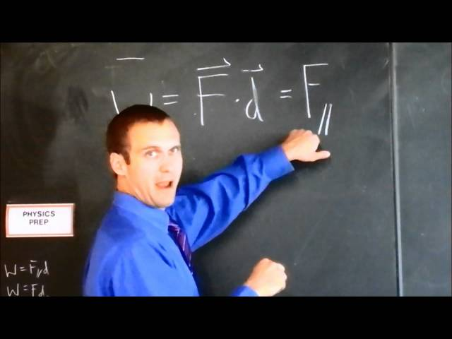

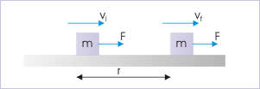
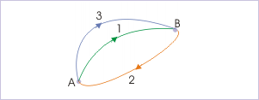
Work and Energy
Introduction
Work Done by a Constant Force
Work Done by a Variable Force
Work-Energy Theorem
]
Potential Energy and Conservation of Energy
Work and Energy
Free to share, print, make copies and changes. Get yours at www.boundless.com

Slide 5
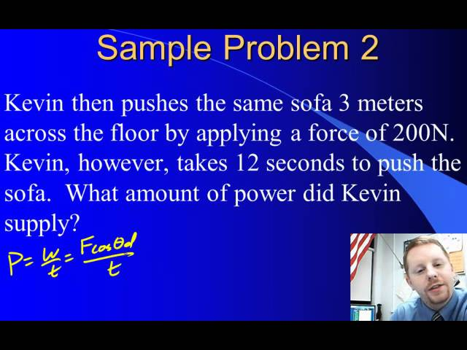
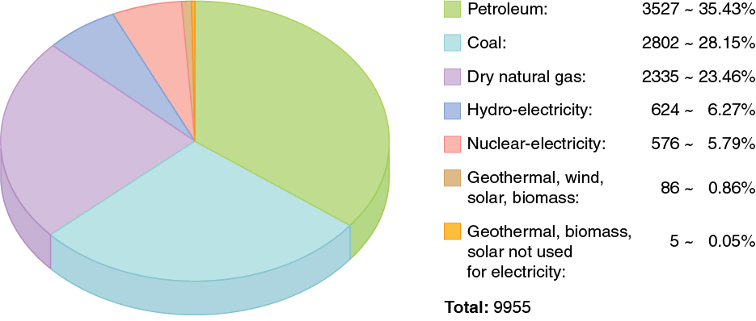
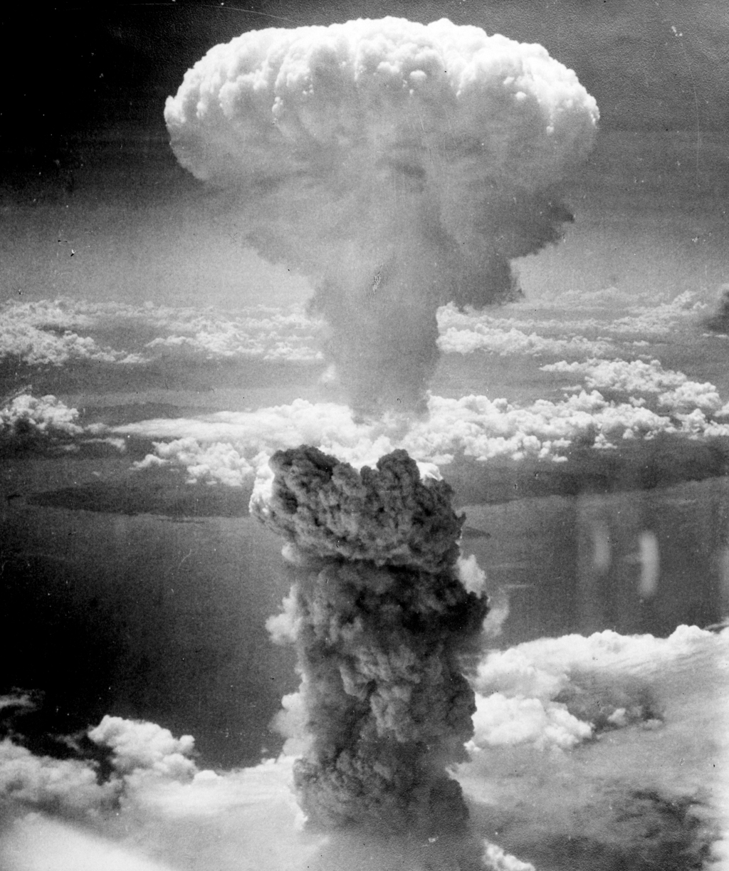
Work and Energy (continued)
Power
CASE STUDY: World Energy Use
Further Topics
]
Work and Energy
Free to share, print, make copies and changes. Get yours at www.boundless.com

Slide 6

Introduction
Work and Energy > Introduction
Introduction to Work and Energy
Free to share, print, make copies and changes. Get yours at www.boundless.com
www.boundless.com/physics/textbooks/boundless-physics-textbook/work-and-energy-6/introduction-60/

Slide 7
Work Done by a Constant Force
Work and Energy > Work Done by a Constant Force
Force in the Direction of Displacement
Force at an Angle to Displacement
Negative Work and Total Work
Free to share, print, make copies and changes. Get yours at www.boundless.com
www.boundless.com/physics/textbooks/boundless-physics-textbook/work-and-energy-6/work-done-by-a-constant-force-61/

Slide 8
Work Done by a Variable Force
Work and Energy > Work Done by a Variable Force
Work Done by a Variable Force
Free to share, print, make copies and changes. Get yours at www.boundless.com
www.boundless.com/physics/textbooks/boundless-physics-textbook/work-and-energy-6/work-done-by-a-variable-force-62/

Slide 9
Work-Energy Theorem
Work and Energy > Work-Energy Theorem
Kinetic Energy and Work-Energy Theorem
Free to share, print, make copies and changes. Get yours at www.boundless.com
www.boundless.com/physics/textbooks/boundless-physics-textbook/work-and-energy-6/work-energy-theorem-63/

Slide 10
Potential Energy and Conservation of Energy
Work and Energy > Potential Energy and Conservation of Energy
Conservative and Nonconservative Forces
What is Potential Energy?
Gravity
Springs
Conservation of Mechanical Energy
Problem Solving With the Conservation of Energy
Problem Solving with Dissipative Forces
Free to share, print, make copies and changes. Get yours at www.boundless.com
www.boundless.com/physics/textbooks/boundless-physics-textbook/work-and-energy-6/potential-energy-and-conservation-of-energy-64/

Slide 11
Power
Work and Energy > Power
What is Power?
Humans: Work, Energy, and Power
Free to share, print, make copies and changes. Get yours at www.boundless.com
www.boundless.com/physics/textbooks/boundless-physics-textbook/work-and-energy-6/power-65/

Slide 12
CASE STUDY: World Energy Use
Work and Energy > CASE STUDY: World Energy Use
World Energy Use
Free to share, print, make copies and changes. Get yours at www.boundless.com
www.boundless.com/physics/textbooks/boundless-physics-textbook/work-and-energy-6/case-study-world-energy-use-66/

Slide 13
Further Topics
Work and Energy > Further Topics
Other Forms of Energy
Energy Transformations
Potential Energy Curves and Equipotentials
Free to share, print, make copies and changes. Get yours at www.boundless.com
www.boundless.com/physics/textbooks/boundless-physics-textbook/work-and-energy-6/further-topics-67/

Slide 14
Appendix
Free to share, print, make copies and changes. Get yours at www.boundless.com

Slide 15
Key terms
Work and Energy
basal metabolic rate The amount of energy expended while at rest in a neutrally temperate environment, in the post-absorptive state.
conservation A particular measurable property of an isolated physical system does not change as the system evolves.
conservative force A force with the property that the work done in moving a particle between two points is independent of the path taken.
conservative force A force with the property that the work done in moving a particle between two points is independent of the path taken.
conservative force A force with the property that the work done in moving a particle between two points is independent of the path taken.
Coulomb force the electrostatic force between two charges, as described by Coulomb's law
dissipative force A force resulting in dissipation, a process in which energy (internal, bulk flow kinetic, or system potential) is transformed from some initial form to some irreversible final form.
dot product A scalar product.
electromagnetic radiation radiation (quantized as photons) consisting of oscillating electric and magnetic fields oriented perpendicularly to each other, moving through space
energy A quantity that denotes the ability to do work and is measured in a unit dimensioned in mass × distance²/time² (ML²/T²) or the equivalent.
first law of thermodynamics A version of the law of conservation of energy, specialized for thermodynamical systems. It is usually formulated by stating that the change in the internal energy of a closed system is equal to the amount of heat supplied to the system, minus the amount of work done by the system on its surroundings.
fission The process of splitting the nucleus of an atom into smaller particles; nuclear fission.
Free to share, print, make copies and changes. Get yours at www.boundless.com

Slide 16
Work and Energy
force A physical quantity that denotes ability to push, pull, twist or accelerate a body, which is measured in a unit dimensioned in mass × distance/time² (ML/T²): SI: newton (N); CGS: dyne (dyn)
fossil fuel Any fuel derived from hydrocarbon deposits such as coal, petroleum, natural gas and, to some extent, peat; these fuels are irreplaceable, and their burning generates the greenhouse gas carbon dioxide.
frictional force Frictional force is the force resisting the relative motion of solid surfaces, fluid layers, and material elements sliding against each other.
fusion A nuclear reaction in which nuclei combine to form more massive nuclei with the concomitant release of energy.
Hooke's law the principle that the stress applied to a solid is directly proportional to the strain produced. This law describes the behavior of springs and solids stressed within their elastic limit.
isolated system A system that does not interact with its surroundings, that is, its total energy and mass stay constant.
kinetic energy The energy possessed by an object because of its motion, equal to one half the mass of the body times the square of its velocity.
kinetic energy The energy possessed by an object because of its motion, equal to one half the mass of the body times the square of its velocity.
pendulum A body suspended from a fixed support so that it swings freely back and forth under the influence of gravity; it is commonly used to regulate various devices such as clocks.
potential A curve describing the situation where the difference in the potential energies of an object in two different positions depends only on those positions.
potential A curve describing the situation where the difference in the potential energies of an object in two different positions depends only on those positions.
potential energy The energy an object has because of its position (in a gravitational or electric field) or its condition (as a stretched or compressed spring, as a chemical reactant, or by having rest mass)
Free to share, print, make copies and changes. Get yours at www.boundless.com

Slide 17
Work and Energy
potential energy The energy an object has because of its position (in a gravitational or electric field) or its condition (as a stretched or compressed spring, as a chemical reactant, or by having rest mass)
power A measure of the rate of doing work or transferring energy.
renewable energy Energy that can be replenished at the same rate as it is used.
torque A rotational or twisting effect of a force; (SI unit newton-meter or Nm; imperial unit foot-pound or ft-lb)
watt In the International System of Units, the derived unit of power; the power of a system in which one joule of energy is transferred per second.
work A measure of energy expended in moving an object; most commonly, force times displacement. No work is done if the object does not move.
work A measure of energy expended in moving an object; most commonly, force times displacement. No work is done if the object does not move.
work A measure of energy expended in moving an object; most commonly, force times displacement. No work is done if the object does not move.
Free to share, print, make copies and changes. Get yours at www.boundless.com

Slide 18
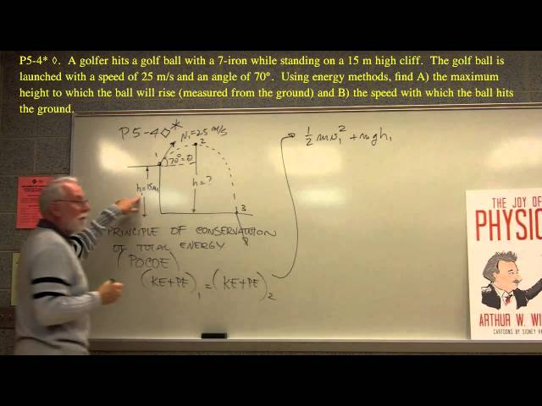

Work and Energy
Energy conservation
Part of a series of videos on physics problem-solving. The problems are taken from "The Joy of Physics. " This one deals with energy conservation. The viewer is urged to pause the video at the problem statement and work the problem before watching the rest of the video.
Free to share, print, make copies and changes. Get yours at www.boundless.com
View on Boundless.com

Slide 19
Work and Energy
Pendulum
This animation shows the velocity and acceleration vectors for a pendulum. One may note that at the maximum height of the pendulum's mass, the velocity is zero. This corresponds to zero kinetic energy and thus all of the energy of the pendulum is in the form of potential energy. When the pendulum's mass is at its lowest point, all of its energy is in the form of kinetic energy and we see its velocity vector has a maximum magnitude here.
Free to share, print, make copies and changes. Get yours at www.boundless.com
Wikipedia. "Pendulum." CC BY http://en.wikipedia.org/wiki/Pendulum View on Boundless.com

Slide 20
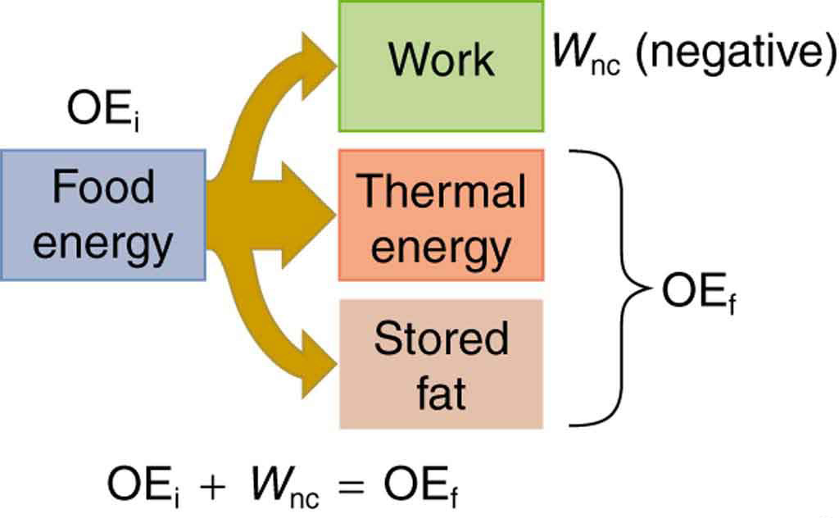
Work and Energy
Energy Conversion in Humans
Energy consumed by humans is converted to work, thermal energy, and stored fat. By far the largest fraction goes to thermal energy, although the fraction varies depending on the type of physical activity.
Free to share, print, make copies and changes. Get yours at www.boundless.com
OpenStax CNX. "OpenStax College, College Physics. November 4, 2012." CC BY 3.0 http://cnx.org/content/m42153/latest/?collection=col11406/1.7 View on Boundless.com

Slide 21
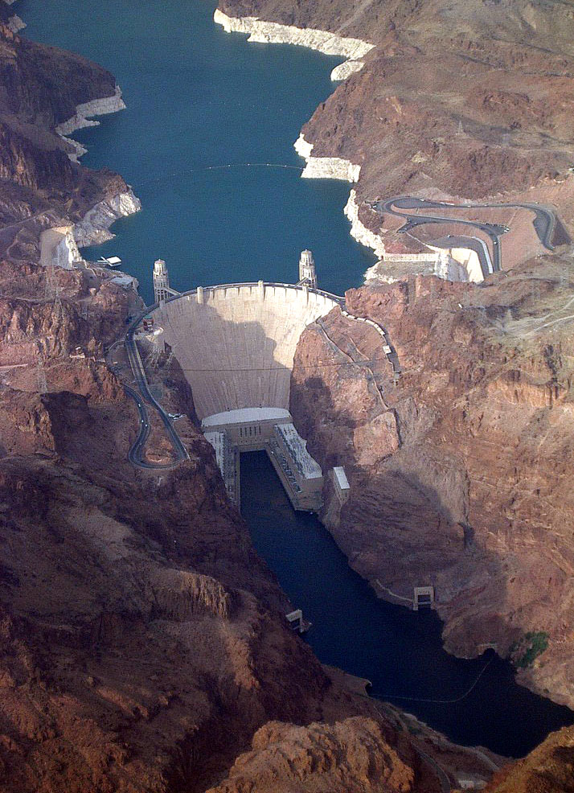
Work and Energy
Hoover Dam
Hoover dam uses the stored gravitational potential energy to generate electricity.
Free to share, print, make copies and changes. Get yours at www.boundless.com
Wikipedia. "Dam." CC BY http://en.wikipedia.org/wiki/Dam View on Boundless.com

Slide 22
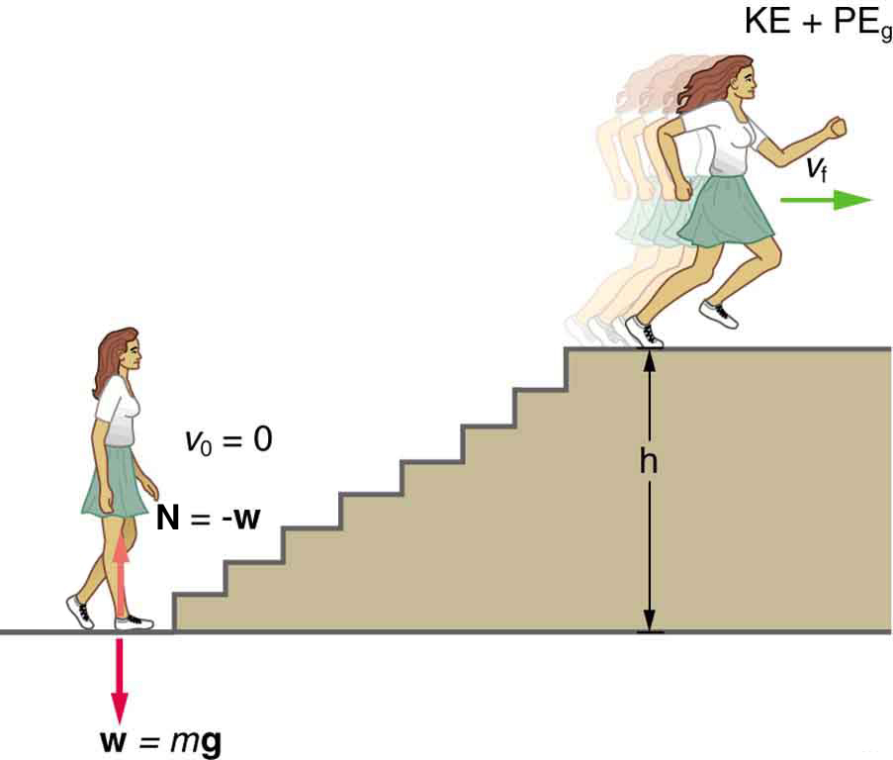
Work and Energy
Woman Running Up Stairs
When this woman runs upstairs starting from rest, she converts the chemical energy originally from food into kinetic energy and gravitational potential energy. Her power output depends on how fast she does this.
Free to share, print, make copies and changes. Get yours at www.boundless.com
OpenStax CNX. "Free High School Science Texts Project, The Atom: Energy Quantisation and Electron Configuration. November 4, 2012." CC BY 3.0 http://cnx.org/content/m42152/latest/ View on Boundless.com

Slide 23
Work and Energy
World Energy Use
This chart shows that the primary worldwide energy sources nonrenewable. If new practices are not put in place now, this model will not be sustainable.
Free to share, print, make copies and changes. Get yours at www.boundless.com
OpenStax CNX. "OpenStax College, World Energy Use. February 8, 2013." CC BY 3.0 http://cnx.org/content/m42154/latest/ View on Boundless.com

Slide 24
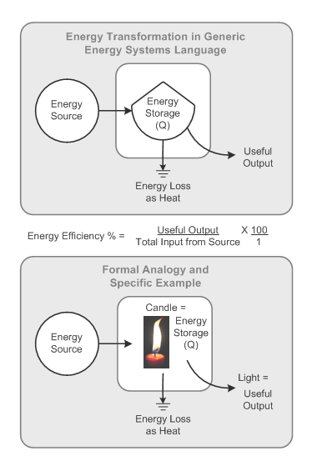
Work and Energy
Energy Transformation
These figures illustrate the concepts of energy loss and useful energy output.
Free to share, print, make copies and changes. Get yours at www.boundless.com
Wikipedia. "EnergyTransformation." Public domain http://en.wikipedia.org/wiki/File:EnergyTransformation.gif View on Boundless.com

Slide 25
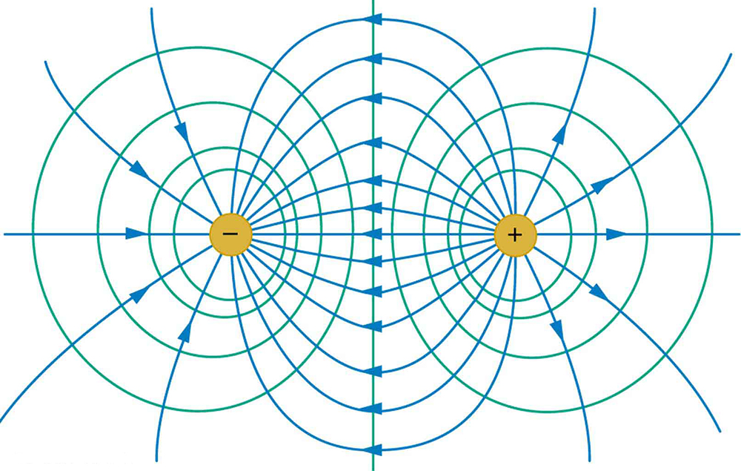
Work and Energy
Equipotential Lines for Two Equal and Opposite Point Charges
Electric field (blue) and equipotential lines (green) for two equal and opposite charges
Free to share, print, make copies and changes. Get yours at www.boundless.com
OpenStax CNX. "OpenStax College, College Physics. February 9, 2013." CC BY 3.0 http://cnx.org/content/m42331/latest/?collection=col11406/latest View on Boundless.com

Slide 26
Work and Energy
Atomic bomb explosion
The mushroom cloud of the atomic bombing of Nagasaki, Japan
Free to share, print, make copies and changes. Get yours at www.boundless.com
Wikipedia. "Nagasakibomb." CC BY-SA http://en.wikipedia.org/wiki/File:Nagasakibomb.jpg View on Boundless.com

Slide 27
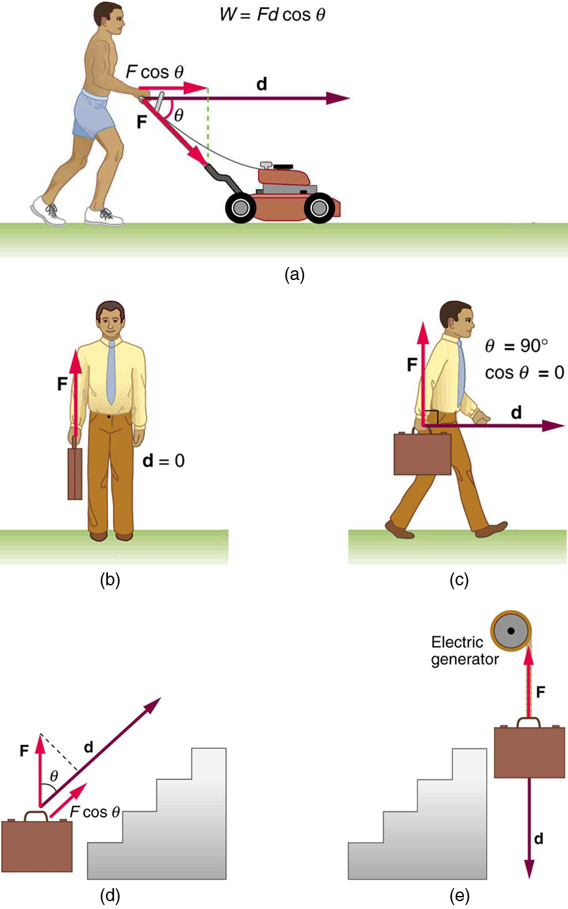
Work and Energy
Examples of Work
This is how work in progress and energy co-exist and operate. Work is the energy associated with the action of a force.
Free to share, print, make copies and changes. Get yours at www.boundless.com
OpenStax CNX. "OpenStax College, Work: The Scientific Definition. November 3, 2012." CC BY 3.0 http://cnx.org/content/m42146/latest/Figure_08_02_01.jpg View on Boundless.com

Slide 28
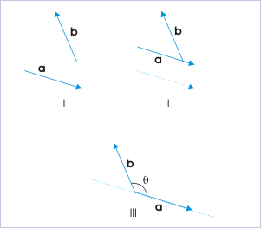
Work and Energy
Angle
Recall that both the force and direction of motion are vectors. When the angle is 90 degrees, the cosine term goes to zero. When along the same direction, they equal one.
Free to share, print, make copies and changes. Get yours at www.boundless.com
OpenStax CNX. "Sunil Kumar Singh, Scalar (Dot) Product. January 3, 2013." CC BY 3.0 http://cnx.org/content/m14513/latest/ View on Boundless.com

Slide 29
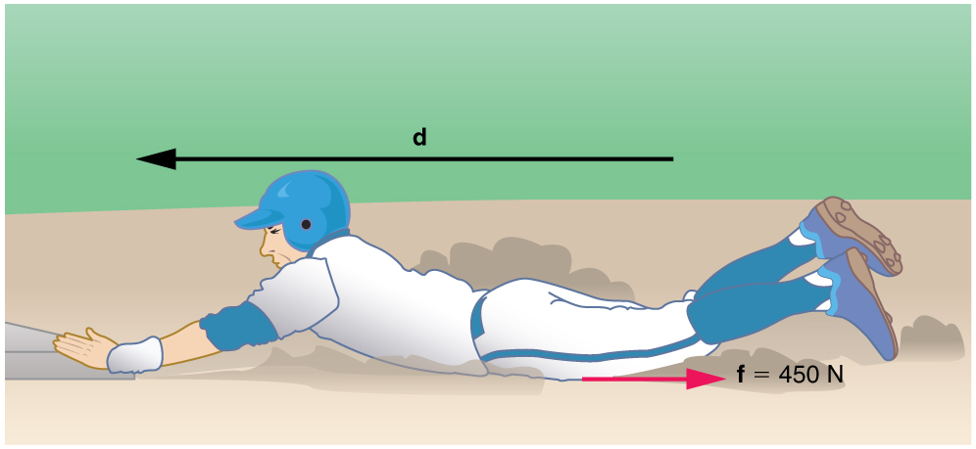
Work and Energy
Fig 1
The baseball player slides to a stop in a distance d. In the process, friction removes the player's kinetic energy by doing an amount of work fd equal to the initial kinetic energy.
Free to share, print, make copies and changes. Get yours at www.boundless.com
OpenStax CNX. "OpenStax College, Nonconservative Forces. February 3, 2013." CC BY 3.0 http://cnx.org/content/m42150/latest/ View on Boundless.com

Slide 30
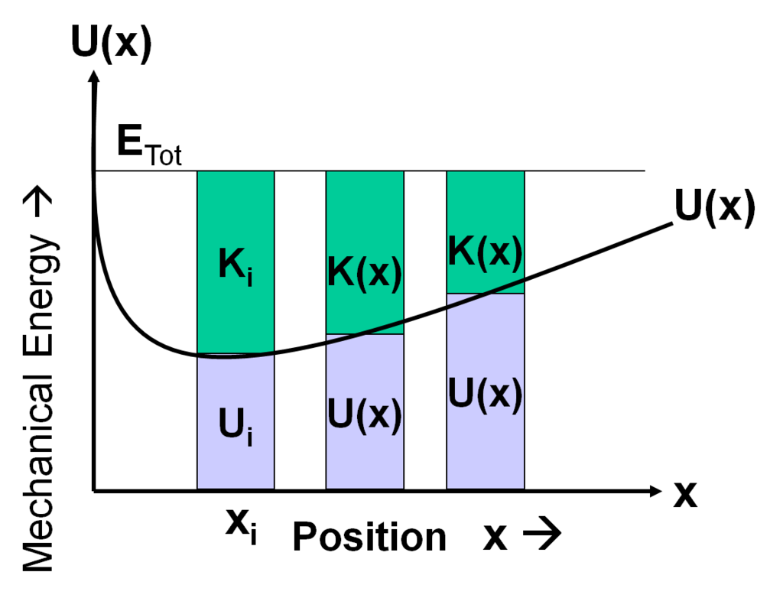
Work and Energy
Potential Energy Curve
This figure illustrates the potential energy of a particle as a function of position. The kinetic energy is also shown and is abbreviated K.
Free to share, print, make copies and changes. Get yours at www.boundless.com
Massachusetts Institute of Technology. "Module 9 -- Potential Energy Graphs - PER wiki." CC BY http://scripts.mit.edu/~srayyan/PERwiki/index.php?title=Module_9_--_Potential_Energy_Graphs View on Boundless.com

Slide 31
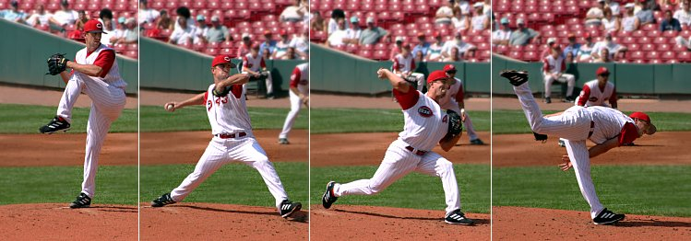
Work and Energy
Baseball Pitcher
A baseball pitcher does work on a baseball by throwing the ball at some force, F, over some distance d, which for the average baseball field, is about 60 feet.
Free to share, print, make copies and changes. Get yours at www.boundless.com
Wikipedia. "Baseball pitching motion 2004." CC BY-SA http://en.wikipedia.org/wiki/File:Baseball_pitching_motion_2004.jpg View on Boundless.com

Slide 32
Work and Energy
Kinetic Energy
A force does work on the block. The kinetic energy of the block increases as a result by the amount of work. This relationship is generalized in the work-energy theorem.
Free to share, print, make copies and changes. Get yours at www.boundless.com
OpenStax CNX. "Sunil Kumar Singh, Work - Kinetic Energy Theorem. February 2, 2013." CC BY 3.0 http://cnx.org/content/m14095/latest/ View on Boundless.com

Slide 33
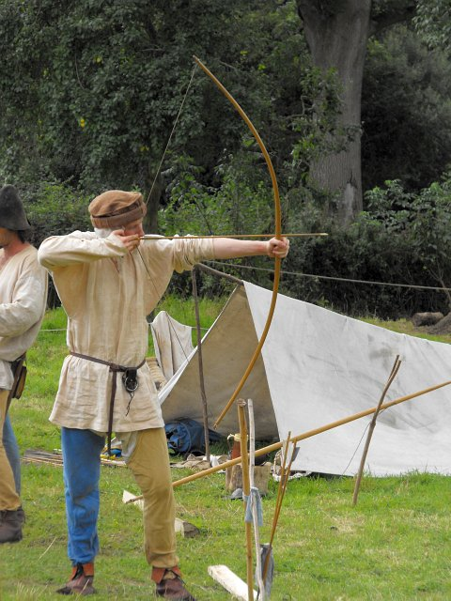
Work and Energy
Potential Energy in a Bow and Arrow
In the case of a bow and arrow, the energy is converted from the potential energy in the archer's arm to the potential energy in the bent limbs of the bow when the string is drawn back. When the string is released, the potential energy in the bow limbs is transferred back through the string to become kinetic energy in the arrow as it takes flight.
Free to share, print, make copies and changes. Get yours at www.boundless.com
Wikipedia. "Potential energy." CC BY http://en.wikipedia.org/wiki/Potential_energy View on Boundless.com

Slide 34
Work and Energy
A Mechanical System
An example of a mechanical system: A satellite is orbiting the Earth only influenced by the conservative gravitational force and the mechanical energy is therefore conserved. This acceleration is represented by a green acceleration vector and the velocity is represented by a red velocity vector.
Free to share, print, make copies and changes. Get yours at www.boundless.com
Wikipedia. "Mechanical energy." CC BY http://en.wikipedia.org/wiki/Mechanical_energy%23Conservation_and_interconversion_of_energy View on Boundless.com

Slide 35
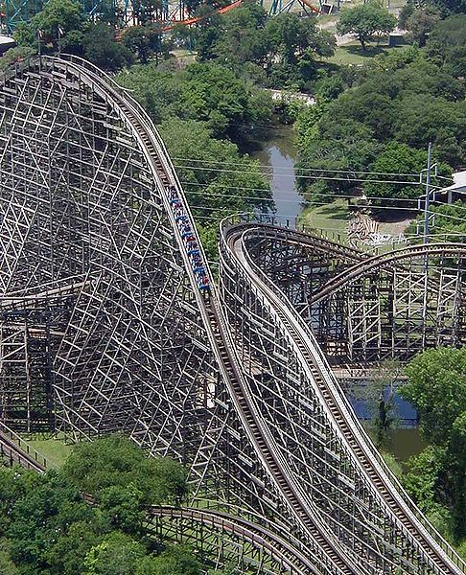
Work and Energy
Determining Energy
The cars of a roller coaster reach their maximum kinetic energy when at the bottom of their path. When they start rising, the kinetic energy begins to be converted to gravitational potential energy. The sum of kinetic and potential energy in the system remains constant, ignoring losses to friction.
Free to share, print, make copies and changes. Get yours at www.boundless.com
Wikimedia. CC BY-SA http://upload.wikimedia.org/wikipedia/commons/thumb/3/30/Wooden_roller_coaster_txgi.jpg/486px-Wooden_roller_coaster_txgi.jpg View on Boundless.com

Slide 36
Work and Energy
Work, Power, and Energy
Biology is useful.
Free to share, print, make copies and changes. Get yours at www.boundless.com
View on Boundless.com

Slide 37
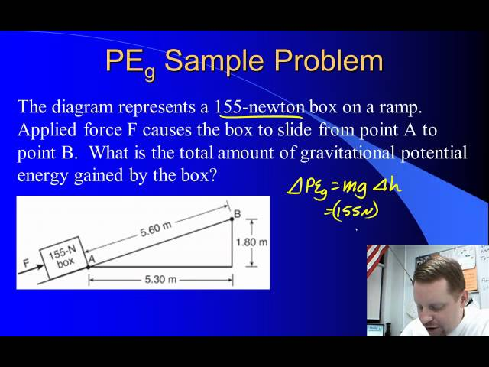
Work and Energy
Types of Energy
A brief overview of energy, kinetic energy, gravitational potential energy, and the work-energy theorem for algebra-based physics students.
Free to share, print, make copies and changes. Get yours at www.boundless.com
View on Boundless.com

Slide 38
Work and Energy
Motion Along Different Paths
Motion along different paths. For a conservative force, work done via different path is the same.
Free to share, print, make copies and changes. Get yours at www.boundless.com
OpenStax CNX. "Sunil Kumar Singh, Conservative Force. February 3, 2013." CC BY 3.0 http://cnx.org/content/m14104/latest/ View on Boundless.com

Slide 39
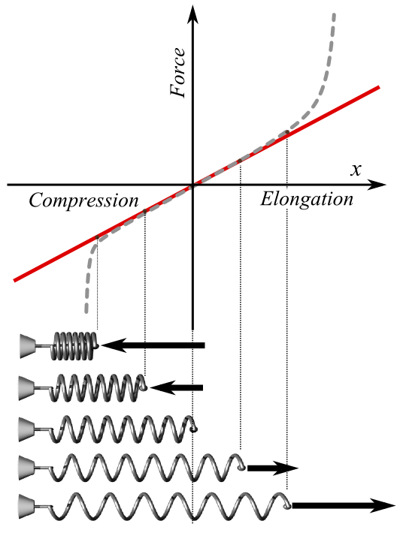
Work and Energy
Hooke's Law
Plot of applied force F vs. elongation X for a helical spring according to Hooke's law (solid line) and what the actual plot might look like (dashed line). Red is used extension, blue for compression. At bottom, schematic pictures of spring states corresponding to some points of the plot; the middle one is in the relaxed state (no force applied).
Free to share, print, make copies and changes. Get yours at www.boundless.com
Wikipedia. "HookesLawForSpring-English." CC BY-SA http://en.wikipedia.org/wiki/File:HookesLawForSpring-English.png View on Boundless.com

Slide 40
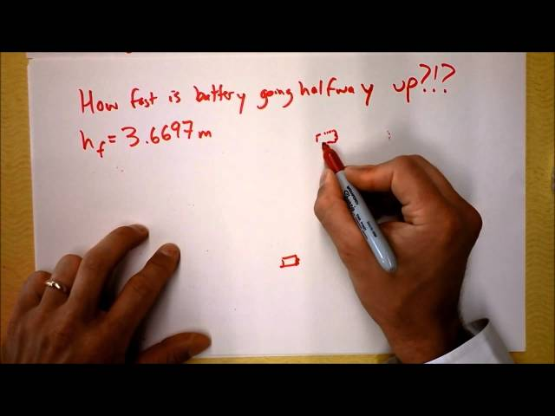
Work and Energy
Conservation of Mechanical Energy
Worked example.
Free to share, print, make copies and changes. Get yours at www.boundless.com
View on Boundless.com

Slide 41
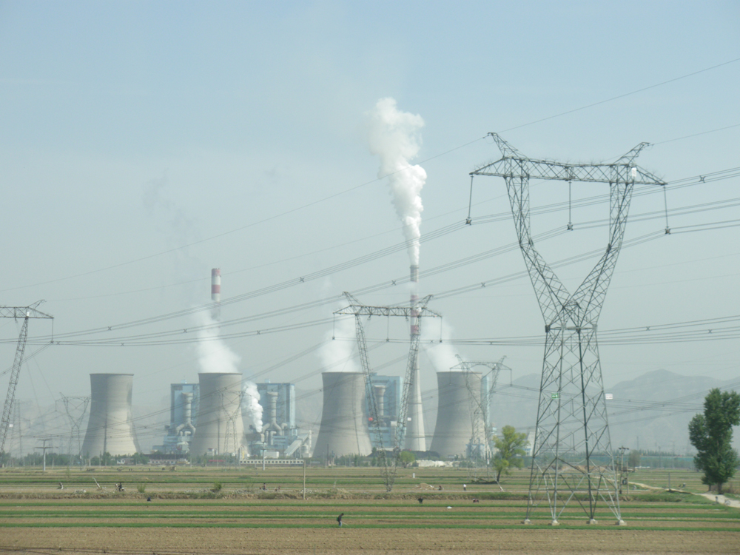
Work and Energy
Coal-fired Power Plant
Tremendous amounts of electric power are generated by coal-fired power plants such as this one in China, but an even larger amount of power goes into heat transfer to the surroundings. The large cooling towers here are needed to transfer heat as rapidly as it is produced. The transfer of heat is not unique to coal plants but is an unavoidable consequence of generating electric power from any fuel—nuclear, coal, oil, natural gas, or the like.
Free to share, print, make copies and changes. Get yours at www.boundless.com
OpenStax CNX. "Free High School Science Texts Project, The Atom: Energy Quantisation and Electron Configuration. November 4, 2012." CC BY 3.0 http://cnx.org/content/m42152/latest/ View on Boundless.com

Slide 42
Work and Energy
Power
A brief overview of power in an algebra-based physics course.
Free to share, print, make copies and changes. Get yours at www.boundless.com
View on Boundless.com

Slide 43
Attribution
Work and Energy
Wikipedia. "conservative force." CC BY-SA 3.0 http://en.wikipedia.org/wiki/conservative%20force
Wikipedia. "Potential energy." CC BY-SA 3.0 http://en.wikipedia.org/wiki/Potential_energy
OpenStax CNX. "Free High School Science Texts Project, Gravity and Mechanical Energy: Potential Energy. September 17, 2013." CC BY 3.0 http://cnx.org/content/m40047/latest/
Wiktionary. "dot product." CC BY-SA 3.0 http://en.wiktionary.org/wiki/dot_product
Wiktionary. "work." CC BY-SA 3.0 http://en.wiktionary.org/wiki/work
OpenStax CNX. "Sunil Kumar Singh, Scalar (Dot) Product. September 17, 2013." CC BY 3.0 http://cnx.org/content/m14513/latest/
Wikipedia. "Work (physics)." CC BY-SA 3.0 http://en.wikipedia.org/wiki/Work_(physics)
Wiktionary. "Coulomb force." CC BY-SA 3.0 http://en.wiktionary.org/wiki/Coulomb_force
Wikipedia. "potential." CC BY-SA 3.0 http://en.wikipedia.org/wiki/potential
Wikipedia. "Potential energy." CC BY-SA 3.0 http://en.wikipedia.org/wiki/Potential_energy
Wiktionary. "force." CC BY-SA 3.0 http://en.wiktionary.org/wiki/force
Wiktionary. "work." CC BY-SA 3.0 http://en.wiktionary.org/wiki/work
Wikipedia. "Work (physics)." CC BY-SA 3.0 http://en.wikipedia.org/wiki/Work_(physics)
Wikipedia. "Work (physics)." CC BY-SA 3.0 http://en.wikipedia.org/wiki/Work_(physics)
Wikipedia. "Force." CC BY-SA 3.0 http://en.wikipedia.org/wiki/Force
Wiktionary. "Hooke's law." CC BY-SA 3.0 http://en.wiktionary.org/wiki/Hooke's_law
Wikipedia. "conservative force." CC BY-SA 3.0 http://en.wikipedia.org/wiki/conservative%20force
Free to share, print, make copies and changes. Get yours at www.boundless.com

Slide 44
Work and Energy
OpenStax CNX. "Sunil Kumar Singh, Work by Spring Force. September 17, 2013." CC BY 3.0 http://cnx.org/content/m14102/latest/
Wiktionary. "gradient." CC BY-SA 3.0 http://en.wiktionary.org/wiki/gradient
Wiktionary. "curl." CC BY-SA 3.0 http://en.wiktionary.org/wiki/curl
Wikipedia. "potential." CC BY-SA 3.0 http://en.wikipedia.org/wiki/potential
Wikipedia. "Conservative force." CC BY-SA 3.0 http://en.wikipedia.org/wiki/Conservative_force
OpenStax CNX. "Sunil Kumar Singh, Conservative Force. September 17, 2013." CC BY 3.0 http://cnx.org/content/m14104/latest/
Wiktionary. "isolated system." CC BY-SA 3.0 http://en.wiktionary.org/wiki/isolated_system
Wikipedia. "frictional force." CC BY-SA 3.0 http://en.wikipedia.org/wiki/frictional%20force
Wikipedia. "conservation." CC BY-SA 3.0 http://en.wikipedia.org/wiki/conservation
Wikipedia. "Mechanical energy." CC BY-SA 3.0 http://en.wikipedia.org/wiki/Mechanical_energy%23Conservation_and_interconversion_of_energy
OpenStax CNX. "OpenStax College, Conservative Forces and Potential Energy. September 17, 2013." CC BY 3.0 http://cnx.org/content/m42149/latest/
Wiktionary. "work." CC BY-SA 3.0 http://en.wiktionary.org/wiki/work
OpenStax CNX. "Sunil Kumar Singh, Work and Energy. September 17, 2013." CC BY 3.0 http://cnx.org/content/m14098/latest/
Wikipedia. "Work (physics)." CC BY-SA 3.0 http://en.wikipedia.org/wiki/Work_(physics)
Wikipedia. "potential energy." CC BY-SA 3.0 http://en.wikipedia.org/wiki/potential%20energy
Wikipedia. "kinetic energy." CC BY-SA 3.0 http://en.wikipedia.org/wiki/kinetic%20energy
OpenStax CNX. "OpenStax College, College Physics. September 17, 2013." CC BY 3.0 http://cnx.org/content/m42331/latest/?collection=col11406/latest
Massachusetts Institute of Technology. "Module 9 -- Potential Energy Graphs - PER wiki." CC BY http://scripts.mit.edu/~srayyan/PERwiki/index.php?title=Module_9_--_Potential_Energy_Graphs
Wiktionary. "watt." CC BY-SA 3.0 http://en.wiktionary.org/wiki/watt
Free to share, print, make copies and changes. Get yours at www.boundless.com

Slide 45
Work and Energy
Wikipedia. "Power (physics)." CC BY-SA 3.0 http://en.wikipedia.org/wiki/Power_(physics)
Wikipedia. "Power (physics)." CC BY-SA 3.0 http://en.wikipedia.org/wiki/Power_(physics)
OpenStax CNX. "Free High School Science Texts Project, The Atom: Energy Quantisation and Electron Configuration. September 17, 2013." CC BY 3.0 http://cnx.org/content/m42152/latest/
OpenStax CNX. "Free High School Science Texts Project, The Atom: Energy Quantisation and Electron Configuration. September 17, 2013." CC BY 3.0 http://cnx.org/content/m42152/latest/
Wiktionary. "basal metabolic rate." CC BY-SA 3.0 http://en.wiktionary.org/wiki/basal_metabolic_rate
OpenStax CNX. "Free High School Science Texts Project, The Atom: Energy Quantisation and Electron Configuration. September 17, 2013." CC BY 3.0 http://cnx.org/content/m42152/latest/
OpenStax CNX. "OpenStax College, College Physics. September 17, 2013." CC BY 3.0 http://cnx.org/content/m42153/latest/?collection=col11406/1.7
OpenStax CNX. "OpenStax College, College Physics. September 17, 2013." CC BY 3.0 http://cnx.org/content/m42153/latest/?collection=col11406/1.7
Wikipedia. "Human power." CC BY-SA 3.0 http://en.wikipedia.org/wiki/Human_power
OpenStax CNX. "Free High School Science Texts Project, The Atom: Energy Quantisation and Electron Configuration. September 17, 2013." CC BY 3.0 http://cnx.org/content/m42152/latest/
OpenStax CNX. "OpenStax College, College Physics. September 17, 2013." CC BY 3.0 http://cnx.org/content/m42153/latest/?collection=col11406/1.7
OpenStax CNX. "OpenStax College, College Physics. September 17, 2013." CC BY 3.0 http://cnx.org/content/m42153/latest/?collection=col11406/1.7
OpenStax CNX. "Free High School Science Texts Project, The Atom: Energy Quantisation and Electron Configuration. September 17, 2013." CC BY 3.0 http://cnx.org/content/m42152/latest/
OpenStax CNX. "OpenStax College, College Physics. September 17, 2013." CC BY 3.0 http://cnx.org/content/m42153/latest/?collection=col11406/1.7
OpenStax CNX. "OpenStax College, College Physics. September 17, 2013." CC BY 3.0 http://cnx.org/content/m42153/latest/?collection=col11406/1.7
Wikipedia. "conservative force." CC BY-SA 3.0 http://en.wikipedia.org/wiki/conservative%20force
Wikipedia. "kinetic energy." CC BY-SA 3.0 http://en.wikipedia.org/wiki/kinetic%20energy
Wikipedia. "potential energy." CC BY-SA 3.0 http://en.wikipedia.org/wiki/potential%20energy
OpenStax CNX. "OpenStax College, Conservation of Energy. September 17, 2013." CC BY 3.0 http://cnx.org/content/m42151/latest/
Free to share, print, make copies and changes. Get yours at www.boundless.com

Slide 46
Work and Energy
Wikipedia. "Kinetic energy." CC BY-SA 3.0 http://en.wikipedia.org/wiki/Kinetic_energy
Wiktionary. "electromagnetic radiation." CC BY-SA 3.0 http://en.wiktionary.org/wiki/electromagnetic_radiation
Wiktionary. "fusion." CC BY-SA 3.0 http://en.wiktionary.org/wiki/fusion
Wiktionary. "fission." CC BY-SA 3.0 http://en.wiktionary.org/wiki/fission
Wikipedia. "Forms of energy." CC BY-SA 3.0 http://en.wikipedia.org/wiki/Forms_of_energy
Wiktionary. "torque." CC BY-SA 3.0 http://en.wiktionary.org/wiki/torque
Wikipedia. "Work energy theorem." CC BY-SA 3.0 http://en.wikipedia.org/wiki/Work_energy_theorem%23Work-energy_principle
Wikipedia. "dissipative force." CC BY-SA 3.0 http://en.wikipedia.org/wiki/dissipative%20force
OpenStax CNX. "OpenStax College, Nonconservative Forces. September 17, 2013." CC BY 3.0 http://cnx.org/content/m42150/latest/
Wikipedia. "first law of thermodynamics." CC BY-SA 3.0 http://en.wikipedia.org/wiki/first%20law%20of%20thermodynamics
Wiktionary. "pendulum." CC BY-SA 3.0 http://en.wiktionary.org/wiki/pendulum
Wikipedia. "Energy conversion efficiency." CC BY-SA 3.0 http://en.wikipedia.org/wiki/Energy_conversion_efficiency
Wikipedia. "Energy transformation." CC BY-SA 3.0 http://en.wikipedia.org/wiki/Energy_transformation
Wiktionary. "energy." CC BY-SA 3.0 http://en.wiktionary.org/wiki/energy
Wikipedia. "Work (physics)." CC BY-SA 3.0 http://en.wikipedia.org/wiki/Work_(physics)%23Work_and_energy
Wikipedia. "Work (physics)." CC BY-SA 3.0 http://en.wikipedia.org/wiki/Work_(physics)%23Work_and_energy
OpenStax CNX. "OpenStax College, College Physics. September 17, 2013." CC BY 3.0 http://cnx.org/content/m42146/latest/?collection=col11406/latest
OpenStax CNX. "OpenStax College, College Physics. September 17, 2013." CC BY 3.0 http://cnx.org/content/m42146/latest/?collection=col11406/latest
Wikipedia. "Work (physics)." CC BY-SA 3.0 http://en.wikipedia.org/wiki/Work_(physics)%23Work_and_energy
Free to share, print, make copies and changes. Get yours at www.boundless.com

Slide 47
Work and Energy
Wiktionary. "fossil fuel." CC BY-SA 3.0 http://en.wiktionary.org/wiki/fossil_fuel
Wiktionary. "renewable energy." CC BY-SA 3.0 http://en.wiktionary.org/wiki/renewable_energy
Wikipedia. "World energy consumption." CC BY-SA 3.0 http://en.wikipedia.org/wiki/World_energy_consumption
OpenStax CNX. "OpenStax College, World Energy Use. September 18, 2013." CC BY 3.0 http://cnx.org/content/m42154/latest/
Free to share, print, make copies and changes. Get yours at www.boundless.com

