Slide 1
1.206J/16.77J/ESD.215J
Airline Schedule Planning
Cynthia Barnhart
Spring 2003

Slide 2
1.963/1.206J/16.77J/ESD.215J The Schedule Design Problem
Outline
  Problem Definition and Objective
  Schedule Design with Constant Market Share
  Schedule Design with Variable Market Share
  Schedule Design Solution Algorithm
  Results
  Next Steps
  A Look to the Future in Airline Schedule Optimization

Slide 3
Airline Schedule Planning
Select optimal set of flight legs
in a schedule
Schedule Design
Assign aircraft types to flight legs
such that contribution is maximized
Fleet Assignment
Aircraft Routing
Crew Scheduling
Notes:
I will now present an overview of the airline schedule planning process. It begins with schedule design, in which… Next is fleet assignment, in which…. 3rd is aircraft routing, in which…. And the last is crew scheduling, in which…. We will now move to our 2nd section, our 1st look at the fleet assignment problem.

Slide 4
Objectives
Given origin-destination demands and fares, fleet composition and size, fleet operating characteristics and costs
Find the revenue maximizing flight schedule

Slide 5
Schedule Design: Fixed Flight Network, Flexible Schedule Approach
Fleet assignment model with time windows
  Allows flights to be re-timed slightly (plus/ minus 10 minutes) to allow for improved utilization of aircraft and improved capacity assignments
Initial step in integrating flight schedule design and fleet assignment decisions

Slide 6
Schedule Design: Optional Flights, Flexible Schedule Approach
Fleet assignment with “optional” flight legs
  Additional flight legs representing varying flight departure times
  Additional flight legs representing new flights
  Option to eliminate existing flights from future flight network
Incremental Schedule Design

Slide 7
Integrated, Incremental Schedule Design and Fleet Assignment Models
Base Schedule
Deletion Candidates
Addition Candidates
Mandatory Flight List
Optional Flight List
Master Flight List
Select optimal set of flight legs from master flight list
Assign fleet types to flight legs
Notes:
We are moving to the 3rd section, schedule design. Our approach to the schedule design problem is incremental.
This is the approach similar to the state of the practice. The only difference is that we use model to select flights while airlines use human to select flights.

Slide 8
Demand and Supply Interactions
A
100
B
150
Market Share
100
40
150
450
100
A
100
B
190
Market Share
410
120
A
100
B
200
Market Share
300
Non-Linear
Interactions

Slide 9
Schedule Design: Constant Market Share Model
Constant market share model
  Integrated Schedule Design and Fleet Assignment Model (ISD-FAM)
  Utilize recapture mechanism to adjust demand approximately
Notes:
We develop 2 models based on IFAM, namely,…

Slide 10
ISD-FAM: Example
A
100
B
150
Market Share
100
450
100
A
100
B
A
100 + recap¹
B
Market Share
150
150 + recap²
100
100 + recap³
450
100

Slide 11
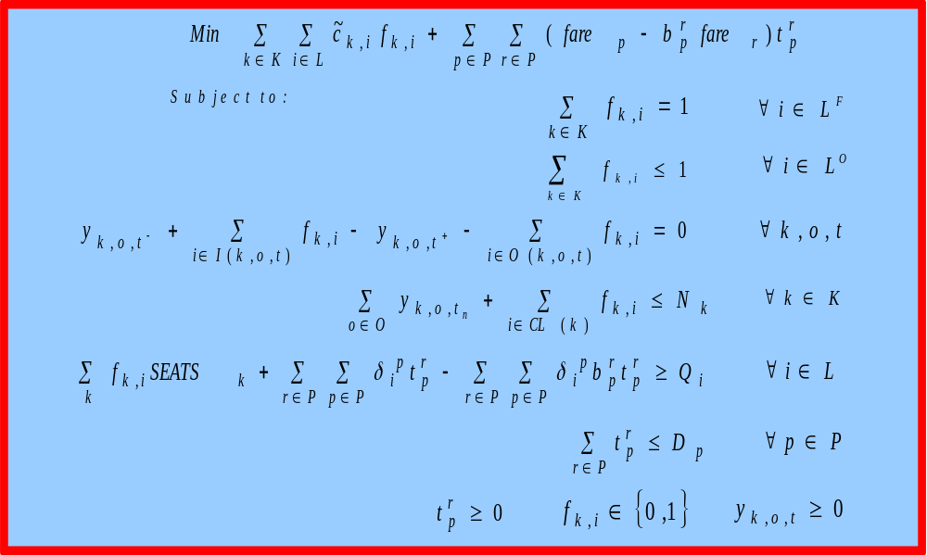
ISD-FAM Formulation
Notes:
Here is the formulation

Slide 12
ISD-FAM Formulation
Flight Selection
FAM
PMM
Notes:
Here is the formulation

Slide 13
ISD-FAM Formulation
Flight Selection
Schedule Design
FAM
Fleet Assignment
Spill + Recapture
PMM
Notes:
Here is the formulation

Slide 14
Schedule Design: Variable Market Share Model
Variable market share model
  Extended Schedule Design and Fleet Assignment Model (ESD-FAM)
  Utilize demand correction term to adjust demand explicitly
Notes:
We develop 2 models based on IFAM, namely,…

Slide 15
ESD-FAM: Demand Correction
A
100
B
150
Market Share
100
40
150
450
100
100 + 0
A
100
B
150 + 40
190
Market Share
100 + 20
410
120
80
A
100
B
150+40+40
Demand Correction Terms
-30
2nd degree
correction
Data Quality Issue

Slide 16
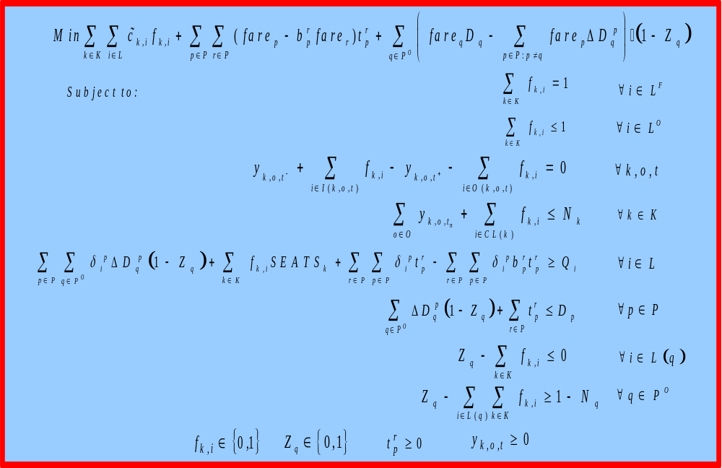
ESD-FAM Formulation

Slide 17
ESD-FAM Formulation
ISD-FAM
Market Share Adjustment

Slide 18
ESD-FAM Formulation
Constant
Market Share
Schedule Design
& Fleet Assgn.
ISD-FAM
Market Share Adjustment
Market Share Adjustment

Slide 19
Solution Algorithm
Update modifiers
START
Solve I/ESD-FAM
Identify itineraries that
cause discrepancies
Contribution 1
NO
Calculate new demand
for the resulting schedule
Has the
stopping criteria
been met?
Obtain revenue estimates
from PMM
Contribution 2
YES
STOP
Notes:
We employ an iterative solution algorithm. The algorithm works as follows.

Slide 20
State Of The Practice/ Theory
Practice:
Most schedule decisions made without optimization
At least one major airline uses Fleet Assignment with Time Windows
Implementation of Incremental Schedule Design approach underway at a major airline
Theory:
Models and algorithms for incremental schedule design have been developed and prototyped
Validation in progress

Slide 21
Computational Experiences
ISD-FAM requires long runtimes and large amounts of memory
  ~ 40 minutes on a workstation class computer for medium size (800 legs) schedules
  ~ 20 hours on a 6-processor workstation, running parallel CPLEX for full size (2,000 legs) schedules
ESD-FAM takes even longer runtimes and exhausts the memory in some cases
  40 mins (ISD-FAM) vs. 12 hrs (ESD-FAM) on same medium size schedule
Notes:
We implement our model

Slide 22
Schedule Design: Results
Demand and supply interactions
  ESD-FAM captures interactions more accurately
Resulting schedules operate fewer flights
  Lower operating costs
  Fewer aircraft required
~$100 - $350 million improvement annually
  Compared to planners’ schedules
  Exclude benefits from saved aircraft

Slide 23
Schedule Design Results
Results are subject to several caveats
  Plans are often disrupted
  Competitors’ responses
  Underlying assumptions
    Deterministic demand
    Optimal control of passengers
    Demand forecast
    Recapture rates/Demand correction terms
Nonetheless, significant improvements are achievable

Slide 24
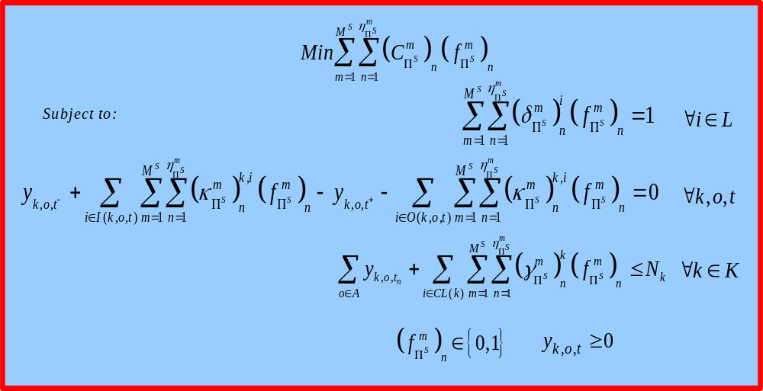
Potential for Improved Results
Replace IFAM with SFAM
≤1

Slide 25
SFAM Basic Concept
Isolate network effects
  Spill occurs only on constrained legs
Potentially
Potentially
Constrained
Constrained
Flight Leg
Flight Leg
Unconstrained
Unconstrained
Flight Leg
Flight Leg
Potentially
Potentially
Binding
Binding
Itinerary
Itinerary
Non
Non
-
-
Binding
Binding
Itinerary
Itinerary
FAM

Slide 26
A Look to the Future: Airline Schedule Planning Integration
Schedule Design
Schedule Design
Integrating crew scheduling and fleet assignment models yields:
Additional 3% savings in total operating, spill and crew costs
  Fleeting costs increase by about 1%
  Crew costs decrease by about 7%
Fleet Assignment
Fleet Assignment
Fleet Assignment
Fleet Assignment
Aircraft Routing
Aircraft Routing
Aircraft Routing
Crew Scheduling
Crew Scheduling
Crew Scheduling

Slide 27
A Look to the Future: Real-time Decision Making
For a typical airline, about 10% of scheduled revenue flights are affected by irregularities (like inclement weather, maintenance problems, etc.)
According to the New York Times, irregular operations (due mostly to weather) result in more than $440 million per year in lost revenue, crew overtime pay, and passenger hospitality costs
Increasing use and acceptance of optimization-based decision support tools for operations recovery

Slide 28
A Look to the Future: Robust Scheduling
Issue: Optimizing “plans” results in minimized planned costs, not realized costs
  Optimized plans have little slack, resulting in
    Increased likelihood of plan “breakage” during operations
    Fewer recovery options
Challenge: Building “robust” plans that achieve minimal realized costs

