Slide 1
New Approaches to Add Robustness into Airline Schedules
Courtesy of Shan Lan, Cindy Barnhart and John-Paul Clarke. Used with permission
Shan Lan, Cindy Barnhart and John-Paul Clarke
Center for Transportation and Logistics
Massachusetts Institute of Technology
May 5 , 2002

Slide 2
Outline
Background, Motivation and Our Contributions
Overview of Robust Airline Schedule Planning
Robust Aircraft Maintenance Routing – reduce delay propagation
Flight Schedule Retiming – reduce passenger missed connections
Summary and Future Research Directions

Slide 3
Airline Schedule Planning Process
Schedule Design
Most existing planning models assume that aircraft, crew, and passengers will operate as planned
Fleet Assignment
Maintenance Routing
Crew Scheduling

Slide 4
Airline Operations
Many reasons can cause delays
  Severe weather conditions, unexpected aircraft and personnel failures, congested traffic, etc.
Delays may propagate through the network
Long delays and cancellations cause schedule disruptions
Airlines must reschedule aircraft/crew and re-accommodate passengers
Huge revenue loss:
  Delays cost consumers and airlines about $6.5 billion in 2000 (Air Transport Association)

Slide 5
Flight Delays & Cancellations
Trend (1995-1999) (Bratu and Barnhart, 2002)
  Significant increase (80%) in flights delayed more than 45 min
  Significant increase (500%) in the number of cancelled flights
Year 2000 (Bratu and Barnhart, 2002)
  30% of flights delayed
  3.5% of flights cancelled
Future:
  Air traffic in US is expected to double in the next 10-15 years (Schaefer et al. (2001))
  Each 1% increase in air traffic → a 5% increase in delays (Schaefer et al. (2001))
  Lead to more frequent and serious delay and schedule disruptions

Slide 6
Passenger Disruptions
Passengers are disrupted if their planned itineraries are infeasible because
  flights cancellation
  Insufficient time to connect
4% of passengers disrupted in 2000 (Bratu and Barnhart, 2002)
  Half of them are connecting passengers
Very long delays for disrupted passengers
  Average delay for disrupted passengers is approx. 419 minutes (versus 14 min delay for non-disrupted passengers) (Bratu and Barnhart, 2002)
Significant revenue loss

Slide 7
Our Contributions
Provide alternative definitions for robustness in the context of airline schedule planning
Develop an optimization model and solution approach that can generate aircraft maintenance routes to minimize delay propagation
Develop optimization models and solution approach to minimize the expected total number of passengers missing connection, and analyze the model properties
Proof-of-concept results show that these approaches are promising
Develop integrated models for more robustness

Slide 8
Outline
Background, Motivation and Our Contributions
Overview of Robust Airline Schedule Planning
  How to deal with schedule disruptions
  Challenges of building robust airline schedules
  Definitions of robustness
  Robust airline schedule planning approaches
Robust Aircraft Maintenance Routing -- reduce delay propagation
Flight Schedule Retiming – reduce passenger missed connections
Summary and Future Research Directions

Slide 9
How to Deal with Schedule Disruptions
Two ways to deal with schedule disruptions
  Re-optimize schedule after disruptions occur (operation stage)
  Build robustness into the schedules (planning stage)
Existing planning systems do not have effective methods to manage disruptions
A more robust plan can reduce the effect of disruptions on the operations ➔ reduce operation costs and improve quality of service
Robust airline schedule planning methods are needed

Slide 10
Challenges of Building Robust Plans
Lack of a systematic way to define robustness in the context of airline schedule planning
Aircraft, crew and passenger flows interact in the hub-and-spoke network
Huge problem size → tractability issue
Difficult to balance robustness and costs

Slide 11
Definitions of Robustness
Minimize cost
Minimize aircraft/passenger/crew delays and disruptions
Easy to recover (aircraft, crew, passengers)
Isolate disruptions and reduce the downstream impact

Slide 12
Robust Airline Schedule Planning
Min
Cost
Min delays/
disruptions
Ease of
recovery
Isolation of
disruptions
Schedule Design
 | This Thesis |  |  | Kang & Clarke
 |  |  | Rosenberger, et al. (2001)
 | This Thesis | Ageeva & Clarke(2000) |  | Kang & Clarke This thesis
Yen & Birge, Schaefer, et al. (2001) |  | Chebalov & Klabjan
Fleet Assignment
Maintenance Routing
Crew Scheduling

Slide 13
Where Should We Start?
Difficult to balance cost that airlines are willing to pay for robustness versus cost of operation
Looking for robust solution without significant added costs
  Aircraft maintenance routing problem: The financial impact is relatively small ➔ It is more a feasibility problem
  How to route aircraft has impacts on flight delays and cancellations, passengers, crews
  Question:
    What robustness can be achieved for the maintenance routing problem?

Slide 14
Outline
Background, Motivation and Our Contributions
Overview of Robust Airline Schedule Planning
Robust Aircraft Maintenance Routing – reduce delay propagation
  Delay Propagation
  Modeling Idea
  String based formulation
  Solution approach
  Proof-of-concept results
Flight Schedule Retiming – reduce passenger missed connections
Summary and Future Research Directions

Slide 15
Delay Propagation
Arrival delay may cause departure delay for the next flight that is using the same aircraft if there is not enough slack between these two flights
Delay propagation may cause schedule, passenger and crew disruptions for downstream flights (especially at hubs)
f1’
f1
MTT
f2
f2’

Slide 16
Propagated Delay vs. Independent Delay
Flight delay may be divided into two categories:
  Propagated delay
    Caused by inbound aircraft delay – function of routing
    20-30% of total delay (Continental Airlines)
  Independent delay
    Caused by other factors – not a function of routing

Slide 17
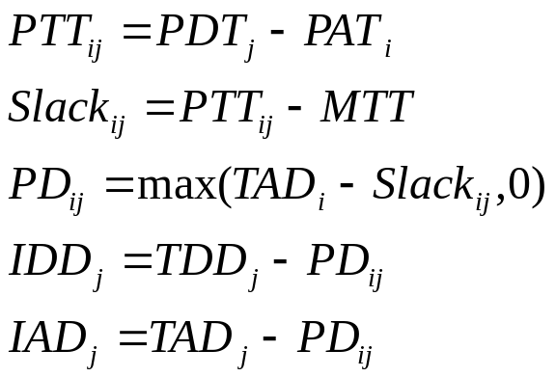
Definitions
TDD
i
i’’
i’
PD
IDD
PDT
ADT
Slack
Min Turn Time
Planned Turn Time
j
j’
PAT
AAT
PD
IAD
TAD

Slide 18
Modeling Idea
Delays propagate along aircraft routes
Only limited slack can be added
Appropriately located slack can prevent delay propagation
Routing aircraft intelligently ➔better allocated slack
Essentially add slack where advantageous, reducing slack where less needed

Slide 19
Illustration of the Idea
f1’
MTT
f1
f2
MTT
f3
f3’
f4
Original routing
f1’
MTT
f1
f2
MTT
f3
f4
New routing

Slide 20
Modeling Issues
Difficult to use leg-based models to track the delay propagation
One variable (string) for each aircraft route between two maintenances (Barnhart, et al. 1998)
  A string: a sequence of connected flights that begins and ends at maintenance stations
  Delay propagation for each route can be determined
Need to determine delays for each feasible route
  Most of the feasible routes haven’t been realized yet
    PD and TAD are a function of routing
    PD and TAD for these routes can’t be found in the historical data
  IAD is not a function of routing and can be calculated by tracking the route of each individual aircraft in the historical data

Slide 21
Generating Flight Delays for Any Feasible Route
Step1: Determine propagated delays from historical data:
  PD_{ij} = max (TAD_{i} – slack_{ij},0)
Step 2: Determine Independent Arrival Delays (IAD) from historical data:
  IAD_{j}= TAD_{j} – PD_{ij}
Step 3: Determine TAD and PD for feasible routes:
  For the first flight on each string, New_TAD = IAD
  New_PD_{ij} =max (New_TAD_{i} – slack_{ij},0)
  New_TAD_{j}= IAD_{j}+ New_PD_{ij}

Slide 22
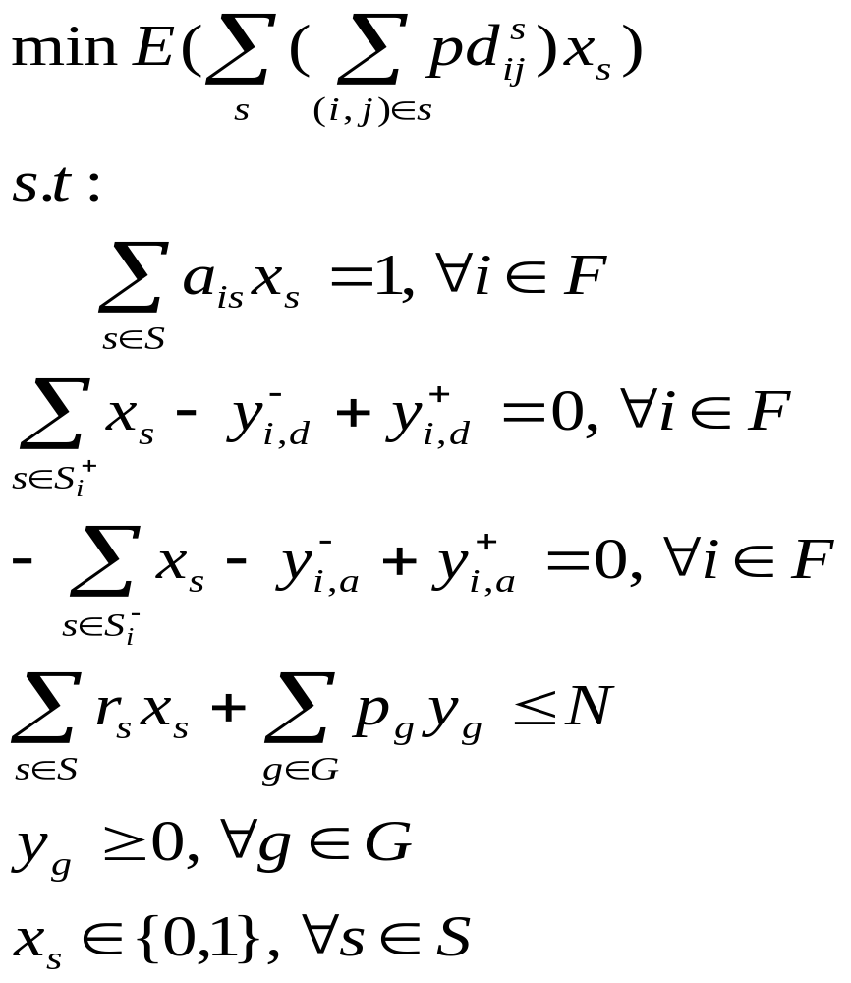
String Based Formulation

Slide 23
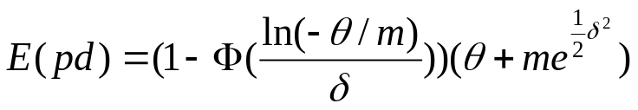
Objective Function Coefficient
Random variables (PD) can be replaced by their mean
Distribution of Total Arrival Delay
  Possible distributions analyzed: Normal, Exponential, Gamma, Weibull, Lognormal, etc.
  Our statistical analysis shows that lognormal distribution is the best fit
A closed form of expected value function can be obtained

Slide 24
Solution Approach
This formulation is a deterministic mixed-integer program with a huge number of 0-1 variables
Branch-and-price
  Branch-and-Bound with a linear programming relaxation solved at each node of the branch-and-bound tree using column generation
IP solution
  A special branching strategy: branching on follow-ons (Ryan and Foster 1981, Barnhart et al. 1998)

Slide 25
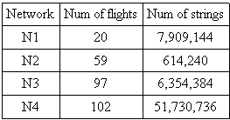
Computational Results
Test Networks
Data divided into two sets:
  First data set (Jul 2000) used to build model and generate routes
  Second data set (Aug 2000) used to test these new routes

Slide 26
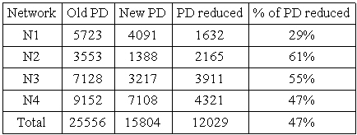
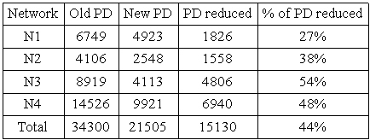
Results - Delays
July 2000 data
August 2000 data

Slide 27
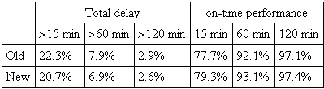
Results - Delay Distribution
Total delays for existing and new routings

Slide 28
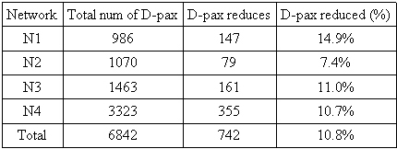
Results - Passenger Disruptions
Disruptions calculated at the flight level
  If a flight was cancelled, all passengers on that flight is disrupted
  If actual departure time of flight B – actual arrival time of flight A < minimum connecting time ➔ all passengers connecting from A to B are disrupted

Slide 29
Outline
Background, Motivation and Our Contributions
Overview of Robust Airline Schedule Planning
Robust Aircraft Maintenance Routing
Flight Schedule Retiming – reduce passenger missed connections
  Passenger delays and disruptions
  Modeling Idea
  Formulations and their properties
  Solution approach
  Proof-of-concept results
Summary and Future Research Directions

Slide 30
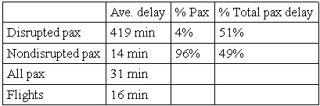
Passenger Delays and Disruptions
Flight delay and passenger delay (Bratu and Barnhart, 2002)
Passenger delay caused by disruptions is the most critical part
Minimize number of disrupted passengers
  A good proxy for passenger delays

Slide 31
Definitions Related to Passenger Disruption
If ACT – MCT < 0, passengers are disrupted
ACT
PAT
AAT
PDT
ADT
Slack
MCT
PCT

Slide 32
Minimize Passenger Missed Connections
If the slack is “eaten” by flight delay, passengers are disrupted
Adding more slack can be good for connecting passengers, but can result in reduced productivity
Appropriately located slack can prevent passenger disruptions
Moving flight departure times in a small time window can lead to better allocated slack

Slide 33




Illustration of the Idea
Suppose 100 passengers in flight f₂ will connect to f₃
Airport A
P (misconnect)= 0.3,
E(disrupted pax) = 30
Airport B
P(misconnect)=0.2,
E(disrupted pax) =20
Airport C
Airport D
➔ Expected disrupted passengers reduced: 10

Slide 34
Where to Apply
Schedule Design
Whether a passenger will be disrupted depends on flight delays, a function of fleeting and routing
Before solving maintenance routing
  Impact of the propagation of flight delays won’t be considered
  New fleeting and routing solution may cause delay propagate in a different way ➔ may eventually change the number of disrupted passengers
After solving fleeting and routing problem
  Delay propagation has been considered
  Need to maintain the current fleeting and routing solution
Fleet Assignment
Maintenance Routing
Crew Scheduling

Slide 35








Connection-Based Formulation
Objective
  minimize the expected total number of passengers missing connection
Constraints:
  For each flight, exactly one copy will be selected.
  For each connection, exactly one copy will be selected and this selected copy must connect the selected flight-leg copies.
  The current fleeting and routing solution cannot be altered.

Slide 36
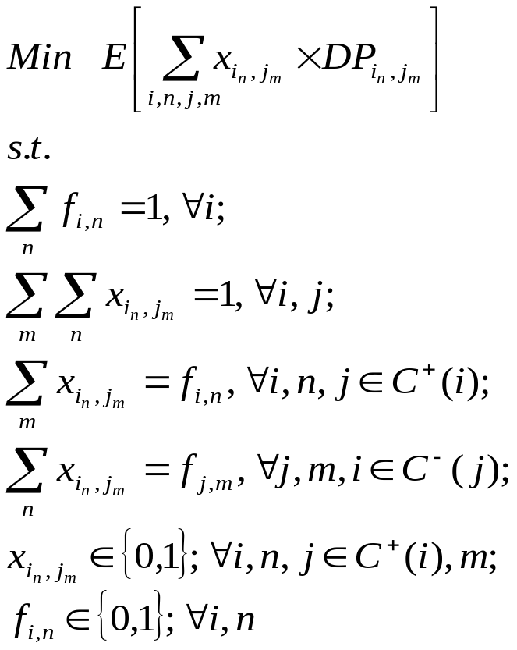
Connection-Based Formulation
Theorem 1:
  The second set of constraints are redundant and can be relaxed
Theorem 2:
  The integrality of the connection variables can be relaxed

Slide 37
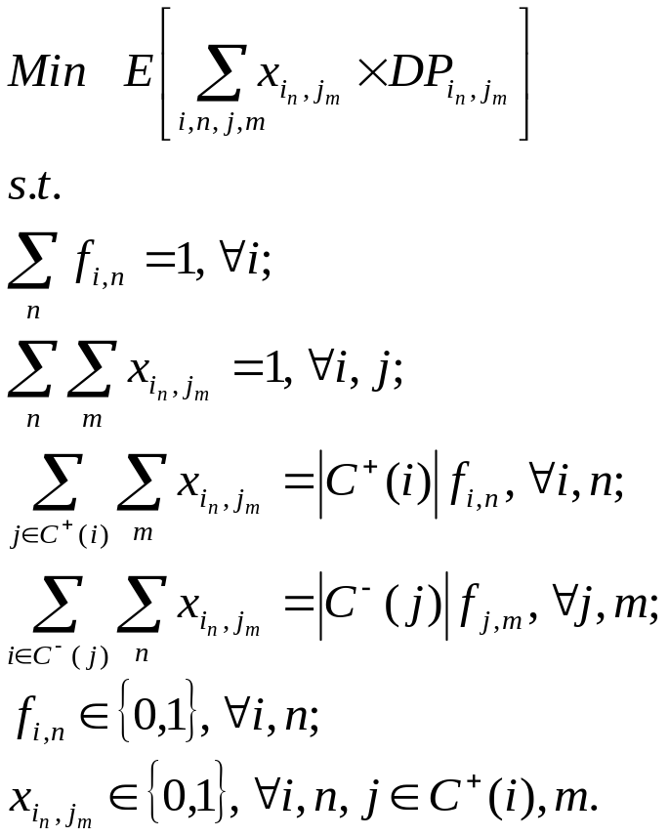
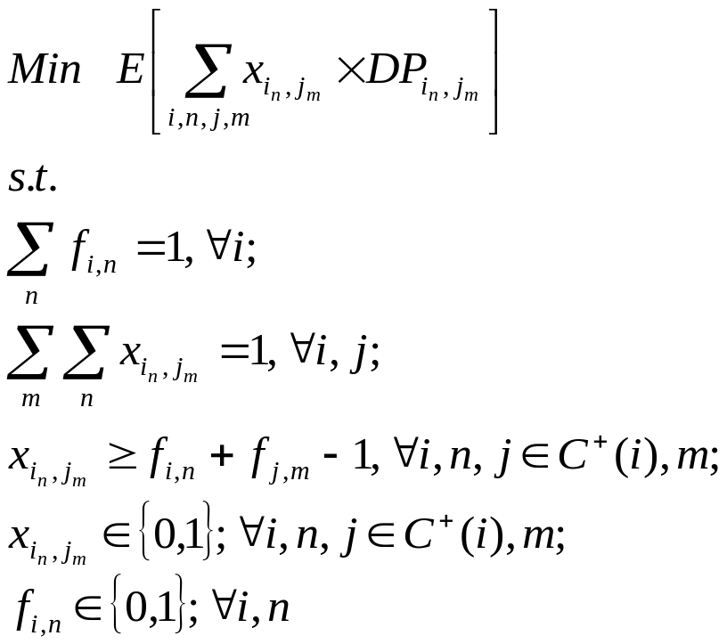
Alternative Connection-based Formulations
Formulation II
Formulation III

Slide 38
Model Properties
Theorems on constraints:
  The second set of constraints are redundant and can be relaxed in formulations two and three
  The integrality constraints of the connection variables can be relaxed in formulations two and three
Theorem on LP relaxations
  The LP relaxation of formulation one is at least as strong as those of formulations two and three

Slide 39
Problem Size
A network from a major US airline used by Barnhart et al. (2001)
  2,044 flights and 76,641 itineraries.
  Suppose 7 copies will be generated for each flight (if 5 minutes interval is used, 7 copies correspond to a 30 minute time window)
  Assume on average every flight connects to 12 flights with connecting passengers.
 | Number of Variable | Number of Integer Variables | Number of Rows
F1 | 1,216,180 | 14,308 | 345,436
F2 | 1,216,180 | 14,308 | 30,660
F3 | 1,216,180 | 14,308 | 1,203,916

Slide 40
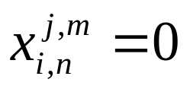
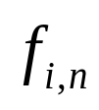
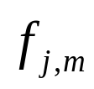
How to Maintain Current Fleeting and Routing Solution
For an aircraft maintenance route: the planned turn time >= minimum turn time
Force , if the time between the arrival of flight copy and the departure of flight copy is less than the minimum turn time.
The upper bounds will be set to zero for these x variables

Slide 41
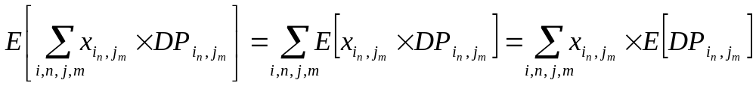

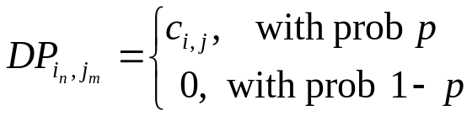
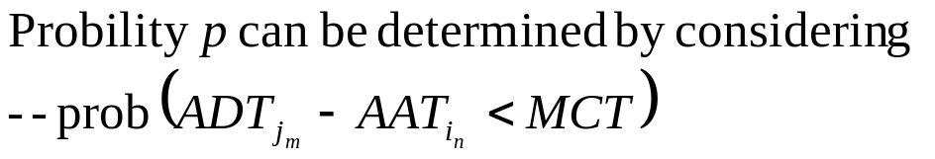
Solution Approach
Random variables can be replaced by their mean
  Deterministic Problem
  Distribution of
Branch-and-Price

Slide 42

Computational Results
Network
  We use the same four networks, but add all flights together and form one network with total 278 flights.
Data divided into two sets:
  First data set (Jul 2000) used to build model and generate schedule
  Second data set (Aug 2000) used to test the new schedule
Strength of the formulations

Slide 43
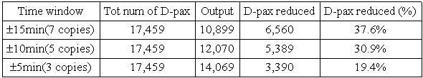
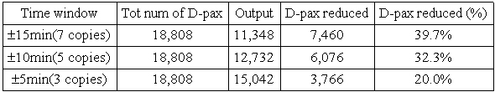
Computational Results
Assume 30 minute minimum connecting time
  For July 2000 data
  For August 2000 data

Slide 44
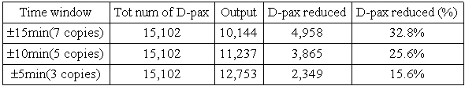
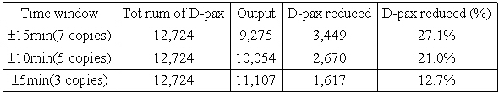
Computational Results
August 2000 data
  Assume 25 minute minimum connecting time
  Assume 20 minute minimum connecting time

Slide 45
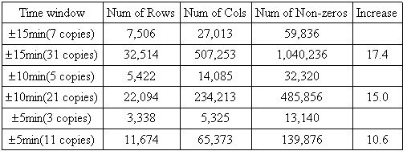
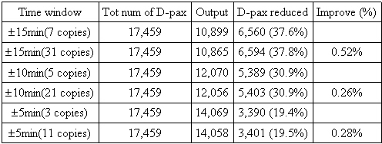
Computational Results
How many copies to generate

Slide 46
Outline
Background, Motivation and Our Contributions
Overview of Robust Airline Schedule Planning
Robust Maintenance Routing
Flight Schedule Retiming
Summary and Future Research Directions
  Summary of Contributions
  Future Research Directions

Slide 47
Summary of Contributions
Provide alternative definitions for robustness in the context of airline schedule planning
Develop an optimization model and solution approach that can generate aircraft maintenance routes to minimize delay propagation
Develop optimization models and solution approach to minimize the expected total number of passengers missing connections, and analyze the model properties
Proof-of-concept results show that these approaches are promising
Develop integrated models for more robustness

Slide 48
Future Research Directions
Integrated Models
  Integrated robust aircraft maintenance routing with fleet assignment
  Robust aircraft maintenance routing with time window
  Integrated flight schedule re-timing with FAMTW
Other approaches
  Fleet assignment with minimal expected cost
  Fleet assignment under demand uncertainty
  Aircraft routes with swap opportunities
  Aircraft routes with short cycles

Slide 49
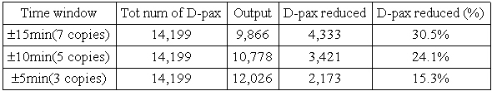
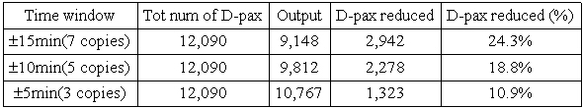
Computational Results
July 2000 data
  Assume 25 minute minimum connecting time
  Assume 20 minute minimum connecting time

Slide 50
Impact on Passengers
Disruptions calculated at the flight level
  If a flight was cancelled, all passengers on that flight is disrupted
  If actual departure time of flight B – actual arrival time of flight A < minimum connecting time ➔ all passengers connecting from A to B are disrupted
Number of disrupted passengers only calculated for connections between flights that both have ASQP records
  ASQP has records only for domestic flights flown by jet airplanes and major airlines
  Actual departure and arrival times for flights without ASQP records are unknown ➔ Assume no disruptions for these flights
Passengers only counted as disrupted once
  If passenger is disrupted on any flight leg of itinerary, passenger not counted as disrupted on the following flight legs

Slide 51
Passenger Delays and Disruptions
Passenger delays
  the difference between scheduled and actual arrival time at passengers’ destination
Passengers are disrupted if their planned itineraries are infeasible
Flight delay and passenger delay (Bratu and Barnhart, 2002)

Slide 52
Passenger Disruption
Disrupted passengers
  Significant numbers: 4% → 20-30 million in U.S.
  Experience very long delay
  Contribute to more than half of the total passenger delay
  Cause huge revenue loss
  Destroy airlines’ image
Reduce disrupted passengers
  Passenger delay caused by disruption is the most critical part
  Hard to determine the delays for each disrupted passengers
  ➔ Minimize number of disrupted passengers

Slide 53
LP Solution
Algorithm for LP relaxation
  Step 0: Create initial feasible solution
  Step 1: Solve the restricted master problem (RMP)
      Find optimal solution to RMP with a subset of all strings
  Step 2: Solve the pricing problem
      Generate strings with negative reduced cost
      If no string is generated, stop: the LP is solved
  Step 3: Construct a new restricted master problem
      Add the strings generated
      Go to step 1

Slide 54


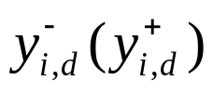
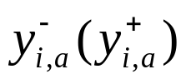
Notation
S: set of feasible strings
F: set of flights
G: set of ground variables
:set of strings ending (starting) with flight i
: binary decision variable for each feasible string s
y: integer variable to count number of aircraft on the ground at maintenance stations
: number of aircraft on the ground before (after) flight i departs at the maintenance station from which flight i departs
: number of aircraft on the ground before (after) flight i arrives at the maintenance station from which flight i arrives

Slide 55
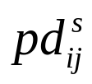



Notation (Cont.)
: propagated delay from flight i to flight j if flight i and flight j are in string s
: indicator variable, equals 1 if flight i is in string s, and equals 0 otherwise
: number of times string s crosses the count time, a single point time at which to count aircraft
: number of times ground arc g crosses the count time
N : number of planes available.

Slide 56
Data
Airline Service Quality Performance (ASQP) provides good source of delay information
ASQP provides flight operation information:
  For all domestic flights served by jet aircraft by major airlines in U.S.
  Planned departure time and arrival time, actual departure time and arrival time (including wheels-off and wheels-on time, taxi-out and taxi-in time, airborne time)
  Aircraft tail number for each flight
  Cancelled flights (reasons for cancellation, and aircraft tail number are not available)

Slide 57
Effect of Cancellations
For cancelled flights in the historical data
  we don’t know which aircraft supposed to fly them
  We don’t have the delay information
  We assume the propagated delays for these flights are zero
Lower cancellation rates
  Less passengers disrupted because of cancellation
  More passengers disrupted because of flight delays
7 days in Aug 2000 with very few cancellations (cancellation rate = 0.19%)
  For Aug 2000, 65% of disrupted passengers are disrupted because of flight delays
  For 7 selected days in Aug 2000, 92% of disrupted passengers are disrupted because of flight delays

Slide 58
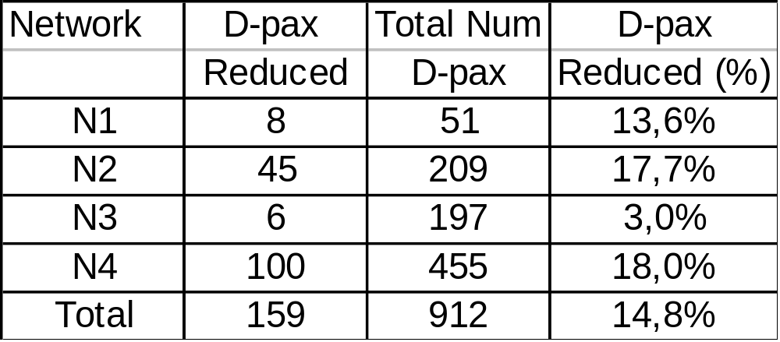
Results - Low Cancellation Days
Passenger disruptions for 7 selected days in Aug 2000 with very few cancellations
Reduction in number of disrupted passengers per non-cancelled flights is same as that for entire month

Slide 59
Extensions
Combine with scheduling
  More slacks may be added ➔ further reduce delay propagation
Combine with fleet assignment
  Need to determine cost for propagated delay
  More feasible strings ➔ better solution
  Minimum turn time is a function of fleet type
Integrate with fleet assignment and schedule generation

