Slide 1
1.206J/16.77J/ESD.215J
Airline Schedule Planning
Cynthia Barnhart
Spring 2003

Slide 2
1.206J/16.77J/ESD.215J Airline Schedule Planning: Multi-commodity Flows
Outline
Applications
Problem Definition
Formulations
Solutions
Results

Slide 3
Application I
Package flow problem (express package delivery operation)
  Shipments have specific origins and destinations and must be routed over a transportation network
  Each set of packages with a common origin-destination pair is called a commodity
    Time windows (availability and delivery time) associated with packages
  The objective might be to minimize total costs, find a feasible flow, ...

Slide 4
Application II
Passenger mix problem
  Given a fixed schedule of flights, a fixed fleet assignment and a set of customer demands for air travel service on this fleeted schedule, the airline's objective is to maximize revenues by accommodating as many high fare passengers as possible
  For some flights, demand exceeds seat supply and passengers must be spilled to other itineraries of either the same or another airline

Slide 5
Application III
Message routing problem
  In a telecommunications or computer network, requirements exist for transmission lines and message requests, or commodities.
  The problem is to route the messages from their origins to their respective destinations at minimum cost

Slide 6
MCF Networks
Set of nodes
  Each node associated with the supply of or demand for commodities
Set of arcs
  Cost per unit commodity flow
  Capacity limiting the total flow of all commodities and/ or the flow of individual commodities

Slide 7
MCF Commodity Definitions
A commodity may originate at a subset of nodes in the network and be destined for another subset of nodes
A commodity may originate at a single node and be destined for a subset of the nodes
A commodity may originate at a single node and be destined for a single node

Slide 8
MCF Objectives
Flow the commodities through the networks from their respective origins to their respective destinations at minimum cost
  Expressed as distance, money, time, etc.
Ahuja, Magnanti and Orlin (1993)-- survey of multi-commodity flow models and solution procedures

Slide 9
MCF Problem Formulations -- Linear Programs
Network flow problems
  Capacity constraints limit flow of individual commodities
  Conservation of flow constraints ensure flow balance for individual commodities
  Flow non-negativity constraints
With side constraints
  Bundle constraints restrict total flow of ALL commodities on an arc

Slide 10
MCF Constraint Matrix
Network flow problem, commodity k=1
Network flow problem, commodity k=2
Network flow problem, commodity k=3
Network flow problem, commodity k=4
Bundle constraints limiting total flow of all commodities to arc capacities

Slide 11
Alternative Formulations for O-D Commodity Case
Node-Arc Formulation
  Decision variables: flow of commodity k on each arc ij
Path Formulation
  Decision variables: flow of commodity k on each path for k
“Tree” or “Sub-network” Formulation
  Define: super commodity: set of all (O-D) commodities with the same origin o (or destination d)
  Decision variables: quantity of the super commodity k’ assigned to each “tree” or “sub-network” for k’
Formulations are equivalent

Slide 12
Sample Network
a
2
d
1
c
4
b
3
e
Arcs
i j cost capy
1 2 1 20
1 3 2 10
2 3 3 20
2 4 4 10
3 4 5 40
Commodities
# o d quant
1 1 3 5
2 1 4 15
3 2 4 5
4 3 4 10

Slide 13
Notation
Parameters
A: set of all network arcs
K: set of all commodities
N: set of all network nodes
O(k) [D(k)]: origin [destination] node for commodity k
c_{ij}^{k} : per unit cost of commodity k on arc ij
u_{ij} : total capacity on arc ij (assume u_{ij}^{k} is unlimited for each k and each ij)
d_{k} : total quantity of commodity k
Decision Variables
x_{ij}^{k} : number of units of commodity k assigned to arc ij

Slide 14
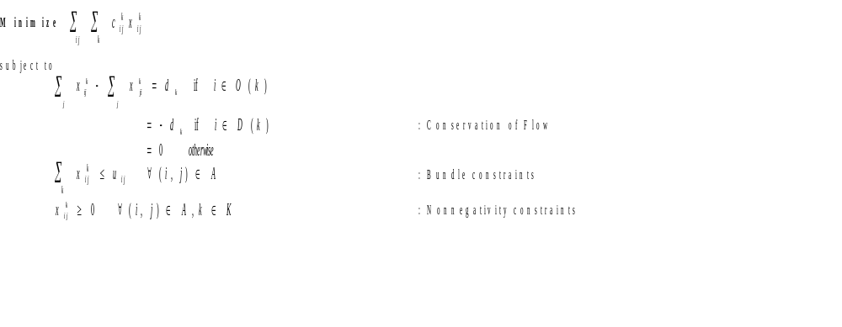
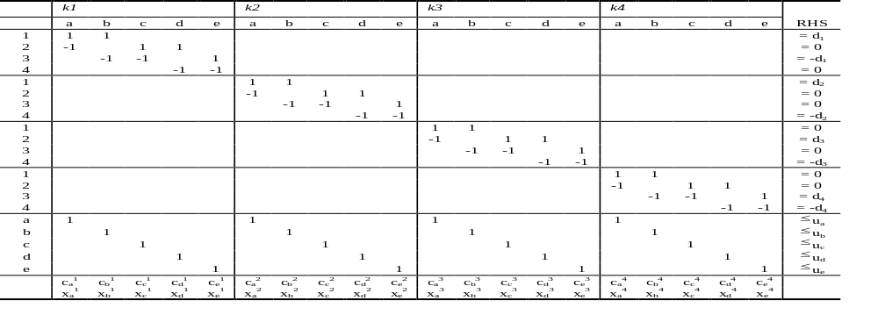
Node-Arc Formulation

Slide 15
Additional Notation
Parameters
P^{k}: set of all paths for commodity k, for all k
c_{p} : per unit cost of commodity k on path p = Σ_{ij ∈p} c_{ij}^{k}
δ_{ij}^{p} : = 1 if path p contains arc ij; and = 0 otherwise
Decision Variables
f_{p}: fraction of total quantity of commodity k assigned to path p

Slide 16
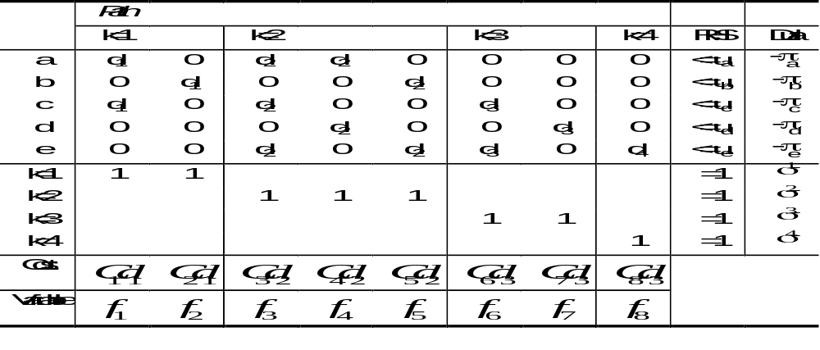
O/D Based Path Formulation
Minimize
∑
∑
d
C
f
k
p
∈
P
k
k
p
p
subject to
∑
∑
d
f
δ
p
≤
u
∀
(
i
,
j
)
∈
A
: Bundle constraints
k
p
∈
P
k
k
p
ij
ij
∑
f
=
1
∀
k
∈
K
: Flow balance constraints
p
∈
P
k
p
f
p
≥
0
∀
p
∈
P
k
,
k
∈
K
: Non-neg. constraints

Slide 17
Additional Notation
Parameters
S: set of source nodes n∈N for all commodities
Q^{s}: the set of all sub-networks originating at s
TC_{q}^{s}: total cost of sub-network q originating at s
ζ_{p}^{q} : = 1 if path p is contained in sub-network q; and = 0 otherwise
Decision Variables
R_{q}^{s} : fraction of total quantity of the super commodity originating at s assigned to sub-network q

Slide 18
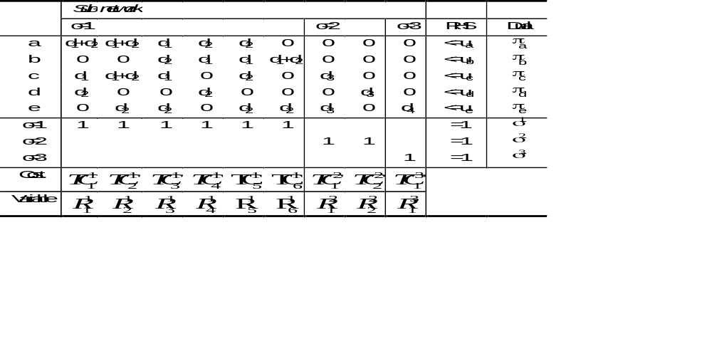
Sub-network Formulation
Minimize
∑
∑
(
∑
∑
C
ζ
q
d
)
^{s}
p
p
k
R
q
S
∈
s
∈
∈
k
s∈
q
Q
k
q
p
P
subject to
∑
∑
∑
∑
δ
p
^{s}ζ
≤
∀
∈
(
d
)
R
q
u
(
i
,
j
)
A
: Capacity Limits on Each Arc
s
∈
k
k
ij
q
p
ij
s
q
∈
Q
k
s
p
∈
P
∑
R ^{s}
=
∀
∈
q
1
s
S
: Mass Balance Requirements
q
∈
Q
s
R ^{s}
≥
0
∀
q
∈
Q
s
,
s
∈
S
: Nonnegative Path Flow Variables
q

Slide 19
Linear MCF Problem Solution
Obvious Solution
  LP Solver
Difficulty
  Problem Size: (|N|=|Nodes|, |C|=|Commodities|, |A|=|Arcs|)
    Node-arc formulation:
      Constraints: |N|*|C| + |A|
      Variables: |A|*|C|
    Path formulation:
      Constraints: |A| + |C|
      Variables: |Paths for ALL commodities|
    Sub-network formulation:
      Constraints: |A|+|Origins|
      Variables: |Combinations of Paths by Origin|

Slide 20
General MCF Solution Strategy
Try to Decompose a Hard Problem Into a Set of Easy Problems

Slide 21
MCF Solution Procedures I
Partitioning Methods
  Exploit Network Structure to Speed Up Simplex Matrix Computations
Resource-Directive Decomposition
  Repeat until Optimal:
    Allocate Arc Capacity Among Commodities
    Find Optimal Flows Given Allocation

Slide 22
MCF Solution Procedures II
Price-Directive Decomposition
  Repeat until Optimal:
    Modify Flow Cost on Arc
    Ignore Bundle Constraints, Find Optimal Flows

Slide 23
Revisiting the Path Formulation
MINIMIZE Σ _{k ∈K} Σ _{p∈P}k d_{k} c_{p} f_{p}
subject to: Σ_{p∈P}k Σ _{k ∈K} d_{k} f_{p}δ_{ij}^{p} ≤ u_{ij} ∀ ij∈A
Σ_{p∈P(k)} f_{p} = 1 ∀ k∈K
f_{p} ≥ 0 ∀ p∈P^{k}, ∀ k∈K

Slide 24
By-products of the Simplex Algorithm: Dual Variable Values
Duals
-π_{ij}: the dual variable associated with the bundle constraint for arc ij (π is non-negative)
σ^{k} : the dual variable associated with the commodity constraints
Economic Interpretation
π _{ij} : the value of an additional unit of capacity on arc ij
σ ^{k}/d_{k} : the minimal cost to send an additional unit of commodity k through the network
1
1

Slide 25
Modified Costs
Definition: Modified cost for arc ij and commodity k = c_{ij}^{k}+π_{ij}
Definition: Modified cost for path p and commodity k = Σ_{ij∈A} (c_{ij}^{k} + π_{ij} )δ_{ij}^{p}
1
1

Slide 26
Optimality Conditions for the Path Formulation
f*_{p} and π*_{ij} , σ*^{k} are optimal for all k and all ij iff:
  Primal feasibility is satisfied
    Σ_{p∈P}k Σ _{k ∈K} d_{k} f*_{p}δ_{ij}^{p} ≤ u_{ij} ∀ ij∈A
    Σ_{p∈P(k)} f*_{p} = 1 ∀ k∈K
    f*_{p} ≥ 0 ∀ p∈P^{k}, ∀ k∈K
  Complementary slackness is satisfied
    π*_{ij}(Σ_{p∈P}k Σ _{k ∈K} d_{k} f*_{p}δ_{ij}^{p} - u_{ij} ) = 0, ∀ ij∈A
    σ*^{k} (Σ_{p∈ P}k f*_{p} – 1) = 0, ∀ k∈K
  Dual feasibility is satisfied (reduced cost is non-negative for a minimization problem)
    (d_{k} c_{p} + Σ _{ij ∈A} d_{k} π_{ij} δ_{ij}^{p} ) - σ^{k} = d_{k} ( Σ _{ij ∈A} (c_{ij}^{k} + π_{ij}) δ_{ij}^{p} - σ^{k} /d_{k} ) ≥ 0, ∀ p∈ P^{k}, ∀ k∈ K

Slide 27
Multi-commodity Flow Optimality Conditions
The price for an additional unit of capacity is 0 unless capacity is fully utilized
    π*_{ij}(Σ_{p∈P}k Σ _{k ∈K} d_{k} f*_{p}δ_{ij}^{p} - u_{ij} ) = 0, ∀ ij∈A
A path p for commodity k is utilized only if its “modified cost” (that is, Σ_{ij∈A} (c_{ij}^{k} + π*_{ij}δ_{ij}^{p})) is minimal, for all paths p∈P^{k}
  Reduced Costs all non-negative:
    c’_{p} = d_{k} ( Σ _{ij ∈A} (c_{ij}^{k} + π*_{ij}) δ_{ij}^{p} - σ*^{k} /d_{k} ) ≥ 0,
    ∀ p∈ P^{k}, ∀ k∈ K
  f*_{p} (Σ_{ij∈A} (c_{ij}^{k} + π*_{ij} ) δ_{ij}^{p} - σ*^{k} /d_{k} ) = 0,
  ∀ p∈ P^{k}, ∀ k∈ K
3

Slide 28
Column Generation- A Price Directive Decomposition
Millions/Billions of Variables
Restricted Master Problem (RMP)
Constraints
Never Considered
Start
Added

Slide 29
RMP and Optimality Conditions
Consider f*_{p} and π*_{ij} , σ*^{k} optimal for RMP, then
  Primal feasibility is satisfied
    Σ_{p∈P}k Σ _{k ∈K} d_{k} f*_{p}δ_{ij}^{p} ≤ u_{ij} ∀ ij∈A
    Σ_{p∈P(k)} f*_{p} = 1 ∀ k∈K
    f*_{p} ≥ 0 ∀ p∈P^{k}, ∀ k∈K
  Complementary slackness is satisfied
    π*_{ij}(Σ_{p∈P}k Σ _{k ∈K} d_{k} f*_{p}δ_{ij}^{p} - u_{ij} ) = 0, ∀ ij∈A
    σ*^{k} (Σ_{p∈ P}k f*_{p} – 1) = 0, ∀ k∈K
  Dual feasibility is guaranteed (reduced cost is non-negative) ONLY for a path p included in RMP
    (d_{k} c_{p} + Σ _{ij ∈A} d_{k} π_{ij} δ_{ij}^{p} ) - σ^{k} = d_{k} ( Σ _{ij ∈A} (c_{ij}^{k} + π_{ij}) δ_{ij}^{p} - σ^{k} /d_{k} ) ≥ 0, ∀ p∈ P^{k}, ∀ k∈ K
3

Slide 30
LP Solution: Column Generation
Step 1: Solve Restricted Master Problem (RMP) with subset of all variables (columns)
Step 2: Solve Pricing Problem to determine if any variables when added to the RMP can improve the objective function value (that is, if any variables have negative reduced cost)
Step 3: If variables are identified in Step 2, add them to the RMP and return to Step 1; otherwise STOP
Notes:
10

Slide 31
Pricing Problem
Given π, the optimal (non-negative) duals for the current restricted master problem, the pricing problem, for each p∈ P^{k}, k∈ K is
  min _{p∈ P}k (d_{k} ( Σ _{ij ∈A} (c_{ij}^{k} + π_{ij}) δ_{ij}^{p} - σ^{k} /d_{k} )
  Or, equivalently:
  min _{p∈ P}k Σ _{ij ∈A} (c_{ij}^{k} + π_{ij}) δ_{ij}^{p}
  A shortest path problem for commodity k (with modified arc costs)

Slide 32
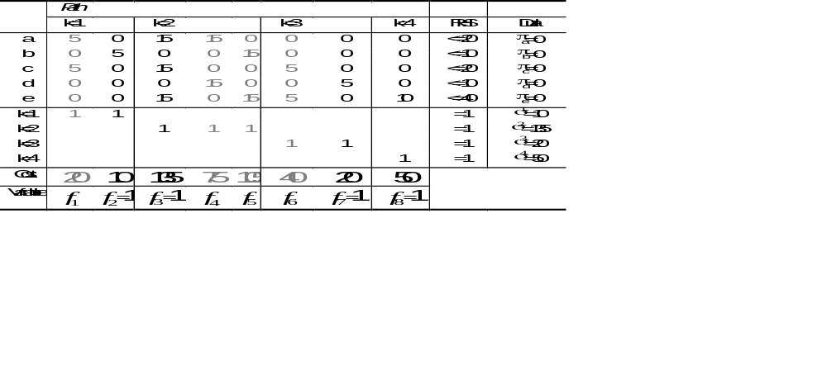
Example- Iteration 1

Slide 33
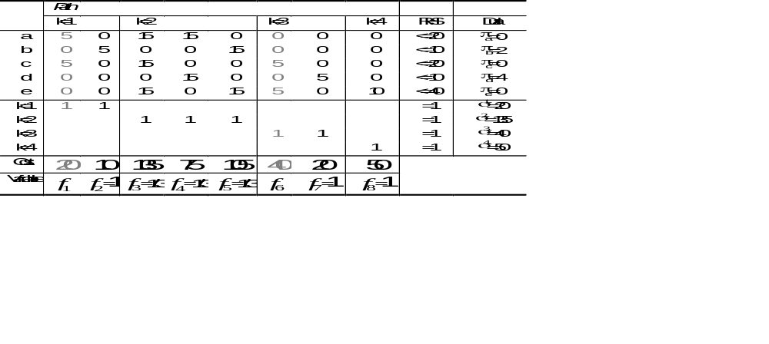
Example- Iteration 2

Slide 34
MCF Optimality Conditions
For each p∈P^{k}, for each k, the reduced cost c′_{p}:
  c′_{p} = (d_{k} c_{p} + Σ _{ij ∈A} d_{k} π_{ij} δ_{ij}^{p} ) - σ^{k} = Σ_{ij} (d_{k}c_{ij}^{k} + d_{k}π_{ij})δ_{ij}^{p} - σ^{k =} Σ_{ij} (c_{ij}^{k} + π_{ij})δ_{ij}^{p} - σ^{k} /d_{k} ≥ 0
    where π, σ are the optimal duals for the current restricted master problem
  c′_{p} = 0, for each utilized path p implies
    Σ_{ij} (d_{k}c_{ij}^{k} + d_{k}π_{ij}) δ_{ij}^{p} = σ^{k}
  or equivalently,
    Σ_{ij} (c_{ij}^{k} + π_{ij}) δ_{ij}^{p} = σ^{k}/d_{k}
  So if, min_{p∈P(k)} c′_{p} ⁼ Σ_{ij} (c_{ij}^{k} + π_{ij}) δ_{ij}^{p*} - σ^{k}/d_{k} ≥ 0, the current solution to the restricted master problem is optimal for the original problem
  If min_{p∈P(k)} c′_{p} = Σ_{ij} (c_{ij}^{k} + π_{ij}) δ_{ij}^{p*} - σ^{k}/d_{k} < 0, add p* to restricted master problem

Slide 35
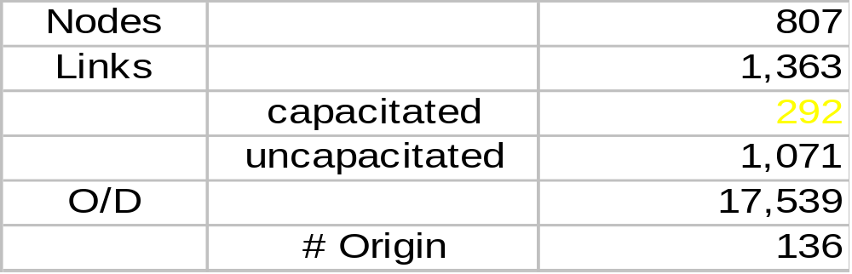
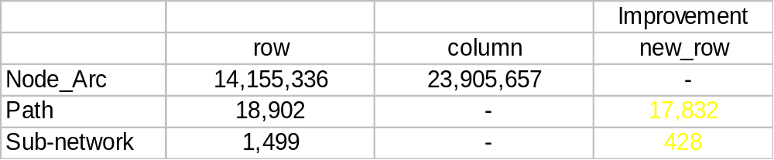
Data Set
Data Set
Constraint Matrix Size

Slide 36
Computational Results
Number of Nodes: 807
Number of Links: 1,363
Number of Commodities: 17,539
Computational Result (IBM RS6000, Model 370)
  Path Model: 44 minutes
  Sub-network Model: < 1 minute

Slide 37
Conclusions I
Choose your formulation carefully
  Trade-off memory requirements and solution time
  Sub-network formulation can be effective when low level of congestion in the network
Problem size often mandates use of combined column and row generation

Slide 38
Conclusions II
Solution time is affected dramatically by
  The complexity of the pricing problem
  Exploitation of problem structure, pre-processing, LP solver selection, etc.

