Slide 1
1.206J/16.77J/ESD.215J
Airline Schedule Planning
Cynthia Barnhart
Spring 2003

Slide 2
1.206J/16.77J/ESD.215J
Multi-commodity Network Flows: A Keypath Formulation
Outline
  Path formulation for multi-commodity flow problems revisited
  Keypath formulation
  Example
  Keypath solution algorithm
    Column generation
    Row generation

Slide 3
Path Notation
Sets
A: set of all network arcs
K: set of all commodities
N: set of all network nodes
Parameters
u_{ij} : total capacity on arc ij
d_{k} : total quantity of commodity k
P^{k}: set of all paths for commodity k, for all k
Parameters (cont.)
c_{p} : per unit cost of commodity k on path p = Σ_{ij ∈p} c_{ij}^{k}
δ_{ij}^{p} : = 1 if path p contains arc ij; and = 0 otherwise
Decision Variables
f_{p}: fraction of total quantity of commodity k assigned to path p

Slide 4
The Path Formulation Revisited
MINIMIZE Σ _{k ∈K} Σ _{p∈P}k d_{k} c_{p} f_{p}
subject to: Σ_{p∈P}k Σ _{k ∈K} d_{k} f_{p}δ_{ij}^{p} ≤ u_{ij} ∀ ij∈A
Σ_{p∈P}k f_{p} = 1 ∀ k∈K
f_{p} ≥ 0 ∀ p∈P^{k}, ∀ k∈K

Slide 5
The Keypath Concept
The path formulation for MCF problems can be recast equivalently as follows:
  Assign all flow of commodity k to a selected path p, called the keypath, for each commodity k∈K
    Often the keypath is the minimum cost path for k
    The resulting flow assignment is often infeasible
      One or more arc capacity constraints are violated
    If the resulting flows are feasible and the keypaths are minimum cost, the flow assignment is optimal
  Solve a linear programming formulation to minimize the cost of adjusting flows to achieve feasibility
    Flow adjustments involve removing flow of k from its keypath p and placing it on alternative path p’∈P^{k}, for each k∈K

Slide 6
Additional Keypath Notation
Parameters
p(k) : keypath for commodity k
Q_{ij} : total initial (flow assigned to keypaths) on arc ij = Σ _{k ∈K} d_{k}δ_{ij}^{p(k)}
c^{r}_{p(k)} : = c_{r} – c_{p(k)} = Σ _{ij ∈A} c_{ij}δ_{ij}^{r} - Σ _{ij ∈A} c_{ij}δ_{ij}^{p(k)}; change in cost when one unit of commodity k is shifted from keypath p(k) to path r (Note: typically non-negative if p(k) has minimum cost)
Decision Variables
f^{r}_{p(k)}: fraction of total quantity of commodity k removed from keypath p(k) to path r

Slide 7
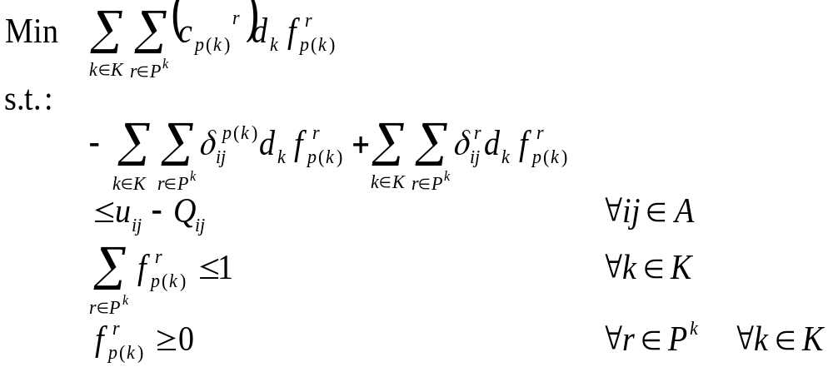
The Keypath Formulation

Slide 8
Associated Dual Variables
Duals
- π_{ij} : the dual variable associated with the bundle constraint for arc ij (π is non-negative)
- σ^{k}: the dual variable associated with the commodity constraints (σ is non-negative)
Economic Interpretation
π _{ij} : the value of an additional unit of capacity on arc ij
σ ^{k}/d_{k} : the minimal cost to remove an additional unit of commodity k from its keypath and place on another path
1
1

Slide 9
Optimality Conditions for the Path Formulation
f*_{p} and π*_{ij} , σ*^{k} are optimal for all k and all ij if:
  Primal feasibility is satisfied
  Complementary slackness is satisfied
  Dual feasibility is satisfied (reduced cost is non-negative for a minimization problem)

Slide 10
Modified Costs
Definition: Reduced cost for path r, commodity k
= Σ_{ij∈A} c_{ij}^{k} d_{k} δ_{ij}^{r} - Σ_{ij∈A} c_{ij}^{k} d_{k} δ_{ij}^{p(k)} + Σ_{ij∈A} π_{ij}d_{k}δ_{ij}^{r} - Σ_{ij∈A} π_{ij} d_{k} δ_{ij}^{p(k)} + σ^{k}
= Σ_{ij∈A} (c_{ij}^{k} + π_{ij} ) δ_{ij}^{r} –
Σ_{ij∈A} (c_{ij}^{k} + π_{ij}) δ_{ij}^{p(k)} + σ^{k /}d_{k}
Definition: Let modified cost for arc ij and commodity k = c_{ij}^{k} + π_{ij}
Reduced cost is non-negative for all commodity k variables if the modified cost of path r equals or exceeds the modified cost of p(k) less σ^{k/}d_{k}
1
1

Slide 11
Column Generation- A Price Directive Decomposition
Millions/Billions of Variables
Restricted Master Problem (RMP)
Constraints
Never Considered
Start
Added

Slide 12
LP Solution: Column Generation
Step 1: Solve Restricted Master Problem (RMP) with subset of all variables (columns)
Step 2: Solve Pricing Problem to determine if any variables when added to the RMP can improve the objective function value (that is, if any variables have negative reduced cost)
Step 3: If variables are identified in Step 2, add them to the RMP and return to Step 1; otherwise STOP
Notes:
10

Slide 13
Pricing Problem
Given π and σ^{k}, the optimal (non-negative) duals for the current restricted master problem and the keypath p(k), the pricing problem, for each k∈ K is
  min _{r∈ P}k (d_{k} (Σ_{ij∈A} (c_{ij}^{k} + π_{ij} ) δ_{ij}^{r} – Σ_{ij∈A} (c_{ij}^{k} + π_{ij}) δ_{ij}^{p(k)} + σ^{k /}d_{k} )
  Or, letting C = Σ_{ij∈A} (c_{ij}^{k} + π_{ij}) δ_{ij}^{p(k)} - σ^{k /}d_{k} equivalently:
  min _{r∈ P}k Σ _{ij ∈A} (c_{ij}^{k} + π_{ij}) δ_{ij}^{r} - C
A shortest path problem for commodity k (with modified arc costs). If min _{r∈ P}k Σ _{ij ∈A} (c_{ij}^{k} + π_{ij}) δ_{ij}^{r} - C ≥ 0, then the original problem is solved, else add column corresponding to x_{p(k)}^{r} to the master problem

Slide 14
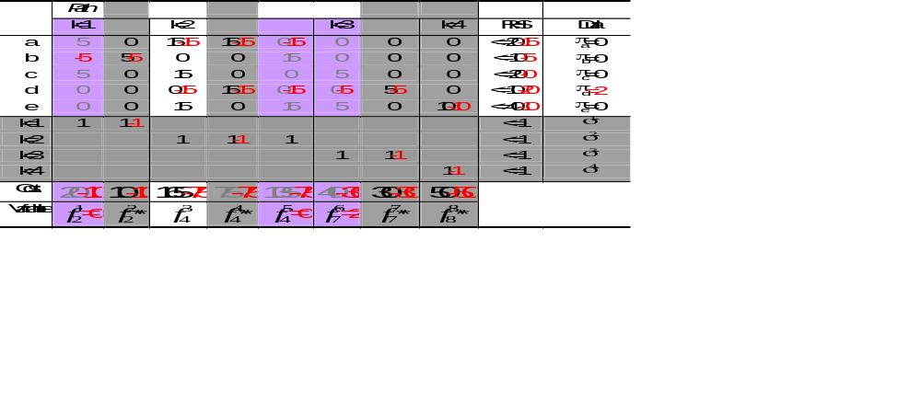
Example- Iteration 1
Let p(1) = 2; p(2) = 4; p(3) = 7; p(4) = 8 (** denotes keypath)
NOTE: Gray columns not included in keypath formulation; purple elements are initial keypath matrix

Slide 15
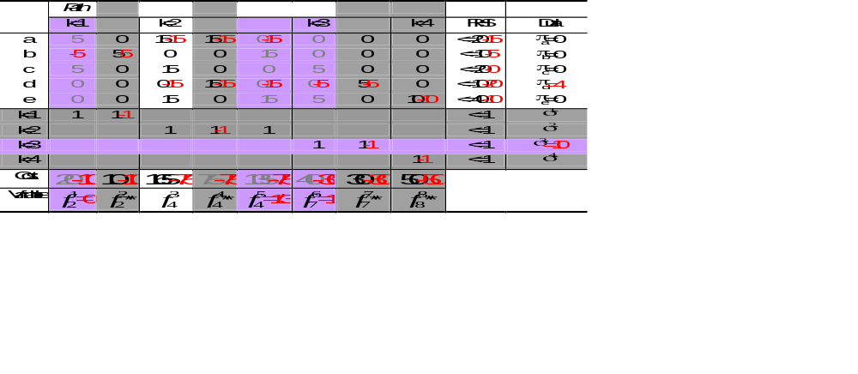
Example- Iteration 2
Let p(1) = 2; p(2) = 4; p(3) = 7; p(4) = 8 (** denotes keypath)
2nd iteration: no columns price out, one constraint for commodity 3 is violated and added; and the problem is resolved– feasibility and optimality achieved

Slide 16
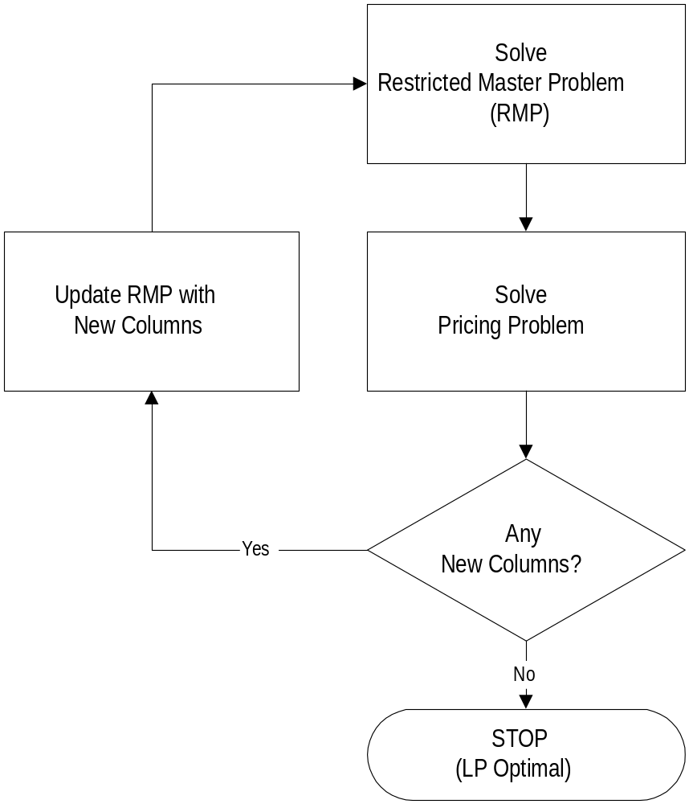
Column Generation

Slide 17
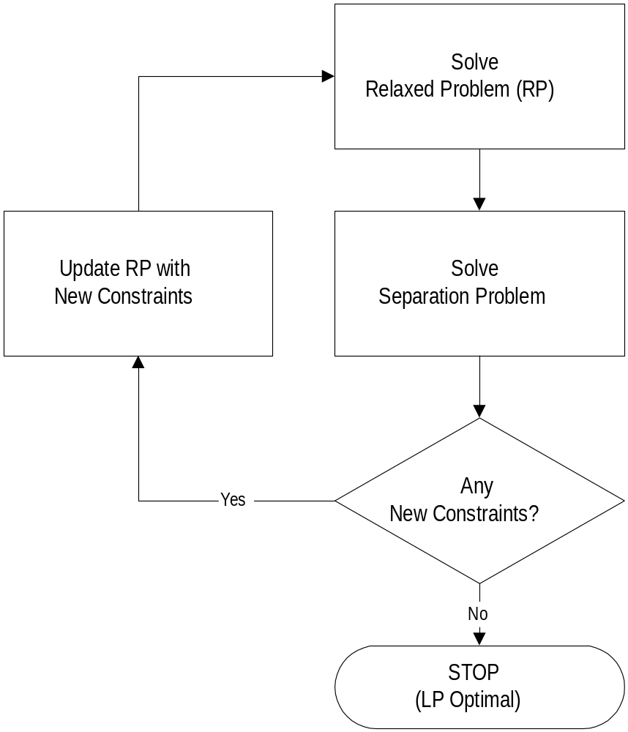
Row Generation

Slide 18
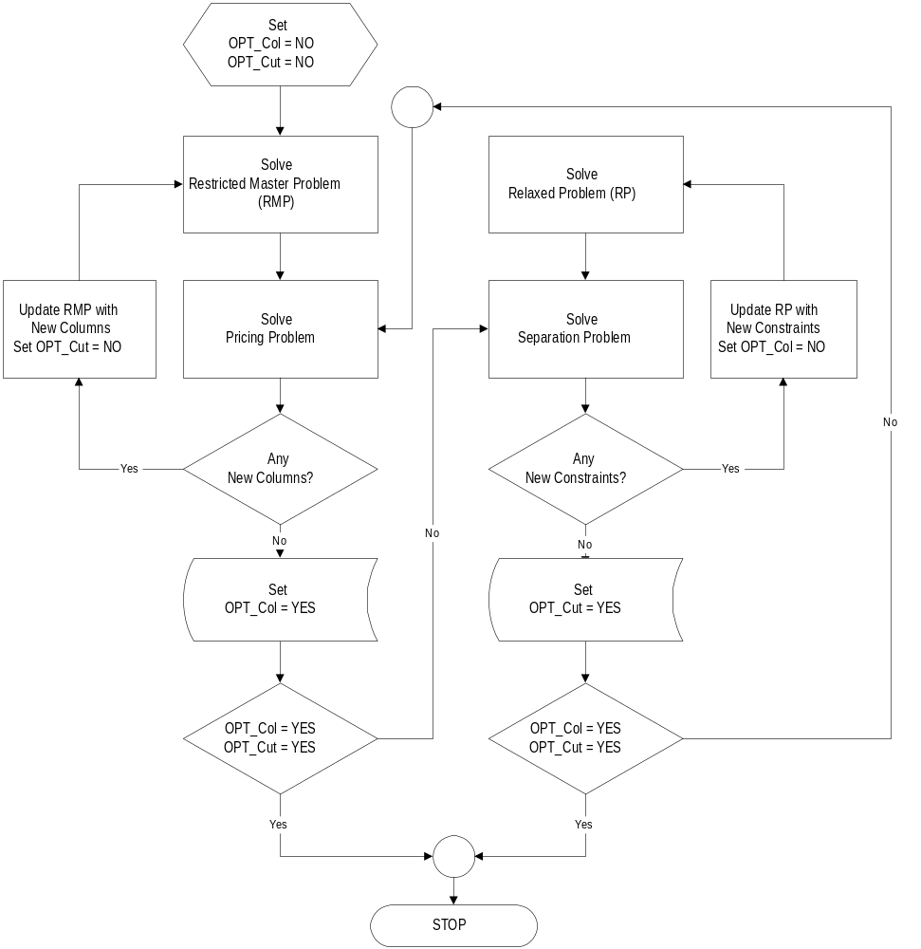
Column and Row Generation

Slide 19
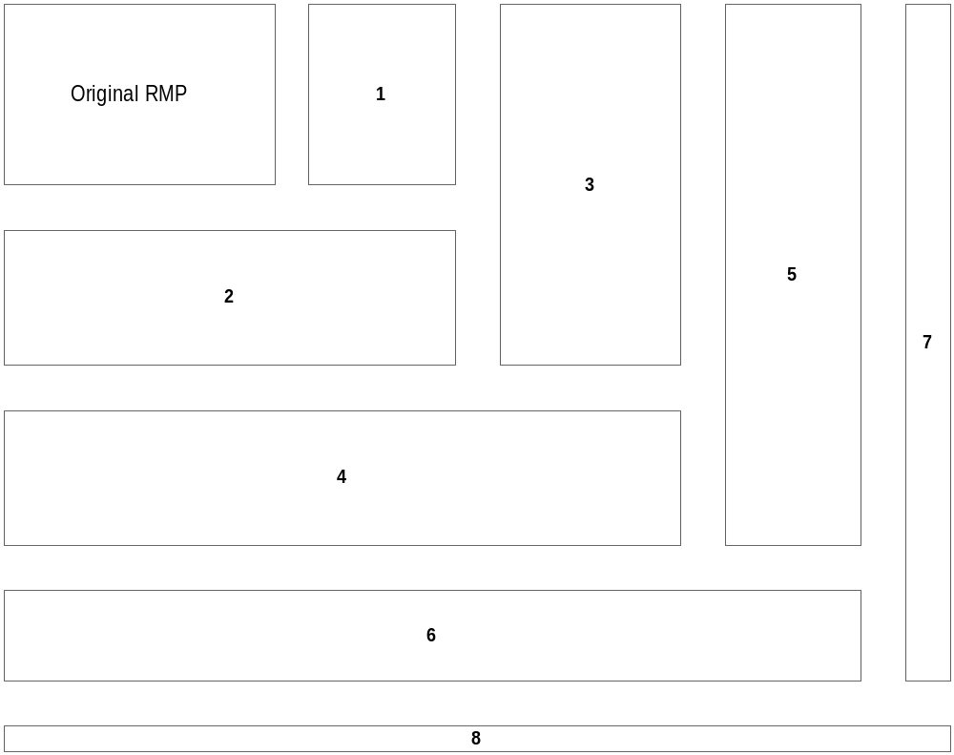
Column and Row Generation: Constraint Matrix

Slide 20

The Benefit of the Keypath Concept
We are now minimizing the objective function and most of the objective coefficients are __________. Therefore, this will guide the decision variables to values of __________.
How does this help?
positive
0

Slide 21
Solution Procedure
Use Both Column Generation and Row Generation
Actual flow of problem
  Step 1- Define RMP for Iteration 1: Set k =1. Denote an initial subset of columns (A₁) which is to be used.
  Step 2- Solve RMP for Iteration k: Solve a problem with the subset of columns A_{k}.
  Step 3- Generate Rows: Determine if any constraints are violated and express them explicitly in the constraint matrix.
  Step 4- Generate Columns: Price some of the remaining columns, and add a group (A*) that have a reduced cost less than zero, i.e., A_{k+1}=[A_{k} |A*]
  Step 5- Test Optimality: If no columns or rows are added, terminate. Otherwise, k =k+1, go to Step 2

Slide 22
Conclusions
Variable redefinition
  Allows relaxation of constraints and subsequent (limited) cut generation
  Does not alter the pricing problem solution
    Shortest paths with modified costs
  Allows problems with many commodities, as well as a large underlying network, to be solved with limited memory requirements

