Slide 1
1.206J/16.77J/ESD.215J
Airline Schedule Planning
Cynthia Barnhart
Spring 2003

Slide 2
1.206J/16.77J/ESD.215J Airline Schedule Planning: Multi-commodity Flows
Outline
  Applications
  Problem definition
  Formulations
  Solutions
  Computational results
  Integer multi-commodity network flow problems
  Integer multi-commodity network flow solutions
    Branch-and-price: combination of branch-and-bound and column generation
  Results

Slide 3
Application I
Package flow problem (express package delivery operation)
  Shipments have specific origins and destinations and must be routed over a transportation network
  Each set of packages with a common origin-destination pair is called a commodity
    Time windows (availability and delivery time) associated with packages
  The objective might be to minimize total costs, find a feasible flow, ...

Slide 4
Application II
Passenger mix problem
  Given a fixed schedule of flights, a fixed fleet assignment and a set of customer demands for air travel service on this fleeted schedule, the airline's objective is to maximize revenues by accommodating as many high fare passengers as possible
  For some flights, demand exceeds seat supply and passengers must be spilled to other itineraries of either the same or another airline

Slide 5
Application III
Message routing problem
  In a telecommunications or computer network, requirements exist for transmission lines and message requests, or commodities.
  The problem is to route the messages from their origins to their respective destinations at minimum cost

Slide 6
MCF Networks
Set of nodes
  Each node associated with the supply of or demand for commodities
Set of arcs
  Cost per unit commodity flow
  Capacity limiting the total flow of all commodities and/ or the flow of individual commodities

Slide 7
MCF Commodity Definitions
A commodity may originate at a subset of nodes in the network and be destined for another subset of nodes
A commodity may originate at a single node and be destined for a subset of the nodes
A commodity may originate at a single node and be destined for a single node

Slide 8
MCF Objectives
Flow the commodities through the networks from their respective origins to their respective destinations at minimum cost
  Expressed as distance, money, time, etc.
Ahuja, Magnanti and Orlin (1993)-- survey of multi-commodity flow models and solution procedures

Slide 9
MCF Problem Formulations -- Linear Programs
Network flow problems
  Capacity constraints limit flow of individual commodities
  Conservation of flow constraints ensure flow balance for individual commodities
  Flow non-negativity constraints
With side constraints
  Bundle constraints restrict total flow of ALL commodities on an arc

Slide 10
MCF Constraint Matrix
Network flow problem, commodity k=1
Network flow problem, commodity k=2
Network flow problem, commodity k=3
Network flow problem, commodity k=4
Bundle constraints limiting total flow of all commodities to arc capacities

Slide 11
Alternative Formulations for O-D Commodity Case
Node-Arc Formulation
  Decision variables: flow of commodity k on each arc ij
Path Formulation
  Decision variables: flow of commodity k on each path for k
“Tree” or “Sub-network” Formulation
  Define: super commodity: set of all (O-D) commodities with the same origin o (or destination d)
  Decision variables: quantity of the super commodity k’ assigned to each “tree” or “sub-network” for k’
Formulations are equivalent

Slide 12
Sample Network
a
2
d
1
c
4
b
3
e
Arcs
i j cost capy
1 2 1 20
1 3 2 10
2 3 3 20
2 4 4 10
3 4 5 40
Commodities
# o d quant
1 1 3 5
2 1 4 15
3 2 4 5
4 3 4 10

Slide 13
Notation
Parameters
A: set of all network arcs
K: set of all commodities
N: set of all network nodes
O(k) [D(k)]: origin [destination] node for commodity k
c_{ij}^{k} : per unit cost of commodity k on arc ij
u_{ij} : total capacity on arc ij (assume u_{ij}^{k} is unlimited for each k and each ij)
d_{k} : total quantity of commodity k
Decision Variables
x_{ij}^{k} : number of units of commodity k assigned to arc ij

Slide 14
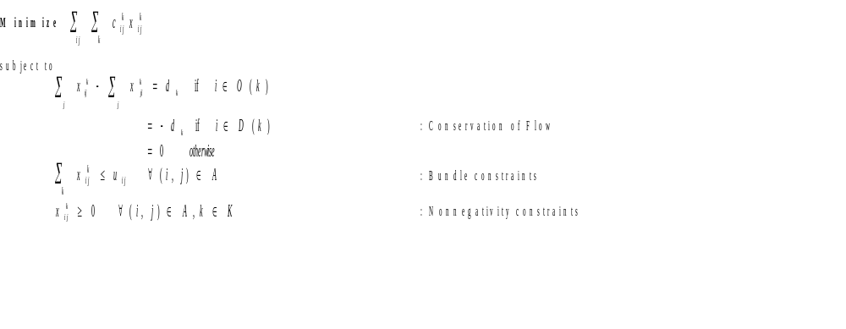
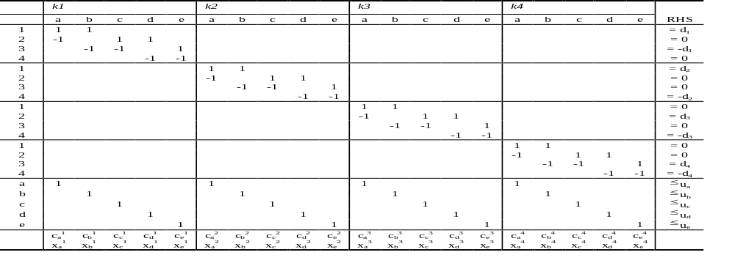
Node-Arc Formulation

Slide 15
Additional Notation
Parameters
P^{k}: set of all paths for commodity k, for all k
c_{p} : per unit cost of commodity k on path p = Σ_{ij ∈p} c_{ij}^{k}
δ_{ij}^{p} : = 1 if path p contains arc ij; and = 0 otherwise
Decision Variables
f_{p}: fraction of total quantity of commodity k assigned to path p

Slide 16
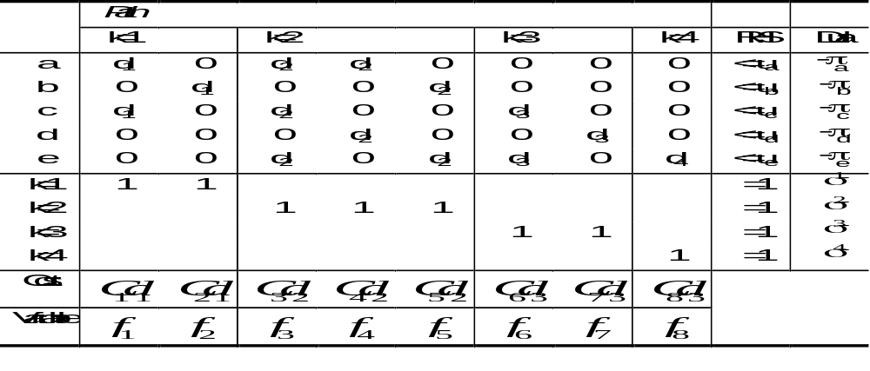
O/D Based Path Formulation
Minimize
∑
∑
d
C
f
k
p
∈
P
k
k
p
p
subject to
∑
∑
d
f
δ
p
≤
u
∀
(
i
,
j
)
∈
A
: Bundle constraints
k
p
∈
P
k
k
p
ij
ij
∑
f
=
1
∀
k
∈
K
: Flow balance constraints
p
∈
P
k
p
f
p
≥
0
∀
p
∈
P
k
,
k
∈
K
: Non-neg. constraints

Slide 17
Additional Notation
Parameters
S: set of source nodes n∈N for all commodities
Q^{s}: the set of all sub-networks originating at s
TC_{q}^{s}: total cost of sub-network q originating at s
ζ_{p}^{q} : = 1 if path p is contained in sub-network q; and = 0 otherwise
Decision Variables
R_{q}^{s} : fraction of total quantity of the super commodity originating at s assigned to sub-network q

Slide 18
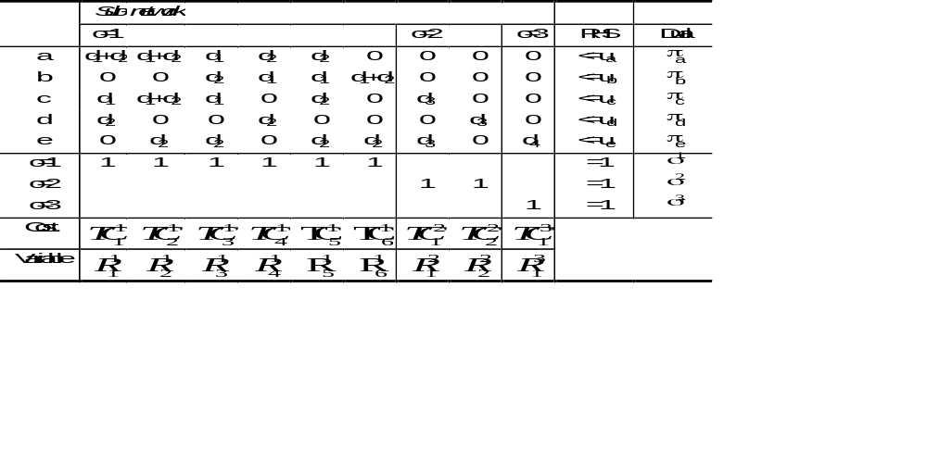
Sub-network Formulation
Minimize
∑
∑
(
∑
∑
C
ζ
q
d
)
^{s}
p
p
k
R
q
S
∈
s
∈
∈
k
s∈
q
Q
k
q
p
P
subject to
∑
∑
∑
∑
δ
p
^{s}ζ
≤
∀
∈
(
d
)
R
q
u
(
i
,
j
)
A
: Capacity Limits on Each Arc
s
∈
k
k
ij
q
p
ij
s
q
∈
Q
k
s
p
∈
P
∑
R ^{s}
=
∀
∈
q
1
s
S
: Mass Balance Requirements
q
∈
Q
s
R ^{s}
≥
0
∀
q
∈
Q
s
,
s
∈
S
: Nonnegative Path Flow Variables
q

Slide 19
Linear MCF Problem Solution
Obvious Solution
  LP Solver
Difficulty
  Problem Size: (|N|=|Nodes|, |C|=|Commodities|, |A|=|Arcs|)
    Node-arc formulation:
      Constraints: |N|*|C| + |A|
      Variables: |A|*|C|
    Path formulation:
      Constraints: |A| + |C|
      Variables: |Paths for ALL commodities|
    Sub-network formulation:
      Constraints: |A|+|Origins|
      Variables: |Combinations of Paths by Origin|

Slide 20
General MCF Solution Strategy
Try to Decompose a Hard Problem Into a Set of Easy Problems

Slide 21
MCF Solution Procedures I
Partitioning Methods
  Exploit Network Structure to Speed Up Simplex Matrix Computations
Resource-Directive Decomposition
  Repeat until Optimal:
    Allocate Arc Capacity Among Commodities
    Find Optimal Flows Given Allocation

Slide 22
MCF Solution Procedures II
Price-Directive Decomposition
  Repeat until Optimal:
    Modify Flow Cost on Arc
    Ignore Bundle Constraints, Find Optimal Flows

Slide 23
Revisiting the Path Formulation
MINIMIZE Σ _{k ∈K} Σ _{p∈P}k d_{k} c_{p} f_{p}
subject to: Σ_{p∈P}k Σ _{k ∈K} d_{k} f_{p}δ_{ij}^{p} ≤ u_{ij} ∀ ij∈A
Σ_{p∈P(k)} f_{p} = 1 ∀ k∈K
f_{p} ≥ 0 ∀ p∈P^{k}, ∀ k∈K

Slide 24
By-products of the Simplex Algorithm: Dual Variable Values
Duals
-π_{ij}: the dual variable associated with the bundle constraint for arc ij (π is non-negative)
σ^{k} : the dual variable associated with the commodity constraints
Economic Interpretation
π _{ij} : the value of an additional unit of capacity on arc ij
σ ^{k}/d_{k} : the minimal cost to send an additional unit of commodity k through the network
1
1

Slide 25
Modified Costs
Definition: Modified cost for arc ij and commodity k = c_{ij}^{k}+π_{ij}
Definition: Modified cost for path p and commodity k = Σ_{ij∈A} (c_{ij}^{k} + π_{ij} )δ_{ij}^{p}
1
1

Slide 26
Optimality Conditions for the Path Formulation
f*_{p} and π*_{ij} , σ*^{k} are optimal for all k and all ij iff:
  Primal feasibility is satisfied
    Σ_{p∈P}k Σ _{k ∈K} d_{k} f*_{p}δ_{ij}^{p} ≤ u_{ij} ∀ ij∈A
    Σ_{p∈P(k)} f*_{p} = 1 ∀ k∈K
    f*_{p} ≥ 0 ∀ p∈P^{k}, ∀ k∈K
  Complementary slackness is satisfied
    π*_{ij}(Σ_{p∈P}k Σ _{k ∈K} d_{k} f*_{p}δ_{ij}^{p} - u_{ij} ) = 0, ∀ ij∈A
    σ*^{k} (Σ_{p∈ P}k f*_{p} – 1) = 0, ∀ k∈K
  Dual feasibility is satisfied (reduced cost is non-negative for a minimization problem)
    (d_{k} c_{p} + Σ _{ij ∈A} d_{k} π_{ij} δ_{ij}^{p} ) - σ^{k} = d_{k} ( Σ _{ij ∈A} (c_{ij}^{k} + π_{ij}) δ_{ij}^{p} - σ^{k} /d_{k} ) ≥ 0, ∀ p∈ P^{k}, ∀ k∈ K

Slide 27
Multi-commodity Flow Optimality Conditions
The price for an additional unit of capacity is 0 unless capacity is fully utilized
    π*_{ij}(Σ_{p∈P}k Σ _{k ∈K} d_{k} f*_{p}δ_{ij}^{p} - u_{ij} ) = 0, ∀ ij∈A
A path p for commodity k is utilized only if its “modified cost” (that is, Σ_{ij∈A} (c_{ij}^{k} + π*_{ij}δ_{ij}^{p})) is minimal, for all paths p∈P^{k}
  Reduced Costs all non-negative:
    c’_{p} = d_{k} ( Σ _{ij ∈A} (c_{ij}^{k} + π*_{ij}) δ_{ij}^{p} - σ*^{k} /d_{k} ) ≥ 0,
    ∀ p∈ P^{k}, ∀ k∈ K
  f*_{p} (Σ_{ij∈A} (c_{ij}^{k} + π*_{ij} ) δ_{ij}^{p} - σ*^{k} /d_{k} ) = 0,
  ∀ p∈ P^{k}, ∀ k∈ K
3

Slide 28
Column Generation- A Price Directive Decomposition
Millions/Billions of Variables
Restricted Master Problem (RMP)
Constraints
Never Considered
Start
Added

Slide 29
RMP and Optimality Conditions
Consider f*_{p} and π*_{ij} , σ*^{k} optimal for RMP, then
  Primal feasibility is satisfied
    Σ_{p∈P}k Σ _{k ∈K} d_{k} f*_{p}δ_{ij}^{p} ≤ u_{ij} ∀ ij∈A
    Σ_{p∈P(k)} f*_{p} = 1 ∀ k∈K
    f*_{p} ≥ 0 ∀ p∈P^{k}, ∀ k∈K
  Complementary slackness is satisfied
    π*_{ij}(Σ_{p∈P}k Σ _{k ∈K} d_{k} f*_{p}δ_{ij}^{p} - u_{ij} ) = 0, ∀ ij∈A
    σ*^{k} (Σ_{p∈ P}k f*_{p} – 1) = 0, ∀ k∈K
  Dual feasibility is guaranteed (reduced cost is non-negative) ONLY for a path p included in RMP
    (d_{k} c_{p} + Σ _{ij ∈A} d_{k} π_{ij} δ_{ij}^{p} ) - σ^{k} = d_{k} ( Σ _{ij ∈A} (c_{ij}^{k} + π_{ij}) δ_{ij}^{p} - σ^{k} /d_{k} ) ≥ 0, ∀ p∈ P^{k}, ∀ k∈ K
3

Slide 30
LP Solution: Column Generation
Step 1: Solve Restricted Master Problem (RMP) with subset of all variables (columns)
Step 2: Solve Pricing Problem to determine if any variables when added to the RMP can improve the objective function value (that is, if any variables have negative reduced cost)
Step 3: If variables are identified in Step 2, add them to the RMP and return to Step 1; otherwise STOP
Notes:
10

Slide 31
Pricing Problem
Given π (non-negative) and σ^{k} (unrestricted), the optimal duals for the current restricted master problem, the pricing problem, for each p∈ P^{k}, k∈ K is
  min _{p∈ P}k (d_{k} ( Σ _{ij ∈A} (c_{ij}^{k} + π_{ij}) δ_{ij}^{p} - σ^{k} /d_{k} )
  Or, equivalently:
  min _{p∈ P}k Σ _{ij ∈A} (c_{ij}^{k} + π_{ij}) δ_{ij}^{p}
  A shortest path problem for commodity k (with modified arc costs)

Slide 32
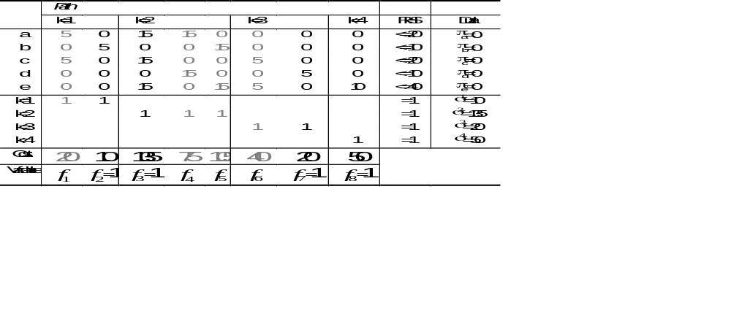
Example- Iteration 1

Slide 33
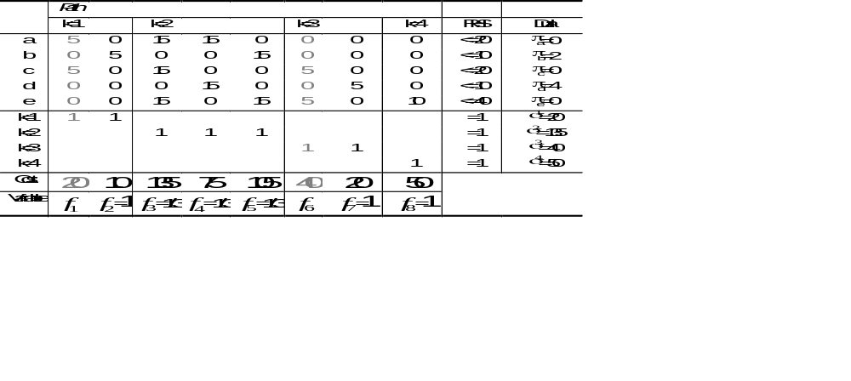
Example- Iteration 2
Notes:
NOTE: Next year, it would be good to supplement this with finding the paths with negative reduced costs by finding the shortest paths on the network, using modified costs.
NOTE: It might be a good idea to also cover lagrangian relaxation and approximation algorithms for mcf problems

Slide 34
MCF Optimality Conditions
For each p∈P^{k}, for each k, the reduced cost c′_{p}:
  c′_{p} = (d_{k} c_{p} + Σ _{ij ∈A} d_{k} π_{ij} δ_{ij}^{p} ) - σ^{k} = Σ_{ij} (d_{k}c_{ij}^{k} + d_{k}π_{ij})δ_{ij}^{p} - σ^{k =} Σ_{ij} (c_{ij}^{k} + π_{ij})δ_{ij}^{p} - σ^{k} /d_{k} ≥ 0
    where π, σ are the optimal duals for the current restricted master problem
  c′_{p} = 0, for each utilized path p implies
    Σ_{ij} (d_{k}c_{ij}^{k} + d_{k}π_{ij}) δ_{ij}^{p} = σ^{k}
  or equivalently,
    Σ_{ij} (c_{ij}^{k} + π_{ij}) δ_{ij}^{p} = σ^{k}/d_{k}
  So if, min_{p∈P(k)} c′_{p} ⁼ Σ_{ij} (c_{ij}^{k} + π_{ij}) δ_{ij}^{p*} - σ^{k}/d_{k} ≥ 0, the current solution to the restricted master problem is optimal for the original problem
  If min_{p∈P(k)} c′_{p} = Σ_{ij} (c_{ij}^{k} + π_{ij}) δ_{ij}^{p*} - σ^{k}/d_{k} < 0, add p* to restricted master problem

Slide 35
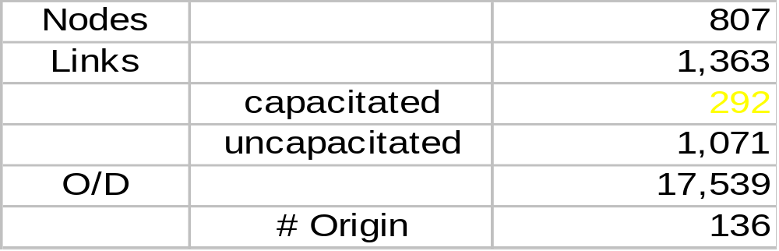
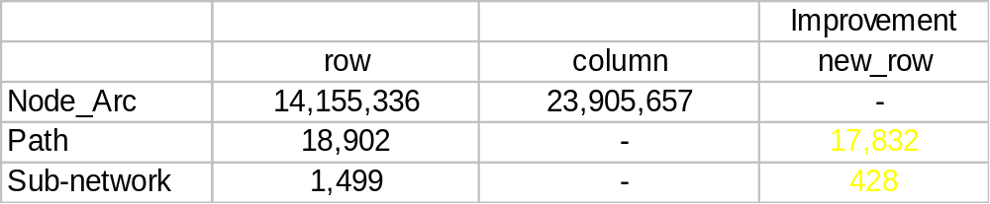
Data Set
Data Set
Constraint Matrix Size

Slide 36
Computational Results
Number of Nodes: 807
Number of Links: 1,363
Number of Commodities: 17,539
Computational Result (IBM RS6000, Model 370)
  Path Model: 44 minutes
  Sub-network Model: < 1 minute

Slide 37
LP Computational Experiment
Test effect of adding most negative reduced cost column for each commodity vs. adding several negative reduced cost columns for each commodity

Slide 38
Generating Several Columns Per Commodity
Select any basic column (f_{p} has reduced cost = 0) for some path p and commodity k, call it the key(k)
Add all simple paths representing symmetric difference between most negative reduced cost path and key(k)

Slide 39
Example
p1- most negative reduced cost path for k
key(k)
Add to LP:

Slide 40
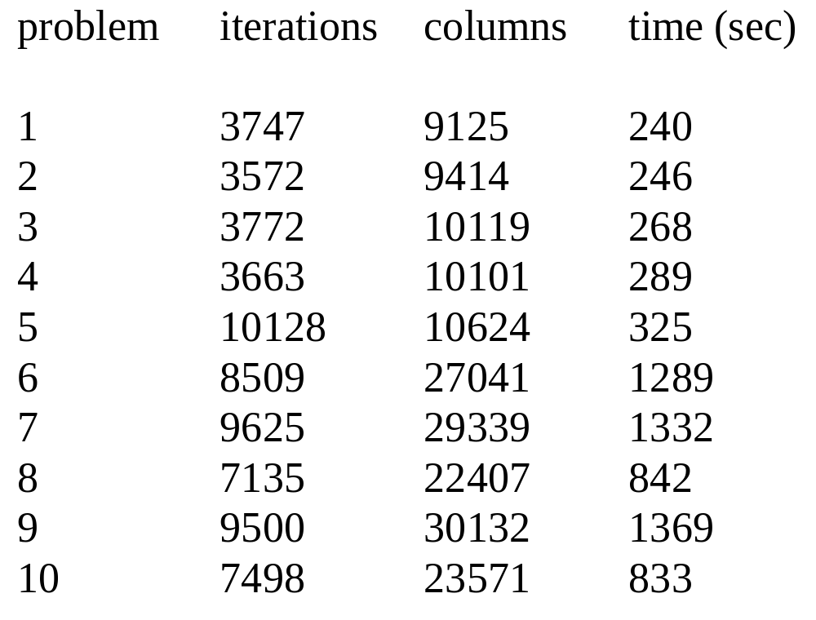
LP Solution:
One Path per Commodity
301 nodes, 497 arcs, 1320 commodities.
Times are on an IBM RS6000/590.

Slide 41
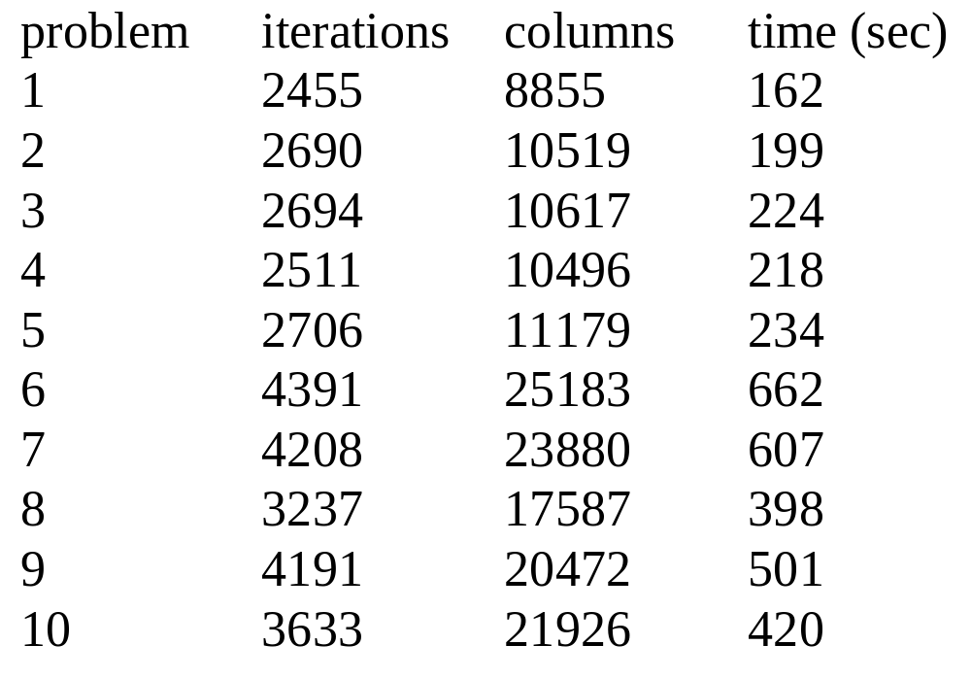
LP Solution:
All Simple Paths for Each Commodity
301 nodes, 497 arcs, 1320 commodities.
Times are on an IBM RS6000/590.

Slide 42
Integer Multi-Commodity Network Flows
Consider the modified multi-commodity network flow problem:
  Added integrality restriction that each commodity must be assigned to exactly one path
    f_{p}∈ (0.1), ∀ p ∈ P^{k}
  Solution procedure: branch-and-bound, specialized to handle large-scale problems

Slide 43
Integer Multicommodity Flows: Problem Formulation
MINIMIZE Σ _{k ∈K} Σ _{p∈P}k d_{k} c_{p} f_{p}
subject to: Σ_{p∈P}k Σ _{k ∈K} d_{k} f_{p}δ_{ij}^{p} ≤ u_{ij} ∀ ij∈A
Σ_{p∈P(k)} f_{p} = 1 ∀ k∈K
f_{p} ∈ (0,1) ∀ p∈P^{k}, ∀ k∈K

Slide 44
Branch-and-Bound: A Solution Approach for Binary Integer Programs
f₁ = 1
f₁ = 0
f₂ = 1
f₂ = 0
f₂ = 1
f₂ = 0
f₃ = 1
f₃ = 0
All possible solutions at leaf
nodes of tree (2^{n} solutions, where
n is the number of variables)

Slide 45
Branch-and-Bound: A Solution Approach for Binary Integer Programs
Branch-and-Bound is a smart enumeration strategy:
  With branching, all possible solutions (e.g., 2number of path for all commodities) are enumerated
  With bounding, only a (usually) small subset of possible solutions are evaluated before a provably optimal solution is found

Slide 46
Bounding: The Linear Programming (LP) Relaxation
Consider the linear path-based MCF problem formulation
  Objective is to minimize
The LP relaxation replaces
f_{p} ∈ 0,1
with
1 ≥ f_{p} ≥ 0
Let z_{LP}* represent the optimal LP solution and let z_{IP}* represent the optimal IP solution
        z_{LP}* ≤ z_{IP}*
  LP’s provide a bound on the lowest possible value of the optimal integer solution

Slide 47
Branching
Consider an IP with binary restrictions on all variables, denoted P(1)
Let LP(1) denote the linear programming relaxation of P(1) and let x*(1) denote the optimal solution to LP(1)
If there is no variable with fractional value in x*(1), x*(1) solves (is optimal for) P(1)
If there is at least one variable with fractional value in x*(1), call it x_{l}*(1), then any optimal solution for P(1) has x_{l}*(1)=0 or x_{l}*(1)=1
  Left branch: x_{l}*(1)=0
  Right branch: x_{l}*(1)=1

Slide 48
A Pictorial View
feasible IP
feasible LP

Slide 49
Relationship between Bound and Tree Depth
Let x*(1) be the optimal solution to LP(1) with at least one fractional variable x_{l}*(1)
Let the optimal solution value for LP(1) be denoted z*(1)
Let LP(2) = LP(1) + [x_{l}*(1) = 0 or x_{l}*(1) = 1]
Let the optimal solution value for LP(2) be denoted z*(2)
Then
      z*(1) ≤ z*(2)

Slide 50
Tree Pruning
Incumbent: Current best
feasible (IP) solution value = z_{IP}
1
x1 = 1
x1=0
2
3
x2=1
x2=0
x2=1
x2=0
4
5
6
7
x3=1
x3=0
x3=1
x3=0
If z*(LP(2)) ≥ z_{IP}, PRUNE (FATHOM) tree at node 2 (solutions on the LHS of tree cannot be optimal. 1/2 of the solutions (nodes) do not need to be evaluated!)
If z*(LP(2)) is integral, PRUNE tree at node 2 (solutions in sub-tree at node 2 cannot be better.)
If LP(2) is infeasible, PRUNE tree at node 2 (solutions in sub-tree at node 2 cannot be feasible.)

Slide 51
Branch-and-Bound Algorithm
Beginning with rootnode (minimization):
Bound:
  Solve the current LP with this and all restrictions along the (back) path to the rootnode enforced
Prune:
  If optimal LP value is greater than or equal to the incumbent solution: Prune
  If LP is infeasible: Prune
  If LP is integral: Prune and update incumbent solution
Branch:
  Set some variable to an integer value
Repeat until all nodes pruned

Slide 52
Branch-and-Price Solution Approach
Branch-and-bound tailored to solve large-scale integer programs
Bounding
  Solve LP using column generation at each node of the branch-and-bound tree
Branching
  New columns might have to be generated to find an optimal solution to the constrained problem
  Want to design the branching decision so that the algorithm for the pricing is unchanged as the branch-and-bound tree is processed

Slide 53
Example Revisited
Notes:
NOTE: Next year, it would be good to supplement this with finding the paths with negative reduced costs by finding the shortest paths on the network, using modified costs.
NOTE: It might be a good idea to also cover lagrangian relaxation and approximation algorithms for mcf problems

Slide 54
Branch-and-Price: Branching and Compatibility with the Pricing Problem
Branching decision for commodity k, f_{p} = 1:
  No pricing problem solution is necessary
  All other variables for k are removed from the model
Branching decision for commodity k, f_{p} = 0:
  The solution to the pricing problem (a shortest path problem) CANNOT generate path p as the shortest path, must instead find the next shortest path
  In general, at nodes of depth l in the branch-and-bound tree, the pricing problem must potentially generate the k^{th} shortest path

Slide 55
An Alternative Branching Idea: Branch on Small Decisions
Consider commodity k whose flow is split
Assume k takes 2 paths, p1 and p2
Let d be the divergence node
o(k)
p1
p2
d(k)
d

Slide 56
Divergence Node
Let a1 be the arc out of d on p1 and a2 be the arc out of d on p2
A(d) = {a1, a2, a3, a4}, A(d,a1) = {a1,a3}, A(d, a2) = {a2, a4}
a1
d
a2
a3
a4

Slide 57
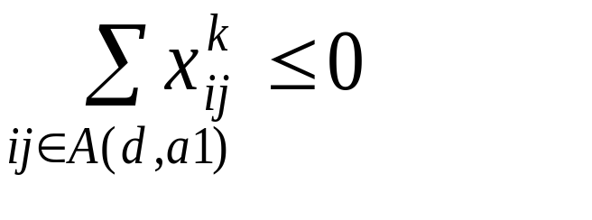
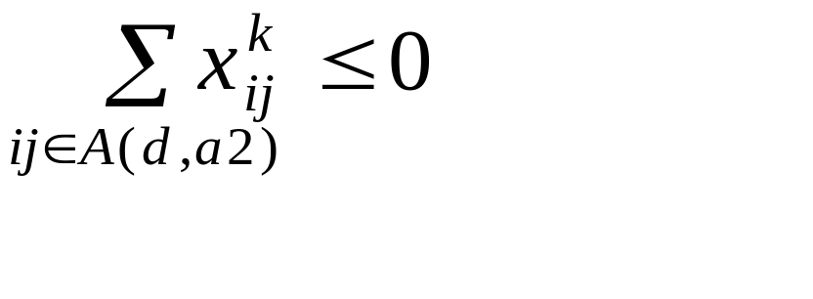
Branching Rule
Create two branches, one where
And the other with

Slide 58
Branch-and-Bound Results: Conventional Branching Rule
Eight telecommunications test problems
  50 nodes, 130 arcs, 585 commodities
Computational experiment on an IBM RS6000/590
For each of the eight test problems, run time of 3600 seconds
  No feasible solution was found

Slide 59
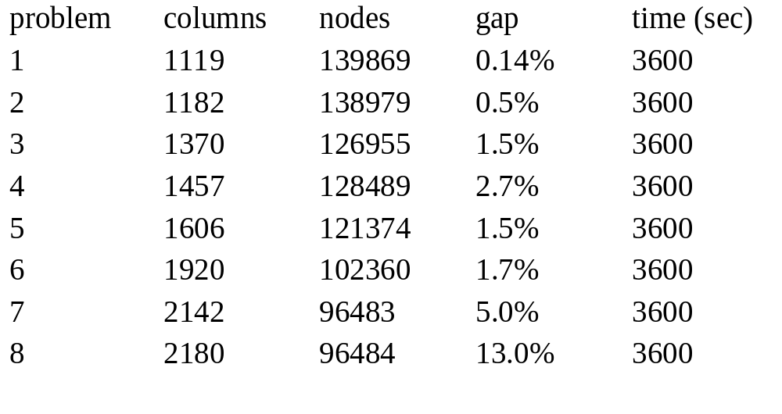
Branch-and-Bound Results: Our New Branching Rule
All test problems have 50 nodes, 130 arcs, 585 commodities.
Run times on an IBM RS6000/590.

Slide 60
Conclusions I
Choose your formulation carefully
  Trade-off memory requirements and solution time
  Sub-network formulation can be effective when low level of congestion in the network
Problem size often mandates use of combined column and row generation

Slide 61
Conclusions II
Solution time is affected dramatically by
  The complexity of the pricing problem
  Exploitation of problem structure, pre-processing, LP solver selection, etc.
Branching strategy should preserve the structure of the pricing problem
  Branch on “small” decisions, not the variables in the column generation formulation

