Slide 1
1.206J/16.77J/ESD.215J
Airline Schedule Planning
Cynthia Barnhart
Spring 2003

Slide 2
1.206J/16.77J/ESD.215J
The Passenger Mix Problem
Outline
  Definitions
  Formulations
  Column and Row Generation
  Solution Approach
  Results
  Applications and Extensions

Slide 3
Some Basic Definitions
Market
  An origin-destination airport pair, between which passengers wish to fly one-way
    BOS-ORD and ORD-BOS are different
Itinerary
  A specific sequence of flight legs on which a passenger travels from their ultimate origin to their ultimate destination
Fare Classes
  Different prices for the same travel service, usually distinguished from one another by the set of restrictions imposed by the airlines

Slide 4
Some More Definitions
Spill
  Passengers that are denied booking due to capacity restrictions
Recapture
  Passengers that are recaptured back to the airline after being spilled from another flight leg

Slide 5
Problem Description
Given
  An airline’s flight schedule
  The unconstrained demand for all itineraries over the airline’s flight schedule
Objective
  Maximize revenues by intelligently spilling passengers that are either low fare or will most likely fly another itinerary (recapture)
    Equivalent to minimize the total spill costs

Slide 6
Example
One market, 3 itineraries
Unconstrained demand per itinerary
  Total demand for an itinerary when the number of seats is unlimited
I,100
J,200
A
K,100
B

Slide 7
Example with Capacity Constraints
One market, 3 itineraries
  Capacity on itinerary I = 150
  Capacity on itinerary J = 175
  Capacity on itinerary K = 130
Optimal solution:
  Spill _____ from I
  Spill _____ from J
  Spill _____ from K
I,100,150
0
25
A
J,200,175
B
0
K,100,130

Slide 8


Revenue Management: A Quick Look
One flight leg
  Flight 105, LGA-ORD, 287 seats available
Two fare classes:
  Y: High fare, no restrictions
  M: Low fare, many restrictions
Demand for Flight 105
  Y class: 95 with an average fare of $400
  M class: 225 with an average fare of $100
  Optimal Spill Solution ( Y and M passengers)
    Revenue: $
    Spill: $
0
33
95*400 + 192*100
33*100

Slide 9


Network Revenue Management
Two Flights
  Flight 105, LGA-ORD, 287 seats
  Flight 201, ORD-SFO, 287 seats
Demand (one fare class)
  LGA-ORD, 225 passengers $100
  ORD-SFO, 150 passengers $150
  LGA-SFO, 150 passengers, $225
Optimal Solution: $
  LGA-ORD, passengers
  ORD-SFO, passengers
  LGA-SFO, passengers
150*100+150*150+137*225
150
150
137

Slide 10
Quantitative Share Index or Quality of Service Index (QSI): Definition
Quantitative Share Index or Quality of Service Index (QSI)
  There is a QSI for each itinerary i in each market m for each airline a, denoted QSI_{i(m)}ª
  The sum of QSI_{i(m)}ª over all itineraries i in a market m over all airlines a is equal to 1, for all markets m

Slide 11
Market Share
The market share of airline a in market m is the sum of QSI_{i(m)}ª over all itineraries i in market m
The market share of the competitors of airline a in market m is 1 – (the sum of QSI_{i(m)}ª over all itineraries i in market m)
  Denote this as msc_{m}ª

Slide 12
Recapture
Consider a passenger who desires itinerary I but is redirected (spilled) to itinerary J
  The passenger has the choice of accepting J or not (going to a competitor)
  Probability that passenger will accept J (given an uniform distribution) is the ratio of QSI_{J(m)}ª to (QSI_{J(m)}ª + msc_{m}ª)
Probability that passenger will NOT accept J (given an uniform distribution) is the ratio of msc_{m}ª to (QSI_{J(m)}ª + msc_{m}ª)
  The ratios sum to 1
  If a is a monopoly, recapture rate will equal 1.0

Slide 13
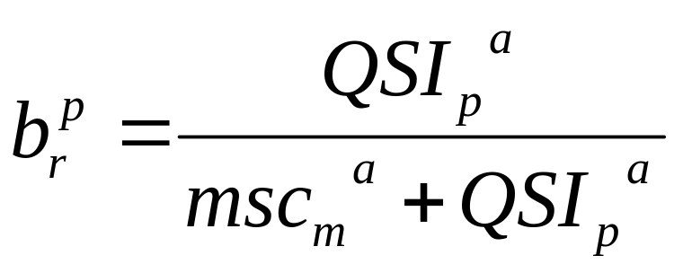
Recapture Calculation
Recapture rates for airline a:
  b_{I}^{J}: probability that a passenger spilled from I will accept a seat on J, if one exists
  QSI mechanism for computing recapture rates

Slide 14


Example with Recapture
Recapture rates:
  b_{I}^{J}= 0.4, b_{I}^{k}= 0.1
  b_{J}^{I}= 0.5, b_{J}^{K}= 0.1
  b_{K}^{I}= 0.5, b_{K}^{J}= 0.4
Assume all itineraries have a single fare class, and their fares are all equal
Optimal solution:
  Spill _____ from I to J, Spill _____ from I to K
  Spill _____ from J to I, Spill _____ from J to K
  Spill _____ from K to I, Spill _____ from K to J
0
0
100
25
0
0
I,100,150
J,300,175
A
B
K,100,130

Slide 15





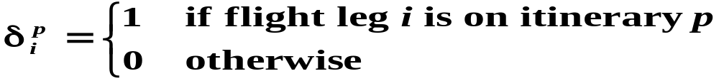
Mathematical Model: Notation
Decision variables
  - the number of passengers that desire travel on itinerary p and then travel on itinerary r
Parameters and Data
    the average fare for itinerary p
    the daily unconstrained demand for itinerary p
    the capacity on flight leg i
    the recapture rate of a passenger desiring itinerary p who is offered itinerary r

Slide 16
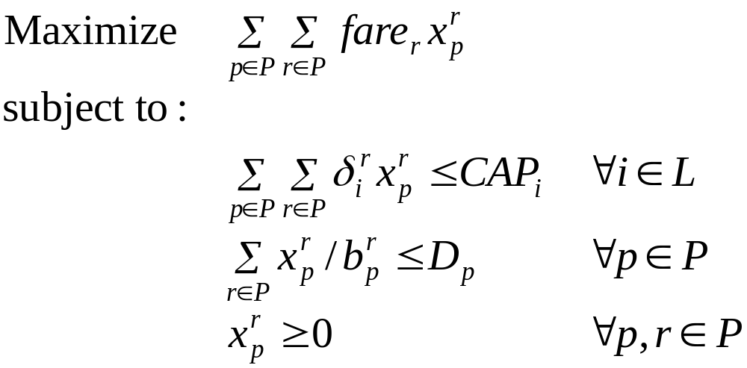
Basic Formulation

Slide 17
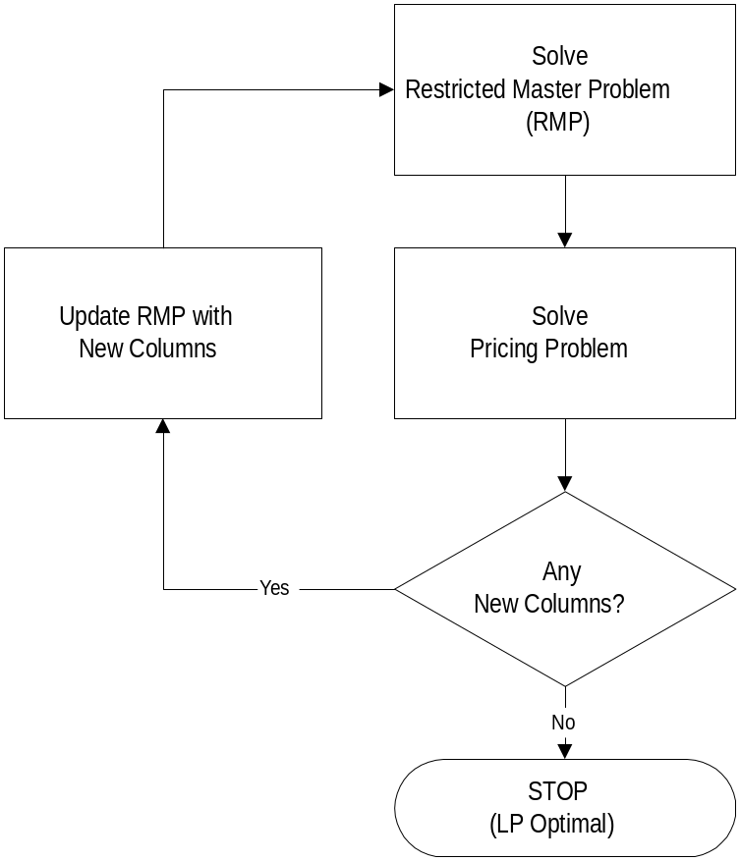
Column Generation

Slide 18
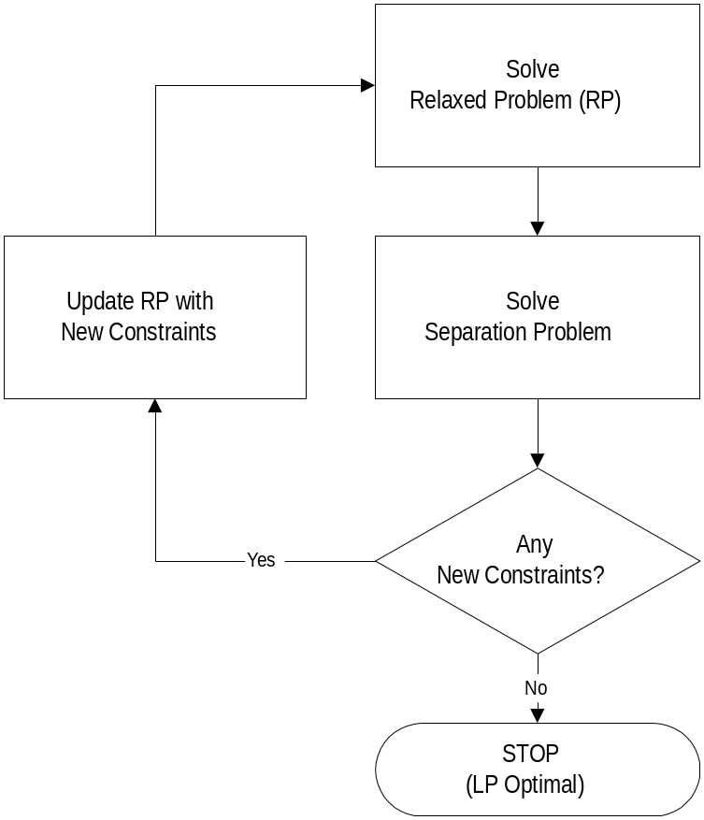
Row Generation

Slide 19
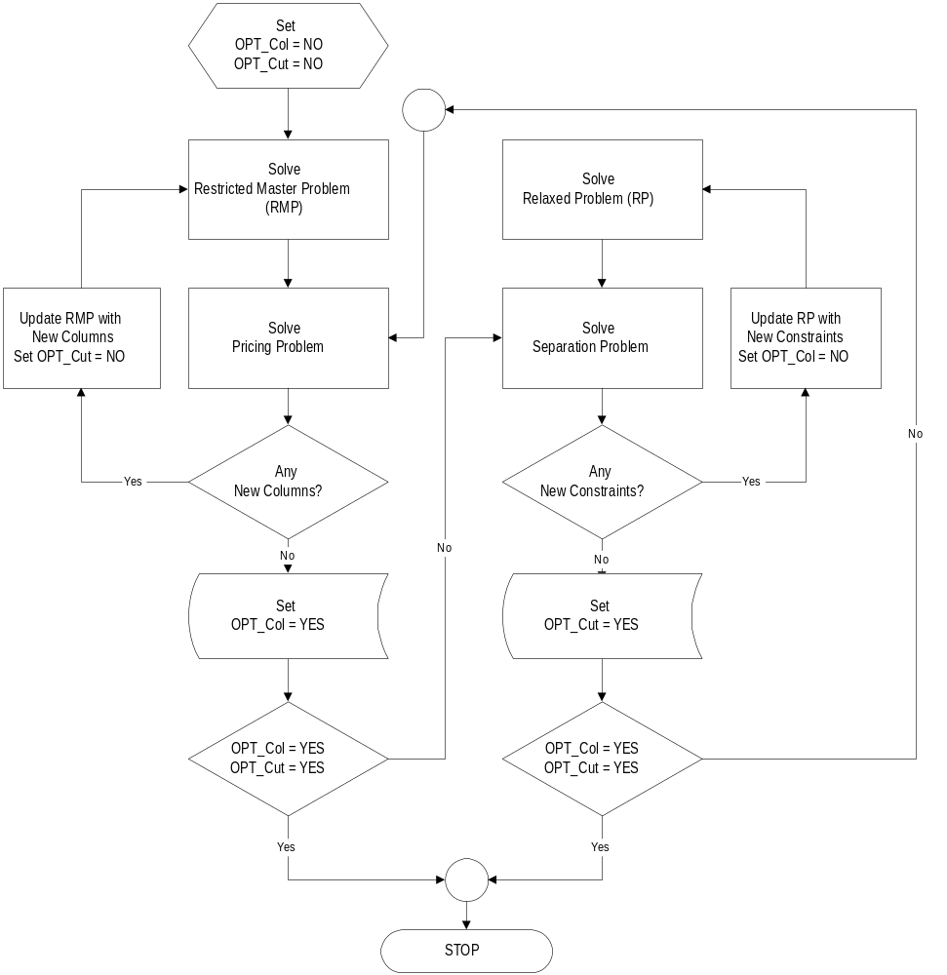
Column and Row Generation

Slide 20
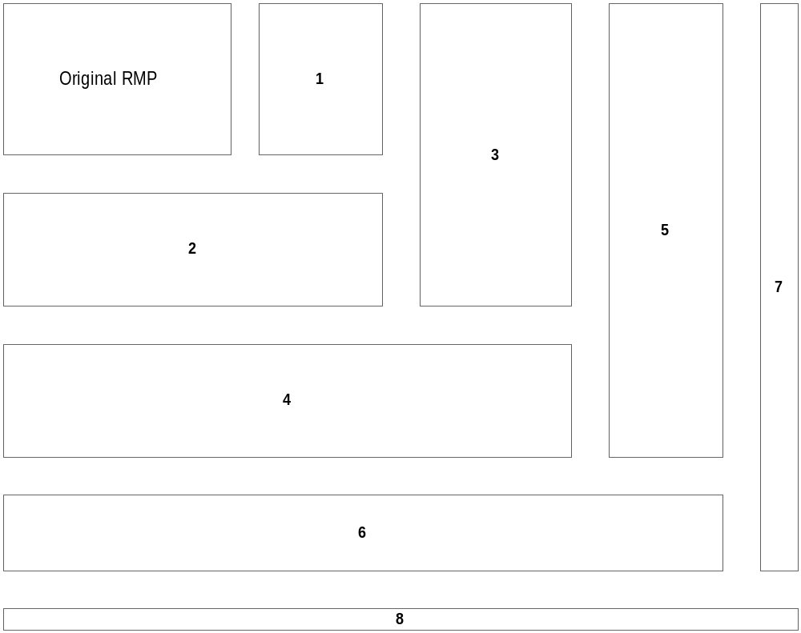
Column and Row Generation: Constraint Matrix

Slide 21


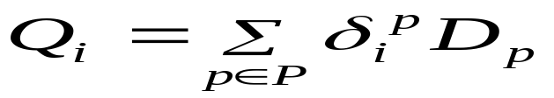
The Keypath Concept
Assume most passengers flow along their desired itinerary
Focus on which passengers the airline would like to redirect on other itineraries
New decision variable
    The number of passengers who desire travel on itinerary p, but the airline attempts to redirect onto the itinerary r
New Data
    The unconstrained demand on flight leg i

Slide 22
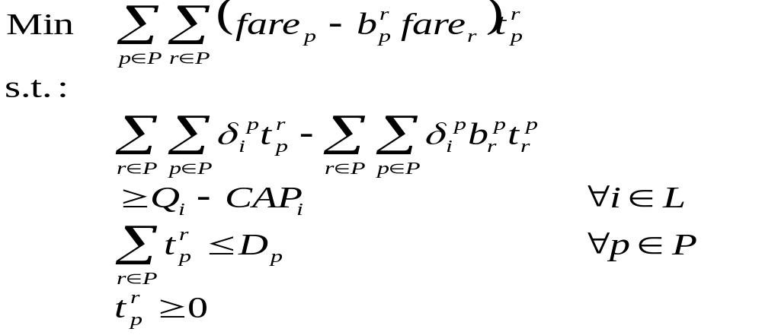
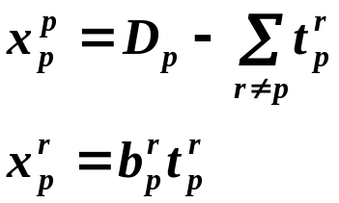
The Keypath Formulation
Change of variable
Relationship

Slide 23

The Benefit of the Keypath Concept
We are now minimizing the objective function and most of the objective coefficients are __________. Therefore, this will guide the decision variables to values of __________.
How does this help?
positive
0

Slide 24
Solution Procedure
Use Both Column Generation and Row Generation
Actual flow of problem
  Step 1- Define RMP for Iteration 1: Set k =1. Denote an initial subset of columns (A₁) which is to be used.
  Step 2- Solve RMP for Iteration k: Solve a problem with the subset of columns A_{k}.
  Step 3- Generate Rows: Determine if any constraints are violated and express them explicitly in the constraint matrix.
  Step 4- Generate Columns: Price some of the remaining columns, and add a group (A*) that have a reduced cost less than zero, i.e., A_{k+1}=[A_{k} |A*]
  Step 5- Test Optimality: If no columns or rows are added, terminate. Otherwise, k =k+1, go to Step 2

Slide 25
Column Generation
There are a large number of variables
  n_{m} is the number of itineraries in market m
  Most of them aren’t going to be considered
Generate columns by explicit enumeration and “pricing out” of variables

Slide 26
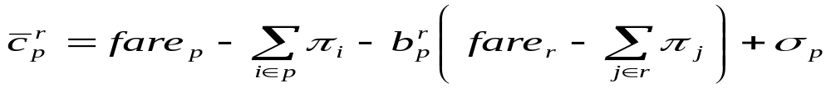


Computing Reduced Costs
The reduced cost of a column is
where is the non-negative dual cost associated with flight leg i and is the non-negative dual cost associated with itinerary p

Slide 27
Solving the Pricing Problem (Column Generation)
Can the column generation step be accomplished by solving shortest paths on a network with “modified” arc costs, or some other polynomial time algorithm?
  Hint: Think about fare structure
  What are the implications of the answer to this question?

Slide 28
Computational Experience
Current United Data
  Number of Markets -15,678
  Number of Itineraries - 60,215
  Maximum number of legs in an itinerary- 3
  Maximum number of itineraries in a market- 66
  Flight network (# of flights)- 2,037
Using CPLEX, we solved the above problem in roughly 100 seconds, generating just over 100,000 columns and 4,100+ rows.

Slide 29
Applications: Irregular Operations
When flights are cancelled or delayed
  Passenger itineraries are cancelled
  Passenger reassignments to alternative itineraries necessary
    Flight schedule and fleet assignments (capacity) are known
    Objective might be to minimize total delays or to minimize the maximum delay beyond schedule
How are recapture rates affected by this scenario?
How would the passenger-mix model have to be altered for this scenario?

Slide 30
Extensions: Yield Management
Can the passenger mix problem be used as a tool for yield management?
What are the issues?
  Deterministic vs. stochastic
  Sequence of requests
  Small demands (i.e., quality of data)
Advantages
  Shows the expected makeup of seat allocation
  Takes into account the probability of recapturing spilled passengers
  Gives ideas of itineraries that should be blocked
  Dual prices might give us ideas for contributions, or displacement costs

Slide 31
Extensions: Fleet Assignment
To be explained in the next lectures…

