Slide 1
1.206J/16.77J/ESD.215J
Airline Schedule Planning
Cynthia Barnhart
Spring 2003

Slide 2
1.206J/16.77J/ESD.215J
The Fleet Assignment Problem
Outline
  Problem Definition and Objective
  Fleet Assignment Network Representation
  Fleet Assignment Model
  Fleet Assignment Solution
    Branch-and-bound
  Results

Slide 3
Airline Schedule Planning
Select optimal set of flight legs
in a schedule
Schedule Design
Assign aircraft types to flight legs
such that contribution is maximized
Fleet Assignment
Route individual aircraft honoring
maintenance restrictions
Contribution = Revenue - Costs
Aircraft Routing
Assign crew (pilots and/or flight
attendants) to flight legs
Crew Scheduling
Notes:
I will now present an overview of the airline schedule planning process. It begins with schedule design, in which… Next is fleet assignment, in which…. 3rd is aircraft routing, in which…. And the last is crew scheduling, in which…. We will now move to our 2nd section, our 1st look at the fleet assignment problem.

Slide 4
Problem Definition
Given:
  Flight Schedule
    Each flight covered exactly once by one fleet type
  Number of Aircraft by Equipment Type
    Can’t assign more aircraft than are available, for each type
  Turn Times by Fleet Type at each Station
  Other Restrictions: Maintenance, Gate, Noise, Runway, etc.
  Operating Costs, Spill and Recapture Costs, Total Potential Revenue of Flights, by Fleet Type

Slide 5
Problem Objective
Find:
  Cost minimizing (or profit maximizing) assignment of aircraft fleets to scheduled flights such that maintenance requirements are satisfied, conservation of flow (balance) of aircraft is achieved, and the number of aircraft used does not exceed the number available (in each fleet type)

Slide 6
Definitions (again)
Spill
  passengers that are denied booking due to capacity restrictions
Recapture
  passengers that are recaptured back to the airline after being spilled from another flight leg
For each fleet - flight combination:
  Cost ≡ Operating cost + Spill cost
Notes:
Let’s clear up some terminology before we go into details of today’s presentation.
Spill happens when passengers are denied booking due to capacity restrictions. That is, when we cannot book a flight.
Recapture happens when those denied booking passengers are re-booked on other similar itineraries; similar being serving the same O and D.
Base Schedule is the status quo.
For fixed and optional flights and fully expanded schedule, let’s refer to the next slide.

Slide 7
Fleet Assignment References
Abara (1989), Daskin and Panayotopoulos (1989), Hane, Barnhart, Johnson, Marsten, Neumhauser, and Sigismondi (1995)
Hane, et al. “The Fleet Assignment Problem, Solving a Large Integer Program,” Mathematical Programming, Vol. 70, 2, pp. 211-232, 1995
Notes:
FAM has been studied by a number of researchers. It has been studied and solved pretty thoroughly based on certain assumptions. The brief problem description for FAM is given, a fixed schedule and available number of aircraft of different types, find the minimum cost assignment of aircraft types to flight legs.

Slide 8
Network Representation
Topologically sorted time-line network
  Nodes:
    Flight arrivals/ departures (time and space)
  Arcs:
    Flight arcs: one arc for each scheduled flight
    Ground arcs: allow aircraft to sit on the ground between flights

Slide 9
Time-Line Network
Ground arcs
City A
City B
City C
City D
8:00
12:00
16:00
20:00
8:00
12:00
16:00
20:00

Slide 10
Time-Line Network
“Daily” problem
  Wrap-around (or overnight) arcs
Time
Washington, D.C.
Baltimore
New York
Boston

Slide 11
Constraints
Cover Constraints
  Each flight must be assigned to exactly one fleet
Balance Constraints
  Number of aircraft of a fleet type arriving at a station must equal the number of aircraft of that fleet type departing
Aircraft Count Constraints
  Number of aircraft of a fleet type used cannot exceed the number available

Slide 12
Objective Function
For each fleet - flight combination: Cost ≡ Operating cost + Spill cost
Operating cost associated with assigning a fleet type k to a flight leg j is relatively straightforward to compute
  Can capture range restrictions, noise restrictions, water restrictions, etc. by assigning “infinite” costs
Spill cost for flight leg j and fleet assignment k = average revenue per passenger on j * MAX(0, unconstrained demand for j – number of seats on k)
  Unclear how to compute revenue for flight legs, given revenue is associated with itineraries

Slide 13
Spill Cost Computation and Underlying Assumption
Given:
  Spill cost for flight leg j and fleet assignment k = average revenue per passenger on j * MAX(0, unconstrained demand for j – number of seats on k)
Implication:
  A passenger might be spilled from some, but not all, of the flight legs in his/ her itinerary

Slide 14
FAM Spill Calculation Heuristics
Fare Allocation
  Full fare - the full fare is assigned to each leg of the itinerary
  Partial fare - the fare divided by the number of legs is assigned to each leg of the itinerary
  Shared fare - the fare divided by the number of capacitated legs is assigned to each capacitated leg in the itinerary
Spill Cost for each variable
  Representative Fare
    A “spill fare” is calculated; each passenger spilled results in a loss of revenue equal to the spill fare
  Integration
    Sort each itinerary by fare, spill costs are sum of x lowest fare passengers, where x = max{0, demand - capacity}

Slide 15
An Illustrative Example
Fleet Type
Seats
A
100
flight 1
flight 2
B
200
X
Y
Z
Average
Fare
No. of
Pax
Market
Itinerary
X-Y
1
$200
75
Y-Z
2
$225
150
X-Z
1-2
$300
75
Fleet Assign.
Partial Alloc.
Full Alloc.
Actual Opt.
Fl. 1- Fl. 2
Spill
Spill
Spill Spilled Pax
A-A
$30,000
$38,125
31,875
50 X-Z, 75 Y-Z
A-B
$11,250
$15,625
12,500
25 X-Z, 25 X-Y
B-A
$22,500
$28,125
28,125
125 Y-Z
B-B
$3,750
$5,625
5,625
25 Y-Z

Slide 16
Spill Calculation: Results
For a 3 fleet, 226 flights problem:
  The best representative fare solution results in a gap with the optimal solution of $2,600/day
  Using a shared fare scheme and integration approach, we found a solution with an $8/day gap.
By simply modifying the basic spill model, significant gains can be achieved

Slide 17
FAM-PMIX: Measures the Spill Approximation Error
FAM
Fleeting
decision
PMIX
Operating
costs
Net
revenues
Fleeting
contributions

Slide 18
Passenger Mix
Passenger Mix Model (PMIX)
  Kniker (1998)
  Given a fixed, fleeted schedule, unconstrained passenger demands by itinerary (requests), and recapture rates find maximum revenue for passengers on each flight leg
PMIX
Network Effects and Recapture

Slide 19
FAM Notations
Decision Variables
  f_{k,i} equals 1 if fleet type k is assigned to flight leg i, and 0 otherwise
  y_{k,o,t} is the number of aircraft of fleet type k, on the ground at station o, and time t
Parameters
  C_{k,i} is the cost of assigning fleet k to flight leg i
  N_{k} is the number of available aircraft of fleet type k
  t_{n} is the “count time”
Sets
  L is the set of all flight legs i
  K is the set of all fleet types k
  O is the set of all stations o
  CL(k) is the set of all flight arcs for fleet type k crossing the count time

Slide 20
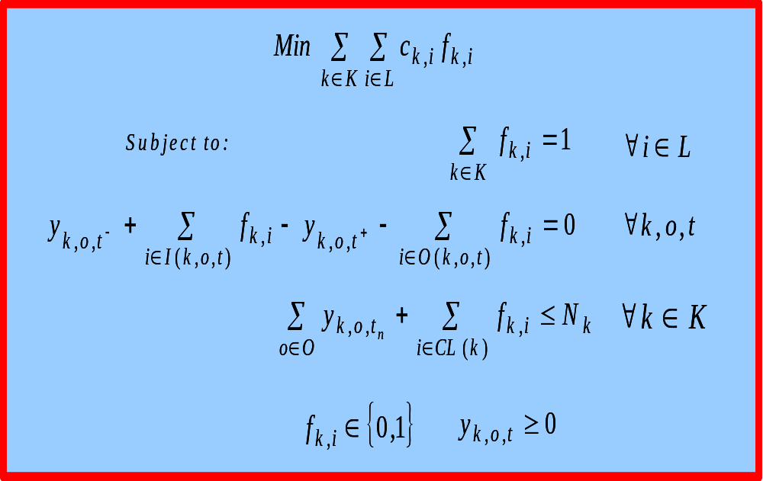
Fleet Assignment Model (FAM)
Hane et al. (1995), Abara (1989), and Jacobs, Smith and Johnson (2000)
Notes:
Shown here is the basic fleet assignment model by Hane et al., which is the kernel to most fleet assignment models currently employed at major U.S. airlines. I will not go into the details of the formulation. I will, however, take one note in the objective function. Notice that the structure of the basic fleet assignment is that fleet types are assigned to flight legs independently. Specifically, fk,i represents assigning fleet type k to flight leg i and ck,i represents the cost of assigning fleet type k to flight leg i. In some cases, you will see a maximization model, in which case ck,I would represent contribution from assigning fleet type k to flight leg I. These cost coefficients are computed for each assignments independently. Here’s how.

Slide 21
FAM Solution
Exploitation of problem structure and understanding context are important
  Node consolidation
  Islands
Branch-and-Bound

Slide 22
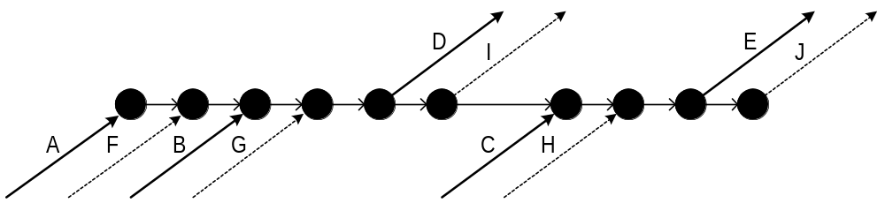
Time-Line Network

Slide 23
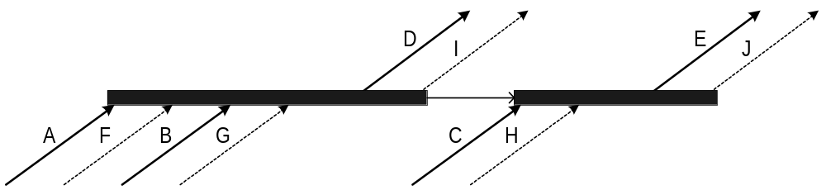
Node Consolidation

Slide 24
Islands
For non-maintenance stations, the minimum number of aircraft on the ground at some point in time during the day is 0
K
L

Slide 25
Fleet Assignment Model and Islands (FAM)
Implications to number of ground variables and “required throughs”
  Required through: same aircraft (type) must fly a sequence of flights

Slide 26
Branch-and-Bound: FAM Branching Strategies
Variable branching
  Set x_{i}^{k} = 0 or x_{i}^{k} = 1
  “Unbalanced” branches: x_{i}^{k} = 0 branch is not as effective as x_{i}^{k} = 1 branch
  “Small” decisions
    Set one variable at a time… might have to solve a number of LPs
Special ordered set branching
  Set x₁^{k} + x₂^{k} +…+ x_{m}^{k}= 0 or x₁^{k} + x₂^{k} +…+ x_{m}^{k}= 1
  More “balanced” branches
  “Larger” decisions
    Allow LP maximal flexibility to select solution, might need to solve fewer LPs

Slide 27
Branch-and-Bound Termination Criteria
Branch-and-bound finds a provable optimal solution when all branches are pruned
Branch-and-bound can be terminated prematurely if solution time limits exist or optimality is not the objective
  Terminate the algorithm when the lower bound on the optimal solution for a minimization problem is close enough to the incumbent IP solution
    Stop when integrality gap is small

Slide 28
Solution
Solve fleet assignment problems for large domestic carriers (10-14 fleets, 2000-3500 flights) within 10-20 minutes of computation time on workstation class computers
Hane, et al. “The Fleet Assignment Problem, Solving a Large Integer Program,” Mathematical Programming, Vol. 70, 2, pp. 211-232, 1995

Slide 29
FAM Shortcomings: Network Effects
A
B
C
( 80, $200 )
( 90, $250 )
( 50, $400 )
( Demand, Fare )
Fleet Type
i
ii
iii
iv
Capacity
80
100
120
150
Spill Cost
?
?
?
$0
Leg Interdependence
Network Effects
Notes:
Problem arises when there are connecting itineraries. Itineraries refer to sequence of flight legs. In this example, 3 cities with 3 itineraries. …

Slide 30
FAM Shortcomings: NO Recapture
100 seats
100 seats
A
B
C
( 80, $200 )
( 90, $250 )
( 50, $400 )
9AM
20
30
X 0.3 = 9 recaptured passengers
29
( 20, $400 )
10AM
( Demand, Fare )
Recapture Rate
Notes:
There is another aspect of the problem that basic FAM cannot address and that is recapture. Recapture happens when….

Slide 31
Itinerary-Based Fleet Assignment
Impossible to estimate airline profit exactly using link-based costs
Enhance basic fleet assignment model to include passenger flow decision variables
  Associate operating costs with fleet assignment variables
  Associate revenues with passenger flow variables (PMIX)

Slide 32
Itinerary-based Fleet Assignment Definition
Given
  a fixed schedule,
  number of available aircraft of different types,
  unconstrained passenger demands by itinerary, and
  recapture rates,
Find maximum contribution
ODFAM
Network effects

Slide 33
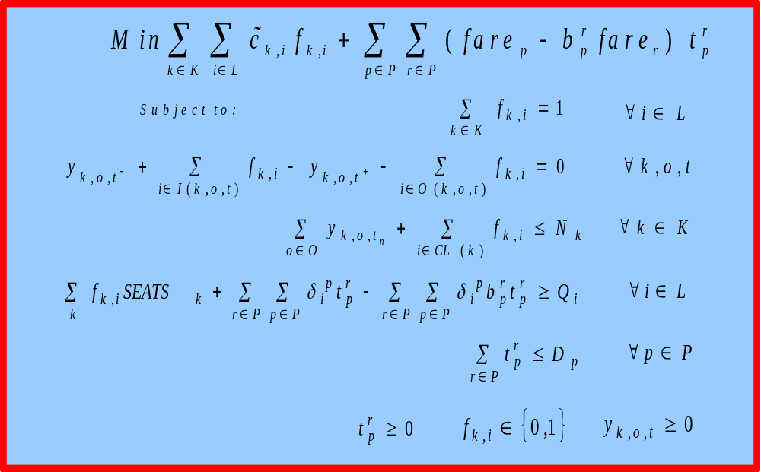
Itinerary-Based FAM (IFAM)
Kniker (1998)
Notes:
IFAM presented by Kinker is capable of addressing the abovementioned issues. Specifically, it address network effects, which happens when spill occur on constrained connecting itineraries and it also address recapture. This is the formulation.

Slide 34
Itinerary-Based FAM (IFAM)
Fleet Assignment
FAM
PMM
Consistent Spill + Recapture
Kniker (1998)
Notes:
IFAM presented by Kinker is capable of addressing the abovementioned issues. Specifically, it address network effects, which happens when spill occur on constrained connecting itineraries and it also address recapture. This is the formulation.

Slide 35
Itinerary-Based FAM (IFAM)
3
1
2
Kniker (1998)
Notes:
IFAM presented by Kinker is capable of addressing the abovementioned issues. Specifically, it address network effects, which happens when spill occur on constrained connecting itineraries and it also address recapture. This is the formulation.

Slide 36
IFAM Solution Algorithm
START
IFAM LP
Solve LP Relax.
YES
Any
rows or columns
added
?
2
Build Restricted
Master Problem
(RMP)
Row Generation
3
Column Gen.
1
NO
Preprocessing
Branch and Bound
NO
STOP
YES
Feas
?
Notes:
This is the solution algorithm for IFAM….. The RMP is first constructed by ignoring recapture onto other itineraries and relaxing demand constraints. It is solved and row and column generations are used to generate rows and columns as needed. Once all rows and columns are generated, integer solutions are obtained.

Slide 37
Implementation Details
Computer
  Workstation class computer
  2 GB RAM
  CPLEX 6.5
Full size schedule
  ~2,000 legs
  ~76,000 itineraries
  ~21,000 markets
  9 fleet types
RMP constraint matrix size
  ~77,000 columns
  ~11,000 rows
Final size
  ~86,000 columns
  ~19,800 rows
Solution time
  LP: > 1.5 hours
  IP: > 4 hours
88% Saving from Row Generation
> 95% Saving from Column Generation
Notes:
Here is the implementation details.

Slide 38
IFAM Contributions
Annual improvements over basic FAM
  Network Effects: ~$30 million
  Recapture: ~$70 million
These estimates are upper bounds on achievable improvements
Actual improvements will be smaller
Notes:
Our computational experience shows that IFAM can lead to an overall saving of up to $100 million. This estimate is an upperbound on the contribution, however. The actual contribution achieved will likely be smaller. To understand why.

Slide 39
Caveats
2. Deterministic Demand
A
B
C
( 80, $200 )
( 70, $250 )
4. Optimal Control of Paxs
( 50, $400 )
9AM
20
3. Demand Forecast Errors
30
X 0.3 = 9 recaptured passengers
1. Recapture Rate Errors
( 20, $400 )
10AM
( Demand, Fare )
Recapture Rate
Notes:
There are a few caveats to the formulation of IFAM. If we take a step back. Let’s examine each of the following elements.

Slide 40
Recapture Rate Sensitivity
Specified
Recapture Rate
IFAM
Fleeting Decision
PMM flows passengers on fleeted schedule assuming full knowledge of passenger choices
Solve PMM with varied recapture rates
Operating Cost
Estimated
Revenue
Fleeting Contribution

Slide 41
Recapture Rate Sensitivity
Recapture Rate Sensitivity
8,000
7,000
6,000
5,000
Basic FAM ($/day)
4,000
Improvement over
3,000
2,000
1,000
0
0.5
0.6
0.7
0.8
0.9
1
1.1
1.2
1.3
1.4
1.5
Recapture Rate Multiplier (
δ
)
Sensitivity of IFAM
Improvement gained from network effects alone
Improvement gained from network effects and recapture

Slide 42
IFAM Sensitivity Analysis
Average Demand
FAM
or
IFAM
Simulations
Simulate 500 realizations of demand based on Poisson distributions
Fleeting Decision
Demand
Variations
Passenger
Allocation
Simulation
Operating Cost
Realizations
Estimated
Revenue
Fleeting Contribution
Notes:
We perform the sensitivity analysis by primarily running simulation as follows.
Certain restrictions can be introduced to the passenger allocation simulator. For example, to test the optimal passenger mix assumption, we introduce a 70% max spill ratio and 95% load factor. To test demand forecast errors, we vary the base forecast demand and simulate demand realizations based on the adjusted base.

Slide 43
IFAM Sensitivity Analysis
Average Demand
FAM
or
IFAM
Simulations
Simulate 500 realizations of demand based on Poisson distributions
Fleeting Decision
Demand
Variations
Passenger
Allocation
Simulation
Operating Cost
Realizations
Estimated
Revenue
Fleeting Contribution
Notes:
We perform the sensitivity analysis by primarily running simulation as follows.
Certain restrictions can be introduced to the passenger allocation simulator. For example, to test the optimal passenger mix assumption, we introduce a 70% max spill ratio and 95% load factor. To test demand forecast errors, we vary the base forecast demand and simulate demand realizations based on the adjusted base.

Slide 44
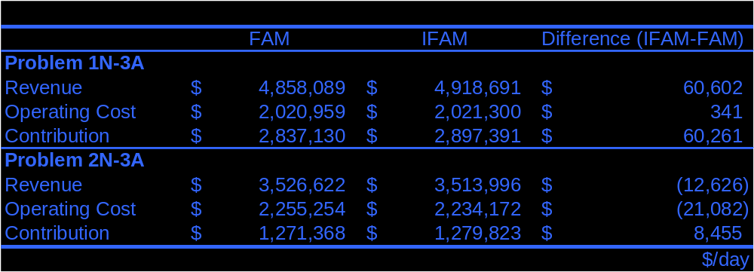
IFAM vs. FAM
Demand
Variations
Demand Stochasticity
Realizations
Demand deviation ~14%
Notes:
I would like to add one note on this table. When we perform the simulation, because of the variation in demand, we have already introduced a 13% absolute deviation to the exercise. When we next look at demand forecast errors, we shift the average demand by –5% to +5%. This shift, however, has very little effect on the absolute deviation, that is, the absolute deviation is still around 13-15%. So the stochasticity appears to dominate the forecast errors in this range. We talked to the airline and asked them to provide their forecast errors estimate. They can only give us the system absolute deviation of demands. And their numbers are also about 13-15% system wide. So it means, that they could be operating anywhere in this –5% to +5% range. Now, we did our experiments and found that in most cases, IFAM performs better than FAM…7 out of 10. But as I said, we do not know where exactly we are operating right now. So, this means that demand forecast is important. If we can get good demand forecast, the benefits of IFAM can be realized.

Slide 45
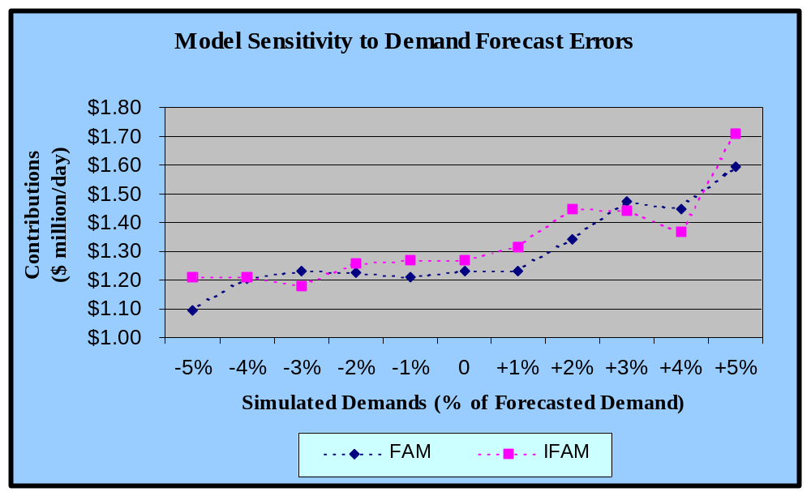
IFAM vs. FAM
Demand
Variations
Demand Stochasticity
Forecast Errors
Realizations
Data Quality Issue
Demand deviation ~15%
Notes:
I would like to add one note on this table. When we perform the simulation, because of the variation in demand, we have already introduced a 13% absolute deviation to the exercise. When we next look at demand forecast errors, we shift the average demand by –5% to +5%. This shift, however, has very little effect on the absolute deviation, that is, the absolute deviation is still around 13-15%. So the stochasticity appears to dominate the forecast errors in this range. We talked to the airline and asked them to provide their forecast errors estimate. They can only give us the system absolute deviation of demands. And their numbers are also about 13-15% system wide. So it means, that they could be operating anywhere in this –5% to +5% range. Now, we did our experiments and found that in most cases, IFAM performs better than FAM…7 out of 10. But as I said, we do not know where exactly we are operating right now. So, this means that demand forecast is important. If we can get good demand forecast, the benefits of IFAM can be realized.

Slide 46
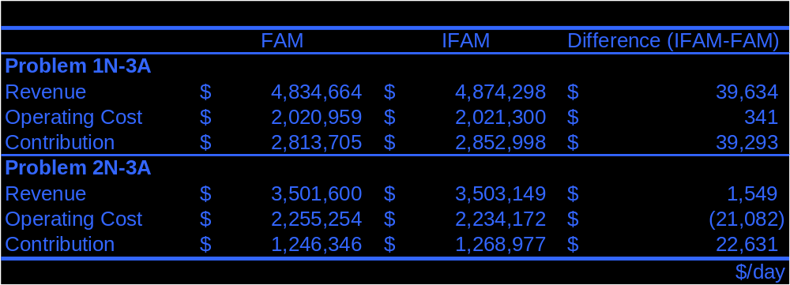
IFAM vs. FAM
Demand Stochasticity
Forecast Errors
Optimal Control of Passengers
From our analysis, there is evidence suggesting that
network effects dominate demand uncertainty
in hub-and-spoke fleet assignment problems.
Notes:
I would like to add one note on this table. When we perform the simulation, because of the variation in demand, we have already introduced a 13% absolute deviation to the exercise. When we next look at demand forecast errors, we shift the average demand by –5% to +5%. This shift, however, has very little effect on the absolute deviation, that is, the absolute deviation is still around 13-15%. So the stochasticity appears to dominate the forecast errors in this range. We talked to the airline and asked them to provide their forecast errors estimate. They can only give us the system absolute deviation of demands. And their numbers are also about 13-15% system wide. So it means, that they could be operating anywhere in this –5% to +5% range. Now, we did our experiments and found that in most cases, IFAM performs better than FAM…7 out of 10. But as I said, we do not know where exactly we are operating right now. So, this means that demand forecast is important. If we can get good demand forecast, the benefits of IFAM can be realized.

Slide 47
Another Fleet Assignment Model and Solution Approach…

Slide 48
Subnetwork-Based FAM
IFAM has tractability issues
Limited opportunities for further IFAM extension
Need alternative kernel
  Capture network effects
  Maintain tractability
IFAM
Modeling
Accuracy
?
SFAM
FAM
Tractability

Slide 49
Basic Concept
Isolate network effects
  Spill occurs only on constrained legs
Potentially
Potentially
Constrained
Constrained
Flight Leg
Flight Leg
Unconstrained
Unconstrained
Flight Leg
Flight Leg
Potentially
Potentially
Binding
Binding
Itinerary
Itinerary
Non
Non
-
-
Binding
Binding
Itinerary
Itinerary
FAM
< 30% of total legs are potentially constrained
< 6% of total itineraries are potentially binding

Slide 50
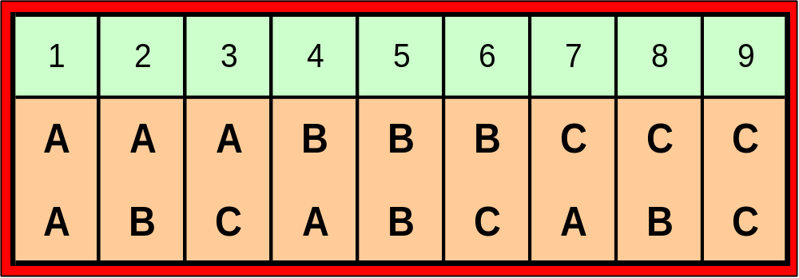

Modeling Challenges
Utilize composite variables (Armacost, 2000; Barnhart, Farahat and Lohatepanont, 2001)
1
1
Challenges
  Efficient column enumeration

Slide 51
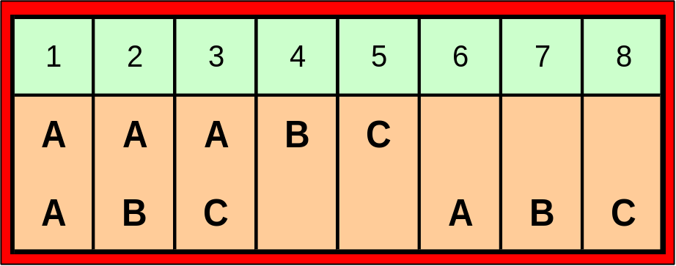
Implementation
Partition construction
  Construct a complete partition
  Subdivide the complete partition
Parsimonious column enumeration
  Potentially constrained leg might become unconstrained if assigned bigger aircraft
1
1
Remove up to 97% of otherwise necessary columns

Slide 52
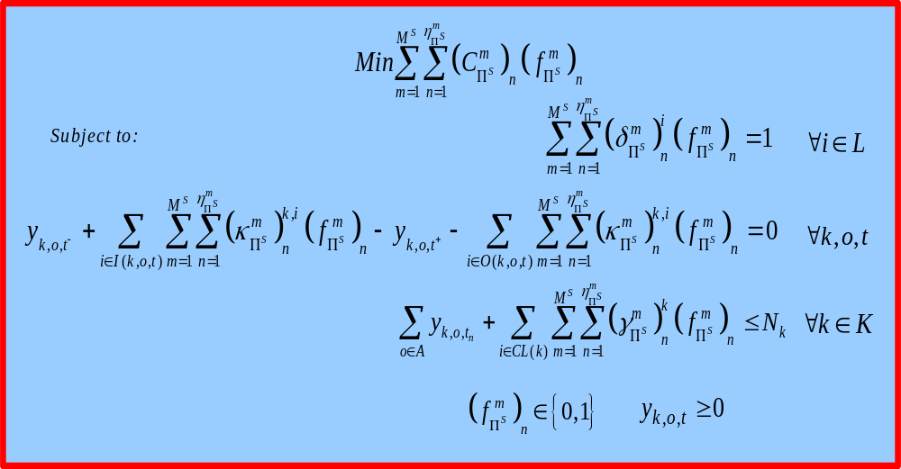
SFAM Formulation
FAM solution algorithm applies

Slide 53
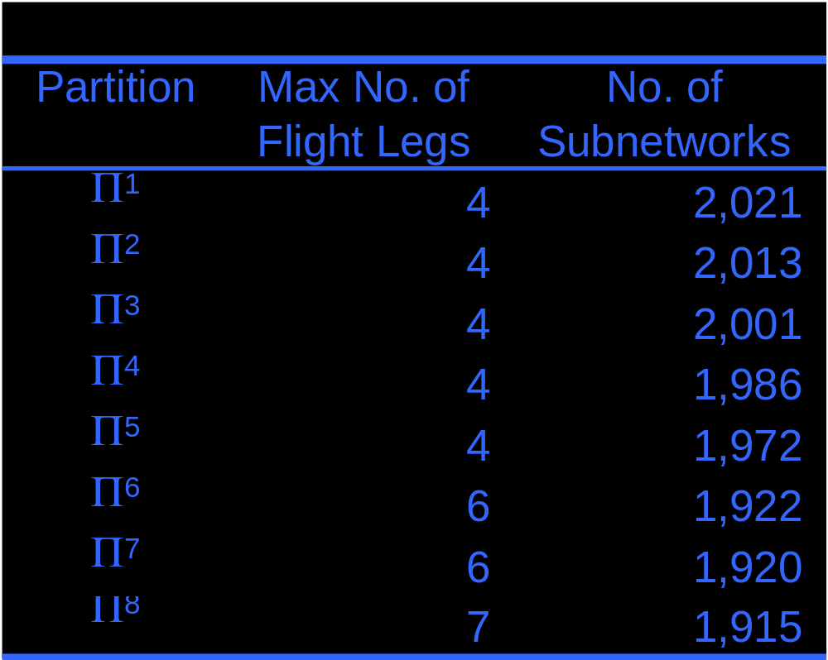
Results
1,888 Flights
9 Fleet Types
75,484 Itineraries

Slide 54
Partition Construction
Allow “spill dependent” subnetworks
  Merge spill dependent subnetworks when solution has a spill calculation error
Potentially
Potentially
Constrained
Constrained
Flight Leg
Flight Leg
Unconstrained
Unconstrained
Flight Leg
Flight Leg
Potentially
Potentially
Binding
Binding
1
Itinerary
Itinerary
Non
Non
-
-
Binding
Binding
Itinerary
Itinerary

Slide 55
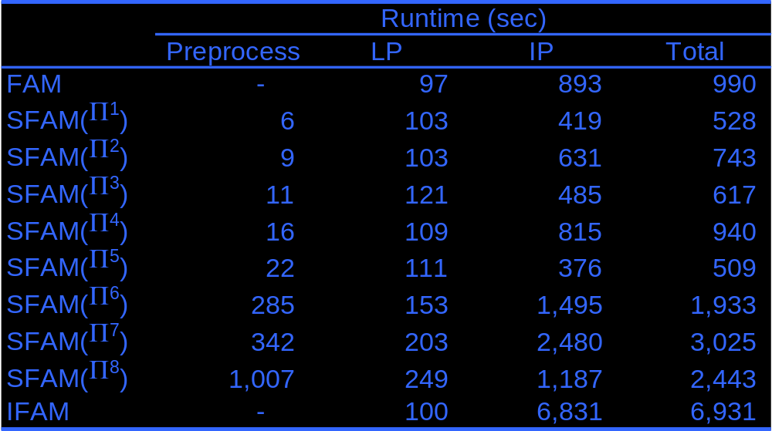
Runtime

Slide 56
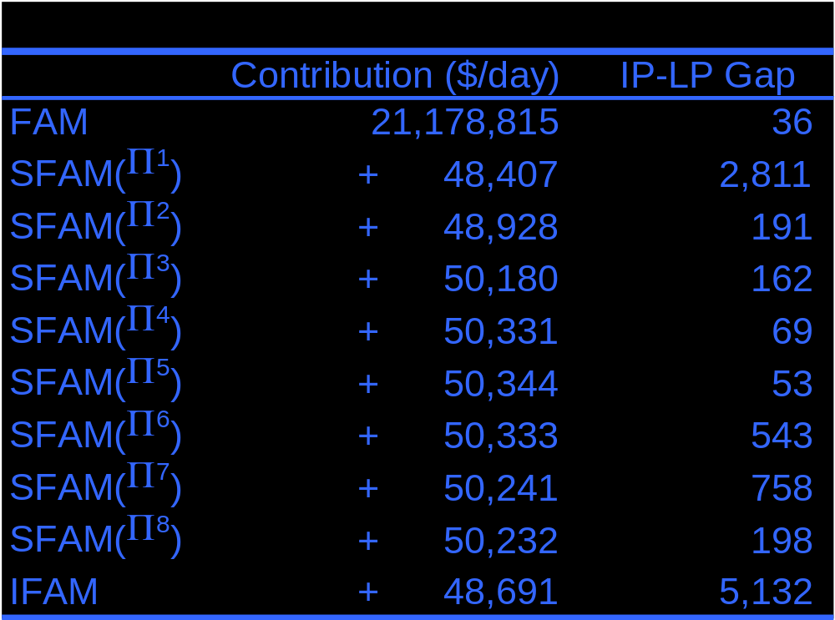
Solution Quality

Slide 57
SFAM: Results & Conclusions
Testing performed on full size schedules
SFAM can achieve optimal solutions equivalent to IFAM’s
Because of formulation structure, SFAM produces tighter LP relaxations
Tighter LP relaxations lead to quicker solution times
SFAM has great potential for further integration or extension
  Time windows
  Stochastic demand
  Schedule design

Slide 58
Extending Fleet Assignment Models to Include “Incremental” Schedule Design…

Slide 59
Airline Schedule Planning Process
Schedule Design
Fleet Assignment
Aircraft Routing
Crew Scheduling
Fleet Assignment with Time Windows: A step to integrate schedule design and fleet assignment

Slide 60
Fleet Assignment with Time Windows (FAMTW)
Assume that departure times (and arrival) times are NOT fixed for each flight, instead there is a time window for departures
  Publication of schedule is several months out
  Passenger forecasts won’t change for minor re-timings
  Produce a better fleet assignment
    Save money (operating costs, spill costs)
    Free up aircraft by “tightening” the schedule

Slide 61
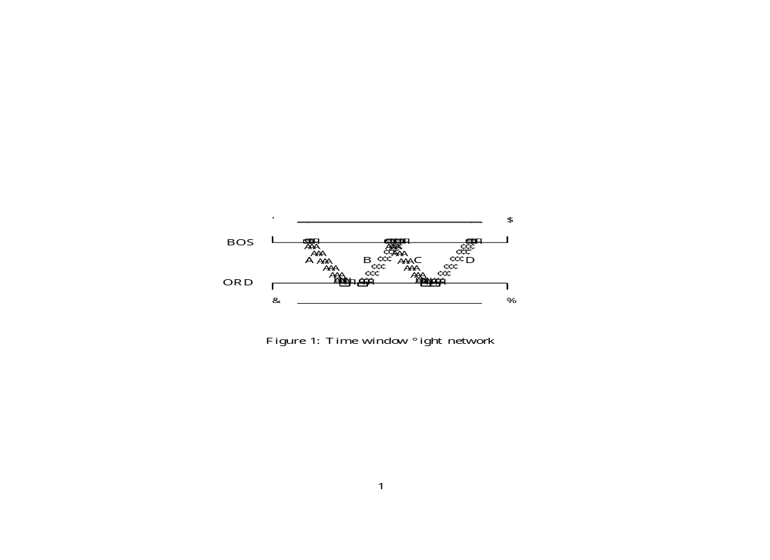
Time Window Flight Network

Slide 62
The New Model
Replace single flight arc with cluster of flight “copies”
  Try various window widths and copy intervals
  Maintain bank structure to ensure appropriate passenger connection times are still met
Change cover constraints to accommodate flight copies

Slide 63
Modified Notations for FAMTW
Decision Variables
  f_{n,k,i} equals 1 if fleet type k is assigned to copy n of flight leg i, and 0 otherwise
Parameters
  C_{n,k,i} is the assignment cost of assigning fleet k to copy n of flight leg i
Sets
  N_{ki} is the set of all copies of flight leg i

Slide 64
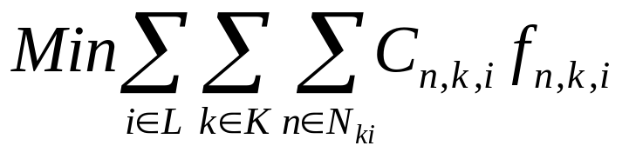
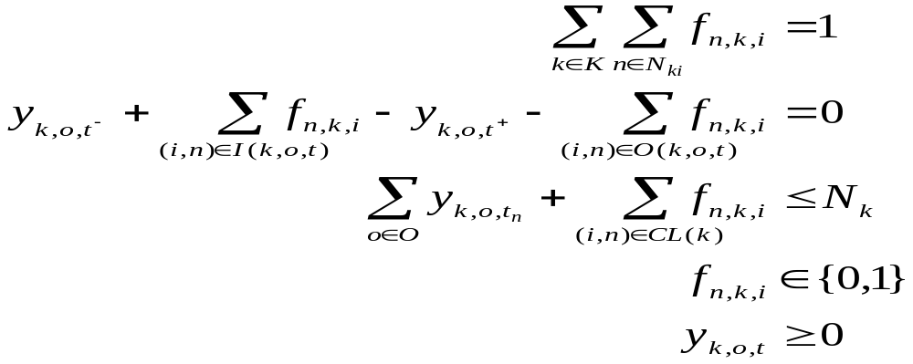
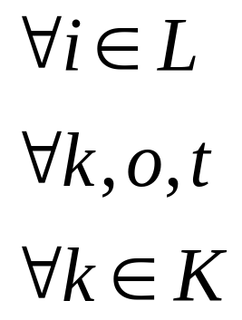
Fleet Assignment with Time Windows Model (FAMTW)

Slide 65
Network Pre-Processing To Reduce Model Size
Node consolidation
Redundant flight copies elimination
Islands

Slide 66
Direct Solution Technique (DST)
Branch-and-bound with Specialized Branching
Specialized branching:
  Special ordered sets (SOS)

Slide 67
Iterative Solution Technique (IST)
Motivation
Not all flights need multiple flight copies, generate as needed
Solve larger problems, perhaps more quickly than the Direct Solution Technique (DST)
Make the problem smaller -- this may be useful if we would like to merge FAMTW with other models

Slide 68
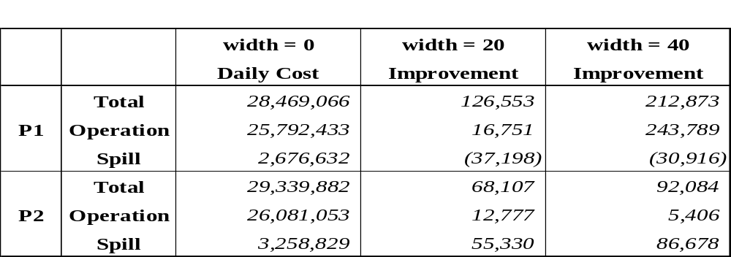
Solution Analysis
Time Window Width

Slide 69
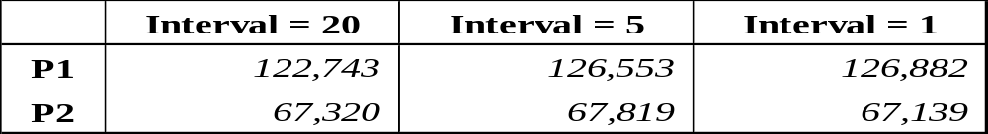
Solution Analysis
Flight Copy Interval
Improvements in optimal objective function value when using 20-minute time windows

Slide 70
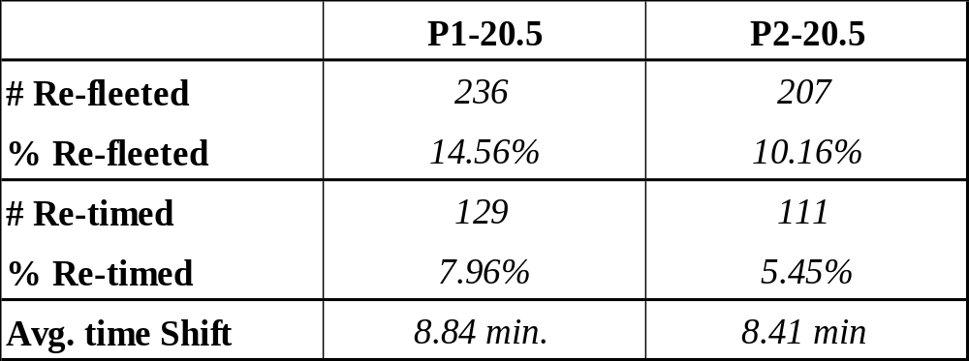
Solution Analysis
Re-fleeting and Re-timing

Slide 71
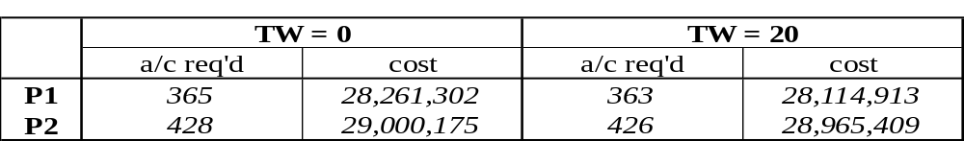
Solution Analysis
Aircraft Utilization
Do time windows allow us to save aircraft?

Slide 72
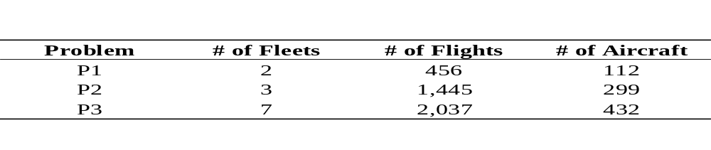
Free Flight
FAMTW Application to Free Flight
Data Sets

Slide 73
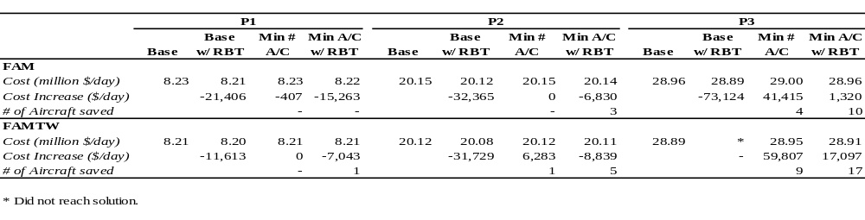
Results
Notes:
Base with RBT– base with reduced block times (to simulate free flight)
Min A/C w/ RBT: objective is to minimize number of aircraft used, given reduced block times

Slide 74
Conclusions
Time windows can provide significant cost savings, as well as a potential for freeing aircraft
Good run times for DST, especially because copies need not be placed at a fine interval
IST provides problem size “capacity” so that FAMTW may be enhanced, integrated with other models, etc.
Applications: Don’t underestimate value of modeling

