Slide 1
1.206J/16.77J/ESD.215J
Airline Schedule Planning
Cynthia Barnhart
Spring 2003

Slide 2
1.206J/16.77J/ESD.215J
The Crew Scheduling Problem
Outline
  Problem Definition
  Sequential Solution Approach
  Crew Pairing Optimization Model
  Branch-and-Price Solution
    Branching strategies

Slide 3
Why Crew Scheduling?
Second largest operating expense (after fuel)
OR success story
Complex problems with many remaining opportunities
A case study for techniques to solve large IPs

Slide 4
Airline Schedule Planning
Schedule Design
Fleet Assignment
Aircraft Routing
Crew Scheduling

Slide 5
The Crew Scheduling Problem
Assign crews to cover all flights for a given fleet type
Minimize cost
  Time paid for flying
  “Penalty” pay
Side constraints
  Balance
  Robustness

Slide 6

Network Flow Problem?
Complex feasibility rules
Non-linear objective function

Slide 7
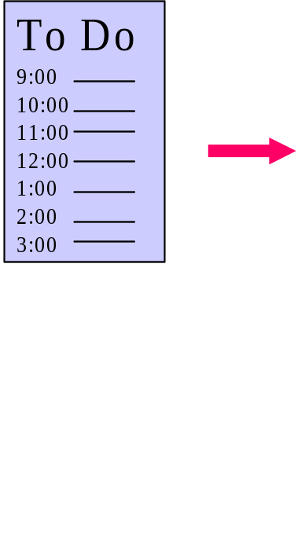


Building Blocks
Flight
Pairing

Slide 8
Duty Periods
Definition:
A duty period is a day-long sequence of consecutive flights that can be assigned to a single crew, to be followed by a period of rest

Slide 9
Duty Rules
Rules:
Flights are sequential in space/time
Maximum flying time
Minimum idle/sit/connect time
Maximum idle/sit/connect time
Maximum duty time

Slide 10
Duty Cost Function
Maximum of:
  Total flying time
  f_{d} * total duty time
  Minimum guaranteed duty pay
Primarily compensates for flying time, but also compensates for “undesirable” schedules

Slide 11
Pairings
Definition:
A sequence of duty periods, interspersed with periods of rest, that begins and ends at a crew domicile

Slide 12
Pairing Rules
Rules:
First duty starts/last duty ends at domicile
Duties are sequential in space/time
Minimum rest between duties
Maximum layover time
Maximum number of days away from base
8-in-24 rule

Slide 13
Pairing Cost Function
Maximum of:
  Sum of duty costs
  f_{p} * total time away from base (TAFB)
  Minimum guaranteed pairing pay

Slide 14
Schedules
Rules:
Minimum rest between pairings
Maximum monthly flying time
Maximum time on duty
Minimum total number of days off
Two key differences:
Cost function focuses on crew preferences
Schedules individuals rather than complete crews

Slide 15
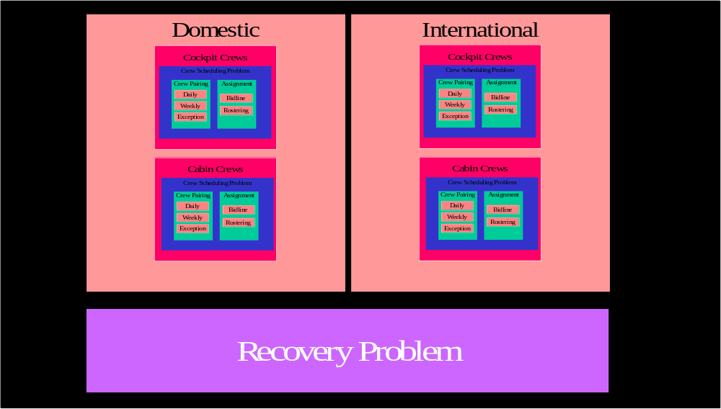
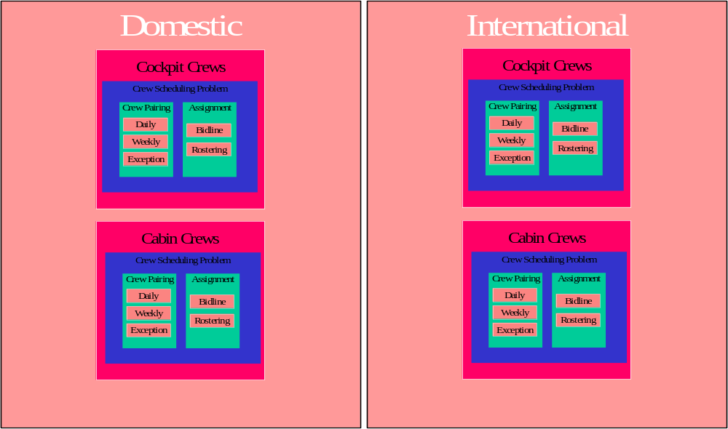
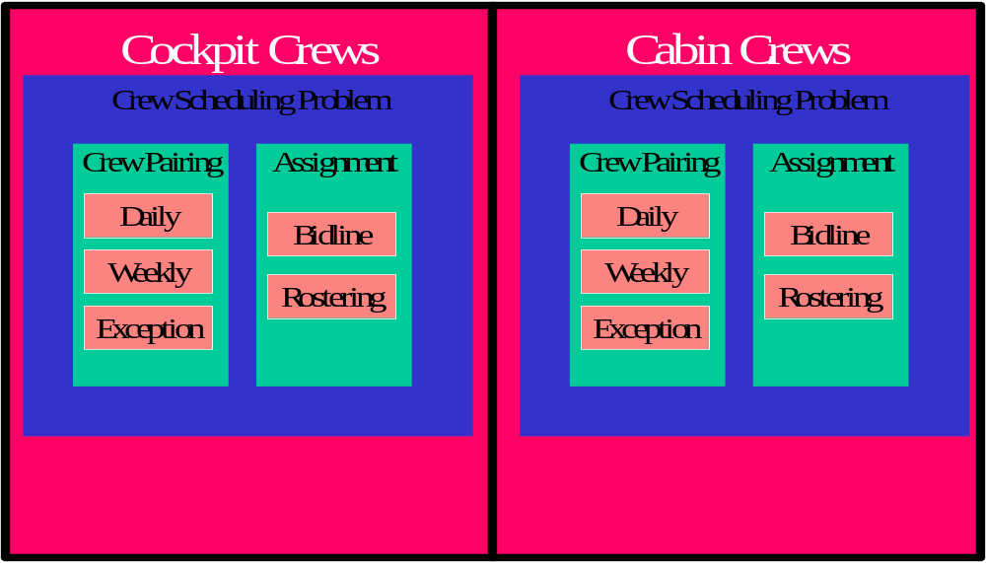
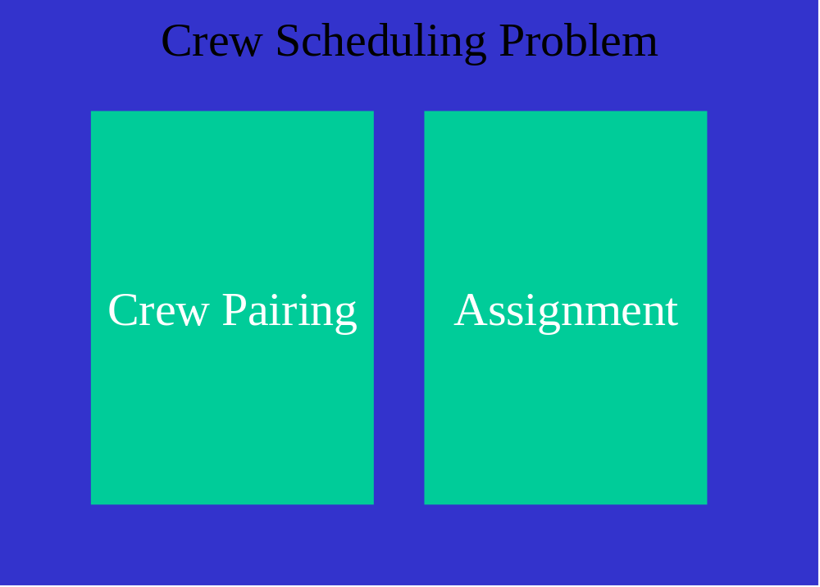
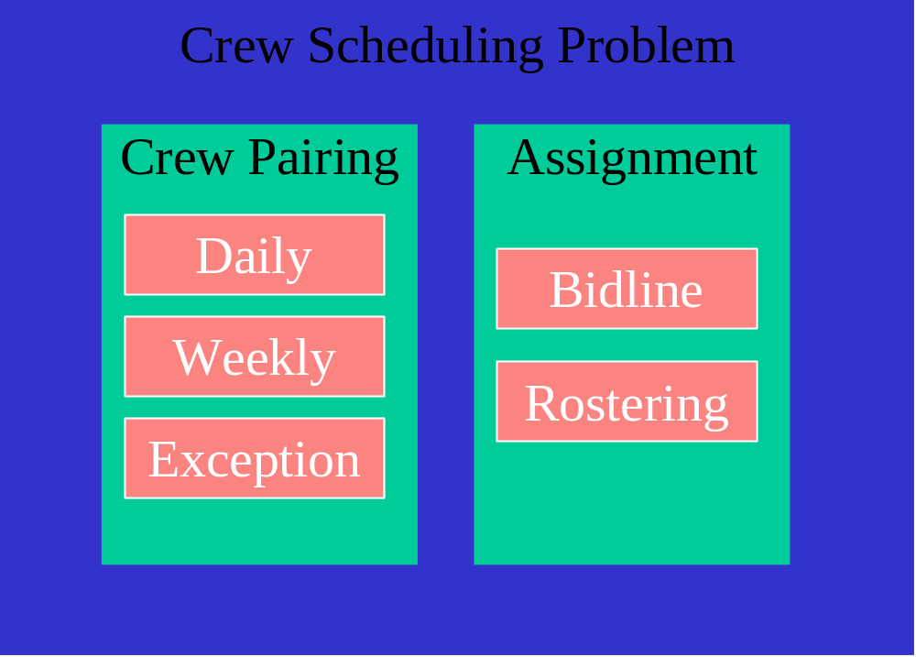
Crew Scheduling Problems
Crew Scheduling Problem

Slide 16
Pairing Problems
Select a minimum cost set of pairings such that every flight is included in exactly one pairing
Crew Pairing Decomposition
  Daily
  Weekly
  Exceptions
  Transitions

Slide 17
Daily
All flights operating four or more times per week
Chosen pairings will be repeated each day
Multi-day pairings will be flown by multiple crews
Flights cannot be repeated in a pairing

Slide 18





Example
MON TUE WED THU FRI SAT SUN

Slide 19
Example, cont.
MON TUE WED THU FRI SAT SUN
Duty A
Duty C
Duty B
Duty C
Duty A
Duty B

Slide 20
Weekly
Cover all flights scheduled in a week-long period
Fleet assignment on a particular flight leg can vary by day of week
Identify flights by day-of-week as well as flight number, location, time

Slide 21
Exceptions
Cover all flights in “broken pairings”
Cover all flights that are scheduled at most three times/week
Identify flights by day-of-week as well as flight number, location, time
Generate “weekly” pairings

Slide 22
Transition
Cover flights in pairings that cross the end of the month
Identify flights by date as well as flight number, location, time, day-of-week
Generate pairings connecting two different flight schedules

Slide 23
Crew Planning
Daily
Problem
Exceptions
Transition
broken
pairings
broken
pairings

Slide 24
Assignment Problems
Specified at the individual level
Incorporates rest, vacation time, medical leave, training
Focus is not on cost but crew needs/ preferences

Slide 25
The Bidline Problem
Pairings are constructed into generic schedules
Schedules are posted and crew members bid for specific schedules
More senior crew members given greater priority
Commonly used in the U.S.

Slide 26
The Rostering Problem
Personalized pairings are constructed
Incorporates crew vacation requests, training needs, etc.
Higher priority given to more senior crew members
Typical outside the U.S.

Slide 27
Pairing vs. Assignment
Similarities
  Sequencing flights to form pairings ⬄ sequencing pairings to form schedules
  Set partitioning formulations (possibly with side constraints)
Differences
  Complete crews vs. single crew member
  Objective function
  Time horizon

Slide 28
Cockpit vs. Cabin
Cockpit crews stay together; cabin crews do not
Cockpit crew makeup is fixed; cabin needs can vary by demand
Cabin crew members have a wider range of aircraft they can staff
Cockpit crew members receive higher salaries

Slide 29
Domestic vs. International
Domestic U.S. networks of large carriers are predominantly hub-and-spoke
  With many connection opportunities
  Domestic networks are usually daily
International networks are typically point-to-point
  More of a need to use deadheads
  International networks are typically weekly

Slide 30
Recovery Problem
Given a disruption, adjust the crew schedule so that it becomes feasible
What is our objective?
  Return to original schedule as quickly as possible?
  Minimize passenger disruptions?
  Minimize cost?
Limited time horizon -- need fast heuristics

Slide 31
Focus: Daily Domestic Cockpit Crew Pairing Problem
Problem description
Formulation
Solution approaches
Computational results
Integration with aircraft routing, FAM

Slide 32
The Crew Pairing Problem
Given a set of flights (corresponding to an
individual fleet type or fleet family), choose a
minimum cost set of pairings such that every
flight is covered exactly once (i.e. every flight is
contained in exactly one pairing)

Slide 33
Notation
P^{k} is the set of feasible pairings for fleet type k
F^{k} is the set of daily flights assigned to fleet type k
δ_{fp} is defined to be 1 if flight f is included in pairing p, else 0
c_{p} is the cost of pairing p
x_{p} is a binary decision variable – value 1 indicates that pairing p is chosen, else 0

Slide 34
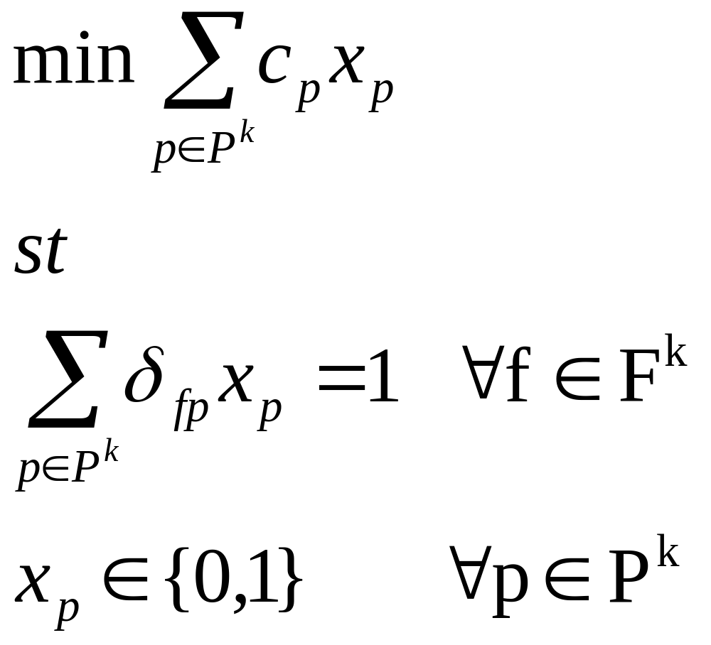
Formulation

Slide 35
Is this an easy problem?
Linear objective function
No complex feasibility rules
Easy to write/intuitive
Small number of constraints
Huge number of integer variables

Slide 36
How do we solve it?
We need branch-and-bound to solve the IP
We need column generation to solve the individual LP relaxations
Branch-and-price combines the two

Slide 37
Column Generation Review
Column generation solves linear programs with a large number of variables
Start with a restricted master – a subset of the variables
Solve to optimality
Input the duals to a pricing problem and look for negative reduced cost columns
Repeat

Slide 38
Generating Crew Pairings
Start with enough columns to ensure a feasible solution (may need to use artificial variables)
Solve Restricted Master problem
Look for one or more negative reduced cost columns for each crew base; add to Restricted Master problem and re-solve
If no new columns are found, LP is optimal

Slide 39
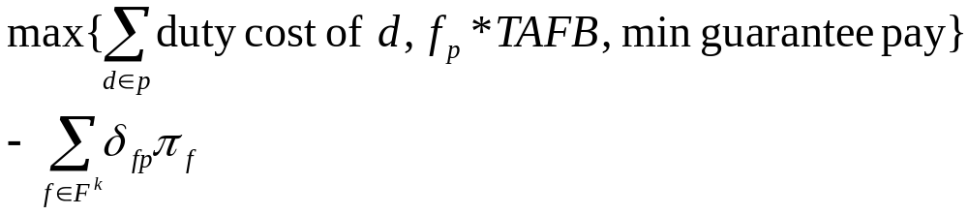
Crew Pairing Reduced Cost
Reduced cost of pairing p is:

Slide 40
Formulation

Slide 41
Pricing as a Shortest Path Problem
A pairing can be seen as a path, where nodes represent flights and arcs represent valid connections
Paths must start/end at a given crew base
For daily problem, paths cannot repeat a flight
Paths must satisfy duty and pairing rules
Path costs can be computed via labels corresponding to pairing reduced costs

Slide 42
Network Structure
Connection arc network
  Nodes represent flights
  Arcs represent (potentially) feasible connections
Multiple copies of the network in order to construct multi-day pairings
Source/sink nodes at the crew base

Slide 43
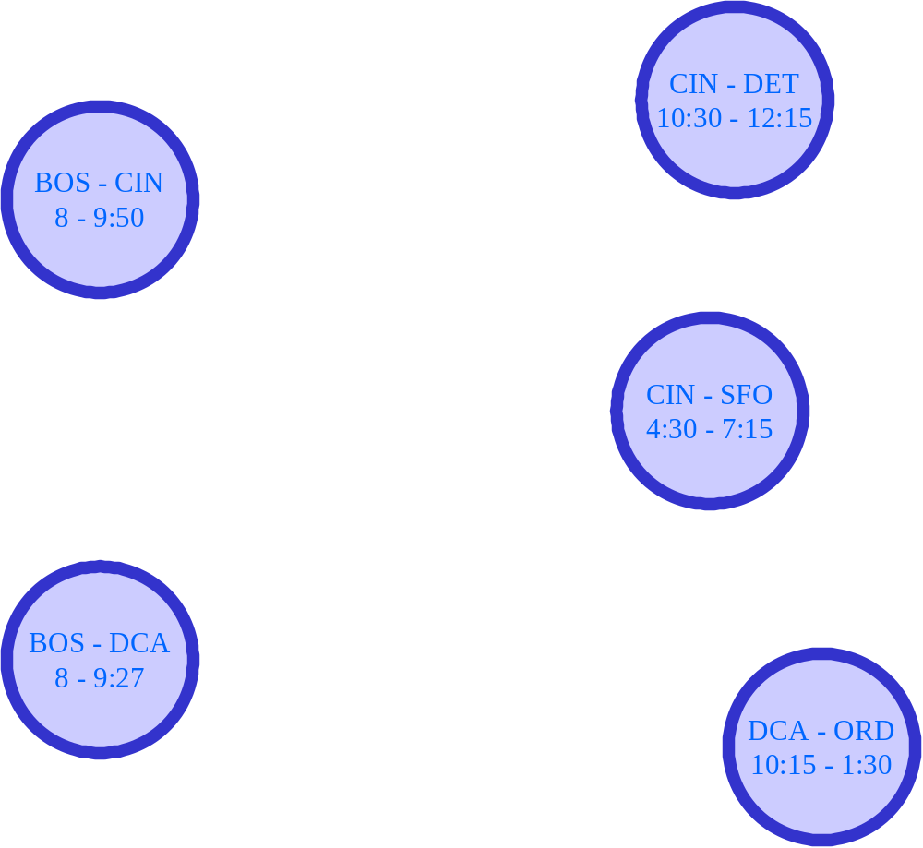



Network Example
BOS

Slide 44
Multi-Day Network

Slide 45
Labels
Feasibility:
Pairing:
  Min rest between duties
  Max rest between duties
  Max # of duties
Duty:
  Max flying
  Max duty time
  Min idle (connection arcs)
  Max idle (connections arcs)
Cost:
Pairing -- max of:
  Sum of duty costs
  f_{p} * TAFB
  min guarantee pay
Duty -- max of:
  Total flying time
  f_{d} * total duty time
  min guarantee pay

Slide 46
Labels, cont.
Labels have to track:
Current duty:
  Flying time in current duty
  Total elapsed time in current duty
  Current duty cost
Pairing:
  Pairing TAFB
  Sum of completed duties’ costs
  # completed duties
  Current pairing reduced cost
Labels also contain:
Label id
Previous flight
Previous flight’s label id

Slide 47
Processing Labels
For each node (in topological order)
  For each label at that node
    For each connection arc out of that node
      Process the arc
      If a label is created, check existing labels for dominance
      If the node ends at the crew base and reduced cost is negative, a potential column’s been found

Slide 48
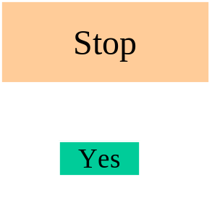
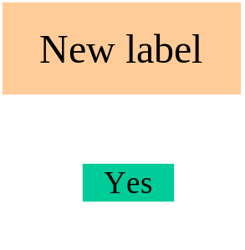
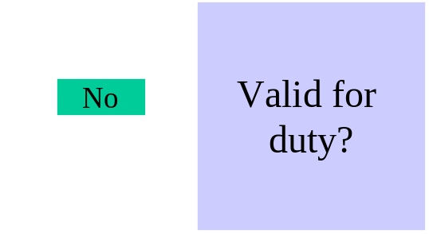
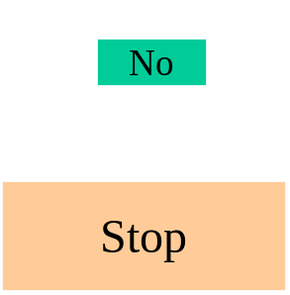
Processing Labels, cont.
Stop
No
Given:
Label
Arc
Flight repeat?
Yes
Valid for
pairing?
New label:
  Update duty time
  Update flying time
  Update duty cost
  Update pairing red. cost
  Update pairing TAFB
  Update sum of duty costs
Valid for duty:
    Doesn’t violate max duty time
    Doesn’t violate max idle time
    Doesn’t violate max flying time
Valid for pairing:
    Doesn’t violate number of duties
    Doesn’t violate min layover
    Doesn’t violate max TAFB

Slide 49
Column Generation and Network Structure
  Duty assignment networks
    Large number of arcs
      One arc per duty
      Can be hundreds of connections per duty
      Ex: 363 flights, 7838 duties, 1.65 M connections
    Fewer labels per path - duty rules are built in
  Flight assignment networks
    Smaller number of arcs
      One arc per flight
      Typically not more than 30 connections per flight
    Larger number of labels

Slide 50
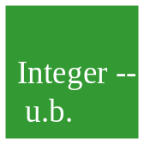
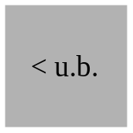
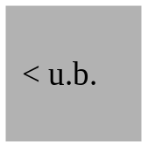
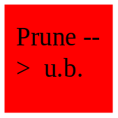
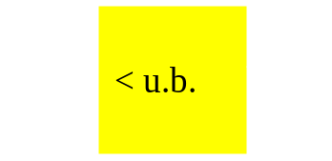

Branch-and-Bound Review
Root
node

Slide 51
Heuristic Solution Approach
Branch-and-bound with only root node LP solved using column generation
  No feasible solution may exist in the columns generated to solve the root node LP
  Conventional wisdom: need some “bad” columns to get a “good” solution

Slide 52
Branch-and-Price
Need a branching rule that is compatible with column generation
  Rule must be enforceable without changing the structure of the pricing problem
    Multi-label shortest path problem
  Branching based on variable dichotomy is not compatible
    Cannot restrict the shortest path algorithm from finding a path (that is, a pairing)

Slide 53
Variable Dichotomy Branching
Given a fractional solution to the crew pairing problem, pick p s.t. 0 < x_{p} < 1
Two new problems: {x_{p} = 1, x_{p} = 0}
Drawbacks:
  Imbalance
  Maximum depth of tree
  Enforcing in the pricing problem:
    x_{p} = 1 is easy
    x_{p} = 0 is hard

Slide 54
Branching on Follow-Ons
Given a fractional solution, there must be two flights f1, f2 such that f1 is followed by f2 a fractional amount in the solution
  Pairing f1-f2-f3 has value 1/2 and pairing f₁-f₄ has value 1/2
Branch on {f₁ is/is not followed by f₂}
  More balanced
  Fewer branching levels
  Easy to enforce in pricing problem

Slide 55
How to Alter Network to Enforce Branching Decision
If follow-on flights a-b required
  Remove all connection arcs from a to flights other than b
  Remove all connection arcs into b from flights other than a
If follow-on flights a-b disallowed
  Remove all connection arcs from a to b

Slide 56
How to Select Flight Pairs for Branching
Sum current LP solution values of all possible flight follow-ons
Branch on the follow-on with the greatest value

Slide 57
Computational Results
American Airlines (1993):
25,000+ crew members
Save $20+ million/year
Solutions in 4 - 10 hours

Slide 58
Other Crew Scheduling Research Topics
Cabin crew scheduling
Integrating pairing and assignment
Robust planning
Recovery
Integrated models

