Slide 1
1.206J/16.77J/ESD.215J
Airline Schedule Planning
Cynthia Barnhart
Spring 2003

Slide 2
Aircraft Maintenance Routing
Outline
  Problem Definition and Objective
  Network Representation
  String Model
  Solution Approach
  Branch-and-price
  Extension: Combined Fleet Assignment and Aircraft Routing

Slide 3
Airline Schedule Planning
Schedule Design
Fleet Assignment
Aircraft Routing
Crew Scheduling

Slide 4
Airline Schedule Planning
Schedule Design
Fleet Assignment
String-
Based
FAM
Aircraft Routing
Crew Scheduling

Slide 5
Problem Definition
Given:
  Flight Schedule for a single fleet
    Each flight covered exactly once by fleet
  Number of Aircraft by Equipment Type
    Can’t assign more aircraft than are available
  FAA Maintenance Requirements
  Turn Times at each Station
  Through revenues for pairs or sequences of flights
  Maintenance costs per aircraft

Slide 6
Problem Objective
Find:
  Revenue maximizing assignment of aircraft of a single fleet to scheduled flights such that each flight is covered exactly once, maintenance requirements are satisfied, conservation of flow (balance) of aircraft is achieved, and the number of aircraft used does not exceed the number available

Slide 7
FAA Maintenance Requirements
“A” Checks
  Maintenance required every 60 hours of flying
  Airlines maintain aircraft every 40-45 hours of flying with the maximum time between checks restricted to three to four calendar days

Slide 8
FAM Representation of Maintenance Constraints
Maintenance arcs for fleet k included in time line network at each maintenance station for k
Each arc
  Begins at an aircraft arrival + turn time
  Spans minimum maintenance time
Constraints added to FAM for each aircraft type k, requiring a minimum number of aircraft of type k on the set of “maintenance arcs”
  Ensures that sufficient maintenance opportunities exist
  One aircraft might be serviced daily and others not at all

Slide 9
Hub-and-Spoke vs. Point-to-Point Networks
Domestic U.S. carriers with hub-and-spoke networks find that approximate maintenance constraints result in maintenance feasible routings
  Sufficient number of opportunities at hubs to swap aircraft assignments so that aircraft get to maintenance stations as needed
Approximate maintenance constraints often do not result in maintenance feasible routings for point-to-point networks
  Flying time between visits to maintenance stations often too long

Slide 10
Network Representation
Connection network
  Nodes:
    Flight arrivals/ departures (time and space)
  Arcs:
    Flight arcs: one arc for each scheduled flight
    Connection arcs: allow aircraft to connect between flights

Slide 11
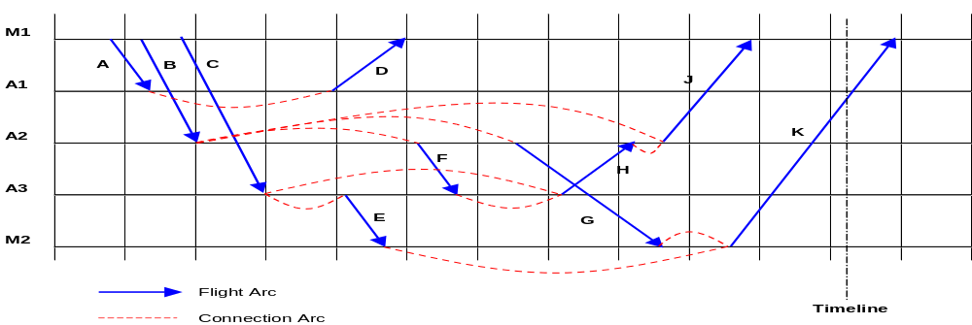
Connection Network

Slide 12
Connection vs. Time-line Network
Network Size
  Time-line network typically has more arcs than connection network
Model capabilities
  Connection network provides richer modeling possibilities
    Through revenues can be captured easily
    Disallowed or forced connections can be modeled easily

Slide 13
String Model: Variable Definition
A string is a sequence of flights beginning and ending at a maintenance station with maintenance following the last flight in the sequence
  Departure time of the string is the departure time of the first flight in the sequence
  Arrival time of the string is the arrival time of the last flight in the sequence + maintenance time

Slide 14
String Model: Constraints
Maintenance constraints
  Satisfied by variable definition
Cover constraints
  Each flight must be assigned to exactly one string
Balance constraints
  Needed only at maintenance stations
Fleet size constraints
  The number of strings and connection arcs crossing the count time cannot exceed the number of aircraft in the fleet
NOTE: If the problem is daily, each string can contain a flight at most once! Assume we focus on weekly problem.

Slide 15
Model Strengths and Weaknesses
Nonlinearities and complex constraints can be handled relatively easily
Model size
  Number of variables
  Number of constraints

Slide 16
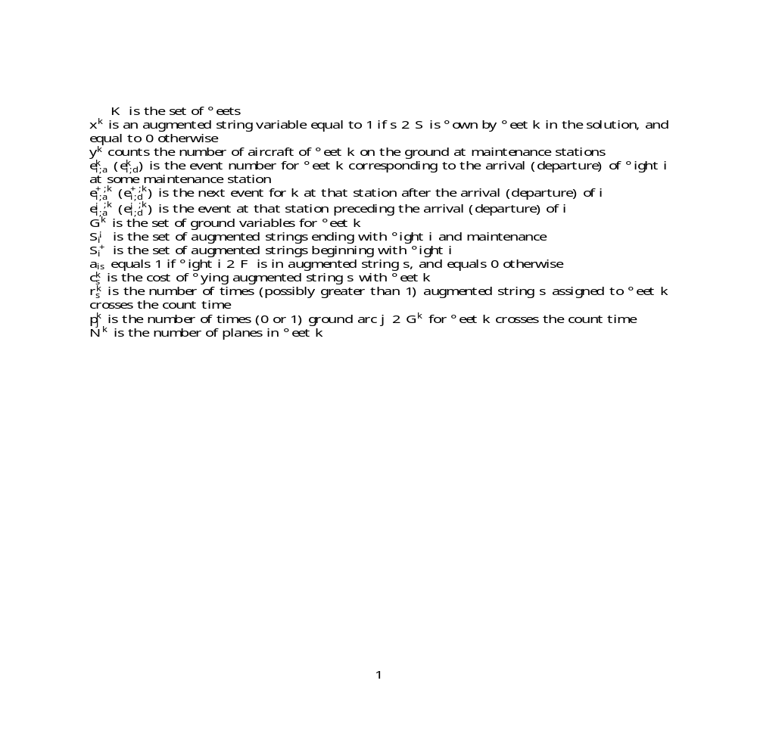
Notations

Slide 17
Aircraft Maintenance Routing: String Model
P
P
m
i
n




P

2
😐
P
⬧
2

⬧
⬧



=
1

8

2
☞
P

2
😐
⬧
2


⬧
⬧


¡


+


=
0

8

2
☞

8

2
😐
(
1
)
+
⬧
¡


≤
+


⬧
2

(




)
(




)
P













¡


¡


+


=
0

8

2
☞

8

2
😐
⬧
2

¡
⬧
¡




+



(



)
(



)
P







P






2
f
0

1
g

8
⬧
2


8

2
😐

❒



+
⬧
❐






8

2
😐
⬧
2

⬧
⬧

2






¸
0

8

2



8

2
😐


2

Slide 18
Model Solution
Integer program
  Branch-and-bound with too many variables to consider all of them
  Solve Linear Program using Column Generation
Branch-and-Price
  Branch-and-bound with bounding provided by solving LP’s using column generation, at each node of the branch-and-bound tree

Slide 19
LP Solution: Column Generation
Step 1: Solve Restricted Master Problem
Step 2: Solve Pricing Problem (generate columns)
Step 3: If columns generated, return to Step 1; otherwise STOP

Slide 20
Generating The Right Variables
Find a Variable with “Negative-Reduced Cost”
  From Linear Programming Theory
    reduced cost of each string between two nodes = cost - sum of the dual variables associated with flights in string + constant
  Not feasible to compute reduced cost for each variable, instead exploit problem structure

Slide 21
The Pricing Problem: A Constrained Shortest Path Problem
Time-Line Network
Time
Washington, D.C.
Baltimore
New York
Boston
If the “Length” of the shortest path is
  negative: a variable has been identified for inclusion in the LP;
  non-negative: the optimal LP solution is found

Slide 22
Pricing Problem Solution
Find negative reduced cost route between maintenance stations
Price-out columns by running a shortest path procedure with costs on arcs modified
Ensure that shortest path solution satisfies maintenance constraints

Slide 23
Path Lengths in Modified Network

Slide 24
Maintenance Requirements and the Pricing Problem Solution
Maximum Elapsed Time Requirement
  Unconstrained, simple shortest path computation
  Computationally inexpensive
Maximum Flying Time Requirement
  Constrained shortest path procedure
    Additional labels need to be maintained
  Computationally expensive

Slide 25
Maximum Flying Time Requirement: Multiple Labels and Dominance
Label i has cost c(i) and elapsed flying time t(i)
Label i dominates label i+1 if c(i) ______ c(i+1) and t(i) _______ t(i+1)

Slide 26
Column Generation Solution Approach
Repeated Solution
of a Series of
Smaller, Simpler
Subproblems
Decomposition
Strategy
Allows Huge Programs
To Be Solved
Without Evaluating
All Variables
Success of Approach
Depends on
Ease of Solution of
Subproblems

Slide 27
Branch-and-Price Challenge
Devise Branching Strategy that:
  Is Compatible with Column Generation Subproblem
    Does not destroy tractability of pricing problem
    Conventional branching based on variable dichotomy does not work

Slide 28
Branching Strategy
Branch on follow-ons:
  Identify two fractional strings s and s’
  Select flight i(1) contained in both strings
    One exists because __________________________
  Select flight i(2) contained in s but not s’
    One exists because __________________________
  Select i(1)-i(2) pair such that i(1) is followed immediately by i(2) in s
    Such a pair exists ______________________________________

Slide 29
Branches
Left branch: force flight i(1) to be followed by i(2) if i(1) and i(2) are in the string
  To enforce: eliminate any connection arcs including i(1) or i(2) but not both
Right branch: do not allow flight i(1) to be followed by i(2)
  To enforce: eliminate any connection arcs from i(1) to i(2)

Slide 30
Summary: Branch-and-Price
At each node of the Branch-and-Bound tree
  Column generation used to solve LP
Column Generation
  Allows huge LPs to be solved by considering only a subset of all variables (columns)
  Solves shortest path subproblem repeatedly to generate additional columns as needed
Nontrivial Implementations
  New branching strategies necessary
  Ongoing research

Slide 31
Extensions: Combined Fleeting and Routing
Motivation: Long-haul applications
  Approximate maintenance constraints in FAM might result in “maintenance-infeasible” solutions
  Exact maintenance constraints necessary
    Need to model individual aircraft routings

Slide 32
Objective
Minimize operating costs plus approximate spill costs minus through revenues

Slide 33
Model Solution
Branch-and-Price
  Branch on “fleet-flight” pairs
    Provides a partition of flights to fleets
    Enforce by _________________________________________
  For each resulting fleet specific aircraft routing problem
    Branch on follow-ons

Slide 34
Case Study
Data provided by a major US long haul airline
  1162 flights per week serving 55 cities worldwide
  11 fleet types and 75 aircraft
  8 maintenance stations
Subproblems generated to perform scenario analyses quickly

Slide 35
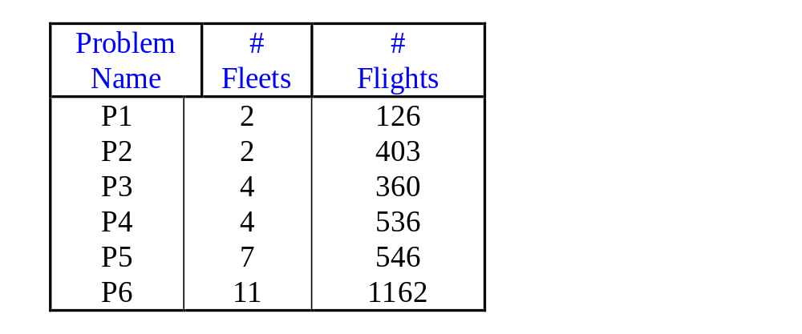
Problem Sizes

Slide 36
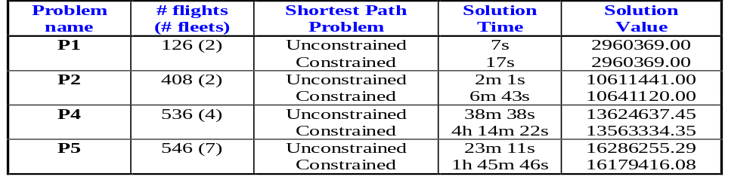
Effect of Maintenance Requirements

Slide 37
Summary
New model and solution approach for the combined fleet assignment and aircraft routing problems
Computational experiments showed:
  Near-optimal solutions in reasonable run times
  Maintenance feasible solutions ensured
  Through revenues captured
One step closer to integration of overall airline scheduling process

