Slide 1
1.206J/16.77J/ESD.215J
Airline Schedule Planning
Cynthia Barnhart
Spring 2003

Slide 2
The Extended Crew Pairing Problem with Aircraft Maintenance Routing
Outline
  Review of Individual Problems
  Interdependence and motivation for an alternative approach
  Sequential Approaches
  Integrated Approaches
  Comparison of Models

Slide 3
The Maintenance Routing Problem (MR)
Given:
  Flight Schedule for a single fleet
    Each flight covered exactly once by fleet
  Number of Aircraft by Equipment Type
    Can’t assign more aircraft than are available
  FAA Maintenance Requirements
  Turn Times at each Station
  Through revenues for pairs or sequences of flights
  Maintenance costs per aircraft

Slide 4
MR Problem Objective
Find:
  Revenue maximizing assignment of aircraft of a single fleet to scheduled flights such that each flight is covered exactly once, maintenance requirements are satisfied, conservation of flow (balance) of aircraft is achieved, and the number of aircraft used does not exceed the number available

Slide 5
MR String Model: Variable Definition
A string is a sequence of flights beginning and ending at a maintenance station with maintenance following the last flight in the sequence
  Departure time of the string is the departure time of the first flight in the sequence
  Arrival time of the string is the arrival time of the last flight in the sequence + maintenance time

Slide 6
MR String Model: Constraints
Maintenance constraints
  Satisfied by variable definition
Cover constraints
  Each flight must be assigned to exactly one string
Balance constraints
  Needed only at maintenance stations
Fleet size constraints
  The number of strings and connection arcs crossing the count time cannot exceed the number of aircraft in the fleet

Slide 7
MR String Model: Solution
Integer program
  Branch-and-bound with too many variables to consider all of them
  Solve Linear Program using Column Generation
Branch-and-Price
  Branch-and-bound with bounding provided by solving LP’s using column generation at each node of the branch-and-bound tree

Slide 8
Crew Pairing Problem (CP)
Given:
  Flight Schedule for a fleet family
    Each flight covered exactly once
    Usually daily or weekly schedule
  FAA and Collective Bargaining Agreements
    Rest
    Maximum duty, sit, flying times in a duty
    8-in-24 rule
    Maximum time-away-from-base
    Brief/debrief
  Crew base locations
  Minimum connection times between aircraft at each station
  Number of crews at each crew base

Slide 9
CP Cost Function
Duty cost is maximum of:
  Flying time
  f₁ * elapsed duty time
  Minimum duty pay
Pairing cost is maximum of:
  Sum of duty costs
  f₂ * time-away-from-base
  f₃ * number of duties

Slide 10
CP Problem Objective
Find:
  Cost minimizing assignment of crews to scheduled flights such that each flight is covered exactly once and all collective bargaining and FAA work rules are satisfied (and the number of crews assigned does not exceed the number available)

Slide 11
CP Set Partitioning Model: Variables and Constraints
A variable is a pairing, that is, a sequence of flights beginning and ending at the same crew base and satisfying all work rules
  Binary variables: = 1 if pairing is assigned to a crew; = 0 if pairing not flown
Set partitioning constraints (crew size constraints often ignored) requiring each flight to be covered exactly once

Slide 12
CP Set Partitioning Model: Solution
Integer program
  Branch-and-bound with too many variables to consider all of them
  Solve Linear Program using Column Generation
Branch-and-Price
  Branch-and-bound with bounding provided by solving LP’s using column generation at each node of the branch-and-bound tree

Slide 13
MR and Its Impact on CP
Maintenance routing problem (MR) finds a feasible assignment of aircraft to flights to ensure adequate maintenance opportunities
Crews need enough time between two sequential flights to travel through the terminal -- minimum connect time
If both flights are covered by the same aircraft, this connection time can be reduced -- tighter connections can be permitted
A short connect is a connection that is crew-feasible only if both flights are covered by the same aircraft

Slide 14
Research Objective
Our goal is to improve crew scheduling by incorporating relevant maintenance routing decisions
Exploit the fact that only a subset of the maintenance routing decisions impact crew scheduling
  To decrease problem size

Slide 15
Motivation
Crew costs are the second largest operating expense faced by airlines
Small improvements in efficiency can have significant financial impact
Scheduling options are limited by maintenance routing decisions made earlier in the airline planning process

Slide 16
MR then CP
Sequential Approach
Current practice:
  Solve MR
  If flight A is followed by flight B in a routing string, B can follow A in a crew pairing, even if the connection is shorter than the minimum connect time
  Output from MR is input to CP
  All other crew connections must satisfy maximum connection time
  Restricts set of feasible CP solutions

Slide 17
Sequential Solution Approach
Maintenance
Routing
Problem
Short
Connects
Crew
Pairing
Network
Valid
pairings
Crew
Pairing
Problem

Slide 18
CP then MR
Sequential Approach
Klabjan, Johnson, and Nemhauser
  CP costs dominate MR revenues
  Solve CP in which all short connects are permitted
  Solve MR, enforcing short connects used by CP
  May lead to infeasibility

Slide 19
Integrated Approach
Solve both problems simultaneously to find optimal solution that is feasible to both problems
Short connects are the only link -- crew can’t fly a tight connection unless the flights share an aircraft in routing solution
Cordeau, Stojković, Soumis, and Desrosiers
  Directly integrate string-based models
  Basic maintainance routing and crew pairing variables and constraints, plus linking constraints
  Benders decomposition approach using a heuristic branching strategy
  Promising computational results

Slide 20
Maintenance Feasibility
Because crew costs dominate, we will focus on maintenance feasibility, rather than on through revenues
Problem is to minimize crew pairing costs subject to maintenance feasibility
Approaches can be easily extended to include through revenues

Slide 21
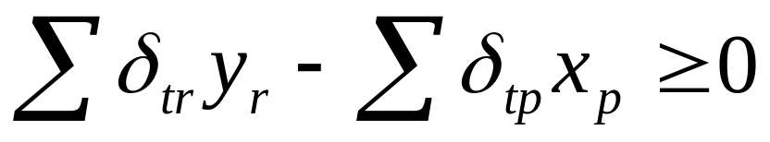
String Based Approach (MRCP)
If y_{r} is the variable for a routing string and x_{p} is the variable for a crew pairing, linking constraint for short connect t is
where δ_{tr} is 1 if routing string r contains short connect t and 0 otherwise, and δ_{pt} is 1 if crew pairing p contains short connect t and 0 otherwise

Slide 22
MRCP Problem
0
Σc_{p}x_{p}
MR
0
0
CP

Slide 23
MRCP Problem Size
Variables:
  One for each routing string
  One for each crew pairing
Constraints:
  Maintenance cover constraints
  Maintenance balance constraints (maintenance stations only)
  Maintenance aircraft count
  Crew cover constraints
  One linking constraint for each short connect

Slide 24
Solving MRCP
Too many columns to enumerate explicitly -- branch-and-price
Column generation:
  Denote by τ_{t} the dual for the linking constraint of short connect t
  Reduced cost of a routing string or a pairing is the same as in the original models, except add τ_{t} for each short connect t included
  Can modify pricing network by adding -τ_{t} to the connection arc representing this turn
TRACTABILITY ISSUES…

Slide 25
Our Objectives
Guarantee maintenance feasibility
Allow the user the flexibility to trade off between solution time and quality
Leverage the fact that only a portion of the maintenance routing decisions are relevant to the crew pairing problem

Slide 26
Approach
In the sequential approach, the crew scheduler is given an MR solution and solves the corresponding CP
We’d like to allow the crew scheduler to choose from a collection of MR solutions the one which contains the most useful set of short connects
Problem: We don’t want to solve one CP for each MR solution
Solution: Extended crew pairing model (ECP)

Slide 27
The Extended Crew Pairing Model (ECP)
In addition to choosing crew pairings, select one maintenance routing solution from a given set of feasible solutions
Add constraints that prohibit pairings containing a short connect from being selected unless the chosen maintenance solution also contains that short connect

Slide 28
Notation
P^{k} is the set of feasible pairings for fleet type k
F^{k} is the set of daily flights assigned to fleet type k
T^{k} is the set of short connects for the flights assigned to fleet type k
S^{k} is the set of feasible MR solutions for the flights assigned to fleet type k

Slide 29
Notation, cont.
δ_{fp} is defined to be 1 if flight f is included in pairing p, else 0
α_{ts} is defined to be 1 if MR solution s includes short connect t, else 0
β_{tp} is defined to be 1 if short connect t is contained in pairing p, else 0
c_{p} is the cost of pairing p

Slide 30
Notation, cont.
y_{s} is a binary decision variable – value 1 indicates that MR solution s is chosen, else 0
x_{p} is a binary decision variable – value 1 indicates that pairing p is chosen, else 0

Slide 31
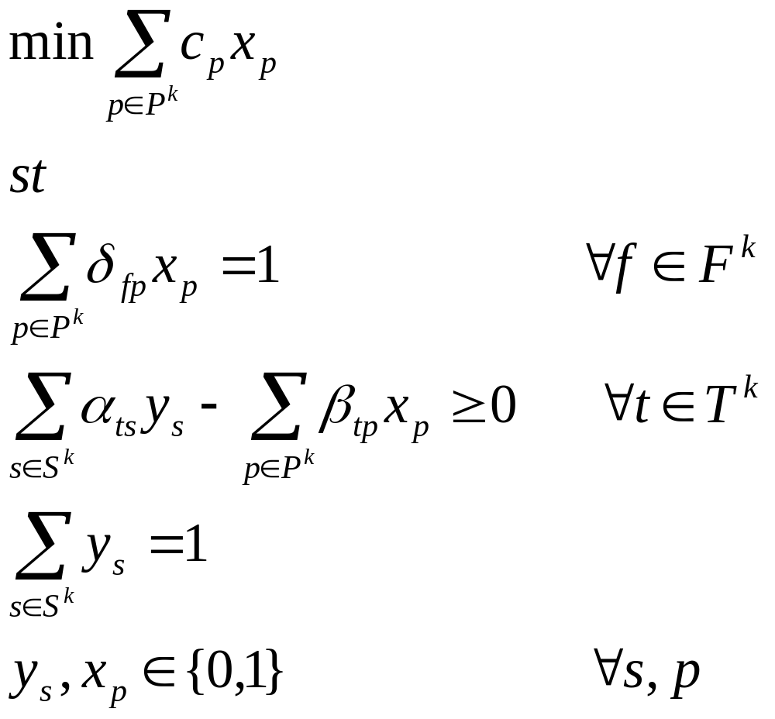
General Formulation
Flights:
short connects:
Convexity:

Slide 32
An Example
Flights:
A B C D E F G H
short connects:
A-B A-C C-D
MR solution (y₁) uses short connects A-C and C-D
MR solution (y₂) uses short connect A-B
Potential pairings:
  A-C-D-F (x₁) - $1
  A-B-E-F (x₂) - $2
  C-D-G-H (x₃) - $4
  B-E-G-H (x₄) - $6
Crew pairing solutions:
  y₁ => pairings 1, 4 -- $7
  y₂ => pairings 2, 3 -- $6

Slide 33
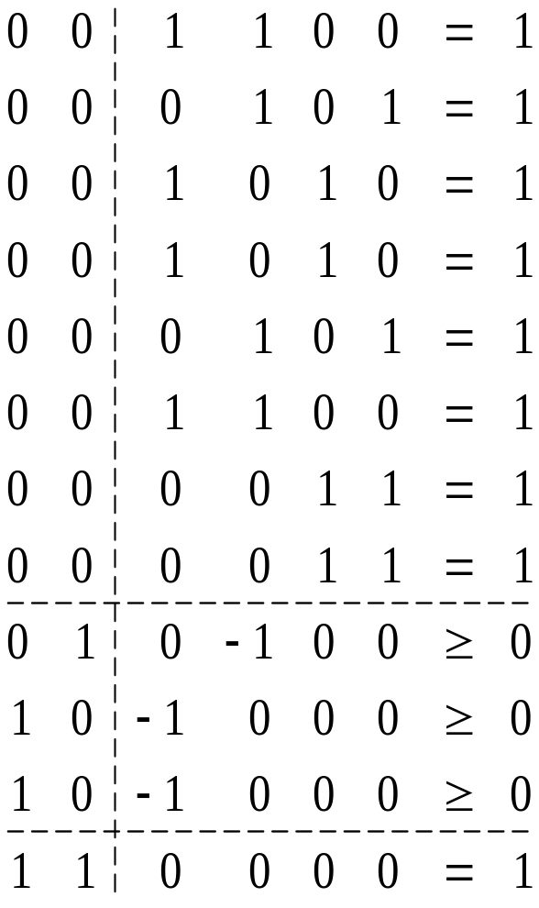
Matrix Representation
y₁ y₂ x₁ x₂ x₃ x₄ rhs
A
B
Flights:
C
D
E
F
G
H
A-B
short connects:
A-D
D-G
Convexity:
Conv.

Slide 34
Solving ECP
Too many columns to enumerate explicitly -- branch-and-price
Column generation:
  Doesn’t change for crew variables:
    Denote by τ_{t} the dual for the linking constraint of short connect t
    Reduced cost of a routing string or a pairing is the same as in the original models, except add τ_{t} for each short connect t included
    Can modify pricing network by adding -τ_{t} to the connection arc representing this turn
  Generating a MR solution variable is the same as solving MR with modified costs
    Minimize negative of duals on short connect connection arcs

Slide 35
Comparison of Models
Time to solve maintenance pricing problems
  MRCP generates routing strings
  ECP generates routing solutions
    Might require generating routing strings!
    Re-optimizing with new objective function; initial column set and known feasible solution

Slide 36
Comparison of Models (cont.)
Size of restricted master problems
  MRCP has one column for each routing string
  ECP has one column for each routing solution -- many more columns?!
    Redundancy
    Dominance
    Example
      14 flights
      104 feasible routing strings
      16 maintenance routing solutions
      11 unique short connect sets
      6 dominant short connect sets

Slide 37
ECP Enhancements
Dramatically reduce the number of MR columns:
  Uniqueness: Eliminate redundant columns
    Example: 41 flights, single set of short connects => >>8,700 solutions => 1 column
  Maximal independence: Eliminate dominated columns
Only need one column per unique, maximally independent, maintenance feasible short connect set
Theoretical bounds and computational observations
  Example: 61 flights => >> 25,000 solutions => 4 required columns

Slide 38
ECP Enhancements, cont.
Relax the integrality of MR columns:
  Same number of binary variables as original CP
LP relaxation of ECP is tighter than LP relaxation of a basic integrated approach

Slide 39
Generating MR Solutions
Algorithm to generate UMI columns -- can generate k UMI columns in at most the time needed to solve k MR problems
Can generate columns using column generation to take advantage of dual information -- pricing problem still yields UMI columns
Can still use existing crew pairing generators

Slide 40
Computational Experiment
Problem A:
Lower bound: 31,396.10
ECP with 16 MR columns: 31,396.10
Optimality gap: 0%
Problem B:
Lower bound: 25,076.60
ECP with 20 MR columns: 25,498.60
Optimality gap: 1.7%

Slide 41
Observations
Zero optimality gap in instance A doesn’t necessarily imply sequential approach would yield an optimal solution – many equivalent crew pairing solutions, some maintenance feasible and some not
Number of short connects in an optimal solution is small relative to total number – UMI sets often capture many of them
  A: 58 max; ~38 per column; 9 used in solution
  B: 68 max; ~37 per column; 10 used in solution

Slide 42
Benefits of ECP
Ensures maintenance feasibility
Can be solved heuristically or to optimality, allowing user to trade off solution time and quality
Leverages the fact that only short connect decisions from the maintenance routing problem impact crew pairing

Slide 43
Benefits of ECP, cont.
No more binary variables than the basic crew pairing model alone
Tighter LP relaxation than a basic integrated approach
Flexible
  Can take advantage of advances in maintenance routing solvers and crew pairing generators
  Can incorporate new maintenance constraints

Slide 44
Conclusions
Crew scheduling is critical to airline profitability but quality can be compromised by making maintenance routing decisions independently
A direct integration can be inflexible and difficult to solve
ECP provides an alternative approach that exploits the fact that only some maintenance routing information is relevant

