Slide 1
Drugs and the Brain
Teaser
Zak Fallows
2013-07-03
http://datb.mit.edu
pharmacology@mit.edu

Slide 2
How the Brain Works
You have about 100 billion brain cells, which are called neurons.
Each neuron has about 1,000 connections, called synapses. (This number is extremely variable.)
Neurons fire action potentials, which are electric signals.
Neurons release chemicals called neurotransmitters, these chemicals carry signals across the synaptic cleft.

Slide 3
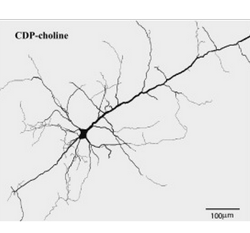
Courtesy of Elsevier, Inc., http://www.sciencedirect.com. Used with permission.
Pyramidal neuron, Golgi stain.

Slide 4
Background: The Synapse

Slide 5
Release
Signal

Slide 6
Receptor binding

Slide 7
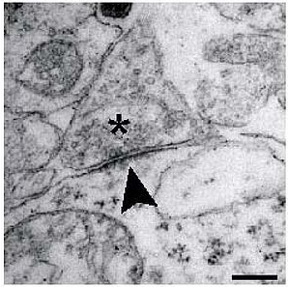
A real synapse!

Slide 8
Vocabulary
Neurotransmitter: A signaling molecule, it crosses the synapse
Hormone: Another type of signaling molecule. The border between neurotransmitter and hormone is blurry, many chemicals are both.
Receptor: A protein that detects a specific chemical, by binding to it
Ligand: A molecule that binds to a receptor

Slide 9
Vocabulary II
Excitatory: Something that increases action potentials (increases neuron firing)
Inhibitory: Something that decreases action potentials
Agonist: A ligand that stimulates a receptor
Antagonist: A ligand that binds to a receptor but does not stimulate it. Antagonists block receptors, and they counteract agonists.

Slide 10
Agonists and Antagonists
Neurotransmitter
Agonist (drug)
Antagonist (drug)

Slide 11
Little quiz
What would each of the following do?:
 | Excitatory receptor | Inhibitory receptor
Agonist
Antagonist

Slide 12
Little quiz
What would each of the following do?:
 | Excitatory receptor | Inhibitory receptor
Agonist | +++ More signal | -- Less signal
Antagonist | -- Less signal | +++ More signal

Slide 13
Example drugs
What would each of the following do?:
 | Excitatory receptor | Inhibitory receptor
Agonist | +++ Nicotine | -- Alcohol
Antagonist | -- Benadryl | +++ Caffeine

Slide 14
Mechanism 1: Receptor Agonist
Here are some famous receptor agonists:
Morphine (also heroin, methadone, OxyContin): These drugs are full agonists at the mu opioid receptor. These drugs cause pain relief, anxiety relief, sedation, nausea, constipation, addiction.
Alcohol: This is a GABA agonist, but it has other mechanisms which are also important.

Slide 15
Mechanism 2: Receptor Antagonist
Here are some famous receptor antagonists, they block receptors:
PCP (also ketamine, dextromethorphan): These drugs are NMDA receptor antagonists. The NMDA receptor is a type of glutamate receptor. These drugs cause convincing and absorbing hallucinations, pain relief, coma, and nausea. These drugs are moderately addictive.

Slide 16
Mechanism 2: Receptor Antagonist
More examples:
Scopolamine (also diphenhydramine, atropine): These drugs block muscarinic acetylcholine receptors. These drugs cause convincing and absorbing hallucinations, memory loss (including retrograde memory loss), dry mouth, rapid heart rate, and dilated pupils. Hallucinogenic doses are extremely dangerous. Diphenhydramine is better known as Benadryl.

Slide 17
Mechanism 2: Receptor Antagonist
More examples:
Caffeine
Antihistamines are histamine antagonists (or inverse agonists)
Antipsychotics are dopamine antagonists (and sometimes also serotonin antagonists)

Slide 18
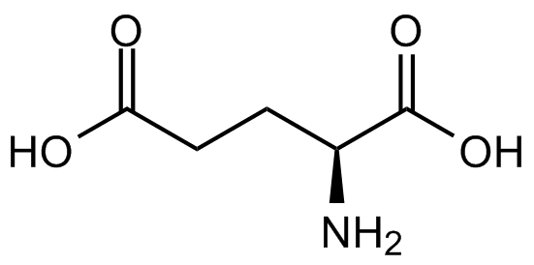
Glutamate (Glu)
Glutamate is the most common excitatory neurotransmitter in the human brain.
Glutamate is about 1,000 times more common than serotonin, dopamine, or norepinephrine.
Glutamate is released by 80% of neurons.

Slide 19
Glutamate Drugs
PCP, ketamine, and dextromethorphan are all glutamate antagonists. They act at the NMDA glutamate receptor.
Memantine (Namenda) is also an NMDA antagonist, it is approved for the treatment of Alzheimer’s disease.
Glutamate agonists tend to cause seizures. This makes sense, because glutamate is excitatory and seizures are caused by excess excitation.

Slide 20
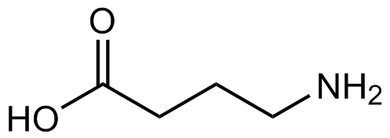
GABA
GABA stands for gamma-aminobutyric acid.
GABA is the most common inhibitory neurotransmitter in the human brain.
GABA agonists cause sleep, anxiety relief, muscle relaxation, and memory impairment.

Slide 21
GABA Drugs
Muscimol: Muscimol is a GABA_{A} agonist found in Amanita muscaria mushrooms. It causes nausea, sedation, and perceptual anomalies.

Slide 22
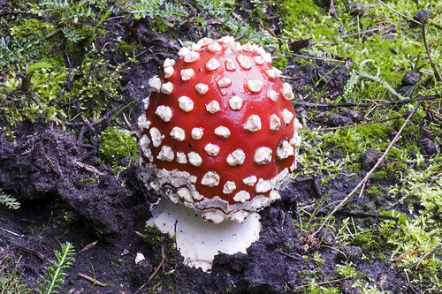
Amanita muscaria mushroom
Image courtesy of Harry-Harms on Flickr. CC-BY-NC-SA

Slide 23
Mechanism 3: Partial Agonist
A partial agonist is like an agonist, but it causes only partial effects. Partial agonists are often safer in overdose than full agonists. Partial agonists may have fewer side effects.
Buprenorphine (brand name Suboxone): This is a mu opioid partial agonist. Like a full agonist (e.g. heroin), it relieves pain and opioid withdrawal. Unlike a full agonist, overdose does not usually cause death.

Slide 24
Mechanism 3: Partial Agonist
More partial agonists:
Psychedelics, such as LSD, psilocybin (in mushrooms), and mescaline (in peyote cactus). Psychedelics are 5-HT_{2A} partial agonists. 5-HT is synonymous with serotonin. Psychedelics cause perceptual distortions and strange thinking. However, unlike certain other hallucinogens, psychedelics do not tend to cause convincing and absorbing hallucinations.

Slide 25
More about Psychedelics
Here is an explanatory example: Psychedelics may make you see a wolf in a patterned carpet. However, psychedelics generally will not allow you to have a conversation with a purple dragon. In contrast, PCP and ketamine can facilitate a conversation with a purple dragon. This is what I call a convincing and absorbing hallucination.

Slide 26
MIT OpenCourseWare
http://ocw.mit.edu
ES.S10 Drugs and the Brain
Spring 2013
For information about citing these materials or our Terms of Use, visit: http://ocw.mit.edu/terms.

