Slide 1
How the Brain Works
Notes:
Welcome
Don’t want to be here?

Slide 2
Background: The Synapse

Slide 3
Release
Signal

Slide 4
Receptor binding

Slide 5
Receptors:
Excitatory: Sends signals (action potentials)
Inhibitory: Blocks signals
Drugs, neurotransmitters, and other ligands:
Agonists: Stimulate receptors, mimic the neurotransmitter
Antagonists: Block receptors

Slide 6
Agonists and Antagonists
Neurotransmitter
Agonist (drug)
Antagonist (drug)

Slide 7
Little quiz
What would each of the following do?:
 | Excitatory receptor | Inhibitory receptor
Agonist
Antagonist

Slide 8
Little quiz
What would each of the following do?:
 | Excitatory receptor | Inhibitory receptor
Agonist | +++ More signal | -- Less signal
Antagonist | -- Less signal | +++ More signal

Slide 9
Example drugs
What would each of the following do?:
 | Excitatory receptor | Inhibitory receptor
Agonist | +++ Nicotine | -- Alcohol
Antagonist | -- Benadryl, Dimetapp | +++ Caffeine

Slide 10
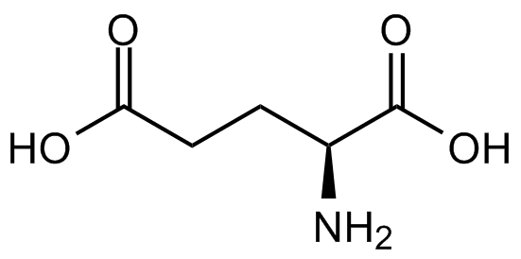
Glutamate
The most common excitatory neurotransmitter Glutamate is releasd by 80% of neurons
Learning
Memory

Slide 11
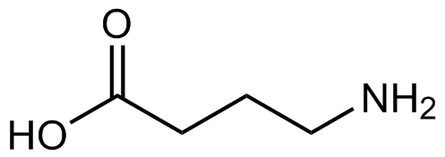
GABA
The most common inhibitory neurotransmitter in the brain
Sleep
Muscle relaxation
Anxiety relief
Impairs memory

Slide 12
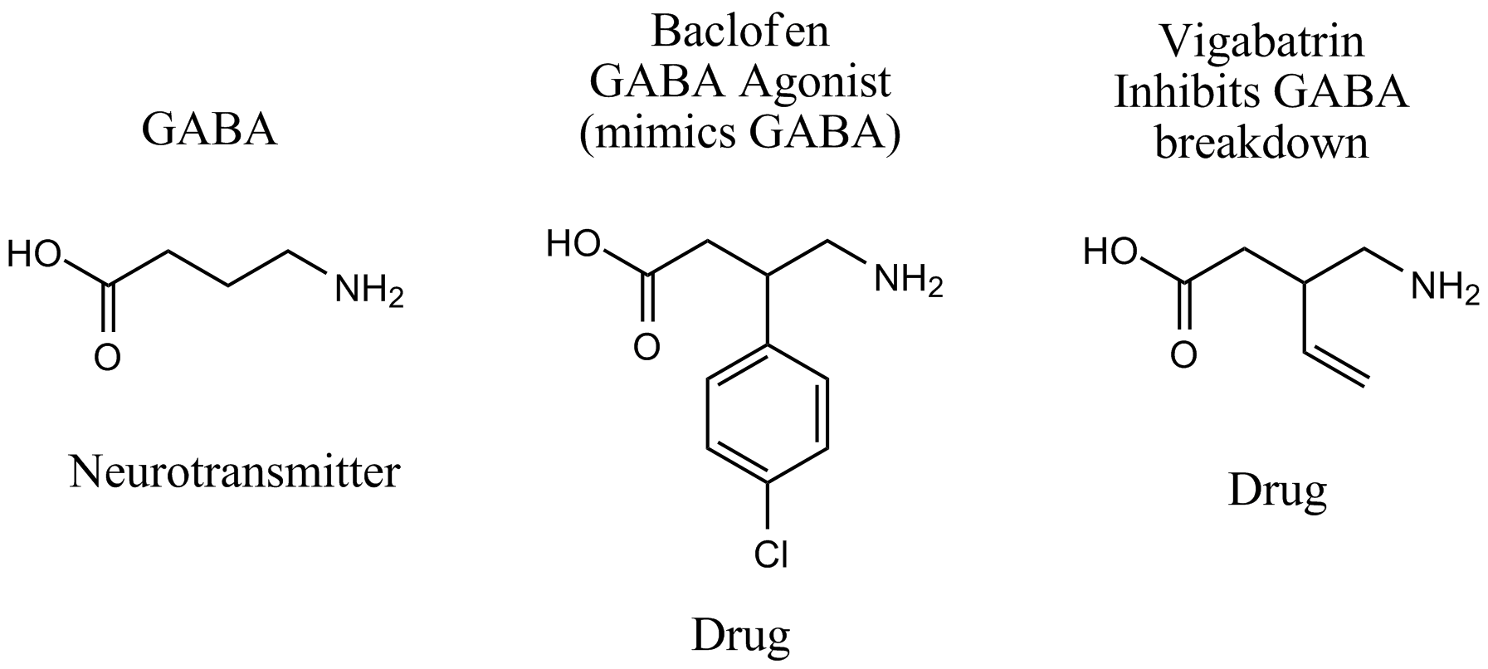
How drugs mimic neurotransmitters: Drugs look like chemicals normally found in your body

Slide 13
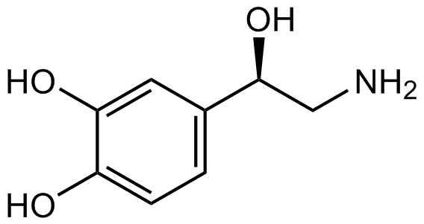
Norepinephrine
Fight or Flight
Increases heart rate
Excitement
Fear

Slide 14
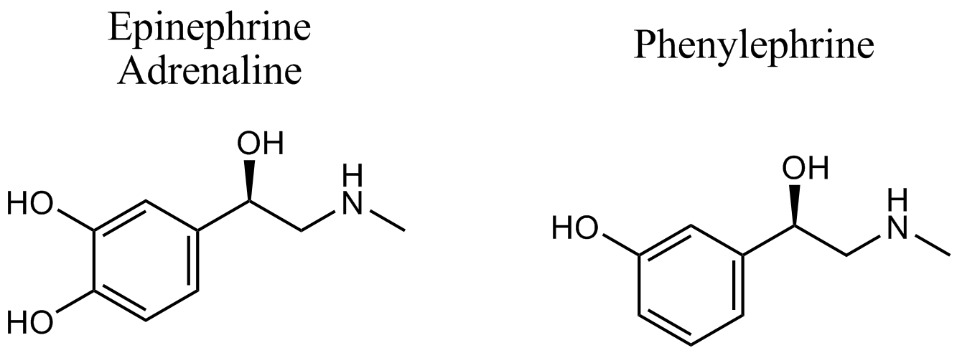
Epinephrine and phenylephrine

Slide 15
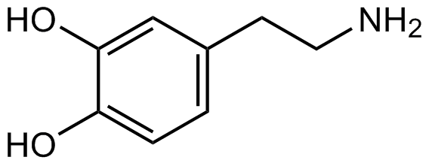
Dopamine
The Salience Neurotransmitter
Rewards sex, eating
Increases alertness, happiness

Slide 16
Addiction
Do more
cocaine
Do cocaine
Damage decision-making
and reward-seeking
parts of brain

Slide 17
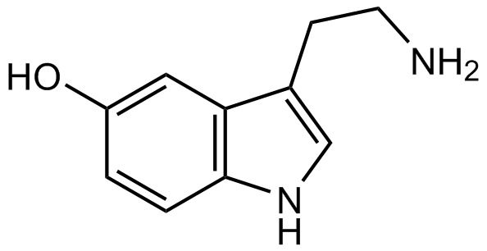
Serotonin (5-HT)
The Satiety Neurotransmitter
Feelings of fullness, contentment
Relieves depression

Slide 18
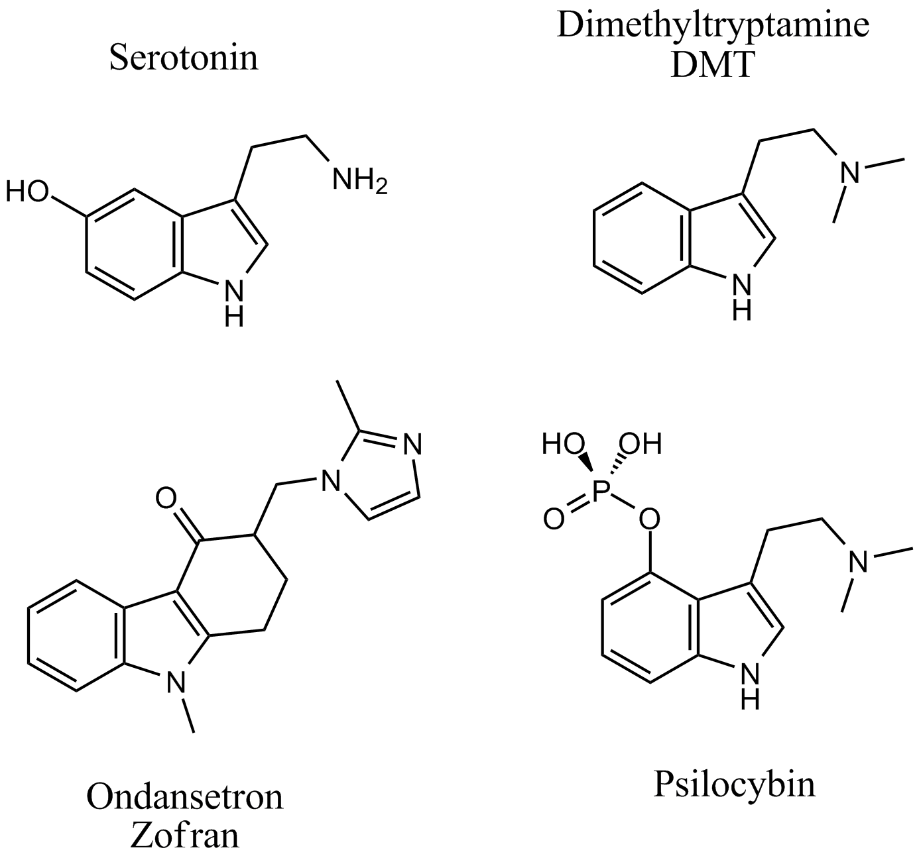
Serotonergic drugs I

Slide 19
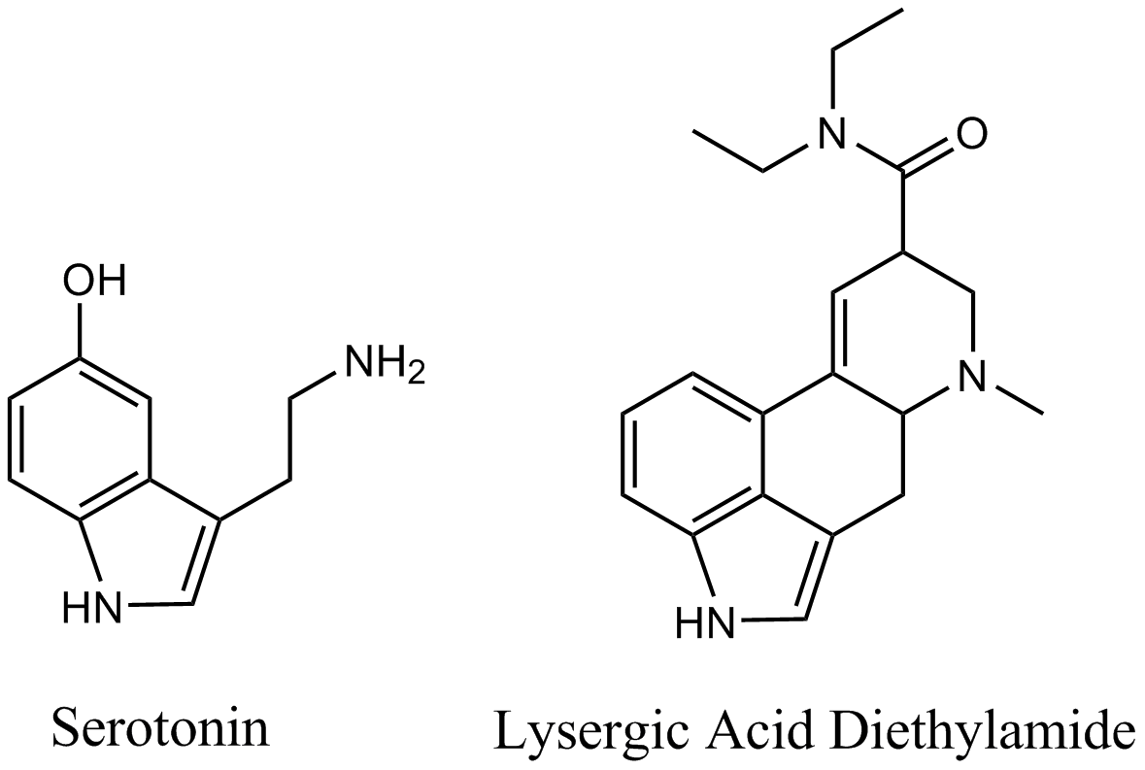
Serotonergic drugs II

Slide 20
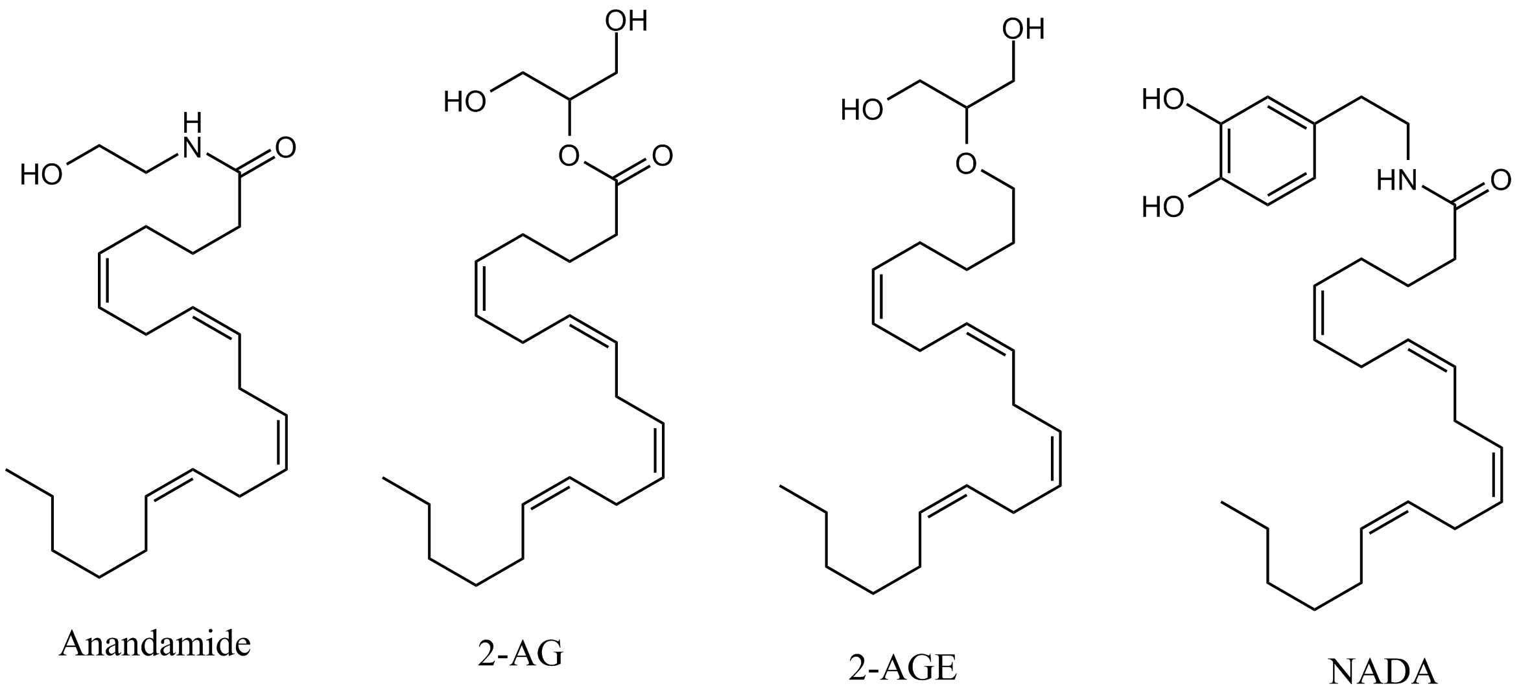
Cannabinoids
Marijuana mimics these molecules in the brain

Slide 21
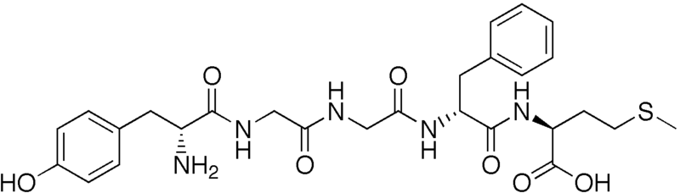
Opioids
Morphine mimics these
Relieve pain and worry
Induce sleep
Slow digestive tract

Slide 22
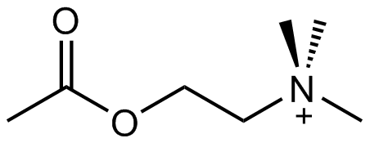
Acetylcholine (ACh)
Nicotine mimics this
Alertness
Memory
Moves muscles
Causes secretions (saliva, sweat)

Slide 23
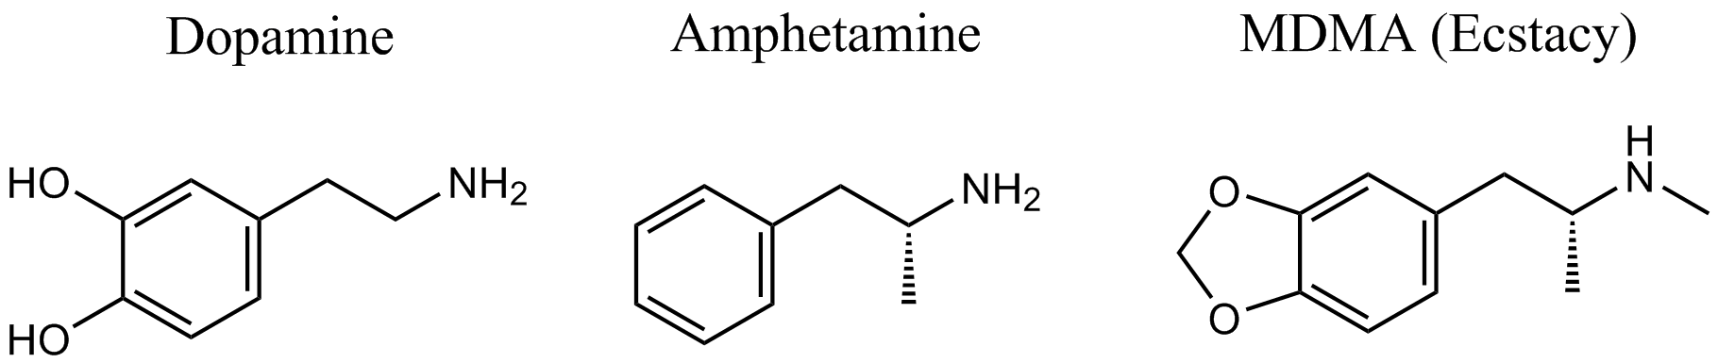
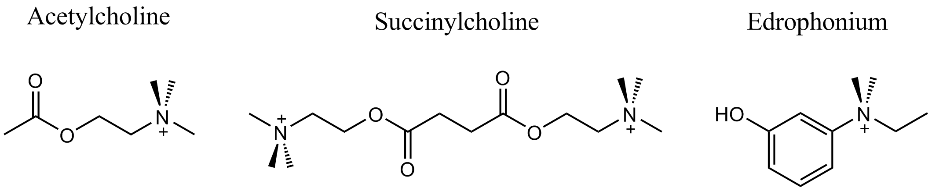
Dopaminergic and cholinergic drugs

Slide 24
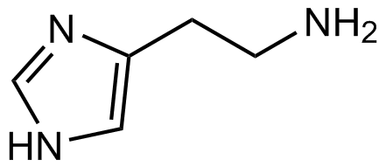
Histamine
Alertness
Itchiness
Rashes
Causes stomach acid secretion

Slide 25
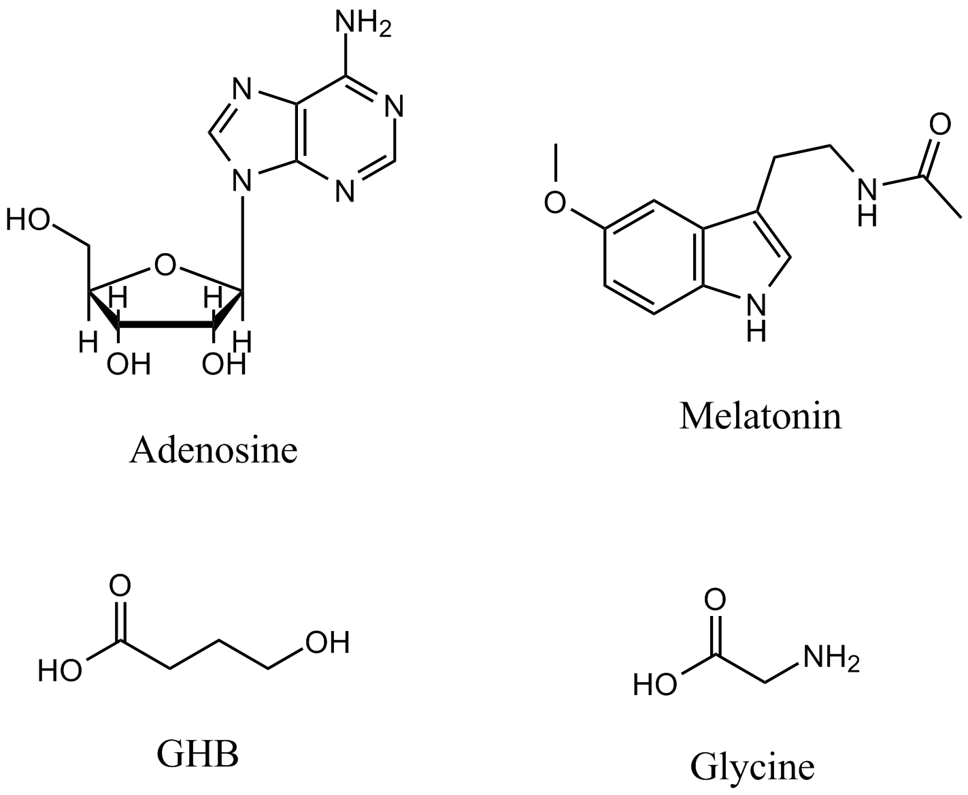
Other small neurotransmitters

Slide 26
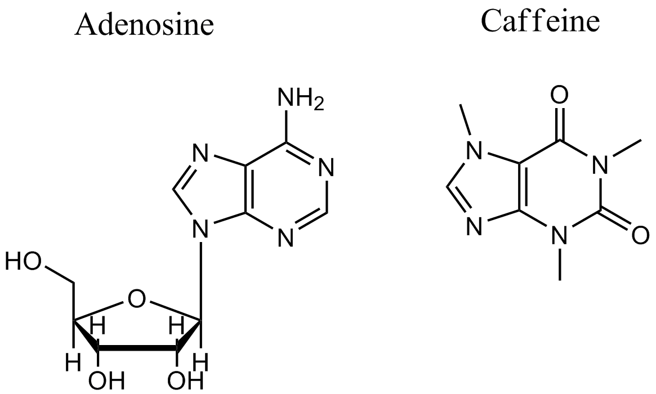
Adenosine and caffeine

Slide 27
MIT OpenCourseWare
http://ocw.mit.edu
ES.S10 Drugs and the Brain
Spring 2013
For information about citing these materials or our Terms of Use, visit: http://ocw.mit.edu/terms.

