Slide 1

Capstone Project – I: Review – 2 on To develop a portal for silk farming information
Presented by the Batch No. : 06
MANJUNATH ACHARI V N BU21CSEN0600130
K VAMSI BU21CSEN0600093
C YOGA NANDA BU21CSEN0600120
K SRINIVASULU BU21CSEN0600095
Under the Guidance of
Dr Dayananda Lal N
Assistant Professor
Department of Artificial Intelligence and Data Science
GITAM School of Technology, GITAM (Deemed to be University),
Bengaluru, Karnataka, INDIA.

Slide 2
Incorporation of suggestion by review panel in Review-1
Sl No. | Suggestions | Incorporation of suggestion (Yes/No)
1 | Add language translator | yes
2 | Include more content and also said the chat bot | yes

Slide 3
CONTENTS
Abstract
Gantt Chart
Introduction
Literature Survey
Problem Statement
Objectives
Requirement Analysis
Identification of tools/technology/algorithms
Final Design Strategy (project workflow/ system design/ DFD/UML design)
Implementation details (Packages/Libraries, Classes, Methods and Datasets only)
Testing
Results
Conclusion
PO’s Attainment
References

Slide 4
Abstract
Silk cocoon rearing is an essential process in the silk industry, yet many farmers face challenges due to limited access to the information.
This project aims to develop a user-friendly website designed specifically for silk cocoon rearing farmers, providing them with up-to-date matter and accurate information to improve their farming practices.
The website will useful for what are the measures to follow in cocoon rearing techniques, pest and disease control, environmental and market insights.
Additionally, it will feature sections for weather updates, government schemes, and a community forum where farmers can exchange knowledge and solutions.
The website will helpful for silk farmers in reduce risks, and increase profitability in silk farming.

Slide 5
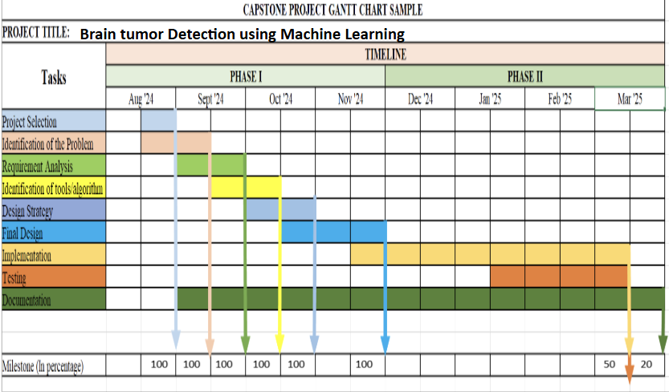
Gantt Chart
To develop a portal for silk farming formation

Slide 6
Introduction
Definition:
Silk farming, also called sericulture, involves the cultivation of silkworms for the production of silk threads, a natural protein fiber used in textiles.
Historical Origins:
Originated in ancient China over 5,000 years ago during the Neolithic Age.
According to legend, silk was discovered by Empress Xi Ling Shi when a cocoon fell into her tea, unraveling into a long, delicate thread.
Global Spread:
The art and techniques of sericulture gradually spread to Korea, Japan, India, and eventually Europe via the Silk Road.
Today, silk farming is practiced in over 60 countries, with India and China being the largest producers.
Economic Importance:
Contributes significantly to the rural economy, particularly in countries like India, where it is an important source of income for small-scale farmers.
Challenges:
Sericulture faces challenges such as pest outbreaks, fluctuating market prices, and climate sensitivity.
Governments and research organizations play a vital role in promoting disease management and weather adaptation strategies.

Slide 7
Literature Survey
Table 1: Literature Survey
S. No. | Paper Details | Summary | Techniques/Algorithms Used | Research Gap
1. | Expansion of sericulture in India using geospatial tools and web | The article describes a project that used geospatial tools and web technology to identify potential areas for expanding sericulture (silk production) in India. The outcomes included identifying additional areas suitable for mulberry cultivation and developing a web portal to provide information on potential areas and sericulture for these districts. | HTML( Hyper Tech Makup Language CSS(Cascading Style Sheets. JAVASCRIPT | UX UI Design Artificial intelligence Machine learning DBMS(Database Management System)

Slide 8
Literature Survey…contd
Table 2: Literature Survey
S. No. | Paper Details | Summary | Techniques/Algorithms Used | Research Gap
2. | A comprehensive view of the web-resources related to sericulture | The survey uses sequencing technologies, bioinformatics tools, and online databases to study silkworms and related organisms in sericulture. Citation analysis evaluates the impact of these resources on research. Additionally, a web portal, "SeriPort," was developed to index these databases for easier access. | Sequencing Data Analysis Machine learning Phylogenetic analysis | Limited Integration of Databases Real-time Data Analysis Tools Data Science Tools like Data Visualization, Data Processing and Analysis Tools

Slide 9
Literature Survey…contd
Table 3: Literature Survey
S. No. | Paper Details | Summary | Techniques/Algorithms Used | Research Gap
3. | Mapping of potential areas for sericulture development and information dissemination through silks webportal | The paper utilizes geospatial technologies like Remote Sensing (RS) and GIS to map potential areas for expanding sericulture in India. It assesses land suitability based on soil, water, and landscape characteristics. The study also introduces the SILKS geoportal | Remote Sensing (RS) Geographical Information System Universal Soil Loss Equation (USLE) | Limited Integration of Databases Lack of Global Accessibility Real-time Data Analysis Tools FAO Limitation Criteria

Slide 10
Problem Statement
Silk farmers face some challenges to get timely and accurate information about proper silk farming practices. This lack of knowledge can cause inefficiencies, lower production, and reduced income.
The silk farming industry does not have a single platform where farmers can find all the information they need, such as
Cocoon rearing methods,
Market prices
News updates(Govt schemes,others)
Disease prevention tips
Weather updates
This project aims to create a simple website that gives farmers useful resources and real-time updates to improve their productivity and earnings.

Slide 11
Objectives
To create an online platform that provides essential information on silk farming, designed to the needs of cocoon rearing farmers.
To empower farmers with knowledge about various aspects of silk farming, including cocoon rearing techniques, disease management, market trends, and government policies.
To facilitate knowledge sharing and networking among farmers through online forums and communities.

Slide 12
Requirement Analysis
Requirement Analysis:
User Needs: Farmers require up-to-date information on silk farming processes, disease management, and market trends.
System Requirements:
A web platform that can be accessed via mobile phones.
Integration with weather and market APIs(manual).
Multilingual support for different regions.

Slide 13
Identification of tools/technology/algorithms
Frontend development
HTML, CSS, JavaScript
APIs:
Weather API.
Silk market price API (if available) or manual updates
Website details
https://ecofriendlysilkfarmportal.on.drv.tw/www.silkfarm.com/mysilkfarm/main.html

Slide 14
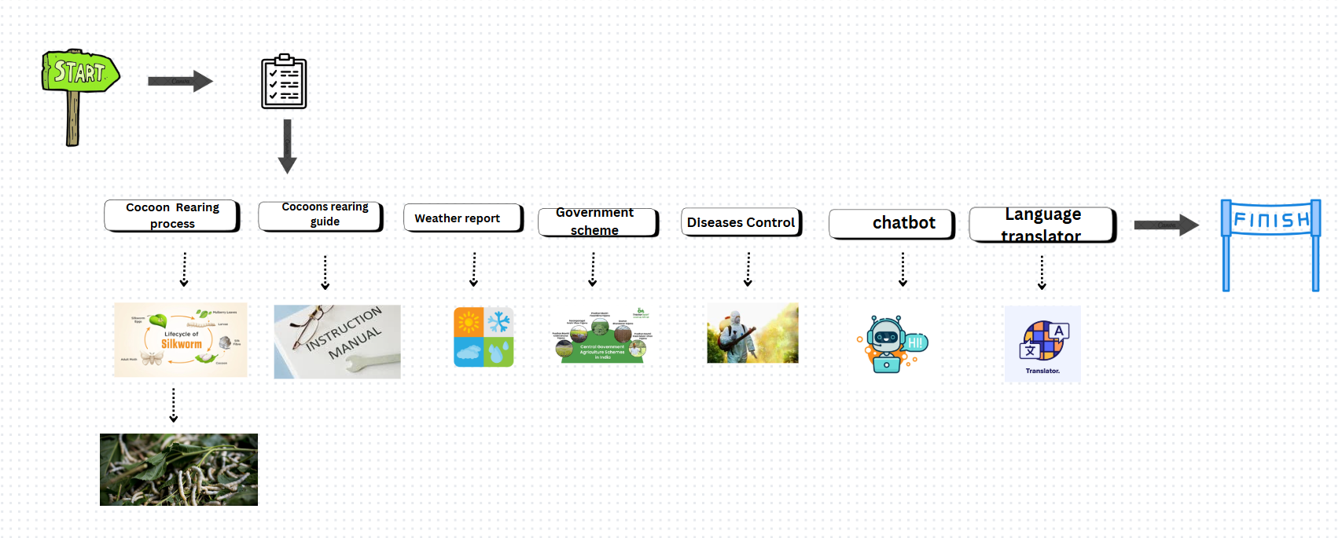

Final Design Strategy

Slide 15
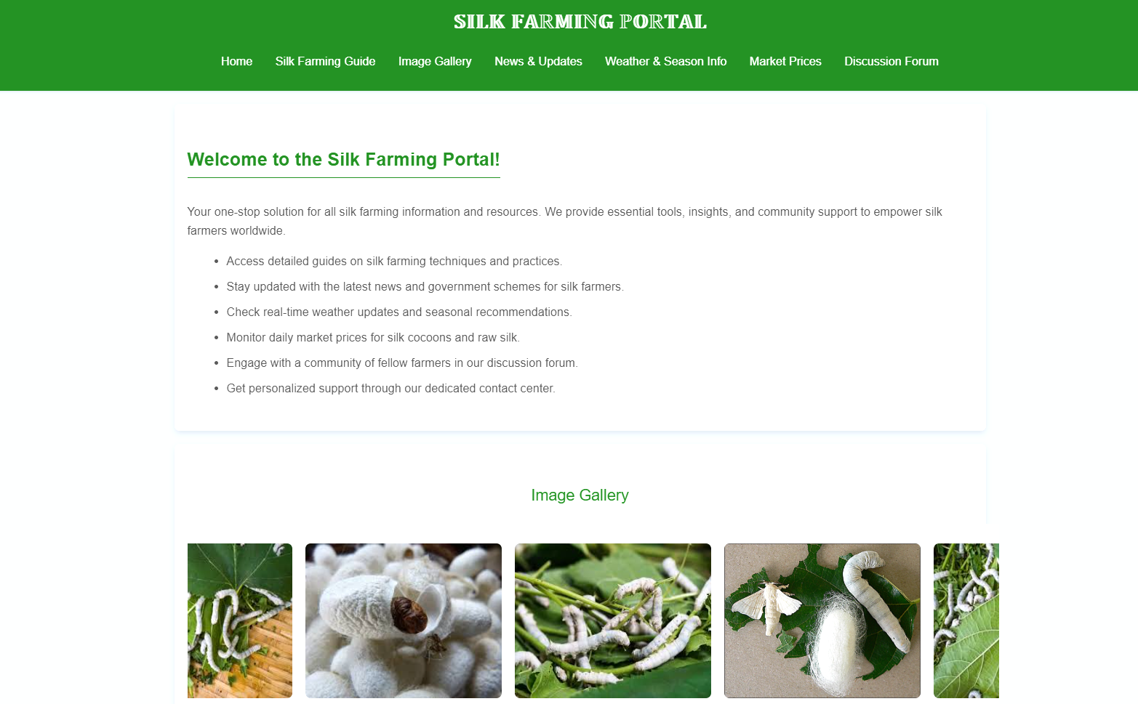
Status of Implementation

Slide 16
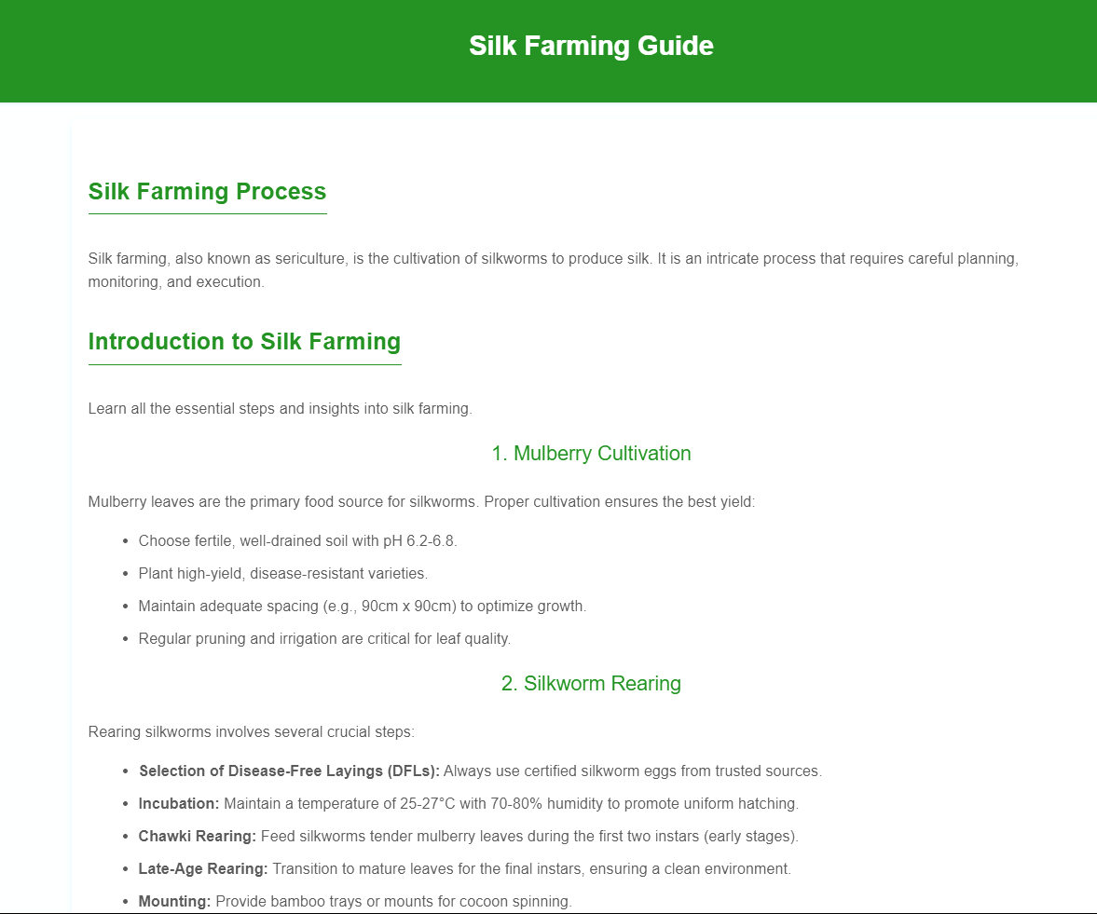
Status of Implementation

Slide 17
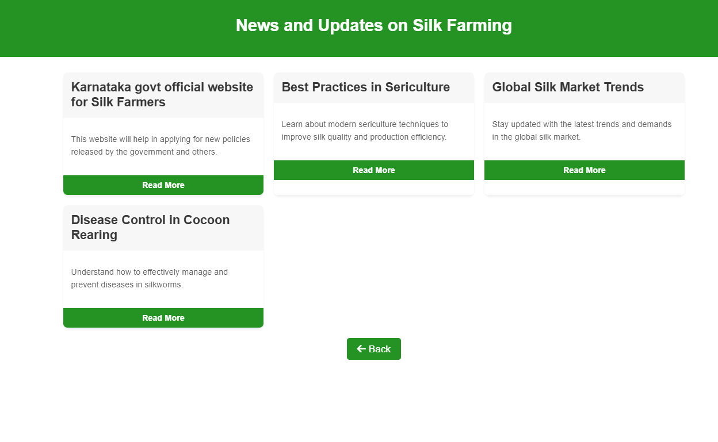
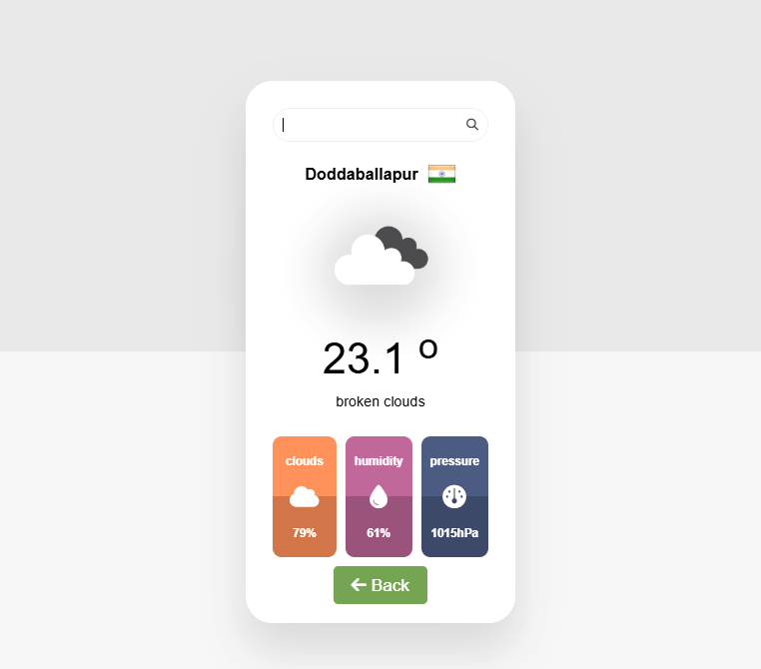
Status of Implementation

Slide 18
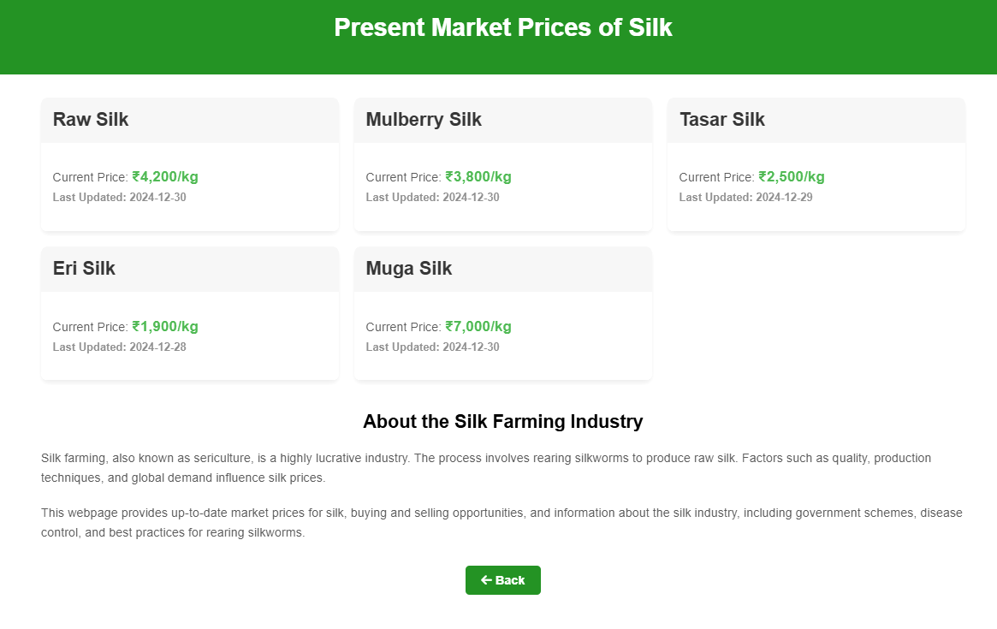
Status of Implementation

Slide 19

Status of Implementation

Slide 20
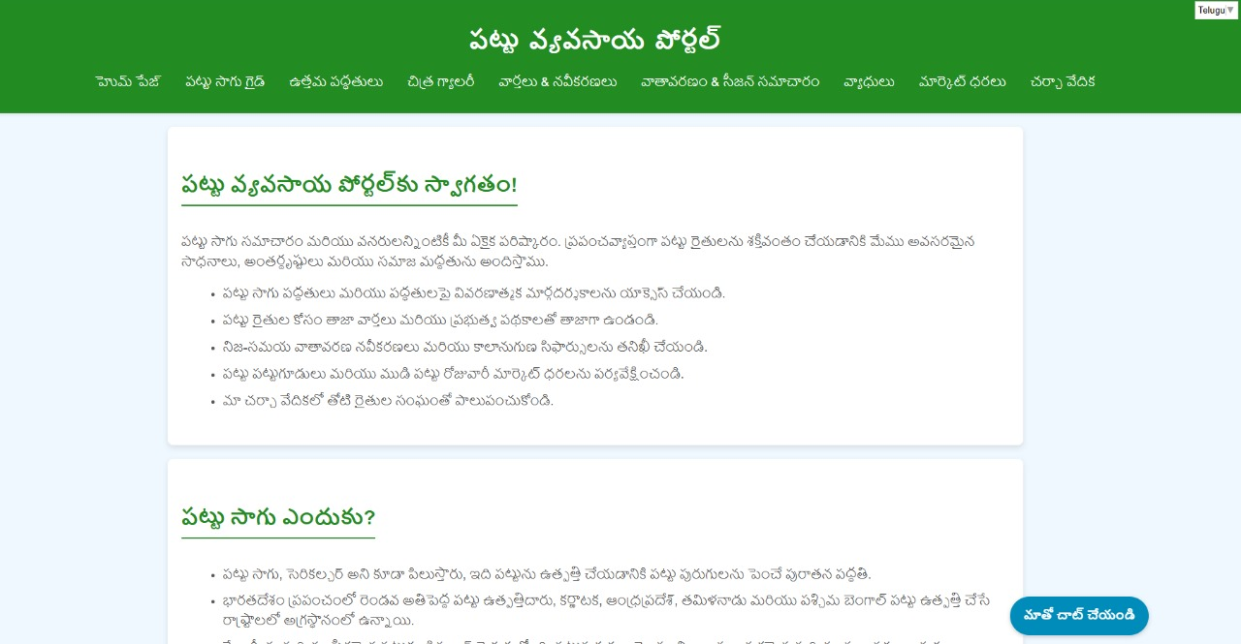
Status of Implementation

Slide 21
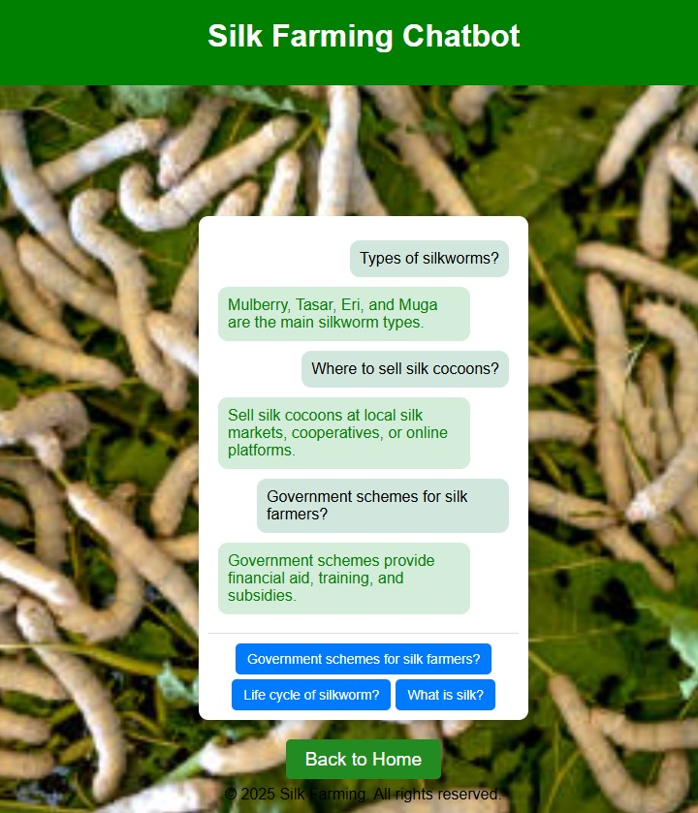
Status of Implementation

Slide 22
Testing
1. Presentation Checks
Slide titles are clear
Consistent font and formatting.
Readable background and text contrast..
2. Content Accuracy
Objectives align with the project goals.
Requirement analysis and tools are relevant.
Conclusion summarizes key points.
3. Formatting & Visuals
Clear images, diagrams, and tables.
No overcrowding of content.
4. Technical Testing
Hyperlinks (if any) work correctly.
Charts and diagrams are labeled.
Gantt chart correctly represents timeline.
5. Final Review
References checked.
Implementation details verified.
Conclusion connects to objectives.

Slide 23
Result

Slide 24
Conclusion
Creating a website for silk cocoon farmers will help modernize the silk farming
industry. This platform will provide farmers with important information like the
best ways to raise silkworms, control pests, manage the environment, and
understand market trends. By using the website, farmers will be able to produce
better yields, reduce risks, and increase profits.
In the long run, this website will help farmers, especially those who have had
limited access to information before. It will improve their ability to compete
in the industry and ensure that silk farming remains successful and sustainable
in the future.

Slide 25
Program Outcomes (POs)
Better Knowledge – Farmers access key silk farming insights.
Higher Productivity – Improved techniques boost yield.
Real-time Updates – Market & weather info aids decisions.
Farmer Networking – Knowledge sharing through forums.
Tech Adoption – Promotes digital tools in farming.
Increased Profitability – Reduces risks, boosts income.

Slide 26
PO’s Attainment:
Title of the Project: To develop a portal for silk farming information
Program Outcomes |  |  |  |  |  |  |  |  |  |  |  | Program Specific Outcomes
PO1 | PO2 | PO3 | PO4 | PO5 | PO6 | PO7 | PO8 | PO9 | PO10 | PO11 | PO12 | PSO1 | PSO2 | PSO3
Note: Guide need to tick (√) corresponding PO’s and PSO’s with respect to the project.

Slide 27
References
Journals
1... NRSC, Manual-National Land Use Land Cover Mapping using Multi-temporal Satellite Data, Land Use Division, National Remote Sensing Agency, Hyderabad, 2006.
NRSC, Wasteland Atlas of India, National Remote Sensing Agen cy, Hyderabad, 2011, pp. 4-14
2. . Xu,H. and O’brochta,D.A. (2015) Advanced technologies for genetically manipulating the silkworm Bombyx mori, a model Lepidopteran insect. Proc. R. Soc. B, 282, 20150487.
Putri,S.P., Yamamoto,S., Tsugawa,H. et al. (2013) Current metabolomics: technological advances. J. Biosci. Bioeng., 116, 9–16
. Knief,C. (2014) Analysis of plant microbe interactions in the era of next generation sequencing technologies. Front. Plant Sci., 5, 216

Slide 28
References
3..CSB (1994), Manual of satellite remote sensing applications for sericulture development, Central Silk Board, Bangalore. FAO (1976). A Framework for Land Evaluation. Soil Bulletin, 32. Food and Agriculture Organization. United Nations. Rome, Italy.
NRSC (2006), Manual- National Land Use Land Cover mapping using multi-temporal satellite data, Land Use Division, National Remote Sensing Agency, Hyderabad.
NRSC (2011), Wasteland Atlas of India, National Remote Sensing Agency, Hyderabad.
Patel, N.R., Mandal, U.K. and Pande, L.M. (2000), Agro-ecological Zoning system. A Remote Sensing and GIS Perspective. Journal of Agrometeorology, 2(1), 1-13

