Slide 1
Reciept and Invoice Digitizer
Team-C
Team members:
Snehitha
Pranavi
Manjunath
Gnana Pravallika
Gayatri

Slide 2
Abstract
The Receipt & Invoice Digitizer is a digital platform designed to simplify the management of financial receipts and invoices through automation and intelligent processing. In everyday business and personal finance, large volumes of paper and digital bills are generated, making manual organization difficult, time-consuming, and prone to errors. This project aims to provide a unified system where users can securely access, manage, and process their receipts in a structured manner.
The application provides a user-friendly interface consisting of authentication and dashboard modules that enable users to register, log in, and navigate the system efficiently. The platform is designed with a modular architecture so that advanced features such as document upload, Optical Character Recognition (OCR), and AI-based data extraction can be seamlessly integrated. Emphasis is placed on responsive design, input validation, and smooth user experience to ensure accessibility across devices.
By automating receipt handling and enabling digital record maintenance, MydigiBill reduces manual effort, improves accuracy, and supports better financial tracking. The project lays the foundation for future enhancements including intelligent expense categorization, analytics, and secure storage, ultimately helping users transition from paper-based billing to an organized digital ecosystem.

Slide 3
Tasks for This Milestone
• Designed and implemented User Registration Page with form validation for email, password strength, and mandatory fields • Developed Login Page with proper error handling and credential verification • Implemented Password Hashing using secure cryptographic algorithms to store credentials safely • Implemented Google OAuth Authentication using Google Cloud Console and OAuth 2.0 API • Configured OAuth Client ID, redirect URIs, and consent screen for “Login with Google” feature • Created a basic Dashboard Interface accessible only after successful authentication

Slide 4
Tech stack
Frontend: • HTML5 • CSS3 • JavaScript
Backend: • Flask (Python)
Database: • MySQL
Authentication & Security: • Password Hashing (bcrypt) • JSON Web Tokens (JWT) • Google OAuth 2.0
Tools & Platforms: • Google Cloud Console • Git & GitHub • VS Code

Slide 5
JWT Authentication
• Used for secure, stateless session management • Generated after successful login • Contains user identity (payload) • Sent with every protected request • Verified before granting dashboard access
Benefit: Secure and scalable authentication

Slide 6
Login Page
• Email & password input • Client-side validation • Hashed password verification • JWT generated on success • Google OAuth login option
Outcome: Only authenticated users access dashboard

Slide 7
Register Page
• Name, email, password fields • Password strength validation • Duplicate email check • Password hashing before storage
Outcome: Secure user account creation

Slide 8
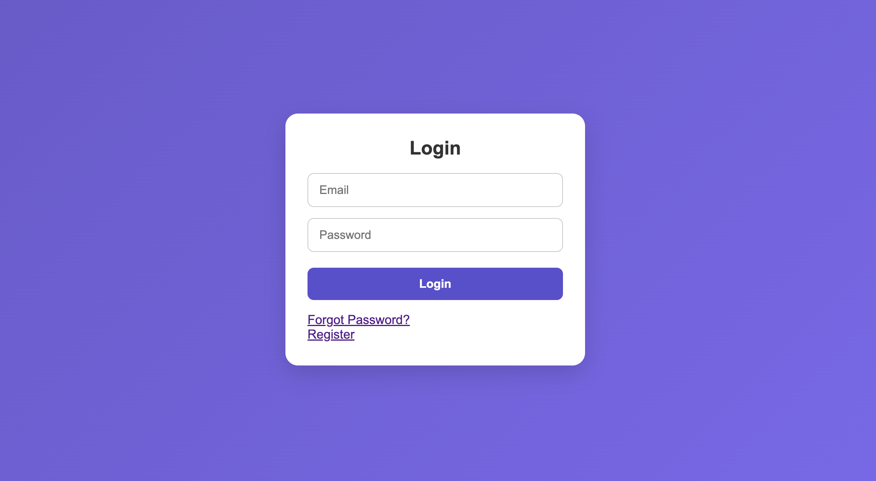
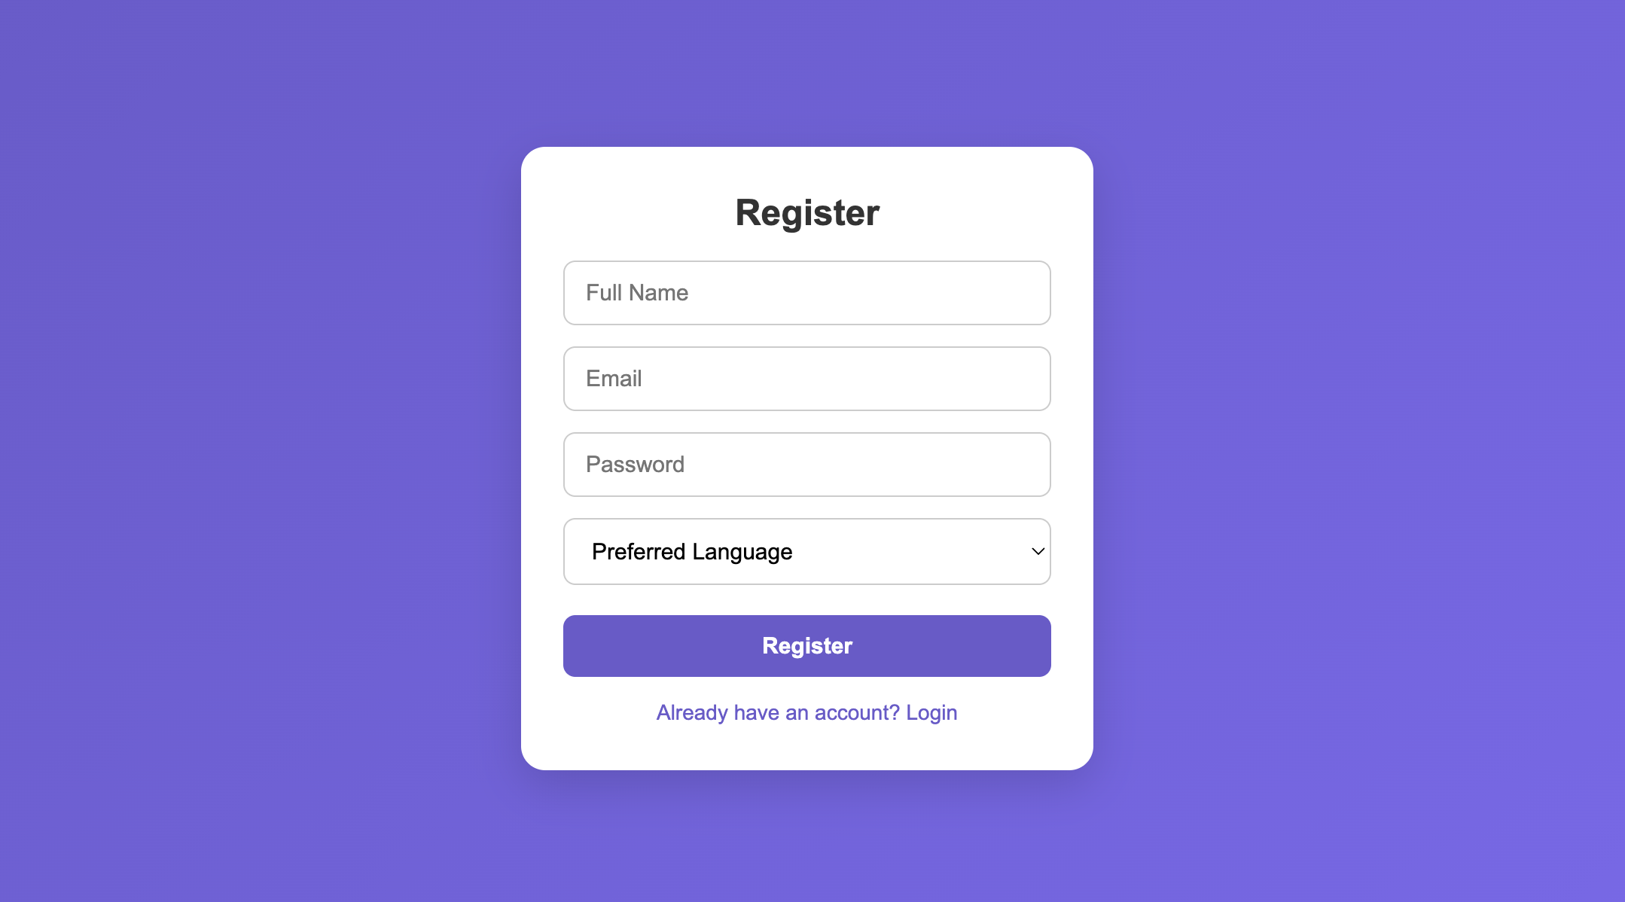
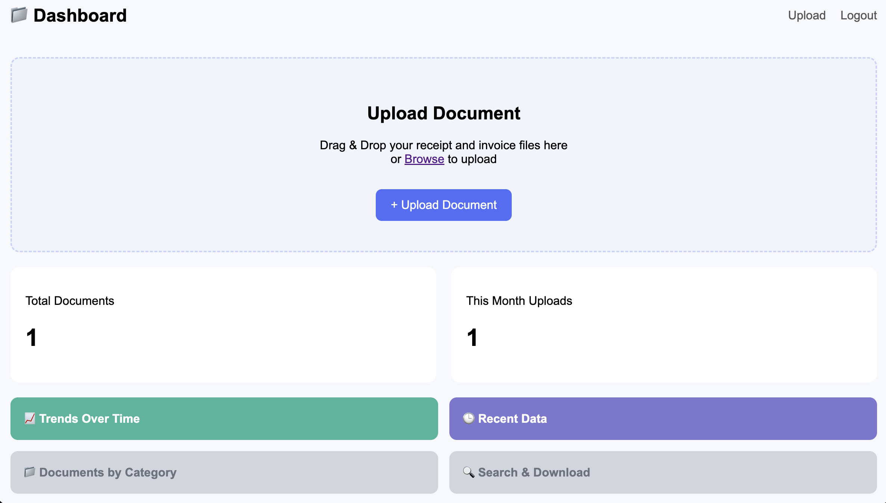
OUTPUT SCREENS

Slide 9
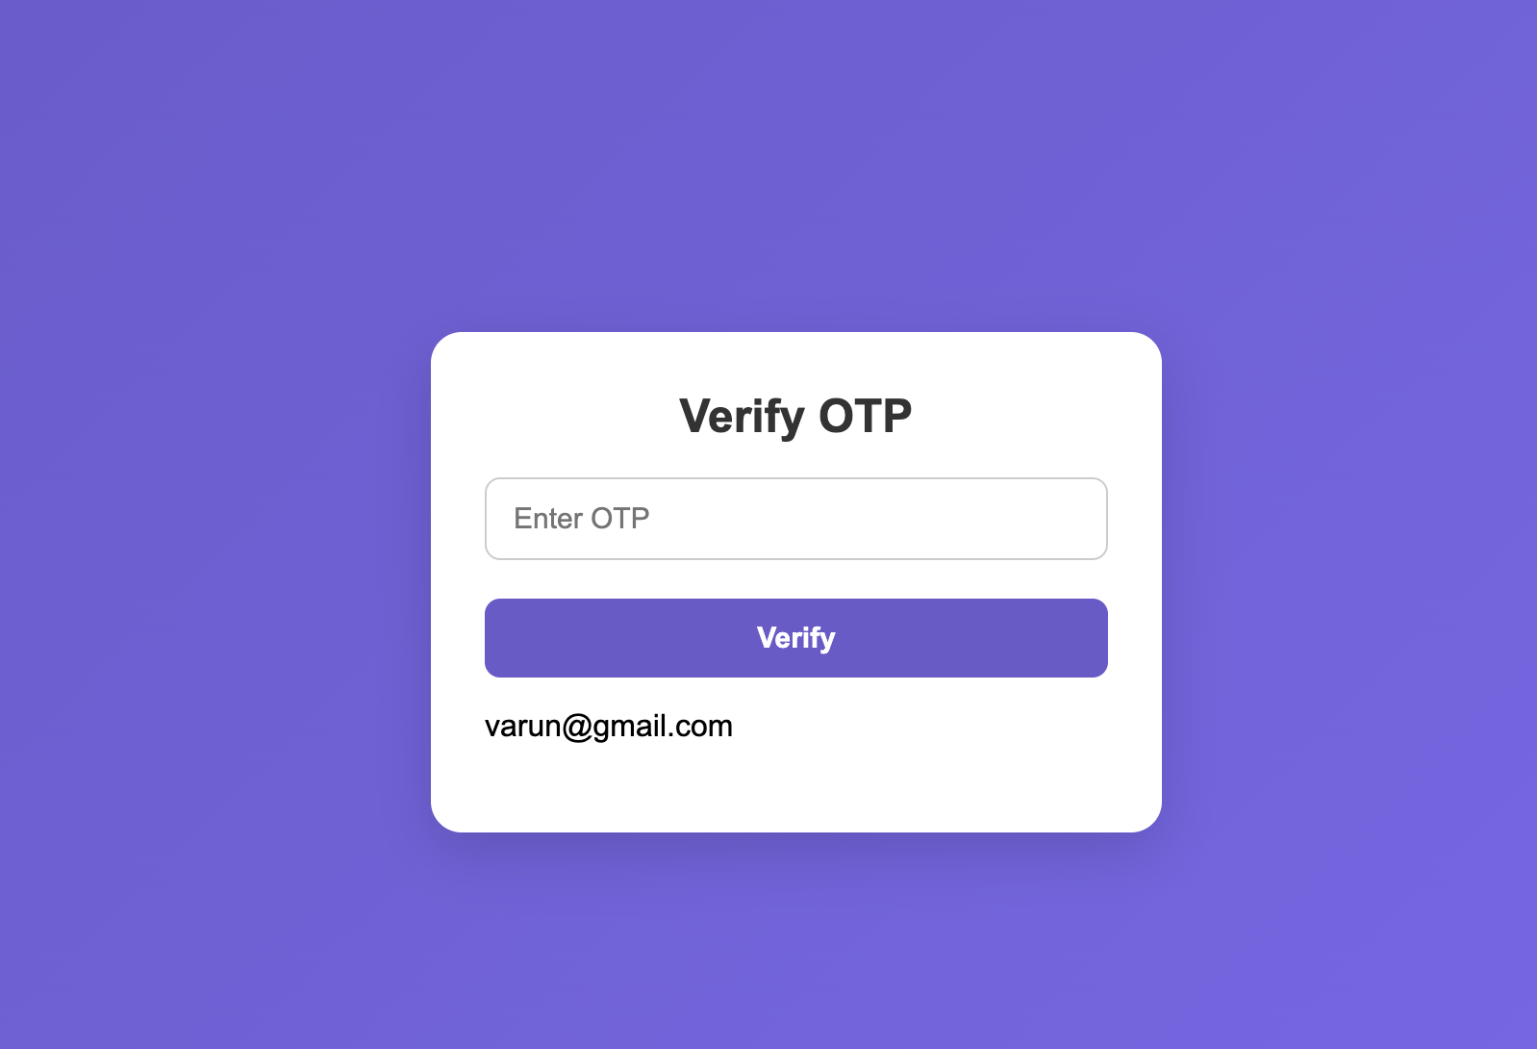
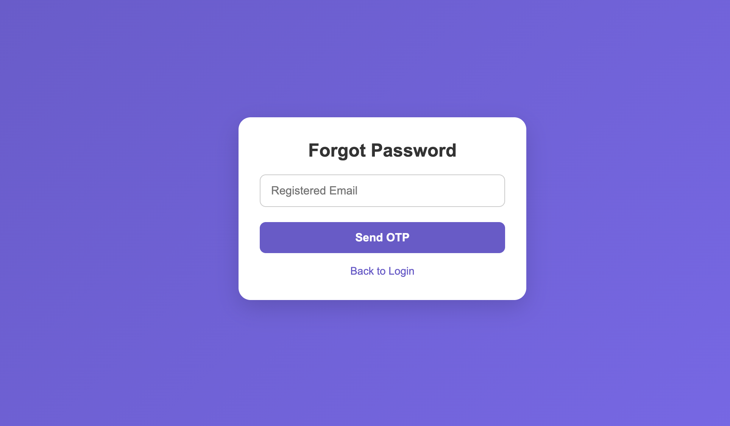
OUTPUT SCREENS

Slide 10
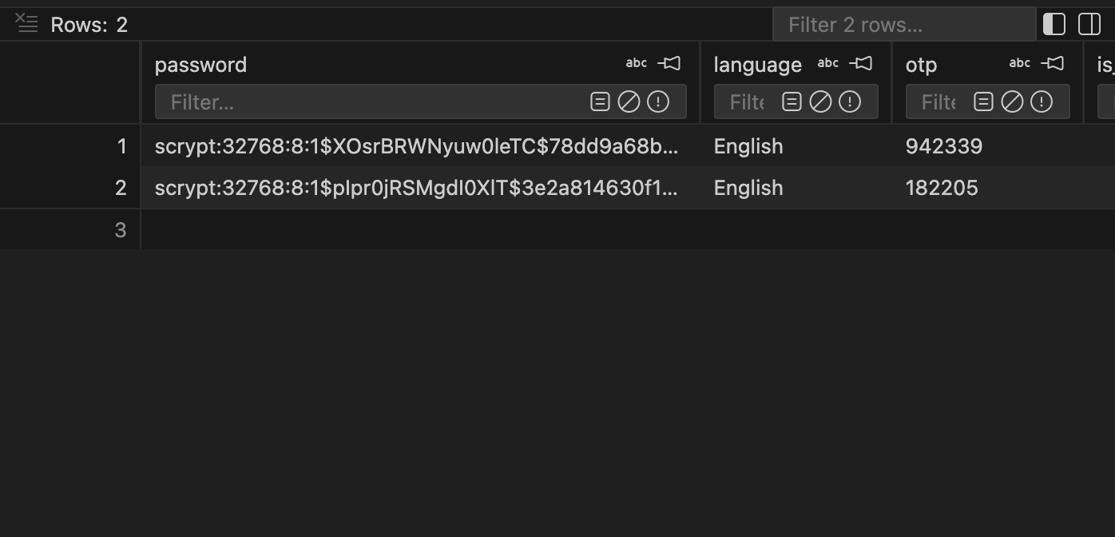
OUTPUT SCREENS

Slide 11
Future Enhancements
• Implement AI-Based Field Extraction (Store Name, Date, Total, Tax, Items) • Develop Intelligent Expense Categorization using LLM models • Add Multi-Page PDF Processing Support • Improve OCR Accuracy using Deep Learning-based OCR engines • Implement Confidence Scoring & Auto-Correction Mechanism • Build Structured Database Storage for Extracted Data • Develop Expense Analytics Dashboard & Visualization • Add Receipt Search using Semantic Embeddings • Enable Cloud Deployment & Scalable Storage • Develop Mobile Application Integration

Slide 12
FUTURE IMPROVEMENTS
Features be added:
1.Documents by Category #bar graph based on vendors
2.Search and download #based on vendors upload moth,year
3.Location of the uploaded document #using geo location
4.Pie chart
5.Error handling in uploading document
6.Manually edit after extracted data

Slide 13
Conclusion
Milestone-1 successfully establishes the frontend foundation of the application.
The project implements a responsive and user-friendly Login and Registration system
with proper input validation and error handling. Secure authentication mechanisms were integrated using password hashing and JSON Web Tokens (JWT) to ensure protected user access.
Google OAuth 2.0 authentication was also configured to enable third-party secure login functionality. Upon successful authentication, users are redirected to a structured dashboard interface.
This milestone ensures secure user authentication, clean UI design, and a scalable frontend architecture, forming the base for integrating advanced backend features and
AI-driven receipt processing in future milestones.

Slide 14
THANK YOU
TEAM C

