Slide 1
Welcome
2

Slide 2
10/01/09
MINI PROJECT
Bandwidth Monitor &
Traffic Reporter
1

Slide 3
Problem Statement
To develop a software to monitor the bandwidth of real time upload and download rates and generating trafic reports to user.
2

Slide 4
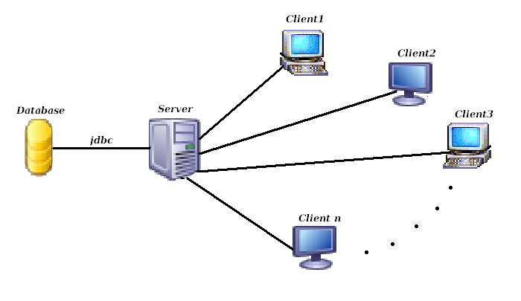
SYSTEM DESIGN

Slide 5
SYSTEM DESIGN CONTINUED…
Client program will be running on all machines which act as client.
Server program will be running on single server machine.
Clients perform upload, download operations.
Client program sends upload, download statistics to server along with IP address.
Server stores the statistic of all clients along with their IP addresses.

Slide 6
SYSTEM DESIGN CONTINUED…
Generates daily traffic report and stores in database.
Generates the graph of bandwidth usage.
Generates daily report, and report between two days based on users choice and displays it.

Slide 7
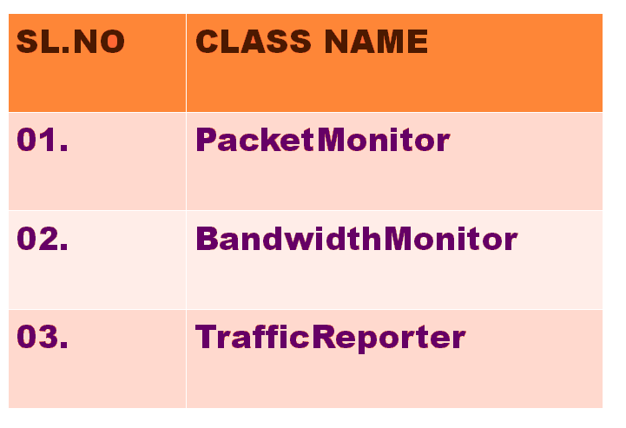
LIST OF MAIN CLASSES

Slide 8
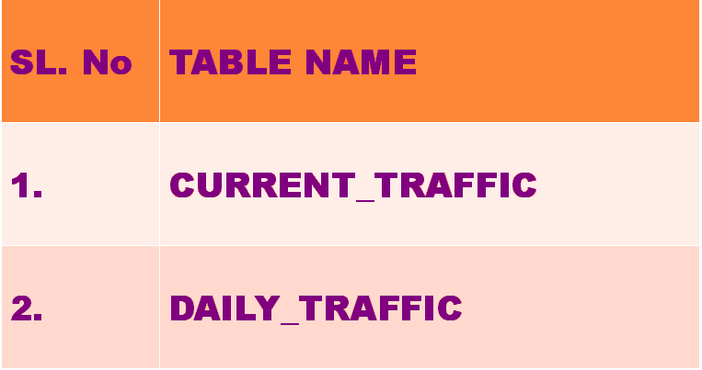
LIST OF TABLES

Slide 9
ER Diagram.
IP_Address
IP_Address
Date
CURRENT_TRAFFIC
N
1
GIVES
DAILY_TRAFFIC
Upload
Upload
Download
Download

Slide 10
AT CLIENT SIDE:
CLASSES:
PacketMonitor
SocketClient

Slide 11
CLASS PacketMonitor
//Input: Usage of available interfaces for
communication.
//Output: Captures the Packets during upload
/Download.
Step1:Imports Jpcap package.
JPcap: is a Java class package which enables to
capture and send IP packets from Java
application. This package uses libpcap and Raw
Socket API.

Slide 12
Using statements:
import jpcap.packet.*;
import jpcap.JpcapCaptor;
import jpcap.JpcapSender;
import jpcap.NetworkInterface;
import jpcap.NetworkInterfaceAddress;

Slide 13
Step2: Fetch available interfaces to listen on
Using inbuilt function getDevicelist().
Socket. These interfaces may be NIC, Ethernet card etc.
Step3:Based on Particular interface selected a device listener is setup.
Listens only to TCP/IP packets using setFilter() function.

Slide 14
Step 5:
start listening for packets
while (true) {
Packet info = getPacket();
If packet content not null
getPacketText(info) function called to retrieve the text in
packet.
Listens separately for uploaded and downloaded data.
}

Slide 15
Step 6:getPacketText()
{//Input: Captured Packet
//Output: Length of Data in Packet.
return packet data in true text
Packet is taken and analysed.
byte[] bytes=new byte[pack.header.length + pack.data.length];

Slide 16
Extract the Header length of packet and copy it to variable Pack_header.
Extract the data length of packet using packet format and copy ito an variable Pack_data.
StringBuffer buffer = new StringBuffer();
Create a String buffer for Storing the bytes of data.
Convert bytes in hexadecimal to binary.
}

Slide 17
Step 7: Rate()
{
//Input: Length of Data in each packet
//Output: Uploaded or downloaded rate.
int download, upload;//initialised to 0
download<- download+Pack_data
Upload<-upload+pack_data
}

Slide 18
CLASS SocketClient
Step1:
Socket socket = null;
PrintWriter out = null;
BufferedReader in = null;
Step2:

Slide 19
//Create socket connection
Void listenSocket()
{
try{
Begin:
Create a new socket for client specifying url as local host and with port address.
socket = new Socket("localhost", 4450);
create objects for printwriter and buffered reader classes.
} catch Exceptions whereever mandatory.
}

Slide 20
Void SendTraffic()
{
//Input: Uploaded and downloaded rate and IP address.
//Output: Server responds and stores the data in database.
Variables upload and download along with IP
address of client machine sent to server after
certain period.
}

Slide 21
Sequence diagram for Packet Monitor:
NETWORK
Packet Monitor
Packet
Monitor
Packet Monitor
Analyse
packet()
Get packet
len()
Store packetsize()
Capture packets.
Analyse captured packet
Based on packet format
Increement
Var until end of packets

Slide 22
PacketMonitor DFD :
Store len by increementing in a variable
Inc packet
len.
Store &
Send traffic rate
Send to server
Inc packet
len.
Get
Packet
length()
Using pkt format
Capture
Packets()
Analyse
Packet()
Network
Download/upload
Send packets

Slide 23
Algorithm for BandwidthMonitor:
public class bandwidthMonitor {
//method to receive the traffic rates from the clients
public void receiveTrafficRate(string IP,int upload,int download)
{
Step1: try{
server <-new ServerSocket(port no);
} catch (IOException e){
print the suitable statement for the exception
}
Step2:try{
client <-server.accept();
} catch (IOException e) {
print the suitable statement for the exception
}

Slide 24
Step3: try{
in <-new BufferedReader(new InputStreamReader(client.getInputStream()));
out <- new PrintWriter(client.getOutputStream());
} catch (IOException e) {
print the suitable statement for the exception
}
//if true enter the loop (i.e while loop)
Step4: try{
line <- in.readLine();
//Send data back to client
out.println(line);
} catch (IOException e) {
print the suitable statement for the exception }
}

Slide 25
//store the traffic rates sent from the client in database
public void storeTrafficRate(string IP,int upload,int download)
{ //database MYSQL Server
//Input: ip address, upload & download rates
Connection con <-null;
String url <-"jdbc:mysql://localhost:3306/";
String dbName <-"jdbctutorial";
String driverName <- "com.mysql.jdbc.Driver";
String userName <-"root";
String password <- "root";
Step1:try{
Class.forName(driverName).newInstance();
con <-DriverManager.getConnection(url+dbName, userName, password);
Step2:try{
Statement st <-con.createStatement();

Slide 26
String table <- "CREATE TABLE CRate (IP varchar(15),upload integer, download integer)";
st.executeUpdate(table);
String table <- "CREATE TABLE DRate (IP varchar(15),upload integer, download integer)";
st.executeUpdate(table);
}catch(SQLException s){
print suitable message for the exception
}//exception caught of inner try block
con.close();
} catch (Exception e){
print suitable message for the exception
}//exception caught of outer try block
}
}

Slide 27
Sequence diagram for Bandwidth Monitor:
packet
Monitor
bandwidth Monitor
bandwidth Monitor
bandwidth Monitor
sendTrafficRate();
recieveTrafficRate();
storeTrafficRate();
generate Graph();
receive Traffic Rate
store traffic rate
Along with IP address
Generate graph for the traffic rate received
in n sec dynamically

Slide 28
Bandwidth Monitor DFD :
trafficRate(stored in database)
recieveTraffic
Rate();
storeTrafficRate();
packet Monitor
Sends traffic rate
store traffic rate
Along with IP address
nsec traffic rate values
generateGraph();

Slide 29
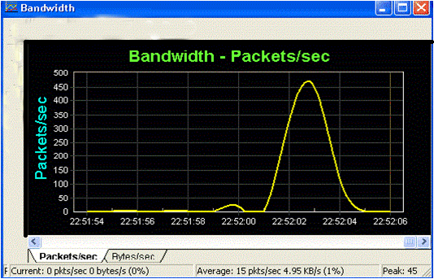
Bandwidth Monitor Graph:

Slide 30
TraficReporter
DATA MEMBERS
date1
date2
METHODS
getDailyReport()‏
getReportBetween2Dates()‏

Slide 31
DFD :
Establish Connection to backend
Connection
object
Create Statement
Load JDBC Driver
Statement object
Date(s)‏
query
result
Store the query result
Query the database
get date(s)‏
Date(s)‏
Displaying Class
User

Slide 32
Sequence Diagram :
MAIN_ MENU
MENU
TrafficReporter
TrafficReporter
DisplayReport
mainMenu()‏
menu()‏
getReport()‏
getReport()‏
init()‏
get Choice
get Date
Query the
database
establish connection to backend
Result
Display

Slide 33
Algorithm for trafficReporter:
//Requires java.sql package
getDailyReport()‏
//input : Date.
//output : ResultSet object.
begin
try
begin
load JDBC driver. //using forName() method
establish connection to the backend database.//using getConnection() method.
create Statement object.
pass the query as parameter to executeUpdate().
store the query result in ResultSet class object.
end(try)‏

Slide 34
Algorithm Continued ...
catch(Exception e)‏
begin
print stack trace using printStackTrace() method.
end(catch)‏
end (getDailyReport)‏

Slide 35
TraficReporter
Algorithm :
//Requires java.sql package
getReportBetween2Dates()‏
//input : From date, to Date.
//output : ResultSet object.
begin
try
begin
load JDBC driver. //using forName() method
establish connection to the backend database.//using getConnection() method.
create Statement object.
pass the query as parameter to executeUpdate().
store the query result in ResultSet class object.
end(try)‏

Slide 36
Algorithm Continued ...
catch(Exception e)‏
begin
print stack trace using printStackTrace() method.
end(catch)‏
end

Slide 37
DisplayDailyReport
DATA MEMBERS
No data members.
METHODS
init()‏

Slide 38
DisplayDailyReport
Algorithm :
//Requires javax.swing and java.awt packages
//class containg this method need to extend from JApplet class
init()‏
//input :ResultSet object.
//output :displays Traffic of given date in tabular form.
does not return any thing.
begin
get content pane and store it in Container class object.//use getContentPane() method.
set layout manager //using setLayout(BorderLayout) method.

Slide 39
Algorithm Continued ...
initialize column heading in 1D String array.
initialize data in 2D Object array.
create JTable object to create table & pass data, heading created above as parameters.
create JScrollPane object to include scroll bars.
add it to content pane using add(JScrollPane) method.
end(init).

Slide 40
DFD:
get content pane
Container
object
set layout manager
Container
object
Create JTable object
add JTable to
content pane
output
Data
output
TrafficReporter class
user

Slide 41
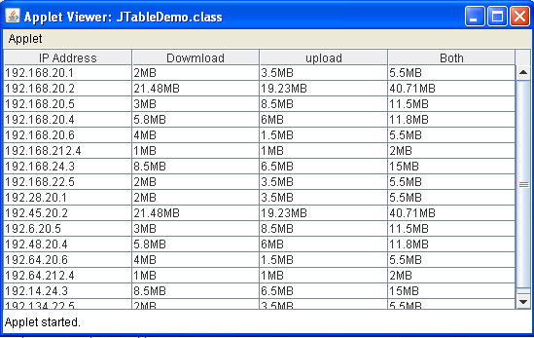

Slide 42
DisplayReportBetween2Days
DATA MEMBERS
No data members.
METHODS
init()‏

Slide 43
DisplayReportBetween2Days
Algorithm :
//Requires javax.swing and java.awt packages
//class containg this method need to extend from JApplet class
init()‏
//input :ResultSet object.
//output :displays Traffic of given 2 dates in tabular form.
does not return any thing.
begin
get content pane and store it in Container class object.//use getContentPane() method.
set layout manager //using setLayout(BorderLayout) method.

Slide 44
Algorithm Continued ...
initialize column headings in 1D String array.
initialize data in 2D Object array.
create JTable object to create table & pass data, heading created above as parameters.
create JScrollPane object to include scroll bars.
add it to content pane using add(JScrollPane) method.
end(init).

Slide 46
Thank You

