Slide 1
welcome

Slide 2

Bandwidth Monitor & Traffic Reporter
Batch a-15
Kavita.K
Priyadarshini.H
Rashmi.A

Slide 3
Software Requirement Specification
Problem Statement:
To Develop a software to Monitor the bandwidth of real time upload and download rates and generating traffic reports to user.

Slide 4
1.Introduction:
1.1 Purpose:
The purpose of Bandwidth Monitor and Traffic Reporter is to monitor bandwidth usages through the computer it's installed on. And generate traffic reports.
1.2 Scope:
The software performs the following activities:
Monitors bandwidth usage.
Displays real-time download and upload speeds in graphical and numerical forms.
Logs bandwidth usages.
Provides daily, weekly and monthly bandwidth usage reports.

Slide 5
1.3 ACRONYMS and Abbreviations :
BM: Bandwidth Monitor.
TR: Traffic Reporter.
BW: bandwidth
Definitions
Bandwidth: The BW is a property of a medium. It is the difference between the highest and the lowest frequencies that the medium can satisfactorily pass.
Traffic: Transmission of messages through a communication network.

Slide 6
1.4 References:
Pankaj Jalote (for SRS)
http//www.bwmonitor.com
support@bwmonitor.com
1.5 Overview:
As a user, we transmit the messages
through the communication network which consumes the BW.
The Software gives this BW consumption, usage rates.
Displays real-time download upload speeds in graphical, numerical forms.

Slide 7
Overview continued…
Logs the details.
Generates daily, weekly and monthly reports.
Helps the user to identify malicious programs running on system.
Helps to increase or decrease
the BW rates.

Slide 8
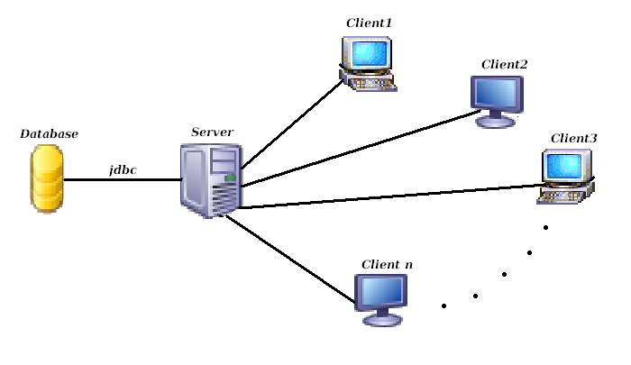
2. Overall Description
2.1 Product Perspective:
. A simple diagram that shows the major components of the overall system, subsystem interconnections is shown below.

Slide 9
2.2 Product Functions:
At the client side
The main function of BM is to track the users, who share their resources over the internet, interact with each other.
Get the no. of packets they downloaded /uploaded send it to the server.
At the server side
Log the details.
Generate the reports.

Slide 10
2.3 User Characteristics:
The major user classes that are expected to use this software are as follows
Software Administrator
The Software Administrator are the main users of this software. They are expected to keep track of the no. of packets downloaded and uploaded periodically and maintain the traffic report provided by this software.
General Users
The general users are expected to generally perform downloading and uploading of files, specially videos, audios and documents for which our software provides the bandwidth monitoring and traffic reports

Slide 11
2.4 General Characteristics:
This software is a web based application. A major constraint on the performance will be due to the client’s usage.
2.5 Assumptions and Dependencies:
System has client-server architecture.
Clients send the upload, download statistics to the server.
Server maintains the statistics and gives graphical, numerical representations.
Server generates the reports.
The software is Main Server dependant, and so if due to some reason the Main Server crashes, the whole software will crash.

Slide 12
3. Specific Requirements:
3.1 External Interface Requirements
3.1.1 User Interface:
Basically there will be 3 user interfaces provided by the software
1.Bandwidth Usage Notification
2.Traffic Summary
3.Graphical view
3.1.2 Hardware Interface
PROCESSOR : PENTIUM IV 2.6 GHz
RAM : 512 MB DD RAM
MONITOR : 15” COLOR
HARD DISK : 120 GB

Slide 13
3.1.3 Software Interface:
Software will depend on the security features provided by the operating system and the language java
Software Requirements :
JDK 1.5
Java Swings ,servlets,networking.
JDBC.
3.1.4 Communication Interface:
Features will be provided for user (of software) for monitoring the bandwidth. The basic communication protocols will be UDP and TCP for file transfer

Slide 14
3.1.5 SYSTEM FEATURES:
Description and Priority:
Running as a system service that monitors bandwidth usages and generate traffic reports automatically.
Real-time graphical and numerical bandwidth speed displaying.
Provides daily, weekly, monthly and summary bandwidth usage reports.

Slide 15
Functional Requirements:
Main Functionality of Software:
Displays real time upload and download speeds in graphical and numerical form.
Logs bandwidth usage.
Providing daily,weekly and monthly bandwidth usage report.
Bandwidth usage notification.

Slide 16
Use cases specify the Functionality of a system by specifying the behaviour of the system.
Use case 1:Monitoring the bandwidth and showing graphs for uploaded and downloaded results.
Primary Actor: Server
Precondition: Client has logged in and uploaded the data or downloaded.
Main Success Scenario:
Server receives the packets from clients after uploading or downloading data by Client machine.
Records or develops the graph for the particular uploads and downloads.
Server after completing its task switches to other.
Exception Scenario:
-Client has not uploaded or downloaded any data.

Slide 17
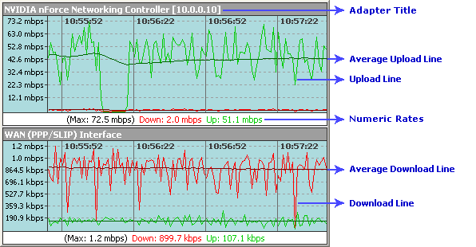

Slide 18
Use case 2: Recording or logging the uploaded and downloaded results .
Primary Actor: Server.
Precondition: Server is active and can receive the packets from client machine after suitable uploads or downloads.
Main Success Scenario:
Server with this Software maintains a database of all the clients information based on the packets sent or received in kbps.
Based on the bandwidth usage the server keeps track of upload and download speed utilization etc separately.
Server frequently updates the database.
Exception Scenario:
-Connection may be lost.
-Acknowledgement may not happen.

Slide 19
Use case 3:Daily report of bandwidth usage.
Primary Actor: Server.
Precondition: Server remains active from the duration specified.
Main Success Scenario:
Server monitors the bandwidth rates of uploads and downloads every day and every moment.
Generates the suitable day to day reports and stores in database the day and the bandwidth usage on that day and name of client machine.
Exception Scenario:
-In the course of monitoring the monthly bandwidth usage server may crash.
-In the course of monitoring ,database may crash.

Slide 20
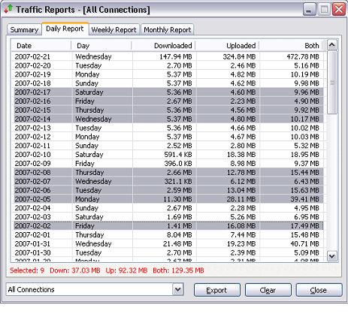

Slide 21
Use case 4:Weekly report of bandwidth usage.
Primary Actor: Server.
Precondition: Server remains active from the duration specified.
Main Success Scenario:
Server monitors the bandwidth rates of uploads and downloads every day and every moment.
Generates the suitable weekly reports and stores in database the starting and end day of week and the bandwidth usage for that month and name of client machine.
Exception Scenario:
-In the course of monitoring the monthly bandwidth usage server may crash.
-In the course of monitoring ,database may crash.

Slide 22
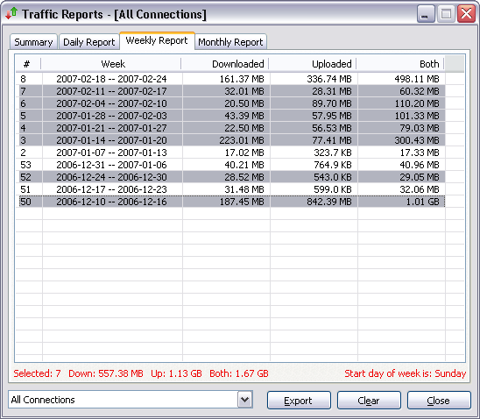

Slide 23
Use case 5:Monthly report of bandwidth usage.
Primary Actor: Server.
Precondition: Server remains active from the duration specified.
Main Success Scenario:
Server monitors the bandwidth rates of uploads and downloads every day and every moment.
Generates the suitable reports for the entire month for effective bandwidth utilization and stores in database the name of month and the effective bandwidth usage for that month and name of client machine.
Exception Scenario:
-In the course of monitoring the monthly bandwidth usage server may crash.
-In the course of monitoring ,database may crash.

Slide 24
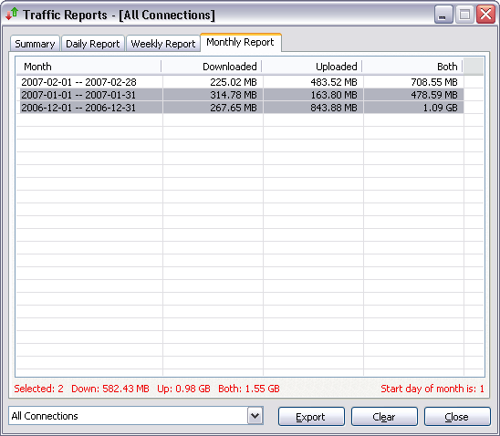

Slide 25
Use case 6:Notification after the exceeded bandwidth usage.
Primary Actor: Server.
Precondition: Server is logged in and keeps track of all the bandwidth usages.
Main Success Scenario:
Server monitors the bandwidth usage of all its client machines.
After the Specified level of usage, server notifies to the client machine about excess usage of bandwidth after uploada or downloads.
Notification is in the form of beep sound.

Slide 26
Thank you

