Slide 1
AI VS. HUMAN : ACADEMIC ESSAY AUTHENTICITY CHALLENGE
PIP2001 Capstone Project
Review-1
Batch Number: PSCS180
Under the Supervision of,
Prof. Sandhya L
Assistant Professor
School of Computer Science and Engineering
Presidency University
STUDENT NAME | ROLL NUMBER
MANJUNATH REDDY | 20211CST0043
MALLIKA | 20211CST0002
HARI NARAYANA | 20211CST0029
RAKSHITHA M | 20211CST0050
Roll Number | Student Name
Name of the Program:
Name of the HoD: Dr.Saira bhanu
Name of the Program Project Coordinator: Dr. H M Manjula
Name of the School Project Coordinators: Dr. Sampath A K / Dr. Abdul Khadar A / Mr. Md Ziaur Rahman

Slide 2
Introduction
This project focuses on addressing the increasing use of AI tools in generating essays, particularly in educational contexts, where maintaining academic integrity is crucial. The aim of the system is to classify essays as either machine-generated or human-authored. The system is capable of identifying texts generated by various large language models, such as ChatGPT, and determining whether the content is AI-generated (Fake) or written by a human (Real). This binary classification task extends to essays written by both native and non-native speakers in two languages: English and Arabic.

Slide 3
Literature Review
1. The Rise of AI in Content Generation
AI-driven text generation models, such as OpenAI's GPT series, have seen significant advancements in recent years. These models have achieved impressive fluency in natural language generation, making them popular for various applications, including automated essay writing, content creation, and dialogue generation. Studies like Radford et al. (2019) introduced the concept of transformer-based architectures, which allow models to learn from vast amounts of data, producing coherent and contextually accurate texts. However, this also presents challenges, particularly in academic environments where authenticity is paramount.
2. Challenges in Distinguishing AI-Generated Text
One of the key issues with AI-generated content is its potential to blur the lines between human and machine authorship. Early research, such as Zellers et al. (2019) with the GPT-2 detector, revealed how difficult it could be to differentiate between human-written and machine-generated text. The rise of models like GPT-3 has further complicated this distinction due to their enhanced linguistic capabilities, as highlighted by Brown et al. (2020). Studies have consistently shown that even experienced human evaluators struggle to accurately detect AI-generated text, making automated detection systems an essential area of research.

Slide 4
3. Existing Detection Techniques
Various machine learning models have been proposed to detect AI-generated content. Bakhtin et al. (2020) demonstrated how language models like RoBERTa could be fine-tuned to detect machine-generated text with reasonable accuracy. This has led to the creation of models like the Roberta-base-openai-detector, which is trained specifically to distinguish between human-written and AI-generated text.
Moreover, Ippolito et al. (2020) compared several detection approaches, emphasizing the importance of context, sentence structure, and stylistic patterns in identifying machine-generated content. They found that AI-written text tends to exhibit repetitive structures or slight grammatical inconsistencies, which models like RoBERTa can effectively identify.
4. Multilingual Detection
Although much research focuses on English, recent studies have extended AI detection models to other languages, including Arabic. Research by Elmadany et al. (2021) emphasized the challenges of detecting AI-generated text in low-resource languages, as large language models tend to perform inconsistently across different linguistic contexts. This project incorporates Arabic essays into the detection framework, acknowledging the growing need to ensure academic integrity in non-English contexts as well.

Slide 5
5. Impact on Academic Integrity
The misuse of AI in academic settings is becoming a growing concern. As noted by Kovačević et al. (2021), the availability of AI-based tools has increased the ease with which students can generate essays or responses, potentially undermining educational integrity. Many institutions have begun adopting AI detectors to combat this trend, and ongoing research focuses on improving detection accuracy, reducing false positives, and ensuring fairness across diverse student populations.

Slide 6
Existing method Drawback
1. Inability to Detect Newer Language Models
As AI text generation continues to evolve, newer models such as GPT-4, LLaMA, and others are becoming increasingly sophisticated, producing content that is harder to distinguish from human-written text. Many existing detection systems are trained on older models (like GPT-2 or GPT-3) and struggle to keep up with these advancements. This means that, as newer models are released, detection models must be constantly retrained, which is both time-consuming and resource-intensive.
2. High Rate of False Positives and False Negatives
Existing detectors, such as RoBERTa-based models, are prone to generating false positives (labeling human-written text as AI-generated) and false negatives (failing to detect AI-generated text). This is particularly problematic in academic settings, where wrongly accusing students of using AI tools can harm their academic standing, while missing instances of AI-generated content undermines the integrity of the evaluation process. These errors can arise due to the subtle differences between human and AI-generated text, which may not always be obvious to detection models.

Slide 7
3. Limited Multilingual Capabilities
Many existing methods are primarily trained and tested on English texts, limiting their effectiveness in multilingual contexts. Detecting AI-generated content in languages such as Arabic, Chinese, or Spanish is far less reliable, as language models tend to perform unevenly across different languages. This can lead to gaps in detection coverage, particularly in regions where educational systems rely on non-English academic content. Additionally, these models may struggle with detecting essays written by non-native English speakers, further reducing accuracy.
4. Challenges with Contextual and Stylistic Nuances
AI detectors often struggle with nuanced language features, such as idiomatic expressions, cultural references, or variations in writing style, which may vary significantly between human authors and AI-generated texts. This is especially true in academic essays, where content may be highly technical or specialized. Current detection models tend to focus on surface-level characteristics, like sentence structure or word frequency, missing deeper contextual or stylistic cues that could better differentiate between human and AI writing.
5. Adversarial Attacks and Evasion Techniques
AI-generated text can be easily manipulated to evade detection by existing methods. Studies have shown that slight modifications, such as paraphrasing or altering sentence structure, can significantly reduce the accuracy of detection systems. This makes it possible for students or content creators to bypass AI detectors by using simple text-spinning tools or manual revisions, rendering current detection systems less effective in real-world scenarios.

Slide 8
Objectives
To address the limitations of existing AI-generated text detection systems, this project proposes a robust method designed to improve accuracy, adaptability, and scalability. The key components of the proposed method are as follows:
Use of the Roberta-Base-OpenAI-Detector Model
User-Friendly Interface with Dash
Adaptive Model Training
Login and signup pages with correct connectivity to database

Slide 9
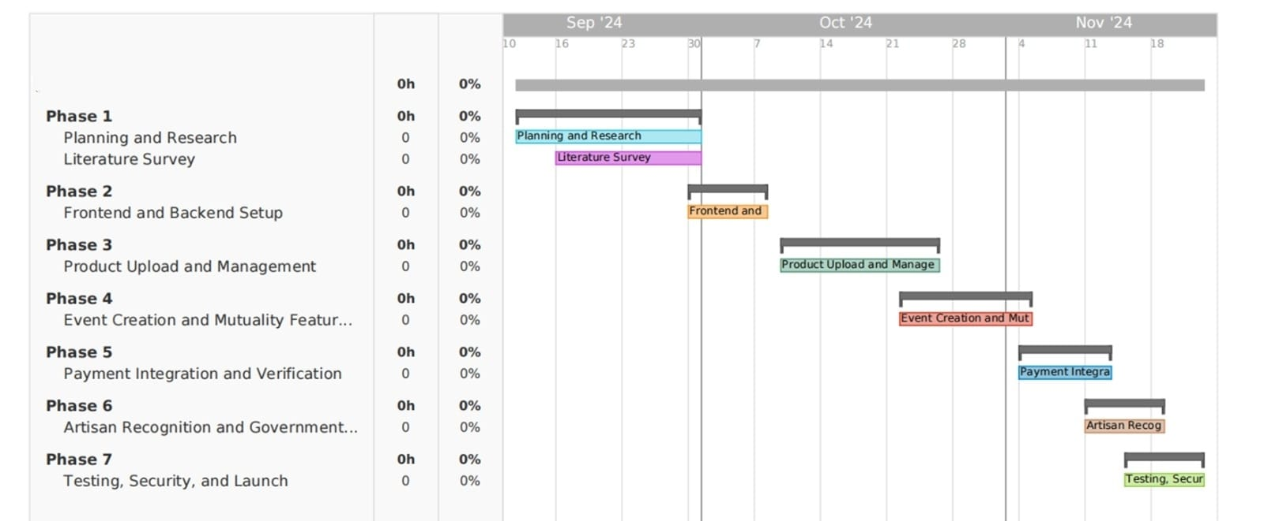
Timeline of Project

Slide 10
Expected Outcomes
The proposed system is expected to yield several important outcomes that will contribute to safeguarding academic integrity and ensuring the authenticity of written content in educational settings:
Improved Detection Accuracy
User-Friendly Interface
Scalable Solution for Large Institutions
Explainable and Transparent AI

Slide 11
Conclusion
This project offers a robust solution for detecting AI-generated essays, ensuring academic integrity by distinguishing between human and machine-authored texts. Utilizing the Roberta-base-openai-detector model, it provides accurate classification with support for both English and Arabic essays. The user-friendly interface and explainability features enhance accessibility and transparency, while the system’s adaptability ensures it remains effective against evolving AI models. By promoting ethical AI use in education, this tool will help institutions maintain fair academic practices and uphold authenticity in student work.

Slide 12
References
[1] R. Corizzo and S. Leal-Arenas, "A Deep Fusion Model for Human vs. Machine-
Generated Essay Classification," IEEE, 2023.
[2] W. H. Pan, M. J. Chok, J. L. S. Wong, Y. X. Shin, Z. Yang, Y. S. Poon, C. Y.
Chong, D. Lo, and M. K. Lim, "Assessing AI Detectors in Identifying AIGenerated
Code: Implications for Education," IEEE, 2024.
[3] V. Pandita, A. M. Mujawar, T. Norbu, V. Verma, and P. Patil, "Text Origin
Detection: Unmasking the Source – AI vs Human," IEEE , 2024.
[4] D. Yan, M. Fauss, J. Hao, and W. Cui, "Detection of AI-generated Essays in
Writing Assessments," Psychological Test and Assessment Modeling, vol. 65,
2023.
[5] X. Peng, Y. Zhou, B. He, L. Sun, and Y. Sun, "Hiding the Ghostwriters: An
Adversarial Evaluation of AI-Generated Student Essay Detection,"
arXiv:2402.00412v1 [cs.CL], Feb. 2024.

Slide 13

Project work mapping with SDG

Slide 14
The project work carried out here is mapped to SDG-4: Quality Education, Industry, Innovation, and Infrastructure
This project contributes to the quality of education by ensuring academic integrity through the detection of AI-generated texts versus human-authored content. By providing educators and institutions with a reliable tool to identify and mitigate the misuse of AI in assessments, the project fosters a fair learning environment. This, in turn, promotes authentic learning experiences for students, ensuring that evaluations reflect true capabilities and knowledge. By upholding standards of academic honesty, the project plays a crucial role in enhancing the overall educational experience.

Slide 15
Thank You

