Slide 1
lntelligent chatbot to answer queries pertaining tovarious Maintenance Processes within Substation
CSE7301 University Project-II
Review-1
NAMES | ROLL NUMBER
V sri Manjunath reddy | 20211CST0043
Rakshitha M | 20211CST0050
JDVSS Mallika | 20211CST0002
P Hari Narayana | 20211CST0029
Under the Supervision of,
Prof. Sandhya L
Assistant Professor
School of Computer Science and Engineering
Presidency University

Slide 2
Introduction
In today's fast-paced and interconnected world, efficient customer support is critical for any business. This project introduces a cutting-edge solution: a Customer Support Chatbot empowered by Machine Learning. Here's a more in-depth look at the project's key components:
Interpret Customer Complaints and Queries
Search the Database for Resolution
Handover to Support Staff
Update the Database
Prepare for Similar Queries in the Future

Slide 3
Literature Review
The chatbot market is anticipated to grow at a CAGR of 23.5% reaching USD 10.5 billion by end of 2026.
Facebook has over 300,000 active chatbots.
According to a Uber all report, 80 % of customers have had a positive experience using a chatbot.
According to IBM, organizations spend over $1.3 trillion annually to address novel customer queries and chatbots can be of great help in cutting down the cost to as much as 30%.
No doubt, chatbots are our new friends and are projected to be a continuing technology trend in AI. Chatbots can be fun, if built well as they make tedious things easy and entertaining

Slide 4
Hardware and Software used
Frontend:
React.js
HTML, CSS
JavaScript
Backend:
Node.js with Express.js
Python/Django
Database:
MongoDB/MySQL
Firebase

Slide 5
Objectives
Following are some of our objectives:
1. The chatbot will be build using machine learning
2. Data base to complete the customer need
3. All modules used to develop the bot should work synchronously.
4. The interactions between the user and the chatbot should be fast.
5. Store User related details such as Name, Phone number, Account ID.
6. Preprocess of the queries given by customer.

Slide 6
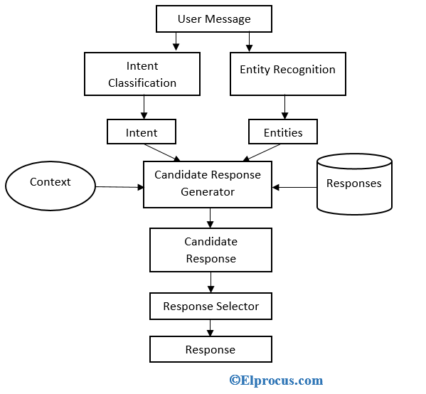
Flow chart / Methodology

Slide 7
Outcomes
Improved Response Time: The chatbot can provide immediate responses to customer inquiries, significantly reducing wait times compared to traditional support channels. This leads to higher customer satisfaction and retention.
24/7 Availability: The chatbot operates around the clock, allowing customers to get assistance at any time, even outside of regular business hours. This increases accessibility and can lead to higher engagement.
Consistent Responses: The AI ensures that all customers receive consistent and accurate information, reducing the chances of miscommunication and providing a reliable source of information.
Efficient Query Handling: The chatbot can handle a high volume of inquiries simultaneously, which helps manage peak times without overwhelming human agents. This efficiency can lead to cost savings for businesses.
Data-Driven Insights: By analysing customer interactions, the chatbot can gather valuable data on customer preferences, common issues, and overall sentiment. This information can be used to improve products and services and enhance customer experience.
Seamless Escalation to Human Agents: For complex inquiries, the chatbot can smoothly escalate issues to human agents, providing them with context from the previous interactions. This ensures that customers receive personalized and effective support when needed.

Slide 8
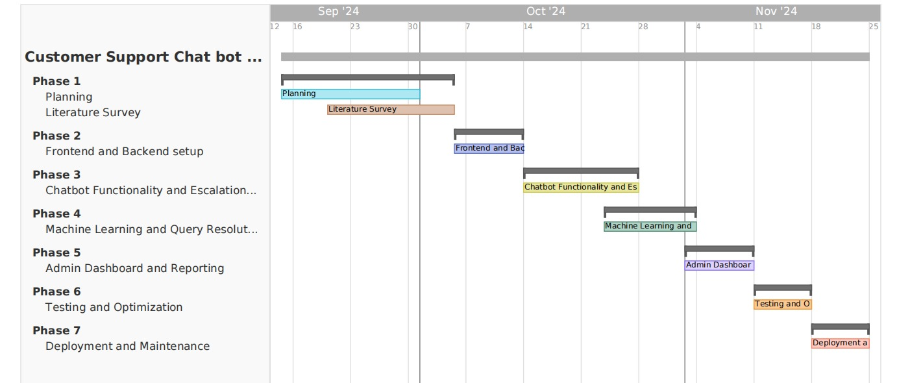
Timeline of Project

Slide 9
Conclusion
The chatbot market is anticipated to grow at a CAGR of 23.5% reaching USD 10.5 billion by end of 2026.
Facebook has over 300,000 active chatbots.
According to a Uber all report, 80 % of customers have had a positive experience using a chatbot.
According to IBM, organizations spend over $1.3 trillion annually to address novel customer queries and chatbots can be of great help in cutting down the cost to as much as 30%.
Finally we would like to tell that Chatbot is a computer program which conducts a conversation in a human-like way. This project implements chatbot which tries to answer users questions as customer support agent

Slide 10
References
, ,
, ,
, ,
1. “Chatbots in customer service: Their relevance and impact on service quality” , Chiara Valentina Misischia, Flora Poecze, Christine Strauss,
sciencedirect.
2. “Chatbots: History, technology, and applications.” Machine Learning with Applications, 2 (100006) (2020),Google scholar
3. “Chatbots – An Interactive Technology for Personalized Communication, Transactions and Services.”IADIS International Journal on WWW/Internet, 15 (1) (2017), pp. 96-109, Google scholar
4. How to create a chatbot with google dialogflow (2020), MEDIUM
5. “A conversation-based perspective for shaping ethical human-machine interactions: The particular challenge of chatbots.”Journal of Business Research, 129 (2021), pp. 927-935 ,Google scholar

Slide 11
Thank You

