Slide 1


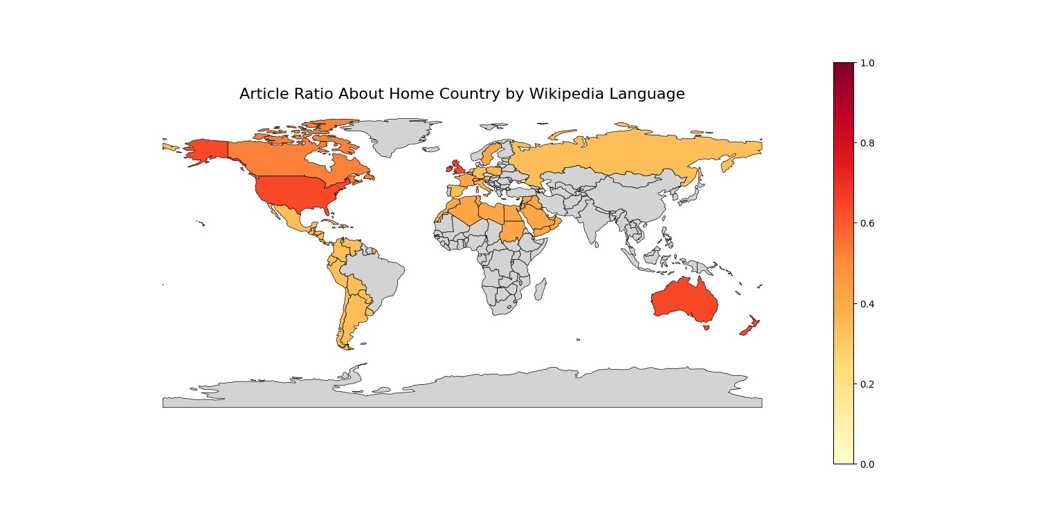
GooGLE vs Wikipedia
Trend divergence analysis
Presentation by
Standard Deviants

Slide 2
Do Google’s AI Overviews Impact Wikipedia Traffic?
A Cross-Language Signal Analysis Using Google Trends & Wikipedia Pageviews
Google Advanced AI mode has been rolled out in May 2025 across the most of the world.
As AI-generated answers surface directly in search, are users bypassing Wikipedia?
Top 100 articles from 10 different languages.
Google Trends vs. Wikipedia Pageviews.
AI Mode as Intervention Signal.

Slide 3
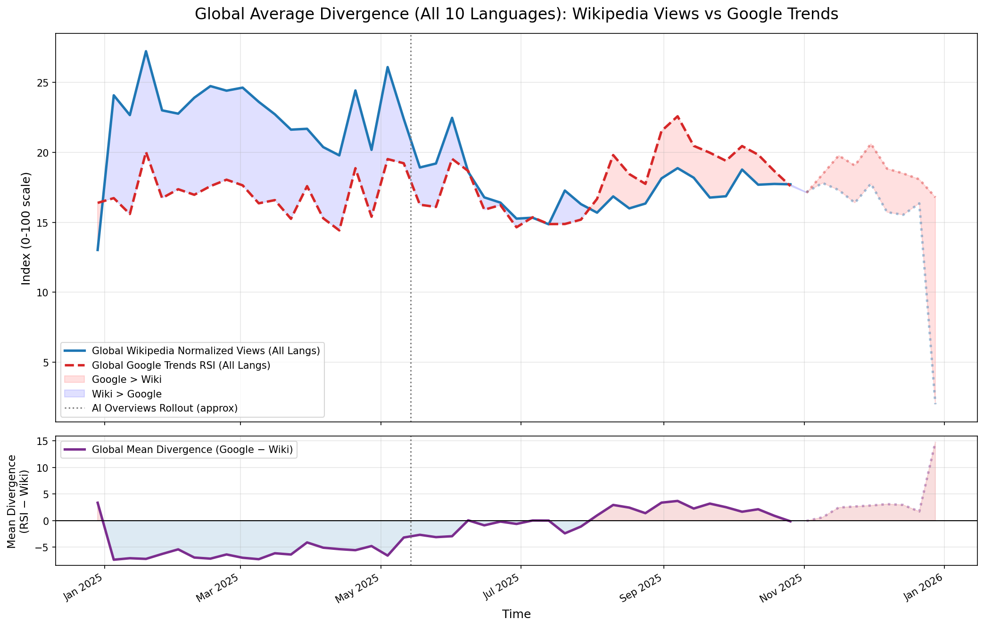
Overall Trend Analysis
Users are searching just as much, if not more but they are no longer clicking through.

Slide 4
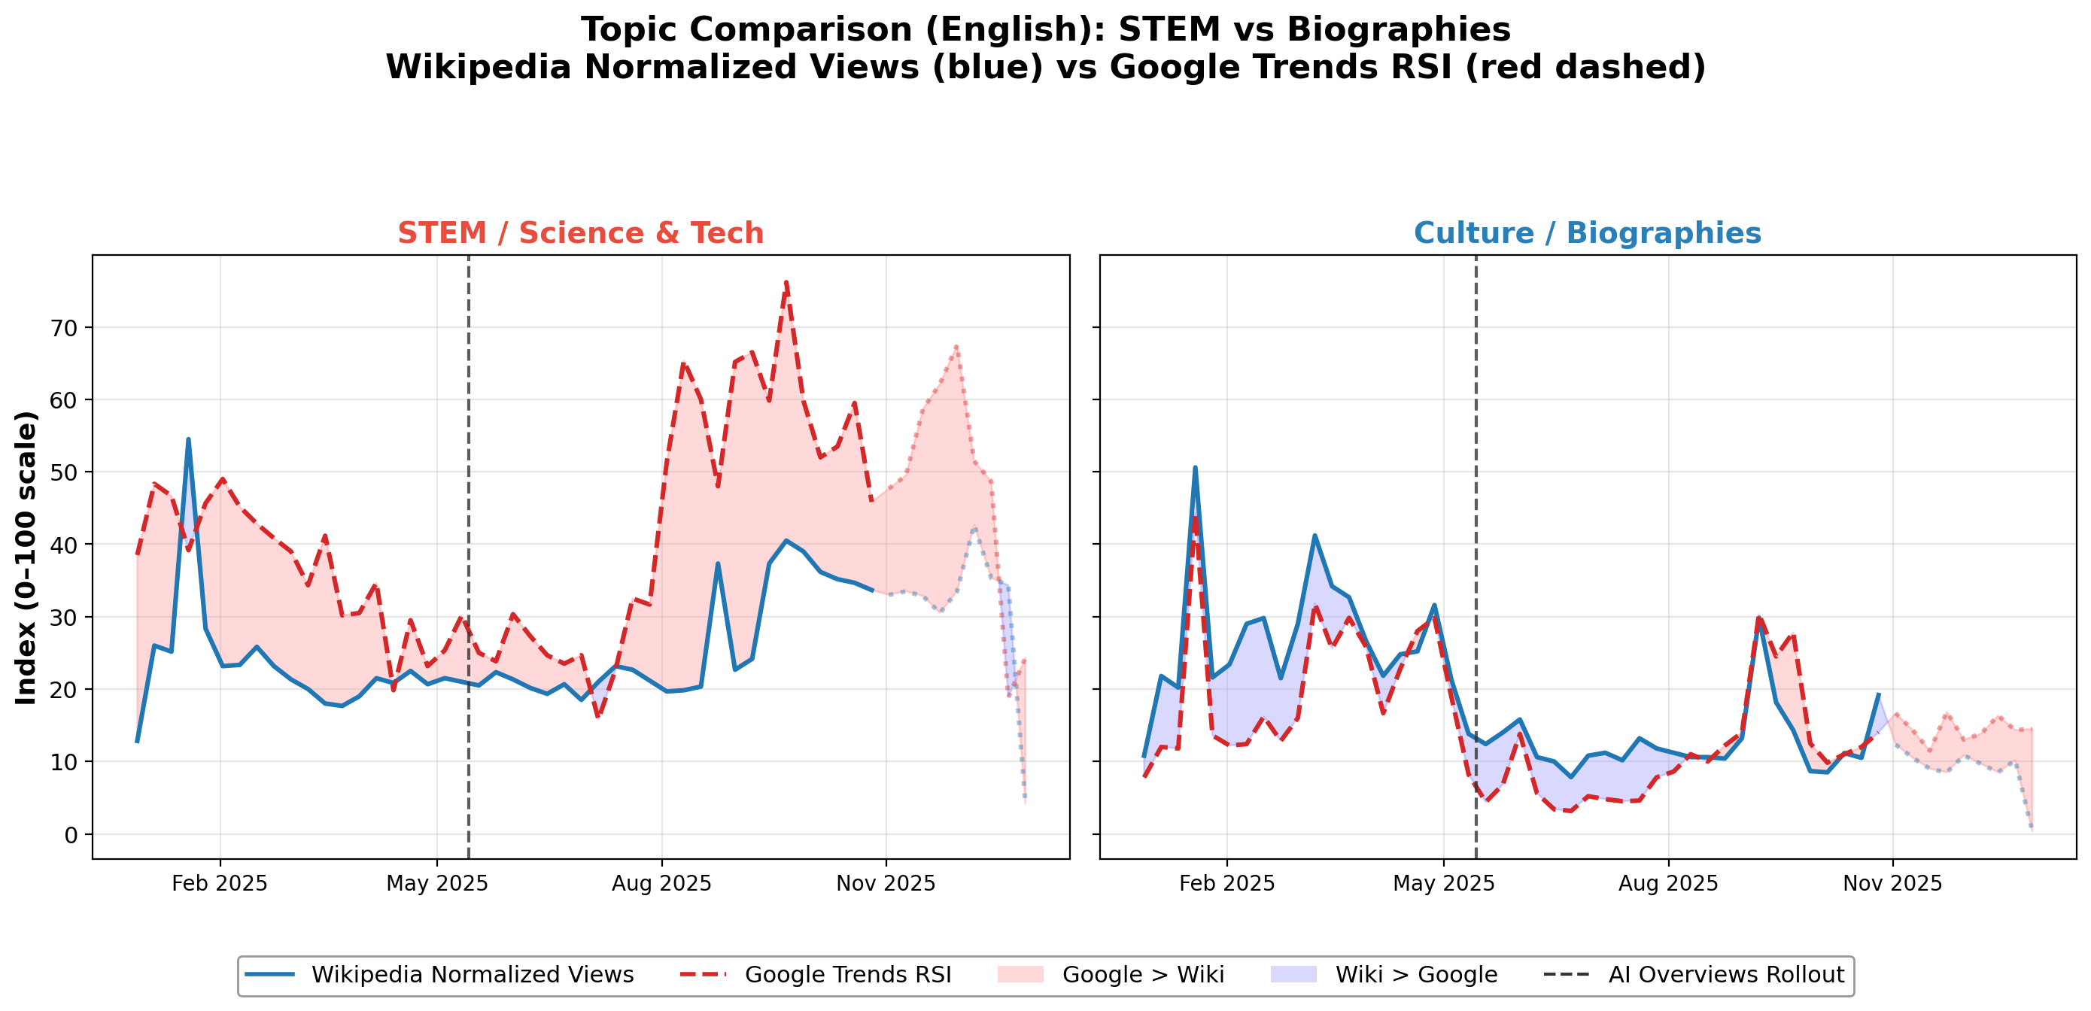
Case Study
22.6↑
0.36↑

