Slide 1
IBM University Engagement Project Submission
“Exploring the Power of Agentic AI with IBM Granite and IBM Bob”

Slide 2
Project Tile – AI-Powered Investment Analyst
Domain of Project – Artificial Intelligence (AI) and Financial Technology (FinTech
Student Name | Recent Passport Photo | Email ID | Mobile number [WhatsApp]
Manjunath S Dyamugol |  | manjunathsdyamugol7@gmail.com | 8660742824

Slide 3
Problem Statement -
Problem Statement :Individual investors and students lack accessible, affordable tools to analyze investment opportunities, assess financial risk, and interpret complex financial documents — without needing a financial advisor.
Specifically:
Information overload — Financial reports (PDFs, spreadsheets) are dense and hard to interpret for non-experts.
Risk blindness — Most retail investors don't have a structured way to assess and quantify investment risk before committing capital.
No real-time guidance — There's no always-available, conversational assistant to answer investment questions in plain language.
Fragmented workflow — Analyzing, tracking, and reporting investments requires multiple disconnected tools.
High barrier to entry — Professional financial analysis tools (Bloomberg, Morningstar) are expensive and inaccessible to students and beginners

Slide 4
Proposed Solution -
Proposed Solution:
Problem | Solution
Financial reports are too complex to read | AI reads & summarizes uploaded PDFs/DOCX/XLSX in plain English
No structured way to assess investment risk | Risk scorer (0–100) with breakdown of risk factors vs. growth signals
No on-demand financial guidance | 24/7 AI chat assistant for investment questions
Portfolio tracking is fragmented | Unified watchlist to track tickers, values, changes, and AI insights
Analysis results are lost after viewing | Saved reports with executive summary, financials & recommendations
Professional tools are expensive | Free, browser-based, no subscription — runs locally

Slide 5
Technology Used:-
IBM Bob platform -For designing and orchestrating multi-agent workflows visually
IBM Grainte model - for eg – ibm-granite-3-2-8b – For natural language understanding, reasoning, and personalization
IBM Cloud – It provides the infrastructure to build, deploy, and scale the Nutrition Agent efficiently. IBM Cloud enables a reliable, secure, and scalable environment for deploying the Nutrition Agent.
RAG– RAG to fetch real data first, then generate intelligent answers, making the Nutrition Agent more trustworthy and effective.
IBM Watsonx.ai - For model deployment, embeddings, and AI governance
Vector Database (FAISS/Chroma) – For RAG-based nutritional data retrieval

Slide 6
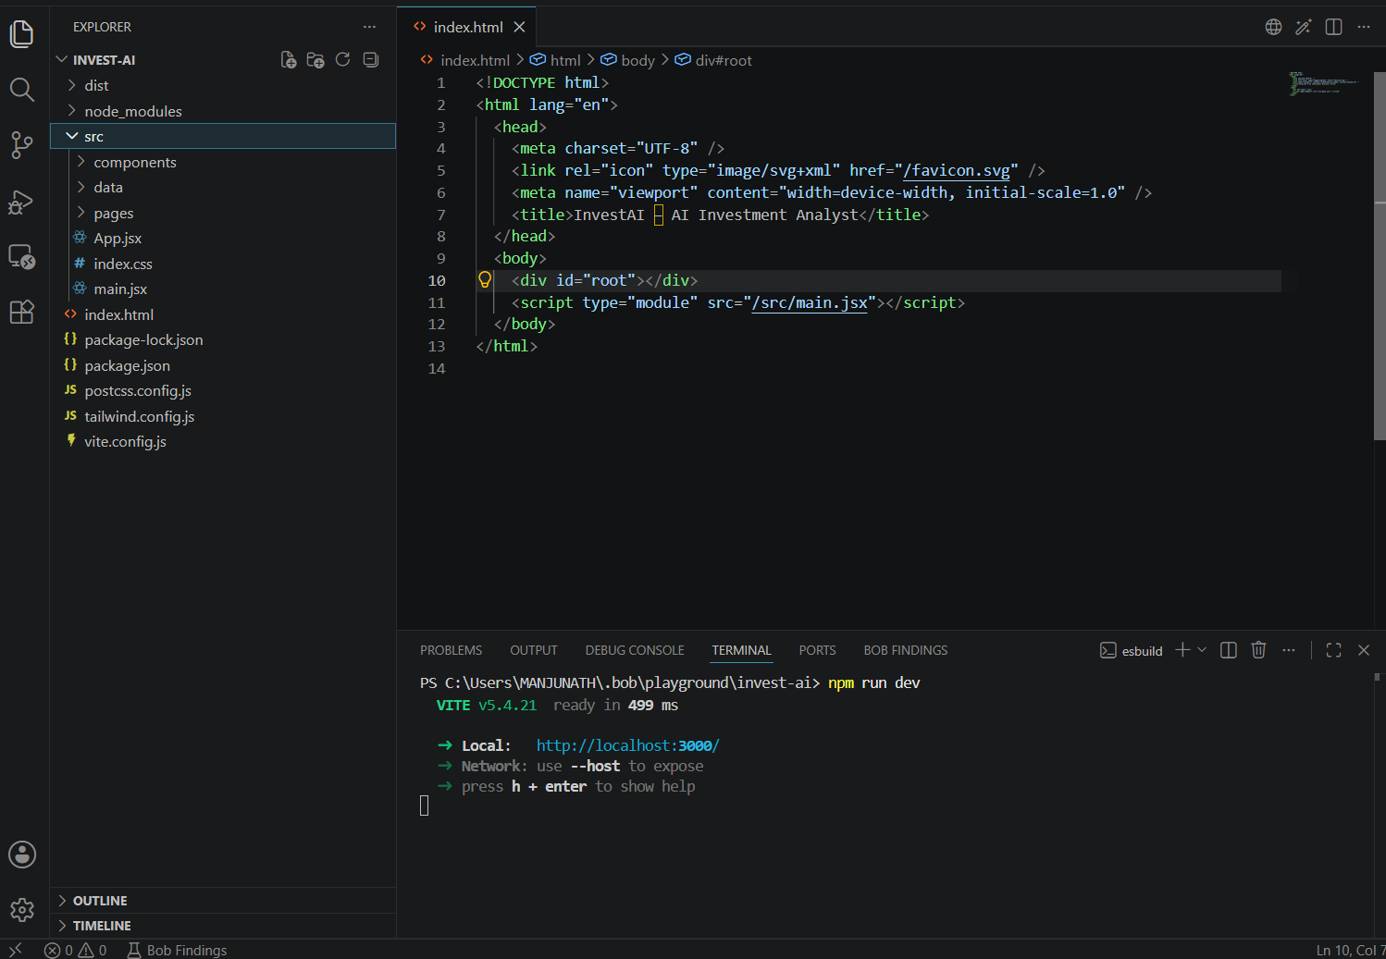
Required Files created using IBM bob -
App.jsx
Main.jsx
index.css
Index.html

Slide 7
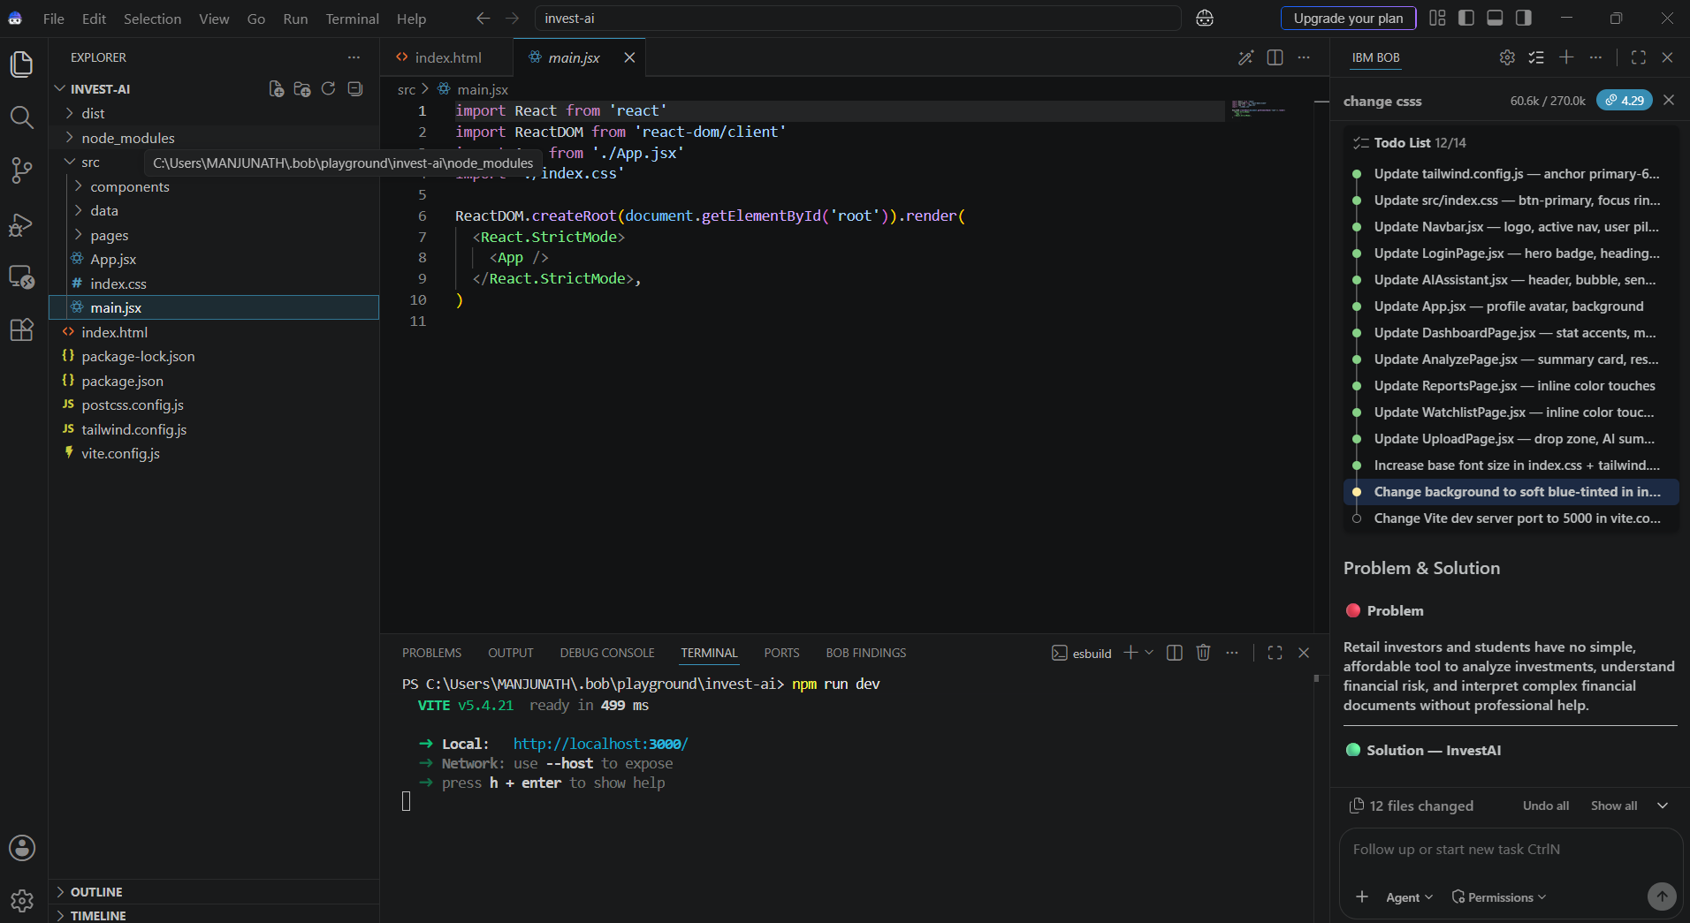
IBM Bob Screenshots:

Slide 8
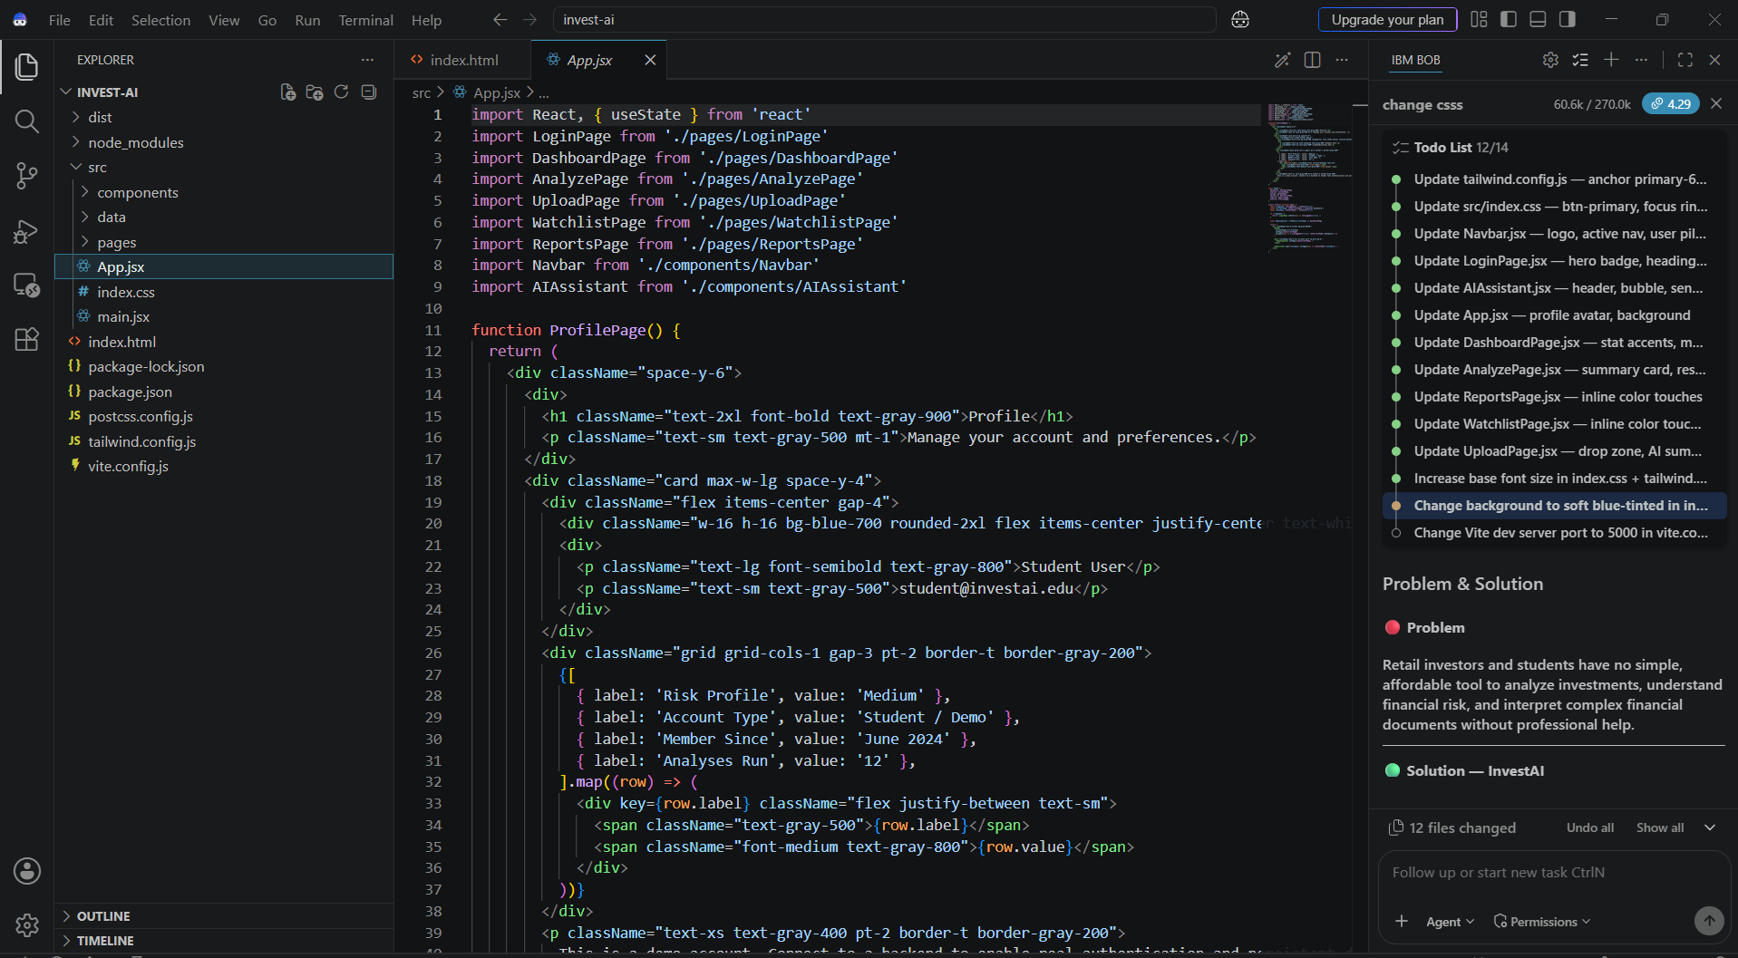

Slide 9

Role of Agentic AI in the solution
Agentic AI perceives context → plans steps → takes actions → delivers results autonomously — without a human guiding each step.
How it applies here
The loop
Input → Perceive → Plan → Act → Reflect → Respond
Page:- | Agentic Role:-
Analyze | Fetches live financials, computes ratios, writes custom report — end to end
Upload | Parses document, extracts KPIs, flags anomalies, summarizes
AI Chat | Remembers conversation, routes to tools, gives contextual advice
Watchlist | Monitors stocks proactively, surfaces alerts without being asked
Reports | Composes full structured report from raw data autonomously

Slide 10
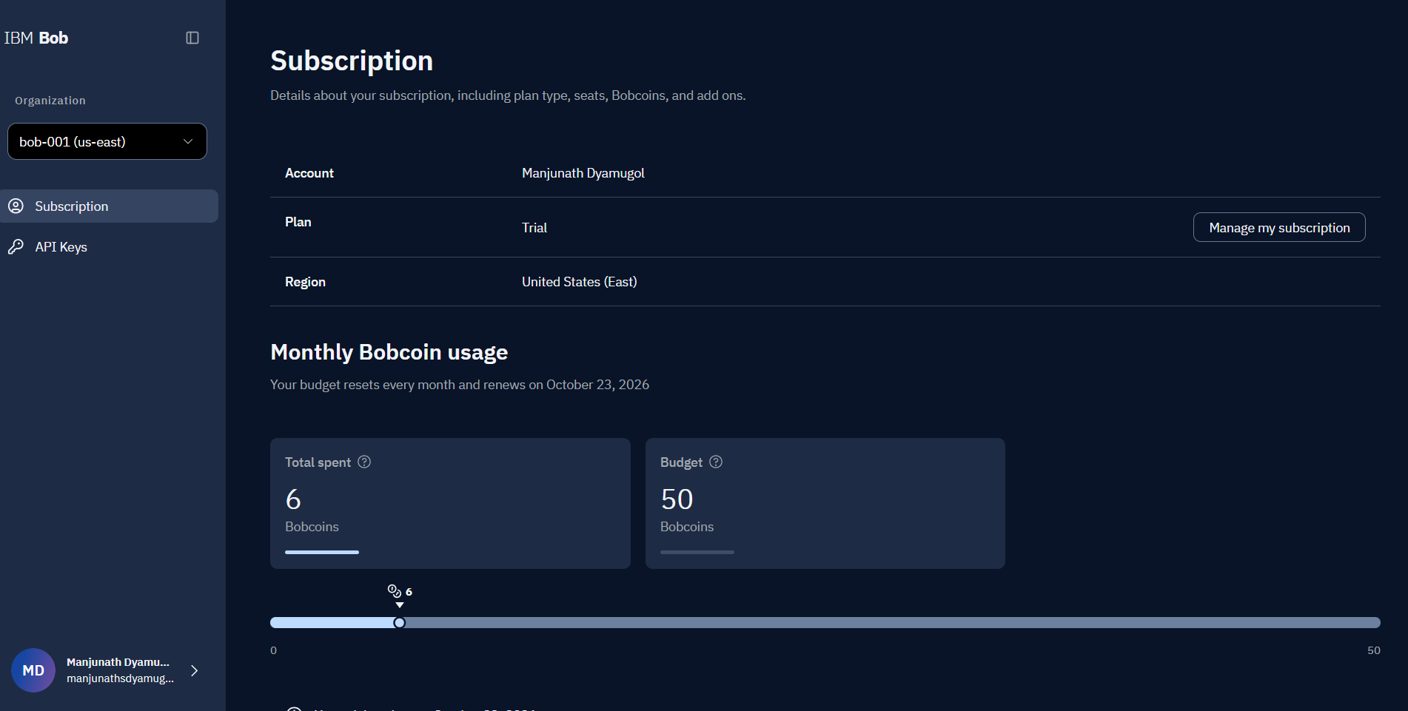
Token Usage:-
6 Bobcoins are used
·
·
·

Slide 11
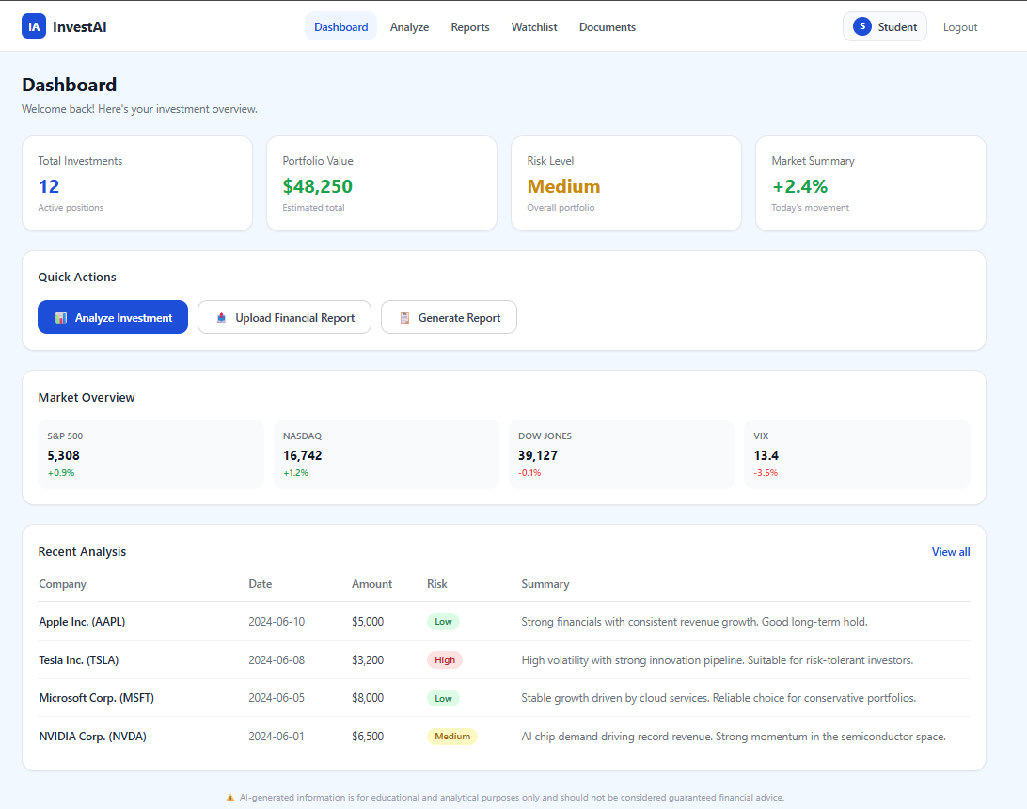
Project Output Screenshot
·
·
·

Slide 12
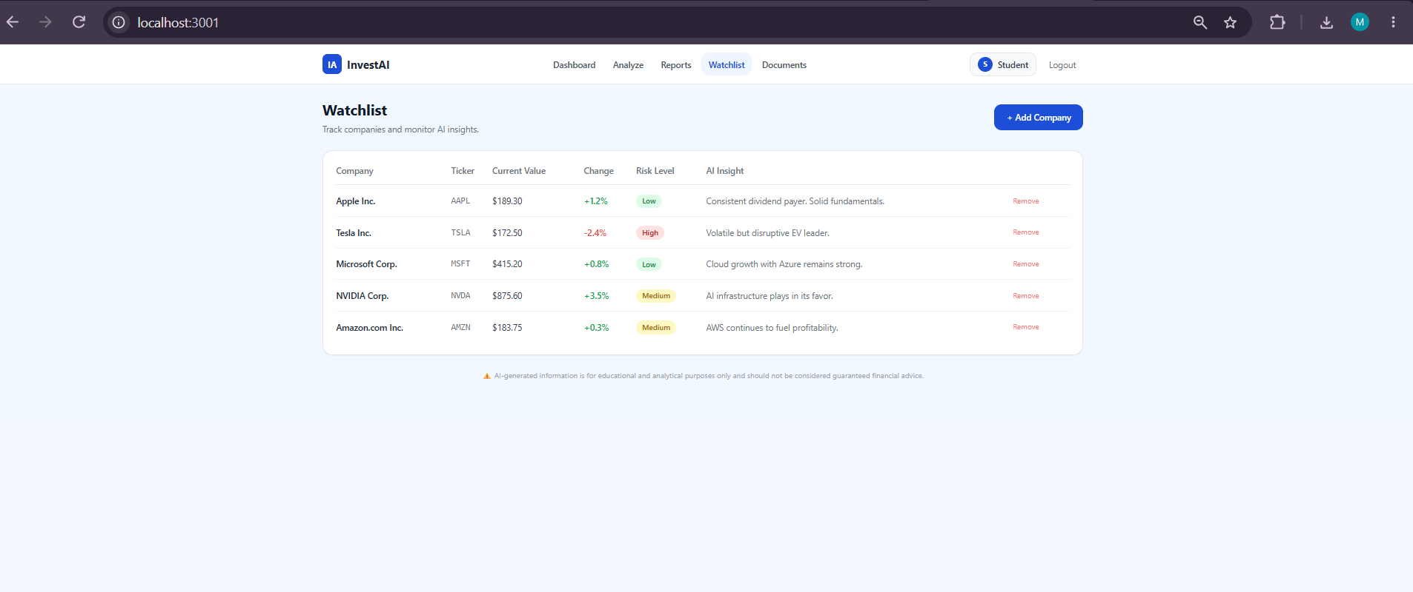
Project Output Screenshot
·
·
·

Slide 13
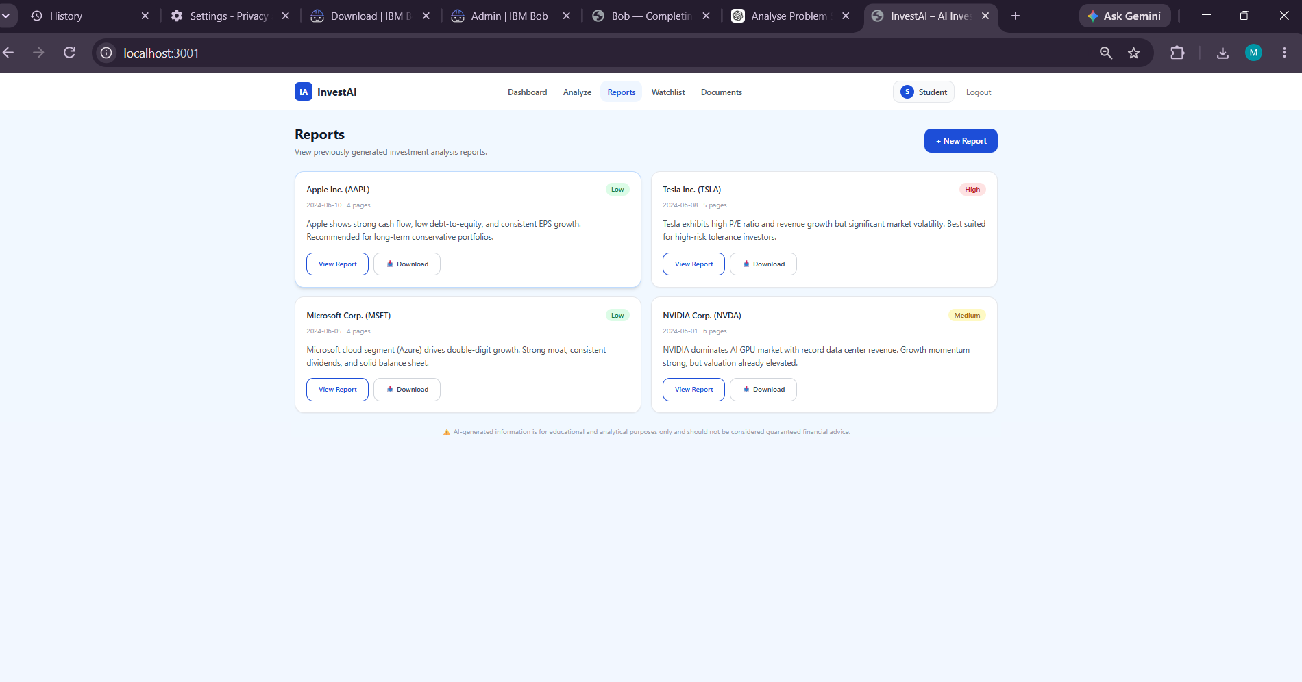
Project Output Screenshot
·
·
·

Slide 14
Novelty and Uniqueness
Novelty & Uniqueness of InvestAI
InvestAI stands out because it brings together everything a student or beginner investor needs into one single, free, browser-based tool — no subscription, no login barrier, no financial background required.
Most existing tools either show you data (stock screeners, dashboards) or answer questions (chatbots) — but none combine document understanding, risk scoring, portfolio tracking, and a conversational AI assistant in one unified experience. InvestAI does all of this together.
The document intelligence feature is particularly novel — users can upload any real financial report (PDF, Excel, Word) and get a plain-English AI summary instantly, something typically reserved for expensive enterprise platforms.
The risk scoring engine goes beyond a simple label. It reasons over multiple factors — market conditions, sector risks, company financials, and the user's own risk preference — and produces a scored, visual, explained output that helps users actually understand why an investment is risky, not just that it is.
The AI chat assistant is context-aware and always available, acting like a personal financial guide that speaks in simple language rather than industry jargon.
Finally, the entire workflow — from analyzing a company to saving a report to tracking it on a watchlist — happens inside one app, with no switching between tools.
In short, InvestAI makes professional-grade investment analysis accessible, explainable, and free for anyone — which is its core novelty.

Slide 15
Git Hub Link
· Please create public github repository (Enable Add README button while creating repository) with format –
Please test and Paste the working Github URL –
Make sure you have Uploaded following three files into your github repository
1) All Agent relevant files of IBM Cloud , 2) yourproblemstatement.pdf file 3) your projectpresntation.pptx file 4)any other files
·
·
·

Slide 16
Future Scope
Area | Future Addition
AI Engine | Real LLM — OpenAI / watsonx.ai
Market Data | Live prices via Alpha Vantage / Yahoo Finance
Backend | Node.js / FastAPI + PostgreSQL / Supabase
Auth | JWT login, user profiles, persistent data
Charts | Interactive portfolio graphs, sector breakdowns
Agentic AI | Proactive alerts, autonomous research, weekly digests
Mobile | React Native app or PWA
Global reach | Multilingual support
·
·
·

Slide 17
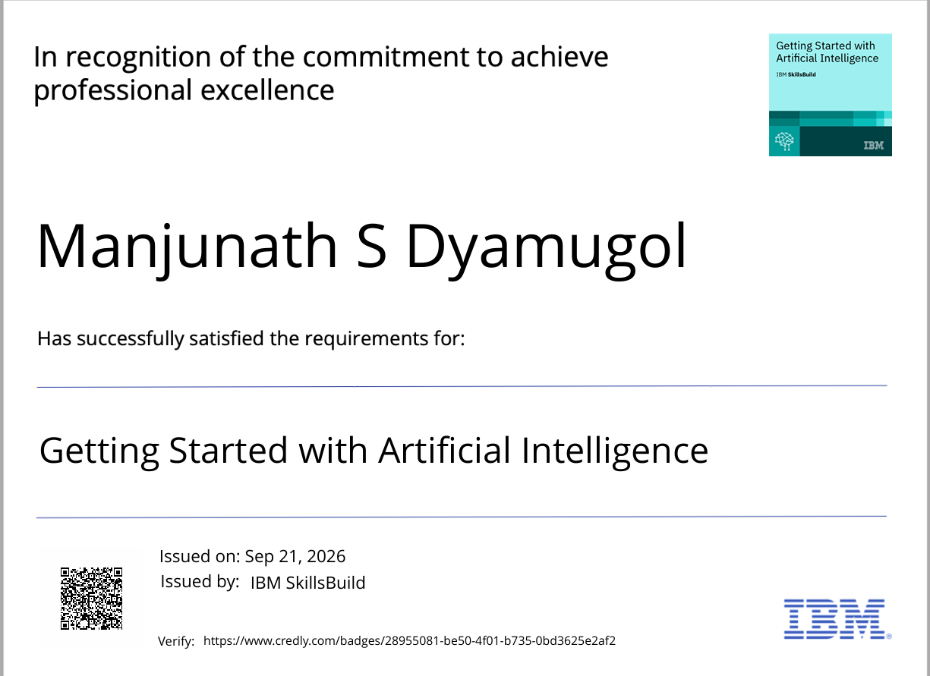
Certificates Earned:

Slide 18
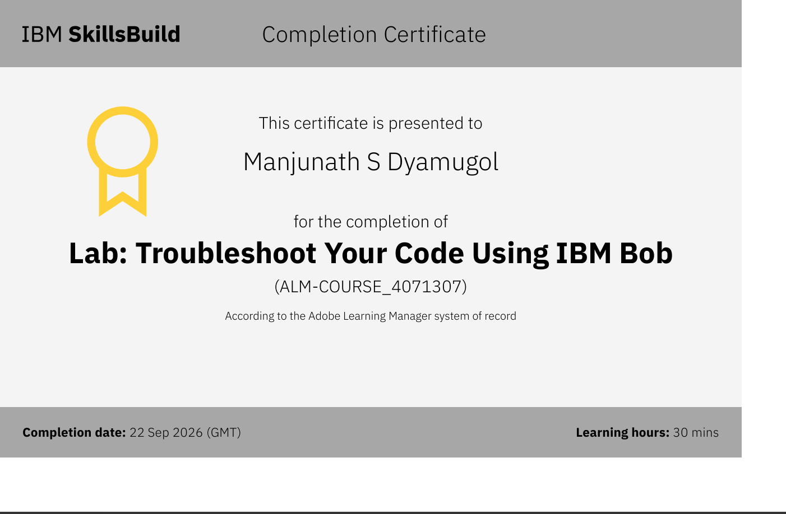
Certificates Earned:​

Slide 19


