Slide 1
RAN & Transport
CORE
Isolation Module
AGG
AGG
AGG
Rank the sites, nodes and transport paths most impacted by transport-network problems — and tell you which are transport vs RAN, with the evidence.
IP Transport Analytics
Impact Analytics Dashboard
Phase-2 Audit Prioritisation
Synthetic-data build · standalone web app · github.com/manjunathsept11/ran-transport-isolation
RAN & TRANSPORT ISOLATION
1 / 20
Notes:
Rank transport-impacted sites and separate transport vs RAN causes, with explainable evidence. Synthetic data now; live feeds later.

Slide 2
THE USE CASE
Correlate experience with transport — then rank and attribute
Ingest and correlate end-user experience metrics with transport-layer telemetry to identify and rank the sites, nodes and transport paths most impacted — and separate transport-attributed impairment from RAN-attributed impairment using serving-cell context and radio signal quality.
Deliverables
Impact analytics dashboard ranking sites, nodes and transport paths
Headline KPIs: TCP RTT, TCP Fail %, Ookla throughput, VoNR MOS, YouTube QoE
Prioritised list of the top 75–100 sites for a Phase-2 field audit (CSV / Excel)
Per-site root-cause indicators and a recommended technician action
Transport-attributed impairment distinguished from RAN-attributed
5
7
75–100
0
data feeds
stitched
analytics
modules
sites for the
Phase-2 audit
LLM calls in
the runtime
RAN & TRANSPORT ISOLATION
2 / 20
Notes:
Straight from the brief. Outputs: ranked dashboard, exportable audit shortlist, per-site root-cause + action.

Slide 3
THE PROBLEM
Users complain. Whose problem is it?
?
PA
AGG
user
RAN
transport
internet
Looks like RAN
Looks like Transport
Coverage hole / poor RSRP
Interference, low RSRQ
PRB exhaustion at busy hour
Sleeping sector, VSWR / feeder fault
Fibre degradation, microwave fade
Backhaul congestion at busy hour
SFP / CRC errors, queue drops
Routing flap, MTU black-hole
Same symptom — high latency, buffering, dropped calls — two different owners, two different fixes.
RAN & TRANSPORT ISOLATION
3 / 20
Notes:
Same user symptom, two possible owners, two different fixes. Today the split is a manual, cross-team argument.

Slide 4
PAIN POINTS TODAY
Manual, siloed, and unmeasurable
Siloed data
Manual triage
Finger-pointing
Ookla, N3 probes, TWAMP, SevOne each live in their own tool — no single correlated view.
Engineers eyeball KPI graphs site by site. It does not scale to a whole market.
RAN and transport teams each say ‘not us’; tickets bounce between them for days.
No prioritisation
No ground truth
Slow Phase-2 audits
Which 80 sites do we audit first? Today that answer is gut feel.
There is no way to check whether the triage call was actually right.
Shortlisting sites for field work takes weeks of cross-team analysis.
RAN & TRANSPORT ISOLATION
4 / 20
Notes:
Six concrete pain points the module removes.

Slide 5
THE DATA
Five feeds, one timeline
Ookla SpeedTest
UL/DL throughput, loaded latency, RSRP, RSRQ
user experience + radio
N3 probe EDRs
TCP client RTT, TCP server RTT, TCP fail %, retransmissions, VoNR MOS
session — the split point
YouTube / Audio QoE
video / audio MOS, rebuffer ratio, startup delay
application
TWAMP
one-way / round-trip delay, frame loss, jitter
pure transport (active probes on each link)
SevOne
router queue depth, discards, interface utilisation, CRC errors
transport devices
Joined on site · cell · transport-path · 5-minute bin.
RAN & TRANSPORT ISOLATION
5 / 20
Notes:
The five feeds and what each contributes. The N3 probe's client-vs-server RTT split is the key one for isolation.

Slide 6
ONE UNIFIED TIMELINE
From five raw feeds to one feature table
1
Serving-cell resolution
each Ookla / QoE test → its serving site by reported cell id, else geo + strongest RSRP; low-confidence matches flagged
2
Topology join
site → transport path → its access, pre-agg and agg links → the TWAMP sessions and SevOne interfaces on them
3
Temporal alignment
every feed bucketed to the same 5-minute grid, then rolled up hourly for the dashboard
4
Feature table
one row per (site, hour): radio, session, app and transport-path KPIs together
5
Robust baselines
deviation vs the site's own trailing median / inter-decile range AND its morphology + load peer group
RAN & TRANSPORT ISOLATION
6 / 20
Notes:
The stitching layer. Serving-cell resolution and the topology join are what make sibling-site correlation possible.

Slide 7
SOLUTION ARCHITECTURE
One pipeline — batch now, streaming later
Feeds
Stitch &
align
Feature
table
Score &
rank
Attribute
transport / RAN
Localise
(graph RCA)
Dashboard
+ audit list
Now — batch
Live — streaming (Phase 2)
Synthetic generator writes the SQLite warehouse + Parquet raw layer
na generate → na analytics → na report (or the Settings page)
Dashboard reads pre-computed serving tables — always fast
The five feeds land continuously via the data-acquisition / ingestion layer
5-min rollups on arrival; analytics recompute on a schedule (e.g. hourly)
Same serving tables, same dashboard — plus alerting on new priority sites
SQLite warehouse · FastAPI backend · React dashboard · background job runner
RAN & TRANSPORT ISOLATION
7 / 20
Notes:
Same pipeline for synthetic and live data; only the source and cadence change. The dashboard never runs analytics inline.

Slide 8
HOW ISOLATION WORKS
Transport vs RAN — the tell
1 The RTT split
2 Signature match
3 Common cause
TCP client RTT = radio + the whole transport path (round trip). TCP server RTT = internet only, site-independent — the control.
Radio: RSRP / RSRQ degraded, PRB near 100 %, usually one sector. Transport: TWAMP loss / jitter, SevOne queue / CRC, per-link delay — the transport layer's own instruments.
A single radio fault cannot degrade 18 sites at once. A shared backhaul link does it every time.
Client RTT up while server RTT flat → access / transport, not the internet.
Pure-transport instruments lit, radio clean → transport.
‘% of sibling sites on the shared uplink also degraded’ is the strongest tell.
transport
RAN
shared
unclear
+ a calibrated confidence score
Any one alone is weak — together they give a class and a confidence.
RAN & TRANSPORT ISOLATION
8 / 20
Notes:
Three independent tests → a class plus a calibrated confidence.

Slide 9
RANKING
Impact scoring — which sites, in what order
Per-KPI severity
robust exceedance of each headline KPI vs its baseline, session-weighted
Composite score
normalise each severity, then a weighted blend over the 5 headline KPIs
Impact weighting
× sessions impacted × users impacted (from the raw session records)
Worst window
the 6-hour span with the largest summed degradation — where to look
Priority slice
top ≈ 75–120 by impact → flagged for the Phase-2 audit, exportable to Excel
Ranking is deliberately transparent — a weighted composite, not a black box — so an engineer can see why a site is at #3.
RAN & TRANSPORT ISOLATION
9 / 20
Notes:
Impact = severity × sessions/users impacted, blended across the headline KPIs. Transparent by design.

Slide 10
ATTRIBUTION ENGINE
Rules ∪ LightGBM + SHAP, calibrated ensemble
Rule engine
deterministic thresholds on the robust-z features; separates pure-transport signals from ambiguous ones; emits a class + a plain-English evidence list
LightGBM classifier
gradient-boosted trees, multiclass, class-weight balanced, trained on the injected ground-truth labels per (site, hour)
SHAP
Shapley values on the booster → the top features that drove each per-site call, shown as bars
Calibrated ensemble
isotonic-calibrated; rule + ML combined, with a guardrail so a confident RAN rule beats an over-eager transport ML vote
Evaluated against ground truth every run: precision / recall / F1 per class, confusion matrix — reported in the dashboard and the notebook.
RAN & TRANSPORT ISOLATION
10 / 20
Notes:
Explainable-first: rules + SHAP + evidence text. LightGBM adds lift. Ensemble is isotonic-calibrated. No LLM.

Slide 11
SUPPORTING ANALYTICS
Anomaly · correlation · variability
Anomaly detection
Correlation
Variability
STL seasonal-residual + robust threshold, per KPI series
Isolation Forest + PCA reconstruction error, multivariate
clustered by time + topology into candidate incidents
matched to ground truth by site-set IoU
Spearman + partial correlation between KPI pairs
lead / lag cross-correlation — finds precursors
e.g. SevOne queue buildup leads the QoE drop
per-site layer driver split (transport vs radio)
variance components: site / hour / day / residual
CV, IQR, busy-hour vs off-peak spread
PSI drift, week over week
flags high-variance / acceptable-mean sites
RAN & TRANSPORT ISOLATION
11 / 20
Notes:
These do not attribute a cause on their own - they corroborate the attribution and surface intermittent faults.

Slide 12
ROOT CAUSE
Localise the fault to a link
The transport network is a tree in a networkx graph. Given the set of sites degraded together in one window, a greedy minimal hitting set finds the smallest set of shared links whose failure explains every one of them — a Noisy-OR-style fault localisation.
AGG
PA
PA
PA
Combines attribution + anomaly cluster + changepoint timing + topology
Confidence = fraction of affected sites the hitting set explains
Matched to ground truth (demo) and given a recommended technician action
one PA→AGG link → 9 sites degrade together → hitting set = 1 link
RAN & TRANSPORT ISOLATION
12 / 20
Notes:
Transport localisation is a graph problem: minimal set of shared links covering the affected-site set.

Slide 13
THE DATA ENGINE
The data is synthetic — on purpose
Why
The layered causal model
Data-pipeline engineering is not in scope yet — real feeds arrive in Phase 2.
A simulator lets us build and validate the analytics against known answers.
Labelled fault injection → every record has a ground-truth cause.
So precision / recall of the attribution is a real, reported number.
Demand
diurnal + weekly load shape
Radio
path loss → RSRP · load → PRB · interference → RSRQ
Transport
M/M/1 queueing on shared links → delay / jitter / loss
Session / App
TCP RTT, throughput, VoNR MOS (E-model), YouTube QoE
Every metric is derived from shared latent state — so the KPI correlations are physical, not bolted-on noise.
RAN & TRANSPORT ISOLATION
13 / 20
Notes:
Synthetic is the only way to measure attribution accuracy. The causal model makes correlations realistic.

Slide 14
DATA GENERATION
Six stages — seeded and reproducible
1
Topology
market → regions → sites → cells; routers; links; per-site 3-hop path
2
Incidents
explicit + Poisson auto faults, resolved to targets & a time window — the GROUND TRUTH
3
Causal metric model
per 5-min bin: demand → queueing → radio → session / app KPIs, with incident state-deltas injected first
4
Raw sessions
a Poisson count of individual Ookla tests / QoE sessions per site-bin, with per-session noise
5
Hourly rollups
5-min parquet → hourly; transport link metrics rolled along each site's path
6
Load
SQLite warehouse: dimensions, ground truth, hourly rollups, raw sessions
~1,200 sites · ~1,450 links · 5-minute granularity · 1–2 weeks · same seed → byte-identical dataset
RAN & TRANSPORT ISOLATION
14 / 20
Notes:
Six generation stages. Determinism verified by row-count and hash checksum.

Slide 15
NETWORK MODEL
A 3-tier transport tree with shared uplinks
Access link: serves 1 site (fibre or microwave)
PA uplink: serves a whole cluster (~18 sites)
AGG uplink: serves a whole region
One PA-uplink fault degrades ~18 sites at once — that is the common-cause signature the analytics keys on
No redundant paths: a fault has a clean, known blast radius to score against
3 sectors × 1–3 carriers per site; band plan by morphology
CORE
AGG
AGG
AGG
PA
PA
PA
PA
PA
PA
site → access link → PA → PA-uplink → AGG → AGG-uplink → core
RAN & TRANSPORT ISOLATION
15 / 20
Notes:
Classic aggregation tree. Shared uplinks give transport faults a clean blast radius and enable sibling-site correlation.

Slide 16
METHODS
Statistical, ML and graph — explainable first
Baselining
robust trailing median + inter-decile range; morphology + load peer-group z-scores
Impact scoring
weighted multi-criteria composite; session- and user-impacted weighting
Attribution
rule engine ∪ LightGBM (gradient-boosted trees) + SHAP; isotonic-calibrated ensemble
Anomaly
STL residual + Isolation Forest + PCA reconstruction error; time + topology clustering
Correlation
Spearman, partial correlation (precision matrix), lead / lag cross-correlation
Variability
variance components, coefficient of variation, PSI drift (week over week)
Root cause
networkx transport graph + minimal hitting set (Noisy-OR fault localisation)
Explainable first: hand rules + SHAP + plain-English evidence. No LLM in the runtime.
RAN & TRANSPORT ISOLATION
16 / 20
Notes:
Tabular ML (LightGBM), not deep learning - fast retrain, handles missing data, auditable via SHAP + rule evidence.

Slide 17
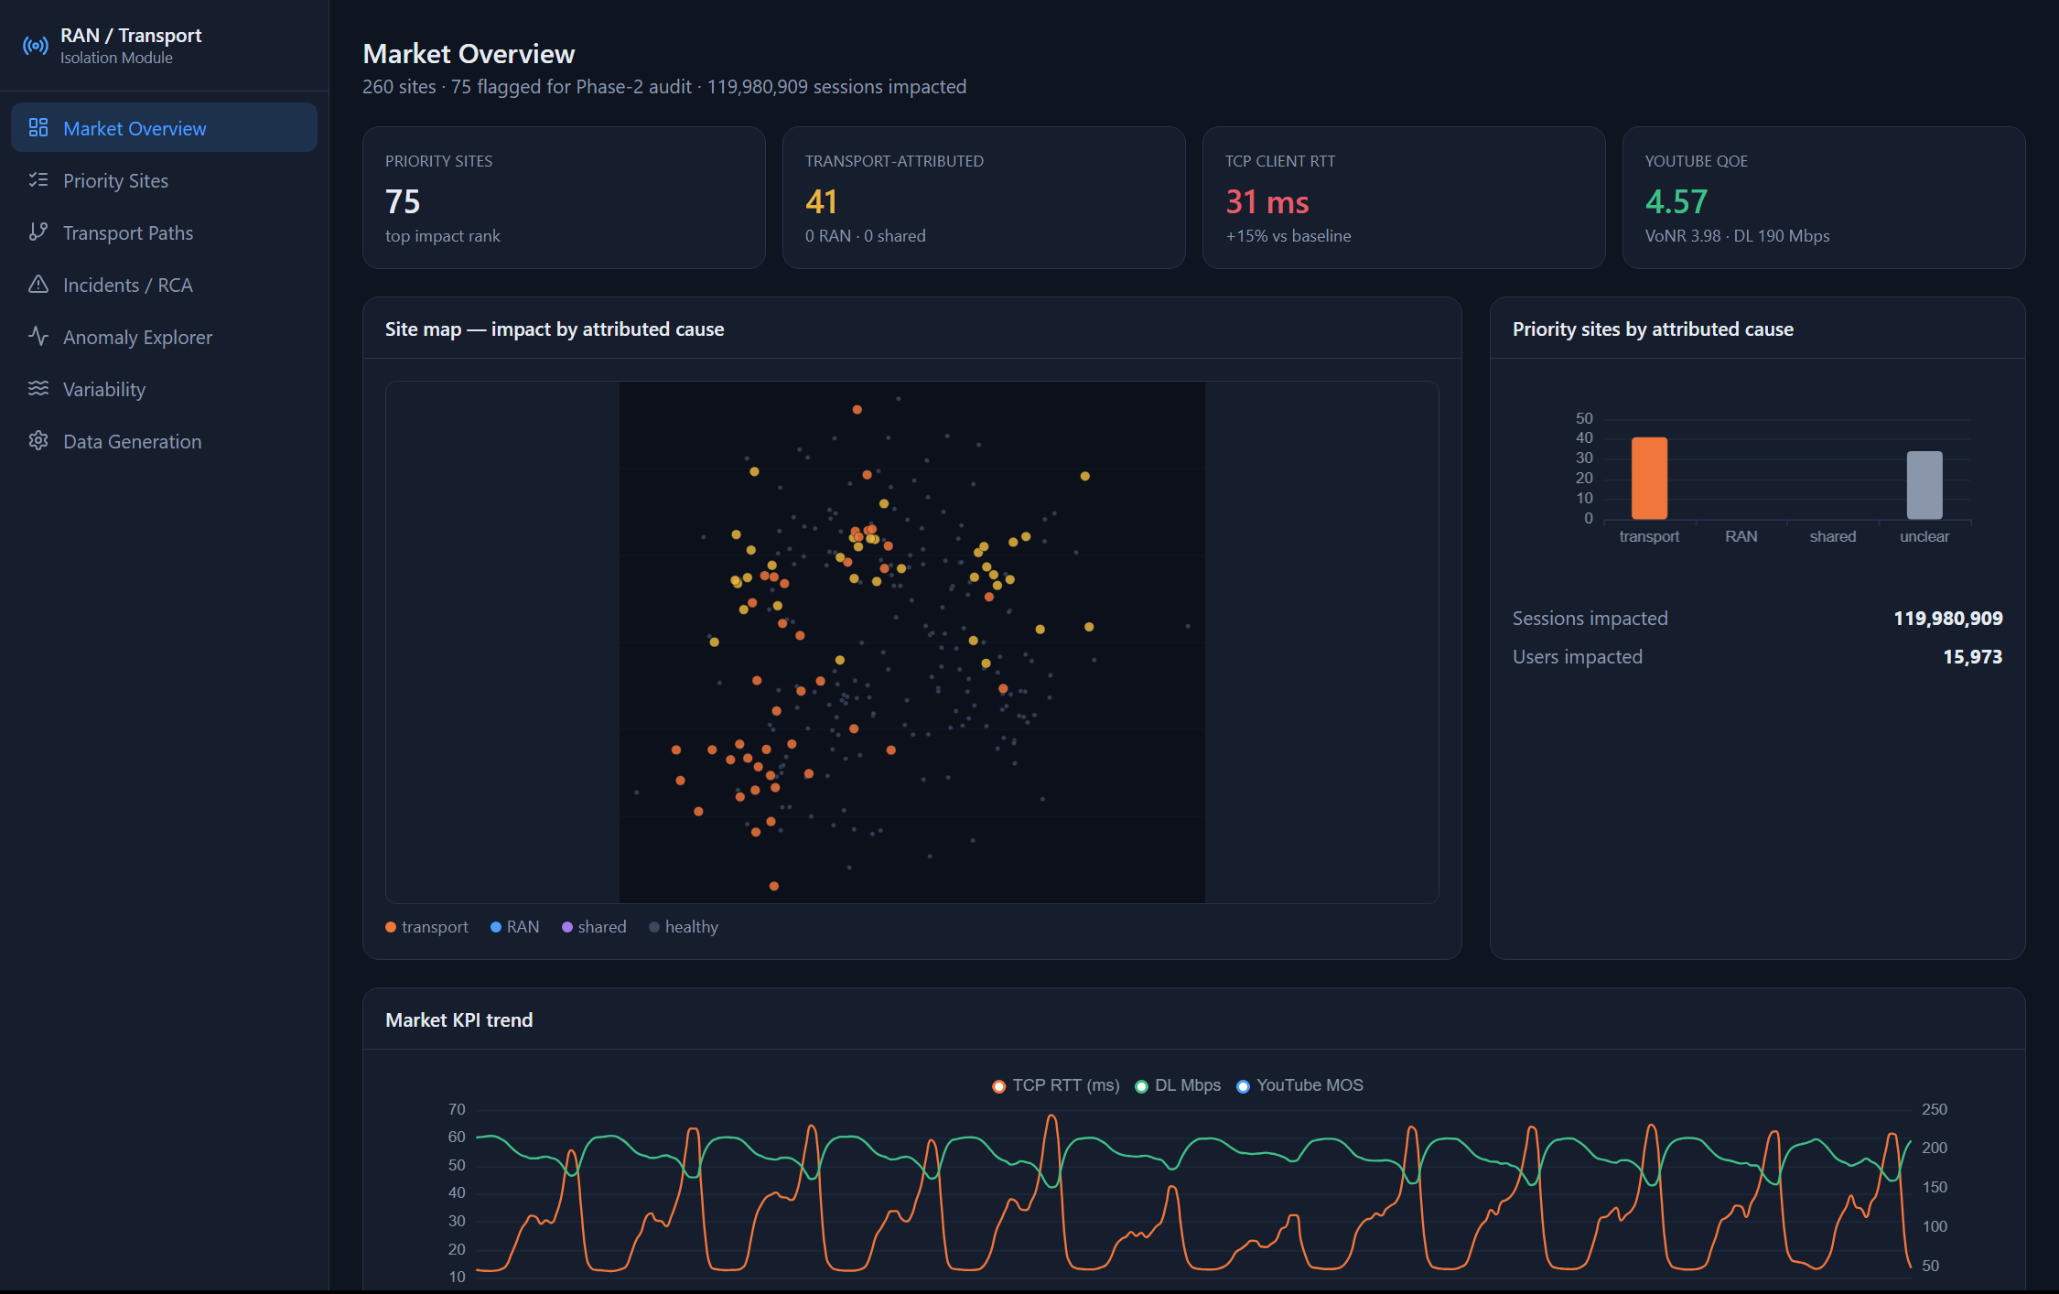
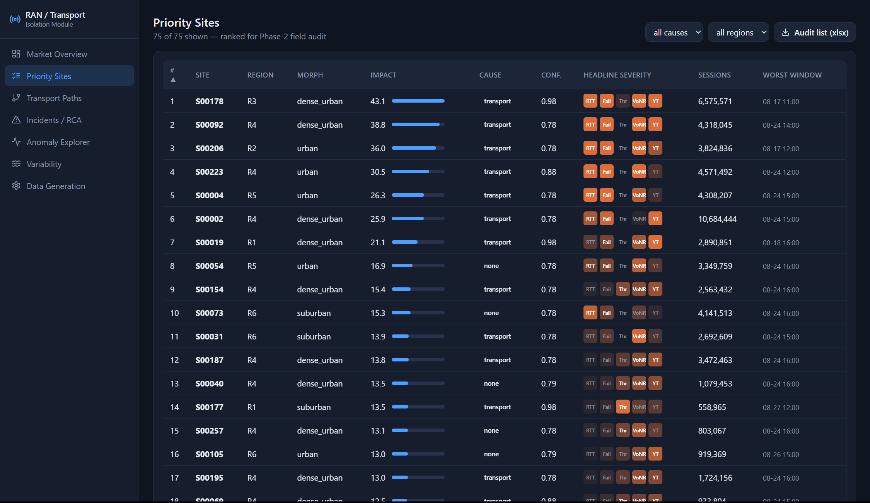
THE DASHBOARD
Market overview → the priority list
Ranked top 75–100 · filter by cause / region
One-click export to the Phase-2 audit list (.xlsx)
Priority Sites — the ranked audit shortlist
Market Overview — site map coloured by attributed cause, KPI tiles vs baseline, attribution split
RAN & TRANSPORT ISOLATION
17 / 20
Notes:
Market Overview and the ranked Priority Sites grid with the audit-list export.

Slide 18
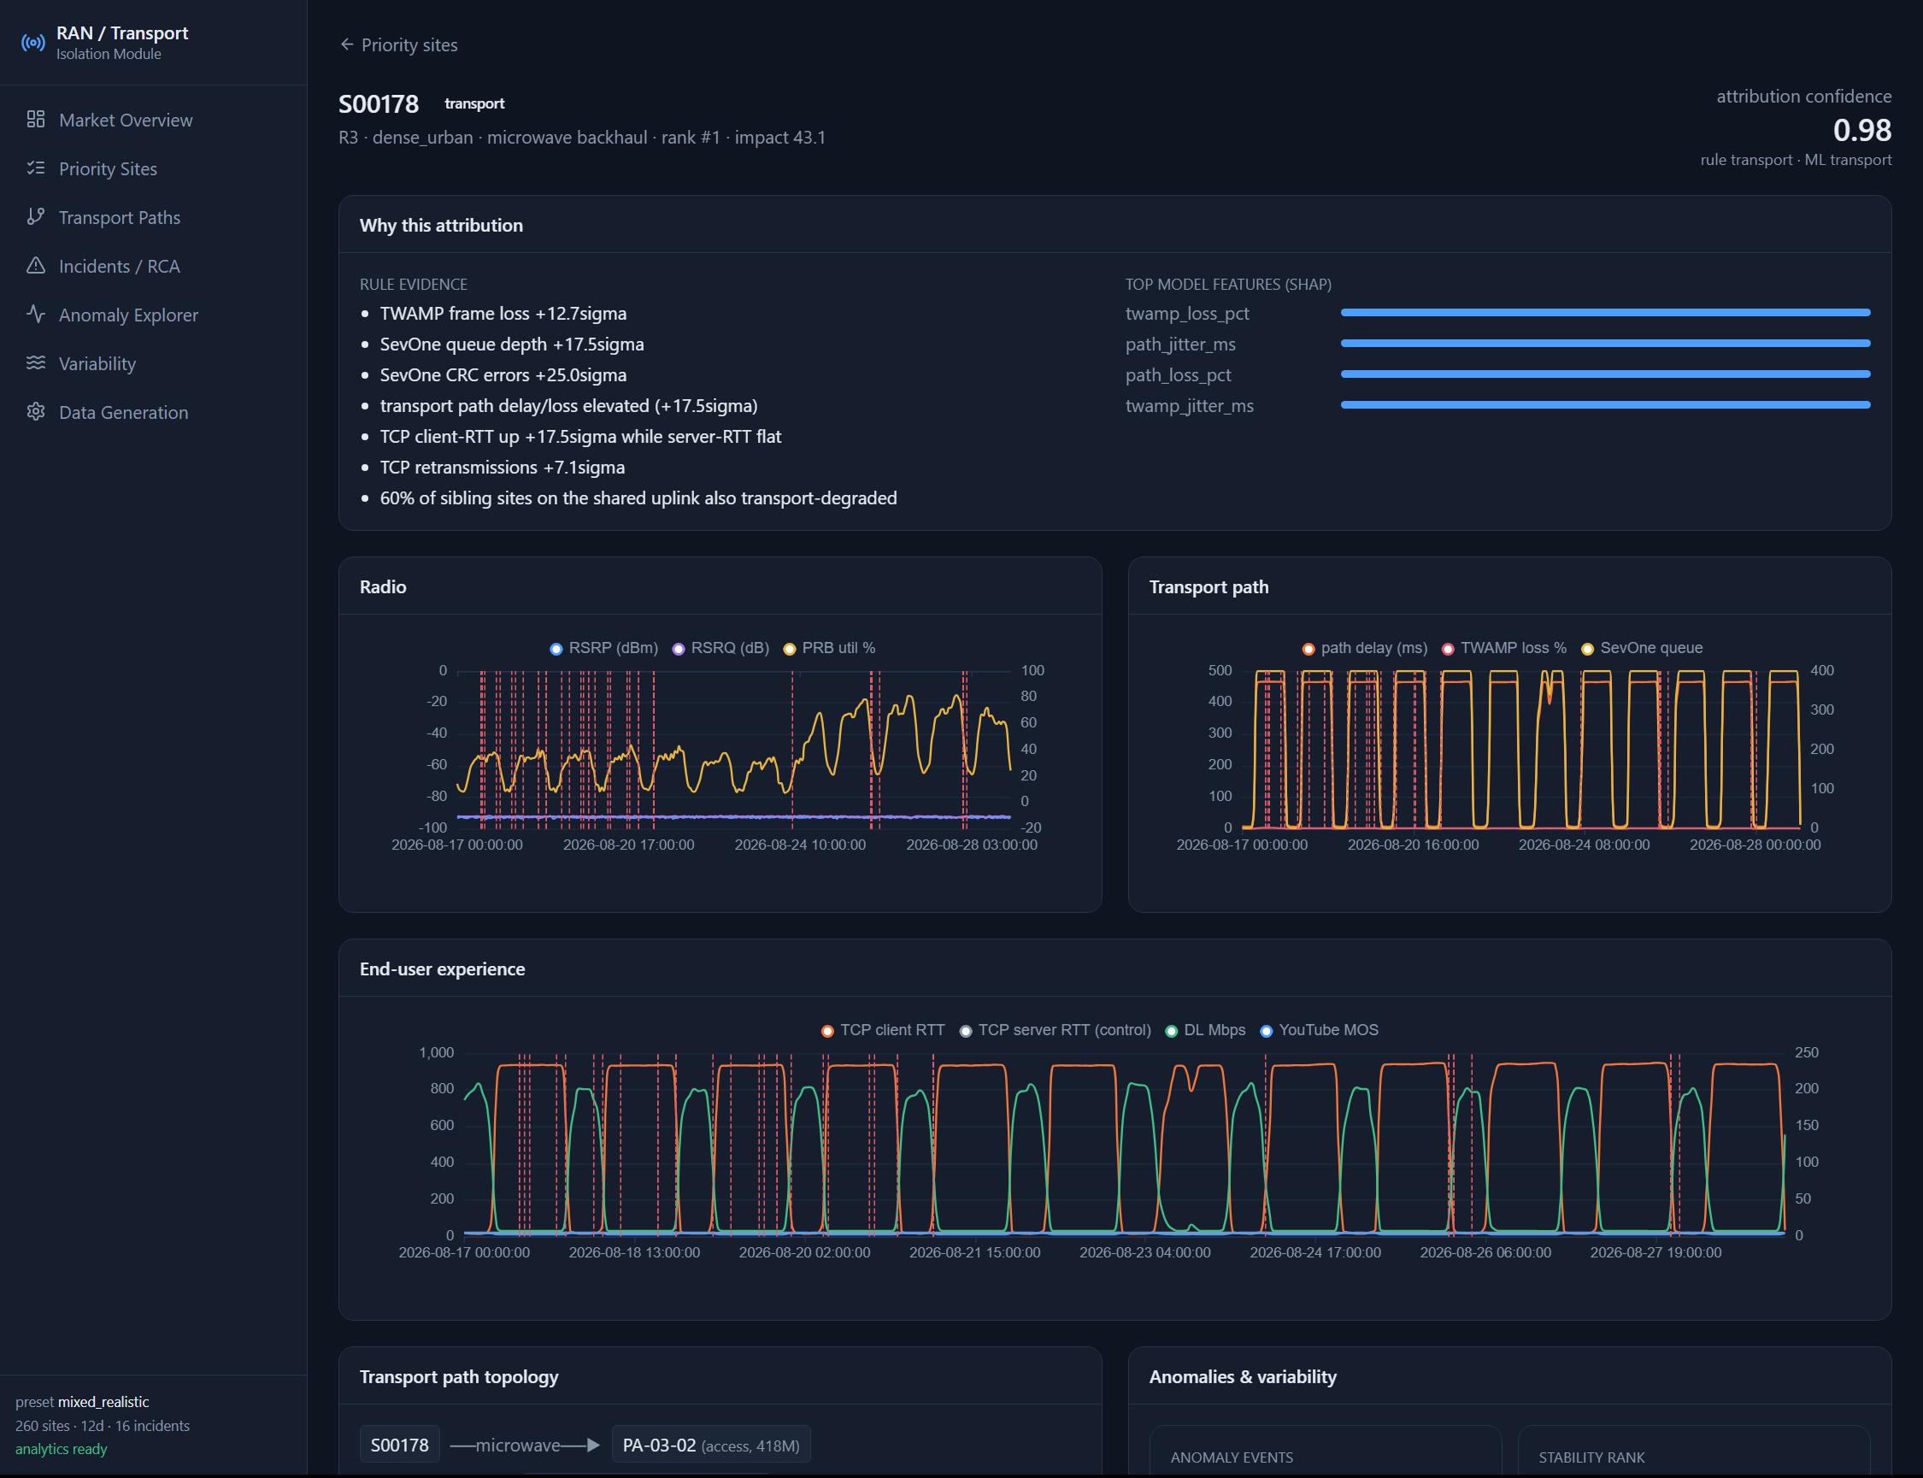
THE DASHBOARD
Per site — why this attribution
Rule evidence
plain-English, threshold-triggered — no model
SHAP
which model features drove the call
Radio vs Transport panels
side by side, with anomaly markers
Ground truth (demo)
the injected fault, so you can check it
Site Detail — S00178, transport-attributed, confidence 0.98
RAN & TRANSPORT ISOLATION
18 / 20
Notes:
The explainability surface: rule evidence, SHAP bars, radio-vs-transport panels, and the true injected fault in demo mode.

Slide 19
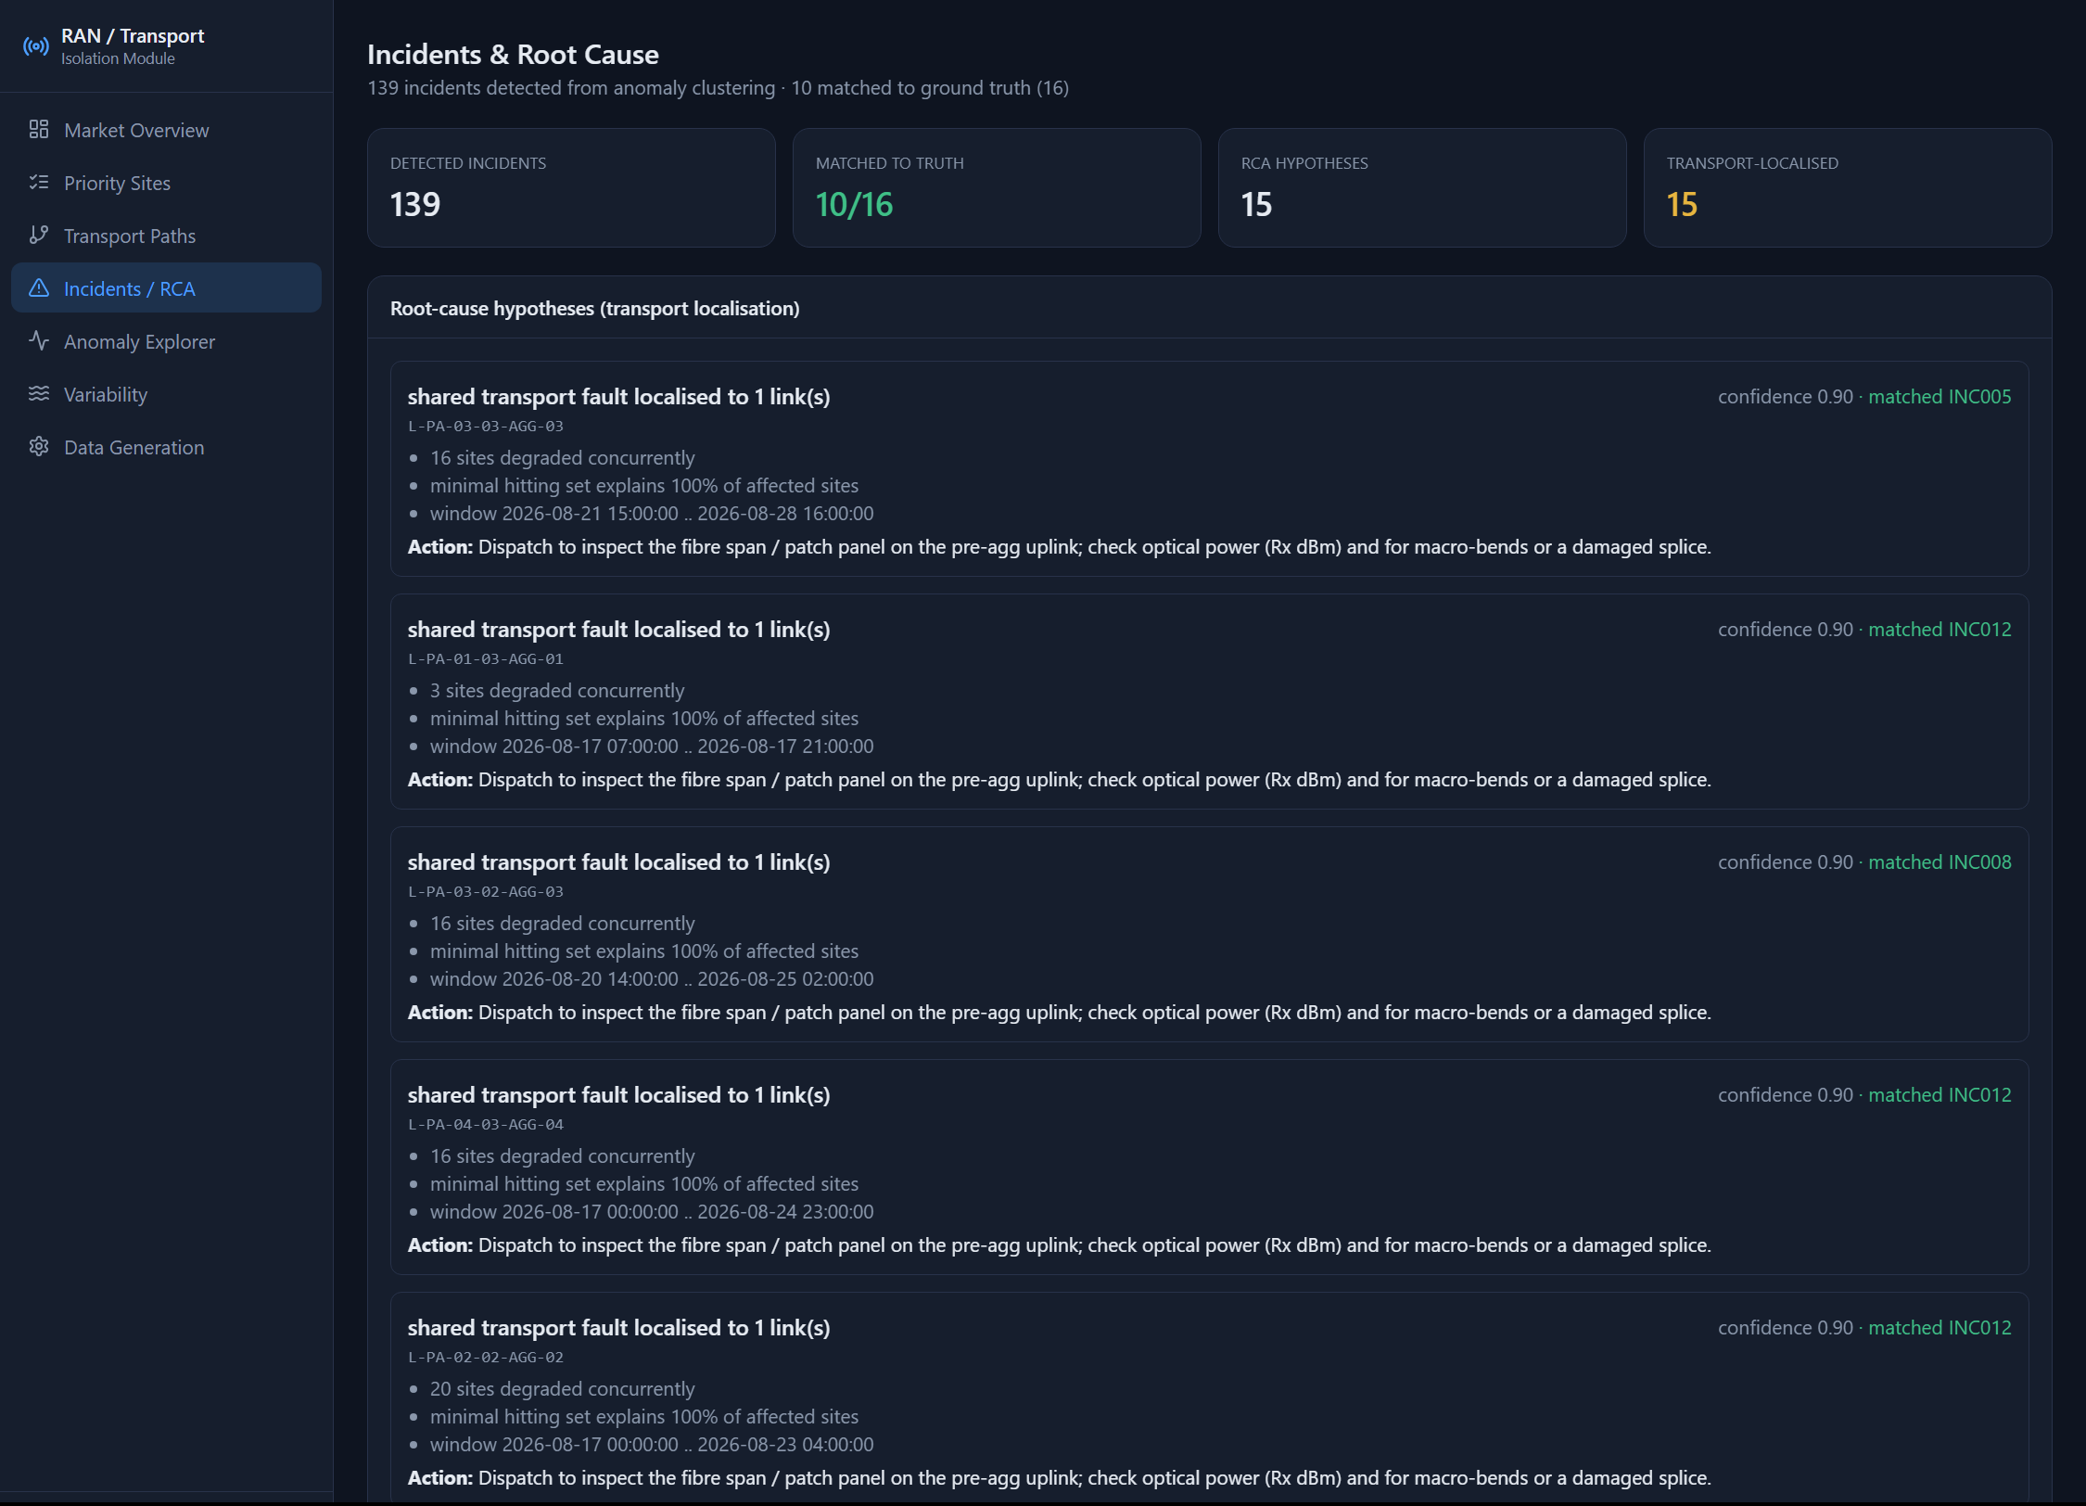
WORKED SCENARIO
Monday 08:10 — a monsoon fibre event
1
Overview
Transport-attributed count jumps overnight; an orange cluster appears in region R2 on the map.
2
Priority Sites
Filter to ‘transport’ — the top rows share region R2 and an 08:00–14:00 worst window. Note S00178.
3
Site Detail (S00178)
Transport panel spikes (TWAMP loss +12.7σ, SevOne queue +17.5σ); radio flat; client-RTT up, server-RTT flat; 60 % of sibling sites also degraded. Confidence 0.98.
4
Transport Paths
S00178's PA-uplink shows 6.6 % loss; almost every sibling on it is orange → the fault is the link, not 19 sites.
5
Incidents / RCA
Already localised: ‘shared transport fault → 1 link, explains 100 %, matched INC005’. Action: inspect the fibre span / Rx power.
6
Export
Send the R2 cluster to the field team as one audit item — the link — with the recommended checks.
RAN & TRANSPORT ISOLATION
19 / 20
Notes:
A concrete investigation: a wet-weather fibre degradation hitting a regional cluster, from symptom to a single audit item in six clicks.

Slide 20
DEPLOY & OPERATE
Standalone, controllable, explainable
Who uses it
Deploy & control
Troubleshoot
NOC / service assurance — daily triage
IP transport ops — target the link
RAN optimisation — filter transport noise
Planning — recurring congestion → upgrades
Field audit team — the prioritised list
docker compose up — or native (uv + Node)
API + dashboard on :8000; SQLite only
Windows / Linux; VS Code tasks included
Data Generation page: presets, distributions, labelled incidents, live progress
‘none’ = degraded, cause unclear — don't dispatch
low confidence → corroborate on Transport Paths
no data → run generate + analytics
reach from a laptop → bind 0.0.0.0 + open port
OOM → fewer sites / days
github.com/manjunathsept11/ran-transport-isolation
Docs in the repo: README · DASHBOARD_GUIDE · METHODS · DATA_GENERATION · INSTALL_VM
RAN & TRANSPORT ISOLATION
20 / 20
Notes:
Packaging, personas, the control surface, and the common gotchas.

