Slide 1
CORE
RAN & Transport
AGG
AGG
AGG
Isolation Module
Rank the sites, nodes and transport paths most impacted by transport-network problems — and tell you which are transport vs RAN, with the evidence.
IP Transport Analytics
Impact Analytics Dashboard
Phase-2 Audit Prioritisation
Synthetic-data build · standalone web app · github.com/manjunathsept11/ran-transport-isolation
RAN & TRANSPORT ISOLATION
1 / 15
Notes:
Title. One-liner: rank transport-impacted sites and separate transport vs RAN causes, with explainable evidence. Built on synthetic data now; live feeds in Phase 2.

Slide 2
THE USE CASE
Correlate experience with transport — then rank and attribute
Ingest and correlate end-user experience metrics with transport-layer telemetry to identify and rank the sites, nodes and transport paths most impacted — and separate transport-attributed impairment from RAN-attributed impairment using serving-cell context and radio signal quality.
Deliverables
Impact analytics dashboard ranking sites, nodes and transport paths
Headline KPIs: TCP RTT, TCP Fail %, Ookla throughput, VoNR MOS, YouTube QoE
Prioritised list of the top 75–100 sites for a Phase-2 field audit (CSV / Excel)
Per-site root-cause indicators and a recommended technician action
Transport-attributed impairment distinguished from RAN-attributed
5
6
75–100
0
data feeds
stitched
analytics
modules
sites for the
Phase-2 audit
LLM calls in
the runtime
RAN & TRANSPORT ISOLATION
2 / 15
Notes:
The use case straight from the brief. Outputs: a ranked dashboard, an exportable audit shortlist, and per-site root-cause + action.

Slide 3
THE PROBLEM
Users complain. Whose problem is it?
?
PA
AGG
user
RAN
transport
internet
Looks like RAN
Looks like Transport
Coverage hole / poor RSRP
Interference, low RSRQ
PRB exhaustion at busy hour
Sleeping sector, VSWR / feeder fault
Fibre degradation, microwave fade
Backhaul congestion at busy hour
SFP / CRC errors, queue drops
Routing flap, MTU black-hole
Same symptom — high latency, buffering, dropped calls — two different owners, two different fixes.
RAN & TRANSPORT ISOLATION
3 / 15
Notes:
The core problem: the same user-visible symptom can be radio or transport, and each goes to a different team with a different fix.

Slide 4
PAIN POINTS TODAY
Manual, siloed, and unmeasurable
Siloed data
Manual triage
Finger-pointing
Ookla, N3 probes, TWAMP, SevOne each live in their own tool — no single correlated view.
Engineers eyeball KPI graphs site by site. It does not scale to a whole market.
RAN and transport teams each say ‘not us’; tickets bounce between them for days.
No prioritisation
No ground truth
Slow Phase-2 audits
Which 80 sites do we audit first? Today that answer is gut feel.
There is no way to check whether the triage call was actually right.
Shortlisting sites for field work takes weeks of cross-team analysis.
RAN & TRANSPORT ISOLATION
4 / 15
Notes:
Six concrete pain points the module removes.

Slide 5
THE DATA
Five feeds, one timeline
Ookla SpeedTest
UL/DL throughput, loaded latency, RSRP, RSRQ
user experience + radio
N3 probe EDRs
TCP client RTT, TCP server RTT, TCP fail %, retransmissions, VoNR MOS
session — the split point
YouTube / Audio QoE
video / audio MOS, rebuffer ratio, startup delay
application
TWAMP
one-way / round-trip delay, frame loss, jitter
pure transport (active probes on each link)
SevOne
router queue depth, discards, interface utilisation, CRC errors
transport devices
Joined on site · cell · transport-path · 5-minute bin.
RAN & TRANSPORT ISOLATION
5 / 15
Notes:
The five feeds and what each contributes. The N3 probe's client-vs-server RTT split is the key one for isolation.

Slide 6
SOLUTION ARCHITECTURE
One pipeline, batch now, streaming later
Feeds
Stitch &
align
Feature
table
Score &
rank
Attribute
transport / RAN
Localise
(graph RCA)
Dashboard
+ audit list
Now — batch
Live — streaming (Phase 2)
Synthetic generator writes the SQLite warehouse + Parquet raw layer
na generate → na analytics → na report (or the Settings page)
Dashboard reads pre-computed serving tables — always fast
The five feeds land continuously via the ingestion layer (Ramoji)
5-min rollups on arrival; analytics recompute on a schedule (e.g. hourly)
Same serving tables, same dashboard — plus alerting on new priority sites
SQLite warehouse · FastAPI backend · React dashboard · background job runner
RAN & TRANSPORT ISOLATION
6 / 15
Notes:
The pipeline is identical for synthetic and live data; only the source and the cadence change. The dashboard never runs analytics inline - it reads serving tables.

Slide 7
HOW ISOLATION WORKS
Transport vs RAN — the tell
1 The RTT split
2 Signature match
3 Common cause
TCP client RTT = radio + the whole transport path (round trip). TCP server RTT = internet only, site-independent — the control.
Radio: RSRP / RSRQ degraded, PRB near 100 %, usually one sector. Transport: TWAMP loss / jitter, SevOne queue / CRC, per-link delay — the transport layer's own instruments.
A single radio fault cannot degrade 18 sites at once. A shared backhaul link does it every time.
Client RTT up while server RTT flat → access / transport, not the internet.
Pure-transport instruments lit, radio clean → transport.
‘% of sibling sites on the shared uplink also degraded’ is the strongest tell.
transport
RAN
shared
unclear
+ a calibrated confidence score
Any one alone is weak — together they give a class and a confidence.
RAN & TRANSPORT ISOLATION
7 / 15
Notes:
Three independent tests. Any one alone is weak; together they give a class plus a confidence.

Slide 8
THE DATA ENGINE
The data is synthetic — on purpose
Why
The layered causal model
Data-pipeline engineering is not in scope yet — real feeds arrive in Phase 2 (Ramoji).
A simulator lets us build and validate the analytics against known answers.
Labelled fault injection → every record has a ground-truth cause.
So precision / recall of the attribution is a real, reported number — not a guess.
Demand
diurnal + weekly load shape
Radio
path loss → RSRP · load → PRB · interference → RSRQ
Transport
M/M/1 queueing on shared links → delay / jitter / loss
Session / App
TCP RTT, throughput, VoNR MOS (E-model), YouTube QoE
Every metric is derived from shared latent state — so the KPI correlations are physical, not bolted-on noise.
RAN & TRANSPORT ISOLATION
8 / 15
Notes:
Synthetic on purpose: it is the only way to measure attribution accuracy. The causal model makes the correlations realistic.

Slide 9
DATA GENERATION
Six stages — seeded and reproducible
1
Topology
market → regions → sites → cells; routers; links; per-site 3-hop path
3-tier transport topology
2
Incidents
explicit + Poisson auto faults, each resolved to targets & a window — GROUND TRUTH
CORE
3
Causal metric model
per 5-min bin: demand → queueing → radio → session/app KPIs
AGG
AGG
AGG
4
Raw sessions
Poisson count of individual Ookla tests / QoE sessions per site-bin
5
Hourly rollups
5-min parquet → hourly; transport rolled along each site's path
PA (pre-agg) → AGG uplinks are shared by whole clusters
6
Load
SQLite warehouse (dims, ground truth, rollups, sessions)
one link fault → a whole cluster degrades → the common-cause signal
~1,200 sites · ~1,450 links · 5-min granularity · 1–2 weeks · same seed → identical dataset
RAN & TRANSPORT ISOLATION
9 / 15
Notes:
Six generation stages and the 3-tier tree topology. Shared uplinks are what make transport faults have a clean blast radius.

Slide 10
METHODS
Statistical, ML and graph — explainable first
Baselining
robust trailing median + inter-decile range; morphology + load peer-group z-scores
Impact scoring
weighted multi-criteria composite; session- and user-impacted weighting
Attribution
rule engine ∪ LightGBM (gradient-boosted trees) + SHAP; isotonic-calibrated ensemble
Anomaly
STL residual + Isolation Forest + PCA reconstruction error; time + topology clustering
Correlation
Spearman, partial correlation (precision matrix), lead / lag cross-correlation
Variability
variance components, coefficient of variation, PSI drift (week over week)
Root cause
networkx transport graph + minimal hitting set (Noisy-OR fault localisation)
Explainable first: hand rules + SHAP + plain-English evidence. No LLM in the runtime.
RAN & TRANSPORT ISOLATION
10 / 15
Notes:
Tabular ML (LightGBM) not deep learning - fast retrain, handles missing data, and a technician can audit it via SHAP and the rule evidence.

Slide 11
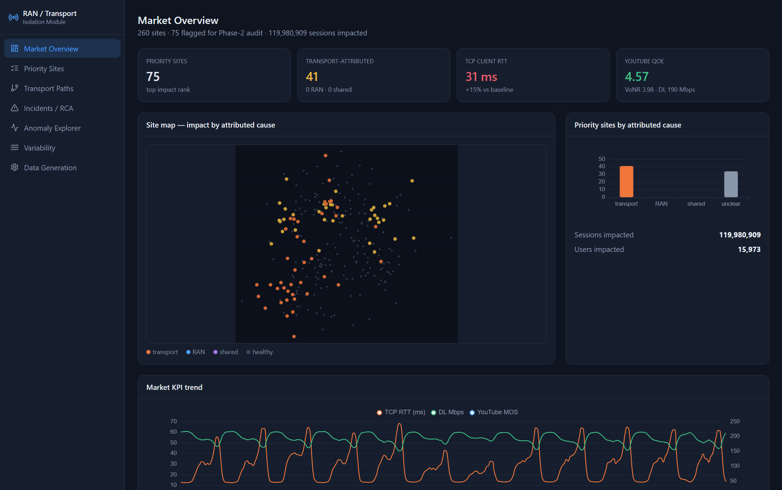
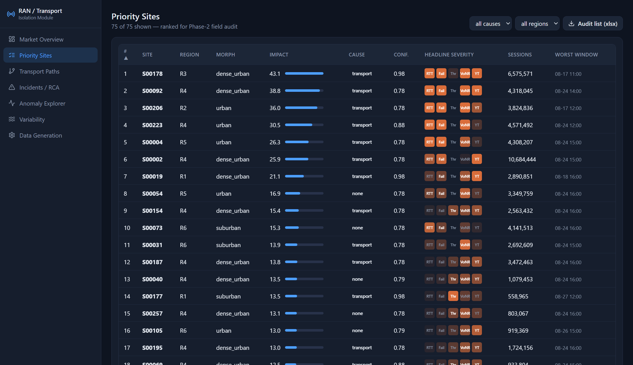
THE DASHBOARD
Market overview → the priority list
Ranked top 75–100 · filter by cause / region
One-click export to the Phase-2 audit list (.xlsx)
Priority Sites — the ranked audit shortlist
Market Overview — site map coloured by attributed cause, KPI tiles vs baseline, attribution split
RAN & TRANSPORT ISOLATION
11 / 15
Notes:
Screens: Market Overview and the ranked Priority Sites grid with the audit-list export.

Slide 12
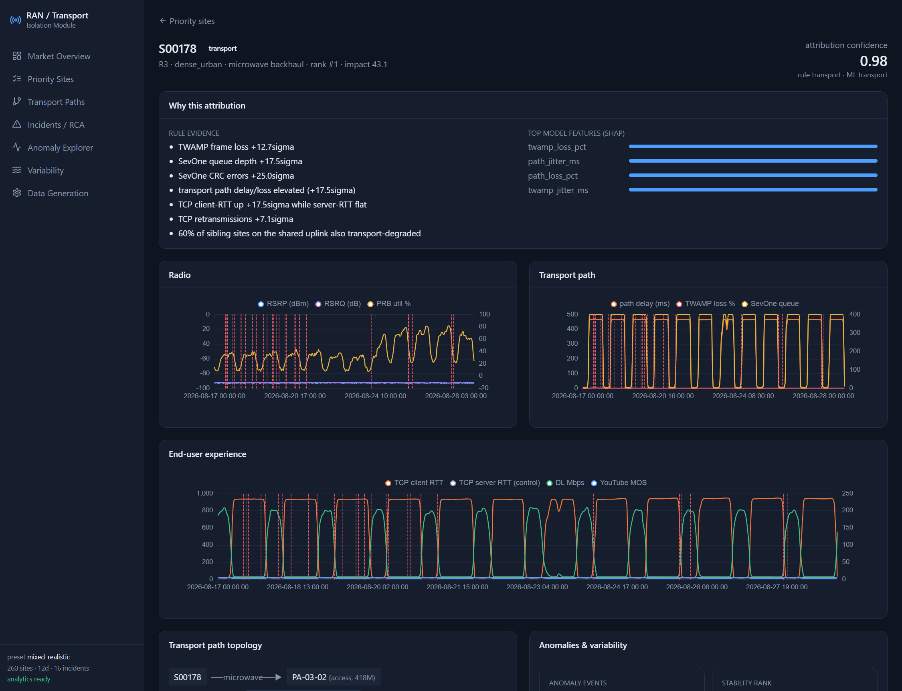
THE DASHBOARD
Per site: why this attribution
Rule evidence
plain-English, threshold-triggered — no model
SHAP
which model features drove the call
Radio vs Transport panels
side by side, with anomaly markers
Ground truth
the injected fault, shown in demo mode
Site Detail — S00178, transport, confidence 0.98
RAN & TRANSPORT ISOLATION
12 / 15
Notes:
Site Detail: the explainability surface - rule evidence, SHAP bars, radio-vs-transport panels, and (demo) the true injected fault.

Slide 13
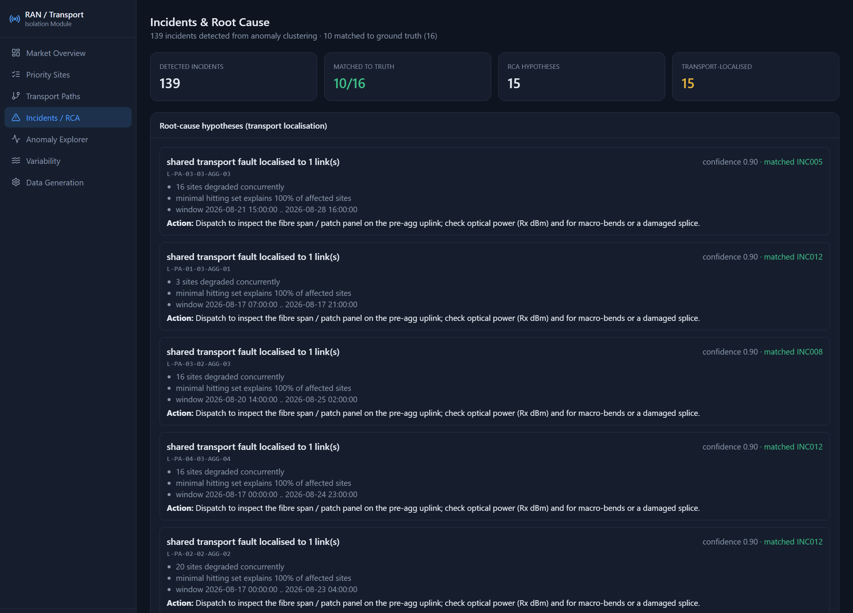
THE DASHBOARD
Root cause — localised to the link
Minimal hitting set
Over the transport graph: the smallest set of shared links whose failure explains the whole affected-site set.
What the technician sees
“19 sites degraded concurrently · hitting set explains 100 % · matched INC017”
Action: inspect the fibre span / patch panel on the pre-agg uplink; check optical Rx power.
Incidents / RCA — anomaly clusters localised, matched to ground truth
RAN & TRANSPORT ISOLATION
13 / 15
Notes:
Incidents / RCA: anomaly clusters localised to a link with a matched-ground-truth badge and a recommended action.

Slide 14
USERS & WORKFLOW
Who uses it — and how
NOC / service assurance
The investigation — six clicks
daily triage — which sites to escalate, to whom
1
Overview — is there a cluster?
IP transport operations
confirm common cause; target the link, not 18 sites
2
Priority Sites — filter to transport
RAN optimisation
3
Site Detail — evidence + confidence
filter out transport noise; focus on real radio issues
4
Transport Paths — siblings on the link?
Network planning
recurring congestion → capacity upgrades
5
Incidents / RCA — already localised?
Field audit team
6
Export the Phase-2 audit list
the prioritised list + the recommended checks
RAN & TRANSPORT ISOLATION
14 / 15
Notes:
Five personas, one shared workflow. The tool turns a multi-team, multi-day analysis into a six-click investigation.

Slide 15
DEPLOY & OPERATE
Standalone, controllable, explainable
Deploy
Control
Troubleshoot
One command: docker compose up — or native (uv + Node).
FastAPI serves the API and the dashboard on :8000.
SQLite warehouse; no external services.
Windows / Linux; VS Code tasks included.
The Data Generation page: pick a preset, edit distributions, schedule labelled incidents.
Hit Generate — analytics runs automatically, with live progress.
Save your own presets; re-run analytics or rebuild the report on demand.
‘none’ = degraded, cause unclear — don't dispatch; low confidence → corroborate on Transport Paths.
No data → run generate + analytics.
Can't reach it from a laptop → bind 0.0.0.0 + open the port.
OOM → fewer sites / days.
github.com/manjunathsept11/ran-transport-isolation
Docs in the repo: README · DASHBOARD_GUIDE · METHODS · DATA_GENERATION · INSTALL_VM
RAN & TRANSPORT ISOLATION
15 / 15
Notes:
Packaging, the control surface (Settings page), and the common gotchas - for the tool's output and for running the app.

