Slide 1

Automating ML with PyCaret
Making Machine Learning Simple & Fast

Slide 2

About Me
Manjunath Janardhan, Principal AI Engineer at MSG Global
21+ years of software engineering experience
Key expertise areas: Gen AI Solutions, Microservices & Cloud
Patent Holder
Speaker, Medium Articles, YouTuber (3 channels).
Notes:
This slide serves as an introduction to my professional background and journey. I will cover my educational background, work experiences, and the skills I've developed. Additionally, I will share my interests and passions within the industry. The LinkedIn QR code will facilitate networking, and the portfolio link will provide insights into my work and projects.

Slide 3

Agenda
Introduction to ML and PyCaret Fundamentals
Live Demo: Training Models with the Diabetes Dataset
Live Demo: Comparing Models for Best Performance
Live Demo: Model Persistence & Deployment
Interactive Q&A Session

Slide 4
Introduction to Machine Learning
Machine Learning (ML): Algorithms enable computers to learn from data and make predictions or decisions.
Typical ML Workflow:
Data preprocessing
Model selection and training
Evaluation
Deployment
Challenges: Complexity, need for coding, time-consuming setup.

Slide 5
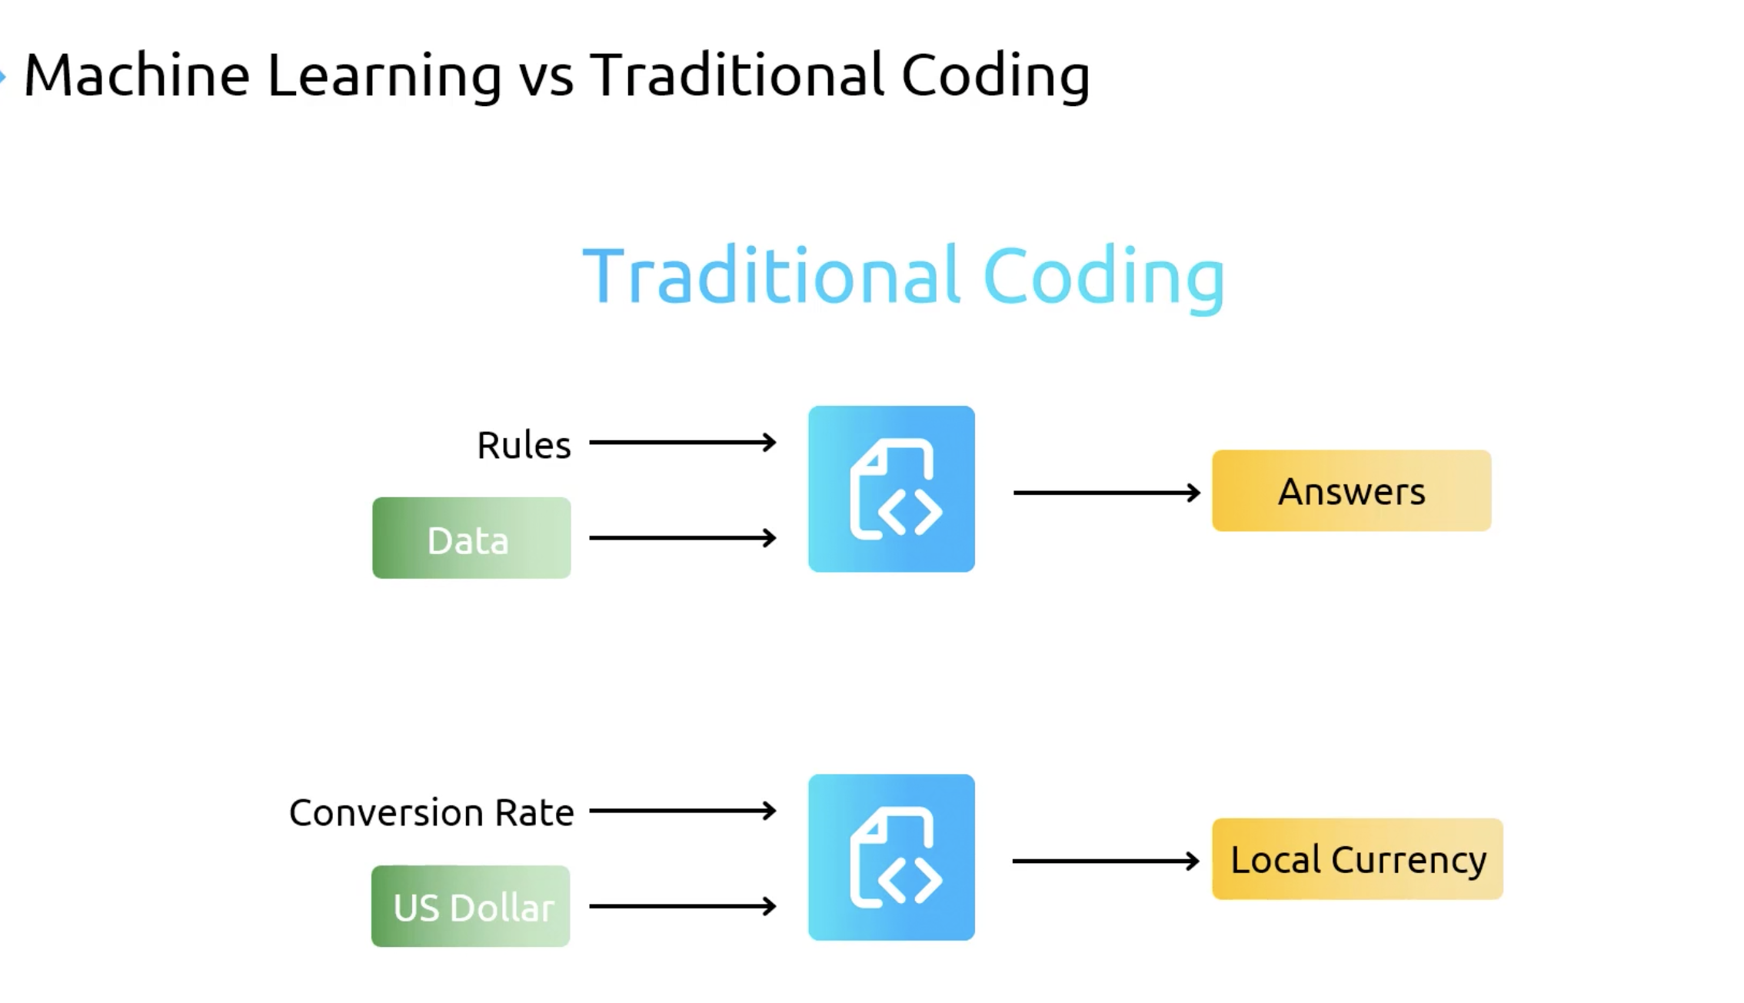

Slide 6
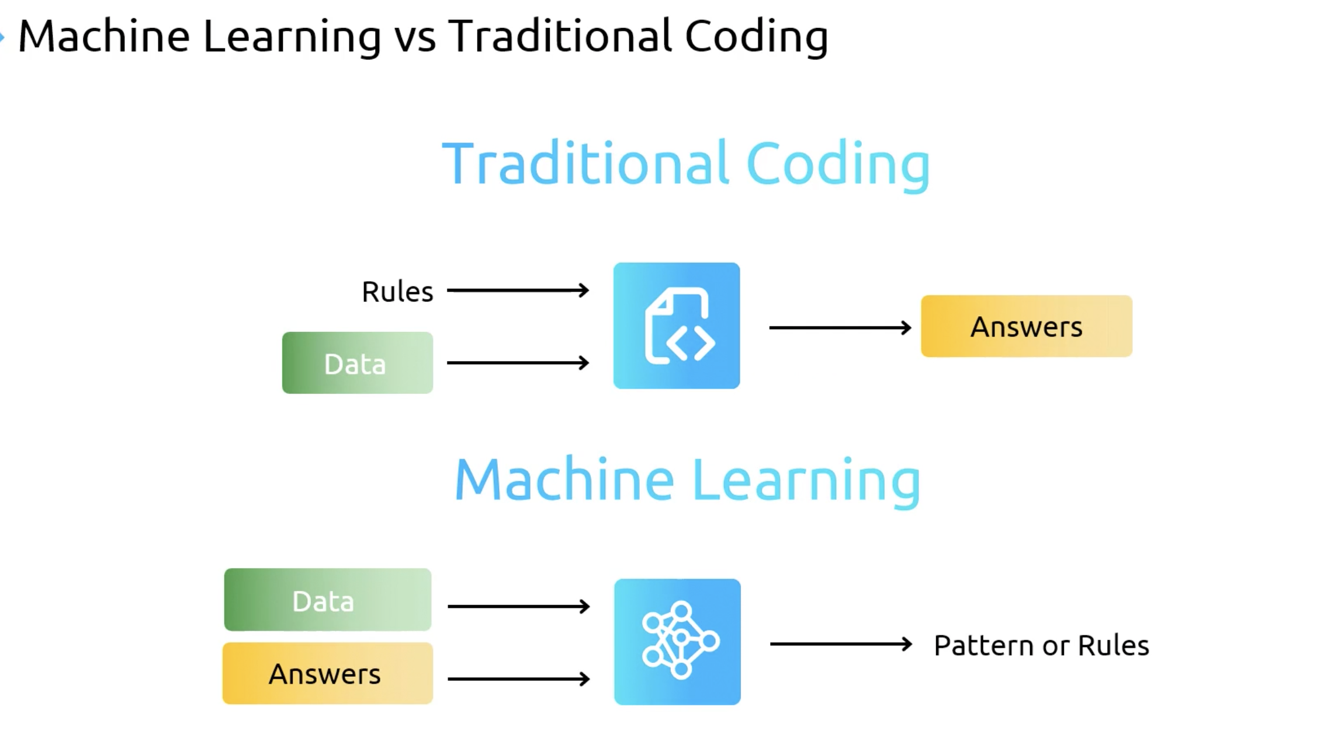

Slide 7
Why PyCaret?
Low-code, fast ML experimentation in Python
Clean API for training, comparing, and tuning models
Automation of preprocessing, imputation, and feature selection
Multiple model benchmarking with one command

Slide 8
Live Demo – Training Models (Diabetes Dataset)
Dataset: Diabetes dataset with health metrics and outcome label.
Features:
Pregnancies, glucose, blood pressure, BMI, age, etc.
Goal: Predict diabetes onset.
PyCaret Workflow:
Import module and datasets
Setup environment
Train models using multiple algorithms with one line of code

Slide 9
PyCaret vs MLOps Tools
Feature | PyCaret | MLflow | Metaflow
Primary Use | Low-code ML development | Model tracking, deployment | Workflow orchestration
Model Training | ✅ Yes | ❌ No | ❌ No
Experiment Logging | Basic (opt-in) | ✅ Full logging | ✅ Supports via integrations
Feature Engineering | ✅ Basic built-in | ❌ Not included | ❌ Not included
Scale / Parallel Training | ❌ Limited | ✅ With plugins | ✅ Supports DAGs
Deployment Support | Basic (pickle export) | ✅ REST, batch, registry | ✅ via AWS, Argo, etc.

Slide 10
Key Takeaways
PyCaret streamlines the entire ML workflow
Enables efficient model development and testing
Supports easy model comparison, persistence, and deployment
Great for rapid prototyping and education!

Slide 11
Resources
Github : https://github.com/pycaret/pycaret
Docs : https://pycaret.readthedocs.io/en/stable/
Dataset : https://github.com/pycaret/pycaret/blob/master/datasets/diabetes.csv
Demo : https://github.com/manjunathshiva/PythonMeetup

Slide 12

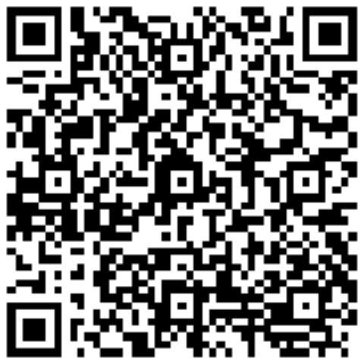

THANK YOU
https://www.youtube.com/@AIBroEnglish
https://www.youtube.com/@AIBroKannada
LinkedIn

