Slide 1
ADVERTISEMENT SUCCESs PREDICTION
- Employability Assessment-

Slide 2
Problem Statement
The holiday season is just around the corner—Christmas trees have been decorated, lights and wreaths hung, streets all decked up, Santa costumes rented out, and holiday cards in the mailbox.
Because of holiday cheer, retail brands, big and small, want to earn considerable profits, and therefore, are investing significantly in advertising. These brands have approached an advertising agency to plan and execute ad campaigns that will help them increase the footfall in their stores.
You have been hired by this advertising company to assess the revenue that can be generated by a proposed ad. Based on the demographic information provided, you need to predict whether the revenue generated will cover costs to produce and air the ad(Whether there will be a net gain from an ad or not)
This will help guide decision-making for the firm, as they will want to pursue ads that are likely to generate a net gain for their clients— thereby boosting the advertising firm’s reputation.

Slide 3
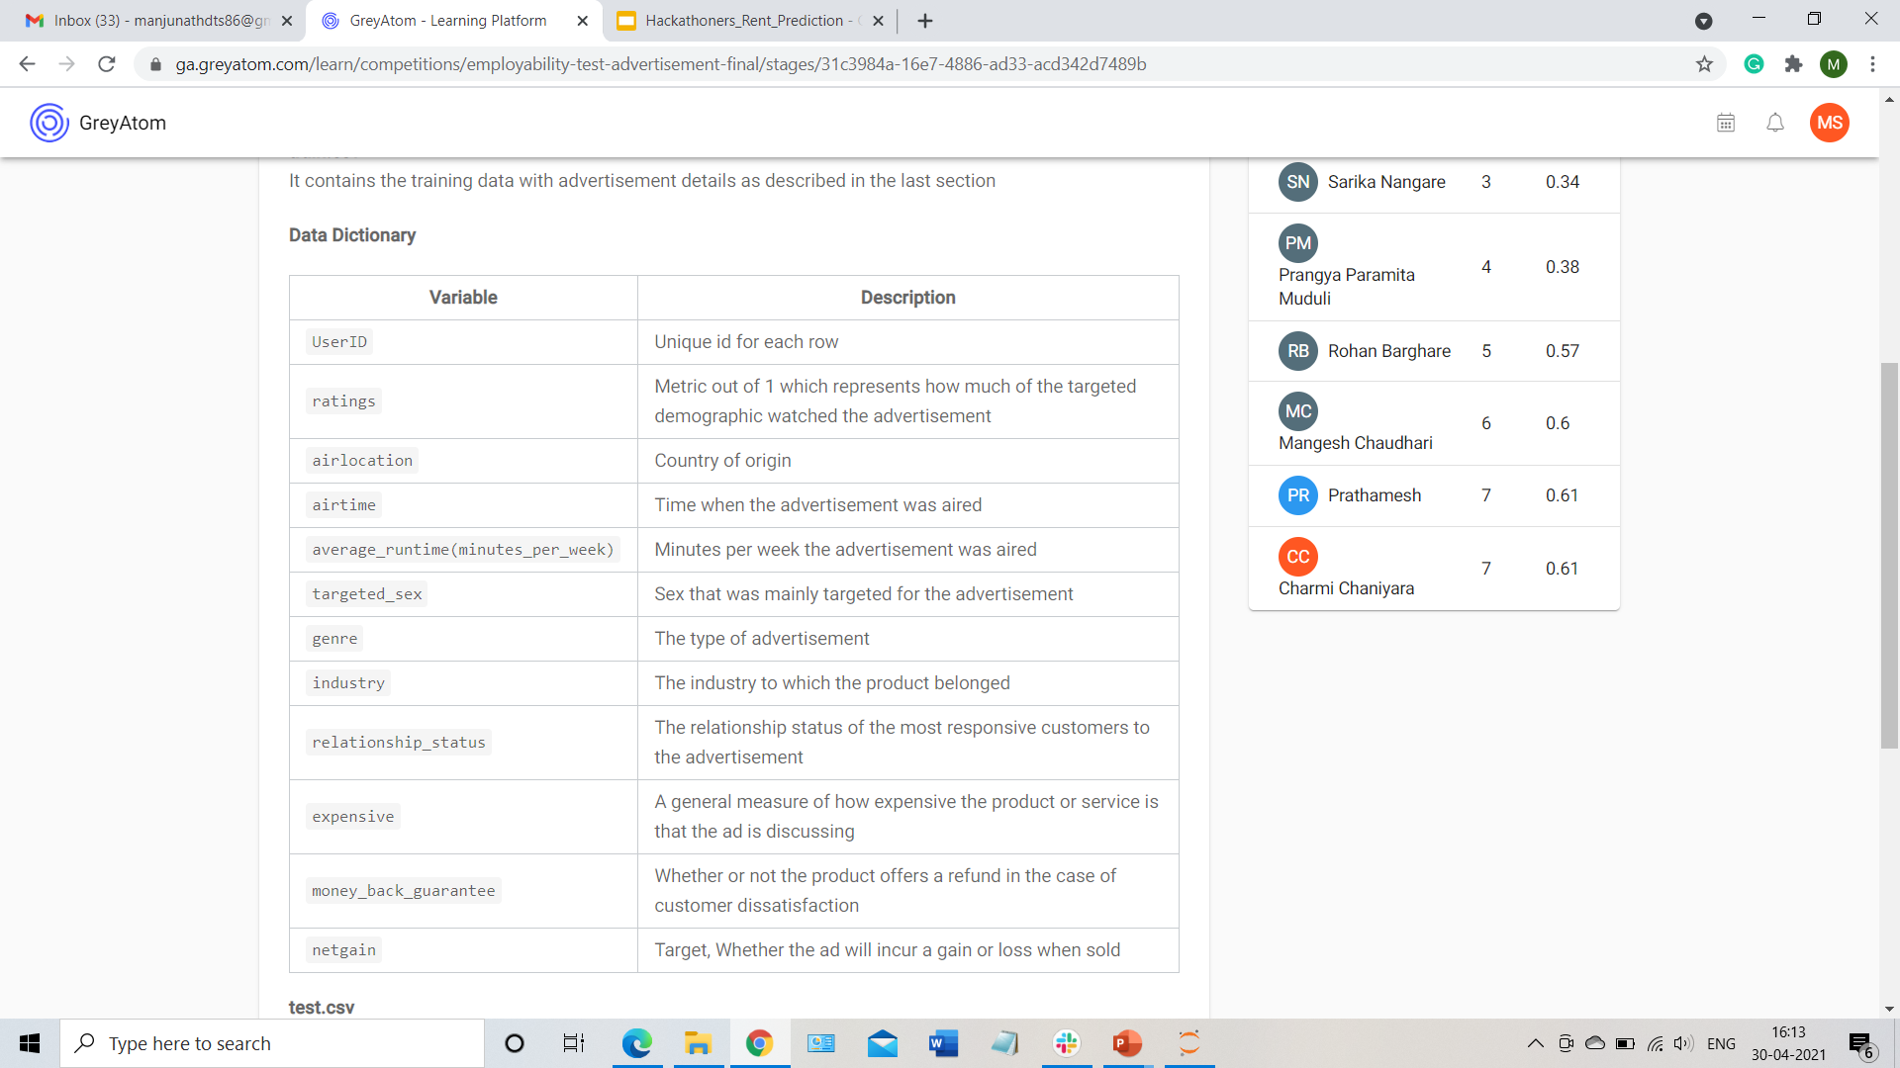
data
The training dataset contains 19536 records and the test dataset contains 6512 records. Following are the features of the dataset:-

Slide 4
Data cleaning
There was no missing/null values in the data set.
Removing the entry with air location 'Trinadad&Tobago' as it is not in Test data.

Slide 5
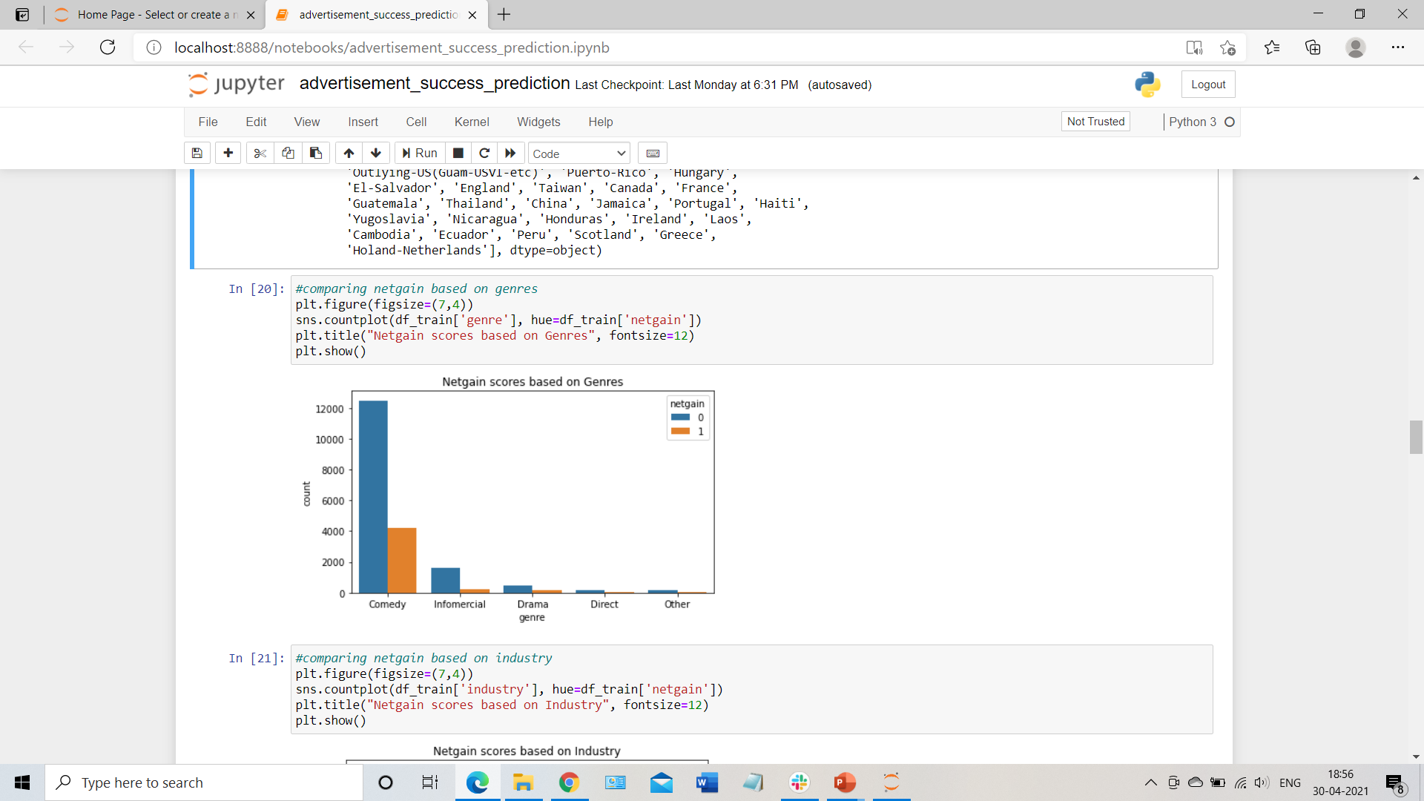
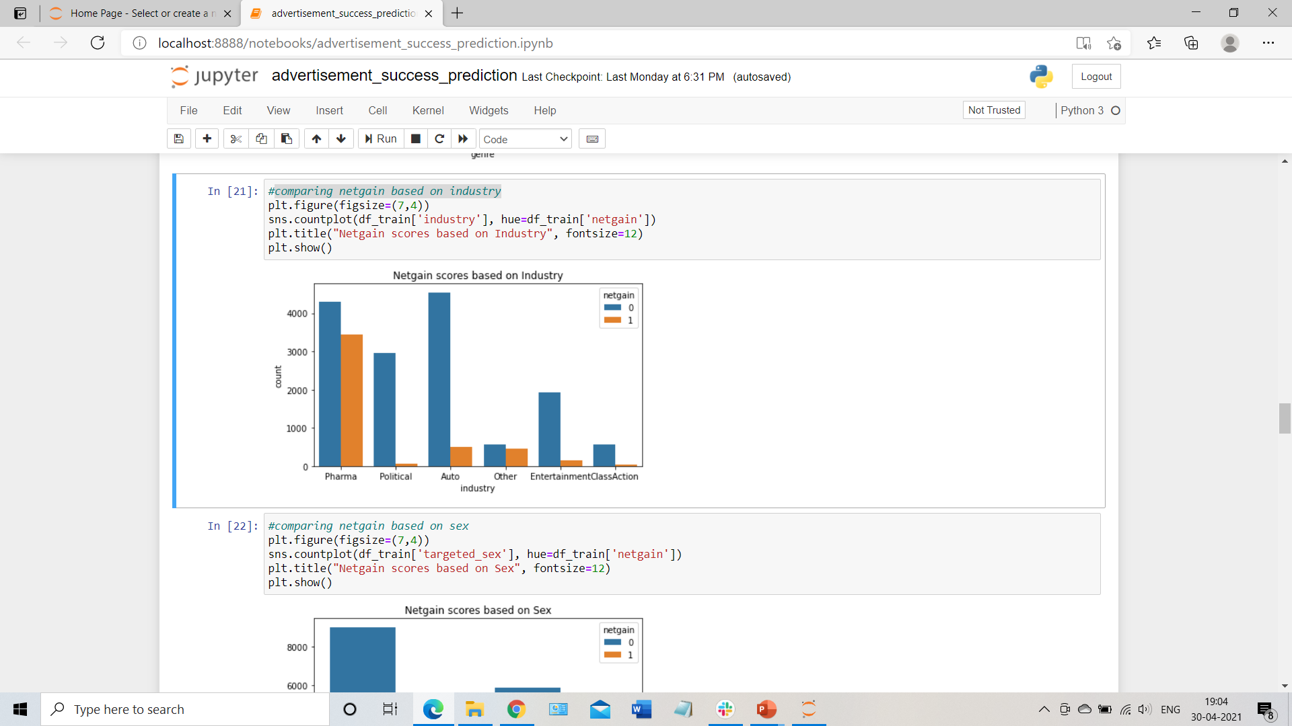
eda
Comparing netgain based on Genres
Comparing netgain based on Industry

Slide 6
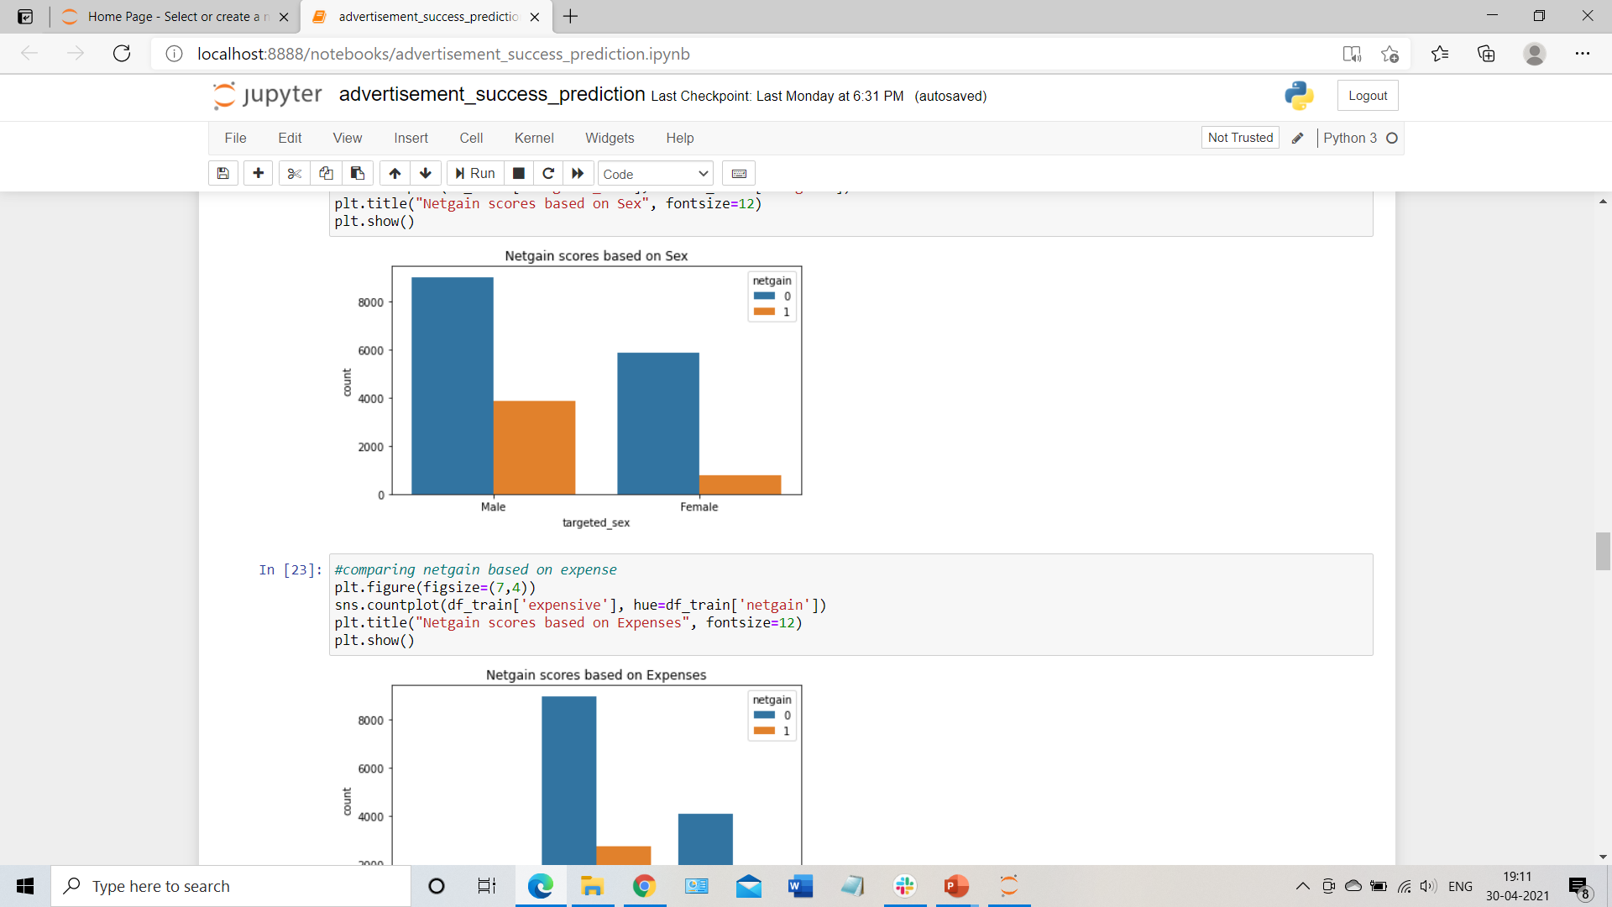
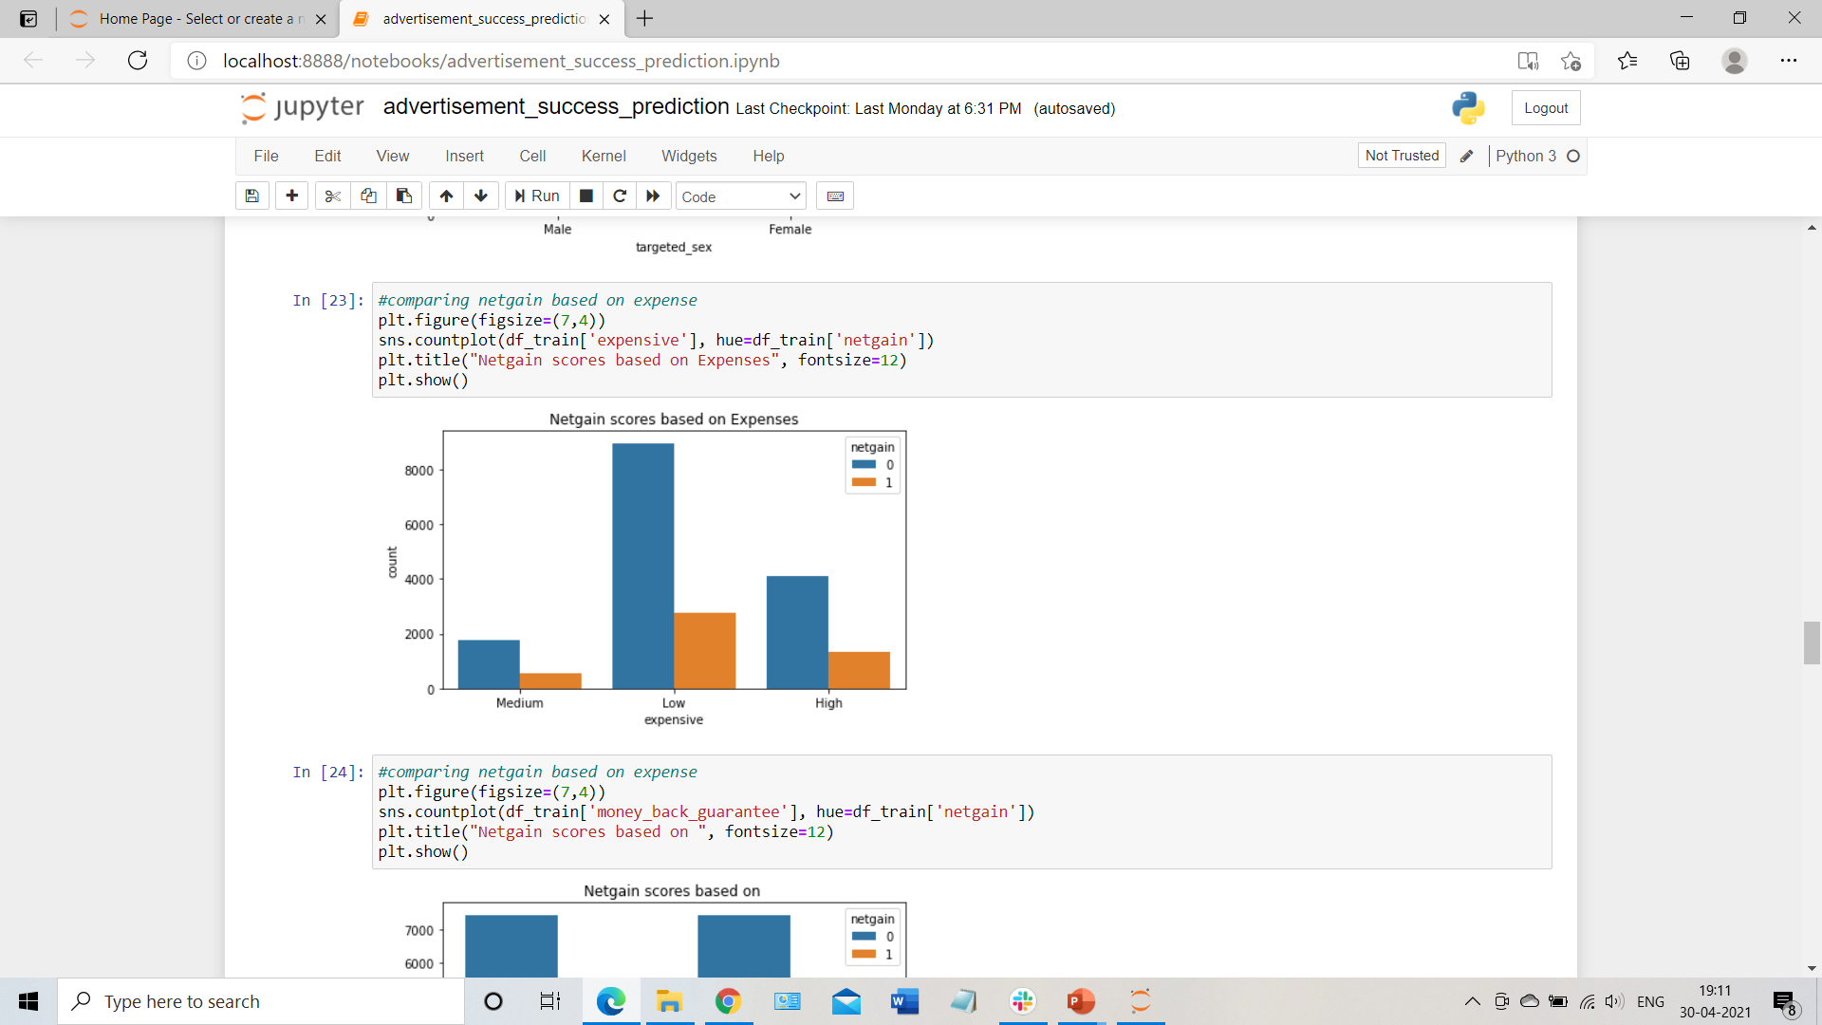
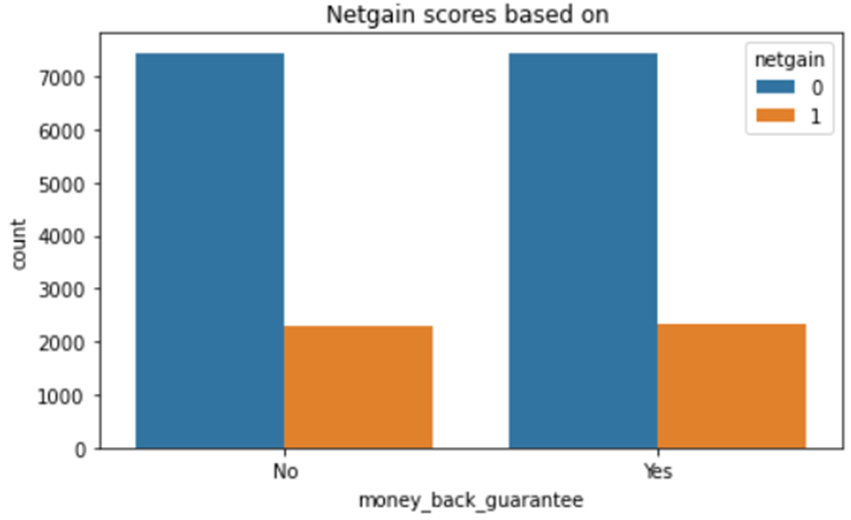
Comparing netgain based
on Sex
Comparing netgain based
on Expenses
Comparing netgain based
on Money Back Guarantee

Slide 7
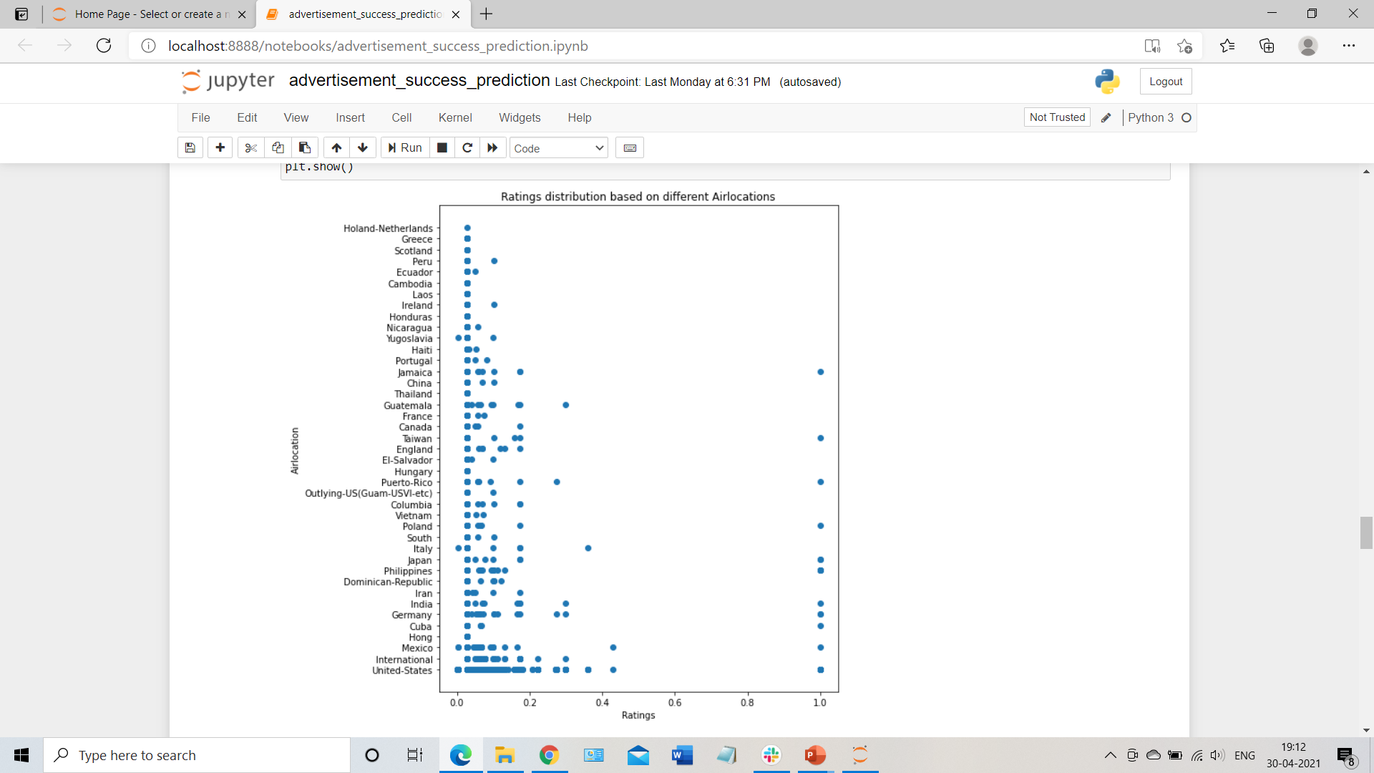
scatterplot of ratings based on air locations

Slide 8
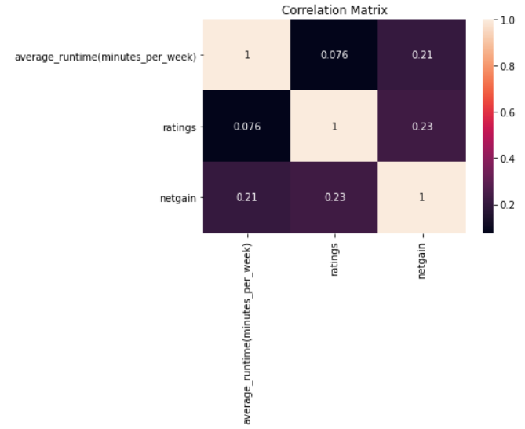
Correlation heat map between numerical columns
Didn’t observe much correlation between the numeric features.

Slide 9
Models used
Logistic Regression
Decision Tree Classifier
Evaluation metric
F1_score(binary)

Slide 10
results
Algorithm Used | On Train data | On Validation data
Logistic Regression | 0.5032015065913371 | 0.48789237668161434
Decision Tree Classifier | 0.6728771049802938 | 0.5114698385726424
As observed from the above table of F1 Scores, the best results were obtained using Logistic Regression algorithm.
Thus, the predictions saved as 'add_succ_submission.csv' is performed using Logistic Regression.

Slide 11
thankyou
By:-
Manjunathdarshan t s

