Slide 1

PROJECT 2: TRAVEL, TOURISM & HOSPITALITY - CUSTOMER RETENTION AND DYNAMIC PRICING ANALYSIS
Data Analytics Project
Technologies: Python, Pandas, NumPy, Matplotlib, Seaborn

Slide 2
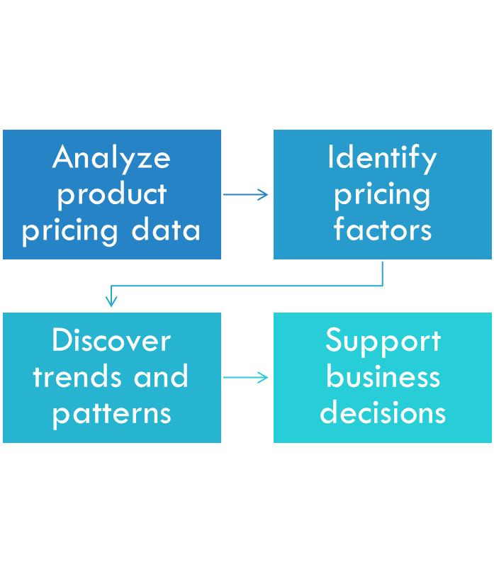
PROJECT OVERVIEW

Slide 3
OBJECTIVES
Data cleaning, EDA, pricing drivers, outlier detection, business insights

Slide 4
DATASET DESCRIPTION
Product pricing dataset with product, category, price, rating, reviews, and brand information.

Slide 5
DATA CLEANING & PREPROCESSING
Handled missing values, removed duplicates, corrected data types, and validated quality.

Slide 6
EXPLORATORY DATA ANALYSIS
Price distributions, category comparisons, brand trends, and summary statistics.

Slide 7
CORRELATION ANALYSIS
Examined relationships between variables and pricing factors.

Slide 8
KEY INSIGHTS
Identified high-priced categories, outliers, and important pricing drivers.

Slide 9
BUSINESS RECOMMENDATIONS
Optimize pricing, monitor premium segments, and improve competitiveness.

Slide 10
CONCLUSION & FUTURE WORK
Generated actionable insights. Future work includes price prediction and forecasting.

