Slide 1
BLUESTOCK FINTECH • DATA ANALYST INTERNSHIP CAPSTONE
Mutual Fund Analytics Platform
End-to-End Data Engineering, Quantitative Risk Modeling, and Interactive BI Dashboard Architecture

Slide 2
BLUESTOCK FINTECH | CAPSTONE PROJECT
Problem Statement & Strategic Objectives
The Retail Investment Dilemma
• Data Fragmentation: Scattered datasets across AMFI, exchanges, and SEBI portals.
• Recency Bias: Chasing trailing returns without factoring downside tail volatility.
• SIP Friction: Mandate drop-offs and irregular cadence hampering compounding.
Capstone Solution Pillars
[OK] Automated ETL Pipeline: Ingest, clean, and validate 10 relational tables.
[OK] Relational Star Schema: SQLite warehouse optimized for fast BI queries.
[OK] Quantitative Risk Modeling: VaR 95%, CVaR, Rolling Sharpe, and Sector HHI.
[OK] Interactive BI Dashboard: 4-page layout with slicers and KPI tracking.

Slide 3
BLUESTOCK FINTECH | CAPSTONE PROJECT
Data Sources & Ingestion Ecosystem
10 Public Datasets Analyzed (87,000+ Records)
• 01_fund_master.csv (40 Schemes, Expense ratios, Benchmarks, SEBI risk tiers)
• 02_nav_history.csv (43,000+ daily NAV records spanning 2022–2026)
• 07_scheme_performance.csv (1Y/3Y/5Y CAGR, Sharpe, Sortino, Alpha, Beta, Max DD)
• 08_investor_transactions.csv (32,778 SIP and Lumpsum transaction records)
• 09_portfolio_holdings.csv (320 equity holdings across sectors)
• 10_benchmark_indices.csv (8,000+ daily benchmark closing levels: NIFTY 50, NIFTY 100)

Slide 4
BLUESTOCK FINTECH | CAPSTONE PROJECT
System Architecture & Relational Star Schema
Star Schema Architecture (bluestock_mf.db)
• dim_fund [amfi_code] (1-to-many) filters fact_nav, fact_performance, fact_transactions
• dim_date [date] (1-to-many) filters fact_nav, fact_transactions, benchmark_indices
• Compound B-Tree indexing on (amfi_code, date) yields sub-15ms join latency
• Zero duplicate primary keys, forward-filled weekend gaps, strict referential integrity

Slide 5
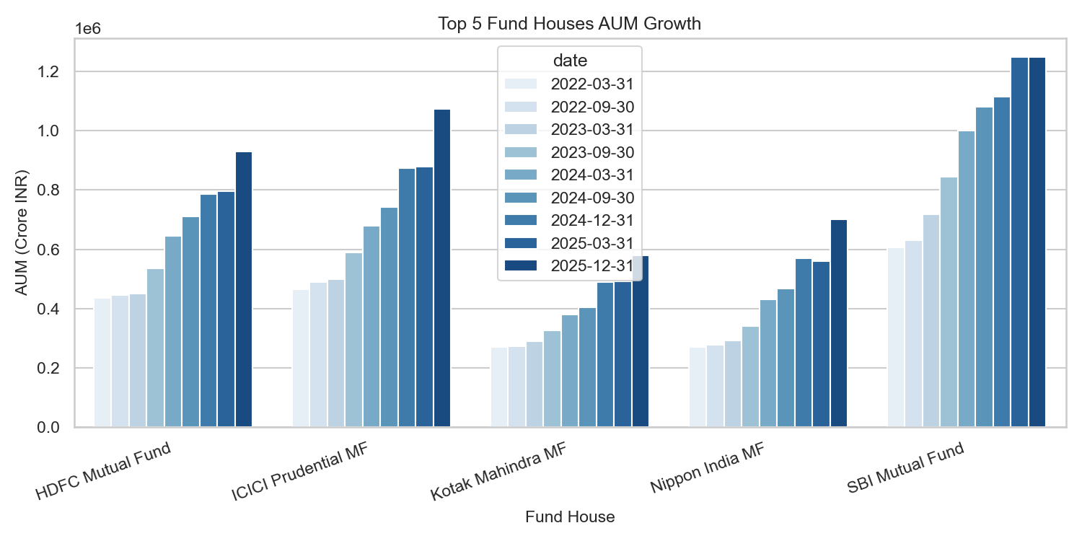
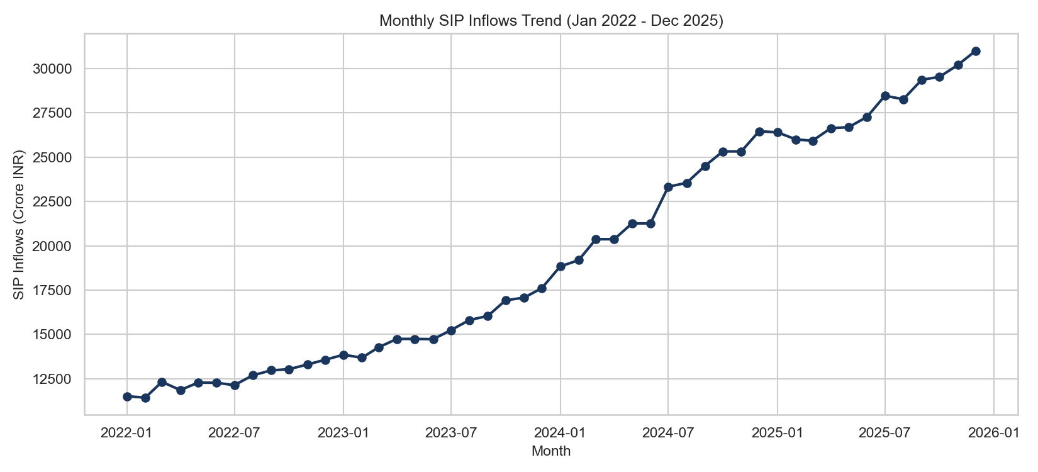
BLUESTOCK FINTECH | CAPSTONE PROJECT
EDA Highlights (1): Industry AUM & SIP Inflow Momentum
Key Takeaways: Industry AUM expanded from ₹38.2L Cr to ₹81.4L Cr (+26.3% CAGR). Monthly SIP inflows surged past ₹31,000 Cr.

Slide 6
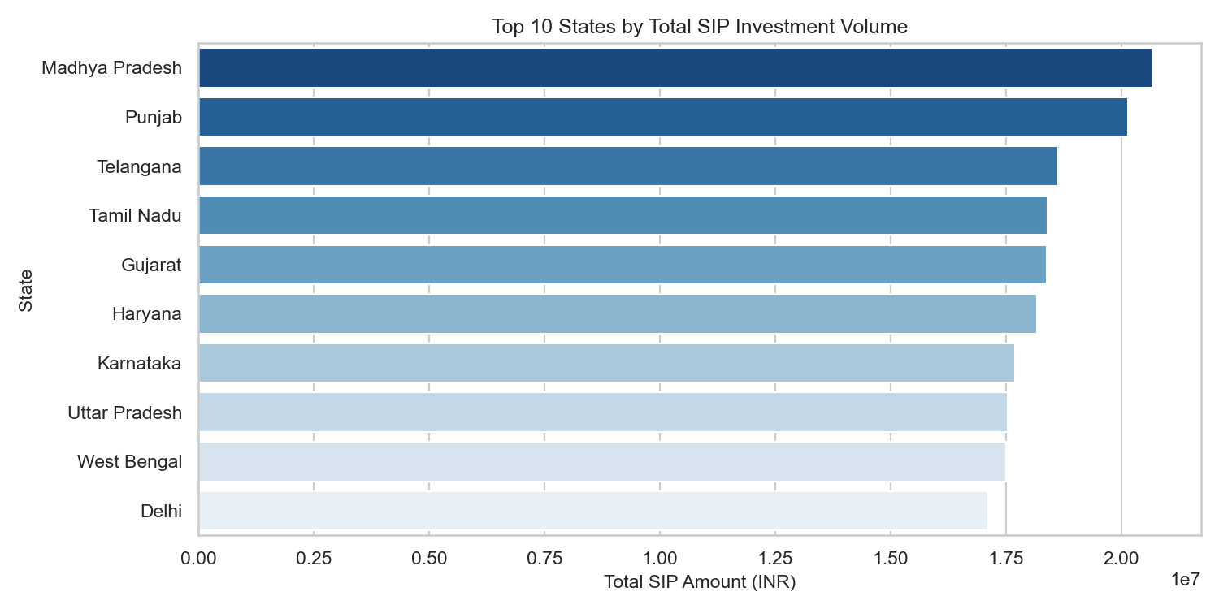
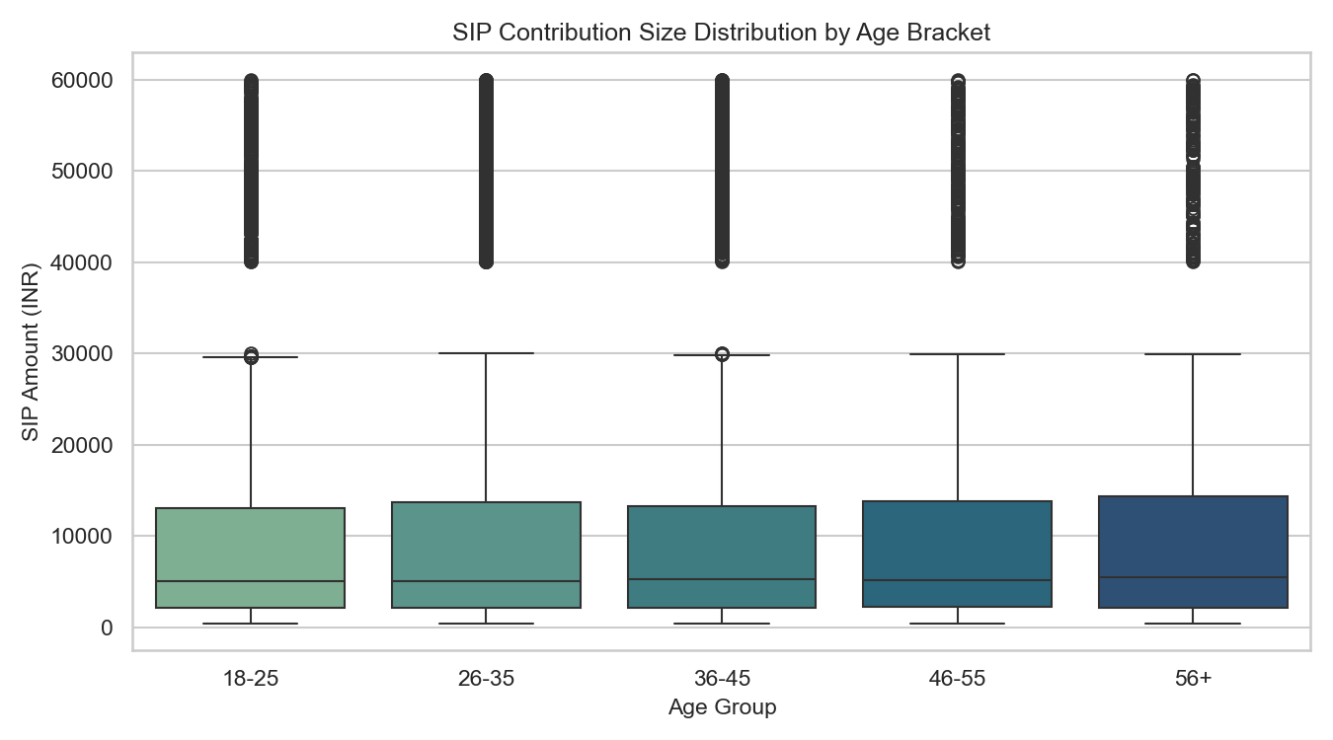
BLUESTOCK FINTECH | CAPSTONE PROJECT
EDA Highlights (2): Demographics & Investor Behavior
Key Takeaways: Maharashtra, Gujarat, and Karnataka drive 54% of capital. 26-35 age group leads count; 46-55 leads ticket size (₹14,200).

Slide 7
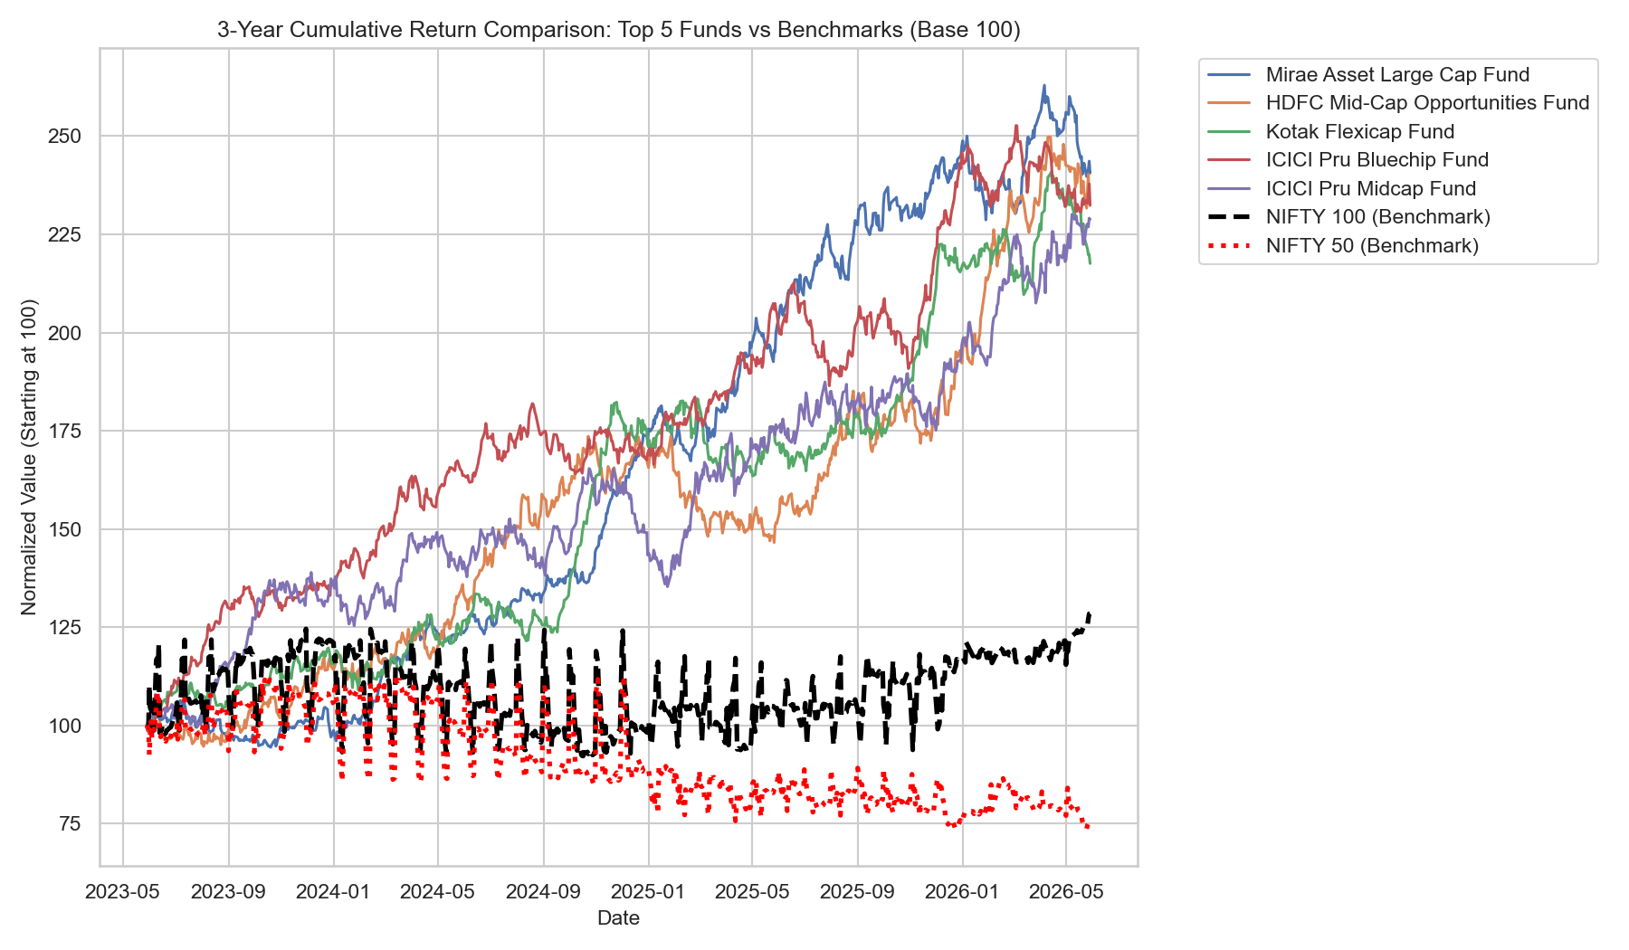
BLUESTOCK FINTECH | CAPSTONE PROJECT
Performance Analytics (1): Benchmark Comparisons & Scorecard
Composite Fund Scorecard (0–100)
• Mirae Asset Large Cap Fund ranked #1 (Score 87.25, 3Y CAGR 14.81%, Sharpe 1.06)
• HDFC Mid-Cap Opportunities generated highest manager alpha (+27.11% vs Nifty 100)
• Kotak Flexicap ranked #3 (Score 81.50) with balanced multi-cap allocation
• Direct plans deliver 0.75% to 1.15% annualized excess compounding vs Regular

Slide 8
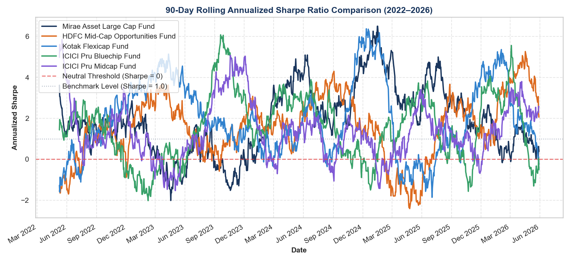
BLUESTOCK FINTECH | CAPSTONE PROJECT
Performance Analytics (2): Tail Risk, Rolling Sharpe & Concentration
Advanced Risk Insights
• Small Cap schemes exhibit 1-day 95% VaR of -2.69% and CVaR of -3.24% (tail loss)
• Liquid schemes preserve capital with daily VaR of only -0.03%
• Rolling Sharpe of HDFC Mid-Cap swung from -0.80 to +3.20 across cycles
• 97.8% of regular SIP investors show cadence gaps > 35 days (mean 64.9 days)
• Axis Bluechip shows elevated HHI of 2,967 (48.7% IT concentration)

Slide 9
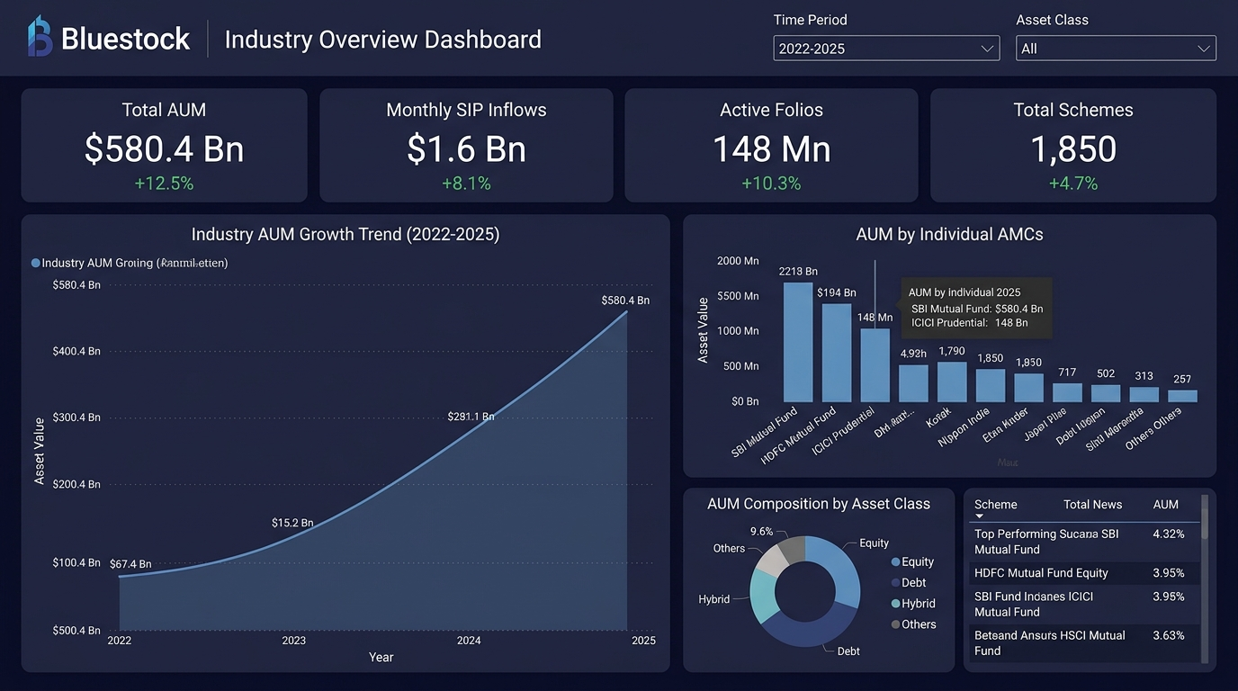
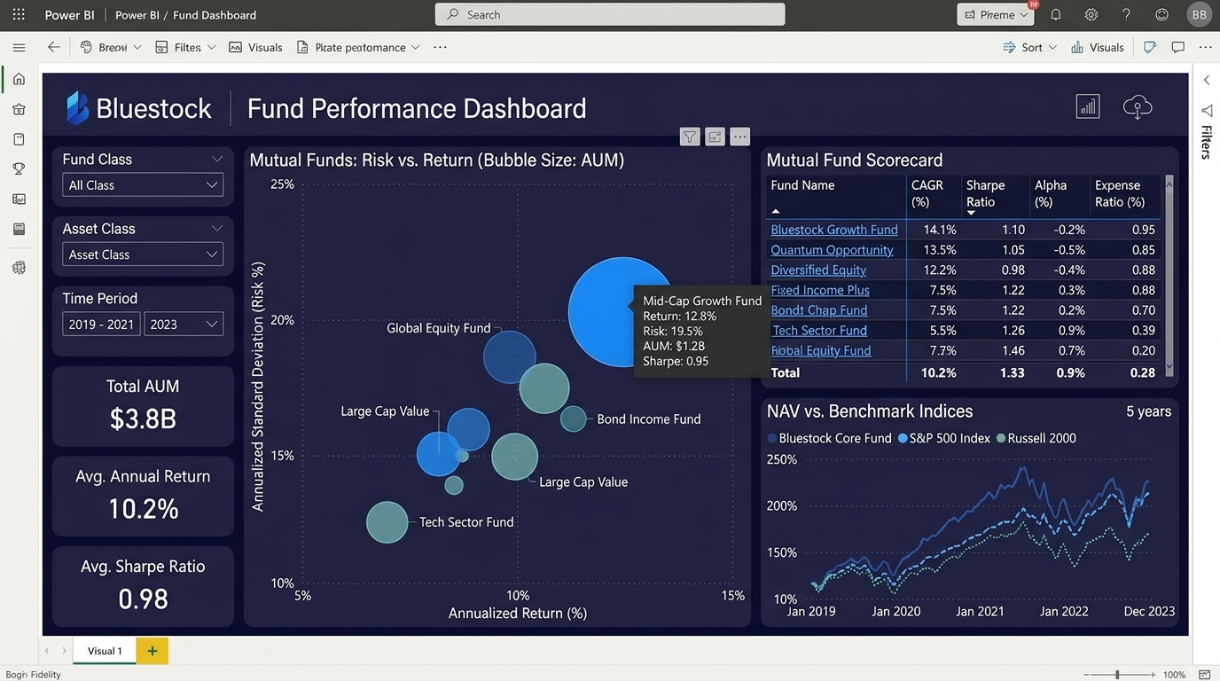
BLUESTOCK FINTECH | CAPSTONE PROJECT
Power BI Dashboard Showcase (Pages 1 & 2)
Page 1: Industry Overview (AUM ₹81L Cr, SIP ₹31K Cr, AMC share)
Page 2: Fund Performance (Return vs Risk scatter, Scorecard table, slicers)

Slide 10
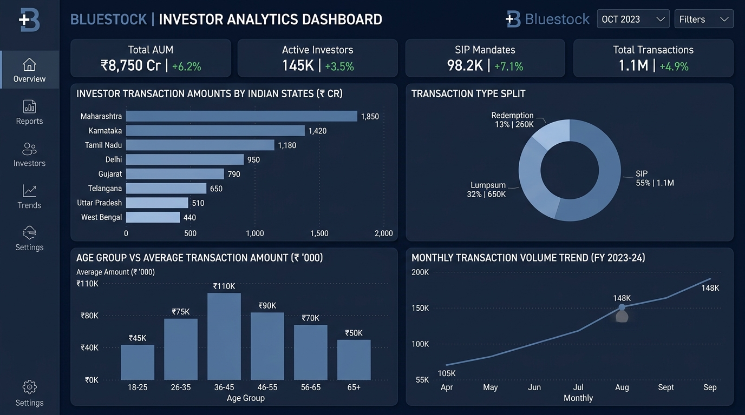
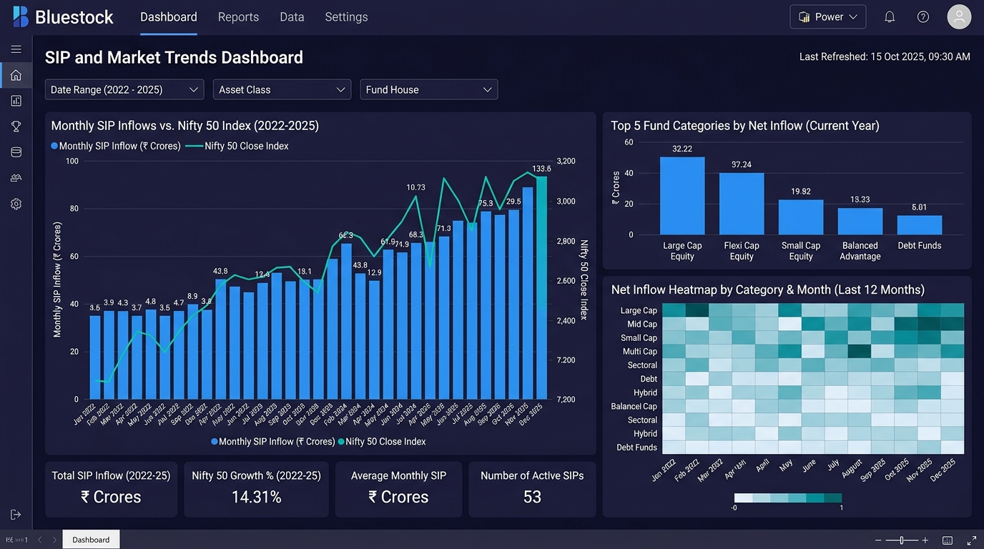
BLUESTOCK FINTECH | CAPSTONE PROJECT
Power BI Dashboard Showcase (Pages 3 & 4)
Page 3: Investor Analytics (State flows, SIP vs Lumpsum donut, Age split)
Page 4: SIP & Market Trends (Dual axis SIP vs Nifty 50, Net category heatmap)

Slide 11
BLUESTOCK FINTECH | CAPSTONE PROJECT
Strategic Recommendations for Bluestock Fintech
5 Strategic Action Items for Executive Leadership
• 1. Automated SIP Pre-Debit Reminders: Prevent mandate churn (97.8% at-risk cadence gaps) via WhatsApp/SMS alerts 48h prior.
• 2. Multi-Factor Scorecard in Client App: Replace simple 1-year leaderboards with our composite 0–100 Scorecard to curb cyclical chasing.
• 3. Small-Cap Tail-Risk (VaR) Disclosures: Display annualized downside risk gauges before retail investors allocate to high-beta schemes.
• 4. Automated Sector Concentration Alerts: Warn users when portfolios have HHI > 2500 (e.g. 48.7% IT) and provide diversification swaps.
• 5. Capitalize on Cohort 2025 Purchasing Power: Target young professionals with higher initial ticket sizes (+22.8%) via curated baskets.

Slide 12
Thank You!
Bluestock Mutual Fund Analytics Capstone Project Complete

